Slide 1

Manufacturing of HTS SECAS samples and preliminary tests in LN₂
WPMAG 2025 Final Meeting
Villigen PSI; January 14th - 16th, 2026
L. Muzzi (on behalf of the ENEA team)
M. Bombardieri, G. Celentano, S. Chiarelli, V. Corato, G. De Marzi, R. Freda, F. Maierna, M. Marchetti, A. Masi, L. Merli, M. Seri, A. della Corte, A. Formichetti, R. Righetti, M. Breschi, G. Colombo, M. A. Caponero, A. Polimadei, W. Hong

Slide 2




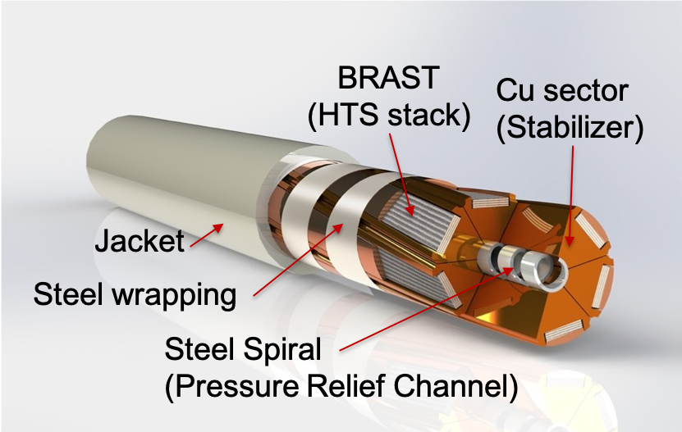
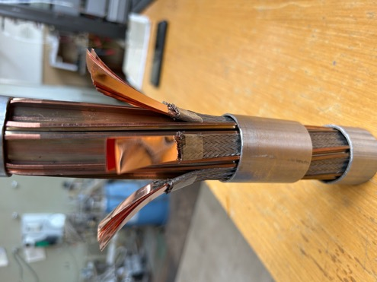
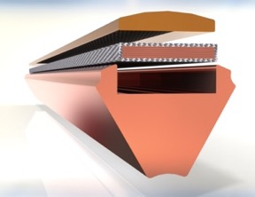
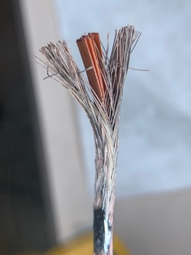
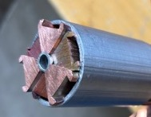
Main Task Objective
Manufacture of a SECAS Sample for SULTAN test, incl. qualification tests at LN₂
SECtor ASsembled cable
(SECAS) CICC concept
BRAided Stack
(BRAST)
Multi-Stage Cable Processing
Cu sector
L. Muzzi, et al., IEEE TAS 2023

Slide 3
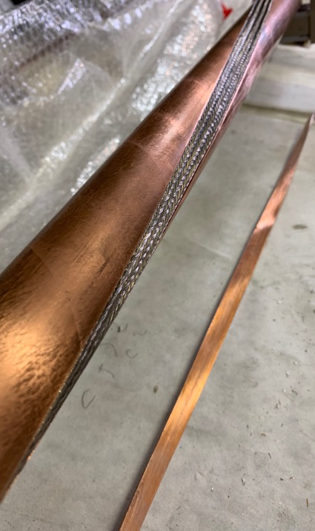
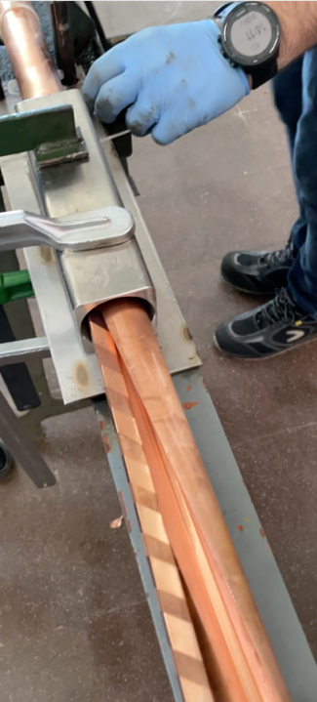
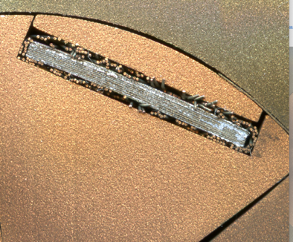
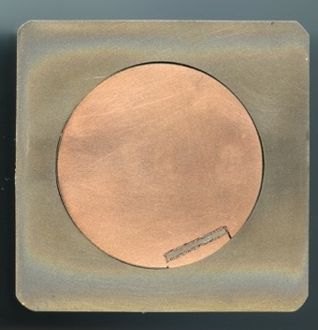
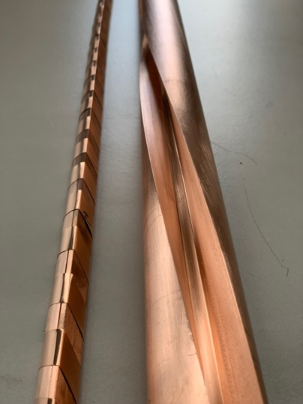
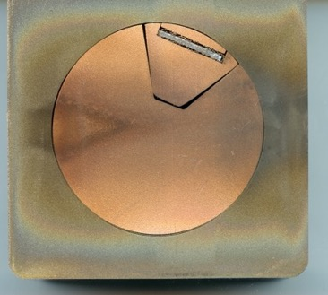
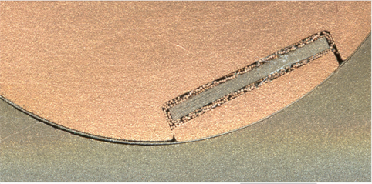
BRAST-SECAS Prototypes Qualification steps
BRAST of 10 Tapes, 12 mm x 0.08 mm
BRAST #3
BRAST in spirally machined slot, and closing filler
SECAS #1
BRAST assembled in straight sector, then inserted in spirally machined slot

Slide 4
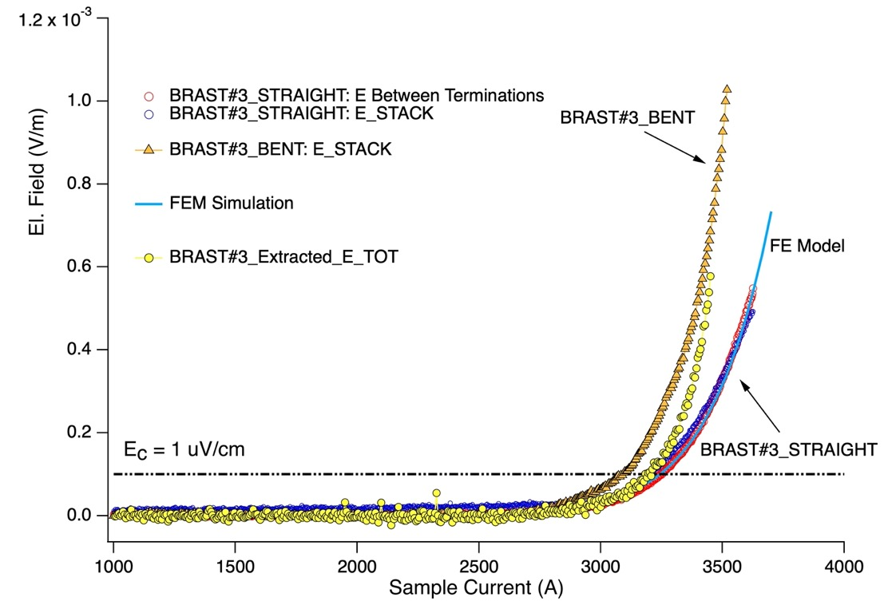
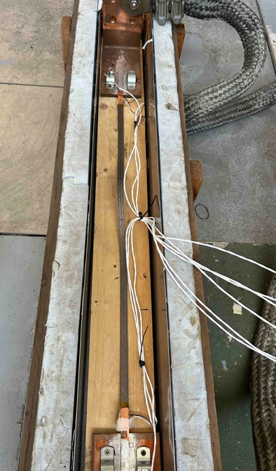
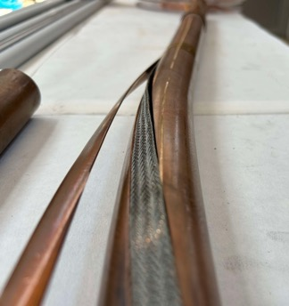
Initial qualification – BRAST (77K – s.f. tests) - bending
Effect of Conductor bending:
BRAST #3
(non soldered stack)
BRAST was extracted from Bent conductor and re-tested
Apparently, the tape stack was not damaged during the bending

Slide 5
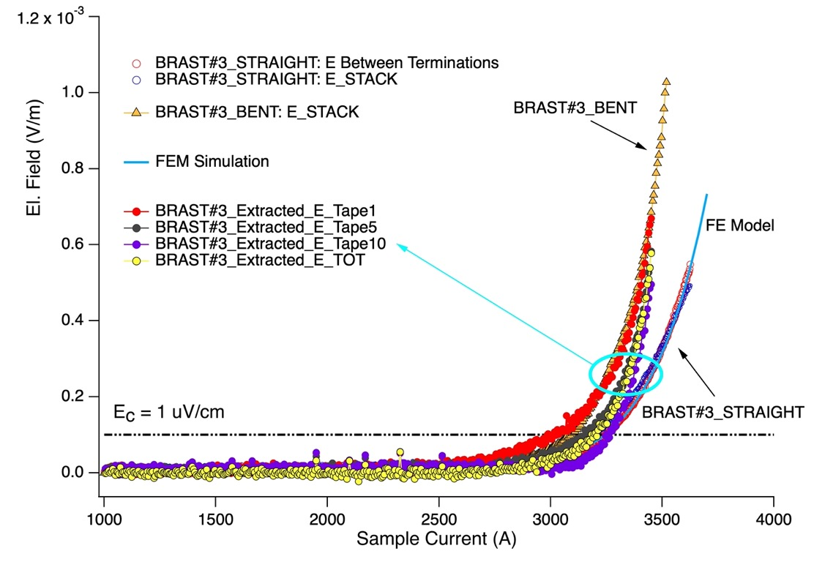
Initial qualification – BRAST (77K – s.f. tests) - bending
Electric field along different tapes
BRAST #3
(non soldered stack)
BRAST was extracted from Bent conductor and re-tested
Voltage development is different on the different tapes within the stack. Effects of self-field, and effects of current distribution / re-distribution (at terminations, in these samples) should be clarified.
Either through modelling, or by means of dedicated tests.
Same qualitative behaviour observed an all tested prototypes

Slide 6
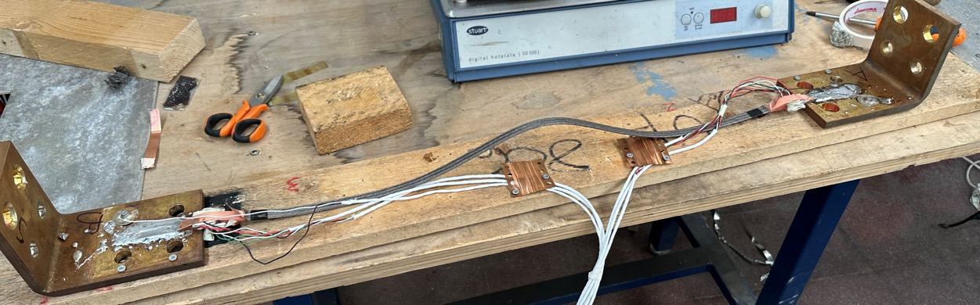
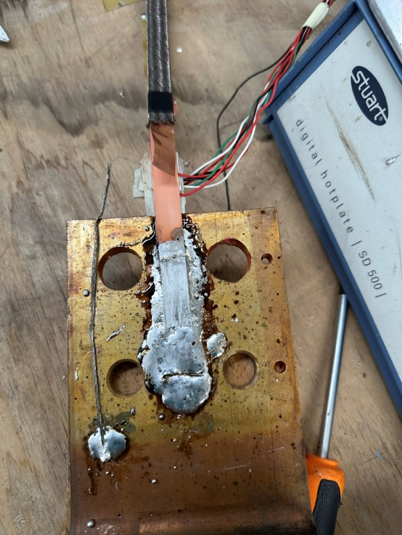
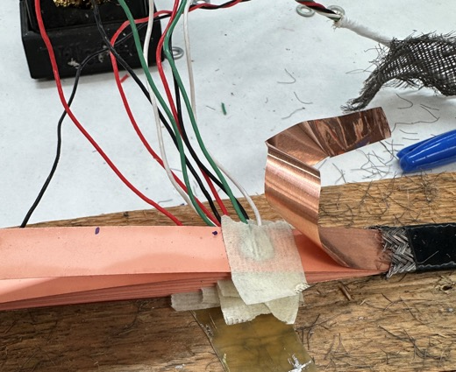
Current distribution study in BRAST (77K – s.f. tests)
Sample for current distribution study: «free-standing» BRAST with 9 tapes (SST) 12 mm wide
Soldered terminations with staggered tapes
V_TERM-TAPE
V tape
Voltage taps welded on tapes:
Voltage between termination and tape, as well as along each tape, can be measured
V termination
Sat-Af-Spe1-04

Slide 7
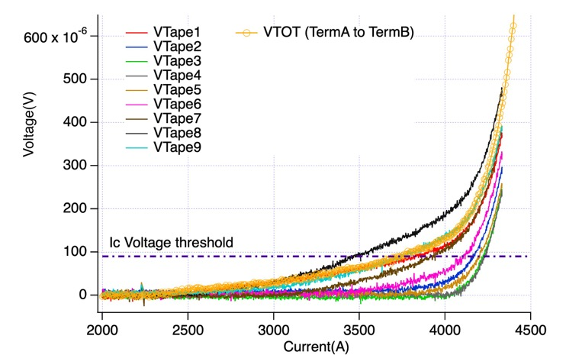
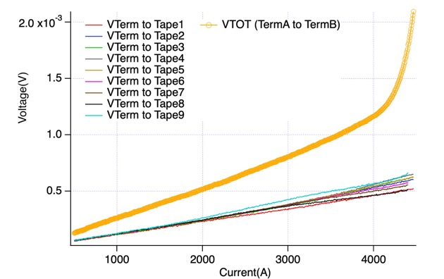
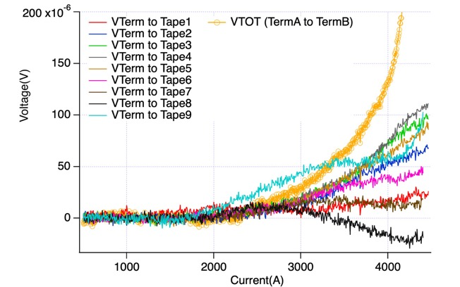
Current distribution study in BRAST (77K – s.f. tests)
Voltage along each tape during current ramp
Voltage between termination and each tape
Raw data
V after subtraction of the resistive component
Wide transition «spectrum» for the different tapes.
Resistance distribution at terminations.
Complex current re-distribution among tapes (in these samples, occurring at terminations); self-field effects also play a role.
Same qualitative behaviour as observed on the BRAST extracted from the bent conductor prototype, tested as well in «stand-alone» mode.

Slide 8
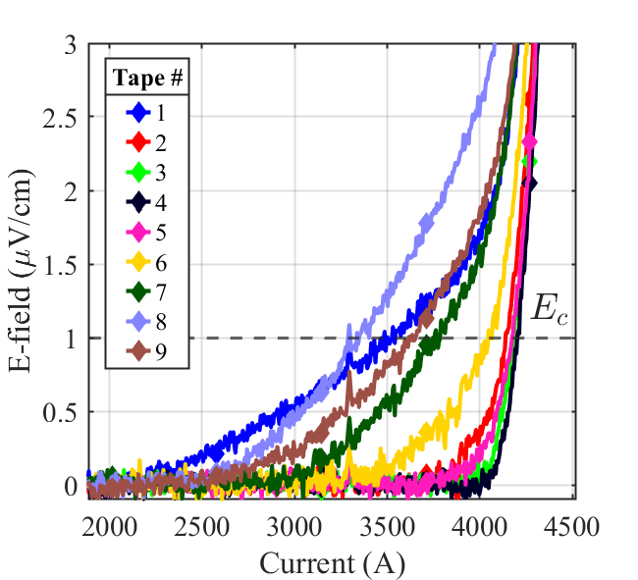
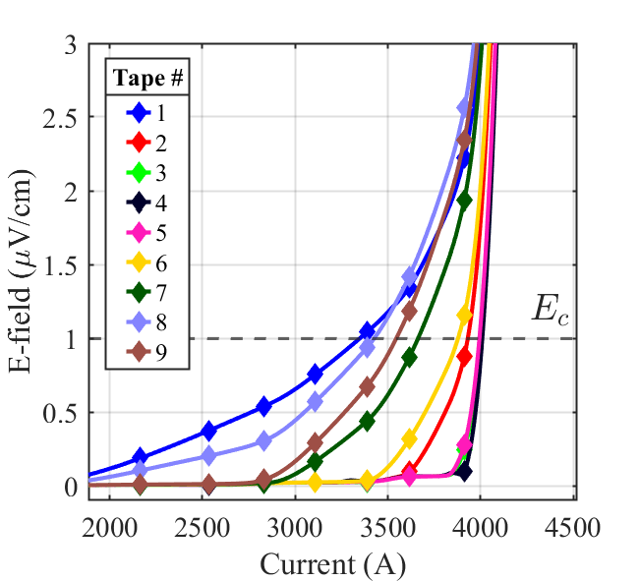
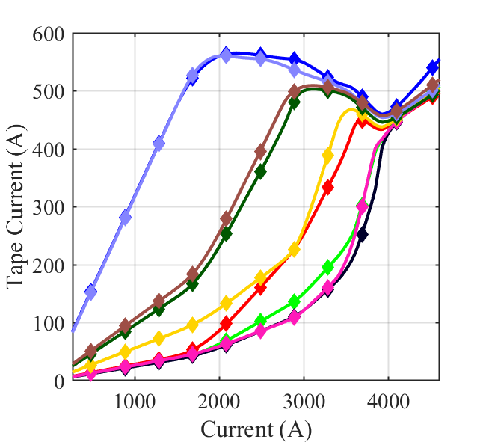
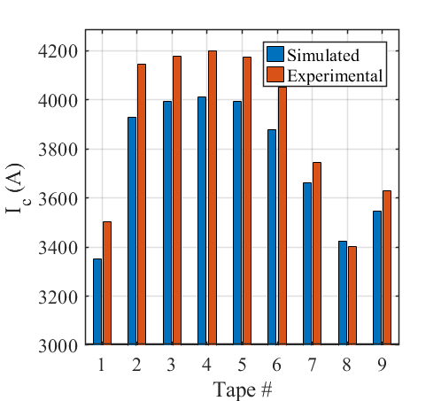
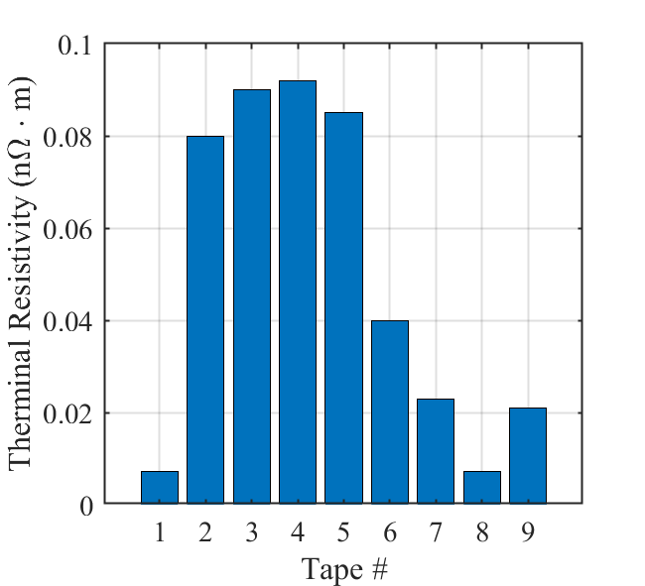
Current distribution in BRAST @77 K & self-field
Non-homogenous transition of the stack
H-form. model by
Dr. W. Hong (ASIPP)
Simulation results accurately reproduce this trend, indicating that in these non-soldered, short samples, the presence of inhomogeneous tape terminal resistances have a strong effect on the distribution of current among the tapes.

Slide 9
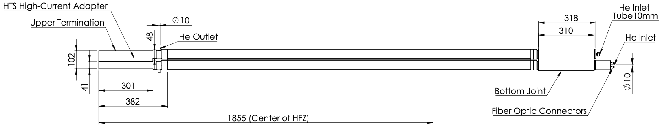
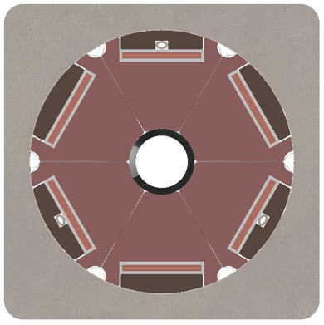
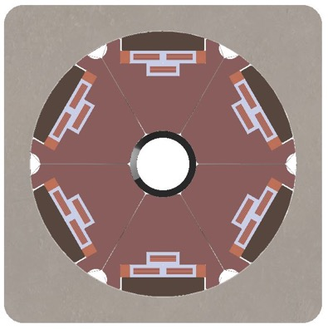

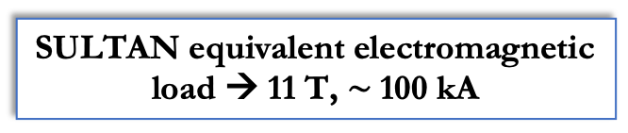
SECAS - SULTAN sample
LEG 1
6 sectors with 1 BRAST
wt. 9 x 12 mm-wide tapes
LEG 2
6 sectors with 3 BRASTs
wt. 7 x 4 mm-wide tapes
EU DEMO target: stable operation
@ 60 kA, 4.5 K, 18 T
SULTAN equivalent electromagnetic load → 11 T, $∼$100 kA
3.7 mm
Cu fillers
Steel capillary for FOS
Cu sectors

Slide 10
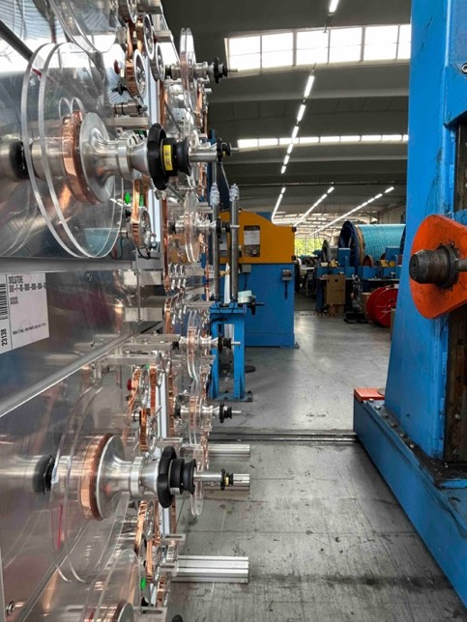
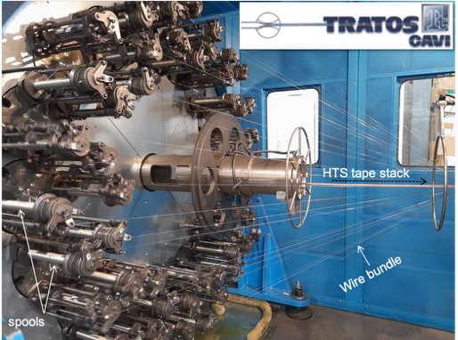
SULTAN sample preparation: some key steps
BRAST manufacture at:
Using the existing in-line braid machine

Slide 11
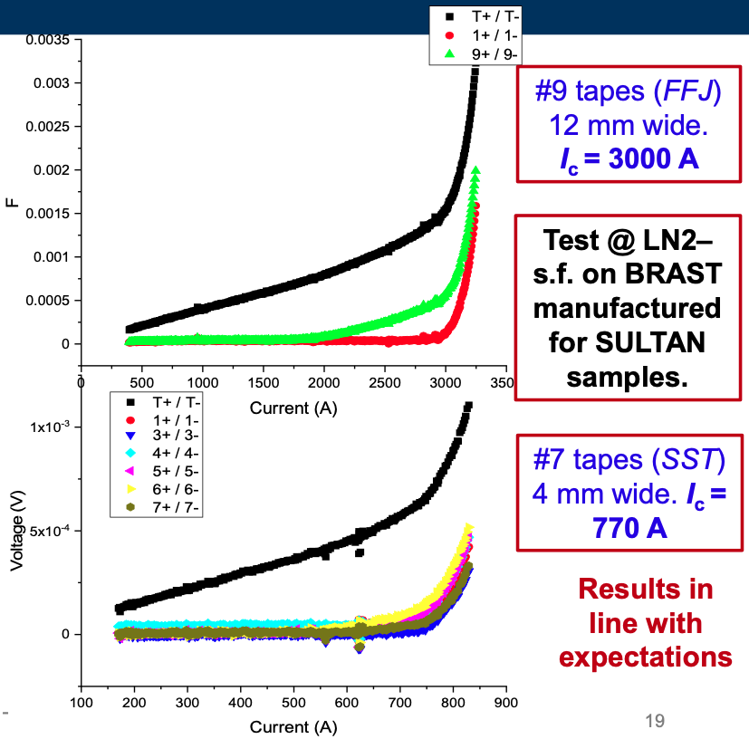
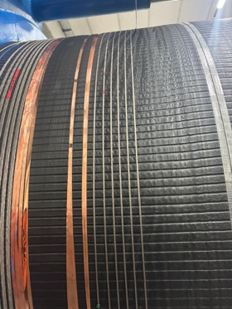
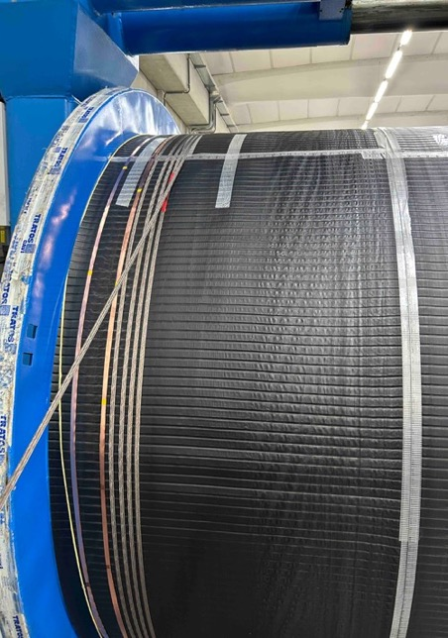
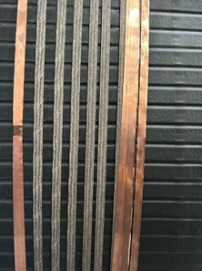
SULTAN sample preparation: some key steps
BRAST manufacture at:
BRAST 4 mm tapes → 60 m
BRAST 12 mm tapes → 60 m

Slide 12
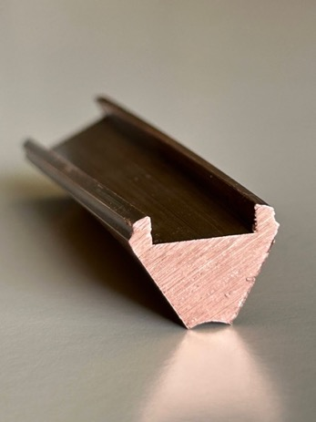
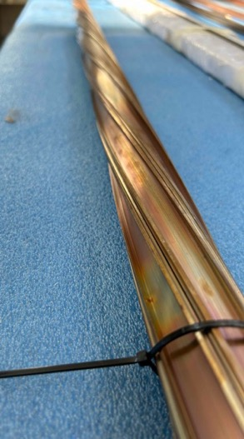
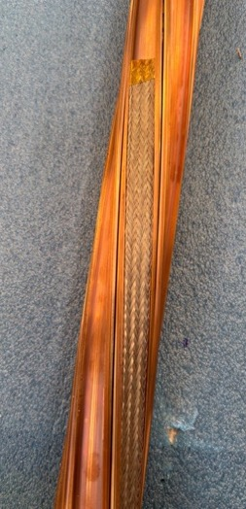
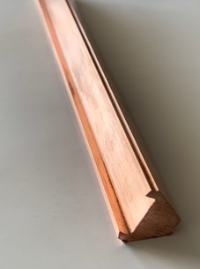
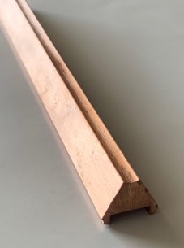
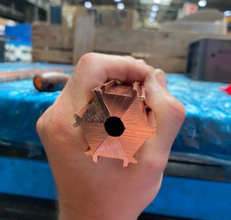
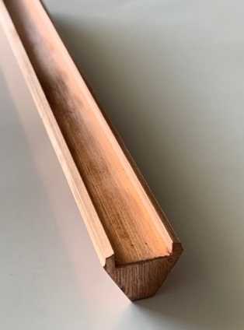

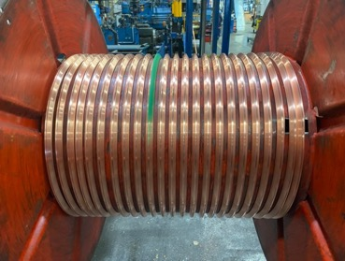
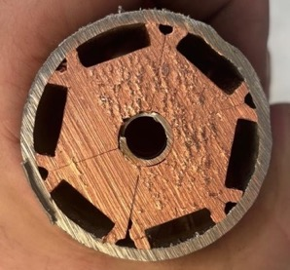
SULTAN sample preparation: some key steps
Cable assembly trials:
Extruded Cu sector
Extruded by KME (D)
Unit lenth 5 m
Hundreds of m produced
Twisting of Cu sectors
Short piece of assembled SECAS

Slide 13
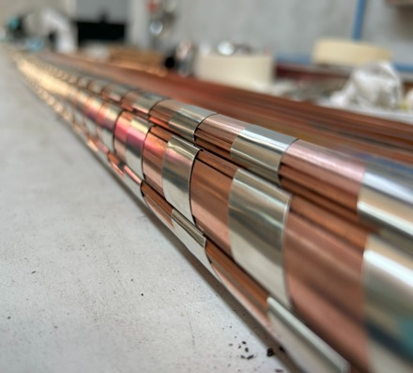
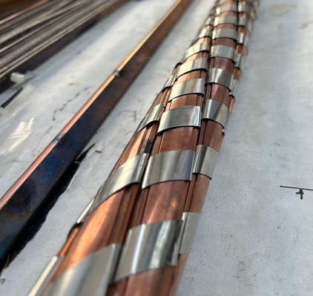
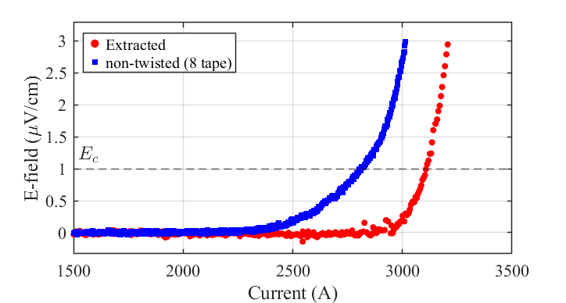
SULTAN sample preparation: some key steps
SULTAN sample manufacturing:
Cable assembly trials:
Twisting of Cu sectors
8-tapes dummy
9-tapes extracted
Sectors assembled, and wrapped in SS tape
Nominal twist pitch
of 1200 mm
Post-twist check at 77 K, self-field
shows no evident sign of degradation
Short piece of assembled SECAS

Slide 14

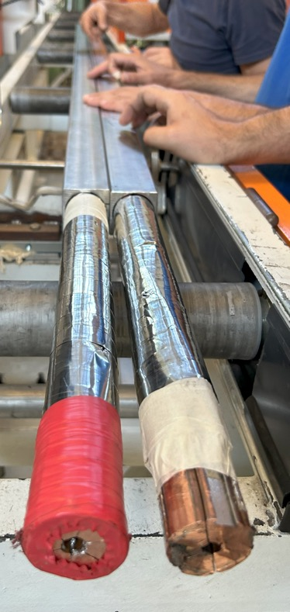




SECAS - SULTAN sample compaction
Jacketing and compaction:
4-mm-wide tapes
12-mm-wide tapes

Slide 15




SECAS – SULTAN sample DFOS QD
One leg has been equipped with 4 SS capillary tubes for distributed or quasi-distributed temperature monitoring:
3 DOFS
1 FBG array
Fiber feedthroughs
Leaking problems at fibers feedthroughs →
DFOS no more adopted in this cable
It will be implemented for the third SULTAN leg (currently in preparation)
SS capillaries for DFOS
Bottom termination
He inlet

Slide 16




SECAS - SULTAN termination manufacturing
Pre-tinned HTS tapes
Conductor is inserted in the pre-tinned copper terminal
Jacket heaters
Conductor
Copper termination heaters
Bath and termination temperature controller
Jacket heaters power supply
Solder crucible
air
solder
The termination is soldered via impregnation while heated stably at 200 °C

Slide 17

SECAS - SULTAN termination manufacturing
Sample
Shipped to SPC in late Sept. ‘25
Jacket heaters
Conductor
Copper termination heaters
Bath and termination temperature controller
Jacket heaters power supply
Solder crucible
air
solder
The termination is soldered via impregnation while heated stably at 200 °C
Sample «assembly», incl. clamps and instrumentation installation, by SPC

Slide 18
SECAS - SULTAN sample
LEG 1
6 sectors with 1 BRAST
wt. 9 x 12 mm-wide tapes
Now in preparation:
LEG 3
6 sectors with 1 BRAST
wt. 9 x 12 mm-wide tapes
BUT with sector twisting applied before insertion of tape stacks, simulating a very different possible processing approach.
CICC length is ready; terminations still to be manufactured.
→ Ready by the end of February 2026.
Cu fillers
Steel capillary for FOS

Slide 19
Next Steps
- manufacture of a third SECAS prototype length is on-going.
- assembly of the full-size sample → SPC
- test of the full-size sample.
- a new sample for KIT FBI facility is also under preparation.
- modelling activities are also on-going, to help clarify the observed effects of current re-distribution among tapes occurring at terminations in short samples.

