Slide 1
Purchase of a FIB-SEM equipped with EDS, EBSD and laser ablation chamber
MAG-T.01.01-T043-D001
WPMAG Final Meeting – 16 Jan. 2026
Alessandro Rufoloni, Angelo Vannozzi
ENEA CR Frascati
Superconductivity Lab.

Slide 2
Aim and outline
In-situ preparation and characterisation of striated commercial REBCO tapes
FIB-SEM
REBCO tape sample description
Proposed tests
Results
Comparison
Conclusion

Slide 3
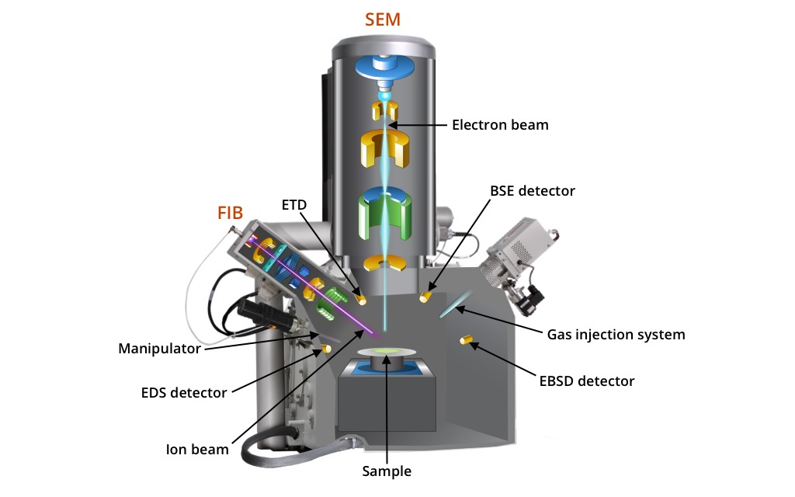

FIB-SEM configuration
Possible solutions
FIB-SEM
Laser beam
+
Stand alone
FIB-SEM
Laser beam
Pre-chamber
FIB-SEM
Fully integrated

Slide 4
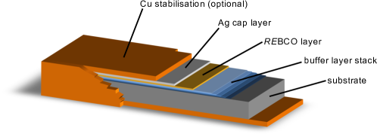
REBCO coated conductor
Multilayer architecture deposited on Hastelloy metallic substrate
REBCO: REBa₂Cu₃O_{7-x} (RE=Y or rare earth)
Copper (10 µm)
Silver (2 µm)
REBCO (2 µm)
Buffer stack (350 nm)
50–100 µm
Hastelloy substrate (60 µm)
Typical tape width 4 mm (or 12 mm)
Silver (1 µm)
Non-symmetric sample, REBCO film on one side only
Region of interest: REBCO+buffer stack
Analysis of film integrity and interfaces
Copper (10 µm)
4

Slide 5
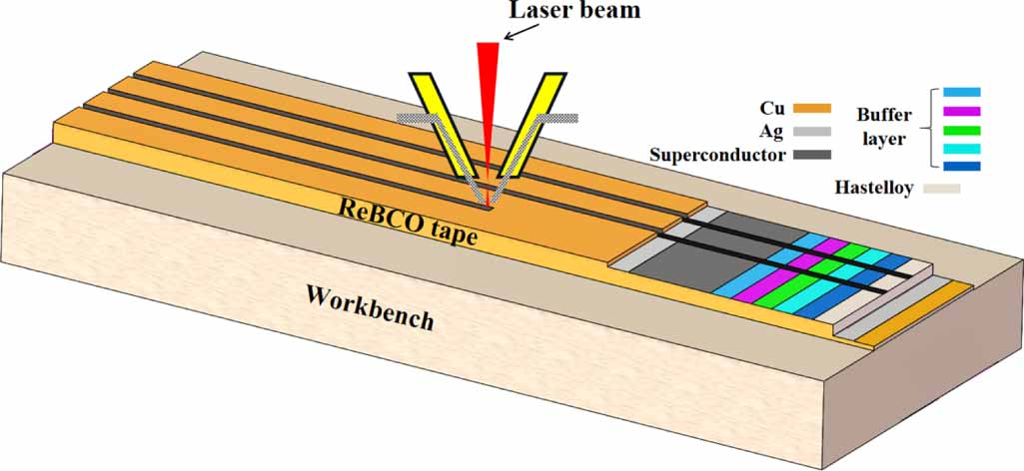
REBCO coated conductor filamentisation
Laser patterning to produce REBCO filaments
Cu
Ag
50–100 µm
REBCO
Buffer
Typical tape width 4 mm (or 12 mm)
Hastelloy substrate (60 µm)
Li et al. SuST 37 (2024)
Silver (1 µm)
Typical strip width 0.4–1 mm
Useful strip length: > 4 mm
Copper (10 µm)
5

Slide 6
Analysis of striated REBCO coated conductor
Analysis of cross-sectional REBCO lamella extracted from patterned tape
STEM for defect detection (cracks, voids, inhomogeneities) across filaments
EDS (linescan or map) to detect possible compositional inhomogeneity produced by laser
EBSD to detect possible phase modification or amorphisation produced by laser patterning
Cu
Ag
REBCO
Buffer
Hastelloy substrate (60 µm)
Li et al. SuST 37 (2024)
Silver (1 µm)
Copper (10 µm)
Shanghai SST 2206 tape was selected for tests
6

Slide 7
Experimental
Three main tests requested
Tape filamentisation by laser patterning to obtain several REBCO strips running parallel to the rolling direction
Extraction of cross-sectional lamella on patterned REBCO tape in correspondence of strip edge
Analysis of cross-sectional lamella with focus on possible damage caused by laser patterning, including STEM, EDS and EBSD

Slide 8
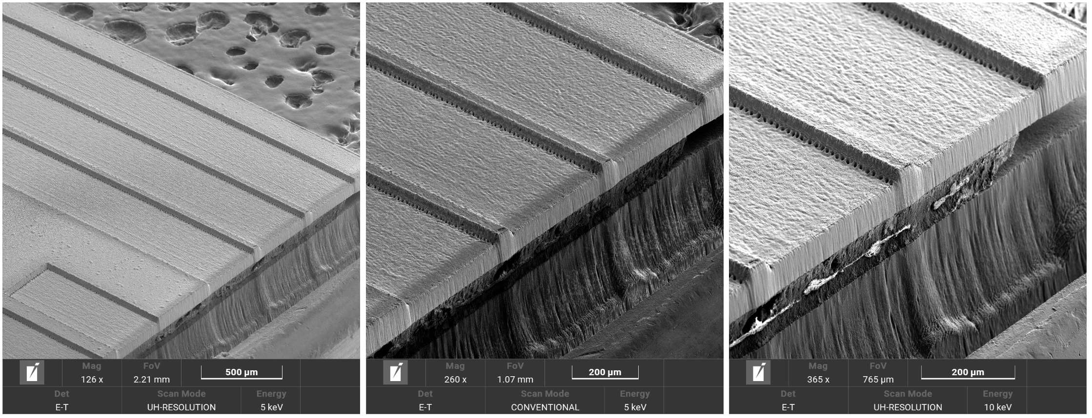
1) Stand-alone laser
REBCO tape striation
Size 3 channels 6.5 mm x 0.4 mm x 40 µm depth
Power 100 mW, Time 57’, f=20 kHz
Spot diam. 10 µm

Slide 9
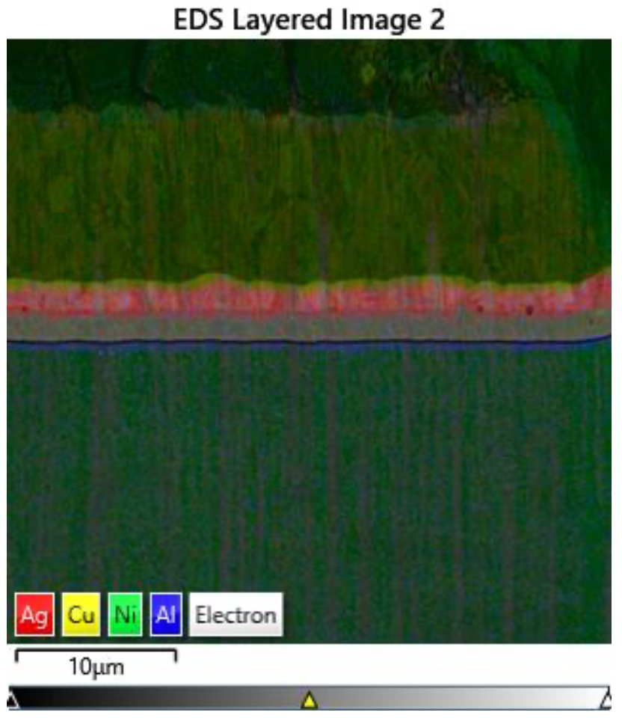
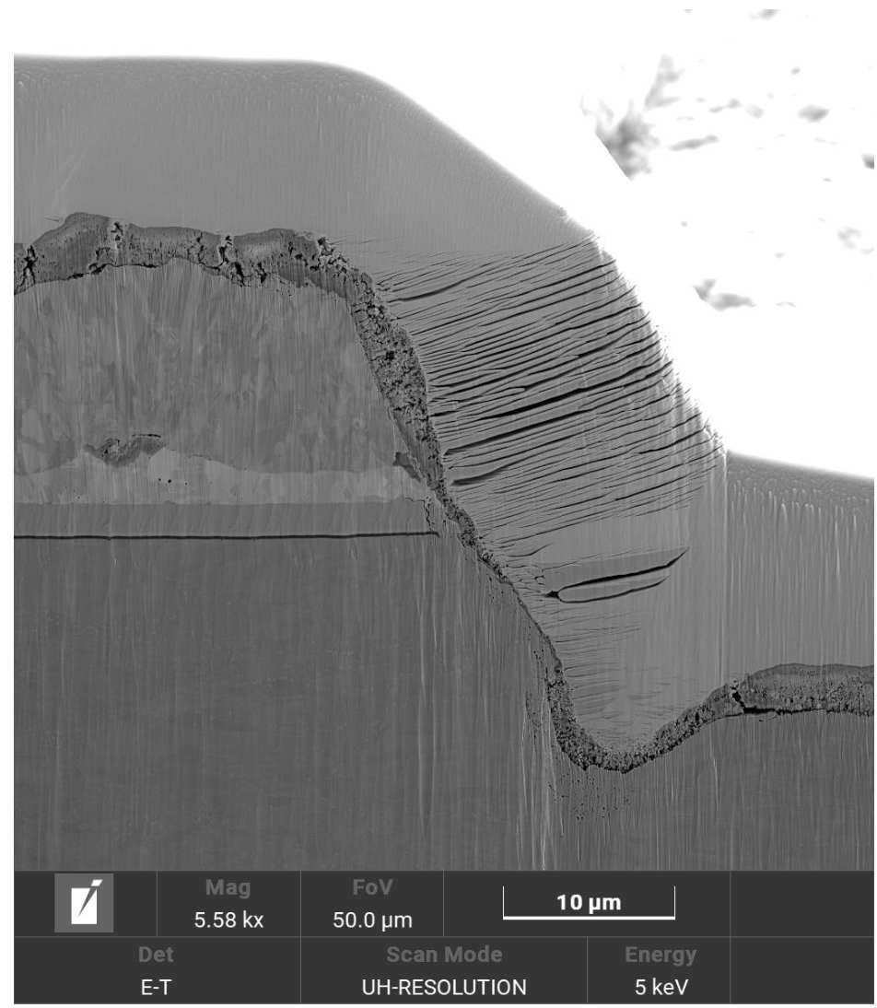
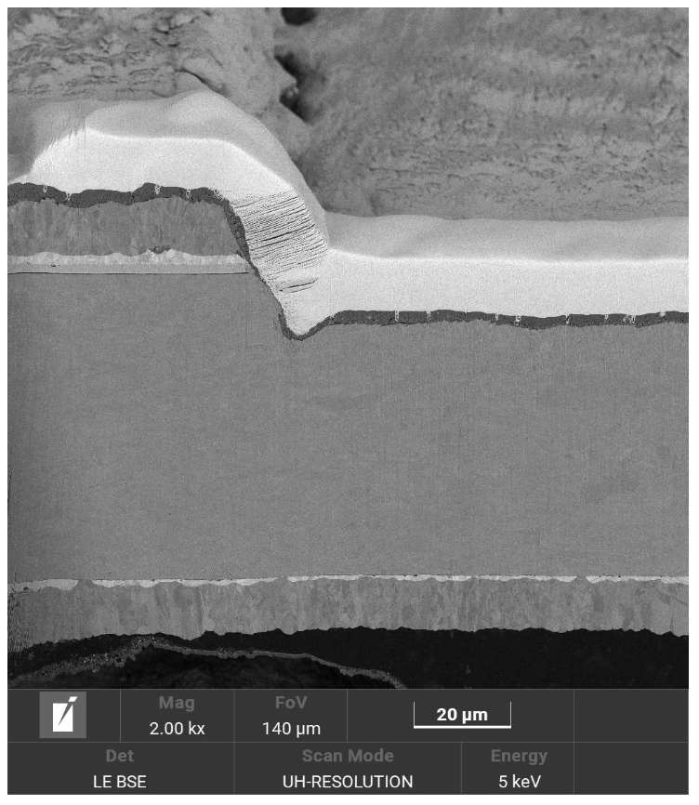
1) Stand-alone laser
Cross section (filament edge)
Ablated material
Pt
Cu
Ag
Cu
REBCO
Hastelloy
Cu
Bulk cross section obtained with plasma-FIB
Ablated material redeposited on the sample

Slide 10
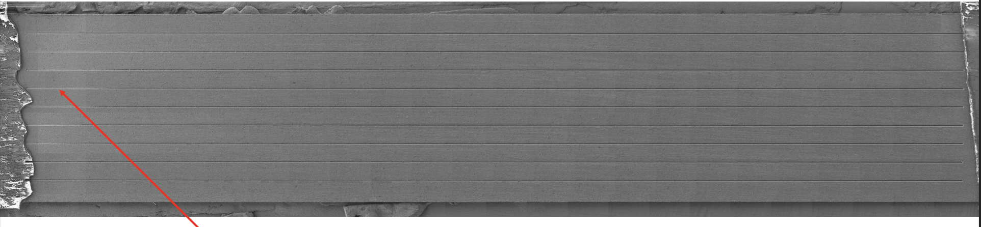
2) Integrated laser unit (pre-chamber)
REBCO tape striation
inhomogeneous milling (bending effect)
Size 20 mm x 35 µm x 23 µm (9 trenches)
Power 50 mW, pulse 350 fs, 10 passes, removal rate c. 2 µm/pass, strip width 350 µm
Time 2.5 h

Slide 11
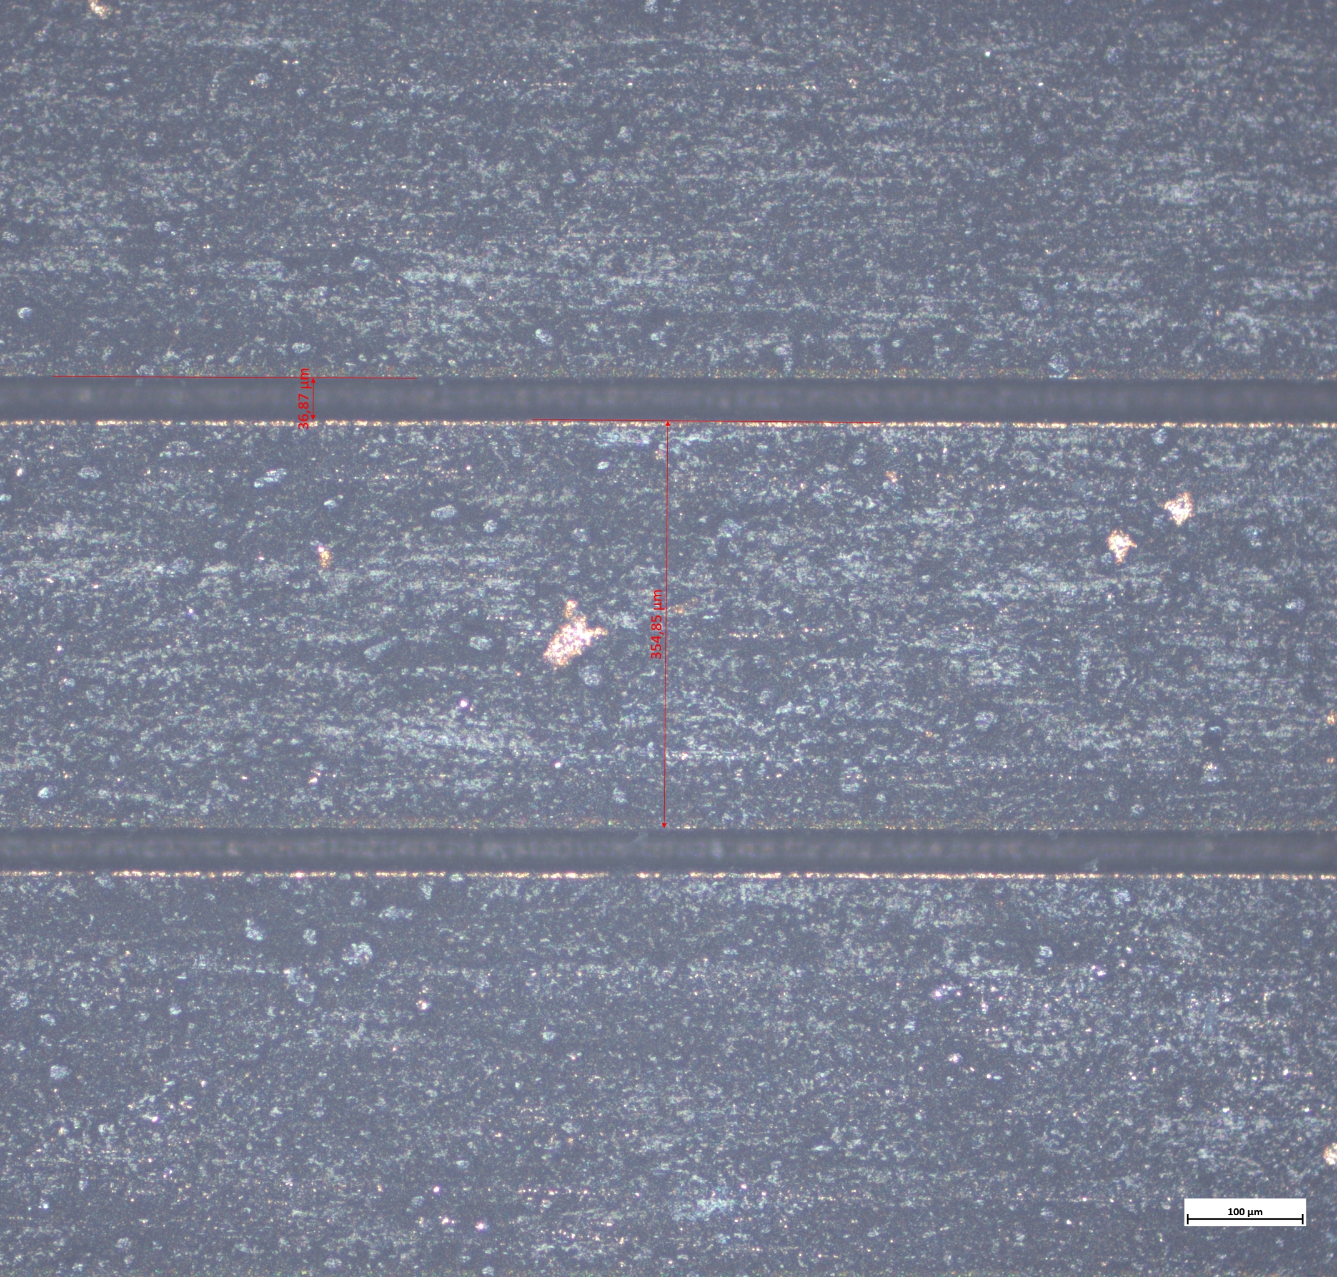
2) Integrated laser unit (pre-chamber)
REBCO tape striation
Gap 35 µm
Strip 350 µm
inhomogeneous milling (bending effect)
Size 20 mm x 35 µm x 23 µm (9 trenches)
Power 50 mW, pulse 350 fs, 10 passes, removal rate c. 2 µm/pass
Time 2.5 h
Thick ablated material layer redeposited on the strips

Slide 12
2) Integrated laser unit (pre-chamber)
REBCO tape striation
inhomogeneous milling (bending effect)
Size 20 mm x 35 µm x 23 µm (9 trenches)
Power 50 mW, pulse 350 fs, 10 passes, removal rate c. 2 µm/pass
Time 2.5 h
Eventually measured I-V (whole sample) and VSM+OM (box) next presentations

Slide 13
2) Integrated laser unit (pre-chamber)
2nd phases
Ablated material
Cross section (filament edge)
Pt
REBCO
BL
Cu
Ag
REBCO
Hastelloy
STEM imaging on thin cross-sectional lamella (4 different signals)

Slide 14
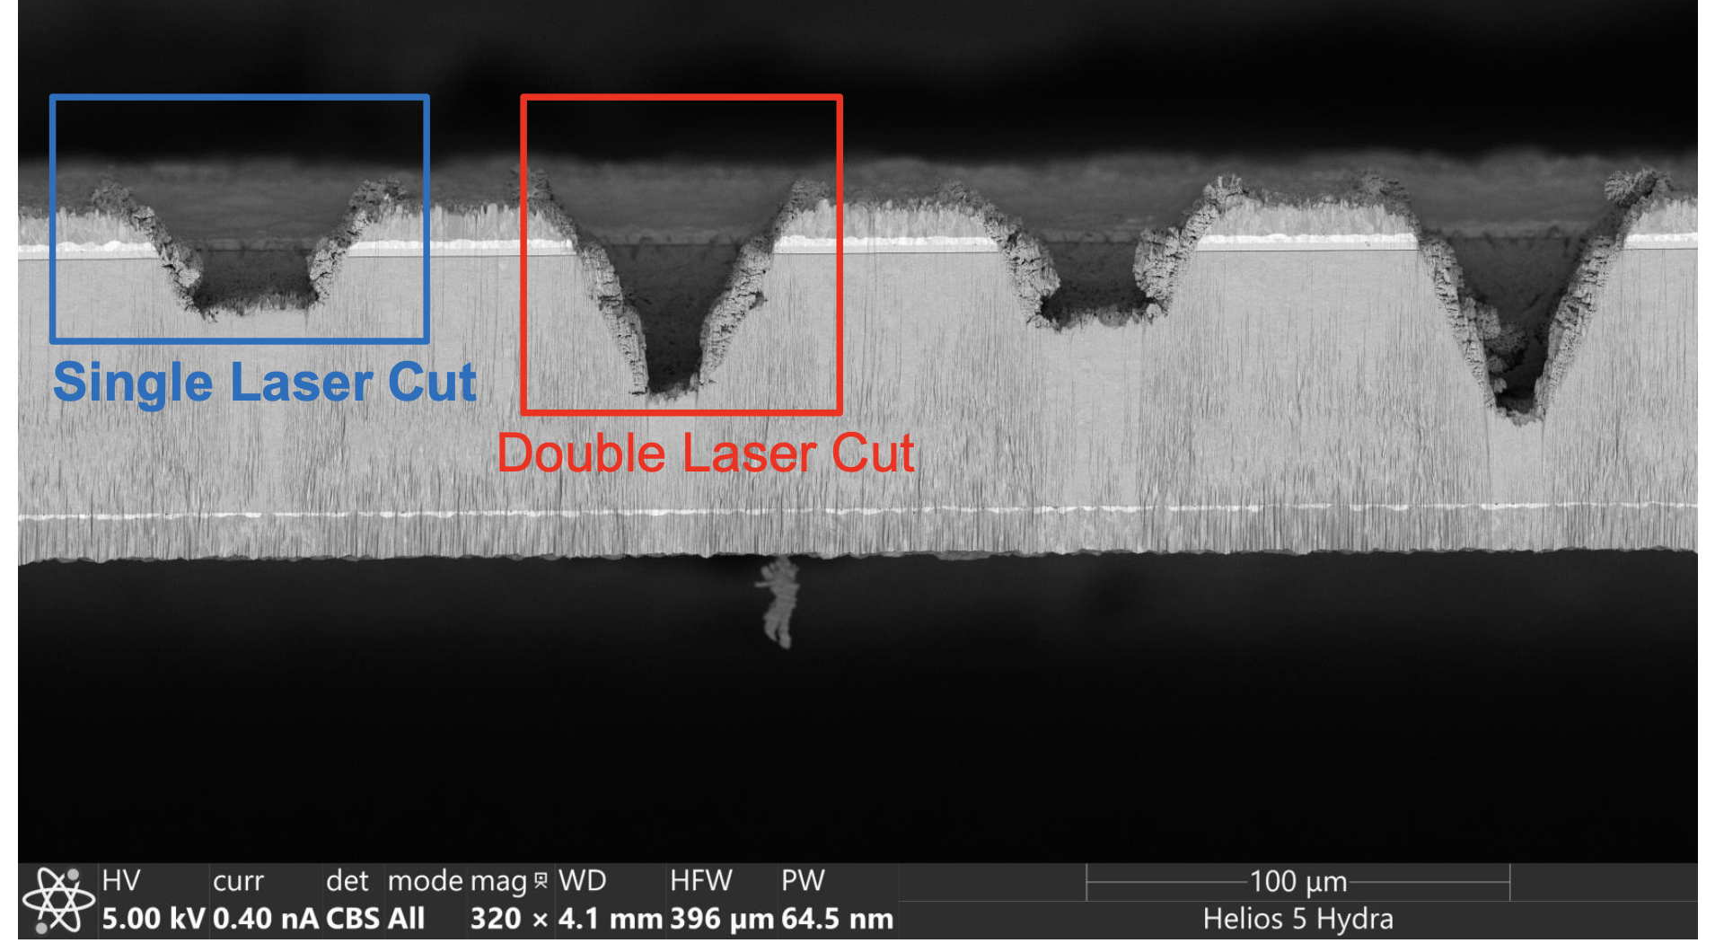
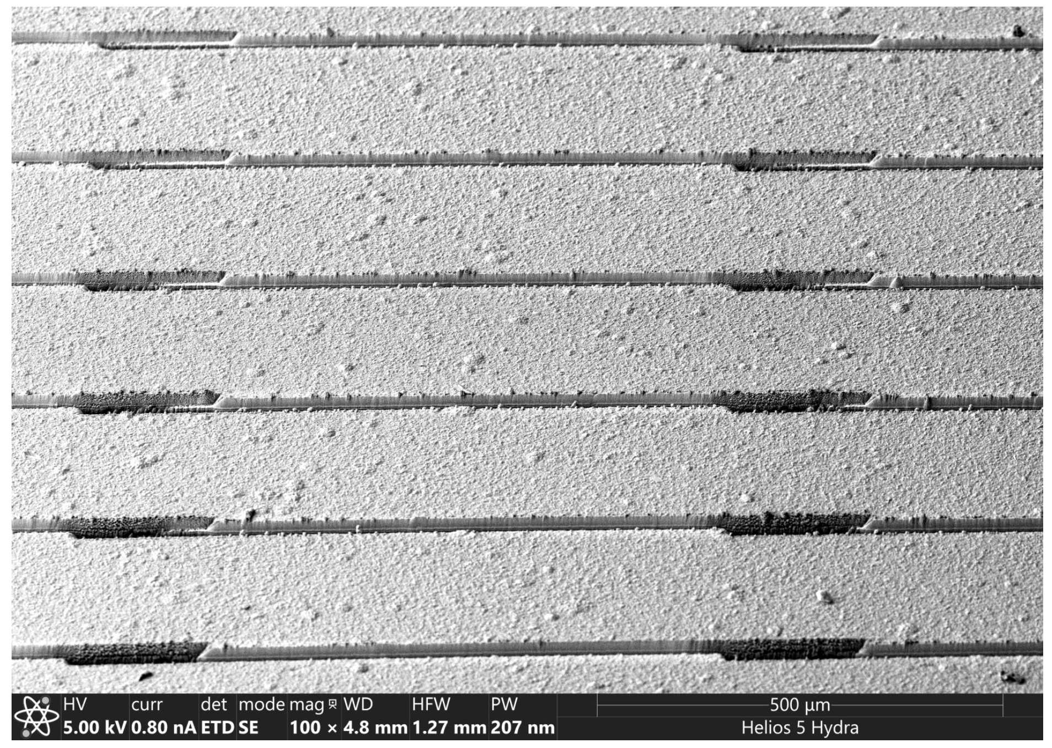
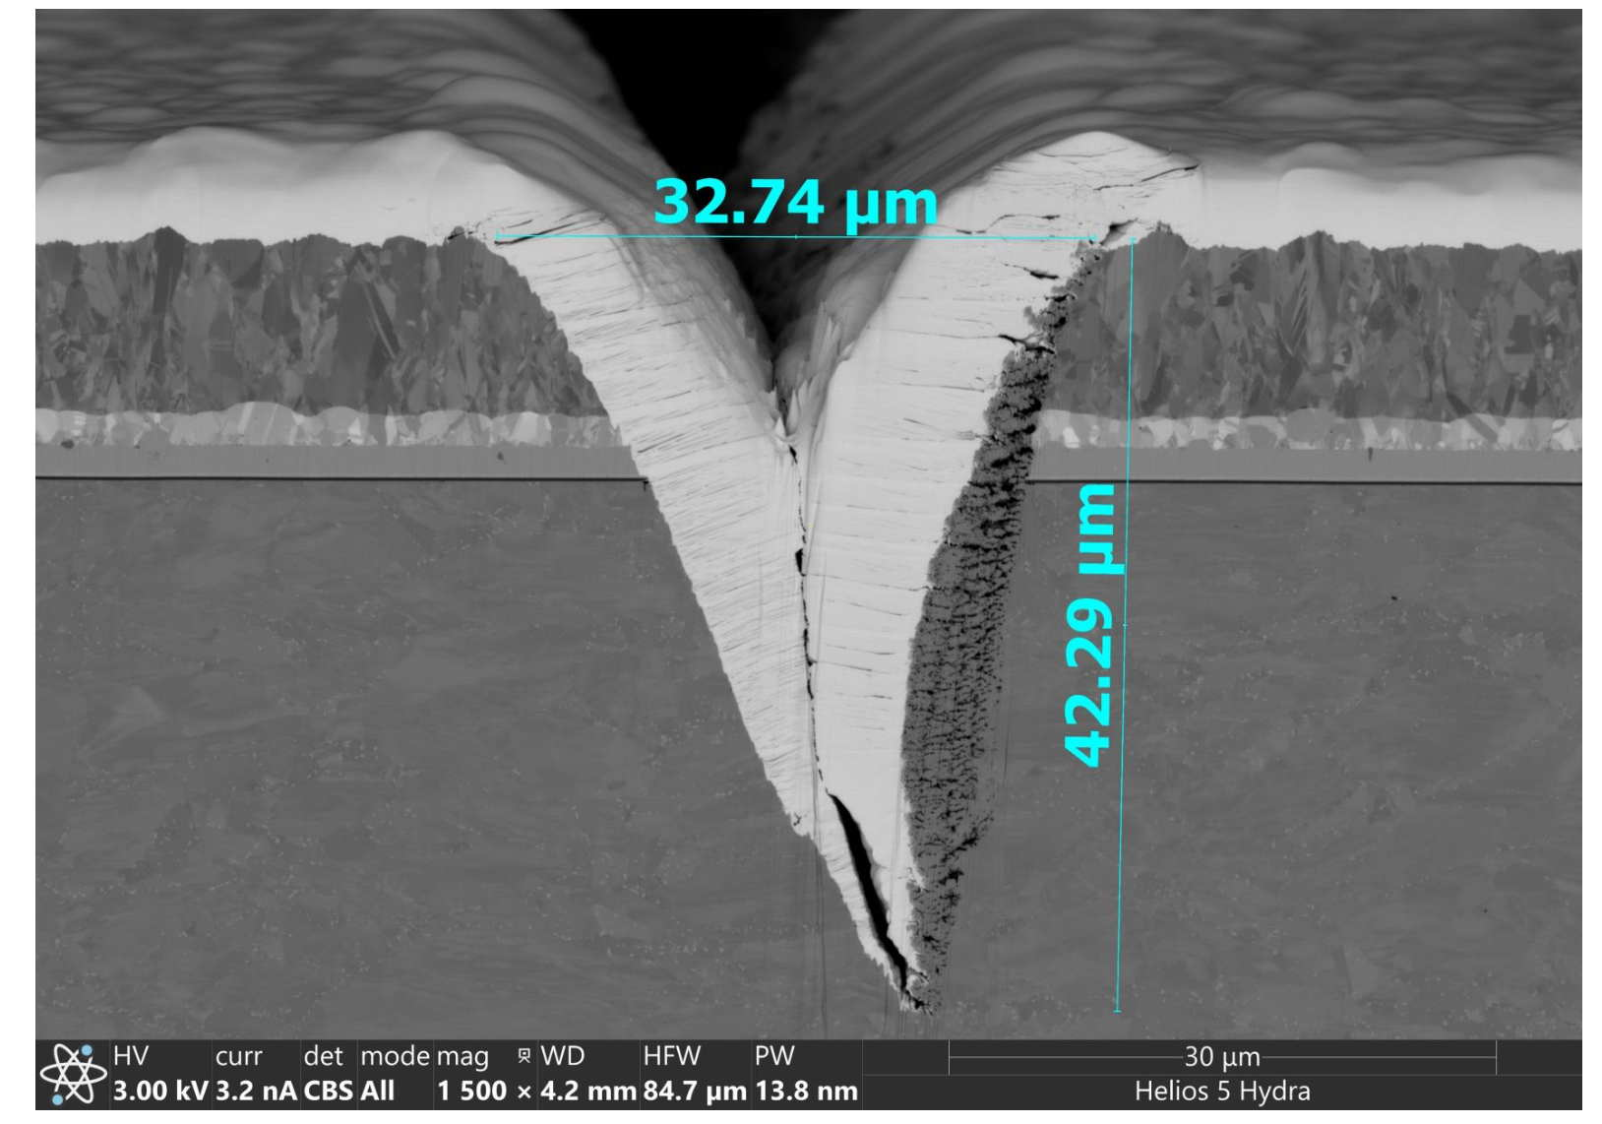
3) Fully integrated laser beam
REBCO tape striation
W
Cu
Size 1 mm x 30 µm x 15 µm (6 trenches)
Power c. 1.2 W, pulse energy 15 µJ, 1-2 passes, removal rate c. 15 µm/pass
Overlap between meeting segments critical
Ag
REBCO
After plasma FIB rocking polishing
Hastelloy

Slide 15
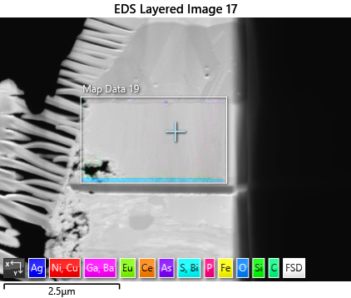
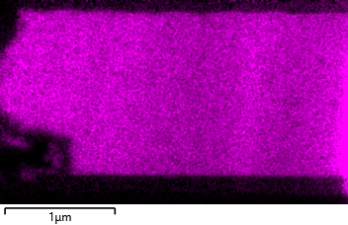
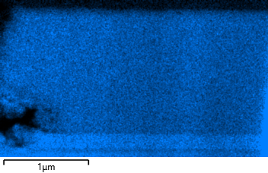
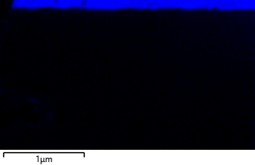
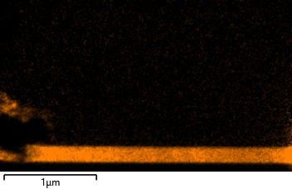
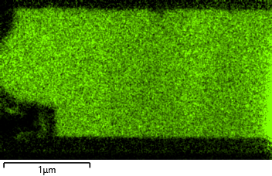
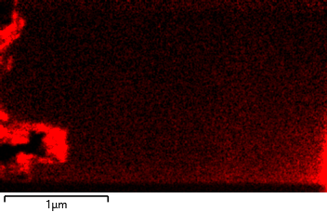
Additional analysis: EDS (producer 2)
EDS on extracted cross-sectional lamella (edge)
Ba- L series
O- K series
Ag- L series
Ce-L series
Eu- L series
Ni- K series
Contamination due to Ni ablated from the substrate
Slight thickness effect (lamella thickness inhomogeneity)
No obvious oxygen content gradient

Slide 16
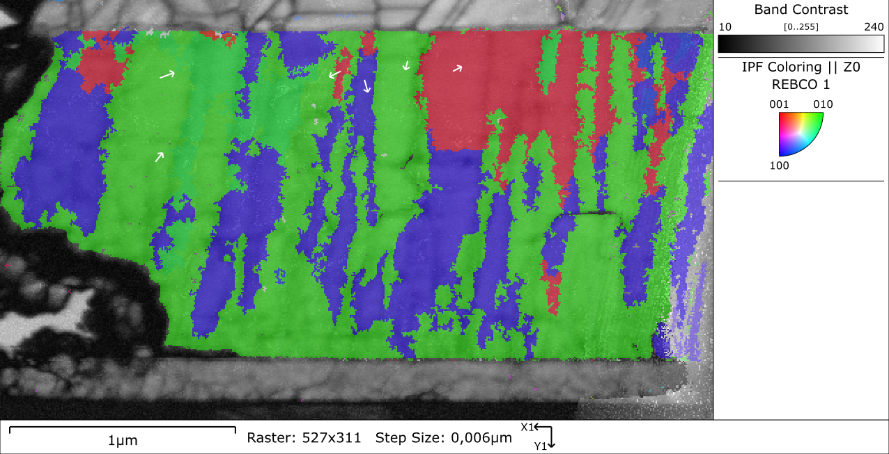
Additional analysis: EBSD (producer 2)
EBSD on extracted cross-sectional lamella (edge)
Majority of REBCO film c-axis oriented; a-axis regions possible, but further investigation required

Slide 17
Comparison
Comparison of different configurations proposed
Producer | 1 | 2 | 3
FIB source | Xe | Ga | Xe
Laser | stand alone | integrated (pre-chamber) | integrated
Laser type | ps/fs | fs | fs
Single trench length (mm) | 45 | 40 | 1
Load lock | Y | Y | N

Slide 18
Comparison
Comparison of different configurations proposed
Producer | 1 | 2 | 3
FIB source | Xe | Ga | Xe
Laser | stand alone | integrated (pre-chamber) | integrated
Laser type | ps/fs | fs | fs
Single trench length (mm) | 45 | 40 | 1
Load lock | Y | Y | N

Slide 19
Conclusion
Preliminary test of REBCO tape filamentisation using laser beam integrated in FIB-SEM
Three FIB-SEM producers considered
Different FIB sources proposed: Xe (plasma FIB) or Ga (conventional source)
Three laser configurations proposed: stand alone, integrated (pre-chamber) and fully integrated
Single trench length varies considerably, from c. 1 mm to > 40 mm
After patterning a considerable amount of material ablated redeposited on the strips
EDS and EBSD on cross-sectional lamella feasible
Analysis of cross-sectional lamella to detect possible negative effects due to laser patterning revealed no apparent damage on REBCO film integrity

Slide 20
Thank you
for your attention
angelo.vannozzi@enea.it

