Slide 1

X-ray Tomography Analysis of Short-Length HTS DEMO Conductors with different architectures
MAG-T.01.01-T047-D001
National Institute for Lasers, Plasma and Radiation Physics, Bucharest, Romania
Team: Daniel AVRAM, Cosmin DOBREA, Adrian SIMA, Ioana DINCA
Contact person
Ion TISEANU (ion.tiseanu@inflpr.ro)
https://tomography.inflpr.ro/
WPMAG EUROfusion Final Meeting – 14 - 16 January 2026

Slide 2
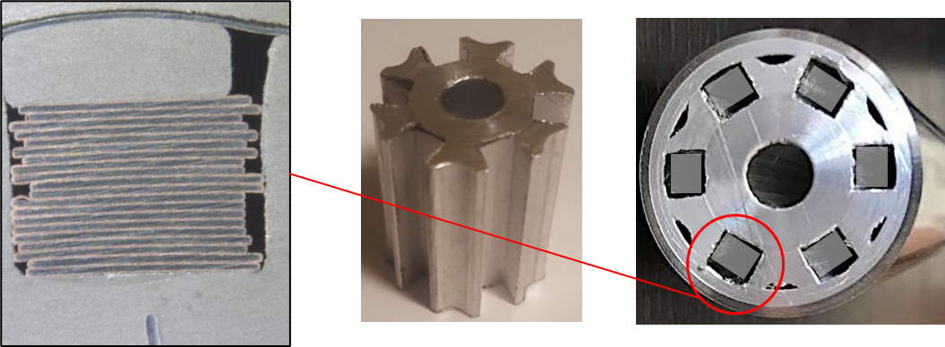
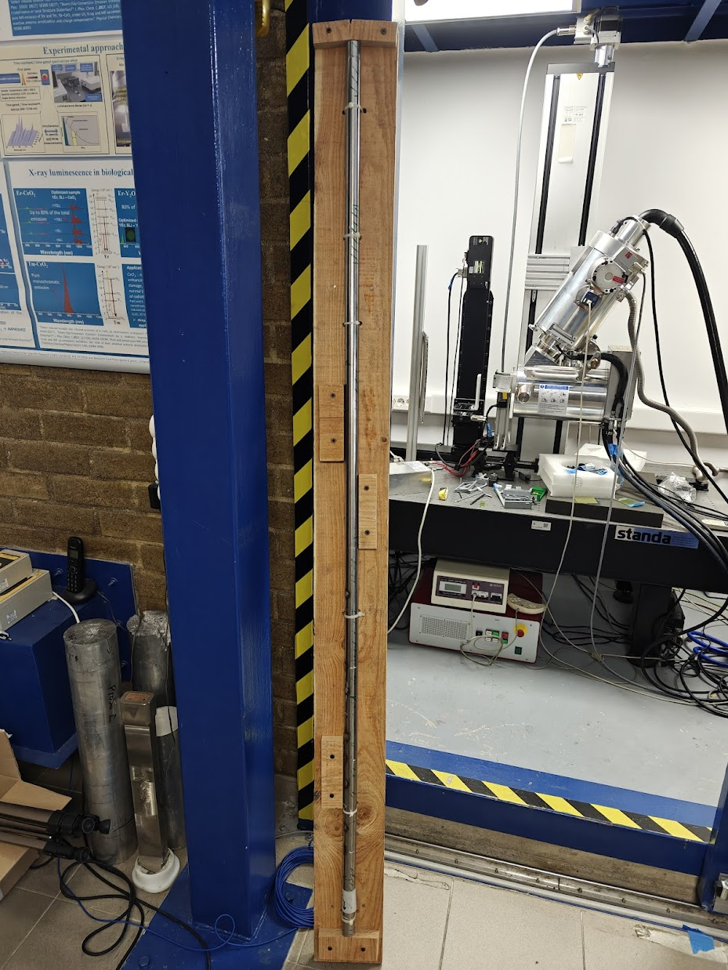
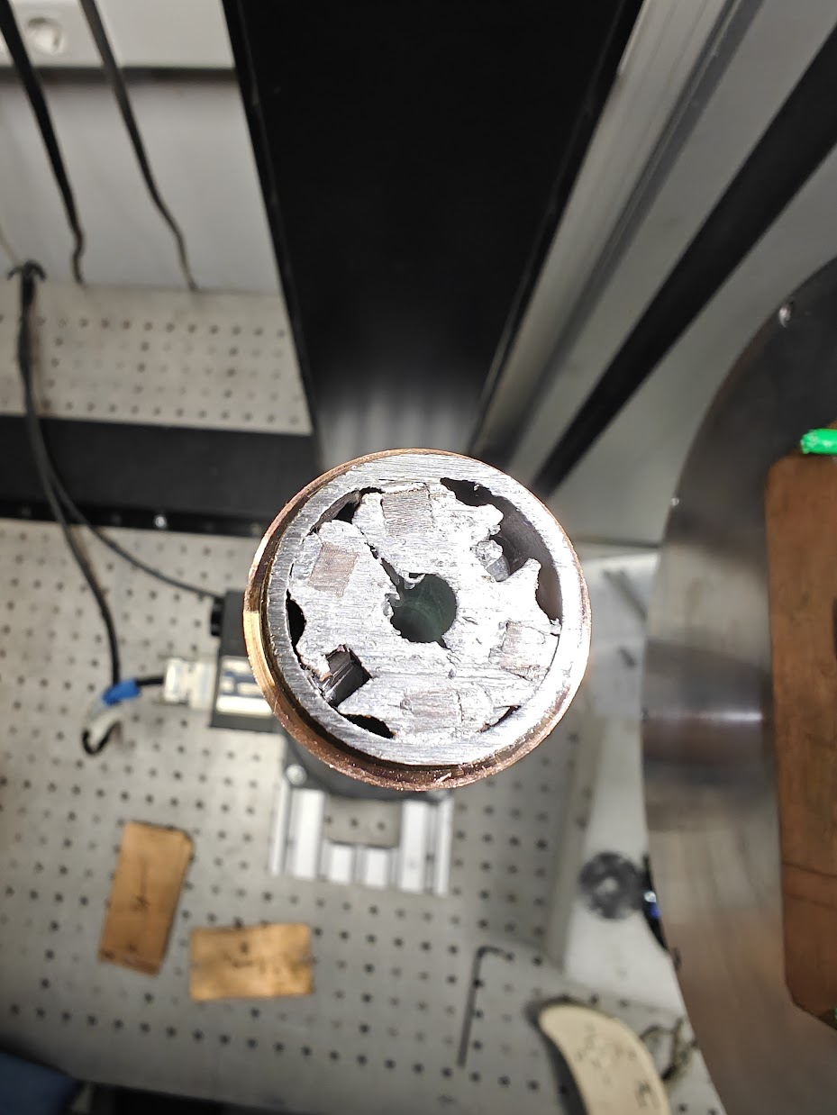
ENEA - HTS Conductors tested at the SULTAN Facility
ENEA HTS conductor tested at the SULTAN Facility features a tape arrangement of 6 stacks × 13 HTS tapes, a total of 78 tapes. It has a 6-slot aluminium core with straight slots and straight stacks. The conductor follows a double jacket concept, consisting of an inner aluminium layer and an outer stainless steel (SS) layer, ensuring structural integrity and thermal stability.
We received the bottom and upper termination and 180 cm long section of the cable B1.
180 cm long section of cable B1

Slide 3
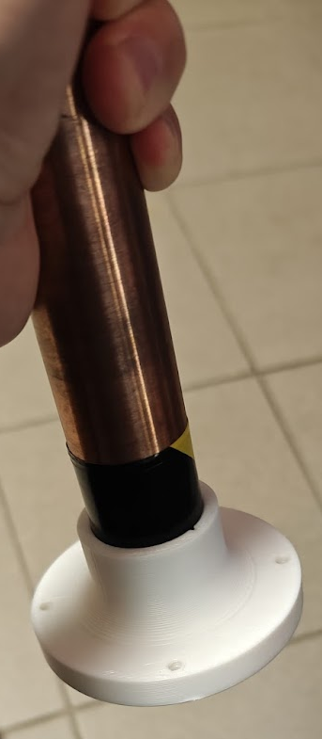
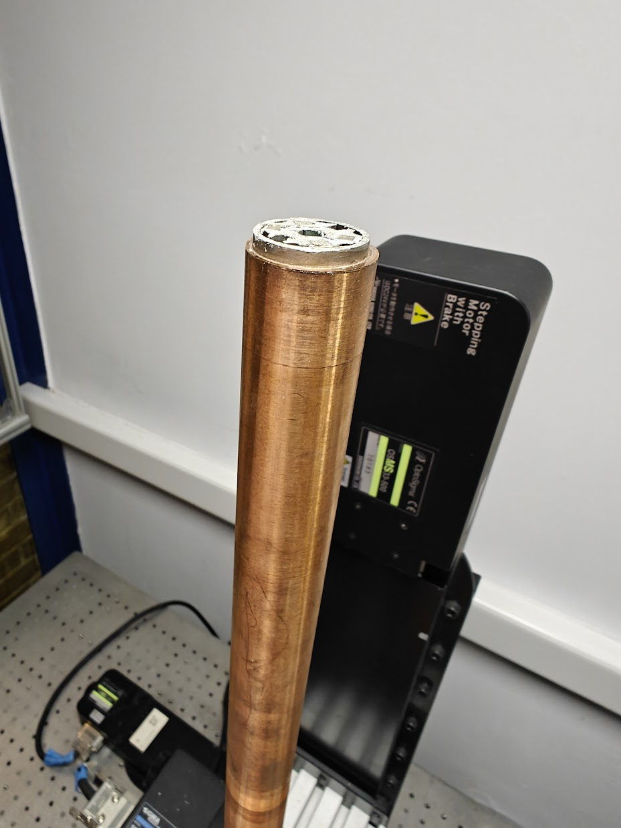
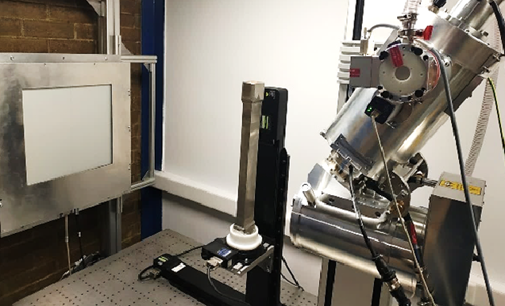
Experimental setup
320 KV high-power set-up:
X ray generator: Nikon micro-focus with 320 KV interchangeable module
X ray detector: high energy flat panel with resolution 2000 x 2000 px, windows size 400 x 400 mm, pixel size 200 µm, 16 bit;
Three high load, high precision motorized stages.
3D printed sample holder.
All CT scans were measured:
U=290-300 kV
20 µm voxel resolution
1 s integration time; 2 average radiography images and 0.18 ° rotational step

Slide 4
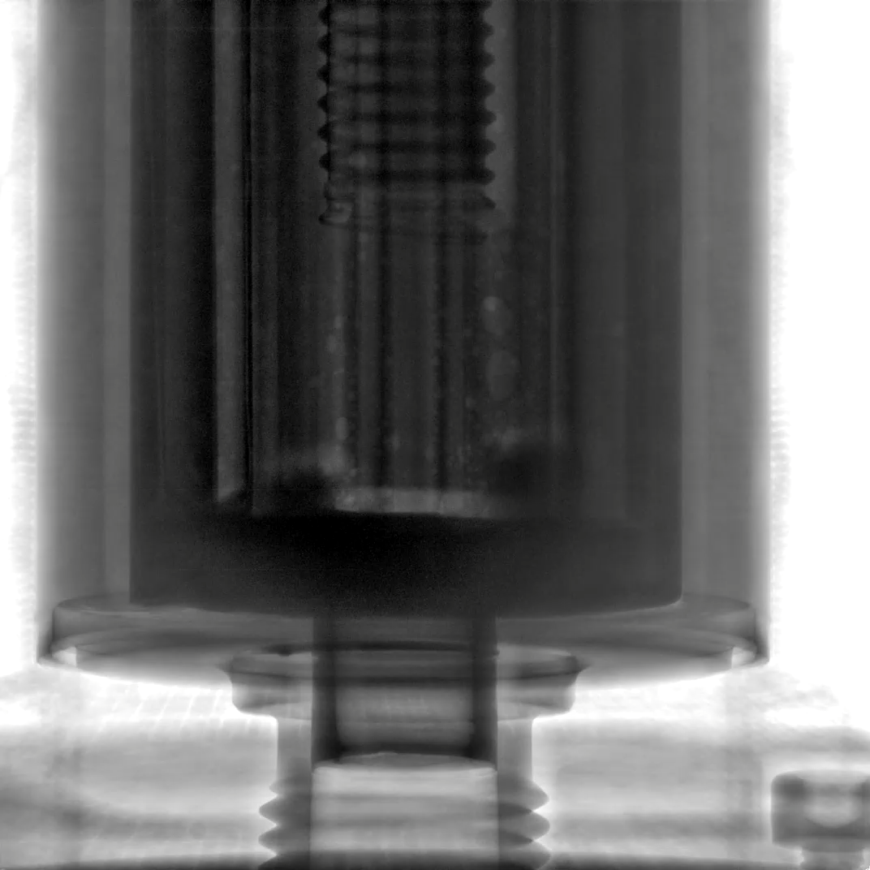
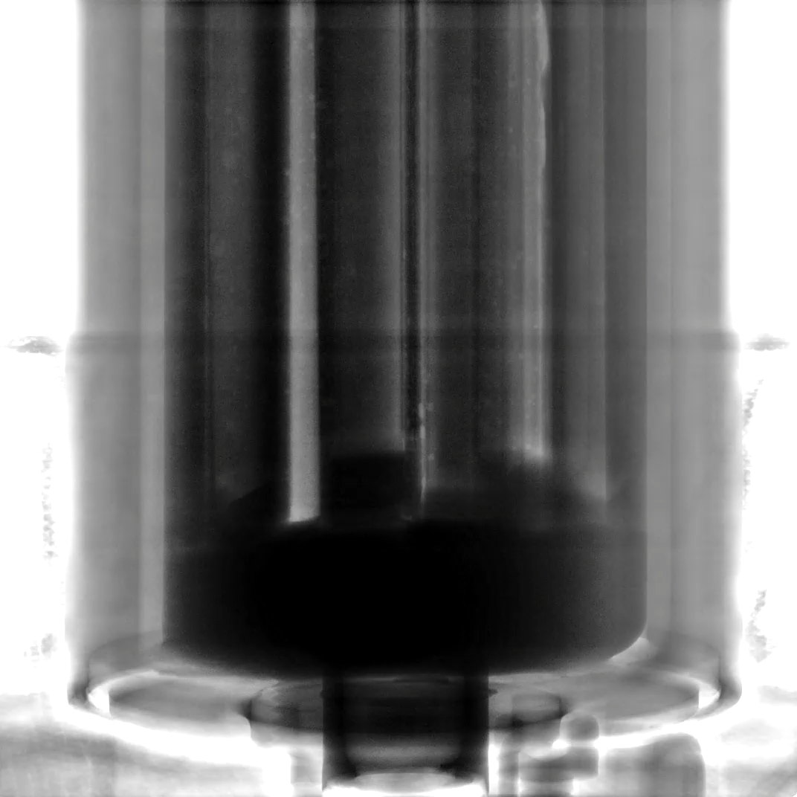
Bottom and upper termination linear radiographic overview
Bottom termination
Upper termination

Slide 5
Bottom and upper termination linear radiographic overview
Upper termination
Wedges to press the soldered stacks
Solder starts to appear
Bottom termination

Slide 6
Bottom termination - wedges
wedges

Slide 7
Bottom termination - wedges

Slide 8
Bottom termination - wedges

Slide 9
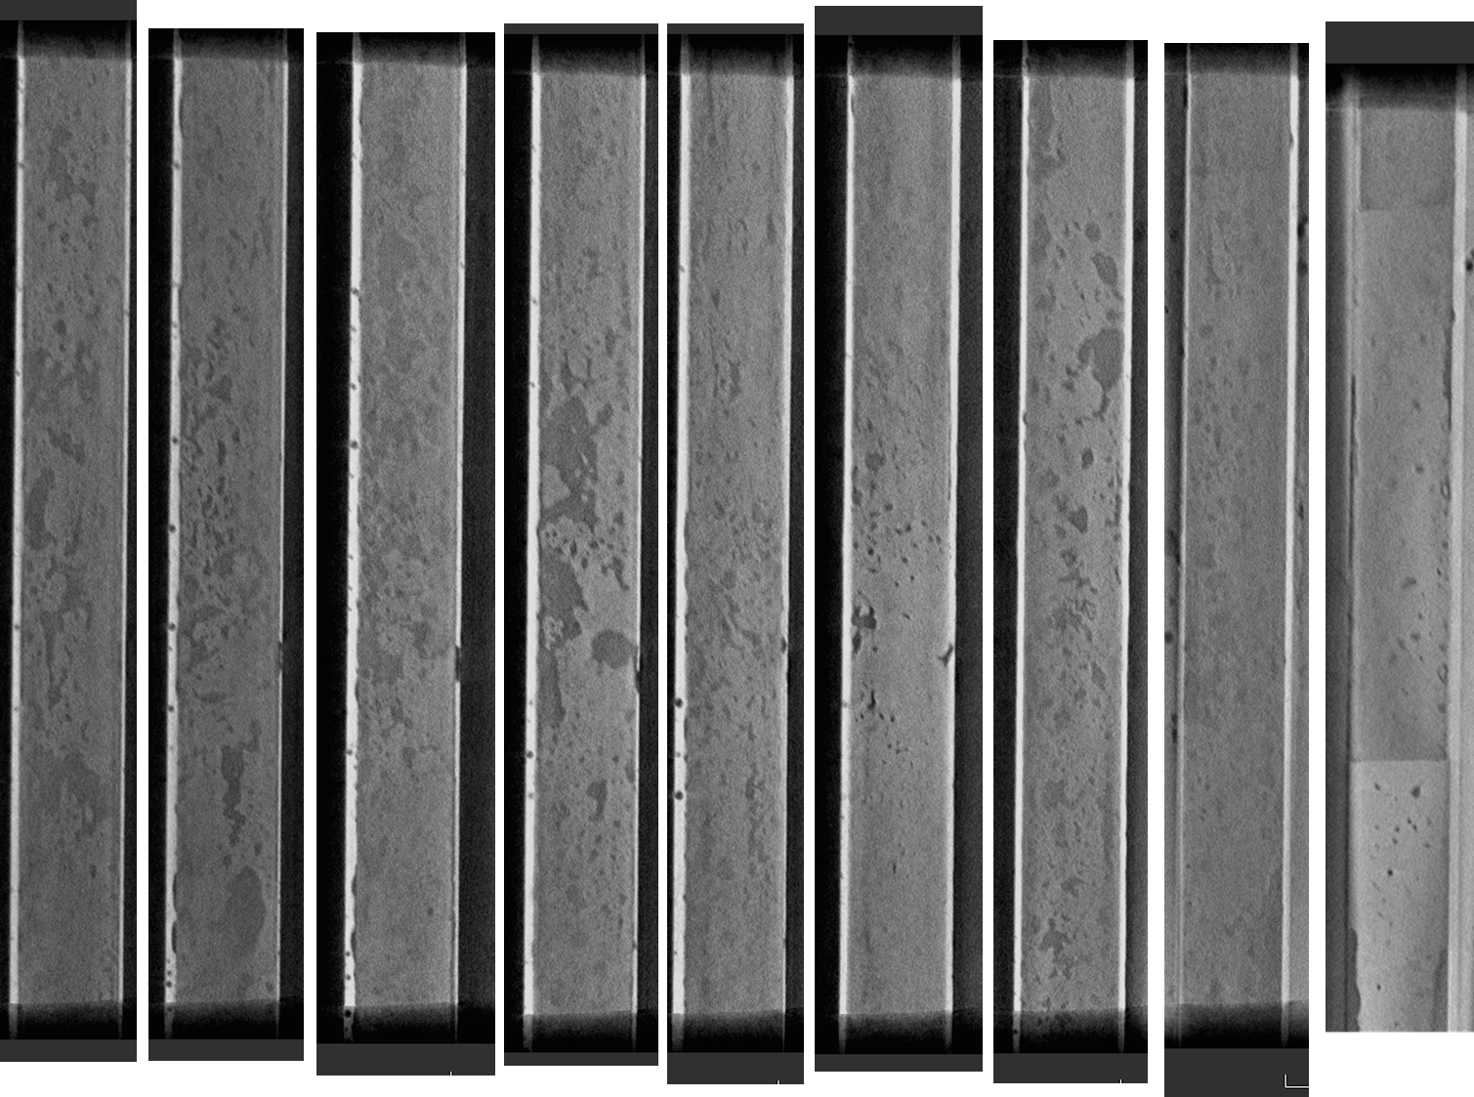
Bottom termination- wedges
Bottom
termination
Solder between the tapes

Slide 10
Bottom termination – solder starts

Slide 11
Bottom termination – solder starts

Slide 12
Bottom termination – solder starts

Slide 13
Upper termination -wedges

Slide 14
Upper termination -wedges

Slide 15
Upper termination -wedges

Slide 16
Upper termination - solder starts

Slide 17
Upper termination - solder starts

Slide 18
Upper termination - solder starts

Slide 19
Upper termination - solder starts

Slide 20
Upper termination - solder starts

Slide 21
Upper termination - solder starts

Slide 22
Upper termination - solder starts

Slide 23
25 cm cut
section

Slide 24
25 cm cut
section

Slide 25
25 cm cut
section

Slide 26
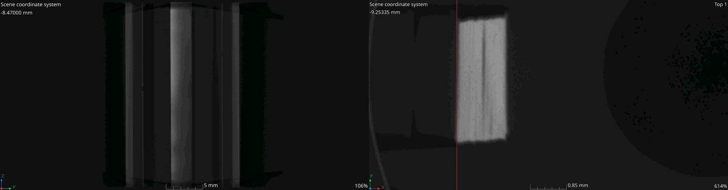
25 cm cut
section

Slide 27
Conclusions
Initial findings suggest that digital radiography, even when conducted from multiple angles, does not adequately visualize the stacks architecture.
Therefore, obtaining CT scan-like data for the extra-size cables is essential.
Preliminary results from the 320 kV X-ray generator in indicate: i) No noticeable non-uniformities were observed in the 25 cm cut section, only small solder spots/droplets of 80-100 µm in dimensions. ii) The CT reconstructions confirmed that all dimensions align with the manufacturer’s design specifications.

Slide 28
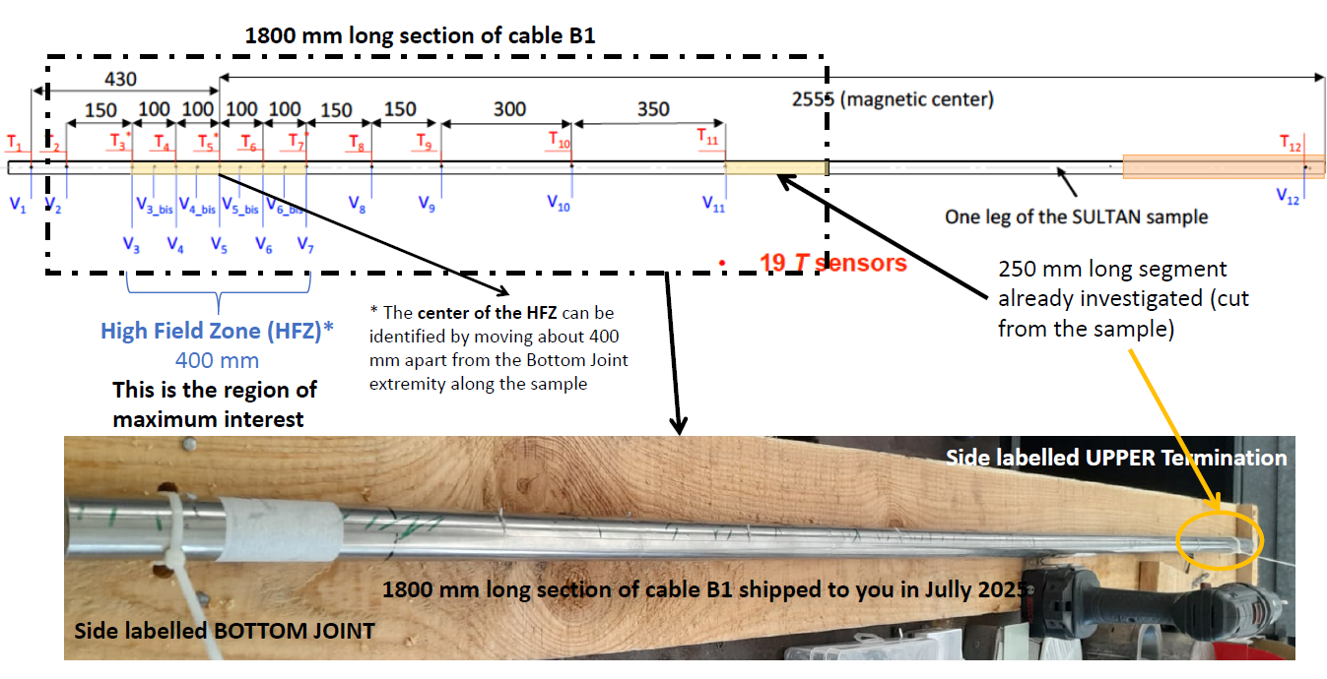
Key Lessons Learned and Future Directions
Implementing of the 225 kV X-ray System is needed for achieving ~5 µm voxel resolution: After feedback received from Giuseppe Celentano and Angello Vannozzi we received the regions of interest in the long middle section of B1 sample (now at 1.55 m long) that will be scanned: a section of 400 mm long is of maximum interest as being the High Field Zone (HFZ).
In 2026 we will focus on that section, and if needed we sill ask for approval to cut the section out for easier access.

