Slide 1
Nb₃Sn cabling activities at EPFL-SPC
X. Sarasola
January 16th, 2026

Slide 2
Outline
EDIPO2 prototype cable:
  Prototype cable: MAG-T.04.01-T001-D001
  Sub-scale coil : MAG-T.04.01-T002
Short length TF conductor (RW5):
  Cabling: MAG-T.01.01-T048-D004
  Sample assembly: MAG-T.01.01-T048-D001 (new task required)
  Test in SULTAN: MAG-T.01.01-T048-D002 (new task required)
Insert coil conductor (RW6):
  Strand: MAG-T.04.03-T001-D002
  Cabling: MAG-T.01.01-T048-D004
  Stabilizer: MAG-T.01.01-T018-D009
  Heat treatment, industrial assembly and test: new tasks required
Short length PF conductor (RW7):
  Strand and stabilizer: MAG-T.01.01-T018-D009
  Cabling: MAG-T.01.01-T048-D004
  Assembly and test in SULTAN: new task required
Double-jacket for CS conductor:
  Industrial feasibility study: MAG-S.01.02-T003-D001
  Demonstration on dummy conductor: MAG-S.01.02-T007-D001 (new task required)

Slide 3
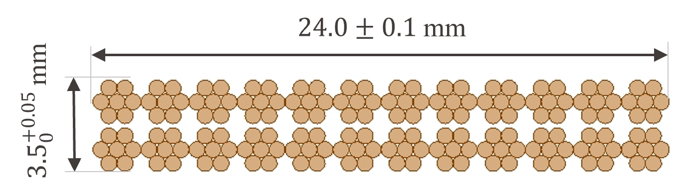
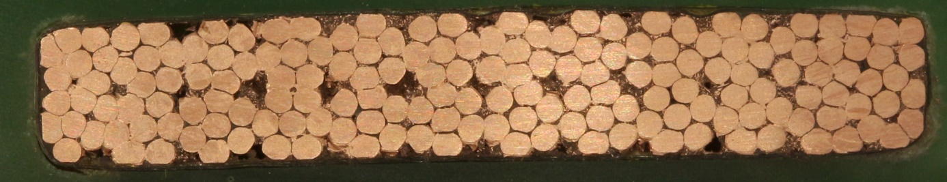
EDIPO2
EDIPO2 prototype cable (MAG-T.04.01-T001-D001):
  Contract awarded to WST in July 2024 to produce:
    Copper dummy cable: 100 m (bare) + 500 m (insulated).
    Insulated superdummy cable ~120 m, made of unstable KAT strand.
    Insulated EDIPO2 prototype cable ~140 m, made of Bruker RRP strand.
  All cable lengths were delivered in October 2025 to be used in:
    Industrial R&D activities for EDIPO2 at ASG (Swiss funding)
    EDIPO2 cable tests in SULTAN: MAG-T.04.01-T001-D001.
    EDIPO2 sub-scale coil test in SULTAN: MAG-T.04.01-T002.
Final EDIPO2 strand (Swiss funding):
  Contract awarded to Bruker in May 2025.
  Production expected to be completed Feb 2026.
Final EDIPO2 cable (Swiss funding):
  Adjudication of the call expected to be published in the coming days.
  Production expected to be completed in 10 months after reception of the Nb₃Sn wires.

Slide 4
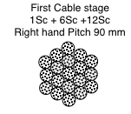

Short length prototypes: TF conductor (RW5)
The high-grade TF conductor R&D at SPC was based since 2018 on the KAT Nb₃Sn strands:
  RW3 (66 kA) and RW4 (105 kA)
The unstable behavior of the strand (identified in 2022) led to instability in both RW3 and RW4.
To demonstrate the 100 kA conductor layout, the production of RW5 was launched in 2022:
  RW5 is identical to RW4, but made of WST Nb₃Sn strands (more stable).
  The strand for RW5 was procured from WST in 2023: MAG-T.01.01-T018-D002.
  The cabling of RW5:
    WST was qualified in 2024 using a Cu-dummy (MAG-S.01.02-T005-D001).
    WST was awarded the Nb₃Sn cabling contract in March 2025 (MAG-T.01.01-T048-D004).
    Production of the Nb₃Sn cable is expected in January 2026.
  The stabilizer for RW5 is already available from the RW4 procurement.
  The assembly and test of RW5 in SULTAN should follow in 2026:
    New task required for 2026 (MAG-T.01.01-T048-D001 and D002 were withdrawn in late 2025).

Slide 5
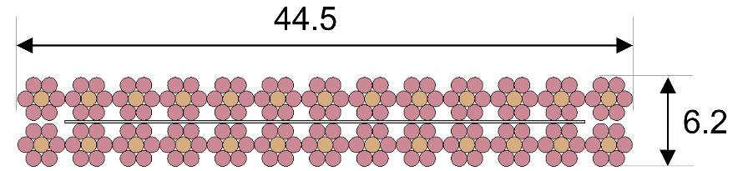
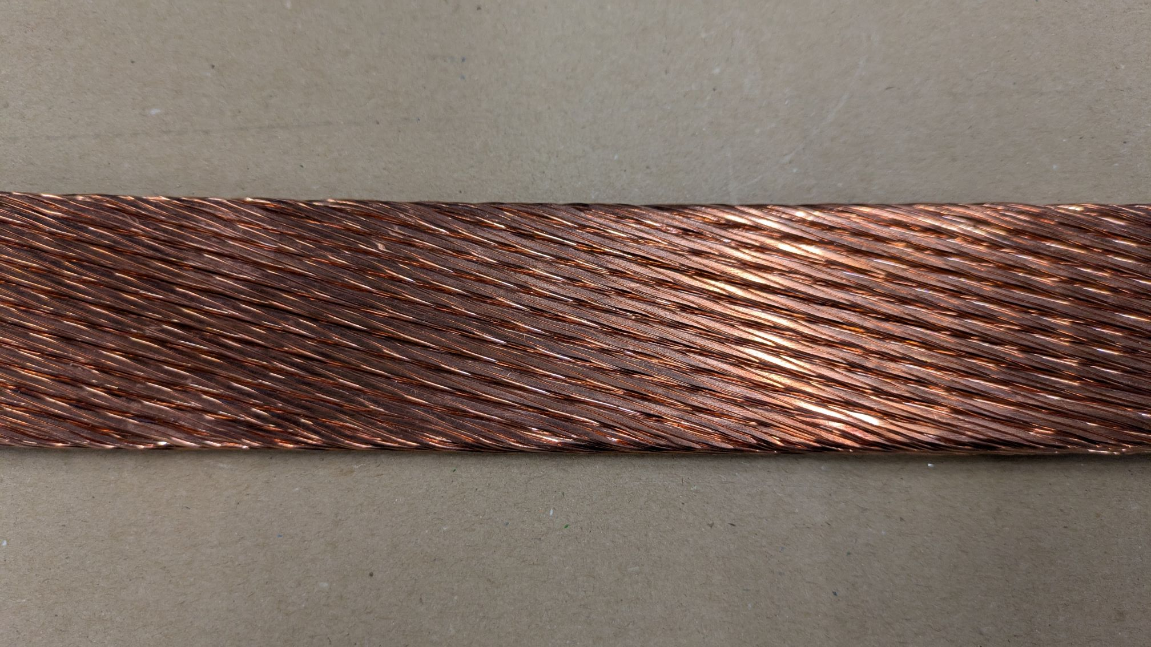
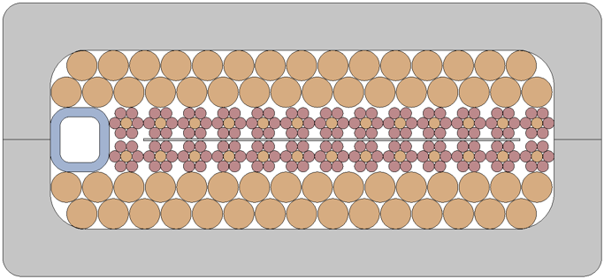
Insert coil conductor (RW6)
The final design of the insert coil conductor is relevant for the DEMO CS:
  Nb₃Sn strand: 1.2-mm-diam internal tin, j_{c} > 1100 A/mm² at 12T and 4.2 K, Cu:non-Cu =1.0
  Cable: RW, fully transposed, I_{op} = 45.6 kA at 13 T
The Nb₃Sn strand was produced at WST in Oct 2025 (MAG-T.04.03-T001-D002)
Cabling is ongoing at WST (MAG-T.01.01-T048-D004):
  Satisfactory Cu and Nb₃Sn samples (Jan 2026).
  Production of 100 m of Nb₃Sn cable in Q1 2026.
Stabilizer cable order with WST (MAG-T.01.01-T018
-D009), ~395 m, delivery Q2 2026. It will be used
for the insert coil conductor and the PF prototype.
New tasks in 2026-2027 to complete this R&D:
  Heat treatment of the Nb₃Sn cable
  Industrial assembly and laser welding of the conductor
    100 m of copper dummy for trials would be desirable
  Test in SULTAN
Test in the Naka test facility as an insert coil?

Slide 6
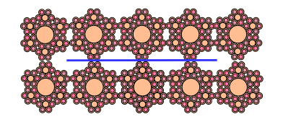
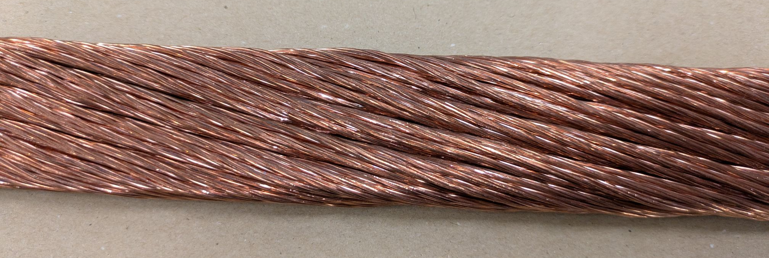
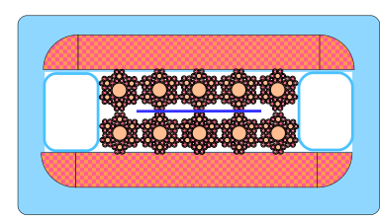
Short length prototypes: PF conductor (RW7)
Design of the high-current PF conductor (MAG-S.01.01-T018-D004):
  Nb₃Sn strand: 0.9-mm-diam bronze strand, low hysteresis loss (< 200 mJ/cm³), j_{c} > 900 A/mm² at 12T & 4.2 K, Cu:non-Cu =1.5
  Cable: RW, three-stage, fully transposed.
  Cabled stabilizer with Cu/CuNi for low eddy loss.
The Nb₃Sn strand was produced at WST in Oct 2025 (MAG-T.01.01-T018-D009)
Cabling is ongoing at WST (MAG-T.01.01-T048-D004):
  Cu sample received in Jan 2026.
  Expected completion in Q2 2026.
Stabilizer cable order with WST (MAG-T.01.01-T018
-D009), ~395 m, delivery Q2 2026. It will be used
for PF short prototype and the insert coil conductor.
We need a new task in 2026 to complete this R&D:
  Assembly of the PF conductor
  Test in SULTAN

Slide 7
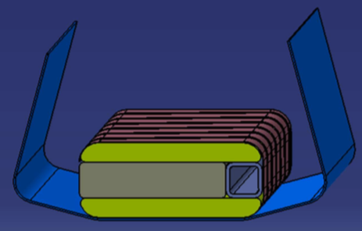
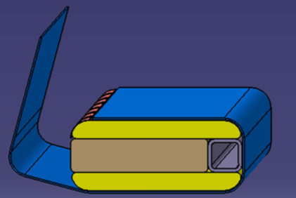
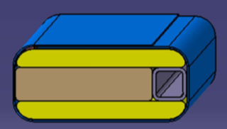
Double-jacket for CS conductor
To separate the structural and hydraulic functions of the CS jacket, a thin, soft jacket is introduced between the thick steel jacket and the cable/stabilizer assembly.
The feasibility of such design option was evaluated in the industrial study with SEA ALP (MAG-S.01.02-T003). The jacket is a 0.5 mm strip of pure Titanium, folded and laser welded along the cable in a dedicated reel-to-reel process.
A demonstration based on dummy conductor was planned in 2025 (MAG-S.01.02-T007-D001):
  100 m of RW5 copper dummy conductor have been produced at WST in 2025 (MAG-T.01.01-T048-D004)
  2×100 m of dummy stabilizer will be likely available in Q2 2026 (MAG-T.01.01-T018-D009).
  We launched a call for tender and identified an industry willing to perform this work for the existing budget.
We need a new task in 2026 to perform this demonstration based on a dummy conductor.

