Slide 1
SULTAN test of LASSO2 coil
Nikolay Bykovskiy
WPMAG final meeting
16/01/2026

Slide 2
Content
EU-CN - Instrumentation and SULTAN test of LASSO2 sample
SULTAN test of LASSO2 coil impregnated by water

Slide 3
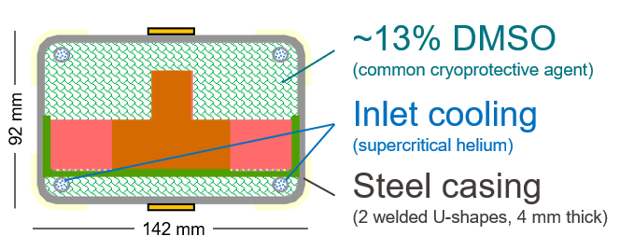
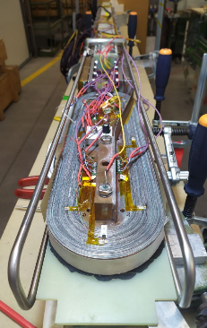
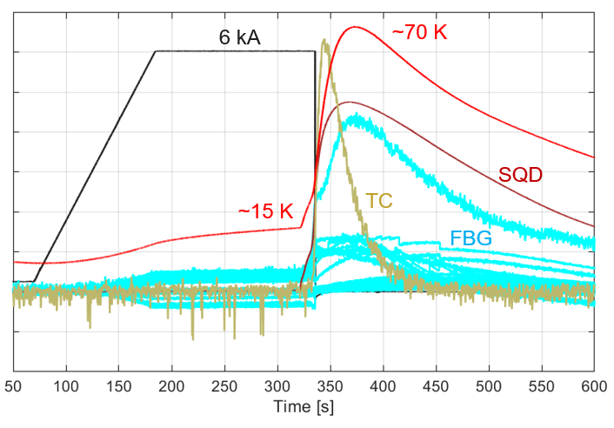
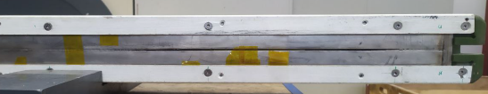
Motivation
Various issues observed during the LASSO coil testing in SULTAN:
Fracture of sample steel structure
High discharge voltages leading to false-positives quench triggers in SULTAN and faults to ground in the sample holder
Considering the sample instrumentation, it is also necessary to increase number of voltage taps along the winding to allow detailed study on quench propagation
Integration of strain gauges applied on steel structure should be revised given that poor response obtained in the first test
Only limited number of FBG could be monitored due to feedthrough issues
The high-field terminal: high resistance of bolted interface and delamination of soldered interface subjected to tensile Lorentz forces.
→ The ‘LASSO2’ sample aims at addressing these issues…
Testing components
Instrumentation / sample layout

Slide 4
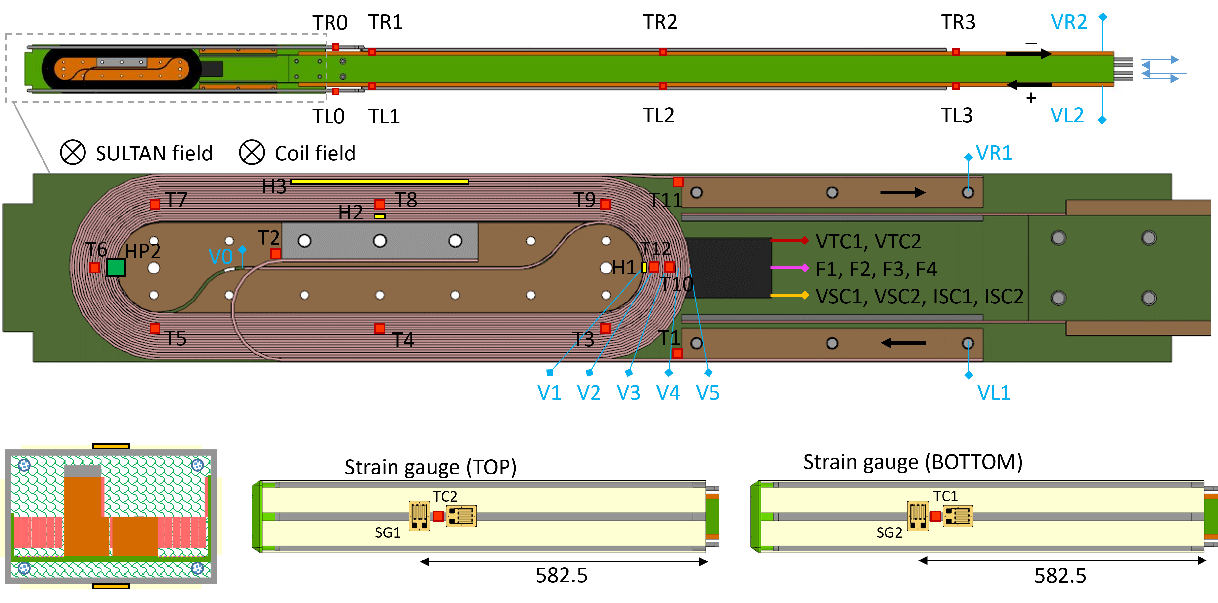
Sample instrumentation
QD plate re-used
Strain gauges: 2 sensors per location, along the EM load and along the sample axis, both rigidly attached
New fiberoptics feedthroughs installed allowing to monitor 8 channels

Slide 5
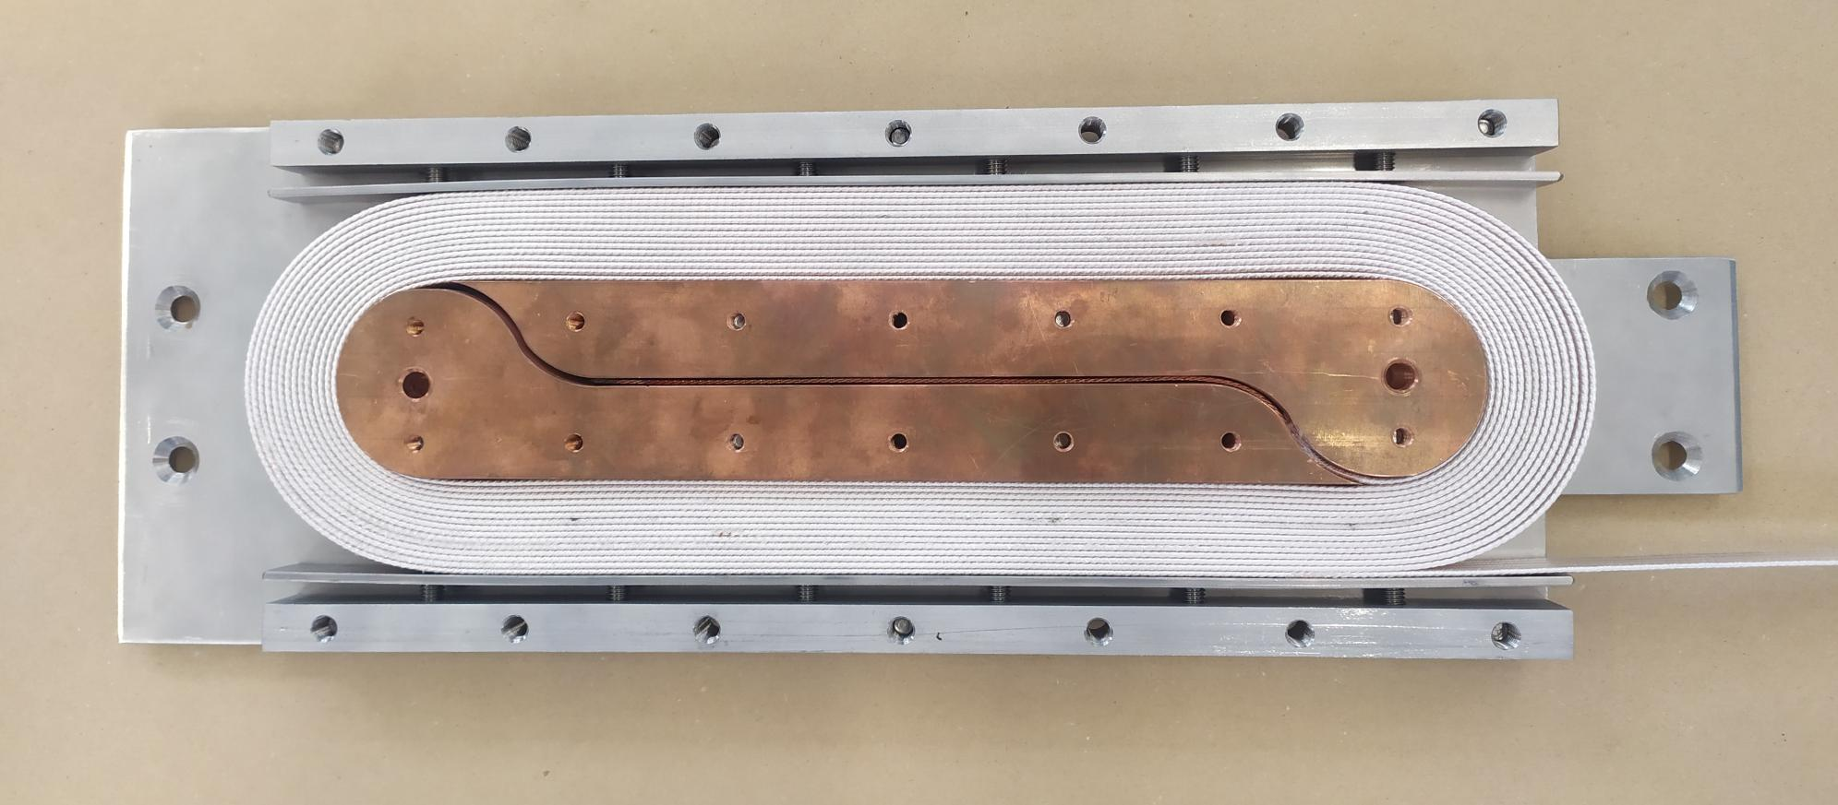
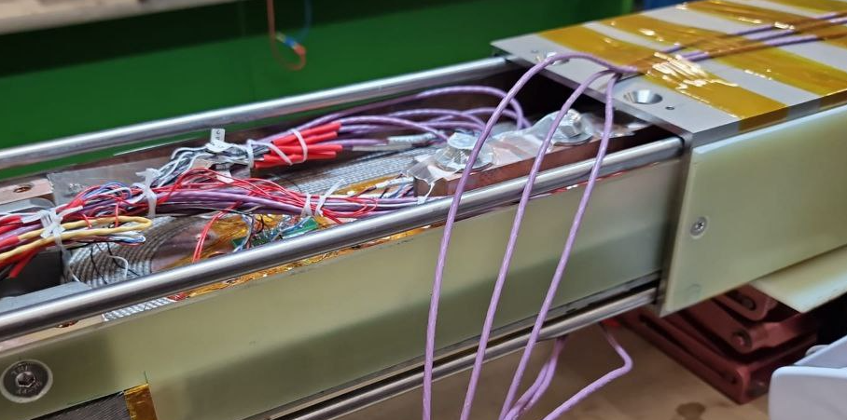
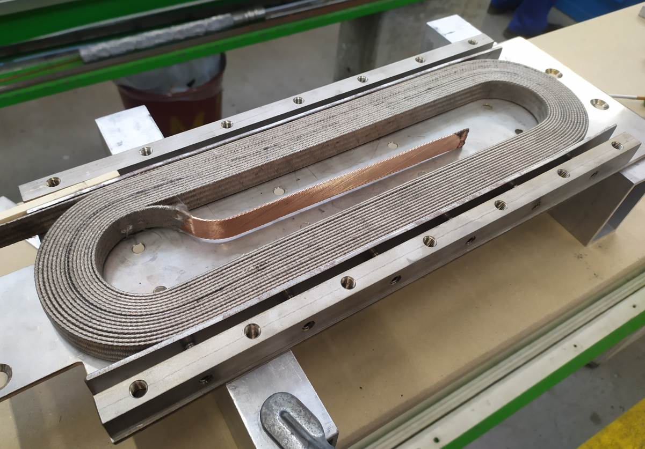
Sample assembly
Flat racetrack using Nb3Sn conductor (MQXF)
Laser-welded steel structure
Ready for splicing after heat-treatment

Slide 6
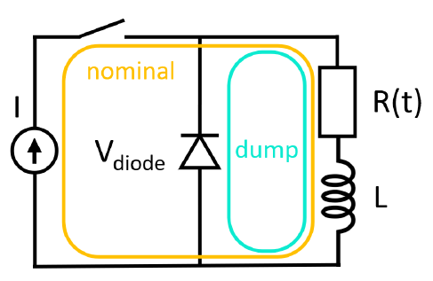
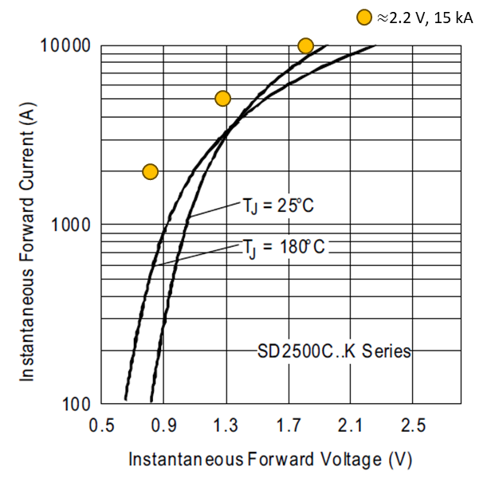
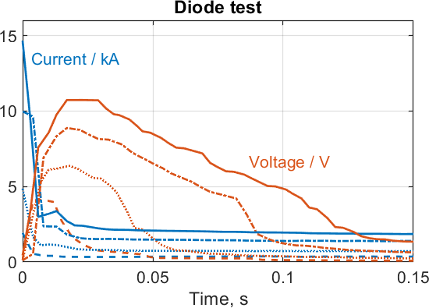
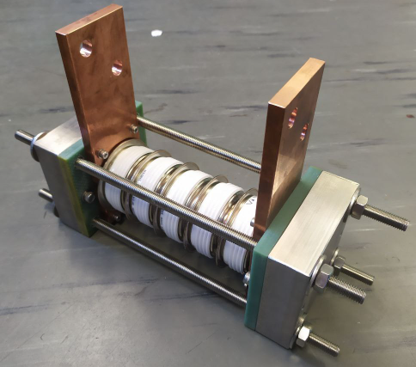
Fast discharge using stack of diodes
Protection circuit
Discharge voltage reduced to ~5 to 10 V, thus arcing and false-positives no longer observed

Slide 7
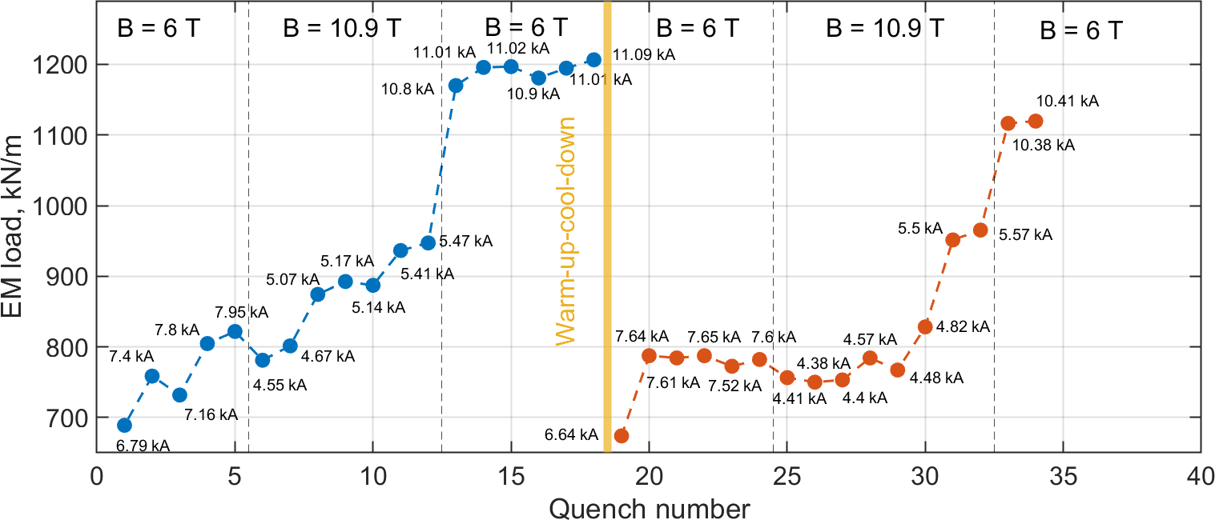
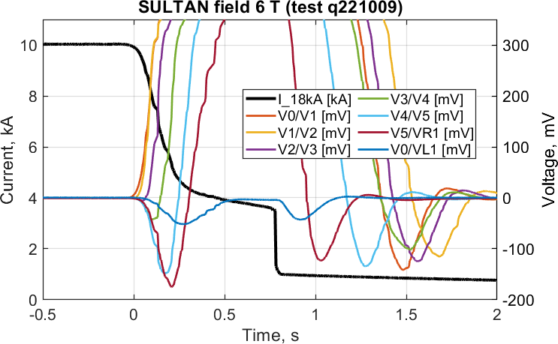
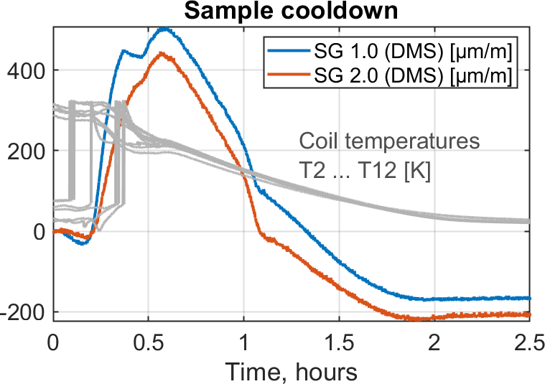
Sample performance
After some training EM load increased up to ~1200 kN/m at 11 kA, 6 T (74% expected value). In the previous sample steel structure fractured at this load.
No ‘memory’ upon WUCD as DMSO impregnation is liquid at RT
Fast quench propagation (up to ~60 m/s) leads to decrease of operating current before discharge
13% DMSO impregnation expands initially during cooldown but then contracts (no pre-compression).
Would impregnation by pure water improve sample performance due to pre-compression and high k?...

Slide 8
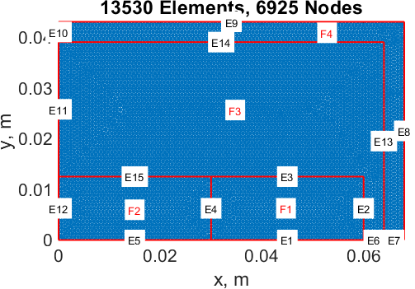
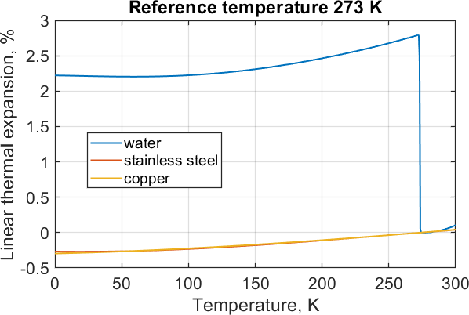
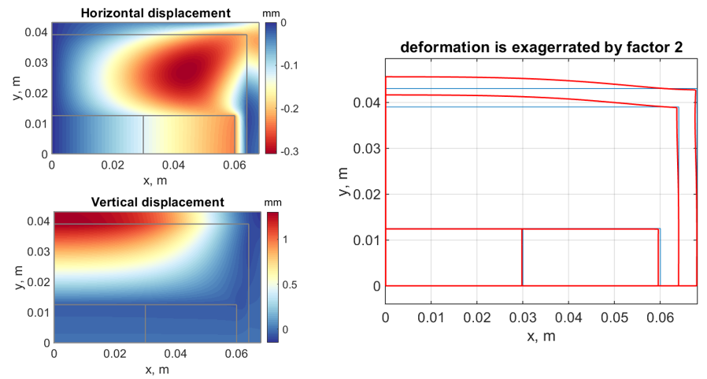
Impregnation by water
Thermoelastic model of 1st quadrant: u=0 at E10-E12; v=0 at E1, E5-E7
Linear thermal expansion from 273 K to 0 K: -0.3% for copper (F2) and steel (F4), 2.2% for water (F3)
Relatively weak horizontal displacement (u), but strong in vertical direction (v), up to ~1.3 mm
As a result, sample dimensions were reduced by 1.5 mm each side using thinner outer insulation, which is further validated in LN2.

Slide 9
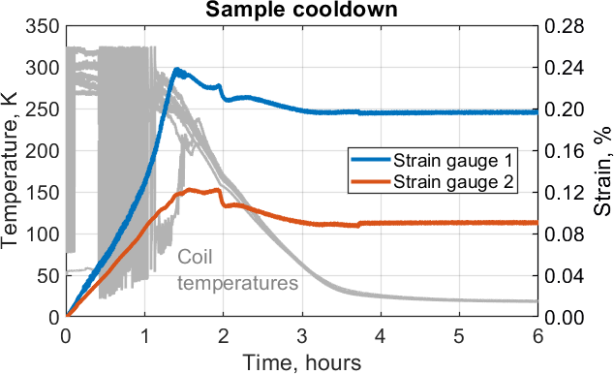
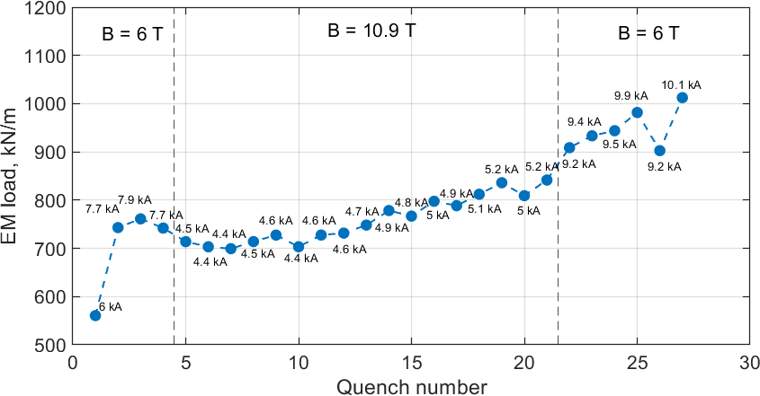
Impregnation by water
Steel structure in tension after cool-down → coil is pre-compressed ✔
Lower T rise in AC loss testing → impregnation has higher thermal conductivity ✔
However, coil training is nearly unchanged 🥲
Thank you for your attention!

