Slide 1
Manufacture of C-profiles and production of 3× 100 m empty jacket for laser welding demonstration
X. Sarasola
January 16th, 2026

Slide 2
Demonstration of a stable laser welding process
The laser welding contract with ICAS (MAG-T.02.01-T002-D002) achieved several important accomplishments:
  Butt-welding (production and QA),
  Handling of 2×2×500-m-long C-profiles,
  Synchronization of the machines in the assembly line.
However, the crucial goal of that contract (developing a reliable and stable laser welding process for long lengths) was not achieved.
The goal of a task in 2025 was to demonstrate a stable laser welding process.
Two deliverables:
  MAG-T.02.01-T004-D001: Production of the required steel profiles at KAMET in February 2025
  https://idm.euro-fusion.org/?uid=2SVLXM
  MAG-T.02.01-T004-D002: Laser welding of multiple 100-m-long segments at Montanstahl in July 2025
  https://idm.euro-fusion.org/?uid=2SVM23

Slide 3
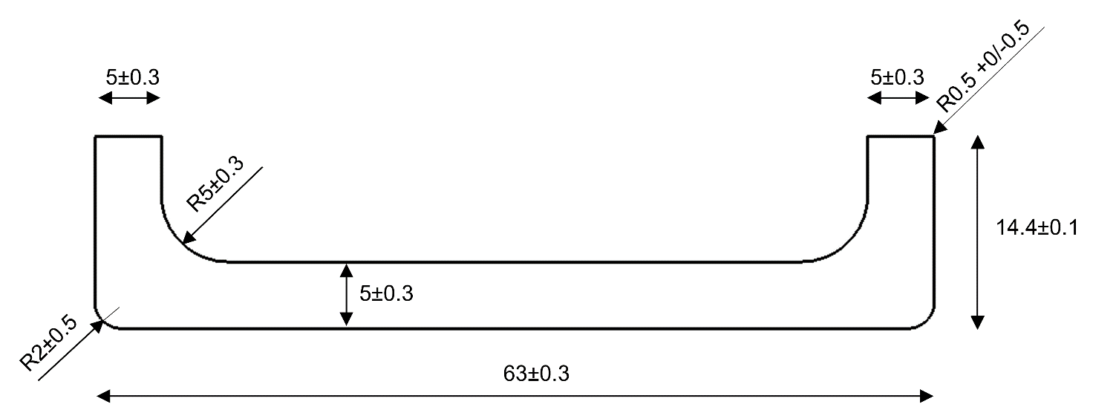
Production of the steel profiles at KAMET
The requested profiles are relevant for the production of the insert coil conductor (RW6)
Cross-section: ~418 mm²
Linear weight: ~3.34 kg/m
Production by hot rolling + final machining step to obtain the tolerances on the vertical wings.
The requested production was ~5.3 tons. The final production was unfortunately ~23% shorter:
Profile (ref) | Bundle (#) | Material | Heat | Length (m) | Weight (kg)
KY2179-A | 1 | W.1.4404 | R30561 | 129 | 455
KY2179-A | 2 | W.1.4404 | R30561 | 168 | 593
KY2179-A | 3 | W.1.4404 | R30561 | 329 | 1,160
KY2179-A | 4 | W.1.4404 | R30561 | 283 | 1,000
KY2179-A | 5 | W.1.4404 | R30561 | 193 | 680
KY2179-A | 6 | W.1.4404 | R30561 | 133 | 470
 |  |  | Total | 1,235 | 4,358
These steel profiles can be produced in long-lengths (might eliminate the need of butt welding!)

Slide 4
Laser welding. Goals
Verify the technical feasibility of full penetration, stable and reproducible laser welding on thick (~5 mm) long-length profiles (≥100 m)
Analyze the weld quality along the entire length, with particular attention to the presence of surface and volumetric defects.
Confirm the ability to perform controlled stops and restarts.
Investigate the possibility of local repairs and the quality and performance of the repaired zones.

Slide 5
Laser welding. Approach at Montanstahl
Three stages:
  8-m-long samples – to characterize the material and determine the main process parameters: ~4 kW, ~2 m/min, no wobbling…
  40-m-long sample – validating the process on a semi-industrial scale.
  The weld quality improves if two welding passes are done:
    An initial low-power (~1.0 kW) pass aimed at closing the gap between the C-profiles.
    A second full-power (~3.7 kW) pass to achieve full penetration.
  Production of the required 3×100-m lengths – using the double-pass strategy:
    Two pairs of lasers (one pair on each side) working synchronously.

Slide 6
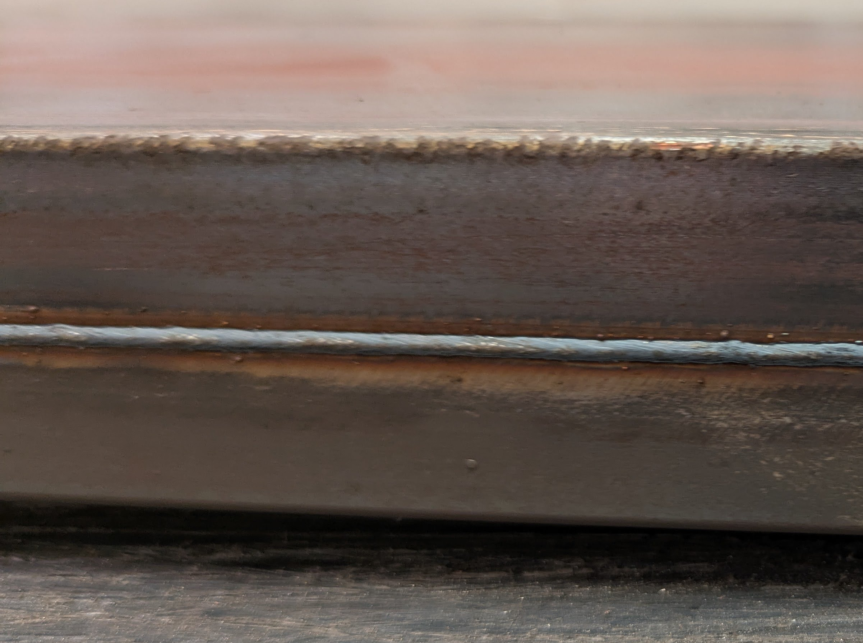
Laser welding. Results
Montanstahl’s two-pass approach performed satisfactorily on 3×100-m-long profiles, with
no severe defects observed.
However, there is room for improvement. Particularly on QA…

Slide 7
Laser welding. Quality Assurance
Online:
  Visual inspection (undercut, cracks, pores, incompletely filled groove, lack of seam)
  Ultrasound test – phased array instrument M2M Multi2000 Pocket (lack of penetration, internal defects)
Offline:
  Ultrasound test
  Dye penetrant test (cracks)
  Micrographic test – destructive test using Keyence VHX-7000 digital microscope (wrong alignment of the steel shells, lack of penetration, porosity)
  Hardness (Vickers Hardness) – testing hardness of steel, weld and heat-affected zone
  Dimensional inspection – Werth ScopeCheck S optical machine (various lengths, thicknesses and radii)
  Mechanical tests – Zwick Z100 testing machine (tensile tests).

Slide 8
Laser welding. Observed defects
Incomplete penetration is considered a defect because it could act as an initial crack, which can grow over time.
If detected, incomplete penetration can be reliably repaired with an additional welding pass.

Slide 9
Laser welding. Observed defects
Incompletely filled groove
These defects can be repaired by manual TIG.
Before the repair:
After the repair:
Dye penetrant testing (OK):

Slide 10
Laser welding. Ultrasound Testing (UT)
The initial laser welding parameters resulted into full penetration during the first ~30 to 100 m, but didn’t achieve reliable full penetration along the entire length
When detected, these defects can be reliably repaired, and the line can be safely stopped and restarted.
An (online) NDT method is required to reliably detect defects.
Montanstahl used their own UT inspection system:
  It could not detect lack-of-penetration defects ≤ 1.5 mm (too big)
  Further improvement is needed:
    a more sensitive UT system?
    an alternative inspection method?

Slide 11
Conclusions
Production of the steel profiles (MAG-T.02.01-T004-D001):
  The C-shape steel profiles can be produced in long-lengths (>300 m)
  This might eliminate (or significantly reduce) the need of butt welding
Laser welding of multiple 100-m-long segments (MAG-T.02.01-T004-D002):
  Montanstahl’s two-pass approach performed satisfactorily on 3×100-m-long profiles
  (no severe defects observed)
  When detected, defects can be reliably repaired, and the line can be safely stopped and restarted
  Further improvement is needed in the NDT inspection method.
Next steps:
  Industrial assembly and laser welding of the insert coil conductor (RW6)
    100 m of copper dummy (highly desirable for trials)
    (new task for the procurement of the copper dummy required)
    100 m of reacted Nb₃Sn RW6 conductor

