Slide 1
EU RD&D program for quench protection: phase 1 sample
Nikolay Bykovskiy
WPMAG
final meeting
16/01/2026

Slide 2
Content
Double pancake Design (MAG-T.04.02-T002-D001)
Double pancake Procurement and Fabrication (MAG-T.04.02-T002-D002)
Double pancake Quench Testing (MAG-T.04.02-T002-D003)

Slide 3
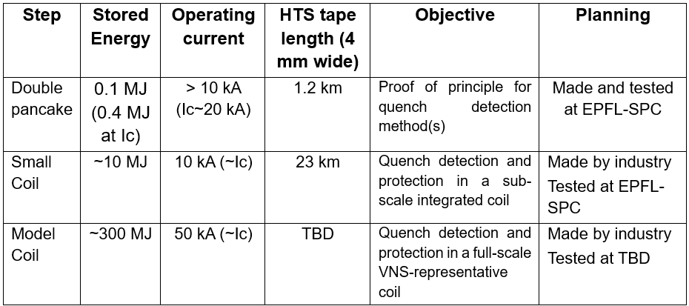
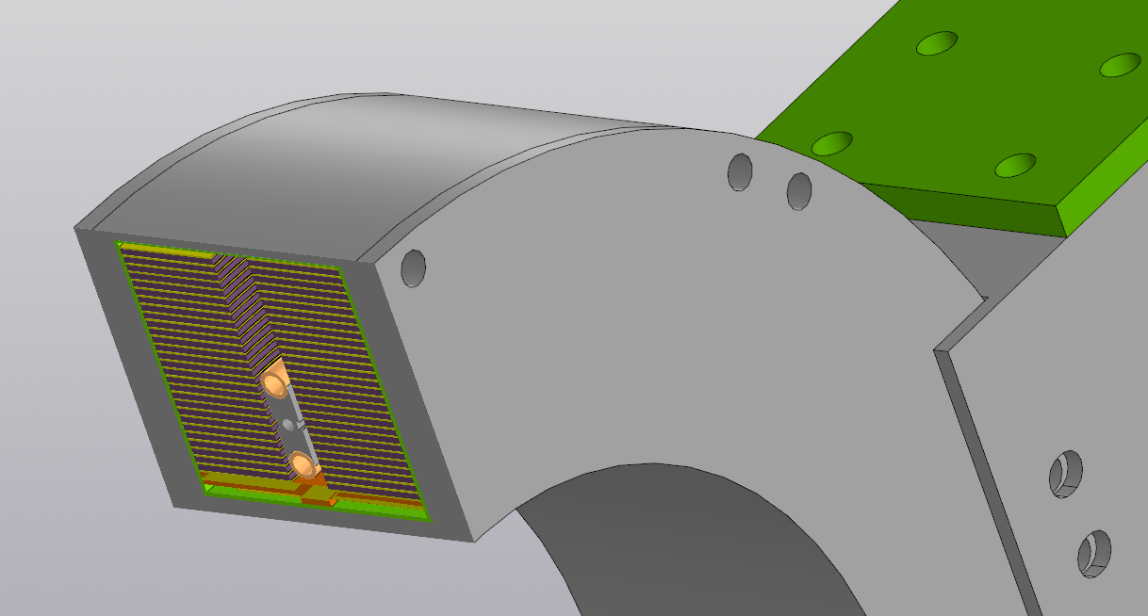
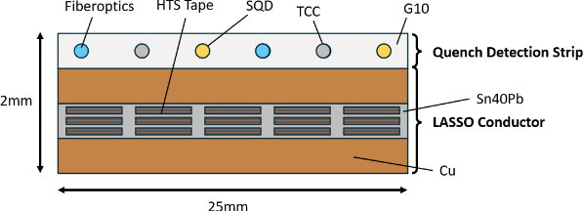
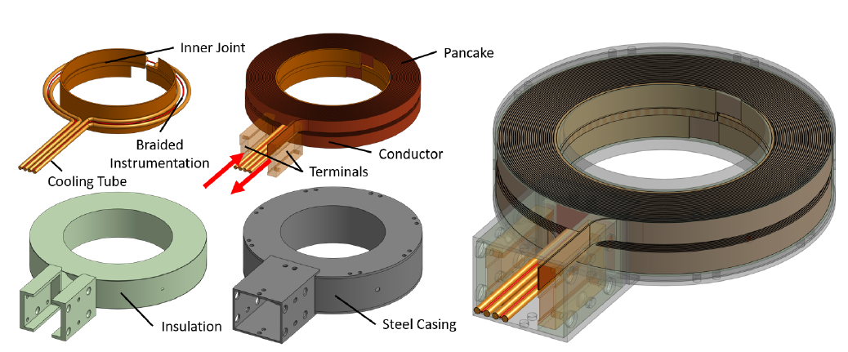
HTS model coil program – Phase 1 sample
Double pancake HTS insulated coil made by:
15-tape LASSO conductor of ~50 m total length split in 3 sections
Bore 200 mm, 29 turns per pancake, ~1 mH
Temperature-based quench detection by a co-wound strip containing SQD wires, thermocouple chains and optical fibers
Inter-pancake and intra-pancake joints, cooling pipe placed between the pancakes

Slide 4
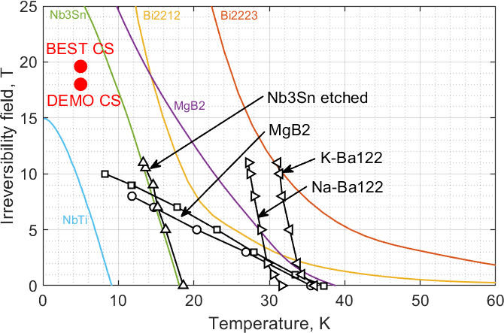
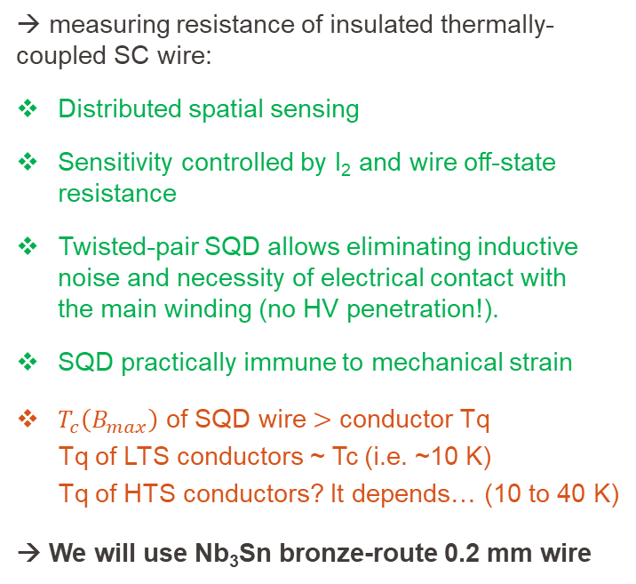
SQD
SQD twisted pair
V
→ measuring resistance of insulated thermally-coupled SC wire:
Distributed spatial sensing
Sensitivity controlled by I₂ and wire off-state resistance
Twisted-pair SQD allows eliminating inductive noise and necessity of electrical contact with
the main winding (no HV penetration!).
SQD practically immune to mechanical strain
$T_{c}\left(B_{max}\right)$ of SQD wire $>$ conductor Tq
Tq of LTS conductors ~ Tc (i.e. ~10 K)
Tq of HTS conductors? It depends… (10 to 40 K)
→ We will use Nb₃Sn bronze-route 0.2 mm wire
I₂
Thermal coupling
Coil winding

Slide 5



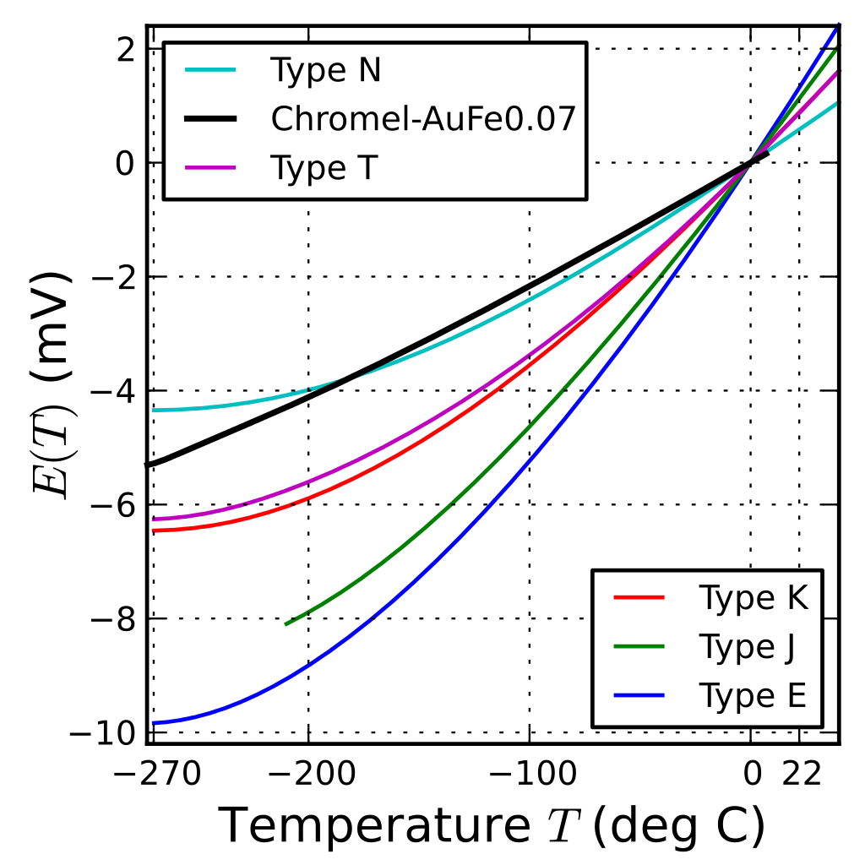
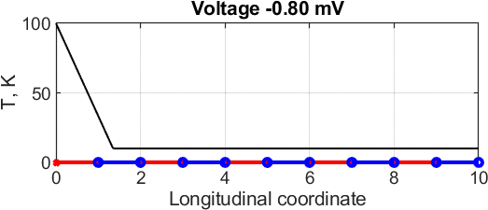
Thermocouple chain
Conventional thermocouple: response on ΔT only at the ends
Array of thermocouple wires connected in series: response on ΔT along the length
V
ref point
sense point
→ measuring voltage over series connected thermocouple wires:
Continuous response on T gradient among joints
Immune to EM noise by using shielding sleeve
Varying sensitivity due to discrete sensing

Slide 6
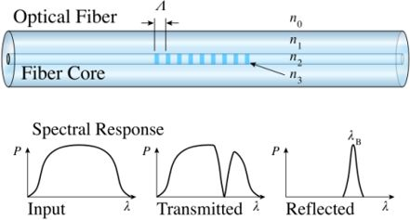
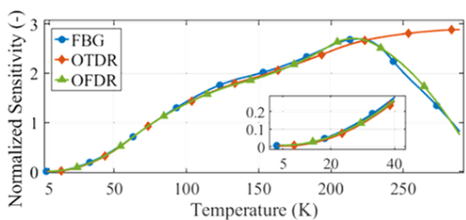
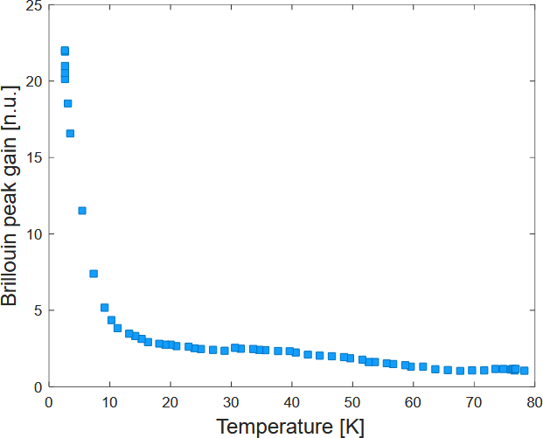
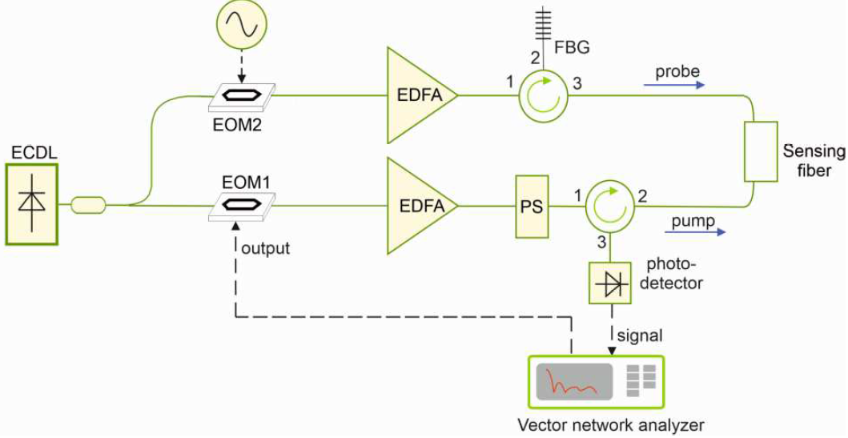
Optical fibers
SPC samples in 2025 will include bare fibers for Distributed Fiber Optic Sensing (DFOS) using:
Rayleigh OFDR by ENEA:
Spatial resolution ~5 mm, Rate ~100 Hz, Range ~0.1 km
FBG studied by Hugo Bajas at SPC till mid-2024
Sensitivity decreasing at low temperature
https://doi.org/10.1109/
TASC.2025.3532931
→ measuring spectral shift of light reflected by each FBG:
Continuous temperature monitoring at each FBG location
Decoupled mechanically by Teflon tubing
Brittle; high spatial resolution over long length is cumbersome
Brillouin OFDA by University of Campania:
Spatial resolution ~10 mm, Rate ~10 Hz, Range ~0.3 km
Closed-loop sensing
Sensitivity increasing at low temperature (!)
https://doi.org/10.1109/
SAS60918.2024.10636574

Slide 7
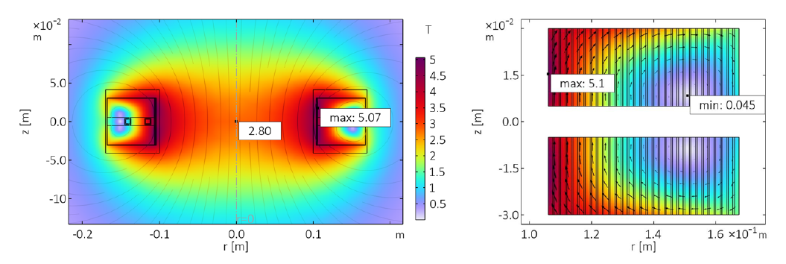
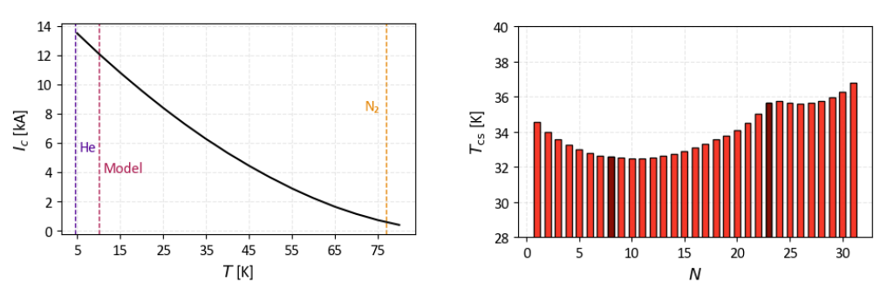
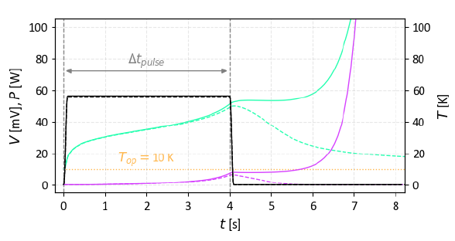
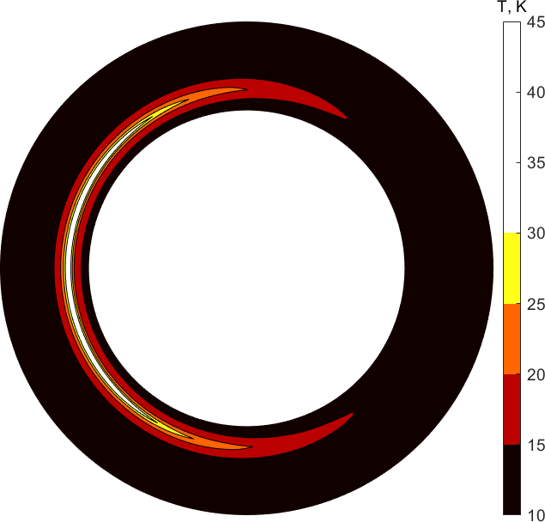
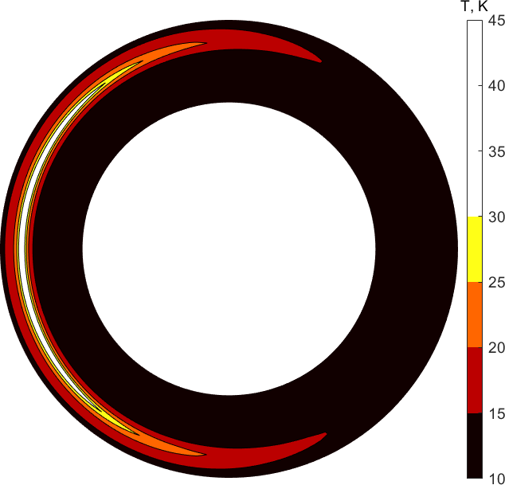

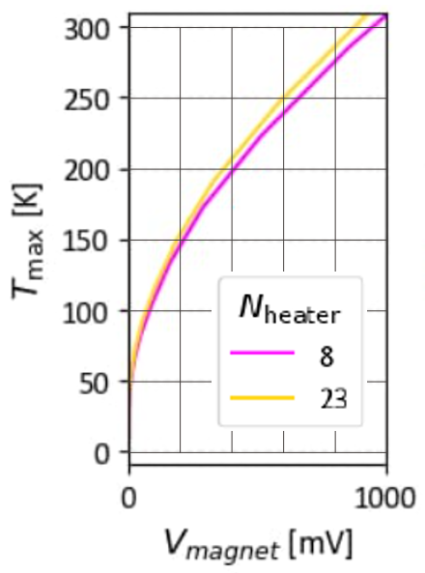
Modelling of the Phase 1 sample
3-D COMSOL model developed by Noël Strasser (Master thesis)
Operation at 10 kA
Turn #8
I_{op} = 8 kA
n=25
n=70
HFZ quench
LFZ quench
Thermal runaway once magnet voltage exceeds ~8 mV (nearly independent of studied cases)

Slide 8
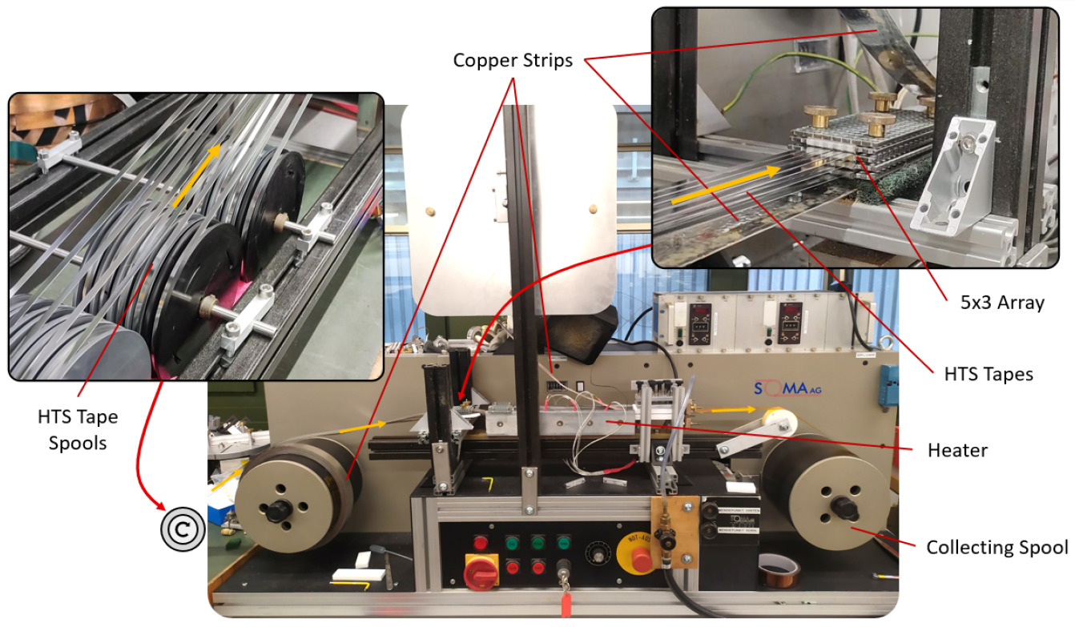
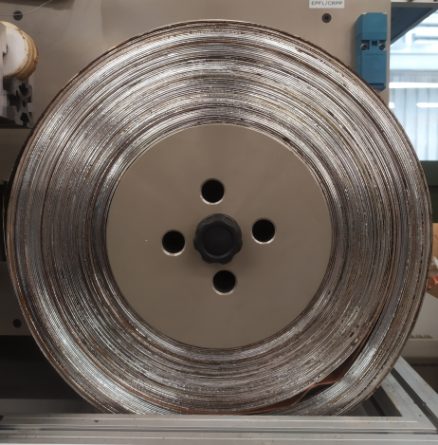
Construction: LASSO cable
~50 m long LASSO cable
‘Buckled’ region caused by winding non-soldered section

Slide 9
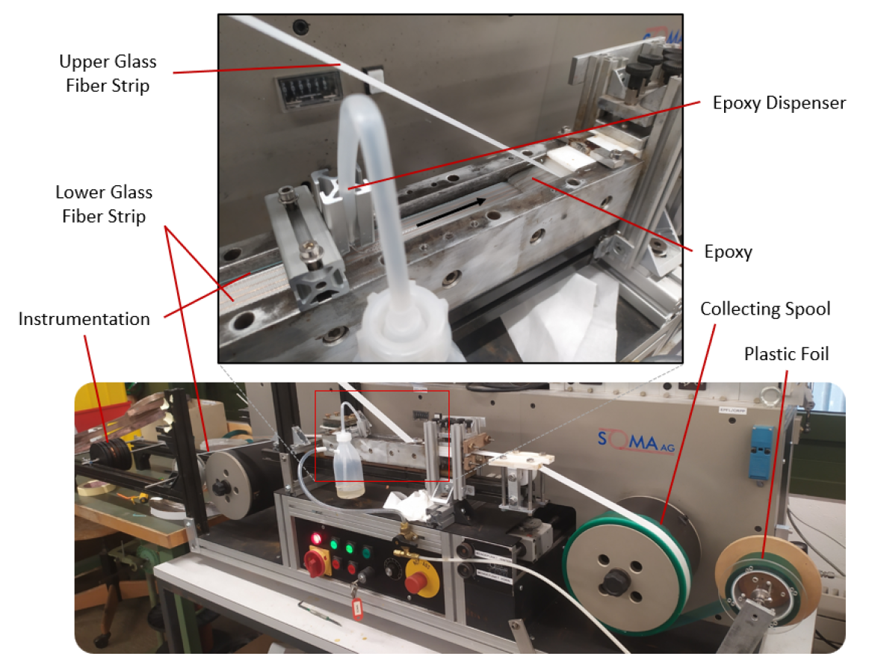
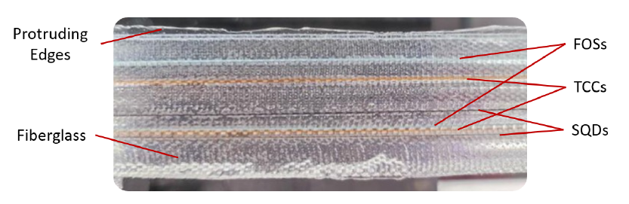
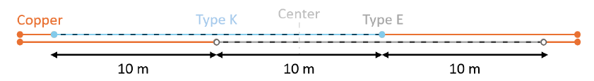
Construction: QD strip
‘If all you have is a hammer, everything looks like a nail…’
~60 m long strip
(ends suitable for fiber splicing)
FOS: bare optical fibers, 0.13 mm OD
SQD: Nb₃Sn reacted wires, 0.20 mm OD
TCC: type K and E wires, 0.13 mm OD
Two sections of ~20 m length (154 x 13 cm) overlap over ~10 m and can only sense ~30 m central section:

Slide 10
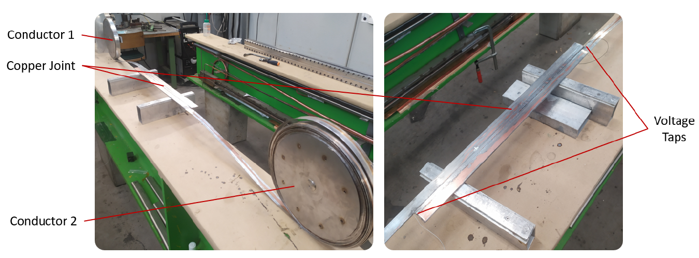
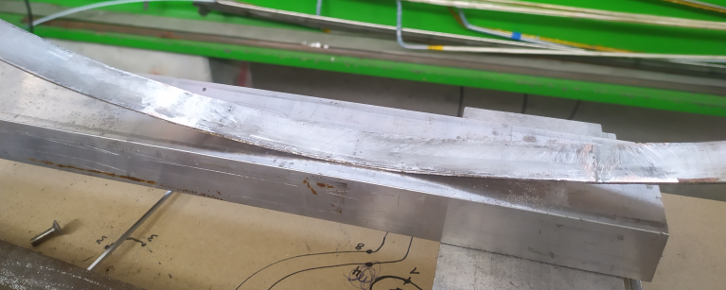
Construction: inter- and intra-pancake joints
Inter-pancake (copper) joint placed at the innermost turn allows to avoid conductor hard bending
Intra-pancake (‘hidden’) joint allows to repair conductor and to introduce ‘grading’ (i.e. change ReBCO cross-section)
Segment 1
Segment 2

Slide 11
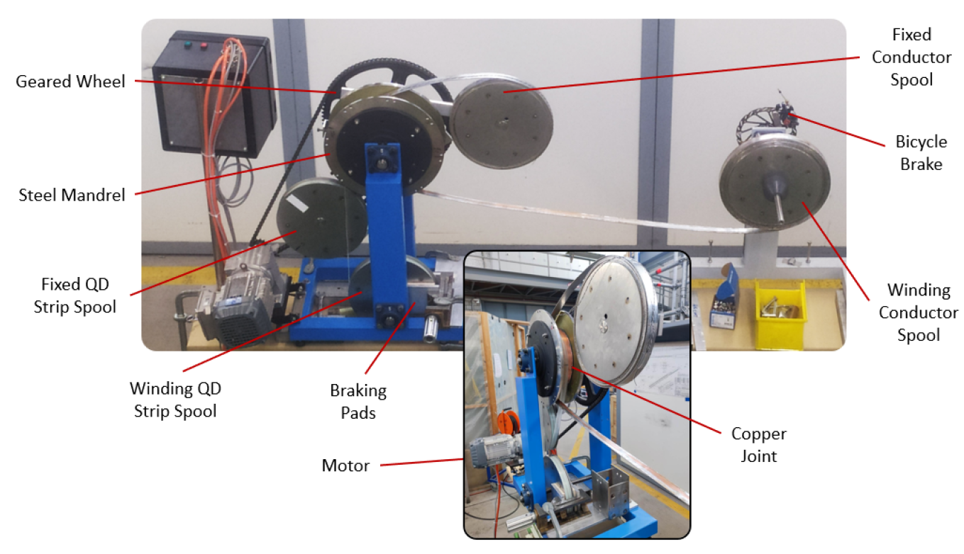
Construction: double pancake winding

Slide 12
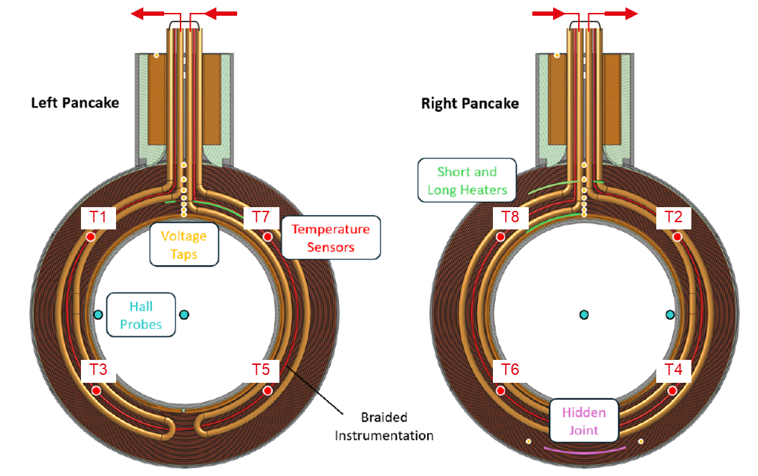
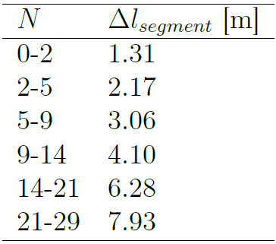
Sample instrumentation
Helium flow
Voltage taps:
CERNOX
Hall probes
Foil heaters
SQD, TCC, FBG

Slide 13
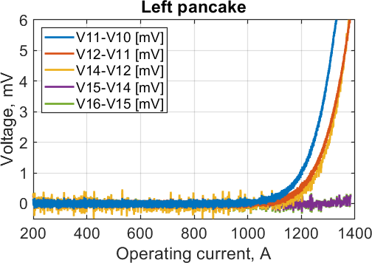
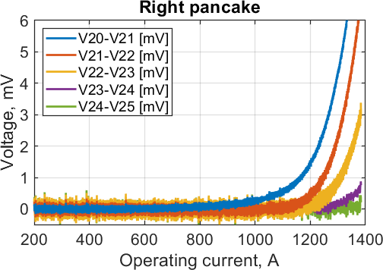
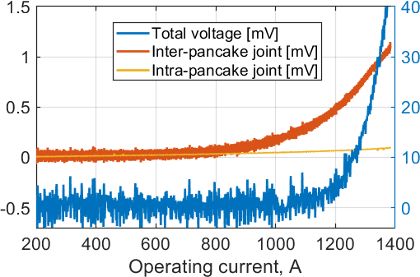
LN2 preliminary check
* inductive offset removed
Coil inductance 1.1 mH
Copper joint ~30 nΩ (inter-pancake), hidden joint ~40 nΩ (intra-pancake)
Critical current ~1000 – 1200 A (depending on criterion)

Slide 14
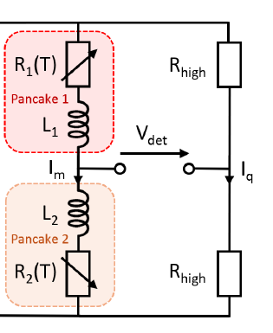
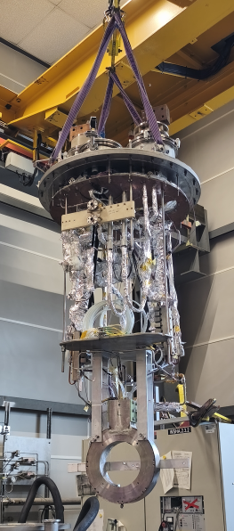
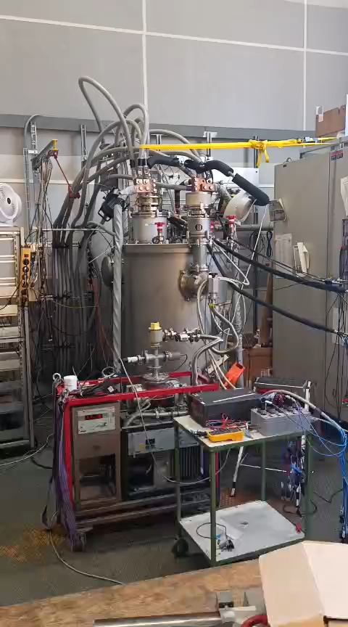
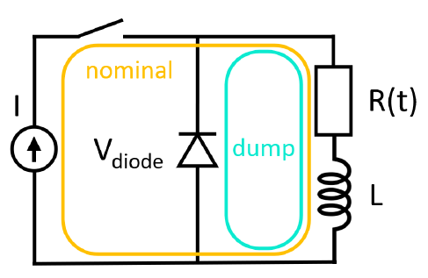
JORDI test – DC performance
Protection circuit
Detection circuit
Copper joint ~6 nΩ, hidden joint ~13 nΩ at 10 K

Slide 15
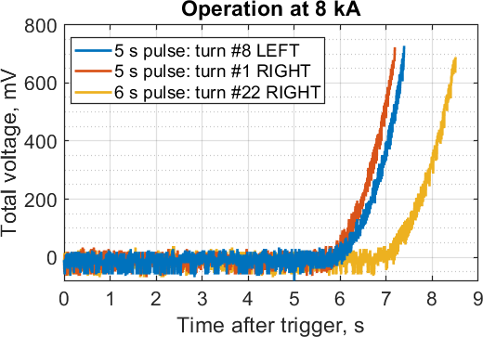
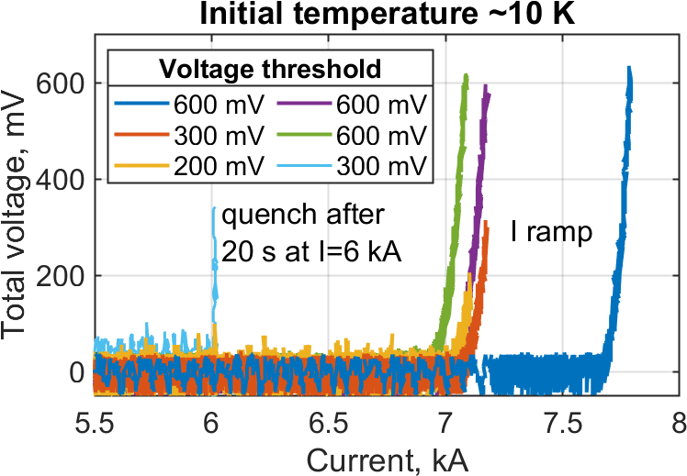
JORDI test – quench by embedded heaters
Tmax ~200 K
200 K
200 K
End of heat pulse
150 K
120 K
55 W heating applied at 8 kA operation:
Turn #8 LEFT recovers after 4 s pulse, but quenches after 5 s pulse.
Voltage threshold increased gradually: 135 mV, 400 mV, 600 mV
Turn #1 RIGHT quenched by 5 s pulse at 600 mV threshold (reached it from 10 mV in less than 2 s!)
Turn #22 RIGHT quenched by 6 s pulse at 600 mV threshold. It resulted in I_{c} degradation…

Slide 16
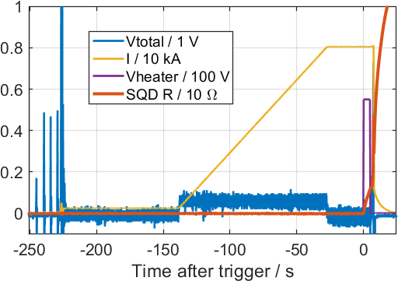
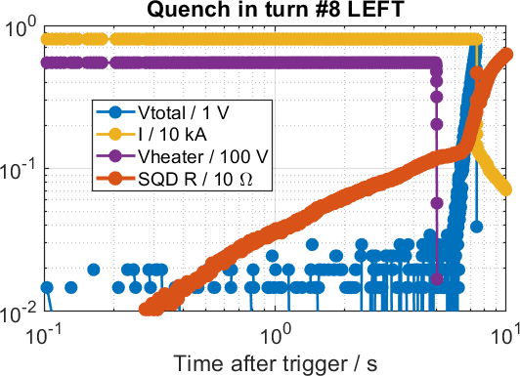
JORDI test – SQD response
Immune to EM noise and mechanical stresses
Following temperature evolution → potential to discharge before thermal runaway
Limited choice for detection threshold (Nb₃Sn vs MgB₂ vs IBS vs ReBCO)
Reliable, i.e. responded on all quenches
No issues on longer length, i.e. industrially available and response independent of L
Requires calibration (can be obtained during initial ‘clean’ testing)

Slide 17
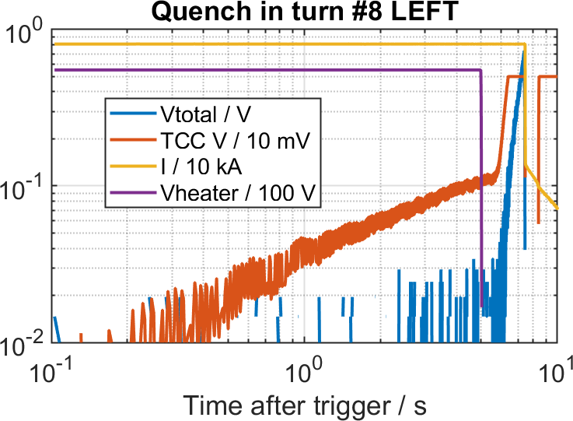
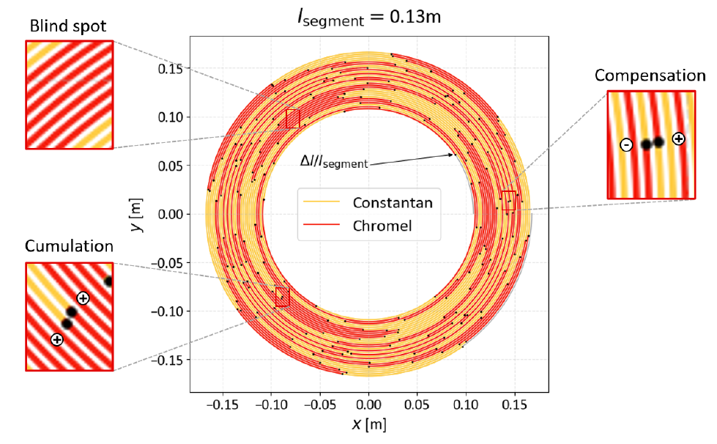
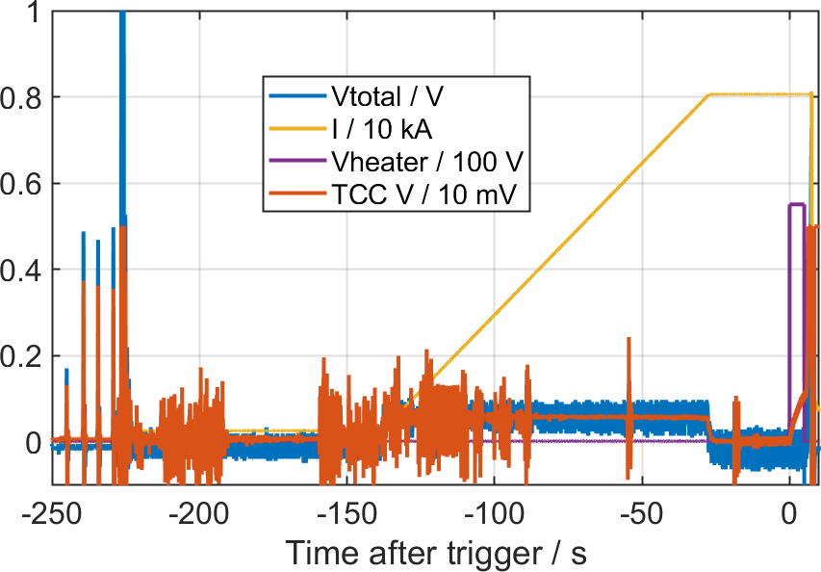
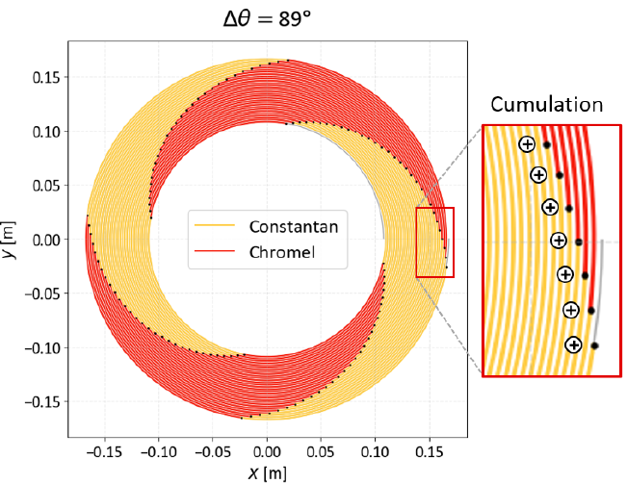
JORDI test – TCC response
Need for improved shielding
Following temperature evolution
Response on T-gradient at any temperature
Requires specific layout to exclude ‘blind’ spots →
Requires special tooling to produce in long length
Requires calibration (can be obtained during initial ‘clean’ testing)

Slide 18
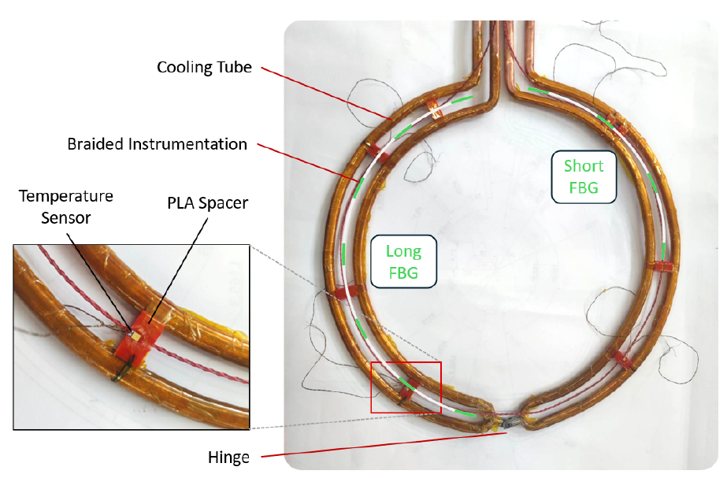
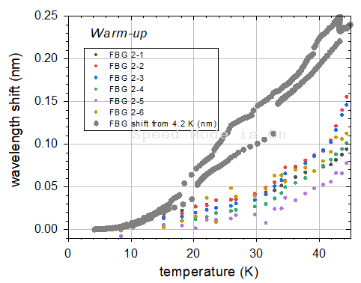
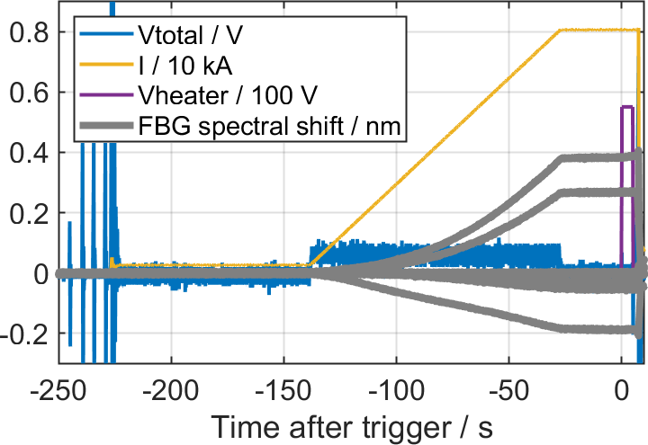
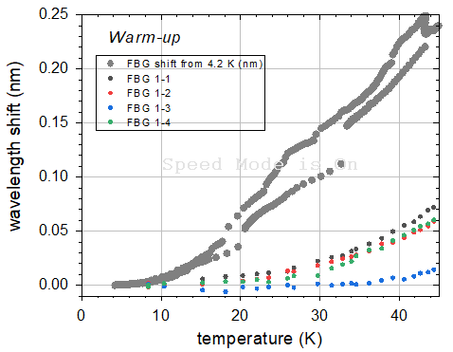
JORDI test – optical fibers
Strong attenuation on bare fibers embedded in QD strip → DFOS methods not applicable
FBGs installed between the two pancakes near the cooling pipe…
However, weak sensitivity on temperature and strong on mechanical strain
Integration method must be changed
Use on longer length becomes more problematic
Requires calibration
reference
‘Long’ FBG
‘Short’ FBG
reference

Slide 19
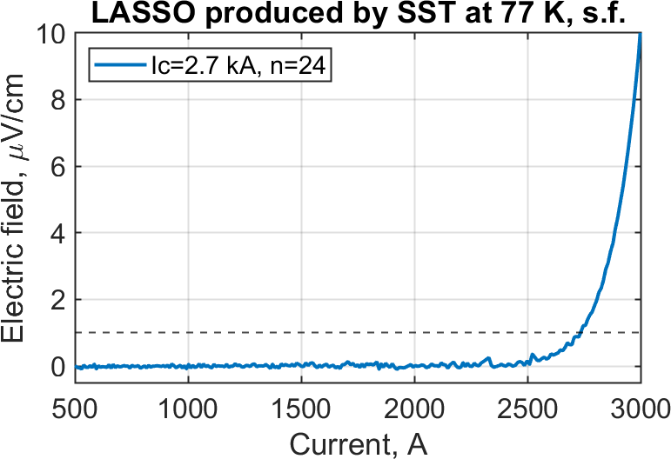
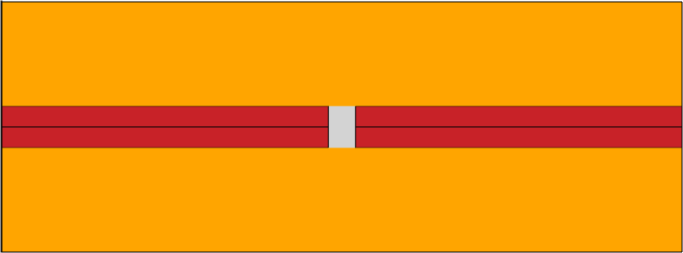
Next steps
4 x 12 mm tapes
Set-up LASSO cable manufacturing by industry
Set-up QD strip manufacturing by industry…
Set-up coil winding by industry…
SQD: attempting to order long-length iron-based superconductors…
TCC: need for automated manufacturing…
Optical fibers: pending further demonstrations…

Slide 21
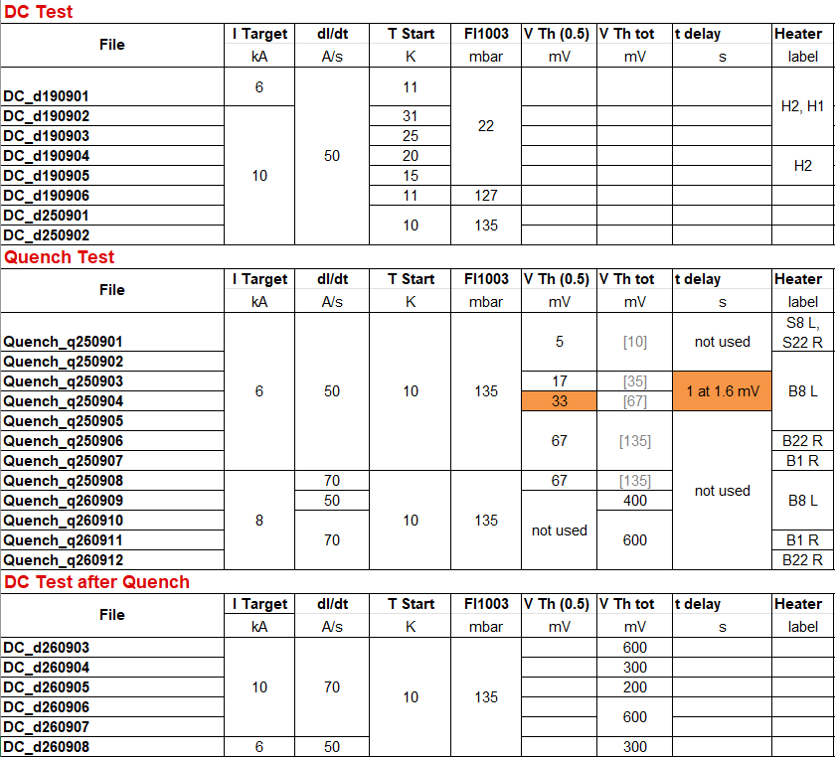

How did SQD react?

Slide 22









SQD R / 10 Ω
SQD R / 1 Ω
1: 8 kA, 600 mV, turn #8L
4: 600 mV
7: 600 mV
5.0 s
2: 8 kA, 600 mV, turn #1R
5: 300 mV
8: 600 mV
5.0 s
SQD signal delayed as turn#1 is not covered
3: 8 kA, 600 mV, turn #22R
6: 200 mV
9: 300 mV
5.0 s
5.5 s
6.0 s

