Slide 1
UKAEA contribution to EUROfusion WPMAG 2026–27 (Indicative / draft for discussion)
Presenter: Min Liao, Group Leader – Magnet Technology, Fusion Technology Division
15/01/2026

Slide 2
I - UKAEA contribution to EUROfusion WPMAG 2026–27
(HTS irradiation- test planning and capabilities overview)
2026 WPMAG Priorities | Relevant UKAEA | 2026 Actions
R&W Nb3Sn manufacture & SULTAN tests (PF, CS; 100 m CS) | Magnet Technology Collaborations; Current Active Projects | Lock SULTAN slots; track jacket/cabling/HT; align cryo tests
HV cold feedthrough prototypes | Key Collaboration Domains; Knowledge Exchange | Cryo HV/PD matrix; ENEA/CEA reviews
HTS conductors (50 m) + tests | Magnet Technology Collaborations; Current Active Projects | Finalise DoE; SULTAN fixtures; link to insert coil
X-ray tomography & defect analysis | Key Collaboration Domains (materials/NDE) | Define voxel size & defect taxonomy
REBCO striation studies | Key Collaboration Domains; Future Opportunities | AC-loss rigs; tensile testing in field; design rules
Irradiation & nuclear-load effects on HTS | Key Collaboration Domains | Plan neutron/ion exposures; model degradation vs dose
EU–CN tasks incl. CORC quench test | Current Active Projects; Knowledge Exchange | Align with ASIPP; prep CORC & protection
Process: submit Task Specifications by 13 Feb 2026 | Summary (programme note) | IMS trackers; facility schedules; OGS items

Slide 3
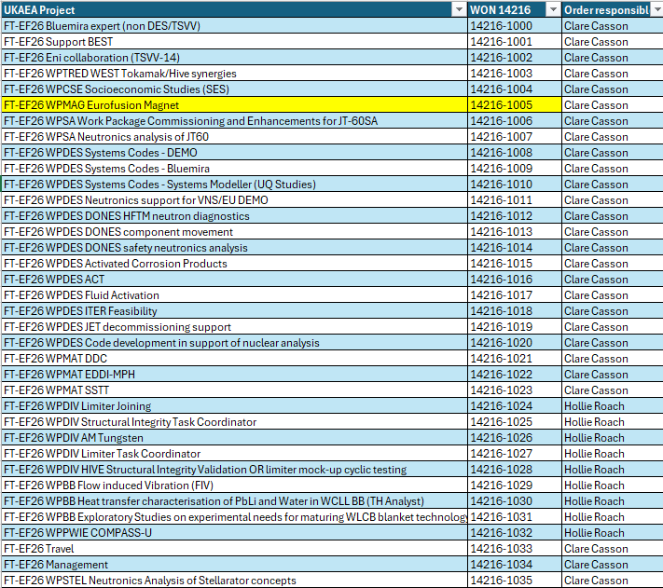
II - UKAEA involvement overview
UKAEA EUROfusion WPMAG involvement:
Technical scope: HTS; HV feedthroughs;
Quench detection; modelling; facilities support
International collab: EU–CN stream (quench detection, AC-loss reduction, CORC, CS tests);
ITER/ENEA/CEA/EPFL/ASIPP
Resources (2026): Contribution aligned to the approved WPMAG budget (~0.2 FTE L5-equivalent; scope limited accordingly)
Strategic opportunity: irradiation — aligns to 'HTS degradation under irradiation' call topic
Budget/Scope caveat
UKAEA activities shown are indicative and subject to (i) confirmed 2026 WPMAG budget (0.2 FTE L5-equivalent) and (ii) facility access approvals/cost recovery (incl. ELSA, SULTAN). No commitment implied.
Facility engagement subject to internal approval and cost recovery.

Slide 4
II -What we will do- Proposed UKAEA contributions (within approved WPMAG scope))
🔧 Technical Work Packages
HTS conductor activities – coordination and test definition (SULTAN interface)
Quench detection R&D (RF waveguide approach)
Modelling (AC losses, EM–thermal coupling, mechanical stresses)
Potential cryogenic test support (subject to access approval and cost recovery)
🌍 International collaboration streams
EU–CN extension: HTS quench detection, AC‑loss reduction, CORC quench test, CS coil testing
Partnerships with ITER, ENEA, CEA, EPFL, ASIPP
Joint work on conductor manufacturing modelling
📦 Resource footprint (2026)
Effort aligned to approved WPMAG 2026 budget (~0.2 FTE L5-equivalent).
OGS for test hardware & characterisation
Facility access: MRF (irradiation-compatible PPMS), ELSA, tomography, cryo rigs
📌 Strategic Opportunity (2026–27): Irradiation
Addresses the WPMAG call topic “HTS degradation under irradiation”
Uses UKAEA–MRF capabilities
Relevant to UKAEA internal magnet programmes (illustrative only) .
* STEP used as an internal reference context only (subject to STEP approval for external sharing)..

Slide 5
III - WPMAG 2026–27 Call — UKAEA HTS Irradiation Subtasks
Core (within approved WPMAG scope)
Definition of irradiation test matrix and metrics
Pre/post-irradiation Ic and AC-loss data handling (where approved)
Dataset structure and metadata for EUROfusion modelling
Conditional (subject to separate agreement & funding) *
Neutron/gamma irradiation campaigns
In-situ cryogenic irradiation experiments
Advanced microstructural characterisation (SEM/TEM)
Collaboration
Activities involving irradiation campaigns to be defined jointly with UKAEA Materials Division / MRF governance
* testing activities are indicative and subject to funding, access approval, and internal governance.

Slide 6
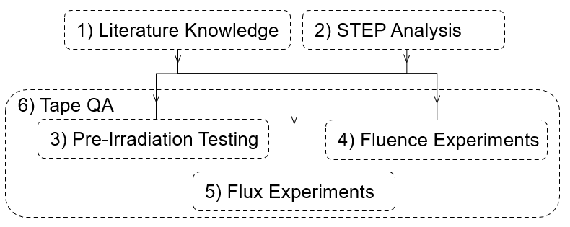
HTS Irradiation test programme aims:
Aim: establish irradiation-related performance limits and testing approaches for commercially available REBCO conductors.
Understand what is currently known about commercially available REBCO CC from literature.
Determine from analysing design what the required performance is for the REBCO CC to be places in the toroidal (TF) and poloidal field (PF) coils.
Determine from 1-2) and testing how the limits of REBCO CC – known as its critical current (I_{c}) – are affected by changes in T, B, ϕ, ε before irradiation.
Determine from 1-3) and testing how REBCO I_{c}(T, B, ϕ, ε) are affected by fluences of neutron (Ø_{n}) and gammas (Ø_{γ}).
Determine from 1-4) and testing how REBCO I_{c}(T, B, ϕ, ε) are affected by fluxes of neutron (Ø_{n}) and gammas (Ø_{γ}).
Determine cost-effective and quick methods of testing REBCO CC ahead of them being assembled into each STEP magnet, known as tape Quality Assurance (QA). Includes each magnet built as part of other test programmes.
Issue: STEP Centre-rod operating lifetime (currently) limited by degradation of REBCO by neutron irradiation
Goal: Understand REBCO subject to neutron irradiation to 1) de-risk and 2) optimise STEP TF centre-rod design.
Contribution from - Iliffe, William, Senior Development Engineer - Contractor • Fusion Technology

Slide 7
IV - Why UKAEA/credibility
— Facilities & Team
Facilities: MRF PPMS (1.8–400 K, up to 14 T) for hands-on radioactive materials; ELSA; tomography; cryo rigs
Team: Chantal group (nuclear materials/irradiation);
Magnet group (Strategy roadmap, HTS technology, test facility design, AC losses, irradiation)
Fit to Call: direct match to 'HTS degradation under irradiation’
with the full chain: irradiation → microstructure → cryo-transport
Capabilities spanning key steps from irradiation to cryogenic characterisation (subject to access and scheduling)

Slide 8
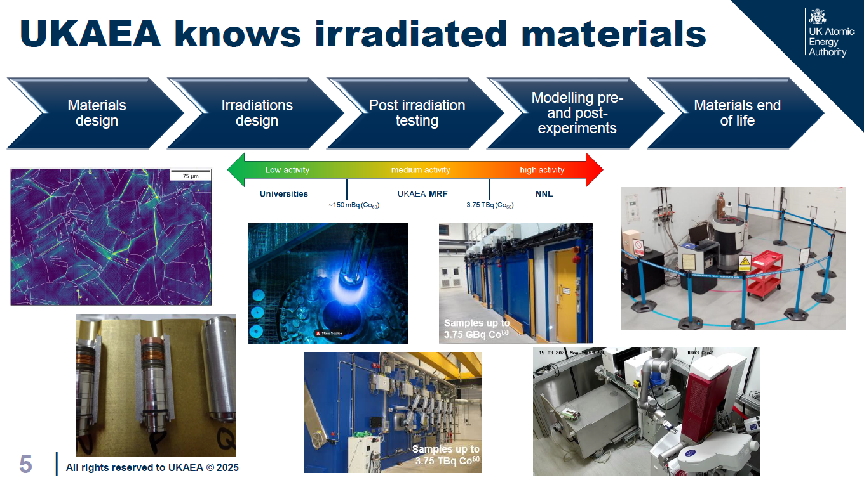

Physical Properties Measurement System (PPMS):
Electrical, magnetic, and thermophysical characterization
Operating range: 1.8 K to 400 K, magnetic fields up to 14 T
Measurements include:
AC magnetic susceptibility and DC magnetisation
Electrical resistance, Hall coefficient, I–V and dI/dV characteristics
Heat capacity and thermal transport
Compatible with “hands-on” radioactive materials (up to 10 µSv/h at 30 cm)
Experimental capability
Controllable irradiation, full PIE characterisation, and integrated cryogenic testing — delivering a full end-to-end workflow. Supporting a defined workflow from irradiation to cryogenic characterisation, within agreed scope.
Team capability
Internationally recognised expertise in nuclear materials, irradiation analysis, and low-temperature electrical testing.
Operation with radioactive materials within licensed limits and RPA approval.

Slide 9
V - How we execute + evidence
Facilities: MRF PPMS (1.8–400 K, up to 14 T) for hands-on radioactive materials; ELSA; tomography; cryo rigs
Team: Chantal group (nuclear materials/irradiation); Oxygen-ion irradiation shows encouraging correlation in selected metrics; neutron benchmarking remains required.
Magnet group (Strategy roadmap, HTS technology, test facility design, AC losses, irradiation)
Fit to Call: direct match to 'HTS degradation under irradiation’ with the full chain: irradiation → microstructure → cryo-transport

Slide 10
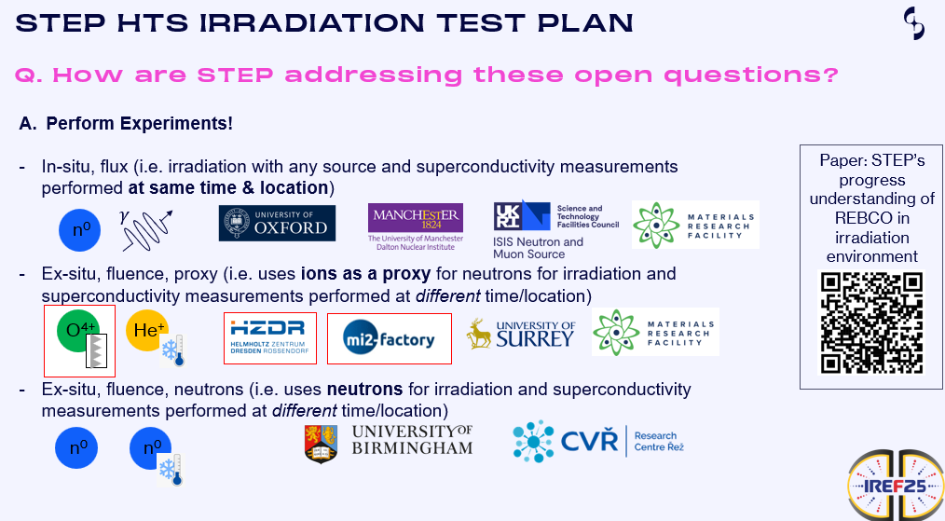
Experimental overview: HTS Irradiation test programme
UKAEA capabilities are relevant to the WPMAG irradiation degradation topic, subject to approved scope and resources.

Slide 11

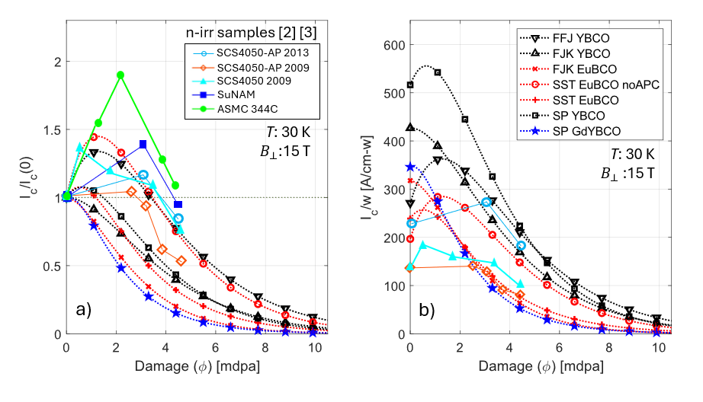
Using Oxygen Ions as proxy for
Fusion neutrons
Results comparison (Ic change, absolute Ic…)
Comparison of a) change in Ic and b) absolute Ic, normalised by tape width, of neutron irradiated REBCO samples and filtered oxygen irradiated samples.
Conclusion: Oxygen Ion irradiation seems to be reasonable proxy
Next step: direct comparison with Neutron irradiated data (Collaboration with TU Vienna)

Slide 12
V - Asks & Next Steps
Propose a scoped plan (workshare and indicative costing) aligned to WPMAG milestones.
Facilities: MRF PPMS (1.8–400 K, up to 14 T) for hands-on radioactive materials; ELSA; tomography; cryo rigs
Team: Chantal group (nuclear materials/irradiation);
Magnet group (Strategy roadmap, HTS technology, test facility design, AC losses, irradiation)
Fit to Call: direct match to 'HTS degradation under irradiation’ with the full chain: irradiation → microstructure → cryo-transport
All asks are to align with the approved 2026 WPMAG budget and agreed facility access routes.

Slide 13
Superconducting Magnet Technology Strategy
STEP needs a dedicated SC Magnet Technology Strategy to ensure fusion viability, de-risk magnet integration, & accelerate UK leadership in clean energy.
This strategy will directly impact STEP’s ability to deliver a prototype fusion plant by 2040.
Why STEP needs a Magnet Strategy
Fusion Magnet Performance Is Mission-Critical
HTS Technology Is Complex & Rapidly Evolving
Supply Chain & Procurement Risks
TRL Advancement & System Integration
Cross-Sector Collaboration & Talent Development

Slide 14
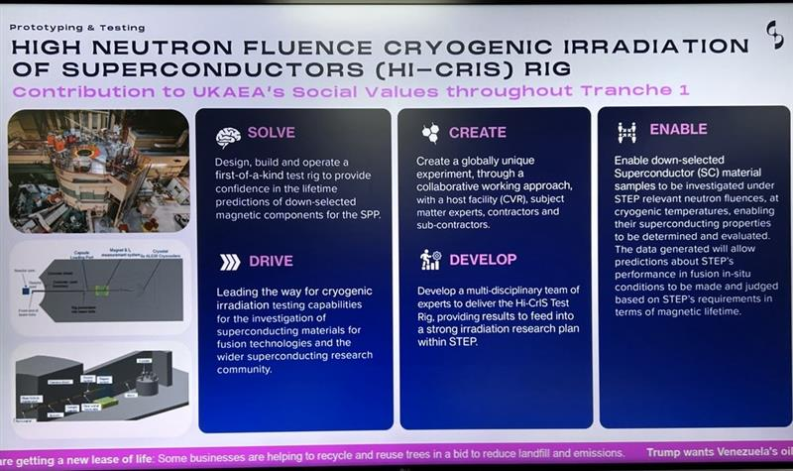
UKIFS Ultimate Plan: HiCRIS - Accelerates Prototype Delivery
Should be able to measure change in Ic of REBCO subject to neutron irradiation in as close to operational
conditions as possible, whilst also being cost effective way.

Slide 15
Accelerates Prototype Delivery
Across 4 Industries
Fusion Energy
Power Transmission
3 Strategic Pillars
Supported by 5 Universities
Renewables
Aerospace

Slide 16
Asks & Next Steps
1. Coordination
Confirm UKAEA scope and contributions for WPMAG 2026–27
Clarify interfaces with CEA / ENEA / EPFL to avoid duplication
Agree workflow and single technical contact points
2. Data & Samples
Finalise availability and access routes for: • REBCO tapes • insulation materials • joints
Agree minimum metadata + FAIR data-sharing rules
Identify what can be shared immediately vs needs approval
3. Test Matrix (Irradiation + AC Loss + Ic)
Prioritise conditions to test first (fluence, spectrum, T, Ic, AC losses, insulation response)
Align with ITER + STEP requirements
Map gaps where EU facilities cannot currently provide coverage

Slide 17
Asks & Next Steps
4. Planning & Resourcing
Map UKAEA capabilities to each WPMAG milestone
Propose timeline for next coordination checkpoint (Feb/March)
Identify dependencies needing early decision (samples, test slots, analysts)
Key Questions for the Group
Access to data?
Access to test facilities?
Joint interpretation of irradiation / Ic results?
Preferred visibility route for UKAEA contributions?
Opportunities for PhD/Postdoc exchanges?

Slide 18
Thank you for your attention
Min Liao UK Atomic Energy Authority min.liao@ukaea.uk

