Slide 1
Investigation of AC loss in filamentized coated conductor tapes 4 mm and 12 mm wide, with the filaments of 500 µm and 250 µm, prepared by industrial process
PRD-3.HTS.01-T022-D001
F. Gömöry, J. Šouc, M. Solovyov, M. Kucharovič
Institute of Electrical Engineering, Slovak Academy of Sciences, Bratislava, Slovakia
WPMAG EUROfusion Final Meeting 14–16 Jan 2026, Paul Scherrer Institute

Slide 2



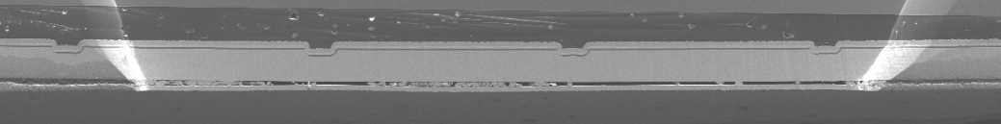


Initial remarks
REBCO deposited by low-cost industrial 2LUPS process utilizing the 3D filamentized metal tape as substrate
A Wulff et al., Supercond. Sci. Technol. 28 (2015) 072001
A R Insinga et al., IEEE Trans. Appl. Supercond.. 28 (2018) 6601705
A R Insinga et al., IEEE Trans. Appl. Supercond.. 29 (2019) 8200704
standard
striation
(mechanical, chemical,…
Ag, Cu
REBCO
patterned substrate
buffer(s)
substrate
Samples prepared within Eurostars-2 project “Filaments4Fusion”
Relevant AC magnetization regime:
B_{ac}
$$B_{ac}=B_{max}sin\left(2πft\right)$$
$$2πf=ω$$
WPMAG EUROfusion Final Meeting 14–16 Jan 2026, Paul Scherrer Institute

Slide 3

Optimization of tape architecture
hysteresis loss reduced in proportion to N_{f} :
high-field approximation:
B_{ac}
$$\frac{Q_{h}}{L}=B_{max}I_{c}w_{f}$$
L
d_{f}
w_{f}
current redistribution around a defect :
standard CC tape
fiamentized CC tape
with Cu in gaps
circulation of currents through metallic gaps: coupling AC loss
fiamentized CC tape
Cu
B_{ac}
WPMAG EUROfusion Final Meeting 14–16 Jan 2026, Paul Scherrer Institute

Slide 4




Optimization of tape architecture
Sample characterisation:
geometry: L, w, t, w_{f} ,w_{g} ,d_{g} ,d_{f}
materials:
gap resistivity
resistivity of metallic overlayer(s)
B_{max} sin(ωt)
$$I_{c,filament} =\frac{I_{c,tape}}{N_{filaments}}$$
L
$$ρ_{g}$$
d_{g}
d_{f}
t
$$ρ_{e}$$
w_{f}
w_{g}
w
AC loss reporting:
magnetization loss: Q_{m}/L [J/m/cycle]
AC susceptibility
(imaginary part) :
$$χ^{,,}=\frac{Q_{m}}{Lwt}\frac{μ_{0}}{{πB}_{max}^{2}}$$
WPMAG EUROfusion Final Meeting 14–16 Jan 2026, Paul Scherrer Institute

Slide 5
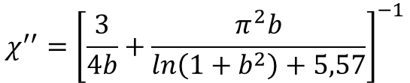
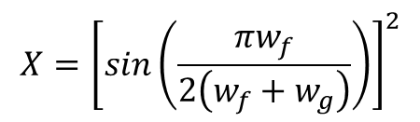

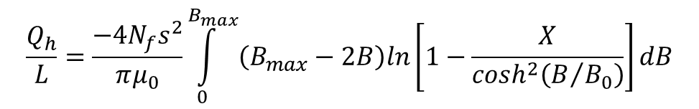
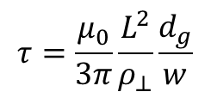
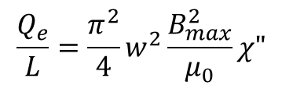
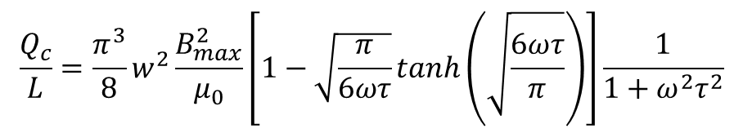

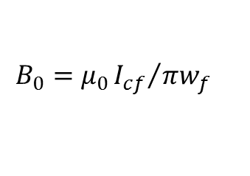

Experiments vs. theory
$$\frac{Q_{h}}{L}=\frac{−4{N_{f}s}^{2}}{πμ_{0}}\int_{0}^{B_{max}}{\left(B_{max}−2B\right)ln\left[1−\frac{X}{\cosh^{2}\left(B/{B_{0}}\right)}\right]dB}$$
Hysteresis loss:
$$B_{0}=μ_{0}{I_{cf}}/{πw_{f}}$$
x-array of strips
Y Mawatari, Phys. Rev. B 54 (1996) 13215
$$X={\left[sin\left(\frac{{πw}_{f}}{2\left(w_{f}+w_{g}\right)}\right)\right]}^{2}$$
$$\frac{Q_{c}}{L}=\frac{π^{3}}{8}w^{2}\frac{B_{max}^{2}}{μ_{0}}\left[1−\sqrt{\frac{π}{6ωτ}}tanh\left(\sqrt{\frac{6ωτ}{π}}\right)\right]\frac{1}{1+ω^{2}τ^{2}}$$
Coupling loss:
$$τ=\frac{μ_{0}}{3π}\frac{L^{2}}{ρ_{⊥}}\frac{d_{g}}{w}$$
effective medium approach
F Gömöry et al., Superconductivity 15 (2025) 100193
$$ρ_{⊥}=ρ_{g}\frac{\left(N_{f}−1\right)w_{g}}{w}$$
Eddy current loss:
$$\frac{Q_{e}}{L}=\frac{π^{2}}{4}w^{2}\frac{B_{max}^{2}}{μ_{0}}χ"$$
$$χ^{′′}={\left[\frac{3}{4b}+\frac{π^{2}b}{ln\left(1+b^{2}\right)+5,57}\right]}^{−1}$$
$$b=ωτ_{e}$$
metallic strip
E. H. Brandt, Phys. Rev. B 50 (1994) 13833
$$τ_{e} =\frac{t_{m}w}{2}\frac{μ_{0}}{ρ_{e}}$$
WPMAG EUROfusion Final Meeting 14–16 Jan 2026, Paul Scherrer Institute

Slide 6
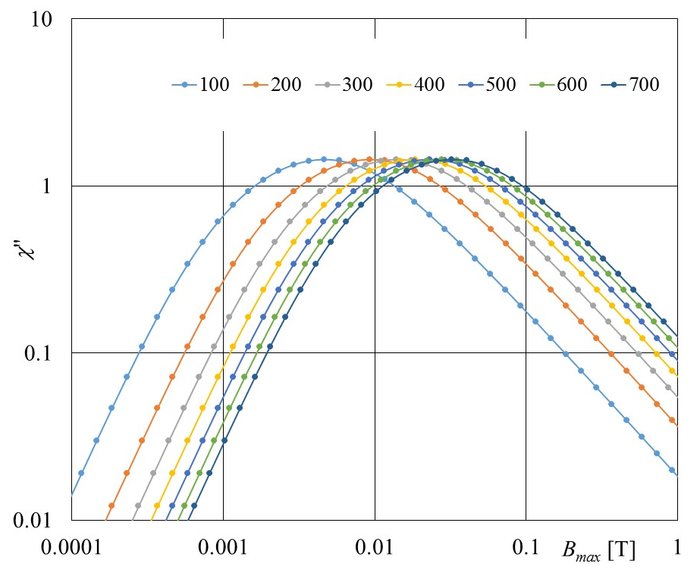
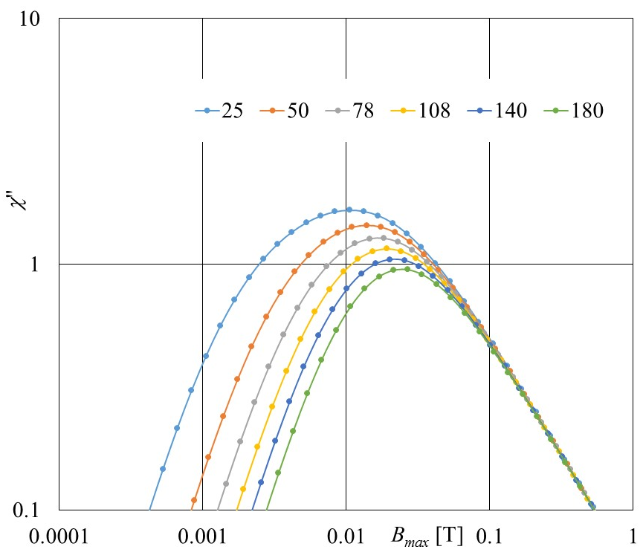
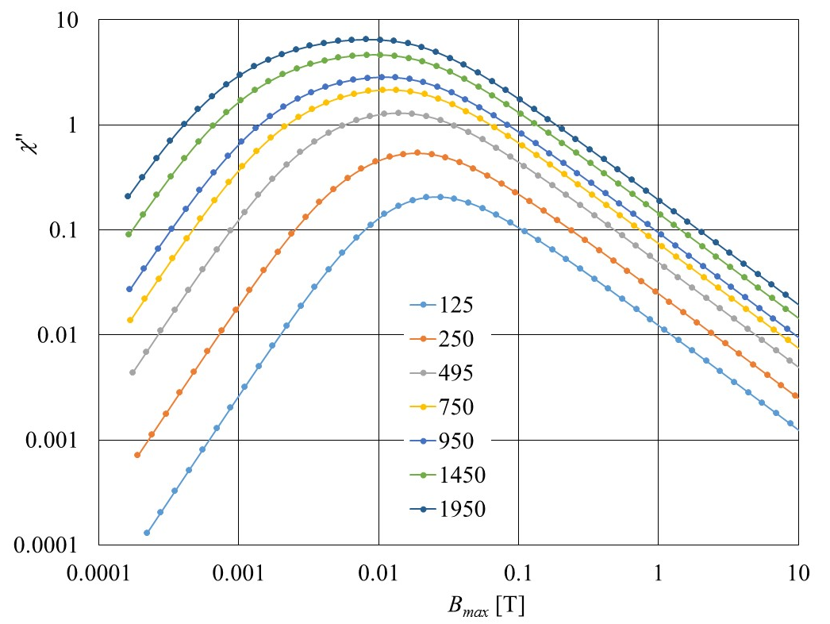
Hysteresis loss vs. filamentary architecture
Y Mawatari, Phys. Rev. B 54 (1996) 13215
Tape 12 mm wide
gaps 50 µm, filaments 495 µm
I_{c} = 300 A, filaments 495 µm
I_{c} = 300 A, gaps 50 µm
I_{c} [A]
w_{g} [µm]
w_{f} [µm]
narrower filaments → lower hysteresis loss
WPMAG EUROfusion Final Meeting 14–16 Jan 2026, Paul Scherrer Institute

Slide 7




Coupling loss vs. filamentary architecture
low frequency limit:
(practical use)
$⁡\lim_{ω→0}{\frac{Q_{c}}{L}}=\frac{π}{12}$ $wd_{g}B_{max}^{2}ω\frac{L^{2}}{ρ_{⊥}}$
$$ρ_{⊥}=ρ_{g}\frac{\left(N_{f}−1\right)w_{g}}{w_{tape}}$$
in reality a fitting parameter
$$ρ_{g}=k_{g}ρ_{Cu}$$
ρ_{Cu} = 2×10⁻⁹ Ωm
W J Carr Jr, Supercond. Sci. Technol. 20 (2007) 168
$⁡\lim_{ω→0}{\frac{Q_{c}}{V}}=\frac{π}{12}$ $B_{max}^{2}ω\frac{L^{2}}{ρ_{⊥}}=\frac{π}{12} B_{max}^{2}ω\frac{L^{2}w}{\left(N_{f}−1\right)}\frac{1}{ρ_{g}w_{g}}$
WPMAG EUROfusion Final Meeting 14–16 Jan 2026, Paul Scherrer Institute

Slide 8
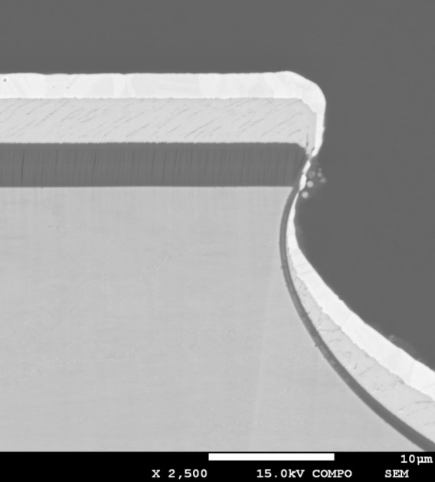
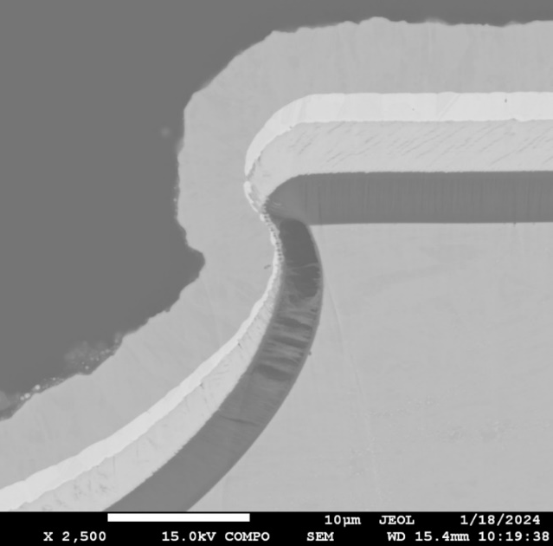
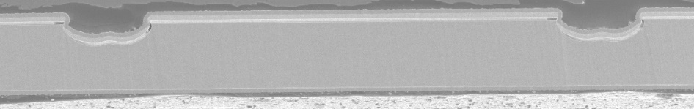
Tapes 12 mm wide – filament width & metallization
A
C
Cu
Sample | N_{f} | w_{f} [mm] | w_{g} [mm] | Cu [µm] | I_{c} [A]
A-2 | 6 | 1.82 | 0.19 | 0 | 340
C-2 | 6 | 1.82 | 0.19 | 3 | 340
A-1 | 11 | 0.98 | 0.12 | 0 | 300
C-1 | 11 | 0.98 | 0.12 | 3 | 300
A-05 | 20 | 0.55 | 0.05 | 0 | 220
C-05 | 20 | 0.55 | 0.05 | 3 | 220
Ag
REBCO 3.5 µm
buffer 3.5 µm
w_{f}
w_{g}
WPMAG EUROfusion Final Meeting 14–16 Jan 2026, Paul Scherrer Institute

Slide 9
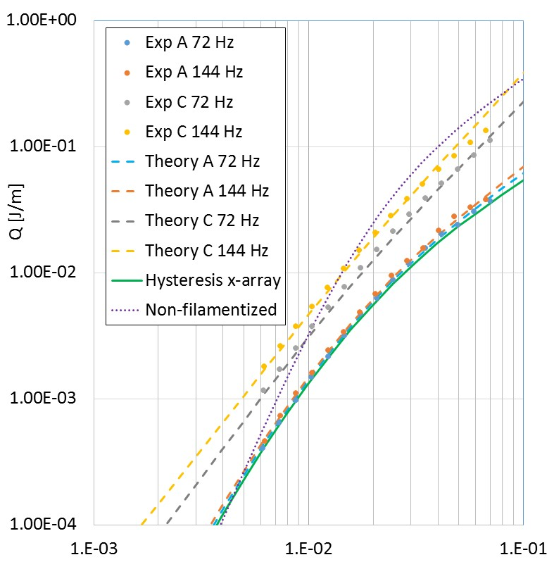
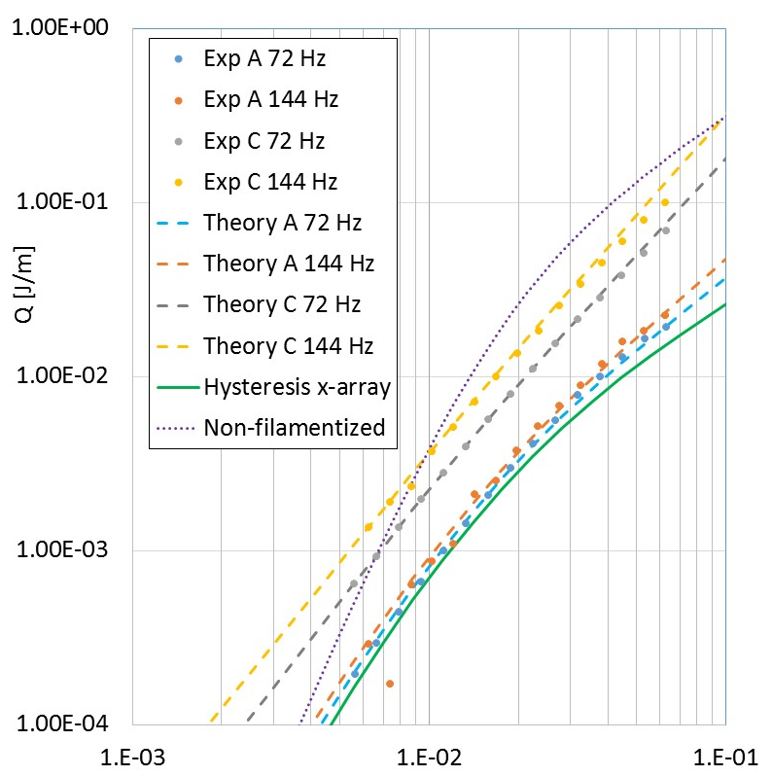
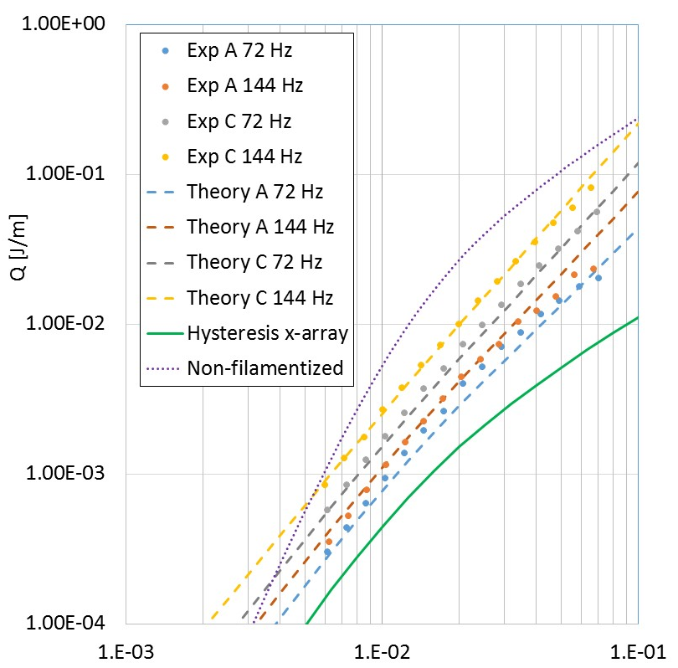
Tapes 12 mm wide – filament width & metallization
6 filaments
11 filaments
20 filaments
A: ρ_{g} = 40× ρ_{Cu}
A: ρ_{g} = 25× ρ_{Cu}
A: ρ_{g} = 15× ρ_{Cu}
C: ρ_{g} = 3.7× ρ_{Cu}
C: ρ_{g} = 3.7× ρ_{Cu}
C: ρ_{g} = 7× ρ_{Cu}
B_{max} [T]
B_{max} [T]
B_{max} [T]
ρ_{Cu} = 2×10⁻⁹ Ωm
WPMAG EUROfusion Final Meeting 14–16 Jan 2026, Paul Scherrer Institute

Slide 10
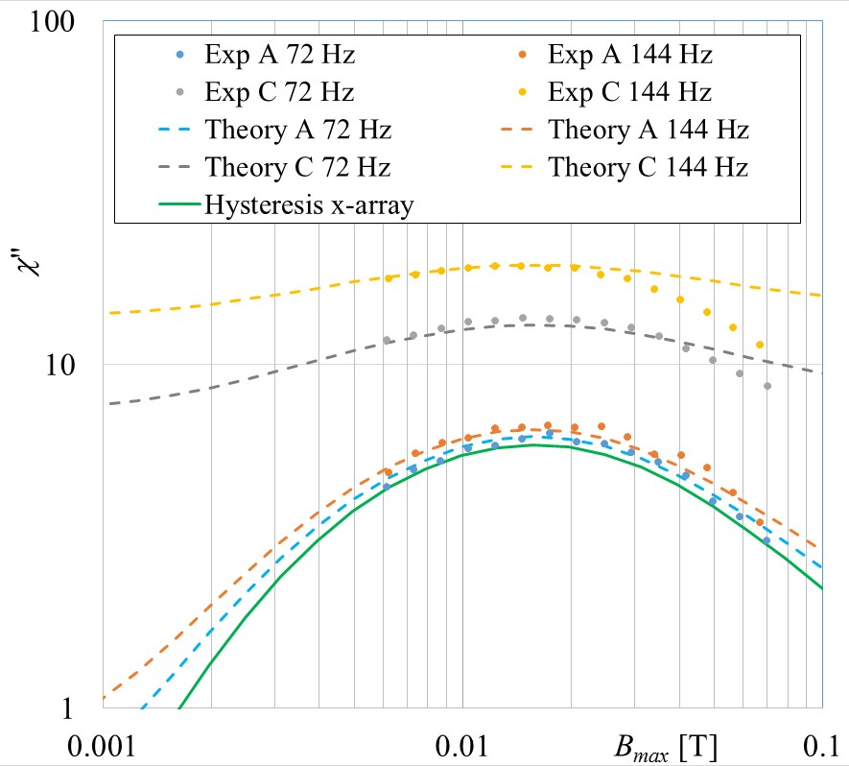
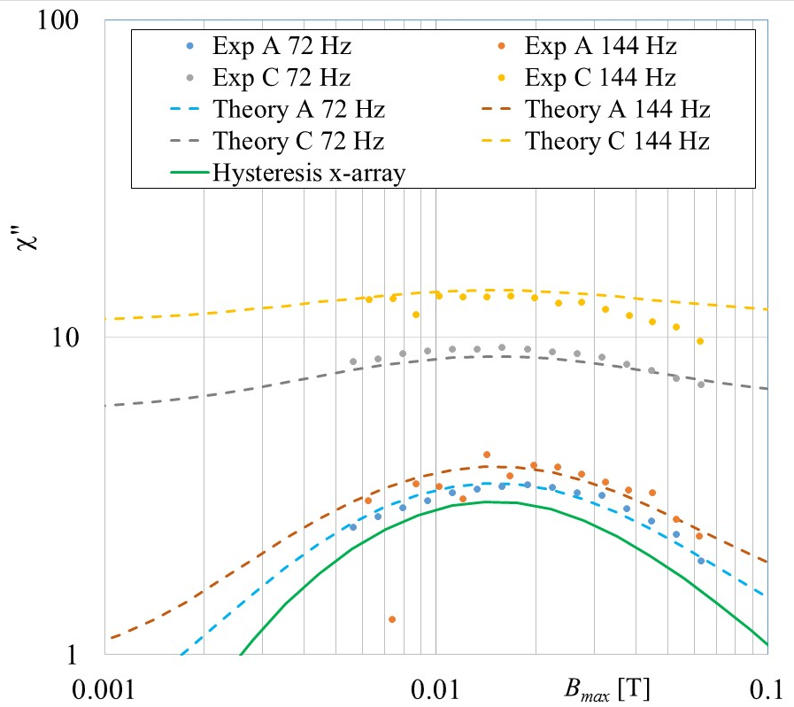
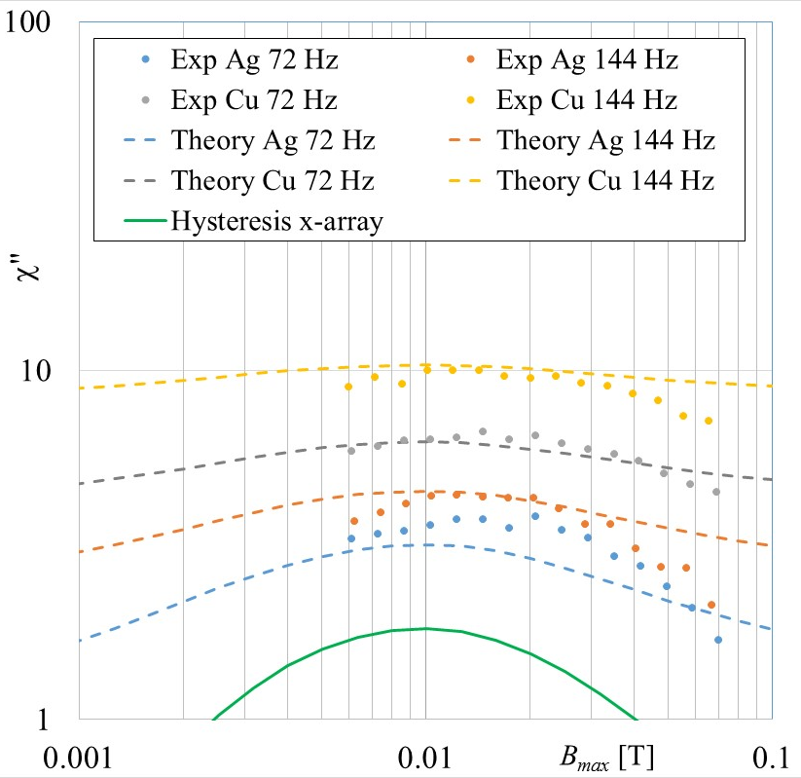
Tapes 12 mm wide – filament width & metallization
6 filaments
11 filaments
20 filaments
A: ρ_{g} = 40× ρ_{Cu}
A: ρ_{g} = 25× ρ_{Cu}
A: ρ_{g} = 15× ρ_{Cu}
C: ρ_{g} = 3.7× ρ_{Cu}
C: ρ_{g} = 3.7× ρ_{Cu}
C: ρ_{g} = 7× ρ_{Cu}
ρ_{Cu} = 2×10⁻⁹ Ωm
WPMAG EUROfusion Final Meeting 14–16 Jan 2026, Paul Scherrer Institute

Slide 11
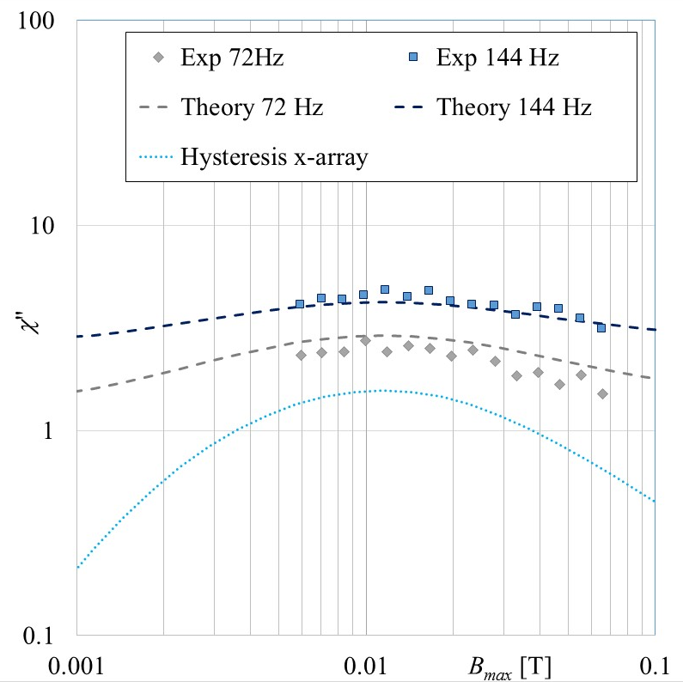
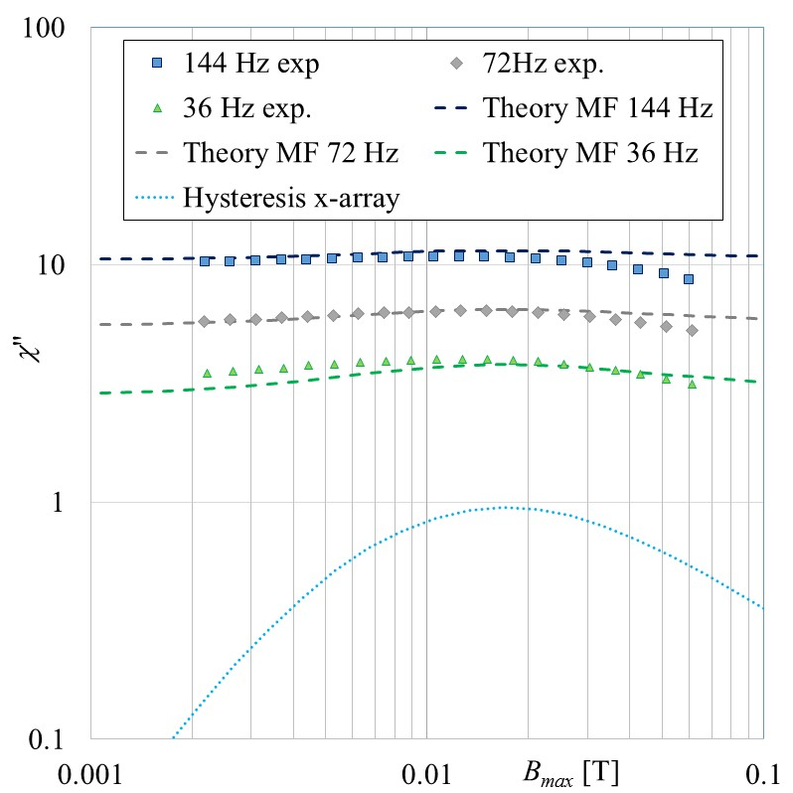
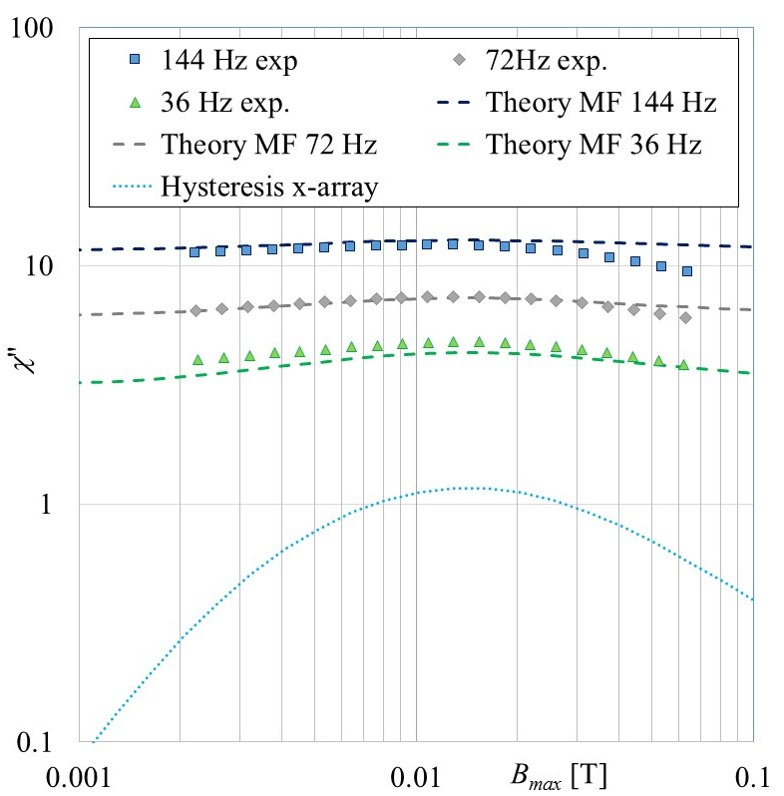

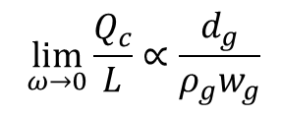
Tapes 12 mm wide, 500 µm filaments – gap width & metallization
Sample | w_{f} [µm] | w_{g} [µm] | Ag [µm] | Cu [µm] | d_{g} [µm] | k_{g} | I_{c} [A]
B-3 | 500 | 80 | 1.3 | 3.9 | 5.2 | 12 | 244
B-4 | 498 | 116 | 1.9 | 14.7 | 16.6 | 3.2 | 264
B-5 | 484 | 69 | 1.35 | 9.2 | 10.55 | 3.3 | 260
$$⁡\lim_{ω→0}{\frac{Q_{c}}{L}}∝\frac{d_{g}}{ρ_{g}w_{g}}$$
$$ρ_{g}=k_{g}ρ_{Cu}$$
ρ_{Cu} = 2×10⁻⁹ Ωm
WPMAG EUROfusion Final Meeting 14–16 Jan 2026, Paul Scherrer Institute

Slide 12
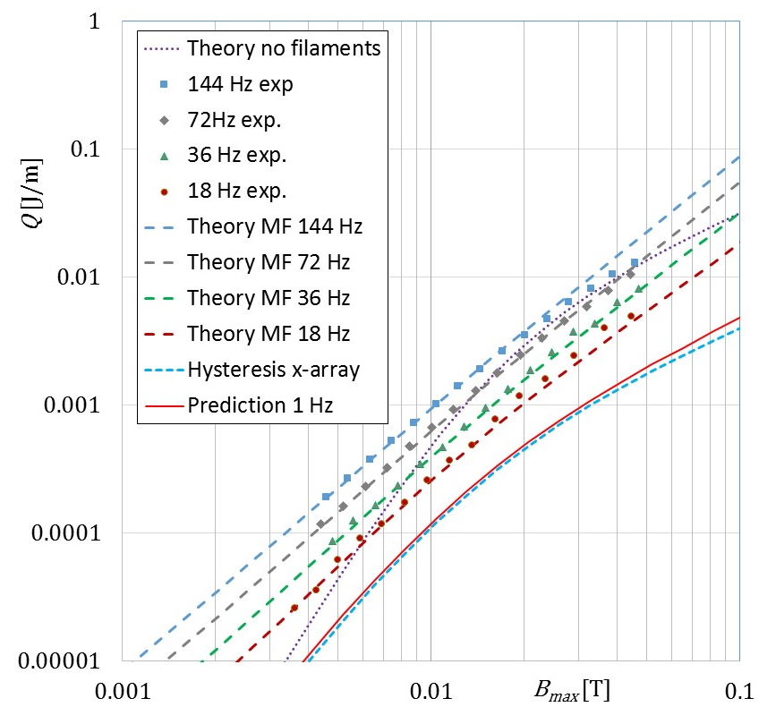
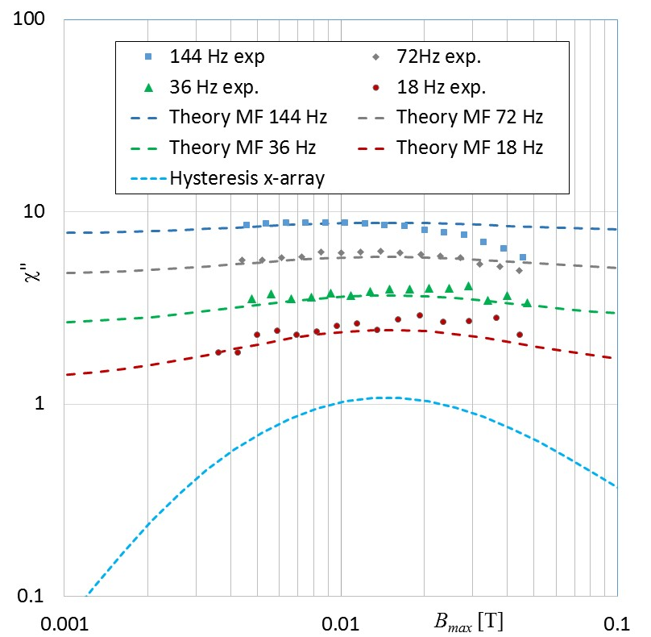
Tapes 4 mm wide
7 filaments 500 µm, 3.56 μm Ag + 13.7 μm Cu, I_{c} = 90 A
ρ_{g} = 5.6× ρ_{Cu}
ρ_{eddy} = 1× ρ_{Cu}
WPMAG EUROfusion Final Meeting 14–16 Jan 2026, Paul Scherrer Institute

Slide 13
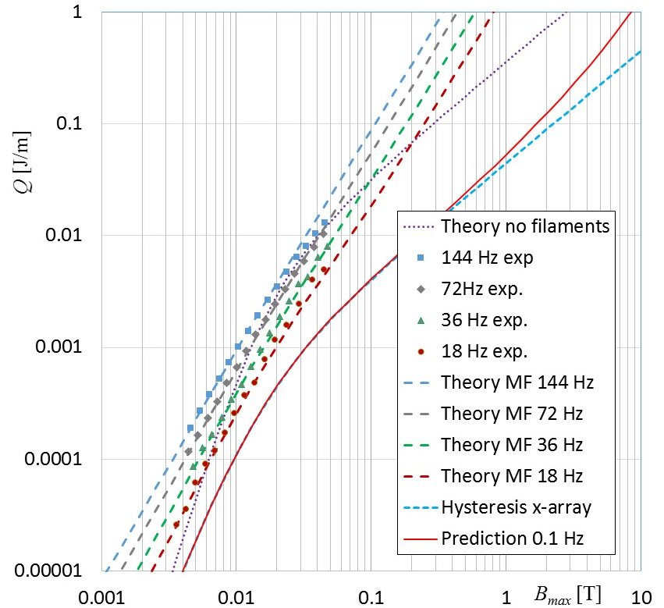
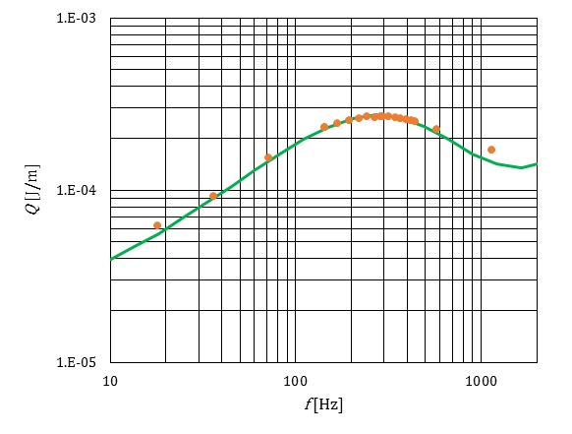
Tapes 4 mm wide
7 filaments 500 µm, 3.56 μm Ag + 13.7 μm Cu, I_{c} = 90 A
B_{max} = 5 mT
ρ_{g} = 5.6× ρ_{Cu}
ρ_{eddy} = 1× ρ_{Cu}
WPMAG EUROfusion Final Meeting 14–16 Jan 2026, Paul Scherrer Institute

Slide 14
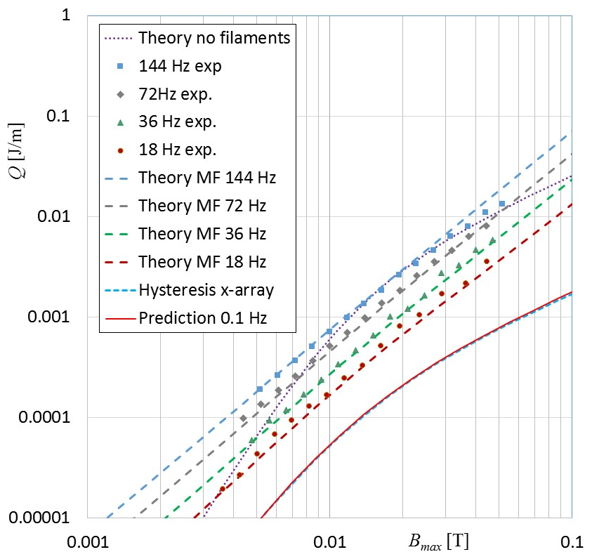
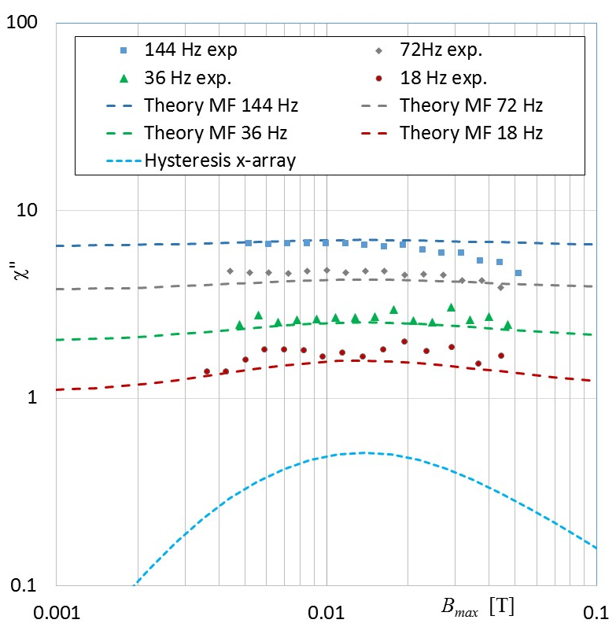
Tapes 4 mm wide
12 filaments 250 µm, 4.3 μm Ag + 13.3 μm Cu, I_{c} = 70 A
ρ_{g} = 6 × ρ_{Cu}
ρ_{eddy} = 1× ρ_{Cu}
WPMAG EUROfusion Final Meeting 14–16 Jan 2026, Paul Scherrer Institute

Slide 15
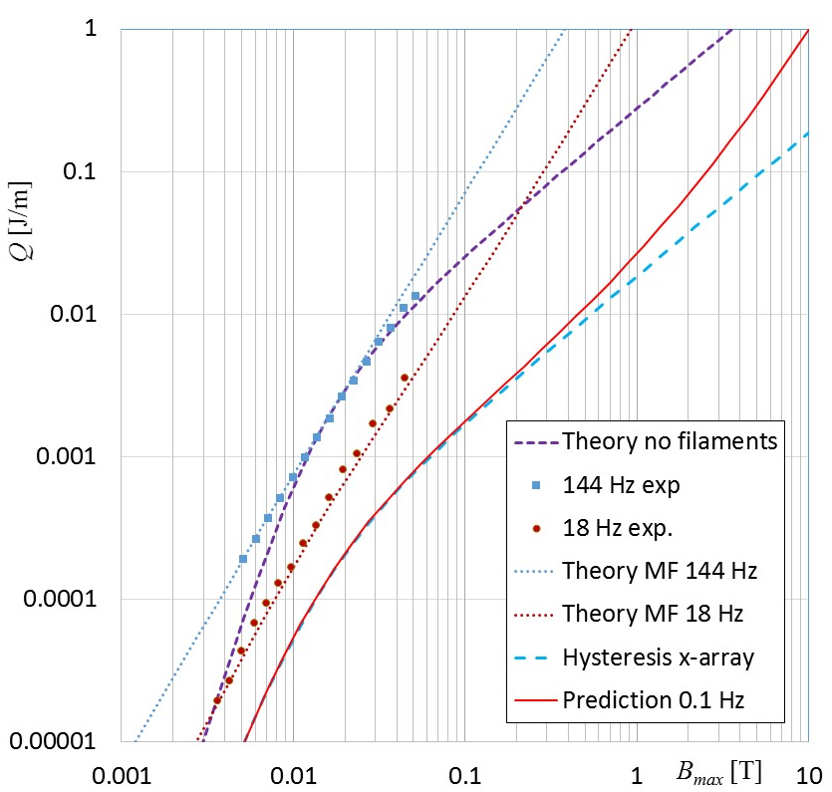
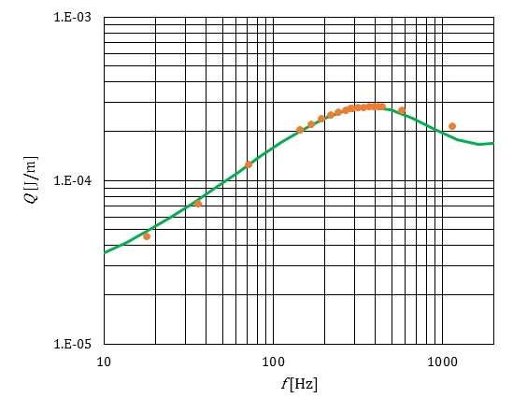
Tapes 4 mm wide
12 filaments 250 µm, 4.3 μm Ag + 13.3 μm Cu, I_{c} = 70 A
B_{max} = 5 mT
ρ_{g} = 6 × ρ_{Cu}
ρ_{eddy} = 1× ρ_{Cu}
WPMAG EUROfusion Final Meeting 14–16 Jan 2026, Paul Scherrer Institute

Slide 16
Conclusions and outlook
Magnetization loss of filamentized tapes prepared by 2LUPS technology in 12 mm and 4 mm versions:
controllable by tape architecture
predictable by theory (transverse resistivity remaining the only fitting parameter)
Outlook for 2026-27:
manufacturing of laboratory models of round cables from MF tapes
experimental testing of magnetization loss, verification of theoretical predcitions
WPMAG EUROfusion Final Meeting 14–16 Jan 2026, Paul Scherrer Institute

