Slide 1

Feasibility study of the system for transport measurements during cryogenic gamma irradiation
PRD-3.HTS.01-T023 - D002
WPMAG Final Meeting 2025 16/01/2026
Valentina Pinto / FUSEN-COND

Slide 2

Acknowledgments
TASK PRD-3.HTS.01-T023: Understanding neutron and secondary radiation effects on the superconducting state and on the microstructure of HTS 2G tapes
Task Coordinator: F. Laviano (POLITO)
Superconductivity Laboratory-ENEA
G. Celentano, R. Freda, A. Masi, A. Angrisani Armenio
Calliope Facility-ENEA
A. Cemmi, R. Carcione, I. Di Sarcina, G. Ferrara, A. Verna, J. Scifo
IRAD Laboratory-ENEA
D. Casagrande, E. Palumbo
Tor Vergata University- Rome
Prof. M. Tomellini, M. De Angelis

Slide 3
Gamma Irradiation Effect on HTS Film
Origin of some contradictions in the literature data:
Scarce statistical significance (often no or few replicates are studied)
Irradiated samples are compared to a reference control sample
Few details on the experimental conditions

Slide 4
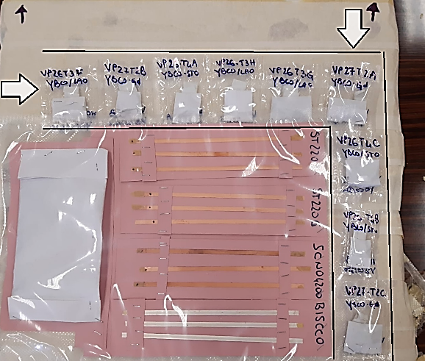
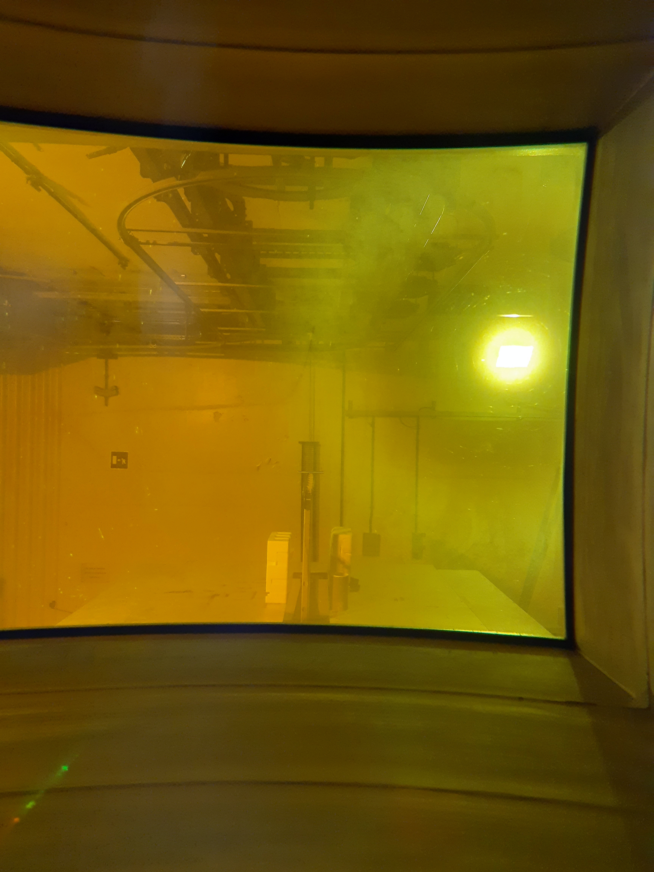
Starting Point: 2024 Activity
⁶⁰Co gamma source
Gamma irradiation of REBCO CCs, BiSCCO wires and lab-scale YBCO films at fusion relevant conditions (dose equal to 7.1 MGy)
HTS samples

Slide 5
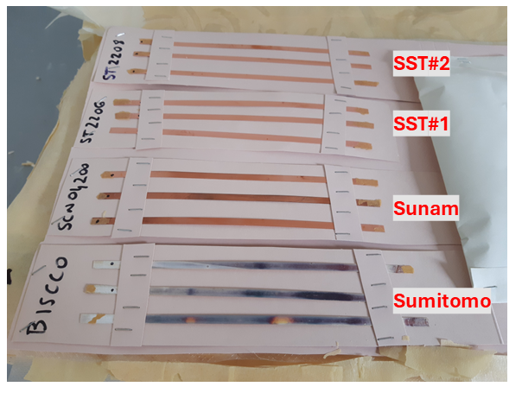
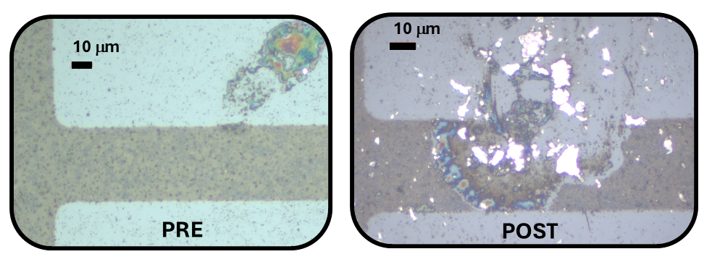
What Emerged by 2024 Activity
Samples degradation due to secondary reactions of photons with the test environment
Absolute necessity of experiments carried out in the real operative conditions
In situ measurements during cryogenic irradiation

Slide 6
2025 Activity
Feasibility study of the proper system for transport measurements during cryogenic irradiation

Slide 7
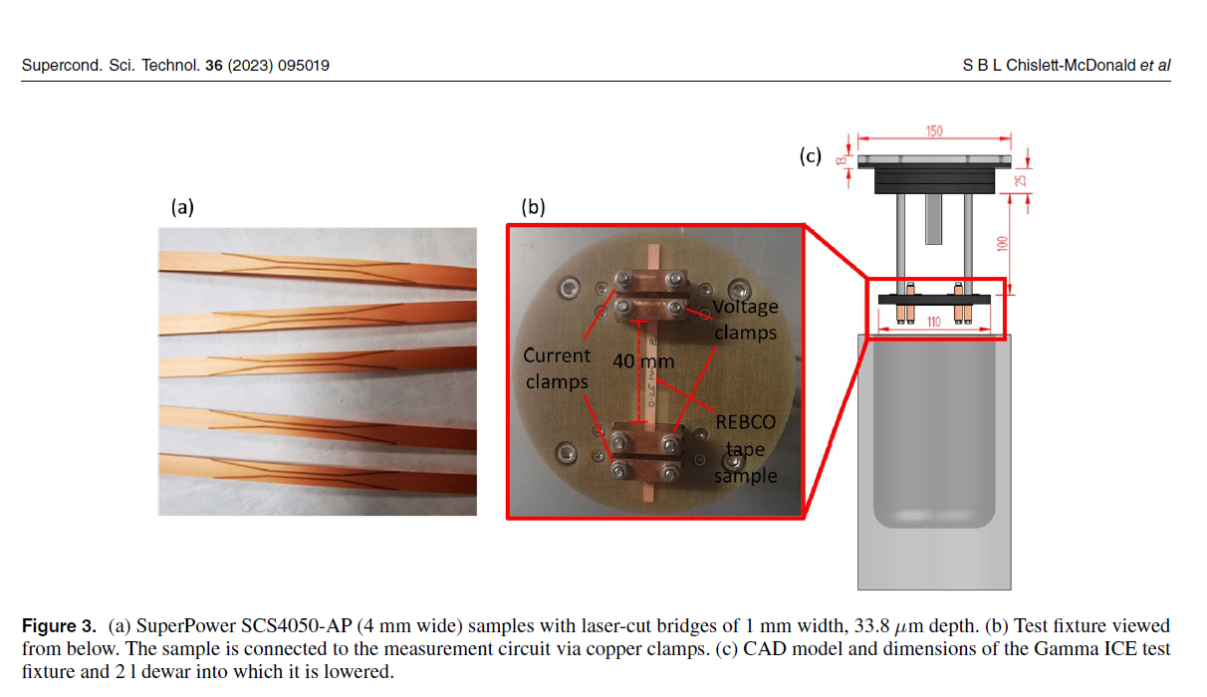
Towards in-situ measurements during gamma irradiation
Gamma irradiation of liquid nitrogen. A real problem?
In-situ measurements of Superpower tapes in LN₂ irradiated up to 3.5 kGy.
Risks of LN₂ explosions after a dose of 10 kGy were reported [Chislett, UKAEA report 2023].
Chislett et al [SUST, 2023]

Slide 8
Towards in-situ measurements during gamma irradiation
Gamma irradiation of liquid nitrogen. A real problem?
Duke et al [IEEE, 2024] reported irradiation study of fiber optics in LN₂ up to 1.2 MGy and 60 kGy/h. No explosion occurred.
Tests of LN₂ irradiation to verify the safety of the apparatus for in-situ transport measurements

Slide 9
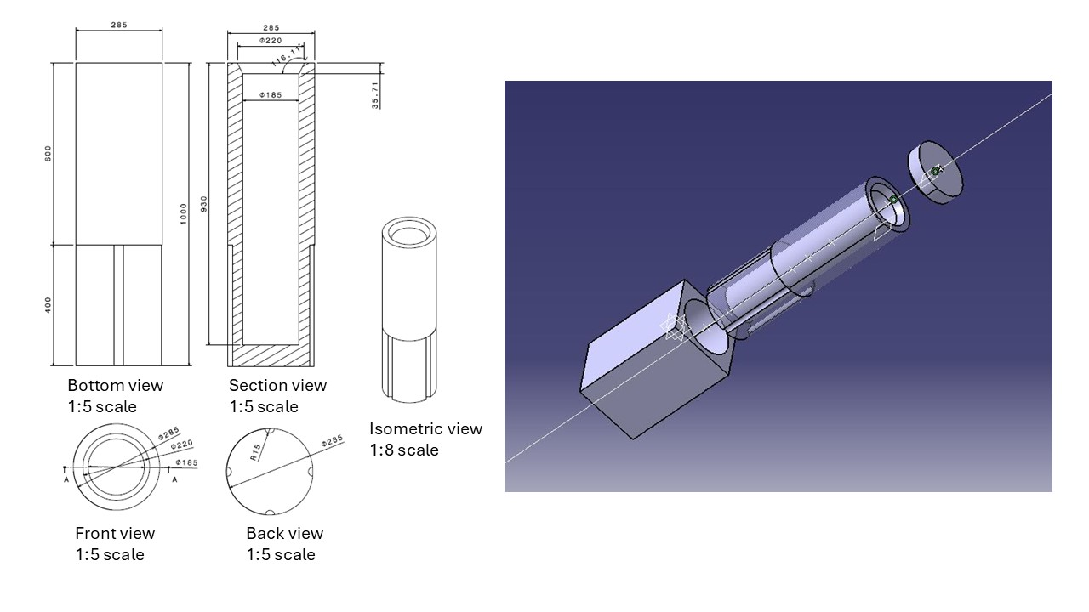
2025 Activity: Design of the Cryostat
High Density Sintered Expanded Polystyrene (HD-EPS)

Slide 10
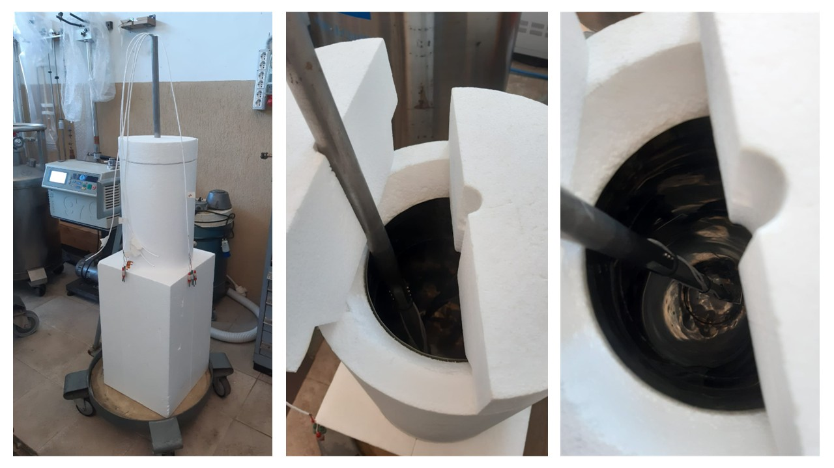
2025 Activity: Design of the Cryostat

Slide 11
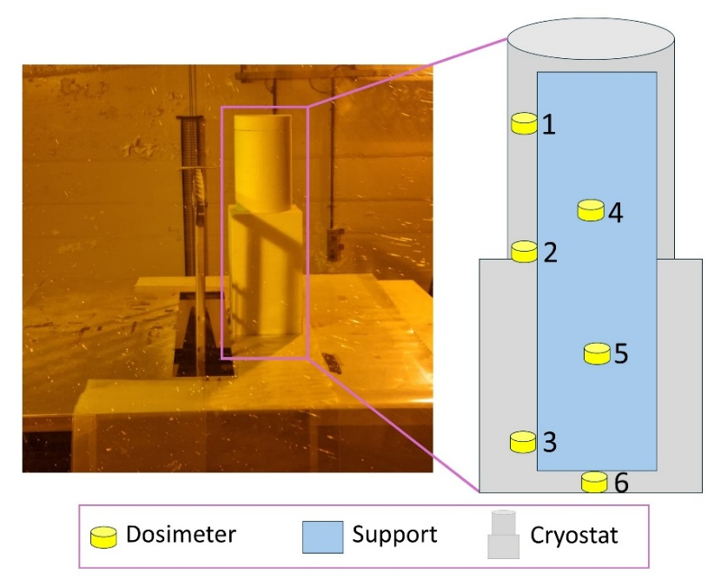
2025 Activity: Liquid Nitrogen Irradiation
Test at Calliope Facility
Dosimeter | Dose rate (water) (Gy/h) | Dose rate (air) (Gy/h)
1 | 2953 | 2541
2 | 3078 | 2642
3 | 2863 | 2463
4 | 2384 | 2049
5 | 2305 | 1991
6 | 1916 | 1647

Slide 12
2025 Activity: Liquid Nitrogen Irradiation
Dosimeter | Dose rate (water) (Gy/h) | Dose rate (air) (Gy/h)
1 | 2953 | 2541
2 | 3078 | 2642
3 | 2863 | 2463
4 | 2384 | 2049
5 | 2305 | 1991
6 | 1916 | 1647

Slide 13
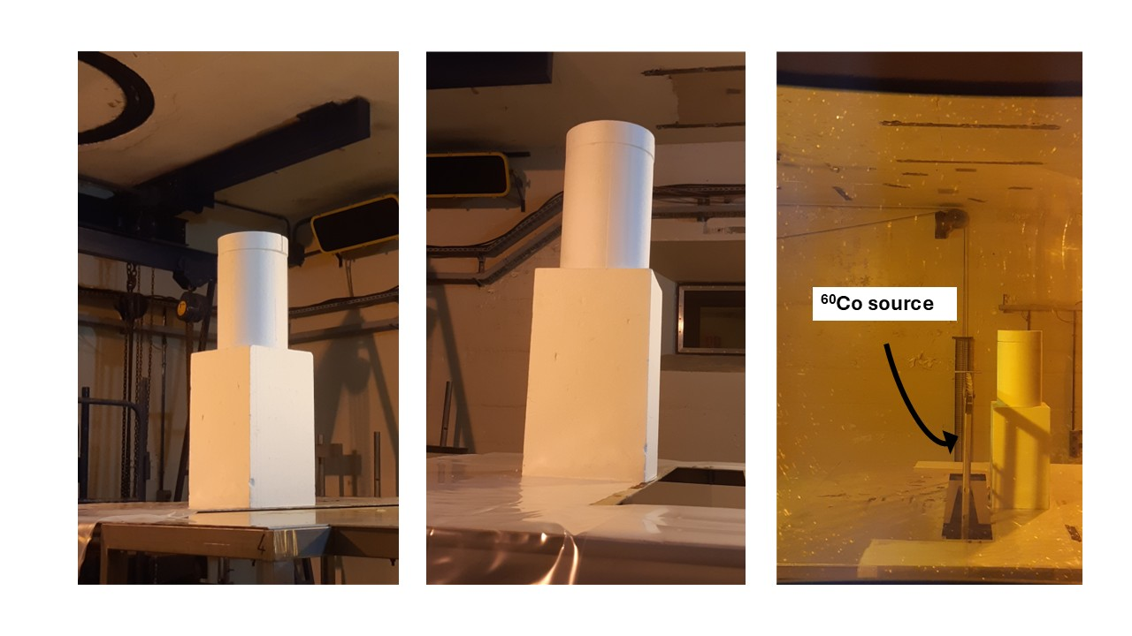
2025 Activity: Liquid Nitrogen Irradiation
LN₂ 5.0 grade with a purity ≥ 99,999% and a level of O₂ contamination < 10 ppmv
Dose [kGy] | Dose/rate (air) [kGy/h] | LN₂ volume [L]
1 | 0.8 | 2
1.5 | 0.8 | 2
5.1 | 2.6 | 19
11.1 | 2.6 | 19
No explosion occurred up to 11.1 kGy

Slide 14
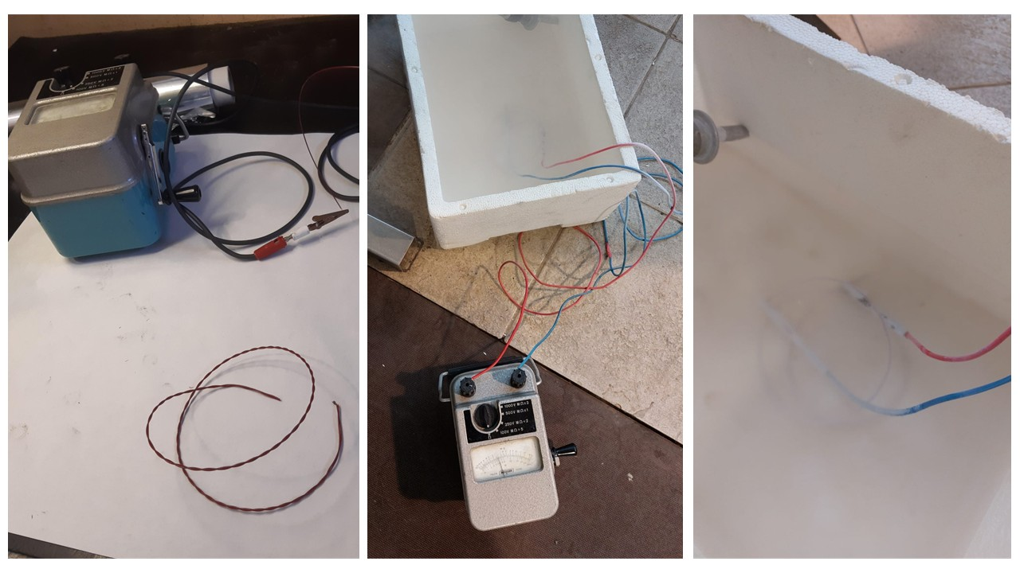
2025 Activity: Tests of Cable Radiation Hardness
Test of radiation hardness of cable for voltage measurement
No changes up to 1.6 MGy and 2.8 kGy/h

Slide 15
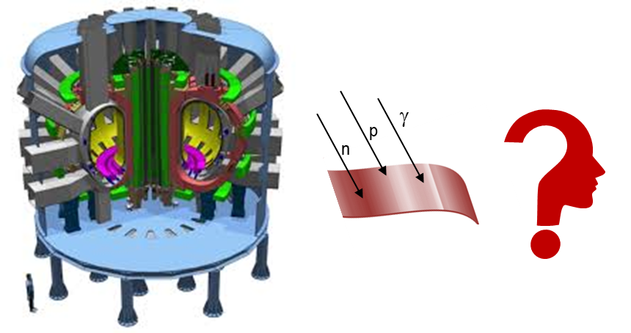
Conclusions
A cryostat was designed, realized and used for the test of LN₂ irradiation
LN₂ can be used as cryogenic liquid up to 11 kGy with no risk of explosions
Tests on radiation hardness of cable for voltage measurement are currently ongoing
The procurement of other necessary equipment, such as source meter, nanovoltmeter and thermometers, has started.

Slide 16
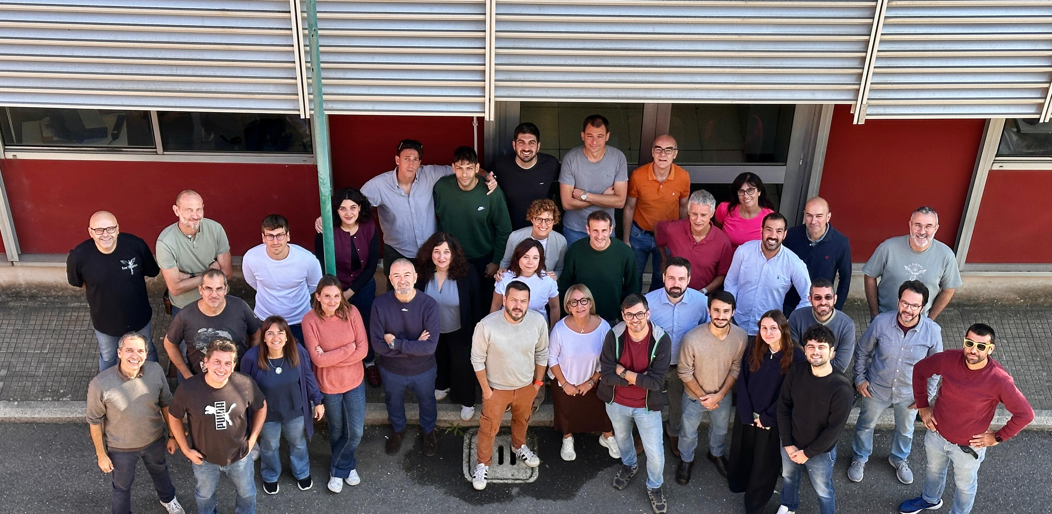
THANK YOU

Slide 17
Valentina Pinto
valentina.pinto@enea.it

Slide 18
Backup

Slide 19
Irradiation Test
Commercial HTS:
EuBCO+BaHfO₃ by Shanghai Superconducting Tech. (#2 different APCs content). Cu stabilizer thickness of 10 μm
GdBCO, SCN04220, by Sunam. Cu stabilizer thickness of 15 μm each side.
BiSCCO 2223, by Sumitomo. Ag/Ag-alloy matrix.
Chemically deposited film used as reference:
YBCO on STO and LAO
YBCO-Gd10% on LAO

Slide 20
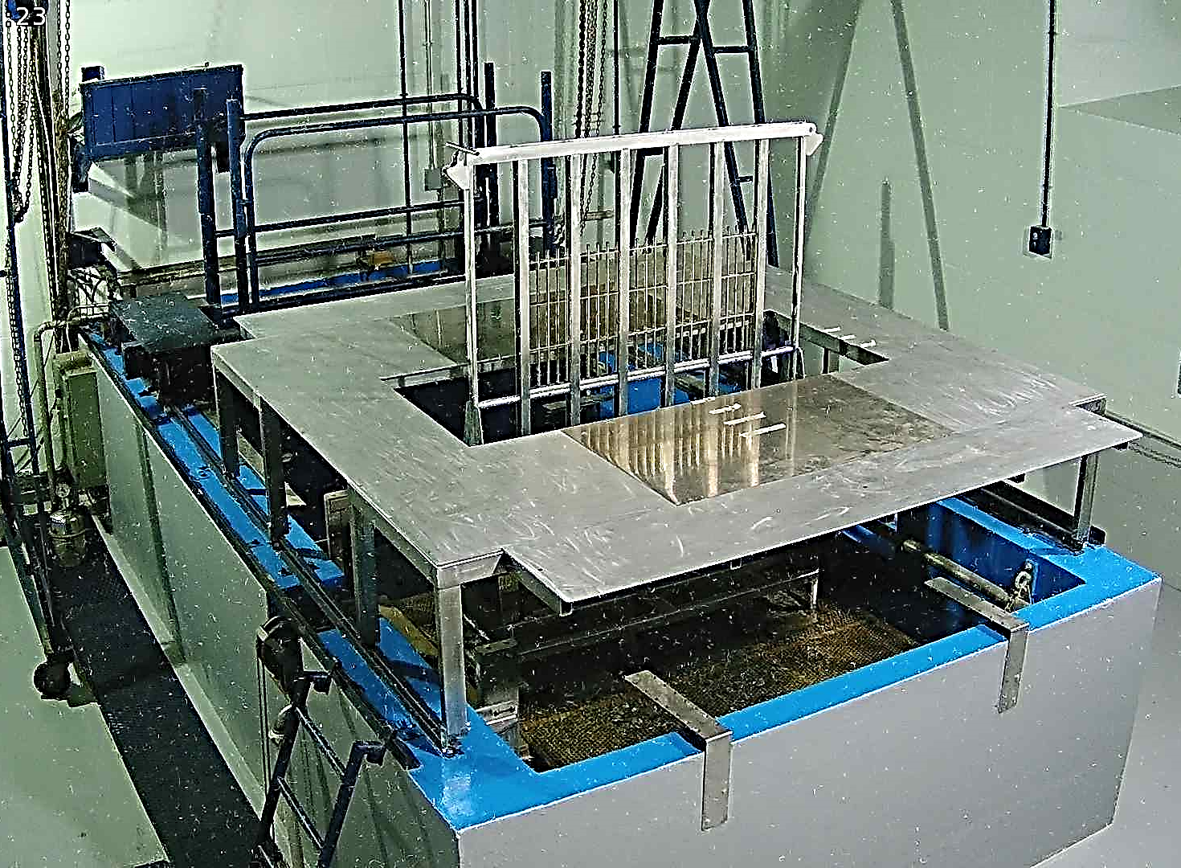
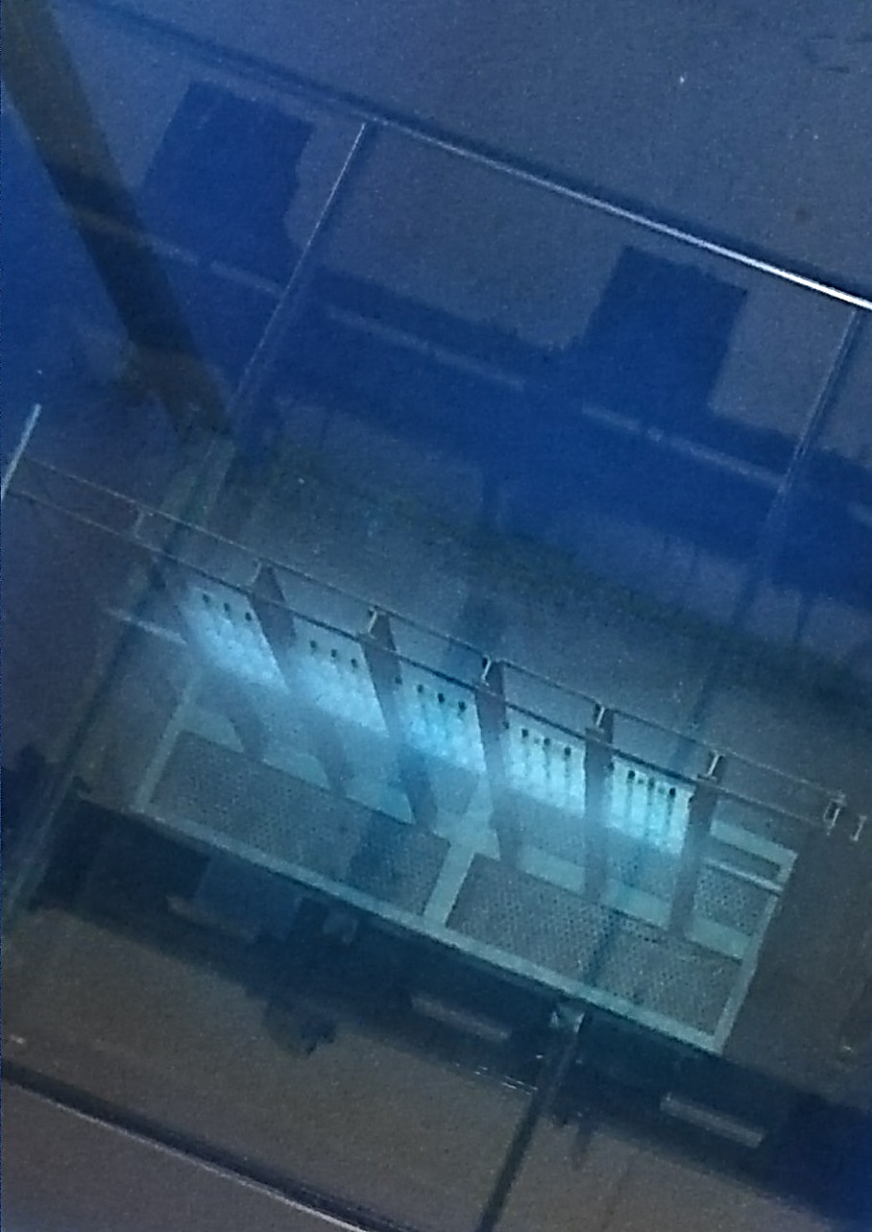
Calliope Facility at ENEA
Large dimensions
Fusion relevant dose/rate
Pool-type irradiation plant in a large volume (7x6x3.9 m³) shielded cell.
Plane rack, active area: 40 cm × 75 cm .
⁶⁰Co gamma source with a maximum dose rate value of about 5.5 kGy·h⁻¹ (June 2024).

Slide 21
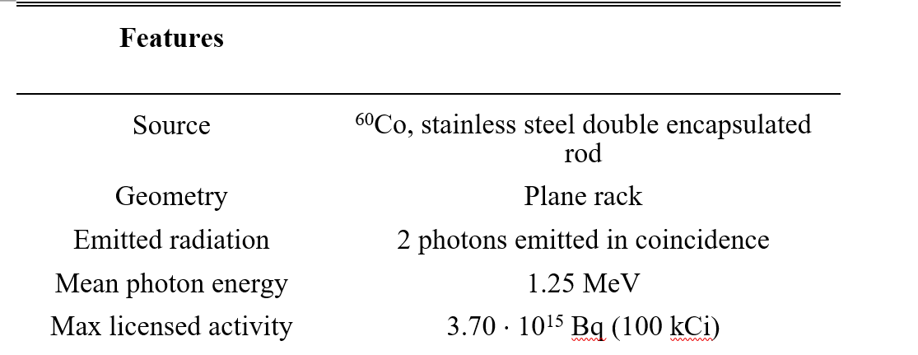
Calliope Plant Main Features

Slide 22
Irradiation test with fusion relevant conditions
Dose: 7.1 MGy (corresponding to 5.9 MGy_{YBCO})
Dose rate: 3.9 kGy/h
⁶⁰Co gamma source
ITER Qualifications: doses up to 8 MGy
‘’the 5 MGy dose was chosen to enable evaluation of prolonged gamma irradiation effects’’ (Campbell et al [J. of Superconductivity and Novel Magnetism, 2024])
HTS samples

