Slide 1
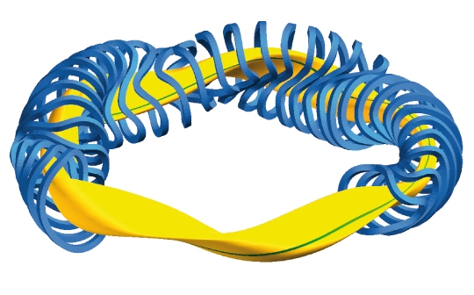
Meeting
Daniel Biek
13.02.2023

Slide 2
Plasma Physics – Stellarator configurations
Technically four different approaches to achieve good confinement of stellarators
  Quasi-axisymmetric (QA)
  Quasi-helical symmetry (QH)
  Quasi-polodial (QP)
  Optimized configuration (quasi-isodynamic) (QI)
1-3 are hidden symmetries of magnetic field => guarantees good plasma confinement, but there are not necessary
4 is optimized configuration which depends on the input parameter
Example of QA is the compact stellarator
QP is not possible from an engineering point of view
QH example is the HSX in Wisconsin and the new idea of Type I energy
QI example is W7-X and all HELIAS stellarator

Slide 3
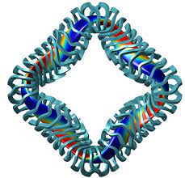
Types of stellarators
QH stellarator
helical-axis advanced stellarator (HELIAS), QH
QA,compact stellarator (CS)
Example: HSX, Starblazer
Currents in the plasma
Research topic of MIT, University of Wisconsin
Example: Wendelstein 7-X
Only configuration without any bootstrap currents
A bit like QP
Hybrid version between tokamak and stellarator
Strong bootstrap currents
Smallest geometry

Slide 4
Plasma Physics – Input from Joaquim
There is no best configuration at the moment
Worth it to explore all different options
Most advanced options are QI and QH
QI rather large at the moment, tendency to smaller fold systems
  Wait from the final input from experiments of W7-X
Load and requirements are similar as in tokamaks
The new versions of stellarators needs to have correction coils to explore different physical settings

Slide 5
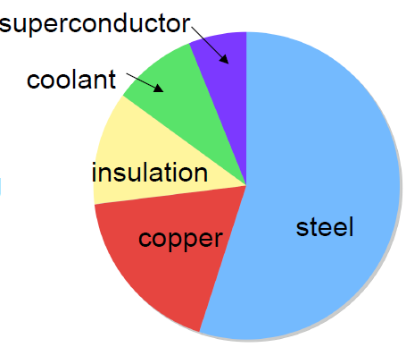

Design procedure – Stellarator Magnets –First loop
Ampere Turn (MA)
$$I_{op} \& N_{turn}$$
HELIAS 5-B Structure
Electromagnetic Analysis
Mechanical Analysis:
Lorentz force, Stress and Strain analysis
Winding pack design
Field Requirements:
HTS (~20T)
LTS (~13T)

Slide 6
Introduction phase - Tasks
Learning Ansys, especially Ansys APDL
  Use old models from Xabi to understand Physics and implementation
  Old material from IPP is implemented in Ansys APDL
  Only 3D configuration
Winding pack (WP) design
  Parallel to learning Ansys, started with the process of WP design
  EuroFusion Reports, Codes and other Material as learning Material
  Focus on optimized coils at the moment

Slide 7
Introduction phase - Tasks
Literature Review
  HTS conductors used for fusion or other application
  LTS conductors (W&R design favorable, R&W probably not implementable)
  Physics behind the design (Mechanics and Thermal Hydraulics)
  New publications from MIT, Type One energy for HTS
Started all tasks, but there was a break since begin of Jan due to teaching duties and exam preparation

Slide 8
Teaching duties/EPFL duties
TA for course “Control and Operation of Tokamaks”
  Block course 6.2 – 17.2
  Also taking the exam this Friday (2 ECTS)
TA for course “Global Issue A: Energy”
  Semester course
  Can communicate in the groups in English
  Exam and poster presentation is in French though
Attend course “Fusion Technologies and Plasma applications” (4 ECTS)
When semester finishes:
  10 ECTS obtained, if all passed
  2 TA duties completed

Slide 9
MT28 - Conference
Hand in an Abstract for the MT28
Title: Preliminary Design and Electromechanical Analysis of a Winding Pack for high field HELIAS Magnets
  Focus on a LTS solution for HELIAS Magnets
  Electromechanical Analysis of the Coils
  First WP design
Part of EuroFusion Task
In contact with Felix Warmer (Taskleader SPPS) and Richard Kembleton (Taskleader PRD)

Slide 10
Next Steps
Continue the tasks
  Finish learning Ansys
  Start analyzing the data of IPP and HELIAS Magnets
    Define free parameters and how the structure changes
  Aim: write a new modelling program for HELIAS Magnets
  WP Design
    First: Recreate the solution of IPP 10 years ago (published also)
    Scaling Law to define Jc
    Nb3Sn based WP
    HTS options (literature) for the future
TA duties

