Slide 1
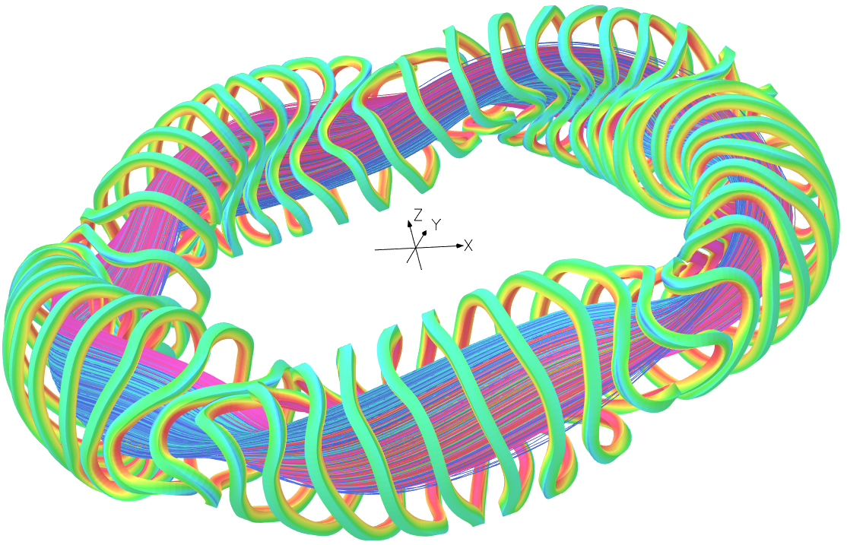
Mechanical Analysis of Helias 5-B Magnet system
Daniel Biek,
K. Sedlak, X. Sarasola, A. Fasoli, G. Bongiovi, F. Warmer
16/01/2026

Slide 2
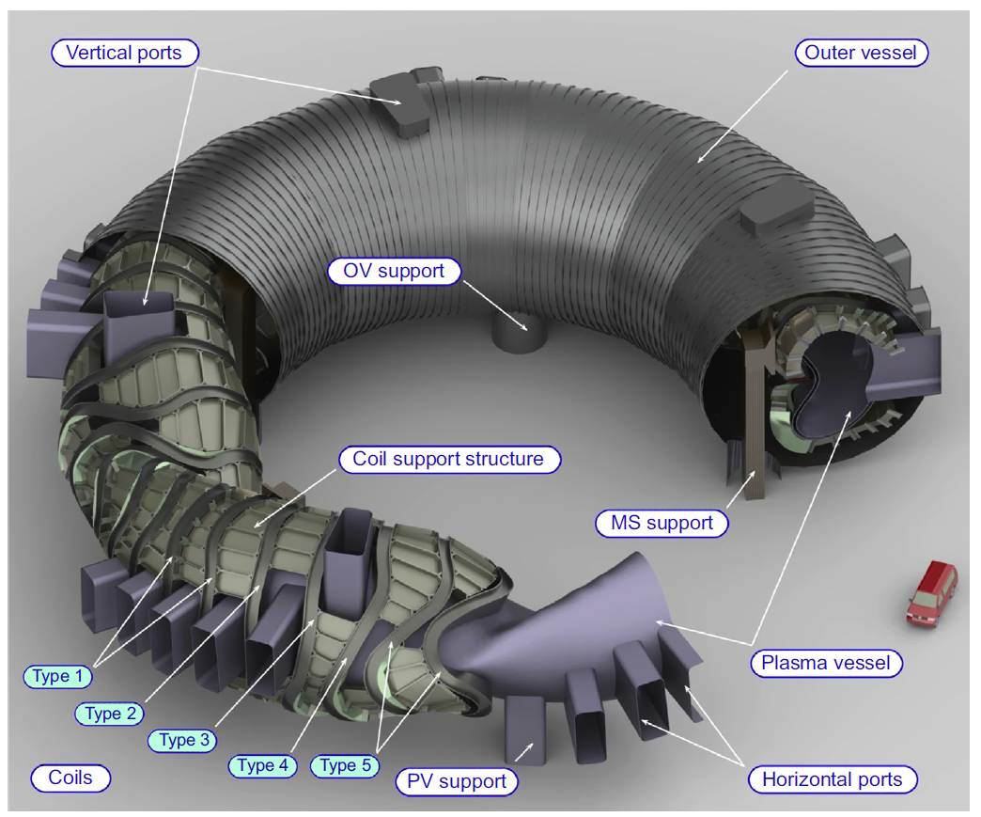
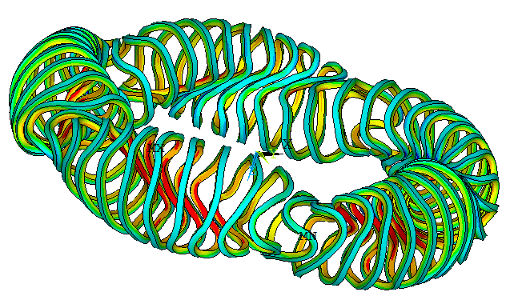
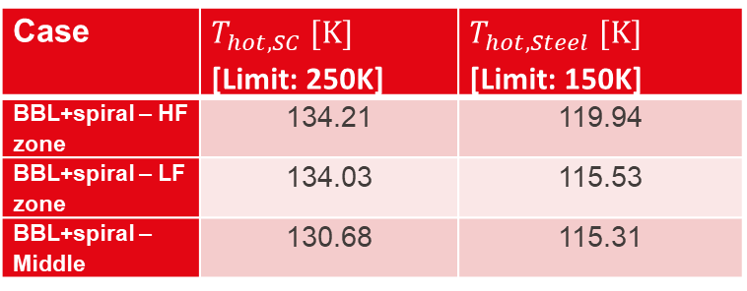
Introduction
Aim: Development of a parameterized code for the analysis of stellarator coils
Test case: Helias 5-B
  Optimized stellarator
Nb3Sn Coils
Electromagnetic and thermal-hydraulic analysis have been performed
Case | $T_{hot,SC} [K]$ [Limit: 250K] | $T_{hot,Steel} [K]$ [Limit: 150K]
BBL+spiral – HF zone | 134.21 | 119.94
BBL+spiral – LF zone | 134.03 | 115.53
BBL+spiral – Middle | 130.68 | 115.31

Slide 3
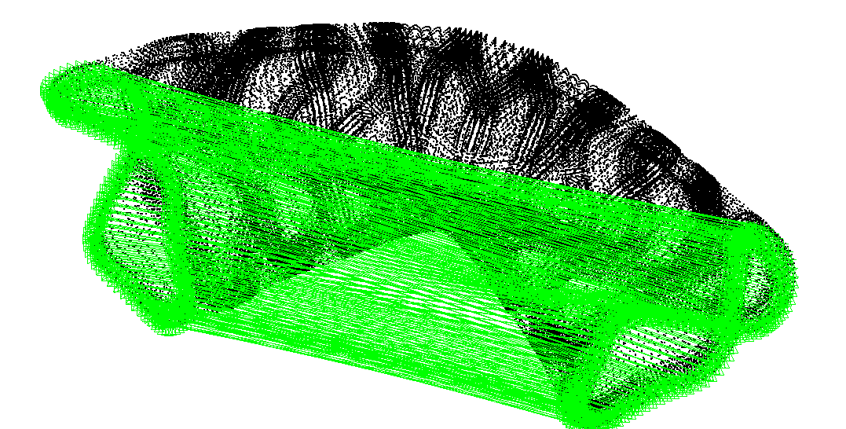

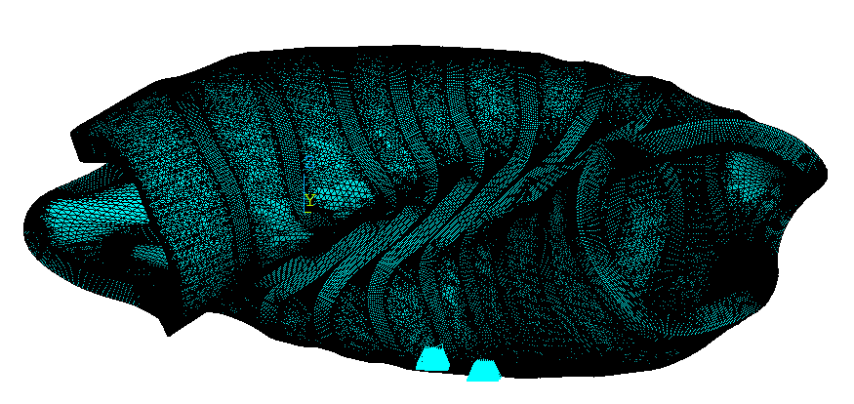
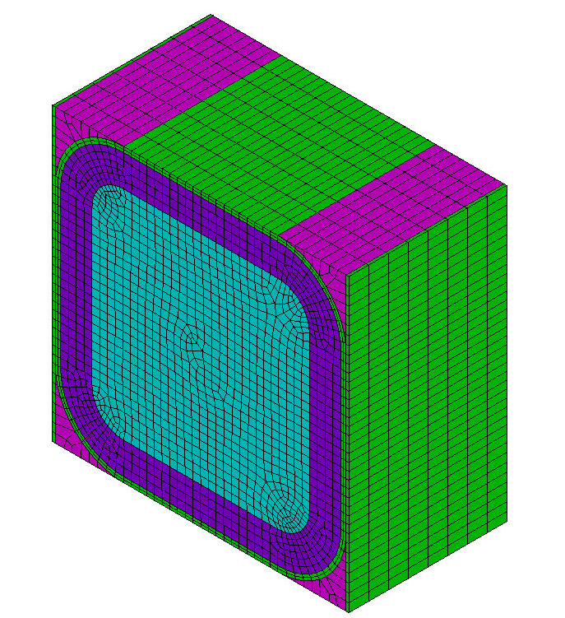
Design procedure – Mechanics
Fully bonded or sliding contact btw. Case and Coil
Lorentz Force from EM simulation
Mechanical Analysis: Coil Cases and Intercoil structure
Cool-down to 4.2K
EM load during operation
Boundary Conditions:
Gravity support: Sliding contact
Periodic boundary conditions
Smeared mechanical properties
Intercoil Structure: Space filled between coils
Gravity support

Slide 4
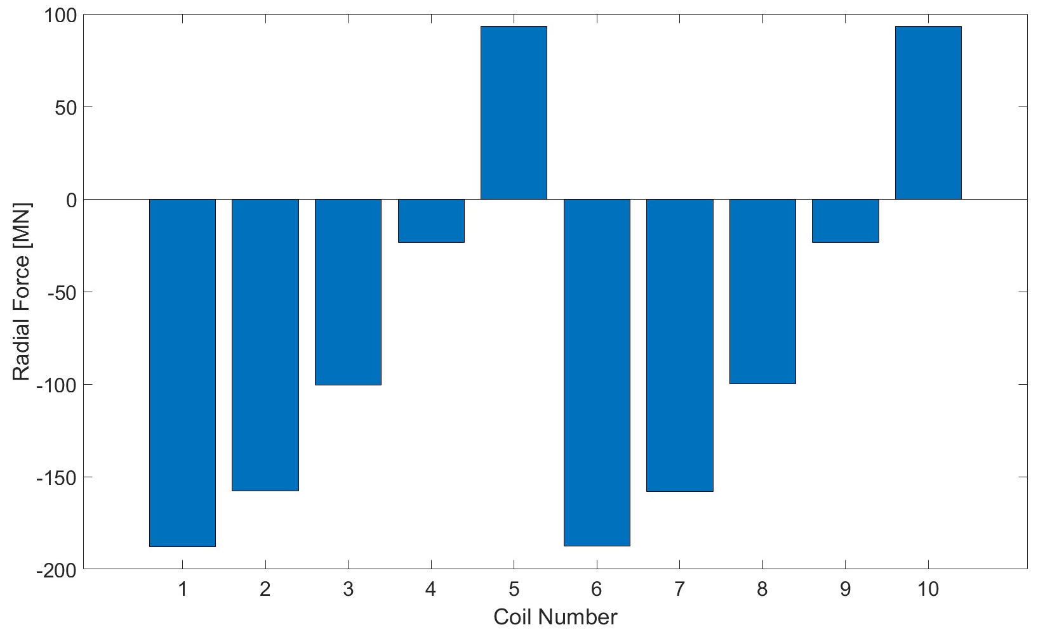
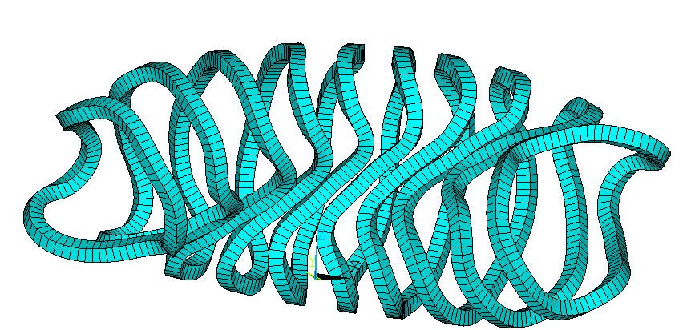
Coil net forces
Coil 6
Coil 1
Coil 5
Coil 10
Total radial force: 750.73 MN
Whole system: 3759 MN

Slide 5
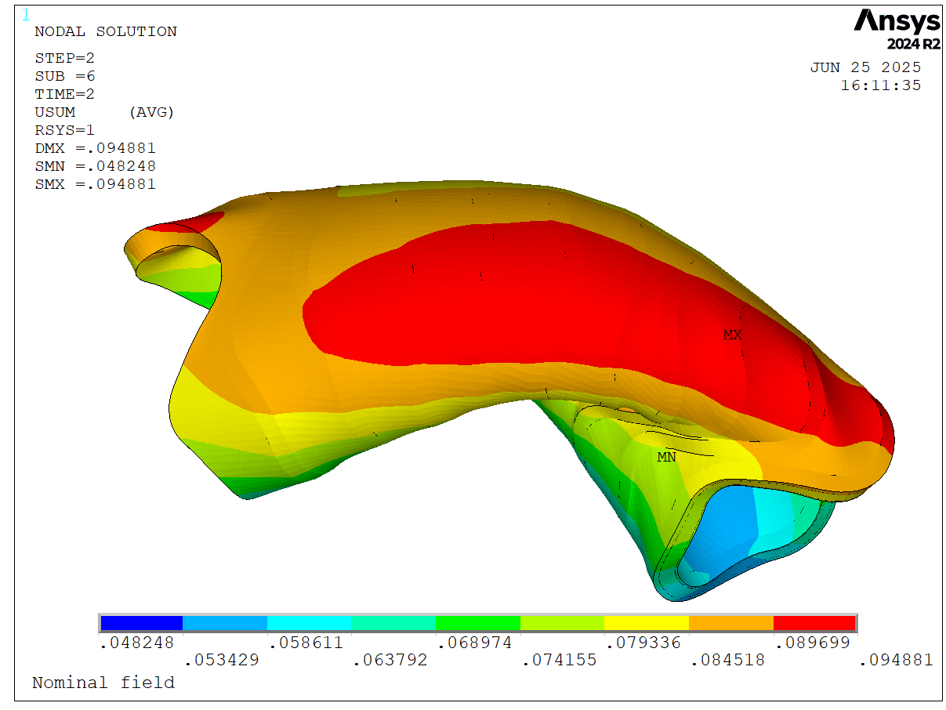
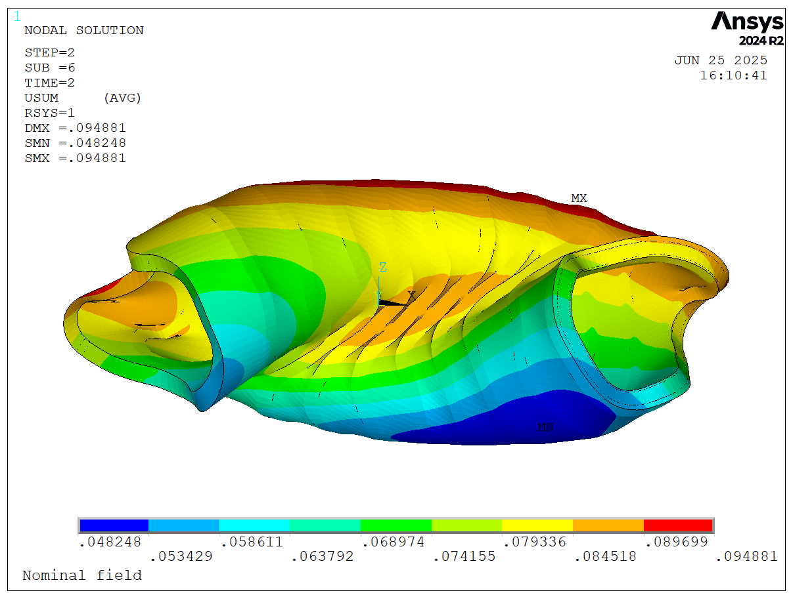
Mechanical Analysis – Displacement

Slide 6
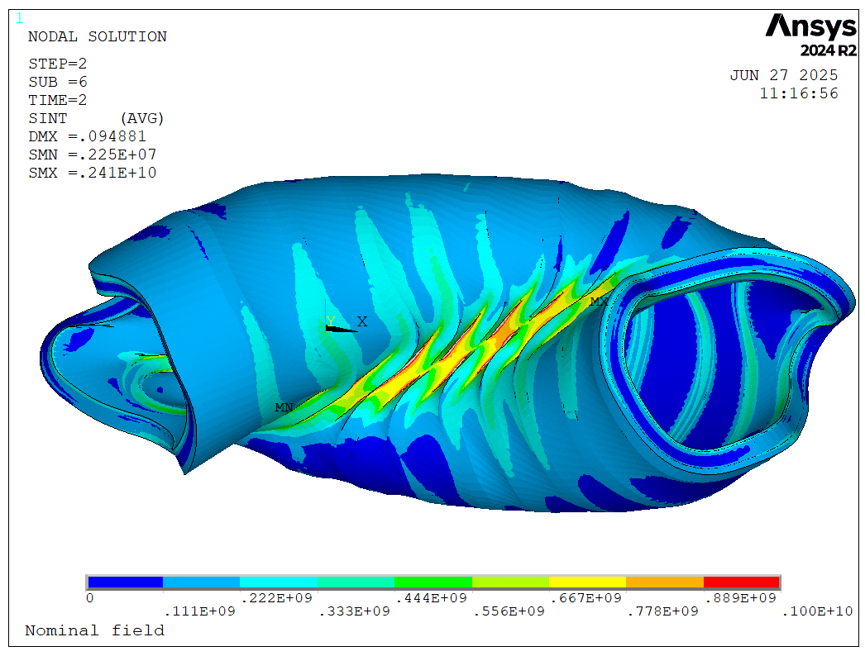
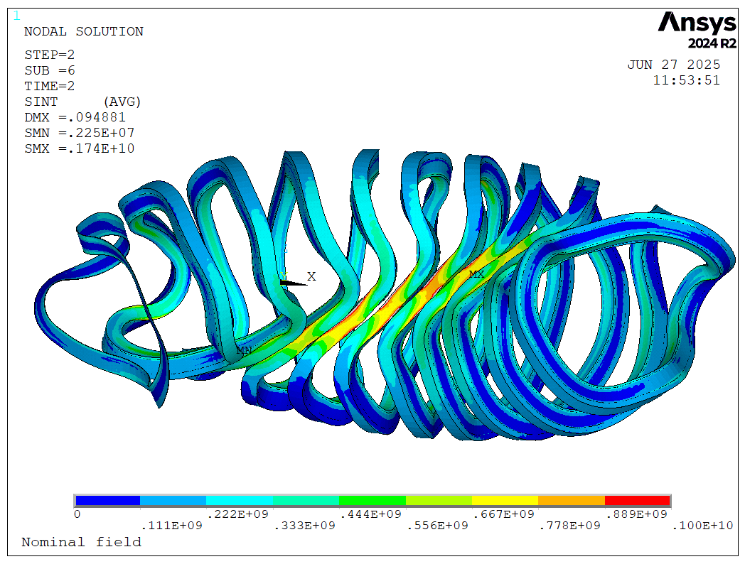
Mechanical Analysis – Stress intensity
Support structure + Coil case
Coil case
Stress intensity (Pa) from 0 to 1GPa (yield strength at 4.2K)

Slide 7
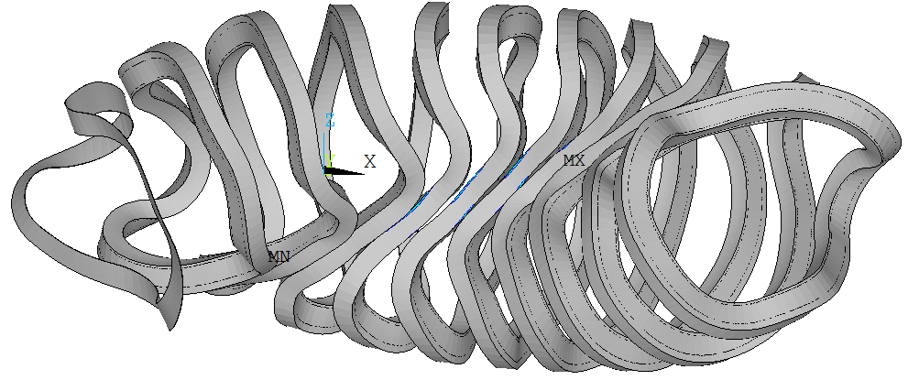
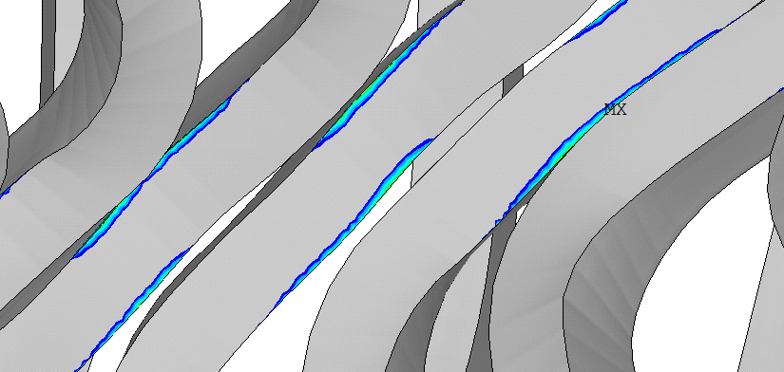
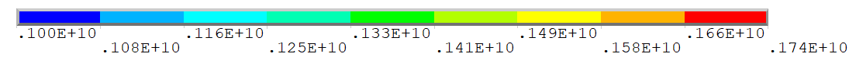
Mechanical Analysis – Stress intensity in the coil case
Outer boundary of the neighboring period

Slide 8
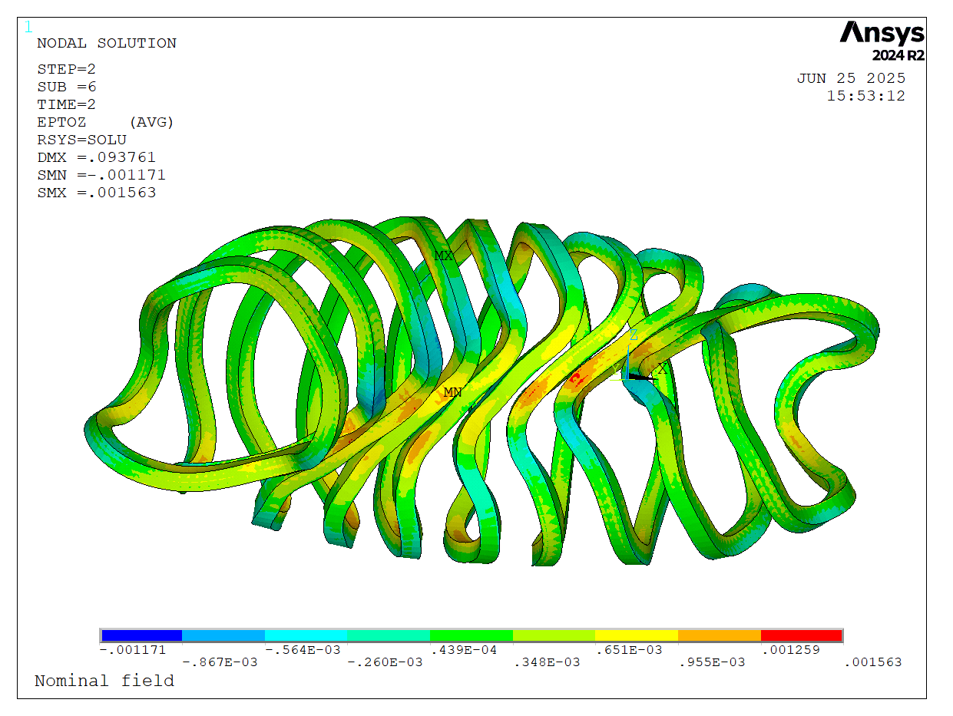
Mechanical Analysis – Winding pack
Longitudinal strain
Quantity | Value
Maximum Stress (yield strength 1GPa) | 1.23 GPa
#Nodes with stress values above 1GPa (yield strength) | 393 (0.08%)
#Nodes with stress values above 867MPa | 1460 (0.3%)
Hook’s Law
Maximum longitudinal strain lower than 0.2%

Slide 9
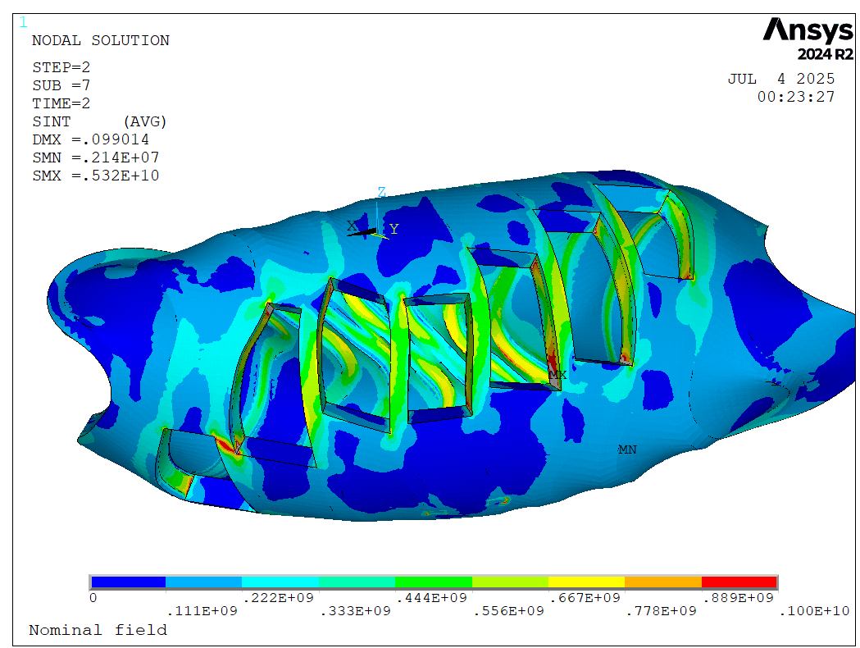
Helias Mechanical Analysis – Ports (Stress intensity <= 1GPa)

Slide 10
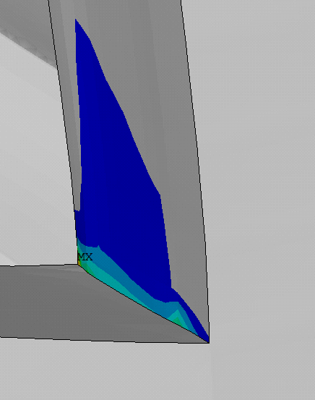
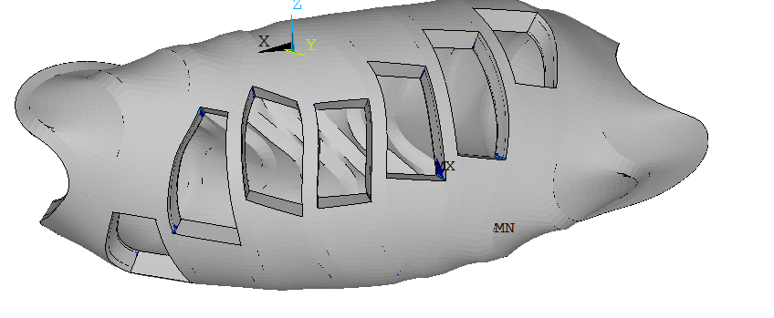
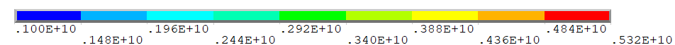
Helias Mechanical Analysis – Ports (Stress intensity > 1GPa)

Slide 11
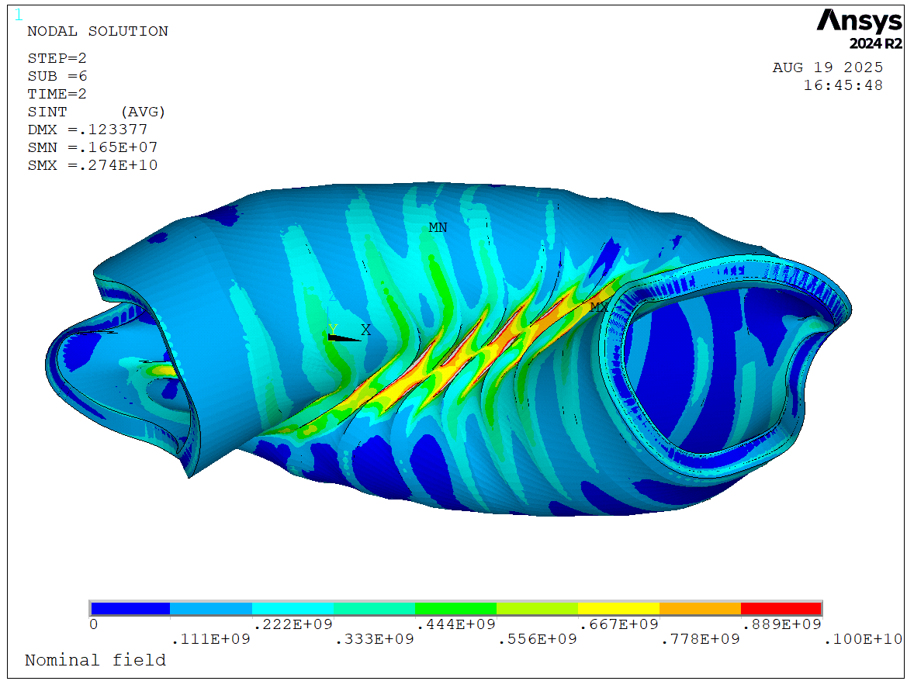
Comparison – Stress intensity
Fully bonded
Sliding contact
Stress intensity (Pa) from 0 to 1GPa (yield strength at 4.2K)

Slide 12
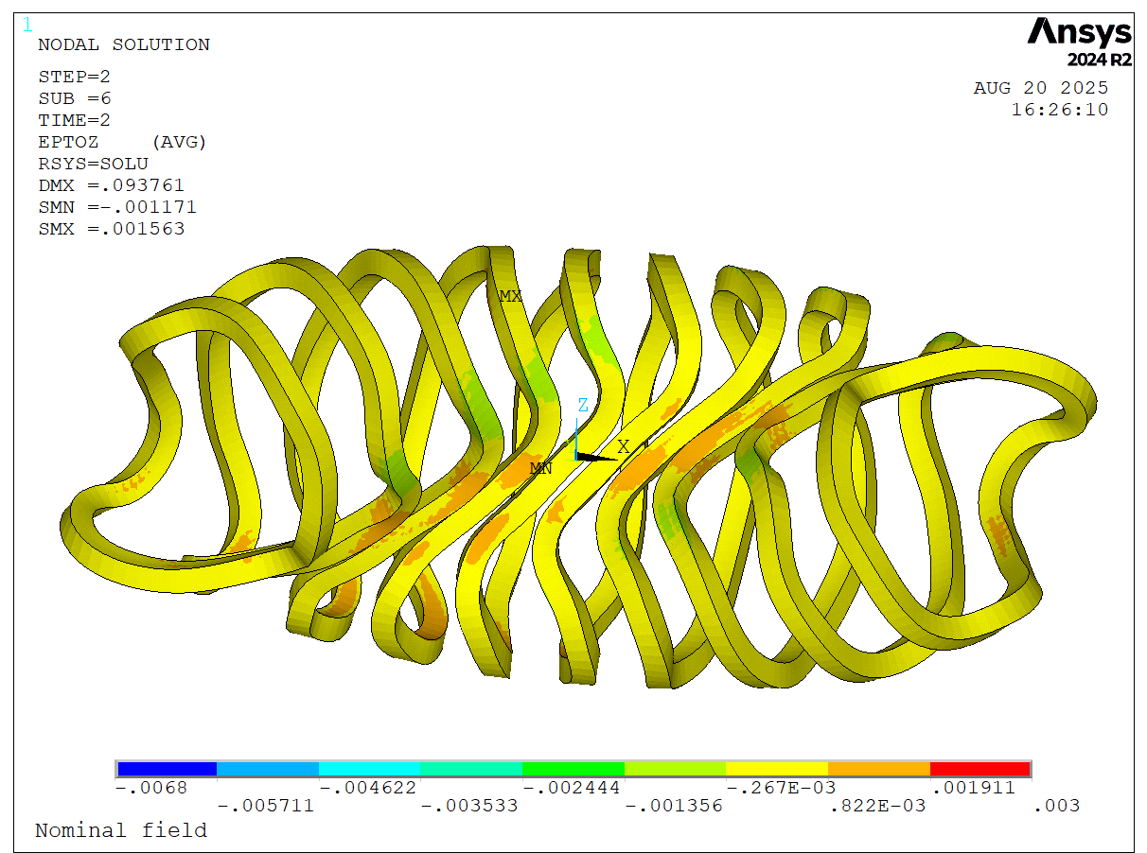
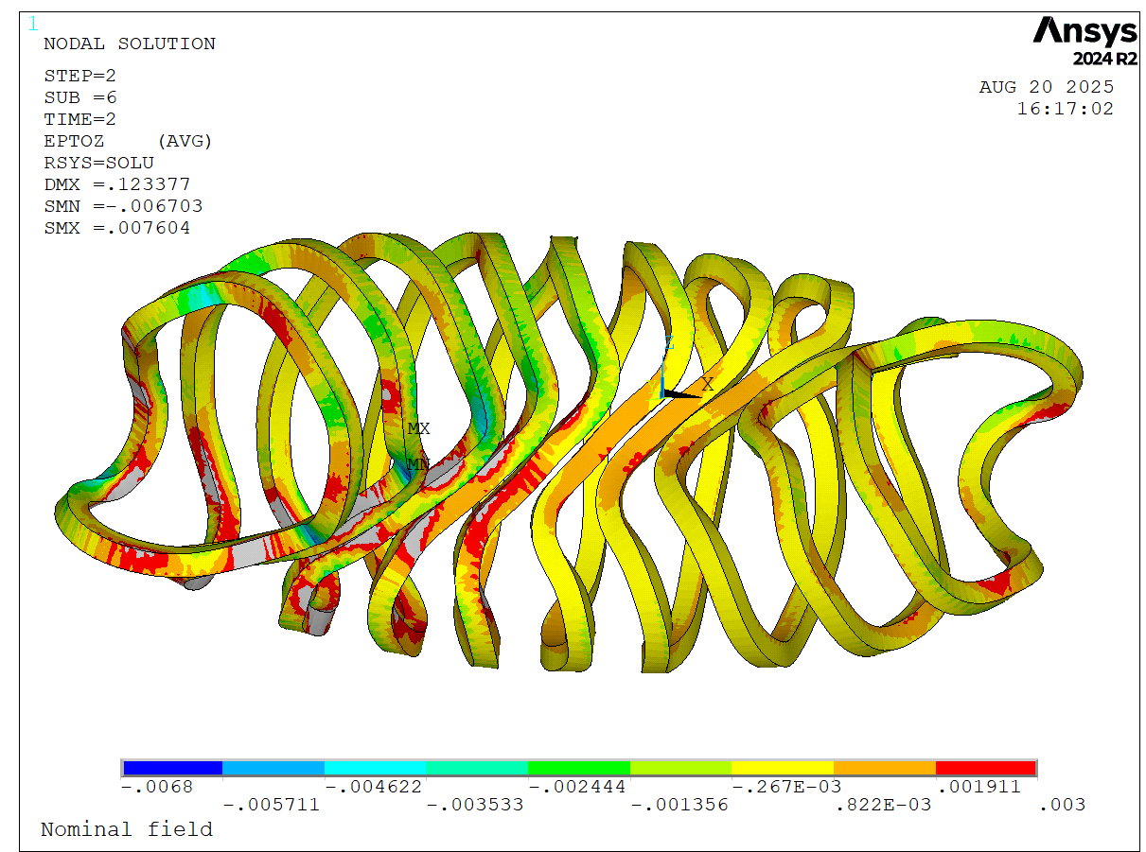
Comparison – Longitudnal Strain
Fully bonded
Sliding contact

Slide 13


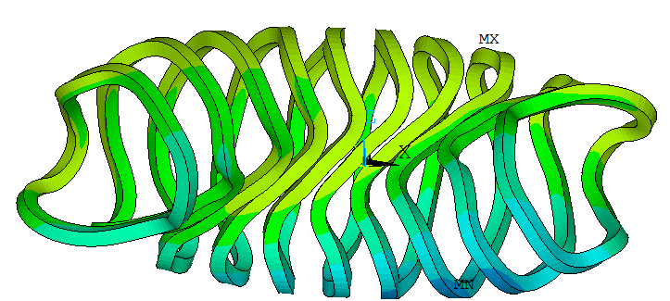
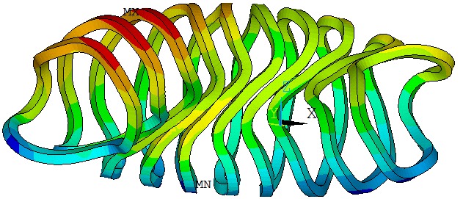
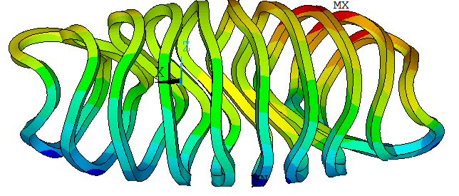
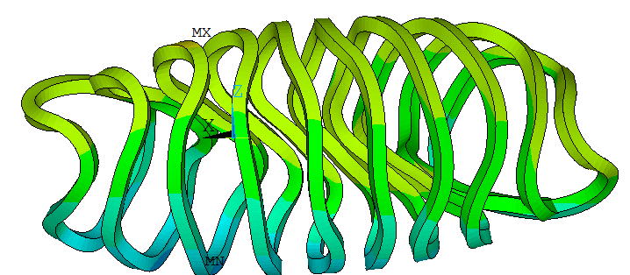
Comparison – Displacement – coil
Sliding contact
Fully bonded

Slide 14
Summary
Stress exceeds stress limit only in localized regions (edges, sharp transitions)
  Possible countermeasures: Central ring, rounding of edges
Strain is within reversible range (fully bonded case) of Nb3Sn
Including ports leads to localized high stress in the corner -> chamfers
Fully bonded vs. Sliding Contact
  Stress is similar
  Strain is higher in the sliding contact due to higher displacements
Possible measures to increase structural integrity would be adding a central support ring
Paper about the whole workflow is published [1]
Next steps: Application to a new configuration + HTS design
[1]: D. Biek et al. ‘A Parametric Workflow for the Design of High-Field Magnets for Optimized Stellarators’, IEEE Trans. Appl. Supercond., pp. 1–6, 2025, doi: 10.1109/TASC.2025.3646598.

Slide 15
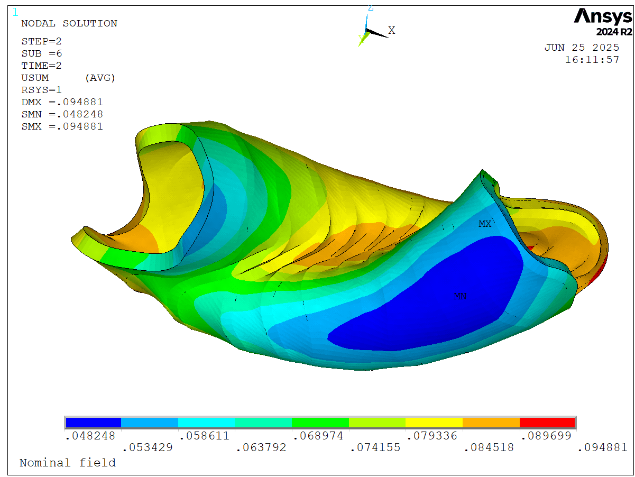
Mechanical Analysis – Displacement

Slide 16
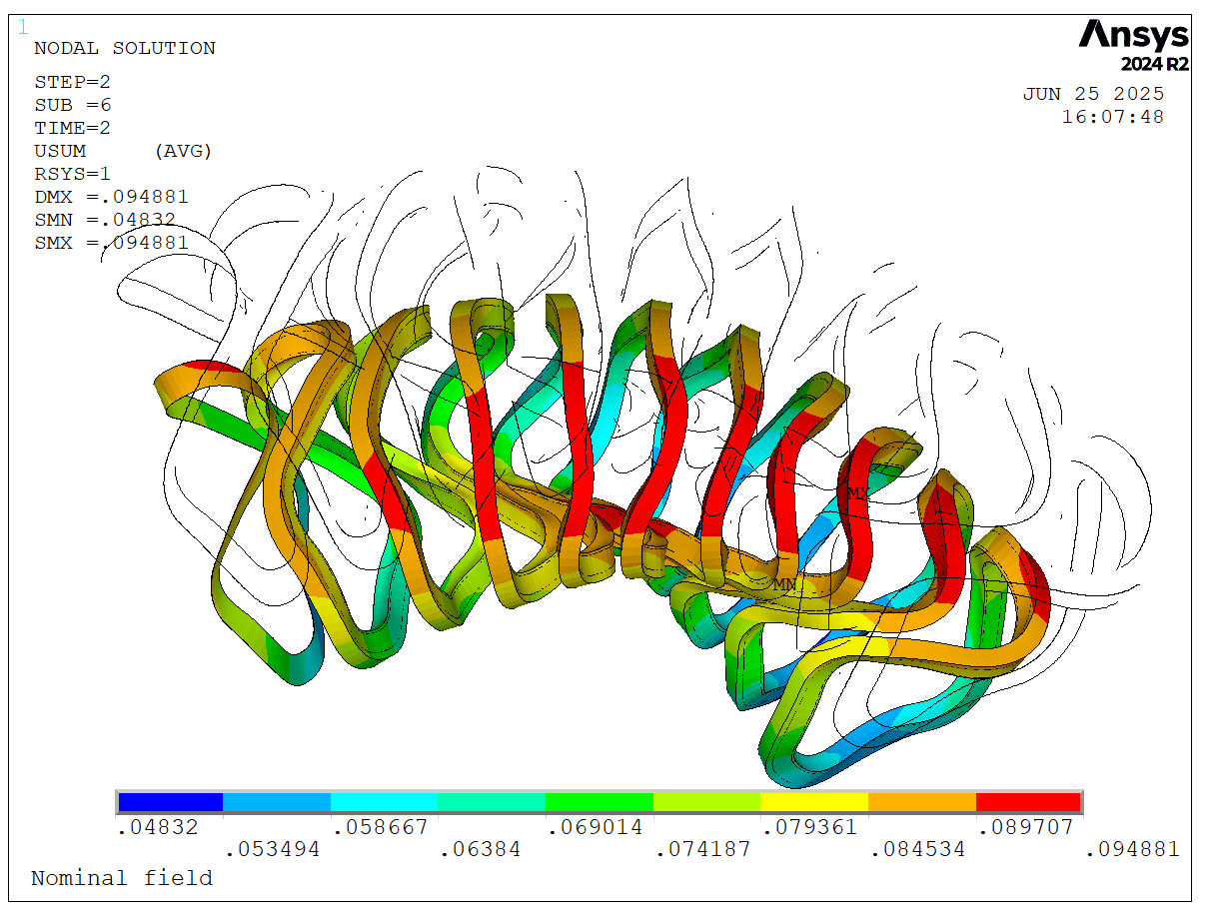
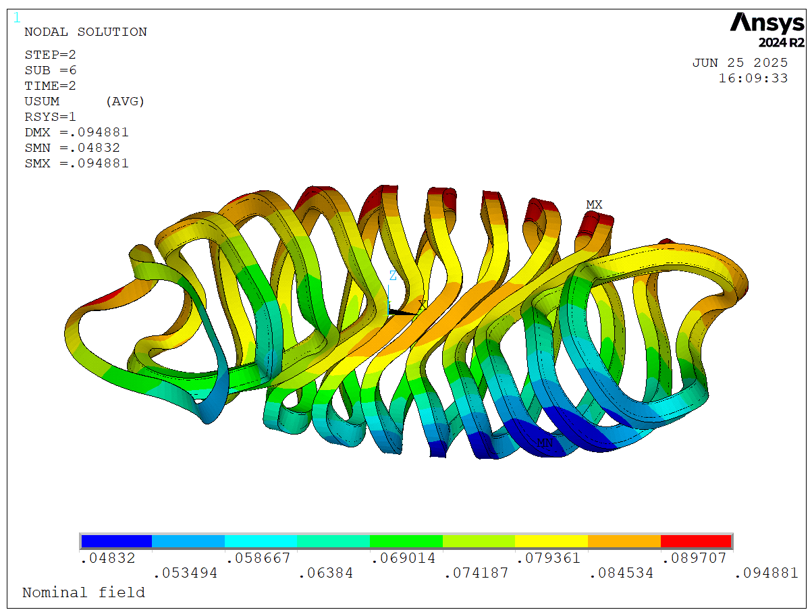
Mechanical Analysis – Displacement – Coil Case

Slide 17
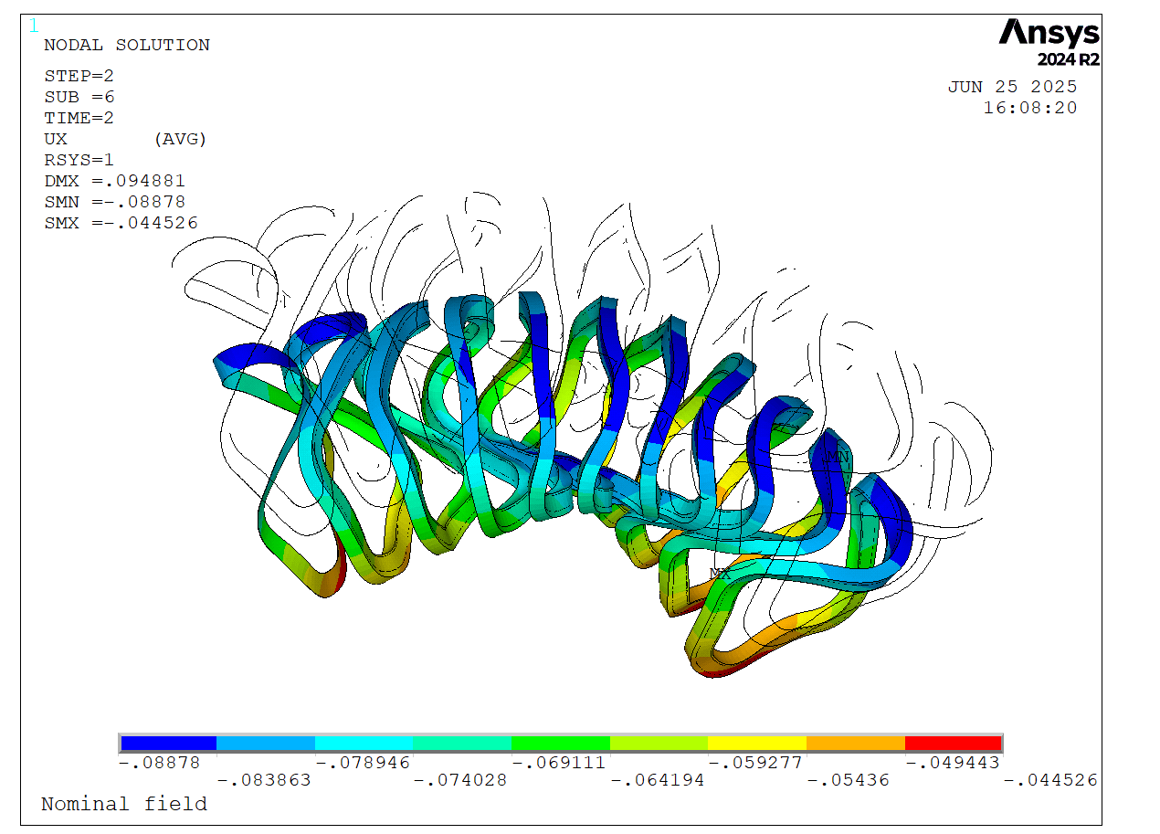
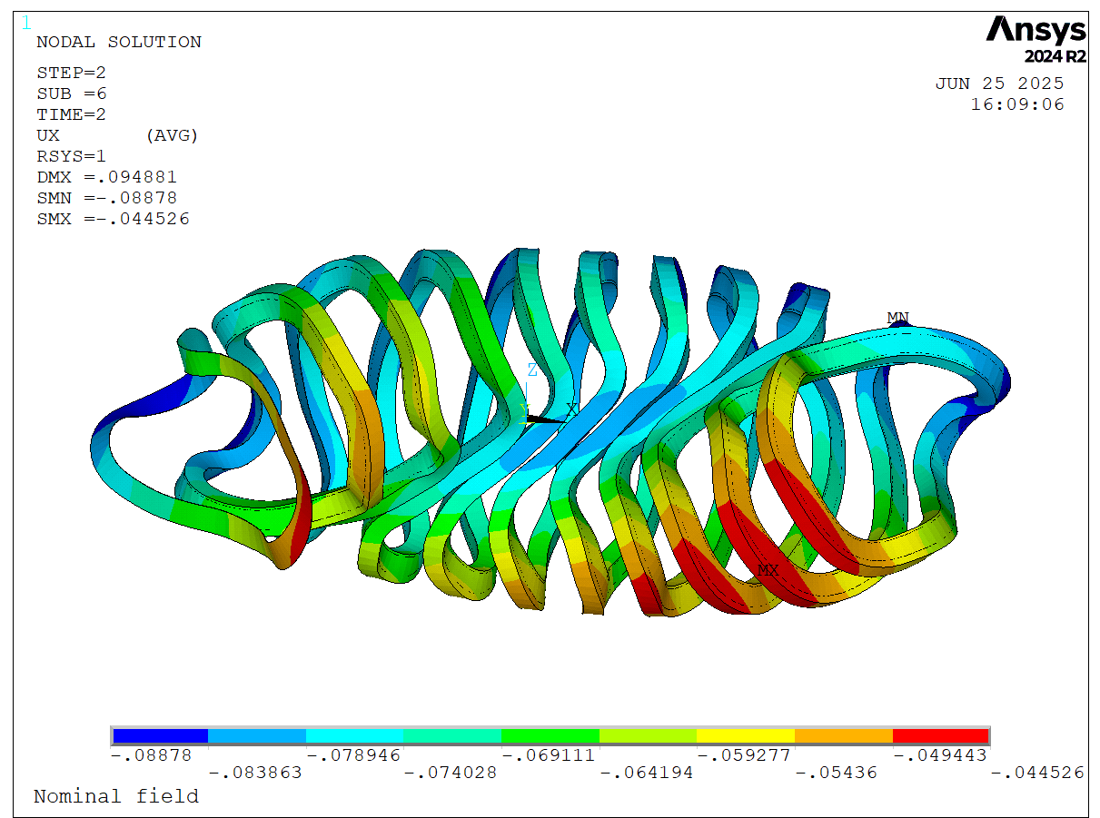
Mechanical Analysis – Radial Displacement – Coil Case

Slide 18
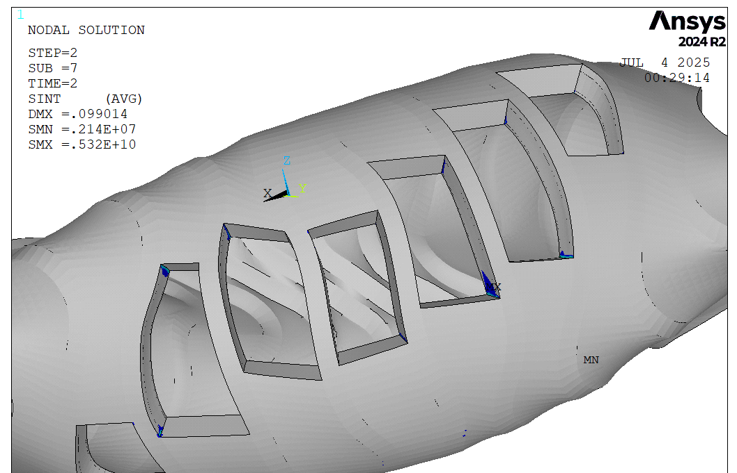
Helias Mechanical Analysis – Ports (Stress intensity > 1GPa)

Slide 19
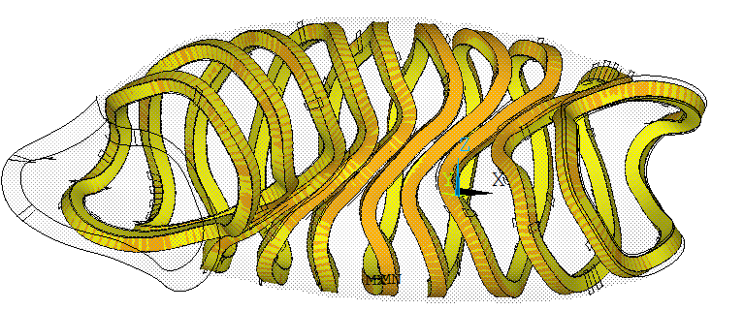
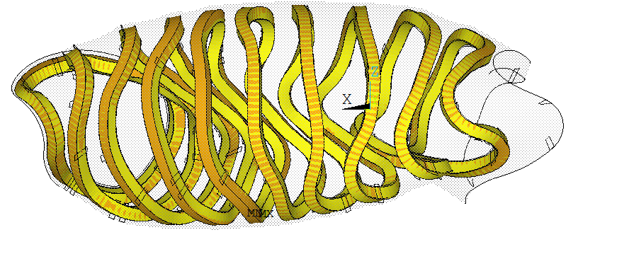
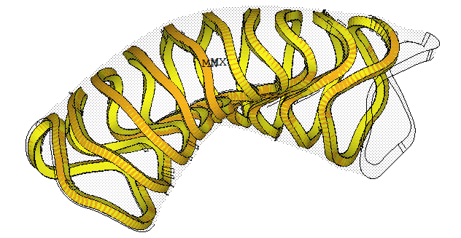
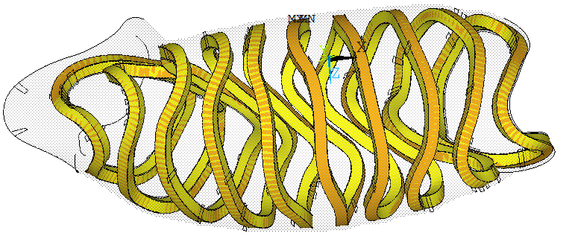

Contact – Sliding model

Slide 20
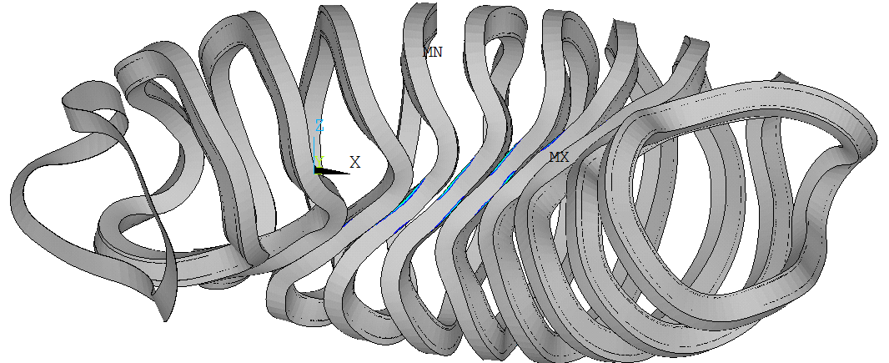
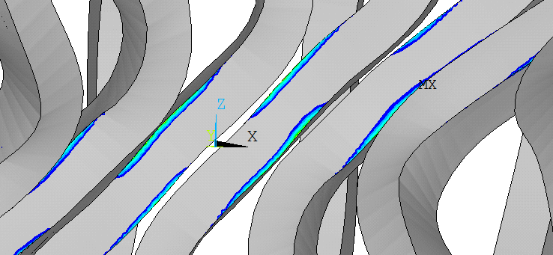
Mechanical Analysis – Stress intensity > 1GPa
Fully bonded
Sliding contact

Slide 21
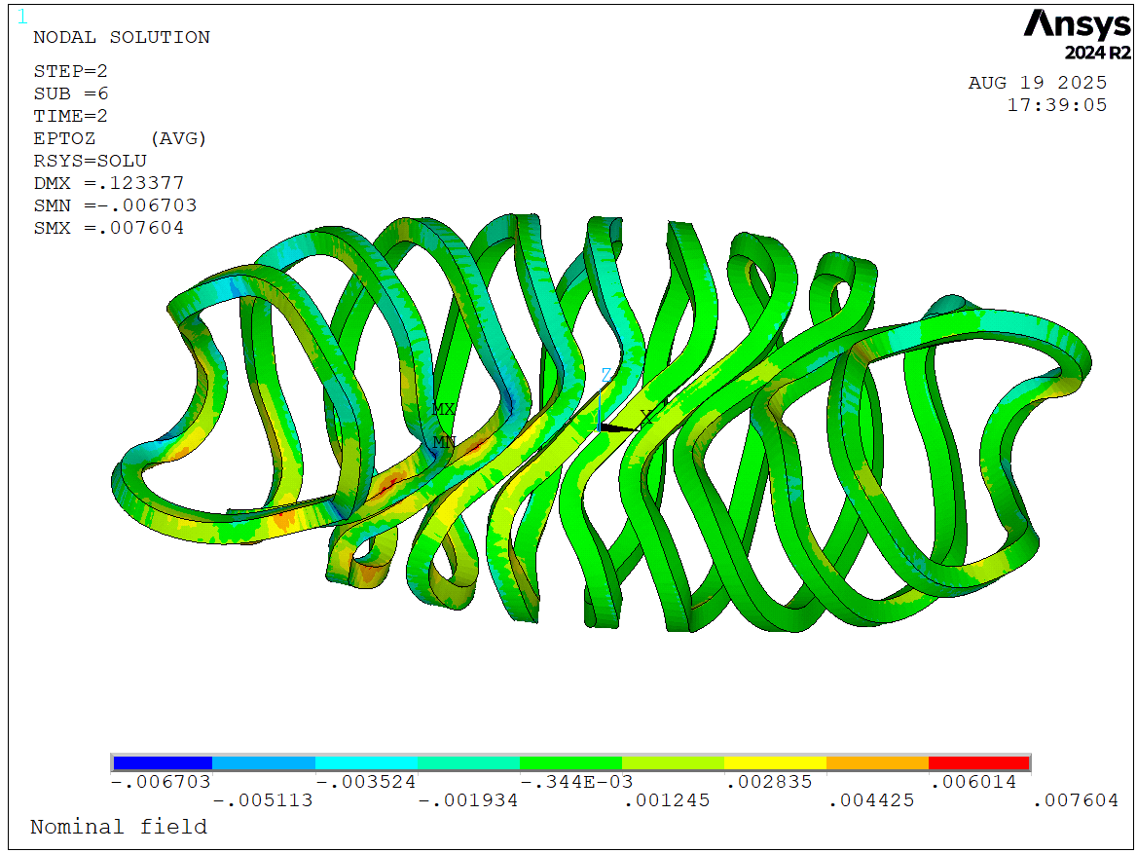
Comparison – Longitudnal Strain
Fully bonded
Sliding contact

Slide 22
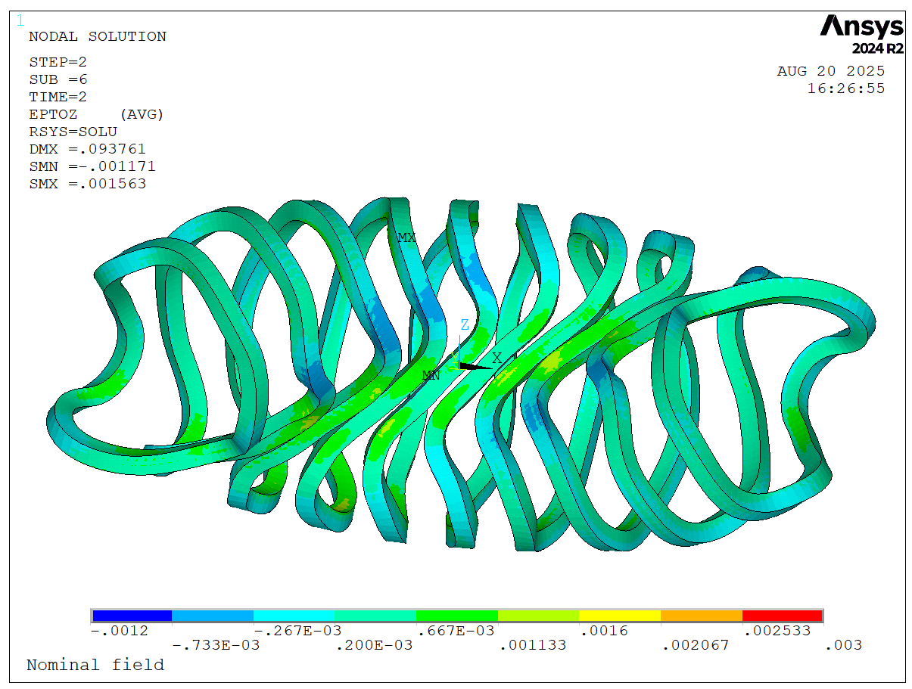
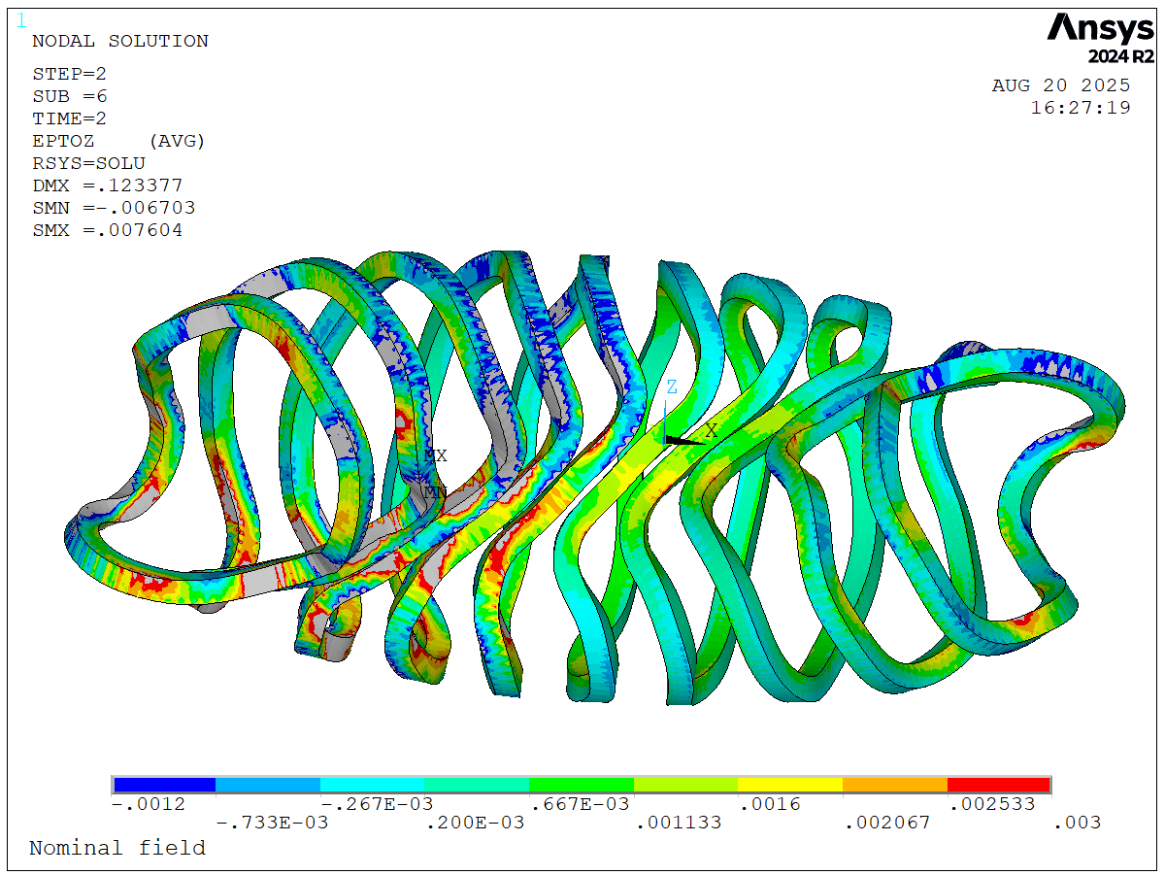
Comparison – Longitudnal Strain
Fully bonded
Sliding contact

Slide 23
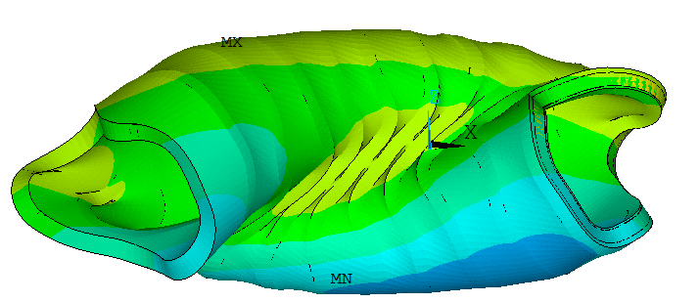
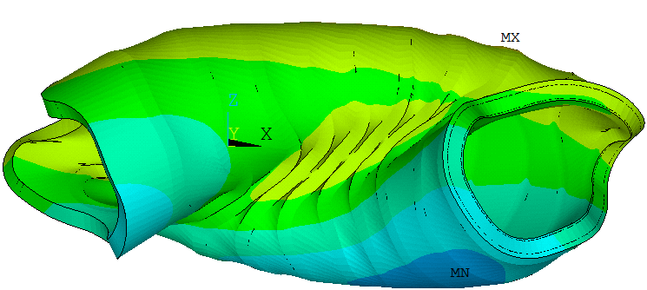
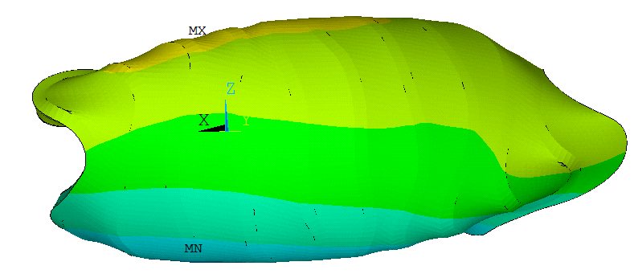
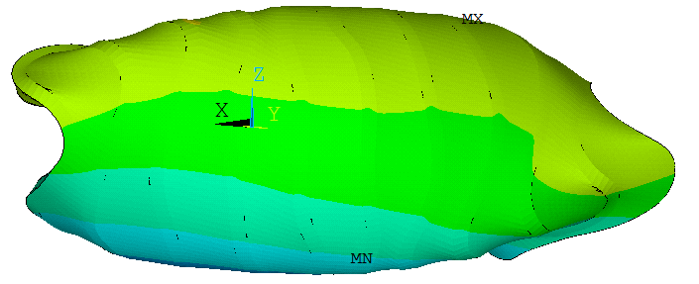
Comparison – Displacement
Sliding contact
Fully bonded

Slide 24
Comparison – Stress in the coil
Fully bonded
Sliding contact
Quantity | Value
Maximum Stress (yield strength 1GPa) | 1.23 GPa
#Nodes with stress values above 1GPa (yield strength) | 393 (0.08%)
#Nodes with stress values above 867MPa | 1460 (0.3%)
Quantity | Value
Maximum Stress (yield strength 1GPa) | 1.81 GPa
#Nodes with stress values above 1GPa (yield strength) | 598 (0.12%)
#Nodes with stress values above 867MPa | 1674 (0.34%)

Slide 25


Smeared Properties
Insulation: epoxy glass with kapton barrier
Started with calculating the smeared properties of the conductor
Using the material references from EuroFusion reports [1]
Periodic boundary condition
Void filler:
Epoxy resin
SC cable (bundle area)
Insulation
Jacket
Central
cooling
channel
$$a_{cond}$$
$$A_{bundle}$$
Steel jacket: Modified and aged SS316LN
(same as Demo TF)
[1]: F. Nunio et al.; “Reference basis for mechanical & thermal analysis of TFC”

Slide 26
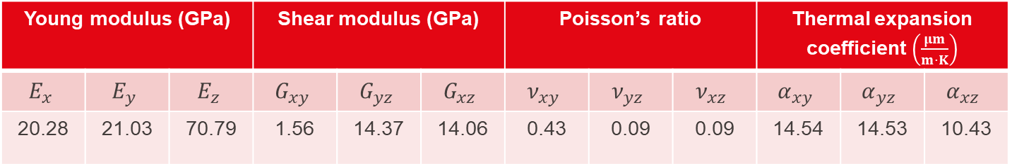
Smeared properties – Results
Young modulus (GPa) |  |  | Shear modulus (GPa) |  |  | Poisson’s ratio |  |  | Thermal expansion coefficient $\left(\frac{μm}{m⋅K}\right)$
$$E_{x}$$ | $$E_{y}$$ | $$E_{z}$$ | $$G_{xy}$$ | $$G_{yz}$$ | $$G_{xz}$$ | $$ν_{xy}$$ | $$ν_{yz}$$ | $$ν_{xz}$$ | $$α_{xy}$$ | $$α_{yz}$$ | $$α_{xz}$$
20.28 | 21.03 | 70.79 | 1.56 | 14.37 | 14.06 | 0.43 | 0.09 | 0.09 | 14.54 | 14.53 | 10.43
Direct input to the mechanical simulation
Validated by analytical calculations

Slide 27
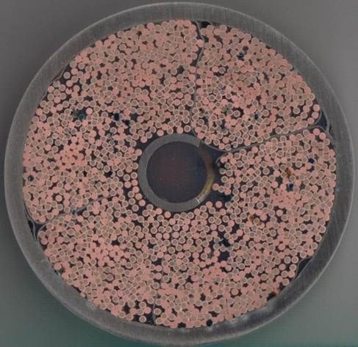
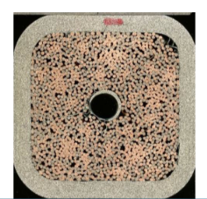

Summary
In Katheder the mass flow rate is higher as in other one
However, the difference is not as high as for example in Federica’s case
So generally, Katheder also works for my conductor
ITER
CEA
SPC
The void distribution in the last one is more systematic, whereas the others is more random
-> Katheder should be used for CICCs my “systematic” voids -> HTS conductors

Slide 28

Summary – Comparison
The BBL and LB leads to almost similar results
Katheder leads for the same void fraction to a higher mass flow rate due to the dependence on the wetted perimeter
  Lowering the wetted perimeter reduces the mass flow rate
  Higher mass flow rate -> lower operating temperature
BBL and LB are independent of the definition of the wetted perimeter and hydraulic diameter and to change the mass flow rate on parameter would be the void fraction
The new heat transfer coefficient has almost no influence on the result
The friction factor correlation for a spiral reduces the mass flow rate and therefore leads to higher operating temperature (lower $∆T$)
The temperature are still quite similar
Further investigation needed for the quench analysis

