Slide 1
IMPACT
Overview IMPACT and Time schedule
Daniela Kiselev
IMPACT Informationsveranstaltung, PSI, 17.12.2025

Slide 2
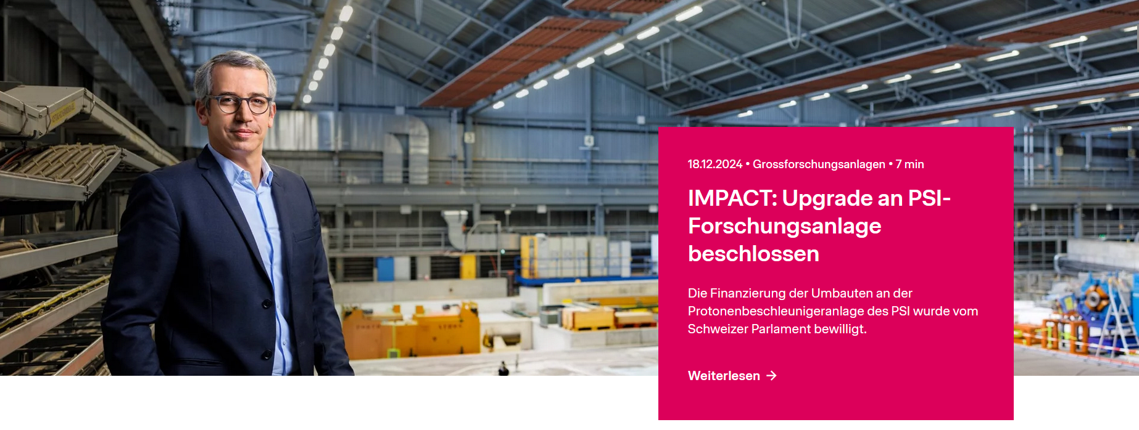
IMPACT: 18.12.24: Financing of IMPACT ensured!
By the Swiss Roadmap for Research Infrastructures 2025 – 2028
IMPACT is the large-scale project!
Project with highest strategic relevance for the period 2025–2028
(PSI Development plan 2025-2028, p. 23)
General-Anzeiger 01/2025
Priority 1 also for SLS to reach the milestone user operation (~ mid25).
potential conflict of resources for SLS/IMPACT,
especially in shutdowns
Working group under the lead of the project office (M. Lüthy):
Goal: find solutions before the problem occur
Evaluates available & needed resources
Reports on resource bottlenecks
helpful in Q1/2025 SD of SLS & HIPA (+ IMPACT prep.)
Next:
SLS SD Q1-Q2/2026
In parallel to HIPA SD + IMPACT prep. work
Notes:
SLS SD 21.12.2025 – 4.5.2026
Upcoming events:
19.3.25 13:00 for project members:
Coffee, speech of director, Info talks, apero
Sept: 25: Info for all interested employees at PSI

Slide 3
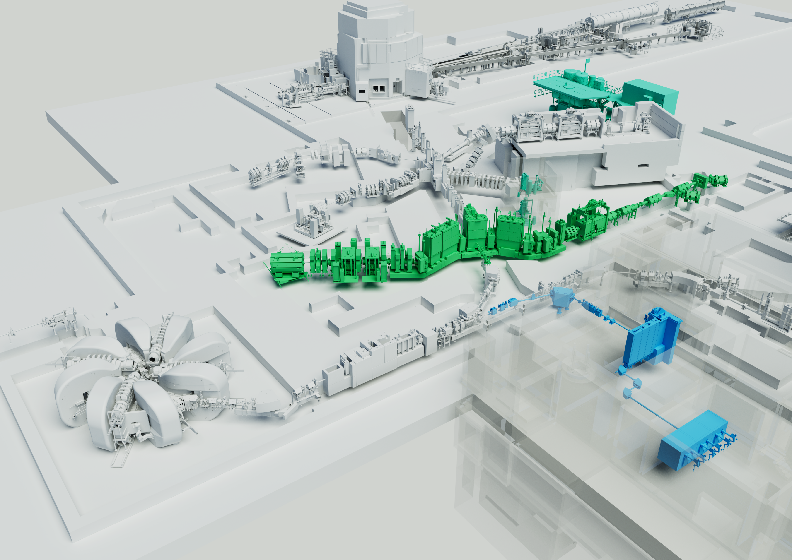
Project IMPACT = HIMB + TATTOOS
Courtesy of Mahir Dzambegovic
SINQ
New location
For He liquifier
New location for
tertiary water cycle 4 & 7
Experimental hall
WEHA
TgE
TgM→HIMB
Material science
PiM3→ MuH3
Particle physics
New beamlines MuH2&3
require extensive renovations
at WEHA with major changes
to the infrastructure
UCN
PiM1→ MuH2
590-MeV- Ring
cyclotron
100 µA
TATTOOS
> 2.2 mA protons
Life science
New building
HIMB: Muon flux * 100
10¹⁰ surface muons/s
Confirmed in realistic simulations!
only for research application
(non-commercial)
TATTOOS: Radionuclides for cancer therapy and diagnostics (clinical studies)
= “Thera(g)nostics”

Slide 4
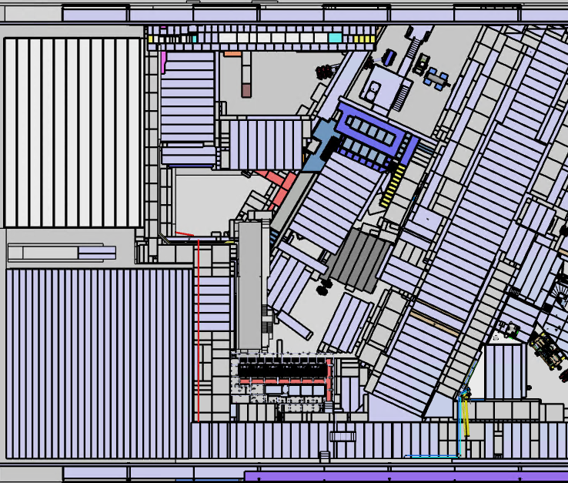
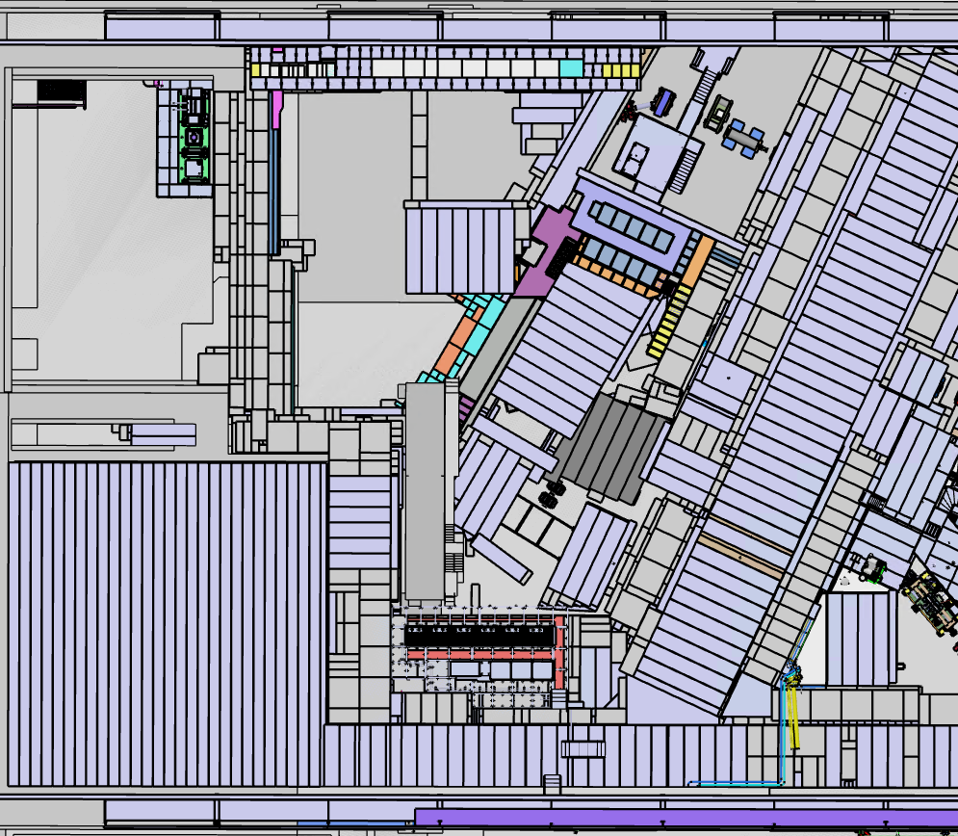
Remodelling WEHA 2026
New exit
→ Shorter emergency route
Now
End of 2026

Slide 5
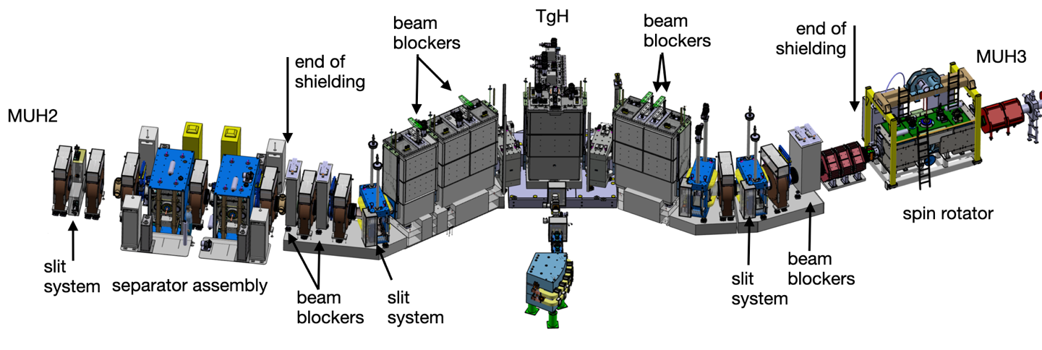
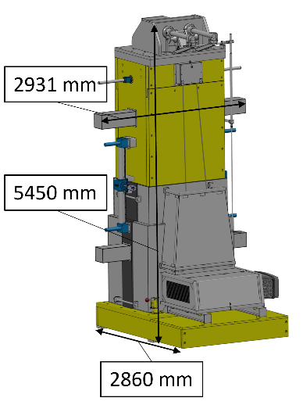
HIMB Layout (TDR): What is needed to operate HIMB & existing user facilities (→”HIPA”)
11.5 m
19.5 m
μ^{+/−}, π
28-60MeV/c
μ^{+/−}, π
28-80MeV/c
2 chicane
magnets
590 MeV
protons
in addition:
re-assembly of PK1,
MuE4 and PiE1
PK1
Within shielding:
needs to be complete for HIPA operation
Exchange
flask H

Slide 6
Timeline for final Decision Long Shutdown:
Status talks
of work packages
Pre-meeting
w. Director
Retreat
8. SteCo
PM decision
Info event (PSI)
2025 |  |  |  | 2026
Sept | Okt. | Nov. | Dez. | Jan. | Feb. | März | April
27/28.
20.
27.
10.
17.
Constraints:
CHRISP User Info
SINQ User Info
MuSR User Info
Procurement
of energy for 2027

Slide 7
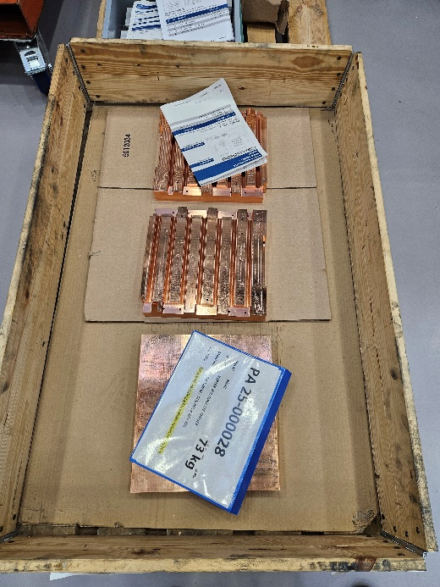
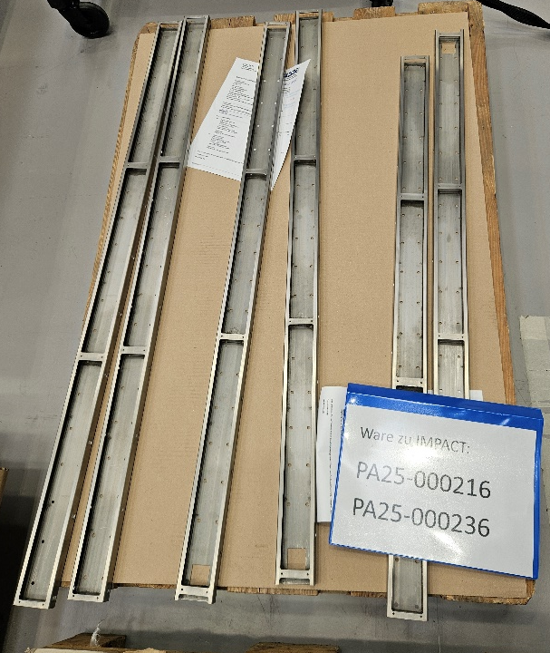
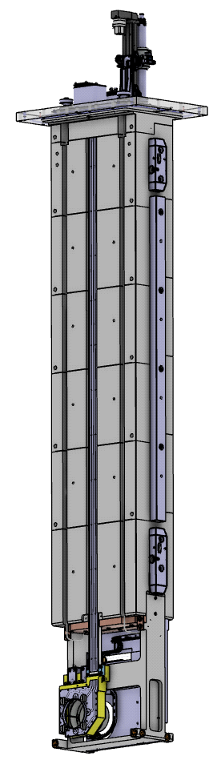
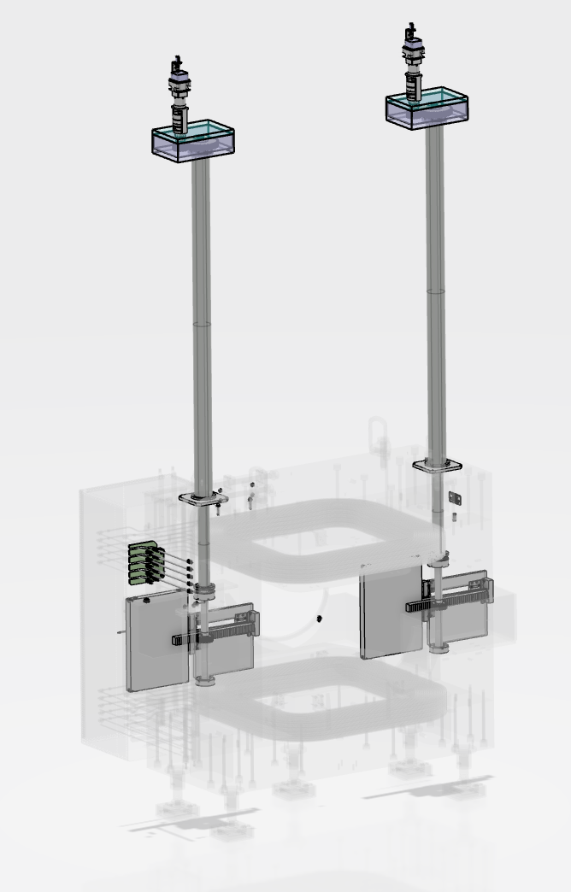
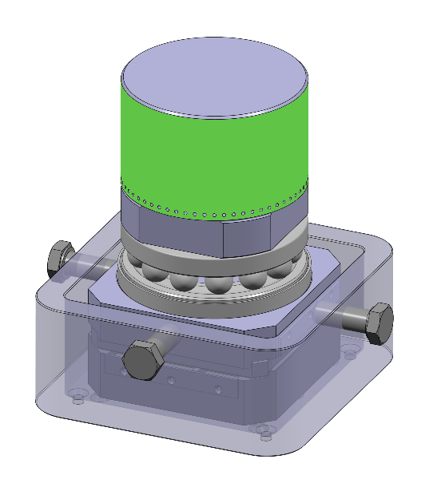
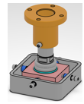
(internal) Manufacturing
3 collimators
profile&position
monitor
movable slits
in dipoles
Signal rails
Cooling plate
Collimator disks
6 types, 150 pieces
KHH0
KHH1
KHH2
MHP/S
10 t foot
50 t foot

Slide 8
Mar 31
Jan 5
Feb 16
Nov 2 '29
May 21 '30
Nov 12 - Apr 7
Sep 2 - May 30
Jan 2 - Jul 4
Dec 3 - Dec 31
Sep 17 - Jun 28
Nov 3 - Nov 30
Feb 18 - Aug 28
Apr 9 - Dec 23
Jun 2 - Oct 29
Jan 2 - Sep 7
Sep 28 - Dec 28
Jan 2 - Jun 30
May 28 - Jun 30
Mar 31 - Feb 1
Oct 18 - Dec 24
Aug 11 - Aug 11
May 31
Nov 25
Jan 4 - Dec 27
Jan 1 - Dec 15
Jan 1 - May 14
Jan 1 - May 26
Jan 1 - May 20
Jan 1 - Jul 1
Jan 1 - May 17
Jul 2 - Aug 31
Jan 7 - Aug 4
203.5 days
Jan 4 - May 3
Sep 30
Dec 2
178.5 days
219.5 days
137 days
248.5 days
103.5 days
129.5 days
262.5 days
49.5 days
99.5 days
97.5 days
149.5 days
390 days
130 days
367 days
185 days
518 days
194 days
105 days
131 days
95.5 days
44.5 days
Sep 3 '29
66 days
86 days
19 days
20 days
25 days
128 days
Dec 16
Dec 27
Jun 11
Mar 31
523 days
Jan 1
Feb 1
Jul 9
Nov 9
2026
2033
Today
2033
Oct 2 '27
Time schedule IMPACT & Milestones
+ 1y
LSD: shift by 1 y due to late delivery of essential components
2026
Oct 2
2027
2028
2029
2030
2031
2032
Q1
Q2
Q3
Q4
Q1
Q2
Q3
Q4
Q1
Q2
Q3
Q4
Q1
Q2
Q3
Q4
Q1
Q2
Q3
Q4
Q1
Q2
Q3
Dec 1
Q4
Q1
Q2
Oct 16
Q3
Q4
Q1
Milestones
Start Shutdown
User Op
HIMB Beam
User Op. HIMB
TATTOOS Concept
PSI Decision Building
Building appl.
Start Construction
TATTOOS Beam
Pre-Assembly
First p-Beam on TgH
1.7.2029
Exchange Flask Tests
Mar 16
.
ATEC Tests
18 Monate
HIMB
SD '26
SD '27
Feb 11
Long Shutdown
.
SD '30
SD '31
SD '32
Dismounting
Jun 13
Installation
Beam Com
Bl. Dism.
Tg M Dismantled
Start HW Comm.
Start User Op.)
Start Tg M Dism.
Oct 15
Sep 3
Start Installation
Building Planning & Tendering
Building Construction
interior finishing
Building Pre-Project
.
.
TATTOOS
Building
UCN & Site preparation
.
Excavation pit incl. pillars
Connection HIPA - TATTOOS
Removal WMFA
TATTOOS Installation
Closing UCN Wall
Jan 2 - Jun 30
TATTOOS Comm.
Jul 2 - Dec 31
Jan 1 - Jan 1
Shielding P-channel
Pre-SD for UCN, PiM1, PiM3, MuE4

Slide 9
Pre-assembly before final installation
Consisting of : 5 vacuum chambers (BIG5) + inserts
+ 2 dipoles (ASP, ) incl. chamber
+ pillow seals
Additional time will be used for intensive tests
(vacuum, functioning) and pre-alignment
Advantages:
Pre-alignment of inserts in vacuum chamber
→ saves time later
Faster installation on p-channel
→ reduces personal dose
Early detection of failures (fitting, functioning)
→ avoiding delays during installation
Important;
Adjustments or mechanical refinishing are not possible
after irradiation due to high dose
Remark: No test of exchange flask possible
due to floor load
Notes:
not tested: Heating of the coil in vacuum chamber and possible influence on alignment
not clear;

Slide 10
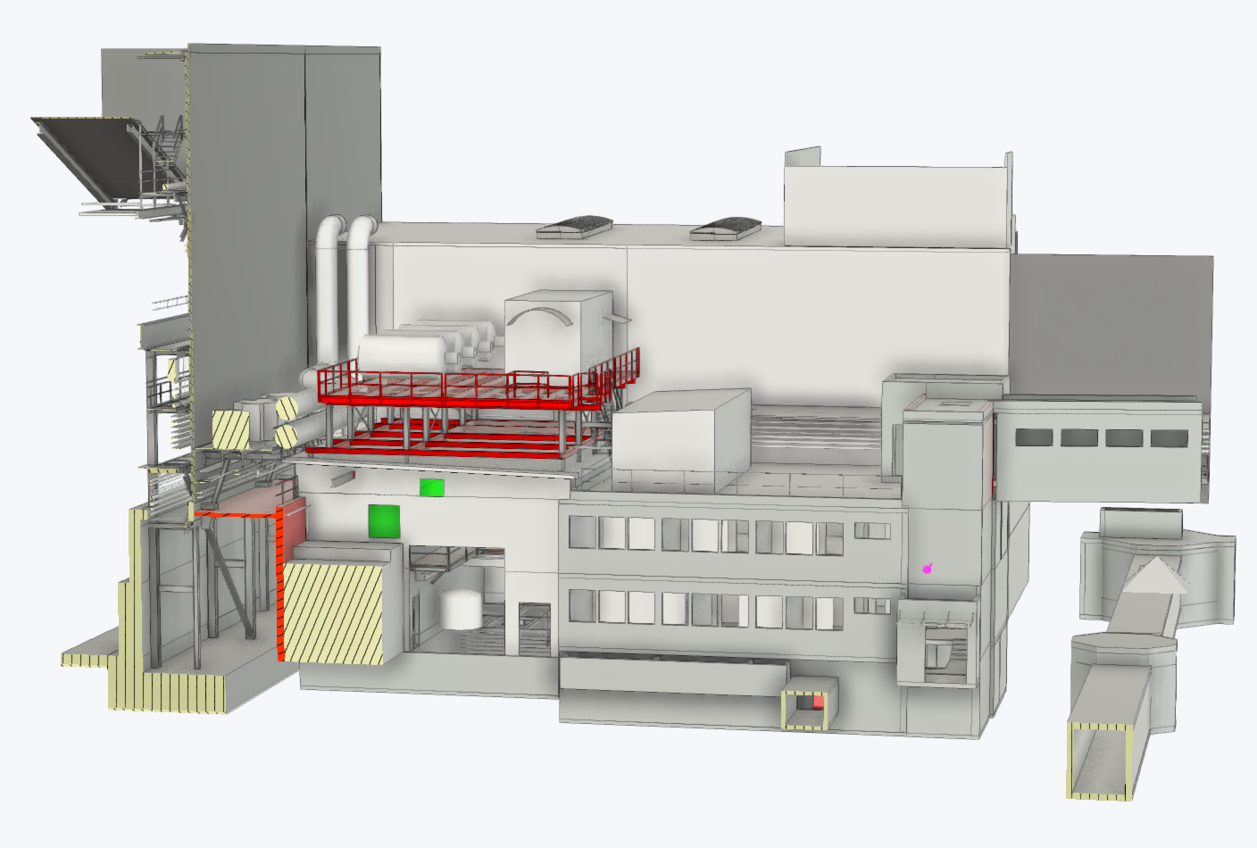
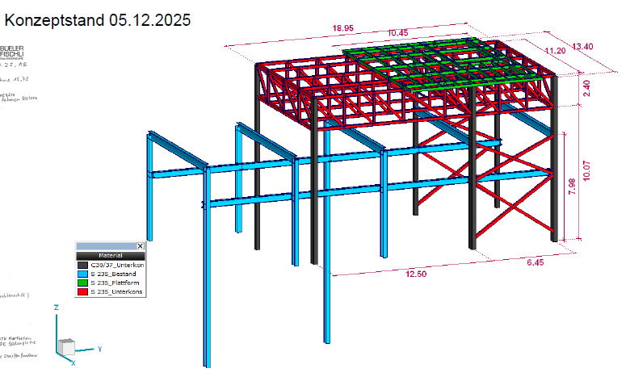
Site preparation: Making space for TATTOOS WMFA → TATTOOS building
Moving D₂-platform (50.5 t, red. 46.2 t) on UCN hall roof (WNAB) –> requires reinforcement & large crane (due to distance)
WNAB
Moving Proscan
ventilation
Relocation of
transformers
WMFA
In addition:
Moving control room UCN to WNAB
Office, Labs WMFA → WLGA
Many electr. & cooling
infrastructure to be moved
Shielding blocks & He compressors dismantled 2024
Dismantling Media channel
Media tunnel
PSI Center for Accelerator Science and Engineering
Notes:
Trafos: neue Plattform zwischen Speisgebäude und WEHA
Schwerster Kran Schweiz: 110 t Last, 52 m Ausleger

Slide 11
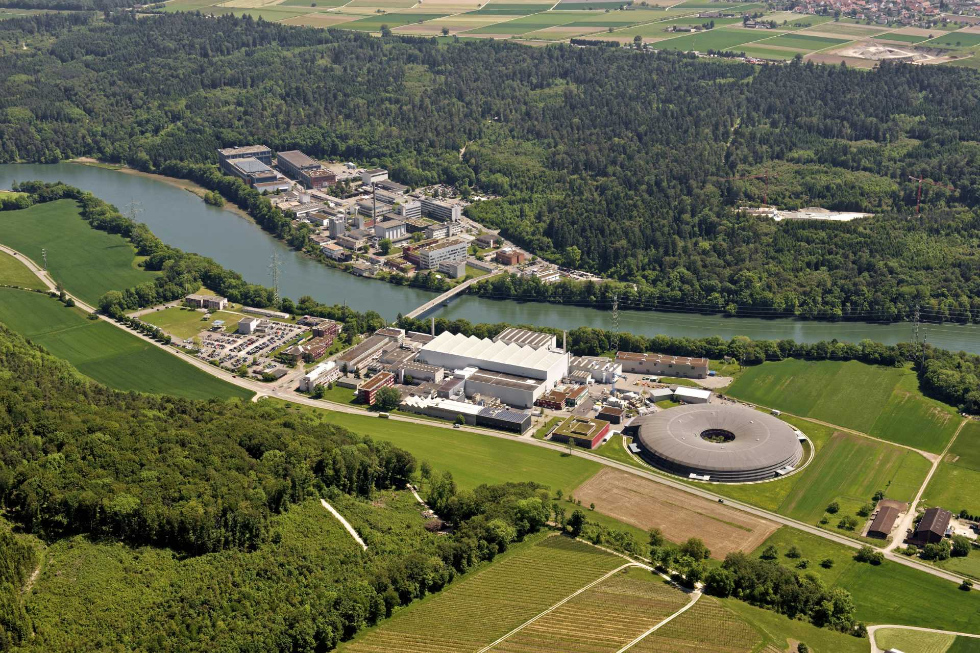
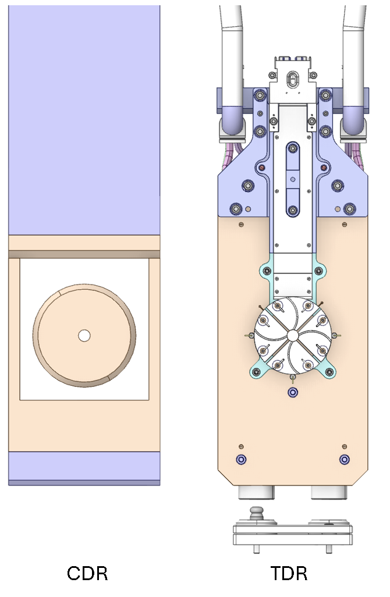
Summary
Decision for shifting the long shutdown by 1 year. Beam on TgH: 1.7.2029
Time will be used for intensive tests of equipment.
Many infrastructure work to make space for HIMB and TATTOOS.
All goals like muon flux 10¹⁰/μ/s confirmed by realistic simulations.
Great progress on the HIMB design moving from CDR to TDR
(Link coming soon).
Introduction to the PSI High Intensity Proton Accelerator (HIPA)
Extraction from the Ring Cyclotron
Beam transfer to the meson production targets M/E and SINQ spallation source
Beam diagnostics for setup & optimization
Feasibility study of beam rotation for SINQ
Beam switchover to the UCN source
Conclusion
https://www.psi.ch/de/impact
CDR
TDR
Thanks to all contributing to IMPACT

Slide 12
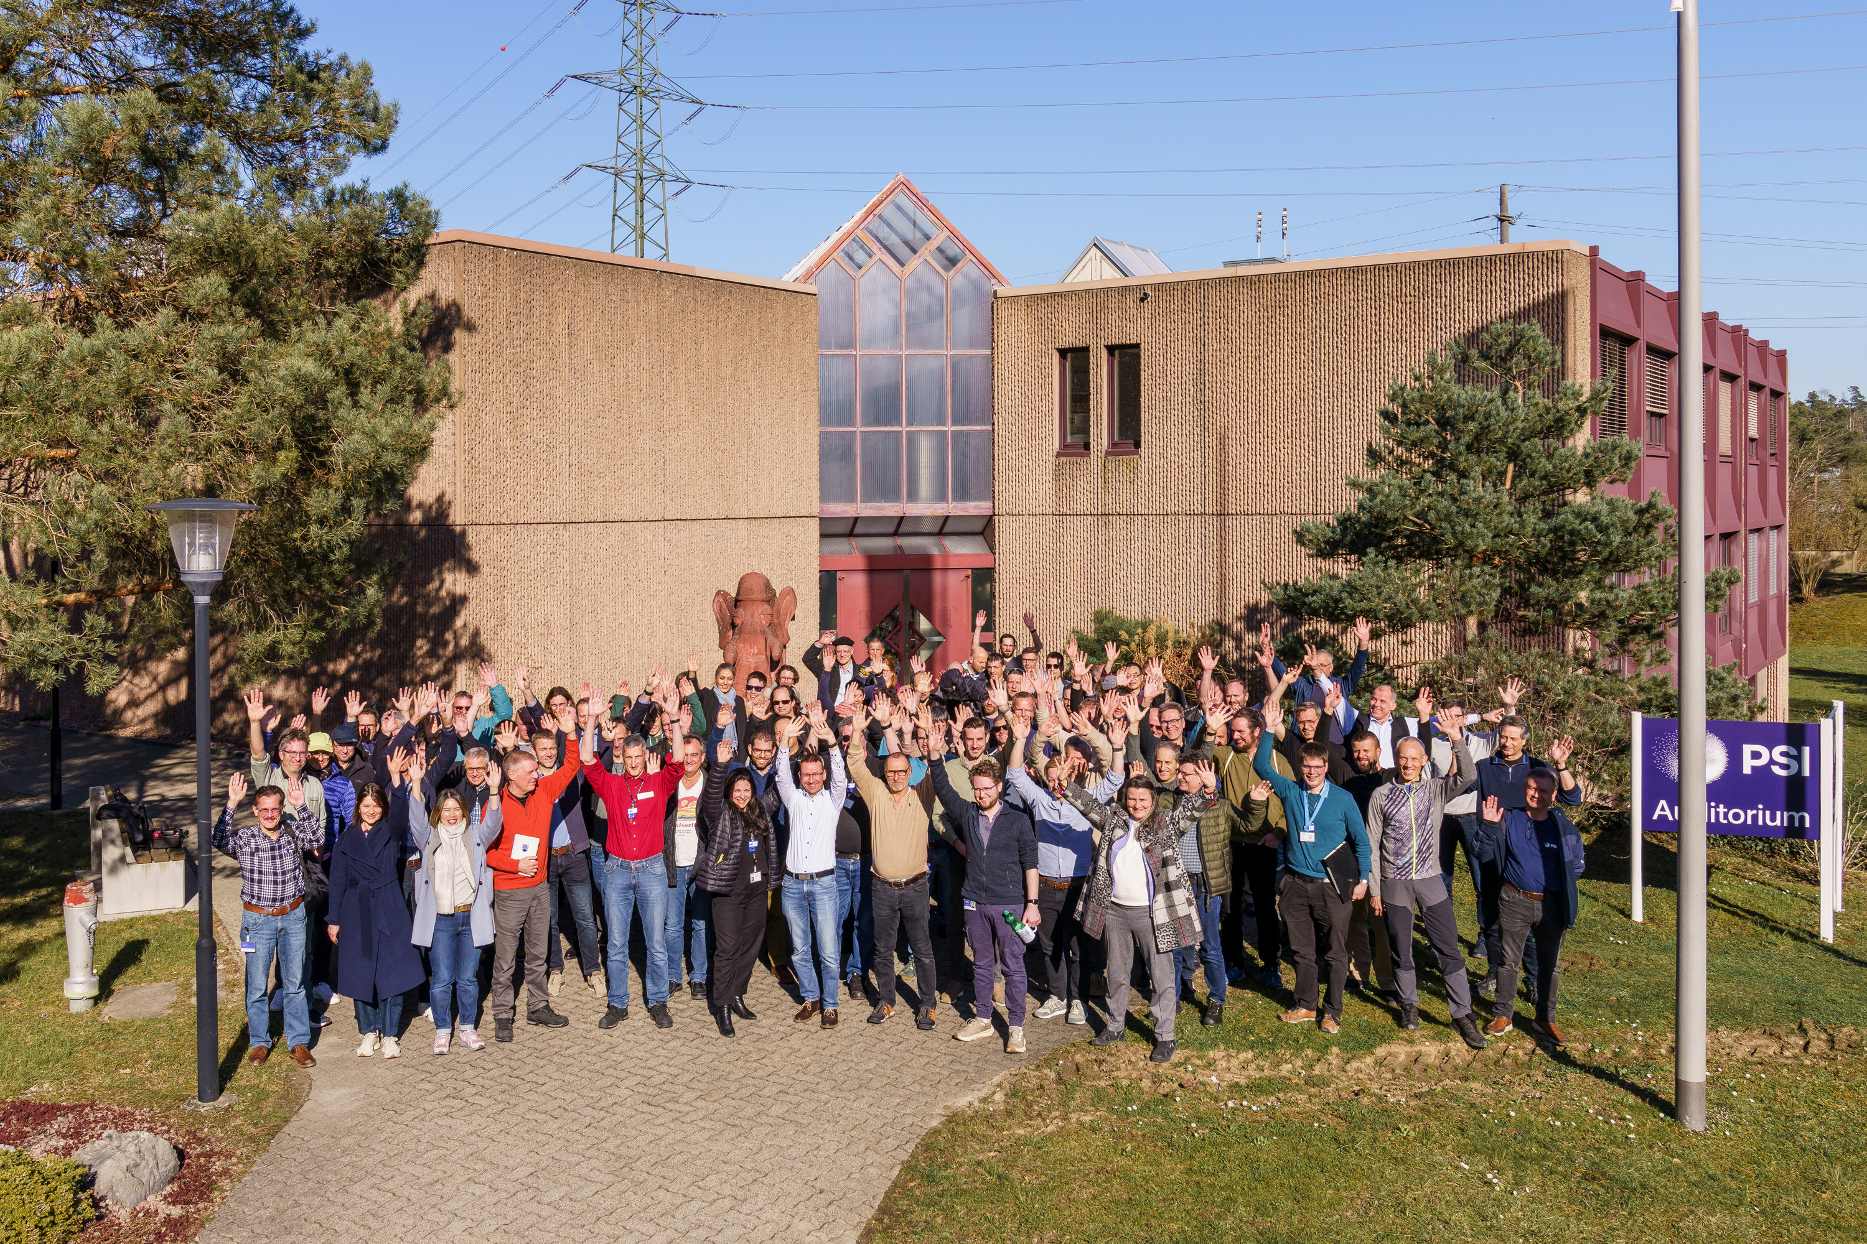
IMPACT Collaboration event (19.3.2025)

Slide 13
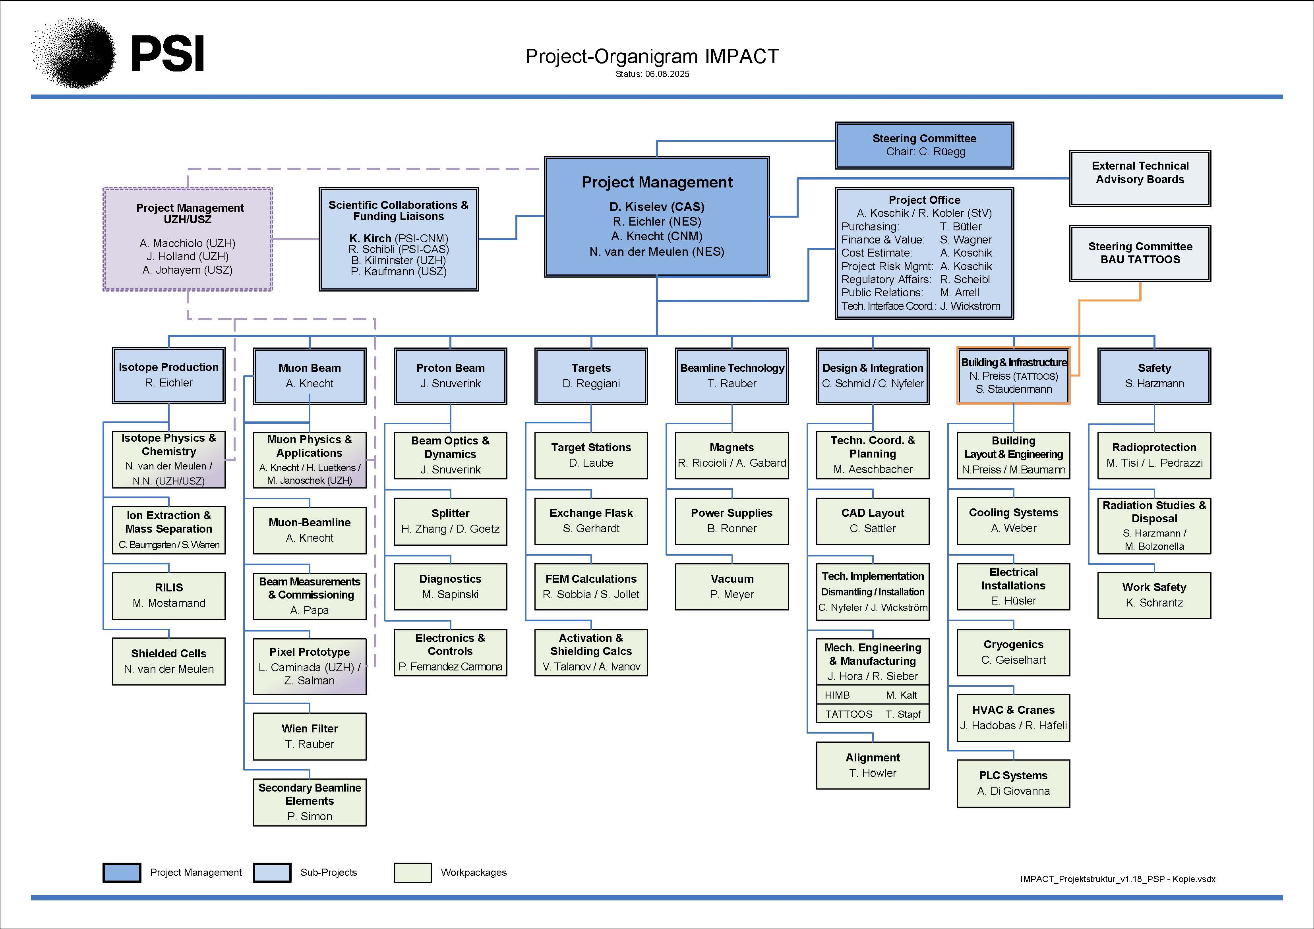
Organisation/Project structure IMPACT
5 centers involved!
CAS
CCS
CLS
CNM
NES
+ UZH & USZ:
no extra financial support
for IMPACT
Contribution UZH, USZ: Detector lab Demeter + Infrastructure for preparation of medical radionuclides
External Advisory Committees (EABs) for HIMB and TATTOOS: twice/year (each)

Slide 14
Steps on the way to approval and financing
April 2021 2-page proposal: «Motivation & Intention», 1. cost estimate
Dez. 2021 SNF-Proposal: scientific motivation
Klaus Kirch, Roger Schibli, Ben Kilminster (UZH), Philipp Kaufmann (USZ)
Jan. 2022: Conceptional Design Report https://www.dora.lib4ri.ch/psi/islandora/object/psi%3A41209
July 2022: Scientific evaluation best marks!
Dec. 2022: Evaluation of techn. feasibility + finances
→ ETH Board recommends IMPACT for Swiss Roadmap
June 2023: Publication of Swiss Roadmap
Jan. 2024: Implementation plan
Timeline, planning, spending profile, organization
March 2024: ETH Board supports financing of IMPACT
Swiss Roadmap .....
Swiss Roadmap for
Research Infrastructures
2025-2028 ERI Dispatch
Final step:
Dec. 24: Decision of Swiss parliament about funding in 2025-2028
Seite 14

