Slide 1
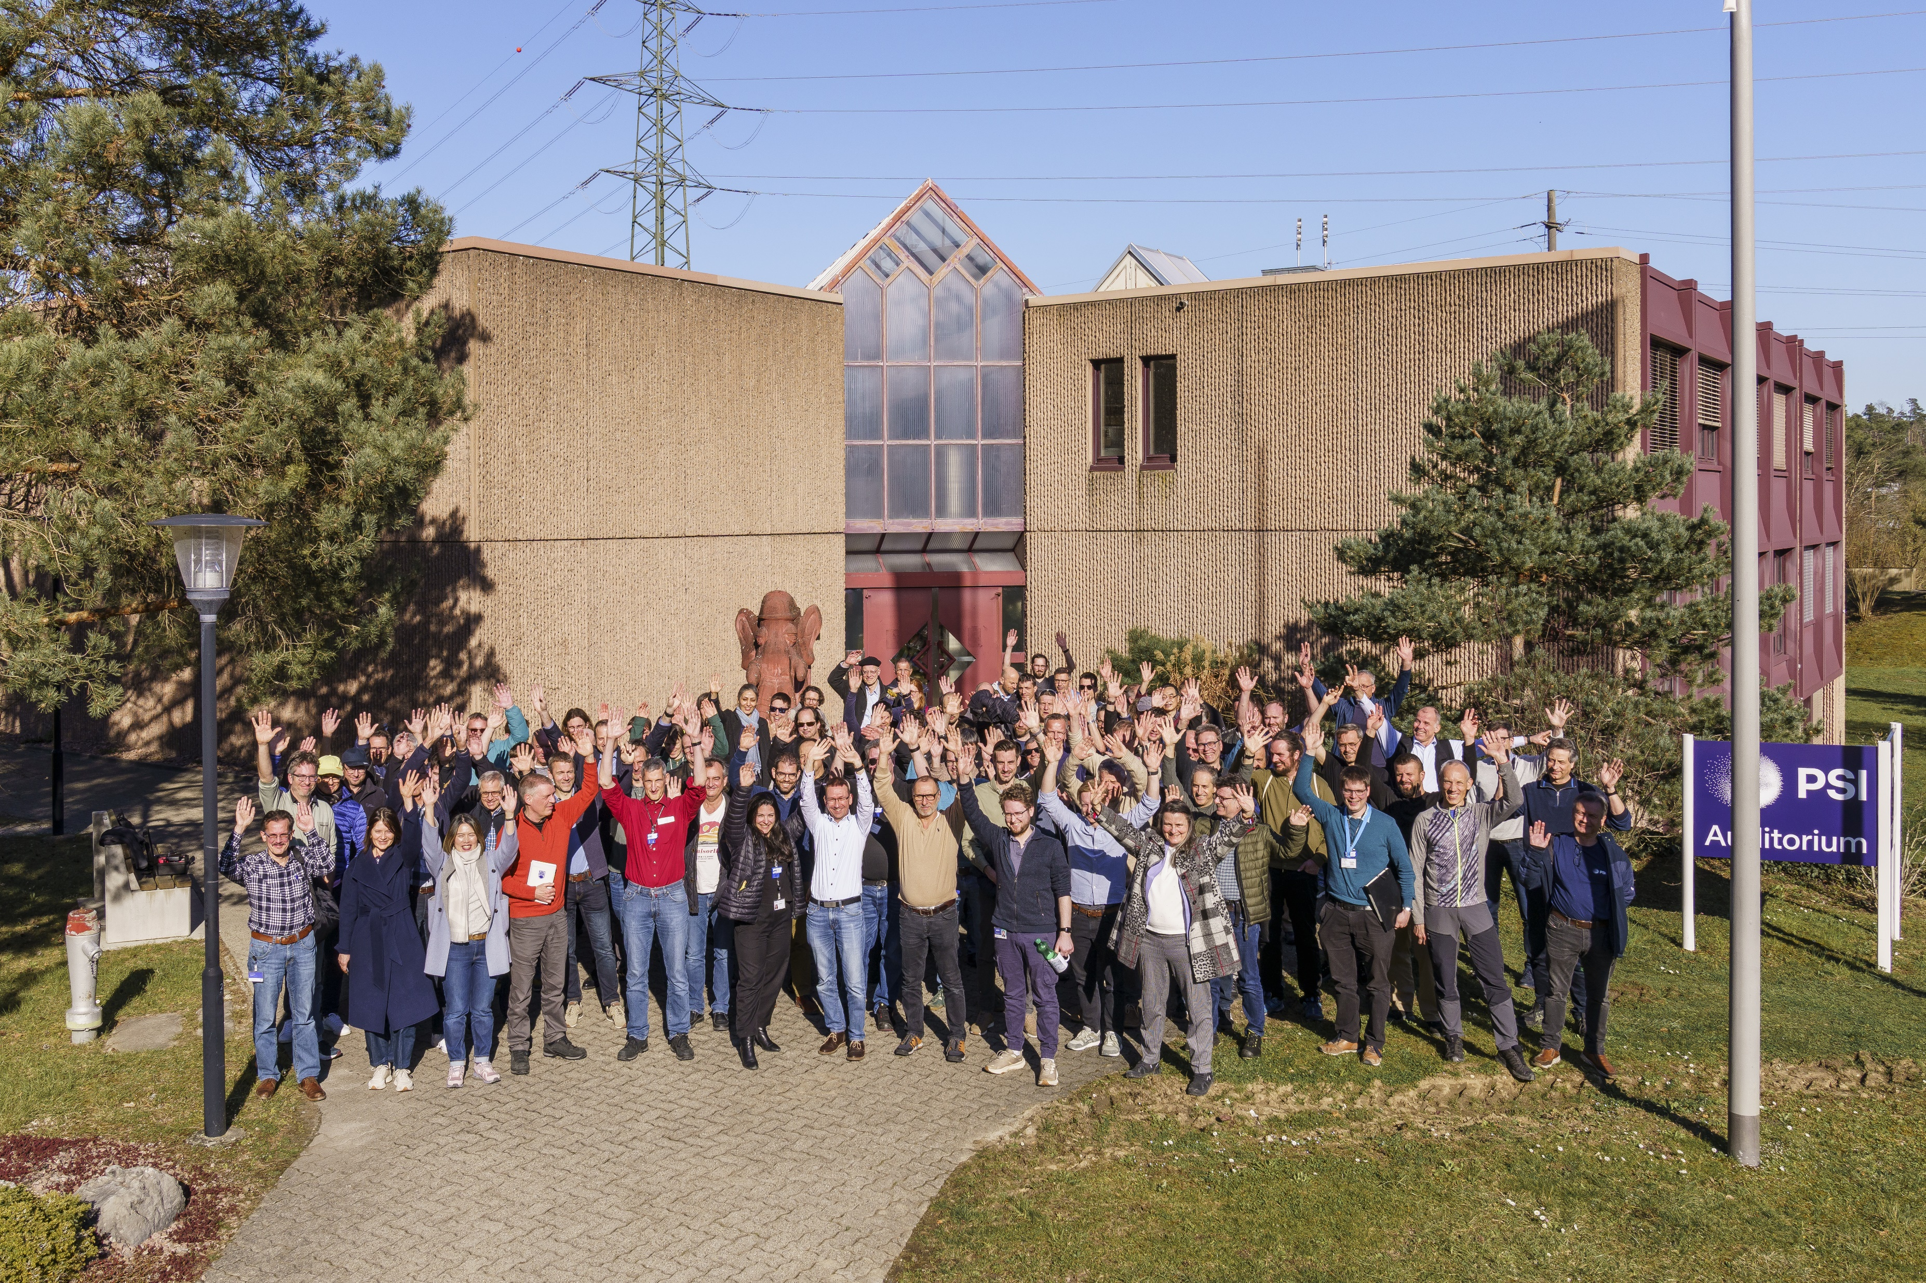
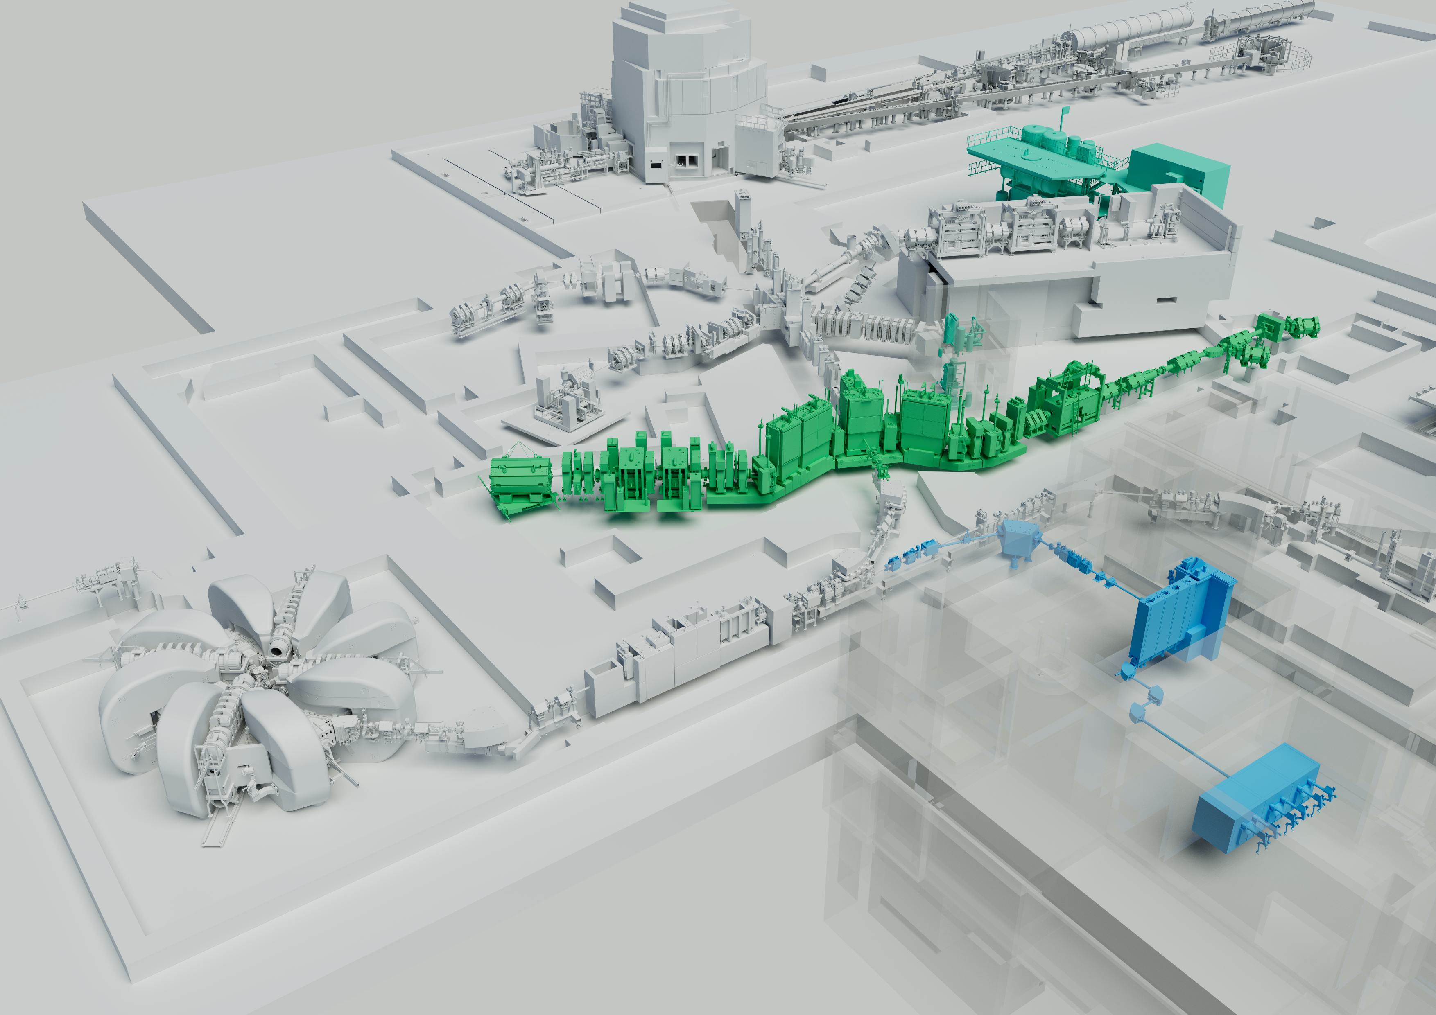
Status TATTOOS and preparatory work
Status 12/25
Robert Eichler :: On behalf of the team
Villigen PSI, IMPACT INFO Event, 17. December 2025

Slide 2
Mar 31
Jan 5
Feb 16
Nov 2 '29
May 21 '30
Nov 12 - Apr 7
Sep 2 - May 30
Jan 2 - Jul 4
Dec 3 - Dec 31
Sep 17 - Jun 28
Nov 3 - Nov 30
Feb 18 - Aug 28
Apr 9 - Dec 23
Jun 2 - Oct 29
Jan 2 - Sep 7
Sep 28 - Dec 28
Jan 2 - Jun 30
May 28 - Jun 30
Mar 31 - Feb 1
Oct 18 - Dec 24
Aug 11 - Aug 11
May 31
Nov 25
Jan 4 - Dec 27
Jan 1 - Dec 15
Jan 1 - May 14
Jan 1 - May 26
Jan 1 - May 20
Jan 1 - Jul 1
Jan 1 - May 17
Jul 2 - Aug 31
Jan 7 - Aug 4
203.5 days
Jan 4 - May 3
Sep 30
Dec 2
178.5 days
219.5 days
137 days
248.5 days
103.5 days
129.5 days
262.5 days
49.5 days
99.5 days
97.5 days
149.5 days
390 days
130 days
367 days
185 days
518 days
194 days
105 days
131 days
95.5 days
44.5 days
Sep 3 '29
66 days
86 days
19 days
20 days
25 days
128 days
Dec 16
Dec 27
Jun 11
Mar 31
523 days
Jan 1
Feb 1
Jul 9
Nov 9
2026
2033
Today
2033
Oct 2 '27
Planung TATTOOS
2026
Oct 2
2027
2028
2029
2030
2031
2032
Q1
Q2
Q3
Q4
Q1
Q2
Q3
Q4
Q1
Q2
Q3
Q4
Q1
Q2
Q3
Q4
Q1
Q2
Q3
Q4
Q1
Q2
Q3
Q4
Q1
Q2
Q3
Q4
Q1
Dec 1
Oct 16
Milestones
Start Shutdown
User Op. (w/o MuH2, MuH3)
HIMB Beam
User Op. HIMB
TATTOOS Concept
PSI Decision Building
Building appl.
Start Construction
TATTOOS Beam
Building Planning & Tendering
Building Construction
interior finishing
Building Pre-Project
Mar 16
.
.
UCN & Site preparation
.
Excavation pit incl. pillars
Connection HIPA - TATTOOS
TATTOOS
Building
Removal WMFA
Feb 11
Jun 13
TATTOOS Installation
Closing UCN Wall
TATTOOS Comm.
Shielding P-channel
Oct 15
Concept / Feasibility
Technical design
Purchase Manufacture
TATTOOS
ONLINE
.
WTOs
Jan 2 - Jun 30
3 Phases
Target/FE; Extraction/Ionization; Mass separation
Jan 1 - Jan 1
Jul 2 - Dec 31
TATTOOS
OFFLINE
Infrastructure
Design validation, development

Slide 3
TATTOOS Ambitions
produce upto 50 times more rare radionuclides compared to other running ISOL installations
have a recoverable target setup/module (less waste & operation budget)
operate tantalum targets in monthly rhythm
24 h target exchange
element specific laser resonance ionization (less isobar contamination)
mass separation factor 1500-2000 at ion beam currents of ~10μA
storage of used targets for 2-3 years on site before disposal
Maintenance of larger components ~1/year (max)
enable a later upgrade to ThCx targets without major infrastructure rebuilt or costs
Place everything into the WMFA site

Slide 4
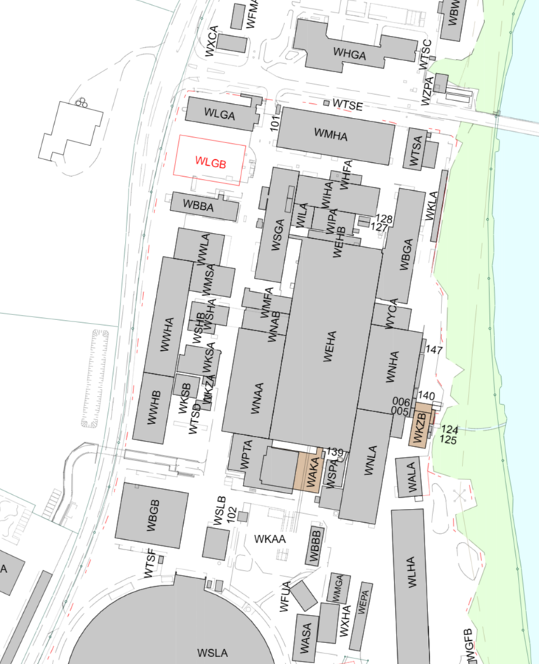
Tattoos

Slide 5
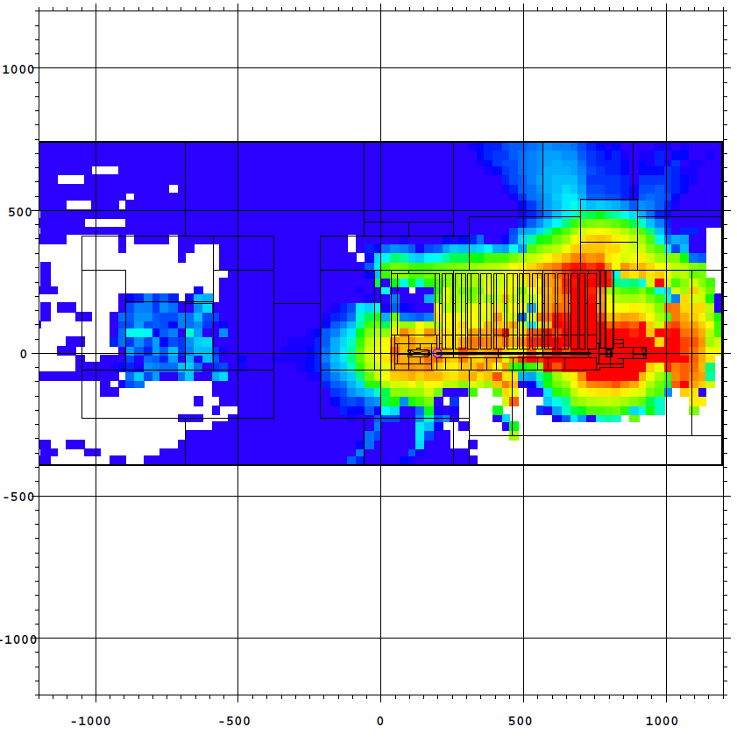
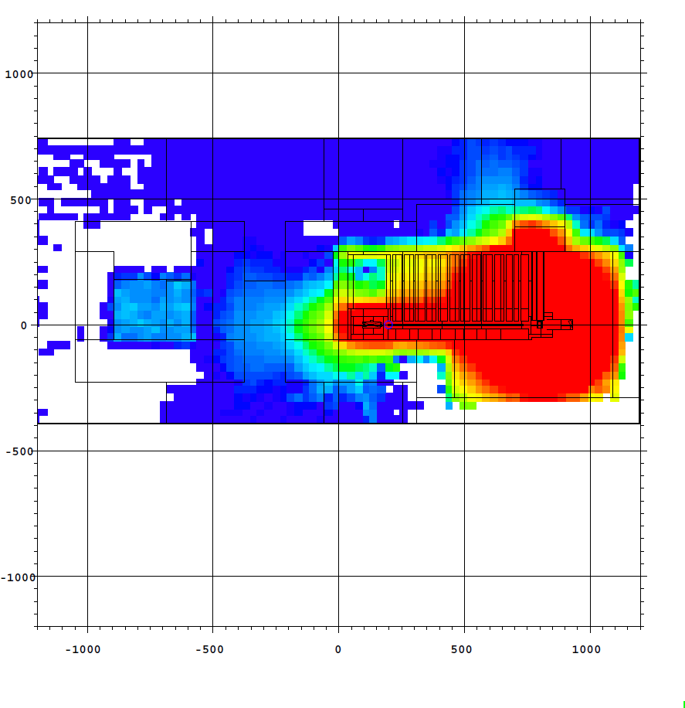
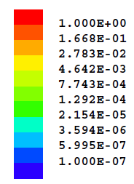
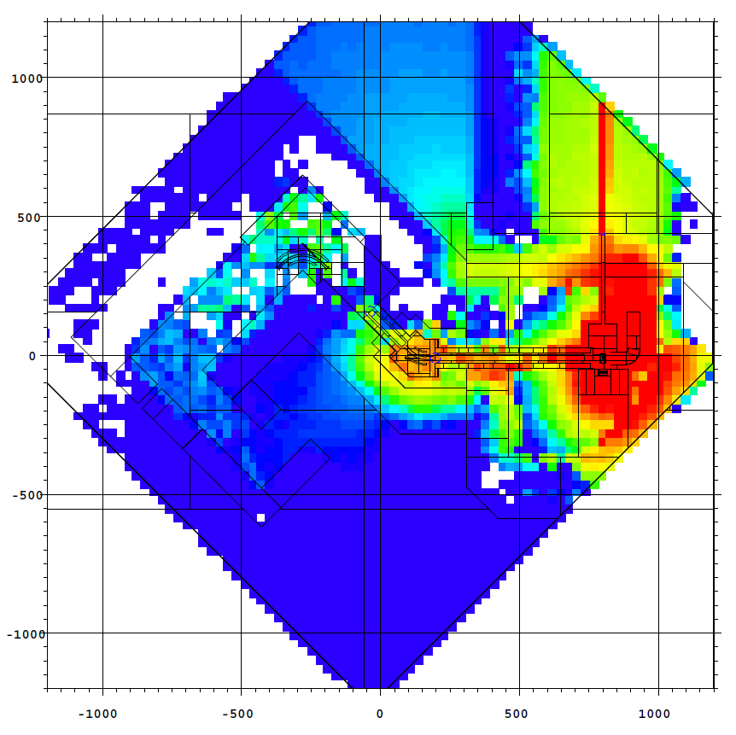
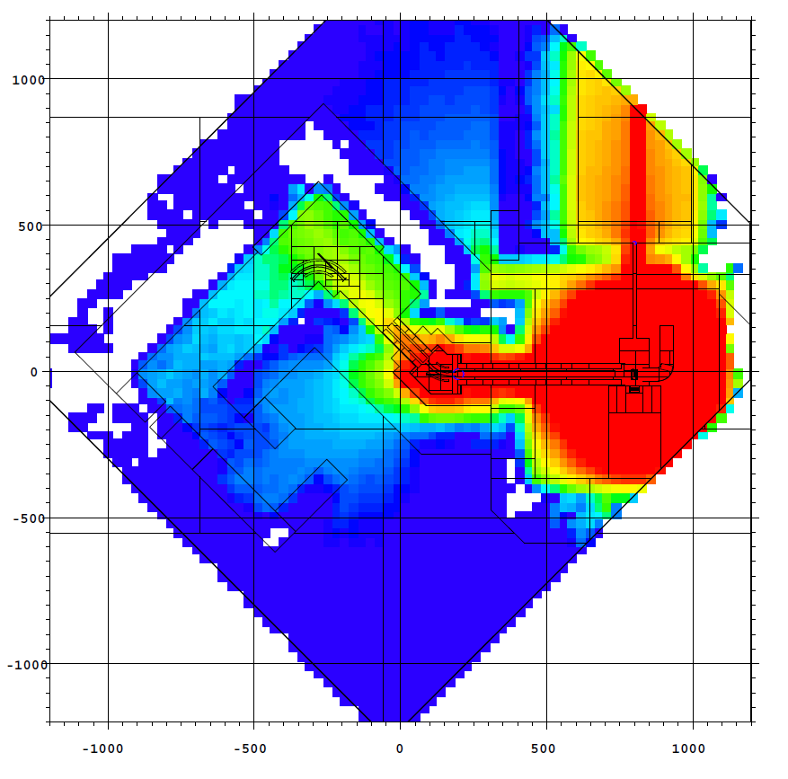
In-situ Dose & Shielding Target
Gamma ODL
Neutron ODL
Sv

Slide 6
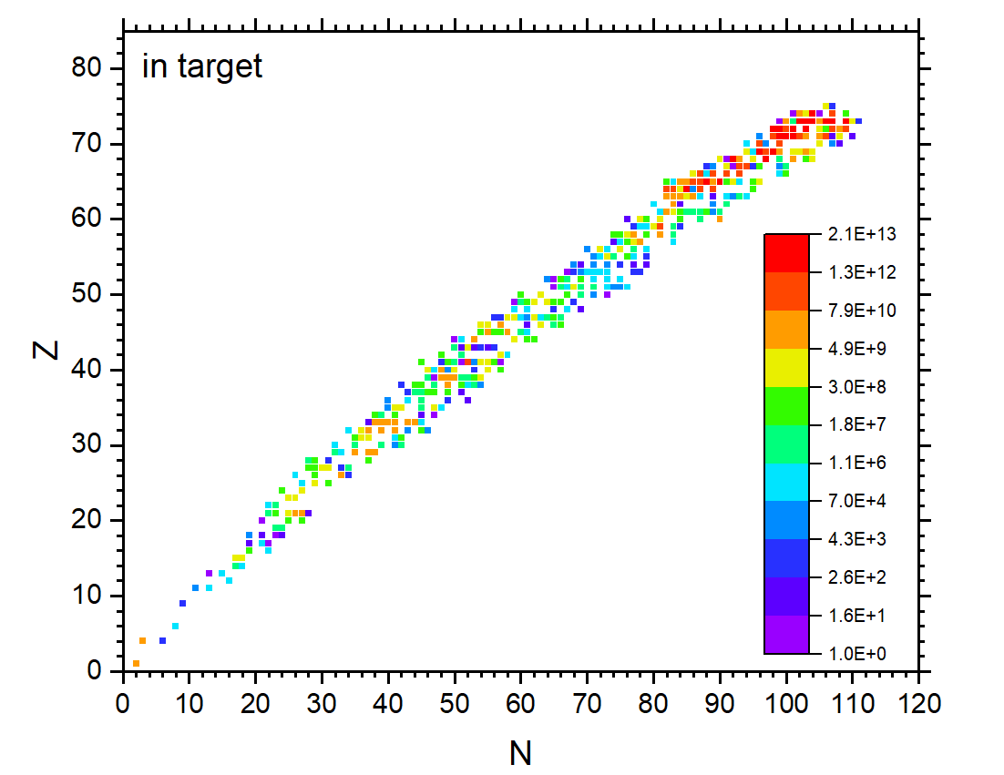
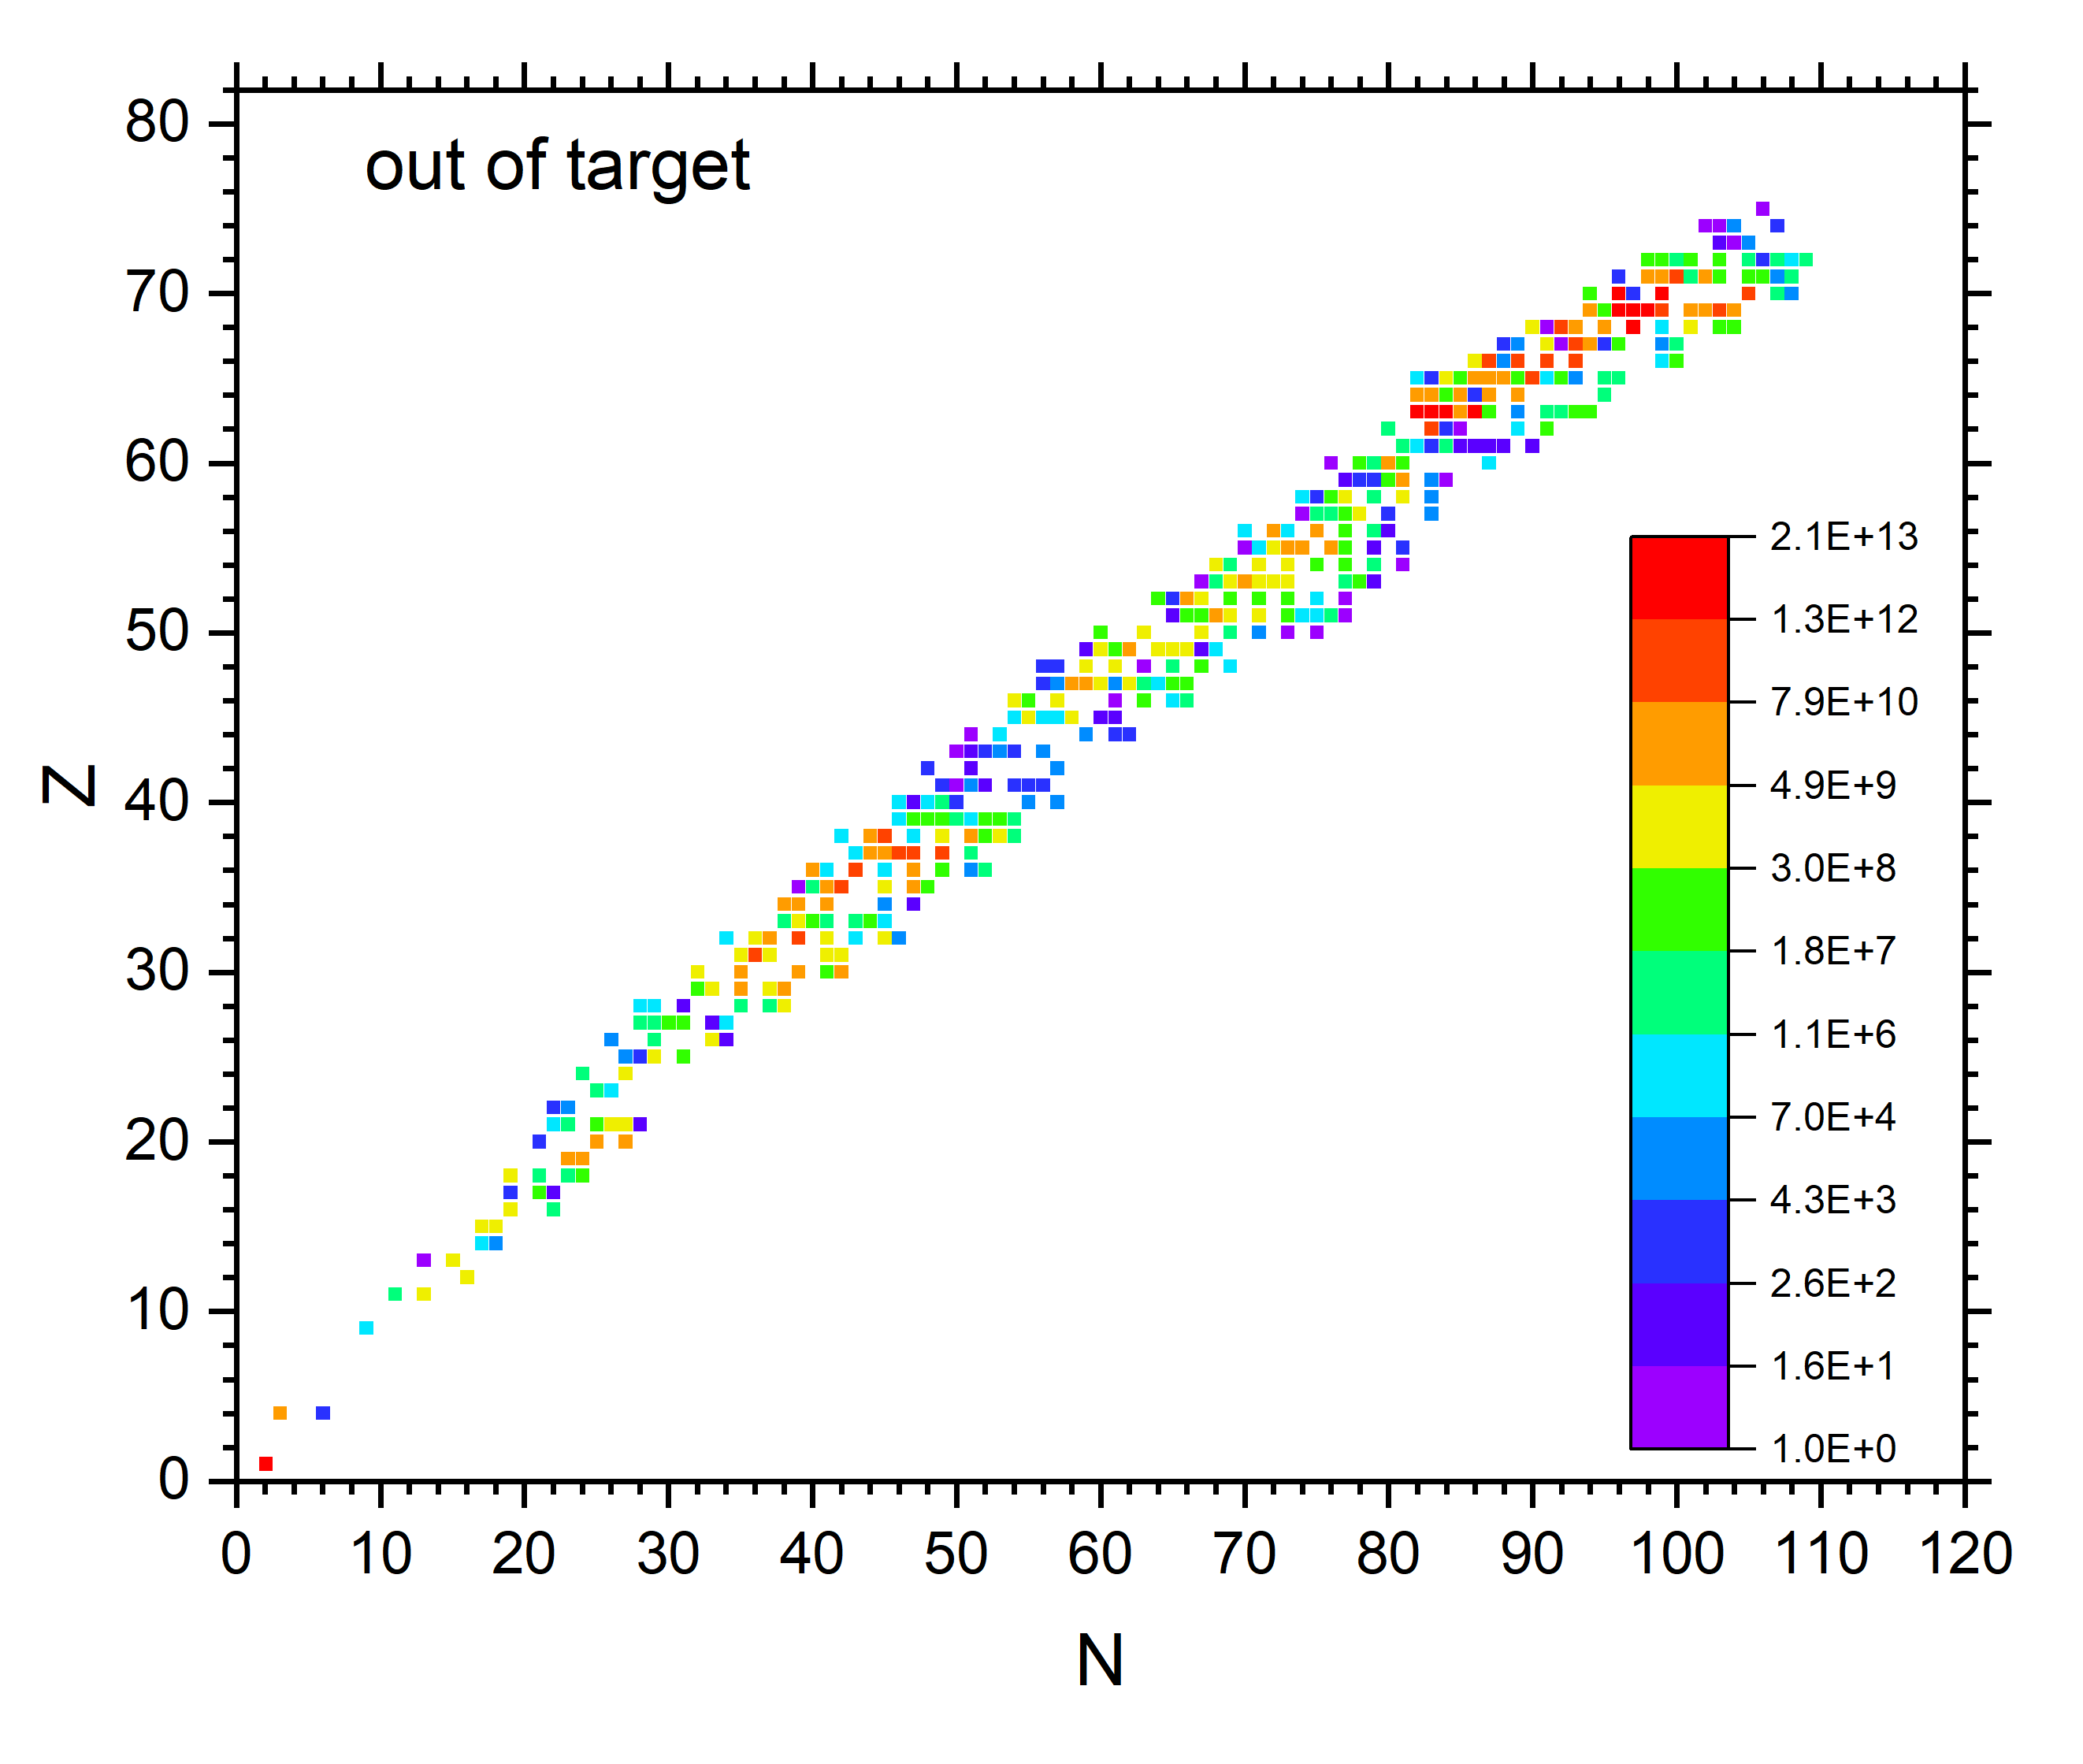
Thermal Release: thermodynamic considerations for Ta
Dose relevant for maintenance and handling
300 mm lead or 1 m heavy concrete or 2 m normal concrete

Slide 7
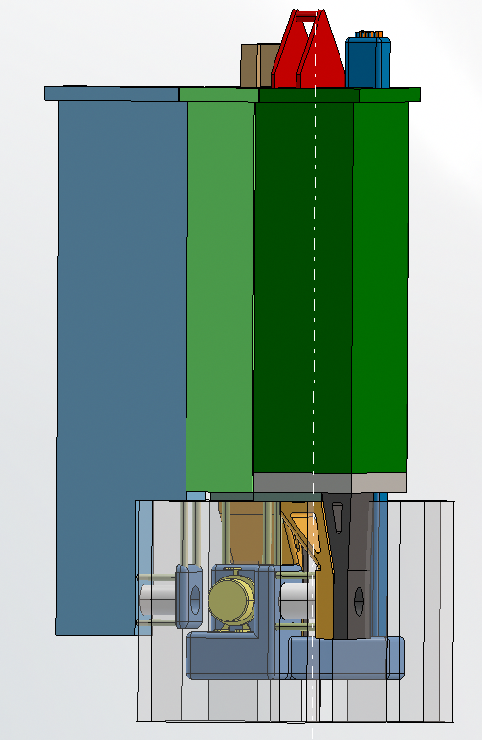
Frontend Size and Handling @ TATTOOS
120 t
~4.5 m
7
12/16/2025

Slide 8
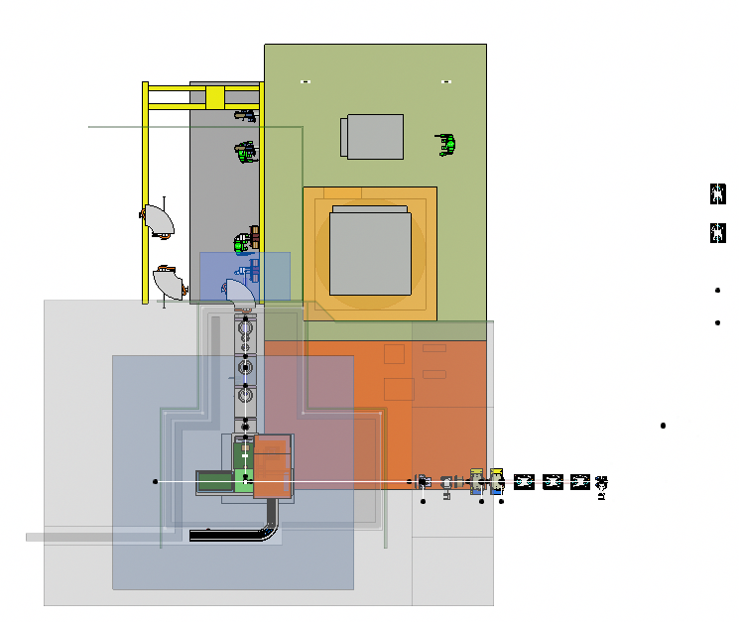
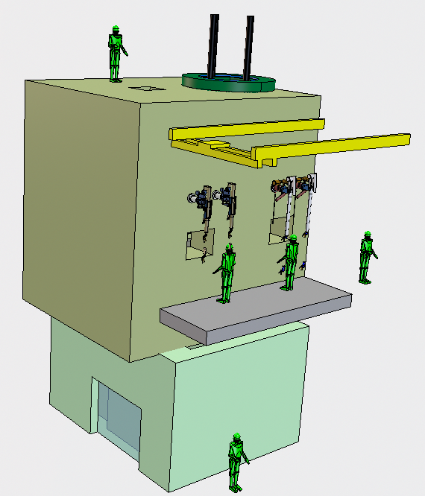
Target Service Cell “TSC” (based on PSI-ATEC)
on site

Slide 9
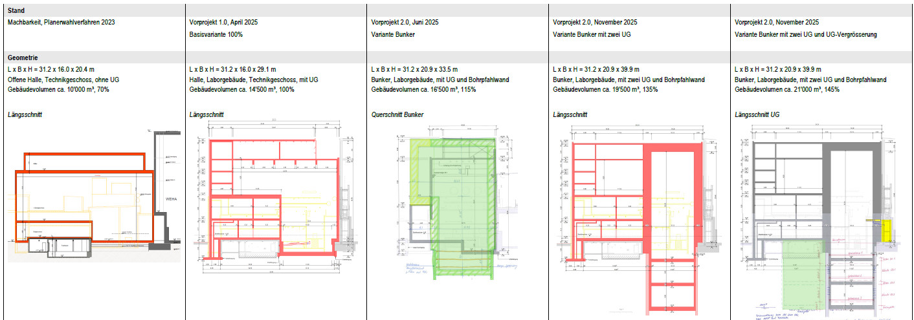
Building Concept Development - History
+ 11`000m³ Gebäudevolumen - Verdoppelung

Slide 10
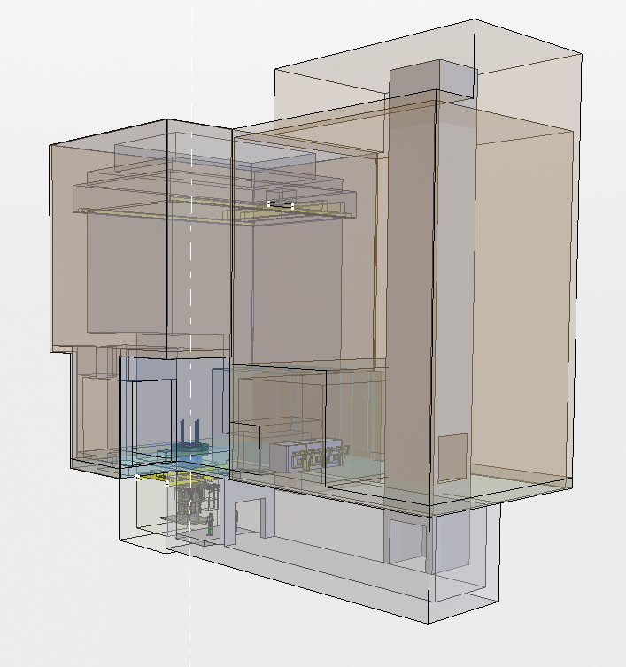
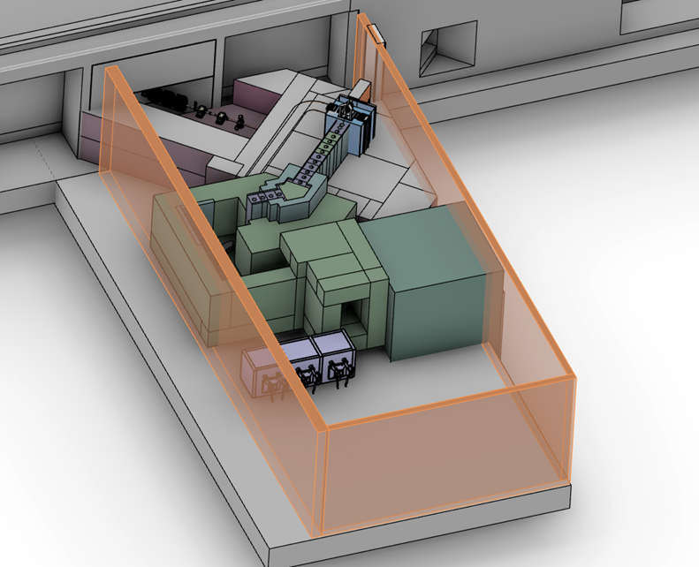
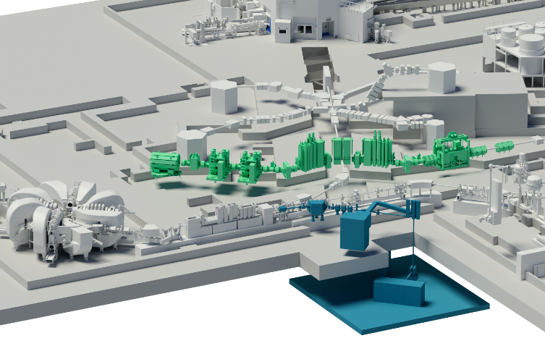
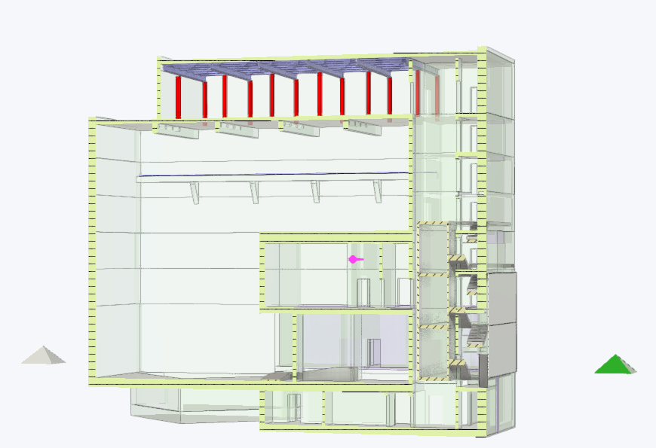
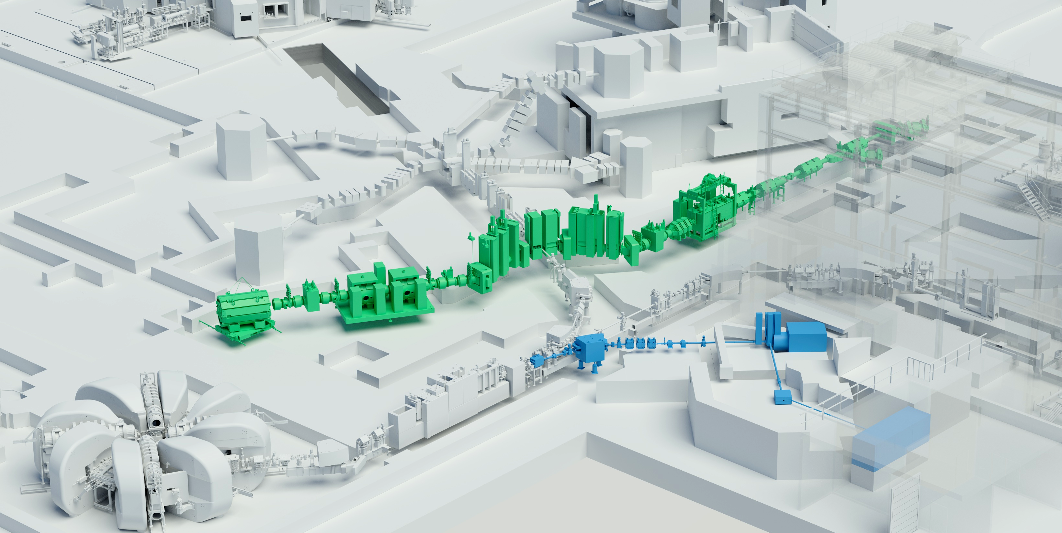
TATOOS Placement & Development
CDR
Preproject
Project

Slide 11
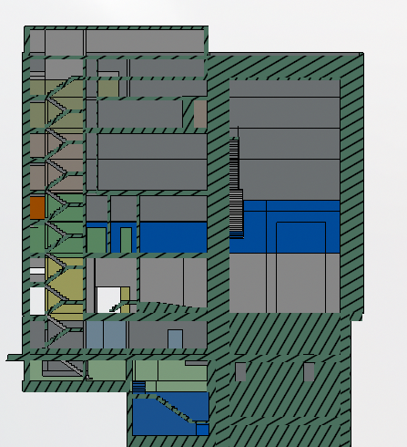
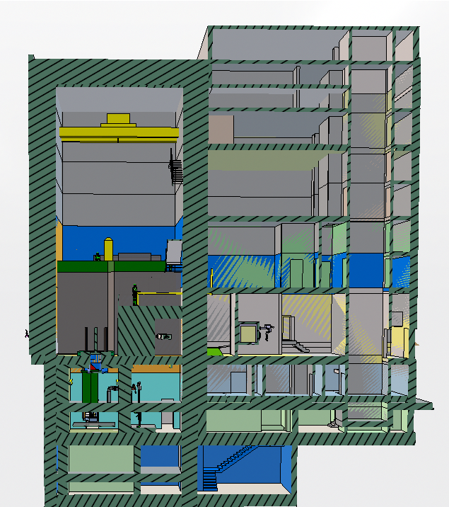
Plan as of now (20.11.2025)
View towards Speisegebäude
C-Lab
Laser & HV & control room
A-lab
Access
Target &
Beam line
Separator & active storage
protons
Service cell
Disposal

Slide 12
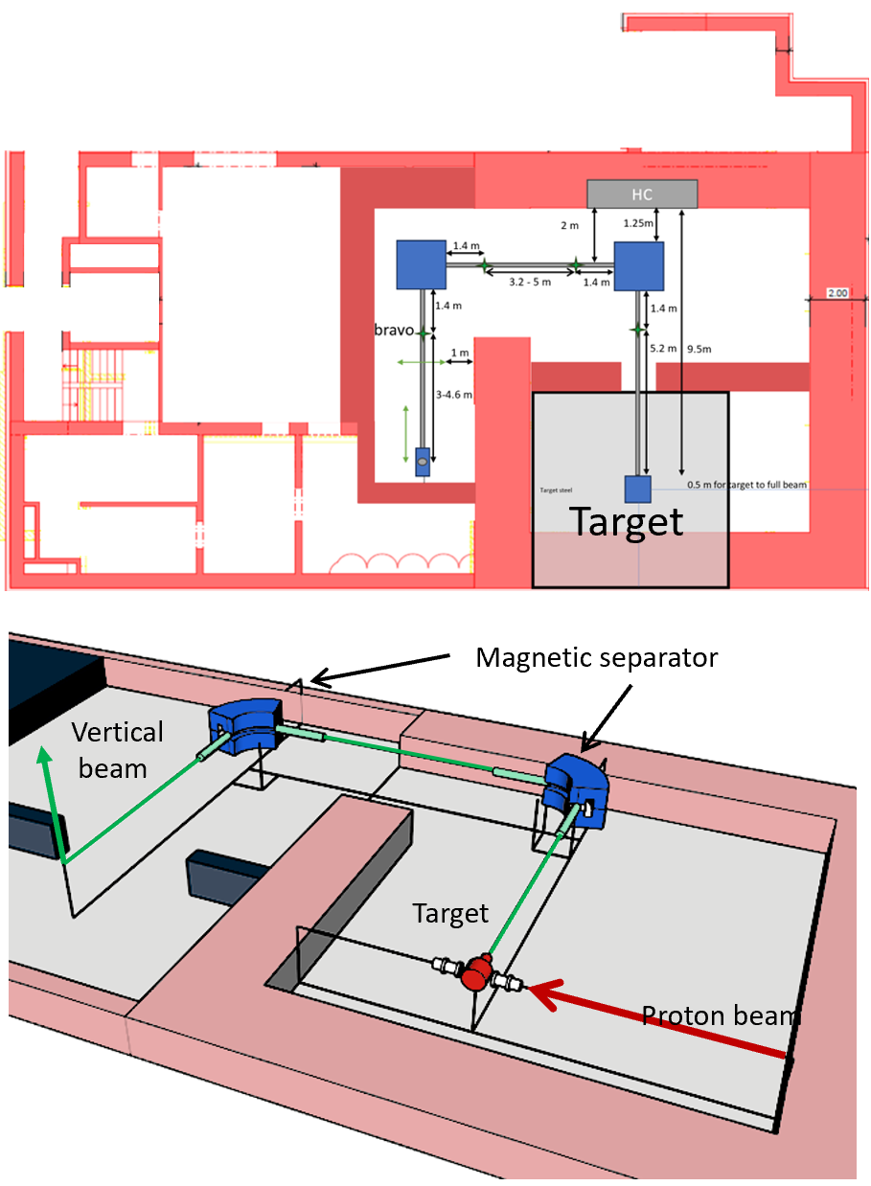
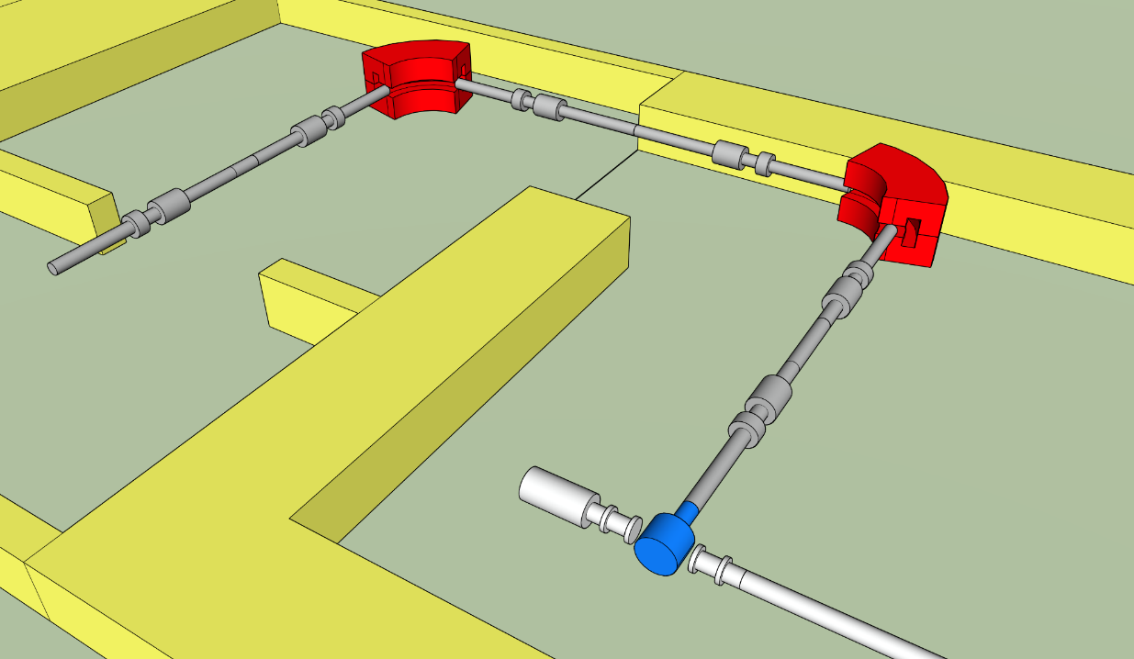
Latest Ion beam line design
Proton beam

Slide 13
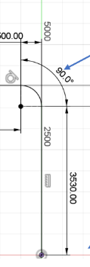
EG from top
Movable
shielding
Material Lock with material lift
Material Lock with material lift
M1
Movable
shielding
M2
M1
0
E
Storage
Cell
Target steel
E1
Ions
vertical
protons
Active storage /
cooling area

Slide 14
OG1 from top
May be a access for material
during construction of the shielded cells
(to be closed later)
Material Lock with material lift
A-LAB
M1
E3
A-LAB access
E2
Ions
vertical

Slide 15
OG2 from top
Material Lock with material lift
Laser Lab
Laser
C-LAB
HV Room
Control room

Slide 16
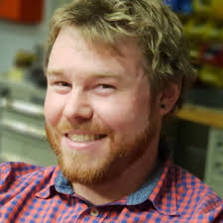
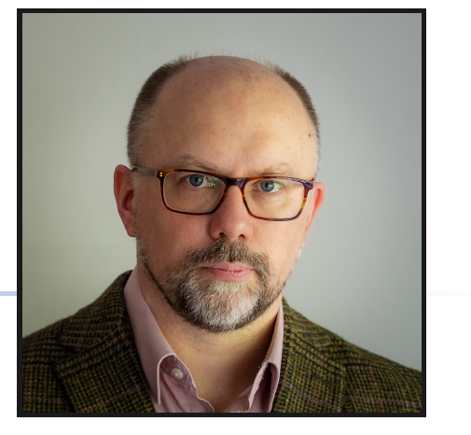
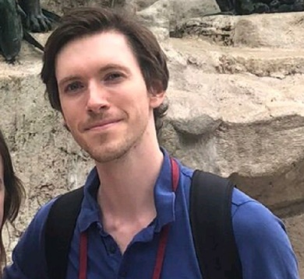
Recent Hirings
Tenure track:
Starting January 2026
Radionuclide Development group
Project position started October 2025
Robert House
Construction engineer
Dr. Reinhard Heinke
Many years of laser operation
At Mainz, CERN-ISOLDE
Permanent:
Starting January 2026
Target group
Project position started October 2025
Timothy (Tim) Giles
Physicist
James Cruikshank
>25 years experience at ISOLDE
Experience from
Building
ISOLDE’s Offline 2

Slide 17
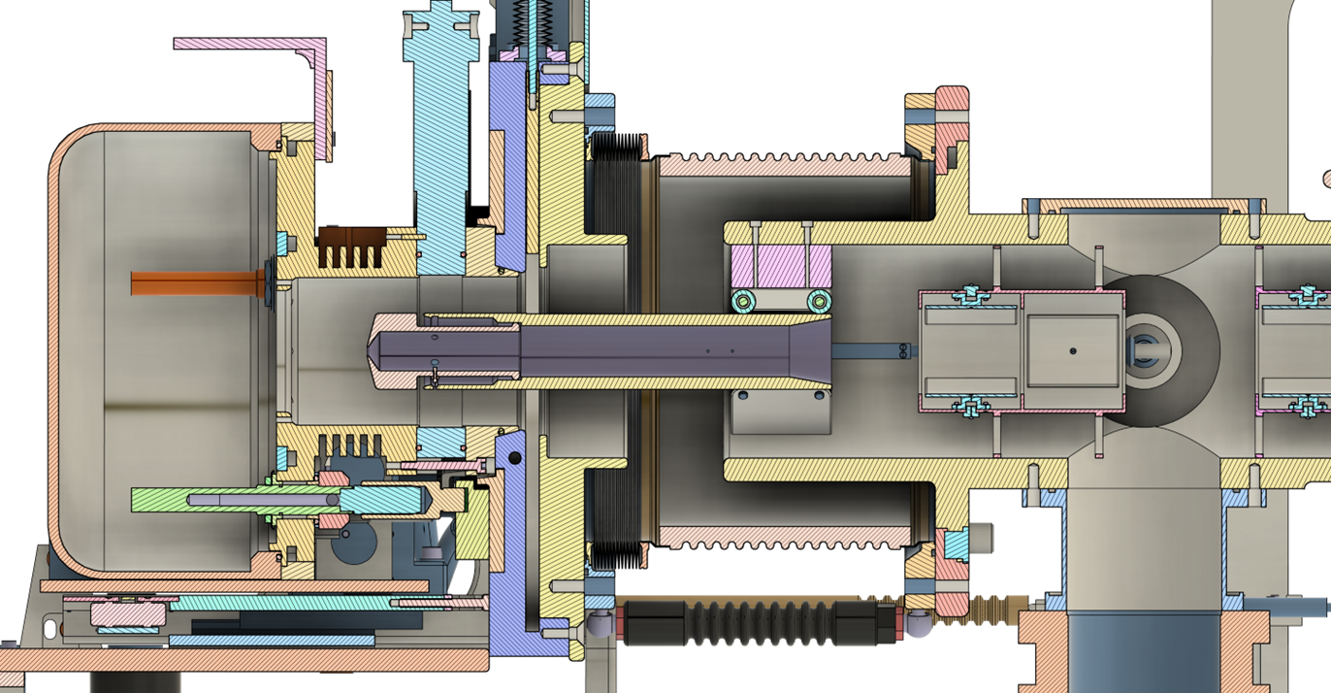
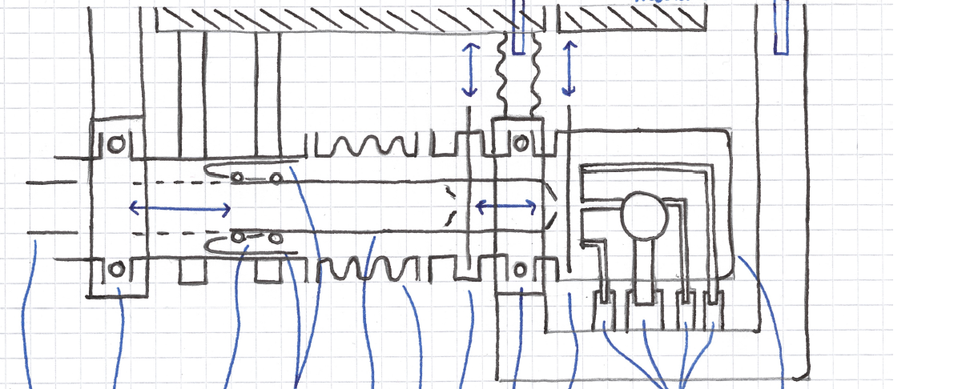
FRONTEND Concepts

Slide 18
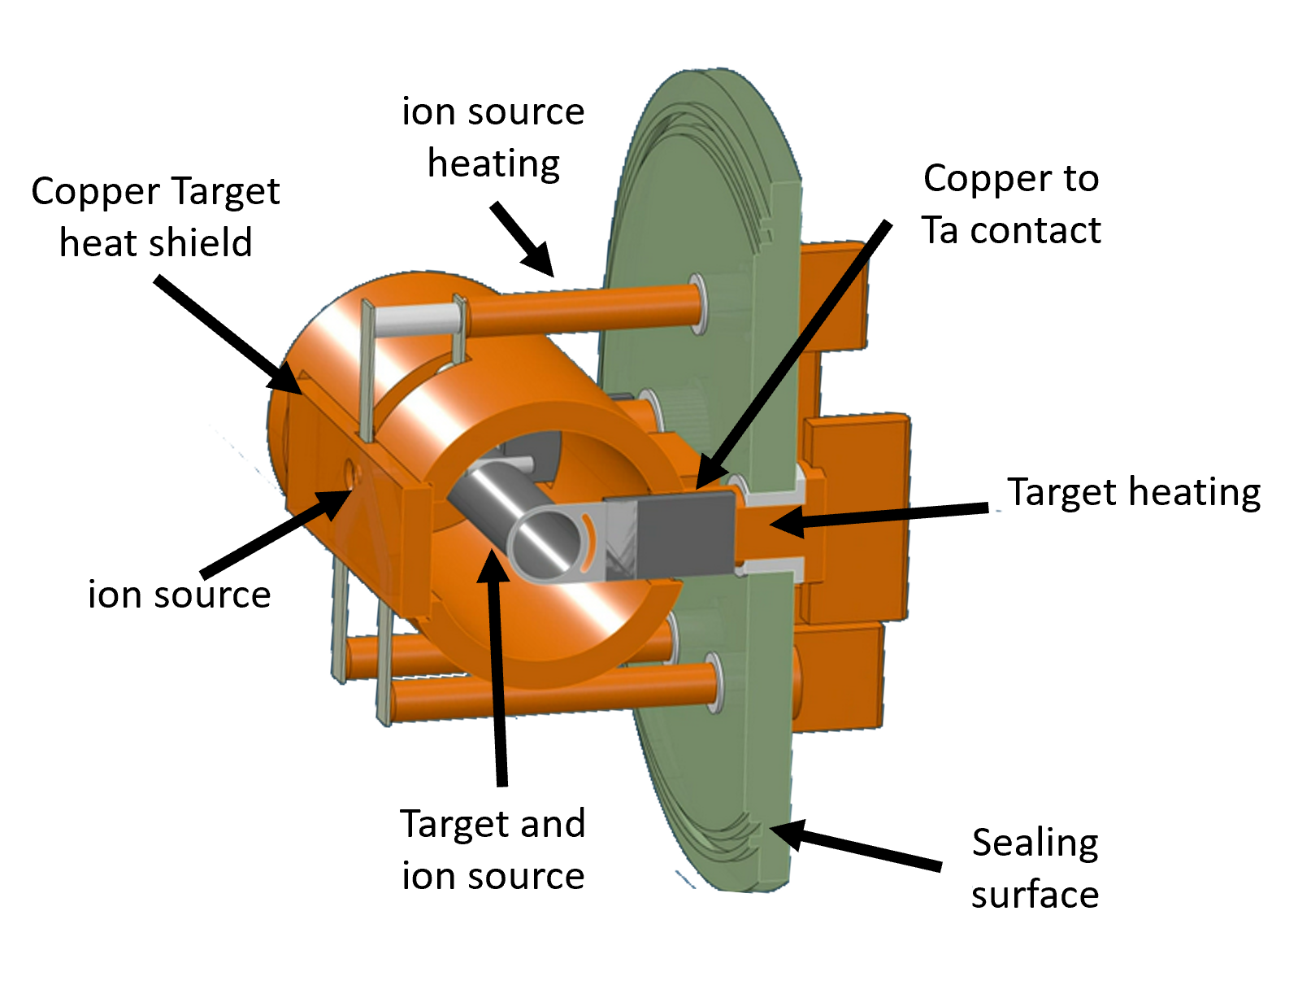
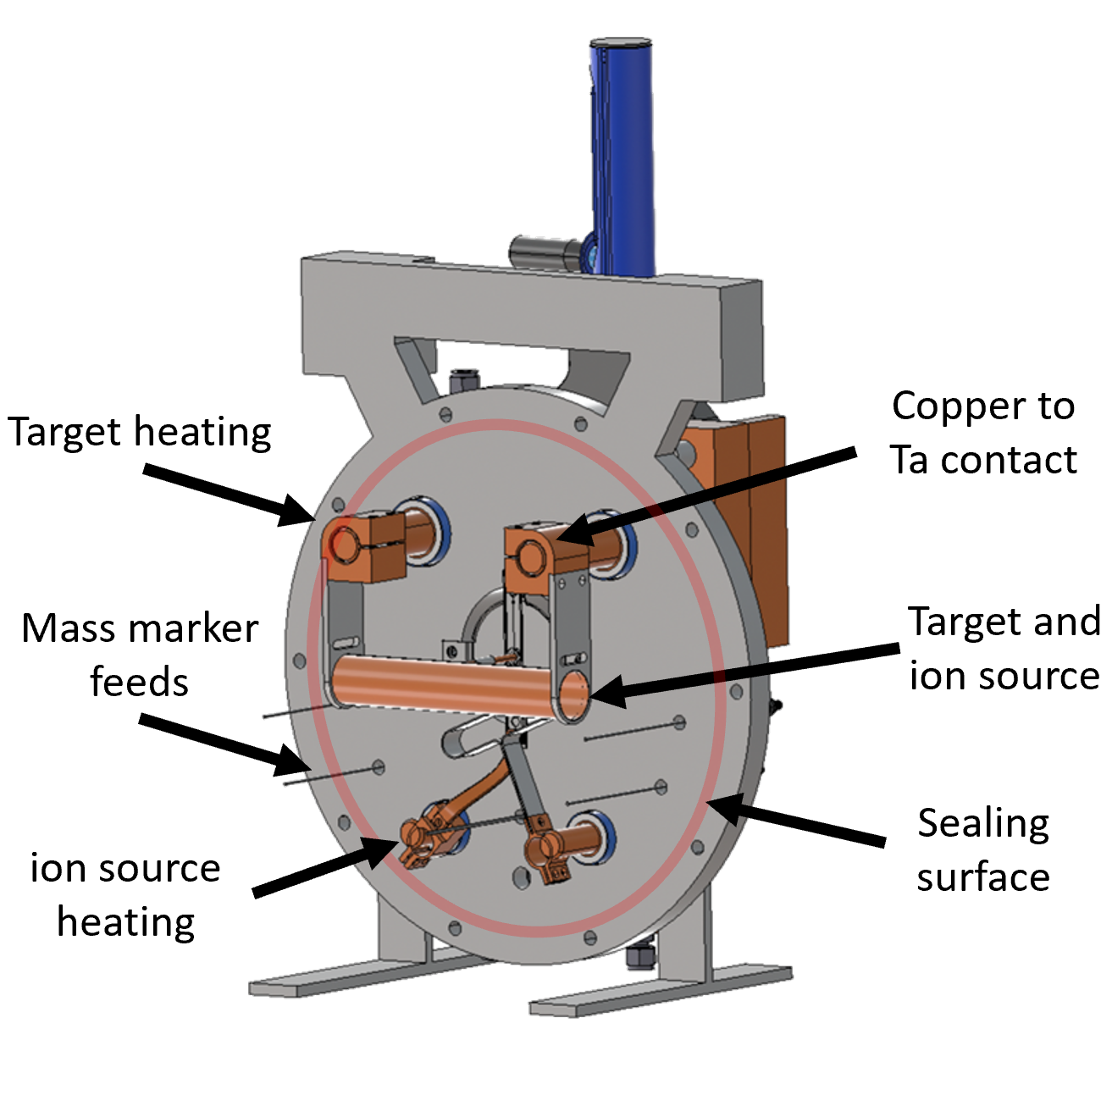
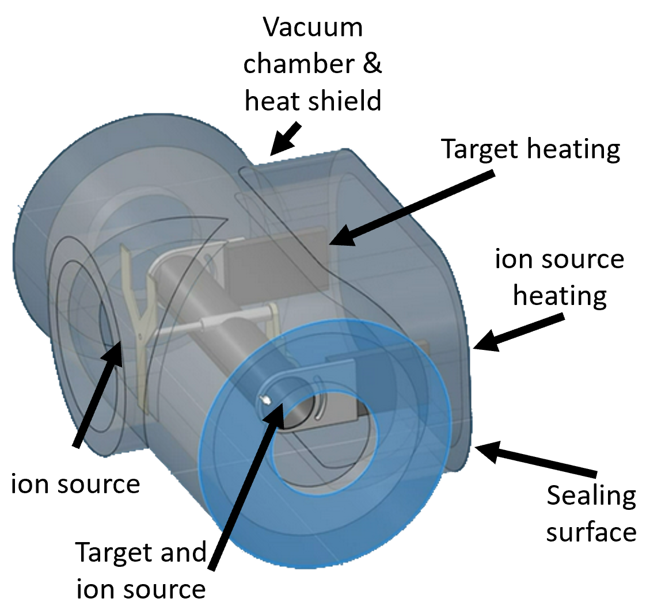
Discussed solutions

Slide 19
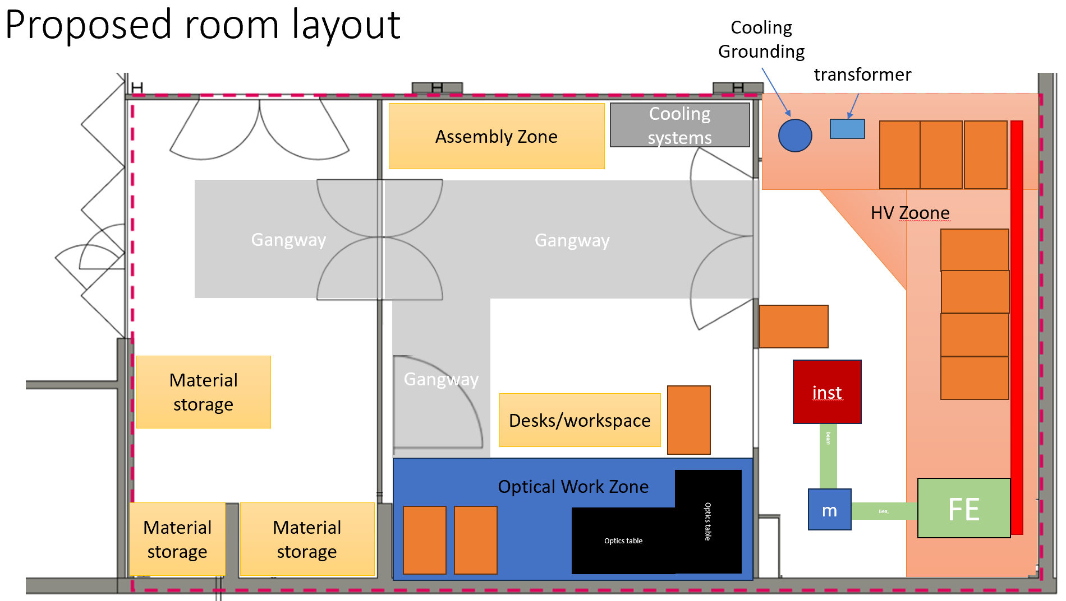
Offline TATTOOS Target/Frontend/Ion source Test Facility (OLT)
Found space in OTLA UG!
Phase 1 Target tests
Phase 2 Frontend & HV Tests
Phase 3 Ion production/RILIS
T/FE

Slide 20
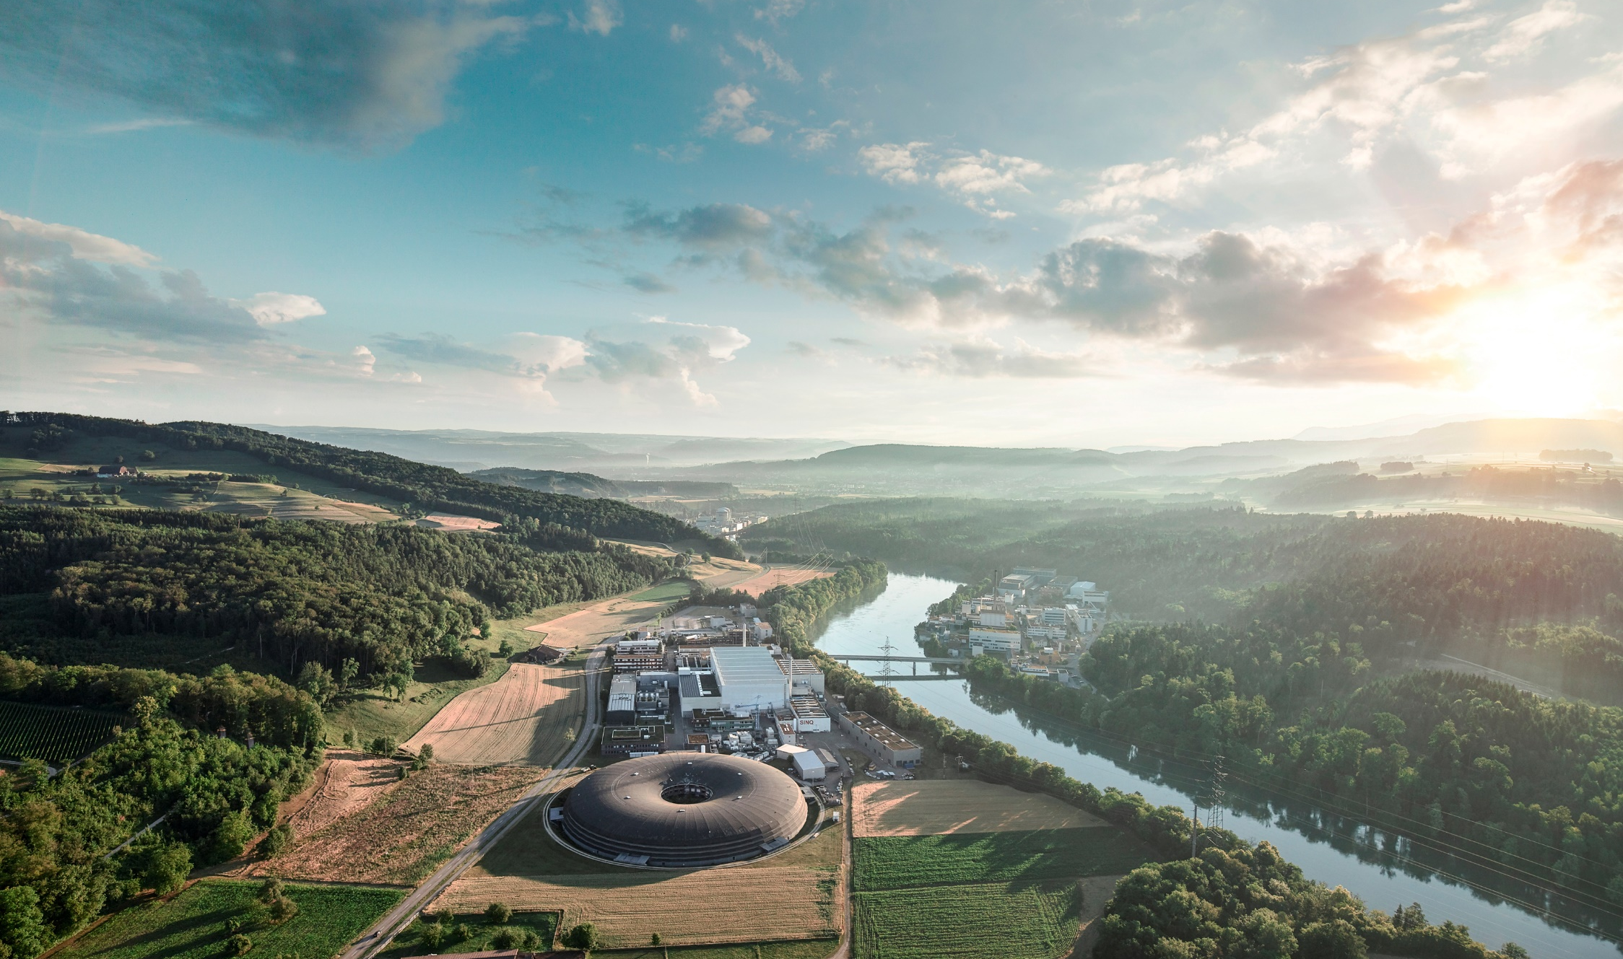
TATTOOS End 2025
Take Home
Further extremely valuable help from all PSI working groups needed
Technical challenges ahead and a lot of learnings!
Patience & know-how built-up required – Real Concept is only about to appear!
Delays in R&D due to delay of the priority and personnel hiring & know-how acquisition
Exciting science in radiopharmacy, radiochemistry and nuclear physics ahead with TATTOOS
A rocket launch costed>300M$ in 1980-90
Today it costs15-50 M$. This is in a scale
reachable for Switzerland!
Let’s launch!
Th. Zurbuchen (former NASA CSO)
@ ETH Domain conference @ EPFL 9.12.25
https://www.psi.ch/en/impact
© PSI

