Slide 1
PSI General Beam Profile Monitor
Kick-off Meeting Jan 30th, 2026
Stefan Ritt
Muon Physics Group, LTP

Slide 2
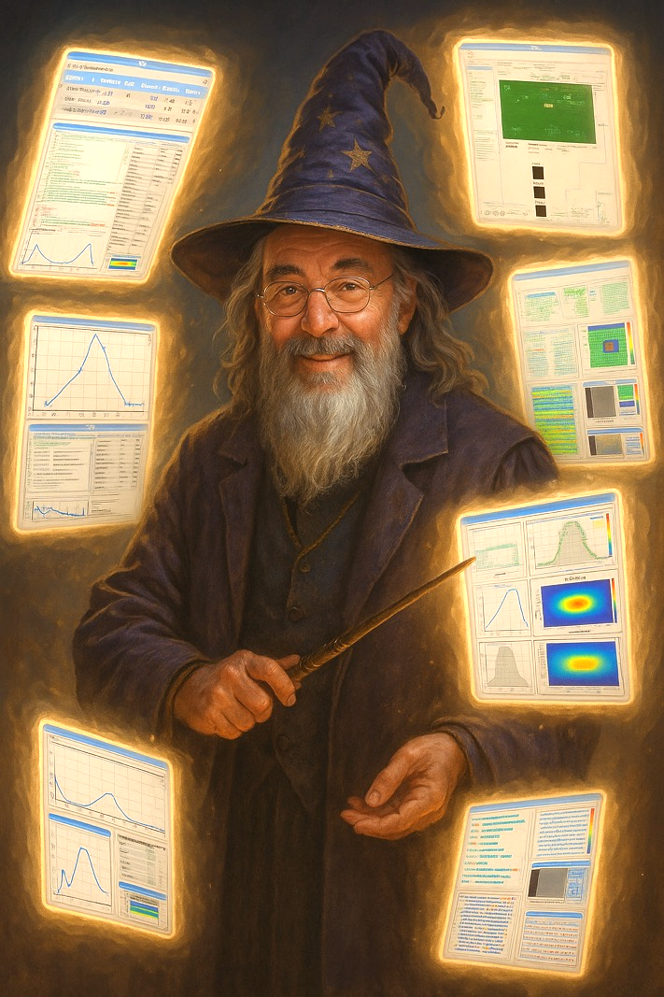
Idea of this meeting
Collect requirements for a general-purpose beam profile monitor
Review existing solutions
Discussion about a path forward

Slide 3
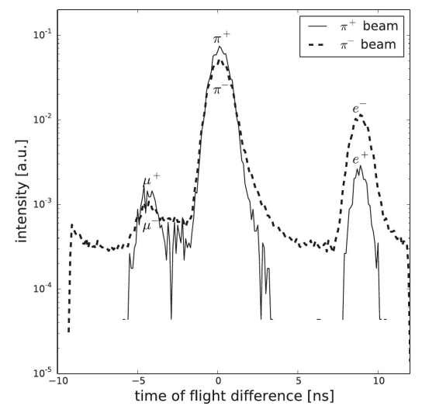
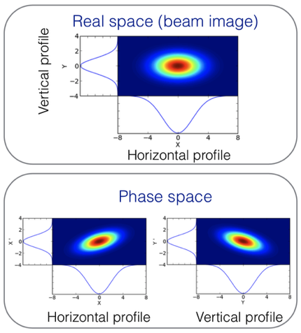
General Requirements
Beam profile X/Y
  Position
  Width
  Phase space
Beam intensity
  Hz to GHz (HIMB)
Particle ID
  ToF on ~ns level
  to distinguish e, μ, π, (p)
  dE/dx

Slide 4
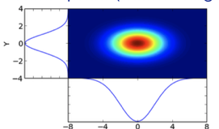
Consolidation of existing solutions
Many beam profile monitor exists: “Pill”-based scanners, Scintillator-based, Pixel-based, GEM-based, … → will review them today
Each solution has its own hardware / software / documentation (?) and typically needs an expert to install and run it → waste of work-power
What about consolidating solutions for an
easy-to-use, general-purpose device?
Detector A
DAQ
“Black box”
Detector B

Slide 5
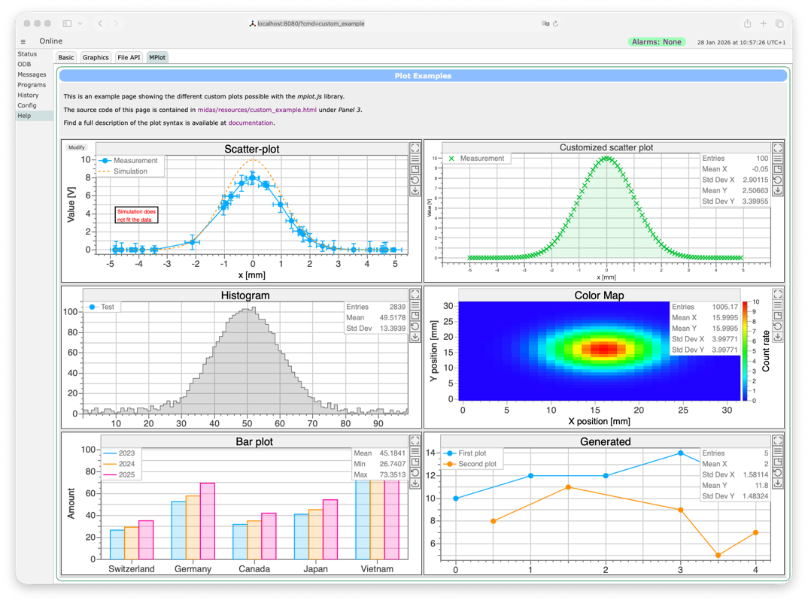
My Vision: Software
MIDAS for detector readout
  Established PSI system (MSetPoint)
  Modern web interface
  Sequencer (Optima, …)
Software should come pre-installed on the beam profile monitor
User Interface should be independent of actual detector → quick learning
How to achieve that?

Slide 6
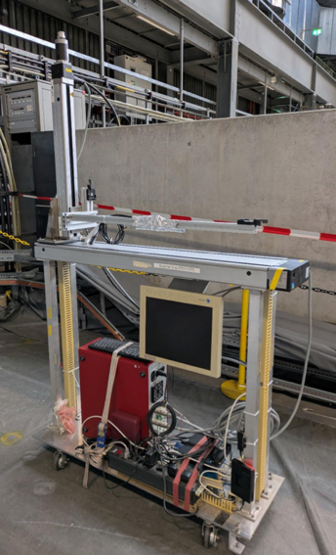
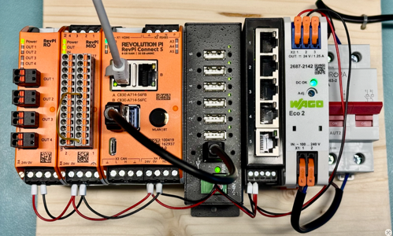
My Vision: Hardware
Avoid Windows & Labview
Cheap & Compact
Detector readout & Slow Control (HV, Temperature, …)
Proposal: RevolutionPi

Slide 7
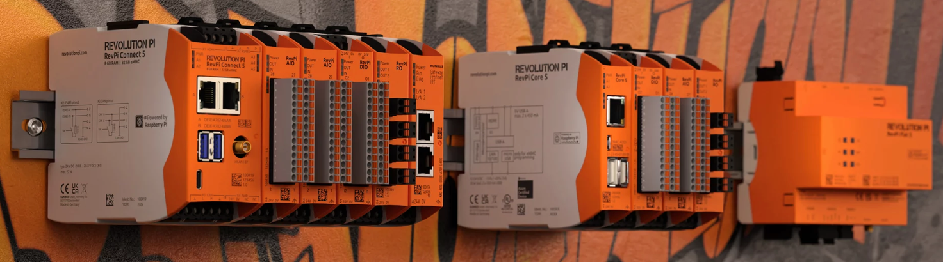
RevolutionPi https://revolutionpi.com (KUNBUS, Denkendorf, Germany)
Raspberry Pi based extendable control units
Digital, Analog (+-10V, 4-20mA, PT1000), Relais expansion units (up to 80 IOs), USB, Ethernet
Standard Linux with Real Time extension (cycle time <10 ms) “Soft Real Time”
Can run MIDAS natively, can read out WaveDREAM boards
Open-Source philosophy (schematics can be downloaded, software under github)
KUNBUS founded in 2008, 1 million devices produced, including nuclear power plants

Slide 8
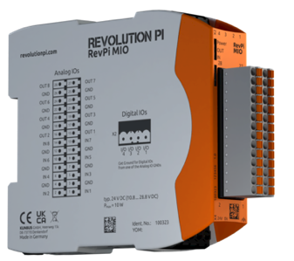
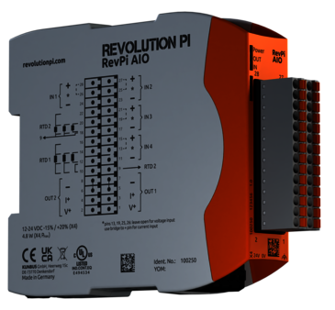
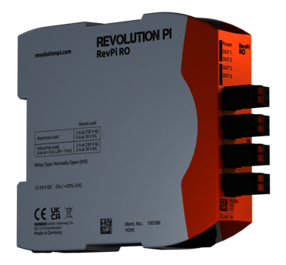

RevolutionPi Devicec
Mixed Analog / Digital IO
  0…10V In/Out
  Digital In/Out
  PWM / Frequency In/Out
Analog IO
  +-10V, +-5V, 0…20mA, PT1000
Relais 4x
Gateway
  Profinet
  EtherCAT
  Profibus
  CAN
  M-Bus
~200 CHF/device

Slide 9
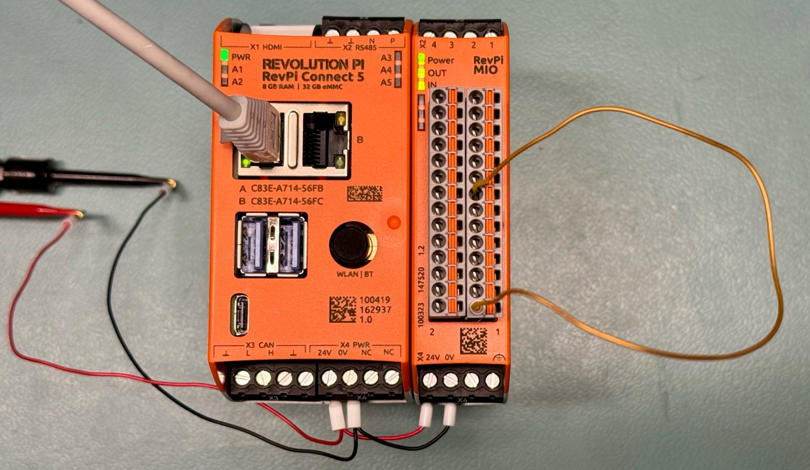
Test Setup
Controller
I/O
24V
AOUT → AIN

Slide 10
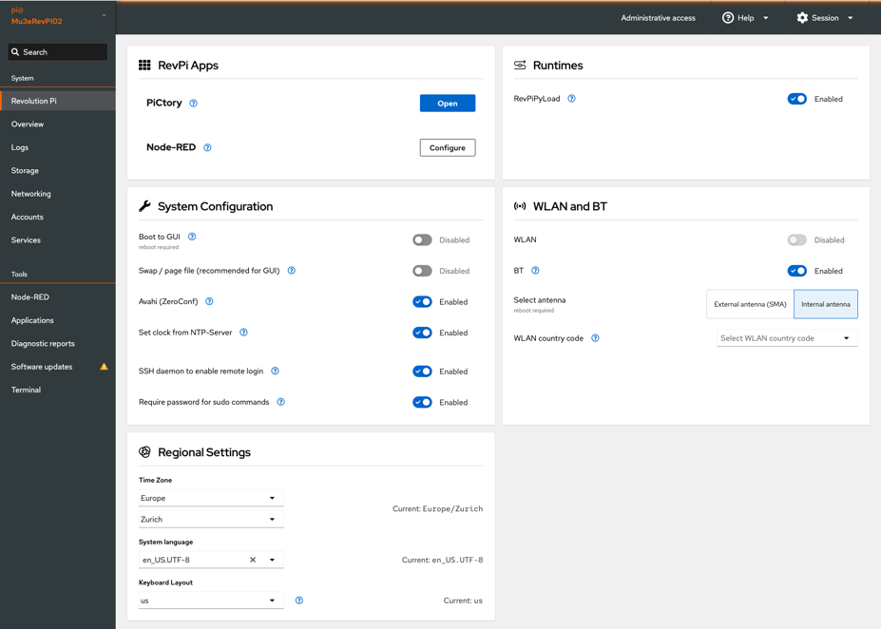
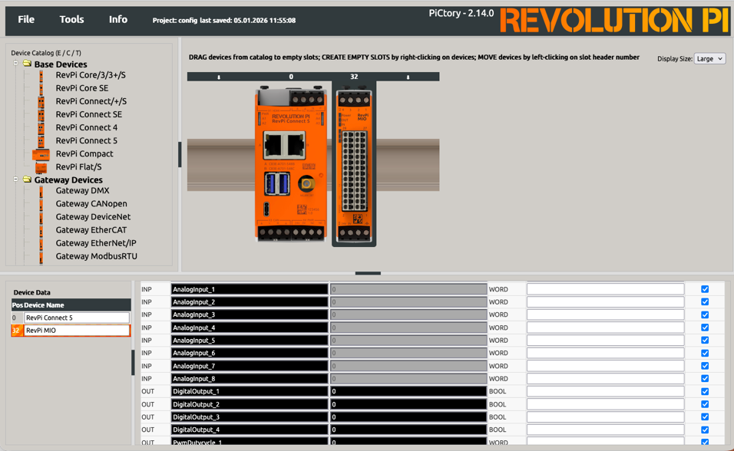
Web access

Slide 11
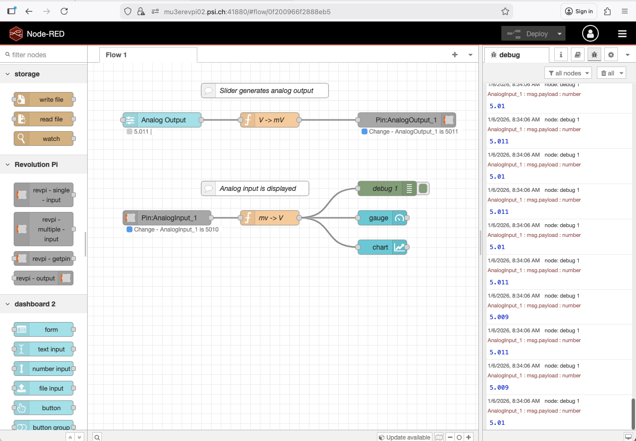
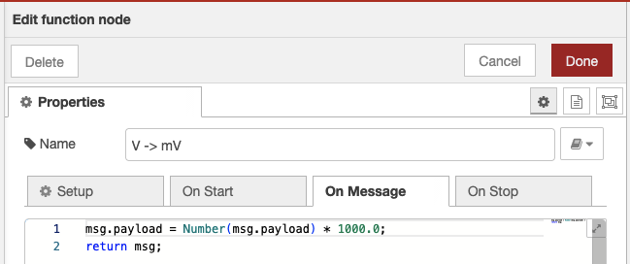
Node-RED https://nodered.org

Slide 12
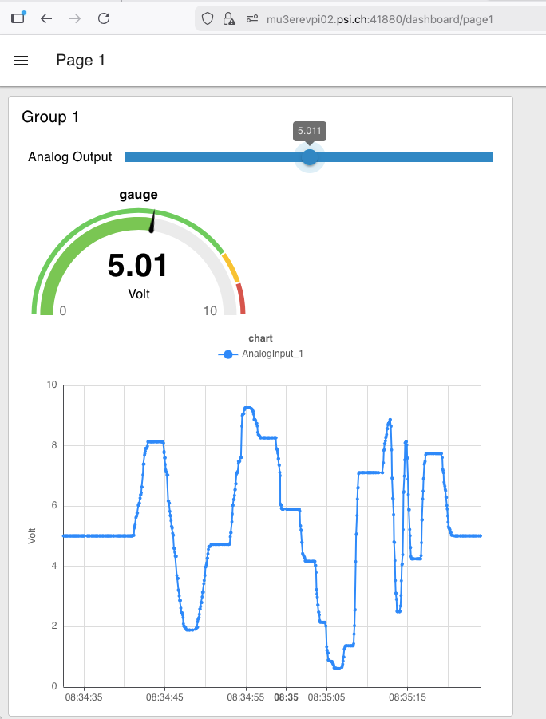
Graphical Output

Slide 13
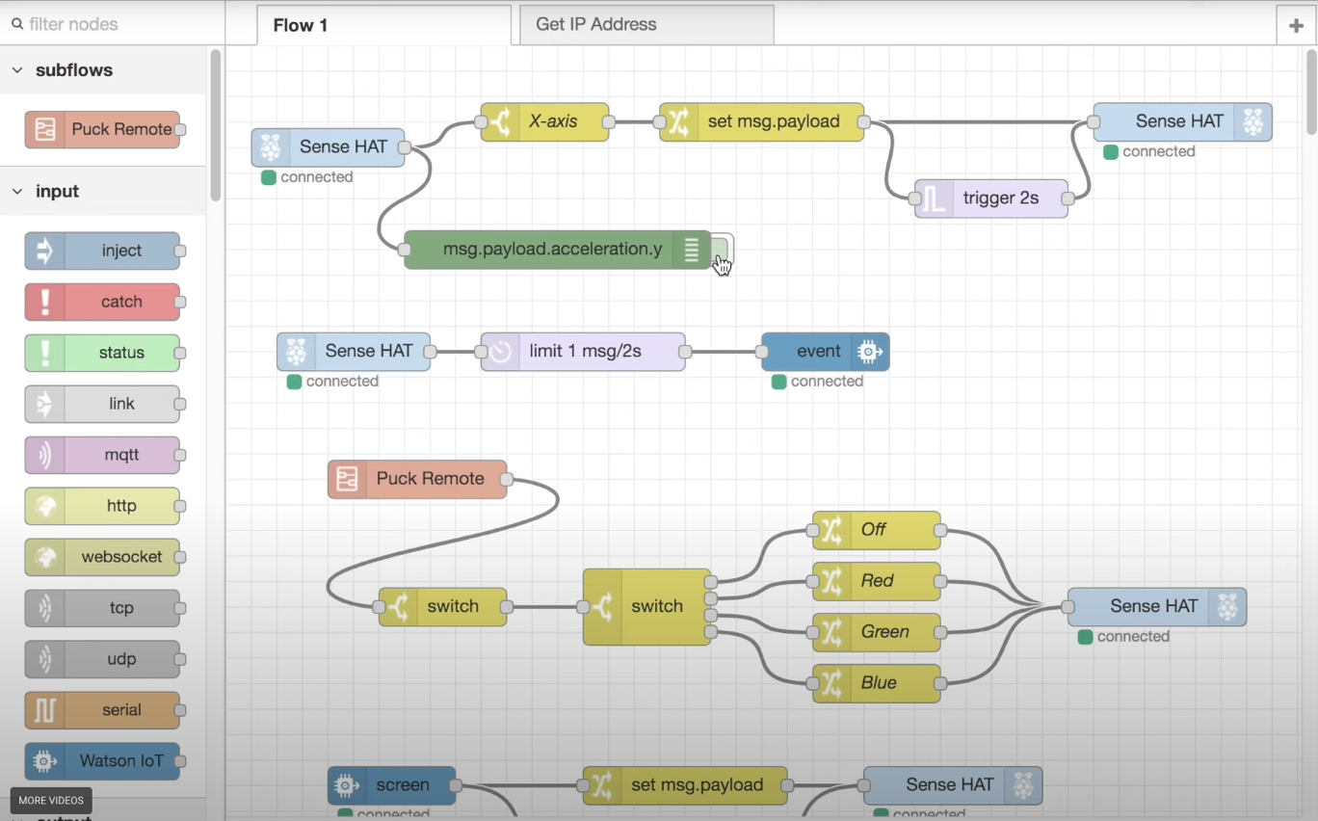
More complicated controls

Slide 14
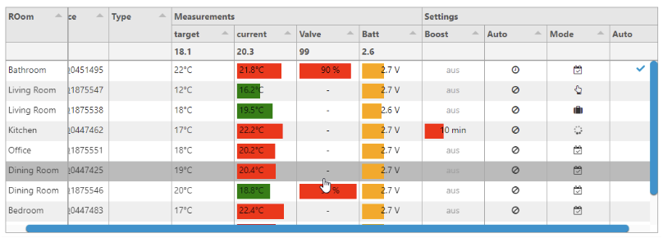
More complicated UI

Slide 15
mdev front-end architecture
Generic “mdev” base class
  Links to ODB /Equipment/<name> tree
  Manages Event ID, readout period etc.
  Implement read_event() for periodic event generation
  Implement odb_setup(), init(), loop() and exit() functions (pure virtual)
  Simple front-end programming
  std::vector<mdev *> mdev_table;
  auto device = new mdev_xxx(”HV");
  device->add_channels(adress1, type1, …);
  device->add_channels(adress2, type2, …);
  . . .
  mdev_table.push_back(device);
  mdev::mdev_odb_setup(mdev_table);
  mdev::mdev_init(mdev_table);
  install_frontend_loop([](){ mdev::mdev_loop(mdev_table)});
Driver derived from mdev
One object per device

Slide 16
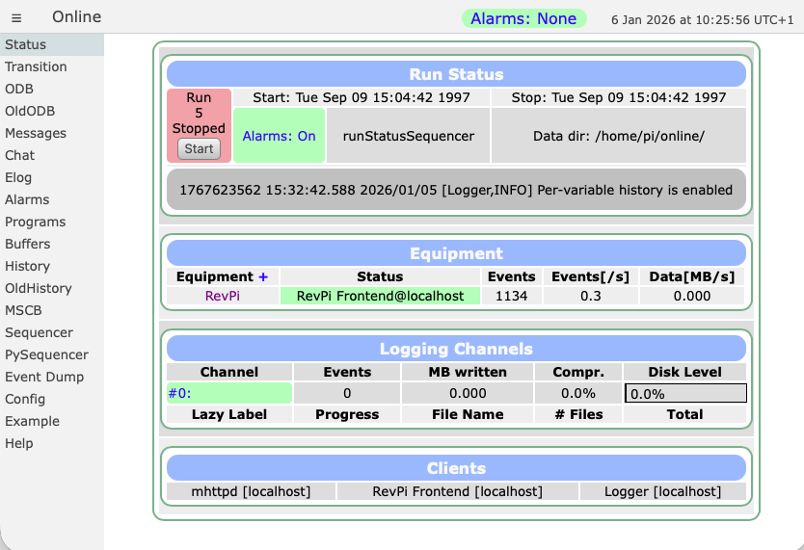
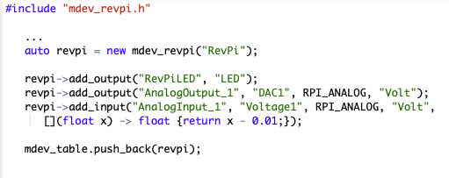
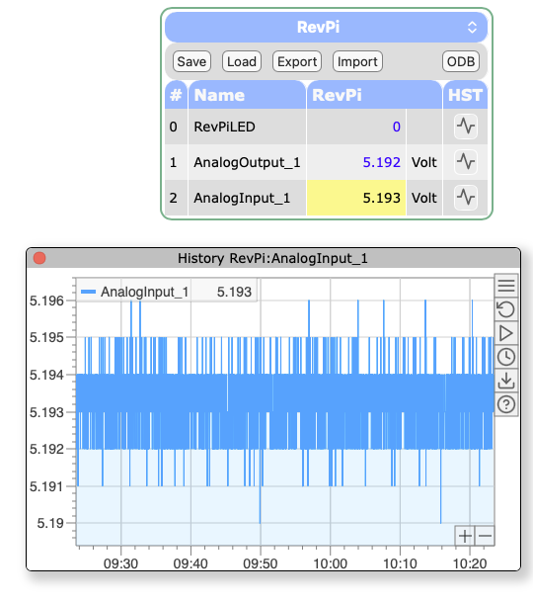
mdev_revpi MIDAS device driver
Stand-alone
MIDAS running
on RevPi
Slow Control:
WaveDREAM readout via Ethernet

Slide 17
My vision: Detector integration through common data format
MIDAS event
N: Number of particles
X,Y,Z: Position in m
T: Time in s
dE/E: Energy in MeV/c²
N
X
Y
Z
T
dE
E
N
X
Y
Z
T
dE
E
N
X
Y
Z
T
dE
E
MIDAS
. . .
Detector A
MIDAS event
DRIVER
N
X
Y
Z
T
dE
E
UI
N
X
Y
Z
T
dE
E
N
X
Y
Z
T
dE
E
. . .

Slide 18
Mapping of different detectors
Pixel
  N = 1
  X/Y = Pixel X/Y + offset
  Z = position(s)
Scanner
  N = count rate
  T = unused
  X/Y = motor
  Z = position
Sandwich
  X/Y = Pixel X/Y + offset
  T = scintillator time
  dE/E = scintillator light
MIDAS event
N
X
Y
Z
T
dE
E
N
X
Y
Z
T
dE
E
N
X
Y
Z
T
dE
E
. . .

Slide 19
Data presentation / analysis
Profile plots
  X/Y
  Cut on Particle ID
Phase Space / Divergence
  X1-X2 / X
  X1-X2 / Y1-Y2
Beam rate
  ΣN / normalization
Particle ID
  T: ToF
  dE/E: Energy loss
MIDAS event
N
X
Y
Z
T
dE
E
N
X
Y
Z
T
dE
E
N
X
Y
Z
T
dE
E
. . .

Slide 20
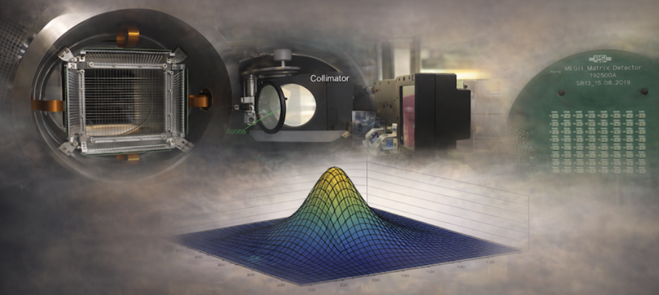
Conclusions
Combining our efforts will benefit our community and safe double work
A general tool is only useful if easy-to-use and well documented
I’m happy to bring in my experience with MIDAS and various hardware,
but rely on others for the detector parts

