Slide 1
SF Startup Report January 2026
Nicole Hiller for the OP- and BD-Teams
N. Hiller
PSI 26.1.2026

Slide 2
Week 4 January 2026 Startup
Time between ICT maintenance and startup was relaxed enough, so the timing & sync were up early enough to allow for a smooth startup of the sub-systems
The biggest issues this time were various IT problems (server / linux / software / afs / path upgrades, some of them partly depending on each other) -> more about the details later on
Technical issues were “as usual” motion control, cameras, but nothing too unexpected.
RF and laser were all working well in the beginning, now some RF issues over the weekend
Many thanks to all the expert groups to bring the machine up!

Slide 3
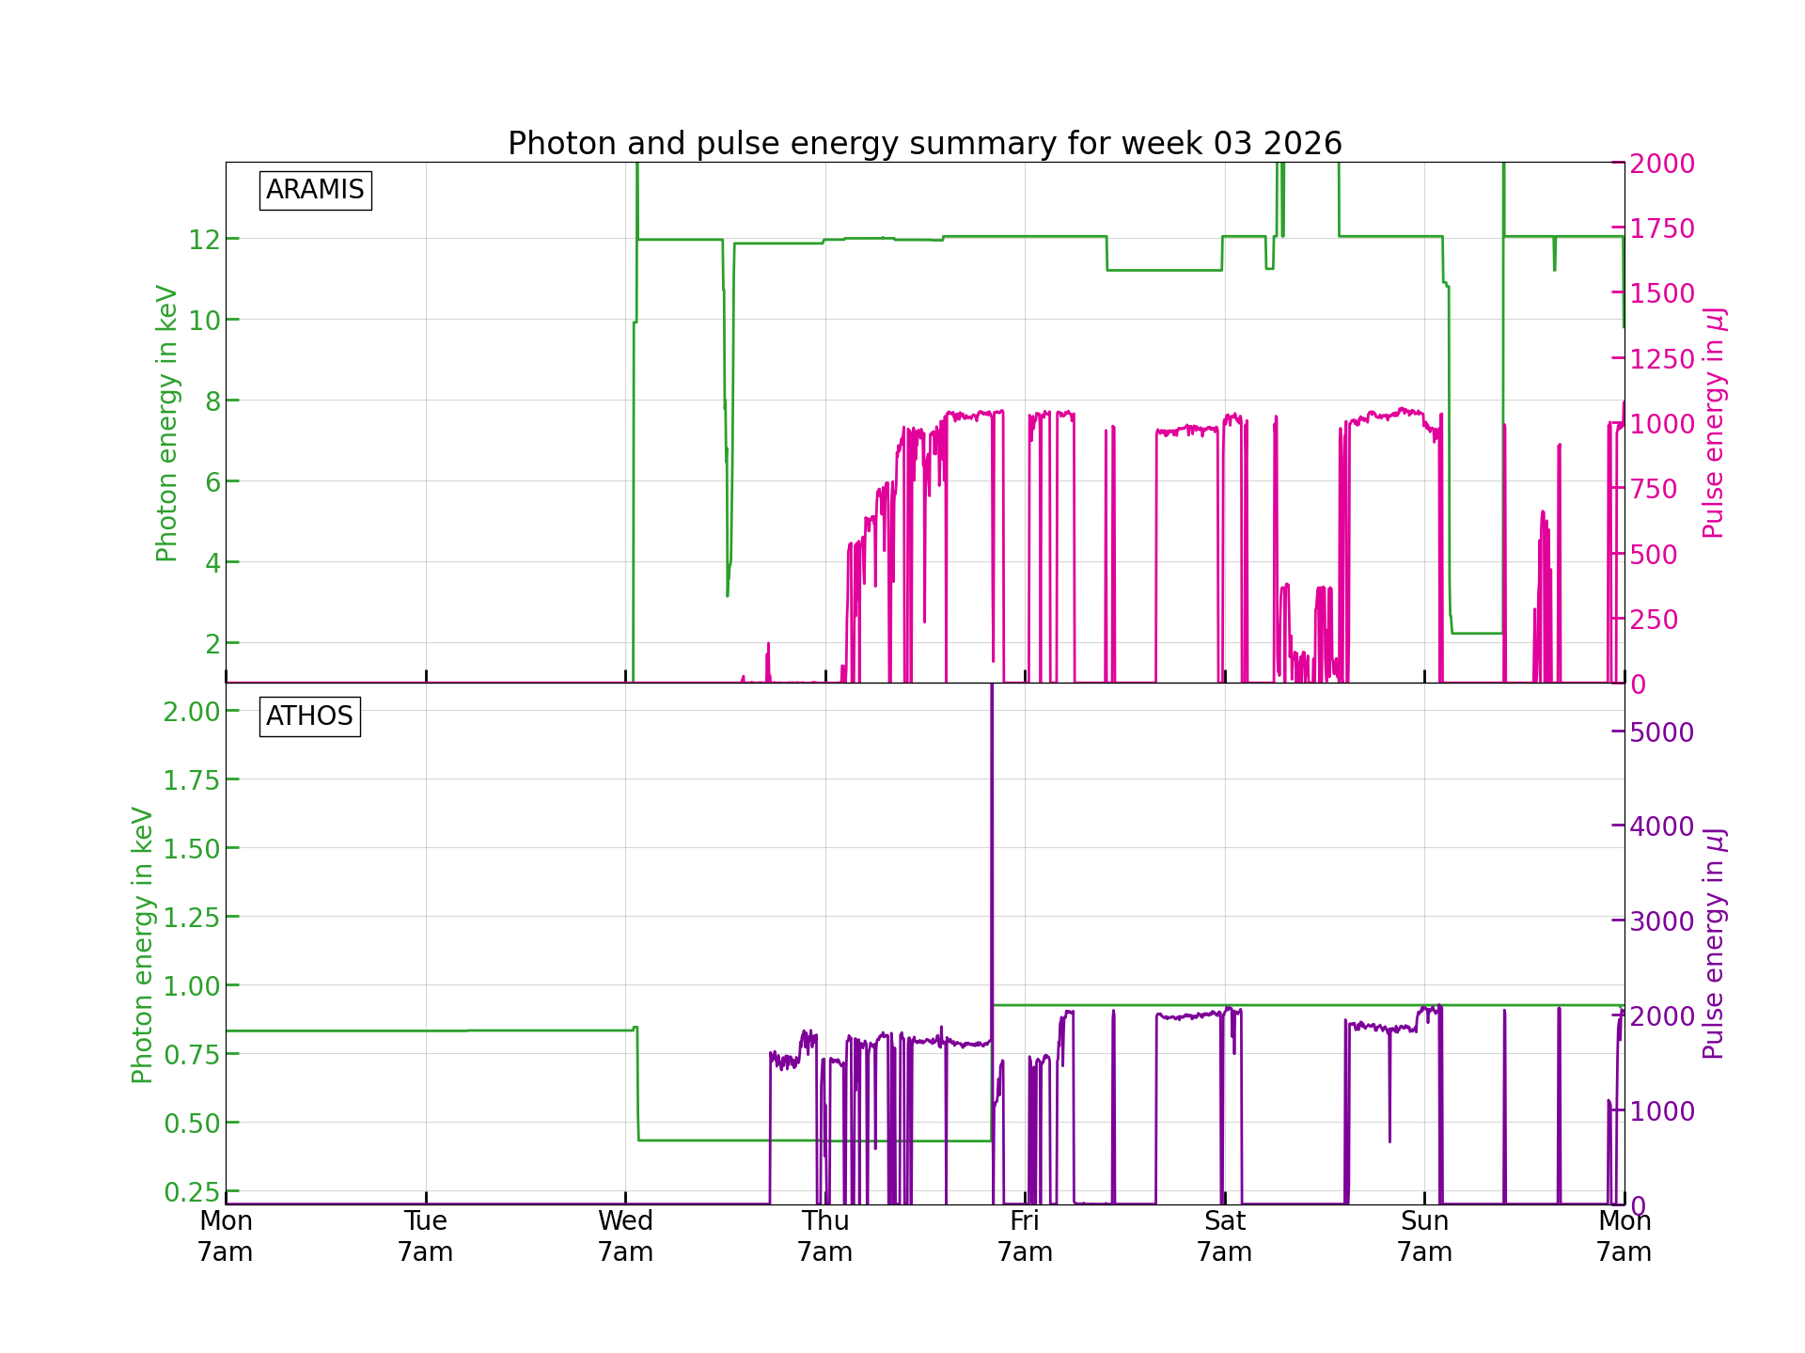
The progress
Managed to restore 1 mJ at 12 keV on Thursday evening in Aramis.
Athos looked decent but had not been optimised to full extent yet.
MD over the weekend took place.

Slide 4
The issues with more detail
Photon shutter did not open because the PSSS did not report motor position correctly (photonics mode monitor) -> was fixed on Thursday morning
Overall timing had to be moved by nearly 180 ps, not sure why -> we moved laser and gun together to have same “coarse” timing on wall current monitor as before the shutdown
RF: 2 S-Band RF Stations switched to “local mode” -> known issue with the touch screen / mouse movement RF is checking what can be done
One occurrence of the “timing issue” of a missed pulse (probably caused by IOC overload) -> gateway not yet installed, for now we will try to bypass the interlock again so we do not generate so much downtime if it happens again
IT issues:
If you log in remotely to sf-lc(a) machines and do not have /sf/op/bin in your path, please type “source op” in the terminal (you will notice this in case you cannot start applications through the launcher
Syntax for calling pshell based programmes with parameters changed -> mail by A. Gobbo
AFS home removed from linux clusters and the new shared home was overflowing -> login problem for several experts

