Slide 1
SwissFEL RC report, week 5, G.L. Orlandi

Slide 2
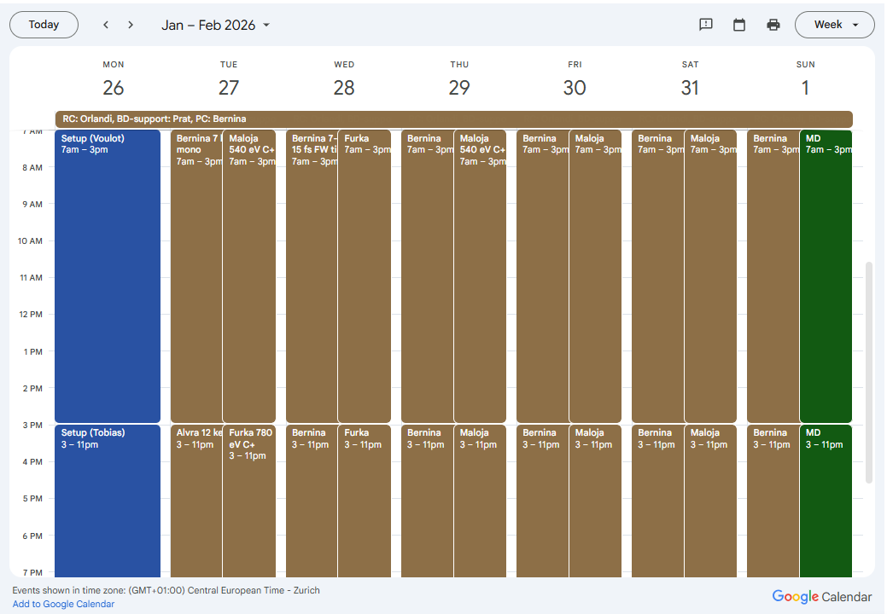
FEL users’ plan, week 5
Aramis:
Alvra+Cristallina: (Tue) 12keV, long pulse
Bernina:
(Tue) 7keV monochromatic+ energy scan
(Wed-Sun) 7 - 7.15 keV mono; 8.5keV; 7.1-7.6 keV mono scanning
Short pulses~15fs
Athos:
Maloja: (Tue, Thu-Sun) 540 eV C+
Furka: (Tue, Wed) 780 eV C+

Slide 3
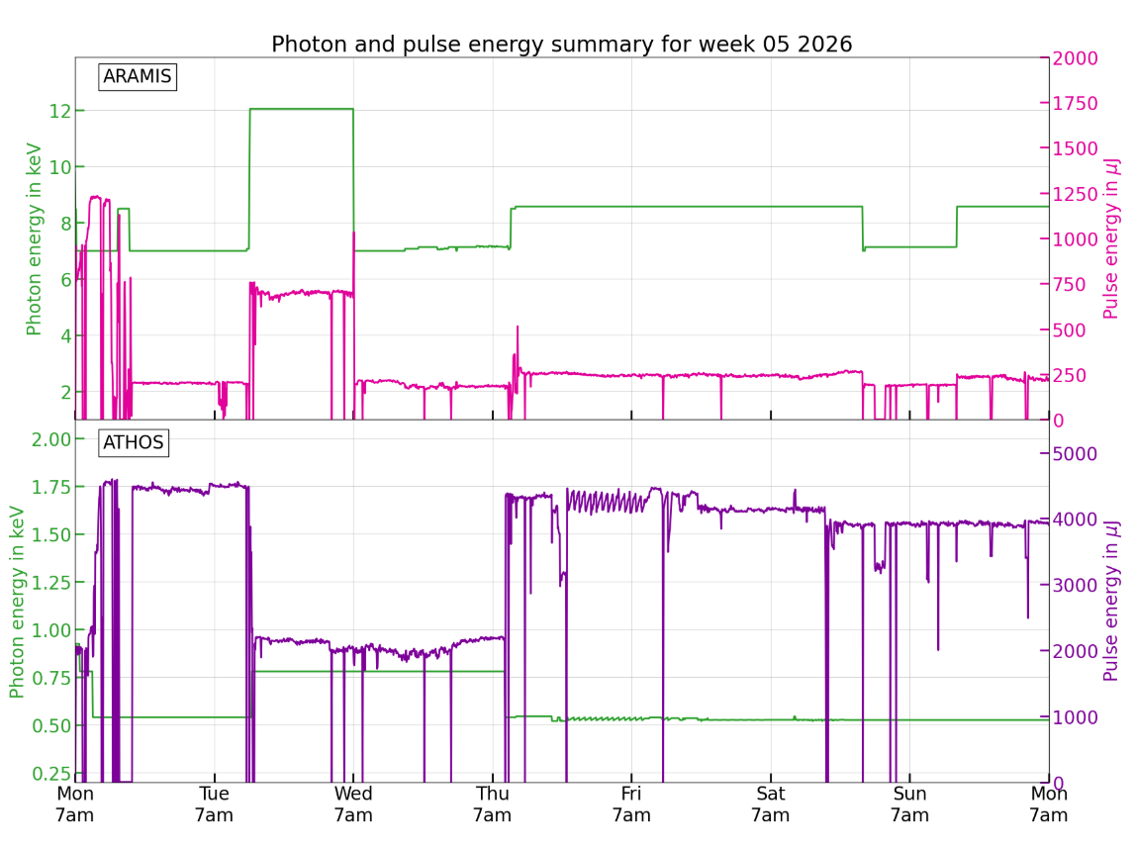

Slide 4
Machine issues:
Issue with collimators S30CB14-DCOL440 (motor to be homed) and S30CB12-DCOL440: beam losses after reloading 12 keV setting
Power supply error in SATUN04-MQUA060
(Thu-Sun): some RF issues (downtime) and several Athos undulator issues (motors got stuck, beam quality degradation)
(Thu) Klystron S10CB07 suffers from "Strange Pulses" (kind of mini arc, frequency of 1 per day)==>modulator failure
Several issues of motors getting stuck in SATUN undulators (SATUN11, SATUN10, SATUN09, SATUN08, SATUN18) :
problem normally fixed by IOC rebooting and controller power-cycling
SATUN18: remote rebooting failed; tunnel access needed (broken encoder replaced)
No other intervention possible during FEL user operations apart from IOC rebooting and power-cycling (no tunnel access planned)
S30CB04 RF several failures (“black-heating”) and manual operation by the RF picket to bring back the RF station in operations (RF experts’ intervention planned today)

