Slide 1
Present status and future prospects of nEDM experiment
(PNPI-ILL-PTI)
Anatolii Serebrov
PNPI, Gatchina
Physics of fundamental Symmetries and Interactions - PSI2013

Slide 2
PNPI, Petersburg Nuclear Physics Institute, Gatchina, Russia
Serebrov, E.Kolomenskiy, A.Pirozhkov, I.Krasnoshekova, A.Vasiliev, A.Polyushkin, M.Lasakov, A.Fomin, I.Shoka
ILL, Institut Laue-Langevin, Grenoble, France
P. Geltenbort, O. Zimmer, S. Ivanov
IPTI, Ioffe Physical Technical Institute, Russ. Acad. Sc.,
St. Petersburg, Russia
E. Aleksandrov, S. Dmitriev, N. Dovator

Slide 3
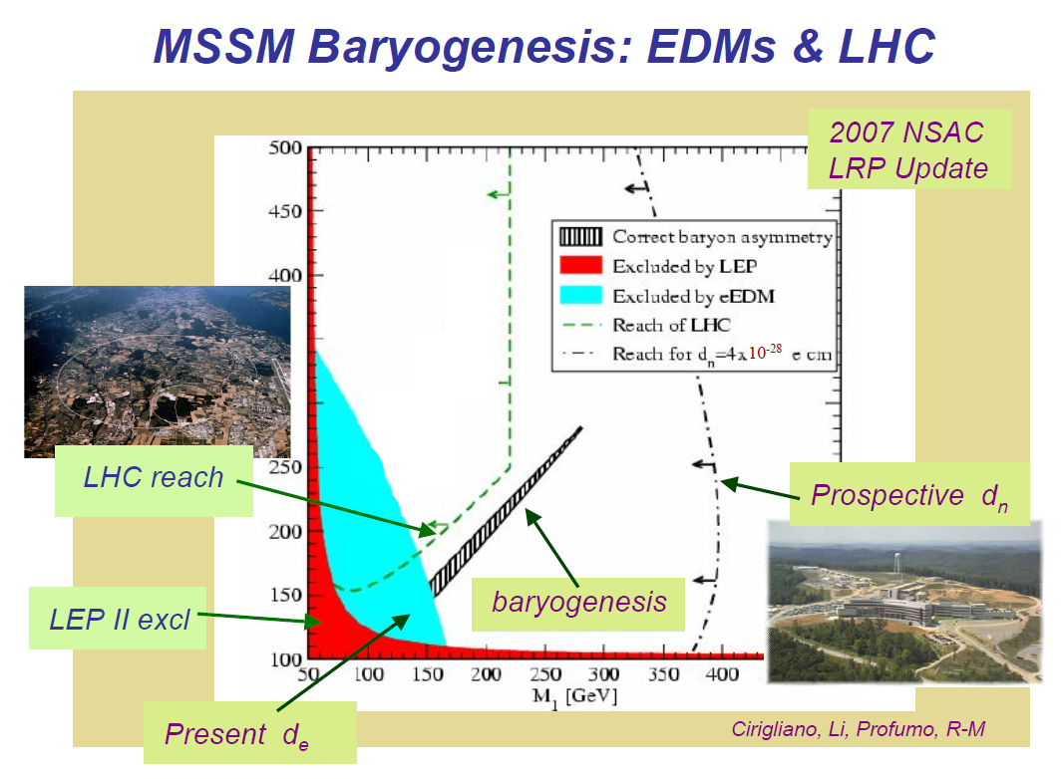
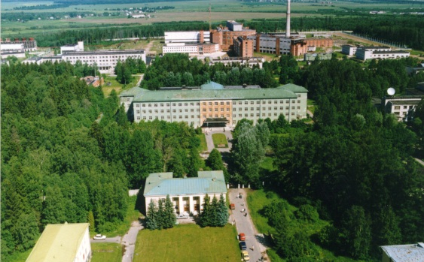
Gatchina PNPI
OAK RIDGE

Slide 4
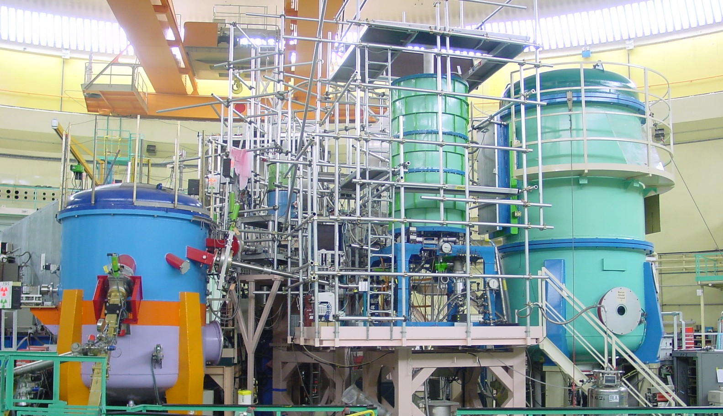
ILL UCN facilities - PF2 MAM
(in the past)
NESSIE vacuum vessel
platform
(iron)

Slide 5
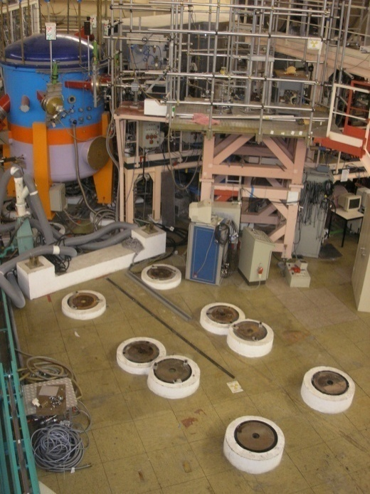
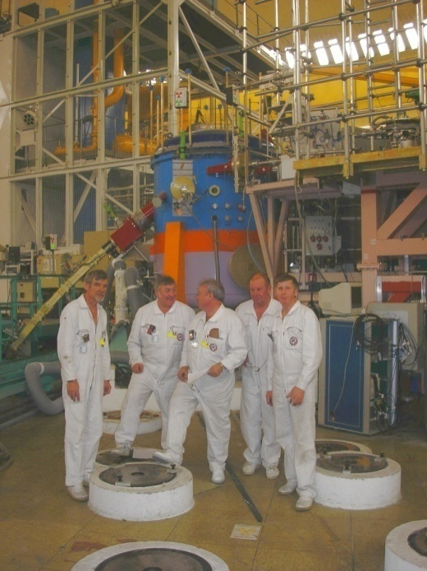
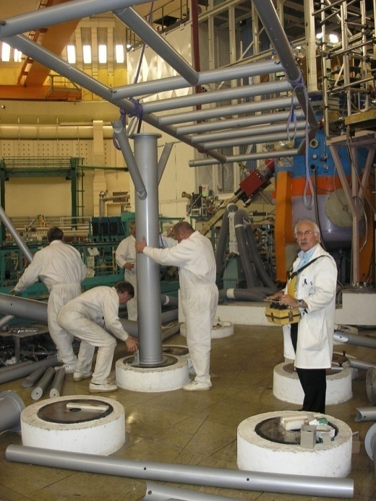
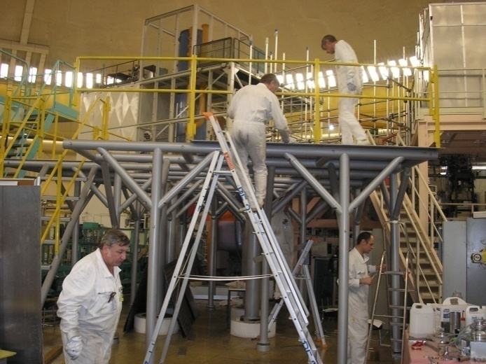
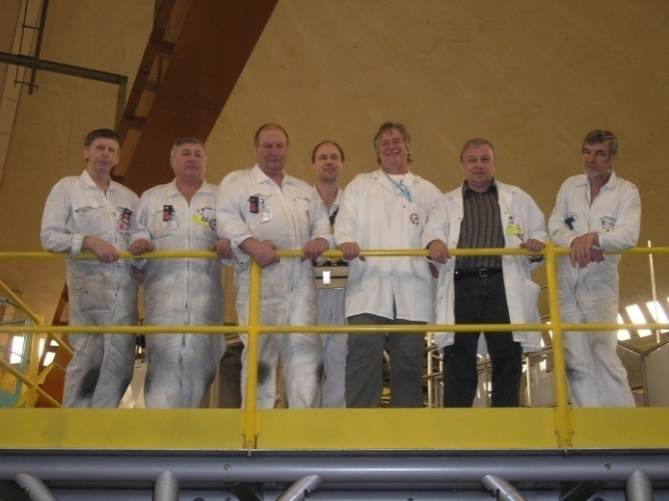
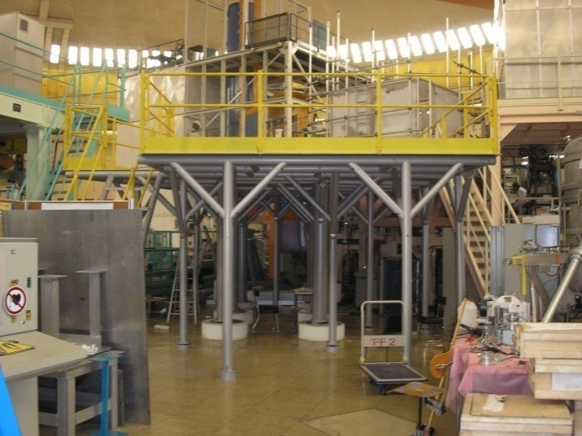
Installation of non-magnetic platform

Slide 6
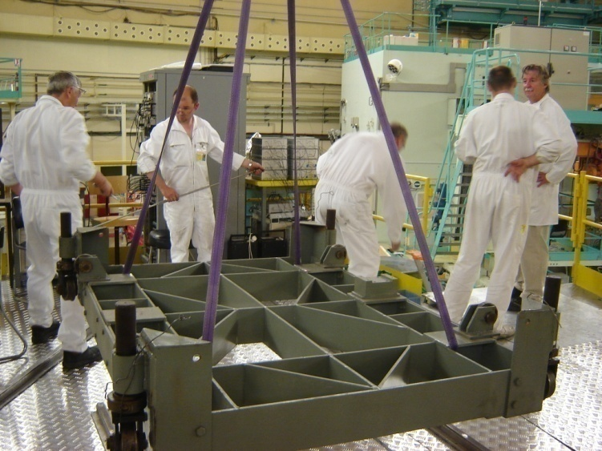
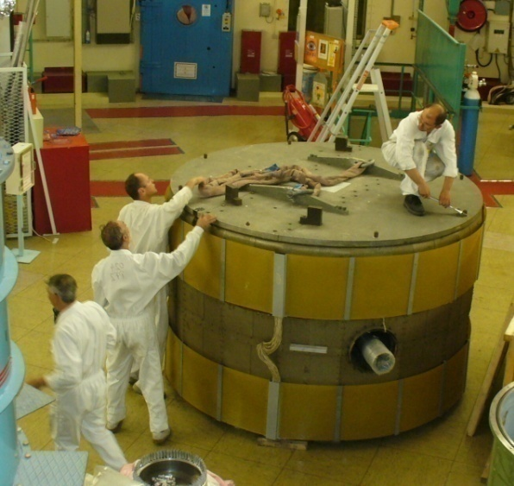
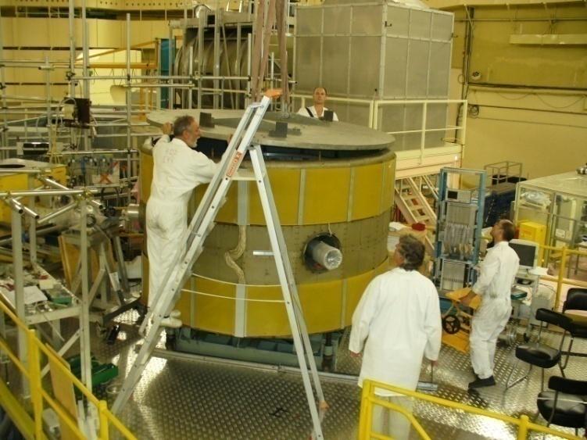
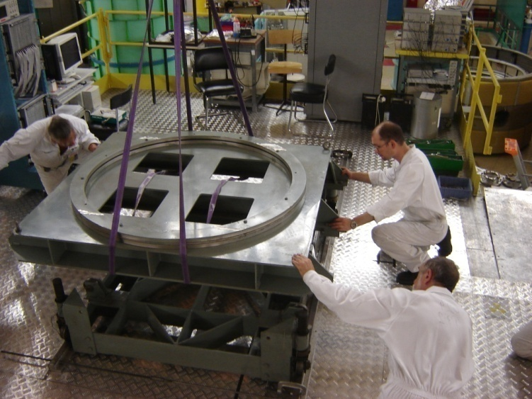
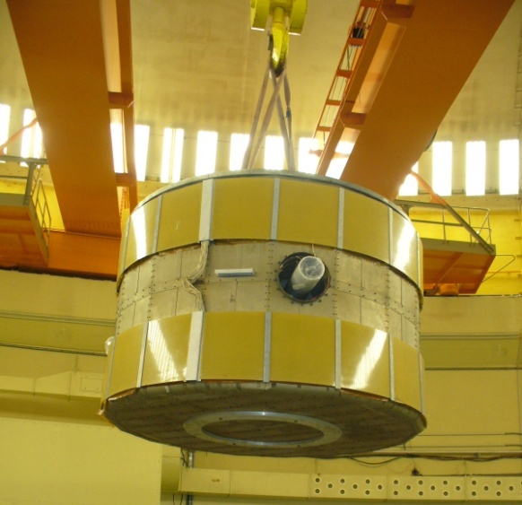
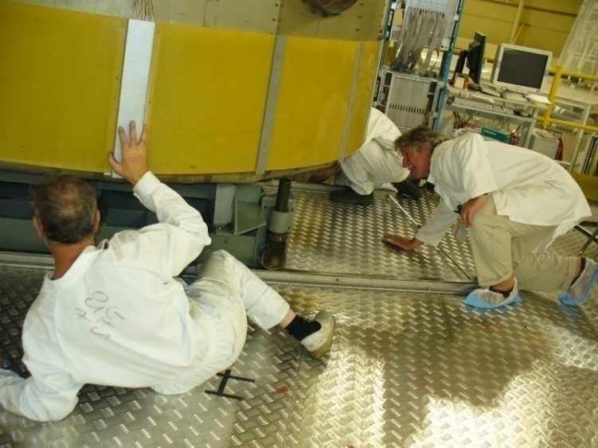
Assembly of double-chamber EDM spectrometer

Slide 7
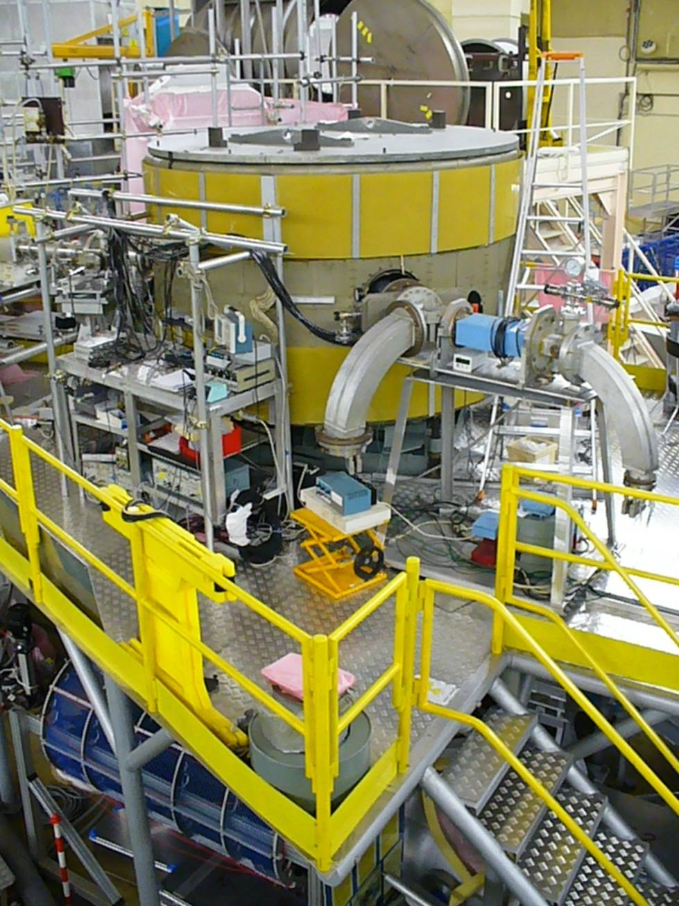
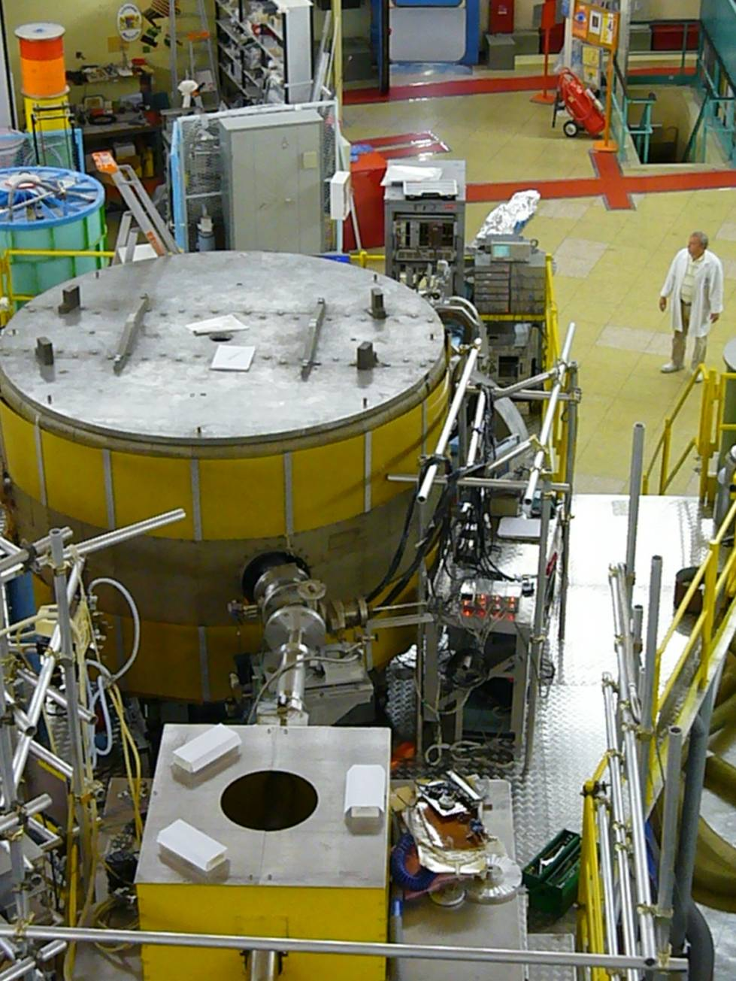
PNPI EDM spectrometer at the position PF2 MAM

Slide 8
Scheme of EDM spectrometer
magnetic field coils
top UCN trap
4 top magnetometers
2 side UCN detectors
2 direct UCN detectors
valves
magnetic
screens
analyzers
UCN
flipper
polarizer
resonance frequency coils
bottom UCN trap
± high voltage electrode
4 bottom magnetometers

Slide 9
Principal scheme of measurements with false effect control
d₁ - top trap
d₂ - bottom trap
d₃ - top trap
d₄ - bottom trap
direct detectors
side detectors
EDM is EDM effect
ν is effect of influence of electric polarity changing on the resonance conditions (magnetic field or frequency)
N is effect of influence of electric polarity changing on the detector counting rate
z is compensation of all effects, including EDM effects
^{(*)} Difference of measurements for 90º and 180º

Slide 10
Measurement of Storage Time
Top chamber
Bottom chamber

Slide 11
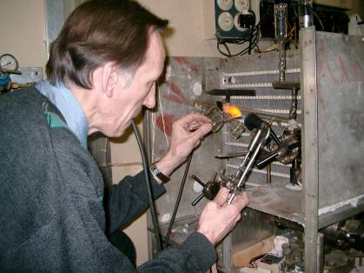
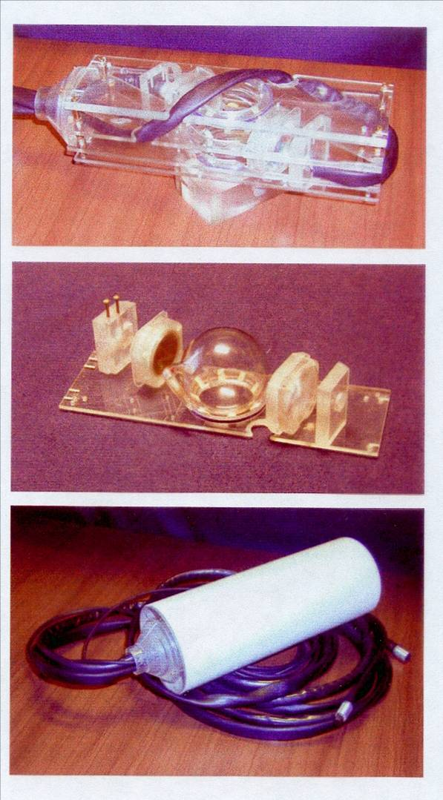
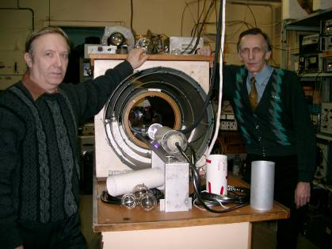
Preparation of Cs-magnetometers at IPTI

Slide 12
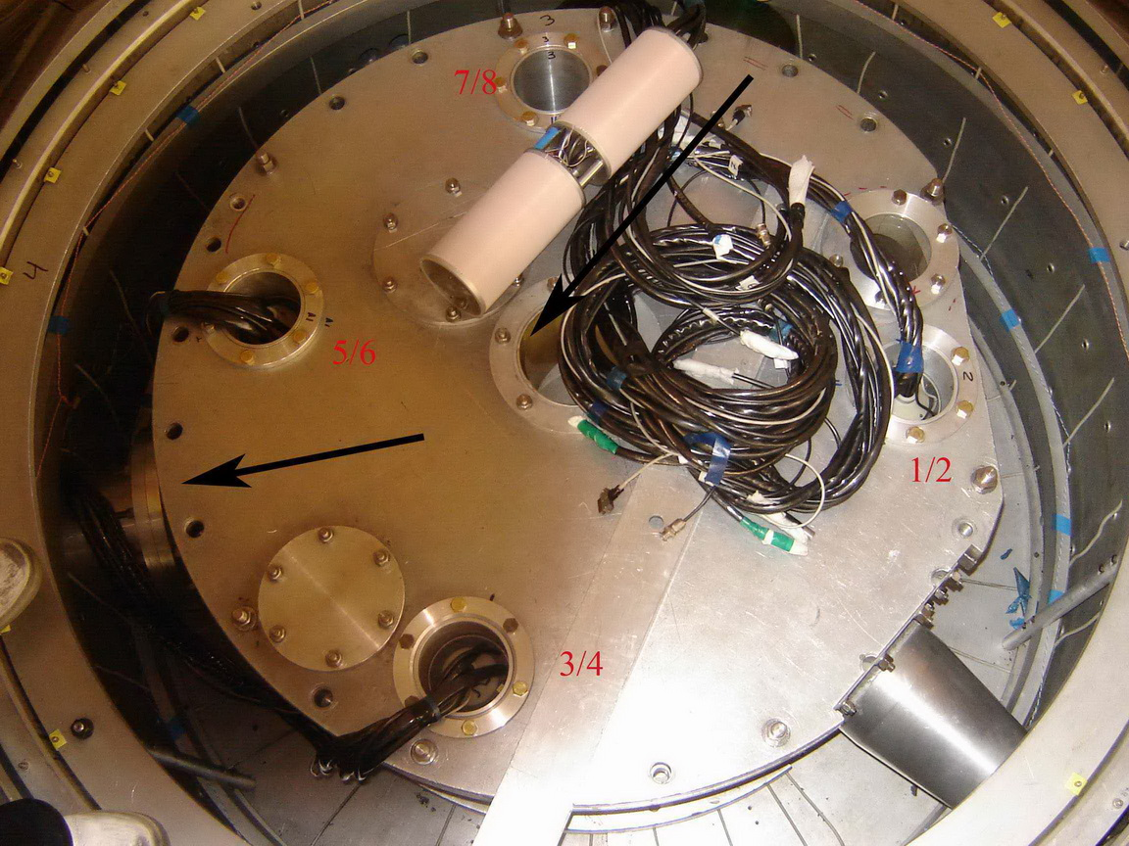
8 (4x2)Cs-magnetometers inside EDM spectrometer

Slide 13
Stabilization of magnetic field during resonance measurements (system of stabilization of resonance conditions + feedback by means of current coils)
quiet magnetic situation
13

Slide 14
Stabilization of magnetic field during resonance measurements (system of stabilization of resonance conditions + feedback by means of current coils)
full day tests of bridge crane

Slide 15
The influence of external magnetic fluctuations on stability of resonance conditions in a spectrometer.
(factor of stabilisation by mean of 8 Cs-magnetometers is about 10 – 15 times)
a)FM is the average frequency measured by means of eight Cs magnetometers;
b) FN is the frequency measured by the additional Cs magnetometers in working volume;
Difference FN – FM.

Slide 16
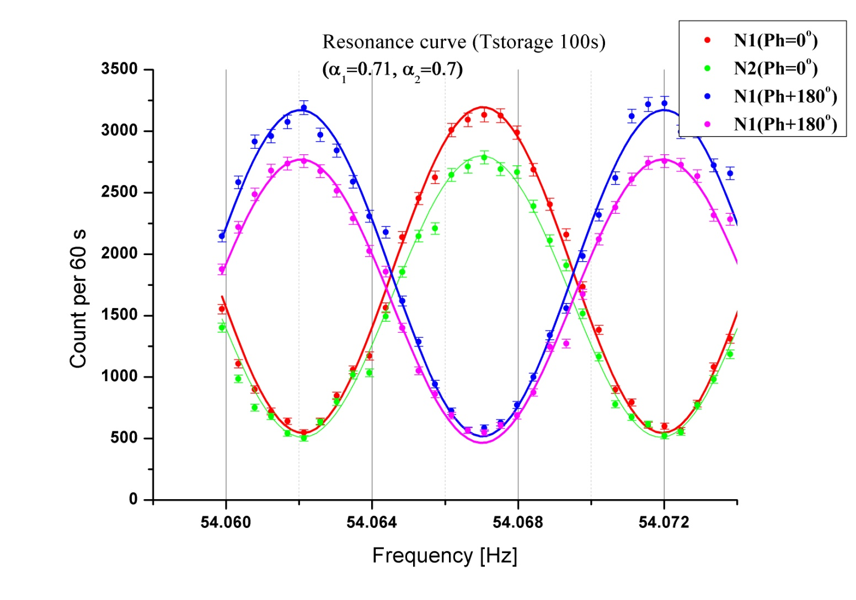
Resonance curves for holding time 100s

Slide 17
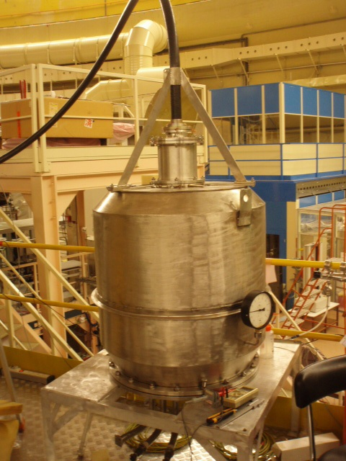
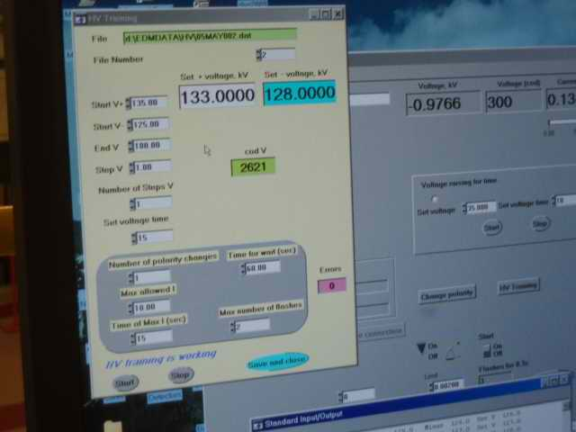
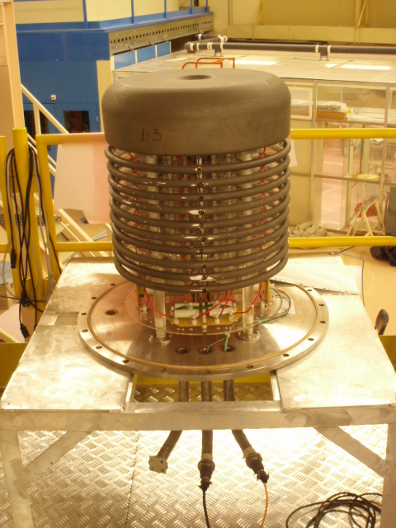
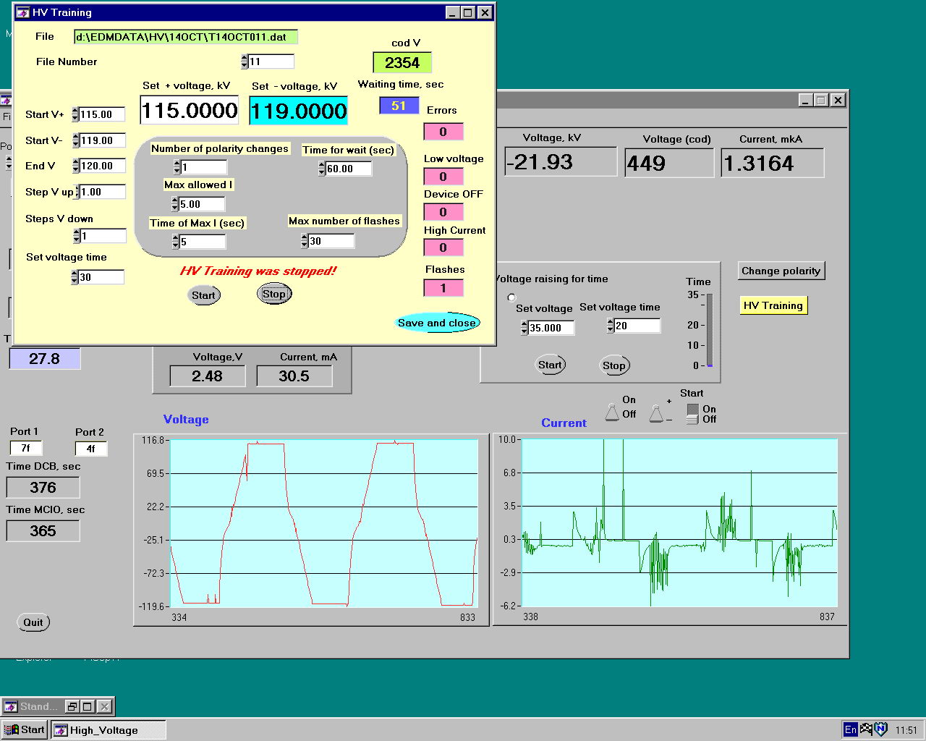
Interactive window of the management program for the HV-source
HV-power supply and operation system

Slide 18
Direct measurement of sensitivity of EDM spectrometer with UCN density 4 ucn/cm³ (at entrance) with electric field 18 kV/cm and T(hold) = 100 s
δD_{edm} ~ 1.7∙10⁻²⁵ e∙cm/day
The best run
15 hours of measurement

Slide 19
Preliminary results of measurements in units
10⁻²⁶ e∙cm
 | Old | New | All
EDM | 0.7±4.0 | 0.363±4.68 | 0.56±3.04
ν | -22.8±9.2 | -10.04±5.98 | -13.8±5.01
N | -14.5±4.4 | 18.62±5.15 | -0.53±3.35
z | -0.8±4.0 | 3.68±4.72 | 1.05±3.05
/nEDM/ ≤ 5.2∙10⁻²⁶ e∙cm
EDM
ν
90% CL
Control of false effect
due to magnetometers
(H_{up}-H_{down})⁺ - (H_{up}-H_{down})– =
= -(12.05±8.44)∙10⁻⁷ nT →
→ -(2.46±1.72)∙10⁻²⁷ e∙cm
N
z

Slide 20
OUR current result
90% CL
Present limit
90% CL

Slide 21
Nearest future prospects
Next step – removal to PF2 position EDM
GAIN FACTOR IN UCN DENSITY is 3 - 4 times.
2. New scheme of UCN trap in EDM spectrometer
Expected factor in UCN intensity – 3 times
Expected EDM sensitivity :
0.7∙10⁻²⁶ e∙cm/100 days

Slide 22
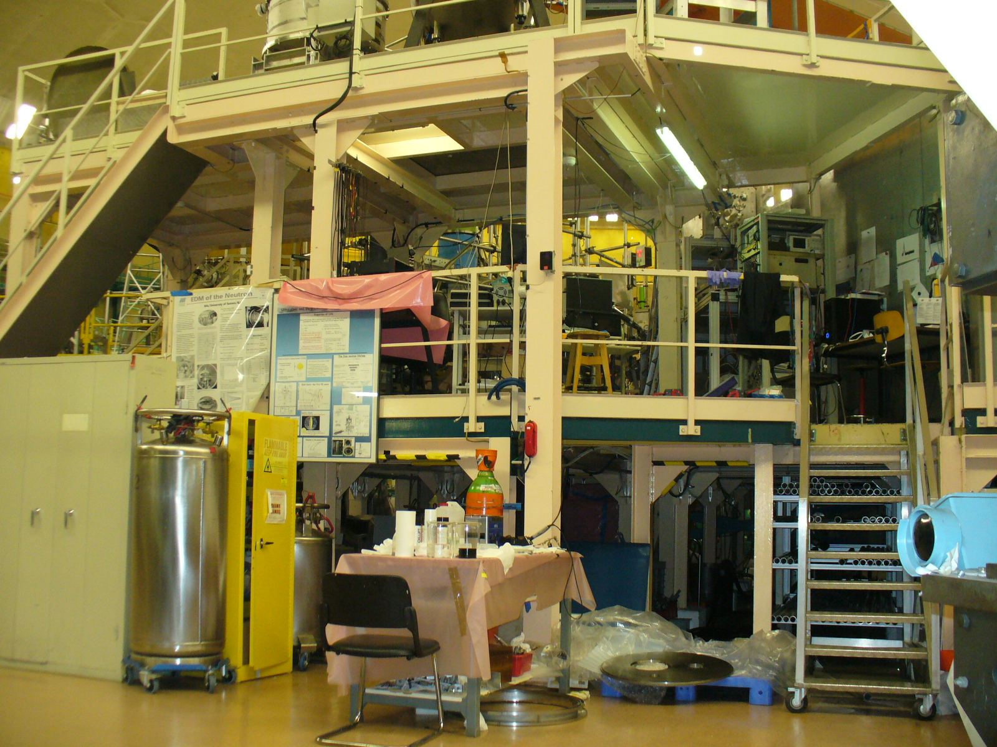
EDM spectrometer and “Big gravitrap”
at the PF2 UCN facilities
turbine
EDM spectrometer
installation
“Big gravitrap”

Slide 23
New scheme of UCN trap in EDM spectrometer
Expected factor UCN intensity – 3 times
New scheme
Old scheme

Slide 24
EDM sensitivity at PF2 position “EDM”
New position at PF2 (EDM instead of MAM) Factor in UCN density is about 3 – 4 times in respect to MAM position. Additionally new scheme of UCN traps in spectrometer can bring factor of 3 in UCN intensity.
Expected EDM sensitivity :
0.7∙10⁻²⁶ e∙cm/100 days

Slide 25
Nearest and distant future prospects to increase sensitivity of EDM measurements
Nearest prospects
Distant prospects

Slide 26
UCN supersources at PNPI reactor WWR-M and reactor PIK
future prospects

Slide 27
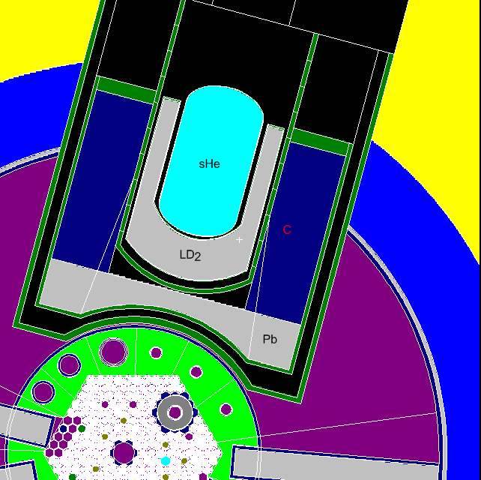
MCNP neutron flux calculation results and heat generation in thermal column of WWR-M reactor at 15 MW
ρ_{ucn}=10⁴ сm⁻³ (τ=10 s)
Ф=4.5∙10¹² n/(сm²s)
Ф(λ=9 А)=3∙10¹⁰ n/(сm²sA)
Q_{He}=6 W
He Т=1.2 К
LD₂ Т=20 К
19 W
Al, Q_{Al}=13 W
C Т=300 К
Pb Т=300 К
LD₂, Q_{LD2+Al}=100 W
C, Q_{C}=700 W
Pb, Q_{Pb}=15 кW
Ф=10¹⁴ n/(cm²s)
Q=15 MW

Slide 28
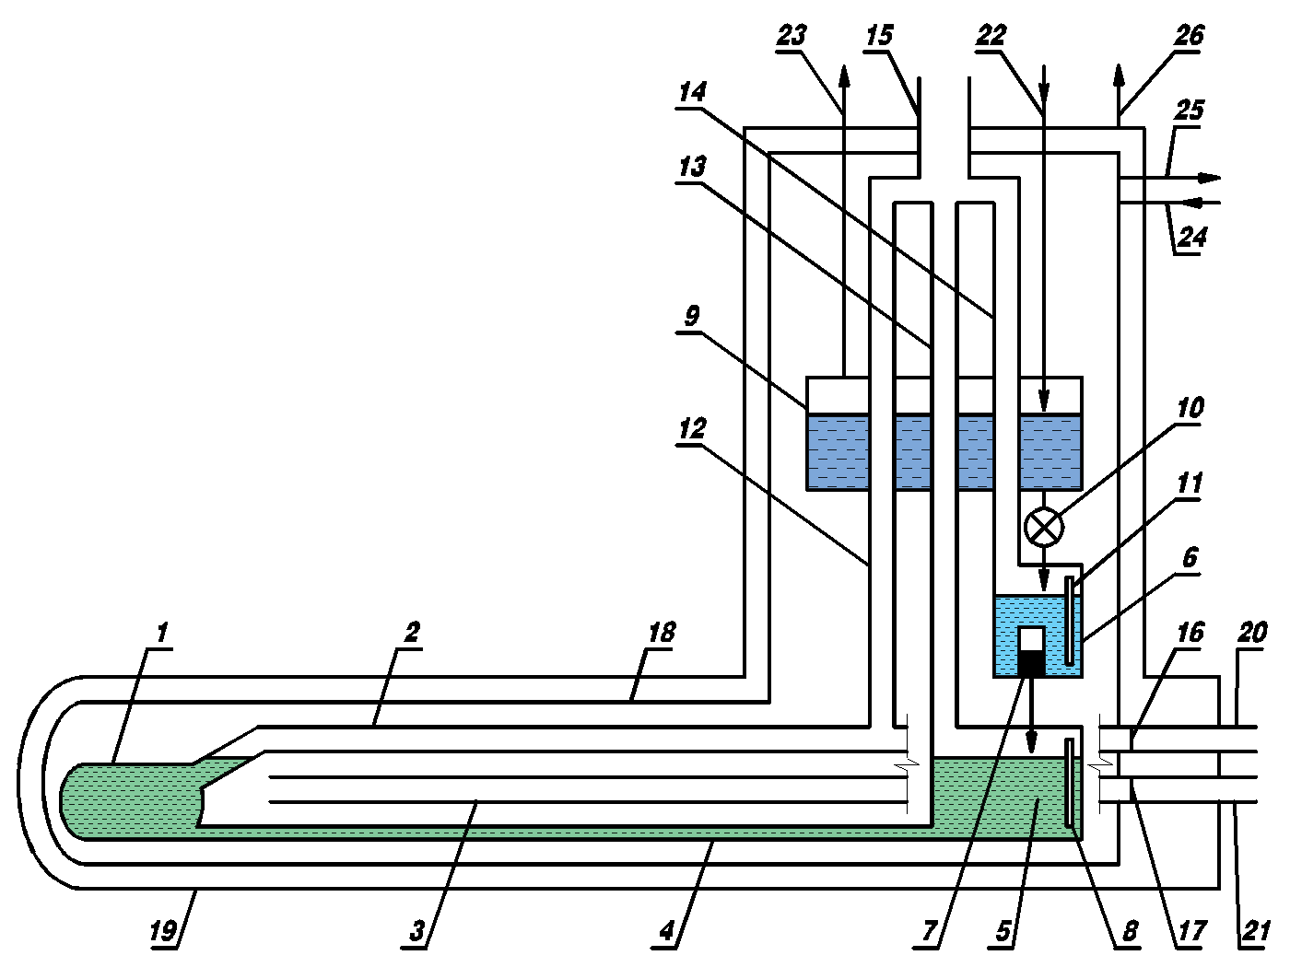
Cryogenic scheme of UCN source with superfluid He
10⁴ cm⁻³
UCN
CN
1 – He II cell; 2 – UCN neutron guide, 3 – CN neutron guide, 4 – He II supply pipe, 5 – lower bath @ 1.2 К, 6 – intermediate bath @ 1.2 К, 7 –³Не filter, 8 – level sensor, 9 – upper bath @ 4.2 К, 10 – helium supply valve, 11 – level sensor, 12 – vacuum pipe (gravitation trap for UCN), 13 – vacuum pipe for lower bath, 14 – vacuum pipe for intermediate bath, 15 – main vacuum manifold, 16 – UCN neutron guide membrane, 17 – CN neutron guide membrane, 18 – thermal shield @ 20 К, 19 – vacuum jacket, 20 – UCN outer neutron guide, 21 – CN outer neutron guide, 22 –helium supply at temperature of 4.2 К, 23 – pipe for helium vapour removal, 24 – helium supply for thermal shield 18, 25 – helium removal from thermal shield 18, 26 – pumping of vacuum jacket.

Slide 29
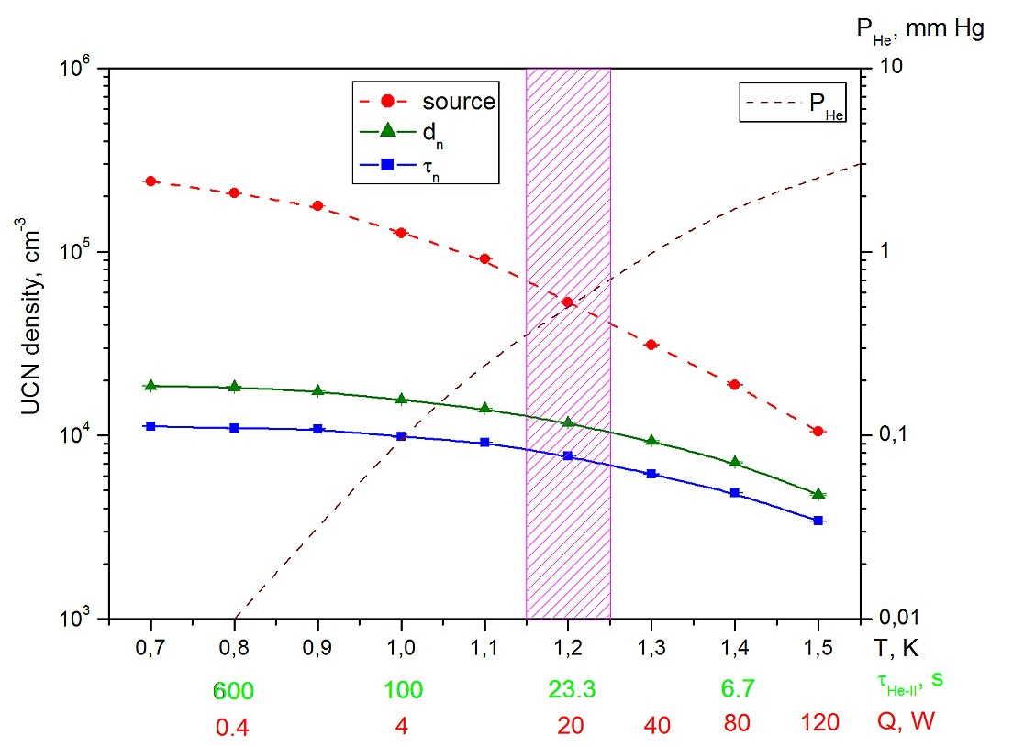
UCN density
maximal density
inside closed source
density in experimental trap with volume 35 l
10⁴ cm⁻³
density in experimental trap with volume 350 l

Slide 30
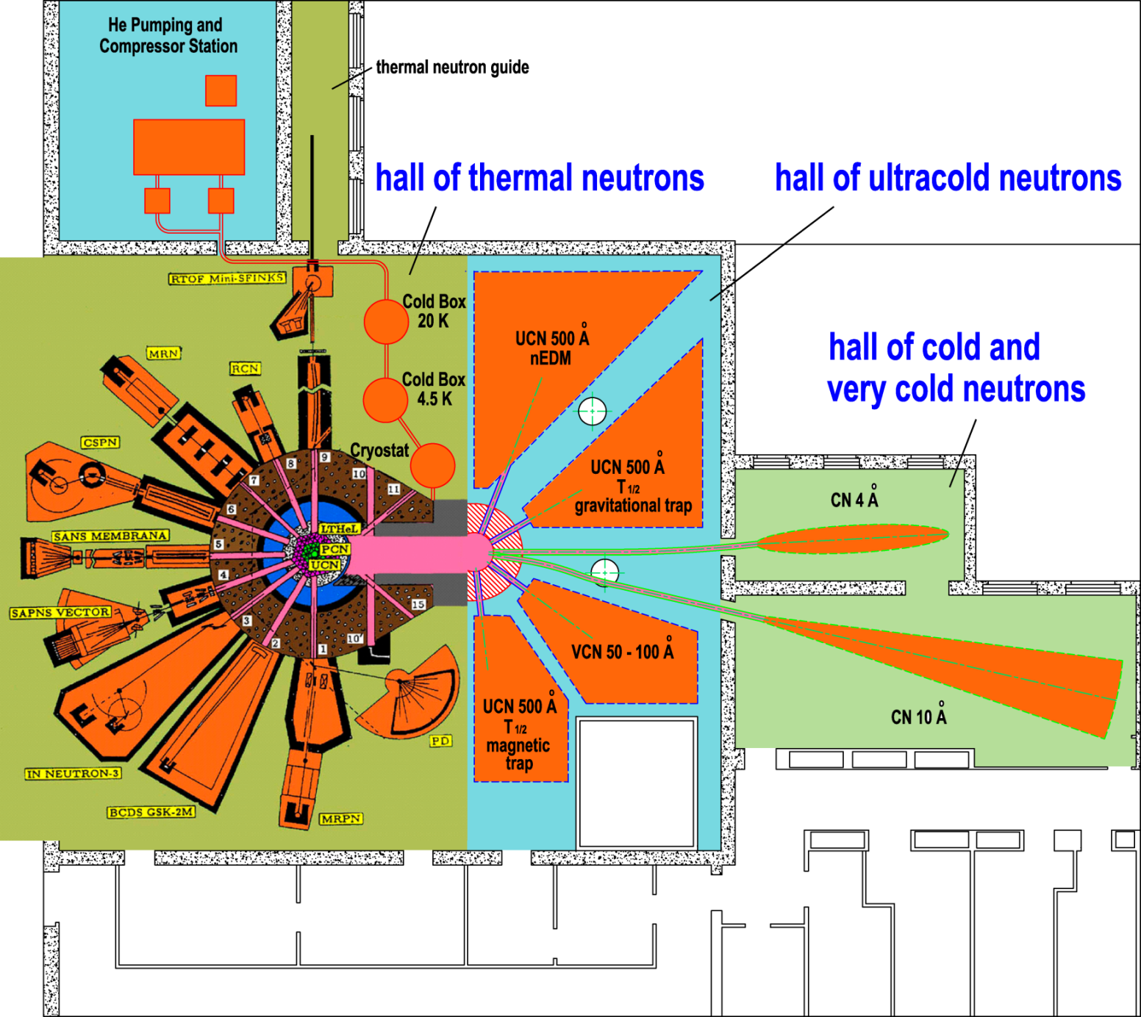
Ultracold and cold neutron source at WWR-M reactor with neutron guide halls

Slide 31
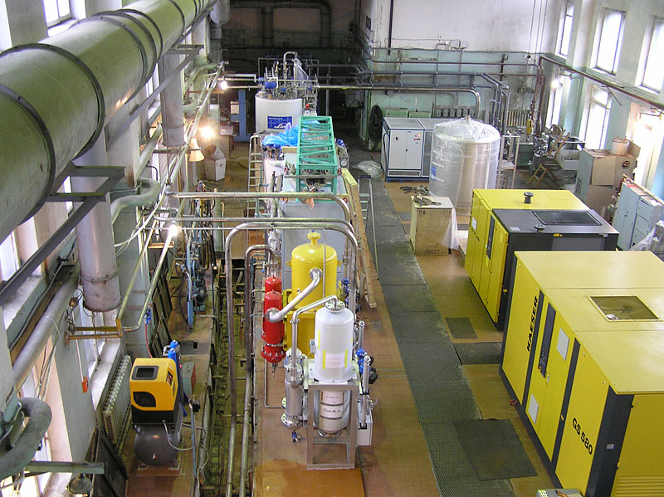
General view with new equipment

Slide 32
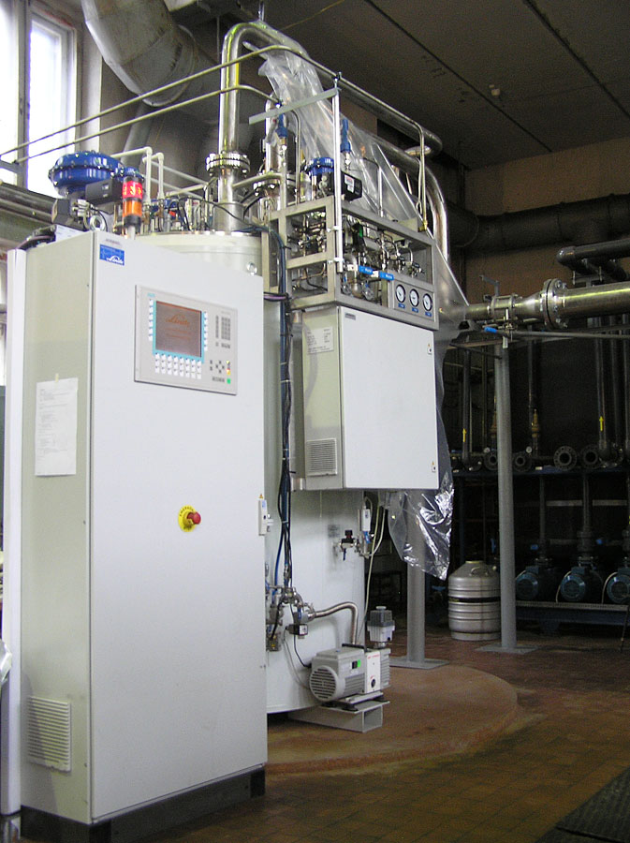
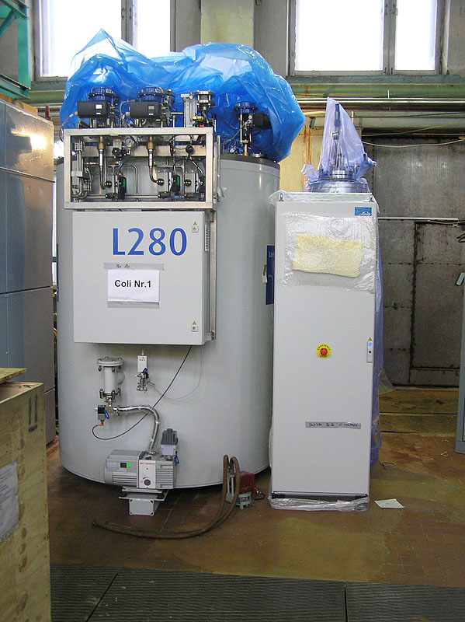
Helium refrigerator 15 K, 3000 Watts
Helium liquefier
50 l/h

Slide 33
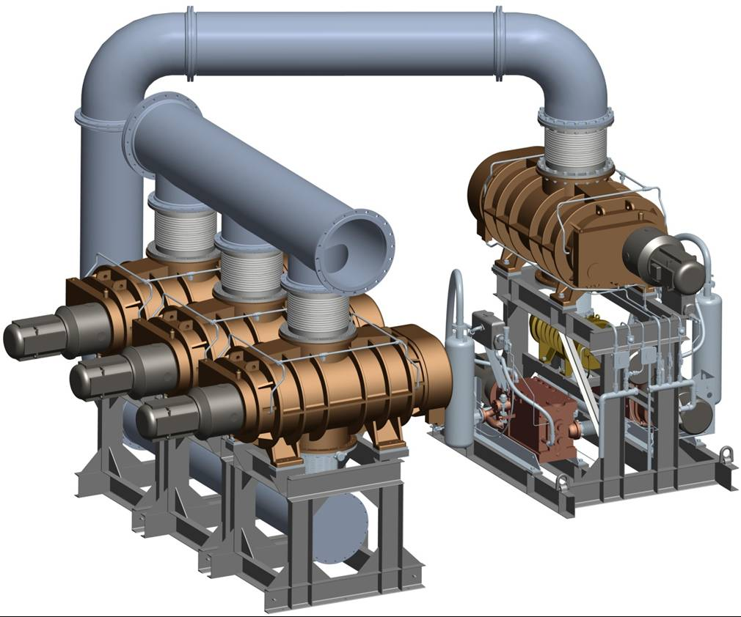
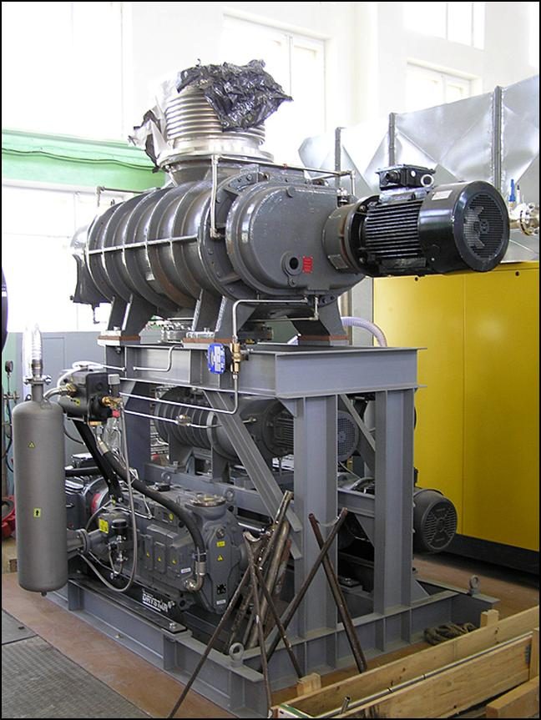
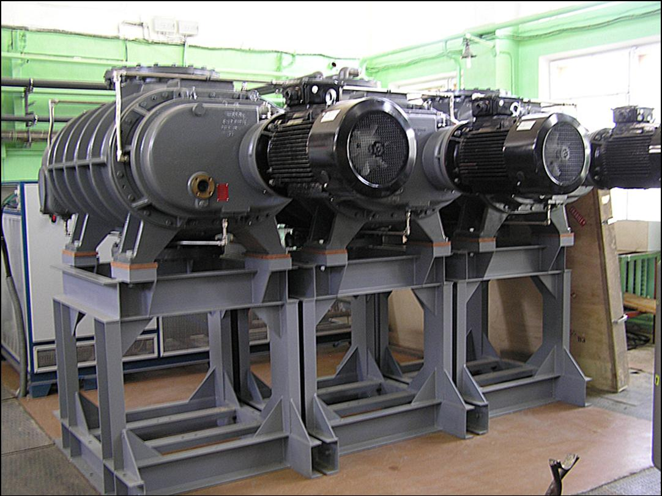
Pumping system of helium

Slide 34
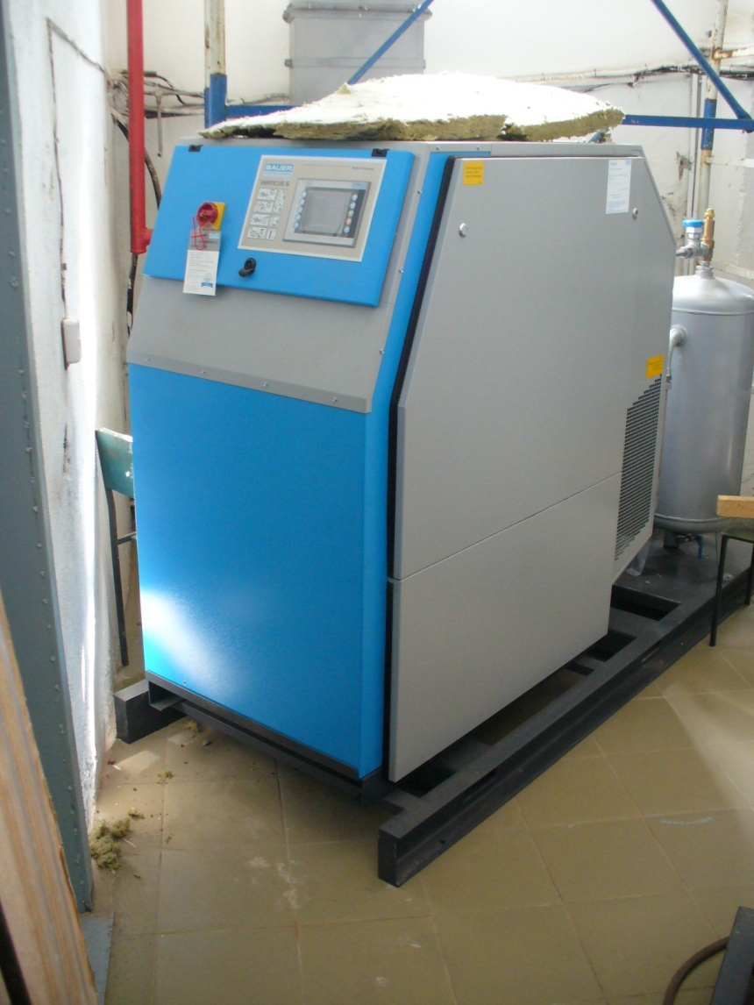
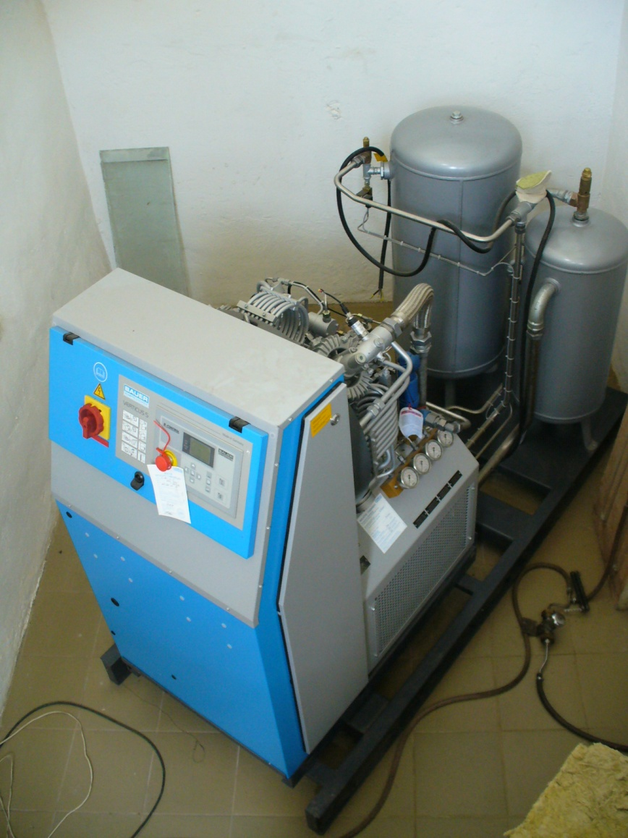
High pressure compressors

Slide 35
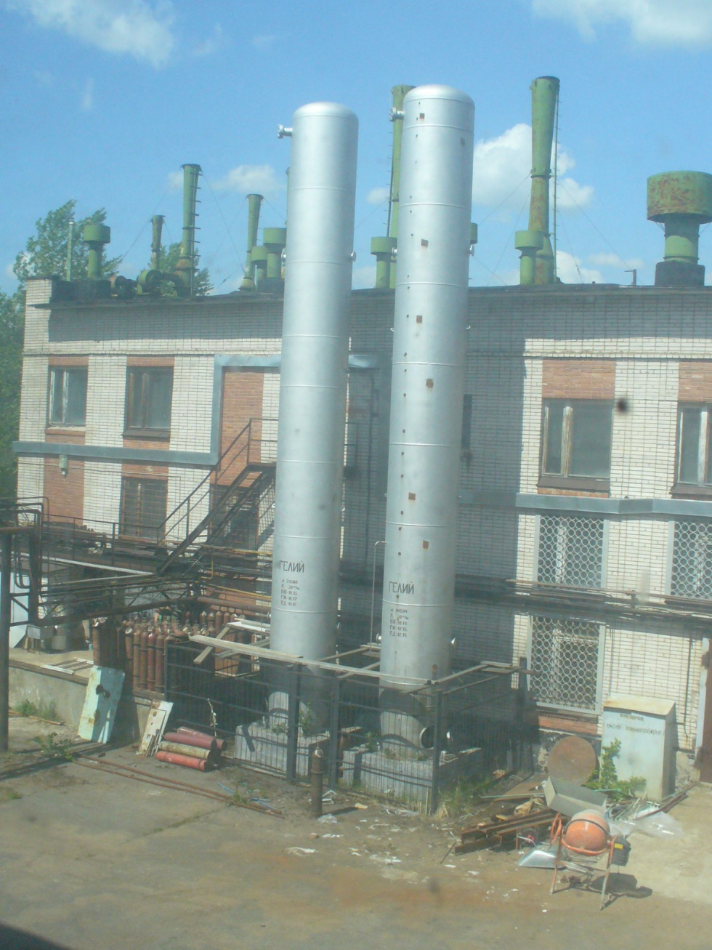
Gas
Storage
System

Slide 36
Preparation of non-standard equipment

Slide 37
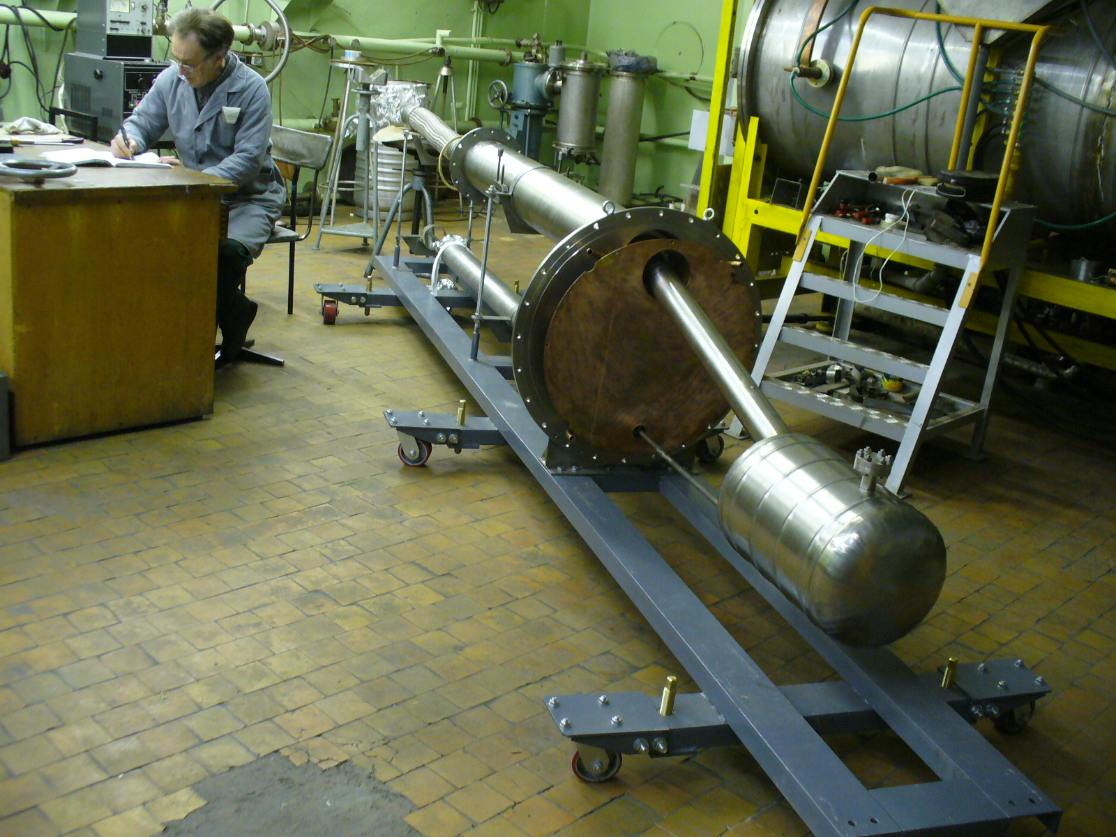
Vacuum test of full-scale model of UCN source

Slide 38
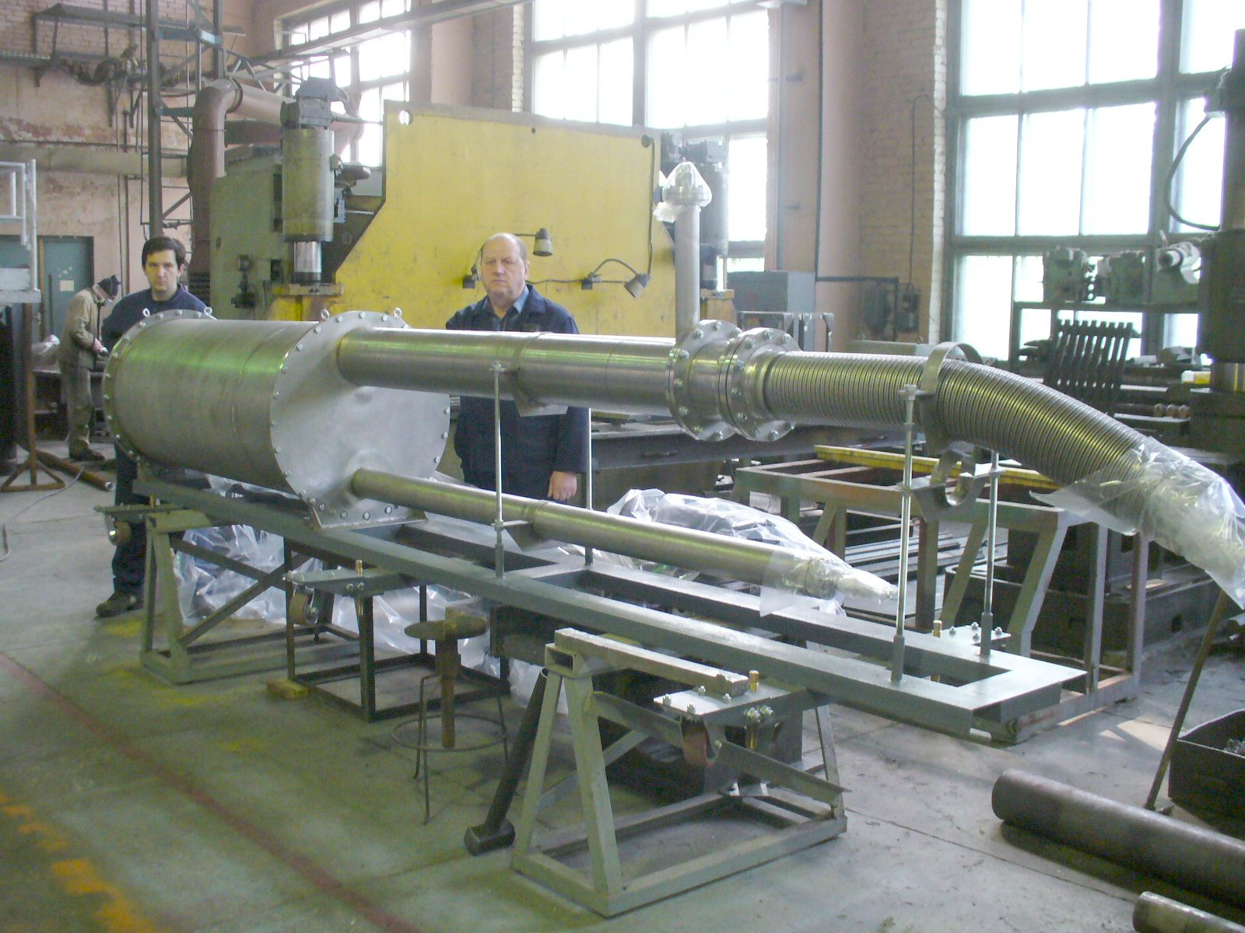
Cryogenic test of full-scale model of UCN source

Slide 39
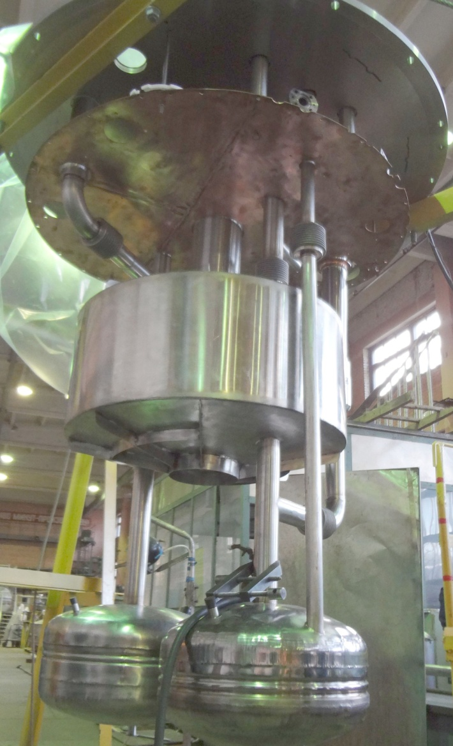
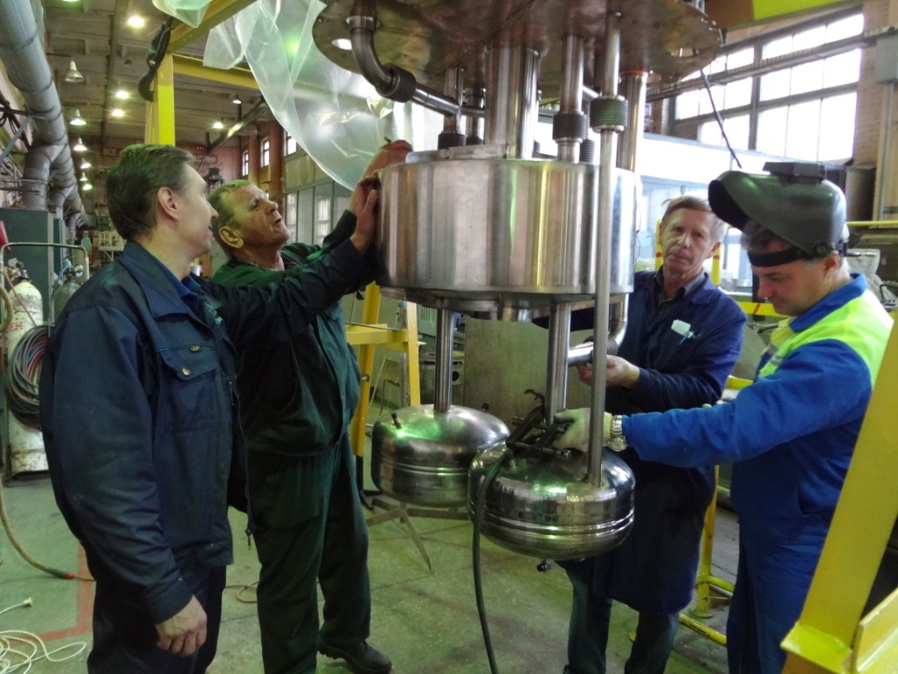
Manufacturing of cryostat for superfluid helium at 1.2 K

Slide 40
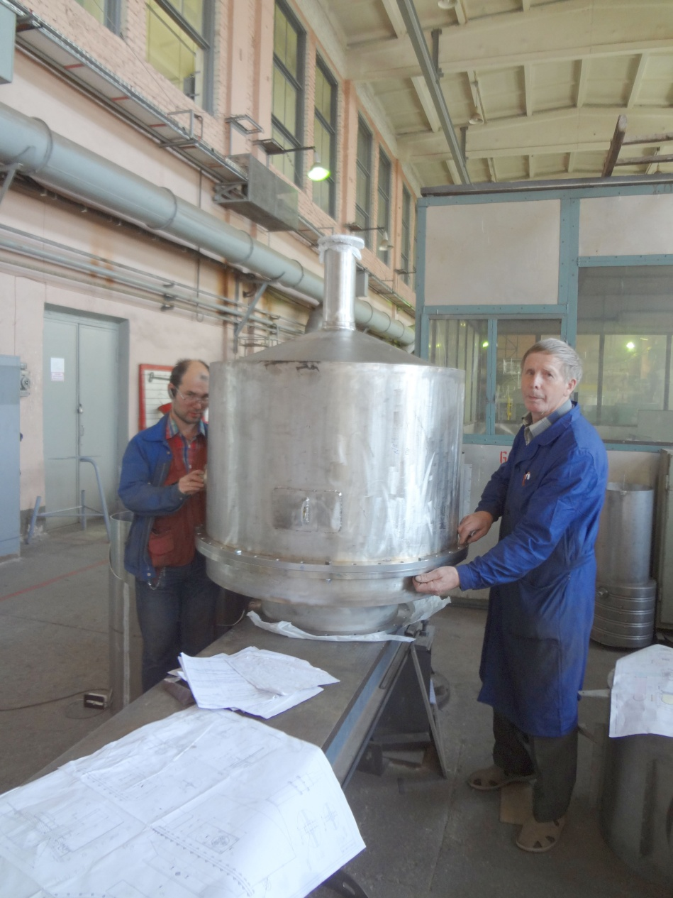
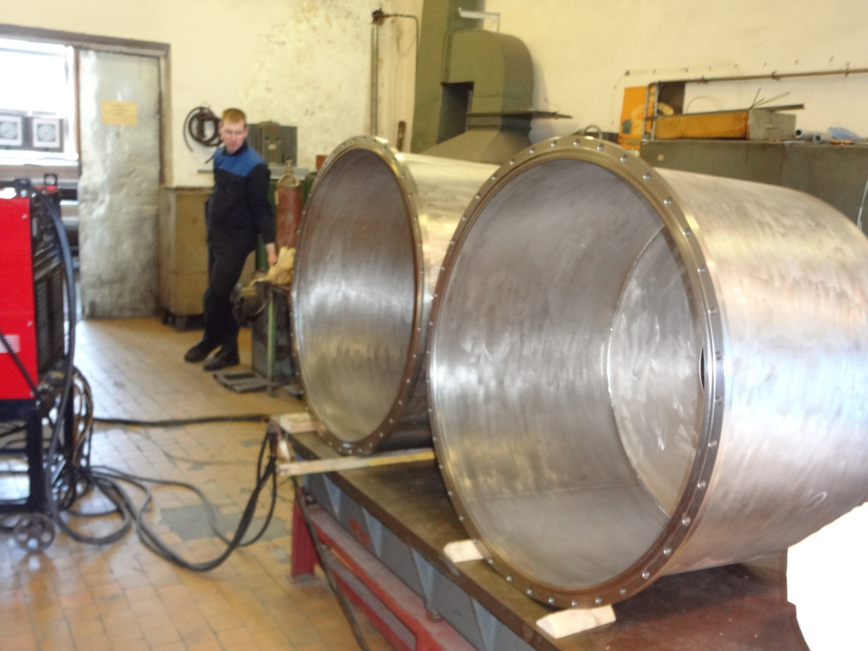
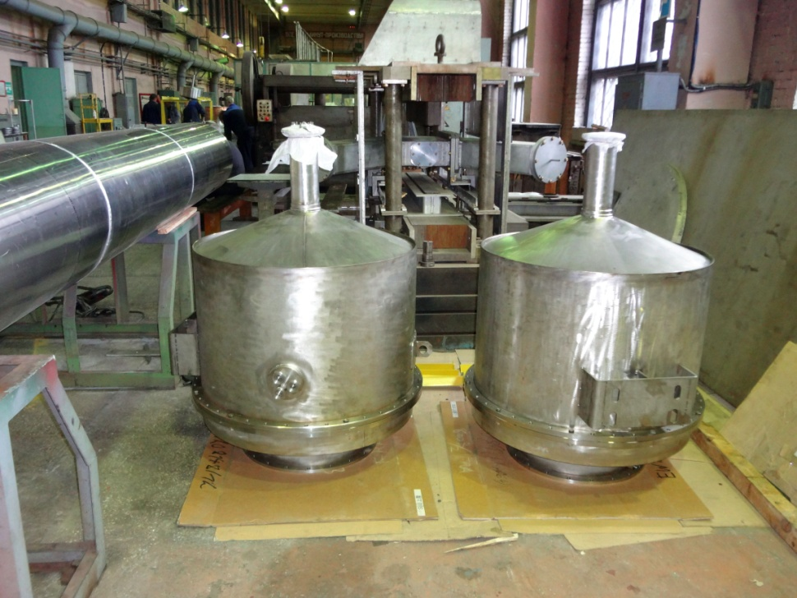
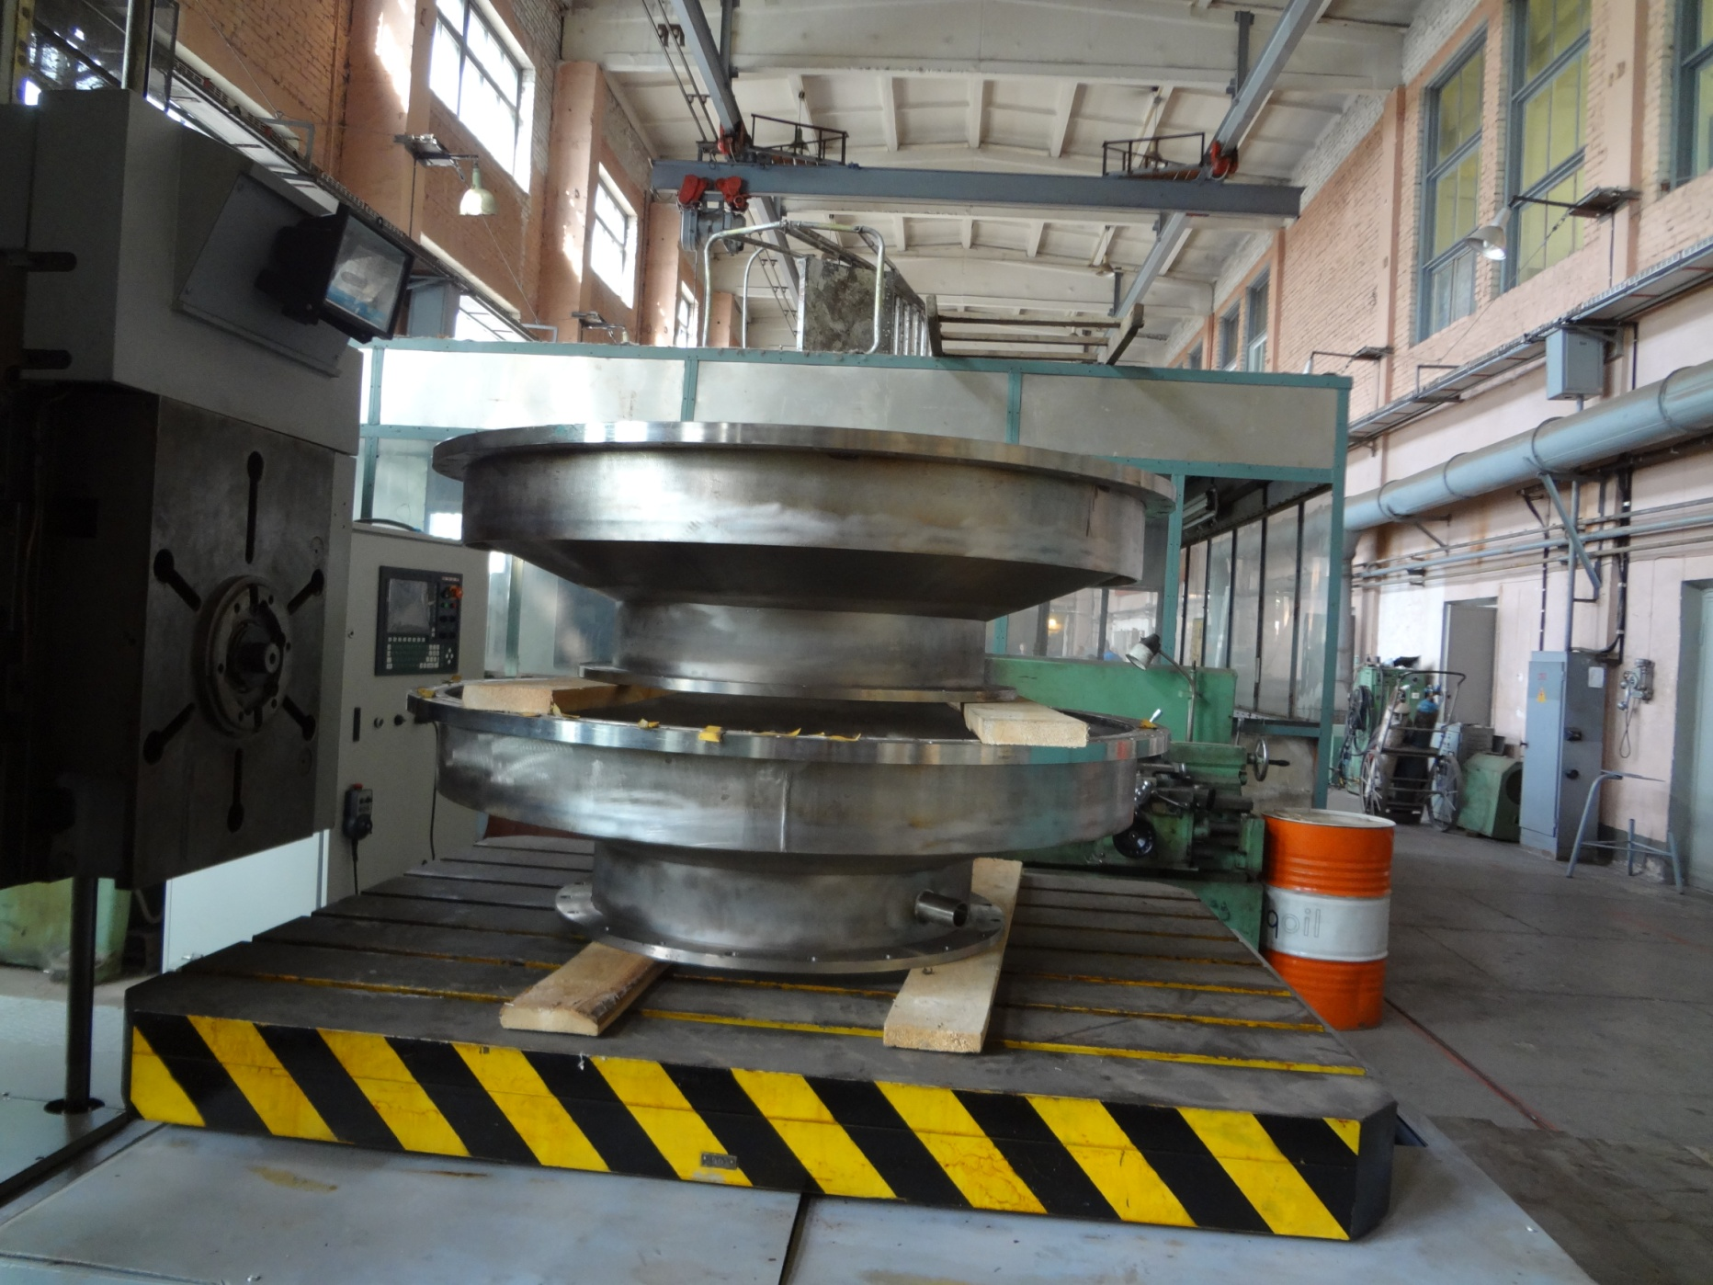
Manufacturing of He heating system

Slide 41
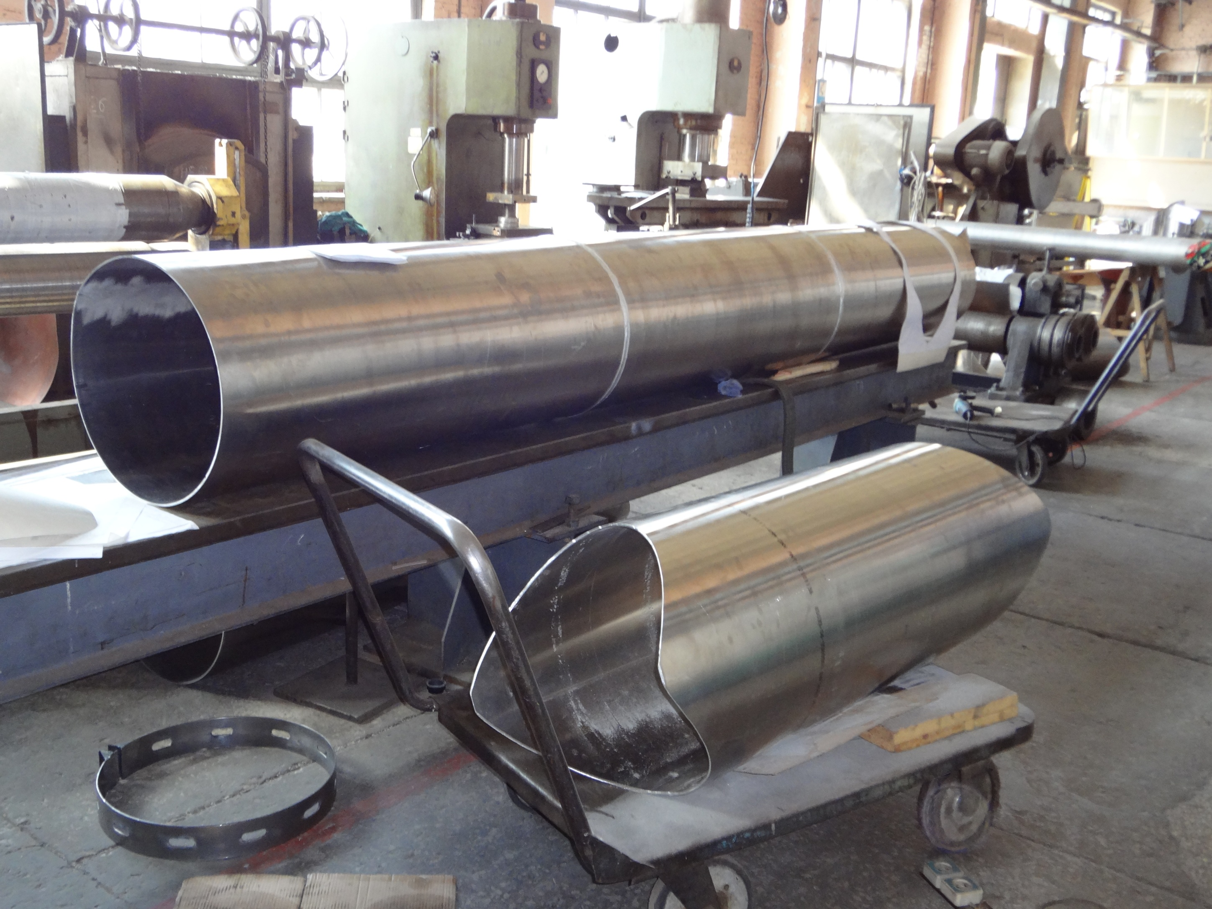
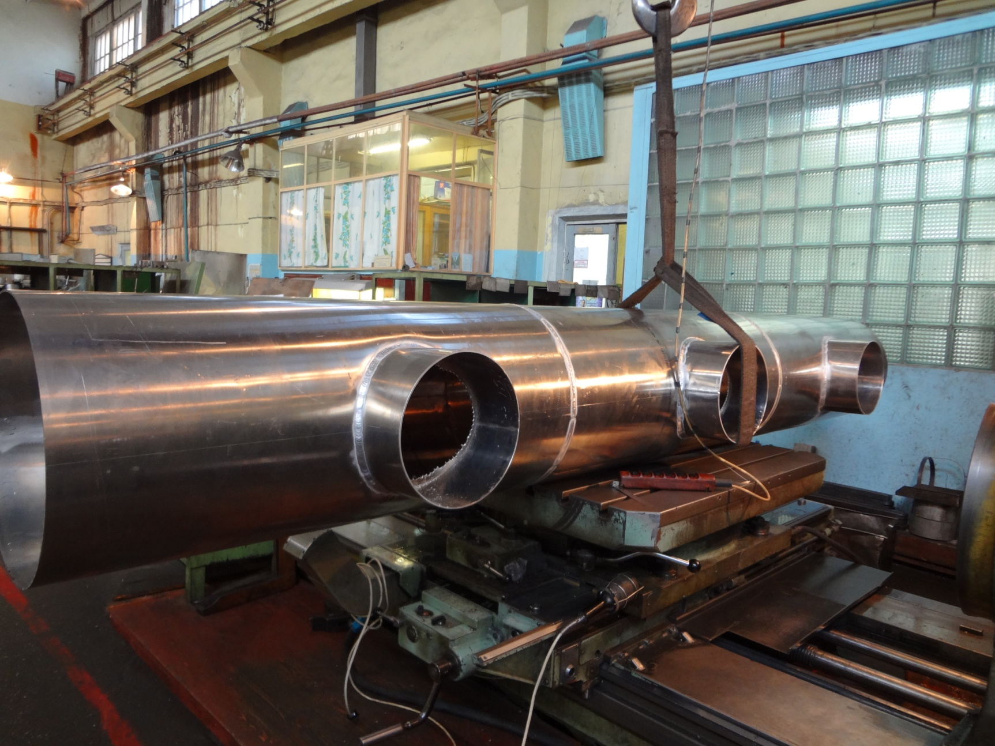


Manufacturing of He pumping tubes

Slide 42

Vacuum test of pumping tubes

Slide 43




Installation of He pumping tubes

Slide 44



Installation of He heaters for vacuum system

Slide 45


Installation of full-scale model of UCN supersource

Slide 46


Montage of cryostat for 1 К
Our task for 2014 is test of full-scale technological system
with model of UCN source

Slide 47

Reactor PIK

Slide 48
UCN facilities at PIK reactor

Slide 49
Conclusion
1. Present status
Our current result - /nEDM/ ≤ 5.2⋅10⁻²⁶ e⋅cm 90% CL
2. Nearest future prospects at PF2 EDM facilities
Sensitivity 1.0⋅10⁻²⁶ e⋅cm for 100 days of measurements
3. Long term prospects
High density of UCN source at WWR-M reactor. 10⁴ cm⁻³
Sensitivity 5.0⋅10⁻²⁸ e⋅cm for 100 days of measurements

