Slide 1

Welcome
to the
13th International Conference on
Muon Spin Rotation, Relaxation and Resonance

Slide 2
Rorschach, Switzerland (1978)
Vancouver, Canada (1980)
Shimoda, Japan (1983)
Uppsala, Sweden (1986)
Oxford, UK (1990)
Maui, USA (1993)
Nikko, Japan (1996)
Les Diablerets, Switzerland (1999)
Williamsburg, USA (2002)
Oxford, UK (2005)
Tsukuba, Japan (2008)
Cancun, Mexico (2011)
Grindelwald, Switzerland (2014)

Slide 3
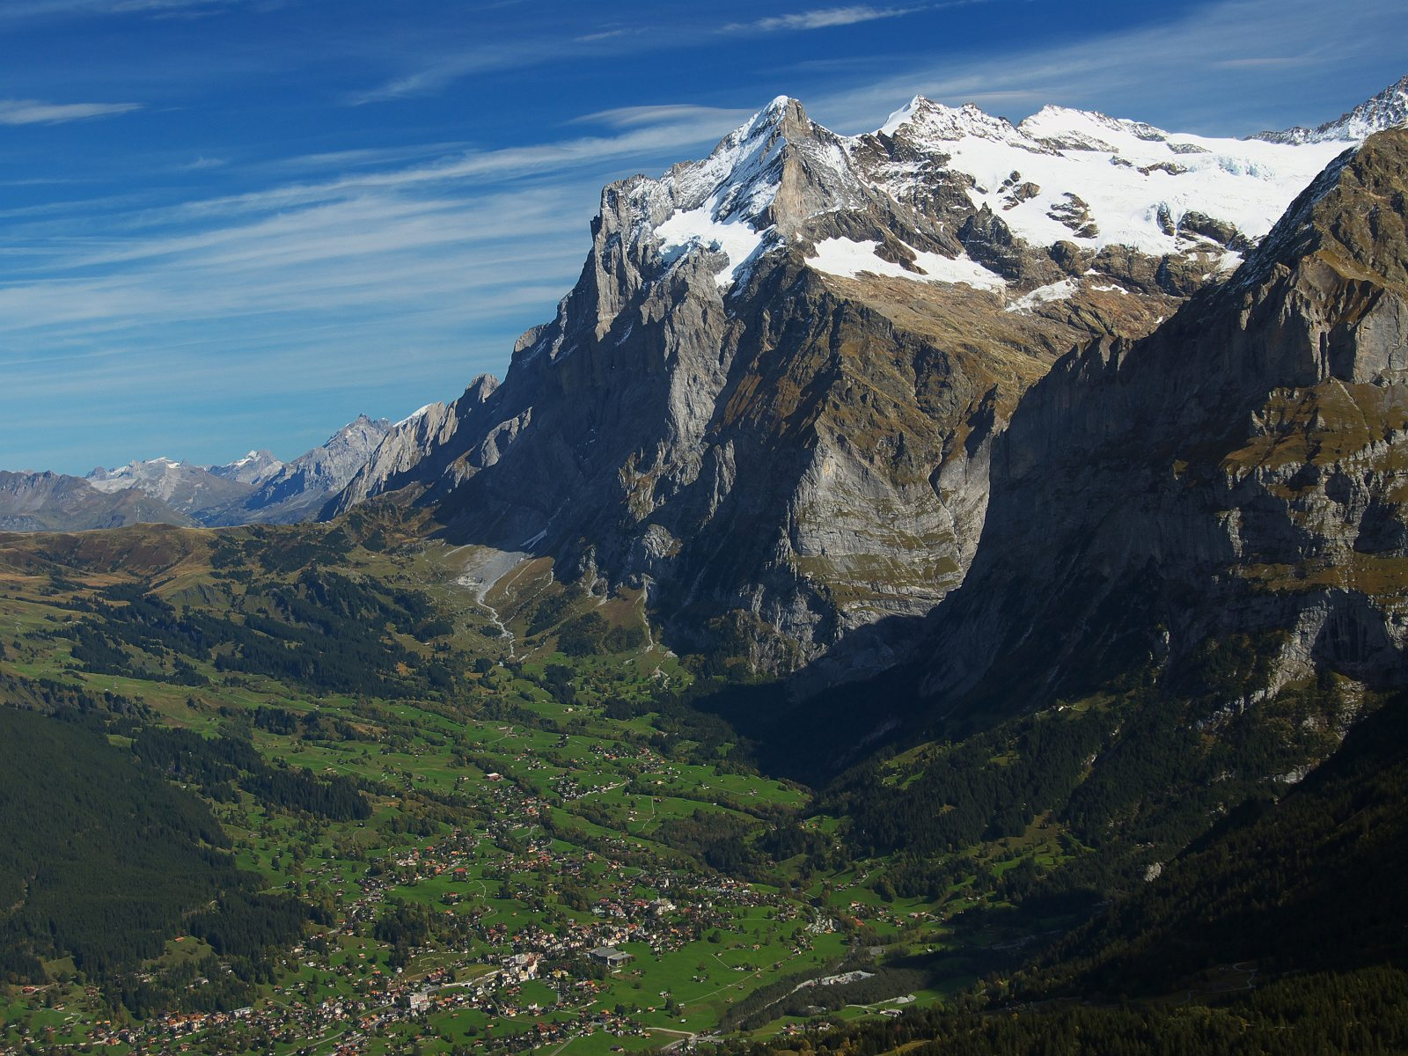

Slide 4
“I have walked myself
into my best thoughts,
and I know of no thought so burdensome that one cannot walk away from it.”
Søren Kierkegaard (1813-1855)
Notes:
Above all, do not lose your desire to walk. Everyday, I walk myself into a state of well-being & walk away from every illness. I have walked myself into my best thoughts, and I know of no thought so burdensome that one cannot walk away from it. But by sitting still, & the more one sits still, the closer one comes to feeling ill. Thus if one just keeps on walking, everything will be all right.

Slide 5
Welcome
to the
13th International Conference on
Muon Spin Rotation, Relaxation and Resonance

