Slide 1
Free-Electron Lasers
Sven Reiche, PSI

Slide 2
I. Motivation

Slide 3
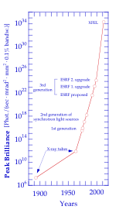
Light Sources
1st Generation: Synchrotron radiation from bending magnets in high energy physics storage rings
2nd Generation: Dedicated storage rings for synchrotron radiation
3rd Generation: Dedicated storage rings with insertion devices (wigglers/undulators)
4th Generation: Free-Electron Lasers

Slide 4
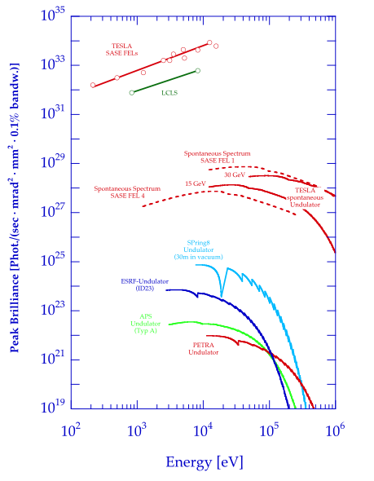
FEL as a Brilliant Light Source
High photon flux
SwissFEL
Small freq. bandwidth
Low divergence
Small source size

Slide 5
4th Generation Light Sources
Tunable wavelength, down to 1 Ångstroem
Pulse Length less then 100 fs
High Peak Power above 1 GW
Fully Transverse Coherence
Transform limited Pulses (longitudinal coherence)
XFELs fulfill all criteria except for the longitudinal coherence
(but we are working on it ☺ )

Slide 6

X-ray/VUV FEL Projects Around the World
WiFel
NLS
PolFEL
FLASH
FERMI
Euro XFEL
PAL FEL
Arc en Ciel
LCLS
SwissFEL
SPARX
MaRIE
SACLA
NGLS
Shanghai LS

Slide 7
II. Very Basic Principles

Slide 8
Controlling the Wavelength – The Idea
Dipole Radiation (Antenna)
Dipole Radiation + Doppler Shift
Wavefront
Trajectory
Oscillating Electron
(forward direction)
For relativistic electrons the longitudinal velocity v_{z} is close to c, resulting in very short wavelength (blue shift of photon energy)

Slide 9
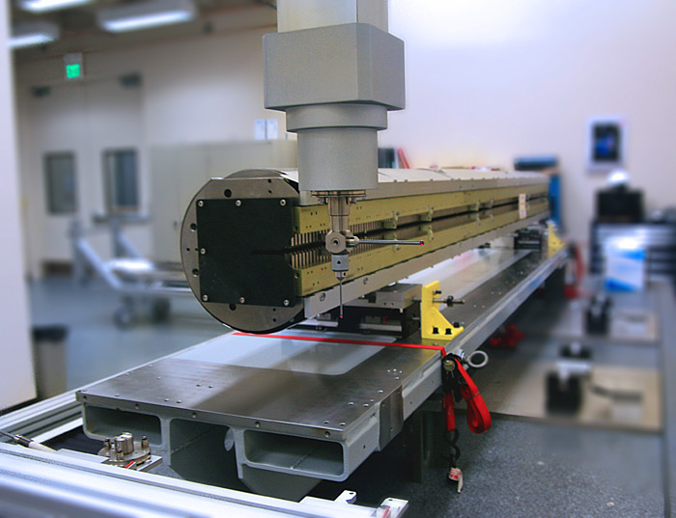
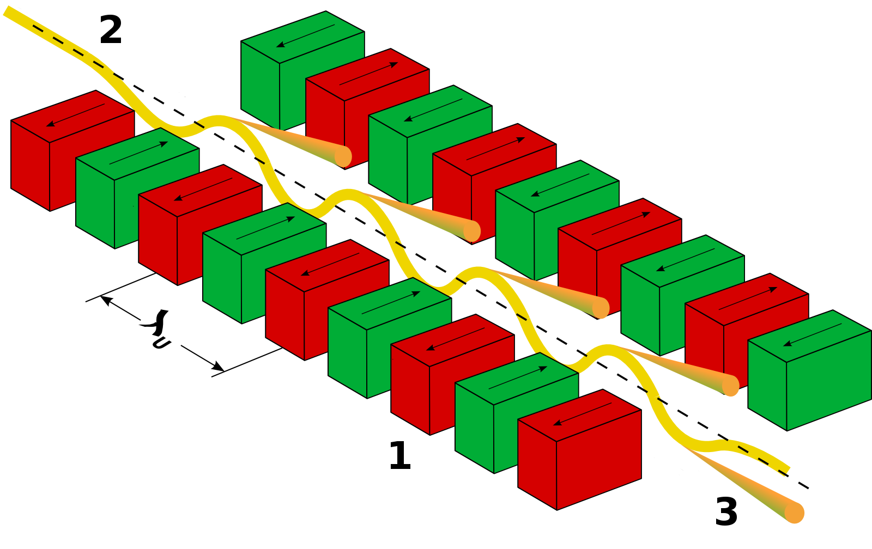
Forcing the Electrons to Wiggle…
… by injecting them into a period field of an wiggler magnet (also often called undulator).
Wiggler module from the LCLS XFEL

Slide 10
Wiggler Field
Defined by a transverse magnetic field which switch polarity multiple times, defining the undulator period λ_{u}
On Axis-Field (we want simple fields!!!):
Planar Undulator
Helical Undulator
Note that field is only valid on-axis. Maxwell Equation requires other field component off-axis.
Valid solution for planar undulator. Impact negligible for following discussion

Slide 11
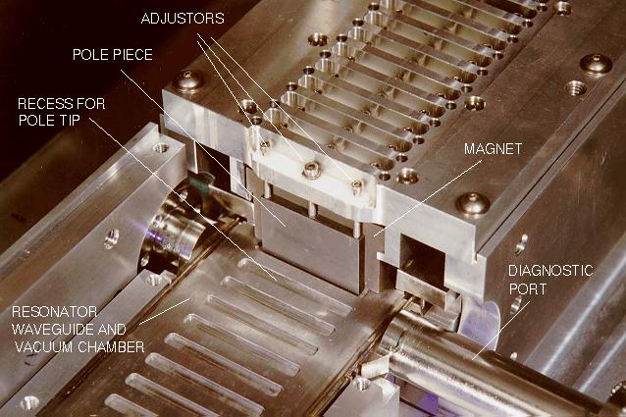
Planar Undulator
Poles
Magnets
Top Part
Flux

Slide 12
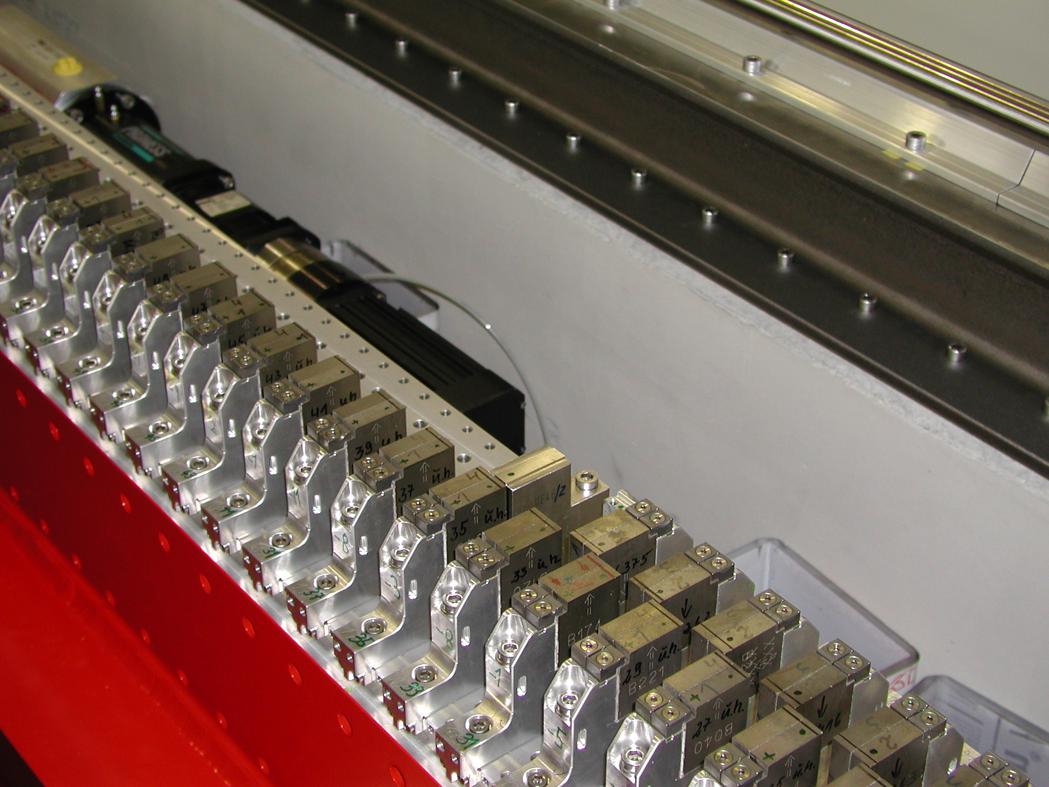
Helical Undulator (APPLE Type)

Slide 13
Motion in Planar Undulator
Lorenz Force:
Dominant field in y
Dominant motion in z (~β_{z}ct)
Undulator parameters put into one constant:
Transverse Motion
Longitudinal Motion

Slide 14
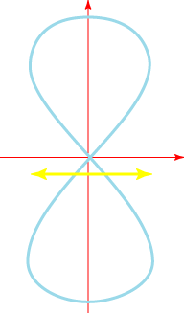
In the Co-moving frame
x
Longitudinal wiggle has twice the period.
Causes a figure “8” motion in the co-moving frame.
The longitudinal position is effectively smeared out
Has some effects on the following discussion
trajectory
z
Effective position
In a helical wiggle the longitudinal motion is constant

Slide 15
III. Undulator Radiation

Slide 16
Resonance Condition:
Accelerated particles are emitting radiation
Wavefront from Emission Point A
Emission Direction: θ
R=cT
θ
For small angles:

Slide 17
Emitted Field within Undulator Period
Lienard-Wichert Field for relativistic particles:
Observation in forward direction
Trajectory
x
Spiked when n and β coincide
t
Observed time:
Compressed when n and β coincide
Rich harmonic content but only fundamental is important for FEL
E
Field
τ

Slide 18
The FEL Resonant Wavelength
The wavelength can be controlled by
  Changing the electron beam energy,
  Varying the magnetic field (requires K significantly larger than 1)
To reach 1 Å radiation, it requires an undulator period of 15 mm, a K-value of 1.2 and an energy of 5.8 GeV (γ=11000)
The Free-Electron Lasers are based on undulator radiation in the forward direction with the resonant wavelength:

Slide 19
IV. Interaction with Radiation Field

Slide 20
Interaction with Co-Propagating Field
The wiggling electrons emit radiation. Some of it co-propagates along the undulator.
The transverse oscillation allows the coupling of the
Electrons, absorbing more photons than emitting, become faster and tend to group with electrons, which are emitting more photons than absorbing.
The FEL exploits a collective process, which ends with an almost fully coherent emission at the resonant wavelength.

Slide 21
Co-Propagation of Electrons and Field
The transverse oscillation allows to couple with a co-propagating field
The electron moves either with or against the field line
After half undulator period the radiation field has slipped half wavelength. Both, velocity and field, have changed sign and the direction of energy transfer remains.
The net energy change can be accumulated over many period.

Slide 22
Step I : Energy Modulation
Energy change:
transverse motion
plane wave
Ponderomotive Phase:
=0
Resonance Condition
Averaging over an undulator period:
  Second exp-function drops out (<exp(iθ-2ik_{u}z)>=0)
  Longitudinal oscillation smears out position → reduced coupling f_{c}

Slide 23
Step II: Longitudinal Motion
For a given wavelength λ there is one energy γ_{r}, where the electron stays in phase with radiation field.
Electrons with energies above the resonant energy, move faster (dθ/dz > 0), while energies below will make the electrons fall back (dθ/dz <0 ).
For small energy deviation from the resonant energy, the change in phase is linear with Δγ=(γ-γ_{r}).
Δγ = 0
Δγ > 0
z
Δγ < 0

Slide 24
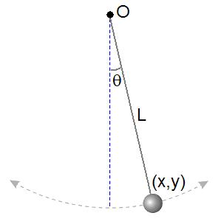
Analogy to Pendulum
FEL Equations
Pendulum Equations
Frequency
Frequency
Stable Fix Point: Δγ=0, θ+φ=0
Instable Fix Point: Δγ=0, θ+φ=π
Oscillation gets faster with growing E-Field (Pendulum: shorter length L)

Slide 25
Motion in Phasespace
Wavelength typically much smaller than bunch length.
Electrons are spread out initially over all phases.
Δγ
Δγ
θ+φ
θ+φ
Δγ
Δγ
θ+φ
θ+φ
Electrons are bunched on same phase after quarter rotation

Slide 26
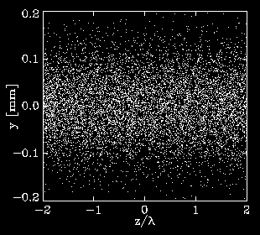
Microbunching
3D Simulation for
FLASH FEL over 4 wavelengths
Frame moving with electron beam through 15 m undulator
Wiggle motion is too small to see. The ‘breathing’ comes from focusing to keep beam small.
Transverse position
Slice of electron bunch (4 wavelengths)
Microbunching has periodicity of FEL wavelength. All electrons emit coherently.

Slide 27
V. Field Emission

Slide 28
Coherent Emission
The electrons are spread out over the bunch length with its longitudinal position δz_{j}. The position adds a phase φ_{j}=kδz_{j} to the emission of the photon.
The total signal is:
Electrons spread over wavelength:
Phasor sum = random walk in 2D
Electrons bunched within wavelength:
Phasor sum = Add up in same direction
Im
Im
Re
Re
Power ~ |E|² -> Possible Enhancement: N

Slide 29
Complete Picture: Evolving Radiation Field
Because the degree of coherence grows the field does not stay constant (Pendulum is only valid for adiabatic changes)
The change in the radiation field is given by Maxwell equation:
Slow Varying Envelope Approximation:
Period-averaged motion:

Slide 30
The Levels of the FEL Model
Evolution along
Bunch (Slippage)
Source Term
Diffraction
Evolution along
Undulator
1D Model: Ignore Diffraction Effects
Steady-State Model: Ignore Time Dependence
To start-easy: 1D, steady-state FEL Model

Slide 31
Scaling of 1D FEL Equations
Δ=Detuning
η=Deviation
Choose ρ to eliminate constants

Slide 32
VI. Easy Solution
(but limited)

Slide 33
1D FEL Equations
Field
Position
Energy
Derivative of field eq.
Derivative again.
Negligible with no energy spread
Ansatz:

Slide 34
Solutions
Electron beam in resonance (no detuning Δ=0)
Only initial field present (A=A₀, A’=0, A’’=0)
Solutions:
Im
Re
oscillating
growing
decaying
General Solution:
Initial Conditions:

Slide 35
Linear Regime and Start-up Regime
For a long distance the growing mode dominates:
Characteristic power gain length (1D):
In start-up, other modes are not negligible. Growth is inhibited. This “lethargy” is about two gain length

Slide 36
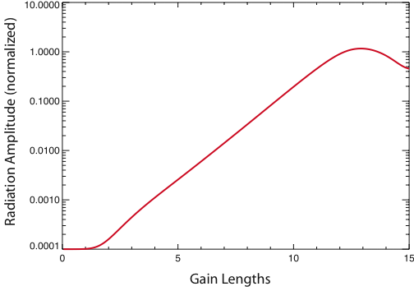
The Generic Amplification Process
Beyond saturation there is a continuous exchange of energy between electron beam and radiation beam.
Saturation (max. bunching)
|A| ~1
Exponential Amplification
FEL Gain
Start-up Lethargy
Lethargy at start-up is the response time till some bunching has formed.

Slide 37
Efficiency and Bandwidth
Energy conservation and efficiency:
Bandwidth:
For a given wavelength the beam can be detuned by Δγ=ργ and still amplify the signal.
For a given energy the wavelength can be detuned by Δω=2ρω and still be amplified.

Slide 38
VII. SASE FELs

Slide 39
How to start the FEL differently…
Previous solution had an initial input field.
However the FEL can be started also with different initial condition:
Initial bunching in the electron position, resulting in some emission of radiation.
Due to the discrete nature of electrons this term is always present (shot noise)
An energy modulation on the period of the wavelength will yield a non-vanishing term. This energy modulation will turn into a bunching over some drift length.
This term is normally negligible

Slide 40
FEL Modes
SASE FEL (Self-Amplified Spontaneous Emission)
FEL Amplifier (starts with an input signal)
Output
Electrons
Undulators
Spontaneous emission (shot nosie)
is a broadband seed of “white noise”
Seed
Output
Electrons
Undulators
Seed must be above shot noise power

Slide 41
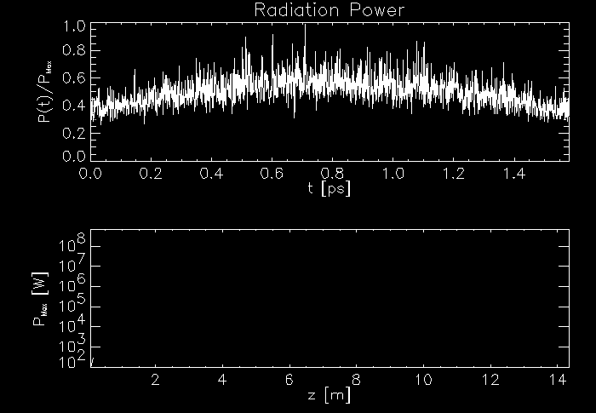
Typical Growth of SASE Pulse
Simulation for FLASH FEL

Slide 42
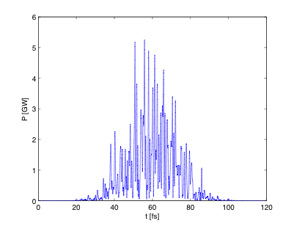
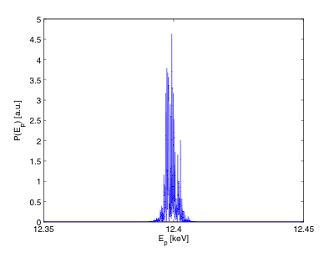
SASE FELs
FEL starts with the broadband signal of spontaneous radiation (almost a white noise signal)
Within the FEL bandwidth Δω=2ρω the noise is amplified
Spikes in spectrum and time profile.
SwissFEL: Simulation for 1 Angstrom radiation
Spectrum at
saturation
1/t_{b}
Pulse at saturation
t_{c}
1/t_{c}=2ρω
t_{b}
Coorperation Length:

Slide 43
VIII. The Importance of ρ

Slide 44
The Importance of the FEL Parameter ρ
Typical values ρ = 10⁻² – 10⁻⁴
Scaling
Beam Requirements:
Gain length
Efficiency
SASE Spike Length
Bandwidth
Energy Spread
Emittance
Beam Size

Slide 45
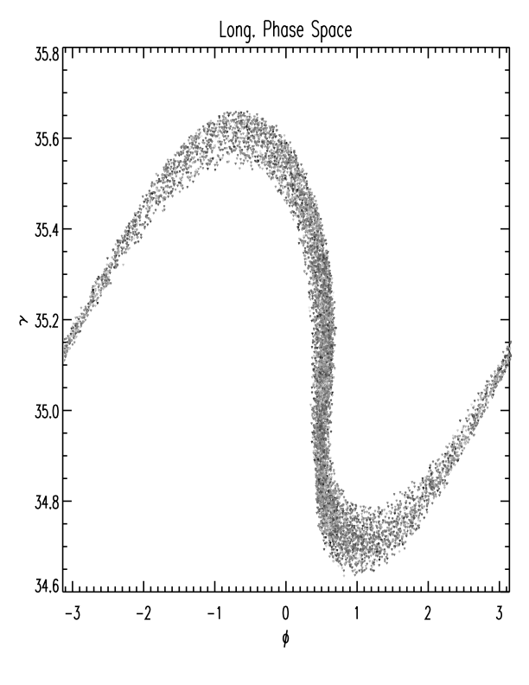
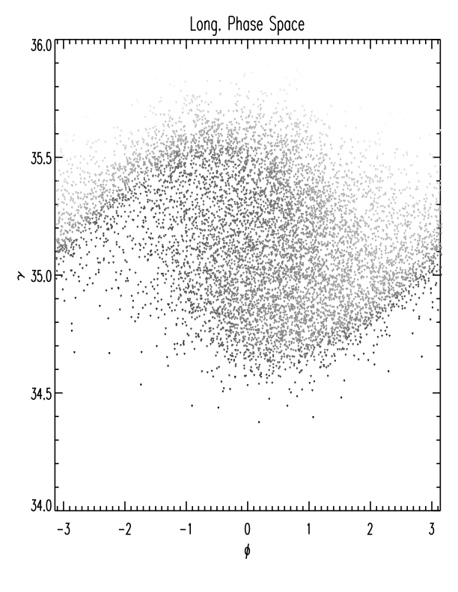
Electron Beam Requirements: Energy Spread
Only electrons within the FEL bandwidth can contribute to FEL gain.
FEL process is a quarter rotation in the separatrix of the FEL. If separatrix is filled homogeneously, no bunching and thus coherent emission can be achieved.
Small spread
Large spread
Strong Bunching
Weak Bunching
Energy Spread Constraint:

Slide 46
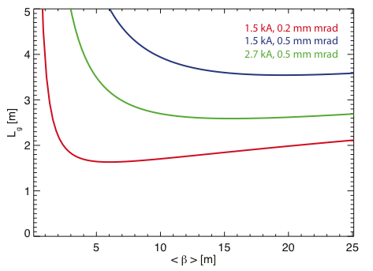
Optimizing the Focusing
Decreasing the β-function (increase focusing), increases the FEL parameter ρ.
Stronger focusing:
  Larger kinetic energy of betatron oscillation
  Less kinetic energy for longitudinal motion
  Smearing out of growing bunching
From 1D Theory:
3D Optimization for SwissFEL

Slide 47
Quick Overview of 3D Theory
New free Parameter: Diffraction Parameter
Assuming electron size as radiation source size:
Rayleigh Length
Scaling length of the FEL (2k_{u}ρ)
“Soft” constraint for emittance to be smaller than photon emittance for all electrons to contribute on the emission process
Electron
p_{x}
x
Photon Emittance
Diffraction Limited
Photon Emittance

Slide 48
Summary
FEL Process
Induced energy modulation
Increasing density modulation
Run-away process
(collective instability)
Enhanced emission
FEL utilized the strong coherent emission in the collective instability with the tuning ability of the wavelength.
Instability can only occur with a beam with low energy spread and emittance.

Slide 49
IX. Some Mathematical Hardcore Stuff
(Exact Solution-1D)

Slide 50
How to solve the Problem?
2N Ordinary and 1 partial differential equation.
Electrons are represented by the density function f(θ,η,z), fulfilling Liouville’s theorem:
Fourier series expansion:
Equation with terms proportional to e^{iθ}:
(Vlasov Equation)
Initial distribution
Current modulation

Slide 51
Including the field equation…
Field evolution is given by density function:
The formal solution for f₁ is:
Problem reduce to integro-differential equation:

Slide 52
Solving the FEL Equations
Laplace transformation: (Fourier transformation does not work) :
FEL Equation:
Integration over z by parts on both sides:
Formal Solution:

Slide 53
Dispersion Equation
Laplace Transformation:
Completed Path
Im(z)
Inverse Laplace Transformation:
x
Laplace
Tran.
Singularities
x
Re(z)
x
Dispersion Equation
Inv. Laplace Tran.

Slide 54
The 1D Solution
No detuning (Δ=0) and no energy spread (f₀=δ(η))
3 Solutions to:
Oscillating
Growing
Decaying
FEL
Mode
Gain Length (e-folding length):

Slide 55
X. Even More Hardcore
(3D Theory)

Slide 56
Scaling of 3D Field Equation
Scaling:
1D Model
3D Model

Slide 57
Vlasov Equation
Assuming a round, rigid beam with no change in transverse momenta and position.
Add a normalized distribution g(r) to describe the transverse beam profile
3D Vlasov Equation same as in 1D
Formal Solution for Field Equation:

Slide 58
Laplace Transformation
Left Hand Side:
Right Hand Side:
Dispersion Function of 1D Model

Slide 59
Analogy to 2D Quantum Mechanics
Effective Potential
Remarks:
  The constant term is the particular solution and omitted in the following discussion
  The solution of the solution needs to be well defined (L₂-norm is proportional to radiation power):
    Solution needs to drop faster than r⁻¹
    Solution has no singularities at the origin
Simple Model:
  Uniform transverse distribution with sharp edge at r=1
  Expansion into radial and azimuthal modes.
with

Slide 60
The Solution for FEL Mode
Differential Equation:
Inside Solution
Outside Solution
Continuation Condition at r=1
Allows for different solution (eigenvalues) for m. Solutions are ordered by the index n

Slide 61
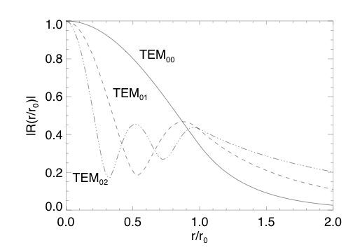
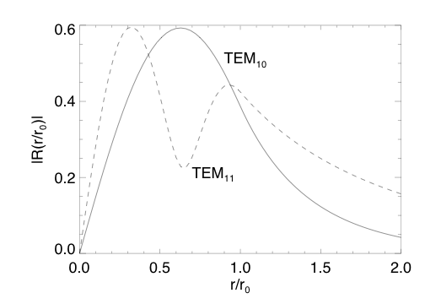
The FEL Eigenmodes R_{mn}
In the limit B →infinity (negligible diffraction) the eigenvalues for μ are degenerated with pB=D
1D Solution:

Slide 62
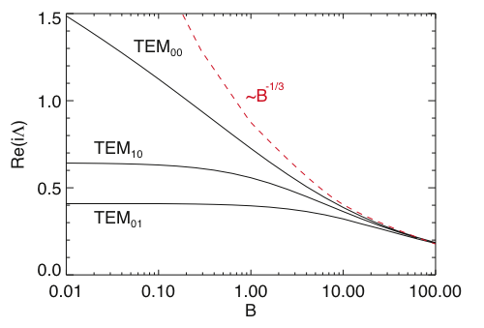
FEL Eigenmodes + Mode Competion
Growth rates for FEL eigenmodes (r,φ-decomposition):
Optimum for SASE:
Only one dominating mode at saturation
Transverse coherence
Optimum growth rate of 1D model
1D Limit
Increased gain length due to strong diffraction
Mode competition and reduced coherence

