Slide 1

MEG 2012 Run
- An Overview
MEG Period Statistics
µ-Stops x 10¹⁴
2.40
1.85
1.10
0.65
2009
2010
2011
2012

Slide 2
MEG 2012 Run Overview
In Essence:
EXTREMELY SUCCESSFUL RUN –
highest statistics obtained so far, approximately 30% more µ-stops than 2011
Technical difficulties with DC replacement modules caused delay in start-up –
systematic studies led to the finding & solving of the problem
Physics Run from 27th July – 21st December Total 148 days:
105 days Physics Data-taking
- 18 days Accelerator Shutdown/Service periods
- 5 days Trigger setup + Full Detector Test Data Taken (start-of-period)
- 11 days CEX Run (pions)
- 5 Days Mott Run (positrons)
- 4 days beam Tests (end-of-period)
Increased µ⁺ Stopping rate «Normal» ⇒ «Intermediate» Intensity + 10-15%
(based on detector rate tests end 2011)
Very Stable Operation & Run Conditions – allowed Remote Shifts over the whole period
(excluding Calibration Runs) Physics Part II had > 40% Remote Shifts
Total of 1108 shifts (886 Normal) allocated with 22 shift coordinators
Final 2012 Calibrations not concluded yet - ∴can only say at present
detector performance consistent with 2011

Slide 3
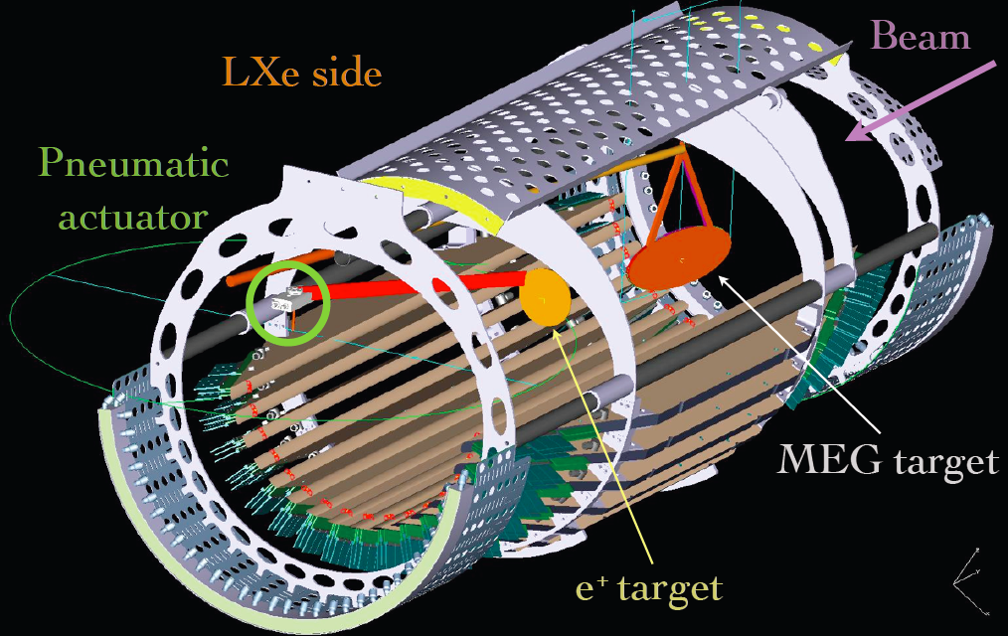
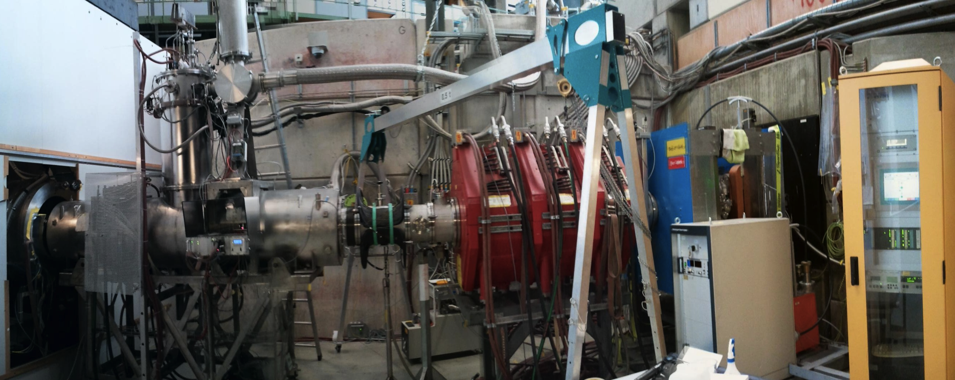
MEG 2012 Overview
Calibrations
Beam Line
Mott scattering e⁺ Beam
- First high statistics Mott Run with
improvements tested in 2011 Run
RF-selection gives good
monochromatic LINE
σ_{E} ~ 450-490 keV (8‰ σ_{E} /E at signal E)
Neutron Generator
with 9 MeV Ni gamma-line used as
standard calibration tool + inter-calib.
tool to bridge Muon & CEX Runs (no C-W)
Dedicated Cosmic Alignment
Cosmic Detector Alignment data run
taken at beginning of period
New PSI Epics Beam Line Control System
- all beam line magnet calibrations & optics
needed to be checked, Power supply
calibrations newly based on current only
Increased Beam Intensity for Run
- after detector intensity tests end 2011
increase shown feasible ∴
stopping intensity for 2012 Run
increased (10-15)%

Slide 4
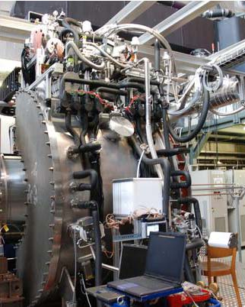
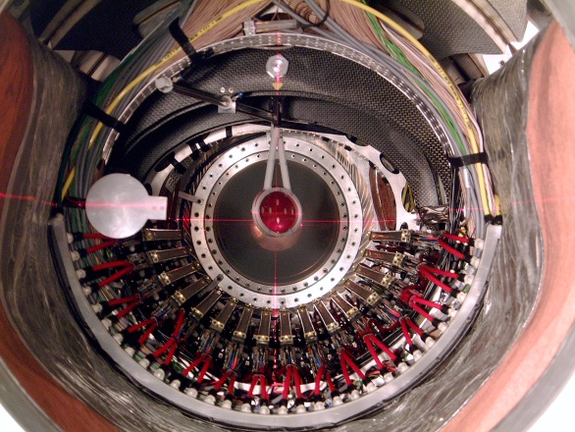
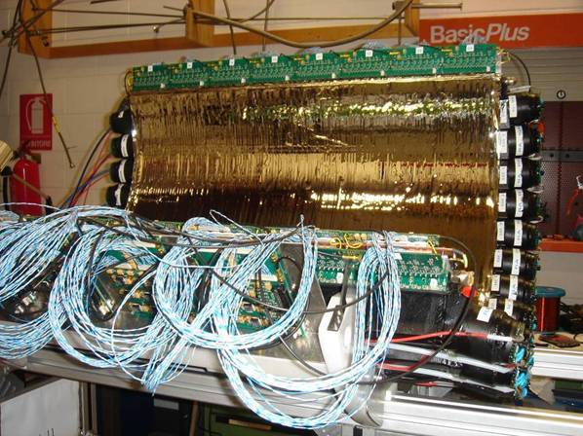
MEG 2012 Overview Cont.
DCs
TCs
Calorimeter
Stable operation of calorimeter
- stable light-yield (well
monitored & compensated)
- PMT gain-loss at 2011 level
< 0.1%/D MEG < 0.2%/D CEX
- provisional energy
resolution consistent with
2011
7 DC Modules replaced
7 DC modules were replaced
For 2012 Run – initial HV
problems with modules located
& solved with extra HV-capacitor potting on prints
– caused start-up delay
- Loss of 7-planes by end of Dec.
TC bar performance
- stable operation
- performance comparable to 2011
TC Fibre performance
- noise influence on DCs
negligable for whole Run
- for ‘’offline’’ analysis only

Slide 5
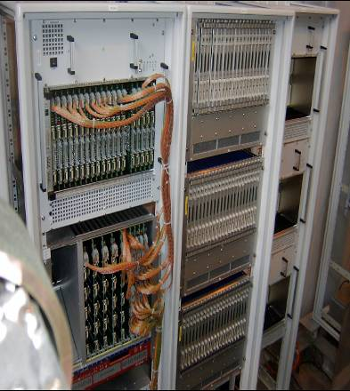
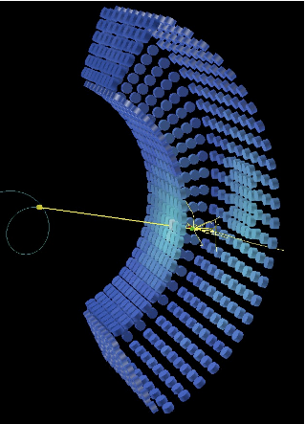
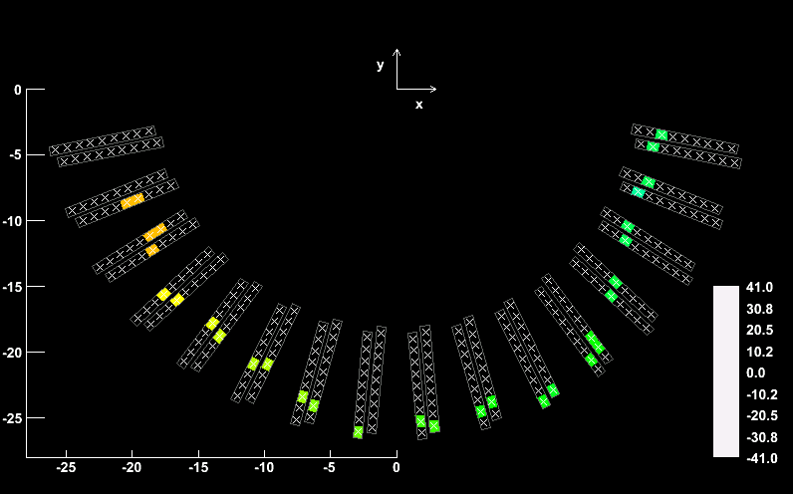
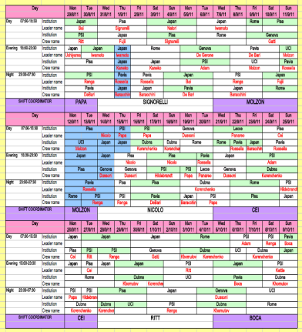
MEG 2012 Overview Cont.
Trigger+DAQ
Offline/Analysis
Offline/Analysis
New Methods Developed in 2012
First test impact on pre 2011 data
- New Kalman-filter Fit
(more detailed model)
leads to improvement Norm.Fac &
Sensitivity improvement
- New Photon Waveform Analysis
(for pile-up identification +
improved E-resolution)
- New Pile-up Rejection method
exploits new waveform analysis
New offline FFT noise-filtering
algorithm for DC-waveforms
Organization
Trigger/DAQ
Performance
- 2011 introduced
Multi-buffering used
with a live-time LT ~ 99%
for normal rate but...
- New data-file compression
introduced to compensate
for intermediate intensity
maintain LT at 98% for new
MEG trigger rate 1013 Hz
bonus file-size significantly
reduced
Remote Shift Scheme
fully Exploited
- supplimented full set of
‘’remote tools’’ to run
experiment over Internet
- added further monitoring
& surveillance tools
- added further electronic
control room aids

Slide 6
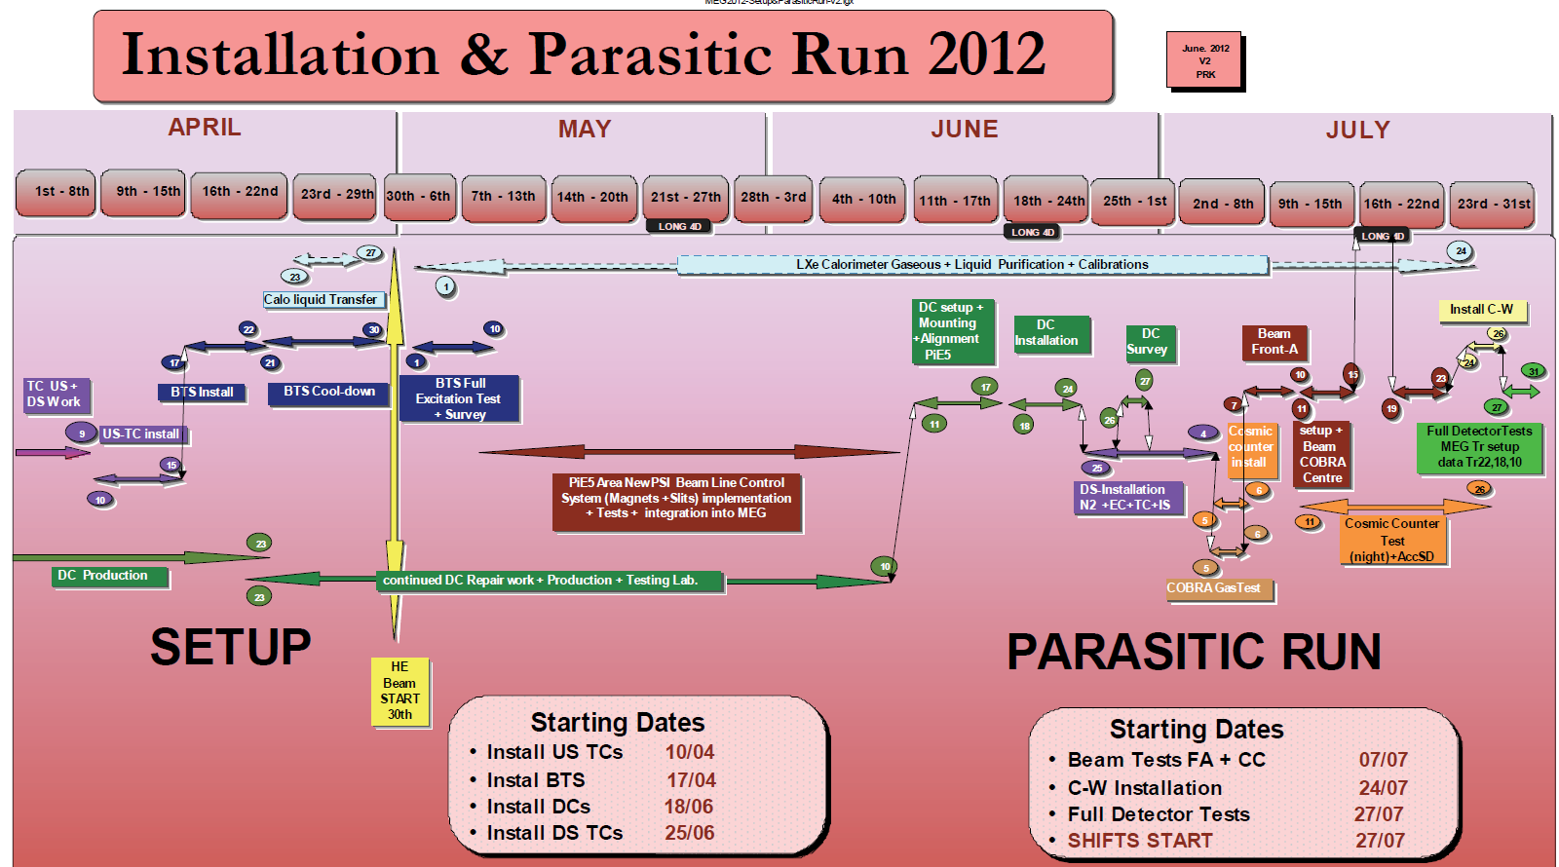
Final Schedule 2012 Run
Technical problem with replacement DCs led to start-up delay of 7 weeks for MEG 2012
- Part of time could be used for checking functionality of new beam line control system

Slide 7
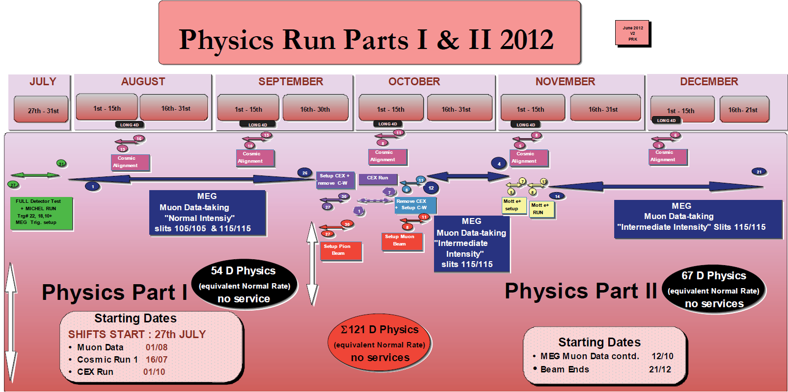
Final Schedule 2012 Run
After “Full Detector Test”
MEG Data-taking Normal/Intermediate
Intensity
CEX Pion Run (set-up overlap Accel. Shutdown)
MEG Data-taking Intermediate Intensity
Mott Positron Run (set-up overlap Accel. Shutdown)
MEG Data-taking Intermediate Intensity
Test Beam Period at EOR (not shown 4D)

Slide 8
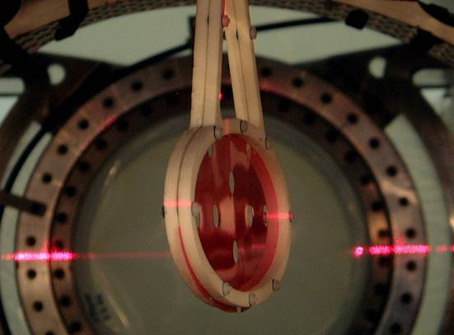
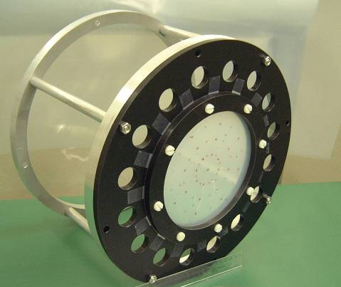
2012 Run Conditions
Muon Target Parameters:
- target
inclination
angle
Inclination Angle β =(19.9±0.3)º
Thickness 205 µm CH₂/Polyester Sandwich
Density 0.895 g/cm³
Degrader
Degrader:
Thickness 300 µm Mylar
Density 1.395 g/cm³
He/Air 94%/6%
Beam Intensity: -
Mode | Measured Rate COBRA Centre at 2.2 mA 300μm Degrader, He/Air 94%/6%
“Normal” (slits 105) | 3.6•10⁷ μ⁺s⁻¹ σ_{X} = 9.2 mm σ_{Y} = 10.0 mm
“Intermediate” (slits 115) | 4.3•10⁷ μ⁺s⁻¹ σ_{X} = 9.3 mm σ_{Y} = 10.1 mm
‘’High’’ (slits 250/280) | 9.4•10⁷ μ⁺s⁻¹ σ_{X} = 10.2 mm σ_{Y} = 11.9 mm
Consistent with 2011 measurements
⇨
<Stopping Rate> for physics Run (300μm degrader) at 2.2 mA ~ 3.3·10⁷μ⁺s⁻¹
Notes:
8

Slide 9
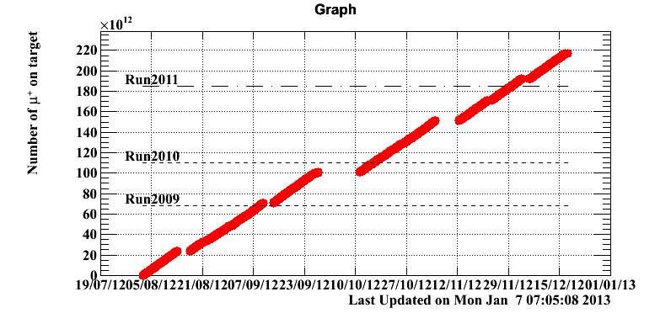
2012 Run in Numbers
Physics Run from 27th July – 21st December
Total 148 days:
105 days Physics Data-taking
- 18 days Accelerator Shutdown/Service periods
- 5 days Trigger setup + Full Detector Test Data Taken
(start-of-period)
- 11 days CEX Run (pions)
- 5 Days Mott Run (positrons)
- 4 days beam Tests (end-of-period)
Statistical – MEG’s most
Significant Physics Run
MEG Period Statistics
µ-Stops x 10¹⁴
2.40
Number of runs: 43833 at ~2k Events Σ MEG-events: 89.4 M Events
Σ DAQ Days ~ 91 Days
Σµ-stops 2.4·10¹⁴
1.85
Actual Values 2012
1.10
0.65
Acc.
Mott
Acc.
2009
2010
2011
2012
CEX
Plot here assumes:
constant stopping
factor for all Runs
Acc.
Acc.
Ser
µ-Stops (2009 -2012)
~ 6·10¹⁴

Slide 10

Preliminary Detector Performance 2012
DCs
TCs
Calorimeter
2012 Data already Processed
though
Final Calibrations still Missing due to Priority placed on reprocessed 2009-2010 data + 2011 data Analysis + Calibrations
Preliminary Data Quality
similar to 2011
Calibrations
2011 - values
E_{γ} ~ 1.65%
T_{eγ}~ 140 ps
E_{e}~ 0.58%
⇒
Beam Line
Trigger+DAQ

Slide 11
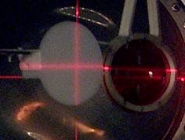
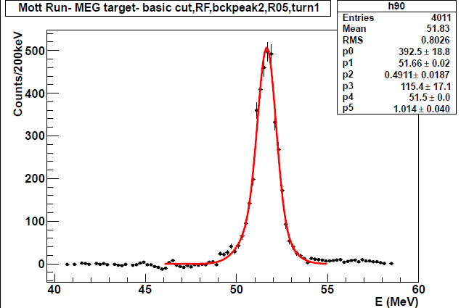
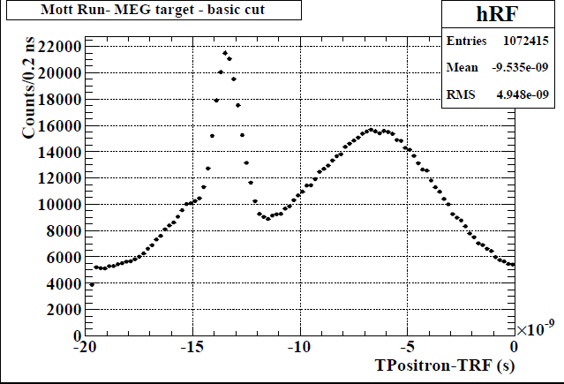
e⁺ Mott Scattered Beam
Coherent Mott-scattered
monochromatic Positron Beam
as a calibration-tool at the
MEG Signal-energy for our
Positron spectrometer
2012 – first high statistics data of Mott events from MEG-target
using the RF tof tested separation technique of 2011 for a 53 MeV/c e⁺-beam
RF TOF Spectrum
Preliminary
Monochromatic
Mott Line
σE = 450 – 490 keV/c
Cloud
µ⁺
Beam
e⁺

Slide 12
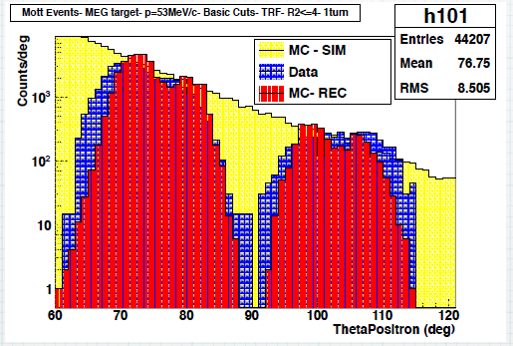
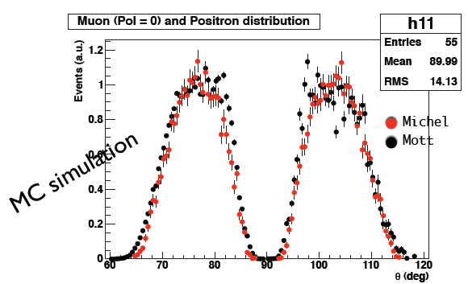
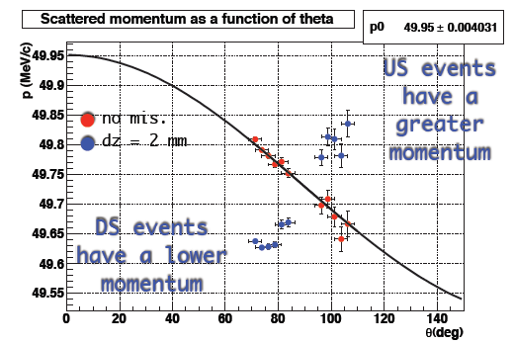
Analysis Study
Should now have sufficient statistics to start planned studies now:
Polarization Study comparison of Michel e⁺ & Mott e⁺ events
θ-Distribution of Mott-events
compared to MC theoretical X-section
& detector "accepted" X-section
Detector Alignment Study
Scattered e⁺ have well known F(θ)
∴from binned θ-Distribution of Mott-events vs. P
Sensitive to misalignment effects – most sensitive for z!
MC Data
Target Positional Resolution
Study of higher-density spaced materials on target

Slide 13
BEAM REQUEST & SCHEDULE
2013
Beam Start Up: 13th MAY 2013
MEG Beam Request Mid May – End August 2013

Slide 14
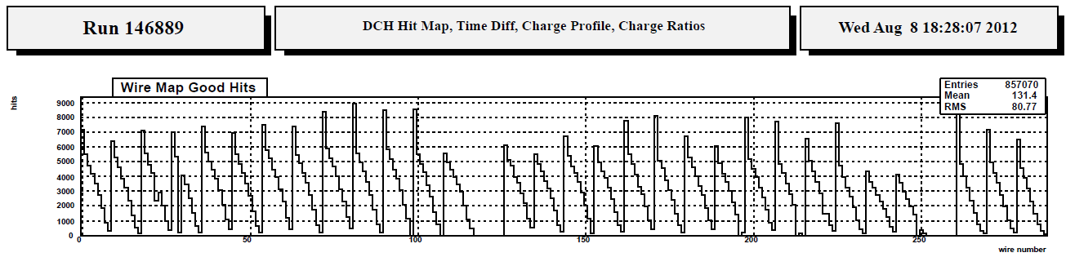
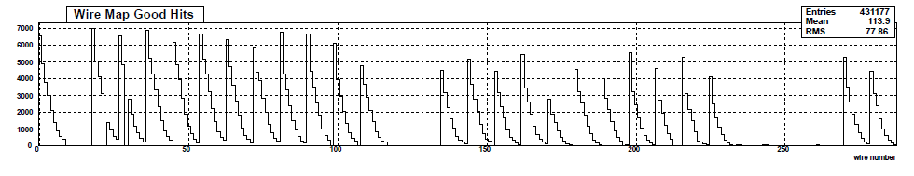
Basis 2013 Beam Request & Aspects
2013 Beam Time Sensitivity Reach Difference:
Summed Sensitivity (2009 – 2012) S ~ 7·10⁻¹³
Summed Sensitivity (2009 – 2013) S ~ 6·10⁻¹³
DC Replacement for 2013 Run needed:
- At start of 2012 Run 30 of 32 DC-planes
Functional, 2-lost at start
- At end of 2012 Run 7 DC-planes defective
& need replacing
HOWEVER
In a much better situation for 2013
Have 6 New & Tested DC-MODULES ready
for Installation NOW
Beginning of Run 2012
End of Run 2012
7 planes missing = 4 chambers
∴NO DELAYS or Beam Time Losses
due to DCs Expected 2013
Fits planned Schedule to start at Beg. of Period

Slide 15
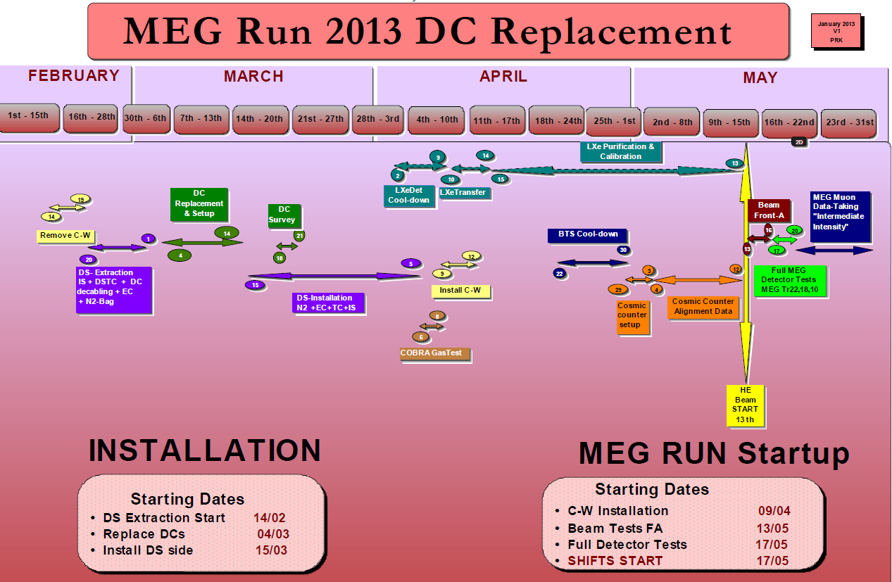
6 Tested Spare DC Modules already
available for Exchange
Start Extraction – Mid February
Ready for Accelerator Startup Mid-May
Sufficient contingency

Slide 16
Ready for MEG Data-taking ~ 1week after Accelerator Switch On
Run at Intermediate Intensity gives ~ 70% of 2012 Statistics with CEX + Mott Runs

Slide 17
Conclusions 2012 Run
Run finished a couple of weeks ago
Data already processed during run period
Final Calibrations not finished yet
Statistically MEG’s MOST SIGNIFICANT RUN so far!
At least 30% more data than previous best run period 2011
Preliminary performances similar to 2011
Analysis will continue after 2009-2011 data fully presented
Final MEG period 2013 Planned 3.5months beam requested
to maximize Sensitivity reach of MEG
Physics Results to be presented next ⇒ Gianluca

