Slide 1
MEG Physics analysis status
Gianluca Cavoto
INFN Roma
MEG BVR meeting
PSI
Jan 14th 2013

Slide 2
Outline
Data analysis and new algorithms
Reanalysis of 2009 and 2010 data
Evaluation of 2011 sensitivity
Outlook

Slide 3
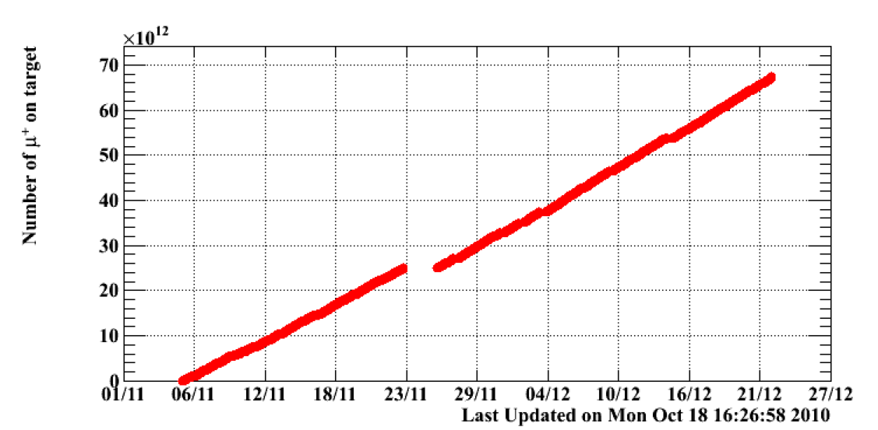
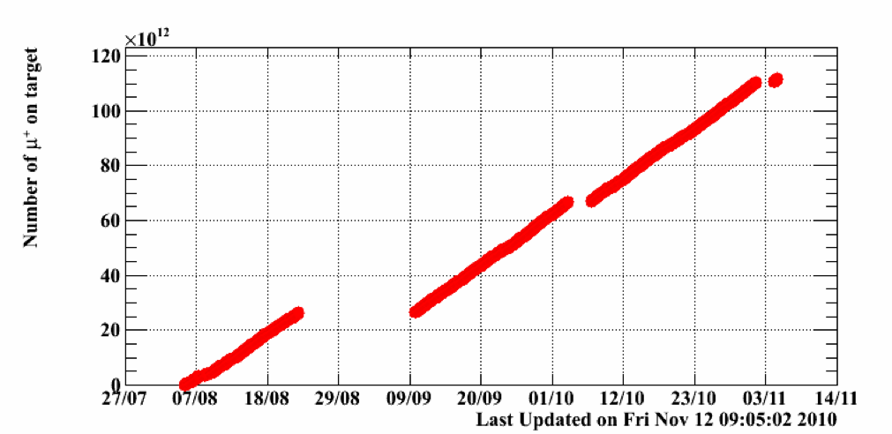
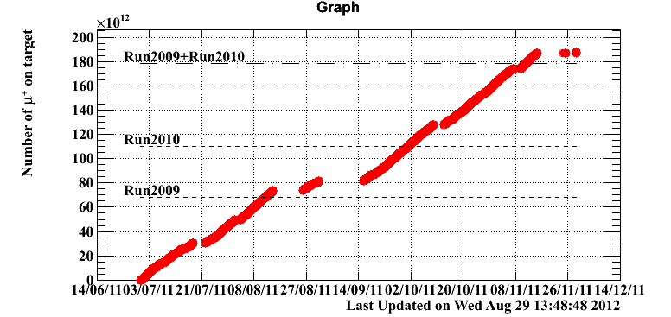
Datasets
muons stopped on target [msot] from proton current measurement
2009: 0.65 10¹⁴msot
2010: 1.10 10¹⁴msot
Detector conditions quite stable
and continuously monitored
Frequent calibrations
2011: 1.85 10¹⁴msot

Slide 4
MEG maximum likelihood analysis
    Extended maximum likelihood analysis
      Determine number of signal S
      in analysis region
      Constraints on background rate
      (Accidental [A] and radiative [R]) from sidebands
    Observables :E_{γ},E_{e},T_{eγ},θ_{eγ},φ_{eγ}
    Probability Density Function (PDF) from data
      Measured resolutions in sideband or dedicated samples
    Different PDF implementations (as cross-check)
      Event by event information or categories, averaged PDF , different functional forms…
Analysis region
48<E_{γ} < 58 MeV,
50<E_{e} < 56 MeV,
|T_{eγ}| < 0.7 ns,
|θ_{eγ}|< 50 mrad, and |φ_{eγ}|< 50 mrad
PDFs
Background rate
constraints

Slide 5
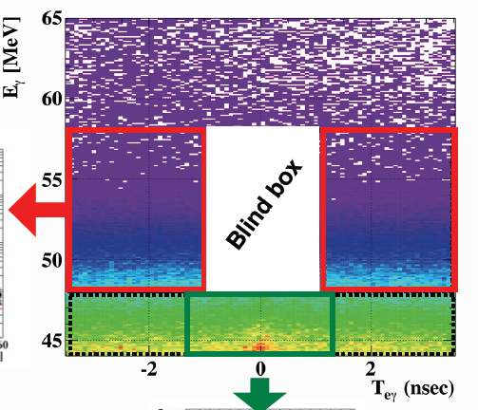
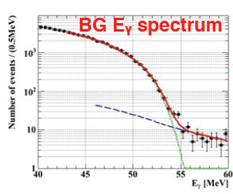
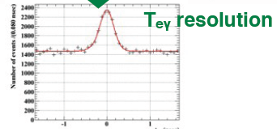
The blind method
      A portion of analysis fit region
      is kept hidden [BLIND BOX]
      Use sidebands to determine
      background shape
      Use ONLY sideband or
      alternative samples
      to determine resolutions
      Reprocess data
      whenever a better
      reconstruction algorithm
      or calibration is available
      Define a list of checks,
      only when fulfilled the box is opened
Left Teg sideband
Right Teg sideband
This is a blind analysis procedure

Slide 6
Last year data analysis
    Substantial progress in NEW algorithm deployment!
      New XEC waveform analysis
      New pile-up rejection method for photons in XEC
      A noise filtering algorithm for DCH waveform
      New Kalman filter fit for positron tracking
    Standard tools of calibrations updated
      XEC continuous monitoring
      DCH alignment
  The three years sample were consistently reprocessed
    Before opening 2011 box we looked
    at 2009 and 2010 reanalysis results
    A compatibility test was (blindly) adopted

Slide 7
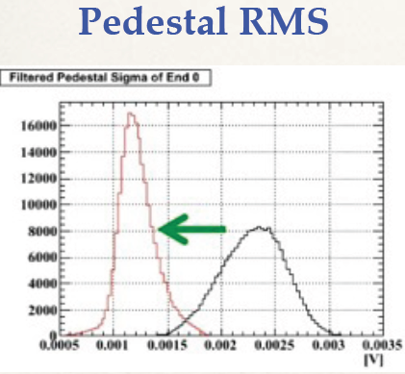
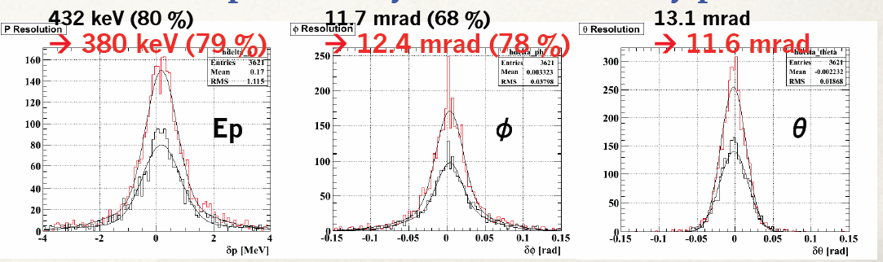
DCH noise filtering algorithm
  Offline FFT noise filtering algorithm for DCH waveforms
    Particularly important for period with higher noise (beg. 2011)
    Applied and useful for all data

Slide 8
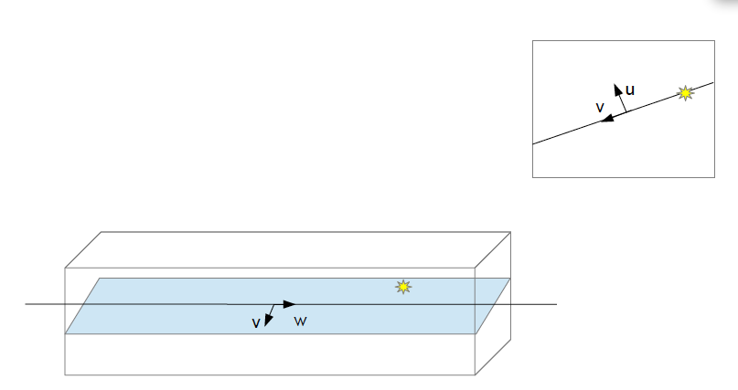
New Kalman Filter fit
  Use a more detailed detector model
    Use of GEANE track model
    (use MC detector model)
  Use a new measurement model
  Extrapolation to TC included, easier addition of TC position (better tracklength estimate)
  TC timing to refine DCH hit
  Easy inclusion of a possible active target meas.
Virtual plane
(wire+hit)
Notes:
Use Yuki notes results for comparison

Slide 9
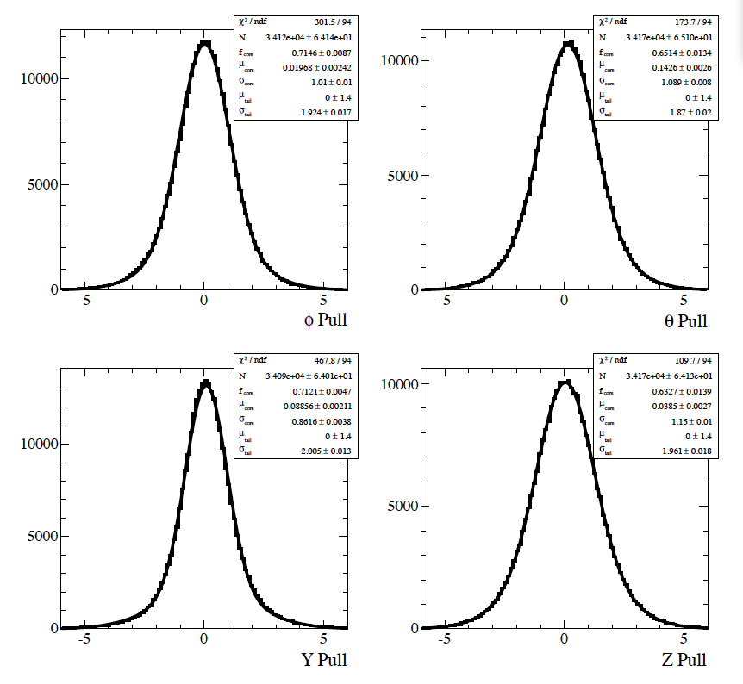
Error matrix validated
Pulls from double-turn
tracks on data
with RMS ~ 1
Several other tests made
on event by event comparison
with respect to OLD tracking code
No bias
Same resolution

Slide 10
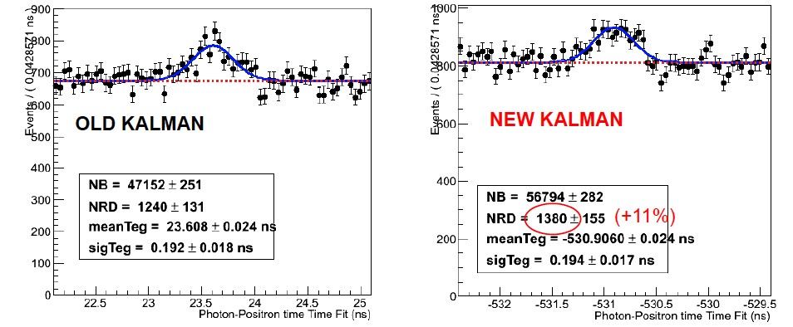
Effect of new KF fit
Radiative decays, E_{γ} > 48 MeV
Overall improvements measured by normalization factor
7% increase

Slide 11


Use of per-event error PDF
    Previous version of analysis divided events in categories of positron tracking quality
    Validation of KF fit errors: per-event error in likelihood definition
Correlations between variables
Included (as it was already done)
Carefully checked in data and MC
    This adds another ~10% improvements
    in BF sensitivity!
Notes:
Francesco’s note

Slide 12
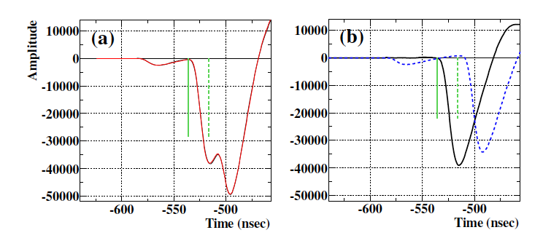
XEC SumWaveform analysis
    Meant to identify pile-up events and improve E_{γ} resolution
      Light distribution in XEC not good enough
    Sum all the PMT (weighted) waveform
      Based on time and position reconstruction
    Multi-template fit: main wf is the closest to event time
Change in start time
of integration window
Three
template
fit
“main”
waveform
“subtracted”
waveform
Crucial for high beam rate !

Slide 13
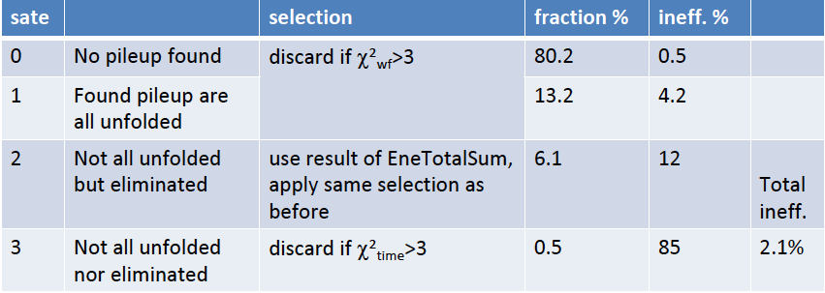
New pileup rejection method
    Selection algorithm modified to exploit the new wf analysis (including information from light distribution)
Gamma efficiency increase: 59% → 63%

Slide 14
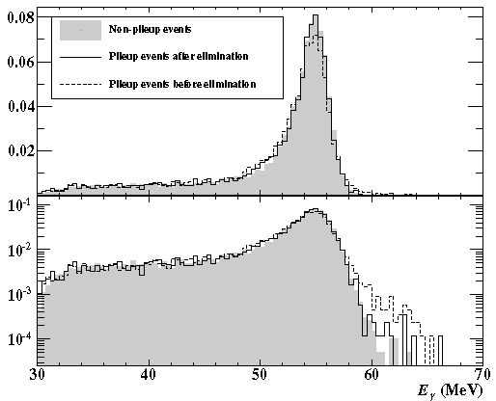
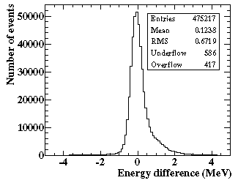
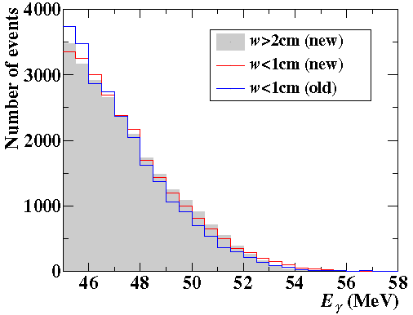
Pile up elimination on high rate
55 MeV photons from π⁰ decay
BKG event by event comparison
NEW-OLD
Better reconstruction
of shallow events
After applying pileup elimination
algorithm, pileup flagged events look
very similar to no pileup events.

Slide 15
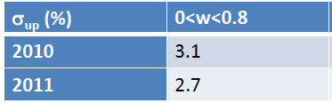
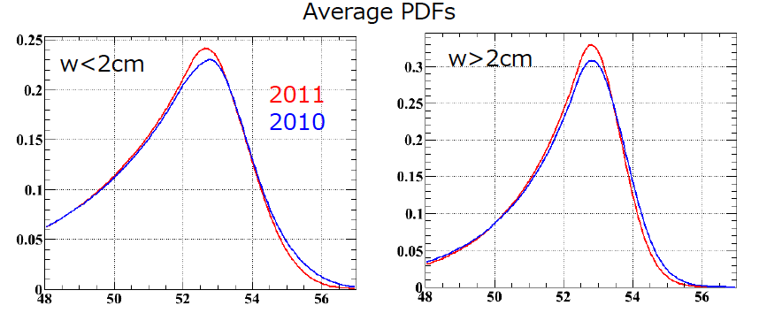
XEC E_{γ} resolution
    Better resolution on shallow events (tuning of integration window)

Slide 16
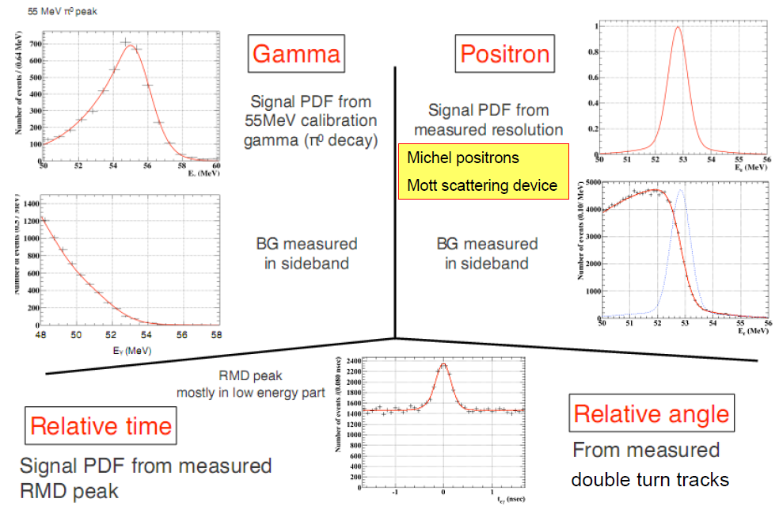
Summary of PDF definitions

Slide 17
Summary of performances
 | 2009 | 2010 | 2011 | Note
Gamma E [%] | 1.89 | 1.90 | 1.65 | Effective sigma
Relative timing T_{eγ} [ps] | 160 | 130 | 140 | RMD with Eγ < 48 MeV
Positron E [keV] | 306(86%) | 306 (85% ) | 304(86) | Michel edge (core resolution)
Positron θ [mrad] | 9.4 | 10.4 | 10.6 | Double turn
Positron φ at zero [mrad] | 8.7 | 9.5 | 9.8 | Double turn
Positron Z/Y [mm] | 2.4/1.2 | 3.0/1.2 | 3.1/1.3 | Double turn, Y core resolution
Gamma position [mm] | 5(u,v)6(w) | 5(u,v)6(w) | 5(u,v)6(w)
Trigger/DAQ efficiency [%] | 91/75 | 92/76 | 97/96
Gamma efficiency [%] | 63 | 63 | 63 | π⁰ sample
Positron efficiency [%] | 43 | 36 | 36 | From MC
Measured quantities are reported here
Correlation and per-event event error included in the ML
Notes:
Positron eff for signal (OLD Kalman)
MC full DCH 40%
Missing DCH layer 2010 34%
NEW Kalman +7% relative
2009 -> 43
2010 -> 36
2011 -> 36

Slide 18
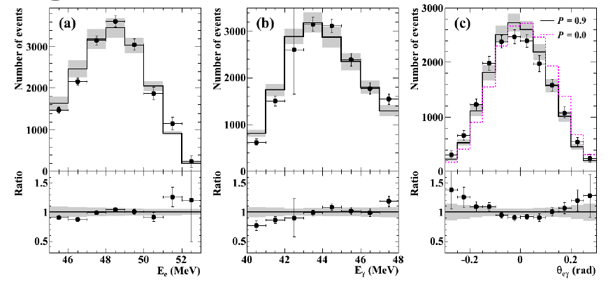
“Normalization” factor k
TWO METHODS:
Count (prescaled) Michel positron – correcting for small difference
with signal
Count radiative decays
Projected RMD distributions (2011 data)
 | k (Michel) [10¹²] | Combined k [10¹²]
2009 | 1.21± 0.07 | 1.20± 0.06
2010 | 2.66 ± 0.13 | 2.52± 0.09
2011 | 4.10 ± 0.20 | 4.05± 0.16
In 2011 data k(RMD) = 3.96 ± 0.24 10¹²
Notes:
Yuki notes

Slide 19
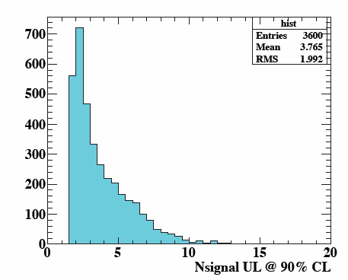
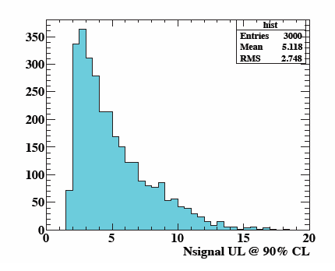
Sensitivity S
Upper limit distribution on ensemble of toy MC experiments
2009
2010
Sensitivity S is the median of such distributions
 | Nsignal | S [10⁻¹²] | Old S [10⁻¹²]
2009 | 3.4 | 2.8 | 3.3
2010 | 4.0 | 1.6 | 2.2
2009+2010 | 4.7 | 1.3 | 1.6
2011 | 4.6 | 1.1 | =

Slide 20
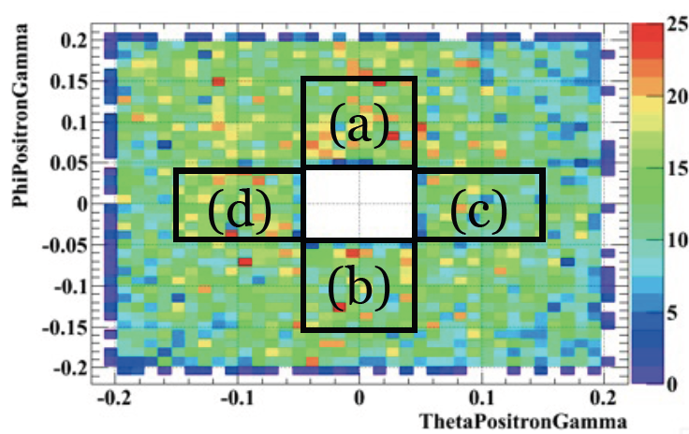
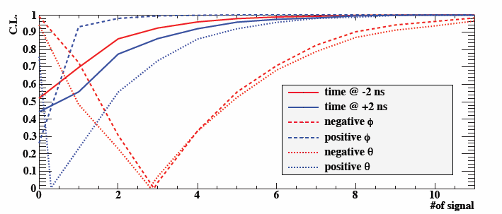
Fit to sideband
Angle sideband definition
(events with T_{eγ} ~ 0 !)
Upper limit evaluated
on sidebands well
compatible with
toyMC expectation
Background is well
understood, no sign of
fake signal
Data 2009

Slide 21
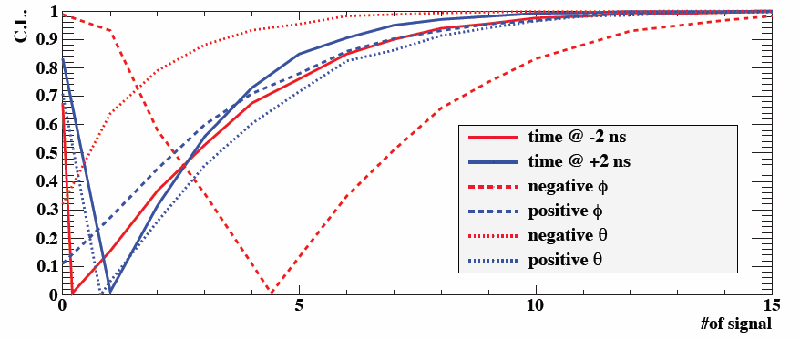
2011 data fit to sidebands
 | Best fit | Upper limit at 90% CL
Time -2ns | 0.25 | 7.0
Time +2ns | 1.1 | 5.9
φ negative | 4.4 | 11
φ positive | -0.70 | 6.9
θ negative | -2.8 | 3.4
θ positive | 0.78 | 7.7

Slide 22
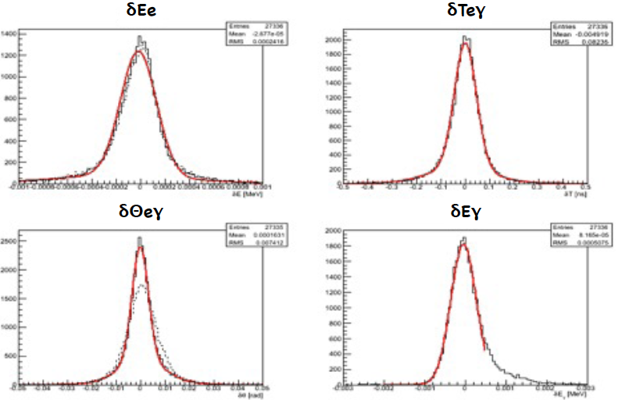
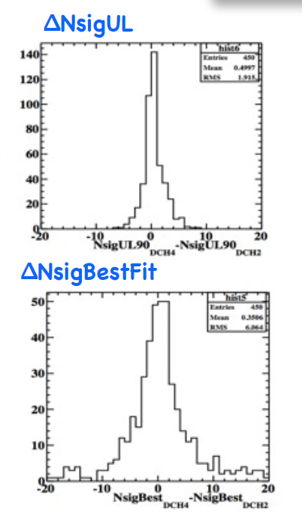
Compatibility tests
 | RMS
δE_{e} | 250keV
δθ_{e} | 9 mrad
δφ_{e} | 11 mrad
δT_{e} | 100 ps
      Event-by-event difference δX due to NEW reconstruction code
      can change the NsigBestfit and NsigUL values
      even with same PDF on same events.
      Generated toyMC-experiments according to these δX
      distributions (old version of the analysis, less sensitive)
Value for δNsigUL and δNsigBestfit in data ARE in the 95% interval of these toyMC distributions.

Slide 23
Other searches and measurement
  Measurement of RMD (μ→eννγ) branching ratio and decay parameters
    Subject of a paper in preparation
  Search for μ→eJ with J a (almost) massless particle [Majoron]
    MEG could improve TWIST limit with full MEG stat
  Search for μ→eJγ
    Feasibility study on going
    (we could improve Crystalbox limit)
  Muon polarization
    Measurement done, subject of a paper
  Polarized muon lifetime in flight
    Exotic theory predicting a different value
    Data without MEG target to be analyzed

Slide 24
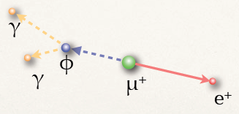
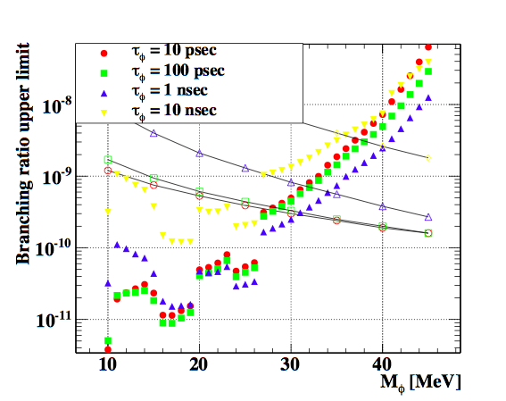
Search for μ→e”φ”, φ→ γγ
Long lifetime, small
mass resonance ”φ”
No signal at 90% CL
Full stat.
(2009 to 2013)
can improve it by a factor 3
Crystal Box
data
2009/2010

Slide 25
Summary
    Last year spent to improve our data reconstruction
      New gamma and positron reconstruction, per-event errors
      in ML analysis
    2009-2010-2011 data fully reprocessed (3.6 10¹⁴ msot)
    On combined 2009/2010 data set (1.75 10¹⁴ msot) we predict:
    S = 1.3 10⁻¹² (was 1.6 10⁻¹² in previous version)
    On 2011 data set (1.85 10¹⁴ msot) we predict
    S = 1.1 10⁻¹²
      Finalizing analysis and ready to unblind in few days
      First 2009-2010 data checks will be completed and then 2011
      unblinding
    New combined result will be made public this Winter

Slide 26
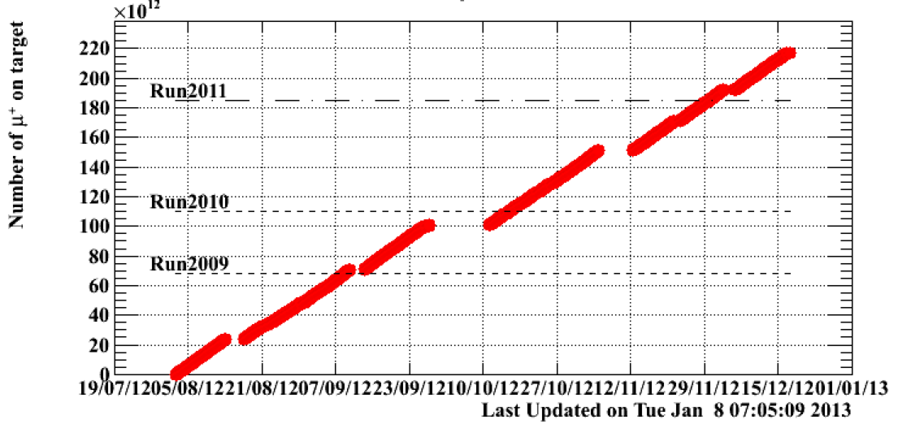
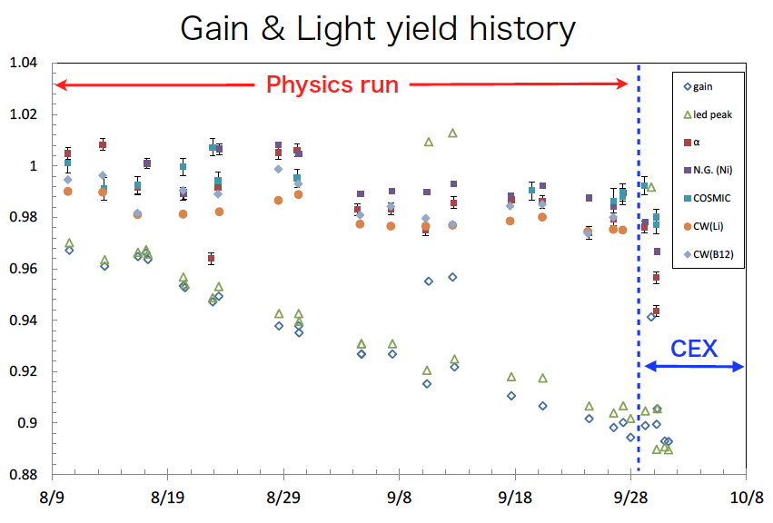
2012 data analysis
Data 2012:
2.4 10¹⁴ msot
  2012 data taking completed few weeks ago
  We have processed data during datataking but the calibration are not yet final
  Data quality is
  at the same level of 2011
XEC on-line
monitoring and calibration
XEC

Slide 27
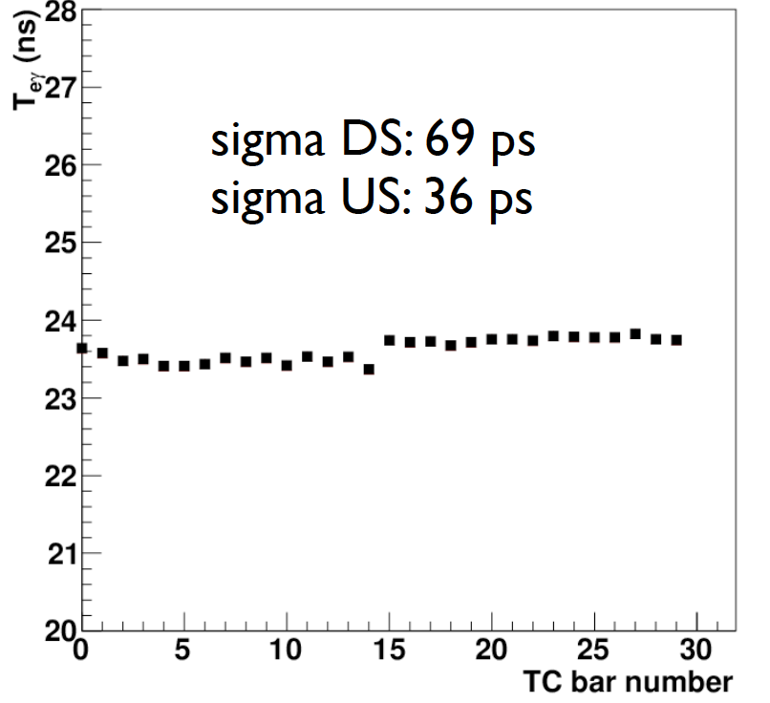
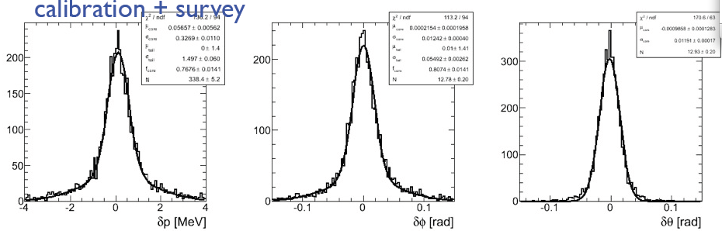
First look at 2012 data
Time difference between
two photons
(one XEC and one in TC)
Tγγ [ns]
Boron
sample
DCH resolutions
(double-turn tracks)

Slide 28
Outlook
  Data analysis of 2012 will be completed and included in a final publication
  on the entire MEG dataset
From the whole data set (2009/10/11/12)
corresponding to 6.0 10¹⁴ msot
we expect to reach S ~ 0.66 10⁻¹²

Slide 29
Back up slides

Slide 30
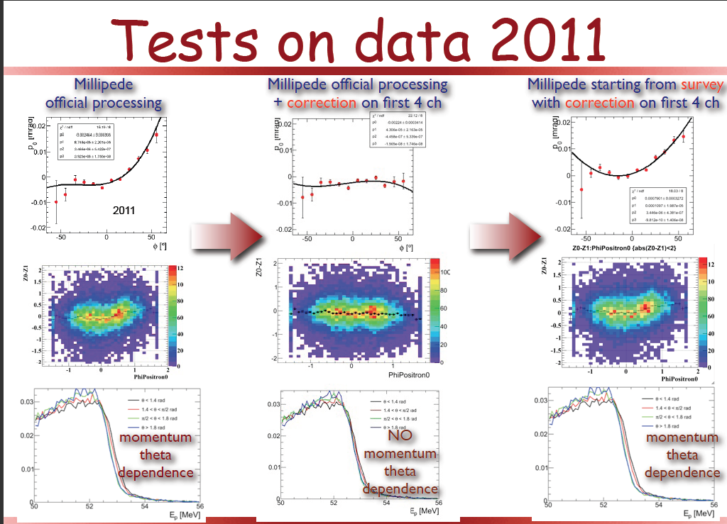
DCH alignment
Residual misalignment of few chambers accounted in systematic error evaluation

