Slide 1
The new MEG tracker
Marco Grassi
INFN - Pisa

Slide 2
Table of content
Performances of the present system
The new tracker
Simulation and expected performances
Key aspects
  Hit resolution
  Ageing
Mechanics, assembly and integration
Resources
Timetable
Conclusions

Slide 3
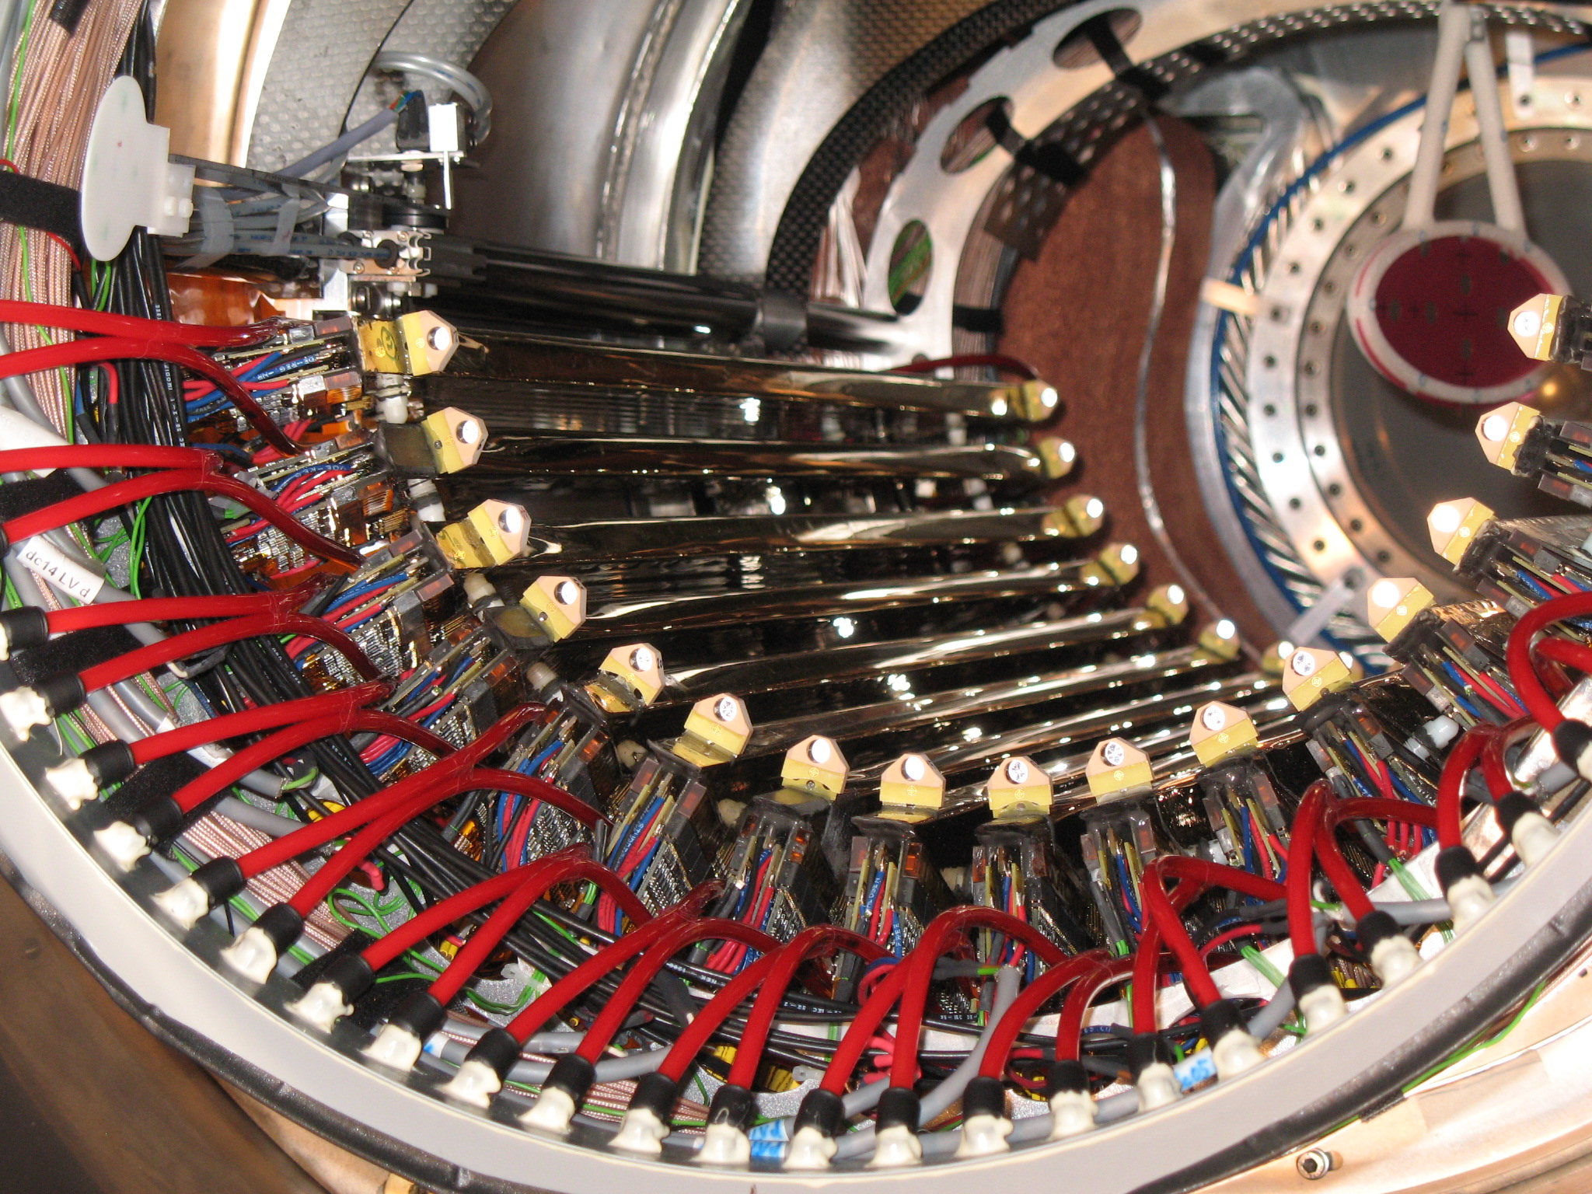
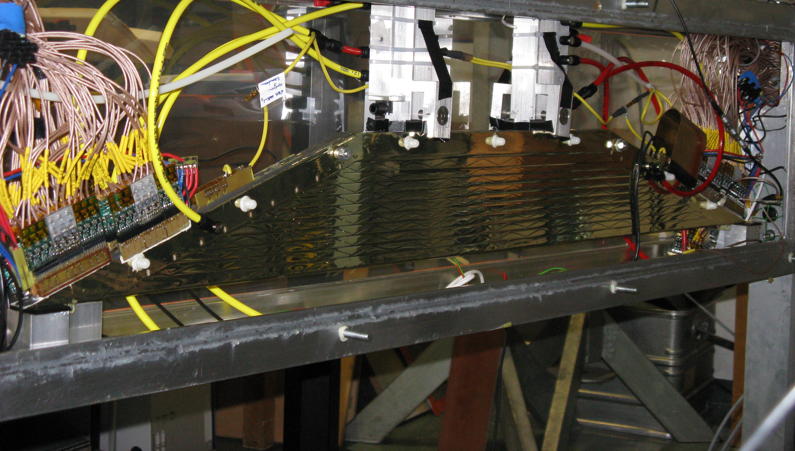
Present system
16 chambers composed as follow
  4 x12 μm of kapton (cathodes)
  50 μm BeCu cathode wires
  25 μm NiCr anode wires
  2 x 7 +3 mm He:C₂H₆ (50/50)
Single chamber x ~ 0.23 10⁻³ X₀
Full e+ turn : x ~ 1.7 10⁻³ X₀
Weak points
  Individual chambers, alignment
  Electrical insulation
  Cathode foil production
  Noise on vernier strips
  Material along e⁺ trajectory

Slide 4
Present performance summary
Single hit resolution
σ_{R} (mm) 250 (core) 300 (RMS)
σ_{Z} (mm) 700 (core) 1000 (RMS)
Track resolution
σ (p) 350 KeV (core)
σ(φ) 7. mrad (at φ = 0, 11 mrad aver.)
σ(θ) 10. mrad
σ(Y) 1.1 mm
σ(Z) 1.8 mm
TC – DC reconstruction
DC-TC matching eff. 41 %

Slide 5
Table of content
Performances of the present system
The new tracker
Simulation and expected performances
Key aspects
  Hit resolution
  Ageing
Mechanics, assembly and integration
Resources
Timetable
Conclusions

Slide 6
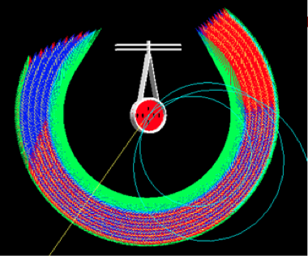
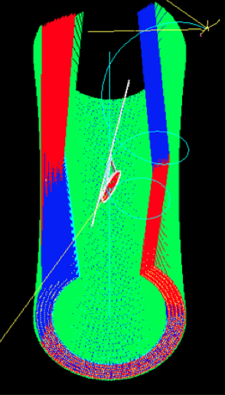
Selected technology
We selected the following detector
single volume gaseous detector
cylindrical shape with longitudinal wires
U–V stereo for hit positioning along the chamber axis
low mass gas ( He : iC₄H₁₀ – 90:10 presently foreseen)
thin wires and small cell size
Tentative goals
Single hit resolution ~130 μm in r
Momentum resolution ~130KeV
Angular resolution ~5 mrad
DC-TC matching eff. ~ 90 %

Slide 7
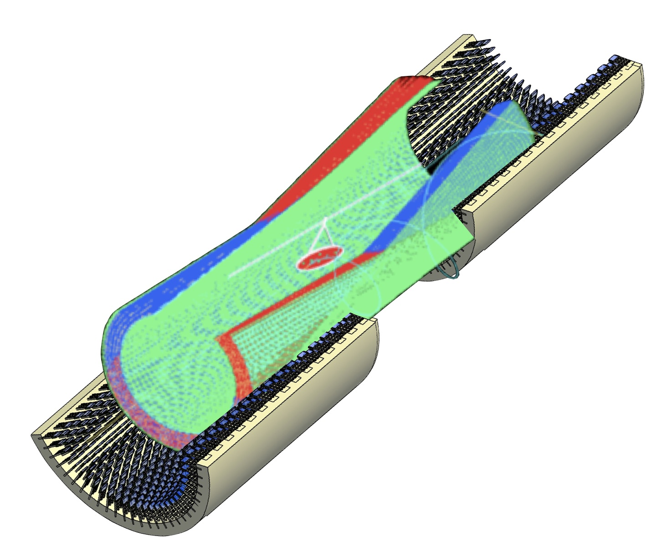
Pictorial view of Positron Spectrometer
Not shown:
COBRA
Tracker Mechanics
Tracker electronics

Slide 8
Geometry
Starting configuration
10 layers
Square projective cells of 0.7 cm
Stereo angle of ~ 8 deg with respect to Z
  Z resolution ~ 7 time the transverse resolution
25 and 40 mm anode and field wires
He / iC₄H₁₀ mixture at 90/10 ratio
Total length 180 cm
Outer radius 29.2 cm
~1380 anode wires
~7500 field wires

Slide 9
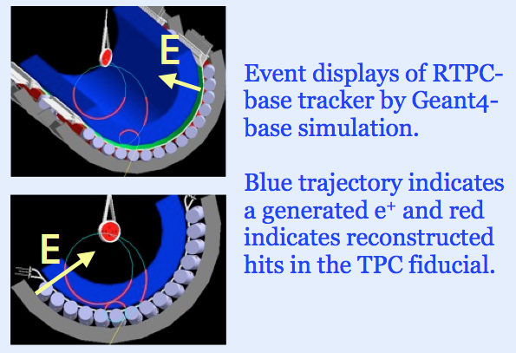
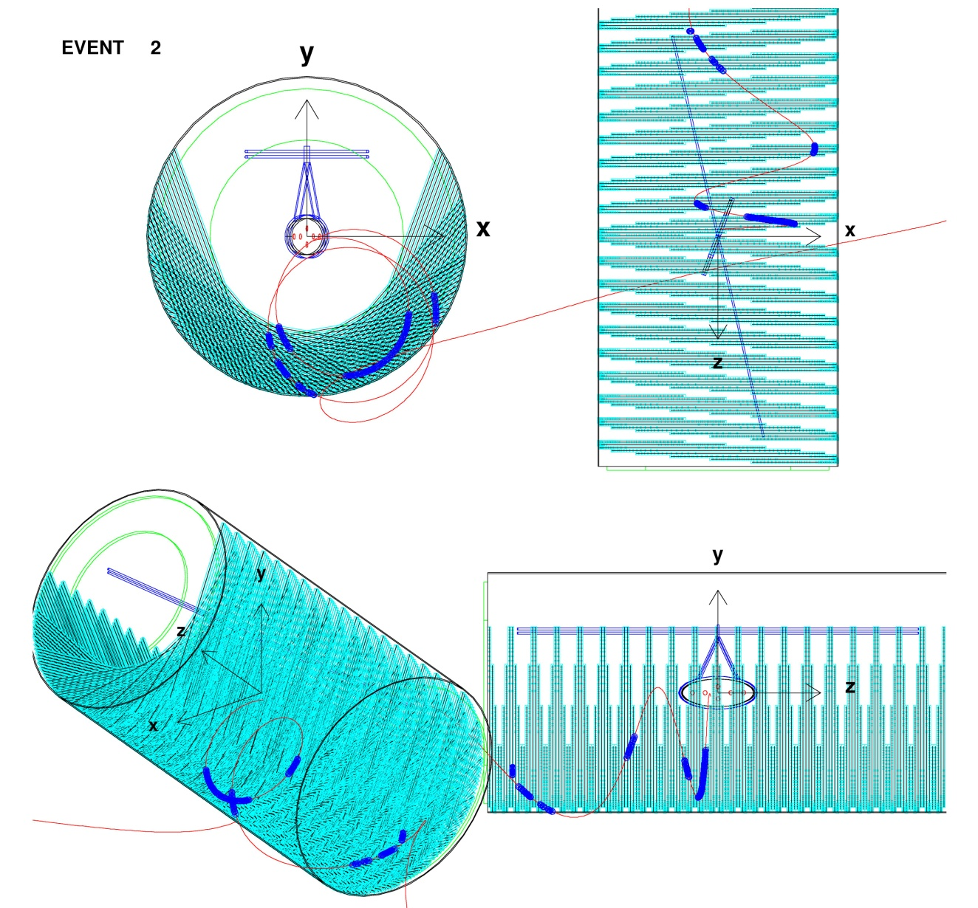
Alternative solutions
Two other options were investigated extensive simulations
Cylindrical drift chamber with transverse wires and stereo readout
Transverse Time Projection Chamber
2.
1.

Slide 10
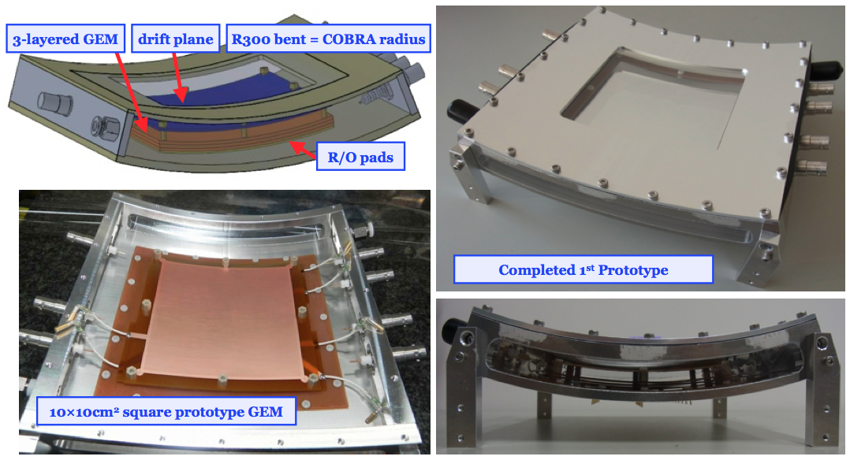
TPC prototype
A prototype of a radial TPC has been assembled
A long term R&D has been started

Slide 11
Alternative solutions
Both options were discarded as tracking devices for MEG for different reasons
Overall performances
Transparency towards the TC
Complexity of building even a single prototype
Long and mandatory research and development phase, not compatible with the tight schedule of the MEG upgrade
Development of appropriate readout devices

Slide 12
Table of content
Performances of the present system
The new tracker
Simulation and expected performances
Key aspects
  Hit resolution
  Ageing
Mechanics, assembly and integration
Resources
Timetable
Conclusions

Slide 13
Simulation and Reconstruction
The fundamental tools to evaluate, design and optimize the new tracker are available
Simulation
MC code: both standard GEANT 3 MEG simulation and GEANT 4
Detector configuration:
target, magnetic field, non optimized chamber geometry, correct material description, gas ionization, signal generation and pile up
Reconstruction
New Kalman filter: adapted to the new tracker
Basic package: GEANE
Detector response: model of single hit resolution

Slide 14
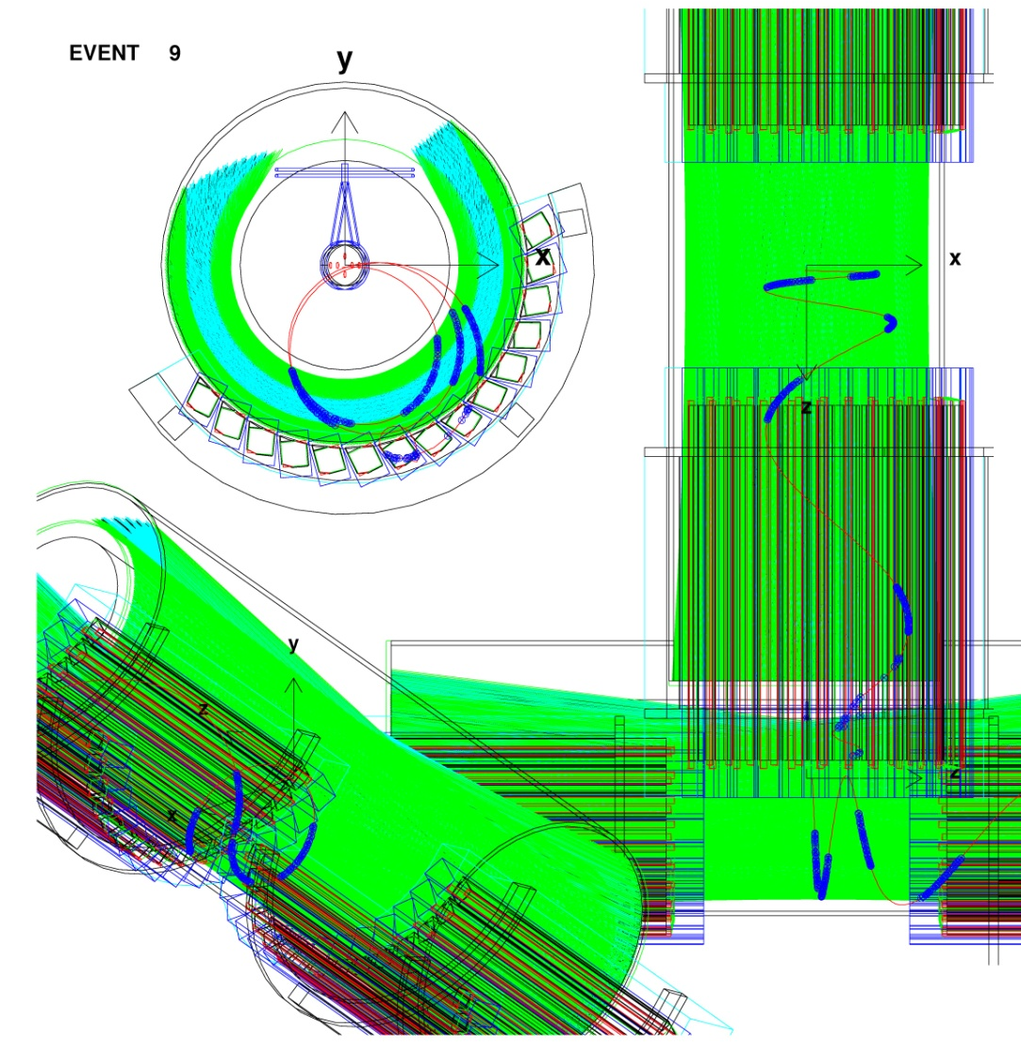

Chamber simulation

Slide 15
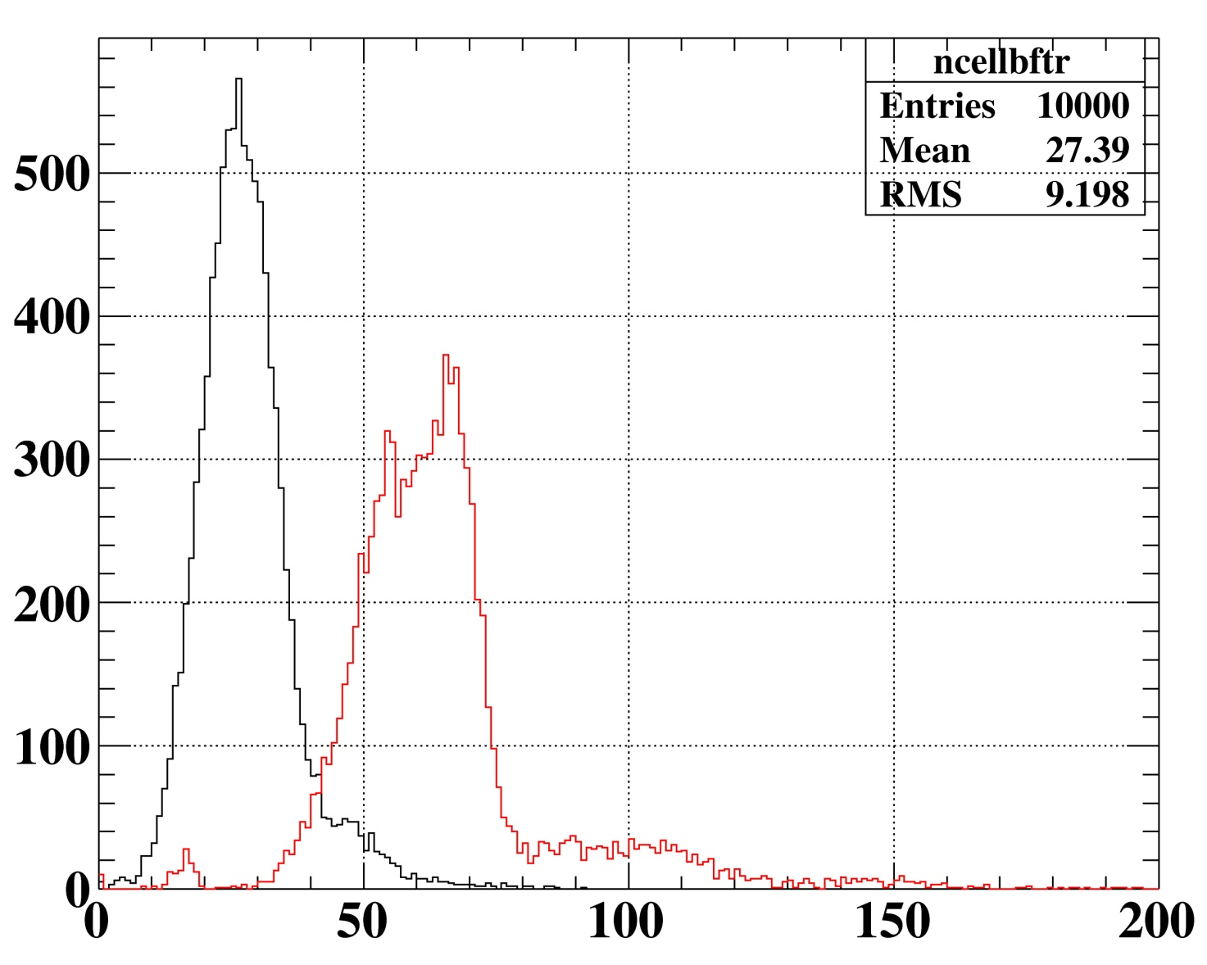
Expected performances
Chamber thickness
Large number of hits
Item | Description | Thickness
 |  | 10⁻³ X₀
MEG target | (115 μm Polietilene) | 0.21
Sense wires | (25 μm Ni/Cr) | 0.16 | 0.54
Field wires | (40 μm Al) | 0.35
guard ring wires | (40 μm Al) | 0.03
protective foil | (20 μm Kapton) | 0.14 | 0.14
Inner gas | (pure He) | 0.06 | 0.56
Tracker gas | (He/iBut. 85/15) | 0.50
Total | 1 full turn w/o target | 1.25
Red: new tracker
<N> ≈ 64
The simulation, which include a thinner target, gives the following resolutions in standard deviations
(black: present system)
Momentum ~130 KeV 350 KeV
Angular ~5 mrad ; ~5 mrad 9 mrad ; 11 mrad
Vertex ~1.2 mm ; ~0.7 mm 1.8 mm ; 1.1 mm
DC-TC matching eff. ~ 90 % 41%

Slide 16
Table of content
Performances of the present system
The new tracker
Simulation and expected performances
Key aspects
  Hit resolution
  Ageing
Mechanics, assembly and integration
Resources
Timetable
Conclusions

Slide 17
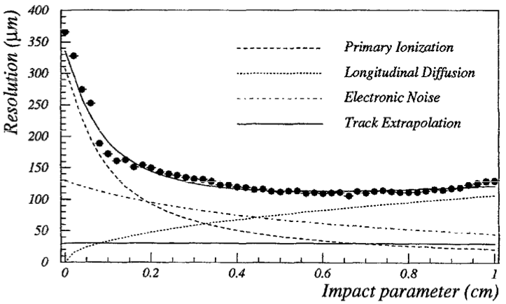
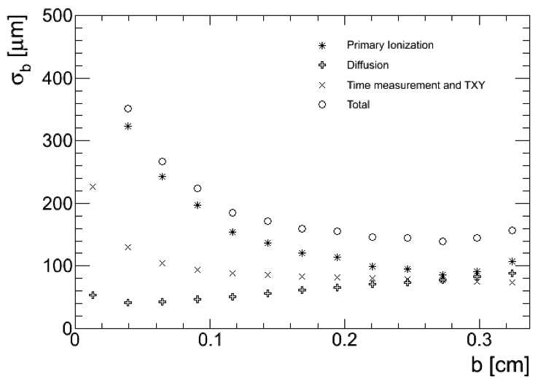
Key item #1: Single hit resolution
Resolution on the impact parameter: 130 ÷ 350 μm
He/iC₂H₄ 90/10 gas mixture
25 μm wires
Limiting factors
Primary ion. Density
Time measurements
KLOE Prototype
MEG aims at better performances
Heavier gas: 85/15
Faster electronic chain
HF preamplifiers + DRS
Better use of all clusters in the signal
Cluster timing
Backup: ATAR active target
Garfield simulation

Slide 18
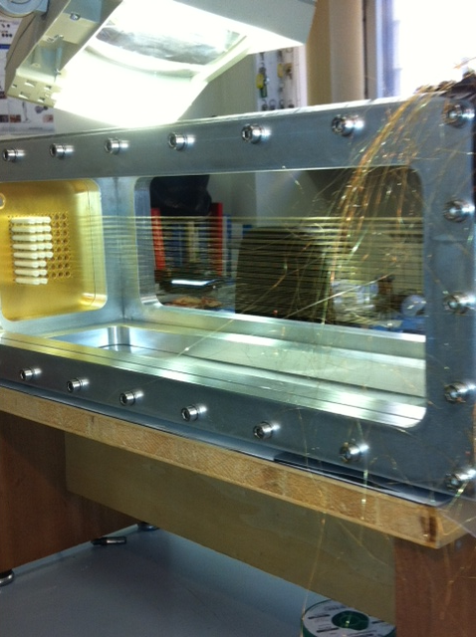
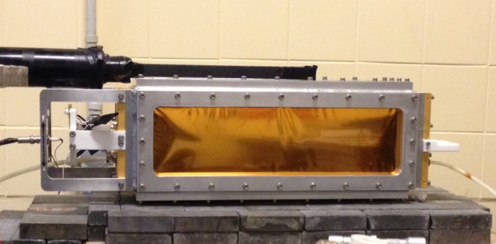
Hit resolution
Small prototype with threefold purpose:
measure the resolution
test the electronic chain
test the cluster timing technique
- 8x8 small squares cell (0.7x0.7cm²)
- 50 cm long
- He/Isobutane 90/10
- No stereo angle
- FE board to test cluster timing
- Test with cosmic telescope
Mylar windows
to reduce MS of
incoming muons

Slide 19
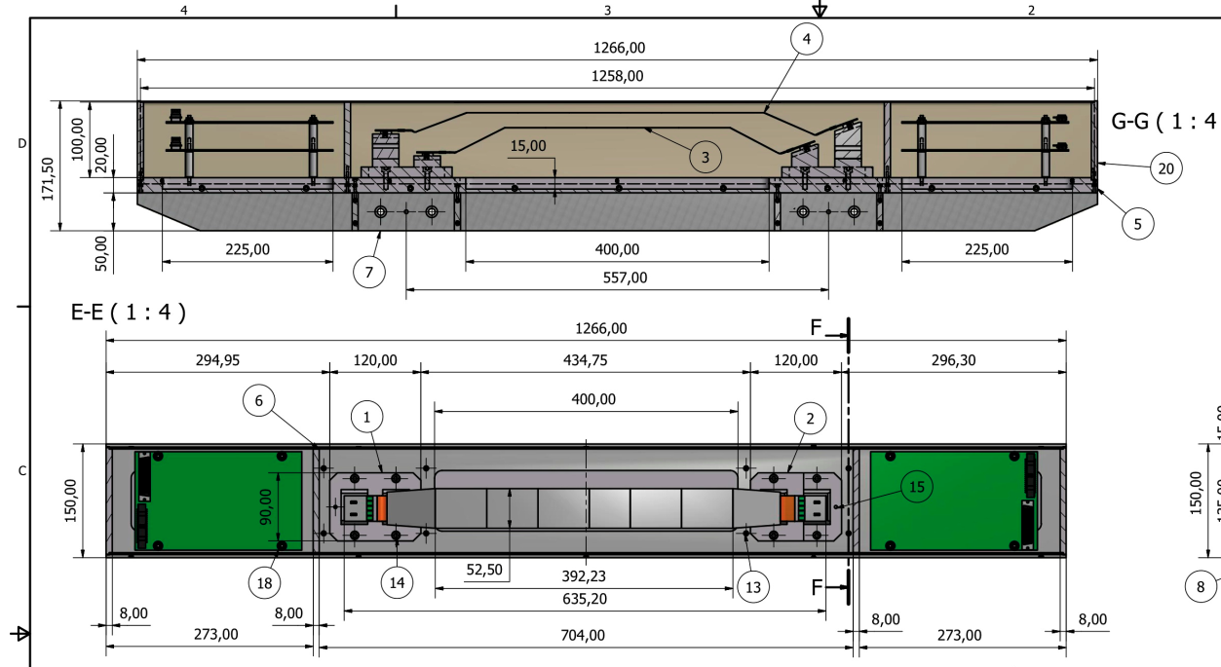
Hit resolution
Si strip telescope
for precise cosmic muon tracking
Reuse spare BaBar tracker elements
Resolutions at the DUT location 20 – 40 μm
Trigger with external scintillator telescope

Slide 20
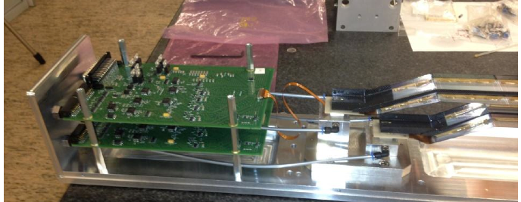
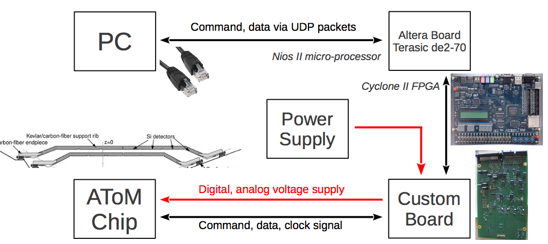
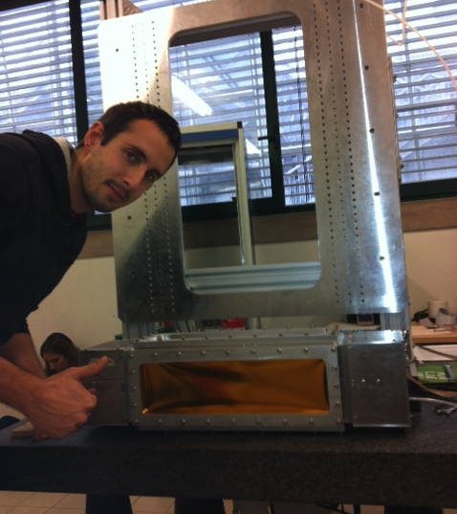
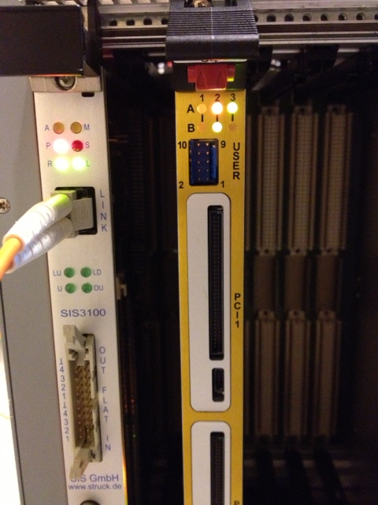
Integration
The small prototype and the cosmic telescope are in integration phase
The system will be operational by the end of January

Slide 21
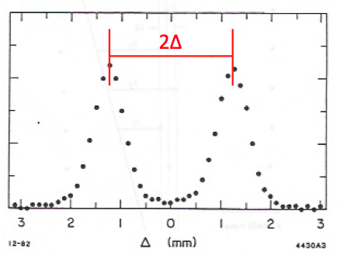
Hit resolution estimate
tracks
Arrange 3 cells with the central one displaced by Δ
Measure t_{i} drift times, compute d_{i} drift distances
For straight tracks it results
independently of drift distance
and angle (almost)
Measure single hit resolution averaged on all impact parameters and angles if
T1
T2
T3
Δ

Slide 22
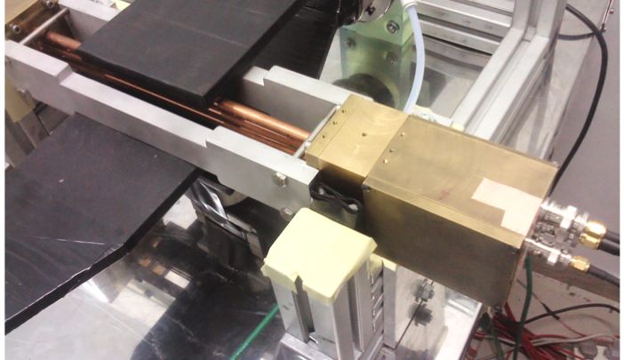
3 cell prototype

Slide 23
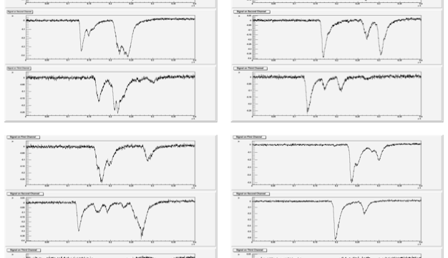
Signals

Slide 24
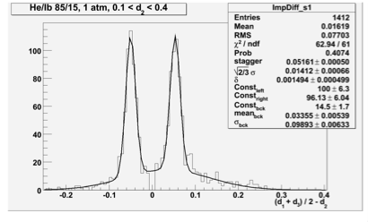
Hit resolution estimate
Setup close to working point
8 mm drift tube
20 μm wire,
He/isobutane - 85/15
200 μm wall thickness
500 μm nominal stagger Δ
2x10⁵ gain, no preamplifiers
<1 muon /min
Measured σ_{d} ≤ 140 μm
for b>1 mm using first cluster only
Remarks
Goal resolution obtained for large impact parameter using the first cluster only
More than 40 hits (out of 60) have adequate resolution
The cluster timing technique is not exploited yet

Slide 25
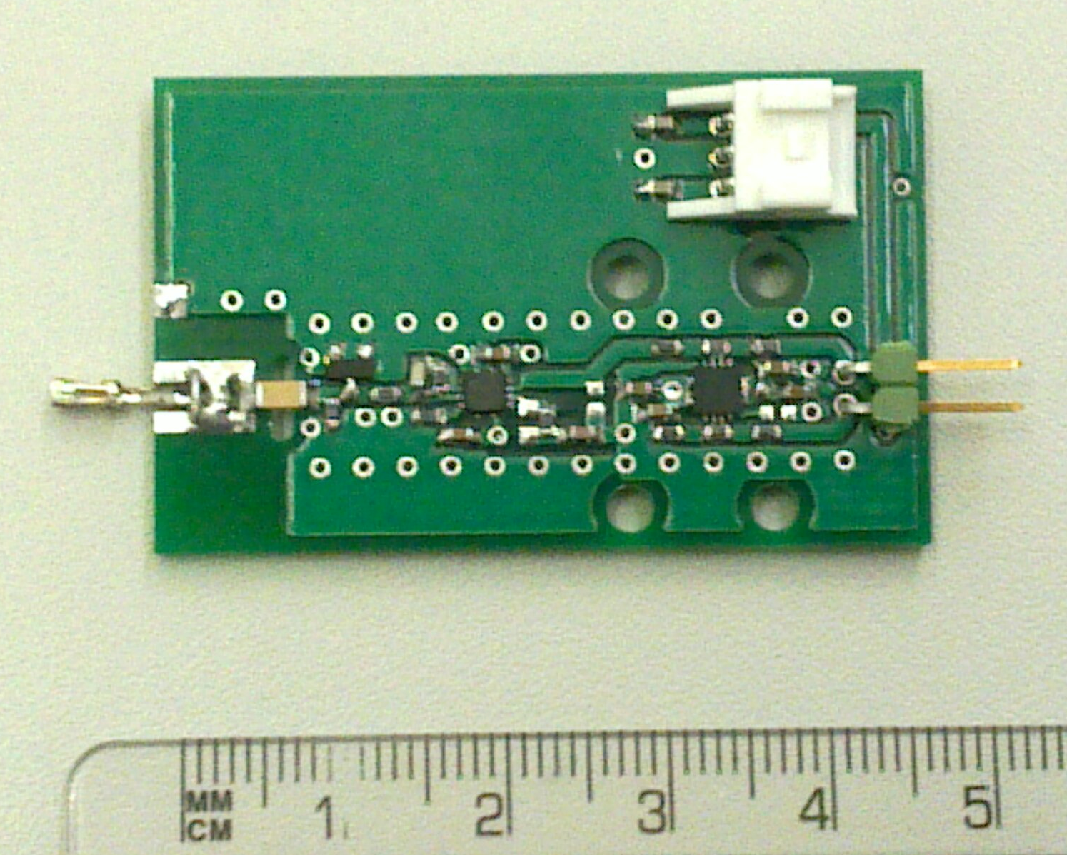
FE
Differential output
Use of commercial IC
AD8009 OpAmp and THS4509 Diff OpAmp
Fulfill BW, gain and linearity requirements
Design in the 7 mm spacing
Version with single ended output soon available
decoupling/
protection/
matching
1° stage
2° stage/
Output driver

Slide 26
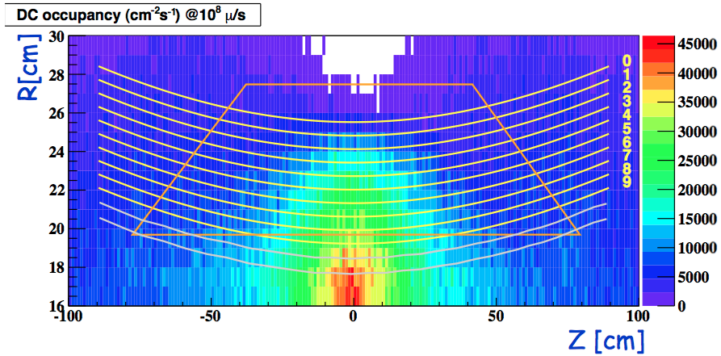
Key item #2: chamber ageing
Positron hit rate density by MC simulation:
Michel e+ generated over 4π at 1x10⁸ mustop/s
max rate 45 kHz/cm²
At 1x10⁵ gain and 7x10⁷ mustop/s
The maximum current is 6 nA/cm
For 3 years of running
The maximum integrated charge is 0.4 C/cm

Slide 27
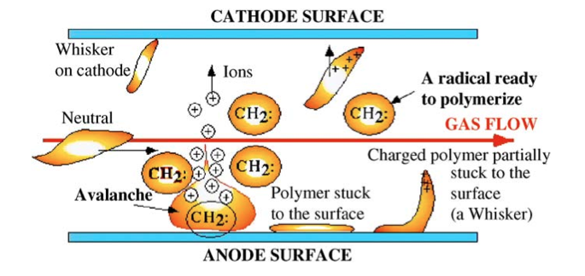
The ageing measurement
By classical ageing we mean the formation of deposits, conductive or insulating, on the electrode surface which may lead to
    gain loss
    worse energy resolution
    excessive chamber current
    self-sustained discharges
    sparking
    high voltage instability
    wire corrosion, swelling, rupture
Free radical polymerization is regarded as the dominating mechanism of wire chamber ageing.
The key elements for the ageing test are
  DC prototype
  Gas system
  Irradiation System

Slide 28
Numbers
What numbers we have in mind for the new DC operation:
    DC gain: 1 x 10⁵
    Current on innermost wire: 6 nA/cm
    Total charge on innermost wire: 0.4 Coulomb/cm
    DAQ time: 630 days
    Chamber volume: (300 litres) 300 000 cc
    Flow rate: (1 volume exchange/12 hours)
To integrate the same charge in 30 days
    x20 speed
    Average current: 120 nA/cm
    Chamber volume: 3 500 cc
    Flow rate: 40 cc/min (1 volume exchange/ 1.5 hour)
Present DC system
    Current of innermost wire: 20 nA/cm (0.7mm cell, 24 clusters, 1.3 e/clu, 5e5 gain)
    Chamber volume: 16 litres 16 000 cc
    Flow rate: 140 cc/min (1 volume exchange/2 hours)

Slide 29
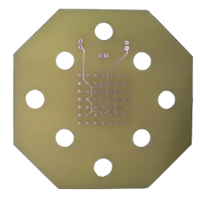
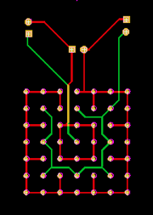
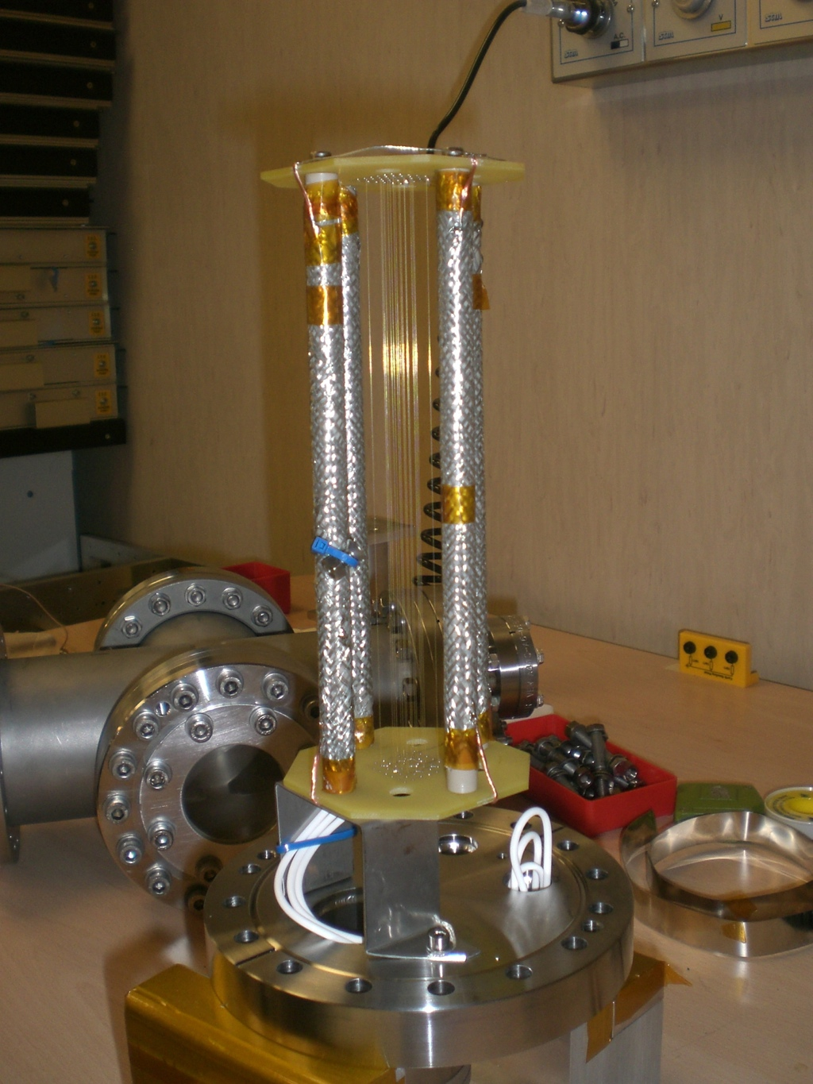
Ageing prototype
Realistic prototype from the point of view of
    field configuration
    Materials
Prototype
  1-complete cells (20 cm length) + guard field
  4 stainless steel rods
  Gold-plated tungsten wires
    ~4 µm plating
    sense wire 25µm/ field+shape 80 µm
  ~1kBq α-source at the center
  Teflon cables
  Assembled in clean room

Slide 30
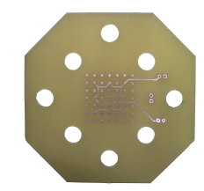
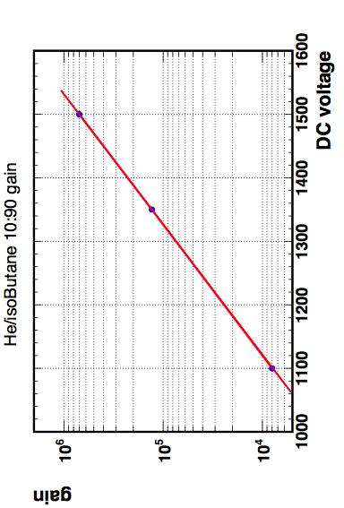
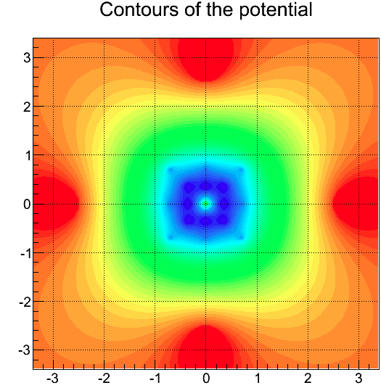
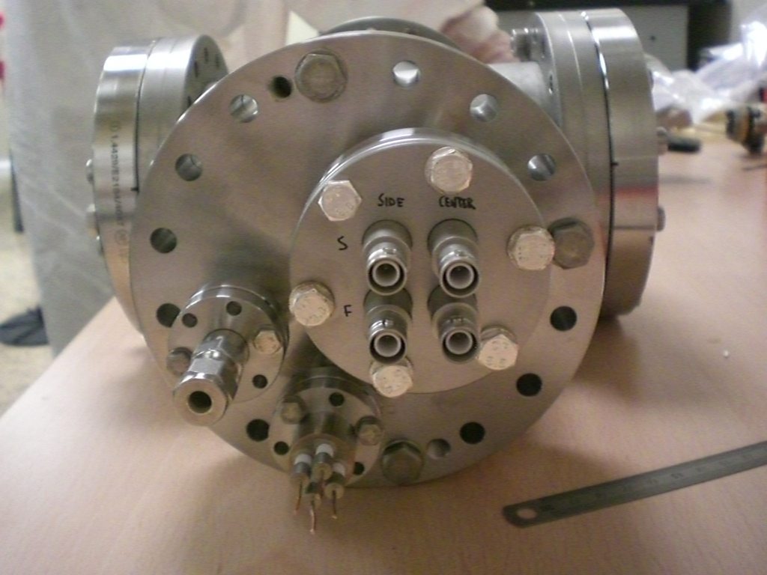
Ageing prototype configuration
To read-out the current of the central signal wire we adopt a “shifted potential” configuration
    sense wires ⇒ zero potential
    field wires ⇒ –HV1, guard wires ⇒ –HV2,
    supporting rods & CF100 cross ⇒ common ground
Not connected
Garfield and Garfield++ simulations
Gain g ~ 2x10⁴ for
HV1 = –1250 V,
HV2 = –1000 V
Guard Wires
–¾ HV
Central Sense
4.6MΩ
GND through picoammeter
Central Field
4.6MΩ
–HV
Readout of sense wire on opposite side

Slide 31
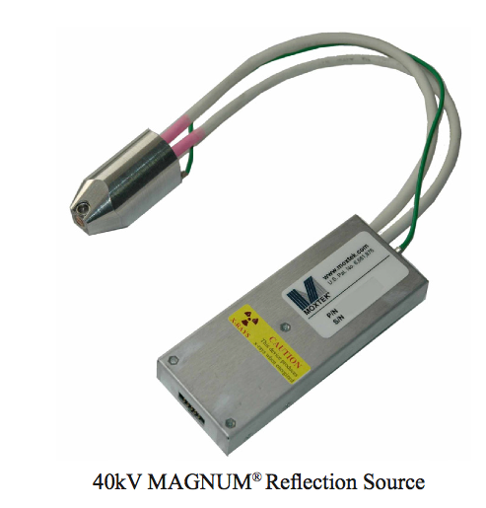
Gas & X-ray source
Gas
Pre-mixed He/isobutane bottles
Stainless steel piping
Tunable gas flow
Absolute pressure regulation
x-ray source
MOXTEK MAGNUM 40kV
Tungsten target
    waiting for the delivery of a more powerful source (Oxford series 5000, 50kV, 50W)
Tunable
    HV: 10 → 40 keV
    Current: 1 → 100 µA

Slide 32

Measuring configuration
On scale
Φ 60mm
150 µm
Mylar window
The supporting rods are rotated 45º away in the actual configuration
Φ 5mm
collimator
on 150µm Mylar window
α-source
NaI
120mm
X-ray source
Φ 0.6mm
collimator
30mm
Lead Shield
Lead Shield
100 mm
~2.5 cm wire are illuminated

Slide 33
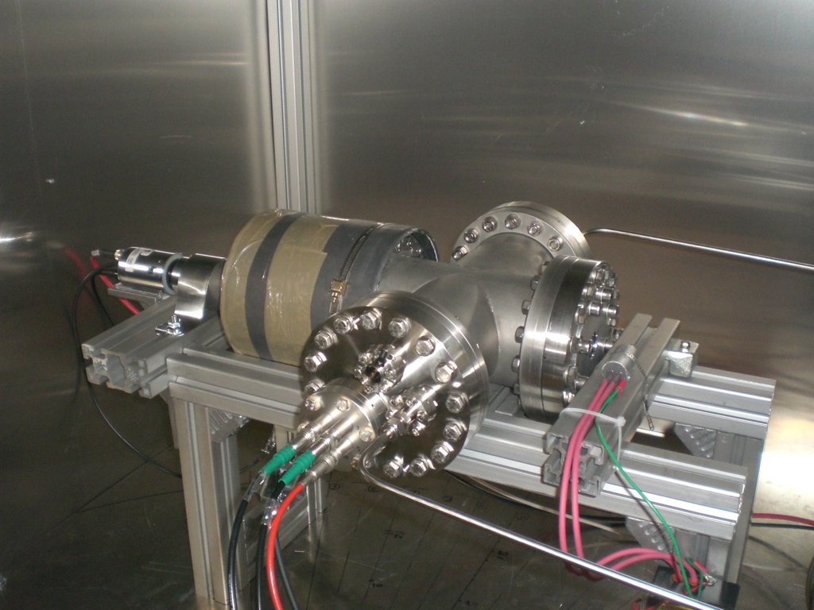
Measuring configuration
Picture of the measuring set-up
NaI
x-ray monitor
Lead shield
X-ray source
gas out
feed-through
gas in

Slide 34
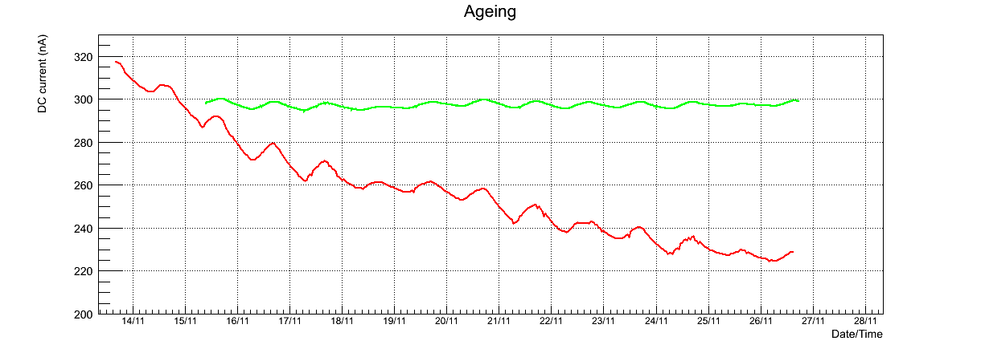
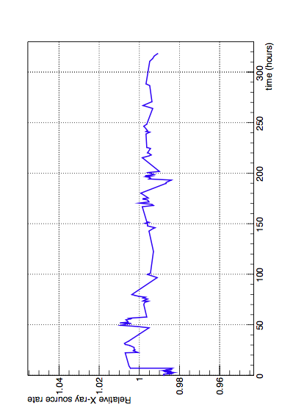
Result: DC current vs. time
~0.12 C/cm in 13 days (equivalent to 260 DAQ days)
X-ray rate monitored by NaI is stable
Daily variations correlated with temperature
Temperature (K)
DC Current (nA)
complete 2012 MEG run
in this scale (6.5 days)
X-ray rate is very stable
RMS < 1%

Slide 35
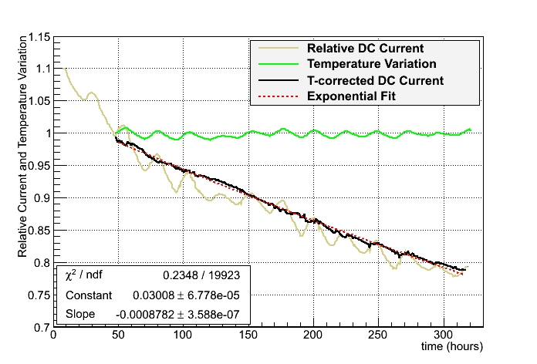
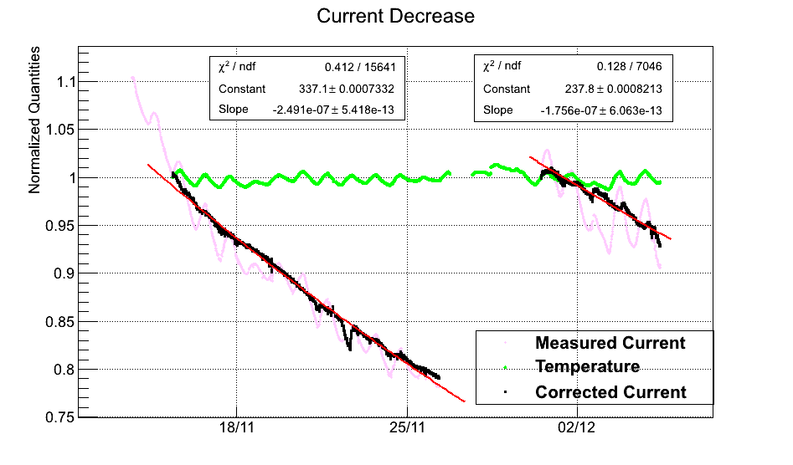
DC Current drop
By applying the correction coefficient we get rid of the daily oscillations
    dI/I ~ 3.14 dT/T
    Temperature measurement available only from day-3
Two measured time constants ~45 days and ~65 days

Slide 36

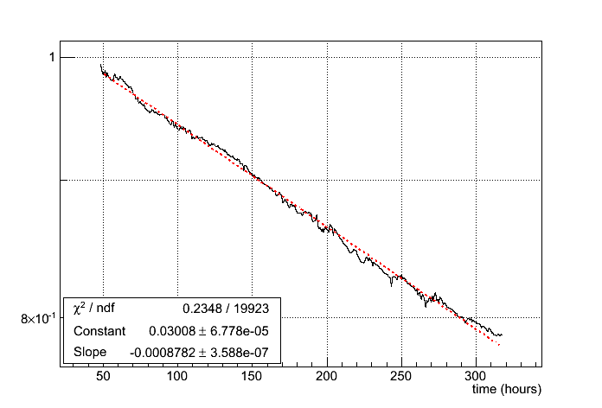
Fit to DC current drop
The current drop is nicely fitted with an exponential function over > 10 days
Actualized time constant = 945 days
    Gain drop 0.11% / day
1 PSI DAQ year (210 days)

Slide 37
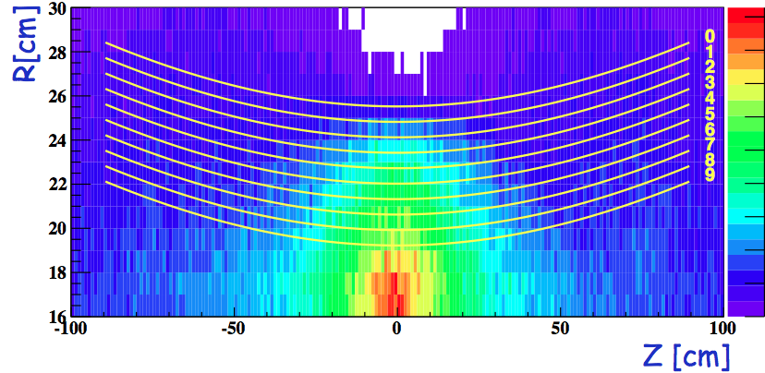
Estimated 1-year aging
With a measured aging of 2.1%/day at a 20x aging speed we estimate the aging of our system in 1-PSI-year (210 days)
Gain drop for every portion of the wires
    Only very limited part of the chamber > 15%/year
25%/year
20%/year
15%/year
10%/year
5%/year
0

Slide 38
Table of content
Performances of the present system
The new tracker
Simulation and expected performances
Key aspects
  Hit resolution
  Ageing
Mechanics, assembly and integration
Resources
Timetable
Conclusions

Slide 39
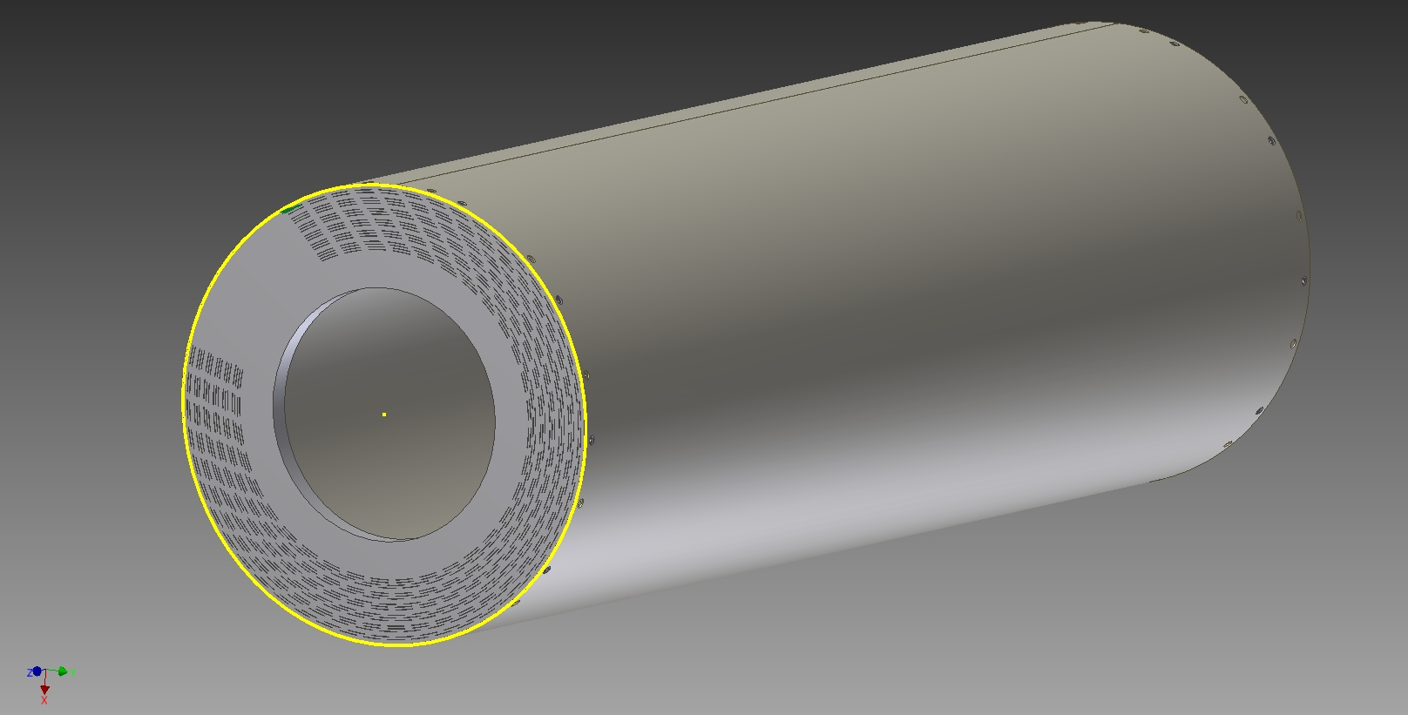
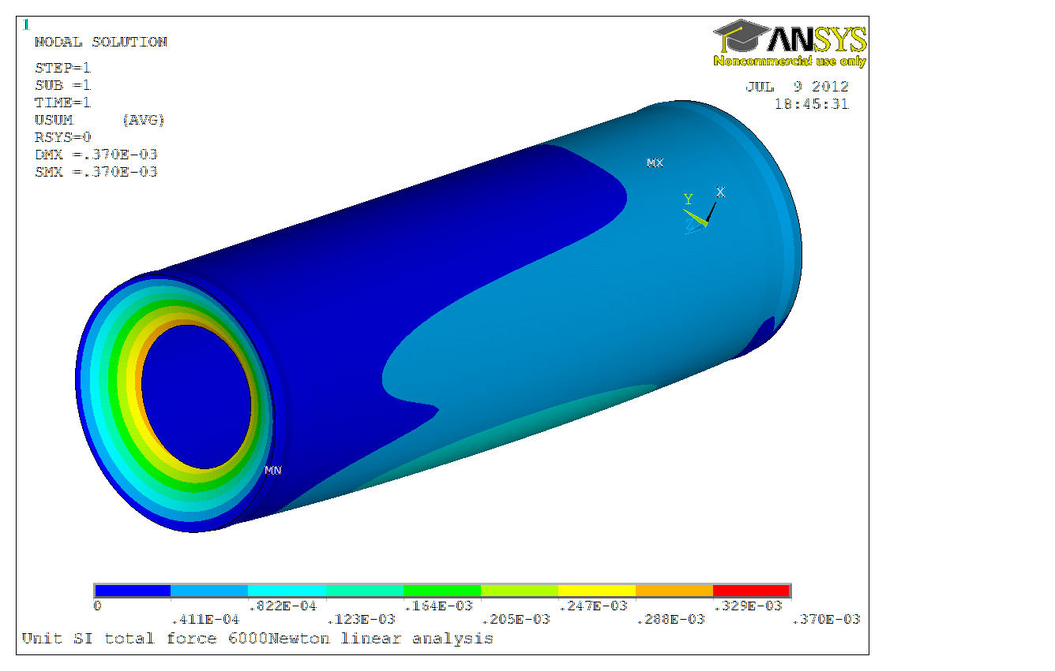
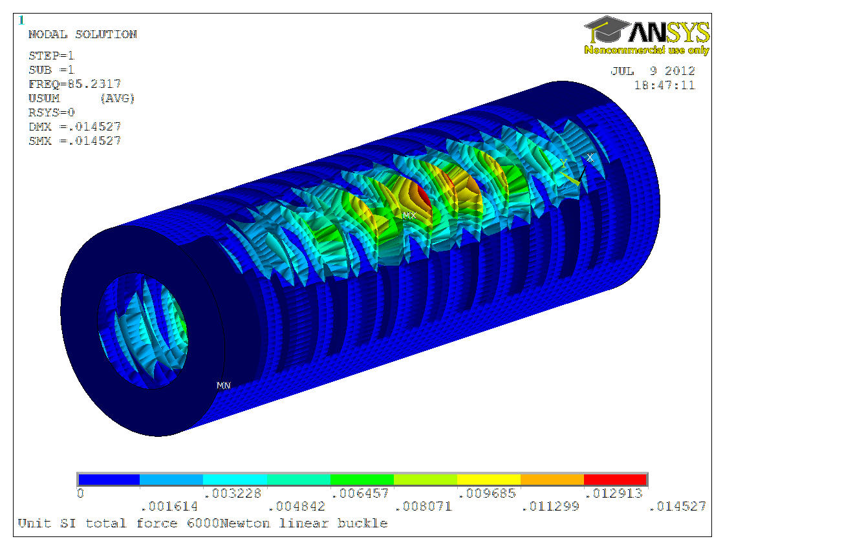
Support structure
Constraints on dimensions and weight by COBRA, target and bellow system
Simple initial mechanical support
Al end plates with PCB slots,
  3 cm thick
Carbon fiber external
  cylinder 2 mm thick 1.8 m long
FEA simulation
Max end-plate flexion 0.37 mm
Acceptable
Cylinder buckling at 85 times the nominal load
Good safety margin

Slide 40
Assembly procedure
A prototype of a tracking chamber for Mu2e , which is similar to the proposed MEG tracker, is under construction in Lecce
Design PCB with wire pads, electronics and connectors for both chamber ends
Mount electronics and connectors
Solder wires with correct tension
Glue together the PCBs and spacers
Sustain tension with external rigid end-plates

Slide 41
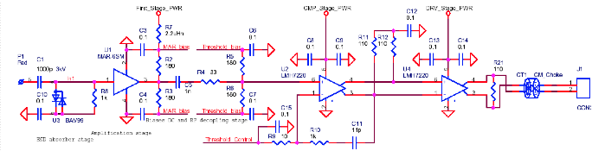
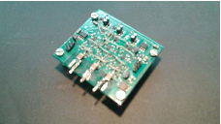
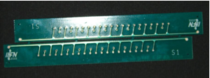
PCB

Slide 42
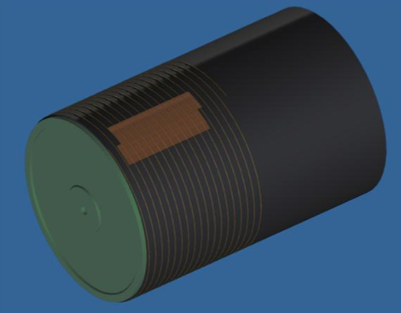
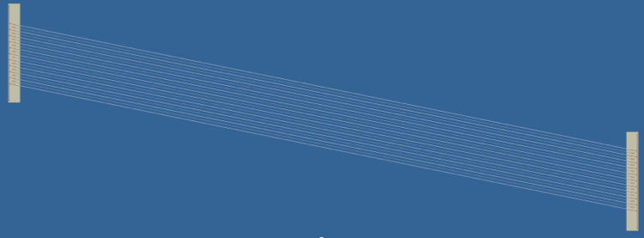
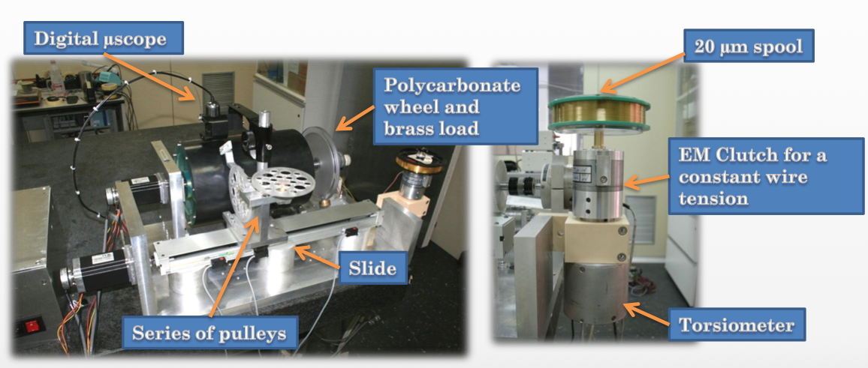
Wiring machine

Slide 43



Assembly

Slide 44
Table of content
Performances of the present system
The new tracker
Simulation and expected performances
Key aspects
  Hit resolution
  Ageing
Mechanics, assembly and integration
Resources
Timetable
Conclusions

Slide 45
Key elements
Benefit from past experience and know how
  similar chambers were already successfully operated for many years
  new assembly technique has been defined and proved
Use or reuse of existing infrastructures
Work in parallel
  PSI
  INFN Lecce
  INFN Roma
  INFN Pisa

Slide 46

Schedule and Milestones
Prototypes
Small prototype for hit resolution
Si telescope for high precision tracking
Short prototype for ageing
Long prototype for validation of construction procedure

Slide 47
Next year commitments

Slide 48

Full schedule

Slide 49


COST

Slide 50
Remarks
The MEG upgrade demand a new tracking system with :
  capability of sustaining high rate
  improved resolutions
  higher transparency towards TC
The MEG collaboration recognize this
A large portion of the collaboration is willing to work coherently to produce and operate the proposed new tracker

Slide 51
Conclusion
Two milestone items got experimental answers: the results are encouraging and we are confident that they will not represent a problem with the final detector.
Many other technical aspects, but in our understanding not critical, need to be carefully worked out.
Several aspects need optimization, but the simulation and evaluation tools are already available.
The cost estimate are solid and with some contingency margin.

Slide 52




Gas circuit
MKS 1179B flow meter (200 cc/min, 10 cc/min) all metal/kalrez
MKS 647C 4-channel flow controller + MKS PR4000 1-channel flow controller
MKS 250E pressure controller
Stainless-steel tubing
He:iC4H10 line
Aux line
Select
Calibrated leak valve
Chamber
pressure
feedback
Low flux
Hi flux
Test
Chamber
Mix
Forepump
Aux pump

Slide 53


X-ray monitoring
We measured the spectrum and intensity distribution
Saint-Gobain NaI X-ray detector 1XMP 040B with PA-12 pre-amplifier
    1”, 1mm thick NaI crystal
    Be window
Shaping preamplifier & DRS evaluation board
Calibrated with ²⁴¹Am x-rays
By using the NaI detector we set-up a scaler circuit to monitor the X-ray rate
Threshold set to ~3keV
    all spectrum
Measure the X-ray source intensity
    absolute intensity being measured
20 keV source spectrum
15 keV source spectrum
10 keV source spectrum

Slide 54

Pattern recognition and filter
The signal e+ hit the pTC crossing the outer support cylinder of the new DC
Tracking information is available up to a few cm from the pTC
So hits on the outer DC wires (the most silent) are spatially correlated to the pTC hit in both directions (Z and Phi)
Need of mildly resistive anodes for rough longitudinal positioning
Possible procedure
Start from pTC hits to identify hits on the exiting wires hits
Use them for the track segment seed
Define rough track segment
Do the Hough transform
Select there good hits
Use them for fitting with Kalman filter
Search for other segments
Do global fit
Repeat for all seeds

