Slide 1

Upgrade of Timing Counter
― Pixelated TC
PSI BVR MEG review meeting
Jan.14.2013, PSI
Yusuke Uchiyama

Slide 2
Contents
Present performance
Concept of upgrade
R&D status
Schedule

Slide 3
Present performance
Measurement of e⁺ time is limited by
  Uncertainty of propagation time from DC to TC: 75 ps
  TC single bar time resolution: 60 ps
    large TTS due to B-field
    position & incident-angle dependence
    long propagation to PMTs
  Time alignment among bars (calibration): 35 ps
  Electronics synchronization: 30 ps
Furthermore,
  PMTs are now working at the edge of proper operation point of hit rate (1 MHz)
  Not fit new DC in geometry (slanted PMTs, N₂ bag)
76 ps

Slide 4
Present performance
Measurement of e⁺ time is limited by
  Uncertainty of propagation time from DC to TC: 75 ps
  TC single bar time resolution: 60 ps
    large TTS due to B-field
    position & incident-angle dependence
    long propagation to PMTs
  Time alignment among bars (calibration): 35 ps
  Electronics synchronization: 30 ps
Furthermore,
  PMTs are now working at the edge of proper operation point of hit rate (1 MHz)
  Not fit new DC in geometry (slanted PMTs, N₂ bag)
Obviously,
upgrade of TC is also necessary
to overcome these.
Naturally, comes to the concept of…
76 ps

Slide 5
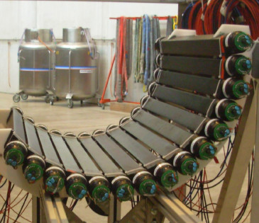
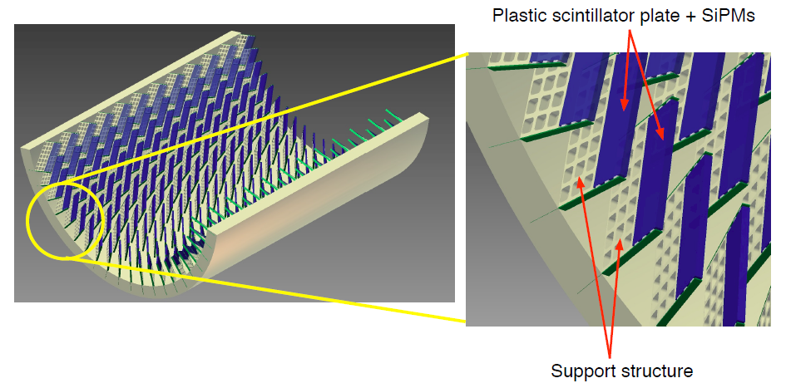
Concept of TC upgrade
Pixelated scintillator detector
  Small scintillator plates
  Several hundreds of counters
  Readout by SiPMs
Advantages
  Operational at high rate
    hit rate is not an issue
    less pileup, no double-hit by single e⁺
  Good single-counter resolution
    proved technology by PSI μSR group (smaller)
    less contributions from position and angle
    operational in B-field and in Helium gas
  Further improvement with multi-counter hits
    reduce electronics & calibration contributions as well

Slide 6
Concept of TC upgrade
Pixelated scintillator detector
  Small scintillator plates
  Several hundreds of counters
  Readout by SiPMs
Advantages
  Operational at high rate
    Hit rate is no more an issue. Less pileup, no double-hit by a e⁺.
  Good single-counter resolution
    proved technology by PSI μSR group (but, for smaller counters)
    less contributions from position and angle
    operational in B-field and in Helium gas
  Flexible layout
  Further improvement with multi-counter hits
    reduce electronics & calibration contributions as well

Slide 7
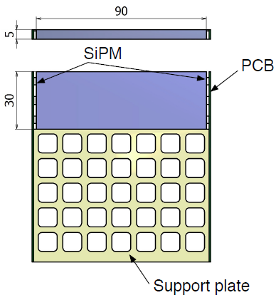

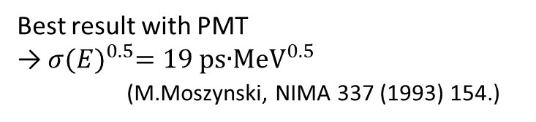
Single Counter
Ultra-fast scintillator + SiPMs
  High performance was already proved by PSI muSR group with smaller counter
    Better intrinsic resolution than PMTs
    Resolution scales as # of observed p.e.
    Small coverage can be recovered by using several SiPMs connected in parallel or series
current TC bar
Measured resolution for small counter
with SiPM readout
properties | BC418 | BC420 | BC422 | BC404
Light Output [% Anthracene] | 67 | 64 | 55 | 68
Rise Time [ns] | 0.5 | 0.5 | 0.35 | 0.7
Decay Time [ns] | 1.4 | 1.5 | 1.6 | 1.8
Wavelength [nm] | 391 | 391 | 370 | 408
Attenuation Length [cm] | 100 | 110 | 8 | 140
$$σ{(k∙E)}^{0.5}=15 \text{ps}\text{∙}{\text{MeV}}^{0.5}$$
(k = area APD / area Scint. = 0.3)
Best result with PMT
→ $σ{(E)}^{0.5}=\text{19 }\text{ps}\text{∙}{\text{MeV}}^{0.5}$
(M.Moszynski, NIMA 337 (1993) 154.)
Established (basic) technology

Slide 8
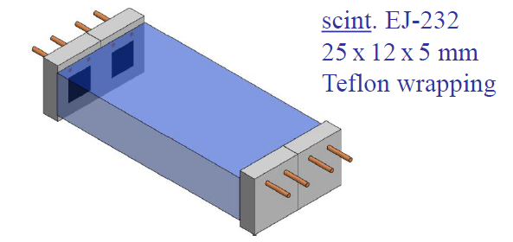
Single Counter
Ultra-fast scintillator + SiPMs
  High performance was already proved by PSI muSR group with smaller counter
    Better intrinsic resolution than PMTs
    Resolution scales as # of observed p.e.
    Small coverage can be recovered by using several SiPMs connected in parallel or series
(≒BC422)
2 MPPCs
Series connection
A. Stoykov et al. NDIP 2011
MPPC: S10362-33-050C
(Hamamatsu, 3x3mm², V~70V)
current TC bar
Measured resolution for small counter
with SiPM readout
properties | BC418 | BC420 | BC422 | BC404
Light Output [% Anthracene] | 67 | 64 | 55 | 68
Rise Time [ns] | 0.5 | 0.5 | 0.35 | 0.7
Decay Time [ns] | 1.4 | 1.5 | 1.6 | 1.8
Wavelength [nm] | 391 | 391 | 370 | 408
Attenuation Length [cm] | 100 | 110 | 8 | 140
$$σ{(k∙E)}^{0.5}=15 \text{ps}\text{∙}{\text{MeV}}^{0.5}$$
(k = area APD / area Scint. = 0.3)
Best result with PMT
→ $σ{(E)}^{0.5}=\text{19 }\text{ps}\text{∙}{\text{MeV}}^{0.5}$
(M.Moszynski, NIMA 337 (1993) 154.)
Established (basic) technology

Slide 9
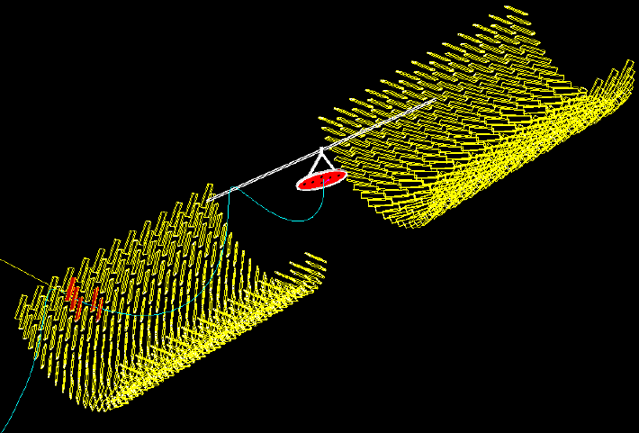
Multi-counter hit
MC simulation
5-counter hit

Slide 10
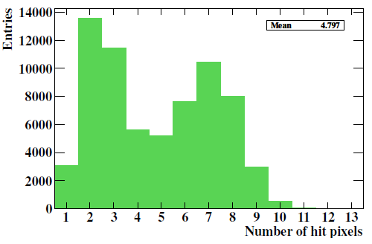
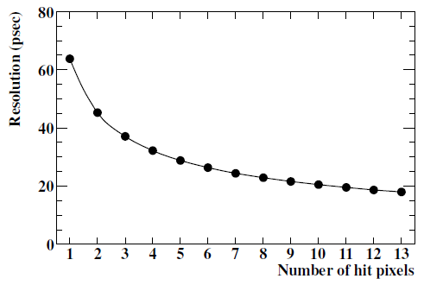

Multi-counter hit
Multiplicity is studied with MC
Measured resolution is used
Overall resolution is significantly improved by combining multiple hits
〈N_{hit}〉=4.8
Overall time resolution vs N_{hit}
${σ^{2}}_{total}^{}\left(N_{hit}\right)=\frac{{σ^{2}}_{single}^{}}{N_{hit}}+\frac{{σ^{2}}_{inter−pixel}^{}}{N_{hit}}+{σ^{2}}_{MS}^{}\left(N_{hit}\right)$
Weaken electronics (jitter, sync) and calibration contribution as well

Slide 11
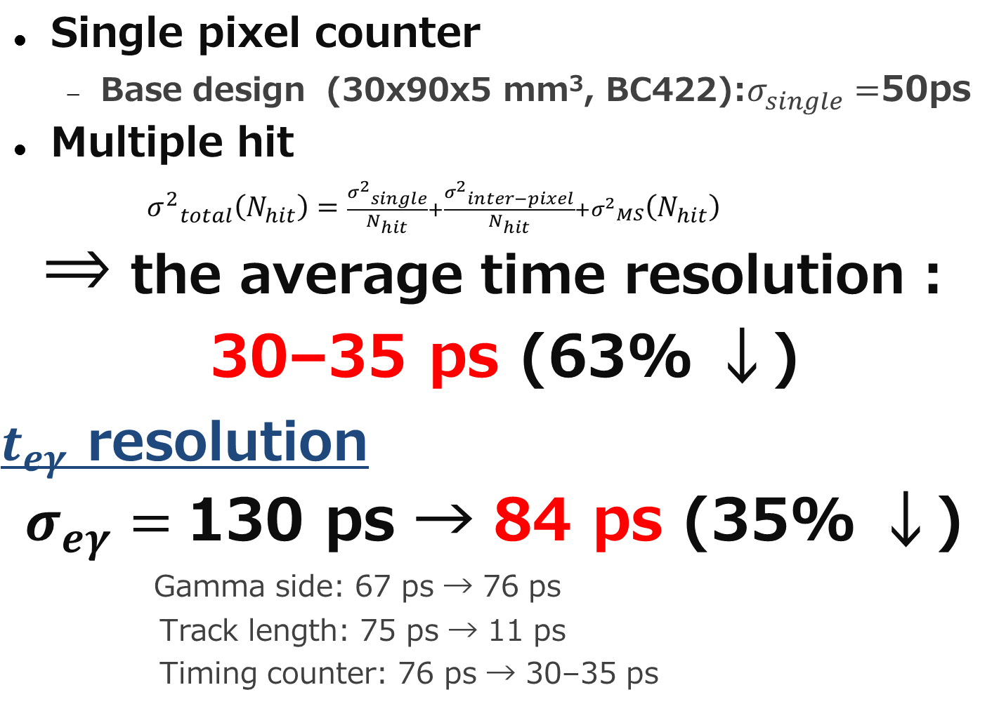
Expected performance
Single pixel counter
  Base design (30x90x5 mm³, BC422):$σ_{single}^{}=$50ps
Multiple hit
${σ^{2}}_{total}^{}\left(N_{hit}\right)=\frac{{σ^{2}}_{single}^{}}{N_{hit}}+\frac{{σ^{2}}_{inter−pixel}^{}}{N_{hit}}+{σ^{2}}_{MS}^{}\left(N_{hit}\right)$
⇒ the average time resolution :
30–35 ps (63% ↓)
$t_{eγ}$ resolution
$σ_{eγ}=$130 ps → 84 ps (35% ↓)
  Gamma side: 67 ps → 76 ps
  Track length: 75 ps → 11 ps
  Timing counter: 76 ps → 30–35 ps
104 ps → 35 ps

Slide 12
Items for R&D
Prove the performance for our application
Larger single counter
Readout system (cabling, electronics…)
Multiple hit principle
Other possible issues
The number of electronics channels (~600 pixels×2 readout) and SiPMs (~600 pixels×6), and cost
Temperature coefficient of SiPM gain
Radiation hardness of SiPM

Slide 13
R&D of single counter

Slide 14
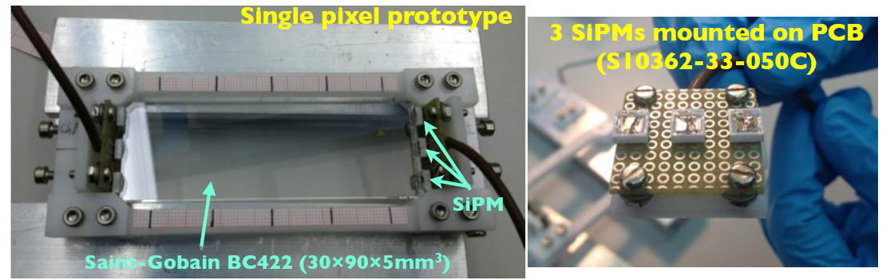
Prototype and Items
Basic study & optimal operation voltage
Scintillator type (fast rise time, longer attenuation,,,)
Dimension of a counter
# of SiPMs & manufacturer
Reflector

Slide 15
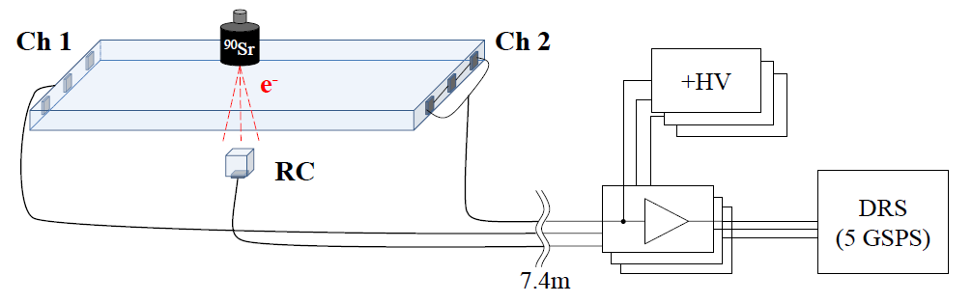
Setup
3 or 4 MPPCs
Series connection
Test counter
  HAMAMATSU MPPC (S10362-33-050C)
    3x3 mm², 50μm-3600 pixels
  glued with optical grease (OKEN6262A) to be able to detach
  Swap scintillators
⁹⁰Sr β-source (<2.28 MeV)
Trigger with reference counter (RC)(5x5x5mm³, 1 MPPC)
  Measured time resolution : σ_{RC} = 28 ps (for E_{dep} > 0.5 MeV)
Voltage preamp from PSI (Gain~20, 600 MHz bandwidth)
  Shaping with high-pass filter & pole-zero cancellation
Long cable before preamp
KEITHLEY Picoammeter for MPPC bias (HV)
DRS4 evaluation board (1 chip, 4 ch) @ 5 GSPS

Slide 16
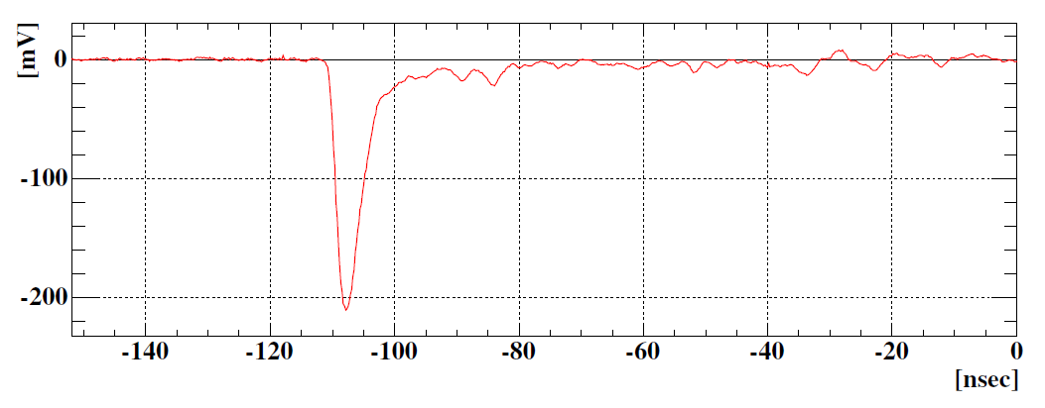
Analysis
Signal time is picked-off by Constant-Fraction method (~10%)
  very leading-edge is relevant to precise timing
e hit time is reconstructed by the average of times measured at the both ends
Resolution of test counter is evaluated from (t₁ + t₂)/2 – t_{ref}
baseline restoration by the
pole-zero cancellation @ preamp
t_{rise}~1.7 ns

Slide 17
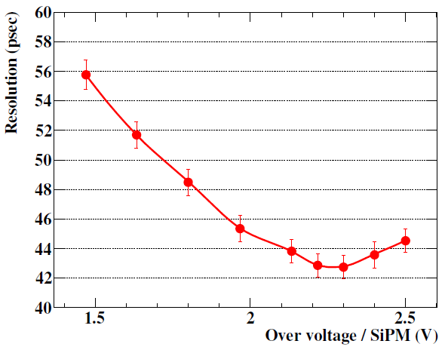
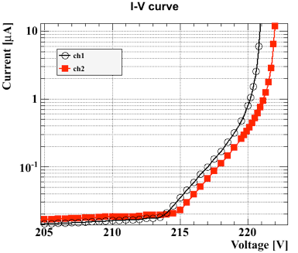
Bias dependence
BC422
6x3x0.5 cm³
3M mirror film
3 MPPCs
connected in series
operation
Break-down
voltage
Improvement in resolution as ΔV
then degraded because of higher dark noise
Following test done at ΔV=2.3V

Slide 18
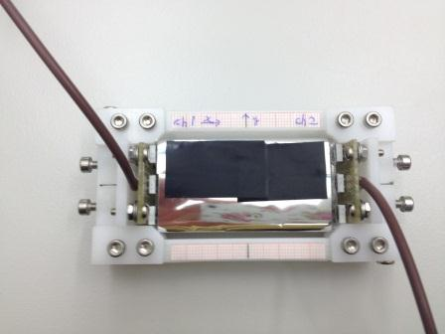
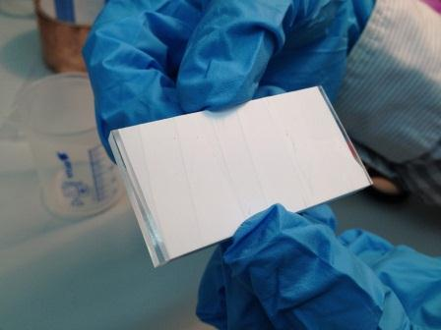
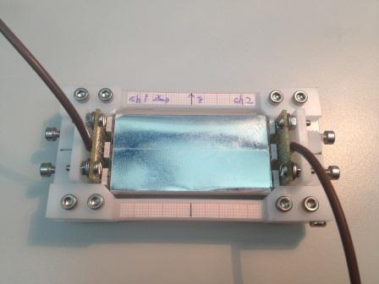
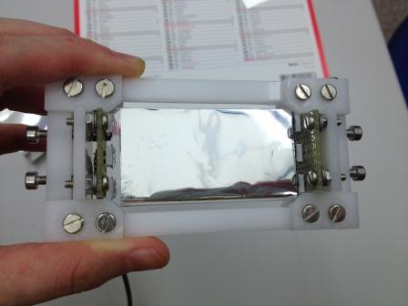
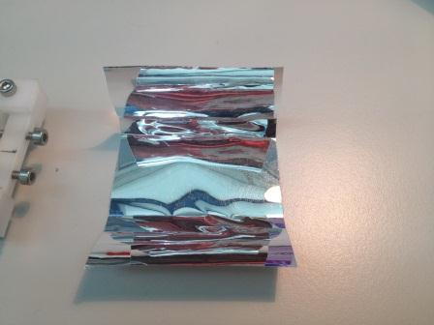
Wrapping w/ reflector
We tested Aluminized Mylar (from Detector group), Teflon tape, 3M radiant mirror film (from Genoa group).
Al Mylar
Teflon
3M
non-adhesive side
  Setup
  BC422, 60x30x4.5 mm3
  3 MPPCs in series each side
  32 ns LEMO cable before preamp
  Preamp 1 kOhm
  Signal divided by two
  RC: 71.5 V, 2.23 uA, signal divided by 4
About all, position scanning was done.

Slide 19
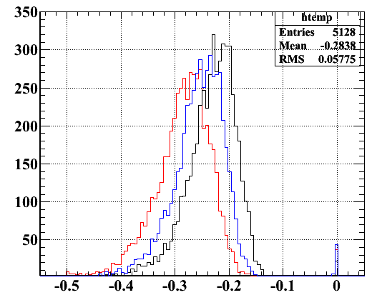
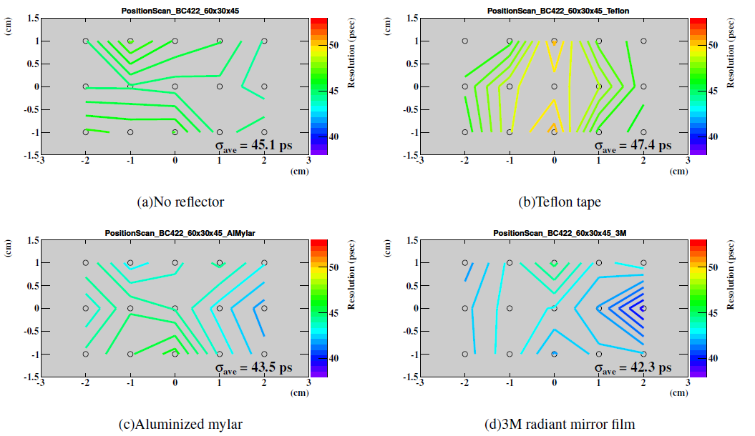
Results w/ wrapping
Naked
Al-Mylar
3M film
Resolution maps
naked (no wrapping)
Teflon
Amplitude (V)
Scan 15 points
(1cm interval in X,Y)
Al-Mylar
3M mirror film
3M-film is the best for time resolution.
The non-uniformity may come from way of wrapping (?)

Slide 20
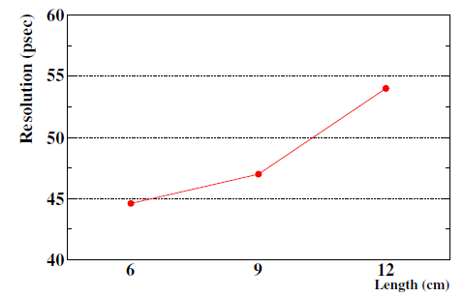
Optimization
Tested different size
  The larger, the worse as expected from # p.e.
    longer → attenuated, wider → smaller coverage
    BC422 is always better than BC418
      fast rise-time has larger impact than long attenuation
    Degradation is not significant
      ~50 ps has been achieved for 9 cm long counter
  The larger, the higher efficiency and the higher multiplicity
    optimization should be done
    with respect to exp. sensitivity
  Not sensitive to thickness
    as far as using 3x3mm² SiPMs
    # p.e is constant
    Thinner is better for multiplicity
4 MPPC connection improves
Optimization is still in progress
  ex) Manufacturer of SiPM (so far, only Hamamatsu)
However
BC422, 3 MPPCs

Slide 21
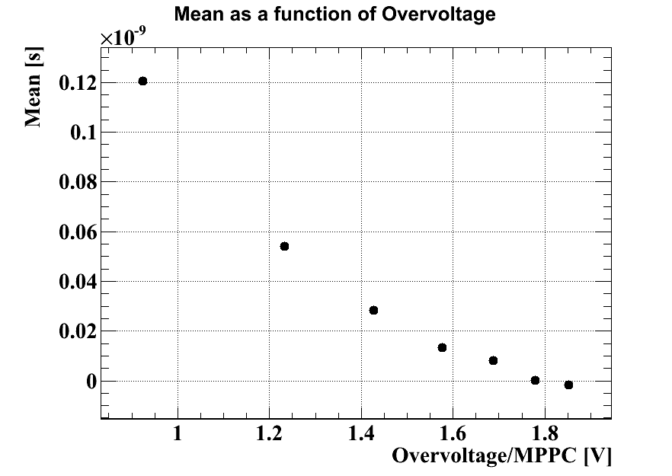
Temperature dependence
Relatively large temperature coeff. of break-down voltage for MPPC (56mV/℃) might be an issue
  Temp. variation in COBRA is a few ℃
  Time shift due to this is expected to be ~15 ps
    doesn’t seem a big issue
  Possible solutions
    Improve detector
    temp. stabilization
    KETEK SiPM with
    lower temp. coeff.
    (<1%/℃)
Measured time shift vs over voltage
~100ps/V

Slide 22
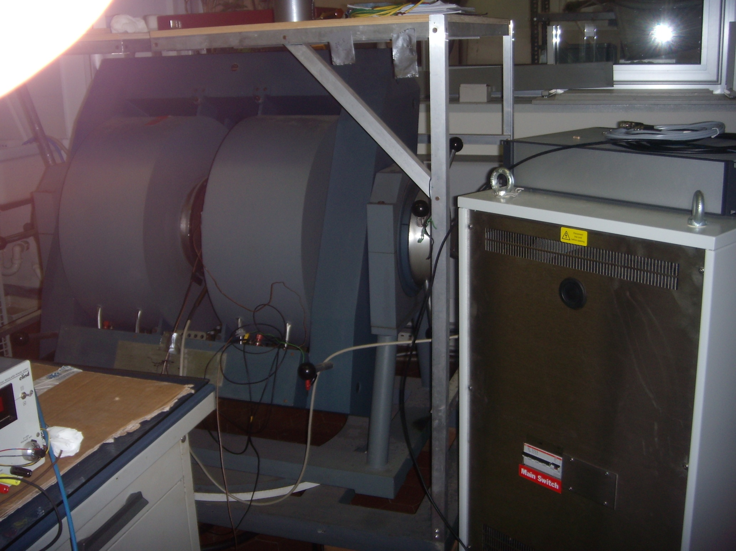
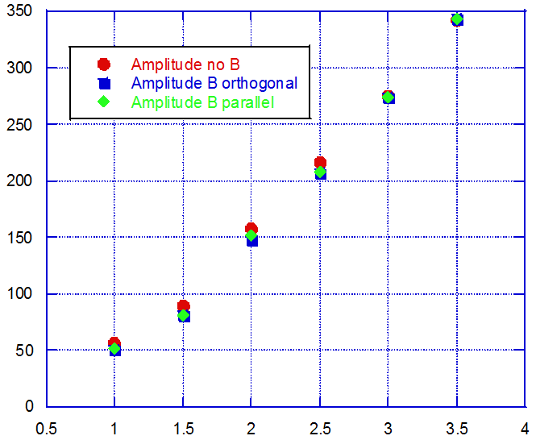
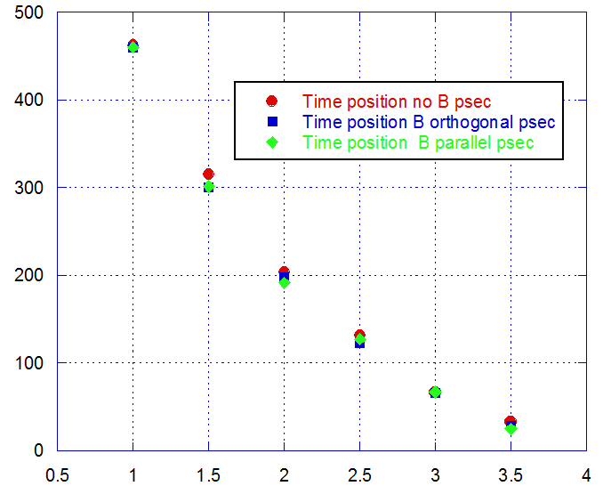
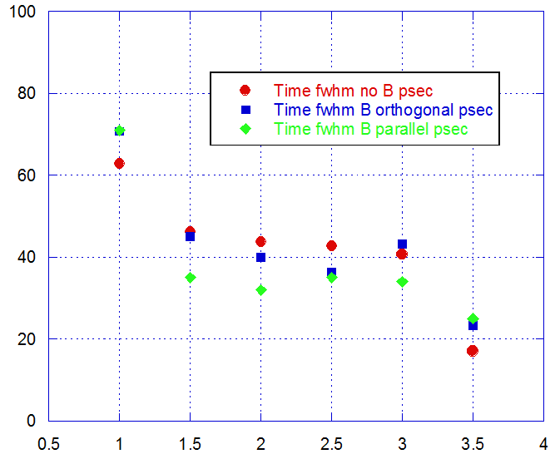
B-field test
Tested effect of B-field on SiPM
  1.25T applied to AdvanSiD SiPM
    both in orthogonal and parallel
  Measurements with Laser
    405nm, 100 ps width
  No appreciable effects observed in gain nor timing
Pavia NMR Lab
B-field up to 1.25 T
Put SiPMs
B-field effects (OFF, ON (orthogonal, parallel))
Amplitude
Time position (psec)
Time resolution (FWHM) (psec)
Over Voltage (V)

Slide 23
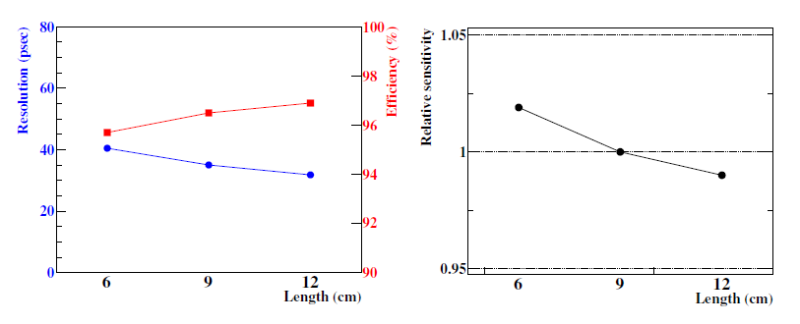
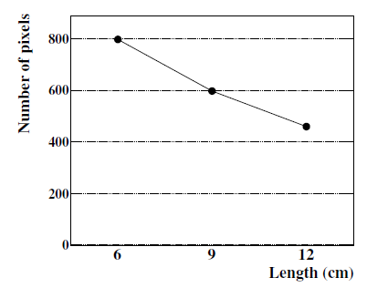
Optimization study (MC)
Final configuration is being designed with respect to exp. sensitivity
  MC study with the measured resolutions as inputs
    sensitivity by simplified (Punzi’s) figure of merit
  Trade off b/w performance vs cost
  Other factors for longer counter (hit rate, pileup) are under study
for 3 cm width
3 MPPCs
efficiency
overall resolution
better
for fixed sensitivity
Longer counter configurations show better overall resolution due to high multiplicity
as well as higher efficiency

Slide 24
Progress post proposal submission
beam test at the end of RUN 2012 at πE5

Slide 25
Introduction
We performed a beam test of the prototype of pixelated TC
  Started discussion after the collaboration meeting (30/Nov) in accordance with the proposal of beam test for Active TARget
  Decided on 12/Dec to carry out with (only) two counters and started preparation
  Successfully carried out tests with beam for several configurations on 20/Dec.
    parasitically to ATAR with less priority
  Ended with accelerator shutdown

Slide 26
Motivations
Test with MIP
  Lab test has been done with ⁹⁰Sr (up to 2 MeV)
    dE/dx is different from MIP
    Not penetrate two counters
Noise situation in the area
  even though not exactly same as final one in COBRA
High hit rate condition
See temperature variation and its impact
Find any possible issues towards the planned beam test in this spring

Slide 27
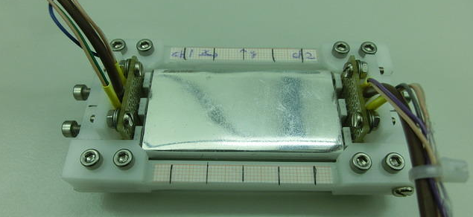
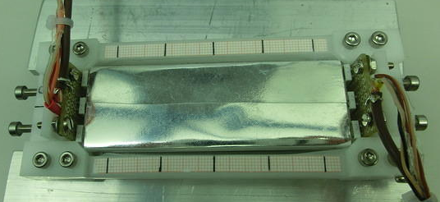
Counters
2 BC422 counters
  C1: 6x3x0.5 cm³
  C2: 9x3x0.5 cm³
  3 MPPCs at each side connected in series
  Wrapped with 3M radiant mirror film
  Pt100 sensors are attached
  Light shielded by black tape
Tested in lab with ⁹⁰Sr in advance
C1
C2
Expected resolution of two-counter measurement
37 ps (C1: 48, C2: 57 ps) for MIP
(no inter-counter jitter)

Slide 28
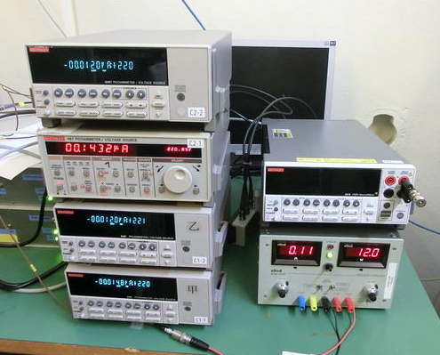
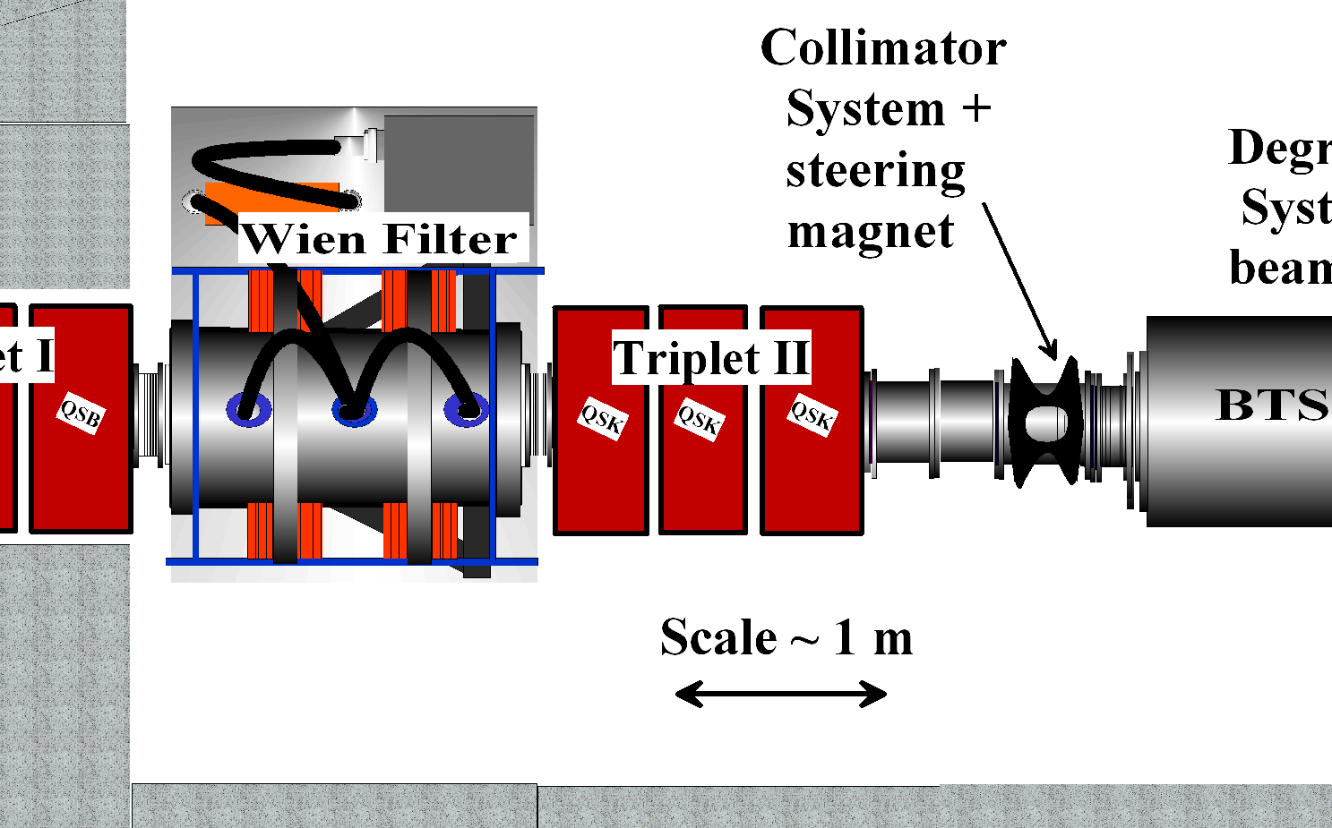
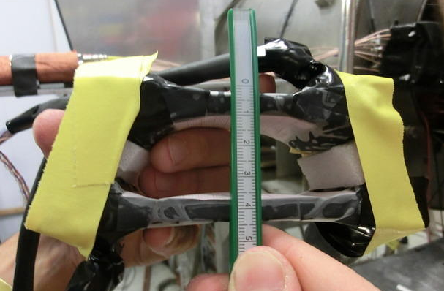
Setup
Independent DAQ system
DRS
7.4 m
C1
C2
πE5 area

Slide 29
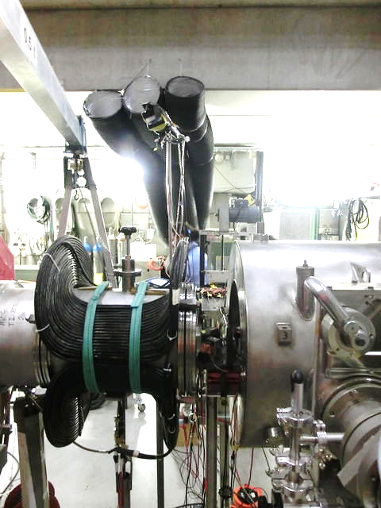

Slide 30
Setup
C1
C2
air
70 cm
BTS
ATAR
y
μ⁺ or e⁺ beam (28 MeV/c)
z
Collimator

Slide 31
Configurations
Parallel | Cross | Staggered
C1+RC1 | C2+RC1 | C2+RC1+RC2
C1
C2
Trigger by 4 (or 3) coincidence

Slide 32
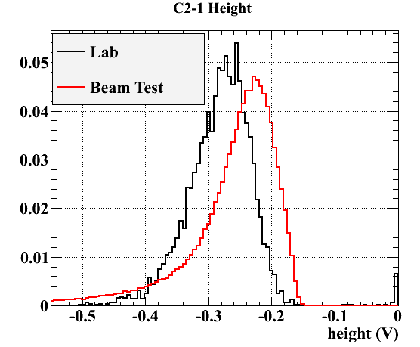
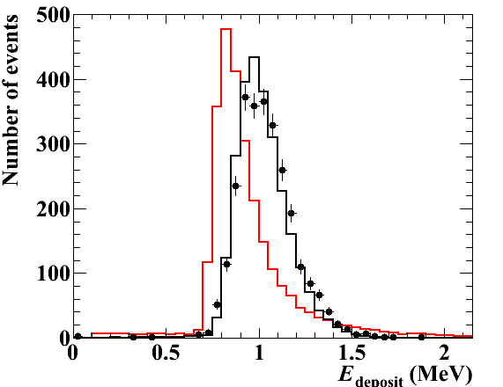
Signal amplitude
Energy deposit
― ⁹⁰Sr (MC)
● ⁹⁰Sr (data)
― 50MeV e⁺ (MC)
Lower E_{dep} for MIP than for ⁹⁰Sr
Longer tail for Landau distribution

Slide 33
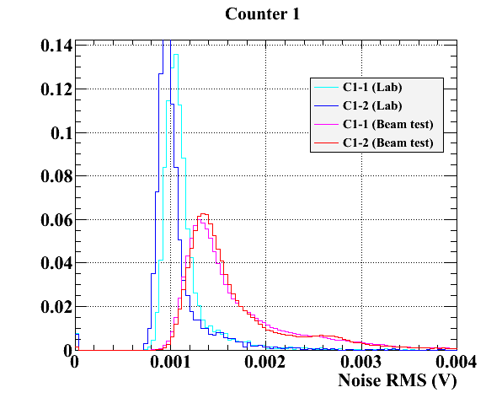
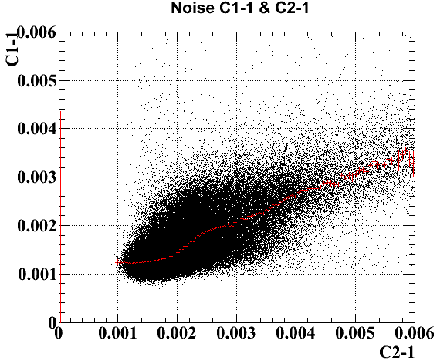
Noise
Lab
Correlation b/w counters
Beam test
Noise increased by ~40%
Picked up coherent noise on SiPM boards?
  RC with PCB (PSI) doesn’t show increase noise
Due to high hit rate?
Under investigation

Slide 34
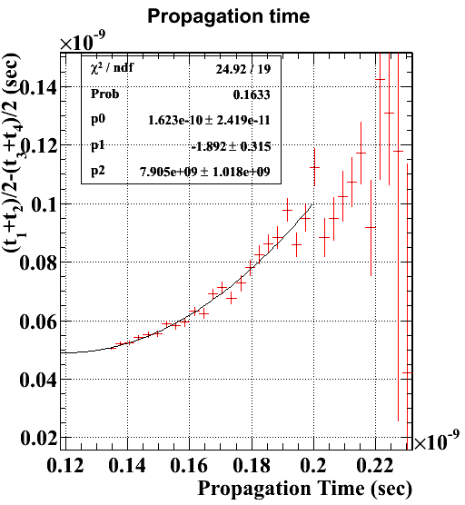
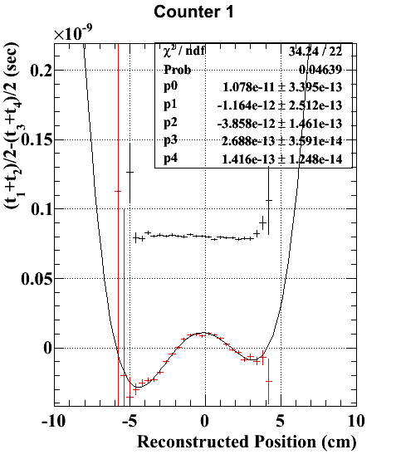
Some analysis & results
Propagation time b/w two counters depends on particle’s direction
  Particles are not collimated.
    Many comes from off-target
    No tracker, no calorimeter
    Uncertainty of the counter’s alignment
  Corrected by reconstructed hit points
    only one direction
Position dependence is observed
  consistent with that in Lab data
  corrected with rec. position

Slide 35
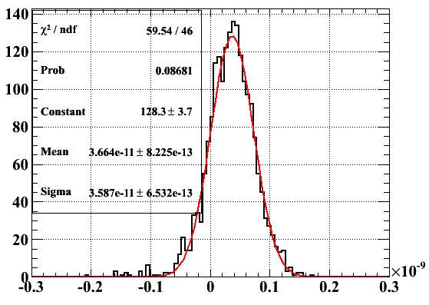
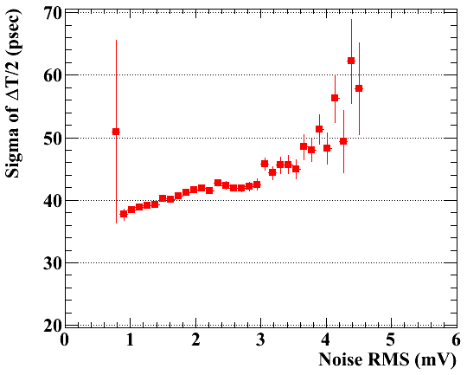
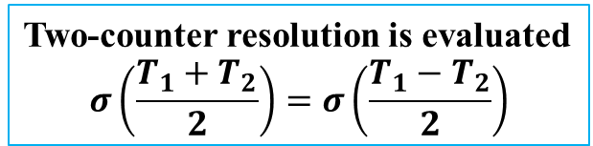
Parallel configuration
C1
Preliminary
5 mm
C2
Noise (C1-1) vs resolution
(T₁ – T₂) / 2 (sec)
Two-counter resolution is evaluated
$$σ\left(\frac{T_{1}+T_{2}}{2}\right)=σ\left(\frac{T_{1}−T_{2}}{2}\right)$$
w/o position cut, two-counter res = 40 ps
w/ position cut for 5mm, 36 ps
Deteriorated as noise

Slide 36
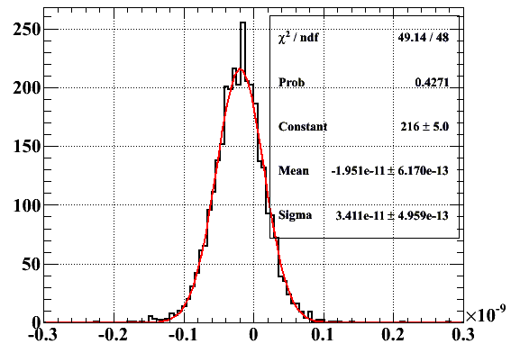
Cross configuration
ch4
View from top
Preliminary
C1
ch2
ch1
ch3
Consistent with lab measurements
(T₁ – T₂) / 2 (sec)
Measured two-counter resolution: 38 ps
Improved by selecting center (5x5 mm²):
  eliminate (reduce) uncertainty of path length
  34 ps

Slide 37
To do
Complete different SiPMs study (underway)
  Hamamatsu, KETEK, SensL, AdvanSiD
  Test new type sensors once we get samples
  Test temperature variation effect in thermostatic chamber
Prototype with several counters
  beam test in spring to prove multi-hits scheme
  make schedule
Electronics (WaveDREAM) test before beam test
  Can manage without preamp? ⇒ offline shaping
  Sampling speed (5G? 3G? 1.6G?) ⇔ trigger latency
Establish calibration methods
  Laser and/or Michel
Design full detector (support, cabling, etc.)

Slide 38
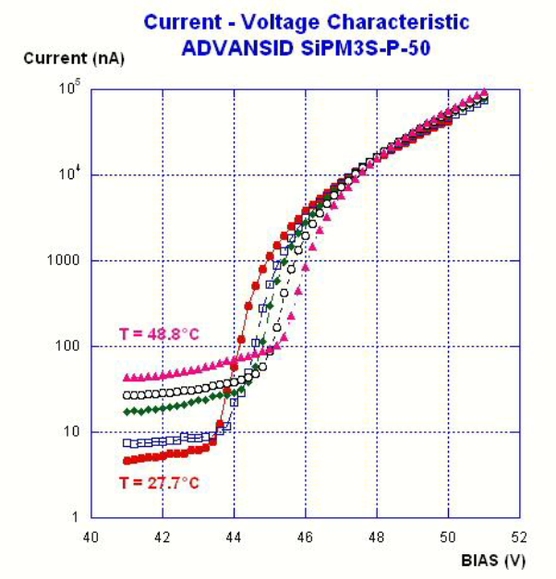
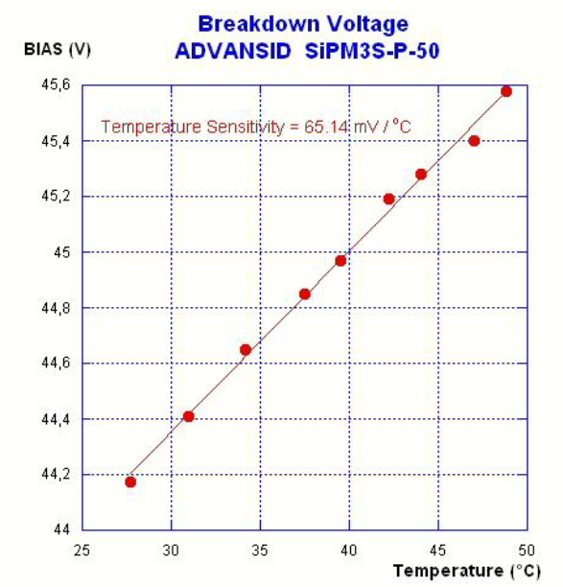
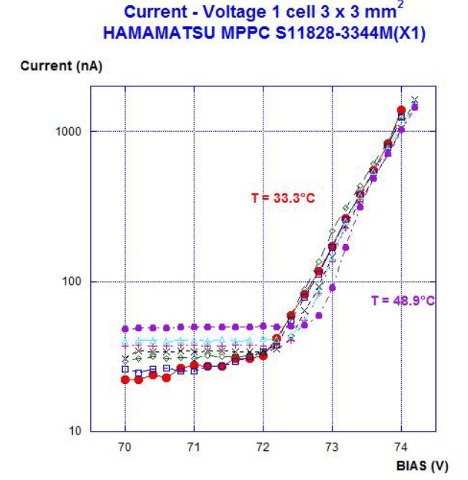
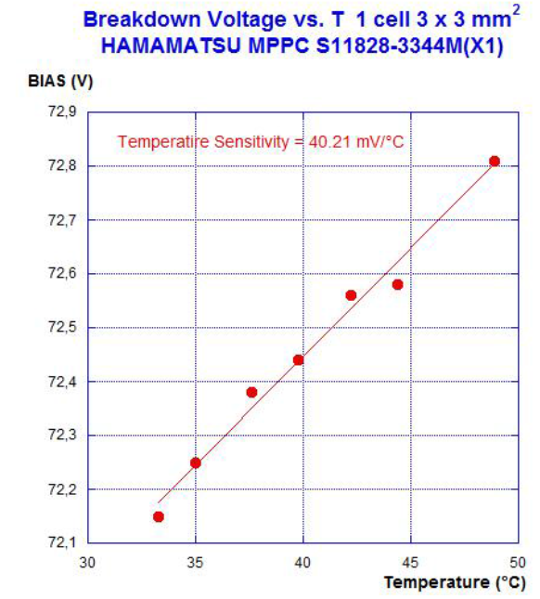
Different SiPMs tests
We have been testing different SiPMs
  Breakdown voltage, its variation, stability
  Temp. sensitivity
  Gain, PDE
  Timing performance
AdvanSiD
BV~44 V
Temp. coeff.
65 mV/℃
HAMAMATSU
BV~72 V
Temp. coeff.
40 mV/℃

Slide 39
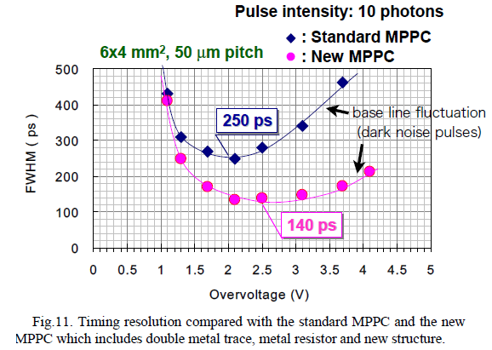

New SiPMs
Hamamatsu MPPC
Recent developments of new types of SiPM
Large impact on time resolution is expected for our application, too

Slide 40
Calibration
Important item for actual operation
Laser calibration
  Light pulse from a laser system
    Hamamatsu PLP10-040
      70 ps width, 405 nm wavelength
  Distribute via optical fibers
Michel (track-based)
  in-situ calibration using data itself
  Develop a technique similar to position alignment
    like Millipede or Linear-fit algorithms
    to calibrate all channels simultaneously
Finally, with RMD

Slide 41

Further improvements,
Backup solutions
Low-power high-bandwidth preamplifier
  For good S/N, even in case of large noise
  O(mW), 0.35–1 GHz
  Work in progress in Genoa
    achieved 0.9 ns rise-time with 8 mW
Study on organic scintillator
  higher light yield than plastic
  scint. (x3) with fast decay time (a few ns)
  ‘p-terphenyl’ (C₁₈H₁₄) is a good
  candidate
  Direct comparison with plastic scint.
  is under way with small counters.
p-terphenyl crystal
(19x11x3 mm³)
2 SiPMs
⁹⁰Sr

Slide 42
Manpower & expertise
The new TC team
Italy (4.5) | Experience of present TC construction & operation. Scintillator. Calibration, analysis. Mechanics, electronics.
Japan (2) | SiPM. Analysis. Simulation, design. Students for intensive work & education.
USA (2) | Tracking (combined analysis with DC), calibration.
PSI (1) | Experience of muSR counters (scinti.+SiPM). Electronics, machining.

Slide 43

Schedule
Milestones: two staged prototypes and beam tests
Several counters prototype
  Beam test in this spring
  @DAΦNE Beam test facility (BTF) at Frascati
  ~30 counters
  Prove multi-hit scheme
~1/4 scale prototype
  Beam test in COBRA
  A few 100 counters
  Prove full performance in situ

Slide 44
Conclusion
Upgraded timing counter
  pixelated TC with ultra-fast scint. & SiPMs
  Significant improvement in timing resolution with multi counters hit
R&D successfully in progress
  Systematic study on single counter with source in Lab
  already achieved good resolution
    43ps for 6cm, 50ps for 9cm long counter
  Carried out 1st beam test with two counters
    confirmed the results in lab
    obtained useful information for further study
      higher noise, Edep, incident position angle effects
Expected resolution of 30–35 ps significantly reduces BG together with the new drift chamber

Slide 45
Back up

Slide 46
Time line
 |  | Dec.12 | Dec.13 | Dec.14 | Dec.15 | Dec.16
 |  | Made decision |  | Counter test in lab | Counter test in lab
Dec.17 | Dec.18 | Dec.19 | Dec.20 | Dec.21
Counter setup (Pre-amplifiers, thermometer, light shielding, building stands, etc.) | Setup in area DAQ setup Check with cosmic ray | Setup at beam line Trigger setup Beam test 18:40- Parallel conf | Beam test -4:00 15:50-16:15 Parallel conf 17:25-19:00 Cross conf | Beam test 2:50-3:40 w/ RC1 4:40-5:00 Staggered conf 5:10-6:30 (beam shutdown) w/ RC1+RC2

Slide 47

Cost estimation

Slide 48



3MTM radiant mirror film
Multi-layer polymeric film.

Slide 49


Position scan
Position dependence of time measurement
position scan w/ reference counter
25ps
1 cm
BC422
1 cm
There is a little position dependence.
However, we can correct it
40ps
EJ228

Slide 50






Position reconstruction
c.f.
current TC Bar
σ~15 mm (MC)
from time diff.
$x=0.5×λ\text{log}\frac{Q_{1}}{Q_{0}}$ ⇒ attenuation length
$x=v×\frac{t_{1}−t_{0}}{2}$ ⇒ scintillation light speed
BC422
EJ228
Resolution ~14.5 mm
↓
Since attenuation length is long, position reconstruction by charge does not work.
BC422
EJ228
Resolution
~8 mm

Slide 51
Preamplifier
Using preamplifier developed at PSI
Parameters were optimized for μSR counter
  signal is larger and faster than ours
Optimize for our application
  Gain
    ~25 (increased by a factor 2)
  Shaping
    High pass + pole-zero cancelation (CR-RC-CR)

Slide 52


Adjust time constant by the potentiometer
  to flat baseline

Slide 53






Pulse shape
0 Ω (attenuation 4)
800 Ω (attenuation 2)
200 Ω (attenuation 2)
1000 Ω (attenuation 2)
400 Ω (attenuation 2)
:
:
:
1680, 1700 Ω
Waveform did not change so much.
600 Ω (attenuation 2)

Slide 54


Measurement at ΔV = 2 V
Shaping of high-pass + pole-zero cancelation is definitively necessary
But performance doesn’t depend on detail value of parameter
  following tests done with 1 kΩ

Slide 55

MC simulation
GEANT4 (gem4)
  Full detector simulation
    optimization of configuration, geometry
    study efficiency, overall spectrometer performance,
  Simulation for R&D
    counter simulation
      to understand the device and test results
      optimize single counter design
    preceding study by PSI muSR group
      NIMA 696, 40–45 (2012)
Status
Basic material & geometry
  Scintillator (BC418 or 422), rise time, decay time
Started scint. photon tracking
  attenuation, reflection (polishedteflonair)
  by GEANT4
MPPC detection
  wavelength-dependent PDE
Scint. photon tracking
(reduced by factor 100 for this display)
MPPC sensitive area
Device simulation to understand diode response?

Slide 56

Hits in analyzer

