Slide 1
MEG Upgrade Programme
Beam & Target
Considerations

Slide 2
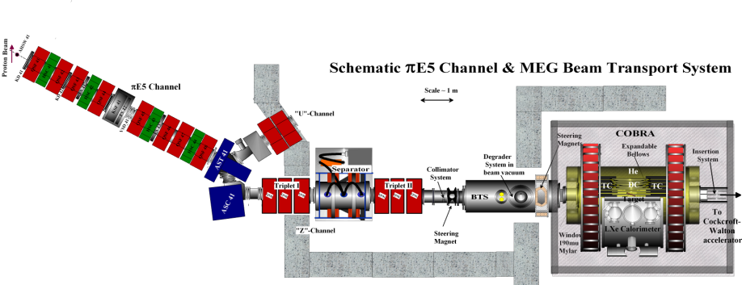
Current MEG Beam Line & Target
Main Characteristics:
High intensity, high transmission optics for surface muons (28 MeV/c) ⇒ maximize µ⁺ at target
Small emittance ⇒ minimize target size
Adustable momentum-byte < 10% ⇒ monochromatic beam with high stopping-density
Ultra-thin slanted target + minimization of material in beam (vacuum, He-environment) ⇒ minimize multipe
scattering for µ⁺ & Michels + minimize photon production AIF or Bremsstrahlung
Minimization & separation of beam-correlated backgrounds ⇒ e.g. e⁺ from π⁰-decay at Target E or µ⁺ decay-in-flight

Slide 3
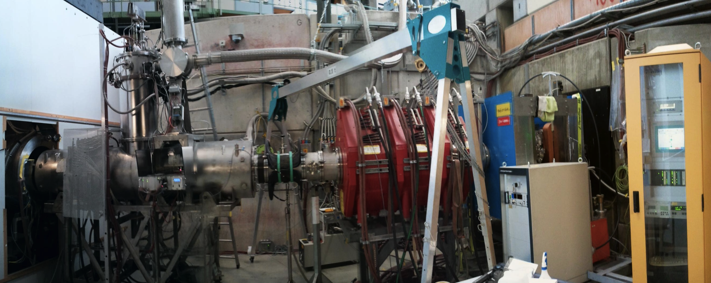
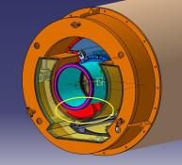
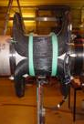
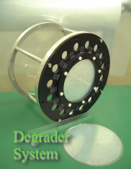
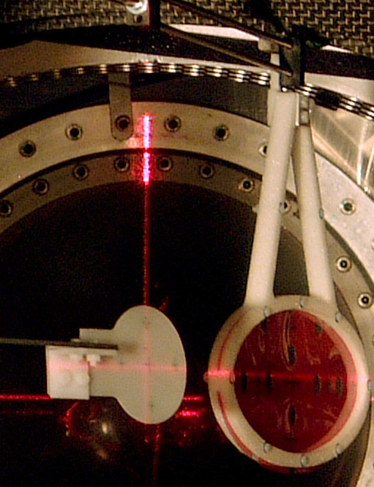
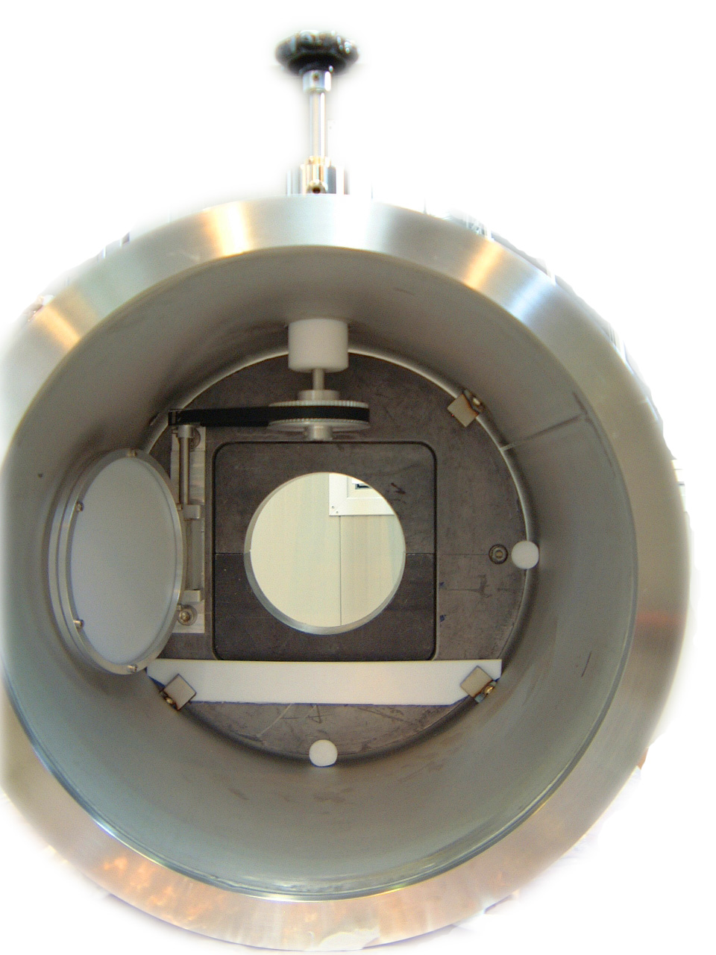
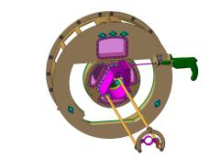
Main Components
SC
BTS
Hor. + Vert.
Correction Magnets
Wien Filter+Triplett I & II
US
End-Caps
+ IS
Target
Systems
Steering
Magnet
Degrader
System
DS
Collimator
System

Slide 4
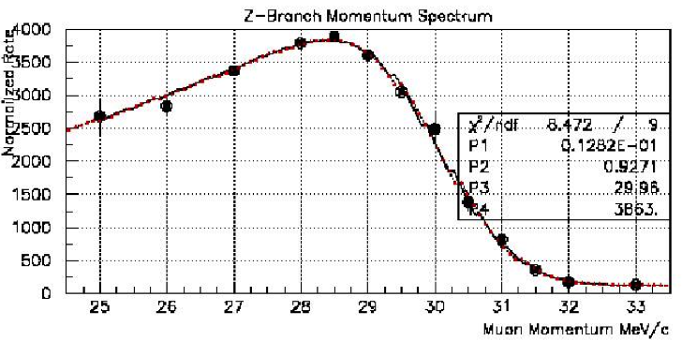
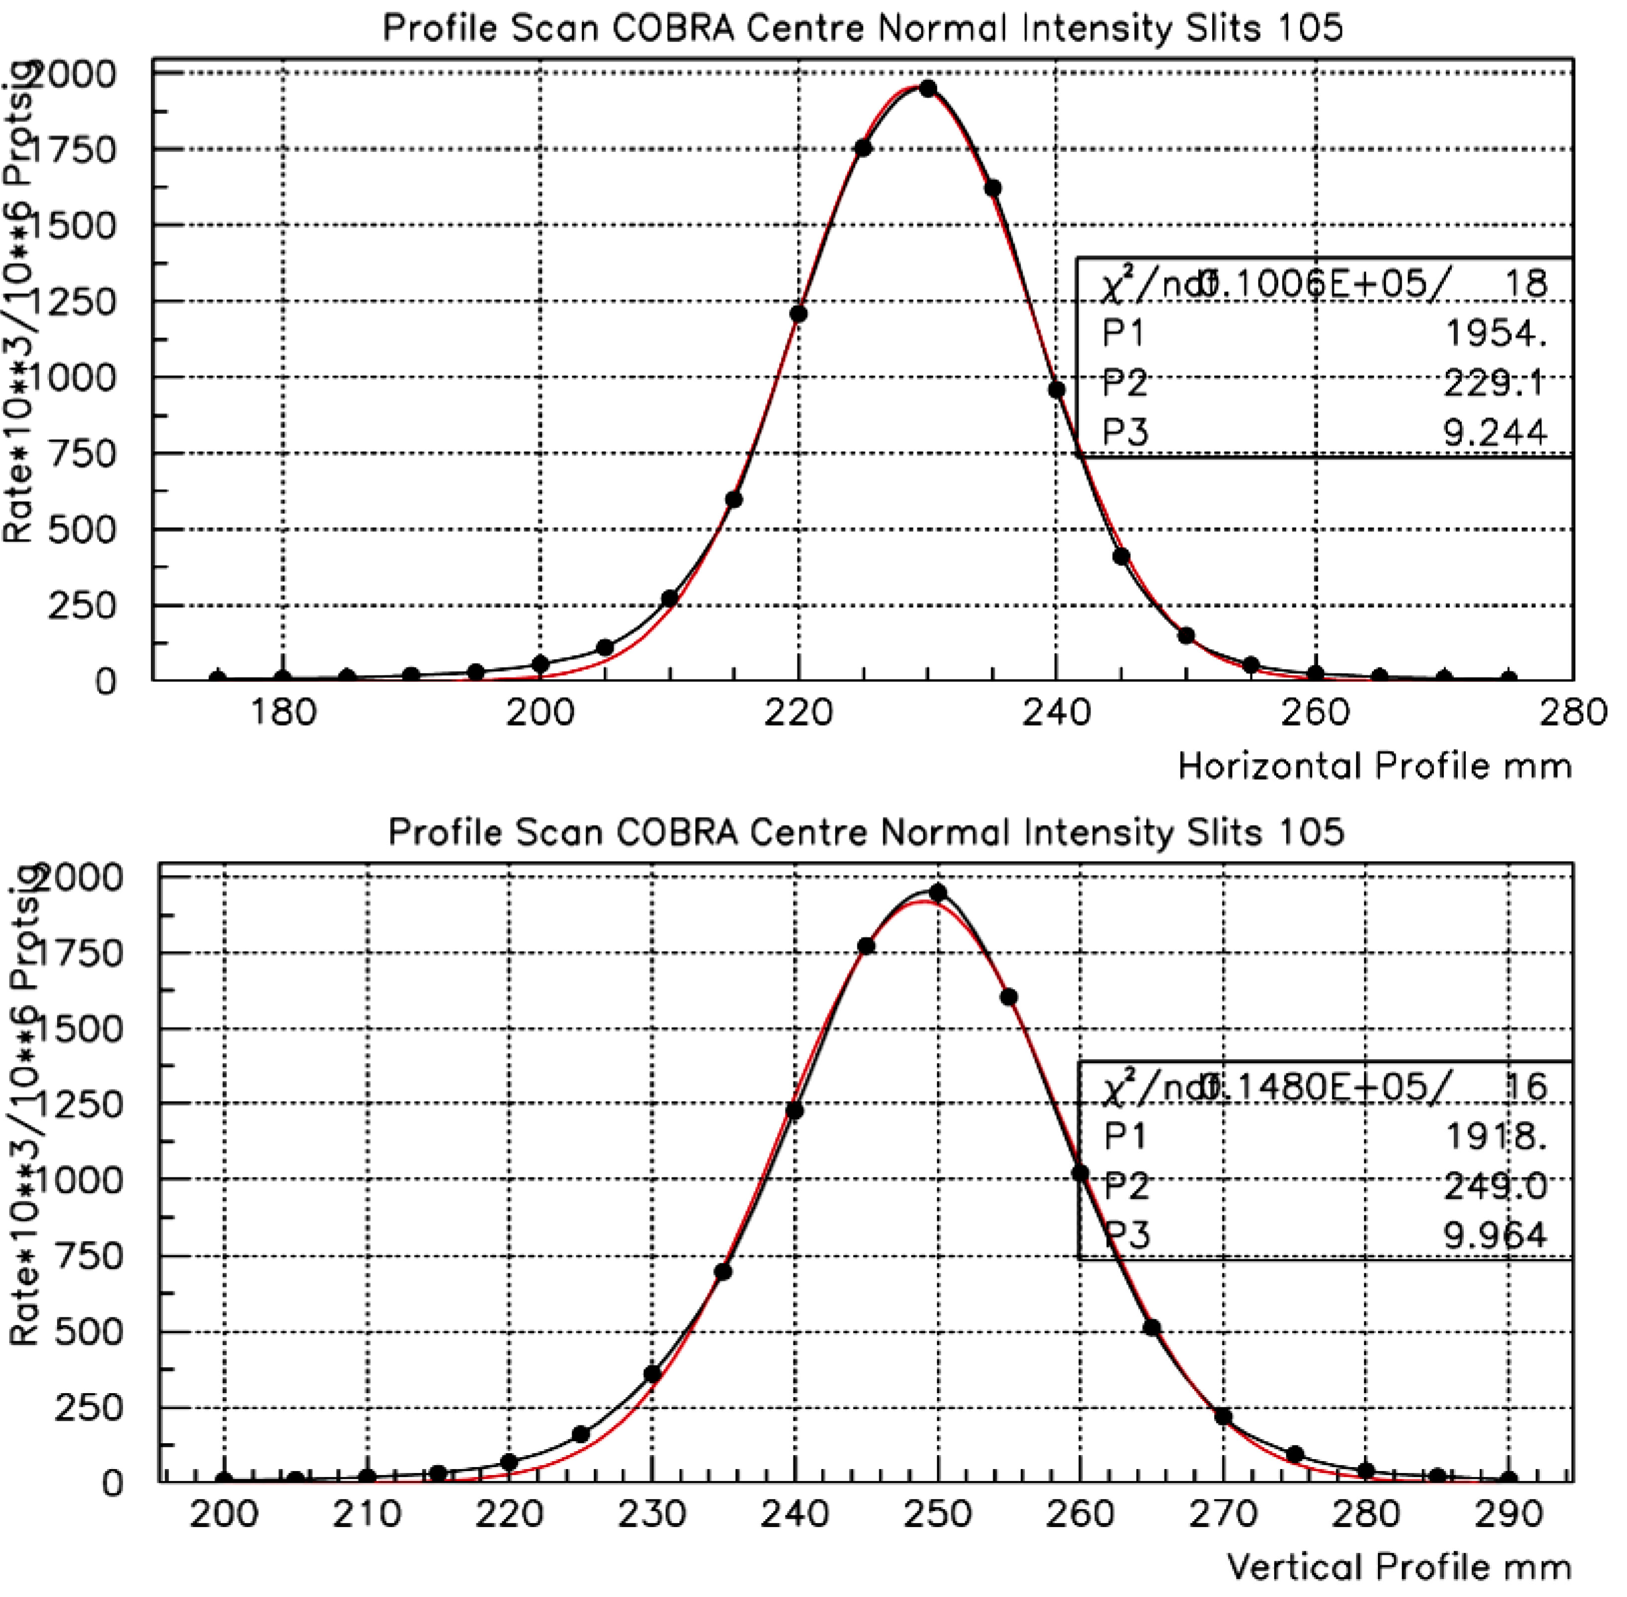
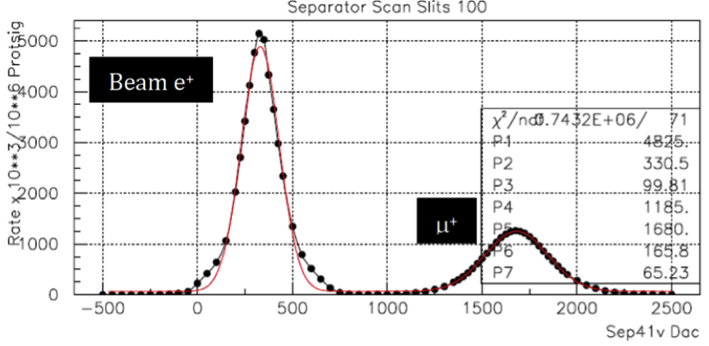
Beam Line Performance
2-D Beam-spot
μ⁺ Momentum Spectrum
(R_{μ} )_{MAX} > 1⋅10⁸ μ⁺s⁻¹ at 2mA
COBRA Centre (no Degrader)
(Δp/p)_{MAX} ~7% FWHM
Horizontal Profile
Separtor Scan
Vertical Profile
σ_{X,Y} ~ 9-10 mm
8.1σ_{μ} Separation ≈ 12 cm physical separation
at collimator

Slide 5
MEG Beam & Target Upgrade Strategy & Possibilities
Currently MEG runs at :
~ 3⋅10⁷ μ⁺-stops/s on a 205μm thick target placed at 20º to incoming beam with
a 300μm thick Mylar degrader - selected for optimal sensitivity with current detector capabilities
MEG Upgrade Sensitivity Reach: aims at approximately an order-of-magnitude improvement.
In order to achieve this with improved detector capabilities and within a reasonable running time
of 3 years - this requires a baseline detector rate capability of about 7·10⁷µ⁺-stops/s
Q: What beam possibilities exist to fully exploit the upgraded detector
intensity reach & try to increase the muon stopping density?

Slide 6
Constraints & Coinsiderations
Increase intensity: - simply open slits since we have spare intensity ☺
⇒ increases Δp ☹
⇒ increases range-straggling ☹
⇒ need thicker target to stop all muons ☹
⇒ increases multiple scattering & radiative background ☹
Target angle Considerations (β & α)
if 3•(σ_{rms})_{MS} > β “Leakage”
on US face
t = target thickness
t₉₀ = measure of e⁺ Multi. Scatt.
<R> = mean range of µ⁺
β = target angle to axis
α = angle between axis & radius r which
meets DS target face
r = <R> “umbral” region 50% stops contour
r = (<R>+ 3σ_{R}) “penumbral”
region 100% stops contour
β
r =<R>
μ⁺
α
if 3•(σ_{rms})_{MS} > α “Leakage”
on DS face
r =<R>
t
t₉₀
So can one increase the intensity & reduce the Range Straggling?

Slide 7
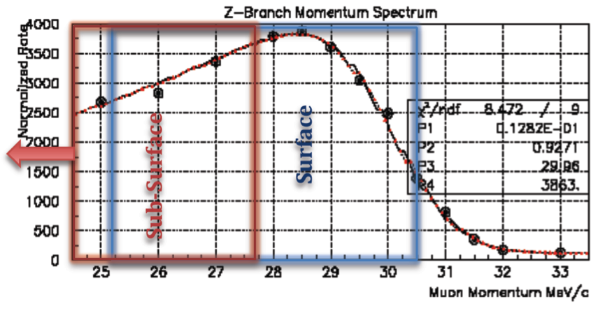

Beam Strategies – a Quick Guide
Muon momentum Spectrum
measured PiE5
Surface or Sub-surface Muons?
Basis – muon momentum spectrum
stopped π-decay kinematic edge 29.79 MeV/c
“Surface” muons come from a layer few hundred microns below
surface range approx. 120 mg/cm²
“Sub-surface” muons from layer shifted below the surface
Why are Sub-surface muons interesting? ➔ Muon Range & Range straggling
Muon Range Straggling in our 30 MeV/c region– 2 components
(i) Dependent on energy-loss straggling = constant ≈ 9% of the range
(ii) Dependent on momentum-byte of channel
dn/dp ∝ P ^{3.5}
R = a⋅P ^{3.5}
To reduce Range-straggling more efficient to Reduce P than Reduce ΔP/P ➪ Sub-surface Beam
BUT!!! Remember Rate reduces as P^{3.5} towards lower momenta ⇒ Compromise
Also expect µ-e separation from Wien-filter to be improved by about 25% ➪ greater velocity difference

Slide 8
Possible Strategies
Simplest Baseline configurations:
Surface muon beam “High Intensity” MEG Target
“Sub-surface” Muon Beam “High Intensity” MEG Target
Different slant-angle & target thickness configurations
Upgrade possibilities Studied:
Active Target – if dominated by multiple scattering then depending on tracking performance
extra vertex should help improve e⁺-resolutions But background Must be studied in detail
Thin Passive Target – multiple scattering reduced & radiative-related background reduced BUT
need REDUCED Range Straggling ➪ otherwise DS background! ➪ Sub-surface Beam
“SURFACE” Muon Beam 27.9 MeV/c
“SUB-SURFACE” Muon Beam 25 MeV/c
ACTIVE Target 250μm
Passive Thin Target 100-205 μm

Slide 9
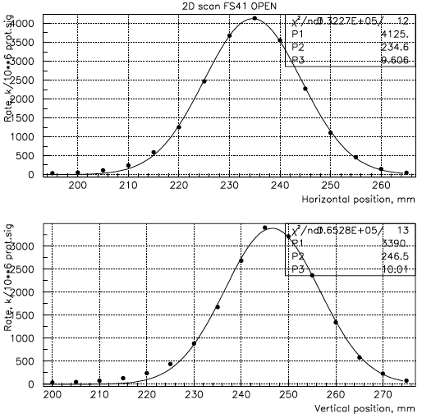
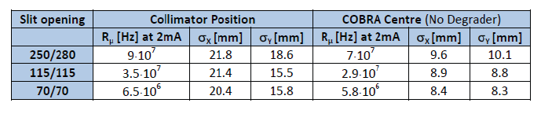
25 MeV/c Sub-surface Beam already Studied for MEG
Measurements made at:
Collimator System
COBRA Centre
High-intensity (slits “Open”)
No Degrader
Horizontal Profile
Vertical Profile
Only “High-intensity” Possible if one wants the RATE for MEG II

Slide 10
High-Rate Measurements (µ⁺ reaching Target)
Collimator: - High rate Surface muons 27.9 MeV/c
1.23⋅10⁸ Hz at 1.8mA Log11/173-173
1.22⋅10⁸ Hz at 1.8mA Log12/111-113
1.22⋅10⁸ Hz at 1.8mA Log13/36-37
<R_{µ}> = 1.5⋅10⁸ Hz at 2.2 mA
COBRA Centre: - High rate Surface muons 27.9 MeV/c
Deg 420 µm CH2 5.7⋅10⁷ Hz at 1.8mA Log12/81-86
Deg 335 µm Mylar 8.6⋅10⁷ Hz at 1.8mA Log13/101-113
Deg 300 µm Mylar 9.1⋅10⁷ Hz at 1.8mA Log13/107
Deg 0 µm 1.3⋅10⁸ Hz at 1.8mA Log13/74-75
Deg 300 µm Mylar 8.4⋅10⁷ Hz at 2mA Log14/105
Deg 200 µm Mylar 1.08⋅10⁸ Hz at 2mA Log15/117
Range straggling:
High Rate - 300 µm Deg σ_{R} =130 µm in l 46 µm in t measured
Normal Rate 300 µm Deg σ_{R} =80 µm in l 28 µm in t measured MC gets 27µm in t
R_{µ} = 1.1⋅10⁸ Hz at 2.2 mA
R_{µ} = (1±0.1)⋅10⁸ Hz at 2.2 mA

Slide 11
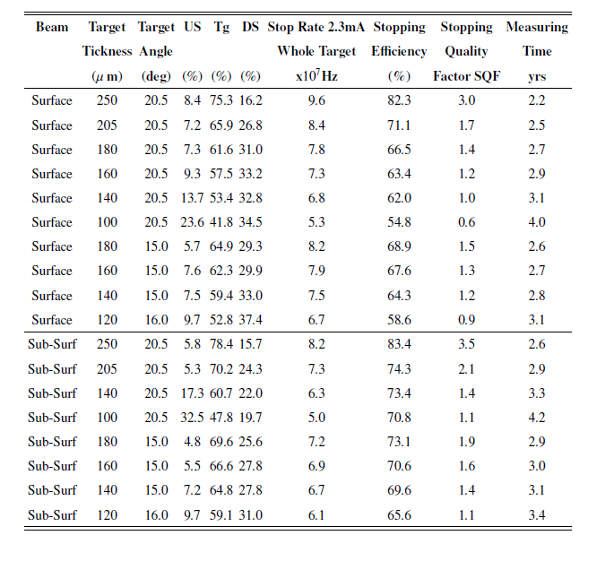


MC Study of Various Beam-Target Combinations
MC-study of «Surface» & «Sub-surface» beams with target thicknesses
Ranging from 250µm «Active Target» to 100µm «Passive Target»
Stop Rates based on MEG-measurements
Running Time normalized to Baseline
MEG sol^{n}.
Stopping Quality Factor (SQF) –
measure of the ratio of Target-stops
to Stops elsewhere
Basic Solutions:
Min. Thickness Target for
3 yrs. Running Time
at ~ ≤ 70 MHz µ⁺-stops

Slide 12
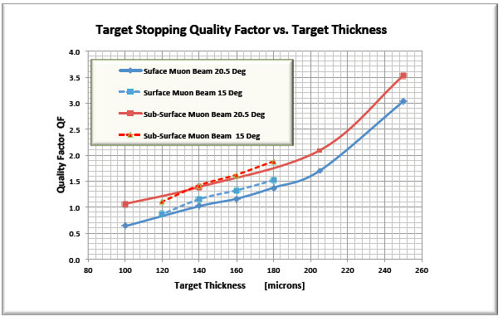
Conclusions
20°
From extensive MC-study 2 solutions with
minimal target thickness meet the baseline
detector sensitivity/rate goal:
Surface beam, 140 µm Target at 15°
Sub-surface beam 160 µm Target at 15°
15°
20°
15°
“Sub-Surface”
“Surface”
Stopping quality better in the case of Sub-surface beam
Separation quality 25% better at Wien-Filter for Sub-surface beam due to larger velocity difference
More gain going to smaller angles in Surface-case since Sub-surface already more optimal
However
For optimal Sensitivity many factors must be taken into account: stopping-density/target thickness, statistics,
multiple scattering, radiative background production
until final background assessment for both scenarios completed
Baseline MEG Solution with the Thinner Target chosen: Surface beam, 140 µm Target at 15°

