Slide 1
Development of X-KIT, a Versatile Readout System for Medipix 2 in Synchrotron Radiation Applications
Hardware development of fast readout system and its integration with the Hexa module
Featuring compatibility with:
Medipix 2
Timepix
USB Interface (Blue Box)
Pixelman 2.0 and newer
Andrea S. Brogna – iWoRID 2011

Slide 2
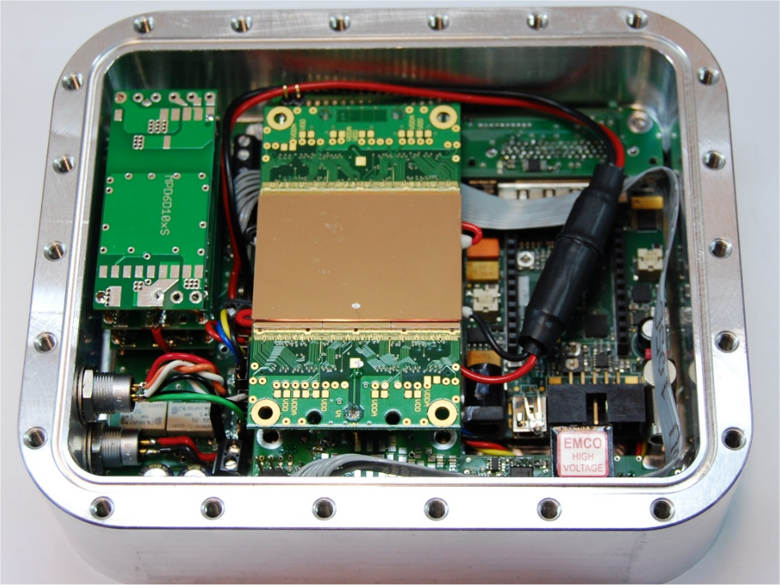
X-KIT integration with the Hexa Module
3 x 2 Medipix 2 chips:
512 x 768 pixels
43 mm x 28 mm
Surface area
Compact system
Vacuum operations
Peltier cooling element
Diagnostics and HV-monitoring
>10Gb/s communication link
Andrea S. Brogna – iWoRID 2011

