Slide 1
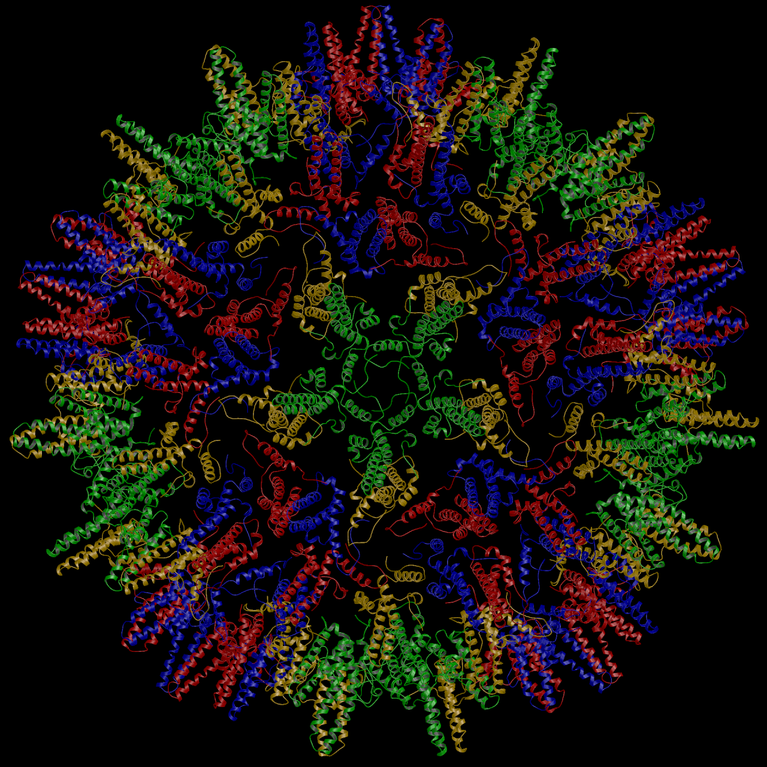
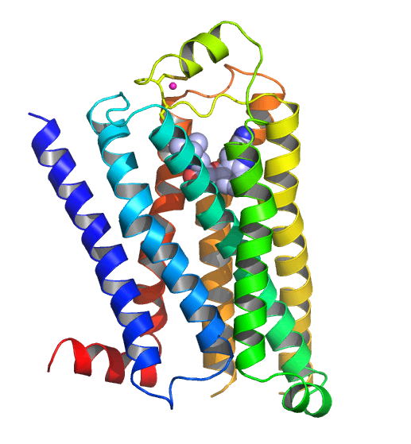
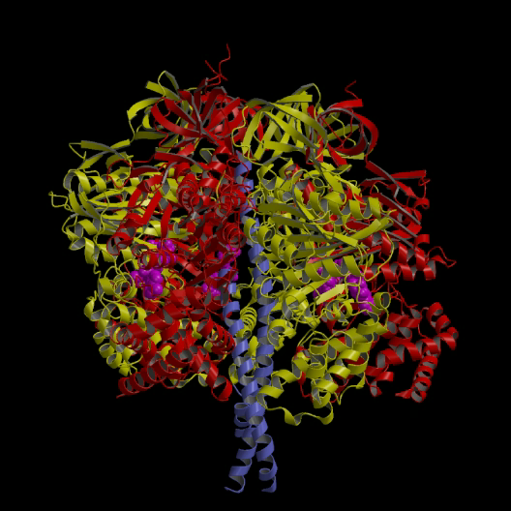
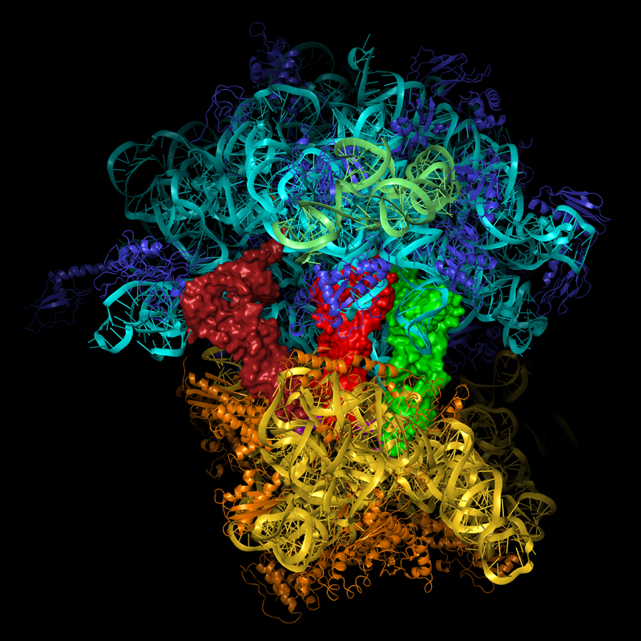
Protein Crystallography: Present and Future Detector requirements
Andrew GW Leslie
MRC Laboratory of Molecular Biology, Cambridge, UK
iWoRID, Zurich, July 2011
Notes:
Outline here the goals of structural biology, with references to improvement in health and understanding the mechanisms of molecular machines, mention GPCR relevence to pharma. And optionally the Nobel prizes.

Slide 2
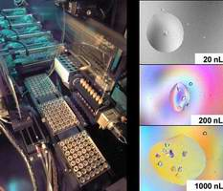
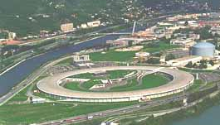
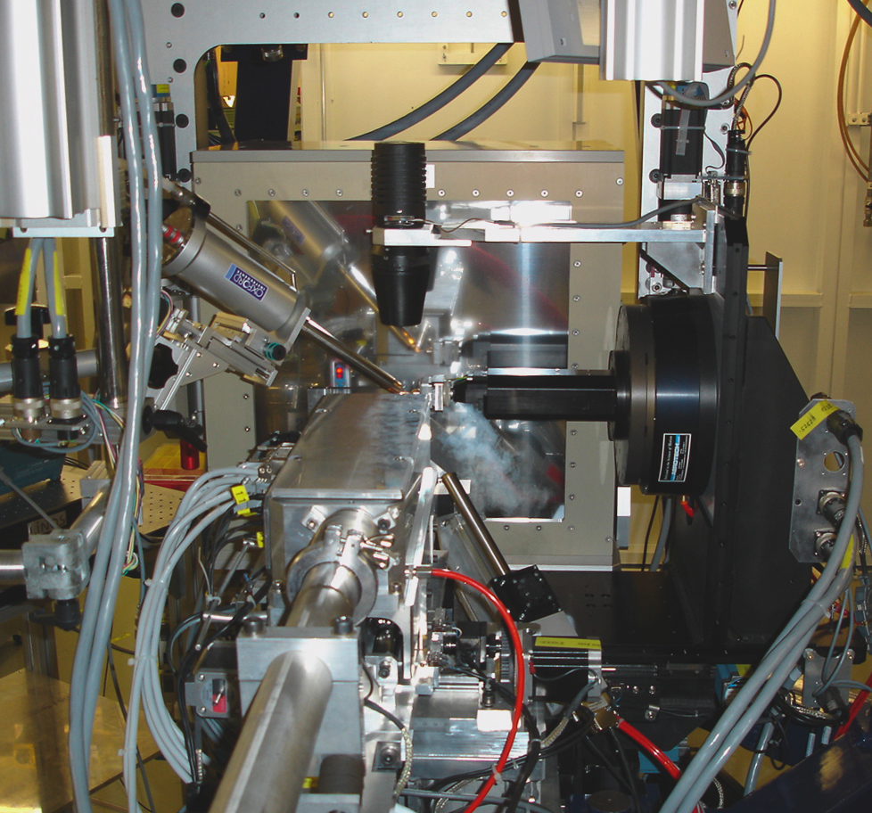
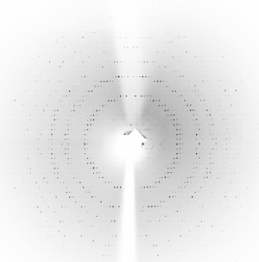
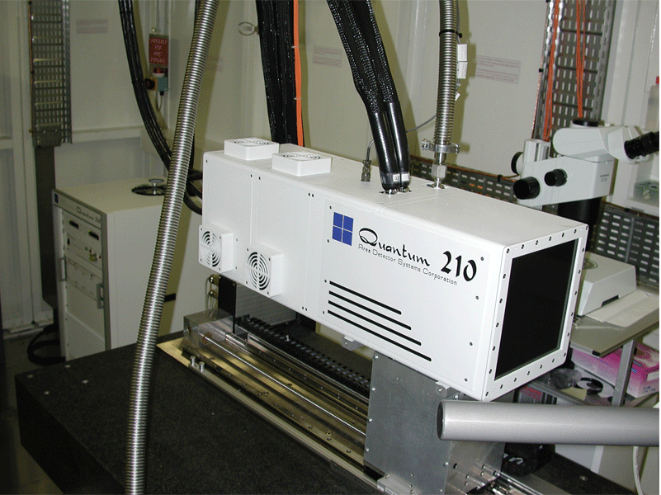
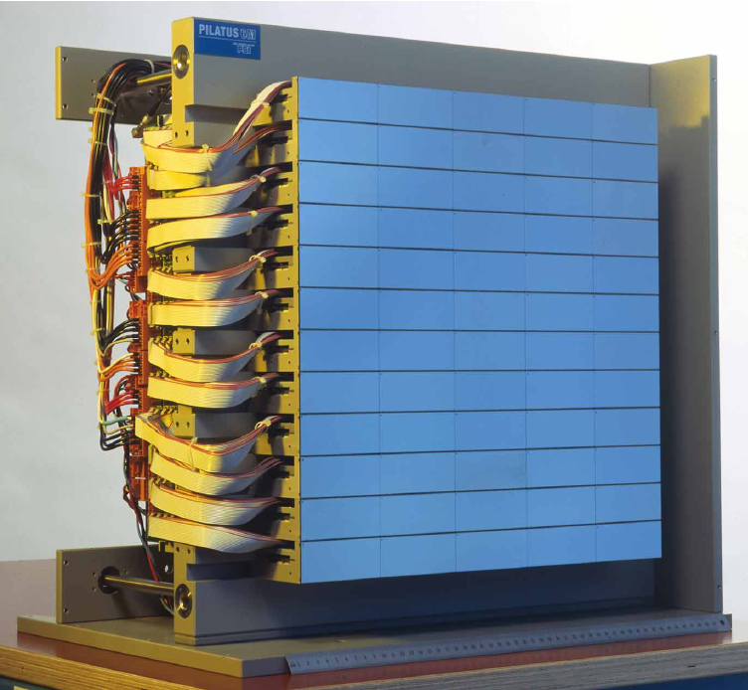
Macromolecular crystallography (MX): The experiment
To collect a complete 3D dataset required for structure solution, the crystal must be rotated by typically 60-180 degrees. The dataset then comprises many 2D images, each corresponding to a rotation of 0.1-1.0 degrees (to avoid spatial overlap of different reflections), with exposure times of between 0.1 and 2 seconds.
Because of the finite readout time for most detectors, a shutter must be used and this needs to be very accurately synchronised to the rotation axis to avoid introducing systematic errors.

Slide 3
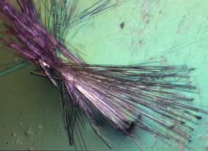
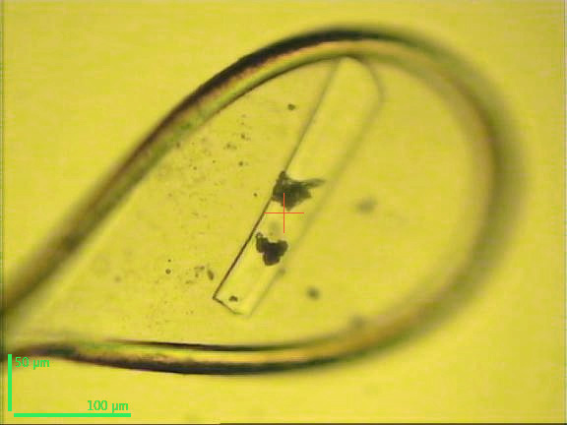
Diffraction data collection from macromolecules: The issues
Poor signal to noise:
Large unit cell volumes (V) imply small diffraction intensities: |F| α 1/V
Crystal defects limit diffraction strength even further; protein crystals are rarely well ordered
Small crystal sizes (a few microns) result in very weak diffraction
Significant non-Bragg scattering from air, collimating slits, mother liquor and mounting loop, especially if beam size is not tailored to crystal size
These effects could in principle be overcome by using long exposure times to improve counting statistics, but in practice this is not possible.
Macromolecular crystals are very sensitive to radiation damage (crystal lifetime is typically tens of seconds on a third generation synchrotron source). Cryo-cooling to 100K greatly reduces, but does not eliminate, the damage.

Slide 4
An example of poor signal to noise
Diffraction from a crystal Hepatitis B virus capsid, recorded on an image plate detector at ESRF. The Bragg peak has pixel values up to 780, but this is superimposed on a background of of almost 700 (pixel values are approximately photons).
The resolution at the edge of the detector is 3.2Å

Slide 5
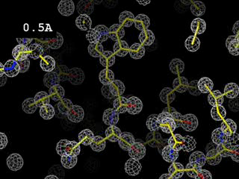
The importance of resolution
The highest resolution terms provide the detail, but these have the poorest signal to noise
Movie produced by James Holton, http://ucxray.berkeley.edu/~jamesh/movies/resolution.mpeg

Slide 6
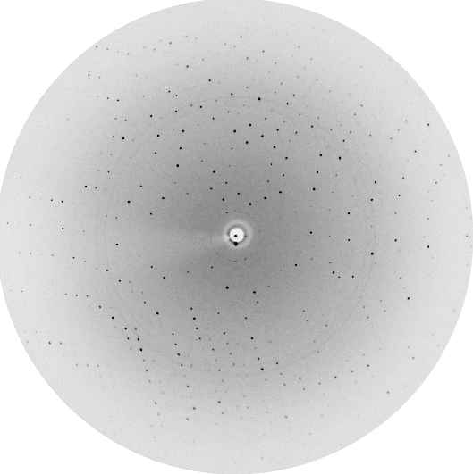
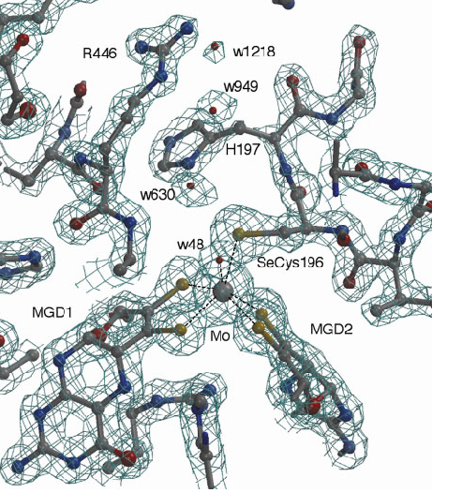
The importance of data quality
Calculation of the electron density maps that are subsequently interpreted to give an atomic model requires phase information that cannot be obtained directly from the diffraction experiment.
The most commonly used experimental method to determine the phases relies of measurement of the anomalous scattering signal (typically from Se atoms replacing sulphur in methionine residues).
This gives an anomalous signal of at best a few percent (several Se in a protein of ~200 amino acids) and in extreme cases less than 0.5% (anomalous scattering from sulphur, typically at a wavelength of ~2Å, far from the absorption edge at 5Å).
Only amplitudes can be measured experimentally.
+ phases

Slide 7
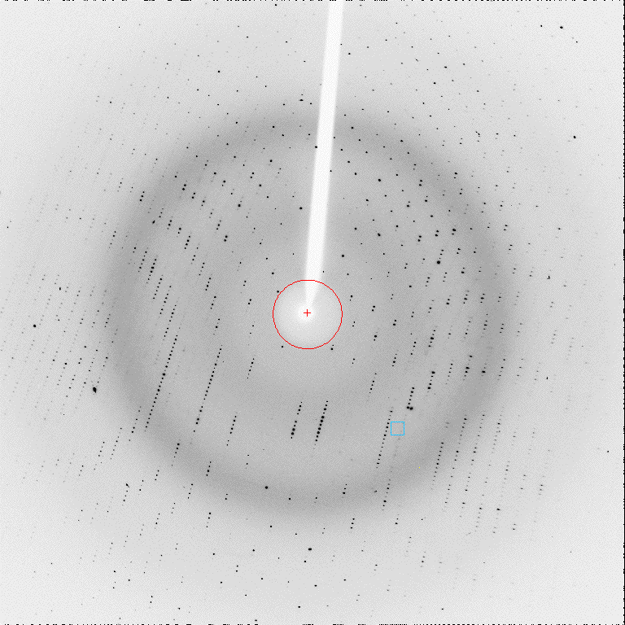
Ideal detector characteristics for macromolecular crystallography
Detects all incident photons and no intrinsic noise (DQE of 1)
Infinite dynamic range
Can be made as large as desired
Very high spatial resolution
Negligible readout time (with no noise)
No spatial distortion or non-uniformity of response
Equally efficient at all wavelengths used for MX
Easy to use and never breaks down
Inexpensive
(From Pixel detector workshop, PSI, November 1998)
In practice, compromises have to be made between these demands, perhaps most particularly with respect to cost.
Historically, detectors employed for MX have been single crystal diffractometers, Xray film, TV camera based area detectors (FAST), multiwire gas chambers, image plates, CCDs and pixel detectors.

Slide 8
How do current CCD and pixel detectors meet these requirements ?
Detects all incident photons and no intrinsic noise (DQE of 1)
Pixel detectors: DQE ~80% for wavelengths normally used for MX (12keV) (photons also lost during chip readout if working in shutterless mode).
CCD: DQE in region of 70-80%, less at very low signals. Very fast readout detectors (eg Rayonix HS series) would allow shutterless operation.
Infinite dynamic range
Pixel detectors: Very large, saturation at 2**20, but significant count rate corrections required at high count rates.
CCD: Limited to typically 65,000 counts
Can be made as large as desired
Pixel detectors: Largest commercial instrument 425x435mm, cost limited
CCD: Largest commercial instrument 405mm square, cost limited
Very high spatial resolution
Pixel detectors: Point spread function typically one pixel (172 microns)
CCD: Several hundred microns at 10% level.
Notes:
Rayonix do 3x3, 4x4, 5x5 tiled fast readout detectors, 300,325 and 405mm square. Pixel size 39/42/42 microns, taper 2.7/2.9/2.9`:1

Slide 9
How do current CCD and pixel detectors meet these requirements ?
Contd ….
Negligible readout time (with no noise)
Pixel detectors: A few ms.
CCD: Typically few 10s of ms, but down to 1ms for Rayonix HS. Fast readout is achieved at expense of increased readout noise (or by binning).
Fast readout is essential for shutterless operation.
No spatial distortion or non-uniformity of response
Pixel detectors: Very minor (correctable) distortion due to misalignment of tiles.
CCD: Significant spatial and non-uniformity corrections required. However, long term stability is good.
For both, still a question of the accuracy of the uniformity correction.
Equally efficient at all wavelengths
Pixel detectors: Issues at both very long (trimming) and very short (Si absorption) wavelengths.
CCD: Poor DQE at long wavelengths, high Z phosphor still efficient at short wavelengths.
Easy to use and never breaks down
Pixel detectors: Overall reliability is high. Significant demands on computing hardware.
CCD: Reliability is good. With supplied corrections, easy to use.
Cheap
Neither !

Slide 10
Practical Issues – Experimental design
Need to decide on total rotation angle, exposure time per degree and rotation angle per image. This is non-trivial because radiation damage is difficult to predict in advance.
Strategies for exposure time have two extremes:
Use an exposure time per degree of rotation that will allow collection of the minimum rotation required (for complete data).
Use a very short exposure time per degree, and keep collecting data until there are visible signs of radiation damage in the diffraction pattern (loss of high resolution data).
Choice of rotation angle per image:
Use a “standard” value, eg 0.5 or 1.0 degrees, providing this does not result in overlapping reflections.
Use a very small angle, 0.1-0.2 degrees (fine phi slicing).
Implications of these strategies for detector requirements:
Need to be able to handle a large dynamic range and a high count rate. Readout time not critical.
Need a very low intrinsic detector noise and a fast readout as many more images will be collected.
Users are tending to adopt the “very short exposure, very small rotation angle” approach.

Slide 11
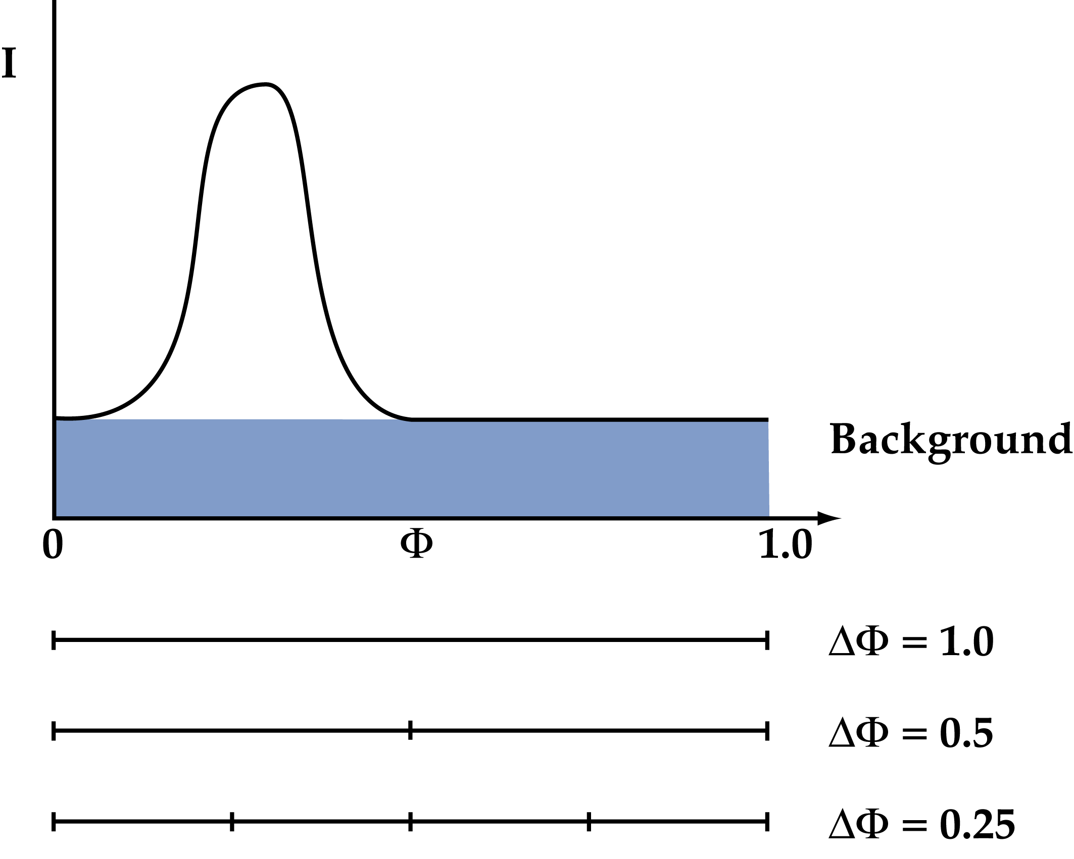
Advantages of fine phi slicing
Imperfections in protein crystals result in a phi width of ~0.3-1.0 degrees Using an oscillation angle smaller than the reflection width (in phi) will improve signal to noise for weak reflections by minimising the background:
Ι_{spot} = Ι_{tot} - Ι_{bck}
var(Ι_{spot}) = var(Ι_{tot}) + var(Ι_{bck})
= Ι_{tot} + Ι_{bck}
Ι/σ(Ι) = (Ι_{tot} - Ι_{bck})/(Ι_{tot} + Ι_{bck})^{1/2}
∼ Ι_{Bragg}/(2.Ι_{bck})^{1/2}
For weak reflections, the background will completely dominate Ι/σ(Ι).
Fine phi slicing should give better data but depends on:
No errors in shutter synchronisation (demanding for very short (<0.2 sec) exposures).
Negligible detector readout noise in each image.
However: If images are too weak (small rotation angle, very short exposure) the integration of the images becomes problematic (instability in parameter refinement).

Slide 12
Outstanding Issues
In many respects, currently available pixel detectors (Pilatus) meet most of the requirements of MX, and this may also be true for the new fast readout CCDs (remains to be confirmed).
Remaining issues with Pilatus:
  Dead space between tiles
  Pixel size
  Count rate corrections
  Improved energy discrimination to eliminate fluorescent scattering when collecting near an absorption edge.
  Readout time
  Improved efficiency at higher energies

Slide 13
Pilatus dead space (6M)
The dead space is ~8% by area. Providing that the direct beam position is offset from the centre of the detector, although reflections falling in the dead space are lost their symmetry equivalents will normally lie in the active area, so only the multiplicity of measurements is reduced and not the overall completeness. The exception to this is when measuring anomalous differences (requires I(h,k,l) and I(-h,-k,-l)) in triclinic symmetry (no symmetry elements), when a maximum completeness of ~90% is possible.
Software has been modified to allow measurement of reflections where part of the spot lies in the inactive area (using profile fitting).

Slide 14
Pixel Size
Profile fitting is technically challenging when the dimensions of the spots are only a few pixels. Because of the finite sampling of the spots (which do not lie exactly on pixel positions) the observed profile must be interpolated onto the calculated spot position to avoid introducing systematic errors arising from broadening the spot profile or a positional mismatch between the standard profile and the spot profile.
Interpolation is difficult when dealing with the very large gradients observed with small spots. Improved profile fitting algorithms may provide a solution, but simple summation integration also works well.

Slide 15
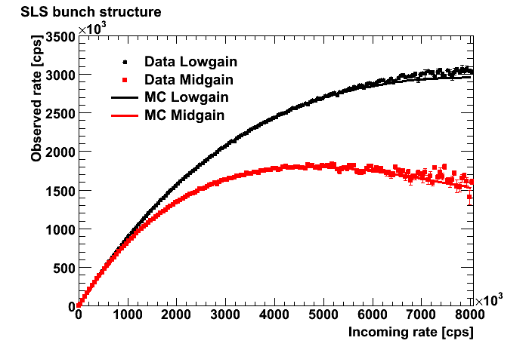
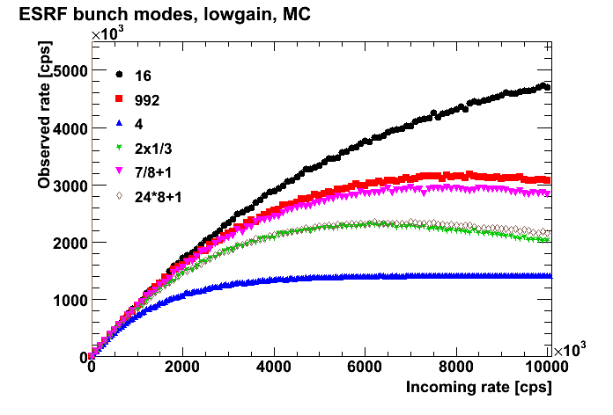
Count rate corrections for the Pilatus
Necessary because of the photon counting nature of the detector. Depending on experimental conditions, this can be a significant correction. A potential problem arises if the count rate is highly variable within a single frame, as the correction applied is based on the average count rate over the period of the frame.
The potential error can be minimised by using short time periods per frame (usually achieved by also using very small rotation angles), but the exposure time per frame needs to be large compared to the readout time.
The correction will depend on the bunch structure at a synchrotron, but for commonly used filling modes the correction does not vary significantly up to ~1.8.10**6 cps.
Graphs from Peter Trueb and Clemens Schulze-Briese, Dectris.

Slide 16
Readout Time
Rapid screening of many crystals will be required, taking diffraction images at multiple locations and using micro beams ( a few microns in size) to locate the best ordered part of the crystals. This requires very rapid readout so that the crystal can be continuously scanned with the shutter open.

Slide 17
Improved efficiency at higher energies
Many MX experiments are carried out at energies close to 12 KeV (the Se absorption edge). At this energy, only 80% of incident photons are absorbed by the Si layer.
Very recently, experiments with high energy (18.6KeV) micron sized beams and crystals have suggested that the radiation damage is reduced as a result of photoelectron escape (Sanishvili et al., PNAS 108,6127-32, 2011). They suggest a further improvement might be obtained in the energy range 20-40 KeV.

Slide 18
Future Challenges
Weakly diffracting crystals:
  Large complexes of many components
  Membrane proteins
  Micro-crystals
The use of very long wavelengths (2-4 Å) to collect anomalous scattering from sulphur for structure solution (eg I23 beamline at Diamond, UK). Anomalous signal from sulphur is ~3 times greater at 4Å then at 2Å (the long wavelength limit of many PX beamlines).
(Talk by Julien Marchal this afternoon)
Use of high energies together with micro-beams to mitigate the effects of radiation damage.
Use of FELs with nanocrystals, as demonstrated at LCLS.
(Talk by Anton Barty, Tuesday pm)

Slide 19
Acknowledgements
Peter Trueb and Clemens Schulze-Briese (Dectris)
Wasi Faruqi
Phil Evans
Sean McSweeney, ESRF
Gwyndaf Evans, DLS

