Slide 1
NMOR R&D for TRIUMF neutron EDM experiment
J. Martin, W. Klassen, C. Cerasani,
R. Mammei, M. Lang, T. Andalib,
D. Ostapchuk, and C. Bidinosti
The University of Winnipeg

Slide 2
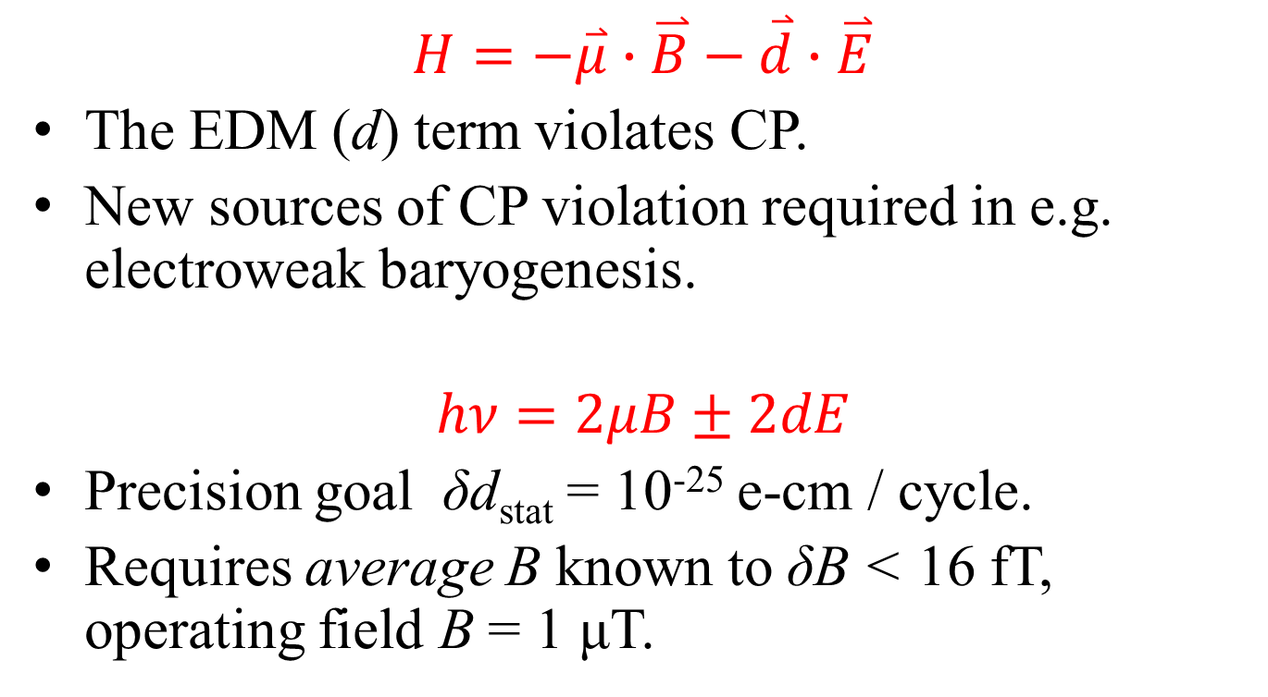
Need for Precision Magnetometry
$$H=−\overset{⃑}{μ}∙\overset{⃑}{B}−\overset{⃑}{d}∙\overset{⃑}{E}$$
The EDM (d) term violates CP.
New sources of CP violation required in e.g. electroweak baryogenesis.
$$hν=2μB±2dE$$
Precision goal δd_{stat} = 10⁻²⁵ e-cm / cycle.
Requires average B known to δB < 16 fT, operating field B = 1 μT.

Slide 3

Magnetic overview: nEDM experiment at TRIUMF
Major Subsystems:
Magnetic Shielding
Active
Passive
  Mag shield Room
  precision shield inside
Magnetic Field Generation
B₀, B₁, shim coils
Magnetometers
Fluxgates
Giant Magnetoresistance sensors
Xe/Hg Co-magnetometer
SQUIDs
Optical (NMOR)
Magnetically Shielded Room
Internal Passive Shield
B_{0,1}
UCN
comag
B₀ $\sim$ 1 µT
magnetometers
Active shield coils

Slide 4
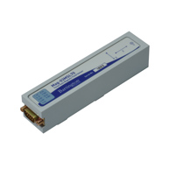
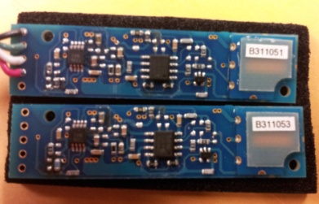
Magnetometers on the Market
Hg-199, Xe-129 10 fT in 100 s
Fluxgates 10 pT/rtHz magnetic
GMI 10 pT/rtHz
SQUID 1 fT/rtHz cryogenic
Alkali Atom Magnetometers
Ls OPM (Mx) ~10 fT/rtHz RF
NMOR 2 fT/rtHz all-optical
SERF 160 aT/rtHz B = 0
We have been studying NMOR-based magnetometers at U. Winnipeg
(as well as Xe-129, Fluxgates, GMI, and SQUID’s but that’s not in this talk)

Slide 5
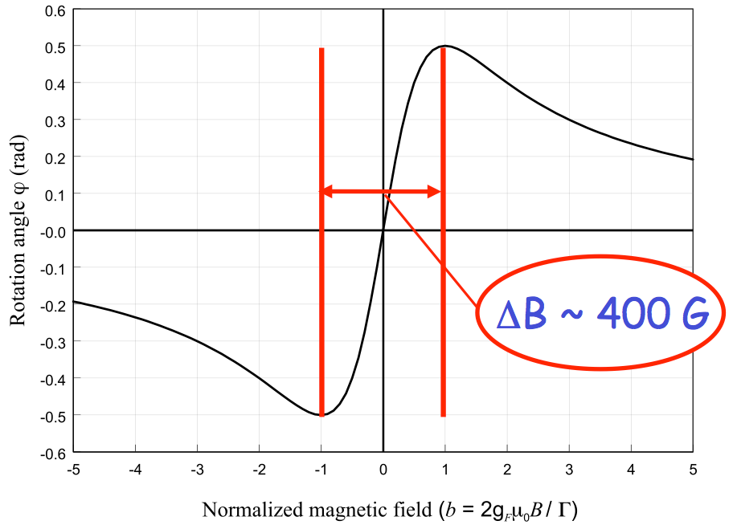

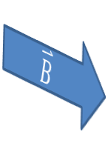



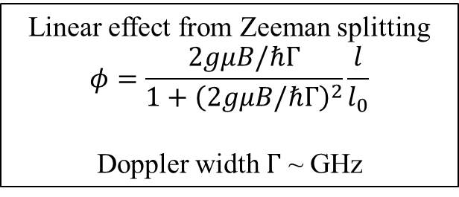

Magneto-optical rotation (Faraday rotation)
Circular components of linear polarization
Circular birefringence ($n_{±})$ rotates plane of polarization
$$φ=π\left(n_{+}−n_{−}\right)\frac{l}{λ}$$
Medium
F’ = 0
$$\overset{⃑}{B}$$
$$σ^{+}$$
$$σ^{−}$$
$$gμB$$
F = 1
M = -1
M = 0
M = +1
Linear effect from Zeeman splitting
$$φ=\frac{2gμB/ℏΓ}{1+{\left(2gμB/ℏΓ\right)}^{2}}\frac{l}{l_{0}}$$
Doppler width $Γ$ ~ GHz
$$φ (rad)$$
= 40 mT
B (Gauss)
D. Jackson-Kimball

Slide 6
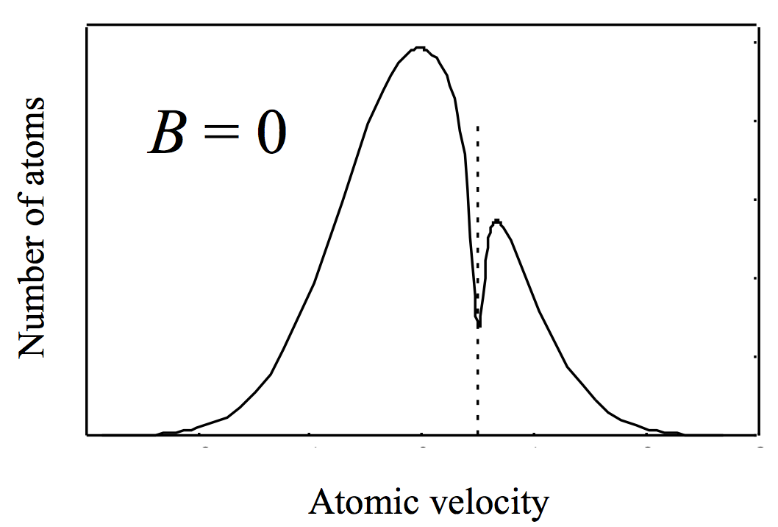
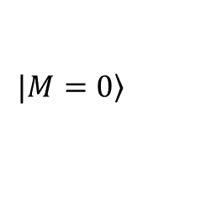
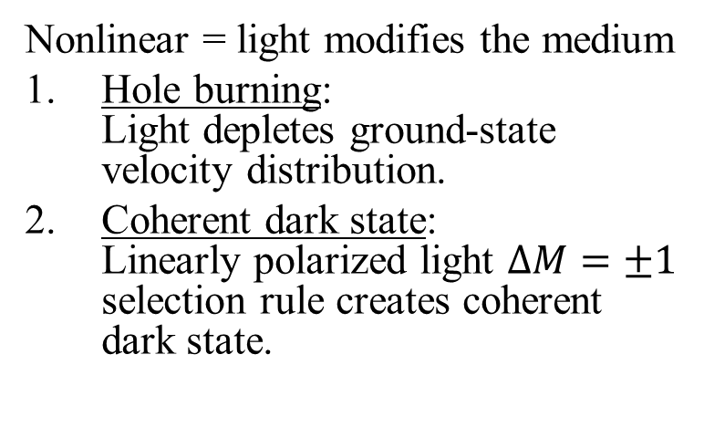
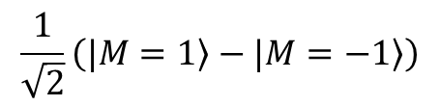
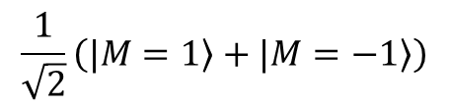
Nonlinear Magneto-Optical Rotation (NMOR)
Nonlinear = light modifies the medium
Hole burning:
Light depletes ground-state velocity distribution.
Coherent dark state:
Linearly polarized light $ΔM=±1$ selection rule creates coherent dark state.
burned
$$\frac{1}{\sqrt{2}}\left(|\left.M=1\right\rangle +|\left.M=−1\right\rangle \right)$$
F’ = 0
$$σ^{+}$$
$$σ^{−}$$
$$|\left.M=0\right\rangle$$
$$gμB$$
F = 1
$$\frac{1}{\sqrt{2}}\left(|\left.M=1\right\rangle −|\left.M=−1\right\rangle \right)$$
M = -1
M = 0
M = +1

Slide 7
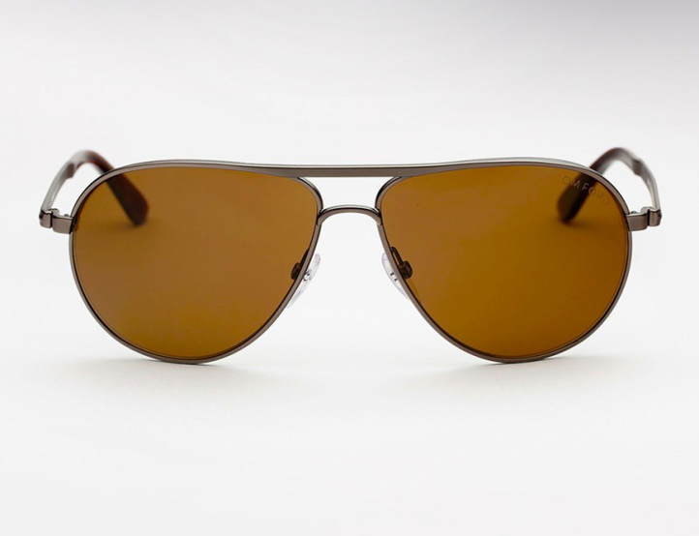
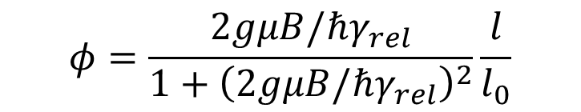

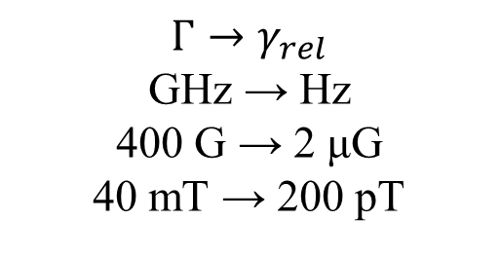
NMOR
Medium becomes linearly dichroic
Axis of alignment rotates by Larmor precession in the magnetic field
Net result: again, circular birefringence.
$$φ (rad)$$
2 μG
= 200 pT
B (Gauss)
$$Γ→γ_{rel}$$
GHz → Hz
400 G → 2 μG
40 mT → 200 pT
$$φ=\frac{2gμB/ℏγ_{rel}}{1+{\left(2gμB/ℏγ_{rel}\right)}^{2}}\frac{l}{l_{0}}$$

Slide 8
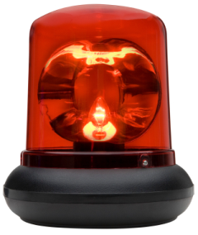
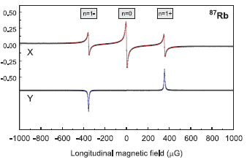
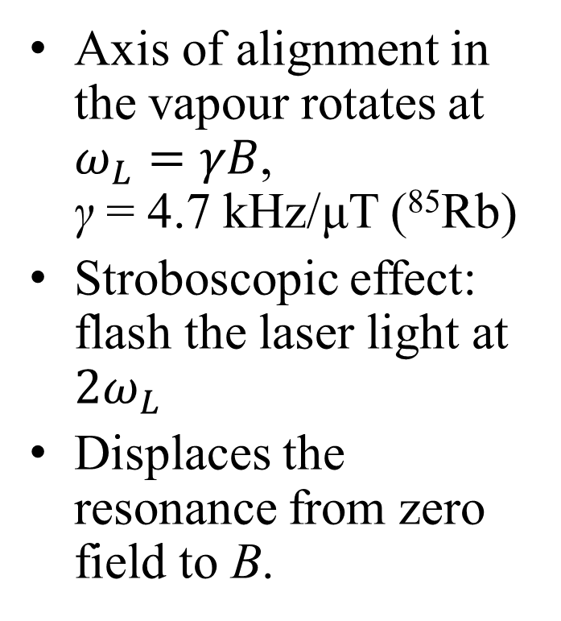

Removing Limitation on the Dynamic Range: AM/FM NMOR
$$ω_{L}$$
Axis of alignment in the vapour rotates at $ω_{L}=γB$,
γ = 4.7 kHz/μT (⁸⁵Rb)
Stroboscopic effect: flash the laser light at ${2ω}_{L}$
Displaces the resonance from zero field to B.
FM NMOR
@ 500 Hz
Rb-87
D.F. Jackson-Kimball, et al.,
J. Appl. Phys. 106, 063113 (2009)

Slide 9
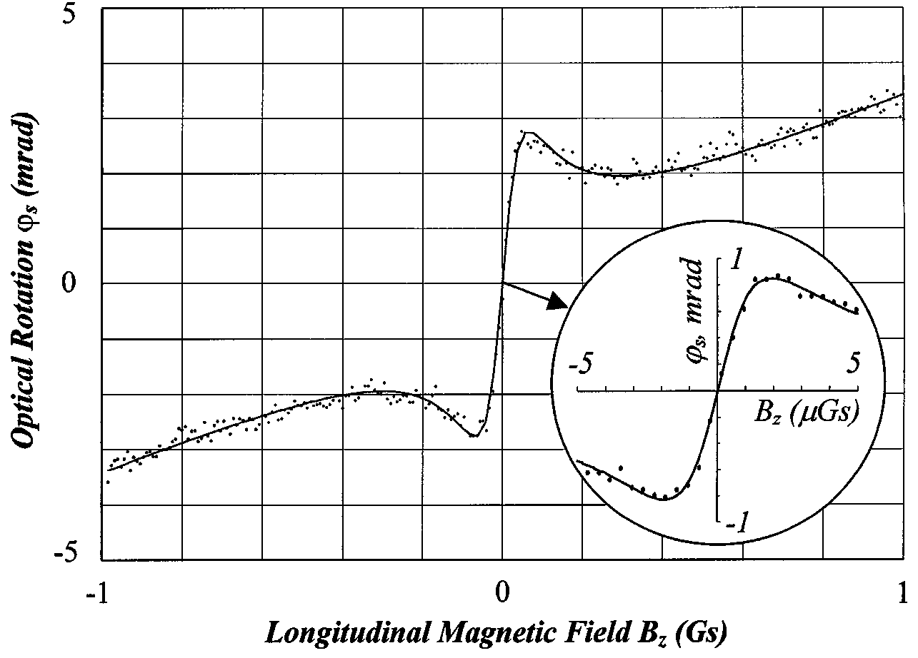
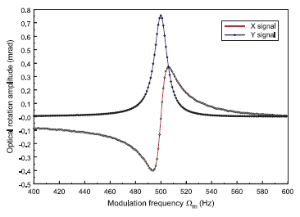

Previous Work of Others
Zero field
Field ~ 500 uG
No modulation
FM NMOR
2.8 μG=
280 pT
15 μG=
1.5 nT
=2 fT/rtHz
(T=35ºC)
D. Budker, et al.,
PRL 81, 5788 (1998)
D.F. Jackson-Kimball, et al.,
J. Appl. Phys. 106, 063113 (2009)

Slide 10
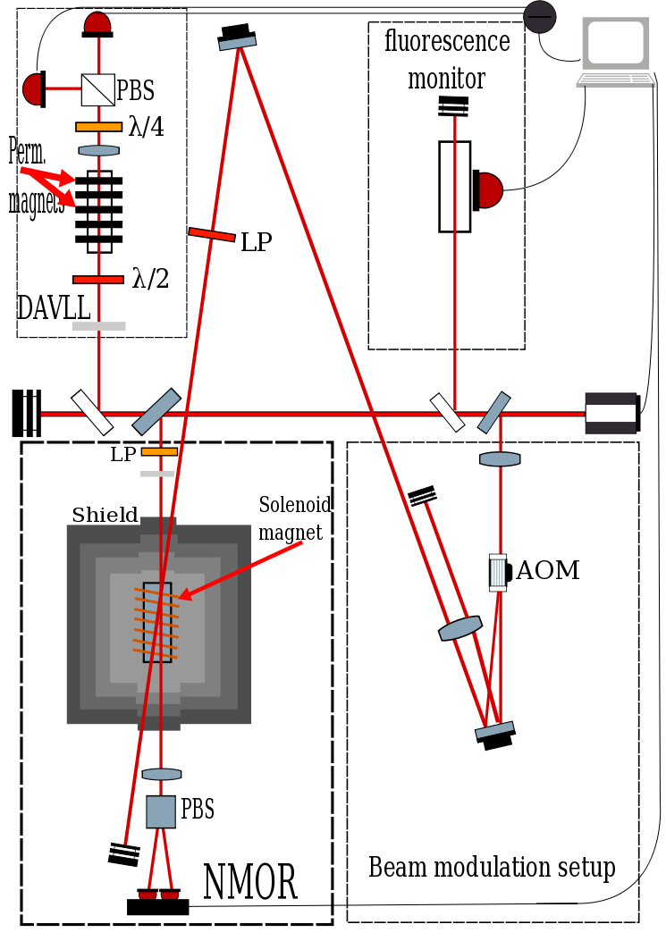
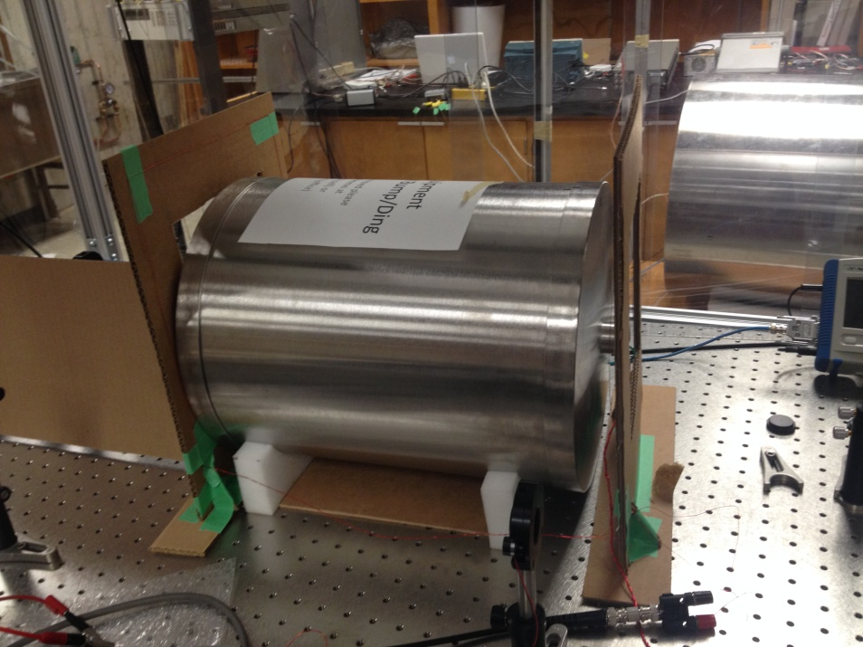
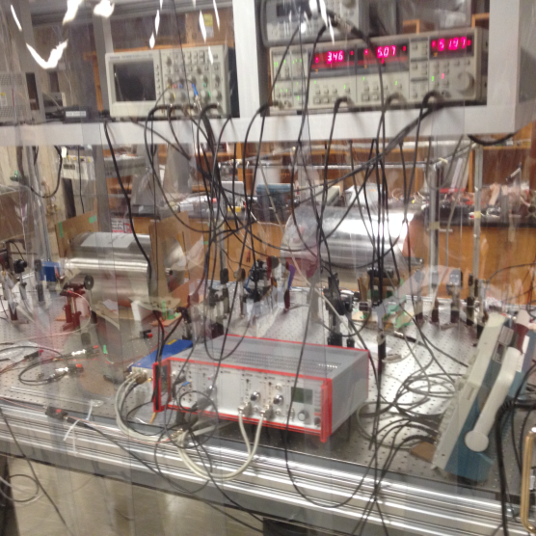
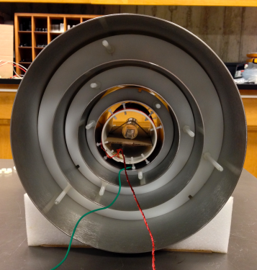
Our Work - Apparatus

Slide 11
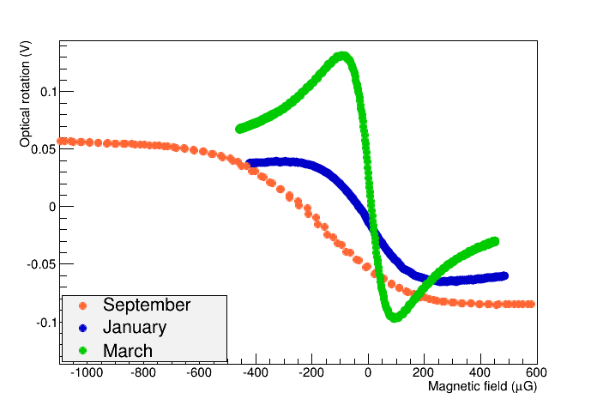
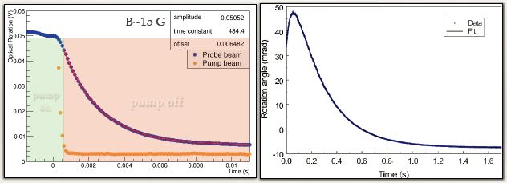
Results from 2013-14 school year
NMOR results
@ zero field
NMOR
Width
~130 uG
C. Cerasani,
Hons. Thesis UW (2014)
New magnetic shield
Cell from Precision Glassblowing, not designed with narrow capillary.
Heat gunning campaign
Graf, et al., Phys. Rev. A 72, 023401 (2005)
Direct Measurement of Relaxation of Axis of Alignment
Clear indicator of issues with cell/coating quality (paraffin)
Us: τ = 2.1 ms = 1/γ_{rel}
Graf: τ = 0.4 s = 1/γ_{rel}

Slide 12
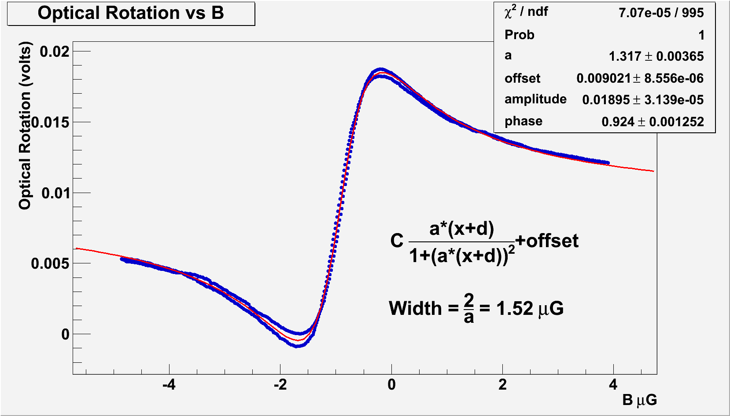
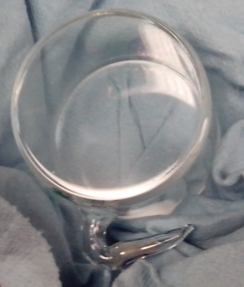
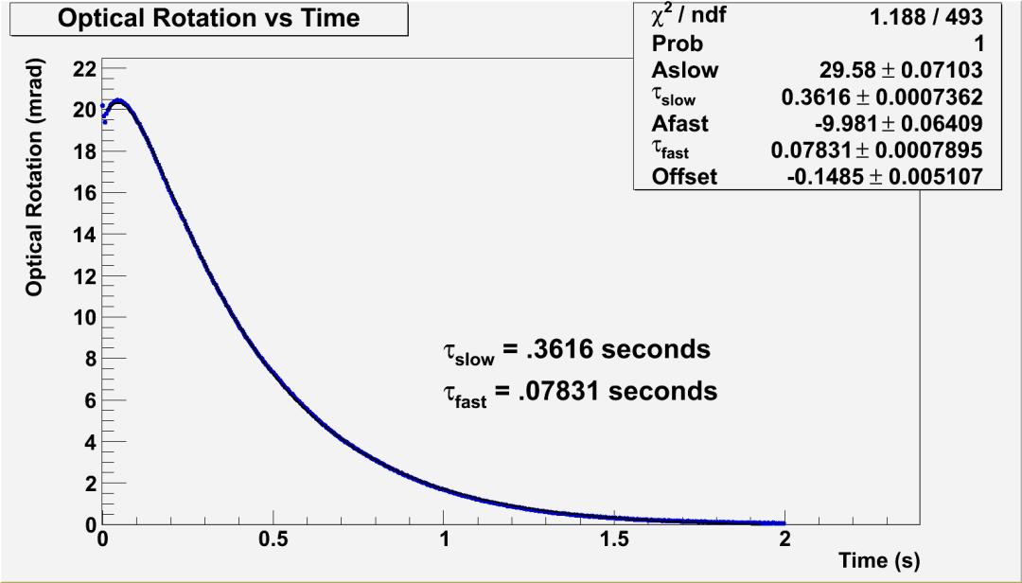
Spring 2014, new cell
(borrowed from D. Budker)
5 cm
NMOR width ~ 1.5 μG = 150 pT
γ_{rel} ~ 1/0.36 s = 2.8 Hz
Consistent with Budker’s best results!
Relaxation time
measurement
“Dear Dima and Brian,
Your cell works great!”
New cells from Balabas expected.
Possibly Precision Glassblowing

Slide 13
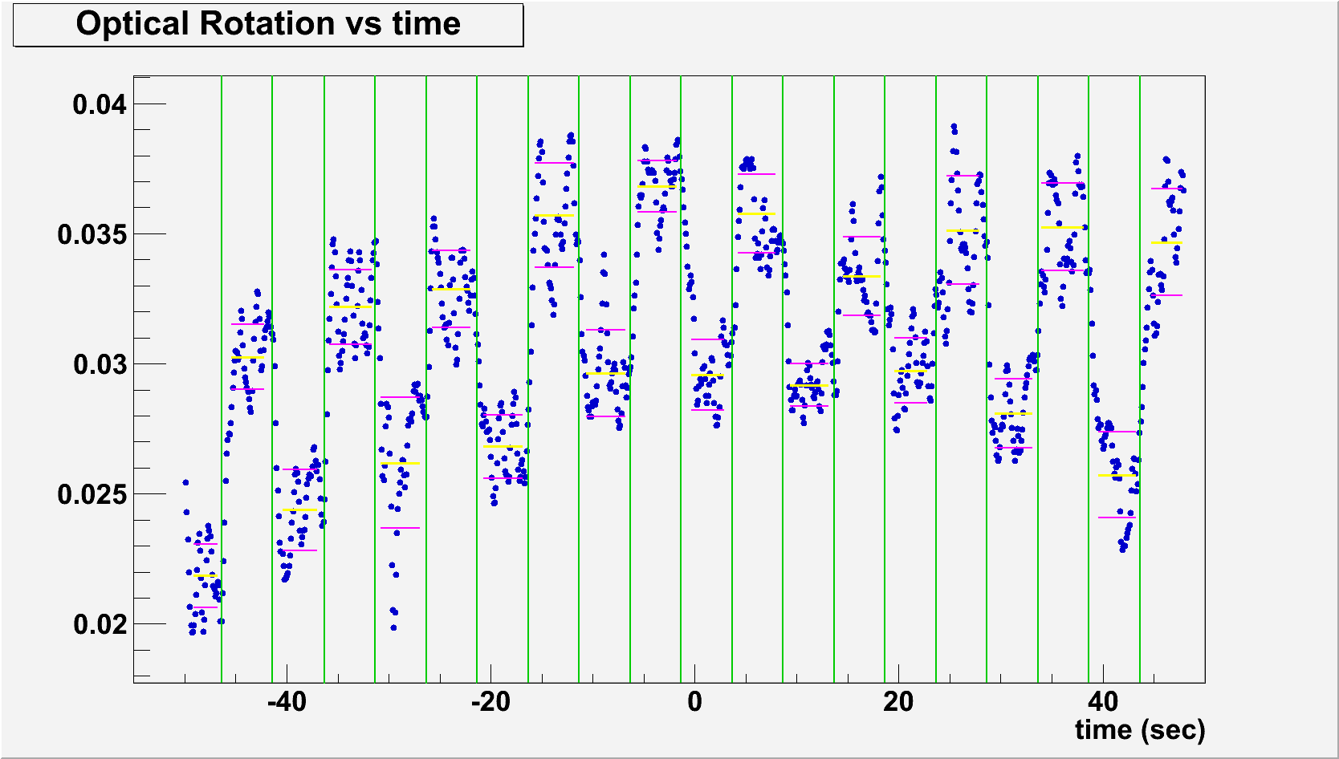
Measuring small fields
± 46 fT steps in internal magnetic field supplied by calibrated coil.
Probe power 13 uW.

Slide 14
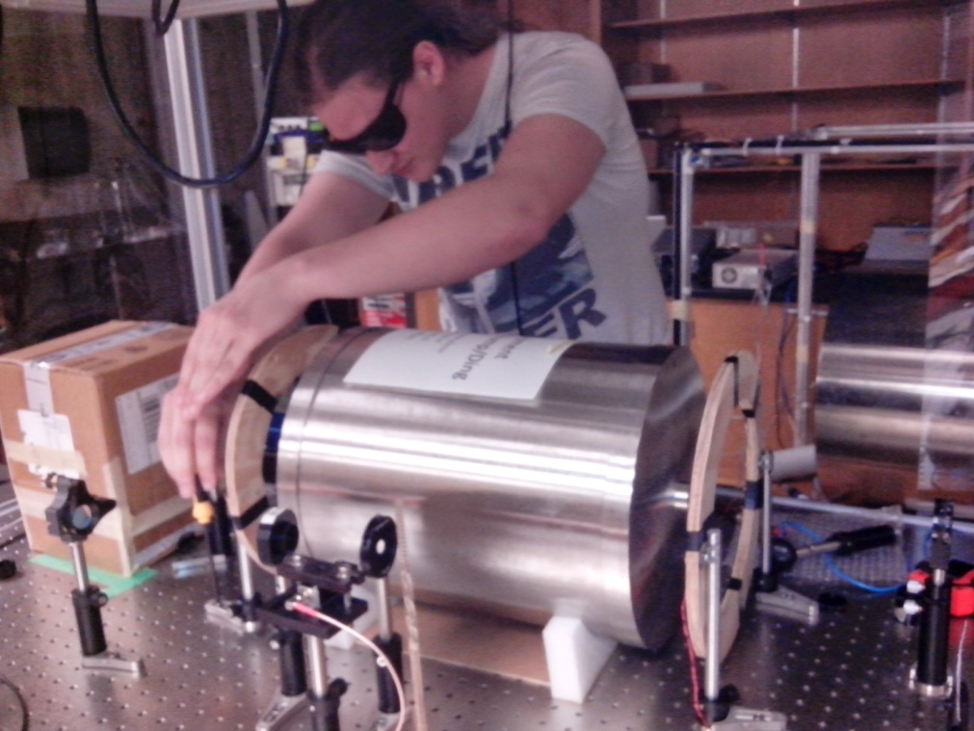
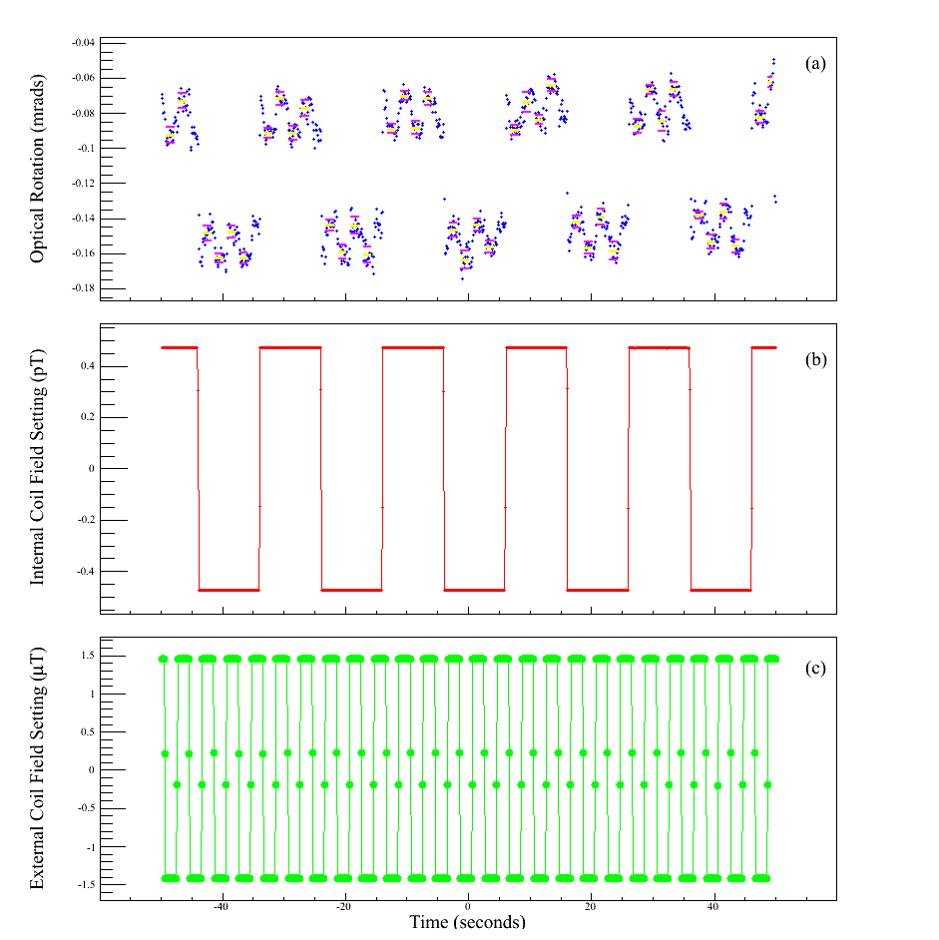
Application: Large axial shielding factors measured with small applied fields
Optical rotation sees shielded field and calibration field
±475 pT applied internally
(calibration)
Wolfgang installing external coils.
Shielding factor = 1.3 x 10⁷
Sensible variation with external coil spacing.
Paper in prep.
±1.45 uT applied externally

Slide 15
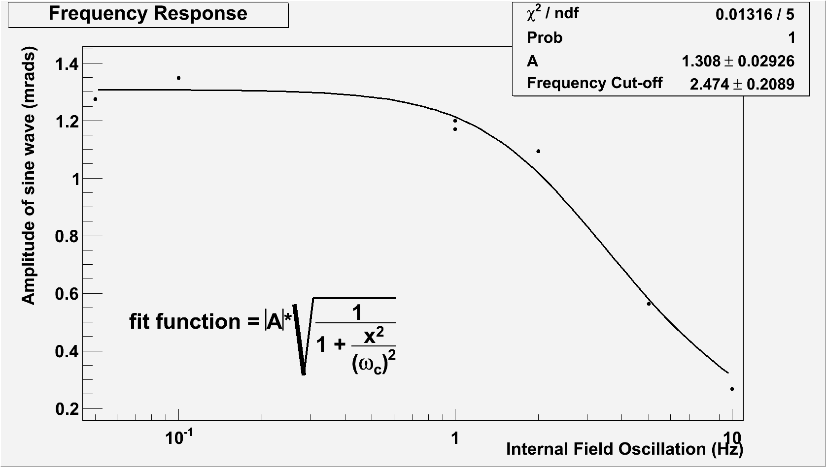
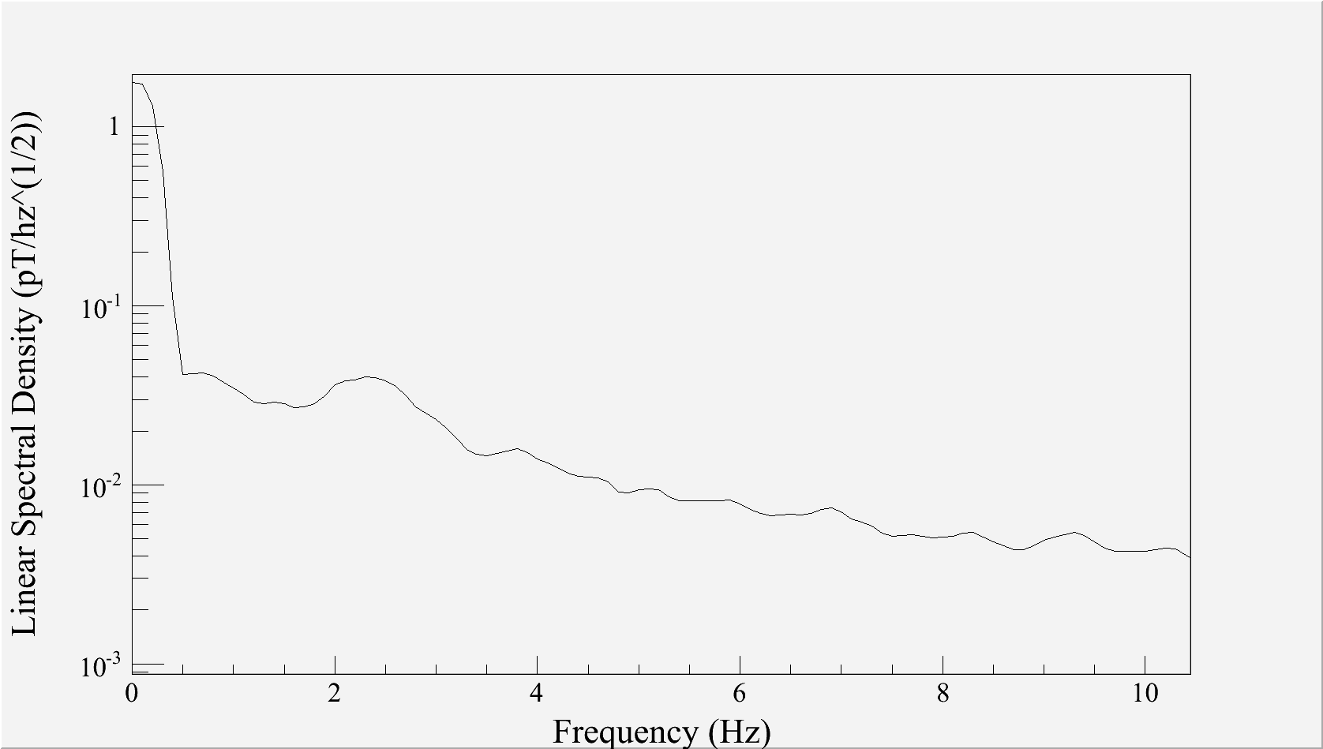
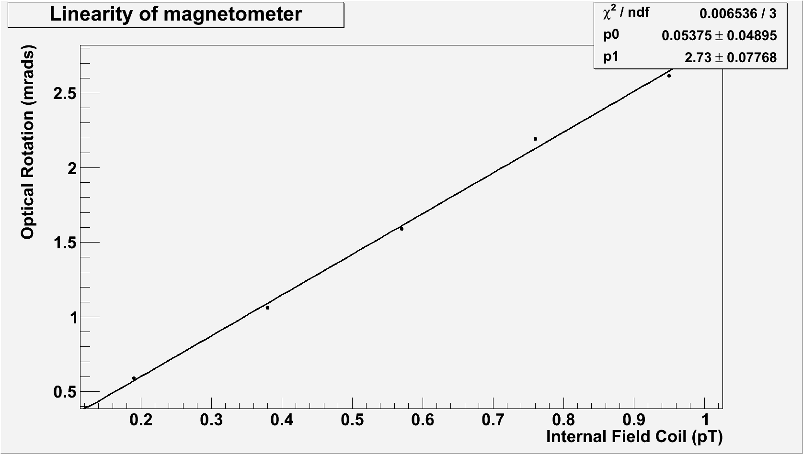
Bandwidth, Noise, Linearity of Zero-Field Magnetometer
-3dB @ 2.5 Hz
30 fT/rtHz @ 1 Hz
  Room temp. cell and Rb
Linear
Also looked at Allan deviation
Sine wave internal field
Noise measurement:
All coils disconnected
Coils at various stable
currents

Slide 16
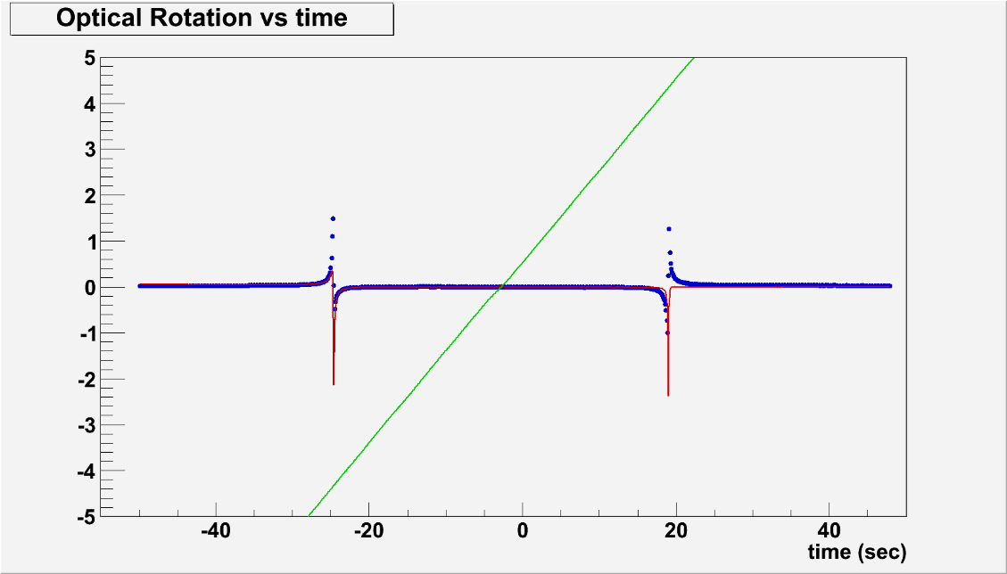
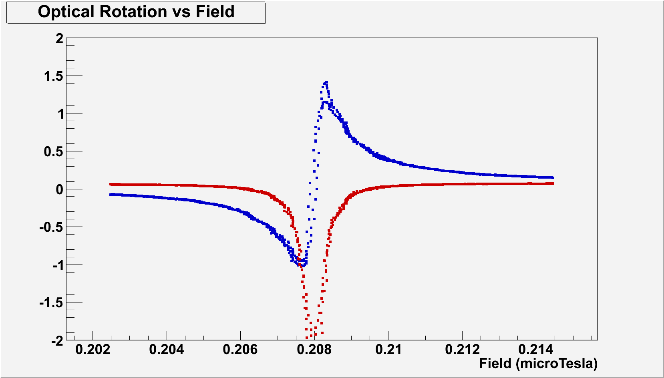
AM NMOR
Width ~ 1 nT Consistent with Jackson-Kimball.
Larmor frequency consistent with fluxgate calibration 0.21 μT
ω_{mod} = 2 kHz = 2 ω_{L}
Noise ~ pT
Still working to make it better.
Room temperature.
Quantifying existing magnetic noise, field quality.

Slide 17
Conclusions
System developed at U. Winnipeg approaches goal of fT-level magnetometry:
    NMOR widths consistent with best published values.
    ~30 fT/rtHz noise @ 1 Hz for zero field
    ~pT/rtHz noise @ 1 Hz for 0.22 uT applied field – we are working hard to understand and make it better.
Method applied to measurements of large axial magnetic shielding factors with small applied fields.

Slide 18
Future
Make the best magnetometer we can based on this system and use it to study magnetic shielding, generation of magnetic fields.
Using this system will make us experts capable of employing a Cs-based fiberized system for the eventual nEDM experiment.
New: B. Patton et al “All-Optical Vector Atomic Magnetometer” PRL 113, 013001 (2014).
Thank you to D. Budker, B. Patton, and M. Solarz for the use of the cell.
Thanks NSERC, CRC, CFI, MRIF.

Slide 20
