Slide 1




Part I: CLIC
Lasers for CLIC and AWAKE projects at CERN
Mikhail Martyanov
EN-STI-LP, CERN
Paul Scherrer Institute Seminar: “Lasers for CLIC and AWAKE projects at CERN”
13.10.2014 Mikhail Martyanov, CERN

Slide 2

Photo-injector Team @ CERN
Valentine Fedossev (section leader)
Eric Chevallay
Christoph Hessler
Mikhail Martyanov
Irene Martini
I acknowledge and thank my present and former colleagues for the input to this presentation !
Paul Scherrer Institute Seminar: “Lasers for CLIC and AWAKE projects at CERN”
13.10.2014 Mikhail Martyanov, CERN

Slide 3
Photo-injector Team Aims
Photo-cathodes development (Cs₂Te, Cs₃Sb, …)
Photo-injectors operation and maintenance
Laser system maintenance and upgrade
CLIC feasibility studies (photo-injector, laser, stability …)
Photo-emission lab
Laser lab
2 Photo-injector installations
Paul Scherrer Institute Seminar: “Lasers for CLIC and AWAKE projects at CERN”
13.10.2014 Mikhail Martyanov, CERN

Slide 4
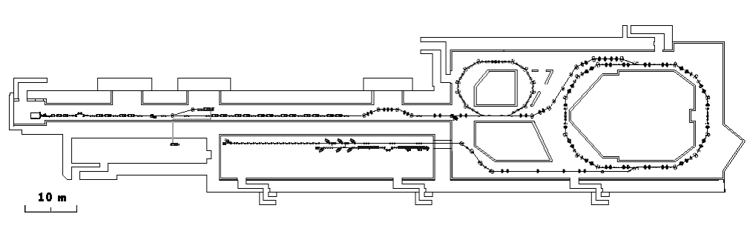
Photo-injectors at CLIC Test Facility (CTF3): CALIFES and PHIN
Delay Loop: x2
Combiner Ring: x4
Drive Beam Injector thermionic gun
Drive Beam Accelerator
An alternative to CTF3 drive beam injector
PHIN
PHIN: Drive beam photo-injector test stand
CLEX: 2 beams test area
CALIFES: Main beam photo-injector
Photo-injector laser lab
(1st floor) and optical transfer lines to PHIN and CALIFES
 | Main beam |  | Drive beam
 | CALIFES/CLIC |  | PHIN |  | CLIC
 | Design | Achieved | Design | Achieved | Design
Bunch rep.rate, GHz | 1.5 | 1.5 | 1.5 | 1.5 | 0.5
Bunch duration, ps | 8-10 | 8-10 | 8-10 | 8-10 | 8-10
Burst duration max, us | 0.14 | 0.2 | 1.27 | 1.27 | 140
Burst rep.rate, Hz | 5 | 5 | 5 | 5 | 50
Charge/bunch, nC | 0.6 | 0.6 | 2.3 | 9.2 | 8.4
Charge stability, % rms | <3 | <3 | <0.25 | 1-2 | <0.1
Photocathode QE, % | 0.3 | 0.3 | 3 | 3 | 1
Cathode lifetime, h |  |  | >50 | >100 | >150
E_{UV}, uJ/pulse | 1 | 2 | 0.6 | 1 | 8
W_{UV}, kW | 1.5 | 3 | 0.9 | 1.5 | 4
CTF3 Photo-injector laser specifics:
Burst mode operation
Burst rep.rate 1-50Hz
Intra-burst rep.rate 1.5GHz
(phase-locked to klystron sub-harmonic)
Pulses in the burst should be equal (stability)
Paul Scherrer Institute Seminar: “Lasers for CLIC and AWAKE projects at CERN”
13.10.2014 Mikhail Martyanov, CERN

Slide 5



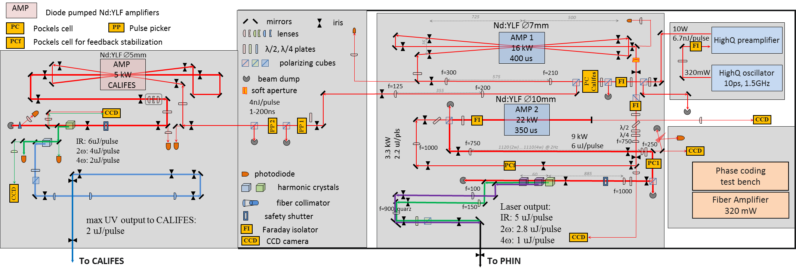
Laser Setup Layout
I.Ross, “Feasibility Study for the CERN "CLIC" Photo-Injector Laser System”, CERN-OPEN-2000-301 ; CLIC-Note-462, https://cdsweb.cern.ch/record/467721
1-200 ns
~8 ps
667 ps
Nd:YLF CALIFES
3-pass, 6 μJ
Nd:YLF PA
10 W 6.7 nJ
Nd:YLF MO
1047nm, 1.5GHz
320 mW 0.2 nJ
High-Q front end:
Nd:YLF passively mode-locked oscillator and preamplifier
1047 nm, 10W, 1.5 GHz, phase-locked to the external signal (3GHz klystron sub-harmonic)
PC
~250 μs
~400 μs
Nd:YLF AMP1
3-pass, 2.2 μJ
Nd:YLF AMP2
2-pass, 6 μJ
Paul Scherrer Institute Seminar: “Lasers for CLIC and AWAKE projects at CERN”
13.10.2014 Mikhail Martyanov, CERN

Slide 6
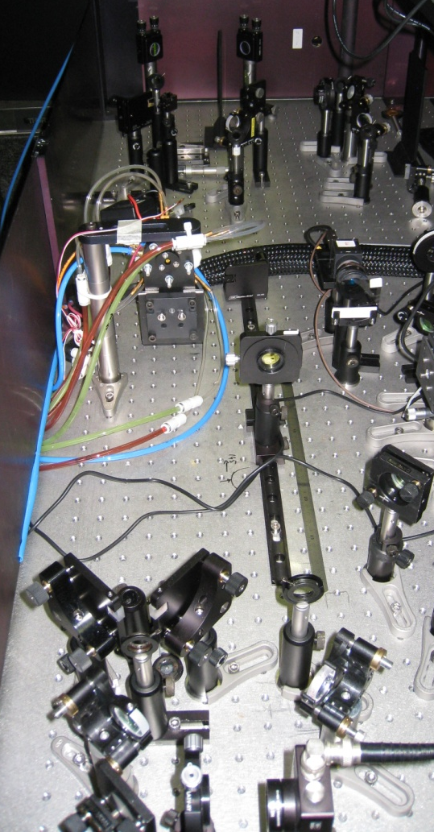
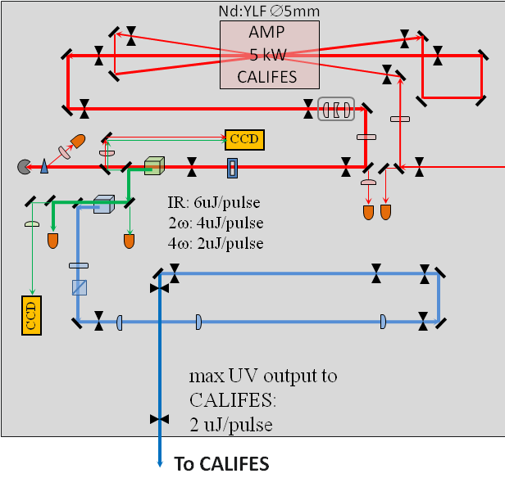
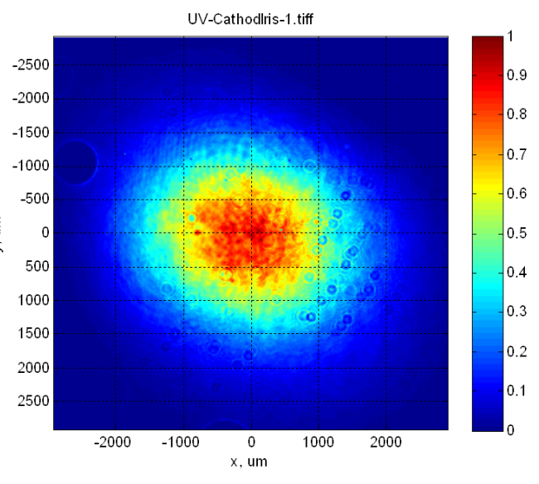
CALIFES Amplifier and Harmonics
Pulsed mode operation
Nd:YLF rod, 5mm diam, 70 mm long
SHG: KTP II-type (oe-e), 10 mm
FHG: BBO I-type (oo-e), 4 mm
5 pumping diodes (Dilas Gmbh.)
Max 5.5 kW pumping power
Pump pulse duration 500us
1-pass gain 12 (3-pass 1700)
IR input: 4nJ/pulse
IR output: 6uJ/pulse
Peak intensity: ~ 100MW/cm2
SHG efficiency: 67%, 4uJ/pulse
FHG efficiency: 53%, 2uJ/pulse
G. Kurdi et al. “Development of the CTF3 photo-injector laser system”, Central Laser Facility Annual Report 2006/2007
Paul Scherrer Institute Seminar: “Lasers for CLIC and AWAKE projects at CERN”
13.10.2014 Mikhail Martyanov, CERN

Slide 7
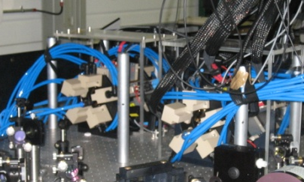
PHIN Amplifiers and Harmonics
Steady-state operation:
AMP1 - Nd:YLF ∅7 x 90 mm, diode pump 16kW @ 500 μs
AMP2 – Nd:YLF ∅10 x 120 mm, dioide pump 22kW @ 500 μs
IR input: 5 nJ/pulse, 7.6 W
IR output AMP1: 2.3 μJ/pulse, intra-burst 3.5 kW
IR output AMP2: 6 μJ/pulse, intra-burst 9 kW
AMP2
AMP1
M. Divall, et al. “Design and testing of amplifiers for the CTF3 Photo-Injector Laser”, CARE-Report-2006-021-PHIN, (https://cdsweb.cern.ch/record/1089233)
M. Petrarca et al. “Study of the Powerful Nd:YLF Laser Amplifiers for the CTF3 Photo-injectors”, IEEE J. Quant. El. 47 (2011) 306-313
Paul Scherrer Institute Seminar: “Lasers for CLIC and AWAKE projects at CERN”
13.10.2014 Mikhail Martyanov, CERN

Slide 8
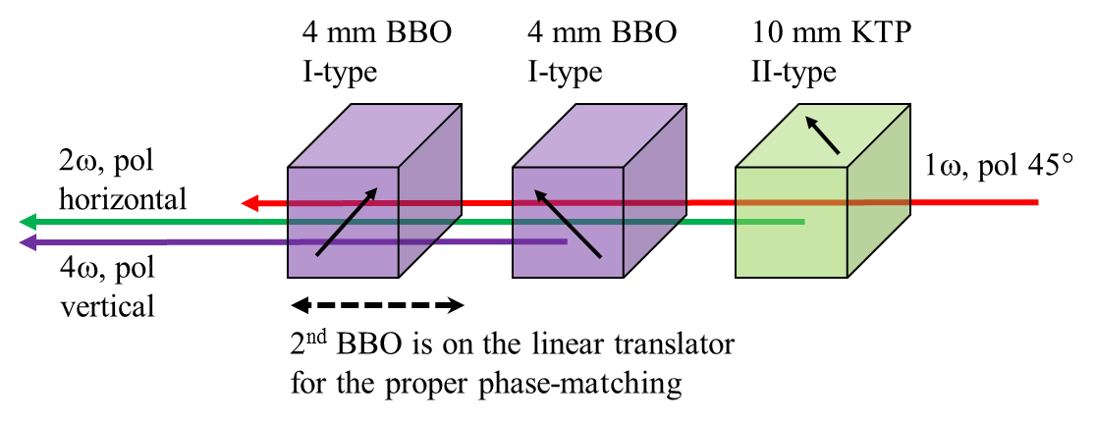
PHIN Harmonics (last PHIN run)
Burst duration for PHIN photo-injector, max 5 μs - short burst!
IR input to harmonics: max 5.3 μJ/pulse, intra-burst 8 kW
IR Peak intensity on SHG crystal: 50 ~ 100 MW/cm²
SHG: 10 mm KTP II-type (oe-e), efficiency up to 50%, 2 μJ/pulse
FHG: 4÷8 mm BBO I-type (oo-e), efficiency up to 50%, 1 μJ/pulse
Paul Scherrer Institute Seminar: “Lasers for CLIC and AWAKE projects at CERN”
13.10.2014 Mikhail Martyanov, CERN

Slide 9
PHIN Harmonics: Beam shapes
Burst duration for PHIN photo-injector, max 5 μs - short burst!
IR Peak intensity on SHG crystal: 50 ~ 100 MW/cm²
2nd Harmonic:
10 mm KTP II-type (oe-e)
Up to 2 μJ/pulse
burst energy stability 0.65% rms
Peak intensity ~32 MW/cm2
8 meter focusing onto the photo-cathode
2nd Harmonic beam on the cathode
Paul Scherrer Institute Seminar: “Lasers for CLIC and AWAKE projects at CERN”
13.10.2014 Mikhail Martyanov, CERN

Slide 10
PHIN Harmonics: Beam shapes
Burst duration for PHIN photo-injector, max 5 μs - short burst!
4th Harmonic: 2 x 4 mm BBO I-type (oo-e)
Up to 1 μJ/pulse, burst energy stability 1÷1.5% rms
Peak intensity ~30 MW/cm2
8 meter focusing onto the photo-cathode
4th Harmonic beam on the cathode
1 x 4 mm BBO
4th Harmonic beam on the cathode
2 x 4 mm BBO
Paul Scherrer Institute Seminar: “Lasers for CLIC and AWAKE projects at CERN”
13.10.2014 Mikhail Martyanov, CERN

Slide 11
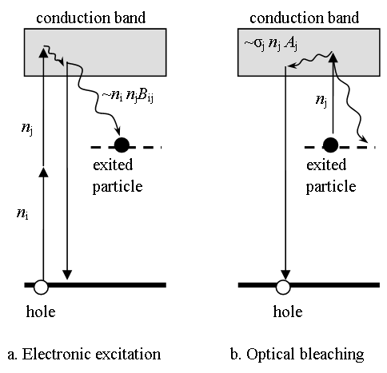
FHG, BBO 4.2 mm
UV and Green bursts oscillograms
High-power 4th Harmonic for CLIC
Model of induced linear absorption, caused by weak 2-photon absorption
2ω incident
2ω residue
4ω
Paul Scherrer Institute Seminar: “Lasers for CLIC and AWAKE projects at CERN”
13.10.2014 Mikhail Martyanov, CERN

Slide 12
FHG, BBO 4.2 mm
UV beam shape for different burst duration
High-power 4th Harmonic for CLIC
UV peak intensity 40 MW/cm²
10us, 4.5mJ
20us, 8.4mJ
40us, 15.1mJ
60us, 20.8mJ
80us, 26mJ
120us, 34.6mJ
Paul Scherrer Institute Seminar: “Lasers for CLIC and AWAKE projects at CERN”
13.10.2014 Mikhail Martyanov, CERN

Slide 13
FHG, BBO 12 mm
UV beam shapes for different burst duration
High-power 4th Harmonic for CLIC
UV peak intensity 30 MW/cm²
2ω incident
10us, 4.4mJ
40us, 14.2mJ
2ω residue
4ω
80us, 25mJ
100us, 27mJ
140us, 41mJ
Paul Scherrer Institute Seminar: “Lasers for CLIC and AWAKE projects at CERN”
13.10.2014 Mikhail Martyanov, CERN

Slide 14
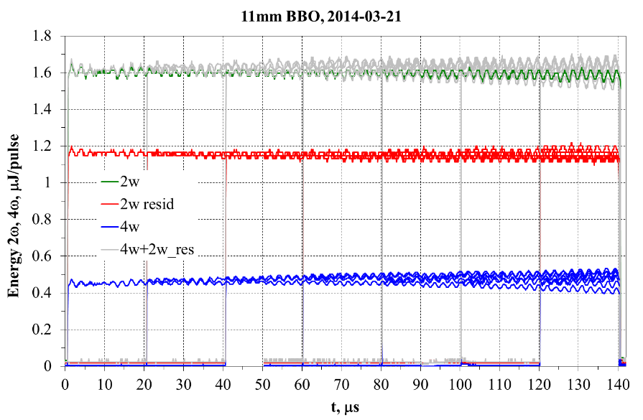
FHG, BBO 11 mm Beam size increased !
UV beam shapes for different burst duration
High-power 4th Harmonic for CLIC
UV peak intensity 12 MW/cm²
2ω incident
20 μs, 13.3 mJ
b) 20 μs
f) 60 μs
2ω residue
4ω
h) 80 μs
j) 100 μs
n) 140 μs
Paul Scherrer Institute Seminar: “Lasers for CLIC and AWAKE projects at CERN”
13.10.2014 Mikhail Martyanov, CERN

Slide 15
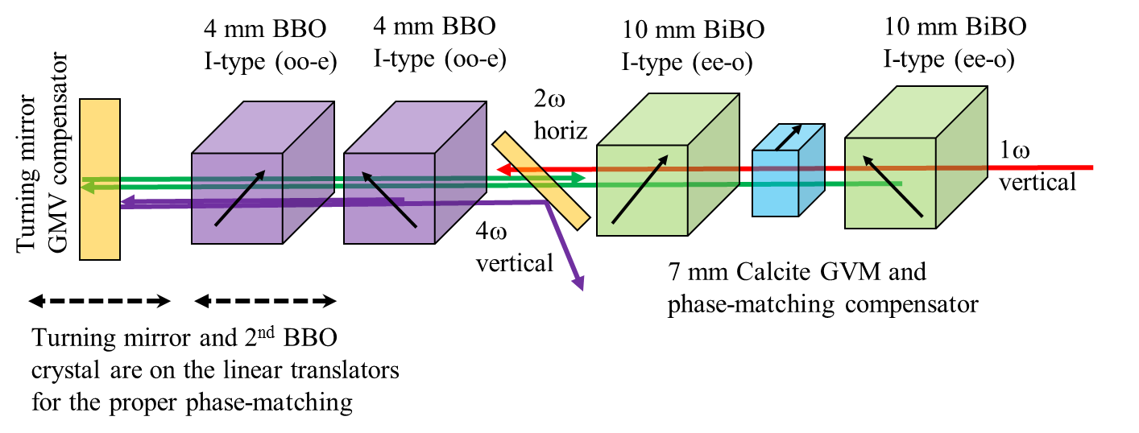
- Increase SHG / FHG efficiency keeping the intensity low
- Total SHG crystal length – 20 mm BiBO
- Total FHG crystal length – 16 mm BBO
- Expected overall efficiency >30%
- max peak UV intensity 10 MW/cm²
High-power 4th Harmonic for CLIC:
Further Improvements
Paul Scherrer Institute Seminar: “Lasers for CLIC and AWAKE projects at CERN”
13.10.2014 Mikhail Martyanov, CERN

Slide 16
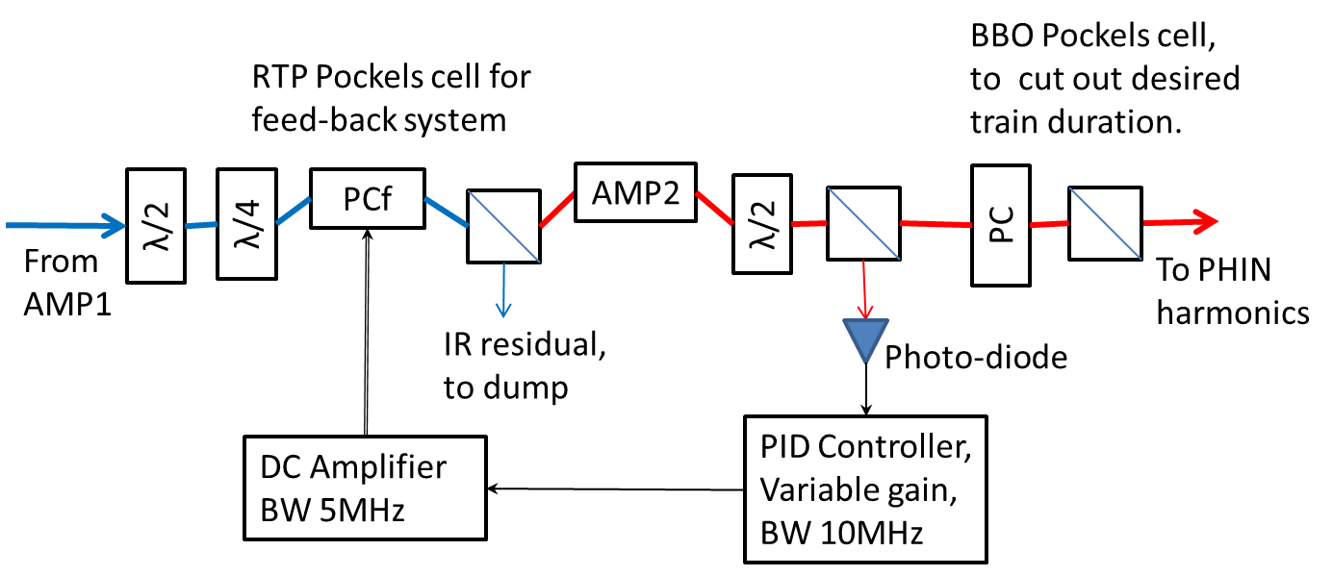
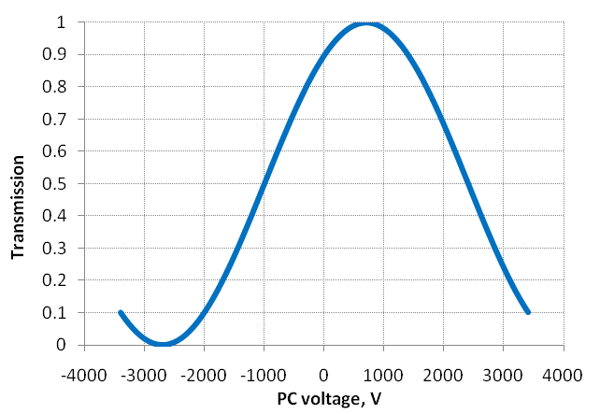
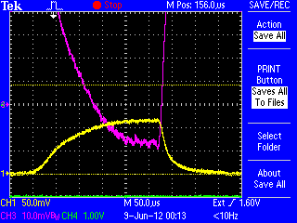
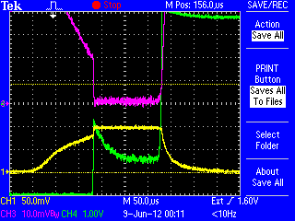
Feed-back Stabilization (MHz Bandwidth)
To reduce an optical load on the feed-back PC it is installed between amplifiers 1 and 2
working point
operating range
feed-back off
feed-back on
Yellow – optical pulse
Red – error signal
Green – driving voltage
Paul Scherrer Institute Seminar: “Lasers for CLIC and AWAKE projects at CERN”
13.10.2014 Mikhail Martyanov, CERN

Slide 17
Feed-back Stabilization (MHz Bandwidth)
Optical noise:
“Fast” – from the oscillator
“Slow” – from the oscillator and amplifiers
Stabilization is needed to suppress the noise
0.1
“Fast” noise from the oscillator (GHz bandwidth)
Zoom, “Slow” noise (MHz bandwidth)
V
0.08
0.06
0.04
0.02
0
0
16.7
33.4
50.1
66.8
ns
83.5
Paul Scherrer Institute Seminar: “Lasers for CLIC and AWAKE projects at CERN”
13.10.2014 Mikhail Martyanov, CERN

Slide 18
Feed-back Stabilization Test
Feedback OFF
Feedback ON
1.34 % rms
0.43 % rms
Laser beam
factor 3
improvement !
Cathode #193
3% rms
Cathode #188
0.97% rms
Electron beam
Paul Scherrer Institute Seminar: “Lasers for CLIC and AWAKE projects at CERN”
13.10.2014 Mikhail Martyanov, CERN

Slide 19
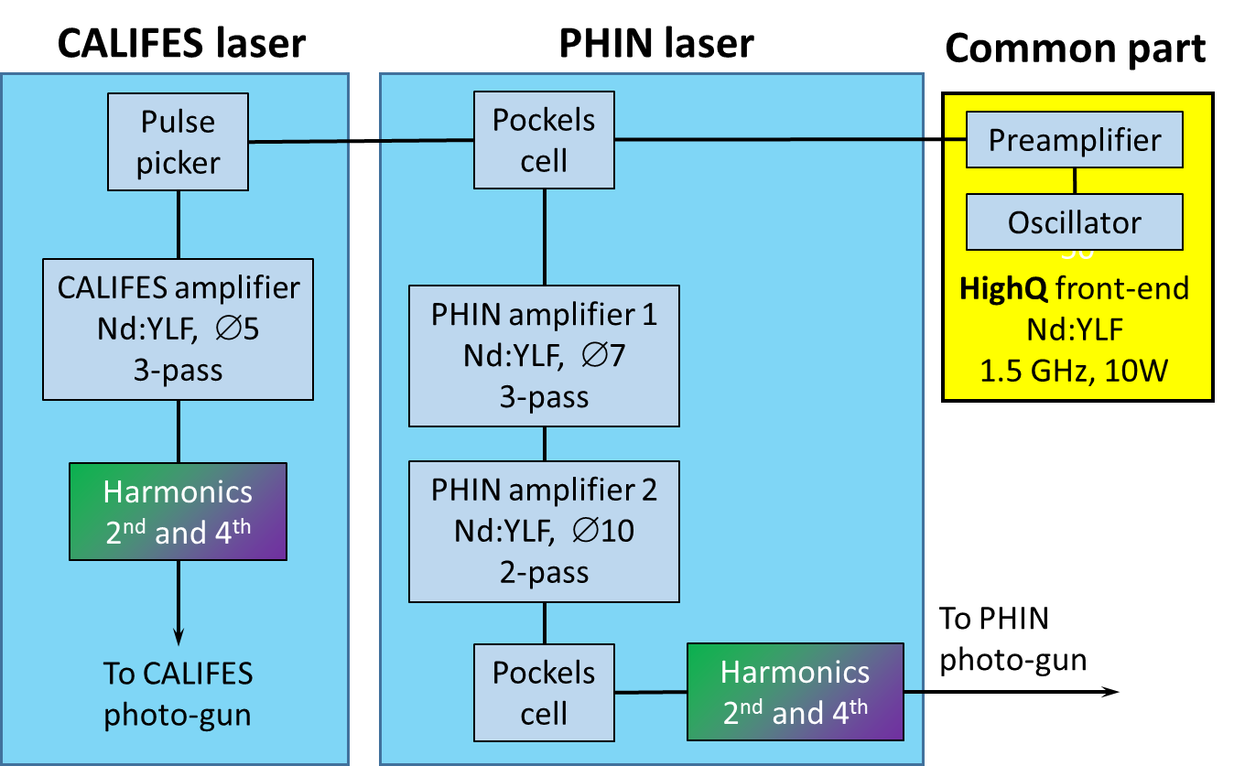
Upgrade of the Laser System
Current laser setup:
Common 1.5 GHz, 10 W HighQ front-end
Simultaneous laser operation of CALIFES and PHIN photo-injectors is possible (with limitations)
Paul Scherrer Institute Seminar: “Lasers for CLIC and AWAKE projects at CERN”
13.10.2014 Mikhail Martyanov, CERN

Slide 20
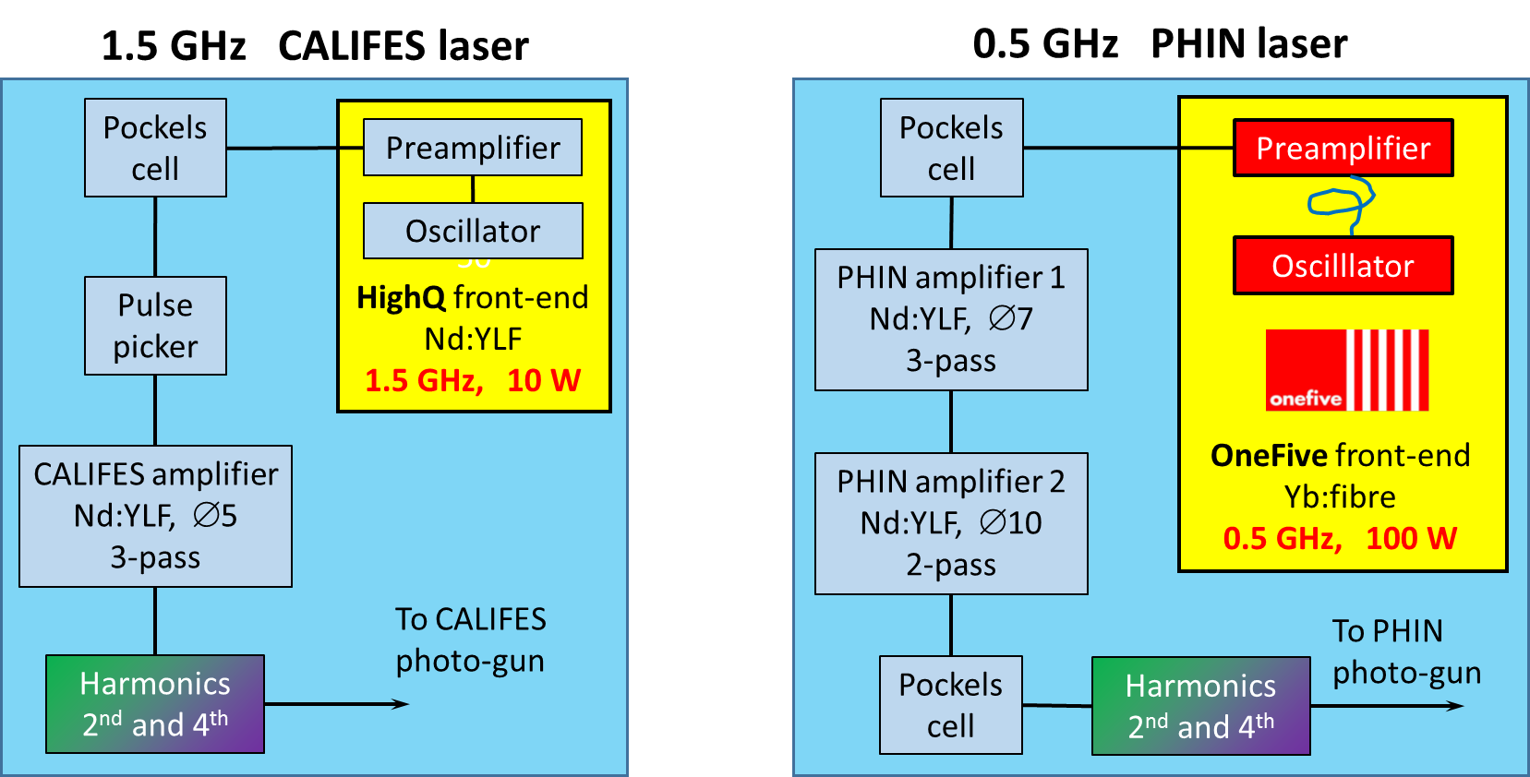
Upgrade of the Laser System
Future laser setup:
CALIFES and PHIN lasers are completely decoupled
Simultaneous laser operation of CALIFES and PHIN photo-injectors
PHIN laser timing parameters pushed towards CLIC requirements due to new front-end ordered from OneFive company.
ORDERED
Paul Scherrer Institute Seminar: “Lasers for CLIC and AWAKE projects at CERN”
13.10.2014 Mikhail Martyanov, CERN

Slide 21
Part II: AWAKE
Advanced Proton Driven
Plasma Wake Field Acceleration Experiment (AWAKE) at CERN
Mikhail Martyanov, CERN
on behalf of AWAKE Collaboration
Paul Scherrer Institute Seminar: “Lasers for CLIC and AWAKE projects at CERN”
13.10.2014 Mikhail Martyanov, CERN

Slide 22
Who Is AWAKE?
AWAKE - is an international collaboration formed to carry on a
Proton Driven Plasma Wake Field Acceleration Experiment
at CERN site with SPS proton bunches.
from AWAKE CDR, CERN 2013
leading institute
Paul Scherrer Institute Seminar: “Lasers for CLIC and AWAKE projects at CERN”
13.10.2014 Mikhail Martyanov, CERN

Slide 23
Who Is AWAKE?
AWAKE Structure:
Spokesperson: Allen Caldwell (MPP)
Deputy Spokesperson: Matthew Wing (UCL)
Technical Coordinator: Edda Gschwendtner (CERN)
Physics and Experiment Coordinator: Patric Muggli (MPP)
Simulation Coordinator: Konstantin Lotov (BINP)
Some useful links:
https://www.mpp.mpg.de/~muggli/AWAKE@MPP/AWAKEatMPP.html
http://indico.cern.ch/category/4278/
AWAKE Design Report:
https://edms.cern.ch/nav/P:CERN-0000094988:V0/P:CERN-0000097681:V0/TAB3
Paul Scherrer Institute Seminar: “Lasers for CLIC and AWAKE projects at CERN”
13.10.2014 Mikhail Martyanov, CERN

Slide 24
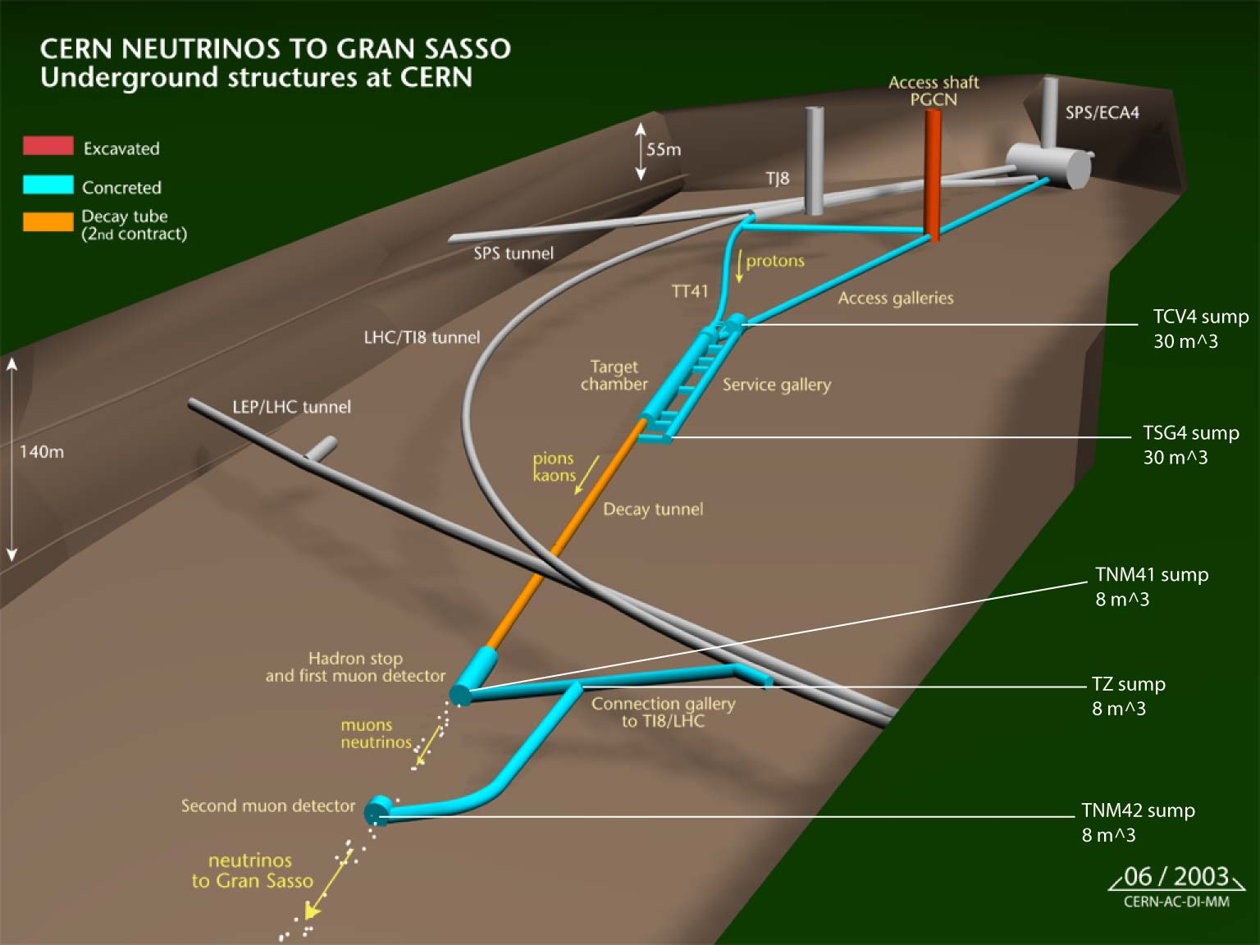
Where AWAKE at CERN?
~100 meters deep underground, former CNGS facility
AWAKE experiment
~1100m
AWAKE
beam dump
Paul Scherrer Institute Seminar: “Lasers for CLIC and AWAKE projects at CERN”
13.10.2014 Mikhail Martyanov, CERN

Slide 25
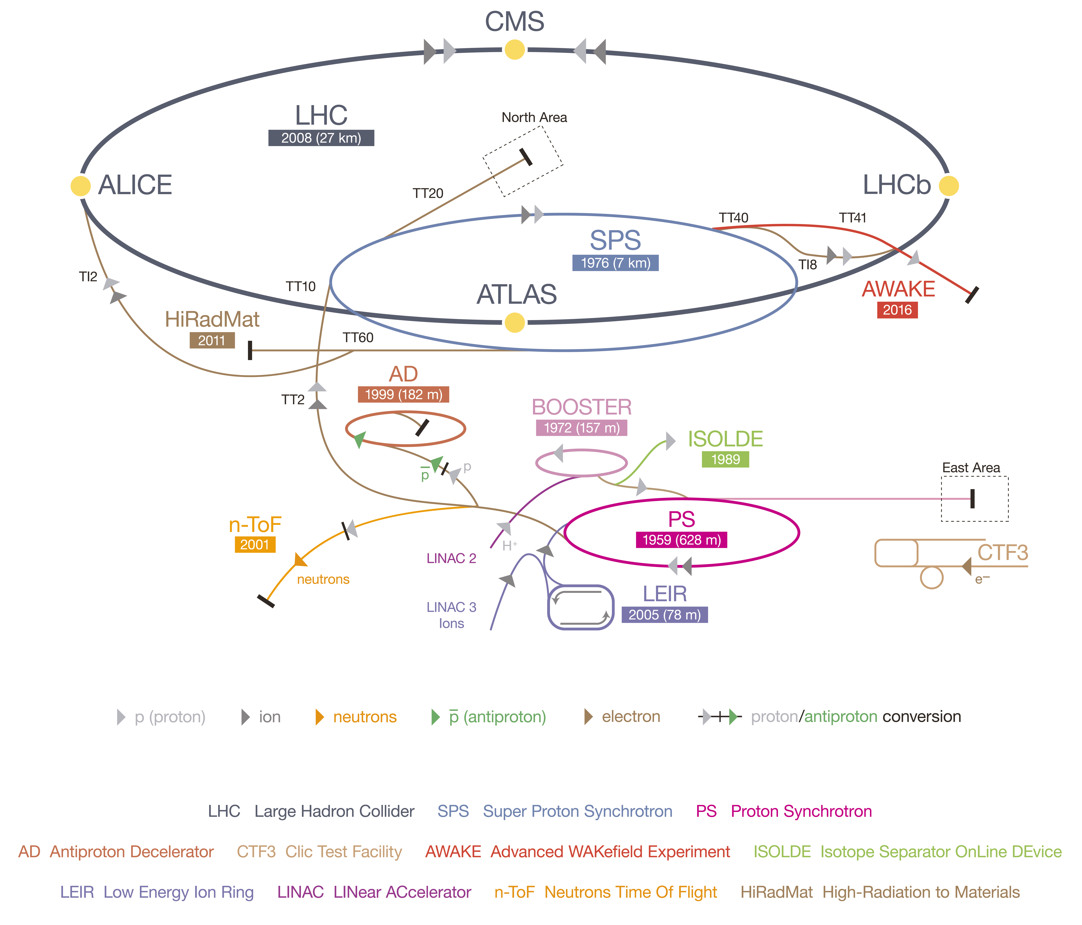
Where AWAKE at CERN?
Paul Scherrer Institute Seminar: “Lasers for CLIC and AWAKE projects at CERN”
13.10.2014 Mikhail Martyanov, CERN

Slide 26
AWAKE Timeline
2 years until physics ! Very tight schedule
Paul Scherrer Institute Seminar: “Lasers for CLIC and AWAKE projects at CERN”
13.10.2014 Mikhail Martyanov, CERN

Slide 27

AWAKE Basics
Four Ingredients:
Protons (from SPS, 400 GeV)
← energy source
Plasma Wake
← transformer to an E-field
(a few GV/m)
Electrons (from photo-gun, 20 MeV)
← enjoy a gradient
Paul Scherrer Institute Seminar: “Lasers for CLIC and AWAKE projects at CERN”
13.10.2014 Mikhail Martyanov, CERN

Slide 28
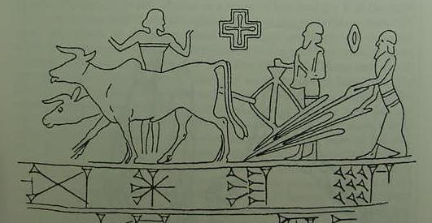
AWAKE Basics
Fourth important Ingredient:
Laser (short pulse)
← To ionize Rb vapor
← To seed an instability
with a stable phase by co-propagating ionization front
Paul Scherrer Institute Seminar: “Lasers for CLIC and AWAKE projects at CERN”
13.10.2014 Mikhail Martyanov, CERN

Slide 29
AWAKE Experiment at CERN
Picture taken from AWAKE CDR, CERN 2013
Paul Scherrer Institute Seminar: “Lasers for CLIC and AWAKE projects at CERN”
13.10.2014 Mikhail Martyanov, CERN

Slide 30
AWAKE Experiment at CERN
~100 meters deep underground,
former CNGS facility
Control room 1km
AWAKE gallery
e-gun
Laser
e⁻ beam
20 MeV
CV
SAS
10 meters Rb vapor / plasma
p⁺ / e⁻
diagnostics
Laser / p⁺ merging point
laser beam
120fs, 450mJ
p⁺ beam 400GeV
Fast valves
e- spectrometer
up to 2 GeV e⁻
Paul Scherrer Institute Seminar: “Lasers for CLIC and AWAKE projects at CERN”
13.10.2014 Mikhail Martyanov, CERN

Slide 31
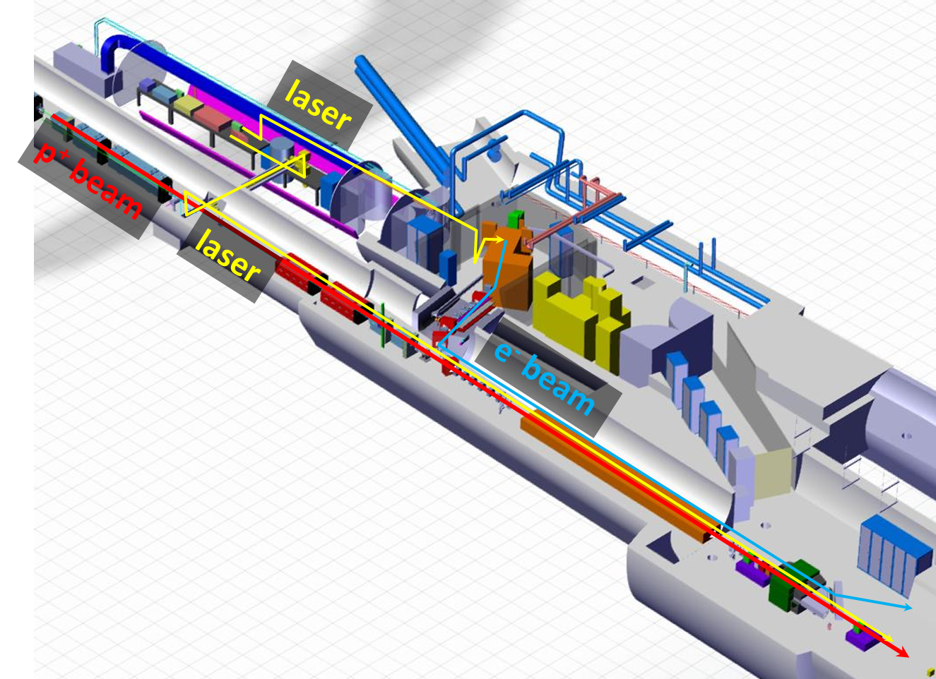
AWAKE “Submarine”
Arms until Rb vapor cell:
Ionizing laser ~ 30m
Photo-injector laser + e-beam ~ 30m
Thanks to
Frederic Galleazzi
Ionizing laser beam transport:
Complete UHV vacuum system up to 10-8mbar
starting from the optical compressor
Motorized 3 inch mirrors in the corner chambers
Long focal length (35m) focusing geometry through the compressor
Paul Scherrer Institute Seminar: “Lasers for CLIC and AWAKE projects at CERN”
13.10.2014 Mikhail Martyanov, CERN

Slide 32
AWAKE “Submarine”
Thanks to
Frederic Galleazzi
Paul Scherrer Institute Seminar: “Lasers for CLIC and AWAKE projects at CERN”
13.10.2014 Mikhail Martyanov, CERN

Slide 33
AWAKE Baseline Parameters
Plasma | Rb plasma density | 10¹⁴ ÷ 10¹⁵ cm⁻³ 7⋅(10⁻³ ÷ 10⁻²) mBar at 500°K
 | Uniformity | <0.1%
 | Length | 10 meters
Proton bunch | Energy | 400 GeV → 64 nJ/p⁺ → 19.2 kJ/bunch
 | Charge | 3⋅10¹¹ particles → 48 nC
 | Length, σ_{z} | 12 cm → 400 ps
 | Radius, σ_{r} | 200 μm
Electron bunch | Energy | 20 MeV → 3.2 pJ/e⁻ → 4 mJ/bunch
 | Charge | 1.25⋅10⁹ particles → 200 pC
 | Length, σ_{z} | 0.25 cm → 8 ps
 | Radius, σ_{r} | 200 μm
Laser | Energy | up to 450 mJ
 | Pulse duration | 120 fs
 | Beam size at Rb vapor (focused from 40m) | a few mm
 | Focused intensity | > 50 TW/cm2
Paul Scherrer Institute Seminar: “Lasers for CLIC and AWAKE projects at CERN”
13.10.2014 Mikhail Martyanov, CERN

Slide 34
Plasma Wake Field: Short Driver
Charge density
As a short driver:
Focused powerful fs-laser pulse
High energy particle bunch (p⁺, e⁻)
Short driver
Witness bunch
Longitudinal E field
Simulation done by Alberto Martinez de la Ossa
n_{e} = 2 10¹⁵ cm³ ν_{pe} = 402 GHz
λ_{pe} = 750 μm E_{0max} = 4.3 GV/m
Taken from the talk by Matthias Gross
at Proton-Driven PWA Meeting
Lisbon, 22 June 2012
Maximum acceleration gradient
Transverse E field
Some radial focusing
Paul Scherrer Institute Seminar: “Lasers for CLIC and AWAKE projects at CERN”
13.10.2014 Mikhail Martyanov, CERN

Slide 35
Plasma Wake Field: Long Particle Bunch Driver
If the driving bunch is long – no efficient wake excitation.
But … there are instabilities!
Presented by J. Vieira, 8 March 2013, CERN, Geneva
at AWAKE Collaboration Meeting
Paul Scherrer Institute Seminar: “Lasers for CLIC and AWAKE projects at CERN”
13.10.2014 Mikhail Martyanov, CERN

Slide 36
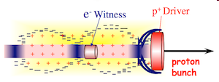
Self Modulation Instability
Short proton bunch driver
No SMI
e⁻
Space charge of drive beam displaces plasma electrons.
Plasma ions exert restoring force.
-
-
-
-
-
-
-
-
-
-
-
-
-
-
-
-
-
-
-
-
-
-
-
-
-
-
-
-
-
-
-
-
-
-
-
-
-
-
-
-
-
-
-
Long proton bunch driver
SMI develops
-
-
-
-
-
-
-
-
-
-
-
-
-
-
-
-
-
-
-
-
-
-
-
-
-
-
-
-
-
₊
₊
₊
₊
₊
₊
-
₊
₊
₊
₊
₊
₊
₊
₊
₊
₊
₊
₊
₊
₊
₊
₊
₊
₊
-
e⁻
-
-
-
₊
₊
₊
₊
-
-
-
-
-
-
₊
₊
₊
₊
₊
₊
₊
₊
₊
₊
₊
₊
₊
₊
-
-
₊
₊
₊
₊
₊
-
₊
₊
₊
₊
₊
-
-
₊
-
₊
₊
₊
₊
₊
-
₊
₊
₊
₊
₊
-
₊
₊
₊
₊
₊
₊
₊
₊
₊
₊
₊
₊
₊
₊
-
-
₊
₊
₊
₊
₊
-
-
-
-
-
-
-
-
-
-
-
proton
bunch
-
-
-
-
-
-
-
-
-
-
-
-
-
-
-
-
-
-
-
-
-
-
-
-
-
-
-
-
-
-
-
-
-
-
-
-
-
-
-
-
-
-
-
-
-
-
-
-
-
-
E_{z}
Paul Scherrer Institute Seminar: “Lasers for CLIC and AWAKE projects at CERN”
13.10.2014 Mikhail Martyanov, CERN

Slide 37
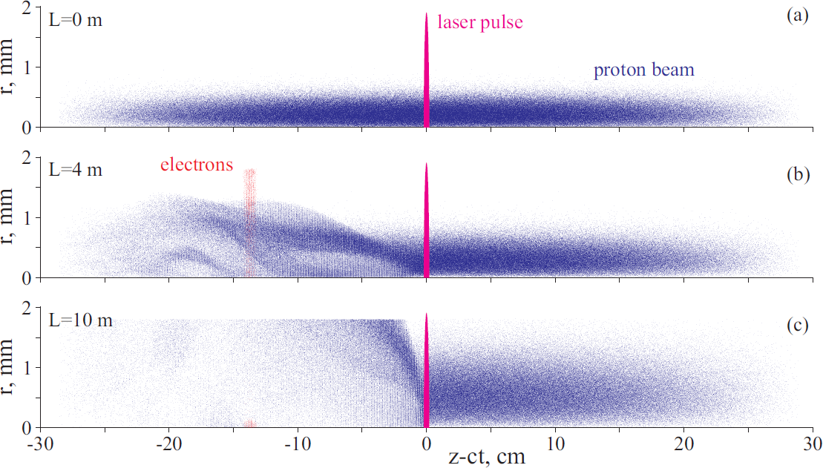
AWAKE Experiment: Principle
Ionization front is co-propagating with a short laser pulse and seeds Self Modulation Instability (SMI)
τ_{laser} ~ 100 fs << τ_{wake} ~ 3 ps
100% Rb plasma
Ionization front
e⁻ are injected
100% Rb vapor
Picture taken from AWAKE CDR, CERN 2013
accelerated and focused e⁻
Paul Scherrer Institute Seminar: “Lasers for CLIC and AWAKE projects at CERN”
13.10.2014 Mikhail Martyanov, CERN

Slide 38
AWAKE Experiment: SMI Details
Picture taken from AWAKE CDR, CERN 2013
NB! No longitudinal (velocity) bunching
Only radial (envelope) “bunching”!
Total current is concerved
Paul Scherrer Institute Seminar: “Lasers for CLIC and AWAKE projects at CERN”
13.10.2014 Mikhail Martyanov, CERN

Slide 39


Proton Bunch Evolution
Presented by K.Lotov at AWAKE Collaboration Meeting, CERN 08.03.2013
0.4
Beam portrait (2nd half)
r , mm
0
30
ξ = z - ct , cm
0
Excited field E_{z}
E_{z} , a.u.
Paul Scherrer Institute Seminar: “Lasers for CLIC and AWAKE projects at CERN”
13.10.2014 Mikhail Martyanov, CERN

Slide 40

On-axis e⁻ injection, trapping and acceleration
Presented by K.Lotov at AWAKE Collaboration Meeting, CERN 10.04.2014
2
black points – injected electrons, false colors – wake field potential
r, mm
0
-17
ξ = z - ct, cm
-16.4
Features to note:
  Electrons are trapped from the very beginning by the wake field of seed perturbation
  At r~3 c/w_{p} there is a defocusing region for any ξ. Reason – incomplete neutralization of the beam current → plasma lens effect for protons, defocusing lens for electrons
  Trapped electrons make several synchrotron oscillations in their potential wells.
  After L=4 m the wake field moves forward in the light velocity frame (newly discovered effect)
Paul Scherrer Institute Seminar: “Lasers for CLIC and AWAKE projects at CERN”
13.10.2014 Mikhail Martyanov, CERN

Slide 41
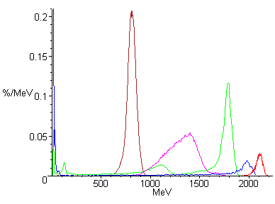
Resulting e⁻ Energy and Spread
Presented by K.Lotov at AWAKE collaboration meeting, CERN 10.04.2014
Comparison of best simulation results
Side injection (CDR baseline):
5% trapping, 3% energy spread
Off-axis injection (collinear electron beam shifted radially by 1.8 mm):
~5% in the main spike
On-axis injection:
40% trapping, 12% energy spread
Improved Side injection:
30% in the main spike, 4% energy spread
45% trapping, 6.5% energy spread
Paul Scherrer Institute Seminar: “Lasers for CLIC and AWAKE projects at CERN”
13.10.2014 Mikhail Martyanov, CERN

Slide 42
AWAKE Laser Overview
Ti:Sa laser system comprises:
- laser with 2 beams (for Rb-vapor ionization and for the e-gun)
- delay line is possible in either of both beams
- focusing telescope (lenses, in air) before vacuum compressor
- long 35 meter focusing to Rb-vapor cell
- optical compressor (in vacuum)
- optical in-air compressor and 3rd harmonics generator for e-gun
Paul Scherrer Institute Seminar: “Lasers for CLIC and AWAKE projects at CERN”
13.10.2014 Mikhail Martyanov, CERN

Slide 43
AWAKE Laser Overview
Ti:Sa laser parameters for Rb-vapor ionization:
- max energy after compression 450 mJ
- pulse duration 100 fs after compression
- max beam diameter 40 mm
Laser energy required for Cu cathode and 1nC
@ 3rd harmonic with some margin = 0.5 mJ
Only reflective optics on the
compressed pulse way
Rule of thumb (B<1):
I[GW/cm²]⋅L[cm]<36
Paul Scherrer Institute Seminar: “Lasers for CLIC and AWAKE projects at CERN”
13.10.2014 Mikhail Martyanov, CERN

Slide 44
How to Ionize Rubidium?
Basic Types of Laser Ionization
Rubidium ϕ_{i} = 4.2 eV = 300 nm
Laser hν = 1.6 eV = 785 nm
Single photon (photo-effect)
hν > ϕ_{i}
ν >> ν_{t}
field E is small,
Δϕ << ϕ_{i}
Multi-photon
n⋅hν > ϕ_{i}
ν >> ν_{t}
field E is small,
Δϕ << ϕ_{i}
Tunneling
ν < ~ > ν_{t}
field E is high,
Δϕ < ϕ_{i}
Strong field
ν << ν_{t}
field E is high,
Δϕ > ϕ_{i}
E⋅x ~ sin(ωt)
E⋅x ~ sin(ωt)
x
hν
hν
Δϕ
ϕ_{i}
ϕ_{i}
ϕ_{i}
Δϕ
ϕ_{i}
lifetime τ=1/ν_{t}
ϕ(x)
ϕ(x)
ϕ(x)
ϕ(x)
Paul Scherrer Institute Seminar: “Lasers for CLIC and AWAKE projects at CERN”
13.10.2014 Mikhail Martyanov, CERN

Slide 45
AWAKE: Strong Field Ionization
Strong field ionization threshold for Rubidium < 2 TW/cm2
Focused laser beam intensity > 50TW/cm2
Well above threshold, really strong field ionization
Paul Scherrer Institute Seminar: “Lasers for CLIC and AWAKE projects at CERN”
13.10.2014 Mikhail Martyanov, CERN

Slide 46
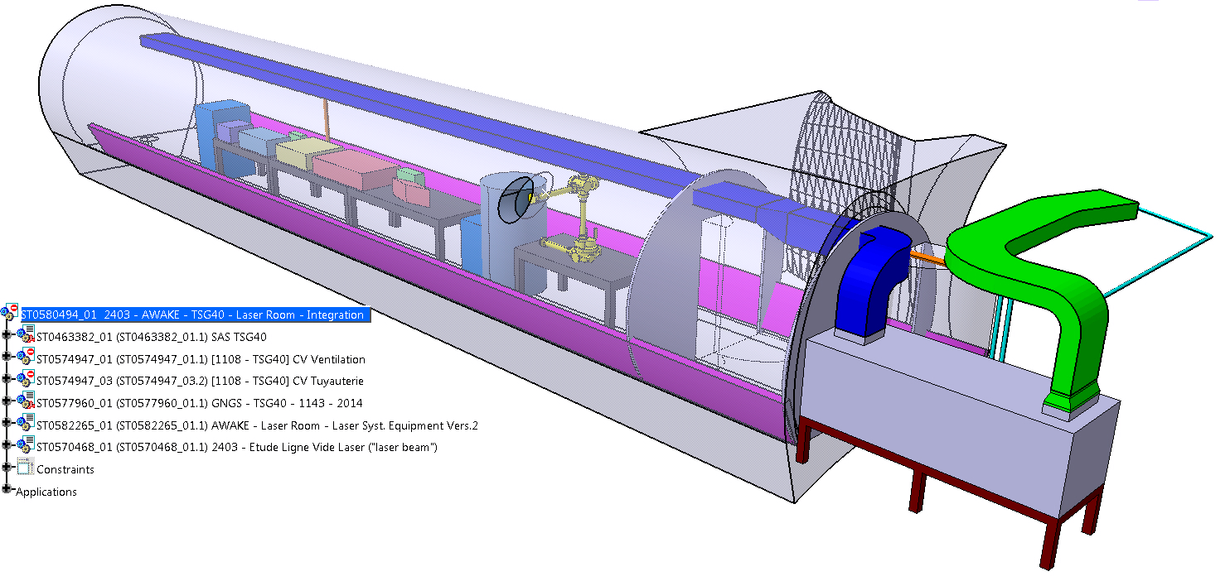
AWAKE Laser Room: Cooling & Ventilation
Design of ventilation system is on-going.
Open question: Which humidity level can be accepted?
Paul Scherrer Institute Seminar: “Lasers for CLIC and AWAKE projects at CERN”
13.10.2014 Mikhail Martyanov, CERN

Slide 47
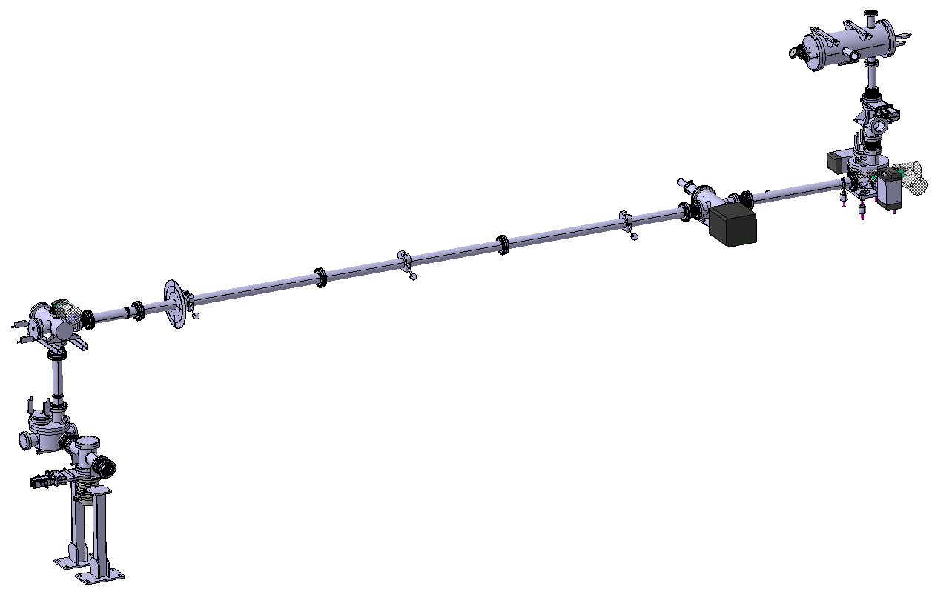
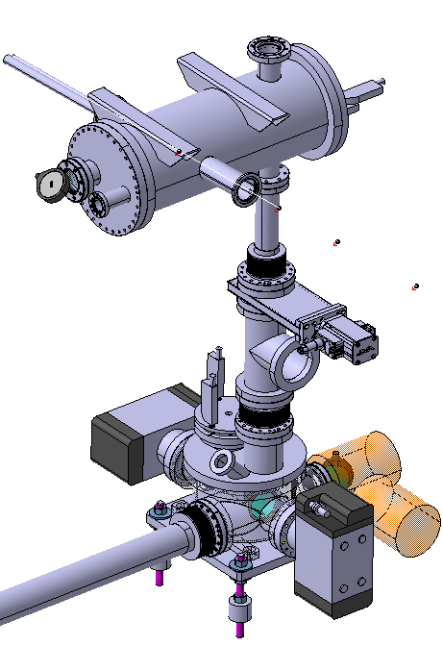
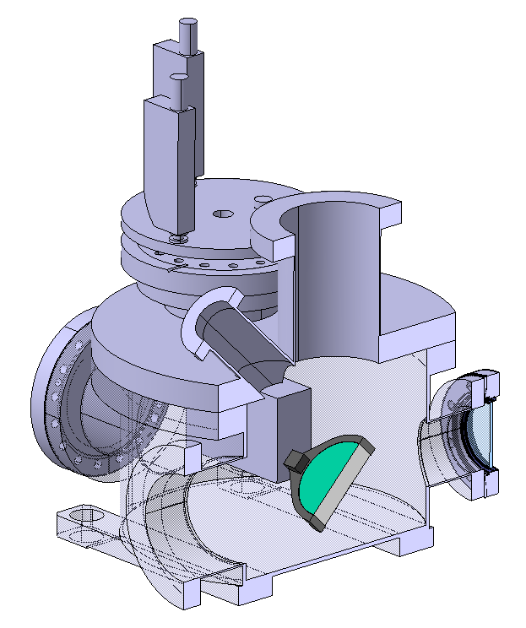
Vacuum Laser Transfer Line
Thanks to
Nicolas Chritin
Paul Scherrer Institute Seminar: “Lasers for CLIC and AWAKE projects at CERN”
13.10.2014 Mikhail Martyanov, CERN

Slide 48
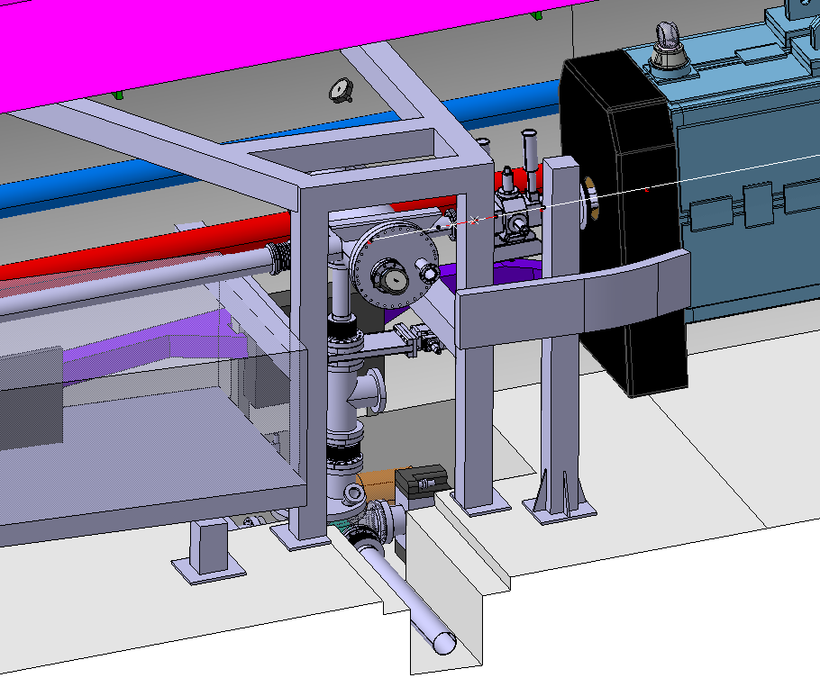
Vacuum Laser Transfer Line
Thanks to
Nicolas Chritin
Paul Scherrer Institute Seminar: “Lasers for CLIC and AWAKE projects at CERN”
13.10.2014 Mikhail Martyanov, CERN

Slide 49
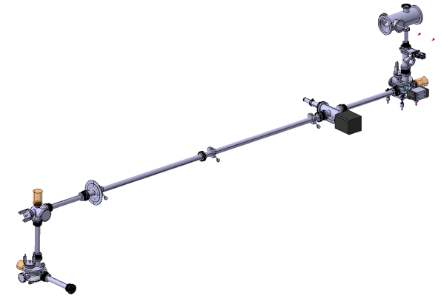
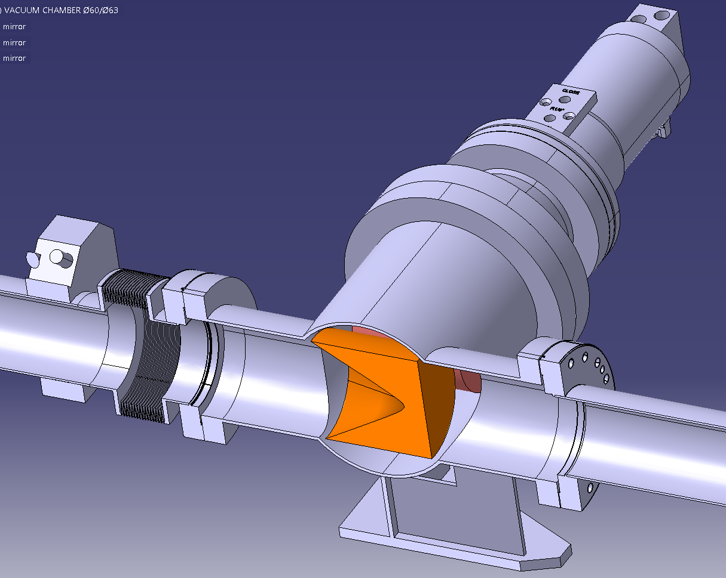

Vacuum Laser Shutter
Thanks to
Nicolas Chritin
Paul Scherrer Institute Seminar: “Lasers for CLIC and AWAKE projects at CERN”
13.10.2014 Mikhail Martyanov, CERN

Slide 50
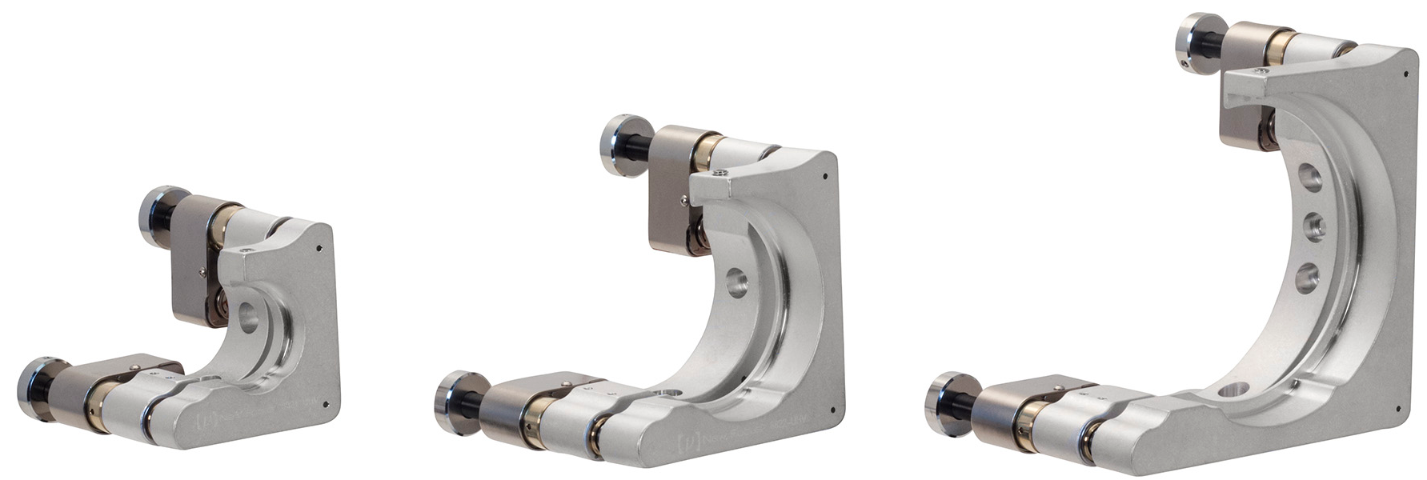

UHV Compatible Optical Mounts
UHV - PicomotorTM ClearEdge Optical Mounts Features:
Customized Picomotor 1.0, 2.0”, and 3.0” in (25.7, 50.8, 76.2 mm) mirror mounts – Clear Edge
ΘX, ΘY Adjustments with angular resolution of <0.7urad
UHV Compatible 10^-9 Torr
Kapton wires ideal for X-ray, UV or EUV applications
All vented holes
Integrated polished carbide pads
Currently under vacuum test
Paul Scherrer Institute Seminar: “Lasers for CLIC and AWAKE projects at CERN”
13.10.2014 Mikhail Martyanov, CERN

Slide 51
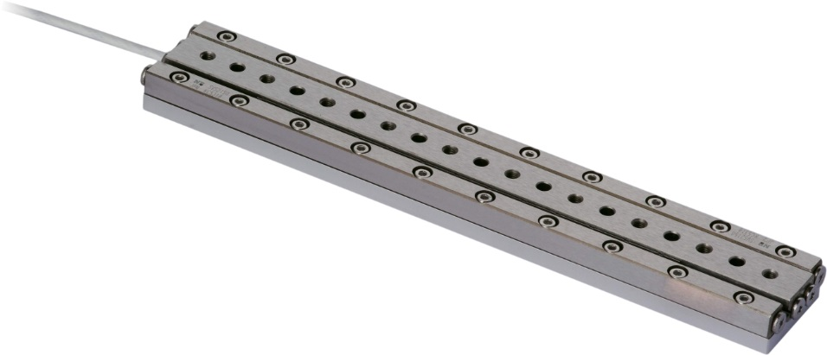
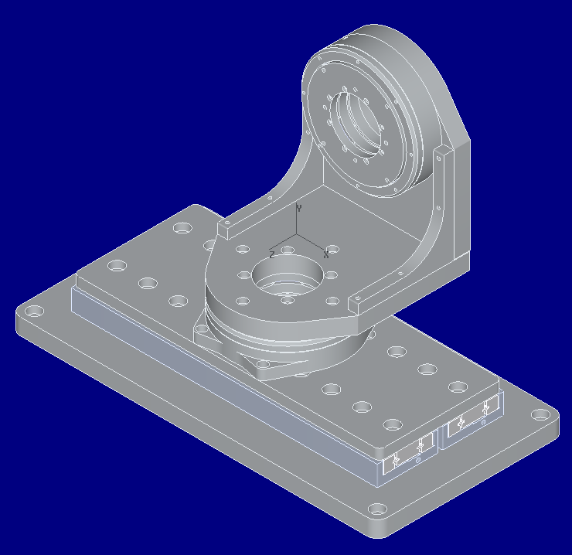
SMARACT: UHV Compatible Linear Translator
“Piezo-walk” technology
Second parallel passive guide-way at the side of the active positioner
Travel 100 mm
Step size ~1 um
Max. vertical load 20 kg
UHV up to 1e-11 mBar, KAPTON wires
Roll, Pitch and Yaw < 100 urad
Currently under vacuum test
Paul Scherrer Institute Seminar: “Lasers for CLIC and AWAKE projects at CERN”
13.10.2014 Mikhail Martyanov, CERN

Slide 52
AWAKE Summary
AWAKE is scientifically and technically challenging experiment with a tight schedule
Main challenges are:
  10 meters long extremely uniform (<0.1%) Rb plasma channel ← oil bath
  Hot (500K) Rb vapor vessel v.s. ultra high vacuum outside ← fast valves
  Synchronization in time and space of 3 beams (p⁺, e⁻, laser)
  Seeding of Self Modulation Instability (SMI)
  Diagnostics of SMI and others
  Long focal waste Rb vapor strong field ionization by Ti:Sa laser
  And many more ...
  First physics – end 2016
Paul Scherrer Institute Seminar: “Lasers for CLIC and AWAKE projects at CERN”
13.10.2014 Mikhail Martyanov, CERN

Slide 53
Part II: AWAKE
Thank you!
Paul Scherrer Institute Seminar: “Lasers for CLIC and AWAKE projects at CERN”
13.10.2014 Mikhail Martyanov, CERN

Slide 55


Laser & Plasma Parameters Glossary
Plasma oscillations (Langmuir oscillations) frequency
for n_{e}=10¹⁵ cm⁻³
ν_{pe} = 284 GHz
λ_{pe} = 1.06 mm
Charge density oscillations in a cold plasma
Response to any local break of quasi-neutrality
Collective motion of plasma electrons with Langmuir frequency
Wake oscillations
Caused by a “driver” moving fast in plasma
Wake fields are intrinsic property of wake oscillations
Simple theory: maximum electric field in plasma
for n_{e}=10¹⁵ cm⁻³
E_{0 max} = 3 GV/m
Paul Scherrer Institute Seminar: “Lasers for CLIC and AWAKE projects at CERN”
13.10.2014 Mikhail Martyanov, CERN

