Slide 1
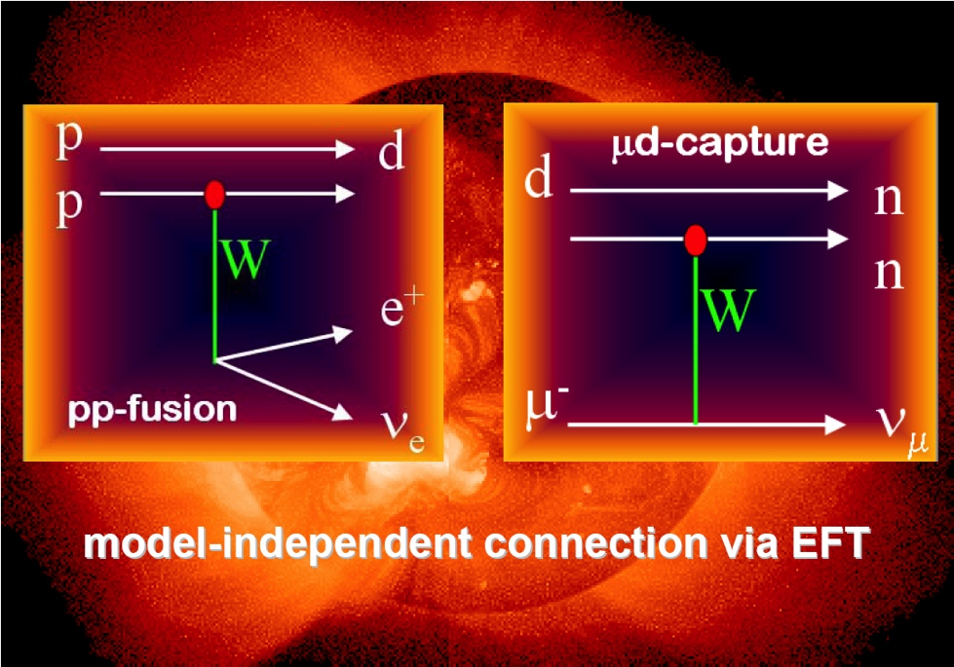
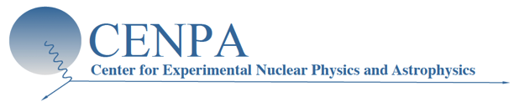
MuSun Experiment
Muon Capture on the Deuteron
Peter Kammel
on behalf of the MuSun Collaboration

Slide 2
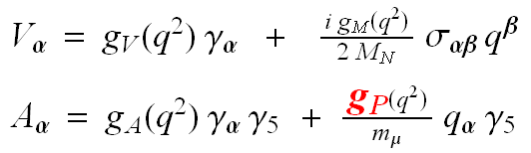

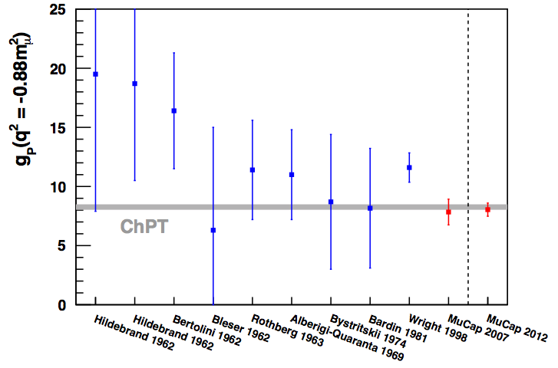
Muon Capture on the Nucleon: MuCap
μ + p → n + ν
rate Λ_{S}
Muon Capture
χPT parameter free prediction: g_{P} = 8.26 ± 0.23
including uncertainty
MuCap final result:
  verifies basic prediction of low energy QCD
g_{P} = 8.06 ± 0.55
PRL 110, 012504 (2013)
APS Editor's spotlight
Eur. Phys. J. A 50, 163 (2014)
Phys. Rev. C, submitted 2/4/2015

Slide 3
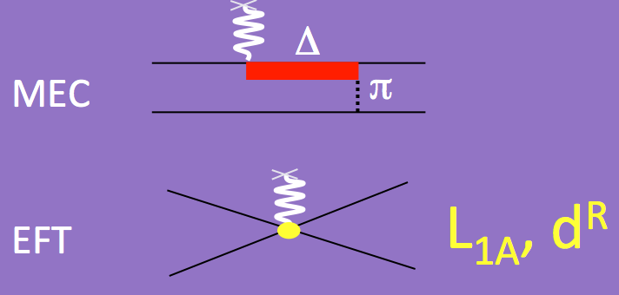
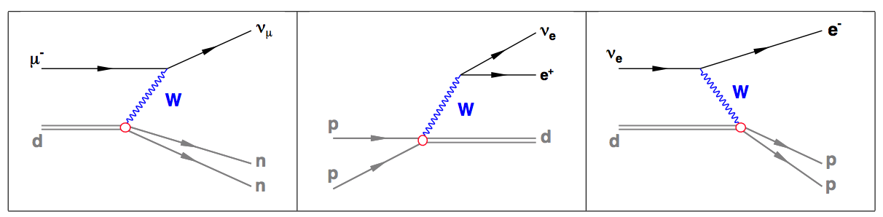

Muon Capture on the Deuteron: MuSun
Main motivation
  Measure weak coupling of two-body axial current: “g_{A} of 2N system”
Theory
  potential models and MECs
  EFT
    pion less EFT, L_{1A}
    HBχPT, d^{R} sole unknown LEC up to N³LO
Model independent connections via d^{R}
  2N weak processes
  Nuclear forces
    Three-body forces, nn scattering length
  Matrix elements for 0ν2β decay
  Sun p p → d e⁺ ν
SNO ν_{e} d → p p e⁻ (CC)
ν_{x} d → p n ν_{x} (NC)

Slide 4
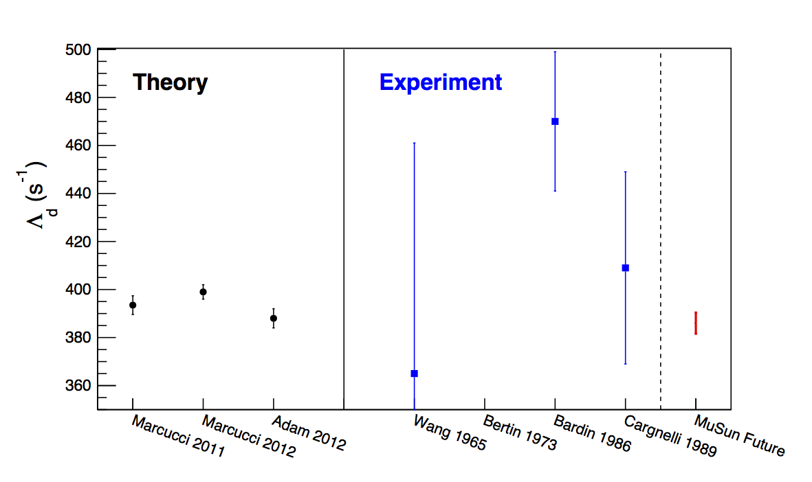
Determine Unknown LEC in μd Capture ?
“Calibrate the Sun”
  d^{R} fixed from more complicated 3N system (tritium beta decay),
  pion-less result omitted, as L_{1A} has large errors.
large improvement in experimental precision required

Slide 5
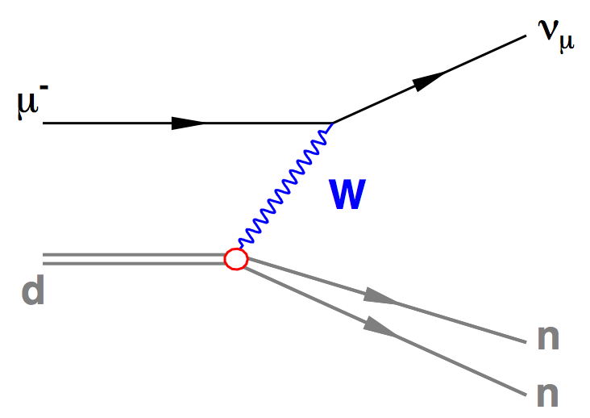
MuSun Goals
Measure rate Λ_{d} for muon capture on the deuteron to better than 1.5%
Λ_{d} denotes the capture rate from the doublet
hyperfine state of the μd atom in its 1S ground state.
Determine the unknown LEC
  Reduce uncertainty from 100% to ~20% in clean 2N system
  Calibrate theory for fundamental astrophysics reaction
  Verify current 3N based predictions
  Natural step in χPT formulation of nuclear physics
  Clarify current experimental discrepancies
μ + d → n + n + ν

Slide 6
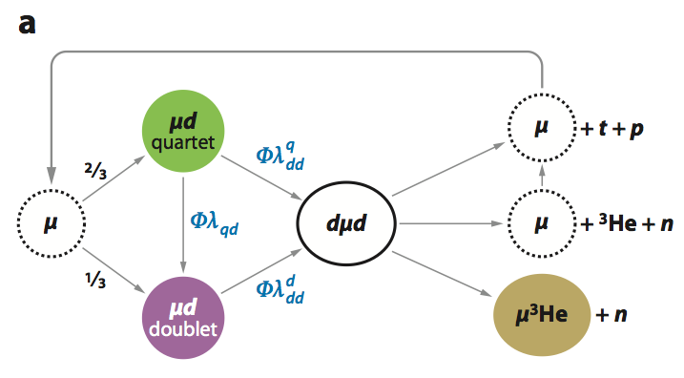
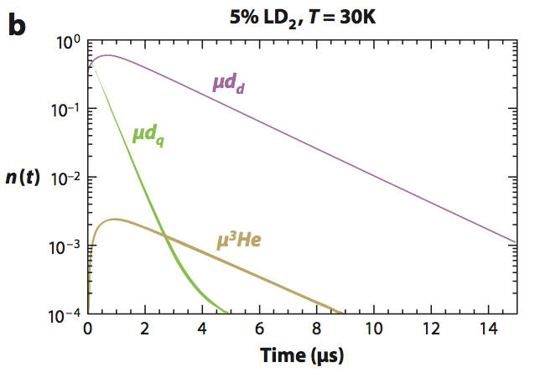
MuSun Experimental Strategy
complex, can one extract EW parameters ?
Clear Interpretation
Precision technique
Clean stops in D₂
Impurities < 1ppb
H/D < 100 ppm
Optimal conditions

Slide 7
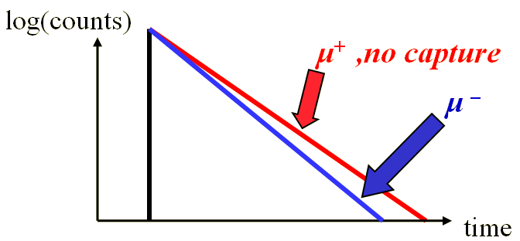
MuSun Experimental Strategy
  μd→nnν rare, only 0.1% of μ→eνν
  neutron detection not precise enough
  Lifetime method
Λ_{S} = 1/τ_{μ−} - 1/τ_{μ+}
measure τ_{μ} to 10ppm
Clear Interpretation
Precision technique
Clean stops in D₂
Impurities < 1ppb
H/D < 100 ppm

Slide 8
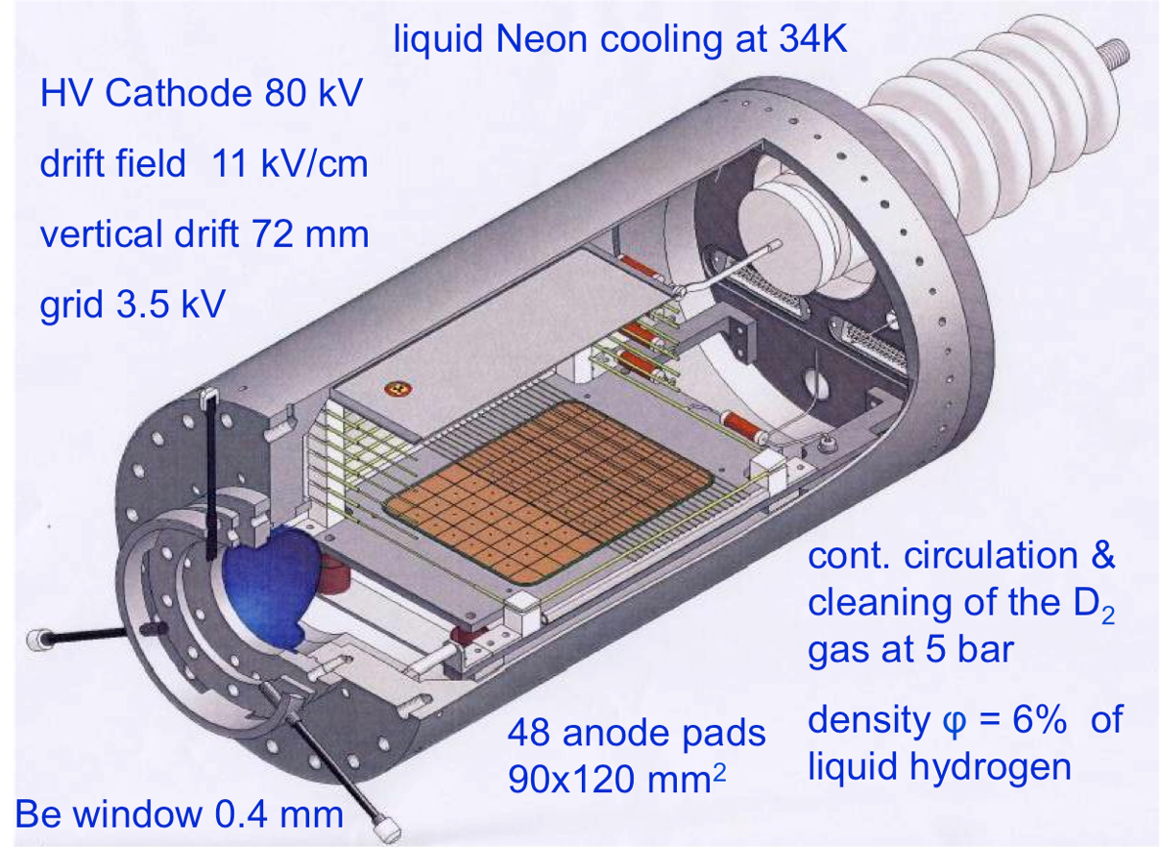
MuSun Experimental Strategy
Clear Interpretation
Precision technique
Clean stops in D₂
Impurities < 1ppb
H/D < 100 ppm
cryo TPC as active target, 3-d tracking

Slide 9
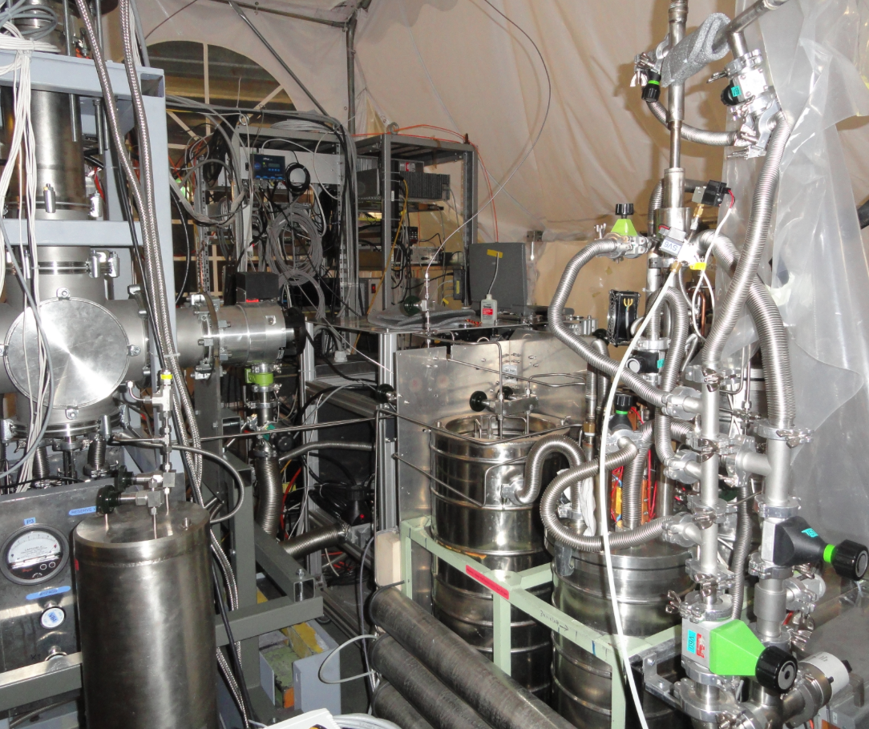
MuSun Experimental Strategy
Clear Interpretation
Precision technique
Clean stops in D₂
Impurities < 1ppb
H/D < 100 ppm
Continuous purification system, PNPI

Slide 10
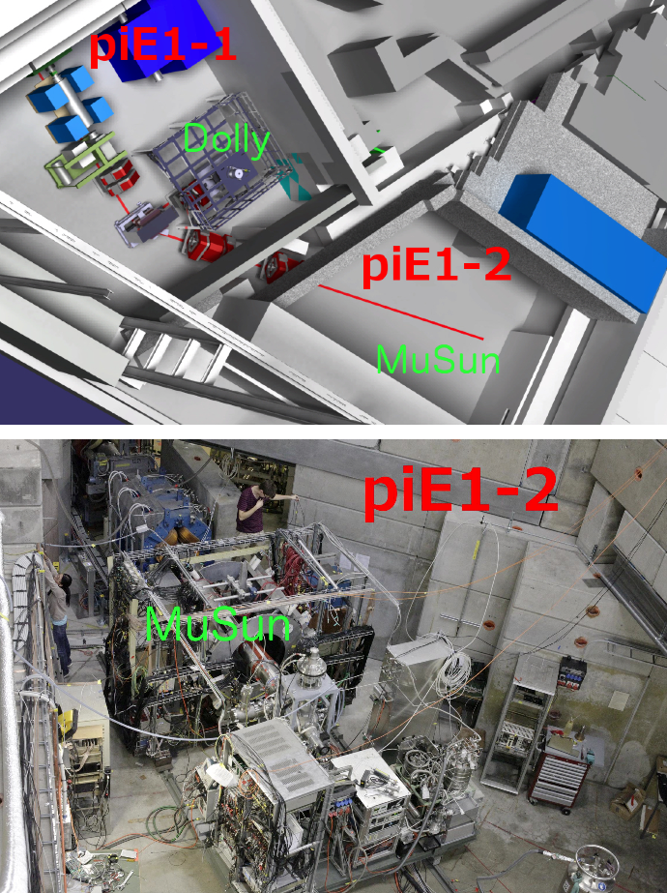
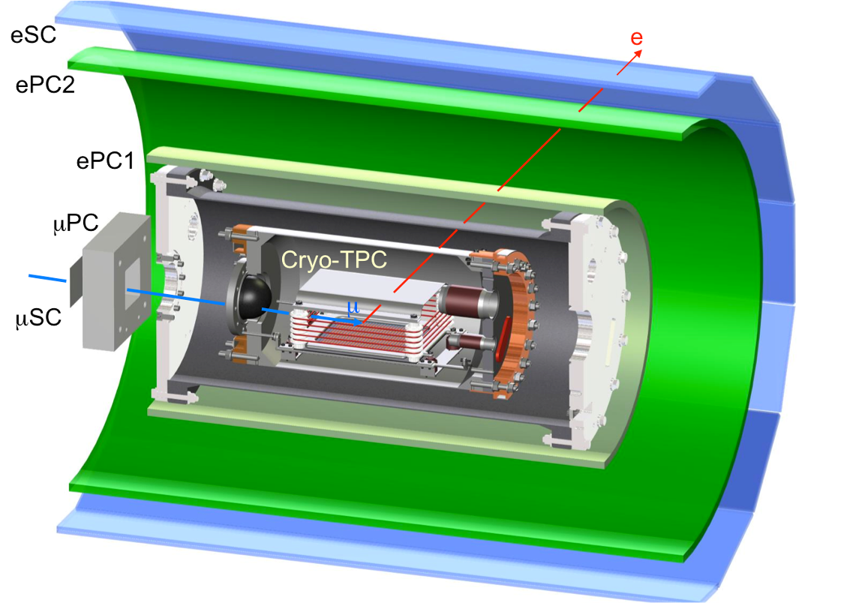
Experimental Setup

Slide 11
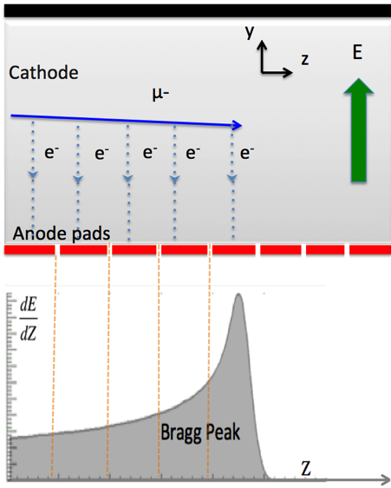
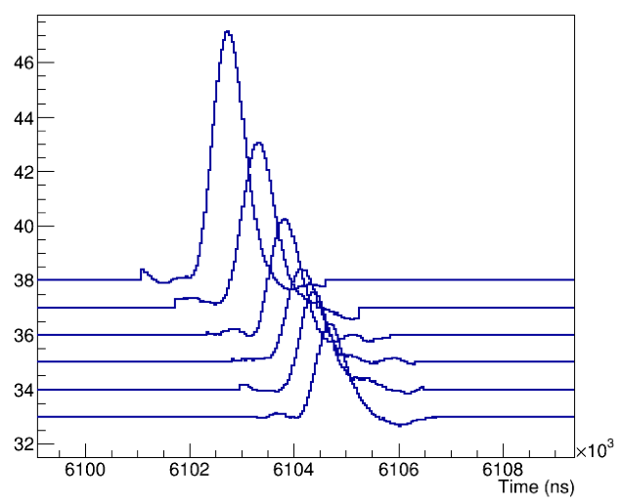
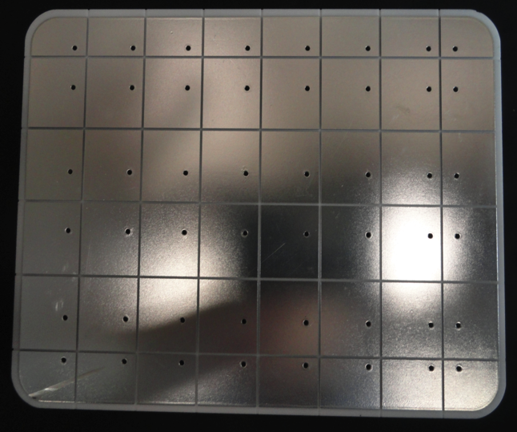
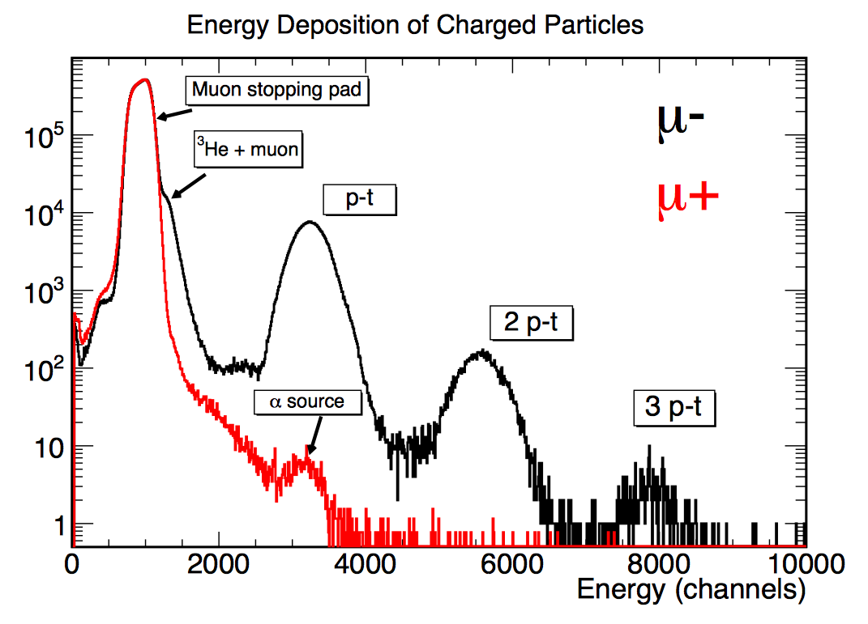
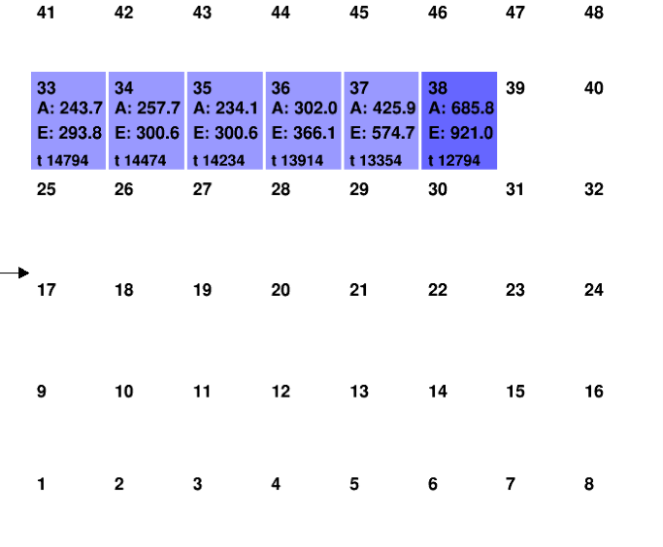
Events in TPC
μ
125.5 mm
μ
95.5 mm

Slide 12
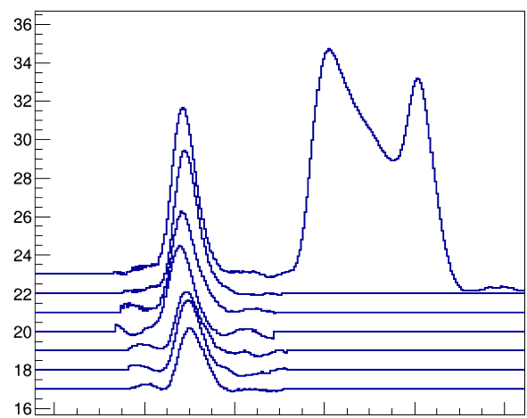
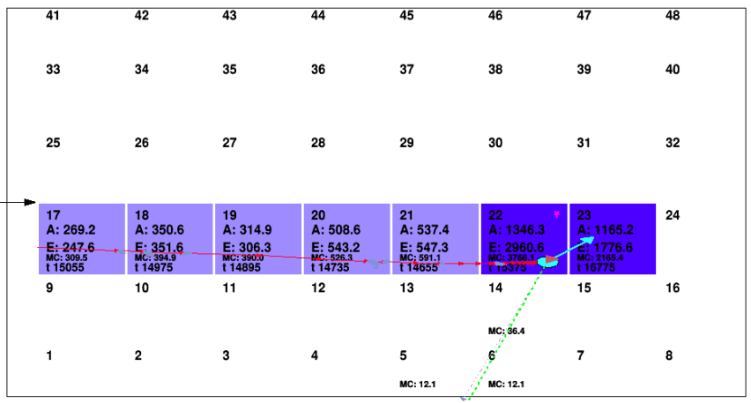
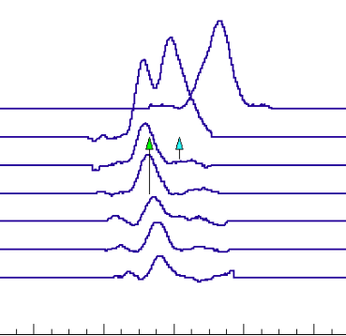
Full Monte Carlo Developed
Essential to
  minimize muon-fusion track interference
  develop robust tracker
    Road tracker
    Upstream tracker
Performance
  10⁹ events in a few hours
  (1000 jobs on Stampede XSEDE cluster)
  p-t enhanced data-sets
  full 2x10¹⁰ statistics planned
Real
p
t
μ
t
p
Monte Carlo
μ

Slide 13
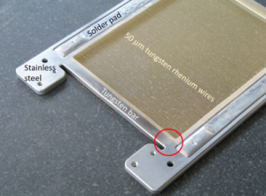
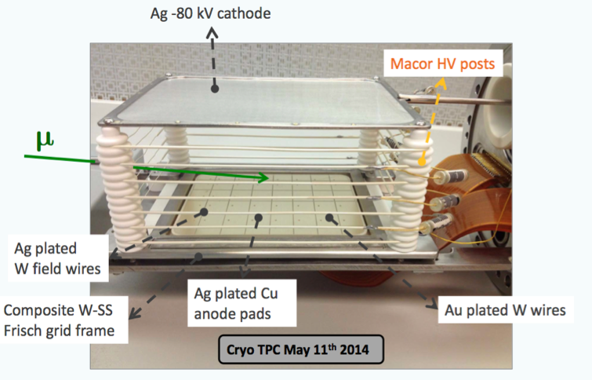
Challenges and Solutions: New TPC
Tight constraints
  cyro compatible, matching thermal expansion
  low outgassing, high Z material
  grid field > 2.2 drift field for full charge collection
Original TPC did not fulfill last two
New TPC designed by UW/PSI
  in 2013-2014
Perfect performance 2014 run

Slide 14
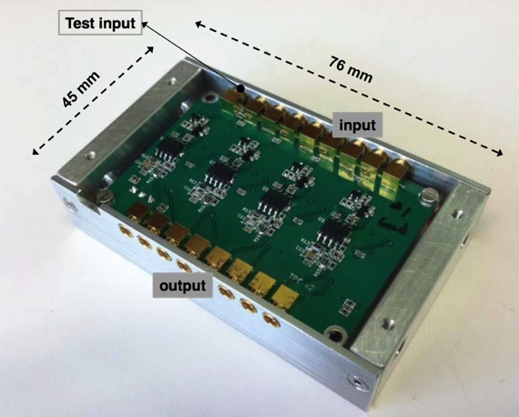
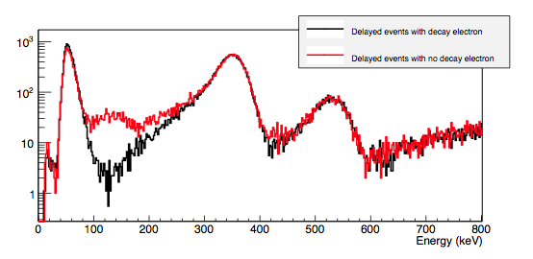
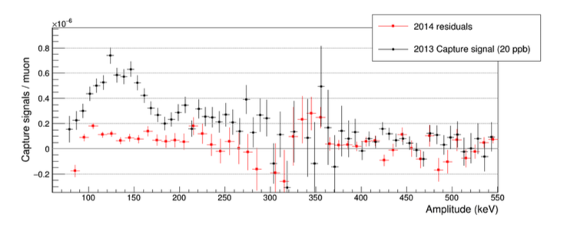
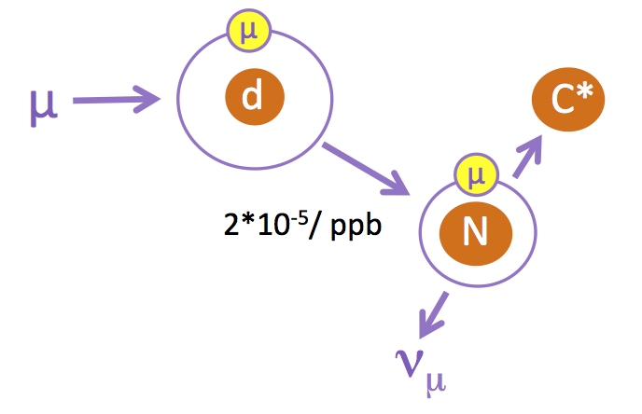
Challenges and Solutions: Purity
JINST 9 7029(2014)
Better resolution with new cryo-preamps
  in isolation vacuum at 140 K
  fully coax shielded
  3x improvement of resolution to 250e rms
  sensitivity 1 ppb impurity level
Much improved gas purity and gas chromatography in 2014 run
  c_{N}=0.91(51) ppb preliminary
capture recoil
2013
~20 ppb
³He
μ³He

Slide 15
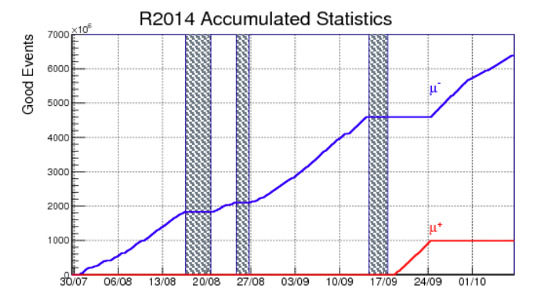
Performance Run 2014
1st main production run with new TPC for 11 weeks
production optimized (beam, DAQ etc.)
excellent detector performance
excellent purity
10⁹ good events/week
accumulated
statistics
after cuts

Slide 16
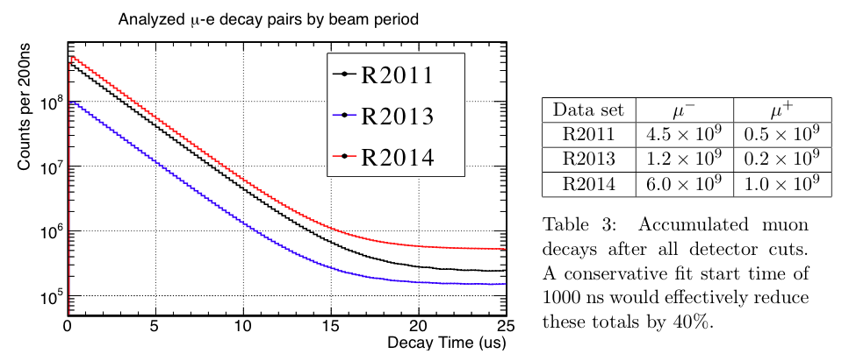
Status and Beam Request
Statistics ΔΛ_{d}= 4 Hz
  12 x 10⁹ required
    2014: 6 x 10⁹
    2015: 8 x 10⁹
  tot: 14 x 10⁹
  probably 1 μs fit start
  tot: 9 x 10⁹
Systematics ΔΛ_{d}= 4 Hz
    Fusion interference
    Purity
    Other ppm lifetime systematics
Beam request
  12 weeks, July-6 to Sept-8: 2 wks setup, optimization, 9 wks production, 1 wk systematics
  Scheduling essential: Expertise of teaching faculty, access before experiment
  Thanks for granting summer run 2014 !
  2016: ? perhaps shorter systematics run

Slide 17
The Team
Collaboration
Petersburg Nuclear Physics Institute (PNPI), Gatchina, Russia
Paul Scherrer Institute (PSI), Villigen, Switzerland
University of Washington, Seattle, USA
University of Kentucky, Lexington, USA
Boston University, USA
Regis University, Denver, USA
University of South Carolina, USA
Grad. Students
  L. Ibanez, K. Ivshin, X. Luo,
  M. Murray, K. Neely, J. Phillips,
  N. Savderova, N. Raha, R. Ryan
  + many undergrads

Slide 18
Backup Slides

Slide 19
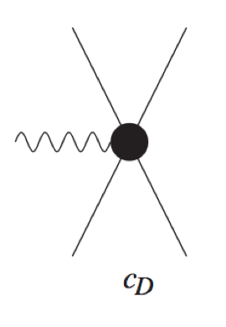
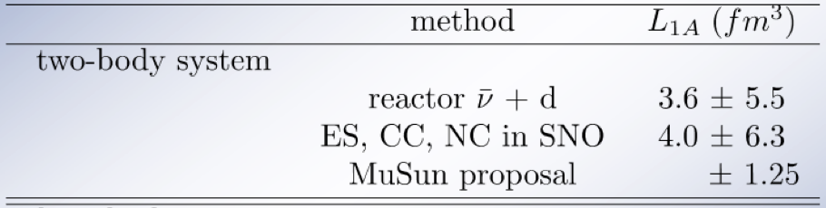
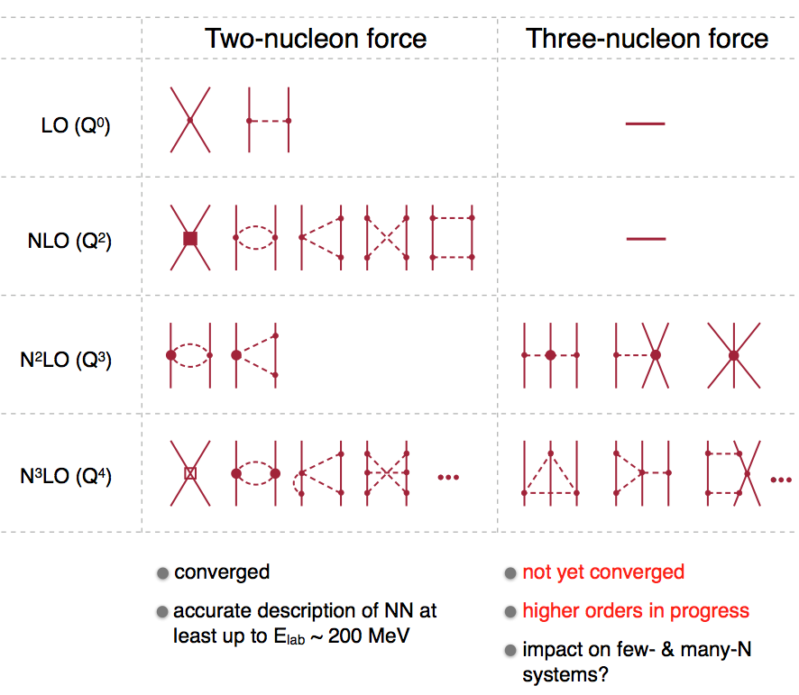
Quest for the Unknown LEC
“Calibrate the Sun”
Axial current d^{R} (or c_{D})
Extract from axial current reaction in
2-body system
  MuSun only realistic option, reduce uncertainty 100% to ~20%
3-body system
  2 LECs and additional complexity enter
  tritium beta decay
  current state of the art
with L_{1A} ~ 6 fm³
c_{D}
c_{E}

Slide 20
Effective Field Theory and Muon Capture
χPT: low-energy EFT of fundamental theory QCD
  Foundations
    systematic expansion in Q/Λ_{χ,}, with Λ_{χ}~ 1GeV
    low-energy degrees of freedom: π, N,
    high-energy dynamics integrated out, low energy constants (LECs)
  Virtues
    based on QCD, retains its symmetries
    assessment of uncertainty
    test of QCD symmetries
    nuclear physics derived from QCD, consistency between forces and currents
    model independent relation between different processes
Muon Capture
  tests electro-weak interaction on nucleon and lightest nuclei
    unique observables
    scarce information available
  tremendous experimental progress with new technique at PSI
    from 10% to sub-percent: μp (1%), μd(1.5% MuSun goal), μ³He (0.3%),

Slide 21
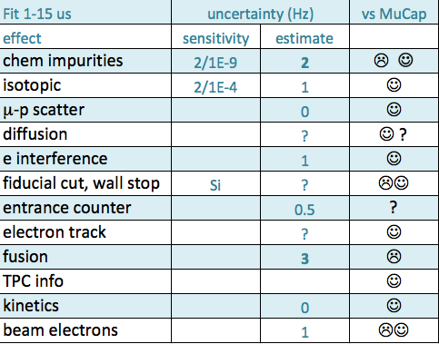
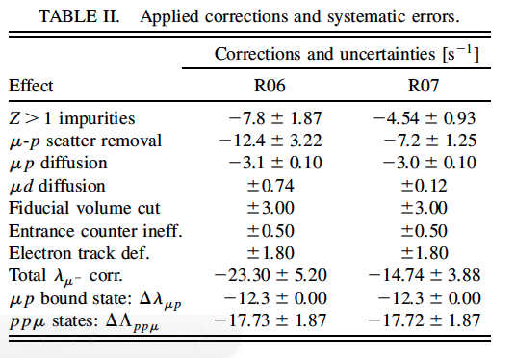
MuCap vs MuSun

Slide 22
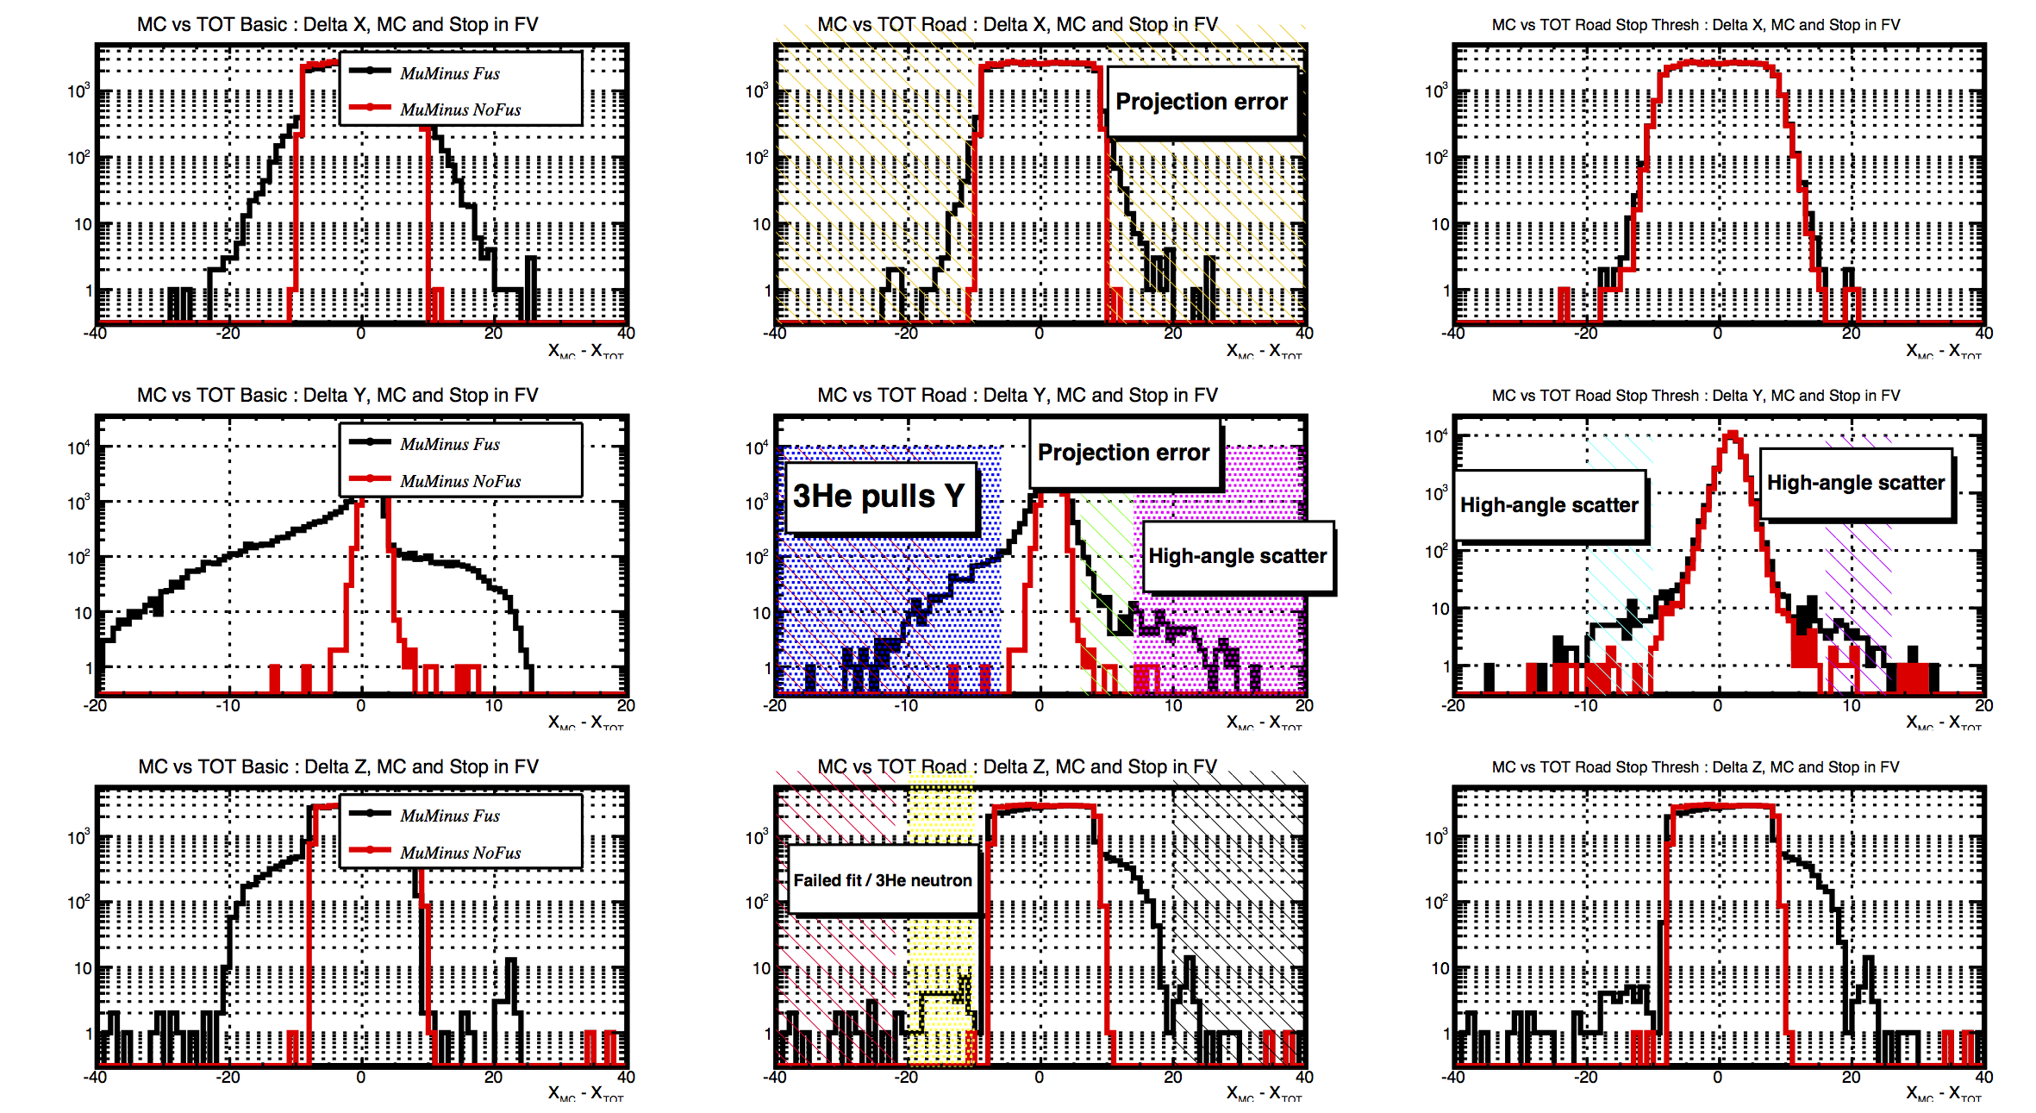
Fusion Interference

