Slide 1
Data size
MEG I
  Trigger rate : ~10Hz
  Event size : 1MB after bzip2 compression
MEG II
  Trigger rate : a few Hz* or ~30 Hz**
  Event size ?
    Much more number of channels (~3500 → ~10000)
    More particles in the DAQ time window (Data reduction more difficult ? ).
Assumed event size (unit of MEG I) | Required minimum event rate to be written on disk
1/4 | 30 Hz
1 | 7.5 Hz
3 | 2.5 Hz
5 | 1.5 Hz
10 | < 1 Hz
likely to be
* could be achivable with 2nd-level TRG ** conservative assumption

Slide 2
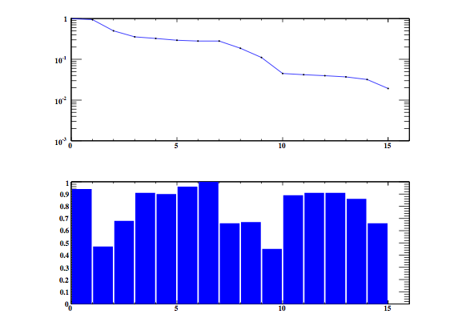
Event selection in MEG I
Relative size after selection
Reduction factor of each selection
TRG0
Phi e⁺-γ
Time TC-γ
Energy γ
Energy e⁺
Time e⁺-γ
Time TC-DC
Track fitted
Theta e⁺-γ
γ CR, pileup
γ acceptance
TC-DC match
nhit per track
Track fit quality
Vertex on target
These selections are necessary to reduce by factor 10—20.
Eγ and TC-DC match reduction factors are modified for this plot to take into account the situation of MEG II

Slide 3
Data flow in MEG I
Raw data is stored here permanently
Tape archive
DAQ backend
Offline storage
Raw data is stored here for 1—2 years until the pre-selection is done.
(need to prepare calibration)
Pre-selected raw data (~40% of events) are stored here permanently

Slide 4

Where the software trigger can be?
(If we need,)
Raw data is stored here permanently
S-TRG computer
Tape archive
S-TRG computer
DAQ backend
S-TRG computer
Offline cluster
the number of S-TRG computer can be O(10)
The “Software TRG” system can consist of multiple PC
Select events using the regular or dedicated analyzer
  We already have a similar selection mechanism in MEG I analyzer
Multiple CPU cores in S-TRG for parallel processing (10—20 jobs)
Required disk access speed is reduced as the number of S-TRG computer increase
Network traffic to the offline cluster is reduced by the event-selection in S-TRG computer

