Slide 1
MEG-II CDCH status
Marco Grassi
PSI, 9 Feb 2015

Slide 2
MEGII Cylindrical Drift CHamber
The new MEGII chamber will be
single volume gaseous detector
U – V wire stringing for hit positioning along the wire
low mass gas (He : iC₄H₁₀ - 85% : 15%)
thin wires and small cell size
Final goals
Single hit resolution ~100 μm in r
Momentum resolution ~150 KeV
Angular resolution ~5 mrad
DC-TC matching eff. ~90 %

Slide 3
Chamber structure
air
He / iB
He
vacuum
air

Slide 4
Technical and geometrical parameters
The parameters with impact on the chamber performances are
  2π
  Rmin e Rmax
  L
  Cell structure
  Wire types
  Gas mixture
  FE
  Double readout
Costraints on wires
R_ext_max | 294.000 | mm
Fiber_thick | 2 | mm
Screws_thick | 3 | mm
R_safe_fiber | 5.000 | mm
R_wire_max | 284.000 | mm
R_ext_min | 157.000 | mm
R_safe_foil | 10.000 | mm
R_wire_min | 167.000 | mm
157 mm
1932 mm
R_safe_int
294 mm
wires
R_safe_ext

Slide 5
Technical and geometrical parameters
The parameters with impact on the chamber performances are
  2π
  Rmin e Rmax
  L
  Cell structure
  Wire types
  Gas mixture
  FE
  Double readout
Geometry used of the chamber
10 layers of cells
  Radius of the outermost anode layer R₀ = 275 mm
  Fixed sector width 2φ = 60 deg
  Planar EndPlate at Z₀ = 966 mm
  Total Φ coverage = 360 deg
  Equal number of cells per sector nC = 32
  Cell Width CW from nC
  Cell Thickness CT equal to CW
  Radial position R from CT
  Stereo angle θ fixed by R

Slide 6
Technical and geometrical parameters
The parameters with impact on the chamber performances are
  2π
  Rmin e Rmax
  L
  Cell structure
  Wire types
  Gas mixture
  FE
  Double readout
Item | Description | Thickness
 |  | 10⁻³ X₀
MEG target | (140 μm plastic) | 0.28 | 0.28
Sense wires | (20 μm W) | 0.41 | 0.78
Field wires | (40 and 50 μm Al) | 0.33
guard ring wires | (40 μm Al) | 0.04
protective foil | (20 μm Kapton) | 0.21 | 0.21
Inner gas | (pure He) | 0.06 | 0.59
Tracker gas | (He/iBut. 85/15) | 0.53
Total | 1 full turn w/o target | 1.58

Slide 7
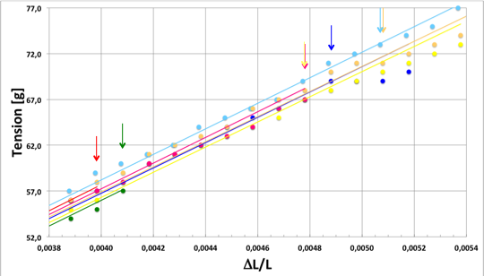
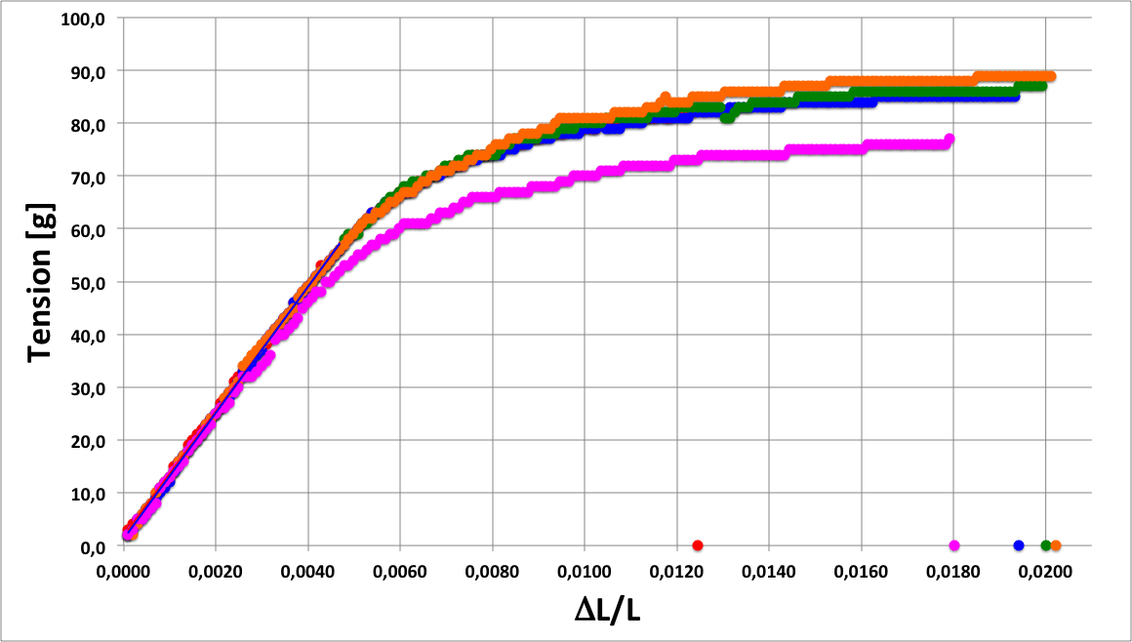
Wires
Selected wires
  Anodes - 20 μm W (Au)
  Cathodes - 40 μm Al (Ag)
  Cathodes - 50 μm Al (Ag)
Producer
  California Fine Wires
Procurement
  Wire procurement was on critical path in 2014
  California Fine wires solved all production issues
  All wires have been delivered in autumn
  Wires respect our specifications

Slide 8
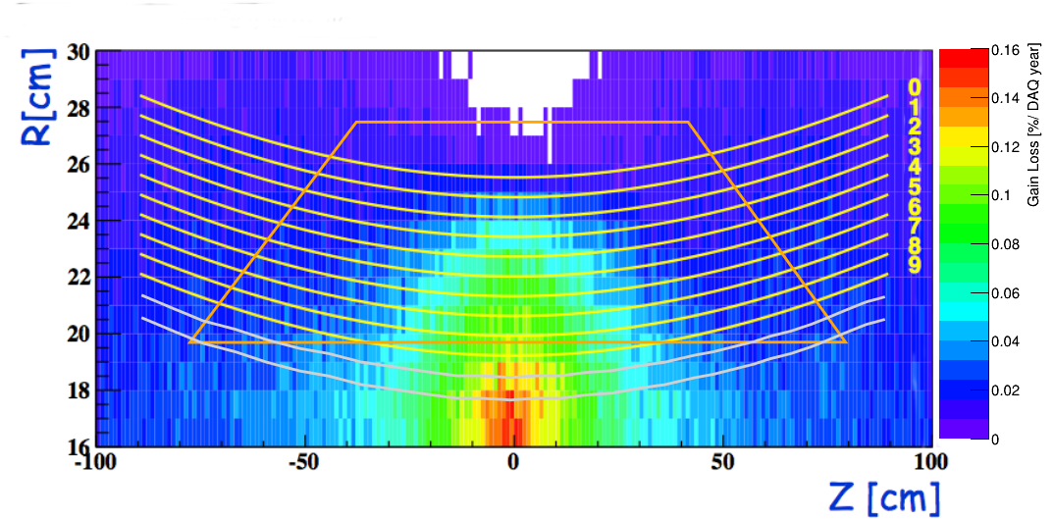
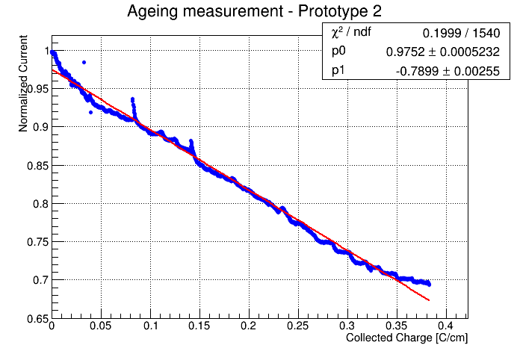
Gas selection and aging
Again dominated by the need of very low X0
He/iB (85/15) (the He/Eth 50/50 of MEG is unusable)
Chamber ageing is under control up to 3 years operation (0.5 C/cm)
20x aging speed with x-ray source
Effect at operation gain (1-2x10⁵) spatially limited and at 15% / year
Norm. current
Accum. charge [C/cm]

Slide 9
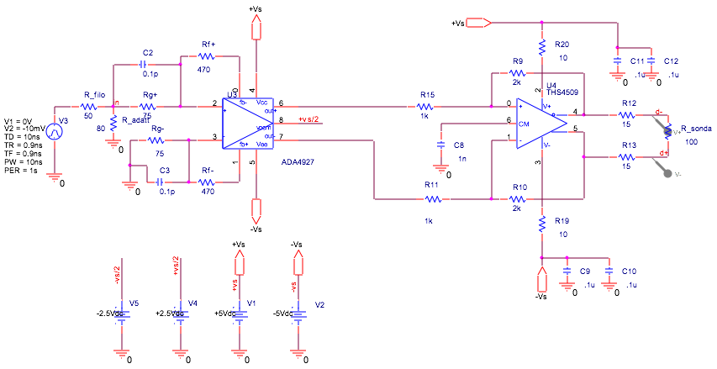
FE preamplifier
The parameters with impact on the chamber performances are
  2π
  Rmin e Rmax
  L
  Cell structure
  Wire types
  Gas mixture
  FE
  Double readout
Requirements
High bandwidth >700 MHz
Good gain: ~20
High density < 7mm width
Layout
Double stage (ADA4927 and THS4509)
Direct connection to DRS WaveDream
Satisfactory used on all prototypes

Slide 10
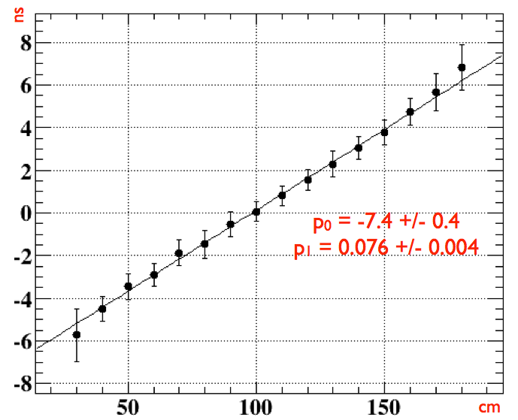
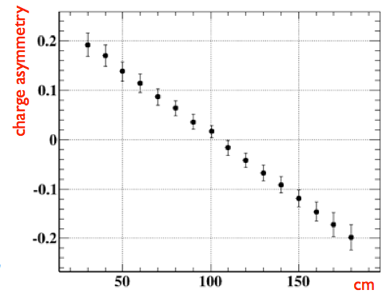
Double side readout
MEGII environment will be crowded and event filter might require large computational time Tracking is greatly simplified and a redundancy margin is added if a coarse longitudinal hit position is obtained by a double wire readout
Longitudinal hit position with time difference
0.5 ns Δt resolution
<10 cm resolution
13.2 cm/ns signal speed
Longitudinal hit position with charge division
170 ohm/m anode resistivity
<10 cm resolution

Slide 11
Simulation performances
All requirements to the new MEGII tracker are obtained
Impact parameter smear of 120 μm
gara

Slide 12
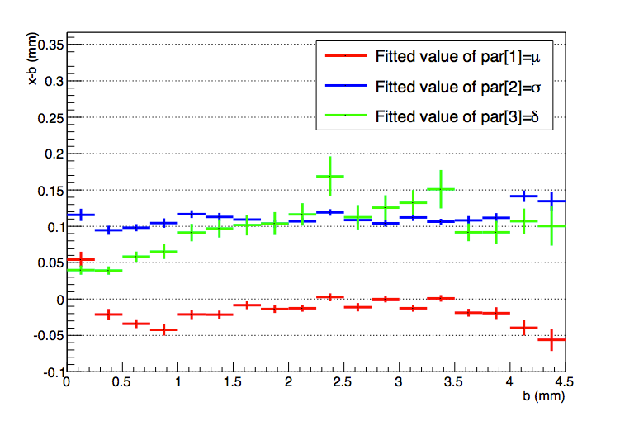
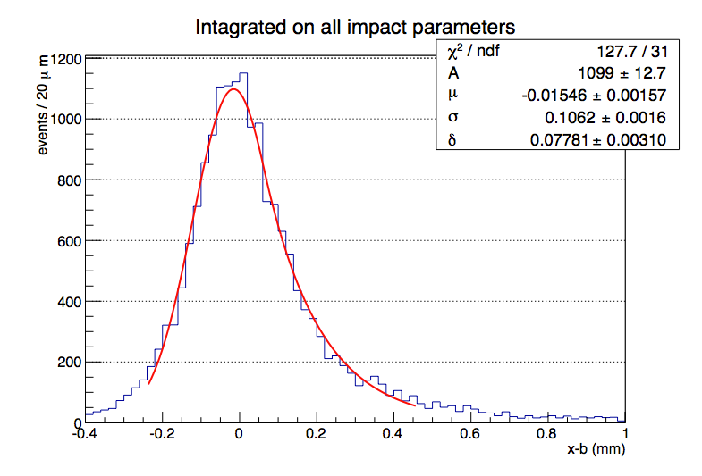
Single hit resolution
True impact parameter defined by an
external silicon tracker
σ_{b-TRUE} ~ 30 μm
Average single hit resolution
106 ± 2 μm
for the three cells

Slide 13
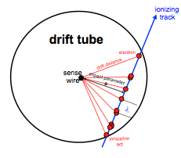
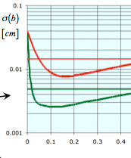
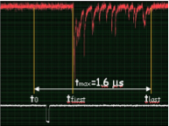
Possible improvements
Cluster timing
  The requirements for a full exploitation of the cluster-timing technique are included in the chamber design
High bandwidth FE with large amplification
  Low ionisation density gas
Waveform digitisation in the GSPS region
  Better performances are expected
σ(b) [cm]
130 μm first cluster
60 μm cluster timing
b [cm]

Slide 14
Constructive details 2014
Defined
  Carbon fiber support
  Connection to endplates
  Endplates structure
  Gas tightness
  Chamber extensions
  Location of target support
  Connections to BTS and Insertion System
To be confirmed/defined
  Adhesive tape
  End-plates sealant
  Kapton foil structure
  Gas distribution
  FE – WirePCB connection
  Cables to DRS
  FE cooling

Slide 15
Constructive details 2015
Defined
  Carbon fiber support
  Connection to endplates
  Endplates structure
  Gas tightness
  Chamber extensions
  Location of target support
  Connections to BTS and Insertion System
Defined
  Adhesive tape
  End-plates sealant
  Kapton foil structure
  Gas distribution
  FE – WirePCB connection
  Cables to DRS
  FE cooling
The production of the chamber is started

Slide 16
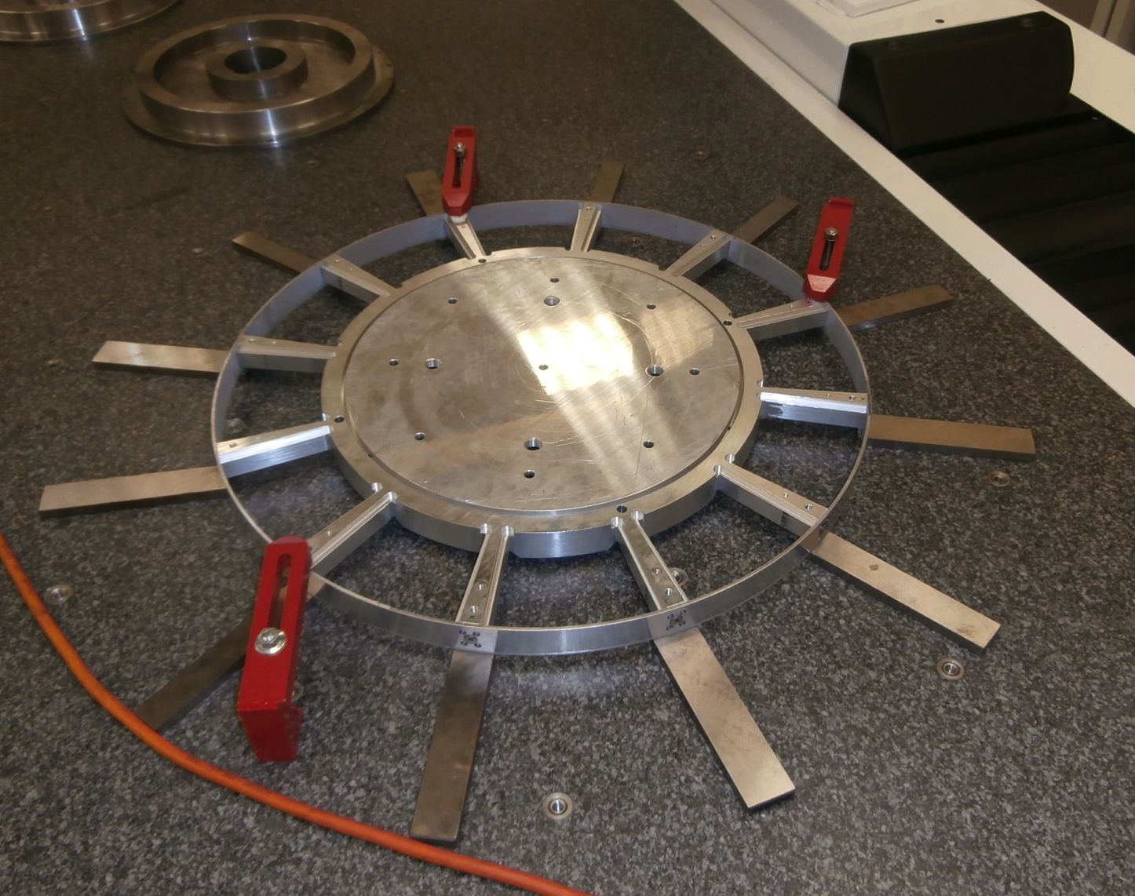
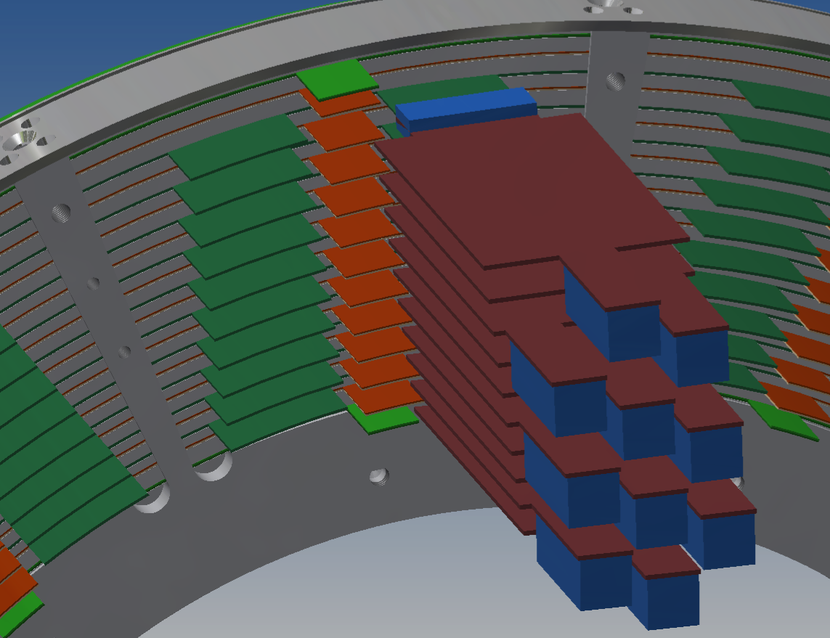
End-Plates
End Plates produced in house
Production precision: better than 50 um
Deformation under load: maximum of 130 +30 um
completed
Mounting procedure
Wires soldered to WirePCB
Placed in the EndPlates
Sequence of peek spacers and WirePCB

Slide 17
WirePCB
Review of all 35 different PCBs
  Increased electrical insulation (2.8 mm)
  Simplified connection to FE
Design completed
First bunch delivery on Friday Feb 06
  Guard03
  Cath10
  Anod09
  Cath09
Delivery completion in 2 bunches: begin of April and middle of June

Slide 18
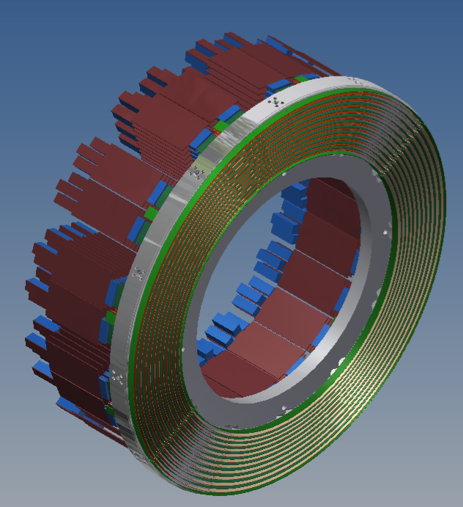
Spacers
End-Plate mechanical design completed
WirePCB spacers designed
Material peek already procured
Production method machined from 29 mm slab
Required precision a surface roughness achieved

Slide 19
Wire stringing
Rφ
θ
−
β
Winding the wire on a cylinder where WirePCB are properly placed permit correct spacing, stereo angle and correct length
Z
Wire wound and soldered on WirePCB at nominal length and stress on a rotating cylinder
Computer controlled rotation, wire translation and tension
Coupling with transport trays
α
Δb
Δp
ΔB

Slide 20
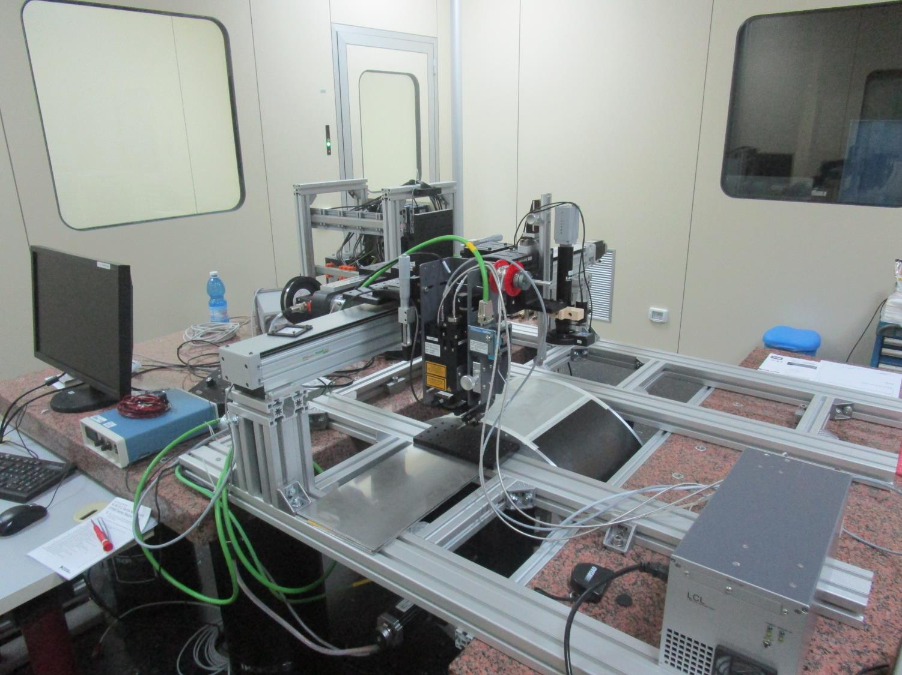
Wiring Machine
The template for the inner layer of the guard wires is ready for wiring.
Sensors and monitoring systems (torque, clutch, brake) were connected to the control system.
Control software development is in progress
Laser, Laser camera and pyrometer
Control system
Coil, clutch
Wiring digital camera
Last pulley
Cylinder
Main slide
Motor and Torque
Laser Controller

Slide 21
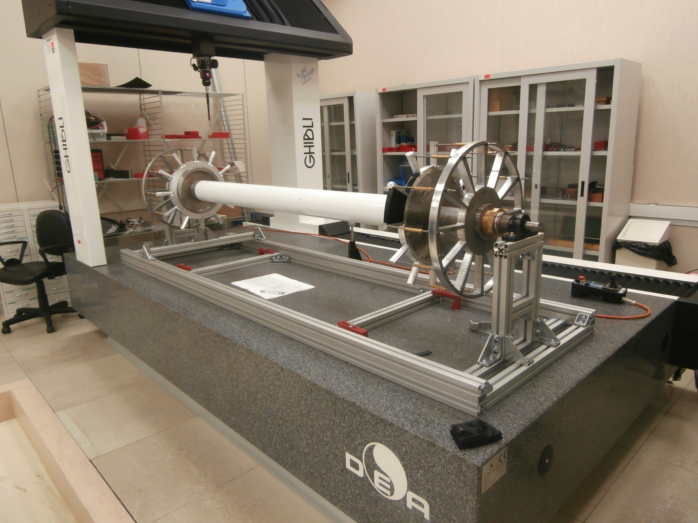
Assembly machine
Machine delivered
Acceptance measurements completed
Mounting completed
System test half of February
  Behaviour under simulating
  load of 350 + 20 Kg
Assembly sequence
Place layer of spacers
Reduce the endplate distance
Mount the wirePCB with wires
Place endplates at nominal distance
Check wire tension and make mechanical survey

Slide 22
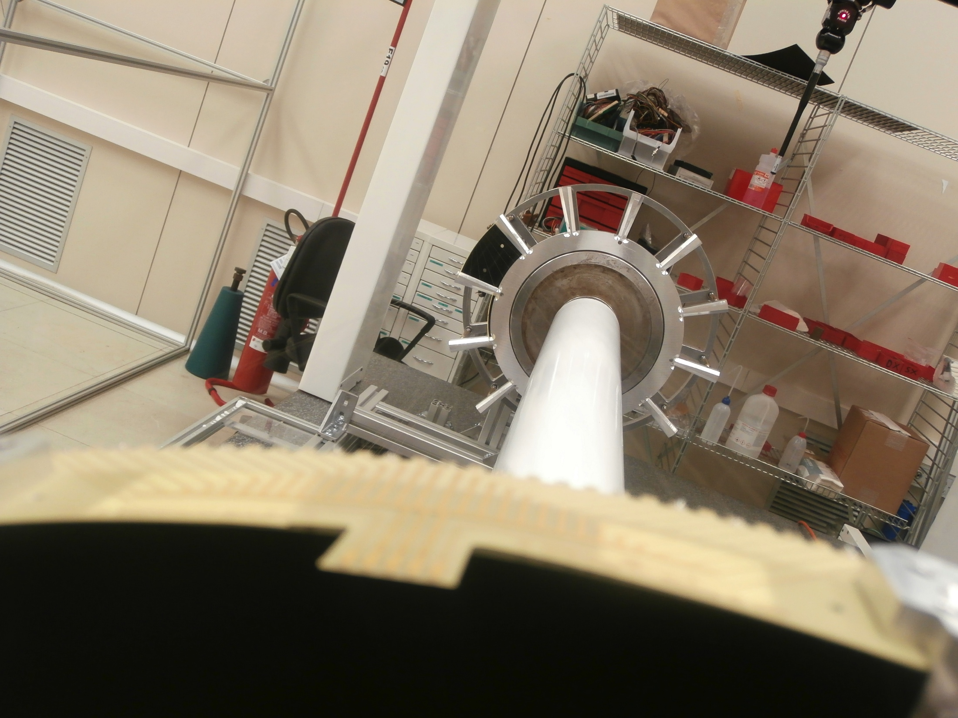
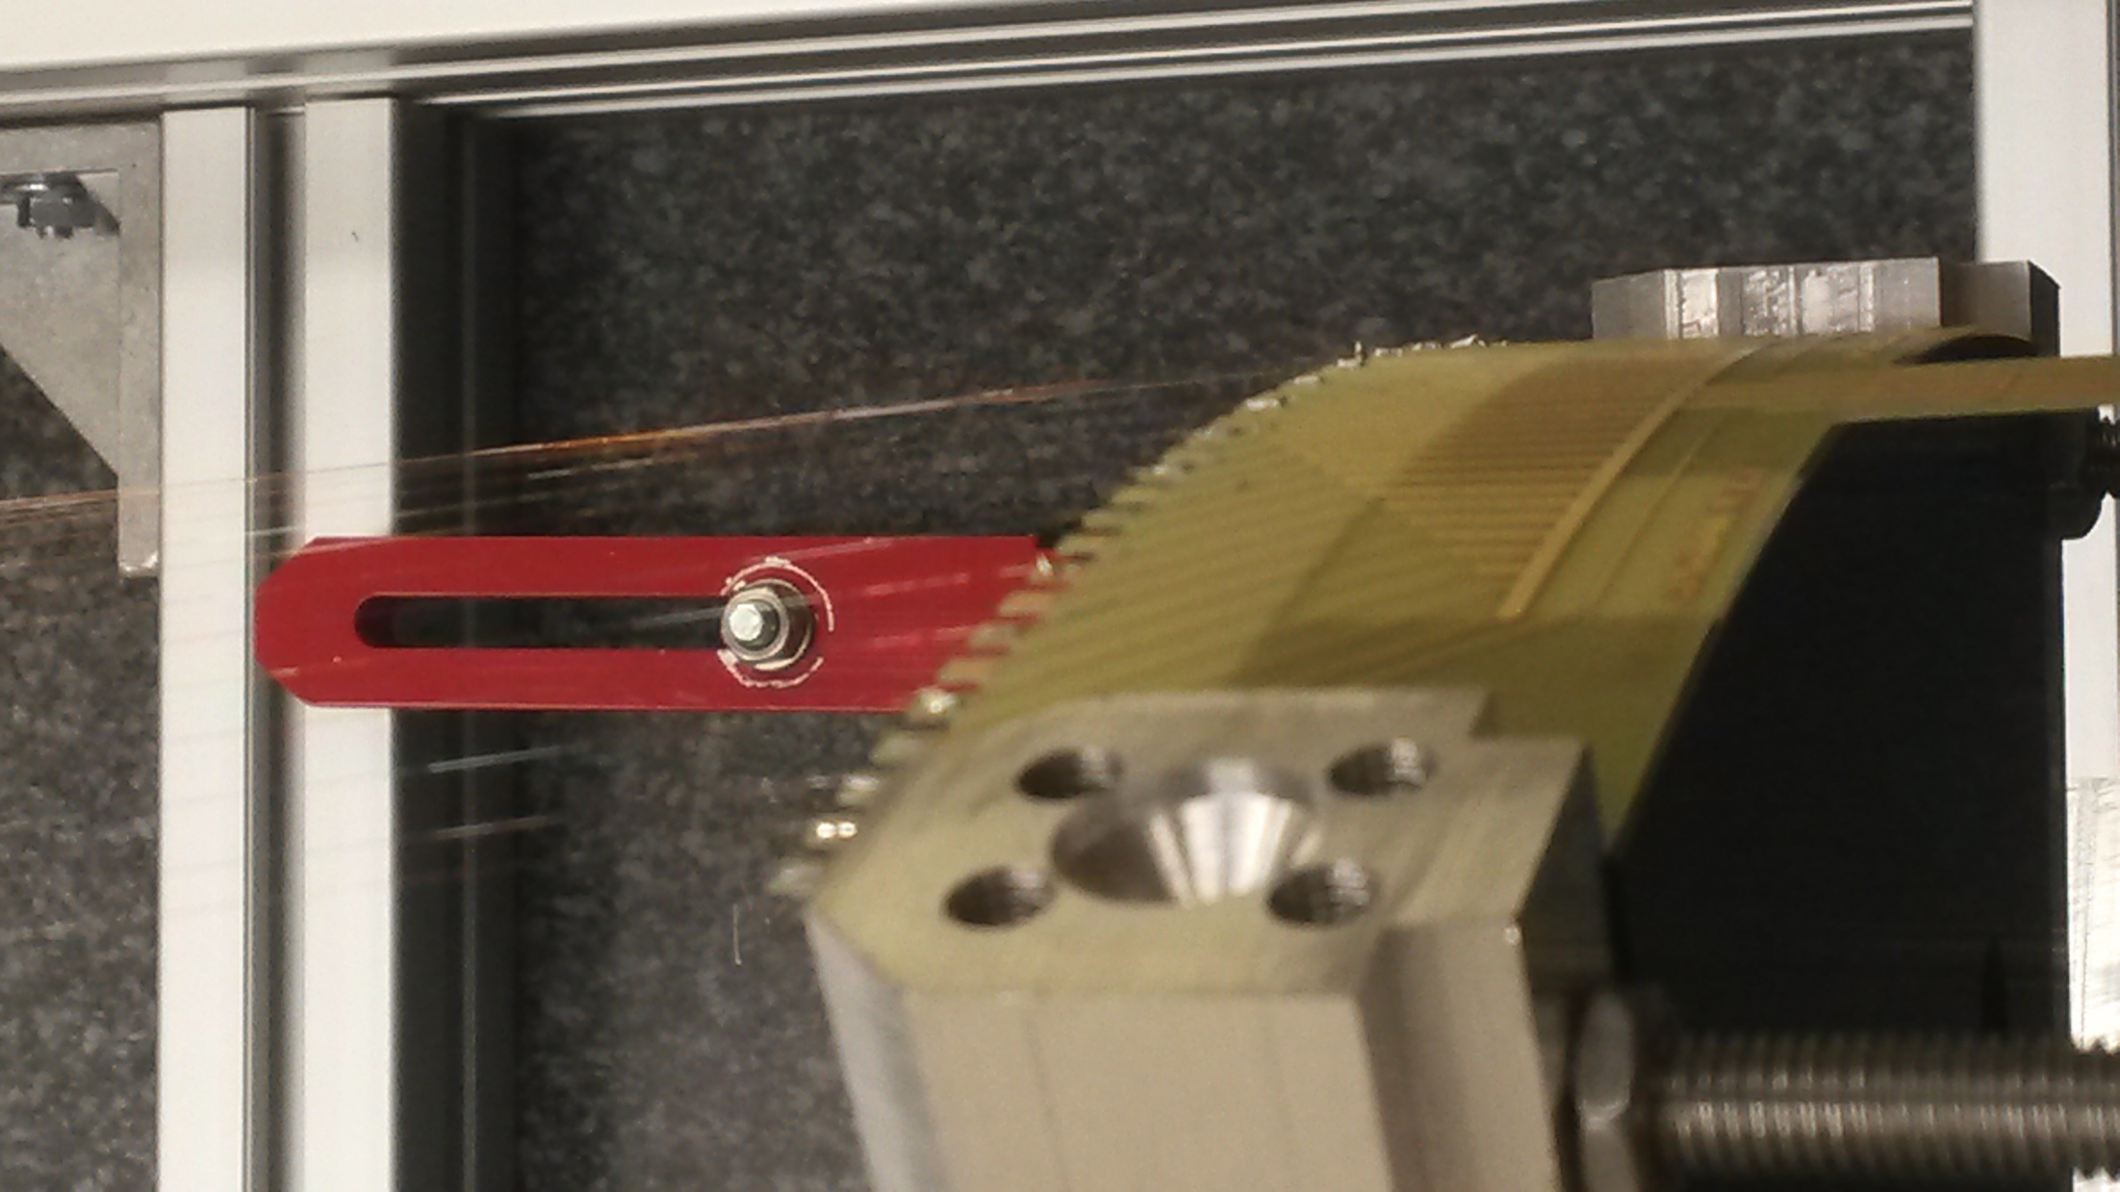
Assembly machine

Slide 23
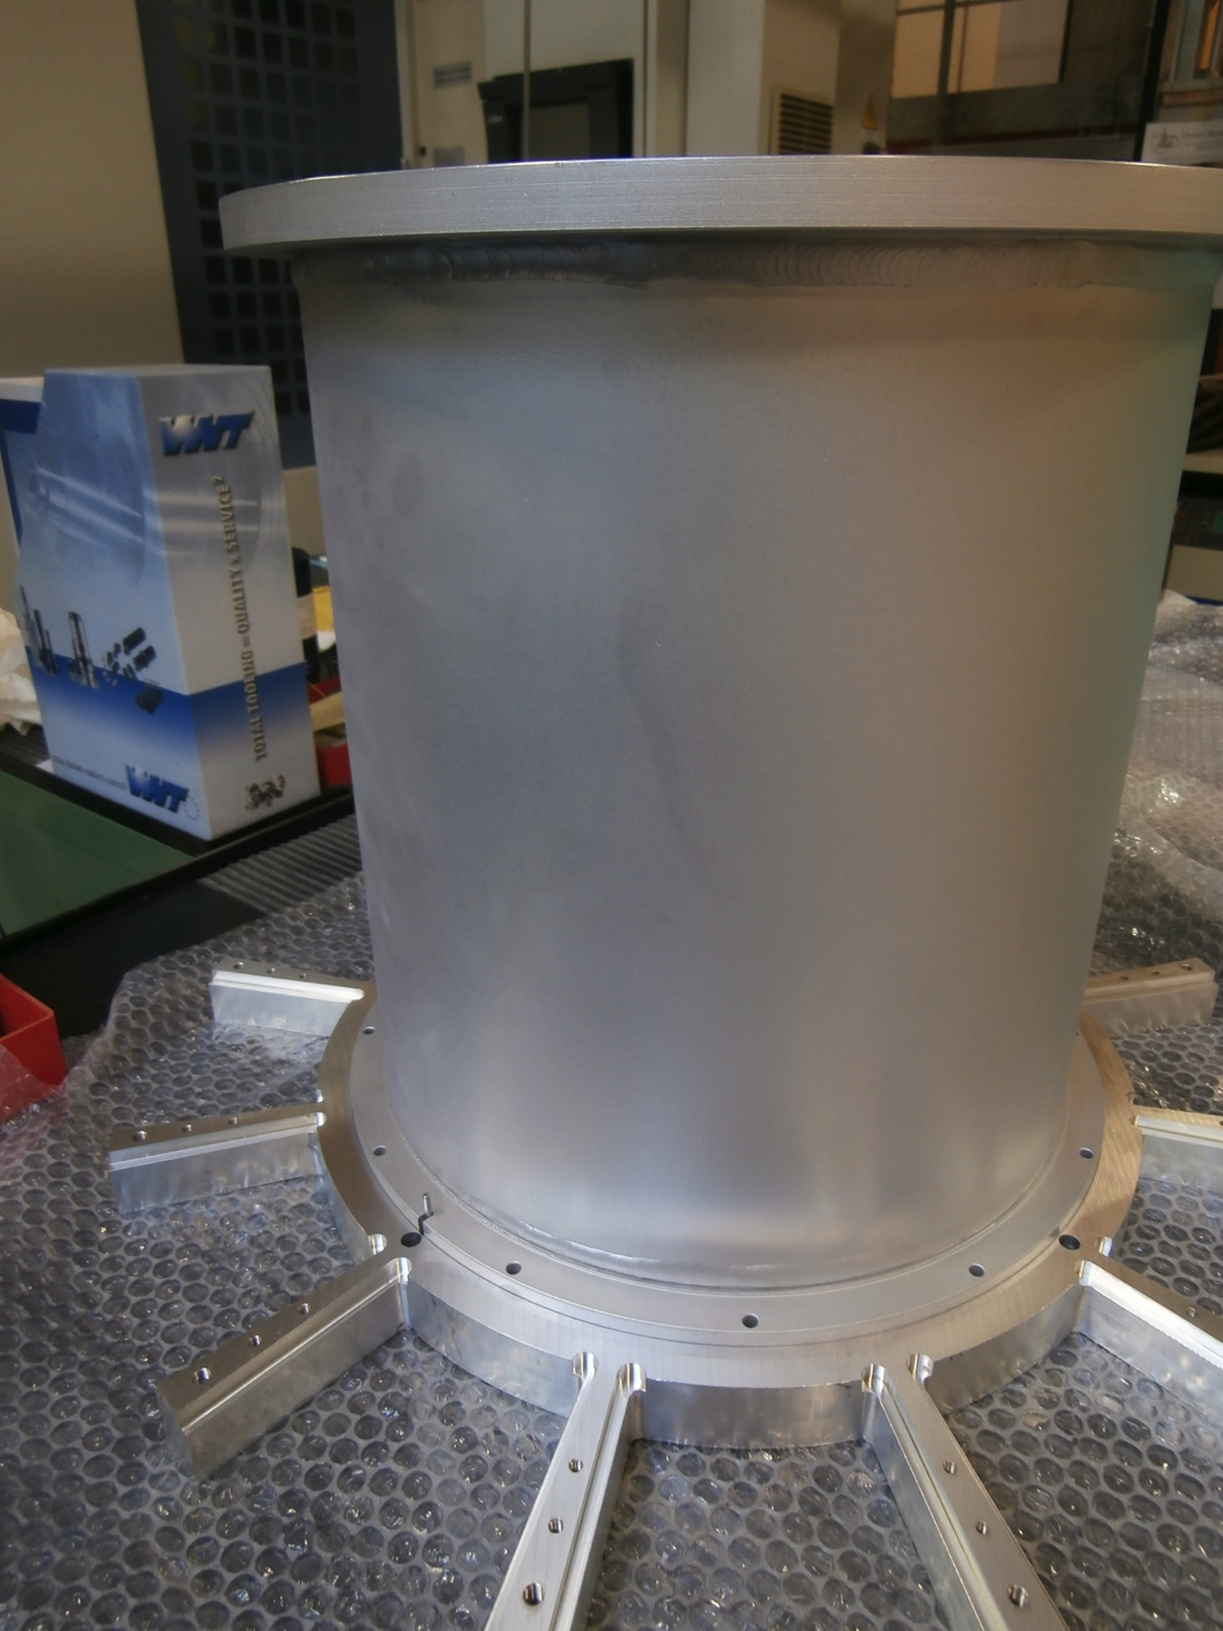
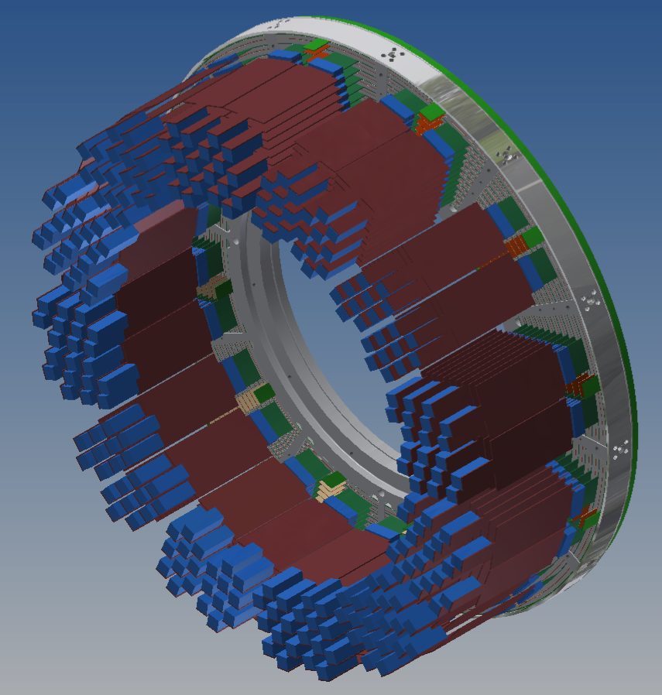
CDCH extensions
Provide coupling to BTS and target support
Hold the FE electronics
First set delivered
Fit with mock-up endplates
Final set production started

Slide 24
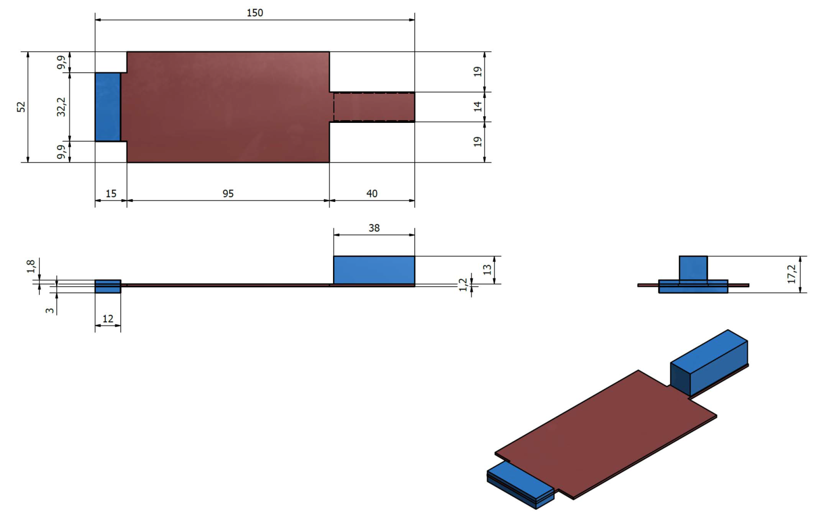
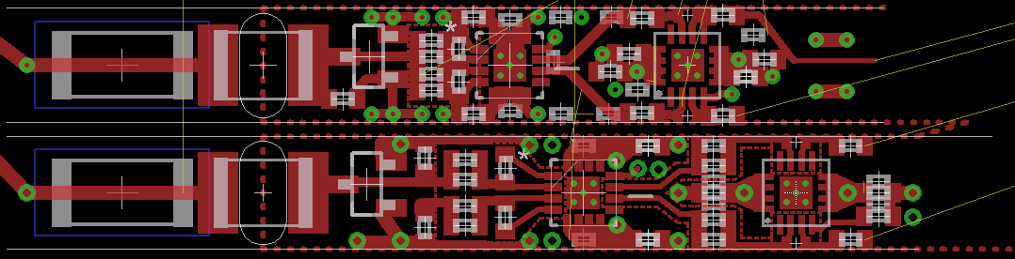
FE electronics
FE PCB dimensions are fixed
The single channel layout fits in a 5.2 mm x 30 mm rectangle
All components have been already ordered

Slide 25
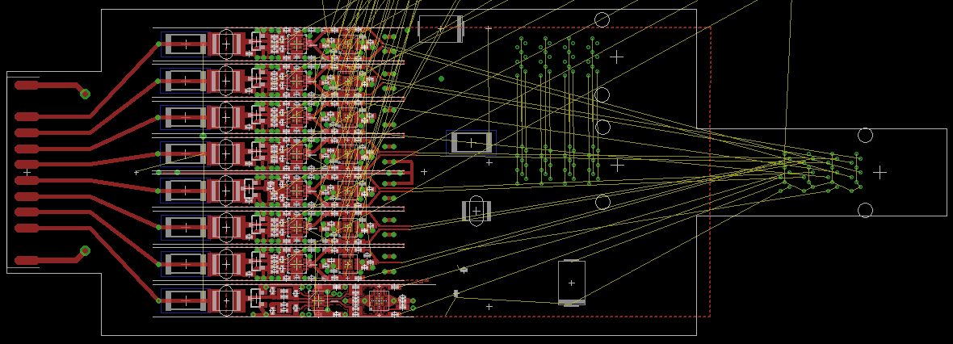
FE electronics
8 channels are accommodated in a single FE board
A cooling slit can be added
The electrical performances are preserved

Slide 26
Carbon fiber support
Designed and simulated
Currently in production
Delivery expected by April 2015

Slide 27
Auxiliary systems
HV system
  Upgrade of the present system
  High performance
  Delivered and tested
  Control software already developed
Wire tension measurement
  Use during chamber assembly
  Working prototype
  Final system in production
Gas system
  Requirements similar to the present system
  Better control of the gas quality
    O2
    H2O
    Hydrocarbones
  All parts already procured
  Assembly started
FE cooling system
  Total FE power 2x400 W
  Limited space available
  Cooling by mean of refrigerated water
  Chillers already delivered

Slide 28
Time plan
The entire production plan has been reviewed
This includes tasks
Laser soldering system setup
Tooling preparation
Wire winding
Wire PCB production
Spacers milling
Mechanical assembly
Chamber survey
Chamber full and extensive test
Shipping
resources
Italian working calendar
Technician manpower
Tooling machines
and some contingency
40 working days for spare part production

Slide 29
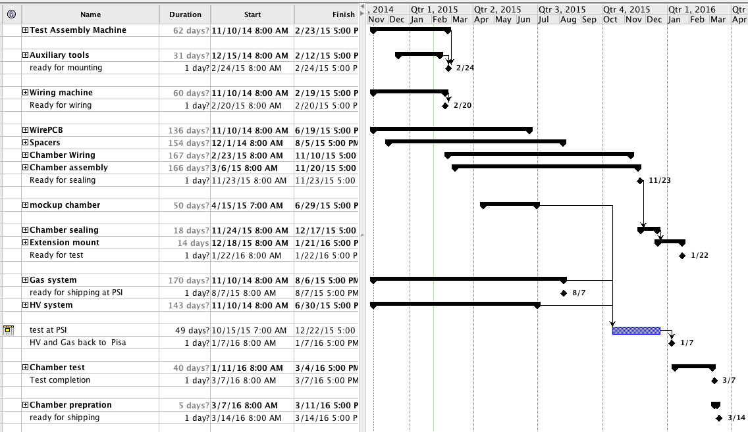
Gantt chart

Slide 30
Conclusions
The single-volume stereo drift chamber fulfils the MEG II requirements
MC simulation is based on solid prototypes results
All critical decisions have been taken
All parts are delivered or under production
The final assembly is expected to start before end of February
The chamber delivery at PSI is foreseen by March 2016
A working mock up chamber will be delivered at PSI by July 2015

Slide 31
Backup slides

Slide 32
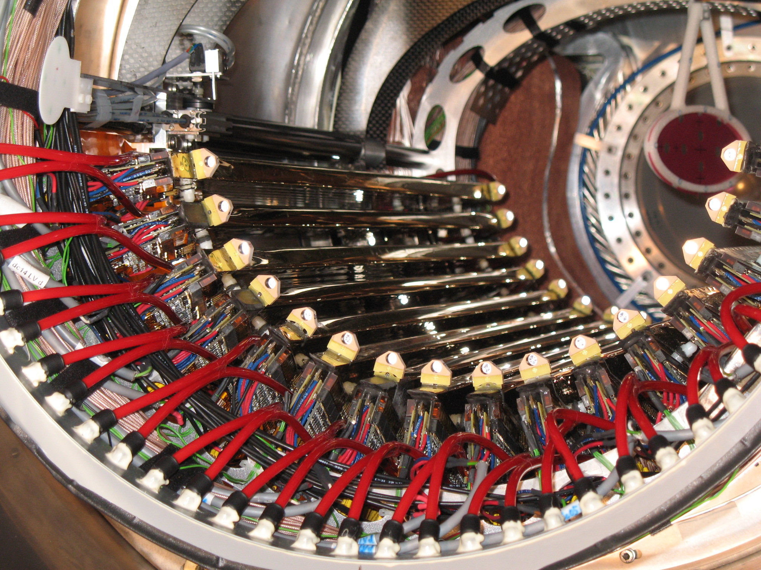
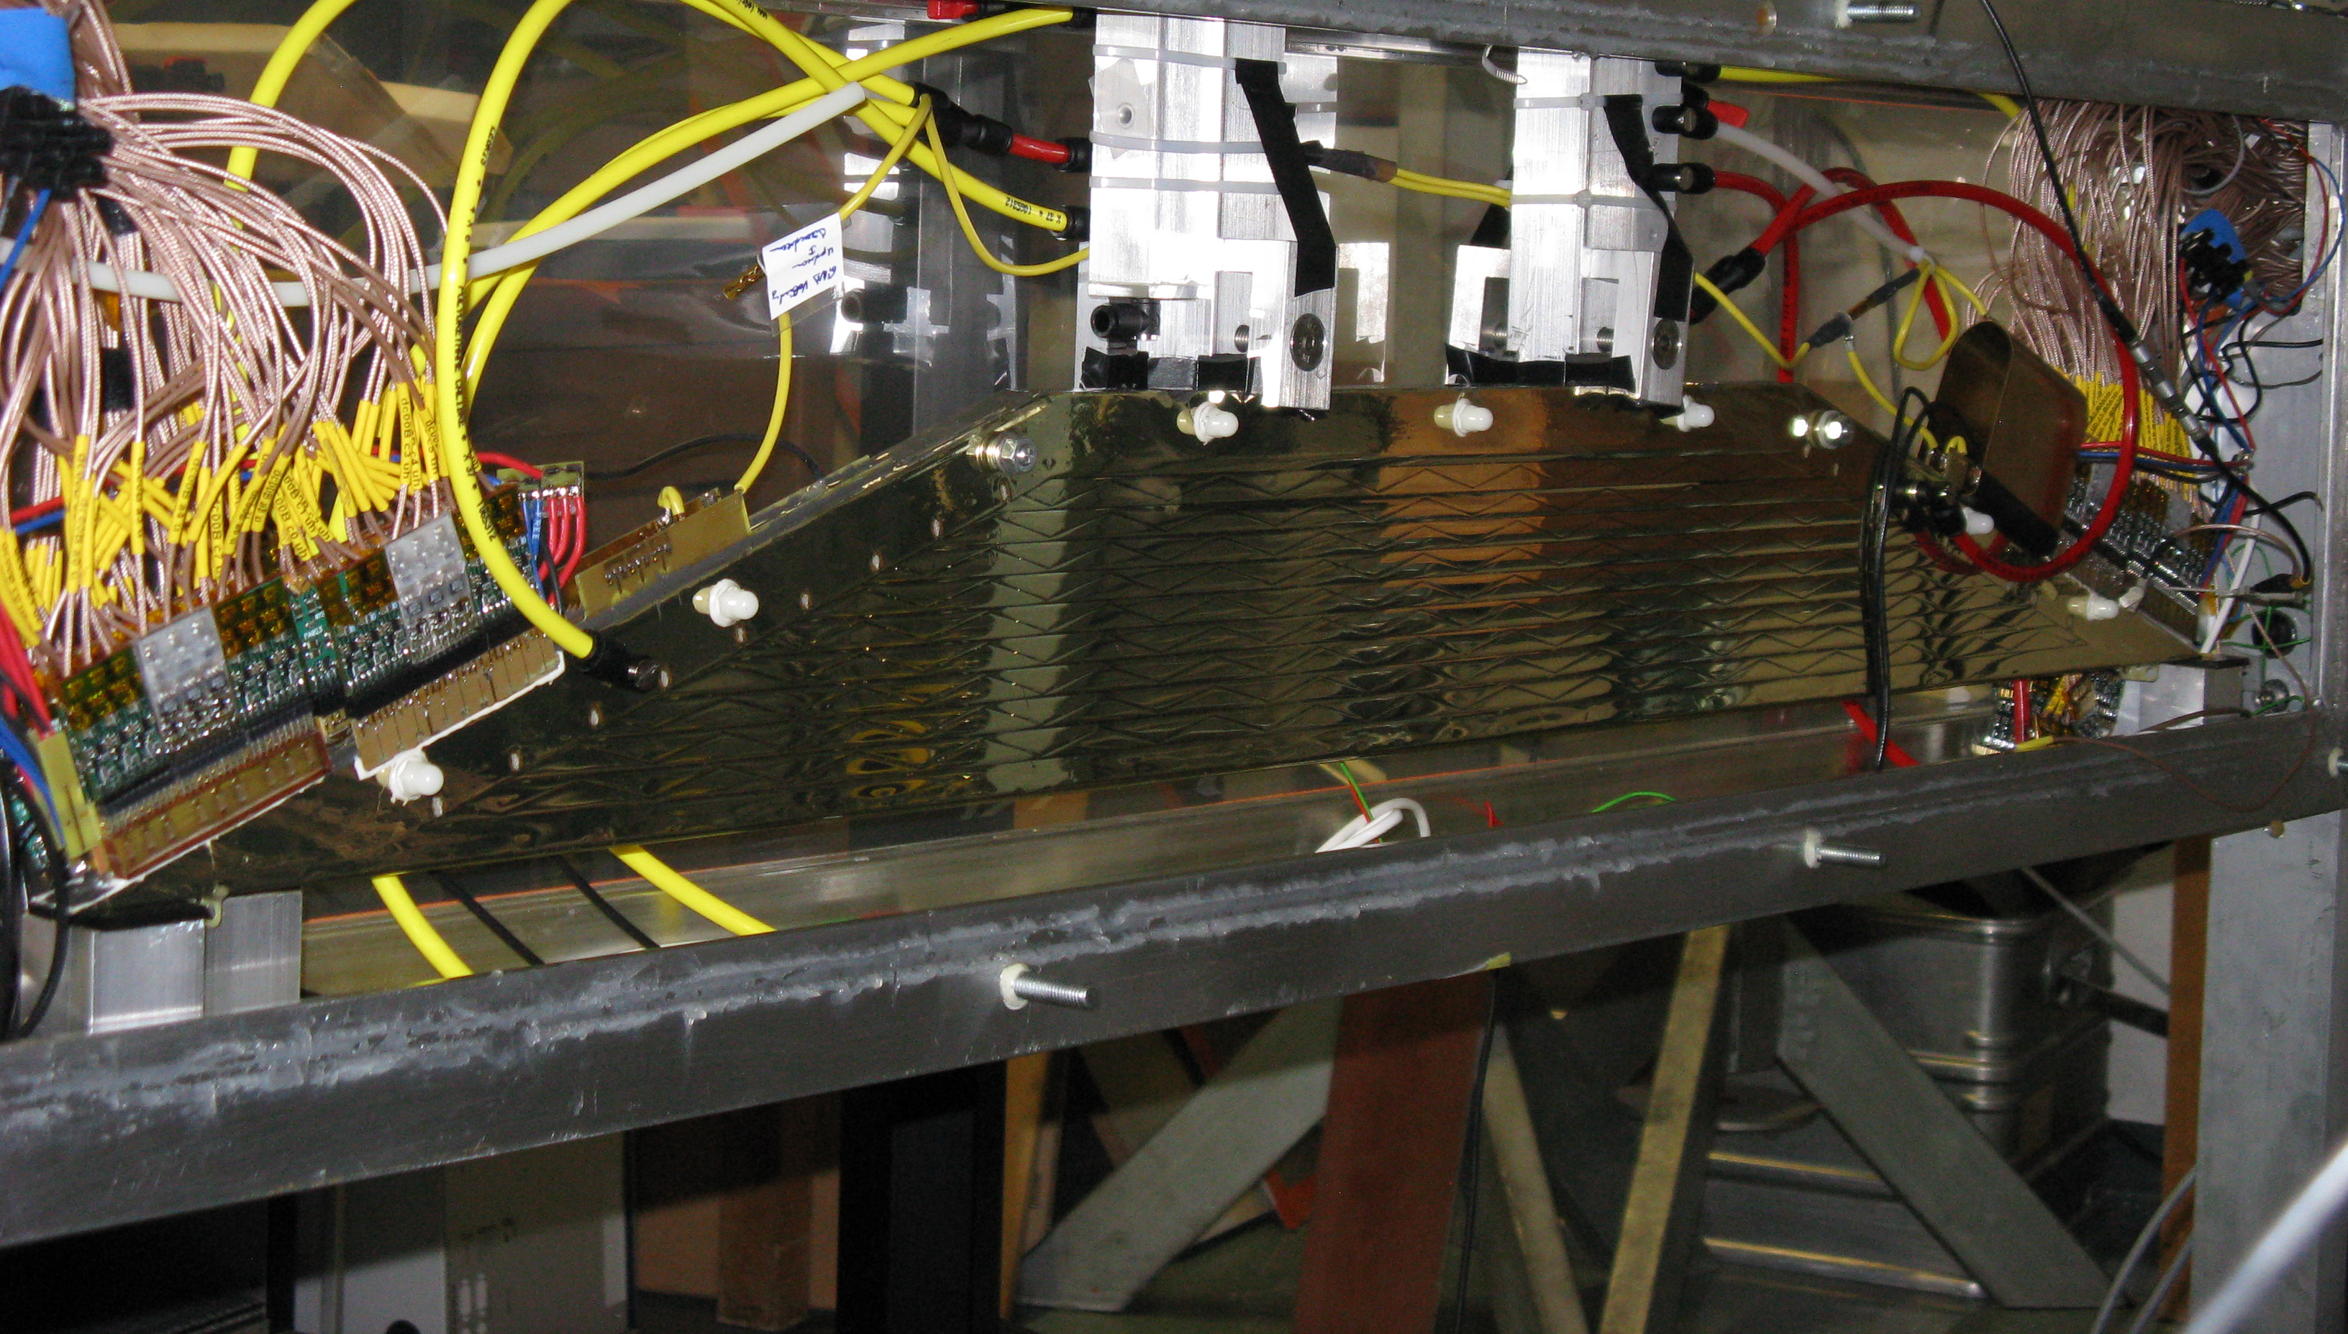
MEG tracker
16 chambers
Each chamber is composed of
  4 x12 μm of kapton (cathodes)
  50 μm BeCu cathode wires
  25 μm NiCr anode wires
  2 x 7 +3 mm He:C₂H₆ (50/50)
Single chamber x ~ 0.23 10⁻³ X₀
Full e+ turn : x ~ 1.7 10⁻³ X₀

Slide 33
Performance summary
Single hit resolution
σ_{R} (mm) 250 (core) 300 (RMS)
σ_{Z} (mm) 700 (core) 1000 (RMS)
Track resolution
σ (p) 310 KeV (core)
σ(φ) 7. mrad (at φ = 0, 10 mrad aver.)
σ(θ) 11. mrad
σ(Y) 1.3 mm
σ(Z) 3.0 mm
TC – DC reconstruction
DC-TC matching eff. 45 %

Slide 34
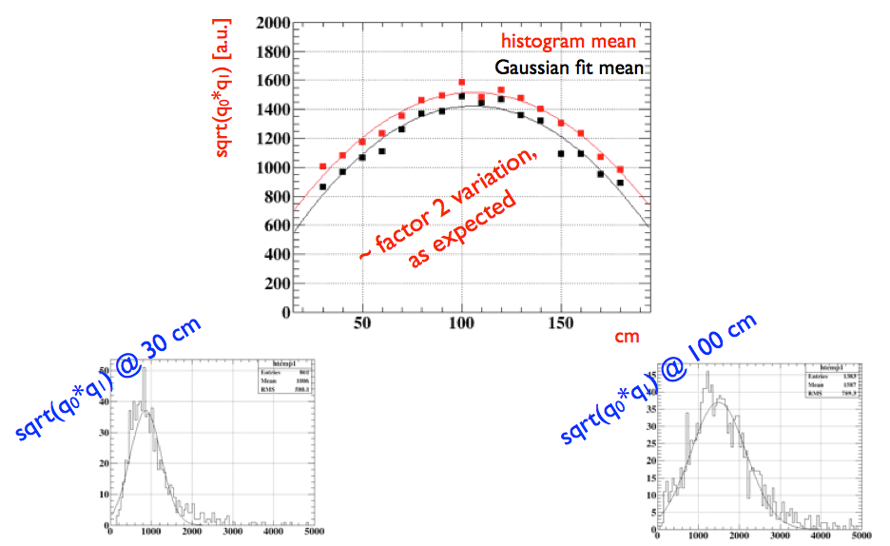
Gain vs Z
Expected gain variation with Z given the hyperbolic geometry

Slide 35

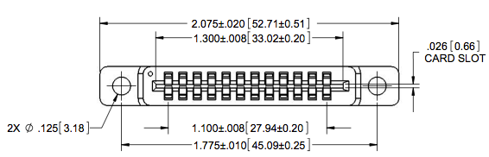
WirePCB: connections
Wire connection
Double pad stucture
Thin line for wire positioning check
Via hole for cathode wire on the second pad
FE connection
EdgeConnector: 12 contact at 2.54 mm
Limit FE wing length
Ensure FE –Wire PCBs alignment
Cope with limited space
Sullins connectors is the main option

Slide 36
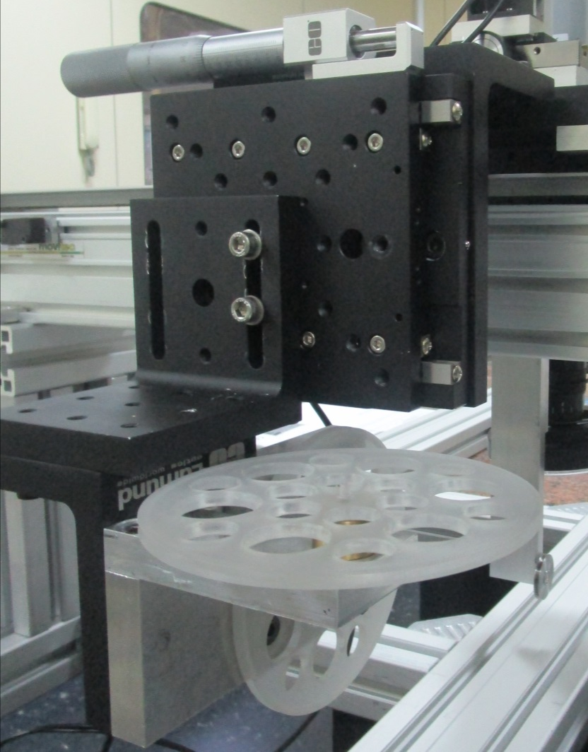
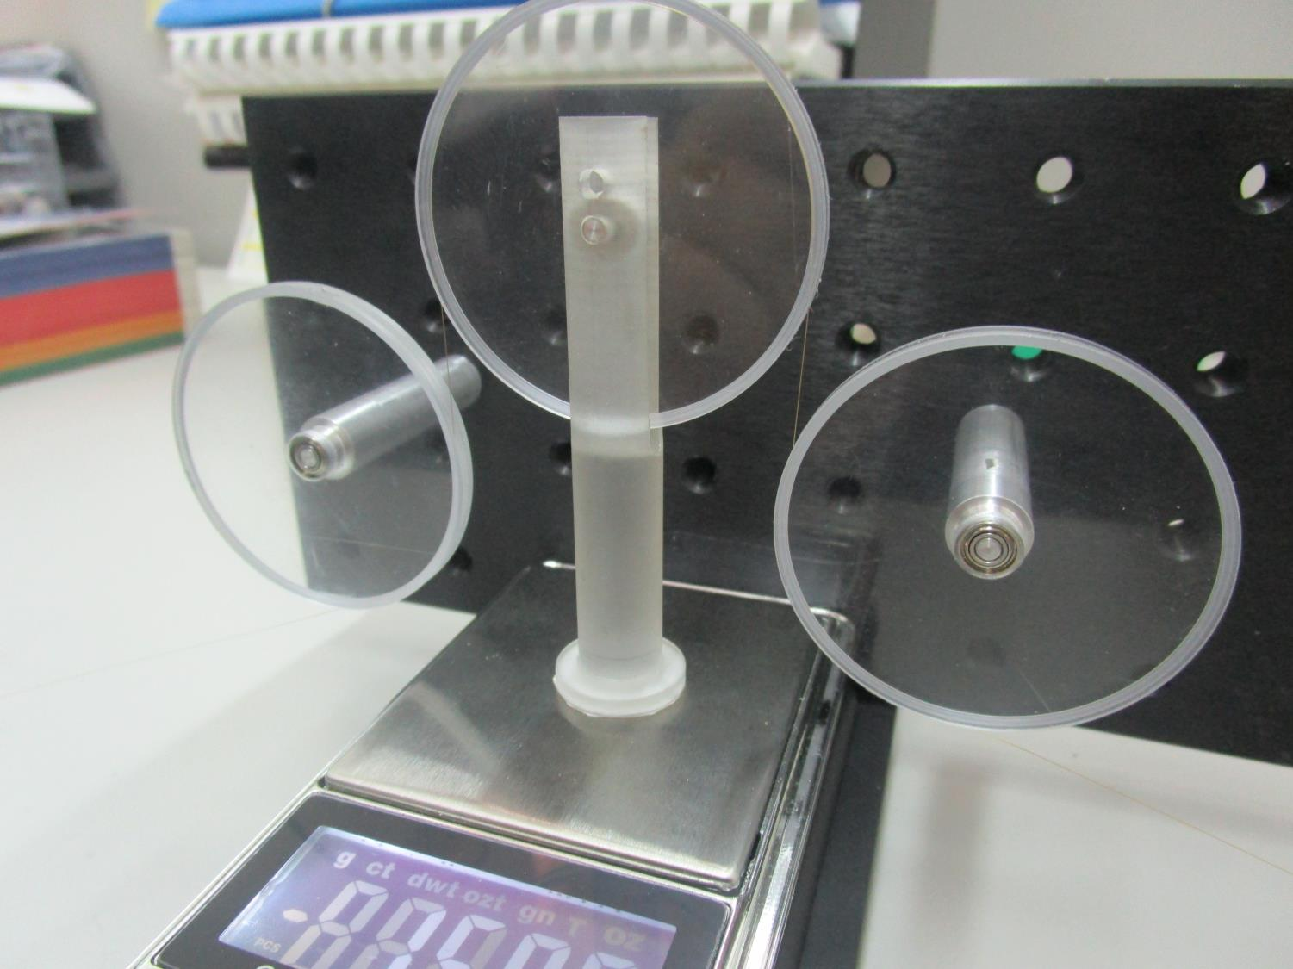
WINDING/SOLDERING SLIDE
The pulley system has been equipped with micrometric slides to allow the adjustments of the position for the different layers.
A real-time control for the wire tension during the process of winding is introduced.
SYSTEM PULLEYS
TENSION SENSOR

Slide 37
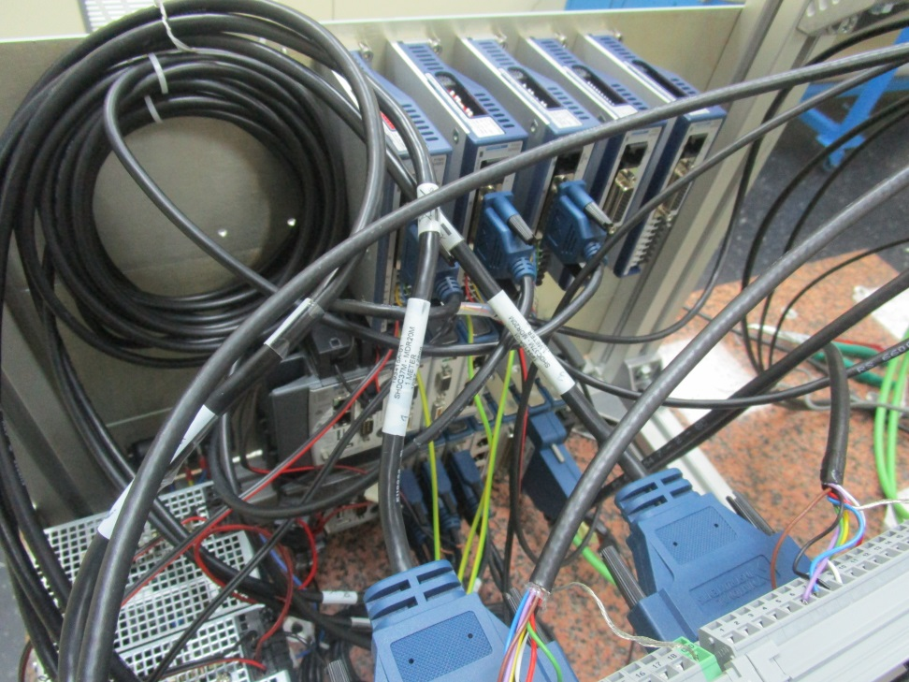
CONTROL SYSTEM
The control system of the cylinder and the slide was mounted and connected.
The control system for PCB wire extraction is on the way.
Different sensors and monitoring systems (torque, clutch, brake) was connected with the control system.
The control software development is in progress.

Slide 38
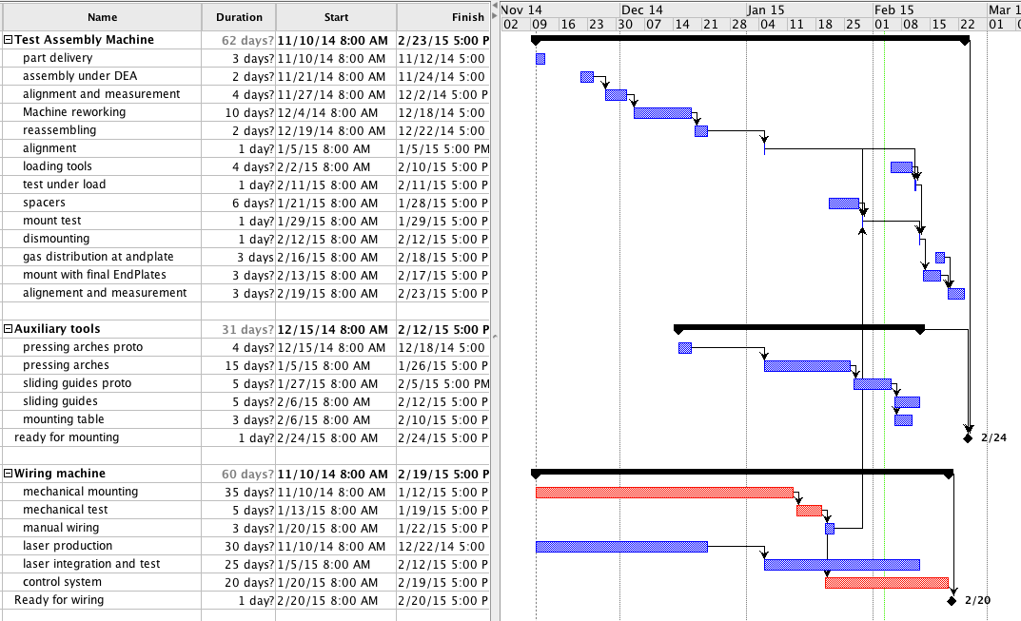
Details

Slide 39
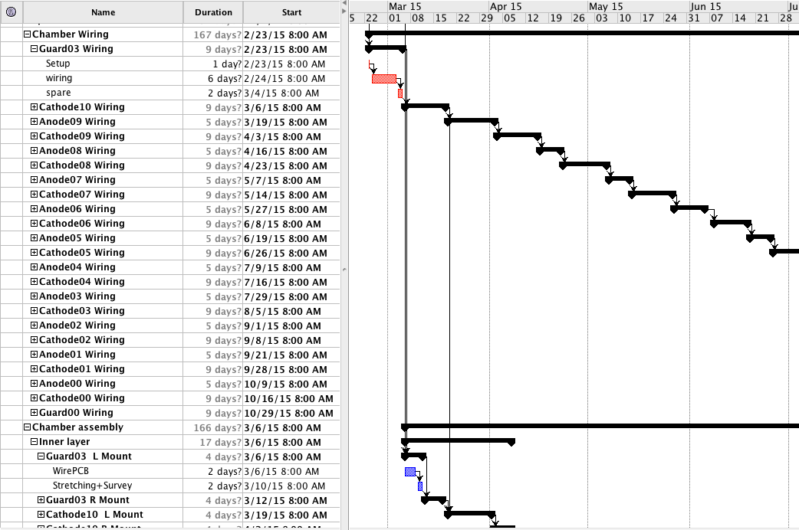
Details

Slide 40
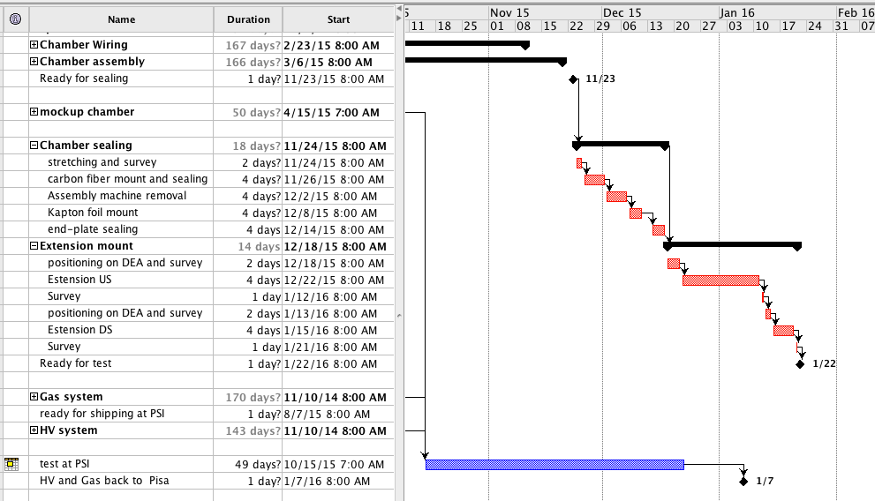
Details

Slide 41
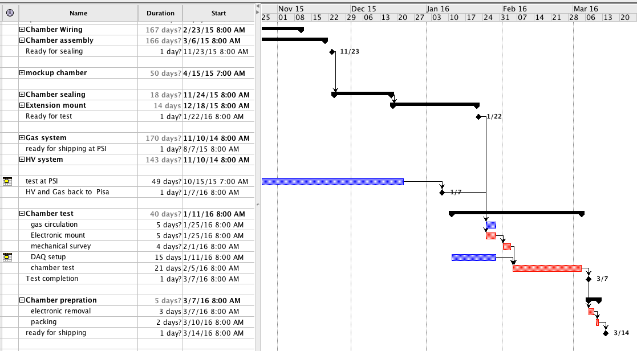
Details

