Slide 1
MEG II
Beam Line & Beam Start-up

Slide 2
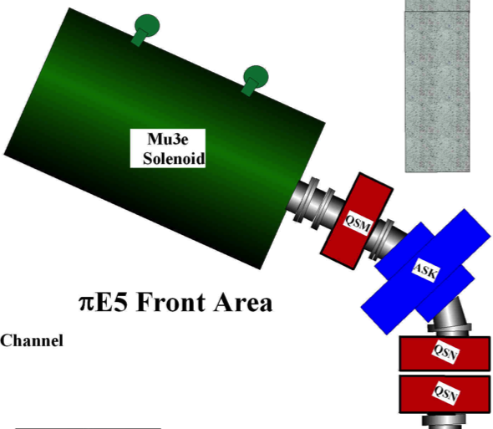
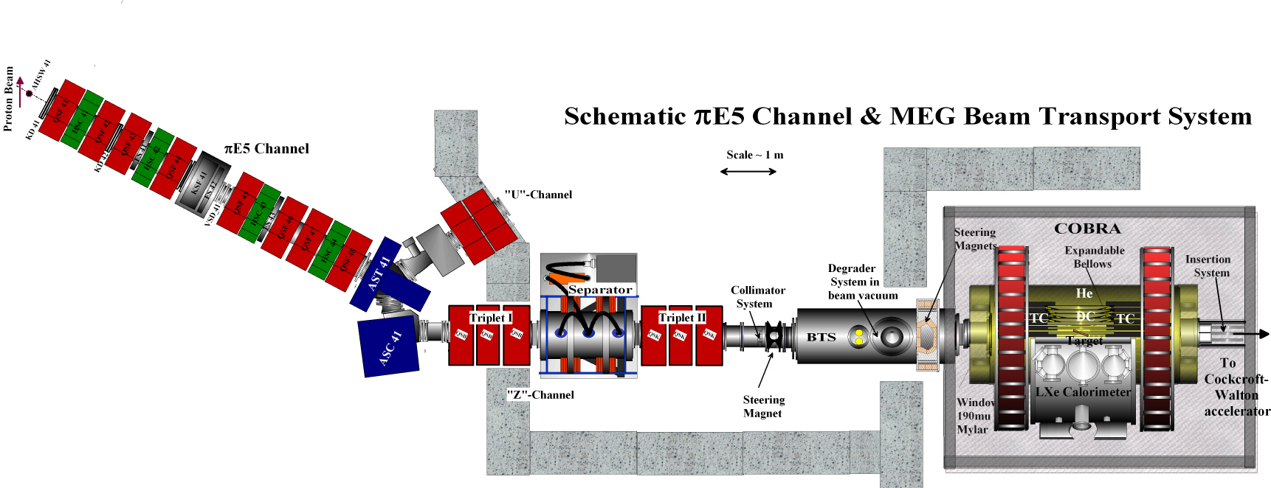
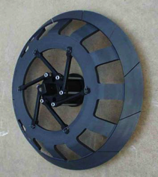
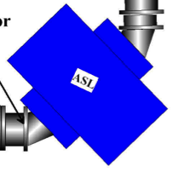

PiE5 Layout Scheme for MEG II & Mu3e
Both Experiments “MEG II” & “Mu3e Phase I” need to share PiE5
Mu3e has similar beam requirements to MEG II O(10⁸) μ⁺/s , 28 MeV/c - ONLY πE5 possible!!!
Solution ➔ Mu3e “Compact Muon Beam Line” Ultra-compact beam line - Allowing both
experiments to CO-EXIST with minimal switch-over & without compromising the physics goals
Keep this part also
for Mu3e
Important for good
beam-correlated
background suppression
For both experiments

Slide 3
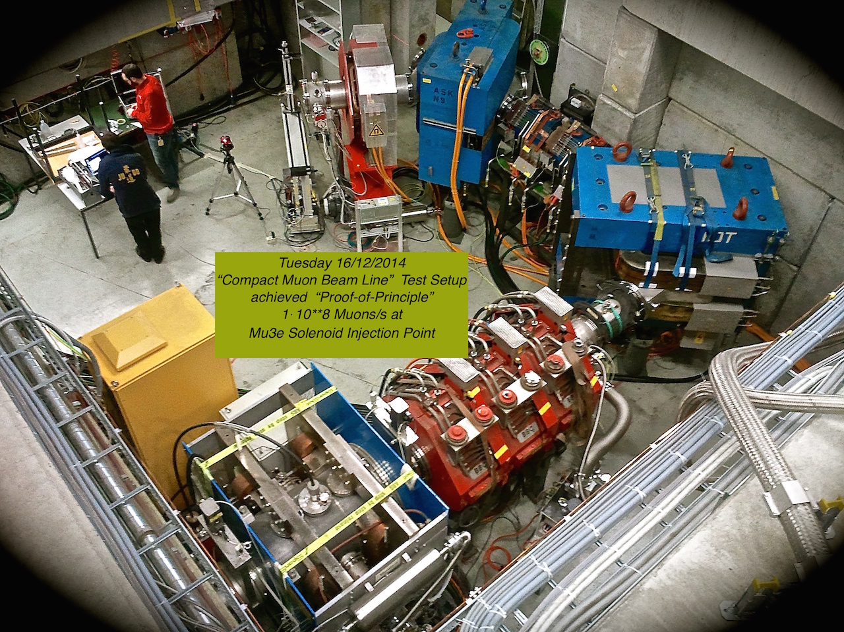
Mu3e CMBL Proof-of-Principle Achieved
!!! GOOD NEWS !!!
End of 2014
Mu3e Proves BOTH Experiments
can Co-exist in PiE5

Slide 4
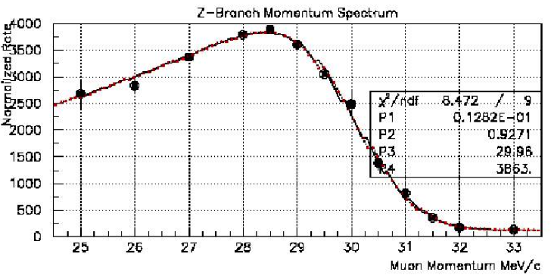
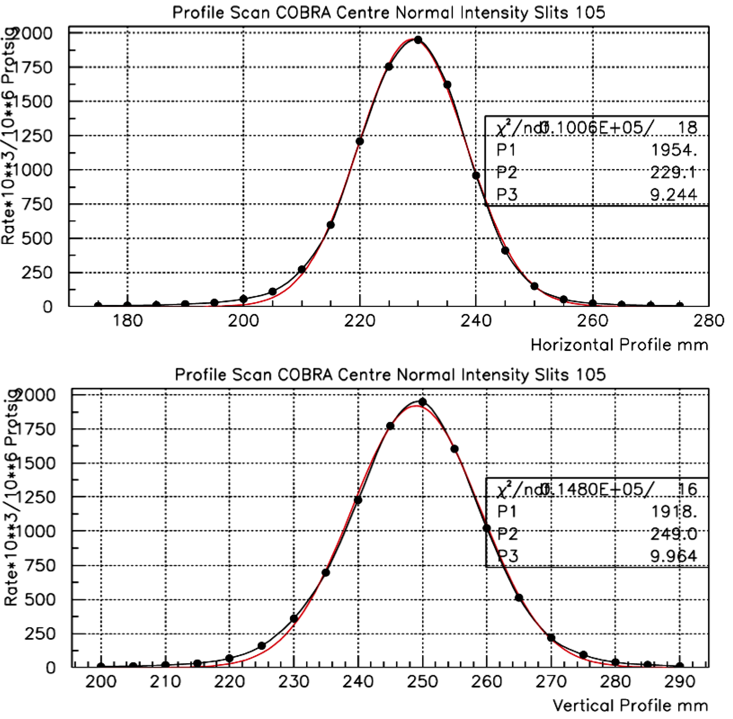
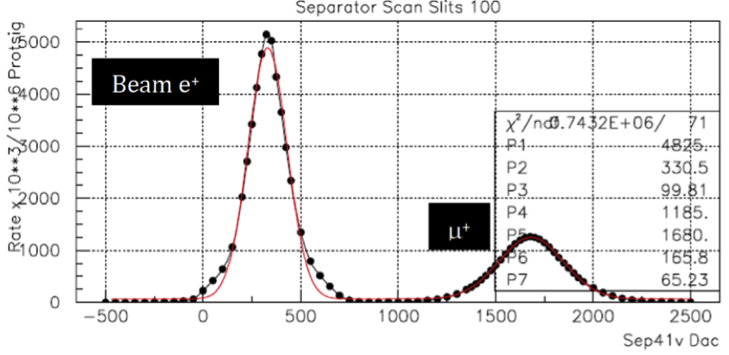
Current Beam Line Performance
2-D Beam-spot
μ⁺ Momentum Spectrum
(R_{μ} )_{MAX} > 1⋅10⁸ μ⁺s⁻¹ at 2mA
COBRA Centre (no Degrader)
(Δp/p)_{MAX} ~7% FWHM (High Intensity)
Horizontal Profile
Separtor Scan
Vertical Profile
σ_{X,Y} ~ 9-10 mm
8.1σ_{μ} Separation ≈ 12 cm physical separation
at collimator

Slide 5
MEG Beam & Target Upgrade Strategy
Currently MEG runs at :
~ 3⋅10⁷ μ⁺-stops/s on a 205μm thick target placed at 20º to incoming beam with
a 300μm thick Mylar degrader - selected for optimal sensitivity with current detector capabilities
MEG Upgrade Sensitivity Reach: aims at approximately an order-of-magnitude improvement.
In order to achieve this with improved detector capabilities and within a reasonable running time
of 3 years - this requires a baseline detector rate capability of about 7·10⁷µ⁺-stops/s
Q: What beam possibilities exist to fully exploit the upgraded detector
intensity reach & try to increase the muon stopping density?

Slide 6
Constraints & Coinsiderations
Increase intensity: - simply open slits since we have spare intensity ☺
⇒ increases Δp ☹
⇒ increases range-straggling ☹
⇒ need thicker target to stop all muons ☹
⇒ increases multiple scattering & radiative background ☹
t = target thickness
t₉₀ = measure of e⁺ Multi. Scatt.
<R> = mean range of µ⁺
β = target angle to axis
α = angle between axis & radius r which
meets DS target face
r = <R> “umbral” region 50% stops contour
r = (<R>+ 3σ_{R}) “penumbral”
region 100% stops contour
Target angle Considerations (β & α)
if 3•(σ_{rms})_{MS} > β “Leakage”
on US face
β
r =<R>
μ⁺
α
if 3•(σ_{rms})_{MS} > α “Leakage”
on DS face
r =<R>
t
t₉₀
Tg Inclination ≈ US-loss, Tg t ≈ DS-loss
Target thickness & inclination angle
are the keys
Q: So can one increase the intensity & reduce the Range Straggling?

Slide 7
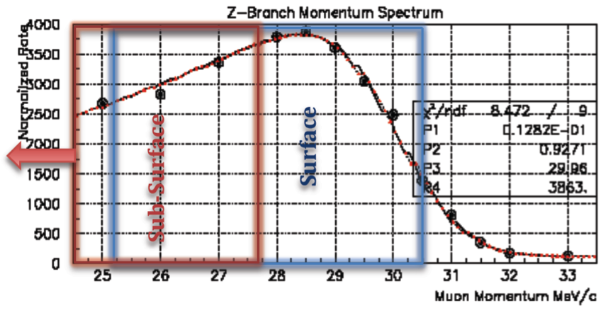

Beam Strategies – a Quick Guide
Muon momentum Spectrum
measured PiE5
Surface or Sub-surface Muons?
Basis – muon momentum spectrum stopped
π-decay below kinematic edge 29.79 MeV/c
“Surface” muons come from a layer few hundred microns below
surface range approx. 120 mg/cm²
“Sub-surface” muons from layer shifted further into the surface
Why are Sub-surface muons interesting? ➔ Muon Range & Range straggling
Muon Range Straggling in our 30 MeV/c region– 2 components
(i) Dependent on energy-loss straggling = constant ≈ 9% of the range
(ii) Dependent on momentum-byte of channel
dn/dp ∝ P ^{3.5}
R = a⋅P ^{3.5}
To reduce Range-straggling more efficient to Reduce P than Reduce ΔP/P ➪ Sub-surface Beam
Also expect µ-e separation from Wien-filter to be improved by about 25% ➪ greater velocity difference
BUT!!! Remember Rate reduces as P^{3.5} towards lower momenta ⇒ Compromise

Slide 8
Strategies Studied
Simplest Baseline Configurations Studied:
Surface muon beam “High Intensity” MEG Target
“Sub-surface” Muon Beam “High Intensity” MEG Target
Different slant-angle & target thickness configurations
Upgrade possibilities Studied:
“SURFACE” Muon Beam 27.9 MeV/c
“SUB-SURFACE” Muon Beam 25 MeV/c
ACTIVE Target 250μm
Passive Thin Target 100-205 μm
Extra vertex pt.
More material e⁺ & γ
Min. material e⁺ & γ
Smaller slant angle
Longer Tg.

Slide 9
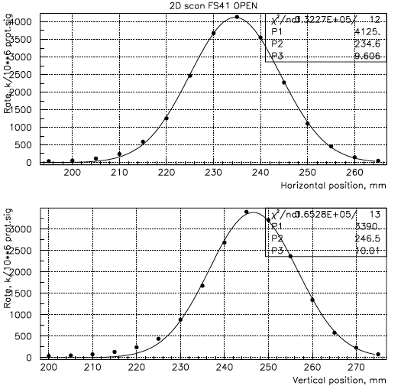
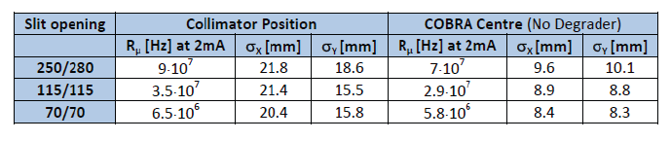
25 MeV/c MEG Sub-surface Beam Studied
Horizontal Profile
Measurements made at:
Collimator System
COBRA Centre
High-intensity (slits “Open”)
No Degrader
Vertical Profile
Only “High-intensity” Possible if one wants the RATE for MEG II

Slide 10
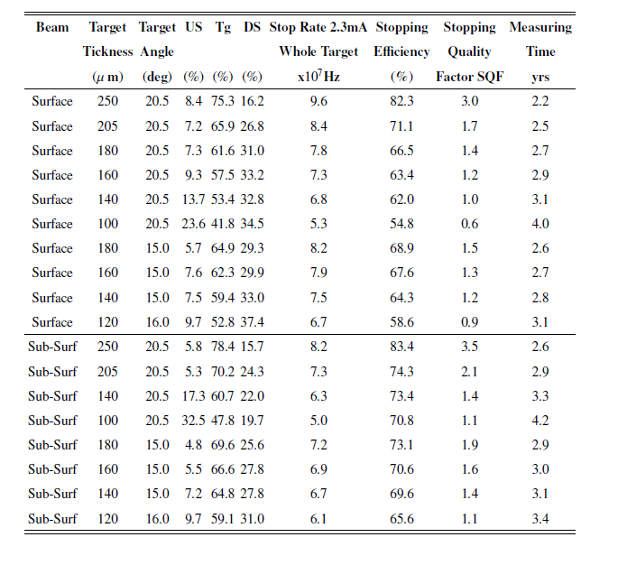


MC Study of Various Beam-Target Scenarios
MC-study of «Surface» & «Sub-surface» beams with target thicknesses
Ranging from 250µm «Active Target» to 100µm «Passive Target»
Stop Rates based on MEG-measurements
Running Time normalized to Baseline
MEG sol^{n}.
Stopping Quality Factor (SQF) –
measure of the ratio of Target-stops
to Stops elsewhere
Basic Solutions:
Min. Thickness Target for
3 yrs. Running Time
at ~ ≤ 70 MHz µ⁺-stops

Slide 11
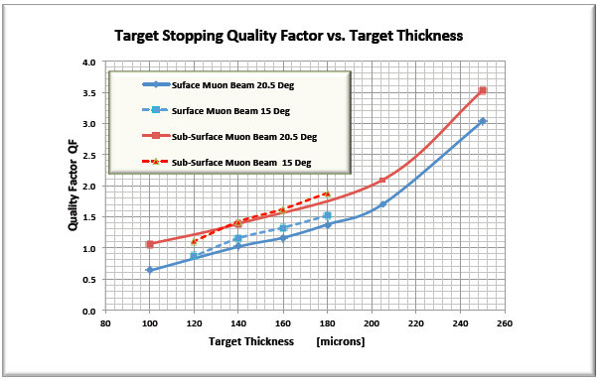
Conclusions
20°
From extensive MC-study 2 solutions with
minimal target thickness meet the baseline
detector sensitivity/rate goal:
Surface beam, 140 µm Target at 15°
Sub-surface beam 160 µm Target at 15°
15°
20°
15°
“Sub-Surface”
“Surface”
Shows Sub-surface
Looks Preferential
But!
Stopping quality better in the case of Sub-surface beam
Separation quality 25% better at Wien-Filter for Sub-surface beam due to larger velocity difference
More gain going to smaller angles in Surface-case since Sub-surface already more optimal
However
For optimal Sensitivity many factors must be taken into account: stopping-density/target thickness, statistics,
multiple scattering, radiative background production, resolutions ➔ Points to Thinner Target solution
Baseline MEG Solution with the Thinner Target chosen: Surface beam, 140 µm Target at 15°
Target material & degrader combintion currently under study G4BL

Slide 12
MEG II 2015/2016
Start-up
Strategy

Slide 13
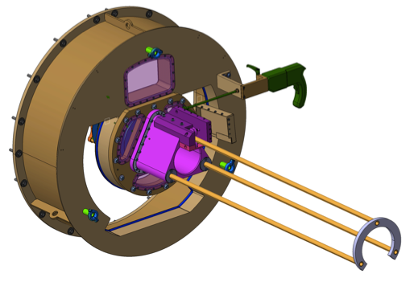
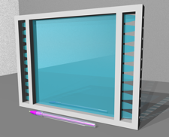
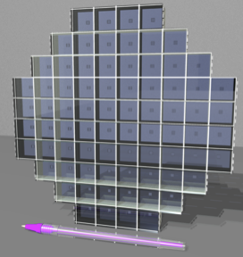
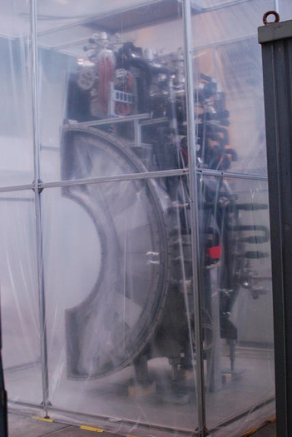
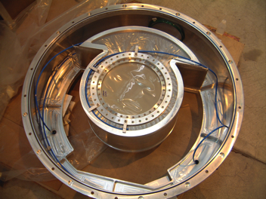
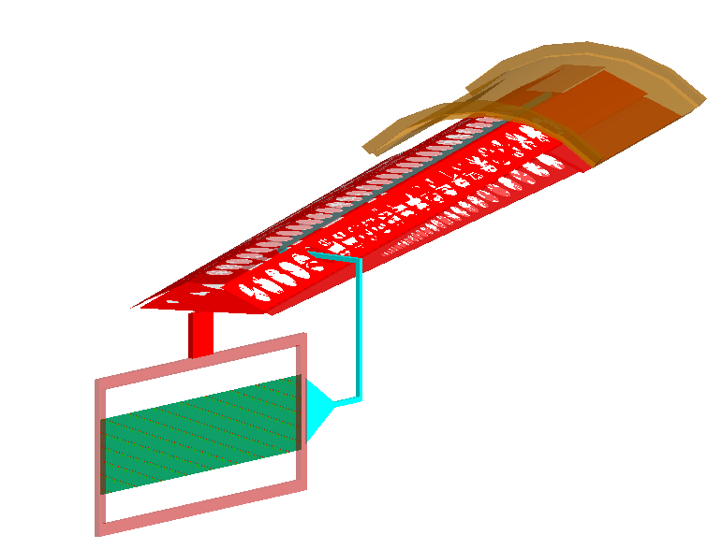
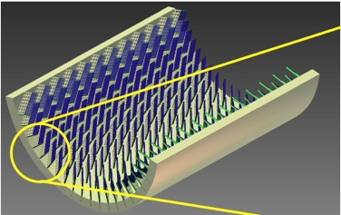
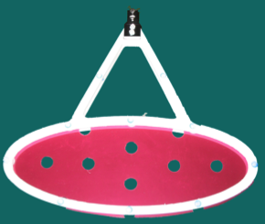
MEG II Beam Start-up Scenario 2015/16
Major Changes to MEG Detectors & Equipment
New DC system
New Target system Passive/ATAR
RDC background suppression system
New pix-TC system
Modified LXe Detector
End-cap Modifications
New Front-end Electronics Digitization
New Trigger System
Modified DAQ
Due to availability of Front-end electronics
Foresee – Staged Start-up
2015 – “Pre-engineering Run” – Priorities:
1. Mechanical integrity & functionality of
MEG II upgrade design
2. Allow design corrections/modification well
before 2016 Engineering Run
3. Allow meaningful detector/Equip. test
2016 – Full “Engineering Run”
Full functionality test with Calibrations
& Test Data

Slide 14
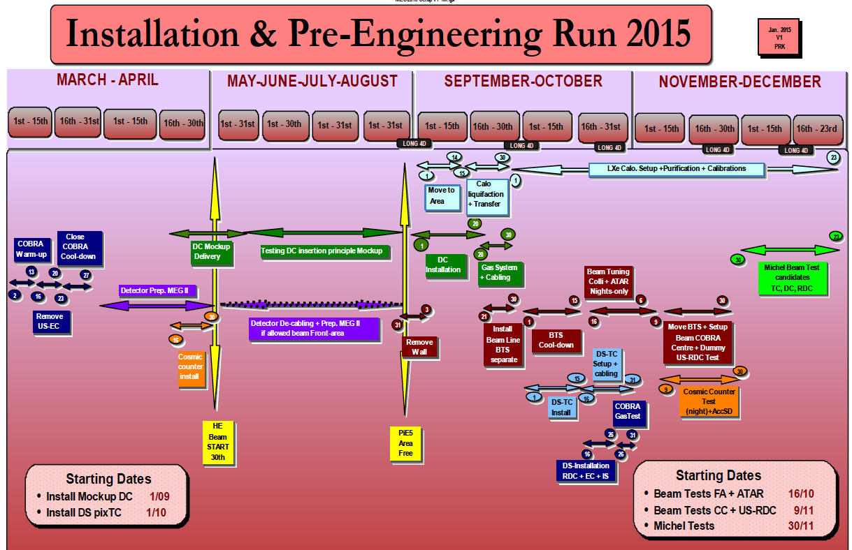
Allows the Mechanical Integrity of the MEG II design
to be tested
Allows full Beam Optimization with New Target
+ Degrader System
Allows Michel Beam Test of PixTC Detector IMPORTANT
HE
Starts
6th MAY

Slide 15
2016 Setup, Engineering & Data-Taking Run
2016 Shutdown Not Fixed Yet – though likely to be 6 months
MEG Engineering & Data Run Scenario fits well to this allows possible
29D Michel Trigger/DAQ debugging setup + 120D Muon data-taking Run

Slide 16
Conclusions Beamtime 2015/2016
2015: “Pre-engineering Run” Possible
Scheduling determined by usage of 600 kV spin rotator
Would mean 2015 for MEG II confirmation of design integrity + beam optimization
+ PixTC beam test
This also seamlessly matches our 2016 setup & Engineering Run scenario
2016: Full Engineering Run Possible
Accelerator shutdown NOT currently known
Likely to be 6 Months
MEG II cannot be ready BEFORE end-of-June 2016 ANYWAY – Matches delayed shutdown
Can achieve a 29D Michel Debugging run + 120D Muon debugging/calibration Run
irrespective 0f 2015 beam

Slide 17
BACKUP

Slide 18
Possibly most likely Scenario
Detector Setup + testing
+ Beam Setup
NO Michel Testing Possible!!!
HE
Starts
6th MAY
3 Months Version
Continues with 2016 Setup & Engineering Run

