Slide 1

Status of physics analysis
Fabrizio Cei
On Behalf of the Physics Analysis Group
PSI BVR presentation, February 9, 2015

Slide 2
Outline
Where we stand
New measurement of magnetic field
Target alignment
AIF analysis
Status of 2012-2013 analysis
Perspectives and conclusions

Slide 3
Where we stand
Published limit
B(μ → eγ) < 5.7 x 10⁻¹³
Sensitivity 7.7 x 10⁻¹³
Expected final sensitivity
∼ (4 ÷ 5) x 10⁻¹³
Why we didn’t yet publish
our final results ?

Slide 4
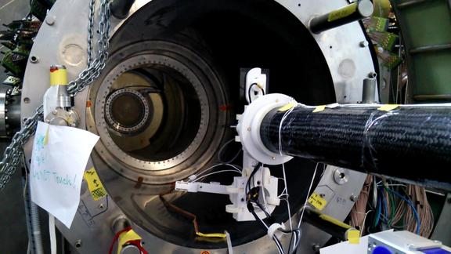
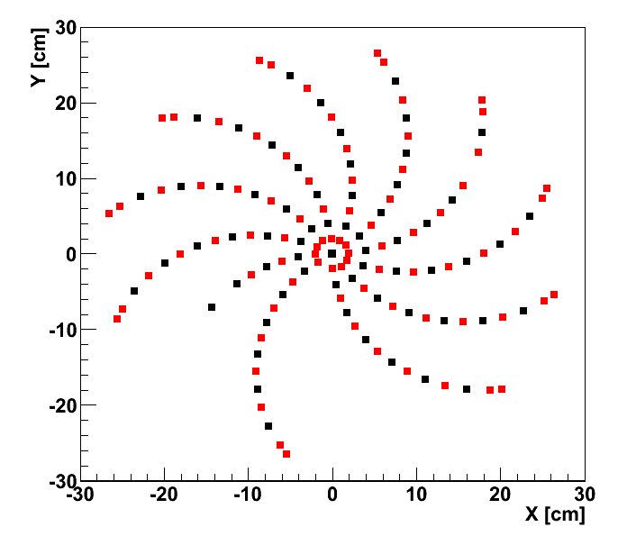
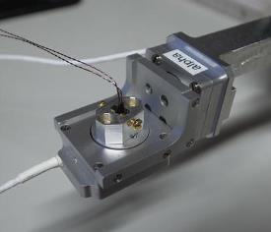
New measurements of COBRA Magnetic Field 1)
XY map of the data points
Z movement
July
August
X, Y
movement
Hall probe
Measured in Spring 2014, but found problem on measurement machine.
Measurement repeated in July and August.
B_{Z}, B_{R} and B_{φ} measured at various (X,Y,Z) position.
Step size in Z: 1 mm, R: 2 cm, Φ: 30 degrees
Data points (XY view)
α
β
sensor orientation
movement (B_{Z}, B_{R}, B_{Φ})

Slide 5
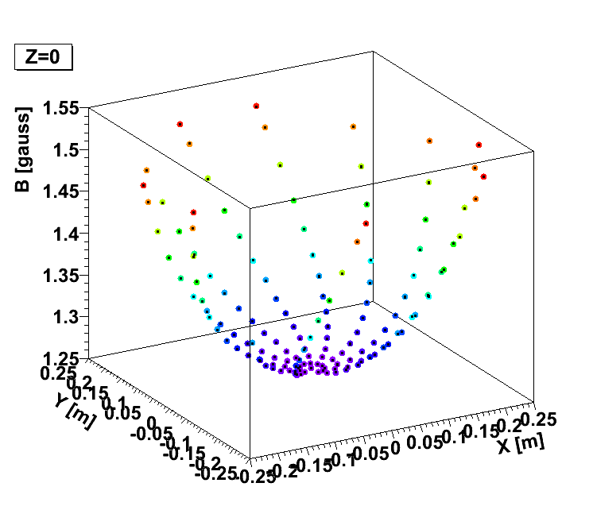
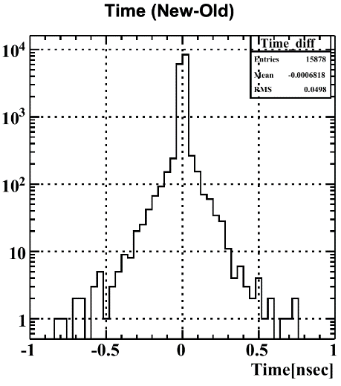
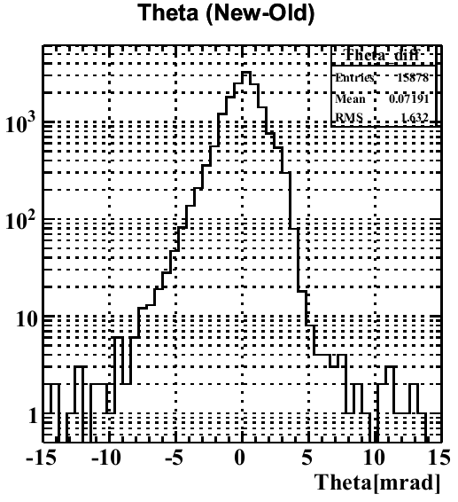
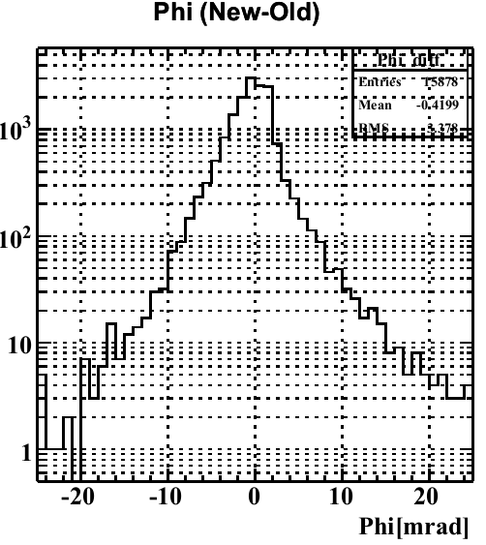
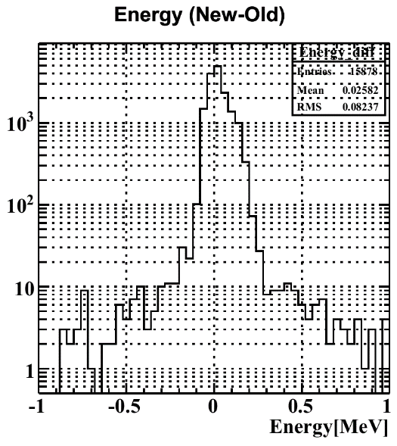
New measurements of COBRA Magnetic Field 2)
Measurement points used to form a complete 3-D
map by a splining algorithm. Maximum relative
difference between new and old field < 0.4%.
Applied to reconstructed positron variables.
Comparison with reconstructed positron
variables using old field shows no significant
differences; results confirmed by analysis of
Mott data. Conclusions: no need to reprocess the data with the new field
RMS ∼ 50 ps
RMS ∼ 1.6 mrad
RMS ∼ 3.4 mrad
RMS ∼ 80 keV

Slide 6
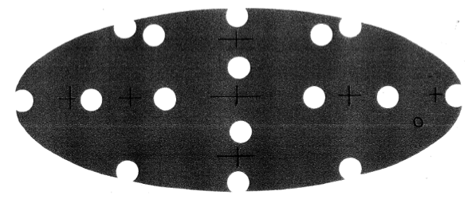
Target alignment 1)
Target and DCH system are measured with different optical surveys → needed knowledge of relative alignment between DCH and target. A disalignment in direction perpendicular to the target causes an error on positron φ.
target
Alignment check:
Reconstruct the position of the holes in the target;
Study the correlation between displacement of
reconstructed hole centers and positron φ.
~10 mrad
1 mm
~10 cm
5
2
0
1
3
4
DC
6

Slide 7
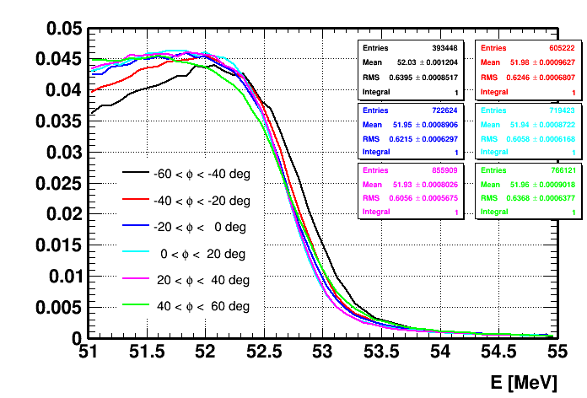
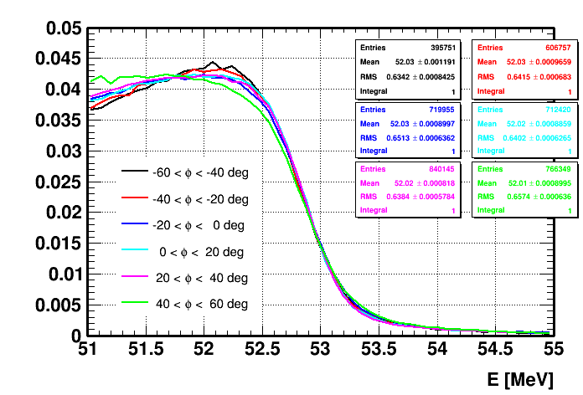
Target alignment 2)
Displacement in perpendicular direction
Fitting this form to experimental data one can
extract ΔP, move the target and re-run the analysis.
Dependence of momentum from φ angle is reduced.
ΔY
ΔY ~ tan(φ)⋅ΔP
2011 not corrected
2011 corrected
0
φ
Hole
displacement

Slide 8
Target alignment 3)
Technique works well for 2009-2012, but problems with 2013:
- unexpected behaviours;
- no improvements in momentum vs φ plot;
- not negligible effects on some positron kinematic variables (mainly φ angle and vertex
coordinates)
Attempt to consider a non planar
target (bowing): paraboloid shape.
Better approximation, but
still not satisfactory.

Slide 9
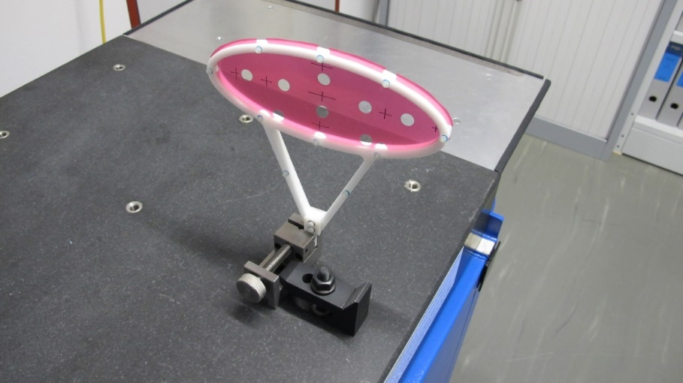
Target alignment 4)
Target measured in January with a microscope and in December with a 3-D faro scan.
DS view
- deformation range ∼ 1 mm;
- qualitative agreement between measurements
close to the holes; checked quantitatively σ = 160-200 micron
- irregular deformations.
US view

Slide 10
Target alignment 5)
Differences of more than one mm with respect to a flat target;
Paraboloid shape approximates reasonably the real target profile close to the central zone, but there are large differences (up to ± 1.5 mm) in the tails.
Studies under way:
- use 3-D scan in analysis;
- include systematic uncertainty on φ angle in likelihood analysis by profile method.

Slide 11
AIF analysis 1)
γ-rays from positron annihilation in flight form one of the
major component of γ-background around signal energy.
We developed algorithms to identify γ-rays from
positron AIF in the tracker.
Now we are inserting the AIF identification in our
likelihood analysis.
AIF variables: Δθ_{e,γ}, Δt_{e,γ} Δφ_{e,γ}

Slide 12
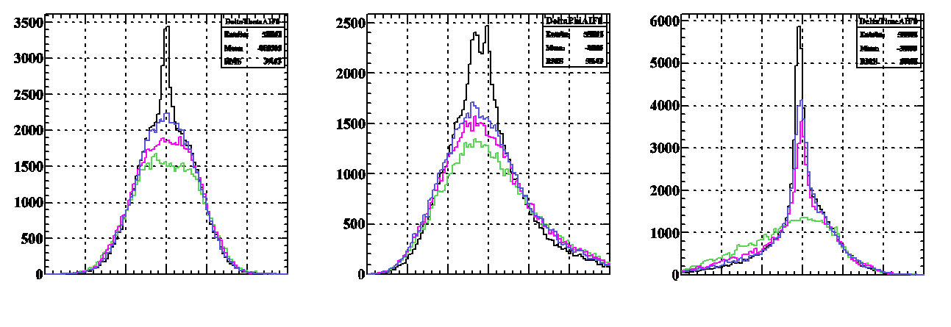
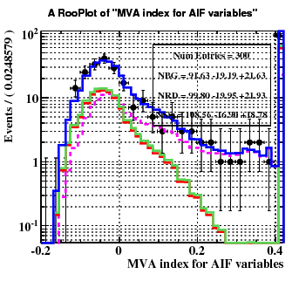
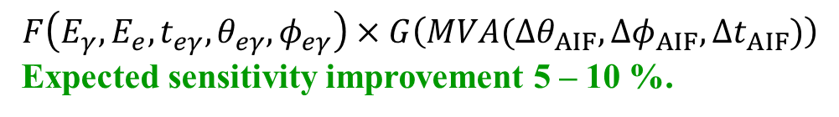
AIF analysis 2)
Works under way:
Formation of PDFs
Treatment of correlations between variables and AIF identification:
Multi Variate Analysis
MVA folded in the likelihood function
Acc BG
Sig + RMD (trig0)
Sig + RMD (trig22)
Sig + RMD (trig31)
Δθ_{AIF}
Δφ_{AIF}
Δt_{AIF}
Acc BG includes AIF,
Sig and RMD no ⇒
the common part
must be the same
$$F\left(E_{γ}, E_{e}, t_{eγ}, θ_{eγ},φ_{eγ}\right)×G\left(MVA(Δθ_{AIF},Δφ_{AIF},Δt_{AIF})\right)$$
Expected sensitivity improvement 5 – 10 %.

Slide 13
Status of 2012-2013 analysis
γ-analysis completed, ready for final reprocessing
e⁺-analysis ready for reprocessing when alignment issues will be solved.
Preliminary tests on events outside the signal region with previous
data processing don’t show unexpected behaviours.
Preliminary evaluation of normalization factors to pass from number of signal events to Branching Ratio (inverse of single event sensitivity):
∼ 5.3 x 10⁺¹² (2012), 3.5 x 10⁺¹² (2013) (4.0 in 2011).

Slide 14
Other analyses and papers
Final MEG paper
  We are writing a final paper for analysis of the full MEG data sample.
  It’s a long write-up paper, with several people involved.
  Some parts already written; strictly linked with analysis conclusions.
Polarization
  We are completing the measurement of residual muon beam polarization
  by evaluating systematics errors and checking all analysis.
  We plan to publish a paper on this subject.
Muon Radiative Decay
  Search for Muon Radiative Decay events in MEG data was presented to
  various conferences. We submitted a paper but since this analysis uses a
  preliminary measurement of the muon polarization as input, it was suggested
  to resubmit it when the polarization analysis will be completed.

Slide 15
Perspectives and conclusions
Our analysis was delayed by several months because of some important issues:
New measurement of magnetic field (finished);
Target alignment;
AIF analysis.
We will have a meeting in Tokyo on March to define final analysis strategy.
We hope to have figured out a solution for target alignment issue at that date.
Application of target alignment correction does not require a full reprocessing
of the data not needed → not too long computing time.
Time needed to complete AIF analysis for all years: about 2 months.
Other things (i.e. inclusion of systematic uncertainties) should require ∼ few weeks.
Our goals:
present final results at Summer Conferences;
submit the final MEG paper in the Summer.

