Slide 1

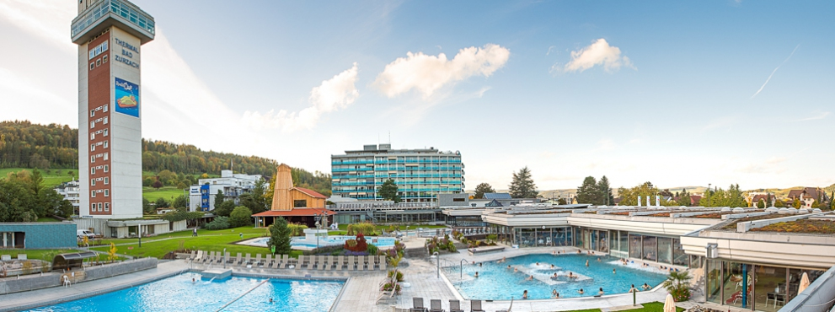
Hotel Therme Zurzach, 09.02.2015 – 11.02.2015
IV. SoFi workshop
General information
+

Slide 2
Details - General
Food
Morning coffee break (10.00-10.30)
Standing lunch (12.30 – 13.30)
Afternoon coffee break (15.30 – 16.00)
Social dinner (Wednesday evening ➔ sign up)
Restrooms (downstairs)
Internet (Free Internet, password t.b.a.)

Slide 3
Details - General
Information / presentations / data / code
http://indico.psi.ch/event/sofi_workshop_ii
Policy for SoFi
Collaboration for 1 – 2 publications per institute
Cite the SoFi paper in AMT (Canonaco et al 2013 )

Slide 4
Details – List of participants
First name | Last name | Institute | Country
Mr. ALROE | Joel | University of Queensland | AUSTRALIA
Mrs. AURELA | Minna | Meteorolgical Institute | FINLAND
BECERRIL | Marta | CIEMAT | SPAIN
Ms. BERTRAND | Amelie | Aix Marseille Université | FRANCE
Mr. BOZZETTI | Carlo | Paul Scherrer Institute | SWITZERLAND
Mr. CANONACO | Francesco | Paul Scherrer Institute | SWITZERLAND
DAY | Doug | University of Colorado, Boulder | UNITED STATES OF AMERICA
Ms. ELSER | Miriam | Paul Scherrer Institute | SWITZERLAND
Ms. FOSSUM | Kirsten | NUIG | IRELAND
Mr. FRÖHLICH | Roman | PSI | SWITZERLAND
GILARDONI | Stefania | ISAC – CNR | ITALY
Dr. GOLLY | Benjamin | Laboratory of Grenoble | FRANCE
Dr. JE?EK | Irena | Aerosol d.o.o. | SLOVENIA
Ms. MILIC | Andelija | University of Queensland | AUSTRALIA
Ms. MUELLER | Laarnie | Helmholtz Zentrum Muenchen | GERMANY
PAGLIONE | Marco | CNR-ISAC | ITALY
Dr. PIKRIDAS | Michael | Cyprus Institute | CYPRUS
Prof. RIFFAULT | Véronique | University of Mines Douai | FRANCE
First name | Last name | Institute | Country
Ms. RIVELLINI | Laura-Hélèna | (SAGE), Mines Douai | FRANCE
Ms. SCHULZ | Christiane | Max Planck Institute | GERMANY
SLOWIK | Jay | Paul Scherrer Institute | SWITZERLAND
Dr. SOSEDOVA | Yuliya | Paul Scherrer Instituite | SWITZERLAND
Dr. SUN | Junying | Chinese Academy of Meteo. Sciences | CHINA
Mr. SYLVESTRE | Alexandre | Laboratoire de Chimie et l'Environ. | FRANCE
Ms. VLACHOU | Athanasia | Paul Scherrer Institute | SWITZERLAND
Mr. PREVOT | Andre | Paul Scherrer Institute | SWITZERLAND
Mr. EL HADDAD | Imad | Paul Scherrer Institute | SWITZERLAND
Mr. Dällenbach | Kaspar | Paul Scherrer Institute | SWITZERLAND

Slide 5
Details – Program
Wednesday
09.00 – 10.00
10.00 - 10.30 | Registration / Coffee break
10.30 - 12.30 | Tutorial on PMF and ME-2 (Presentation, plenum) -Key words: PMF, CMB, PMF2, ME-2, Q-space, robust mode, rotational ambiguity -Key words: validation of PMF solution, exploration of solution space (fpeak, a-value, CMB-like approach), propagation of statistical uncertainty, AuRo-SoFi
12.30 - 13.30 | Lunch
13.30 - 15.30 | Prepare ACSM data on the PC/Laptop for the afternoon Tutorial on SoFi 5.0 (Interactive, plenum/individual) -Learn how to prepare the data for a PMF run in SoFi
15.30 - 16.00 | Coffee break
16.00 - 18.00 | Tutorial on SoFi 5.0 (Interactive, plenum) - Learn how to import and look at various PMF results

Slide 6
Details – Program
Thursday
09.00 – 10.00 | Tutorial on SoFi 5.0 (Interactive, plenum) - Learn how to import and look at various PMF results - Strategies for the validation of a PMF solution are applied
10.00 - 10.30 | Coffee break
10.30 - 12.30 | Tutorial on SoFi 5.0 (Interactive, plenum) - Learn how to import and look at various PMF results Data analysis (Individual, support from PSI users) -Users will analyze their own data in SoFi 5.0
12.30 - 13.30 | Lunch
13.30 - 15.30 | Data analysis (Individual, support from PSI users) -Users will analyze their own data in SoFi 5.0
15.30 - 16.00 | Coffee break
16.00 - 18.00 | Intermezzo (presentations, plenum) -Input from experienced SoFi users
***** Social dinner *****

Slide 7
Details – Program
Friday
09.00 – 10.00 | Data analysis (Individual, support from PSI users) -Users will analyze their own data in SoFi 5.0
10.00 - 10.30 | Coffee break
10.30 - 12.30 | Data analysis (Individual, support from PSI users) -Users will analyze their own data in SoFi 5.0 -Start compiling a short presentation (15 min. in total per data set, i.e. 10 min. presentation, 5 min. discussion)
12.30 - 13.30 | Lunch
13.30 - 15.30 | Presentations (Plenum) -Users exchange experience with SoFi
15.30 - 16.00 | Coffee break
16.00 - 17.30 | Presentations (Plenum) -Users exchange experience with SoFi
17.30 – 18.00 | Conclusion of the SoFi workshop -General things -Questionnaire

Slide 8
Hotel Therme Zurzach, 08.04.2015 – 10.04.2015
IV. SoFi workshop
Tutorial - PMF
Key words:
PMF, CMB, PMF2, ME-2, Q-space, robust mode, seed runs, local/global minima, rotational ambiguity / uncertainty

Slide 9
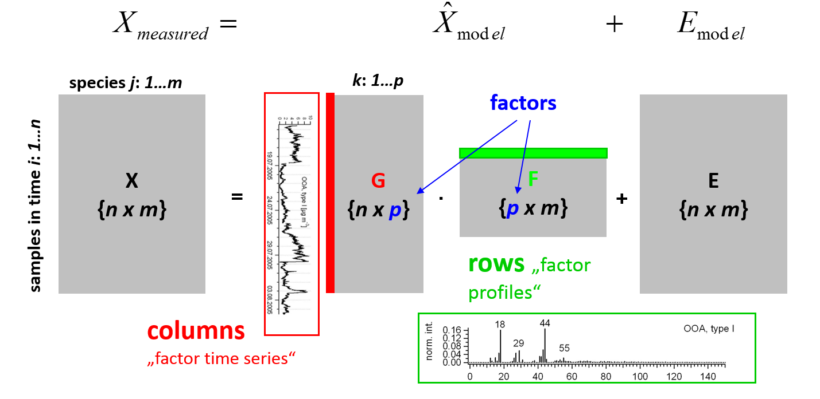
Model – Positive Matrix Factorization (PMF)
Bilinear factor analytic algorithm
Paatero 1994

Slide 10
Model – PMF/CMB/solvers
PMF / CMB (chemical mass balance) approach
Solvers
PMF
CMB
Constraining F
Solver | Unconstrained | Constrained | Communication
PMF2 / PMF3 | X | only to zero | Limited
ME-2 | X | X | All quantities easily accessible
Paatero 1999

Slide 11
Model – Positive Matrix Factorization (PMF)
Least-squares problem
Q will be minimized with respect to all model variables
ME-2 starts the conjugate gradient algorithm for solving this task
Goal
Factor solution must be environmentally reasonable
Unstructured weighted residuals over time (ts, diurnals, etc.) and over profile (variables)
e_{ij}: difference (measured – model)
σ_{ij}: uncertainty (statistical error)
Paatero 1999

Slide 12
Model – Positive Matrix Factorization (PMF)
Least-squares problem
Weight Q by Q_{exp}, the remaining degrees of freedom
If all residuals were similar as their σ’s, Q / Q_{exp} ~1
Monitor Q / Q_{exp} values ➔ Too high values might indicate issues
Monitor the changes of Q/Q_{exp} over various model runs
e_{ij}: difference (measured – model)
σ_{ij}: uncertainty (statistical error / rotational ambiguity, model error)

Slide 13
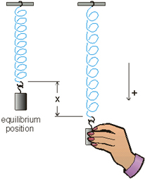
Model – Positive Matrix Factorization (PMF)
Least-squares algorithm
Advantages
Values in G & F are non-negative
Factors represent sources / processes
PMF algorithm scales with the residual
e_{ij}: difference (measured – model)
σ_{ij}: uncertainty (statistical error / rotational ambiguity, model error)
Paatero 1994

Slide 14
Model – Positive Matrix Factorization (PMF)
Disadvantages
Assess number of factors
Constant factor profiles (mass spectra)
Uncertainties are not well-known, minimal Q-value is not necessarily the best solution
➔ Investigate the solution space even for slightly higher Q-values (few %)
Bilinear factor analytic models suffer from rotational ambiguity
➔ Investigate the solution space
$$X_{model}=G∙F=G∙T∙T^{−1}∙F=G′∙F′$$
Paatero 1994/97

Slide 15
Model – robust mode
PMF run (non-robust mode)
Computational power is proportional to the residual (in theory ideal)
Outliers, e.g. transient sources, wrong nb. of factors, electronic recording issues, etc. violate this relation and PMF could spend more time, reducing “wrong” residuals
PMF run (robust mode)
Allow for this dependency only in a certain range and damp afterwards (robust mode, default value = 4)

Slide 16
Model - Q-space
Real case
ACSM data with 100 variables for 1000 scans, four factors, unconstrained
G{nxp}, F{pxm} ➔ G{1000x4}, F{4x100}, there are 4400 model variables
➔ Q(4400 model variables), multidimensional Q-space
Simplified case
Simply the real case with two model variables
➔ Q(2 model variables), three dimensional Q-space

Slide 17
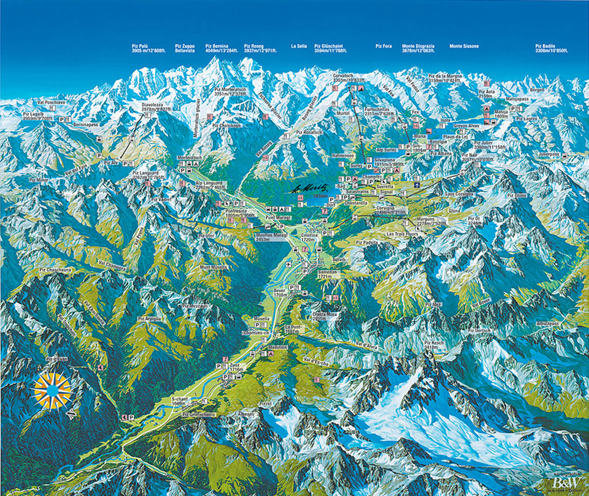
Model - Q-space
Q(2 model variables) similar to the height h(x,y) in the map
PMF is performed through the conjugate gradient algorithm minimizing Q based on the starting conditions, following the steepest descent (from red to the green point)
Goal is to find the smallest possible Q-value (global minimum) (violet area) together with the best solution
Search for this minimum based on different starting values (seed run)
There are many points on the map, for which h(x,y) is equal ➔ rotational ambiguity
Explore the rotational ambiguity with proper techniques (fpeak, ind. fpeak, a-value, CMB-like)

Slide 18
Hotel Therme Zurzach, 08.04.2015 – 10.04.2015
IV. SoFi workshop
Tutorial – ME-2
Key words:
ME-2, validation of PMF solution, exploration of solution space (fpeak, a-value, CMB-like approach), propagation of statistical uncertainty, AuRo-SoFi

Slide 19
Model – Positive Matrix Factorization (PMF)
bilinear PMF runs
>2 variables
measured over time
Environmentally reasonable solution
SoFi 5.0
future
I.
seed runs
Seed runs
Initialize PMF run with random values for the unconstrained model variables
Search for the PMF solution(s) with the smallest possible Q-value (ideal ➔ global minimum)
-PMF is a local mininum algorithm
search for the global minimum

Slide 20
Model – Positive Matrix Factorization (PMF)
bilinear PMF runs
>2 variables
measured over time
Environmentally reasonable solution
SoFi 5.0
future
II.
solution space
Solution space
Vary the model variables (fpeak, individual fpeak, a-value, CMB-like, pulling) and monitor the change of the PMF solution with various parameters:
  Q-value
  Residual (global / key variables)
  Weighted residual (global / key variables)
  Shape of factor profile(s)
  Time series / diurnal correlation with external tracers
-PMF sol. suffer from rotational ambiguity
-PMF sol. depend strongly on uncertainty
Explore solution space

Slide 21
Model – Positive Matrix Factorization (PMF)
bilinear PMF runs
>2 variables
measured over time
Environmentally reasonable solution
SoFi 5.0
future
II.
solution space
Solution space
fpeak (φ) technique
  All rotations are performed at the same time
  Advantage: easy to perform
  Disadvantage: rotations cannot always be fully predicted, lower estimate of the rotational uncertainty
  e.g. three factors
-PMF sol. suffer from rotational ambiguity
-PMF sol. depend strongly on uncertainty
Explore solution space

Slide 22
Model – Positive Matrix Factorization (PMF)
bilinear PMF runs
>2 variables
measured over time
Environmentally reasonable solution
SoFi 5.0
future
II.
solution space
Solution space
Individual fpeak (φ) technique
  Rotations can be chosen
  Advantage: all rotations are accessible
  Disadvantage: rotations cannot always be fully predicted, weak estimation of the rotational uncertainty
  e.g. three factors
-PMF sol. suffer from rotational ambiguity
-PMF sol. depend strongly on uncertainty
Explore solution space

Slide 23
Model – Positive Matrix Factorization (PMF)
bilinear PMF runs
>2 variables
measured over time
Environmentally reasonable solution
SoFi 5.0
future
II.
solution space
Solution space
a-value technique (fast and ME-2-controlled)
  Full Q-space can potentially be investigated
  Advantage: easy to perform and computationally inexpensive
  Disadvantage: Sensitivity analysis on the constrained model variables (!!! p > 1 issue with the validation !!!)
  e.g. a-value for F
-PMF sol. suffer from rotational ambiguity
-PMF sol. depend strongly on uncertainty
Q
good sol.
Explore solution space
unconstr. PMF
a-value

Slide 24
Model – Positive Matrix Factorization (PMF)
bilinear PMF runs
>2 variables
measured over time
Environmentally reasonable solution
SoFi 5.0
future
II.
solution space
Solution space
a-value technique (fast and ME-2-controlled)
  e.g. a-value for F (a = 0.1)
-PMF sol. suffer from rotational ambiguity
-PMF sol. depend strongly on uncertainty
Explore solution space

Slide 25
Model – Positive Matrix Factorization (PMF)
bilinear PMF runs
>2 variables
measured over time
Environmentally reasonable solution
SoFi 5.0
future
II.
solution space
Solution space
a-value technique (fast and ME-2-controlled)
  Current constrained factor profile is not satisfactory
  example from previous slide
-PMF sol. suffer from rotational ambiguity
-PMF sol. depend strongly on uncertainty
Q
good sol.
➔ change factor profile (http://cires.colorado.edu/jimenez-group/AMSsd/)
unconstr. PMF
Explore solution space
a-value

Slide 26
Model – Positive Matrix Factorization (PMF)
bilinear PMF runs
>2 variables
measured over time
Environmentally reasonable solution
SoFi 5.0
future
II.
solution space
Solution space
CMB-like technique (fast and constrainted-controlled)
  Choose randomly within boundaries and call PMF
  Advantage: easy to perform, propagate profile distribution
  Disadvantage: many runs required
-PMF sol. suffer from rotational ambiguity
-PMF sol. depend strongly on uncertainty
Explore solution space

Slide 27
Model – Positive Matrix Factorization (PMF)
bilinear PMF runs
>2 variables
measured over time
Environmentally reasonable solution
SoFi 5.0
future
III. statistical error
Statistical error
Propagate the statistical uncertainty to the PMF result (computationally expensive)
  Monte Carlo method (noise insertion)
  ➔ vary the PMF input within the measurement error and call PMF with the constrained pr/ts for the good solution
  Bootstrap method (resampling strategy)
  ➔ resample data with identical underlying sources and call PMF with the constrained pr/ts for the good solution
-PMF model result(s) must show the uncertainty
Propagate the statistical uncertainty

Slide 28
Model – Positive Matrix Factorization (PMF)
bilinear PMF runs
>2 variables
measured over time
Environmentally reasonable solution
SoFi 5.0
future
IV.
AuRo-SoFi
Automatic Rolling SoFi
Run PMF using a small frame, e.g. two weeks/one month of data (Assumption: source is constant over this period)
Optimize PMF solution based on parameters defined in advance based on manual pretests ➔ Automatic part
Call part III. (statistical error) to estimate the PMF error
Shift PMF frame forward and rerun PMF ➔ Rolling part
➔ AuRo – SoFi algorithm
-PMF profiles are static over time (real sources evolve)
Rolling PMF frame

Slide 29
Model – Positive Matrix Factorization (PMF)
bilinear PMF runs
>2 variables
measured over time
Environmentally reasonable solution
SoFi 5.0
future
I.
seed runs
II.
solution space
III. statistical error
IV.
AuRo-SoFi
-PMF is a local mininum algorithm
-PMF sol. suffer from rotational ambiguity
-PMF sol. depend strongly on uncertainty
-PMF model result(s) must show the uncertainty
-PMF profiles are static over time (real sources evolve)
search for the global minimum
Explore solution space
Propagate the statistical uncertainty
Rolling PMF frame

Slide 30
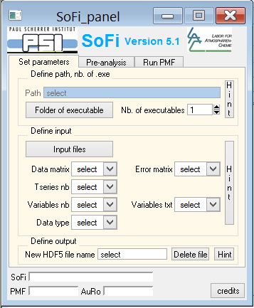
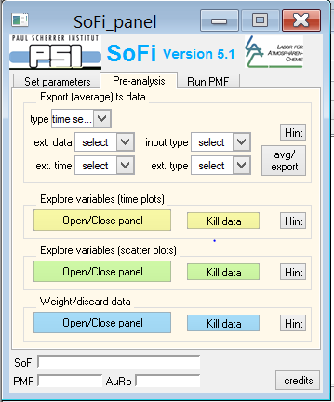
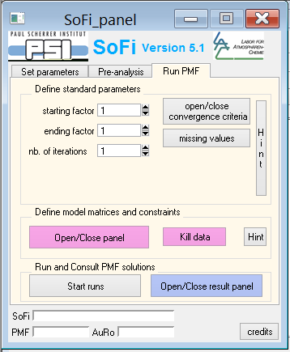
Source Finder - SoFi
ME-2 that allows for the full exploration of the solution space solves a problem defined in a script file (instruction file)
➔ SoFi, a user-friendly interface for the communication with the ME-2 engine
Canonaco et al., 2013

Slide 31
Hotel Therme Zurzach, 09.02.2015 – 11.02.2015
III. SoFi workshop
Tutorial – SoFi
Learning goal
Learn how to prepare the data for a PMF run in SoFi

Slide 32
Hotel Therme Zurzach, 09.02.2015 – 11.02.2015
III. SoFi workshop
Tutorial – SoFi
Learning goals
- Learn how to import and look at various PMF results
- Strategies for the validation of a PMF solution can be applied

