Slide 1



Modulators for High Power RF Sources
Carlos A. Martins
ESS – Accelerator Division - RF Electrical Power Systems
www.europeanspallationsource.se
March 1st , 2016

Slide 2

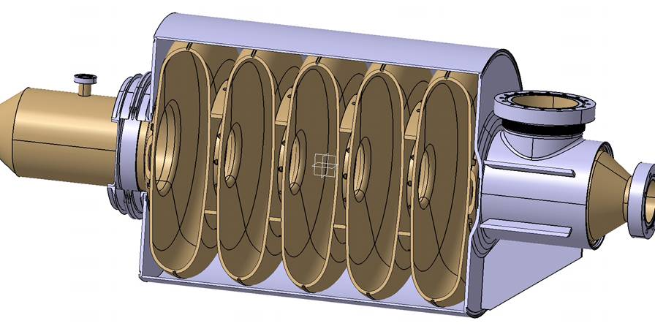
General architecture of a RF source
- Schematics and main components
5
Modulators are HV power supplies that feed the RF amplifiers.
- RF amplifiers are therefore the loads of modulators
Electrical network
Particle beam
RF power out
3
RF cavity
HV
AC
-
1
2
4
3
3
RF signal in
3
3
6
+
1- Modulator (HV power supply)
- Converts the electric power from a standard AC network into High Voltage (HV), either DC (Direct Current) or pulsed, depending on the accelerator duty-cycle (i.e. beam “on” versus beam “off” time) ;
2- RF amplifier (generator)
Converts electrical power into RF power, by amplifying a low power input RF signal (RF signal in) into a large power electromagnetic wave (RF power out);
3- Waveguides; 4- circulator; 5- RF load; 6- power coupler;

Slide 3
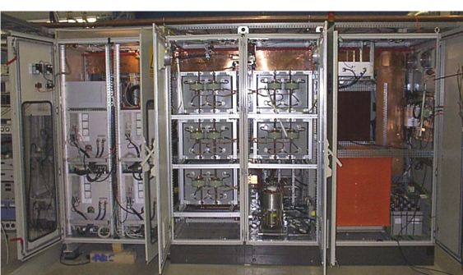
Modulators for high power RF sources:
– A challenging component to design and procure
Sophisticated power electronic systems
1)- Multidisciplinary design:
Power Electronics;
High Voltage;
Mechanical design;
Thermal design and cooling;
Advanced control architectures and software
development;
2)- Complex circuits, with many different topologies possible;
Some topologies have opposite principles and construction techniques;
Modularity, monolithic, redundancy, HV versus LV sharing;
3)- Diversified type of electronic components required;
HV components, Power semiconductors, Oil tanks, Advanced control systems, Large capacitors, etc.
4)- Impacts directly on operations’ safety
High voltage devices (above hundred kV);
High electrical short circuit power (up-to tens MVA);
Large energy stored (up-to tens of kJ);
Heavy loads to handle and transport;
modulator
5)- No solution exists today fulfilling the ESS requirements
(on the contrary to the majority of other accelerator components)

Slide 4
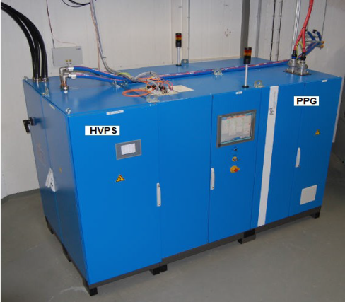
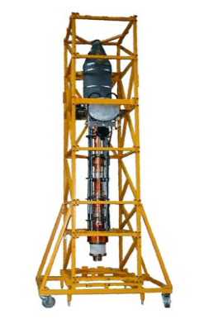
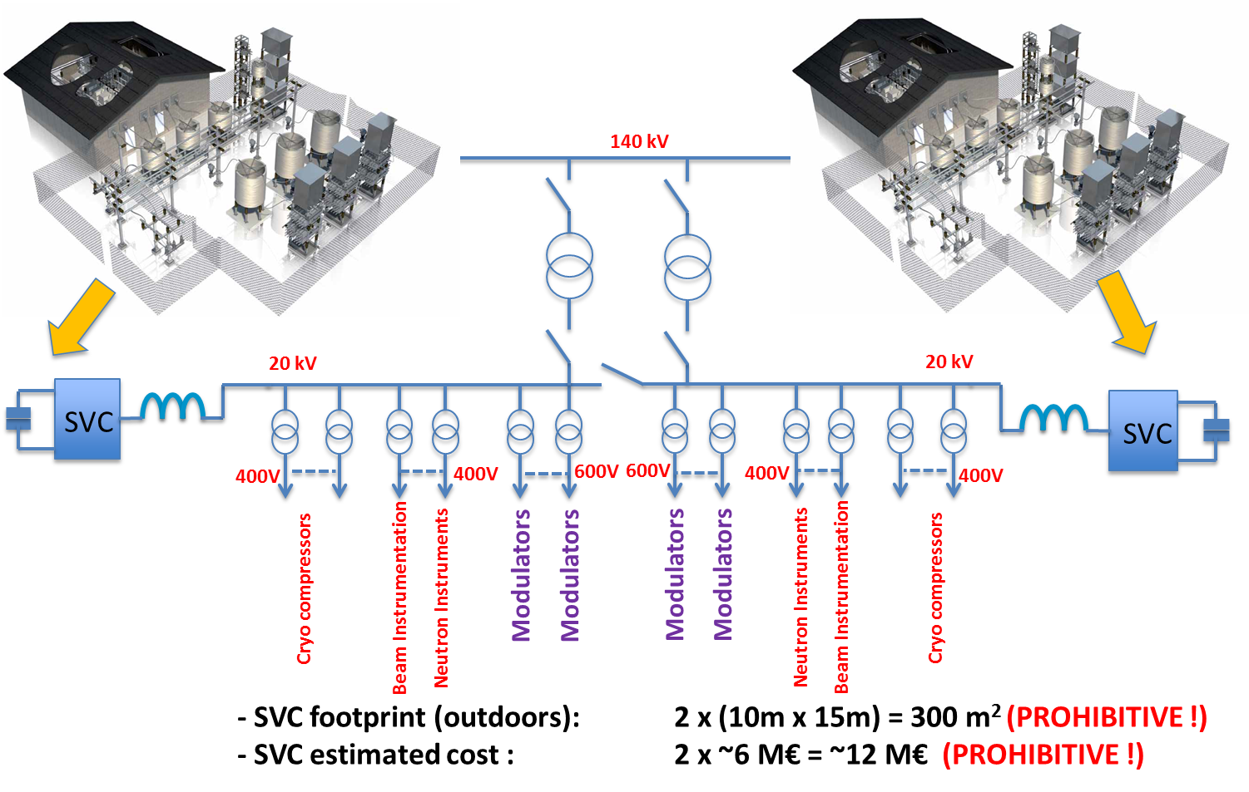
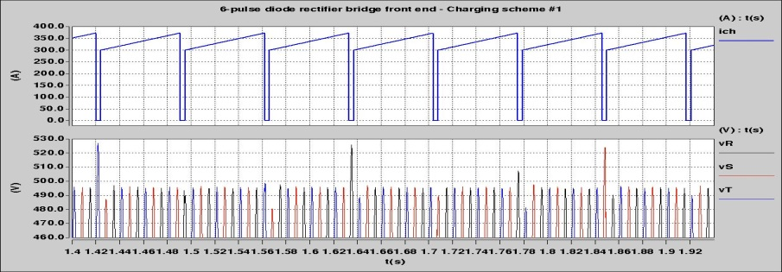
Modulators for high power RF sources:
– A challenging component to design and procure
Large footprints, impacting strongly on the sizing of the RF gallery
modulator
Vertical klystron
AC electrical grid power quality
1)- Flicker (if pulsed application with 10mHz<PRR<20Hz);
2)- Current harmonic distortion
3)- Power factor
1.6m
3.8m
1m

Slide 5
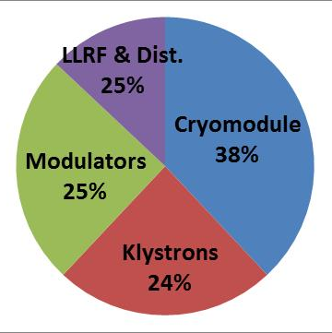
Modulators for high power RF sources:
– A challenging component to design and procure
High Voltage pulse quality
V
1)- Pulse rise time;
2)- Pulse width;
3)- Pulse power amplitude;
4)- Pulse flat-top droop;
5)- Pulse flat-top ripple;
6)- Pulse flat-top stability (pulse-to-pulse and long term drifts);
7)- Maximum energy in case of arc;
8)- Maximum reverse voltage;
Rise time
Fall time
time
Flat-top
Pulse width
Reverse voltage
High cost impact in the whole accelerator

Slide 6
Modulators for high power RF sources:
– A challenging component to design and procure
High impact in accelerator availability
A = MTBF / (MTBF + MTTR);
A : Availability;
MTBF : Mean Time Between Failures (Reliability)
- Type and quantity of components;
- Number of interconnections;
- Redundancy schemes;
MTTR : Mean Time To Repair (Reparability)
- Embedded Diagnostics;
- Modularity;
- Size and weight of components;
Few specialized companies worldwide, most of them SMB’s (Small Medium Business)
1)- Engineering design capabilities;
2)- Construction capacity and testing capabilities;
3)- Quality Assurance and risk mitigation capacity;

Slide 7
Modulators for high power accelerators:
– A wide spectrum of business opportunities in scientific applications
Business opportunities by scientific project worldwide, over next 10 to 15 years
Accelerator project name | Country | Quantity | Average power, per unit (kVA) | Total average installed power (MVA) | Pulsed: P (pulse length in ms) or CW | Total estimated cost (M€)
ESS (Mβ+Hβ) – ESS ERIC | Sweden | 33 | 660 | 21.8 | P (3.5ms)
SPL - CERN | Switzerland | 90 | 660 | 59.4 | P (1.8ms)
FCC - CERN | Switzerland | 600 | 600 | 360 | CW
ILC | Japan | 450 | 150 | 67.5 | P (1.5ms)
X Project - Fermilab | USA | 200 | 70 | 14 | CW
All projects |  | Total installed power = 516 MVA |  |  |  | ~ 800

Slide 8
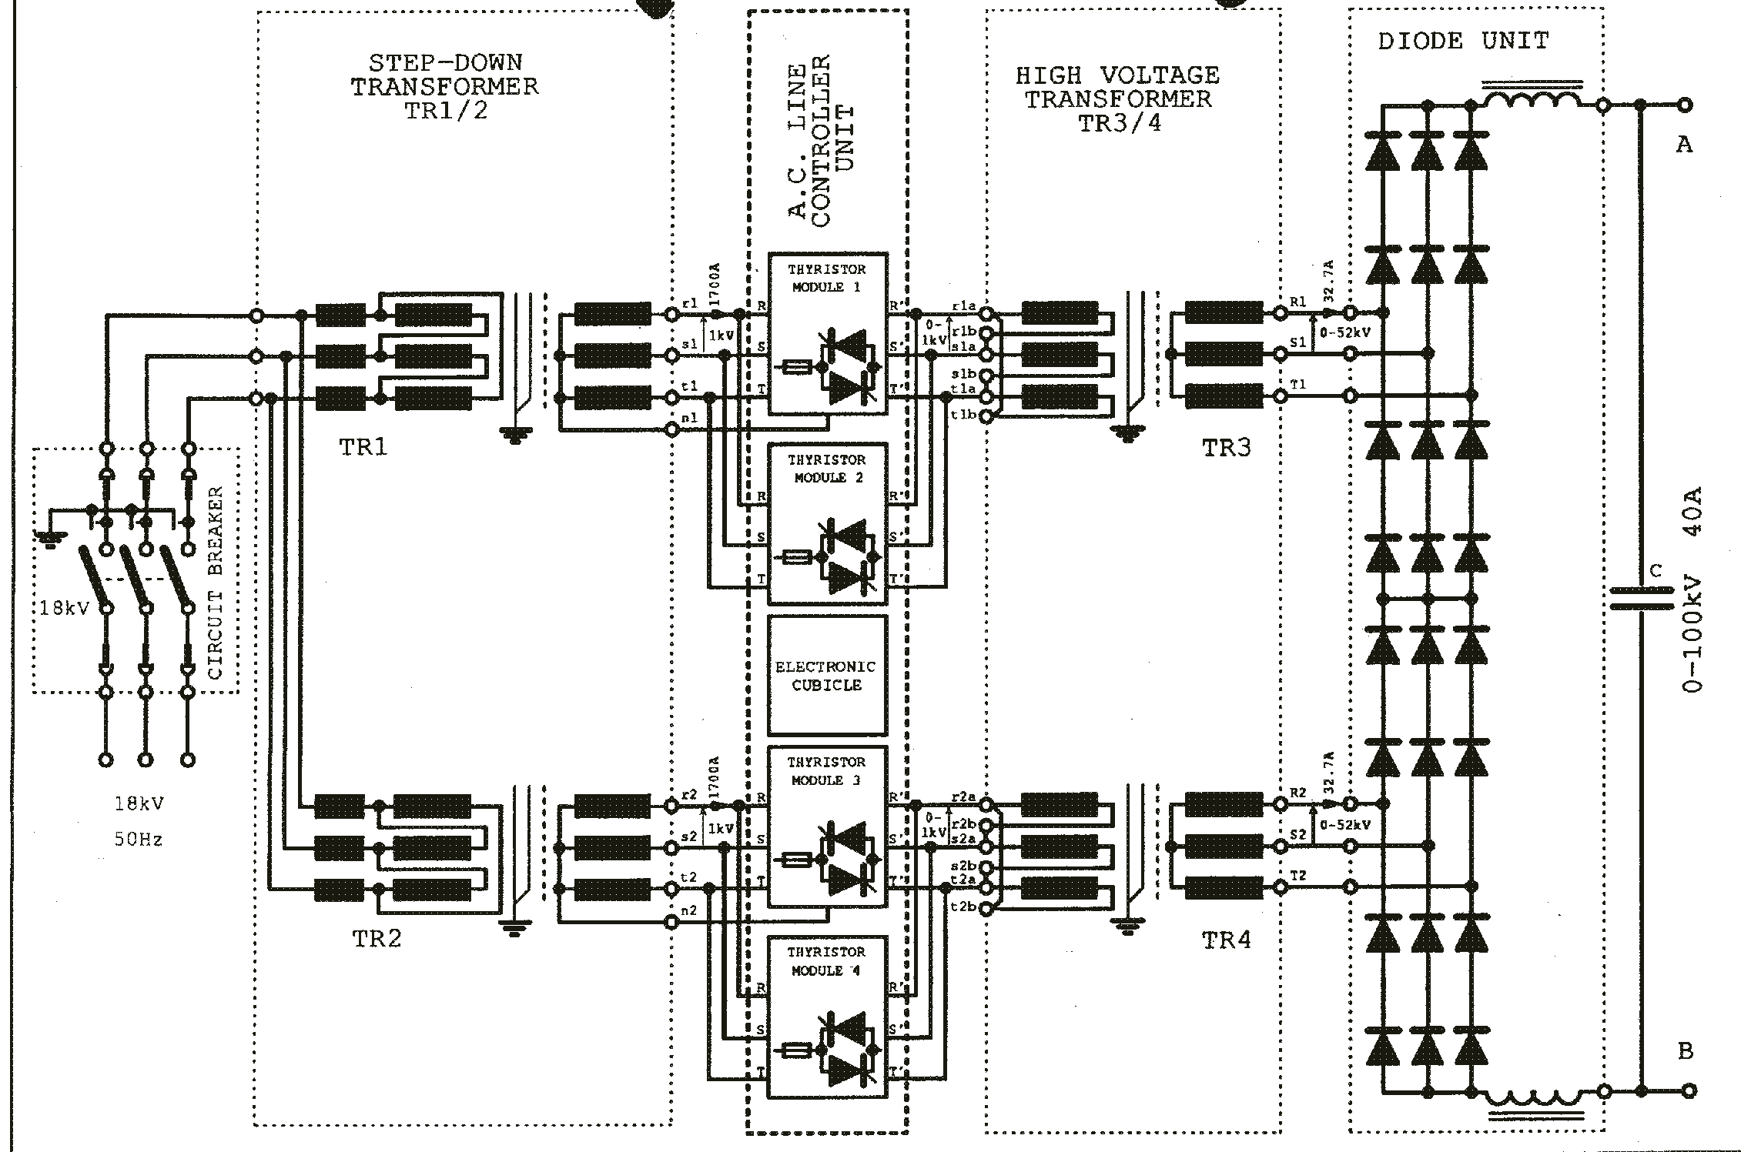
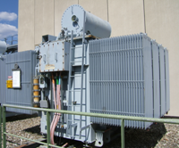
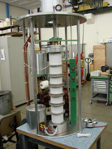
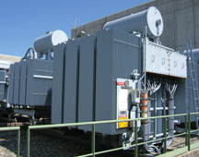
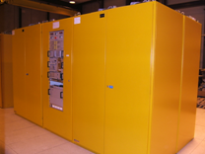
CW (Continuous Wave) modulators:
- A conventional topology
AC electrical network
A CW modulator is generally just a High Voltage power supply that feeds:- the Anode of tetrodes or the Cathode of klystrons, etc;
Depending on the type of HV power supply a CROWBAR might be needed to bypass the current in case an arc occurs in the RF amplifier tube
100 kV crowbar (Thyratron)
Klystron
Thyratron CROWBAR

Slide 9
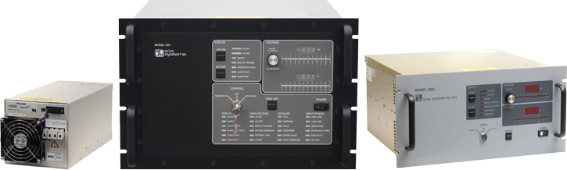
CW (Continuous Wave) modulators:
- A modern switch mode based topology
The parallel CROWBAR can be avoided since the Power Converter can be switched off very quickly by acting on the H-bridge inverter and the stored energy in the output filter and HF transformer is very small
More compact, higher stability, lower voltage ripple solution

Slide 10
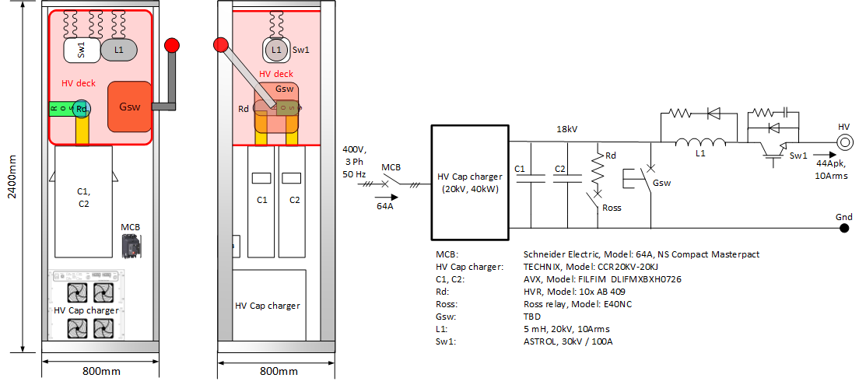
Pulsed modulators for gridded tubes (Tetrodes or IOT’s)
Example: ESS Tetrode modulators for spoke cavities
Modulator
Tetrode
Grid bias PS
Anode
Grid
+
-
Cathode
Tetrodes are gridded tubes, therefore the pulsed power can be generated by pulsing the grid terminal using the RF input driver ;
In that case, the Anode can be permanently connected to a HV source formed by a HV capacitor charger and a capacitor bank (C1 and C2);
The series switch, Sw1, is always at “on” state in normal operation. Only in case of an arc in the tetrode Sw1 is switched “off”, therefore lowering the voltage across the Anode down to zero clearing the arc.
When the RF input driver is switched “on”, the current starts flowing from Anode to Cathode, initiating the pulse;
During the pulse, the energy flows from the capacitor bank to the tetrode, discharging partially the capacitor bank (by ~5%);
The capacitor bank is recharged after the pulse has finished and before the next pulse starts;

Slide 11
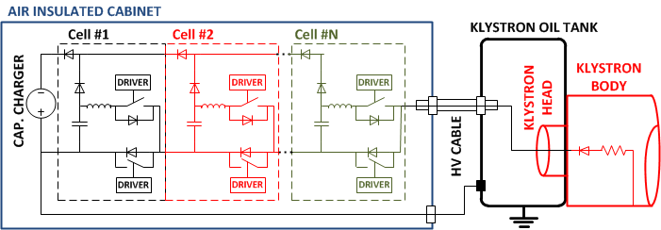
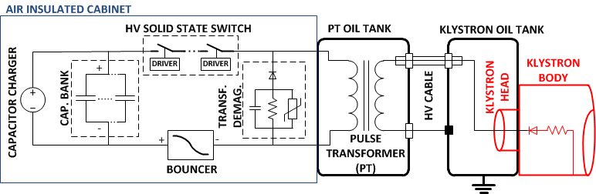
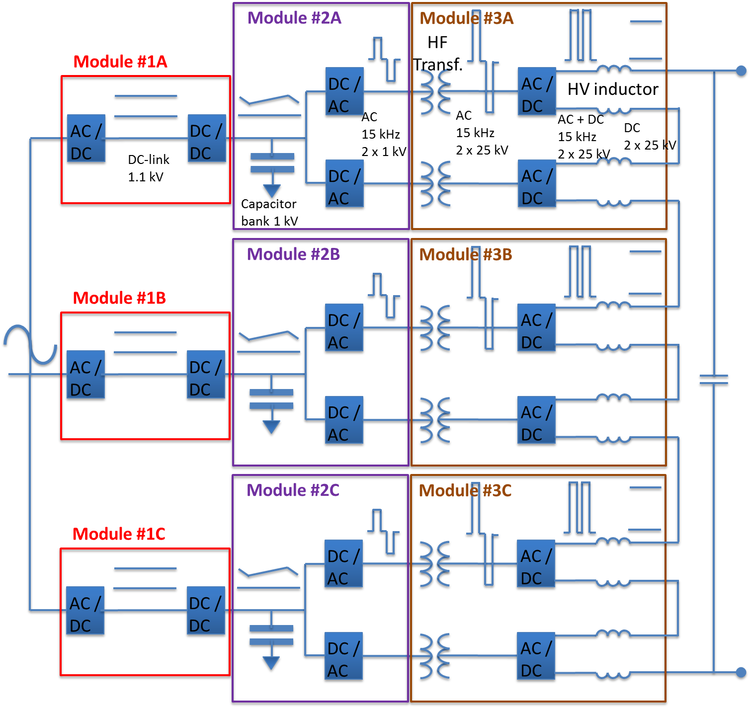
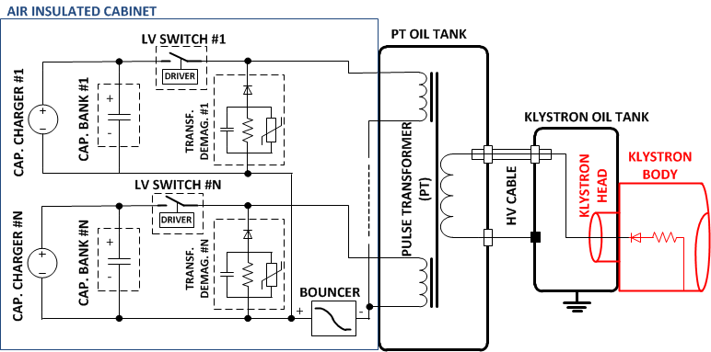
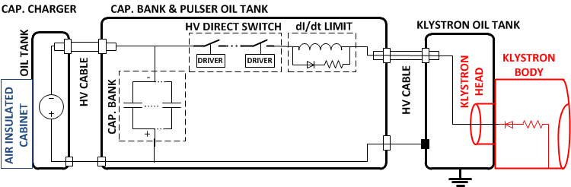
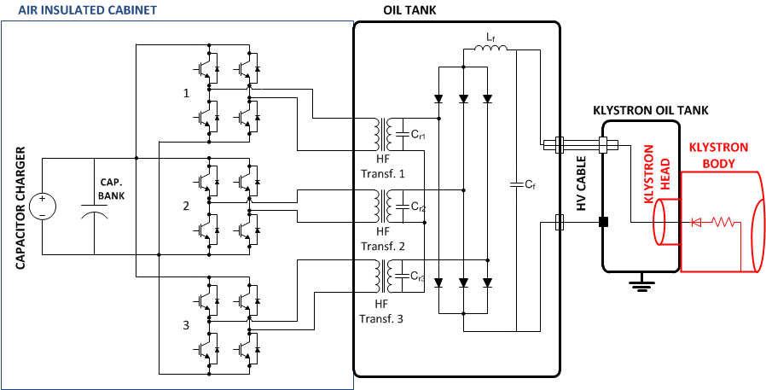
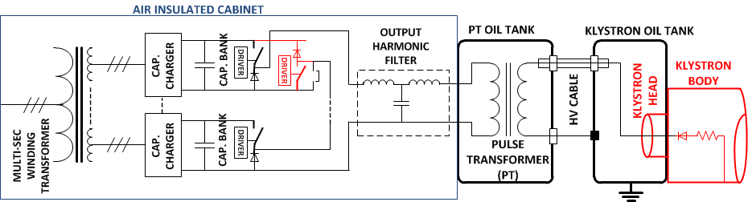
Pulsed modulators for non gridded tubes (klystrons):
- main topologies
“Pulse” transformer based | “HF” transformer based | Transformerless
Pulse transformer based (ver. 1-monolithic PT) Pulse transformer based (ver. 2-multi prim. winding) Pulse transformer based (ver. 3- stacked converters) | Stacked Multi-Level (ESS design) Resonant polyphase | Marx generator Direct switch

Slide 12
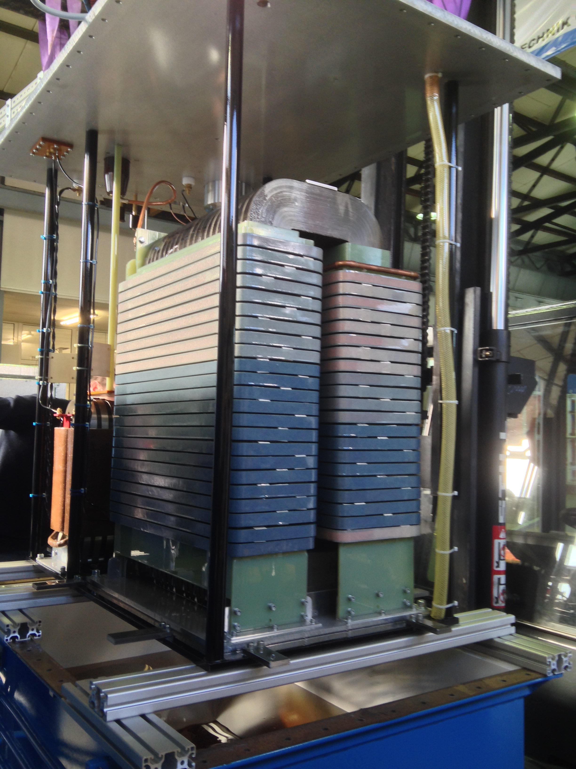
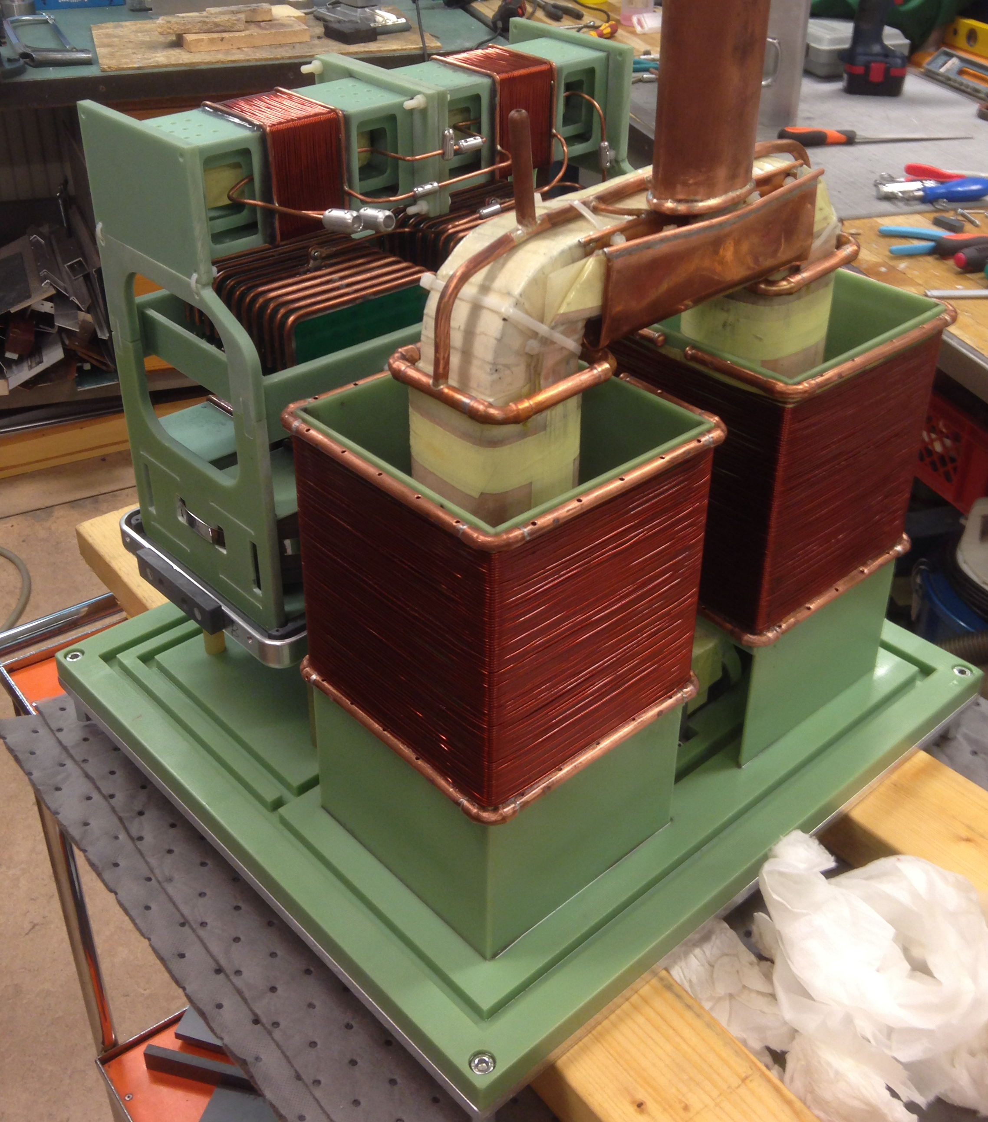
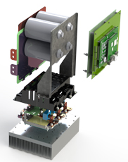
Pulsed modulators for klystrons:
- the two most common topologies (on my view)
Topology 1: Pulse Transformer based
HV pulse transformer
Topology 2: HF transformer based
HV HF transformer + AC/DC + filter
HV switch
LV DC/AC Inverter

Slide 13
Pulsed modulators for klystrons:- Topology based on pulse transformers
Pulse Transformer Based Modulator
Modulator main requirements:
Vp – Pulse voltage;
Ip – Pulse current;
fp – Pulse repetition rate;
Tp – Pulse width;
Tr – Max. rise time;
os – Max overshoot;
Drp – Max pulse flat-top droop;
PPr – Pulse to pulse reproducibility;
Pripp – Max voltage ripple on flat-top;
Earc – Max energy deposed in case of klystron arc
t_{p}
Droop
Vp
Overshoot
t_{r} rise time
Tp=1/fp

Slide 14
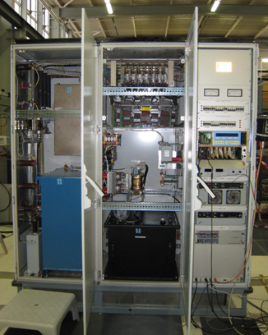
Pulsed modulators for klystrons:- Topology based on pulse transformer. Example of CERN Linac4
100 kV, 20A, 0.8ms, 2 Hz
Simplified schematics
The power absorbed by the klystron during the pulse cannot be delivered by the electrical network;
A capacitor bank is required to store the energy that will be given to the klystron during the pulse (buffer);
A capacitor charger charges the capacitor bank before the pulse is generated. It is fed from the AC network;
The pulse is formed by switching “on” and “off” the main solid state switch, therefore connecting/disconnecting the capacitor bank to the primary side of the pulse transformer;
The pulse transformer steps-up the voltage to the value required by the klystron cathode;
A droop compensation system is required to keep the voltage flat over the entire duration of the pulse despite the fact that the voltage across the capacitor bank droops down by 5 to 15% (discharge during the pulse);
No HV crowbar is needed. In case of arcing in the klystron, the main solid state switch is opened in less than 10µs

Slide 15

Pulsed modulators for klystrons:
- Topology based on HF transformers.
The ESS Stacked Multi-Level (SML) modulator
Ratings: 115kV / 100A; pulsed at 3.5ms/14Hz
Modular topology, scalable to higher power levels;
Compact and cost effective;
High efficiency (92%);
Good pulse quality (low ripple, low rise-time);
Excellent grid power quality due to AFE’s (low flicker, low current THD);
High reliability (MTBF ~ 70’000 hours)

Slide 16
The Stacked Multi-Level (SML) modulator:
- Keypoints
Modular concept, allowing the increase of rated power by adapting the number of modules, keeping their size and weight under control. Facilitates maintenance;
Up to 660 kVA average power possible, allowing the supply of 4 x 1.2MW klystrons / IOT’s in parallel;
Compatible both with PULSED and CW operations and with different types of RF amplifiers (Klystrons, IOT’s, tetrodes, etc.);
Lower cost due to usage of standard LV components into a great extent (about 45% price reduction with respect to other topologies);
No active power electronic devices inside oil tanks (facilitates maintenance);
Reduced footprint/volume due to minimal sub-systems count;
Improved efficiency (~92%), due to minimal number of conversion stages;
Good pulse quality (~110µs rise time 0..99%, <0.15% flat-top ripple, <1% voltage droop);
Good AC grid power quality. AC/DC + DC/DC allow constant power absorption:
  - flicker-free operation (<0.2%), sinusoidal current absorption (THD<3%), unitary power factor (>0.99);
16

Slide 17
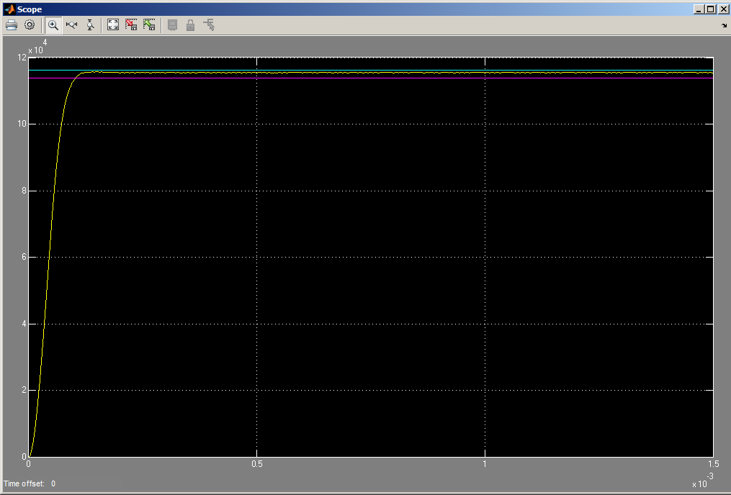
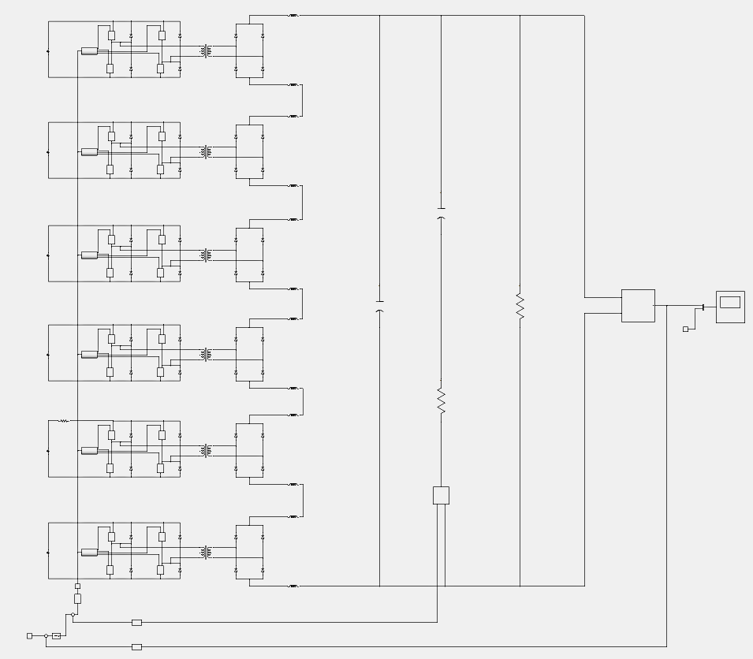
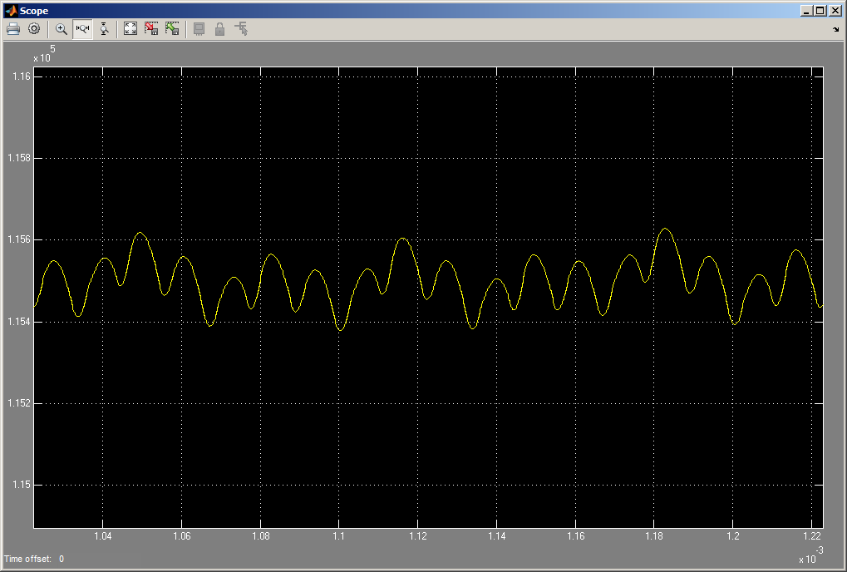
SML modulator HV Pulse Generation stage:
– Simulation results with models incorporating parasitic elements
Rise time (0..99%)= 100µs
Flat-top ripple (pk-pk)= 0.13% @ 90kHz
200V

Slide 18
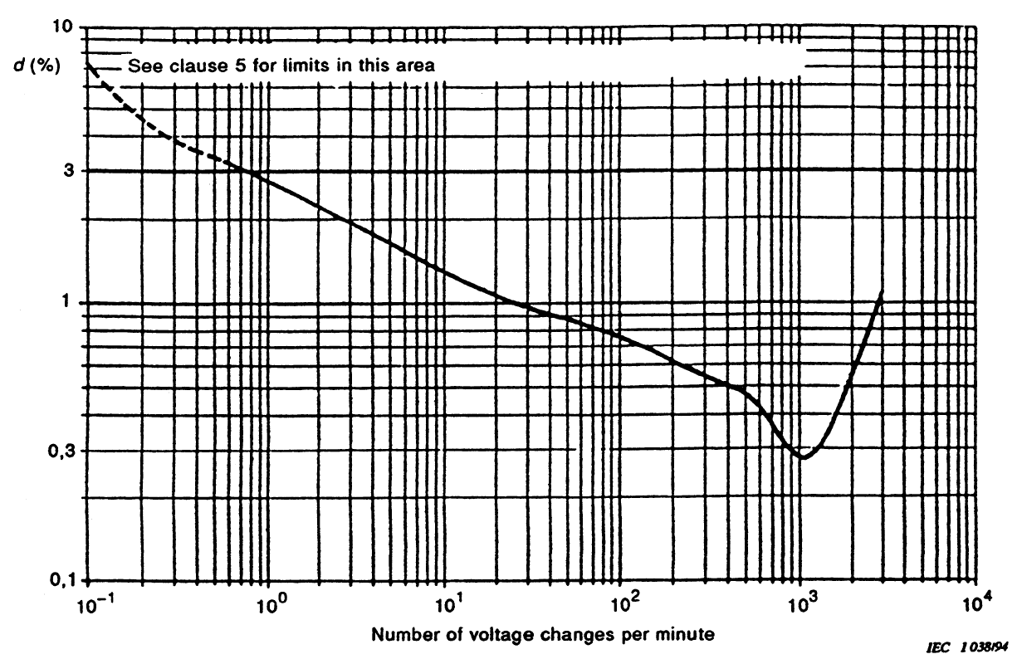
SML modulator, AC grid power quality:
– An All In One approach
Grid power quality (IEC 61000-x-x)
(dictated by the capacitor charger)
EMC (conducted noise, immunity & susceptibility)
Current harmonic distortion (depends on the capacitor charger topology)
Flicker (depends on the capacitor charger topology & on the charging control scheme)
Flicker standard IEC 61000-3-2 and IEC 61000-3-11 (low voltage public grids)
(ΔV/V)_{max}=0.3%
Capacitor Charger:
Active Front End + DC/DC converter with constant power regulation
14 Hz
Active Front End
18

Slide 19
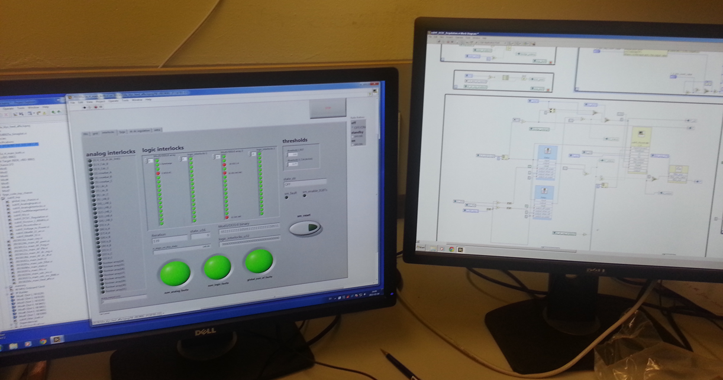
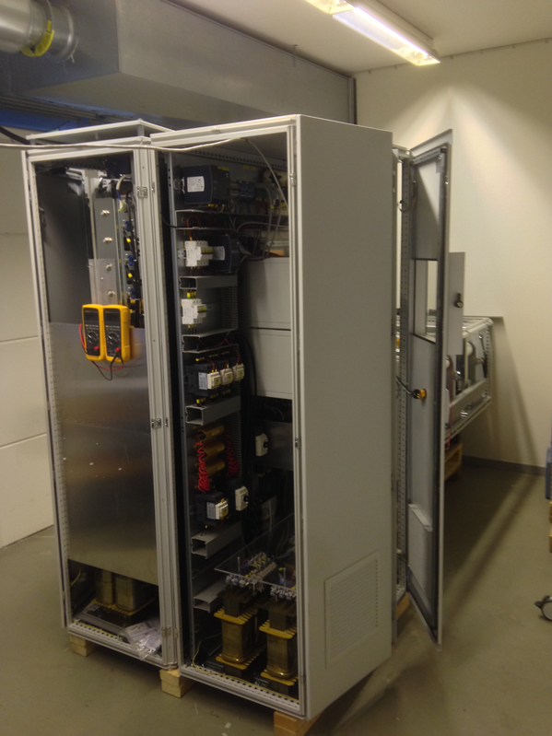
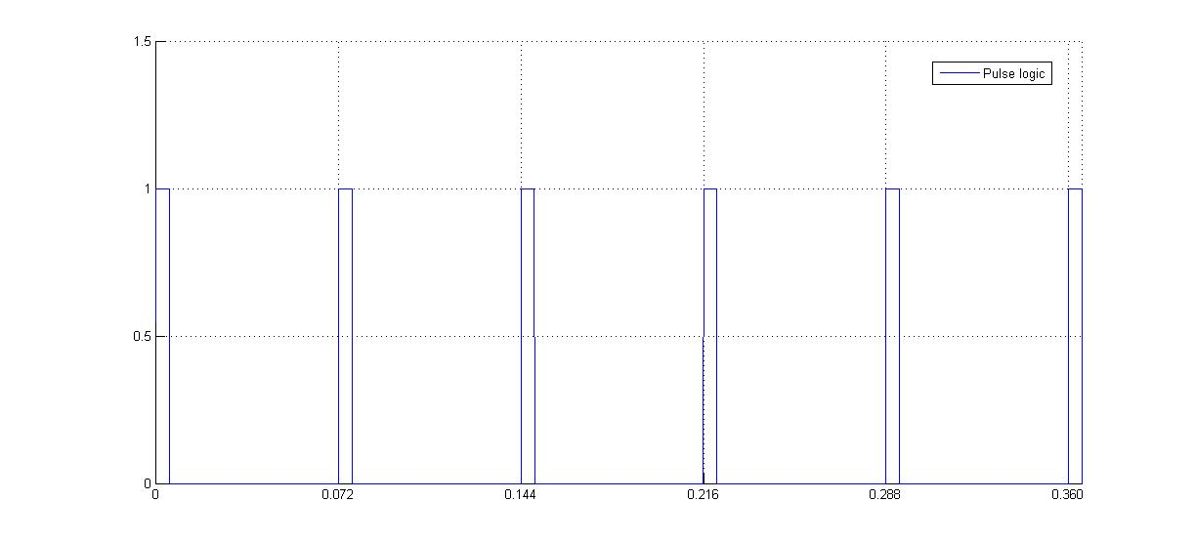
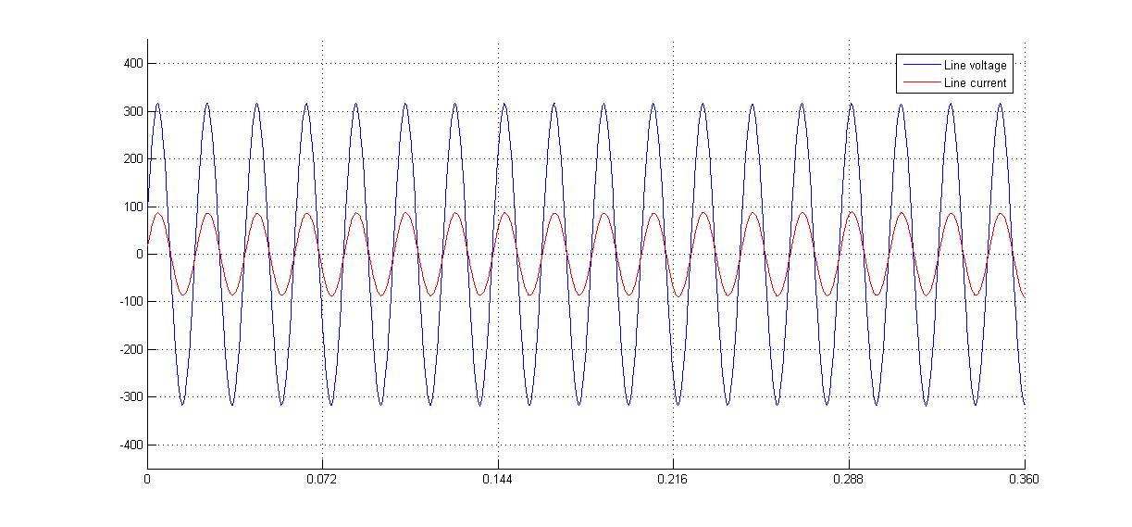
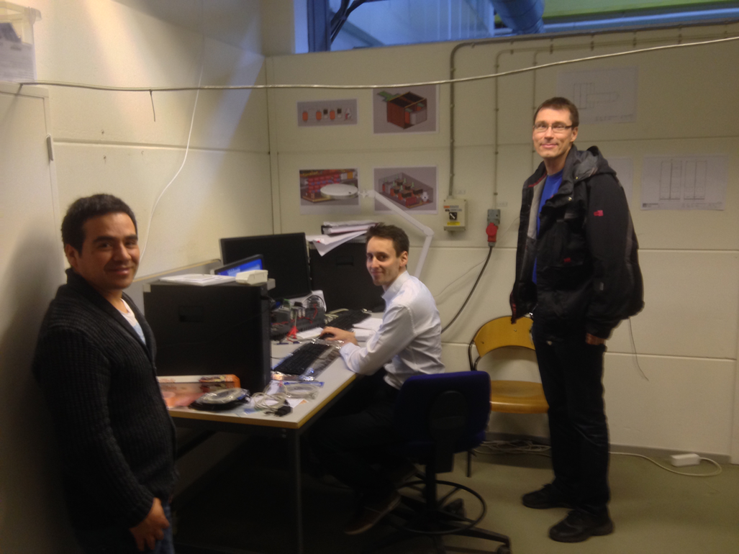
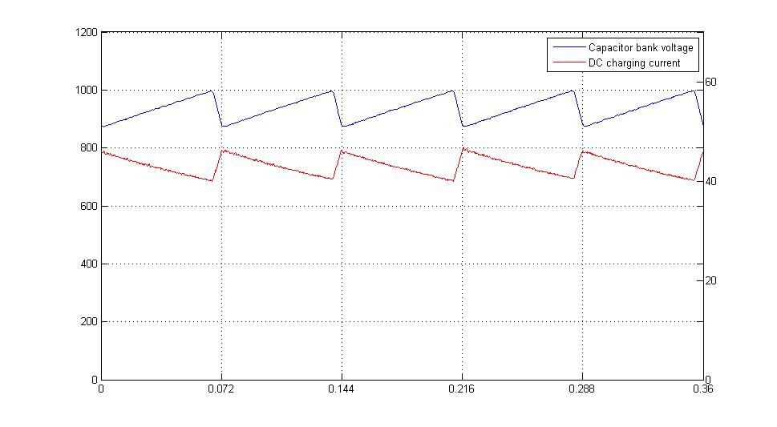
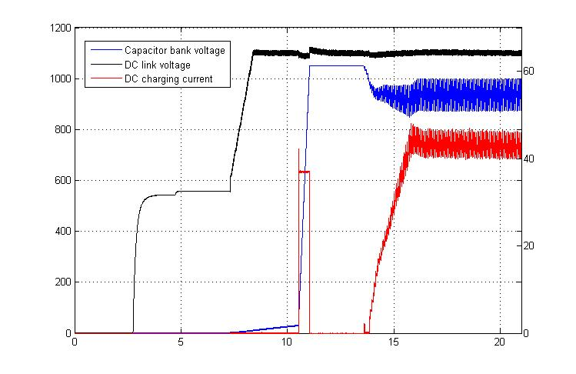
SML modulator, AC grid power quality:
- Experimental results of the low voltage power conversion stage
Controls & Human Machine Interface (labview)
Pulse (1kV)
AC line voltage
AC line current
Part I - Low voltage power converter stage
Unitary power factor;
Sinusoidal line current, constant amplitude -> No flicker
Capacitor bank voltage
Capacitor bank charging current
Automatic start-up sequence
(state machine)
Design and specifications:
ESS and LTH;
Charging current adapted as an inversed function of the voltage;
Constant power flow
Jun ’13

Slide 20
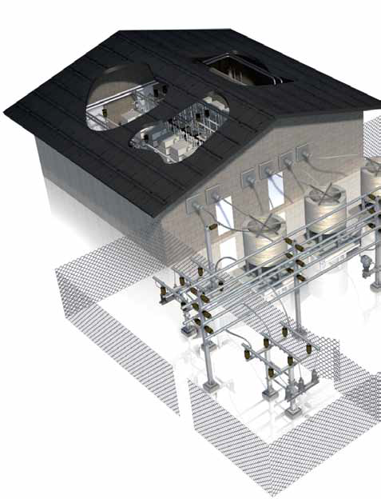
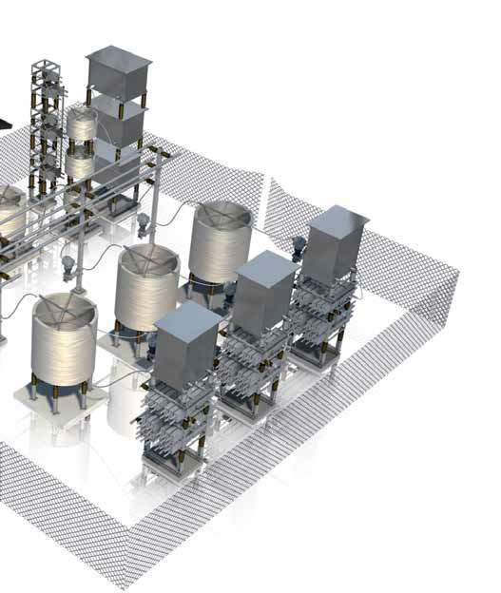
AC grid power quality:
– A classical approach with external grid compensators
140 kV
20 kV
20 kV
SVC
SVC
400V
400V
600V
400V
400V
600V
Modulators
Modulators
Modulators
Cryo compressors
Modulators
Cryo compressors
Beam Instrumentation
Beam Instrumentation
Neutron Instruments
Neutron Instruments
- SVC footprint (outdoors): 2 x (10m x 15m) = 300 m² (PROHIBITIVE !)
- SVC estimated cost : 2 x ~6 M€ = ~12 M€ (PROHIBITIVE !)
20

Slide 21
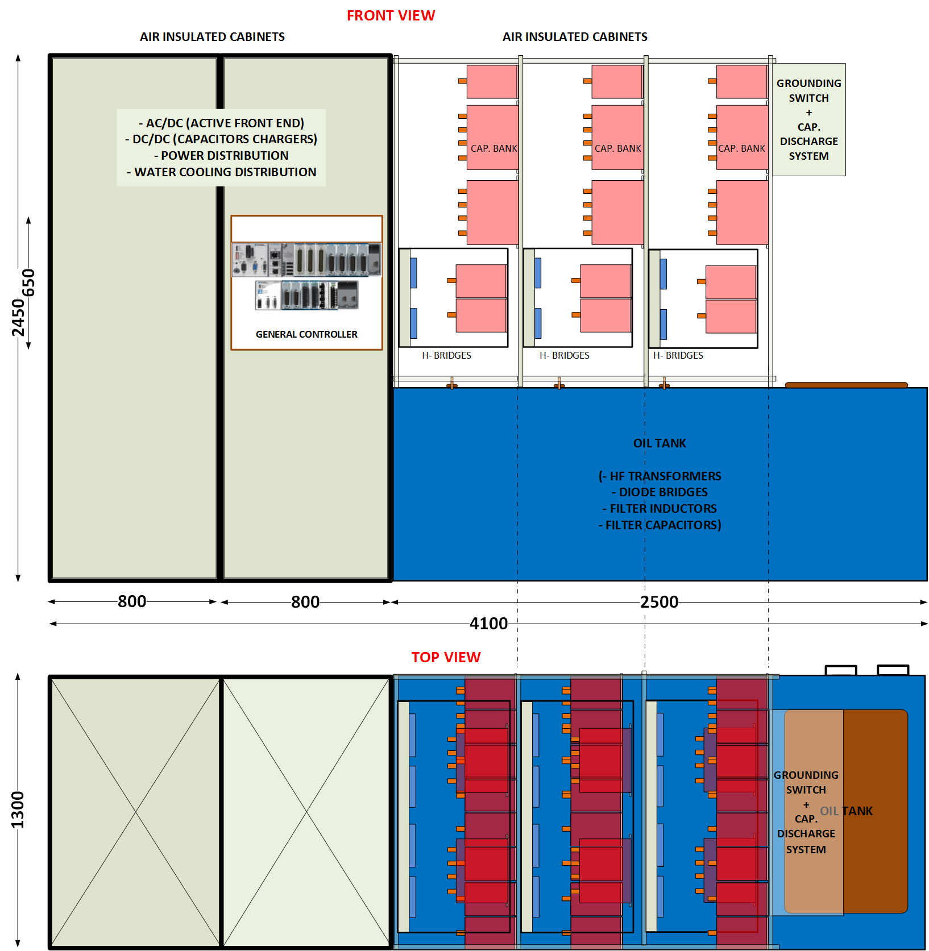
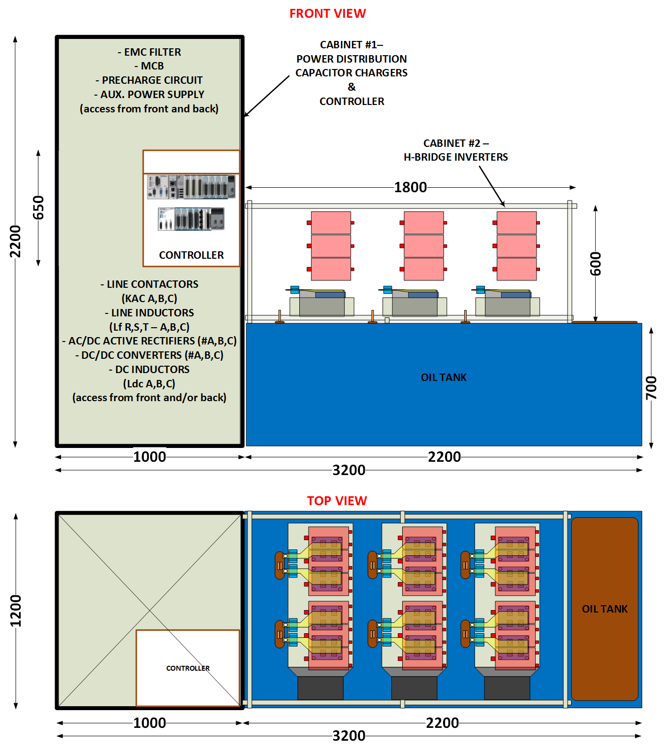
SML modulator:
- Reduced scale prototype and scaling up to full power
Possible reduced scale prototype for R&D:
115kV / 20A ; 3.5 ms / 14Hz
(130 kVA – 1x 704 MHz klystron)
Full scale system
115kV / 100A ; 3.5 ms / 14Hz
(660 kVA – 4x 704 MHz klystrons)

Slide 22
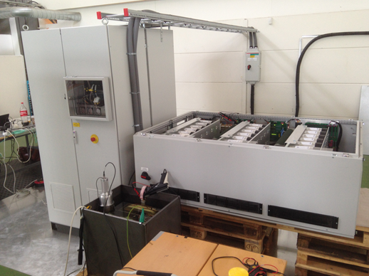
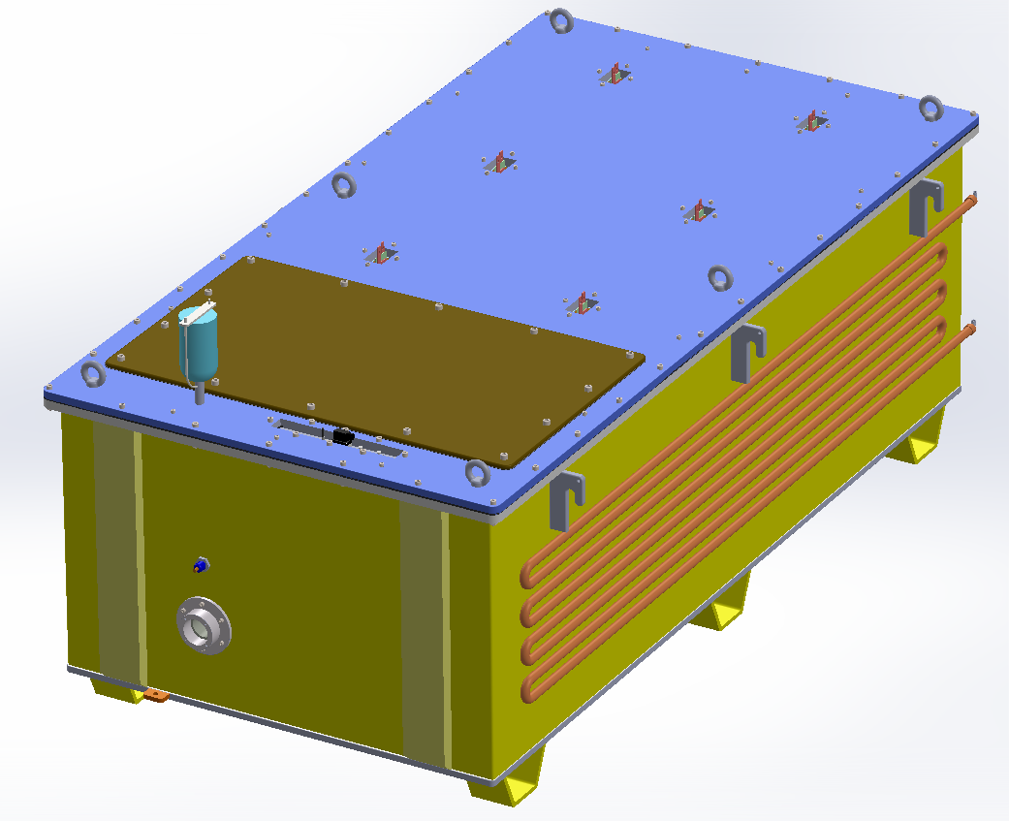
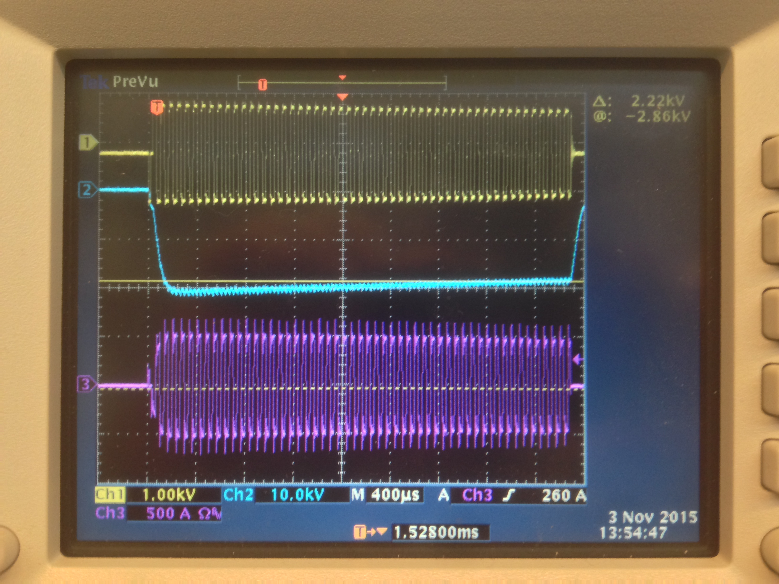
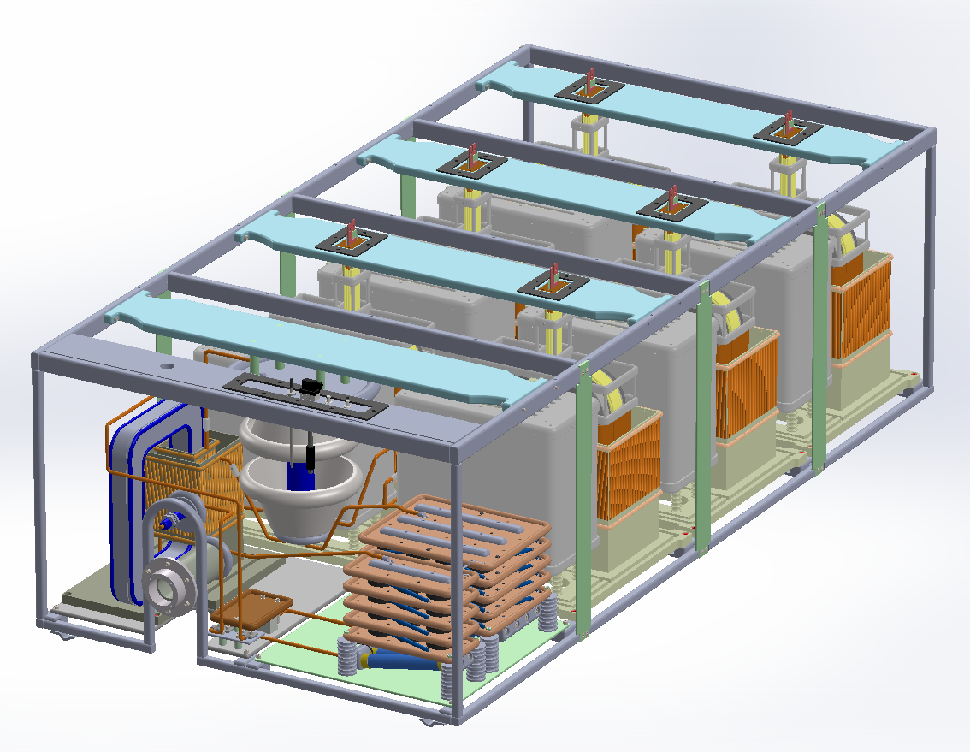
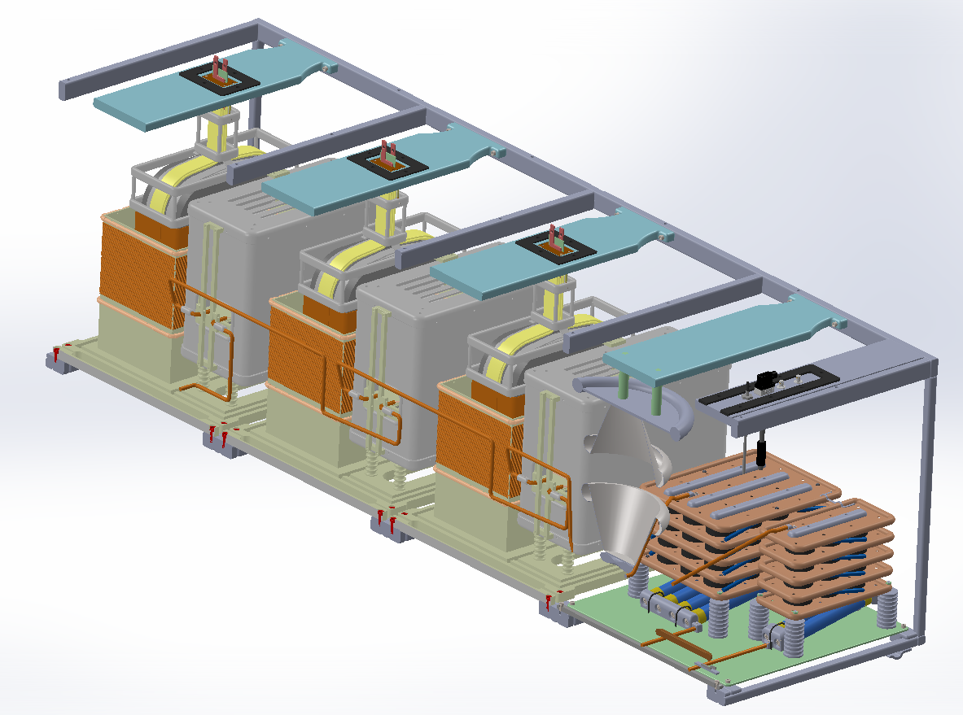
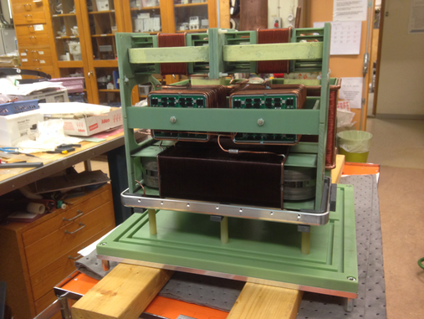
SML modulator :
- Design, prototyping and testing of the HV oil tank assembly.
Part I – Low voltage power converter
Silica gel breather
Tank lid
Part II – HV modules in oil tank
Inspection lid
Water cooling serpentine
HV output connector
Experimental results at full power: Pulsed at 20kV/20A, 3.5ms/14Hz
3.5ms pulse
HV module prototype in assembly workshop at LTH

Slide 23
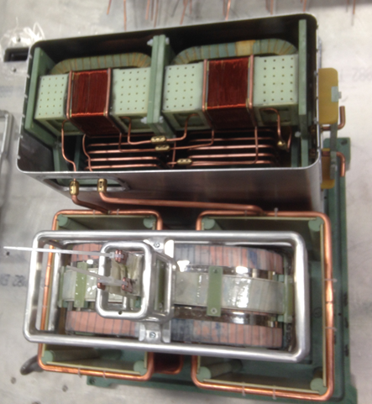
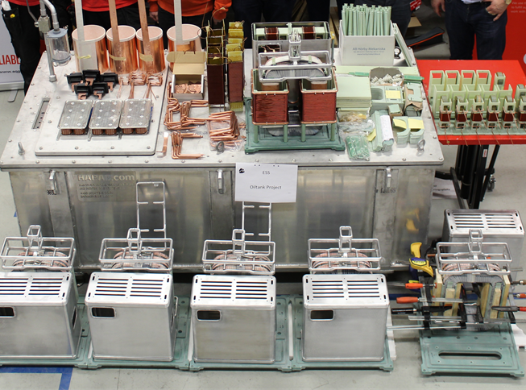
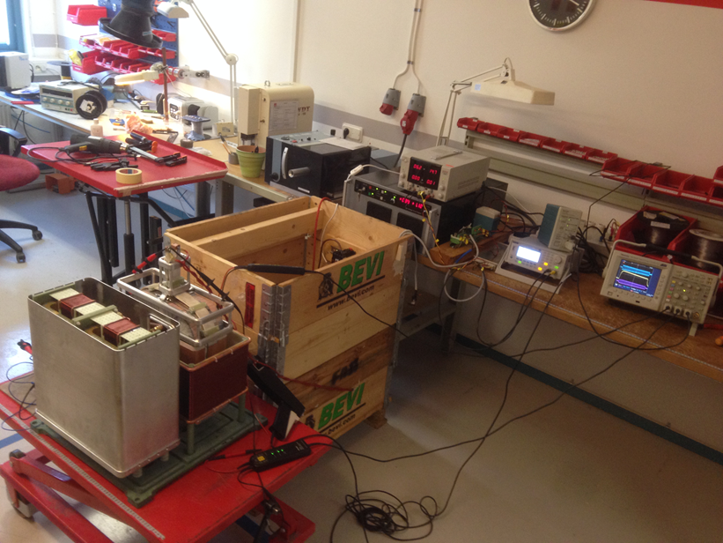
SML modulator HV oil tank assembly:
– Latest developments (beginning Feb. 2016)
HV module #1 assembled
Oil tank and components for HV modules
HV module #1 being tested

