Slide 1
Tabletop source of intense hard x-rays
toward a
Compact XFEL
W.S. Graves
MIT and Arizona State University
presented at Paul Scherrer Institute, July 2015

Slide 2
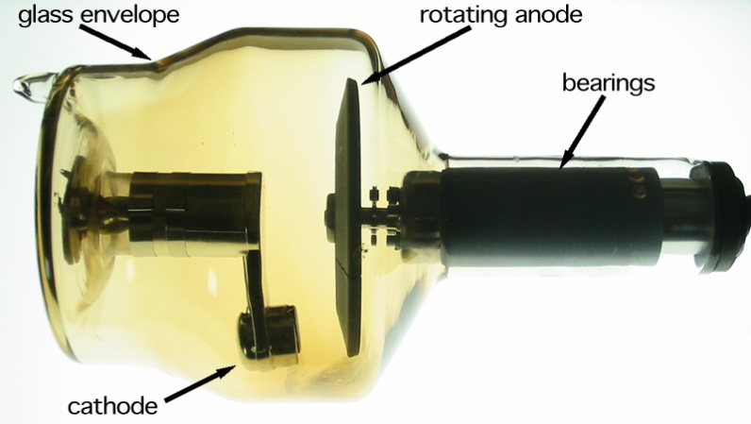
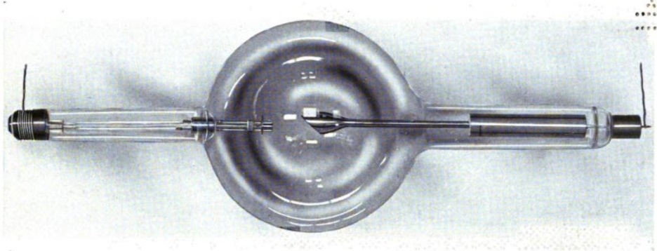
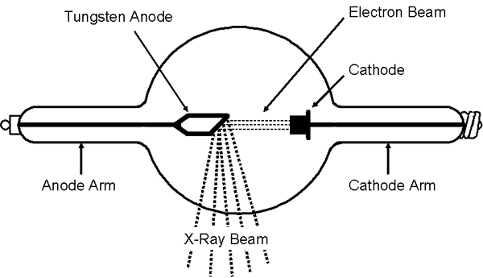
From Rontgen’s tube to today’s best laboratory-scale sources
X-ray tube from 1917
X-ray tube today
Tubes are primitive low energy (0.1 MeV) electron accelerators
Flux of 5 X 10⁹ photons/sec
Brilliance* of 10⁹
Factor of ~100 better than 100 years ago
*Brilliance is in units
photons/(sec mm² mrad² 0.1%)
X-ray flux of 10⁷ photons/sec from source of few mm² and large opening angle

Slide 3
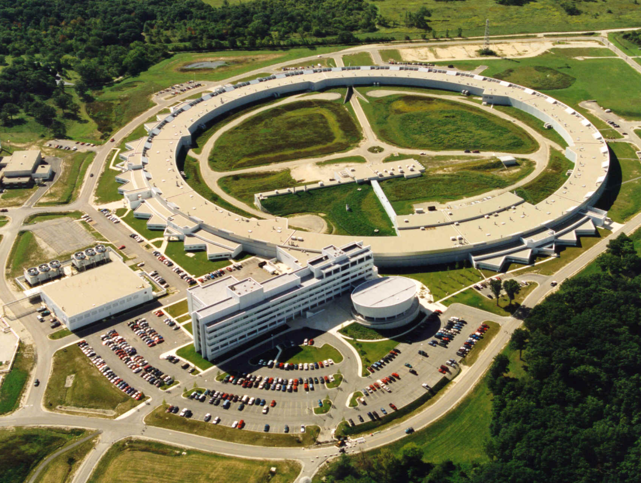
Particle accelerators in the 20th century
Synchrotron radiation from relativistic beams first developed around 1960 and is now mature 50 years later
X-ray flux of 10¹⁵ photons/sec into a 50 X 50 micron spot
X-ray brilliance of 10²¹ photons/(sec mm² mrad² 0.1%)
Roughly a trillion times brighter than a laboratory source!
kilometers in size
$1 billion in cost
7,000 MeV electron energy
1000’s of users
Advanced Photon Source (APS) at Argonne Nat’l Lab

Slide 4
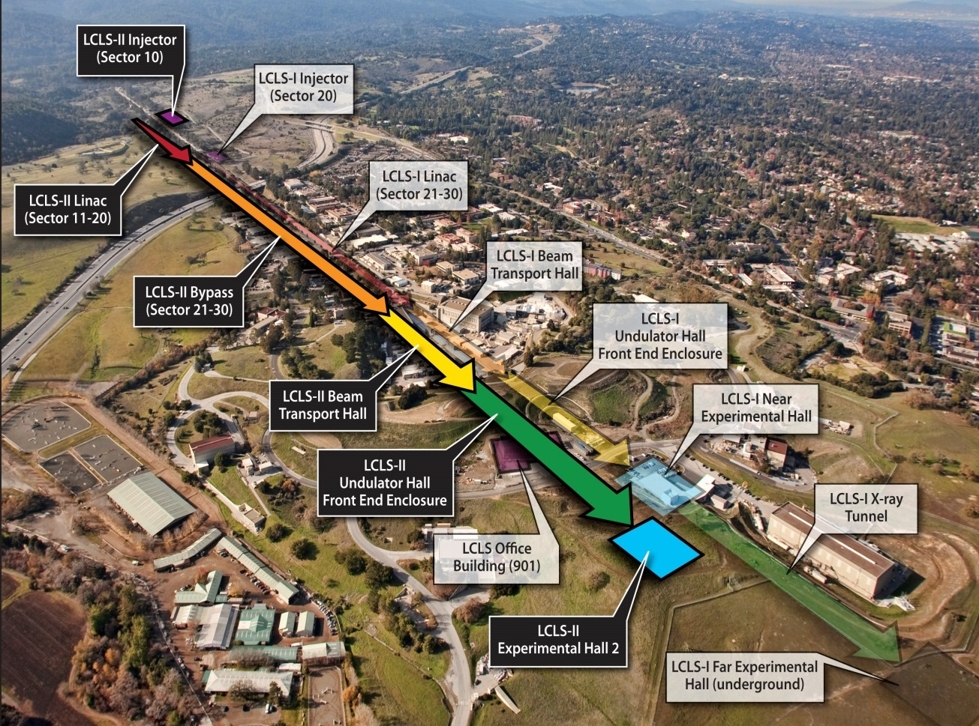
X-ray Free Electron Laser (XFEL)
Linac Coherent Light Source (LCLS) at Stanford
X-ray bursts of 10¹² photons in 100 fs
Peak x-ray brilliance of 10³³ photons/(sec mm² mrad² 0.1%)
Transverse coherence (not yet temporally coherent)
kilometers in size
$1 billion in cost
14,000 MeV electron energy
100’s of users

Slide 5
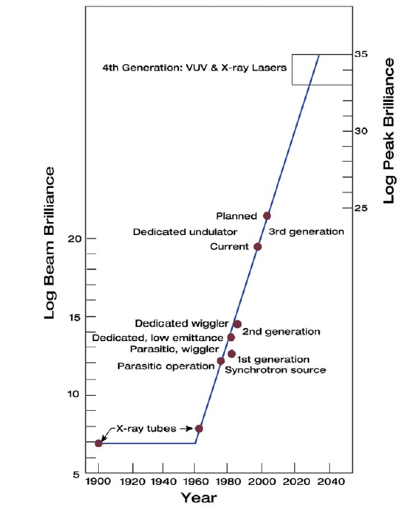
Generational advances in beam brilliance
X-ray Lasers
Coherent
Emission
Synchrotron
Radiation
Relativity
X-ray Tubes

Slide 6
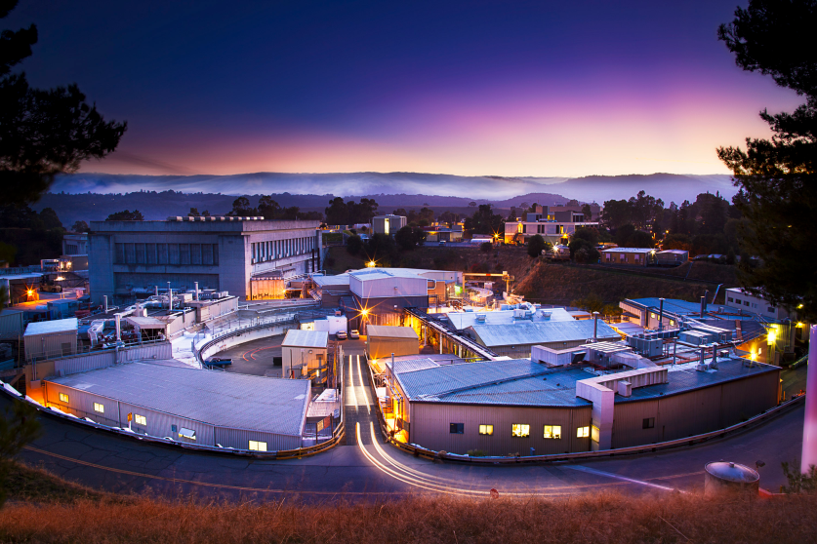
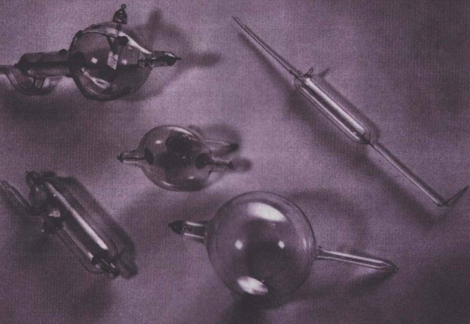
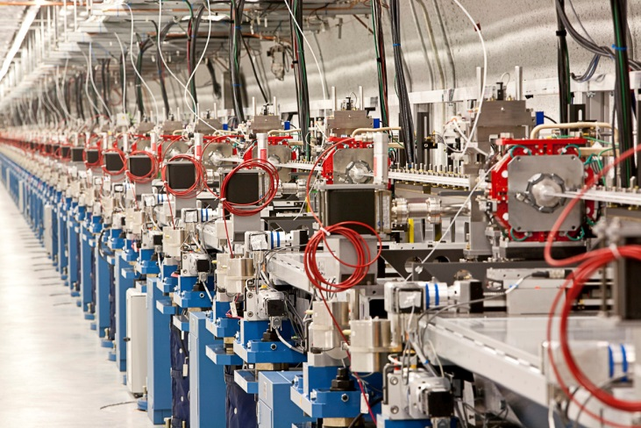
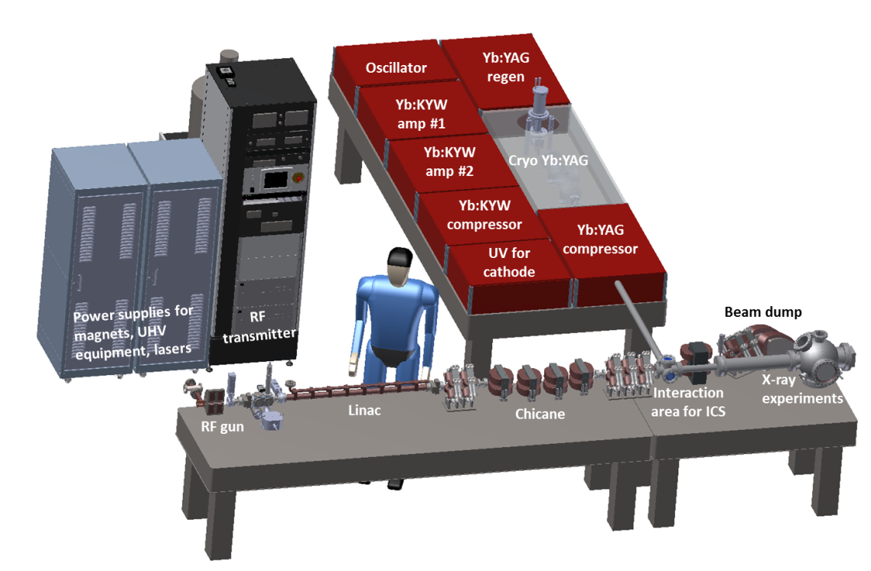
Blueprint for an intense compact x-ray source
Synchrotron radiation from relativistic beams (1975)
Coherent emission from XFEL (2010)
Compact size (1900)
Compact X-ray Light Source

Slide 7
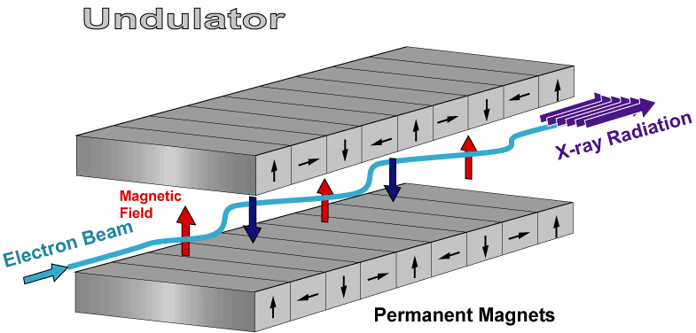
How to make a compact source?
Undulator Radiation
Use relativistic electrons but shrink the undulator period from cm to microns
Switch from static B-field to propagating EM field (laser)
Inverse Compton Scattering
Laser field
X-ray radiation
Electron beam

Slide 8
Basic Layout for ICS
Laser amplifier
Detector
RF gun
Quads
1 meter long linac
ICS
Dipole
Sample
X-ray optic
Laser cavity
Electron dump
<4 m

Slide 9
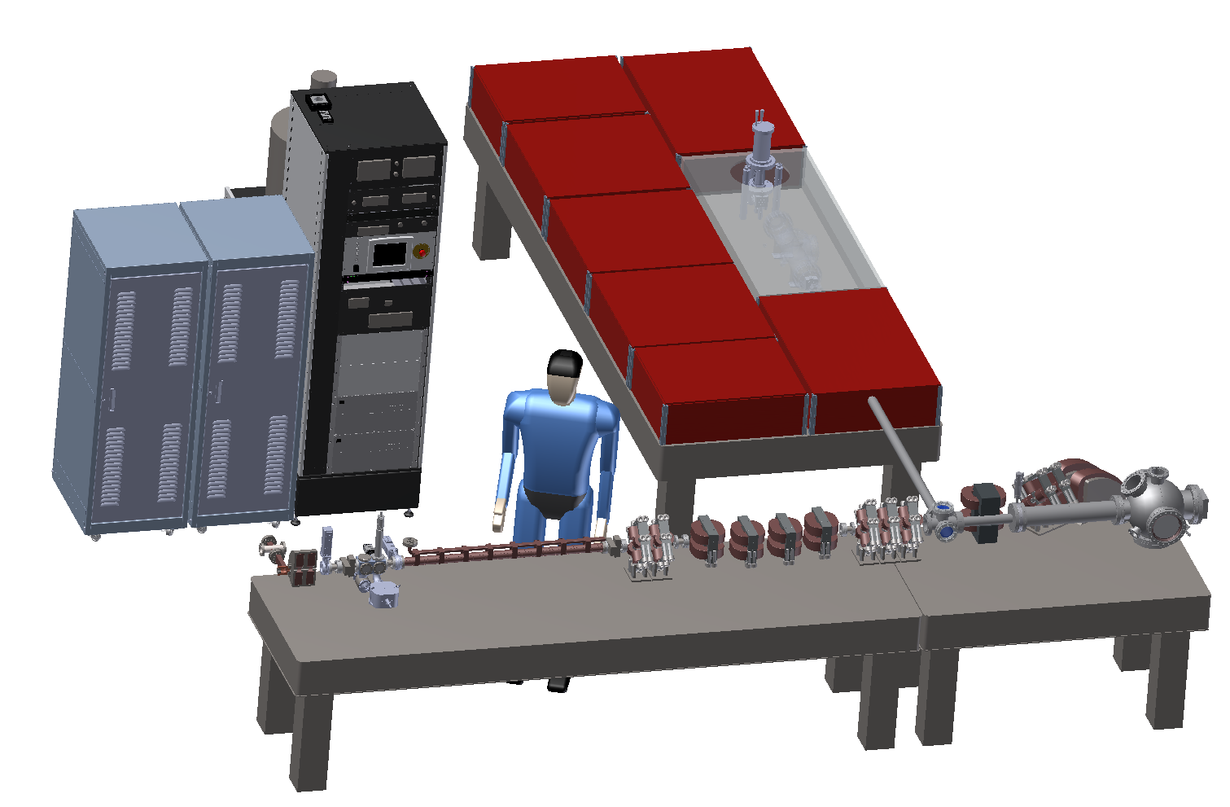
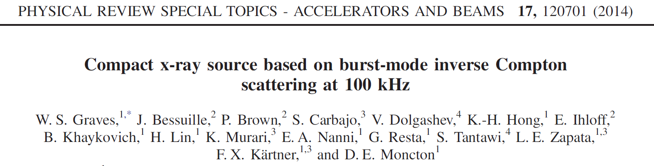
Compact X-ray Light Source (CXLS)
Oscillator
Yb:YAG regen
Yb:KYW amp #1
Yb:KYW amp #2
Cryo Yb:YAG
Yb:KYW compressor
Yb:YAG compressor
UV for cathode
Power supplies for magnets, UHV equipment, lasers
RF transmitter
Beam dump
Interaction area for ICS
X-ray experiments
Linac
Chicane
RF gun

Slide 10
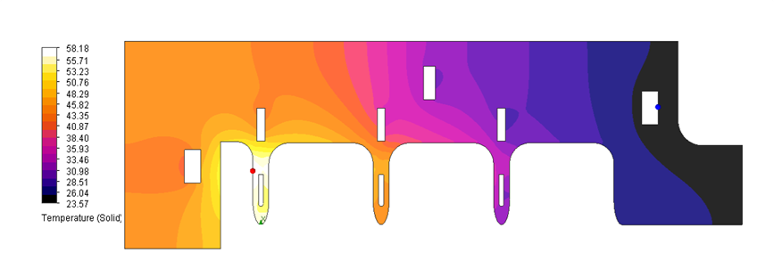
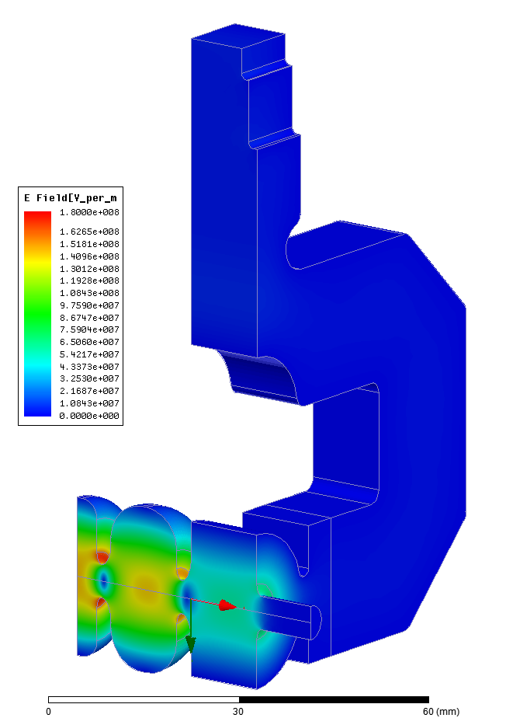
9.3 GHz RF photoinjector
V.A. Dolgashev, SLAC
2MW of RF power
Impedance transformer
Thermal profile at 2 kW avg power
Matched splitter
Input cell with race-track shape to minimize
quadrupole fields
High shunt impedance
accelerating cell
Photo-cathode
surface
Laser beam in
Electrons out

Slide 11
Novel 9.3 GHz SW Linac Structure
S. Tantawi, SLAC
Very high efficiency standing wave structure at 9.3 GHz
1 kHz rep rate
Every cell coupled from waveguide
Inexpensive to build
CUT-AWAY VIEW OF BRAZE ASSEMBLY
INCONEL SPRING PIN
ACCELERATOR CELL
FEED WAVEGUIDE
PRECISION ALIGNMENT HOLES
TUNING PIN
(2 PER CELL)
COUPLING HOLE
FEED WAVEGUIDE
CIRCUIT ‘HALF’
AXIAL COOLANT HOLES

Slide 12
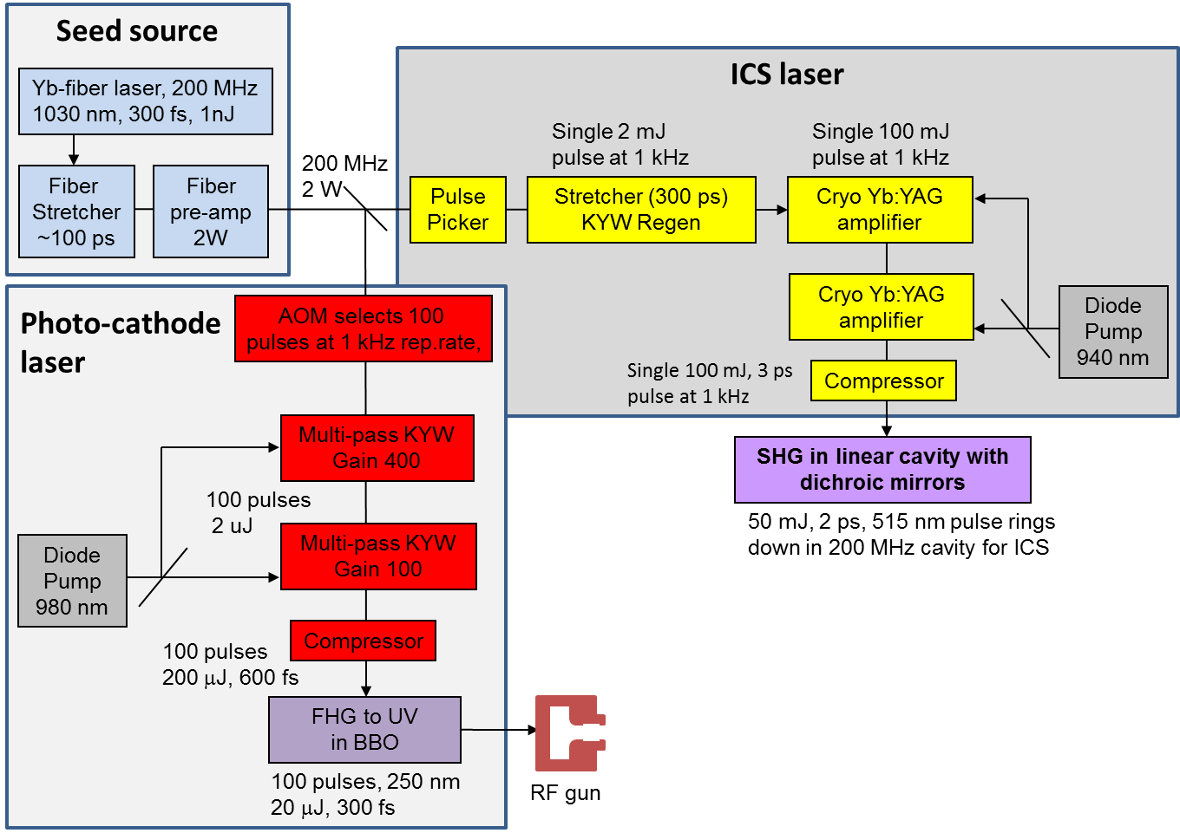
Two lasers, cathode and ICS
F. Kaertner group DESY and MIT

Slide 13
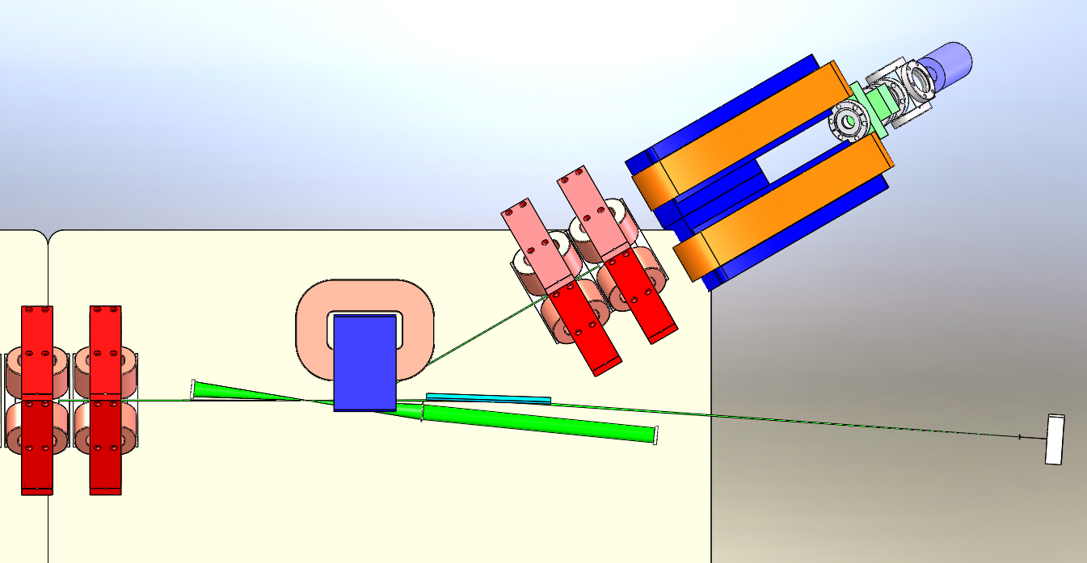
ICS Interaction Point (IP)
Interaction point
Electron dump
ebeam out
Dipole
Montel x-ray optic
x-rays out
Detector
ebeam in
Linear laser cavity with harmonic conversion
Quadrupole magnets

Slide 14
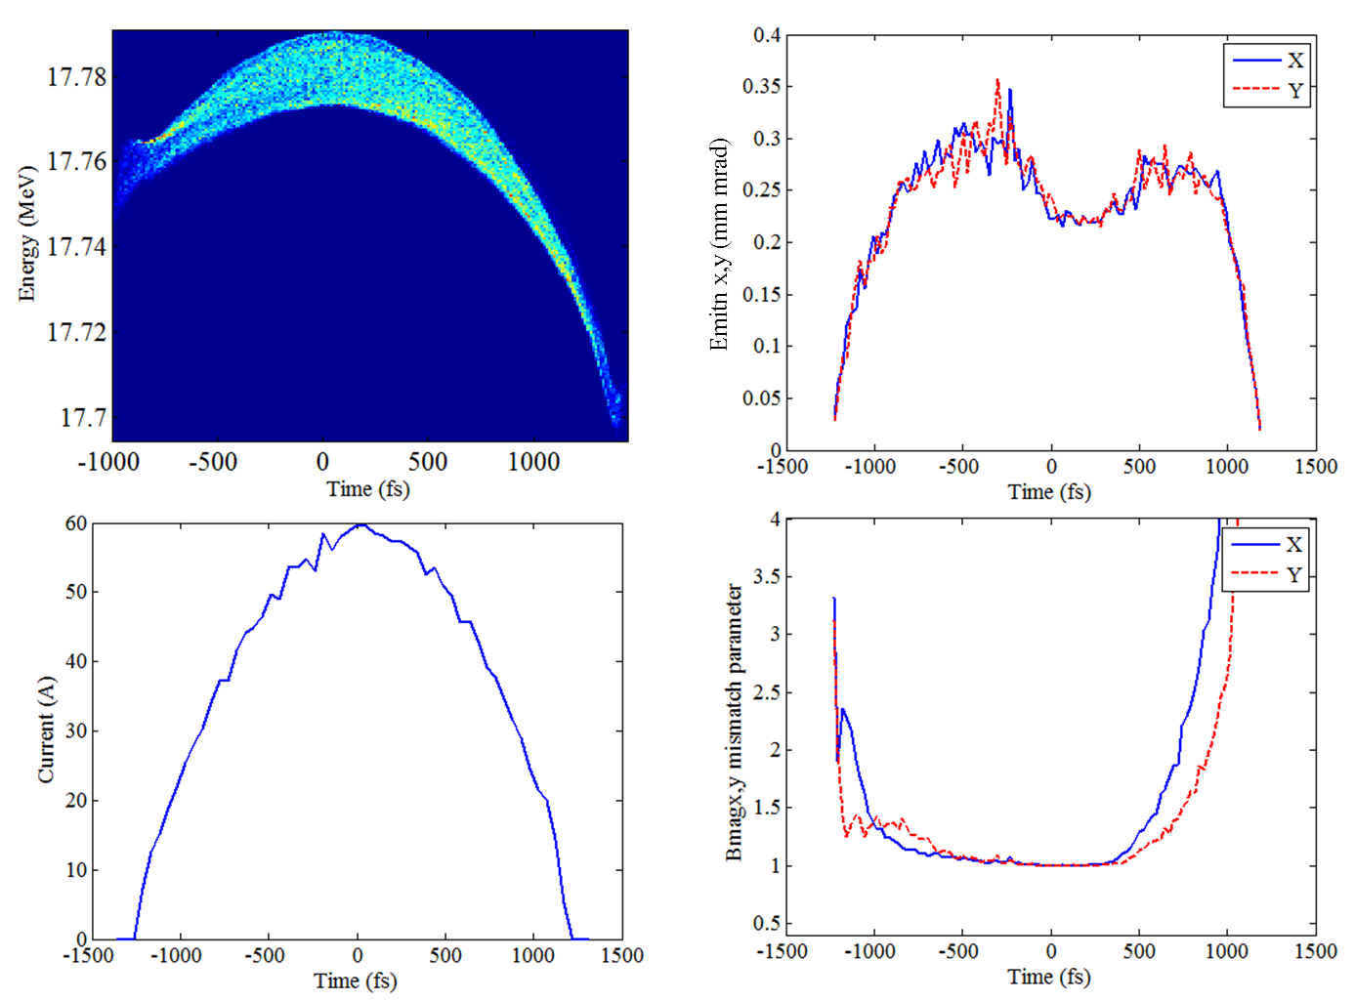
Slice ebeam parameters at IP

Slide 15
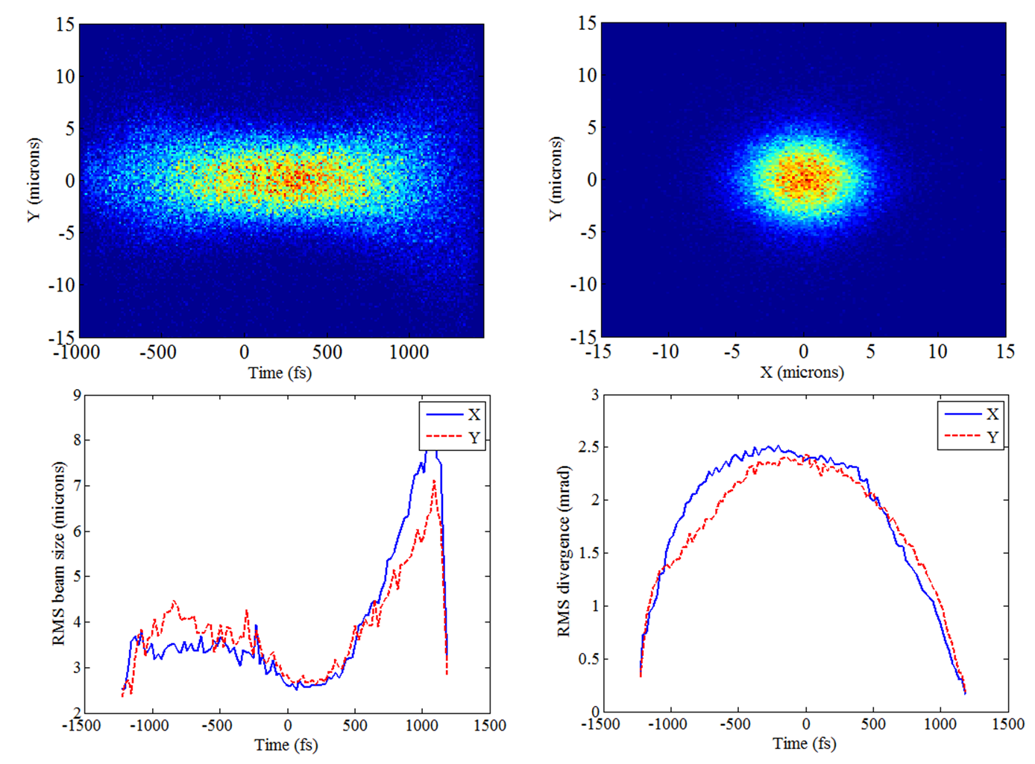
Electron beam at IP
PARMELA simulations

Slide 16
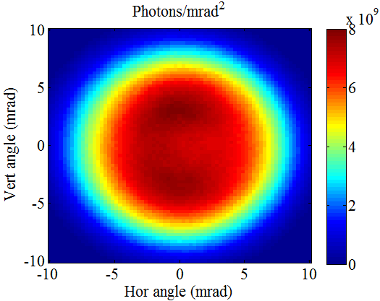
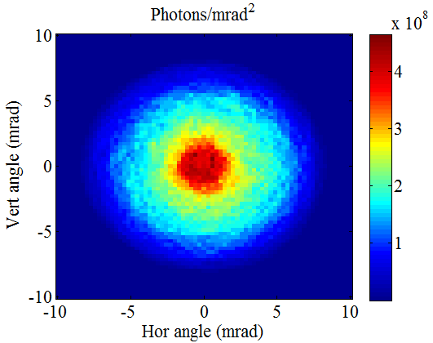
Opening angle of 12 keV radiation
Intensity vs angle for 5% bandwidth
Flux is 5x10¹¹ per second
Intensity vs angle for 0.1% bandwidth
Flux is 2x10¹⁰ per second
COMPTON simulations

Slide 17
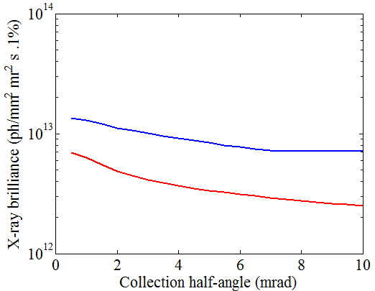
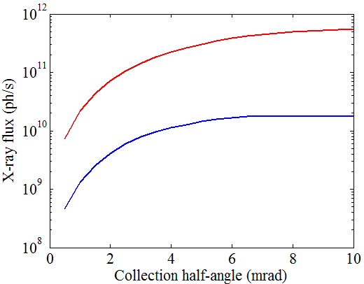
Flux and brilliance
5% BW
0.1% BW
0.1% BW
5% BW
Brilliance
7e12 in 0.1% BW
2e12 in 5% BW
Flux
2e10 in 0.1% BW
5e11 in 5% BW
ICS can put 10¹⁰ – 10¹¹ photons/sec into a 5 X 5 micron spot
Synchrotron bend is typically 10¹⁰ – 10¹¹ photons/sec in 100 X 100 micron spot

Slide 18
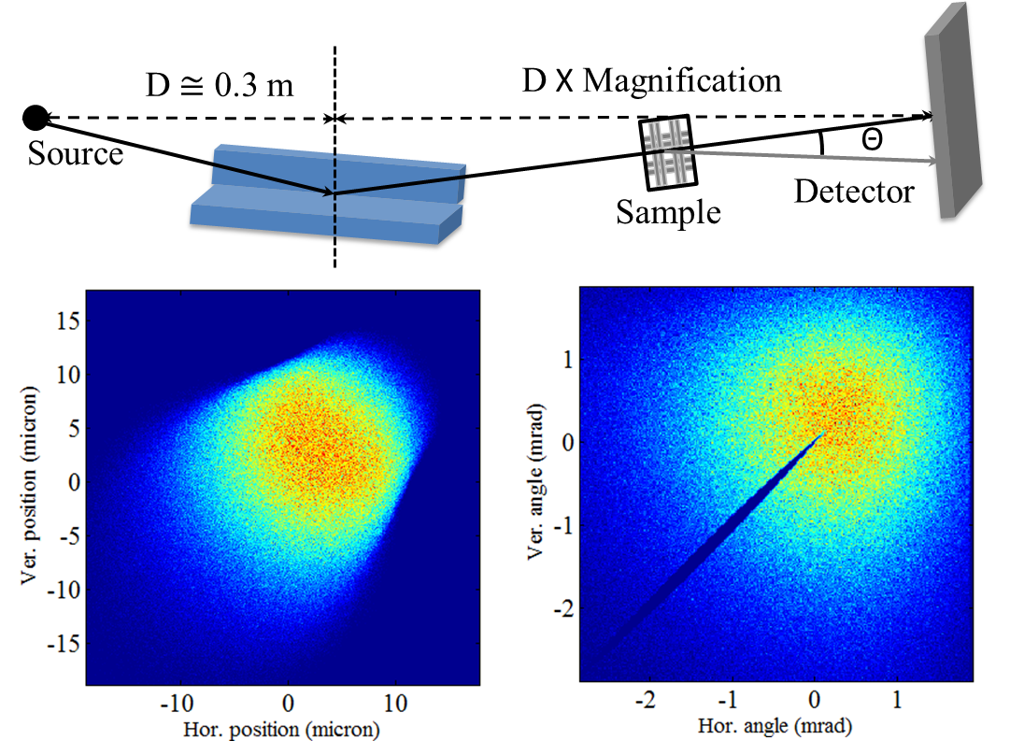
Focusing Optics
RMS source size and divergence are 2 microns and 4 mrad
Nested Si K-B optic with graded multilayer magnifies factor of 3
Optic collects 84% of light within 5% bandwidth.
Detector is ~1.2 m from source.

Slide 19
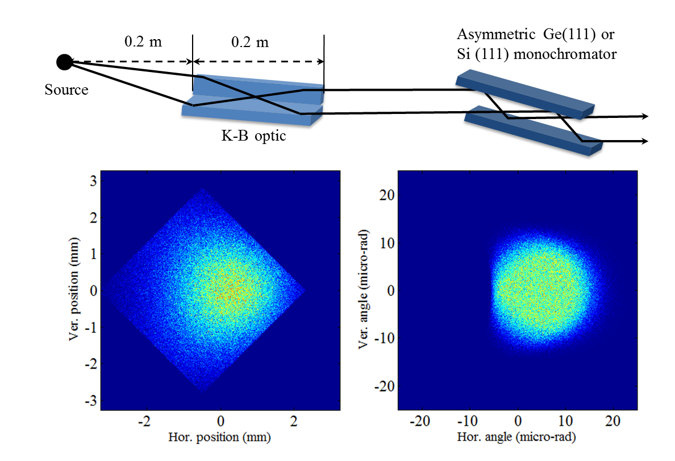
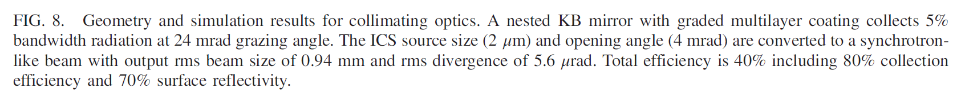
Collimating Optics

Slide 20
Summary of 12 keV parameters
(incoherent ICS, undulator-like radiation)
Parameter | 0.1% Bandwidth | 5% Bandwidth | Units
Average flux | 2x10¹⁰ | 5x10¹¹ | photons/s
Average brilliance | 7x10¹² | 2x10¹² | photons/(s .1% mm²mrad²)
Peak brilliance | 3x10¹⁹ | 9x10¹⁸ | photons/(s .1% mm²mrad²)
RMS horizontal size | 2.4 | 2.5 | microns
RMS vertical size | 1.8 | 1.9 | microns
RMS horizontal angle | 3.3 | 4.3 | mrad
RMS vertical angle | 3.3 | 4.3 | mrad
Photons per pulse | 2x10⁵ | 5x10⁶
RMS pulse length | 490 | 490 | fs
Repetition rate | 100 | 100 | kHz

Slide 21
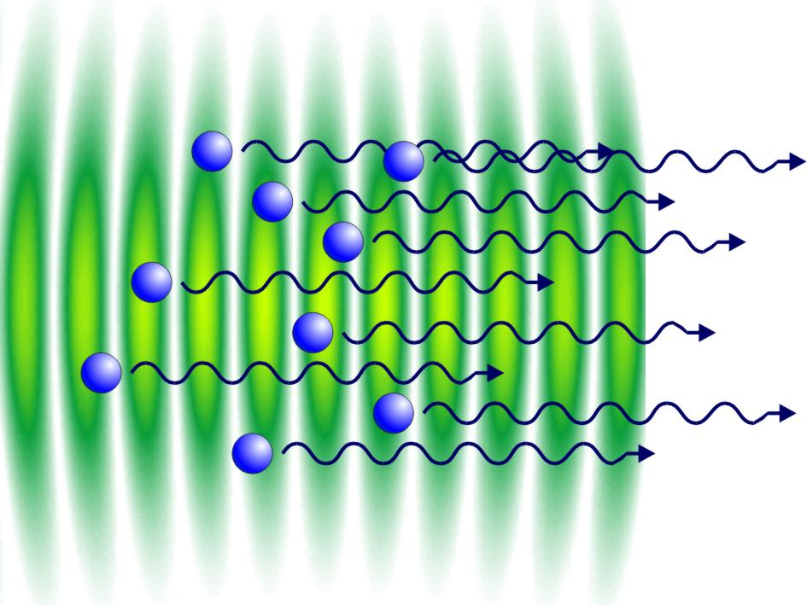
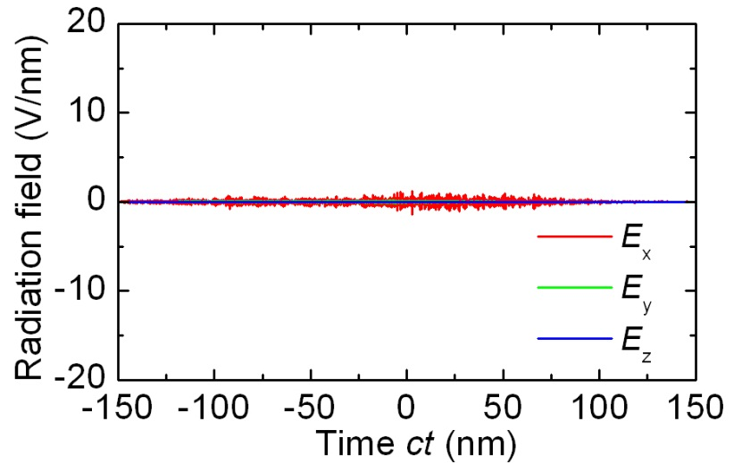
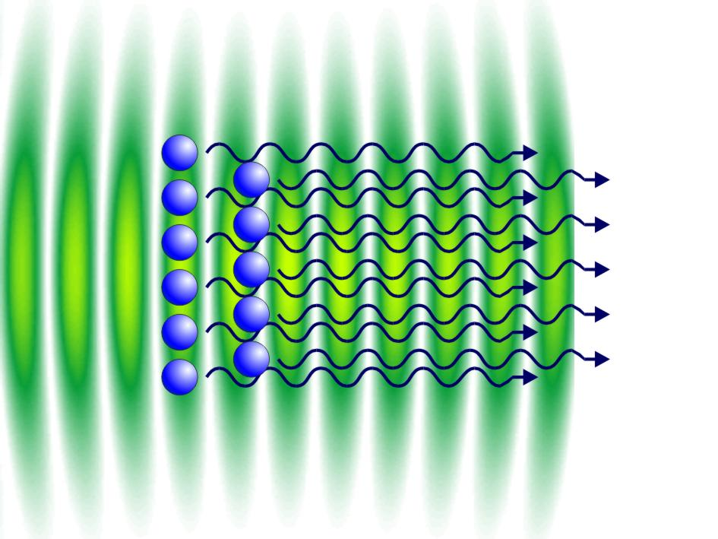
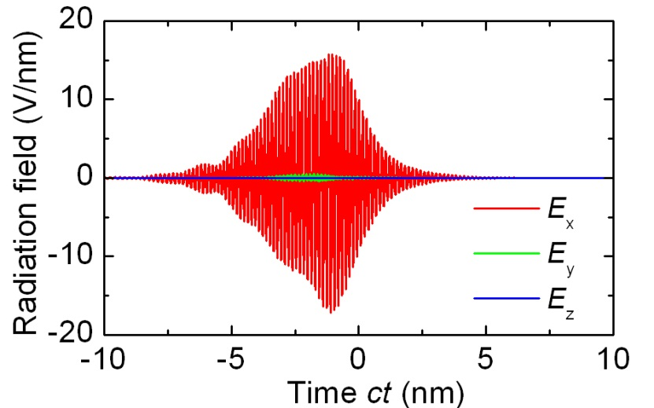
Toward an XFEL using coherent ICS
Randomly distributed electron beam
Graves et al, Phys Rev Lett 108, 263904 (2012)
Regular:
I_{x-ray} ~ N
Bunched electron beam
Coherent:
I_{x-ray} ~ N²
N > 10⁶

Slide 22
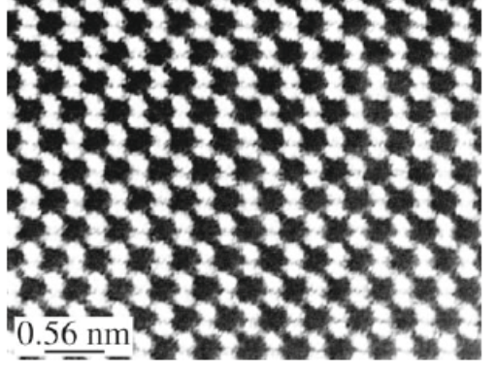
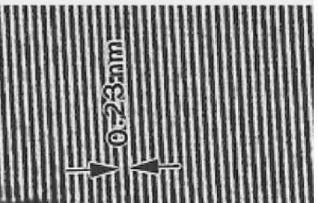
Transmission Electron Microscopy (TEM)
TEMs routinely achieve sub nm resolution (density modulation) with electron energy < 1 MeV
Perfect Si Crystal
Fringes from Stacking Faults in Al-Cu-Mg-Ag
0.23 nm

Slide 23
Emittance Exchange
y
Current
Diffracted beamlets
x
t
x’
Energy
x
t
EEX
x’
Energy
x
t
Bunched beam emits coherent ICS
y
Current
x
t

Slide 24
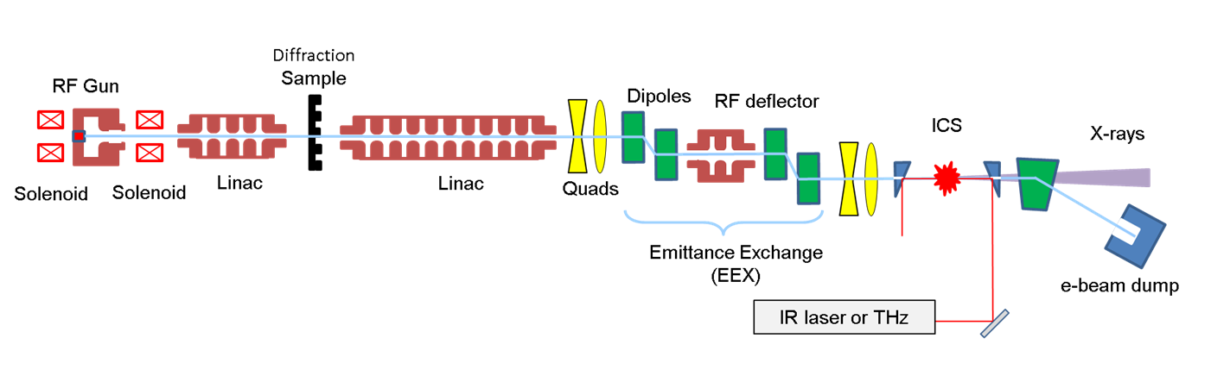
Compact XFEL layout
Electron Diffraction
Emittance Exchange (EEX)
“Nano-modulated electron beams via electron diffraction and emittance exchange for coherent x-ray generation”
E.A. Nanni, W.S. Graves, F.X. Kaertner, D.E. Moncton
arXiv:1506.07053v1, submitted to Phys Rev Lett
“Intense Superradiant X Rays from a Compact Source Using a Nanocathode Array and Emittance Exchange”
W.S. Graves, F.X. Kaertner, D.E. Moncton, and P. Piot
Phys Rev Lett 108, 263904 (2012)

Slide 25
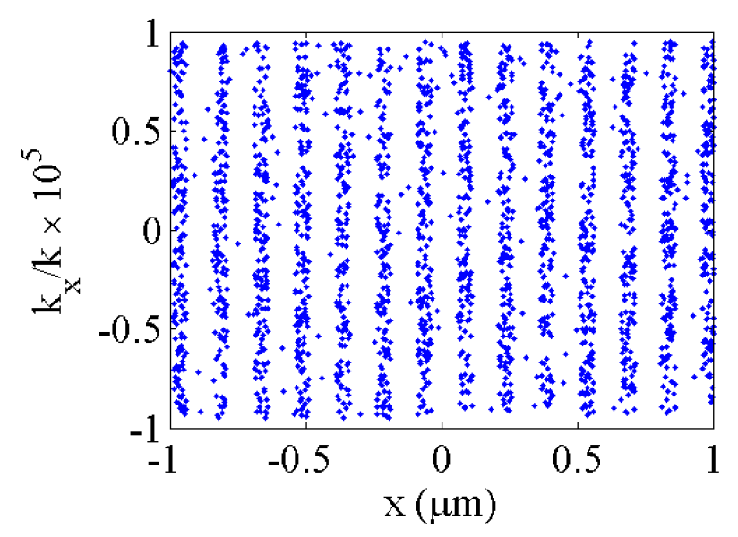
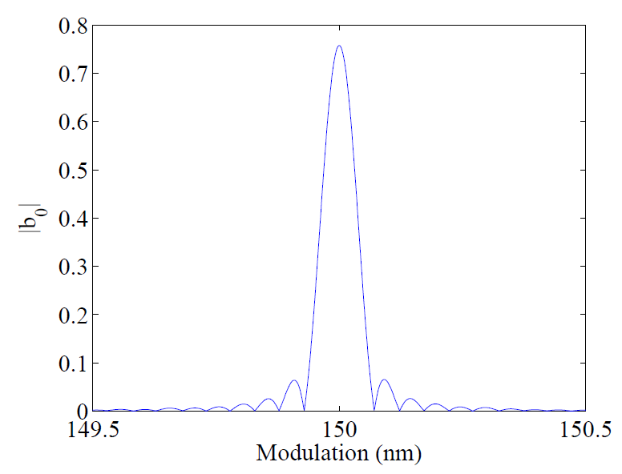
Diffraction Contrast Image
1st Order
0th Order
Tune the modulation spacing of the diffracted beam with patterned Si substrate
150 nm
675 nm
675 nm
Si
Incident Beam
Modulated Electron Beam
Bunching Factor
Emittance at IP:
ε_{x} = 9 nm-rad
ε_{y} = 9 nm-rad
ε_{z} = 10 nm-rad
~2000 Modulations

Slide 26
Electron Optics to the Interaction Point
Nanni, E. A., and W. S. Graves. "Aberration Corrected Emittance Exchange." arXiv:1503.03493 (2015), submitted to Phys Rev ST-AB
Accelerate electron bunch to the desired energy
Match resonance condition
Magnification of modulation to match
Exchange emittance (phase space) with aberration correcting geometry*
Diffraction
Sample
Electron
Diffraction

Slide 27
1.24 nm Modulation at Interaction Point (IP)
Electron beam simulated from photo-cathode to IP
Electron beam accelerated to 22.5 MeV after diffraction
Acceleration, Telescope and EEX result in M=1/120
0.35 pC of reaches IP
Modulated Electron Beam
Bunching Factor
Emittance at IP:
ε_{x} = 10 nm-rad
ε_{y} = 10 nm-rad
ε_{z} = 10 nm-rad
~2000 Modulations
~3 µm or ~10 fs

Slide 28
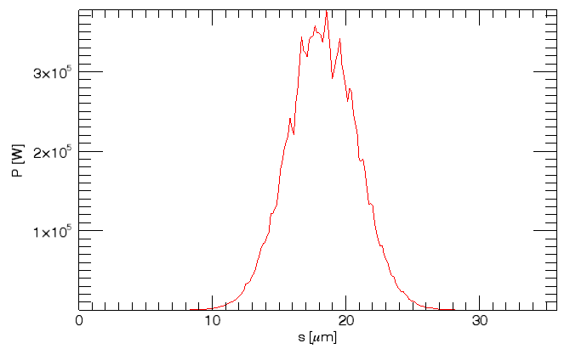
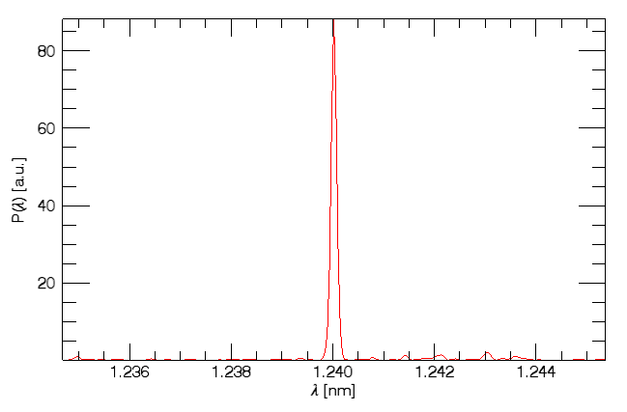
Simulation Results
1.24 nm Modulation – 1 keV X-ray
Pulse in Time
Parameter | Value | Units
Photons per pulse | 3.1x10⁷
Pulse energy | 5.0 | nJ
Average flux* | 3.1x10¹² | photons/s
Bandwidth (FWHM) | 0.1 | %
Average brilliance* | 10¹⁸ | #
Peak brilliance | 10²⁸ | #
Opening angle | 0.5 | mrad
Source size | 0.5 | µm
Pulse length | 28 | fs
Repetition rate | 100 | kHz
Average current | 50 | nA
Spectrum
*average values for 100 kHz rep rate
#photons/(s .1% mm²mrad²)

Slide 29
Brilliance of Compact Light Sources
X-ray Lasers
Compact XFEL (peak)
Compact XFEL (avg)
CXLS
X-ray Tubes

Slide 30
Conclusions
A low-risk hard x-ray compact source can outperform today’s lab sources by a factor of 10,000
CXLS flux/brilliance similar to synchrotron bending magnet beamline
CXLS has many applications inaccessible to a synchrotron
A fully coherent compact XFEL based on this technology is likely within 5 years

Slide 31
People
MIT
K. Berggren, J. Bessuille, P. Brown, W. Graves, R. Hobbs, K.-H. Hong, W. Huang, E. Ihloff, F. Kärtner, D. Keathley, D. Moncton, E. Nanni, M. G. Resta, Swanwick, L. Vasquez-Garcia, L. Wong, Y. Yang, L. Zapata
DESY
J. Derksen, A. Fallahi, F. Kärtner
Northern Illinois University
D. Mihalcea, P. Piot, I. Viti
Jefferson Lab
F. Hannon, Feisi He, J. Mammosser
SLAC
V. Dolgashev, S. Tantawi

