Slide 1
Heidelberg Solenoid Magnet for Mu3e Experiment
Danfysik proposal
Nils Hauge 23/9-2015

Slide 2
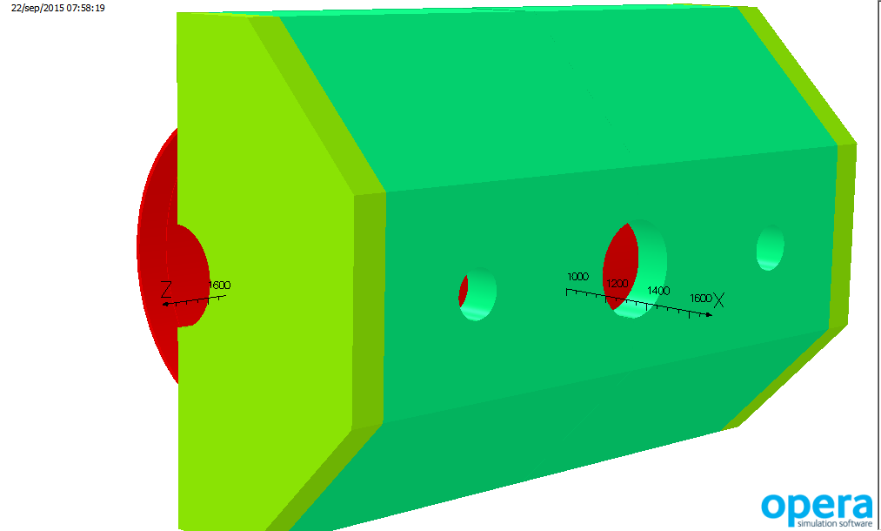
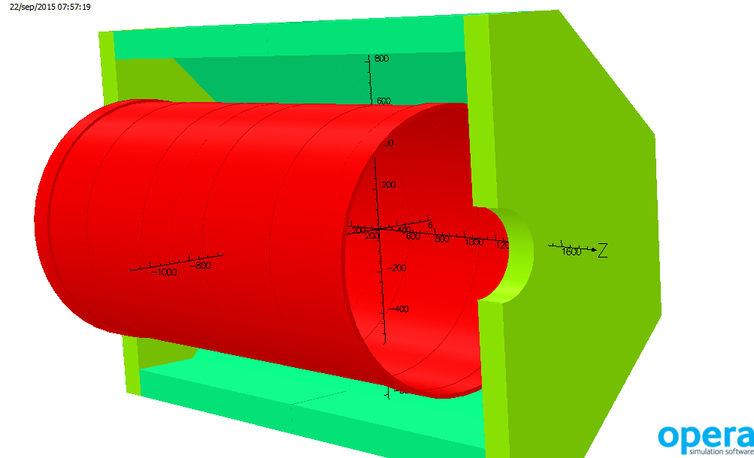
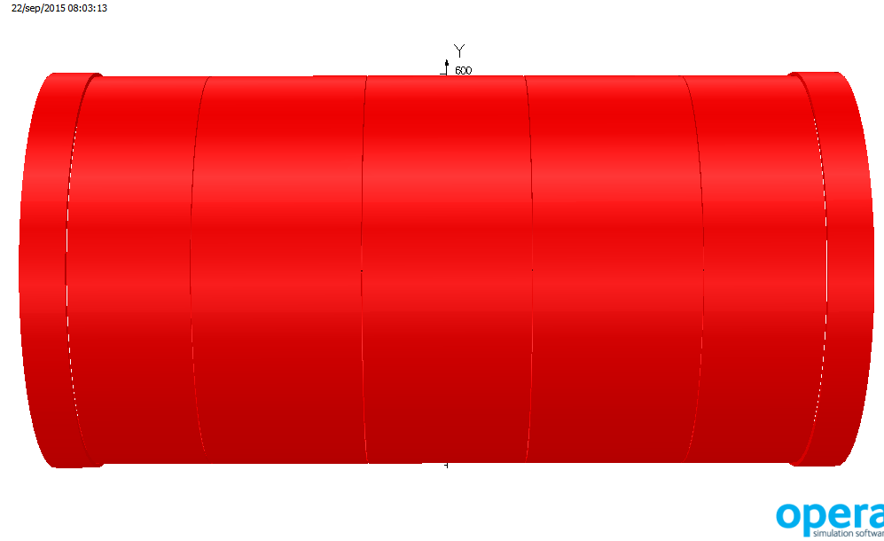
Heidelberg SC Solenoid Magnet
Octogonal Return Yoke
Split End Plates with holes
Main Coil in 5 Subcoils
Shim Coils at each end

Slide 3
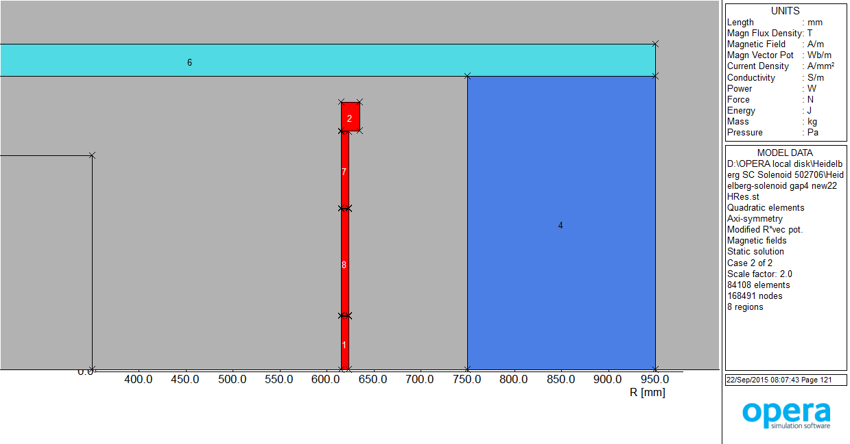
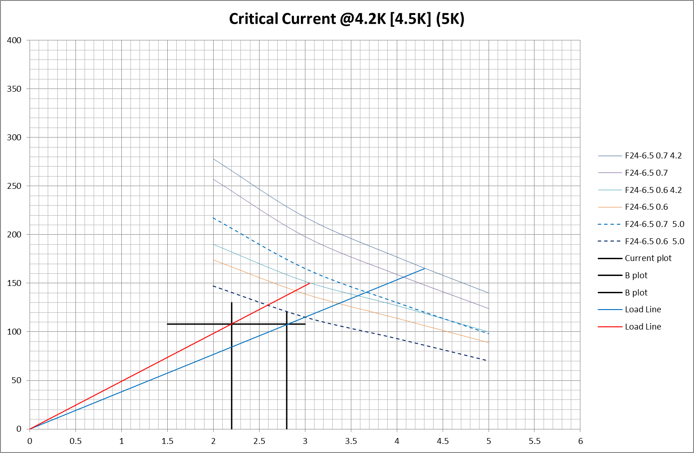
Heidelberg SC Solenoid Magnet
Main Coil wound with dia0.6mm wire
Shim Coil wound with dia0.7mm wire
Optimum Load Line levels
Wire F24-6.5, Formvar enamelled

Slide 4
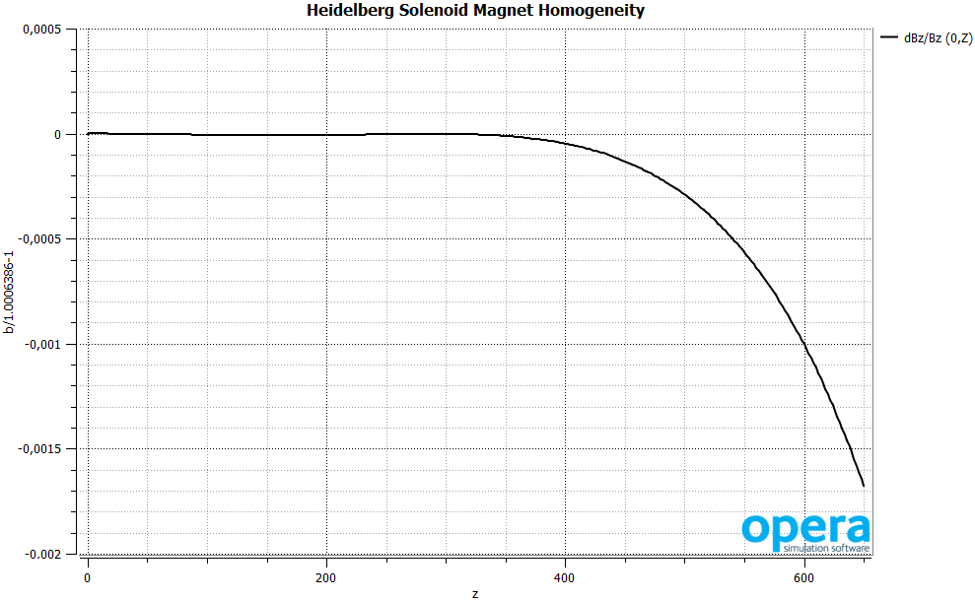
Heidelberg SC Solenoid Magnet
Homogeneity <0.2% on axis, z=650, Bz0 = 1T
Maxima at Z=0
Local Maxima at Z=300

Slide 5
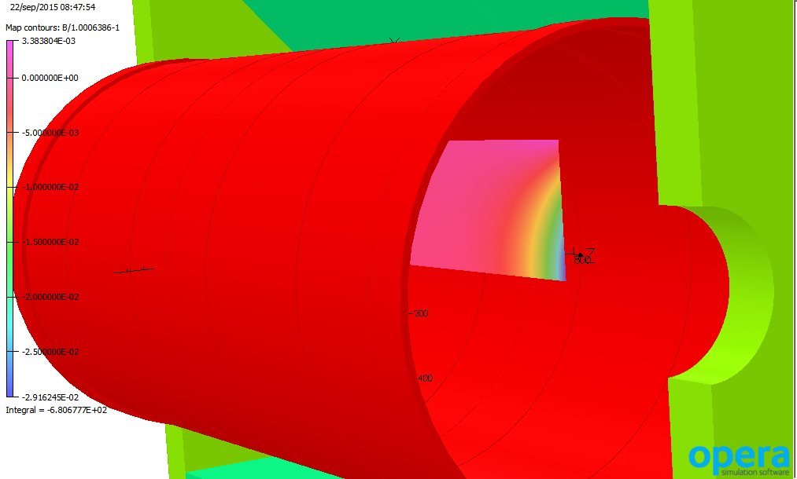
Heidelberg SC Solenoid Magnet
Homogeneity <3.3% up to (R,Z) = (350,1000)
Bz(0,0) = 1T

