Slide 1
Paul Scherrer Institut
Sven Forss
Dismantling injector 1 – Status

Slide 2
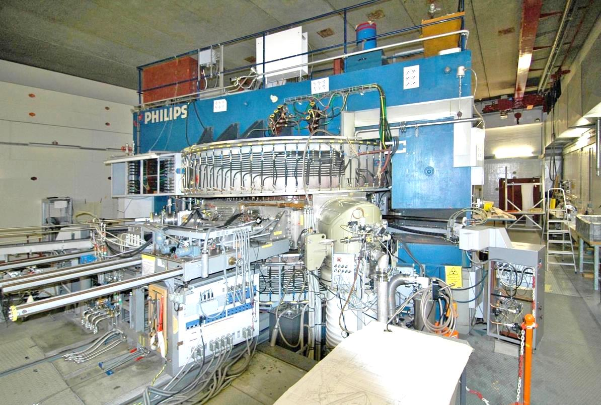
Cyclotron „injector 1“
© Paul Scherrer Institut, 5232 Villigen
Inj1 – peripheral installations, rf-resonators

Slide 3
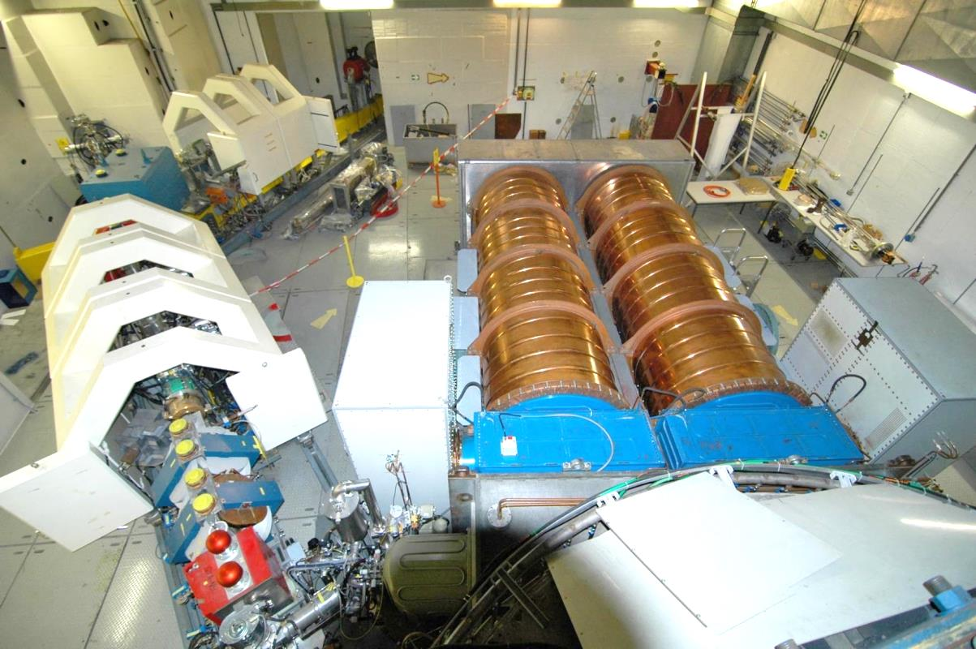
Cyclotron „injector 1“ – peripheral installations
© Paul Scherrer Institut, 5232 Villigen
Inj1 – peripheral installations, rf-resonators

Slide 4
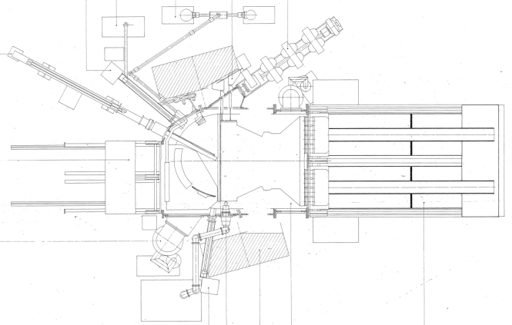
Overview on main components
main target
ion source
cryo
trim plate (stabilisation rf)
extraction beam line
main magnet
high vacuum
rf-amplifier
vacuum chamber (2 parts)
resonator
coupling box
resonator inner tube
Dee
Anschlussbox
extractor on table
EMD
isolation plate
coupling box
rf-amplifier
short circuit sliding dvice
cryo panel
resonator carriage
axial injection
high vacuum
septum + ESD
additional target
rf-amplifier

Slide 5
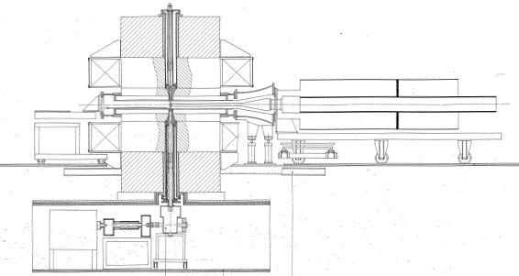
Overview on main components
mirror
main magnet
main coils
vacuum chamber (2 parts)
extractor
pole plates with trim coils
Resonator carriage with resonatores
basement: injection area
axial injection

Slide 6
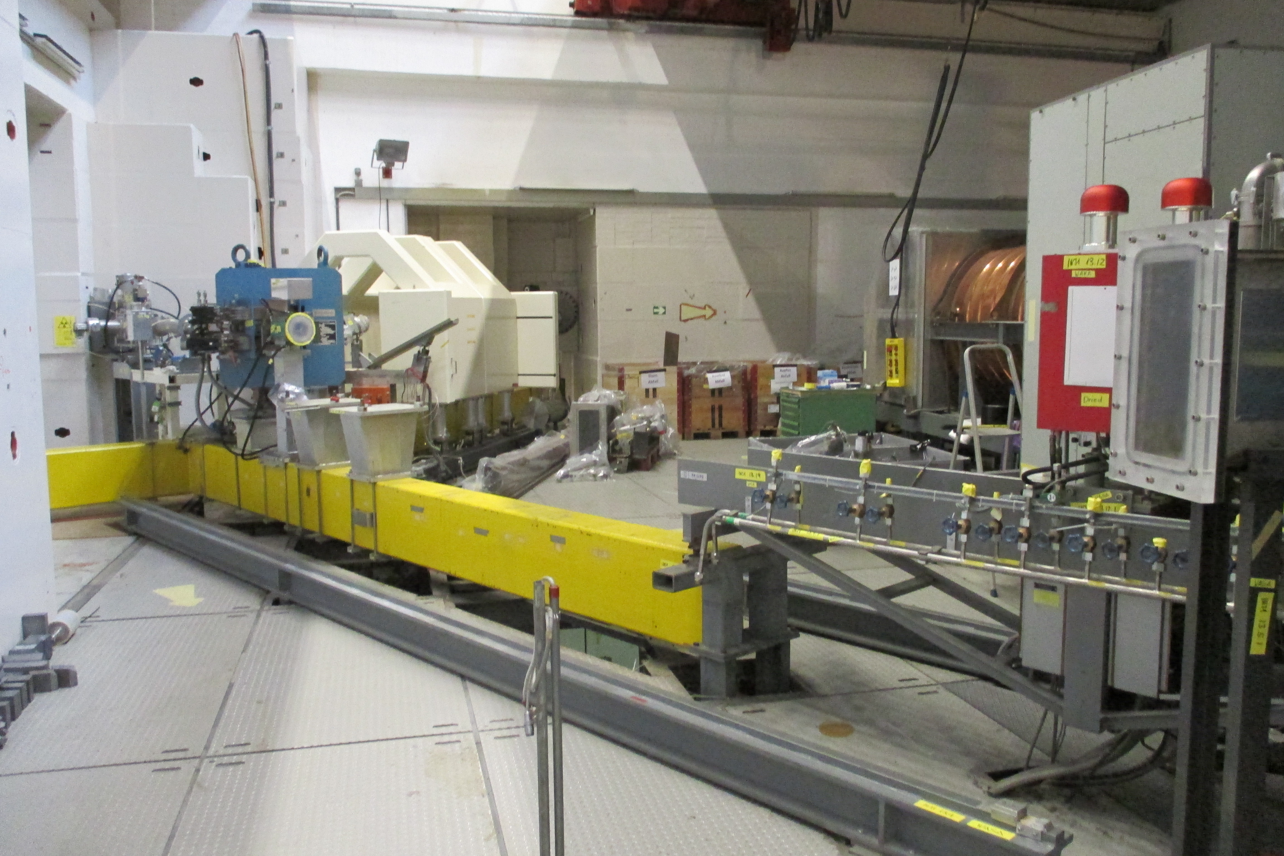
Inj 1 – dismantling beam line

Slide 7
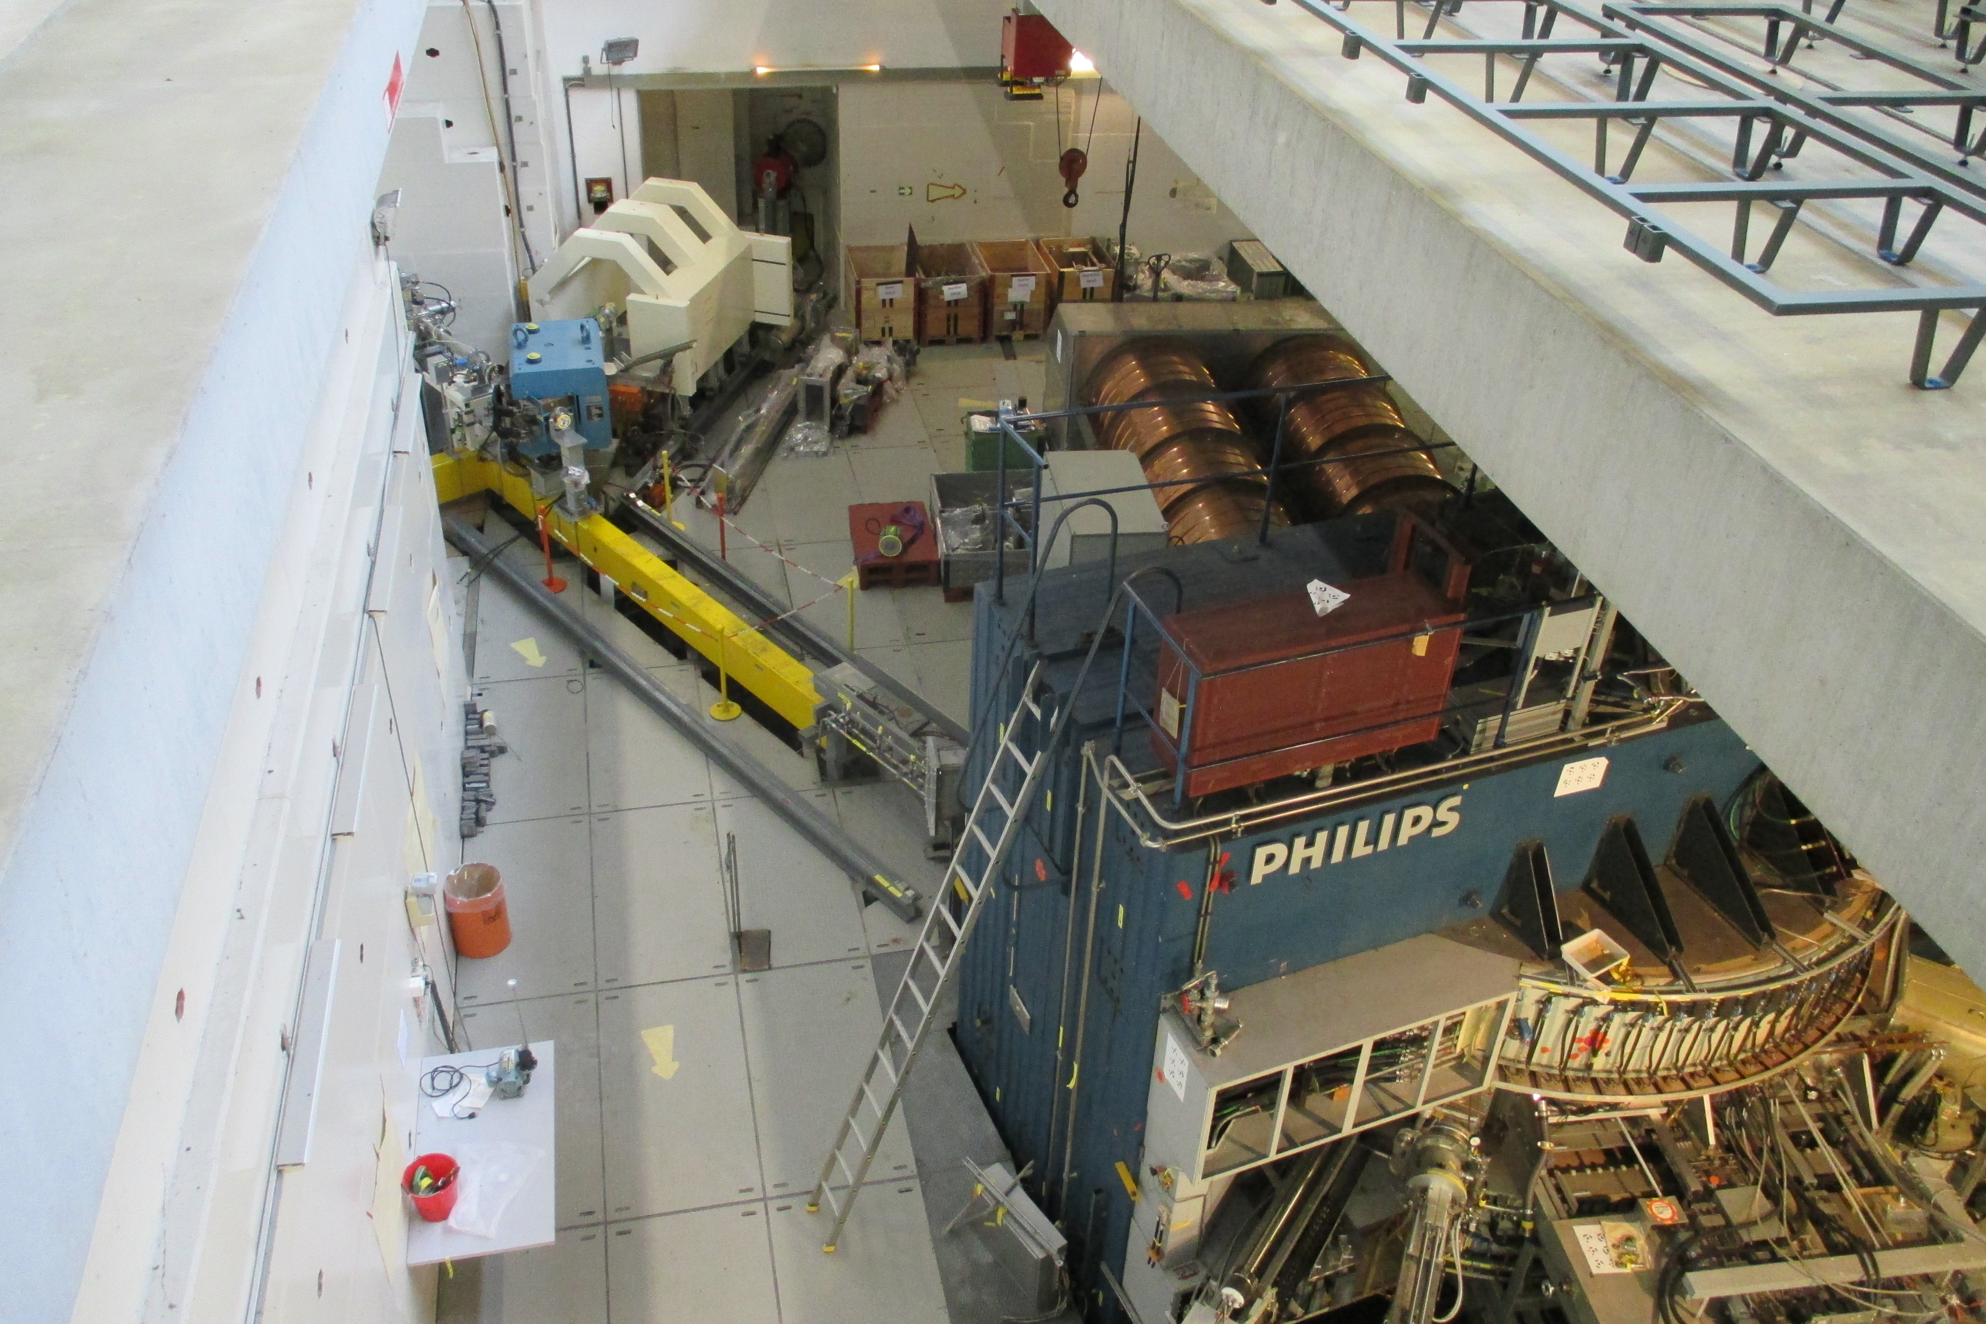
Inj 1 – dismantling beam line

Slide 8
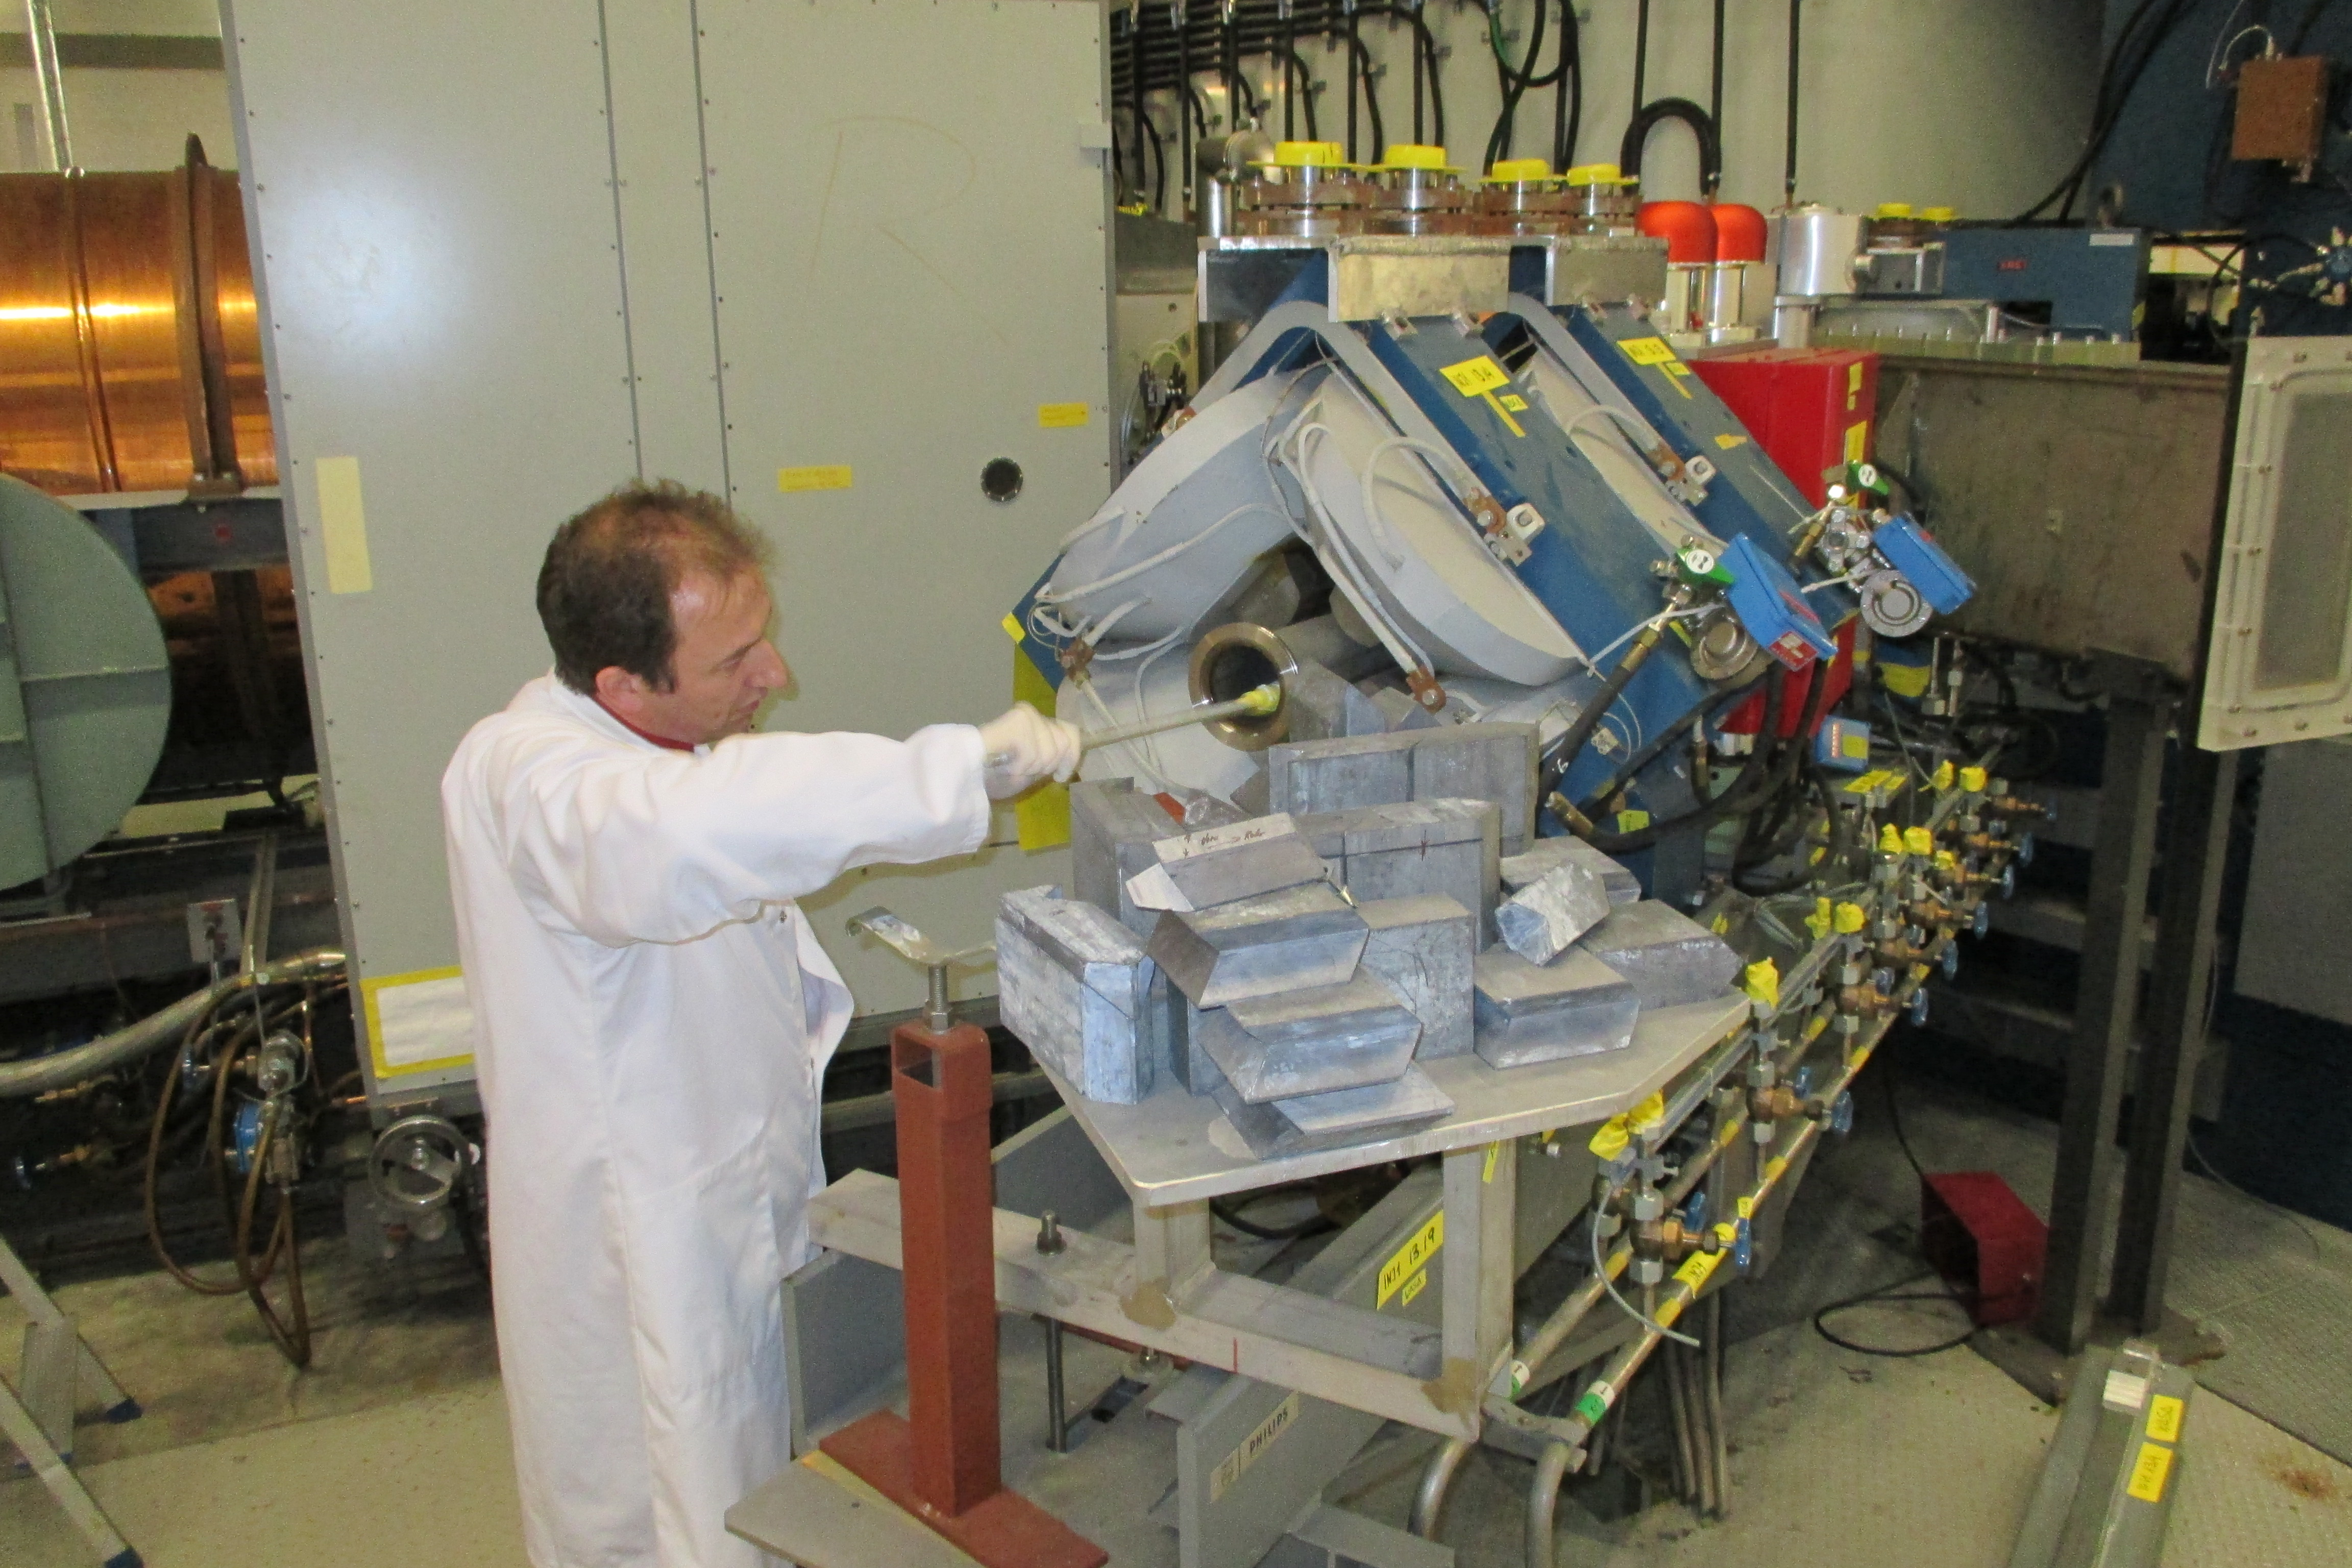
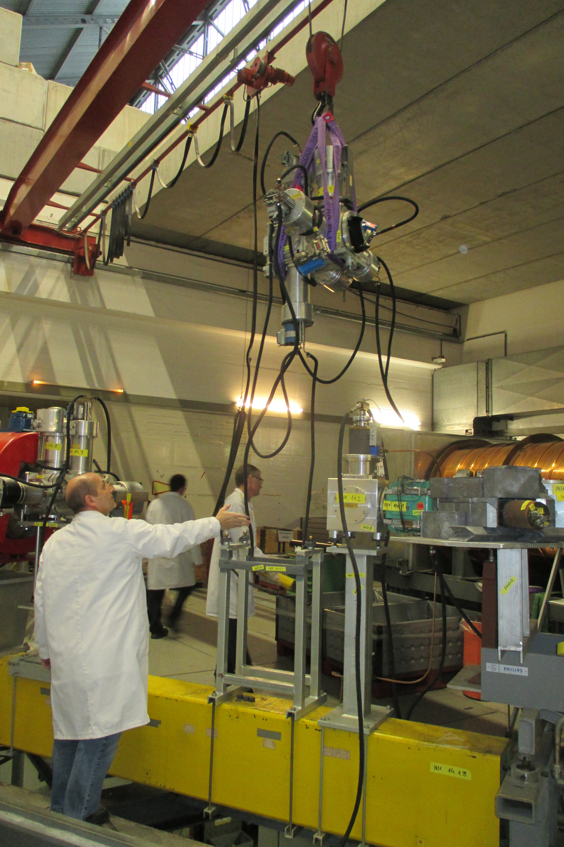
Careful disassembling of the
injector parts

Slide 9
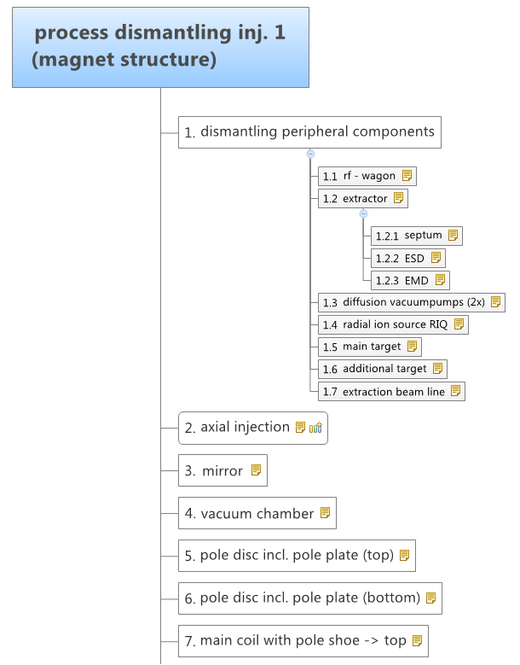
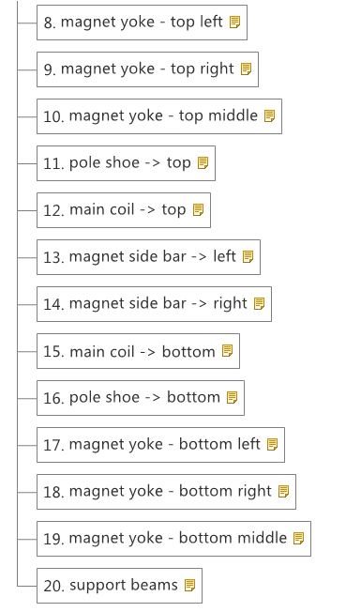
inj.1 – dismantling process
Phase 1

Slide 10
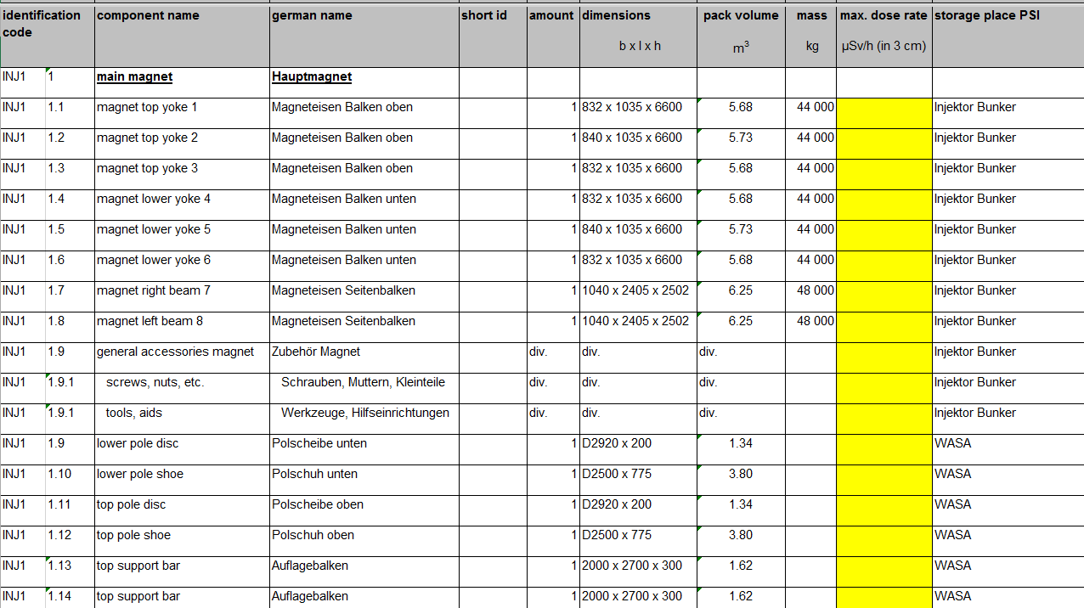
Inj 1 – labels

Slide 11
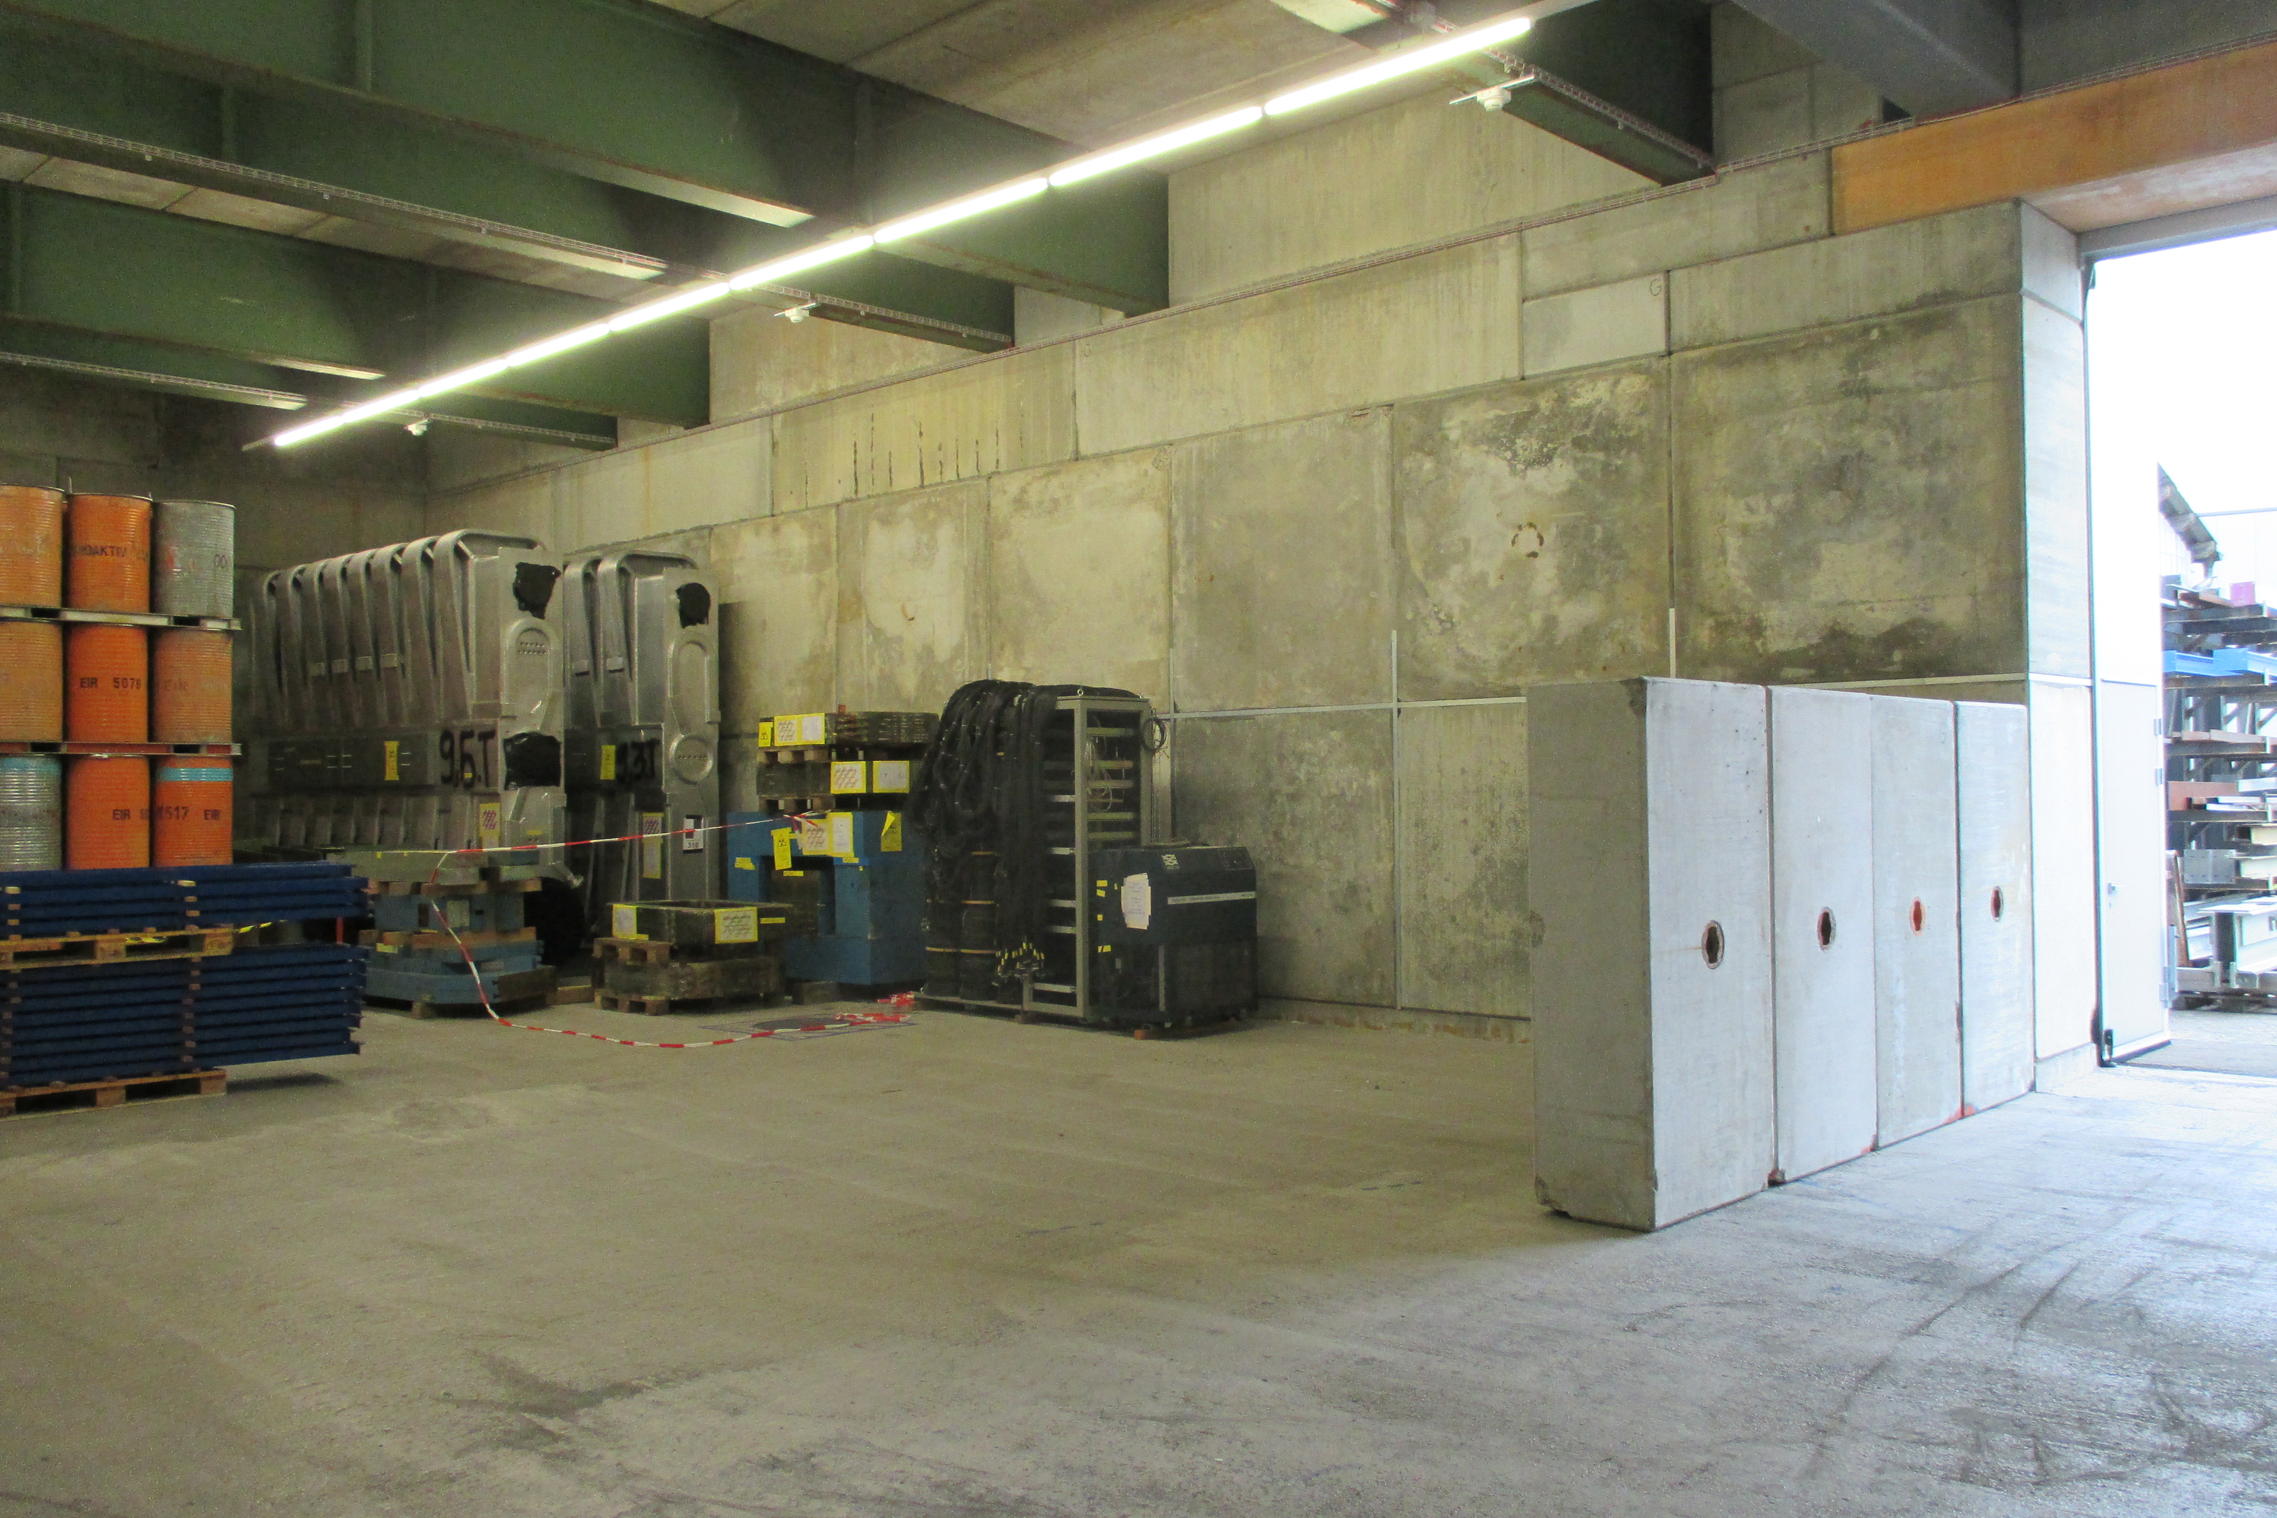
Temporary storage place

Slide 12
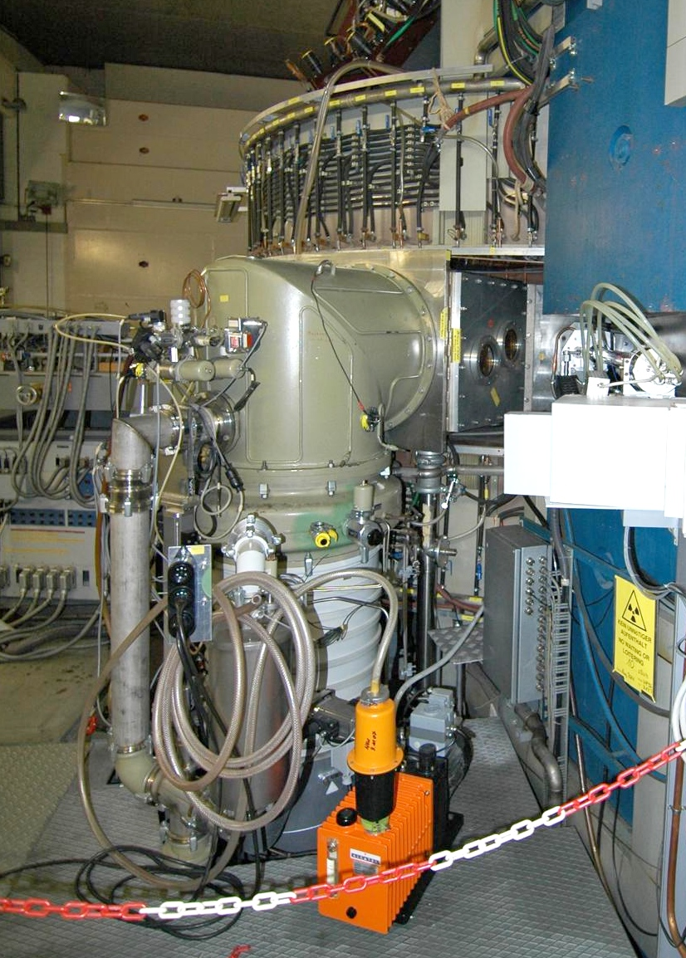
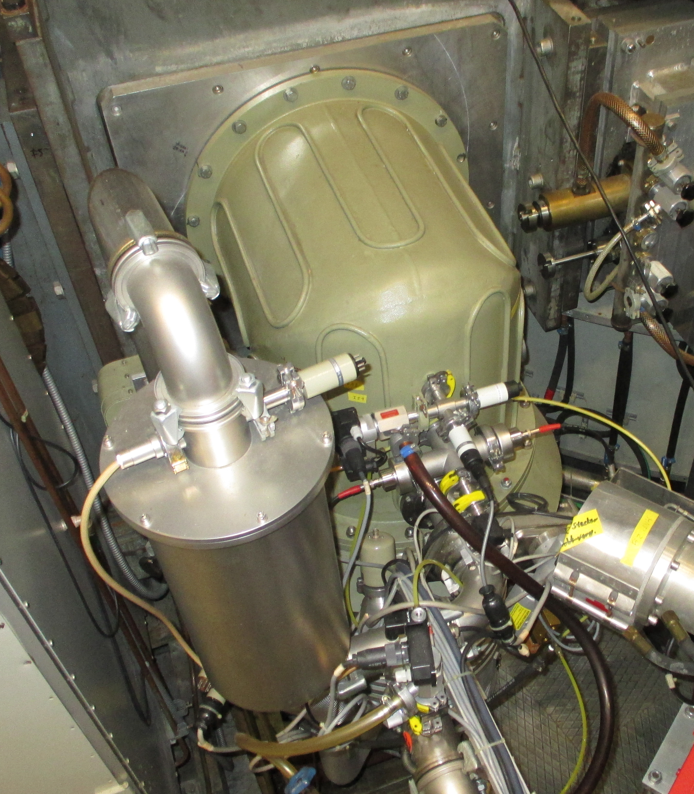
Inj 1 – next steps
Next steps
Dismantling diffusion pumps
Evaluation of nuclide vectors
Apply for permits and approvals

Slide 13
process
Main process of heavy components
Dismantling in bunker
Installing lifting lugs
Internal transfer PSI (WEHA) to loading area
Loading, positioning on truck
Meassuring doserate and contamination → labelling and protocol by PSI radiation safety group
Installing supports (vibration) and packaging in foils / welding of foil
Fastening on truck
(Temporary storage)
Transfer

Slide 14
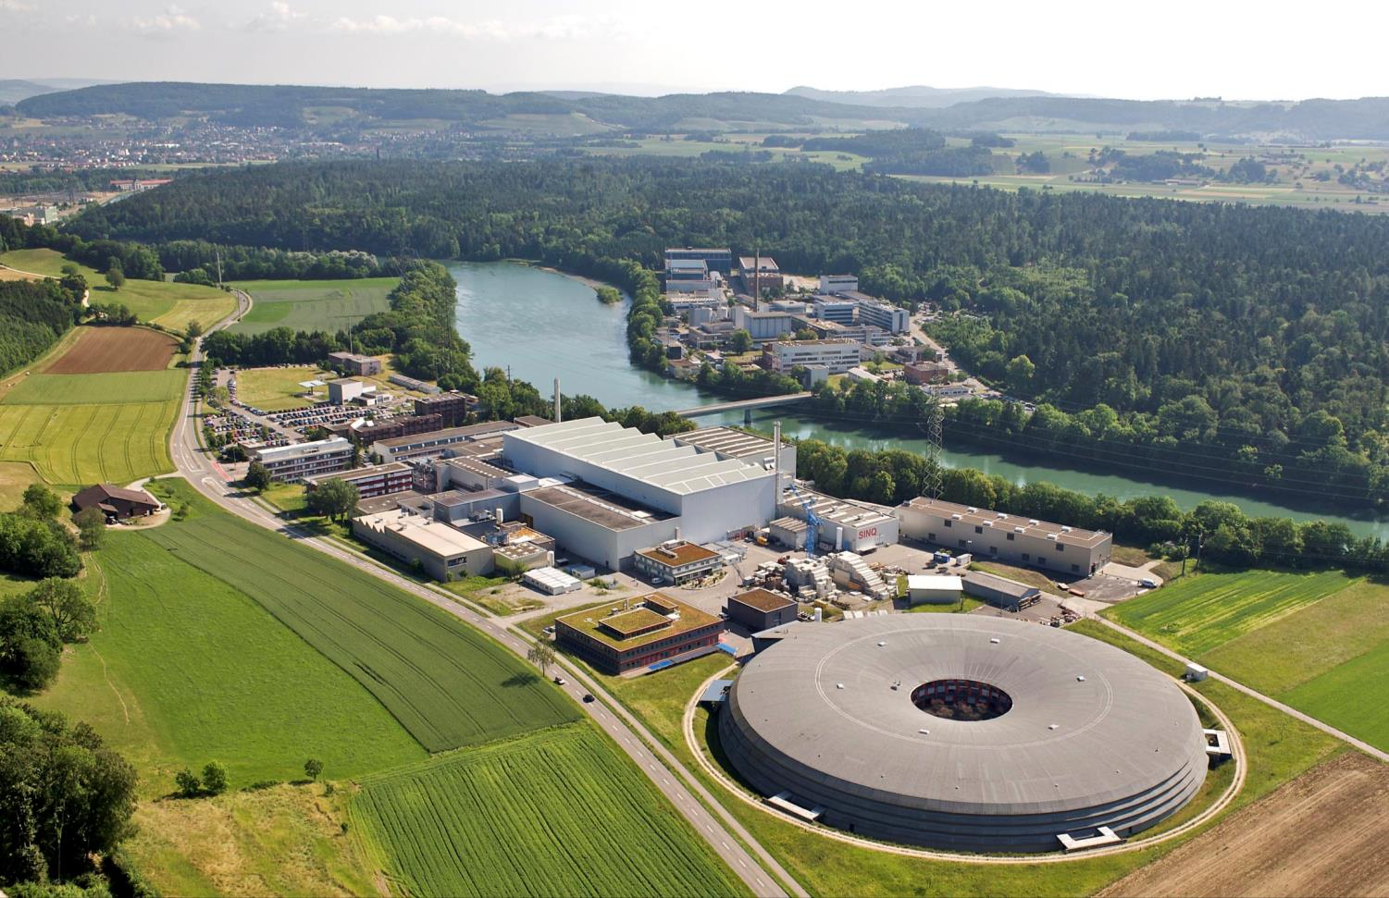
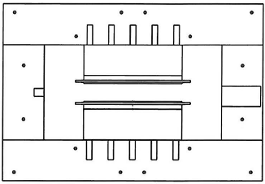
Thank you for your attention

Slide 15
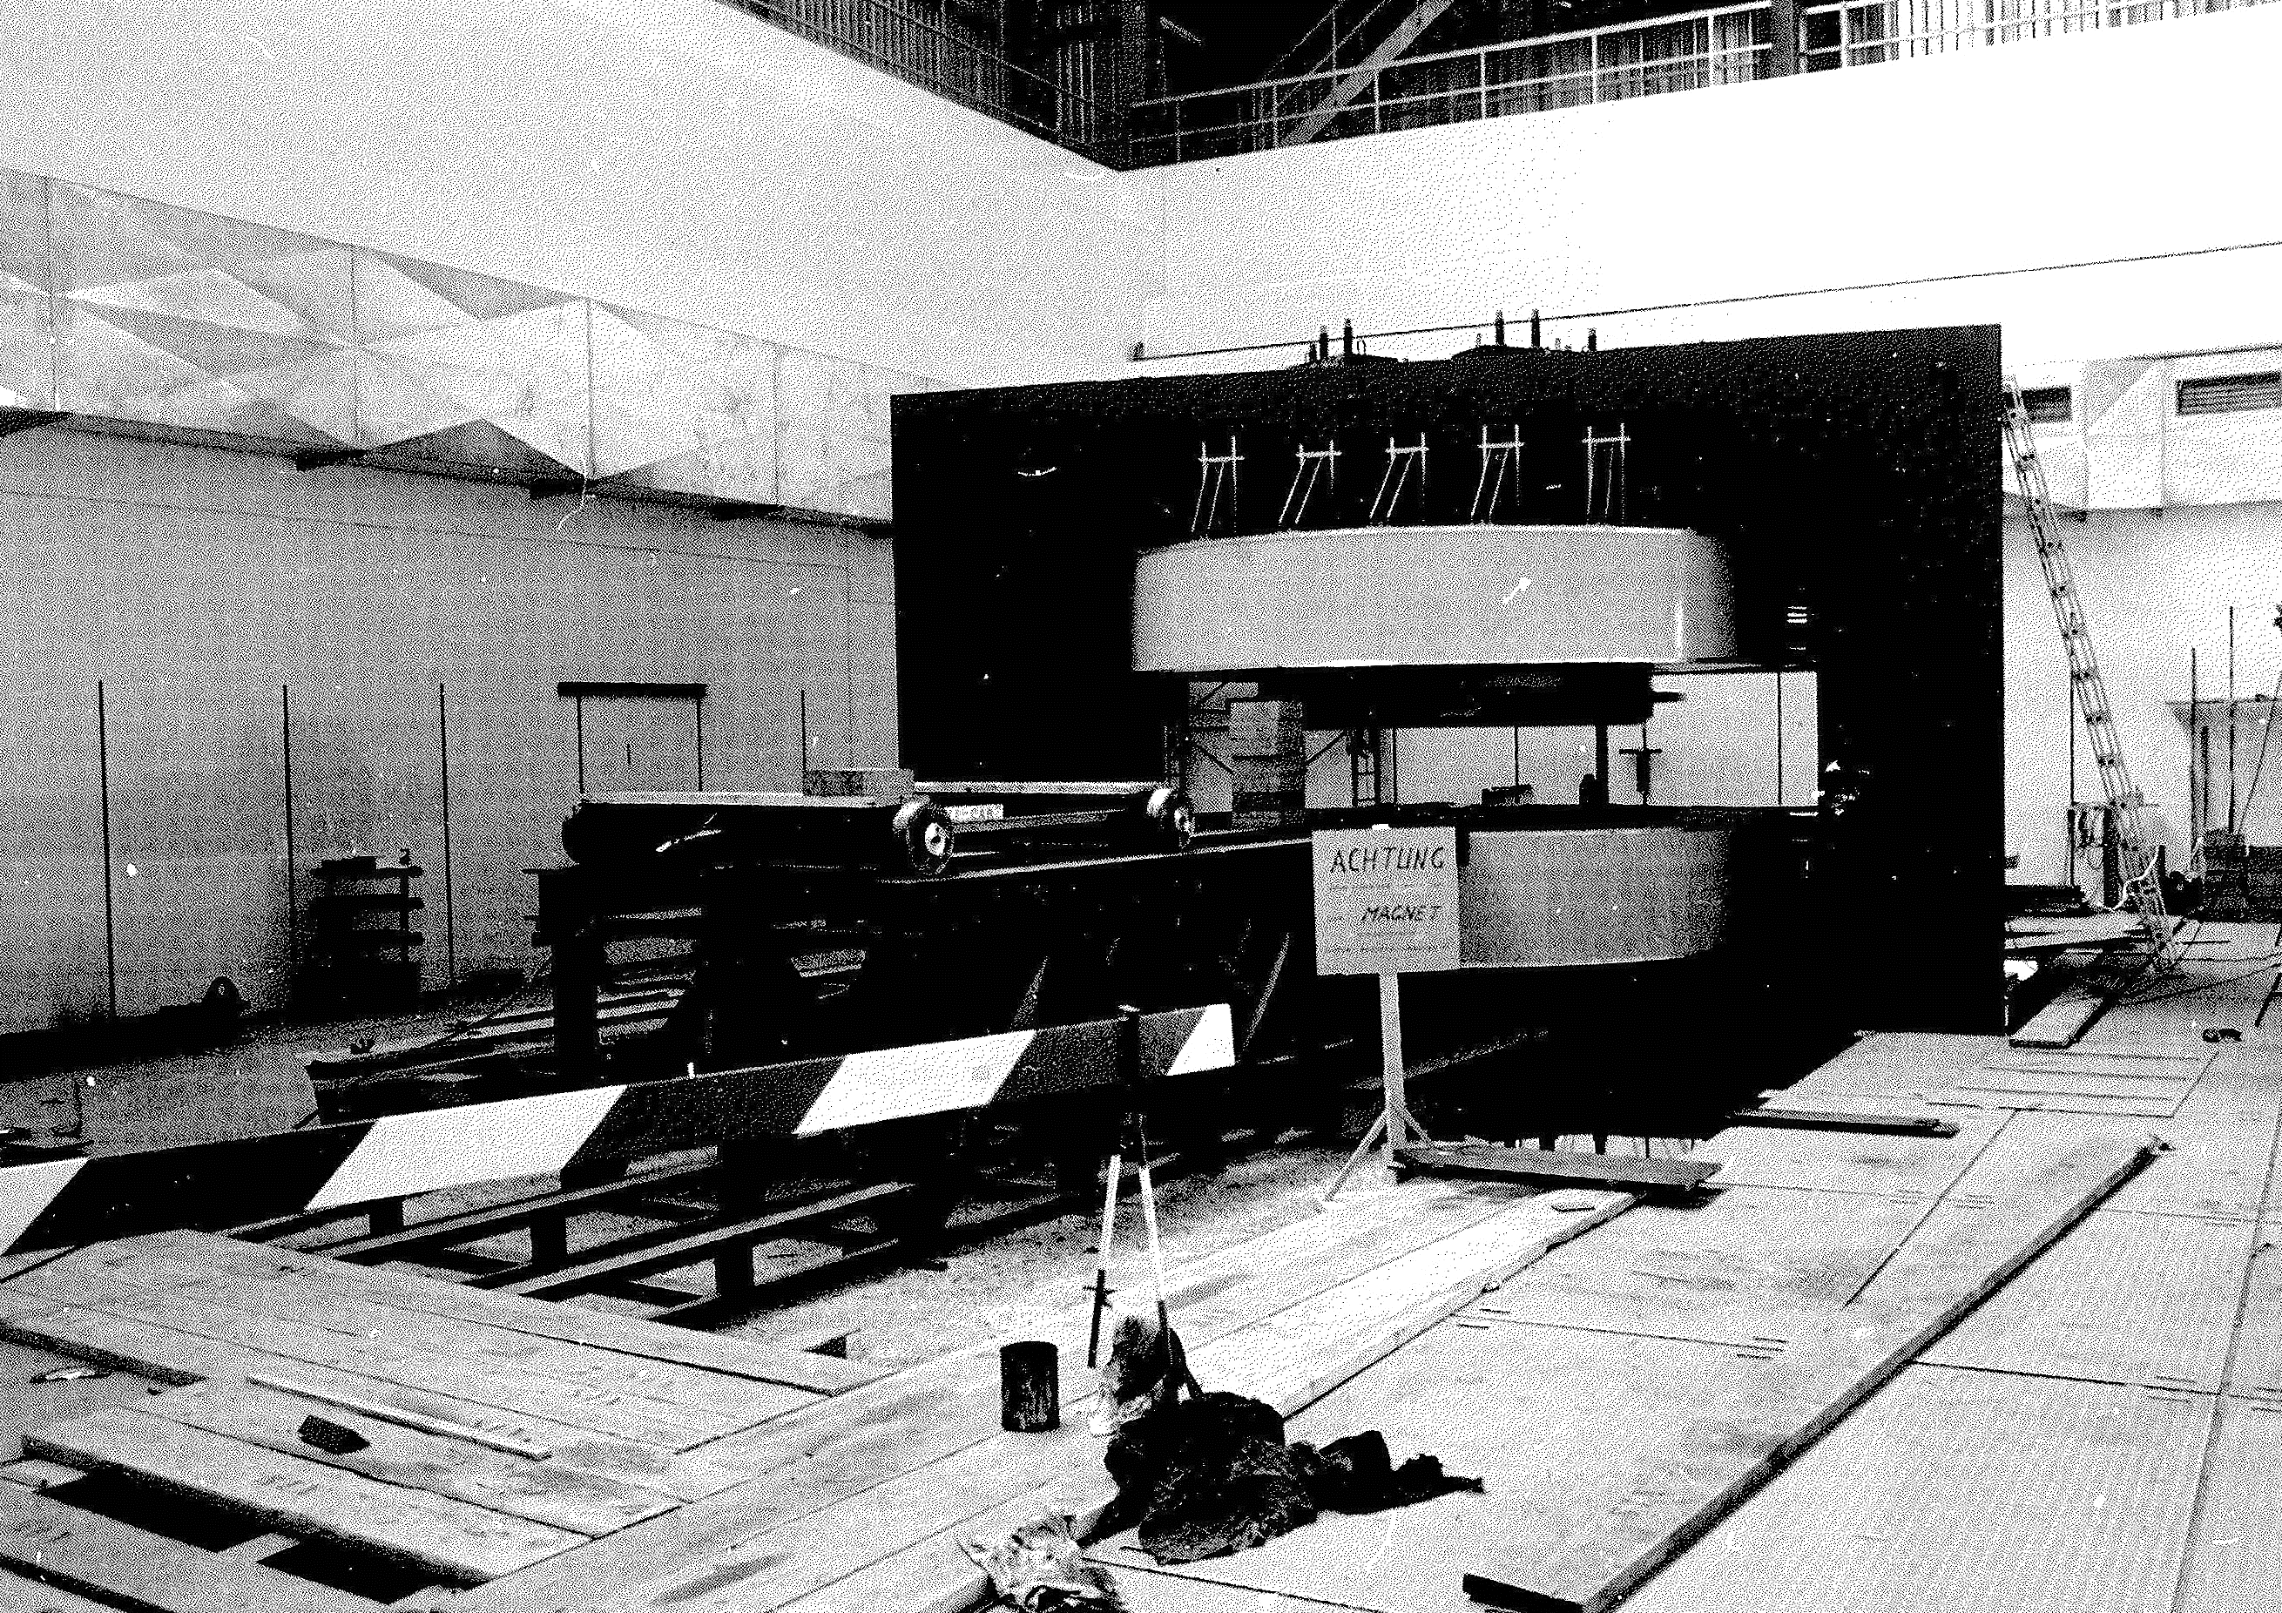
Supporting structure for assembling

Slide 16
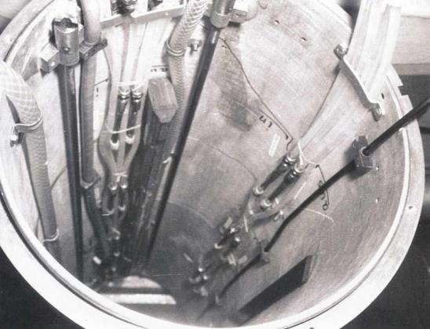
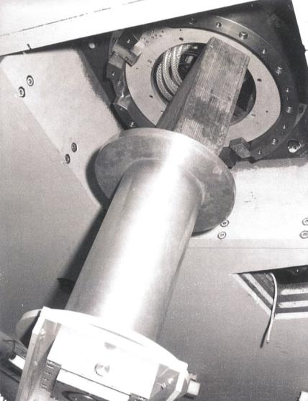
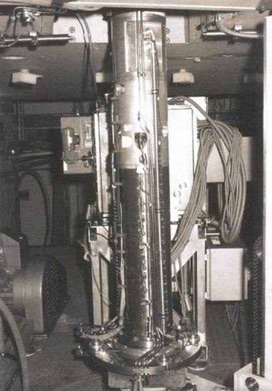
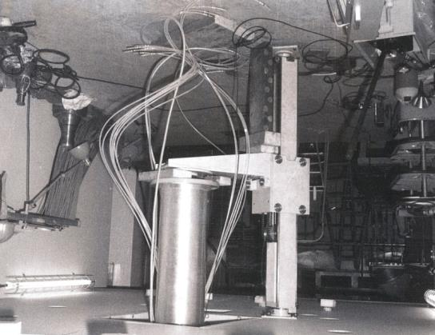
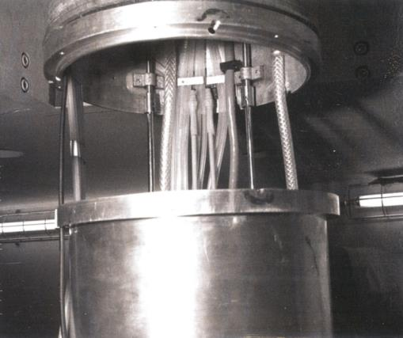
Axial injection – lower part

Slide 17
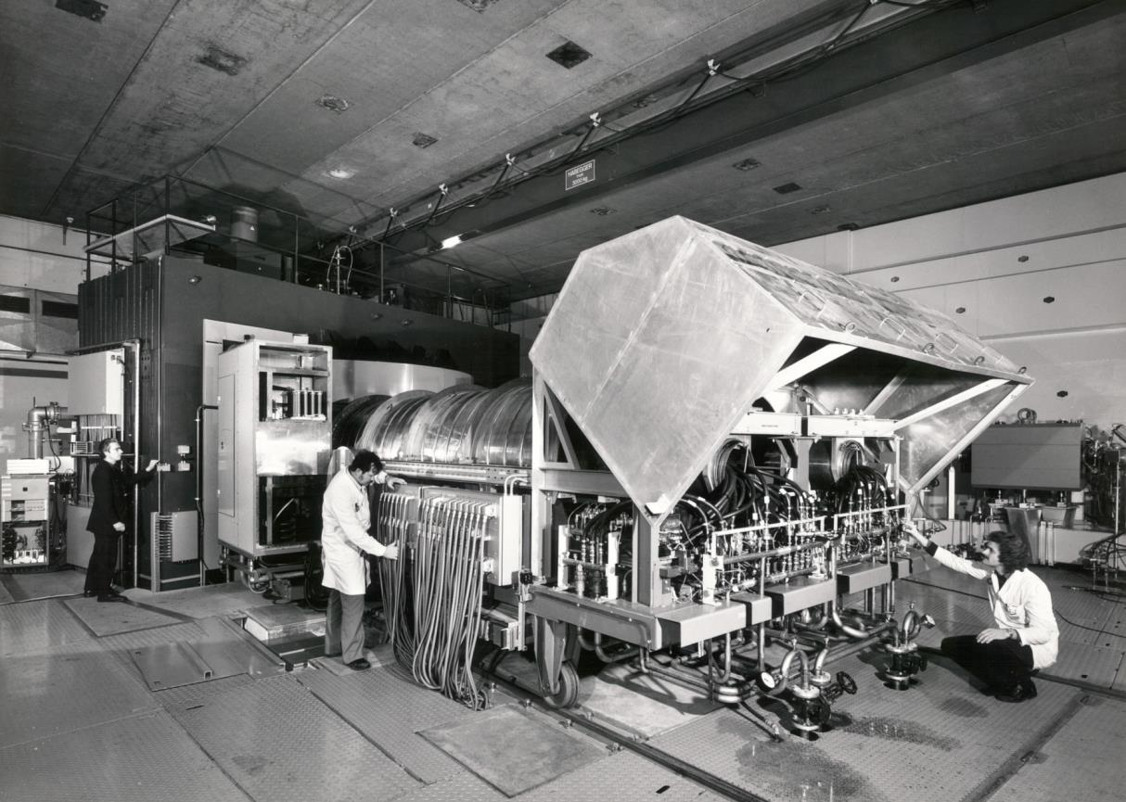
rf carriage with 2 resonators and coupling box

Slide 18
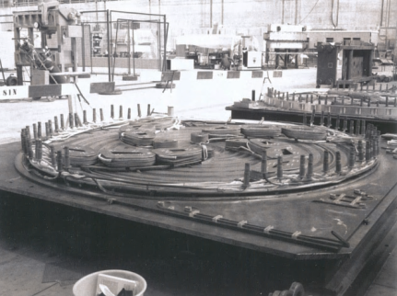
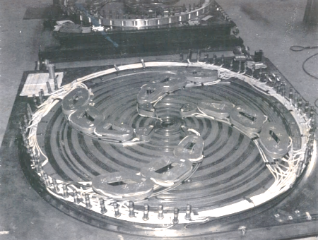
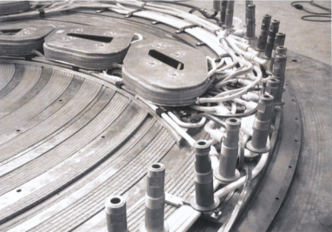
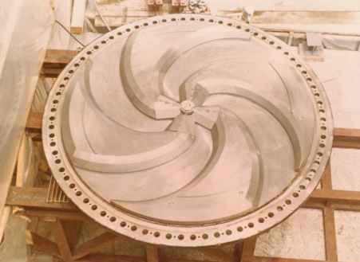
Pole plate with trim coils

Slide 19
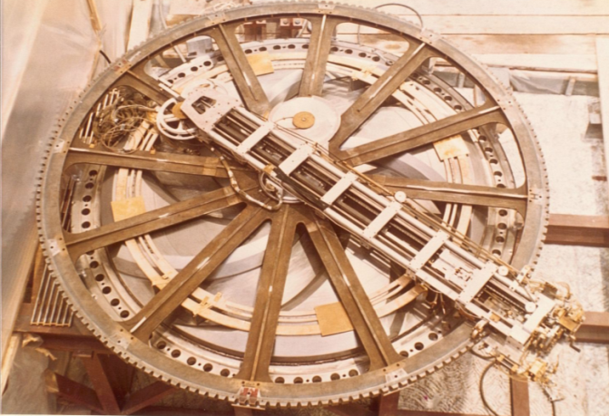
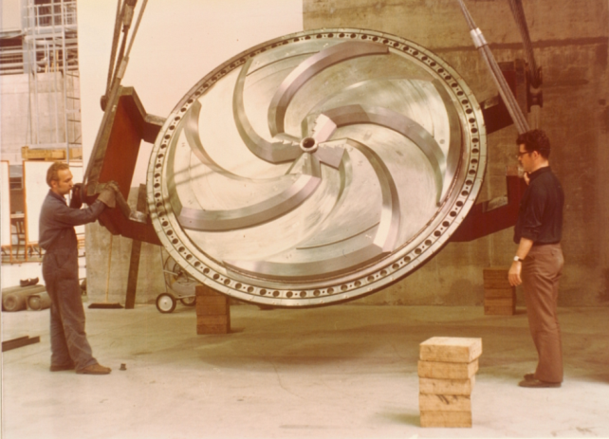
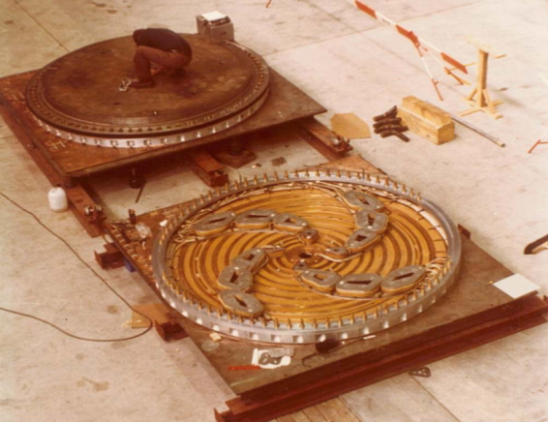
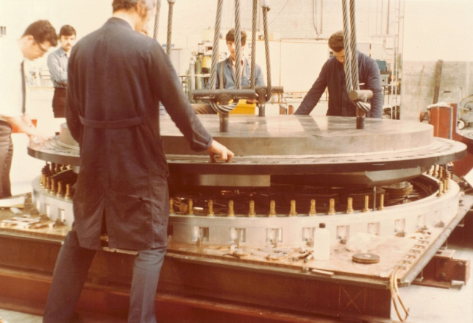
Assembling of pole plate

