Slide 1
3rd CCT Meeting
CERN/Paul Scherrer Institut
24.5.2017

Slide 2
Overview
Updates
Impregnation Process and Equipment
Next Steps

Slide 3
Update
LBNL proposes to test CD1 at LBNL
  pro:
    LBNL needs to justify why DOE conductor is used in PSI magnet → make it appear to be part of the LBNL program.
    PSI gets dedicated test team with lots of CCT experience.
    Likely can equip magnet with acoustic sensors for quench localization.
  con:
    CERN would have been closer for more of us to attend the test.
    Need to ensure that no long delays are introduced and the test happens foreseen (flights, etc.).

Slide 4
Overview
Updates
Impregnation Process and Equipment
Next Steps

Slide 5
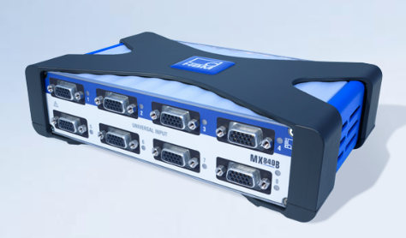
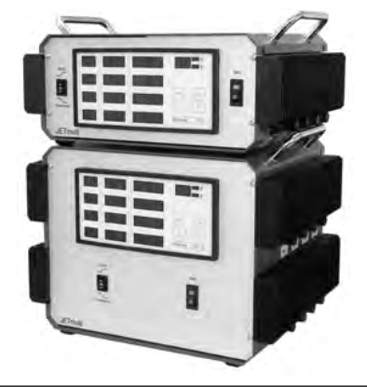
Dry Process, Impregnation, Curing: CTD 101-K
Prepare mould, tubing, and valves with heater circuits,
temperature sensors.

Slide 6
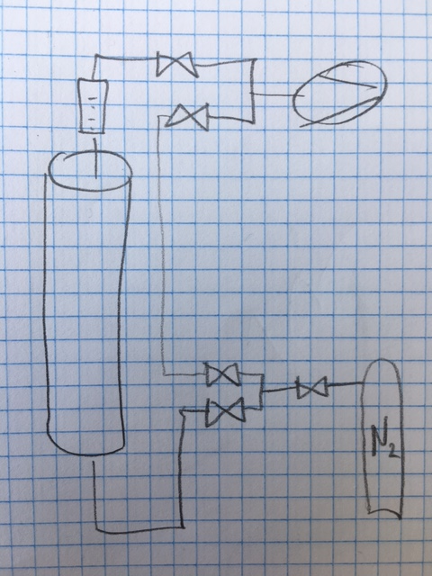
Dry Process, Impregnation, Curing: CTD 101-K
Connect resin inlet hose, resin outlet hose, inlet and outlet buffer, capacitance measurement cables, valves, vacuum pump with filter (standard filter or cold trap against resin fumes).
Heat mould to 110°C (or equivalent resin curing temperature) with 20°C/h, then heaters ‘off’.
Connect N2 bottle on mould inlet .
Vacuum pump ‘on’.
Fill mould with pressurized N2 (up to 3.5
bars, coil drying and leakage test),
leave for 1 hour
Open mould downstream valve and
pump N2 out of the mould.
Repeat 6-7 for 3-4 times, disconnect N2.
Vacuum drying for at least 48 h,
heaters maintain 60°C.

Slide 7
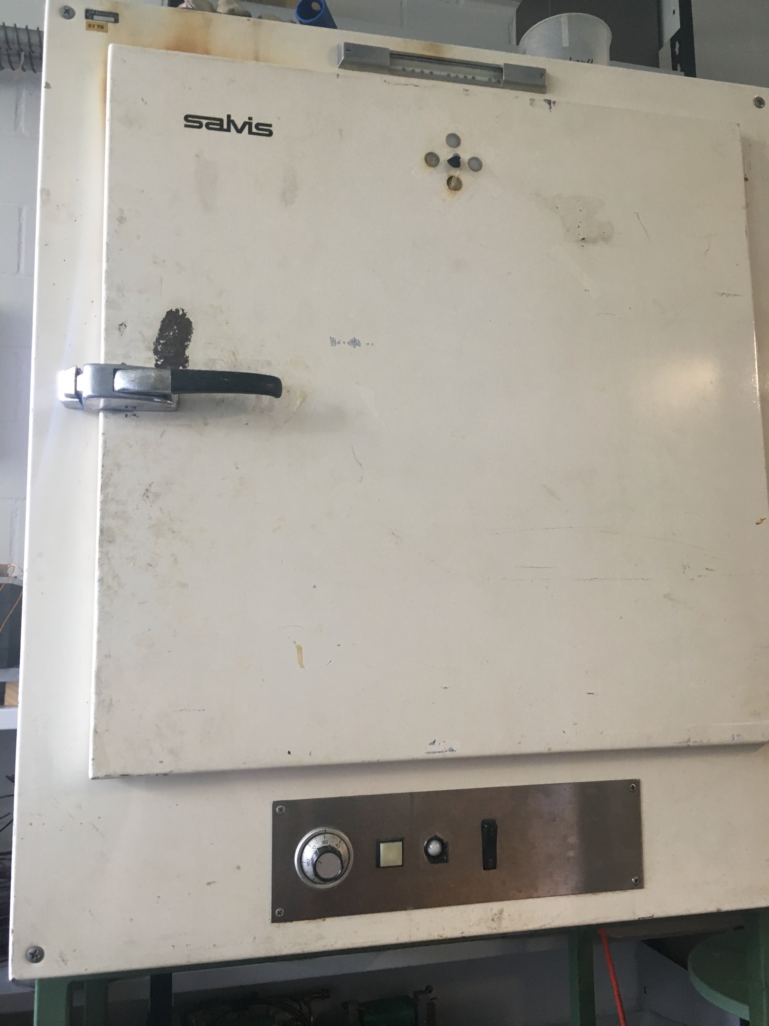
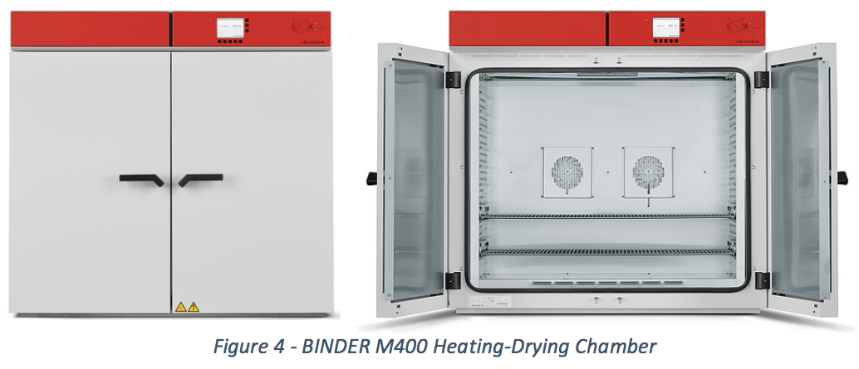
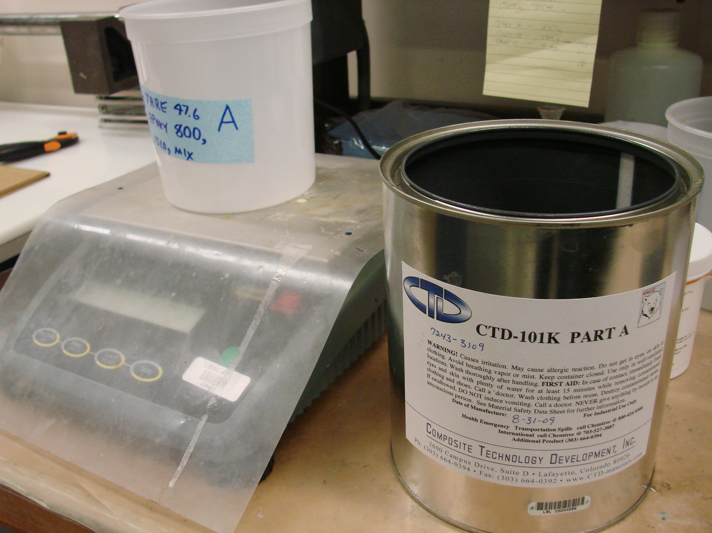
Wet Process for CTD 101-K
Pre-heat resin and hardener at 60°C.
Prepare mix in bucket with precision scales
(1 g for resin and hardener, 0.1 g for accelerator)

Slide 8
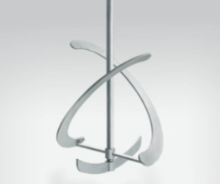
Wet Process for CTD 101-K
Pre-heat mixer to 60°C
Heater controller
  for min. 8 channels.
  automatic heater/sensor identification
  missing heater detection
  over-heating detection
  short-to-ground detection
  programmable

Slide 9
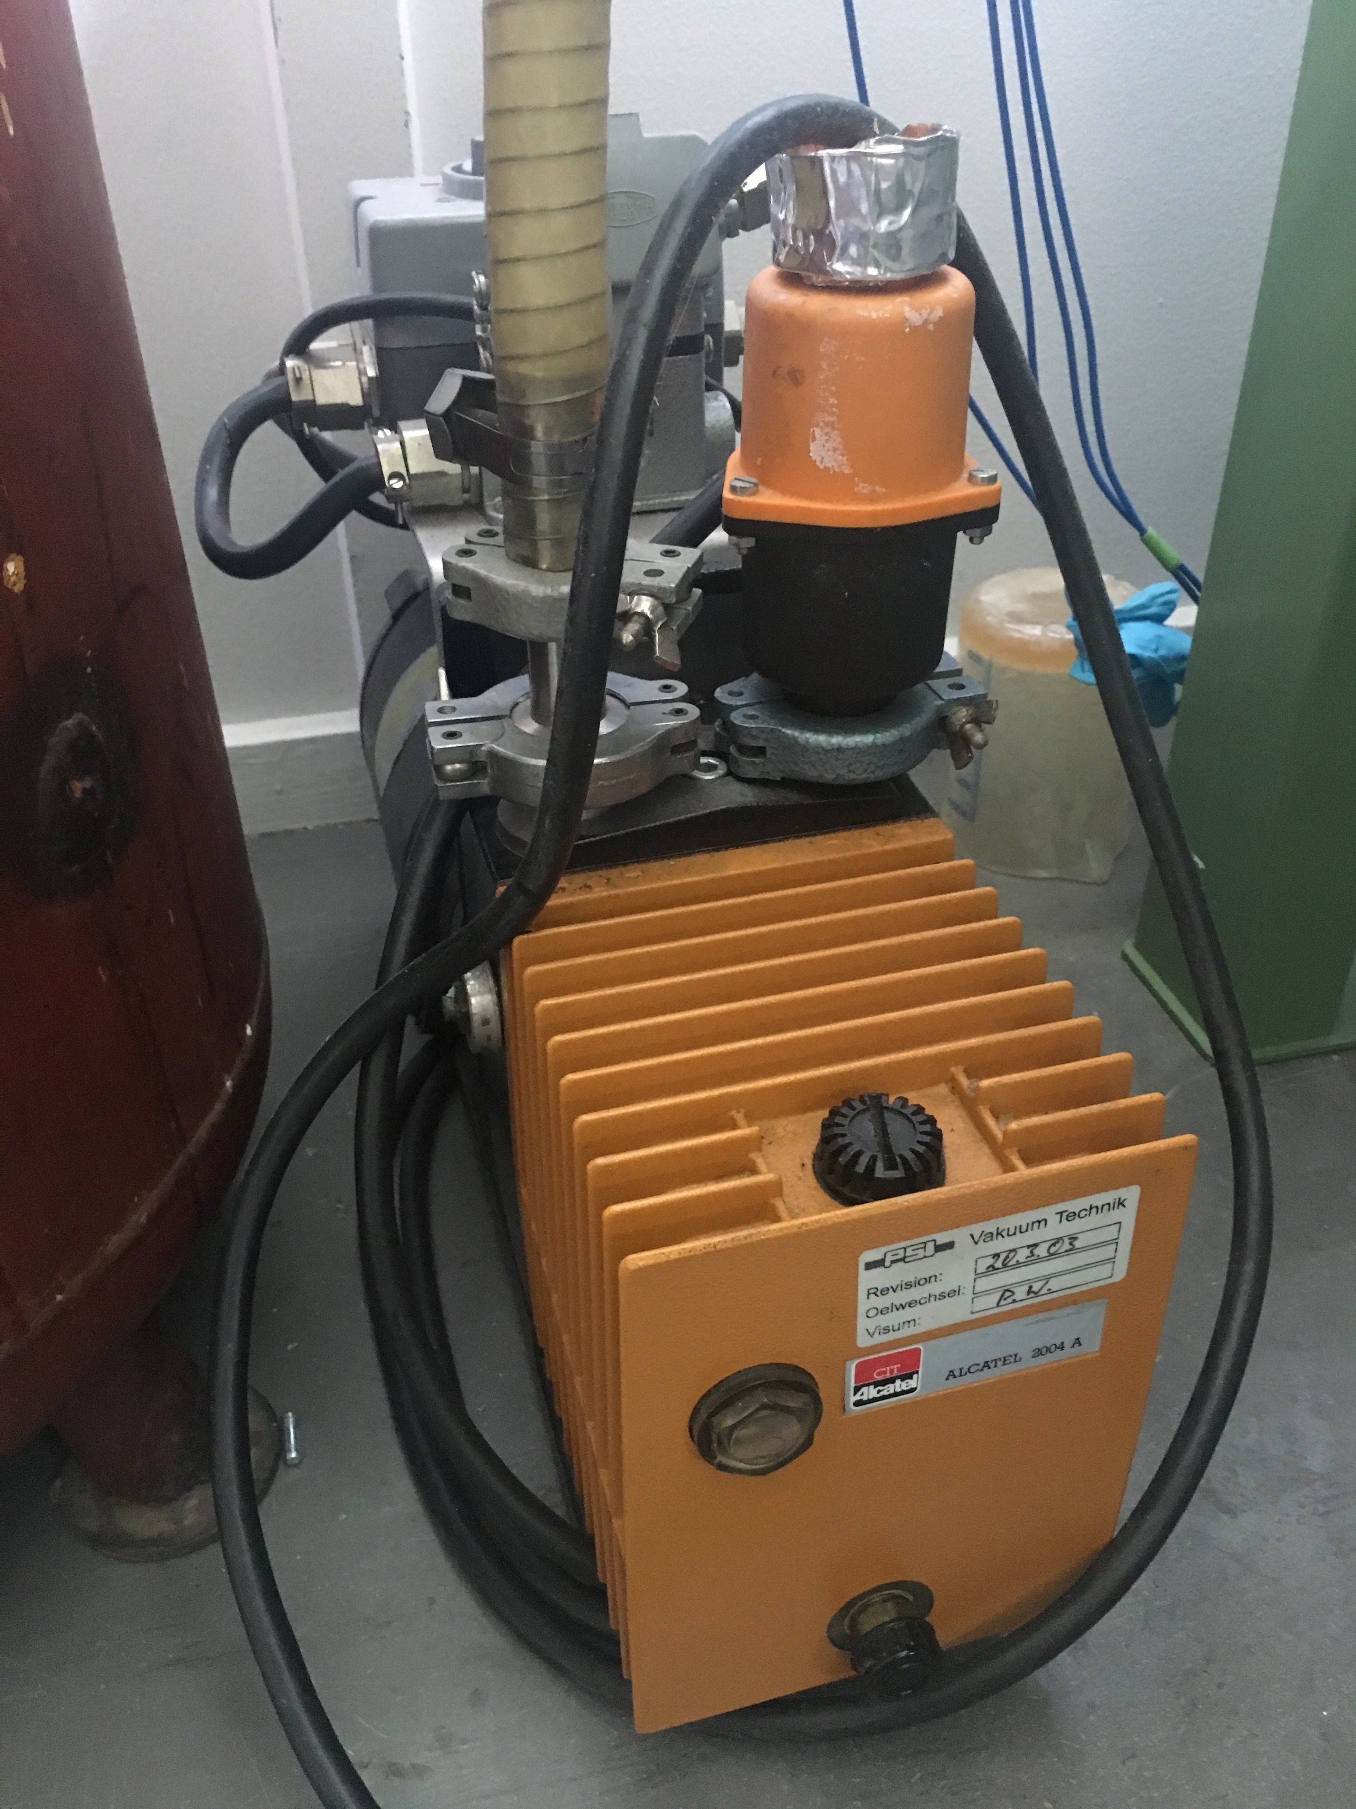
Wet Process for CTD 101-K
Close mixer.
Pump on the mixer (cheap pump with filter,
resin vapors will limit life time, possibly fume
extraction).
Open valve to bucket and suck mix into mixer.
Degas the epoxy
  Interrupt pumping, close the isolation valve
  between mixer and pump, observe pirani reading.
  Open valve and pump again.
  Repeat 1-2 until constant low pressure increase
  similar to the one before inserting the mix, plus
  some evaporation, but no more enhanced by
  outgassing (monitoring of mixer temperature and
  vacuum pressure on PC).

Slide 10
Wet Process for CTD 101-K
  Stop pump, close vacuum valves, stop impeller, disconnect vacuum line
  Transport mixer to vacuum vessel
  Reconnect power for blanket heater (impeller ’off’ to avoid mixing N2 into the resin; see below)

Slide 11
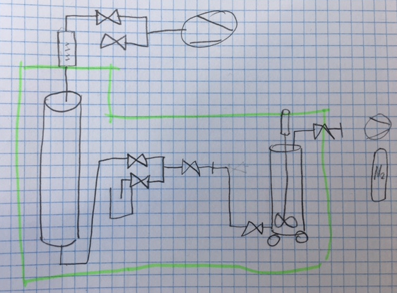
Impregnation, Curing CTD 101-K
  Connect mixer, keep mould heaters at 60°C.
  Pre-heat connections/valves/etc. between mixer to 60°C
  Open valves and inject N2 into mixer (enough pressure to have reliable pirani reading, e.g., 1 bar, must overcome hydrostatic pressure, which will be very low, < 1 bar in our case.)
  Direct first resin injection to the sample bucket (scrap first injection and/or impregnate sample.)

Slide 12
Impregnation, Curing CTD 101-K
  Set valves for impregnation and wait that resin reaches the upper bucket, and constantly check for leaks (place mould in a spillage tray), check the capacitive measurement to see if epoxy keeps rising
  Stop resin flow from mixer, let soak for a few minutes and inspect to detect resin leaks or (upper) bucket emptying, check capacitance is not varying.
  Disconnect mixer, lower mixer temperature to 40°C to extend pot life.
  Close all valves and use mould heaters for curing cycle (48h).

Slide 13
Cleaning
  Disconnect tubes, put caps on them (they contain liquid resin), then polymerize them before disposal.
  Transfer remaining epoxy into a bucket and cure in lab oven for easier disposal.
  Manual valves cleaned in acetone.
  Mixer cleaned with acetone (check with manufacturer for optimal method).
  Think about:
  ventilation
  floor coating for easier cleaning

Slide 14
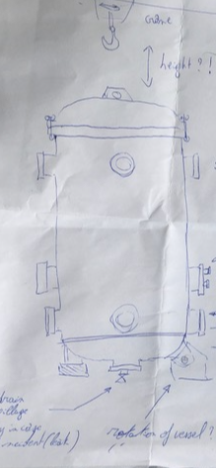
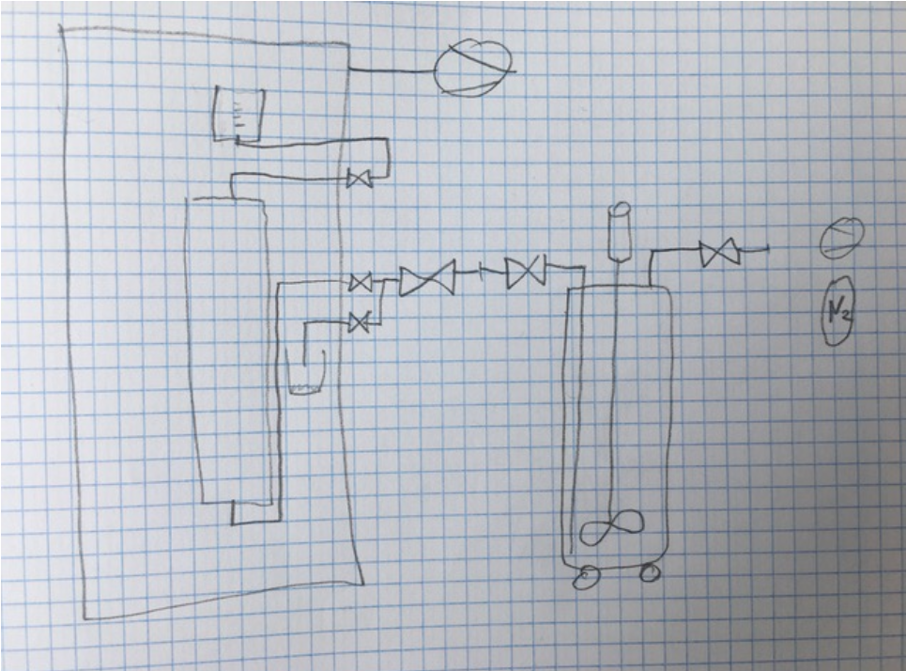
Equipment Overview:
Vacuum pump + instrumentation: CHF 8000 (CERN Store, Volkart-sa.ch)
Heater System: CHF 8000 (Hewid.de)
Mixer: CHF 7000 (Walther-Pilot.de)
Scales: CHF 600 (shop.faust.ch)
Viscometer (optional): CHF 2000 (amazon.com)
Drying&Heating Chamber (if needed): CHF 6000 (vwr.com)
DAQ (also, in fact mostly, for mechanical measurements): CHF 20000 (hbm.com)
Lots of disposables (rugs, buckets, cloths, gloves, etc.)
Vacuum vessel advantages:
  heat insulation,
  possibility to equip it with radiators,
  possibility to impregnate with
  open mould.

Slide 15
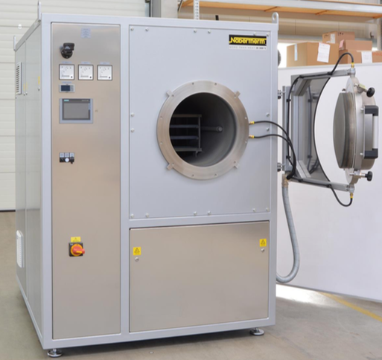
Reaction Furnace
Cheapest offer from Nabertherm: EUR 125,000. Two competitors start at EUR 240,000.

Slide 16
Next steps
Next steps (coming 4 weeks)
  FCC week.
  Finalize sensitivity study / CDR input (full 3D model?).
  Finalize technical design short mechanical model.
  Settle on mechanical instrumentation + DAQ package, prepare PO.
  Settle on modular heater + control system, prepare PO.
  Settle on mixer design, prepare PO.
  Settle on vacuum pump(s) to use with filter(s).
  Procure lab scales and viscometer.
  Order components of NHMFL 61 (CTD 101-K already ordered).
  Devise mould setup and have former + mould 3-D printed in Duraform HST (1x IL former CHF 680).
  Establish CERN Team account for PSI (can buy numerous types of equipment in CERN store).

Slide 17
END

