Slide 1
5th CCT Meeting
CERN/Paul Scherrer Institut
07.09.2017

Slide 2
Overview
Furnace update, infrastructure finances, space
Cable (incl. fiber optics and Cu)

Slide 3
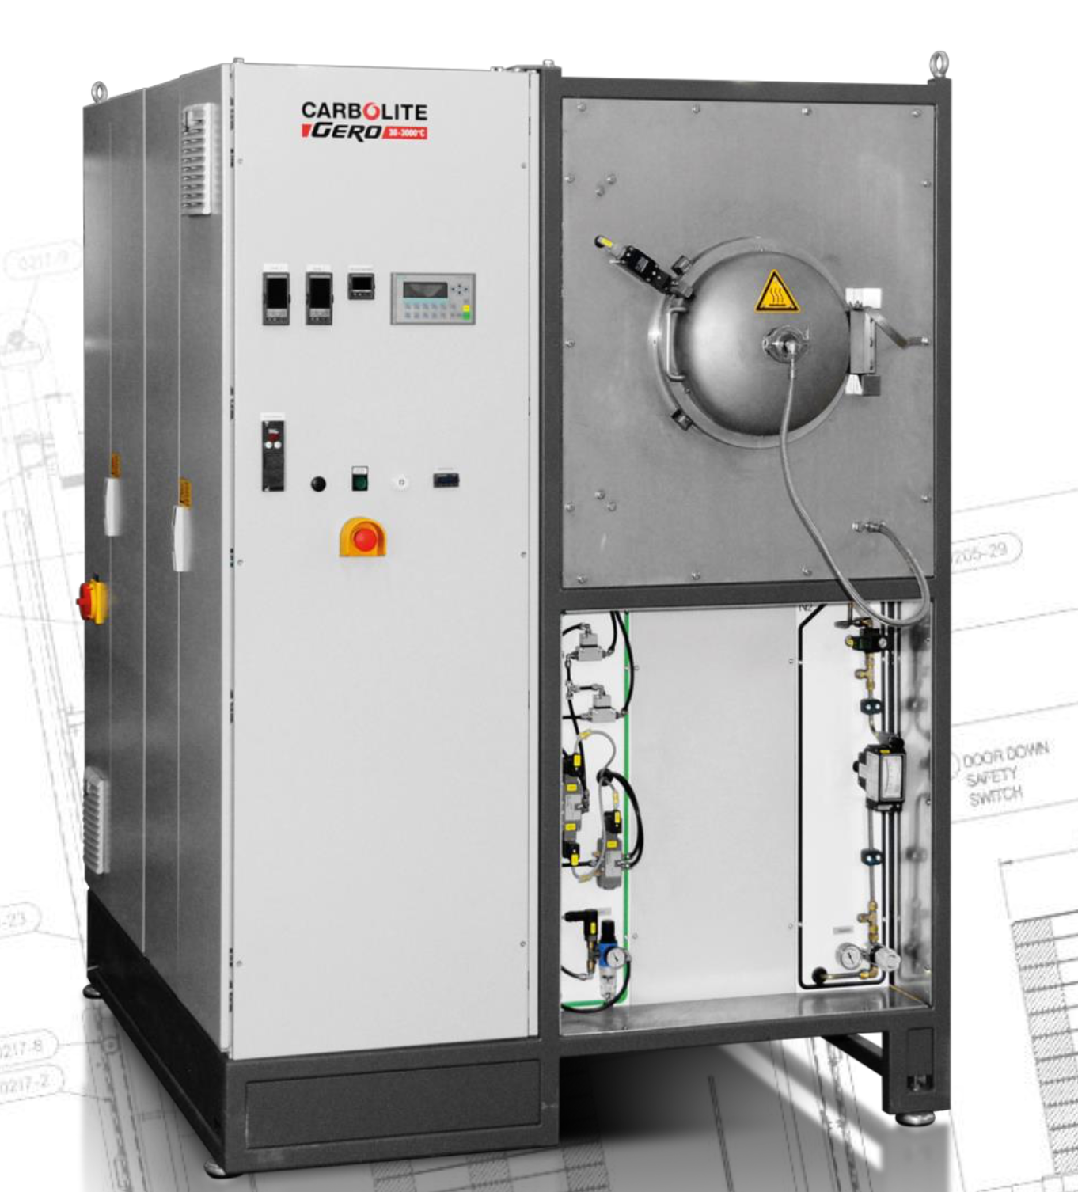
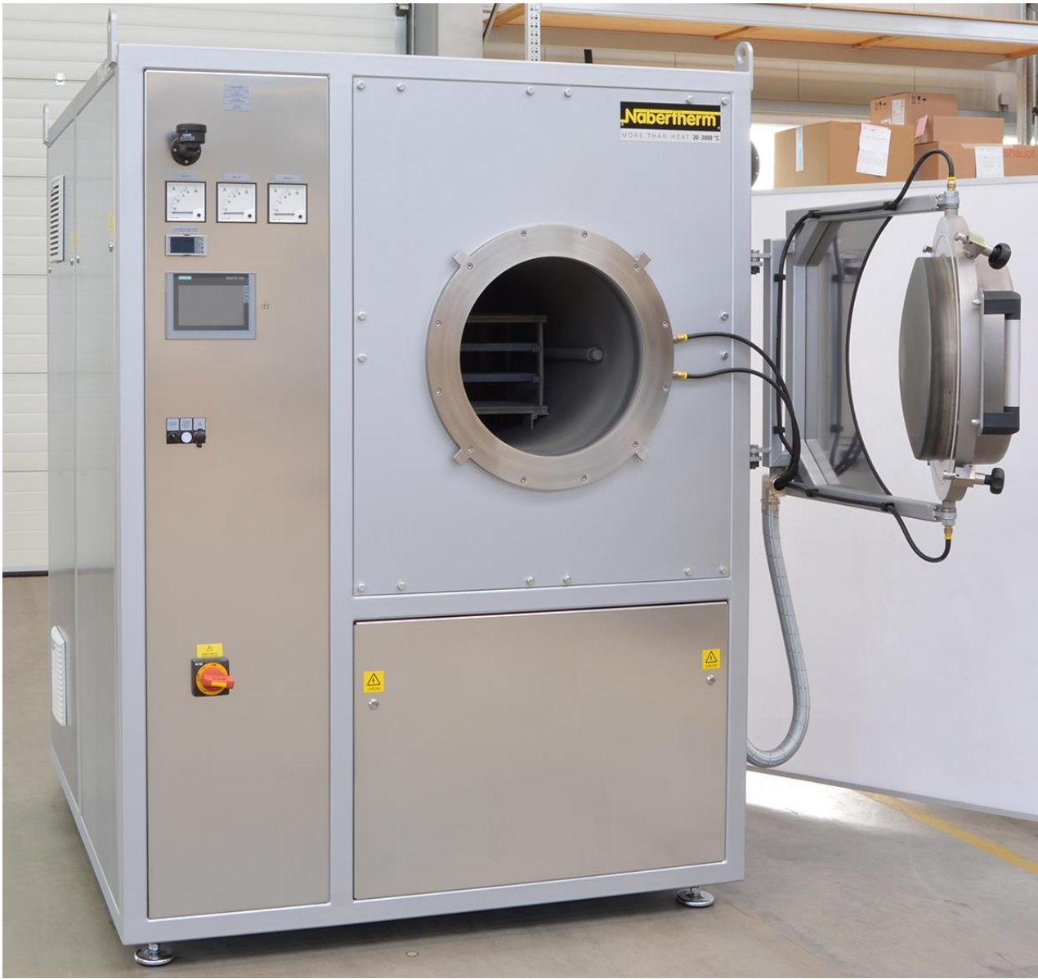
Carbolite Gero & Nabertherm

Slide 4
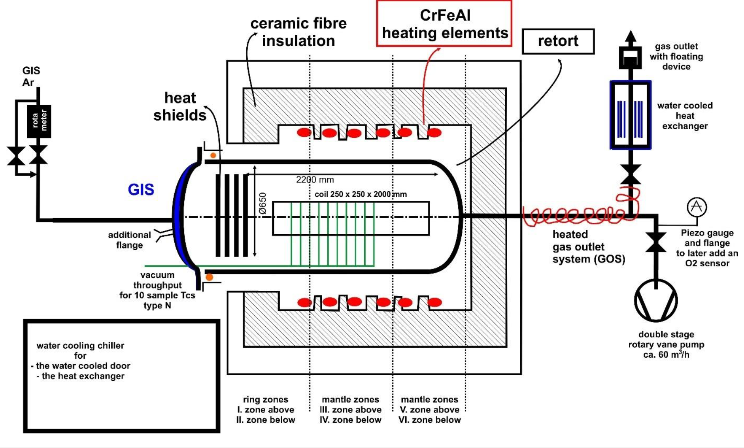
Concept

Slide 5
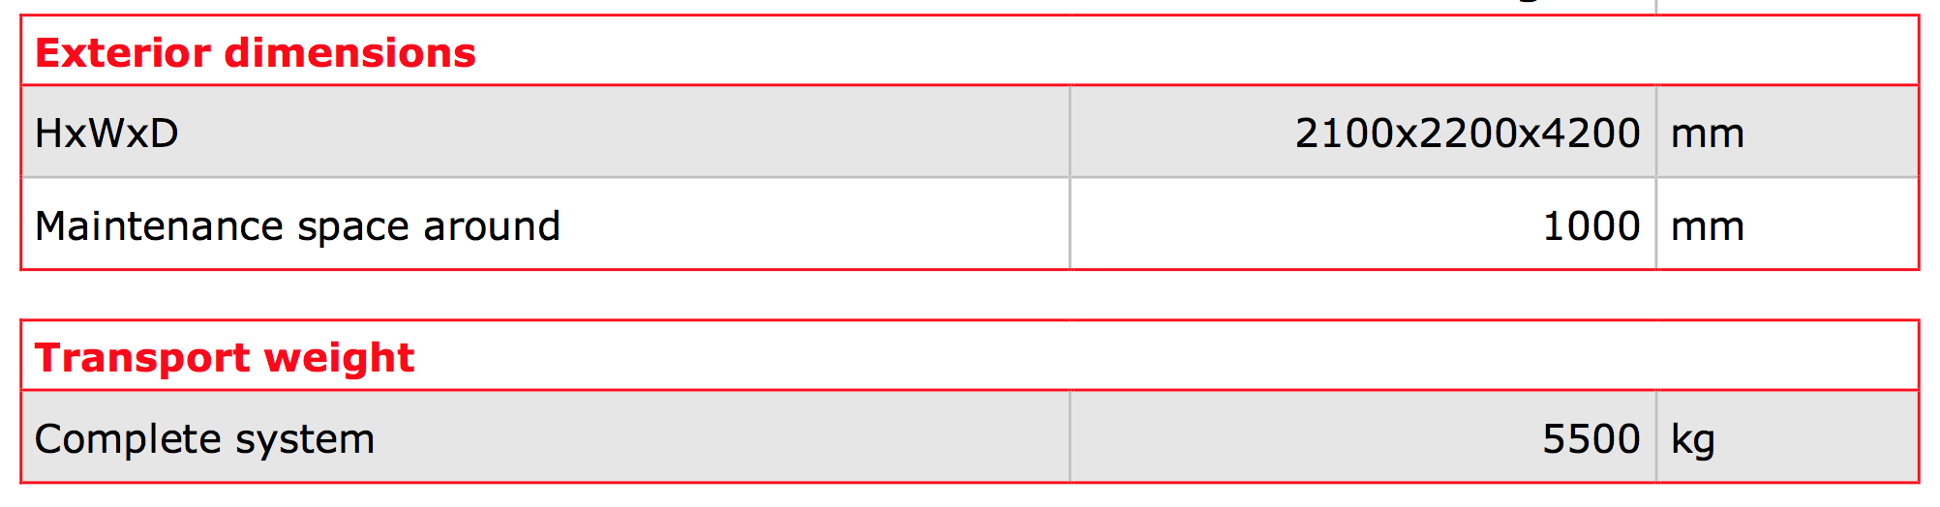
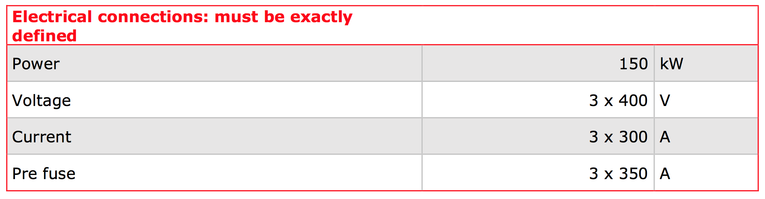
Connection
Effective space requirement: 4x8 m
Power requirement reduced from 180 to 150 kW, still under discussion.

Slide 6
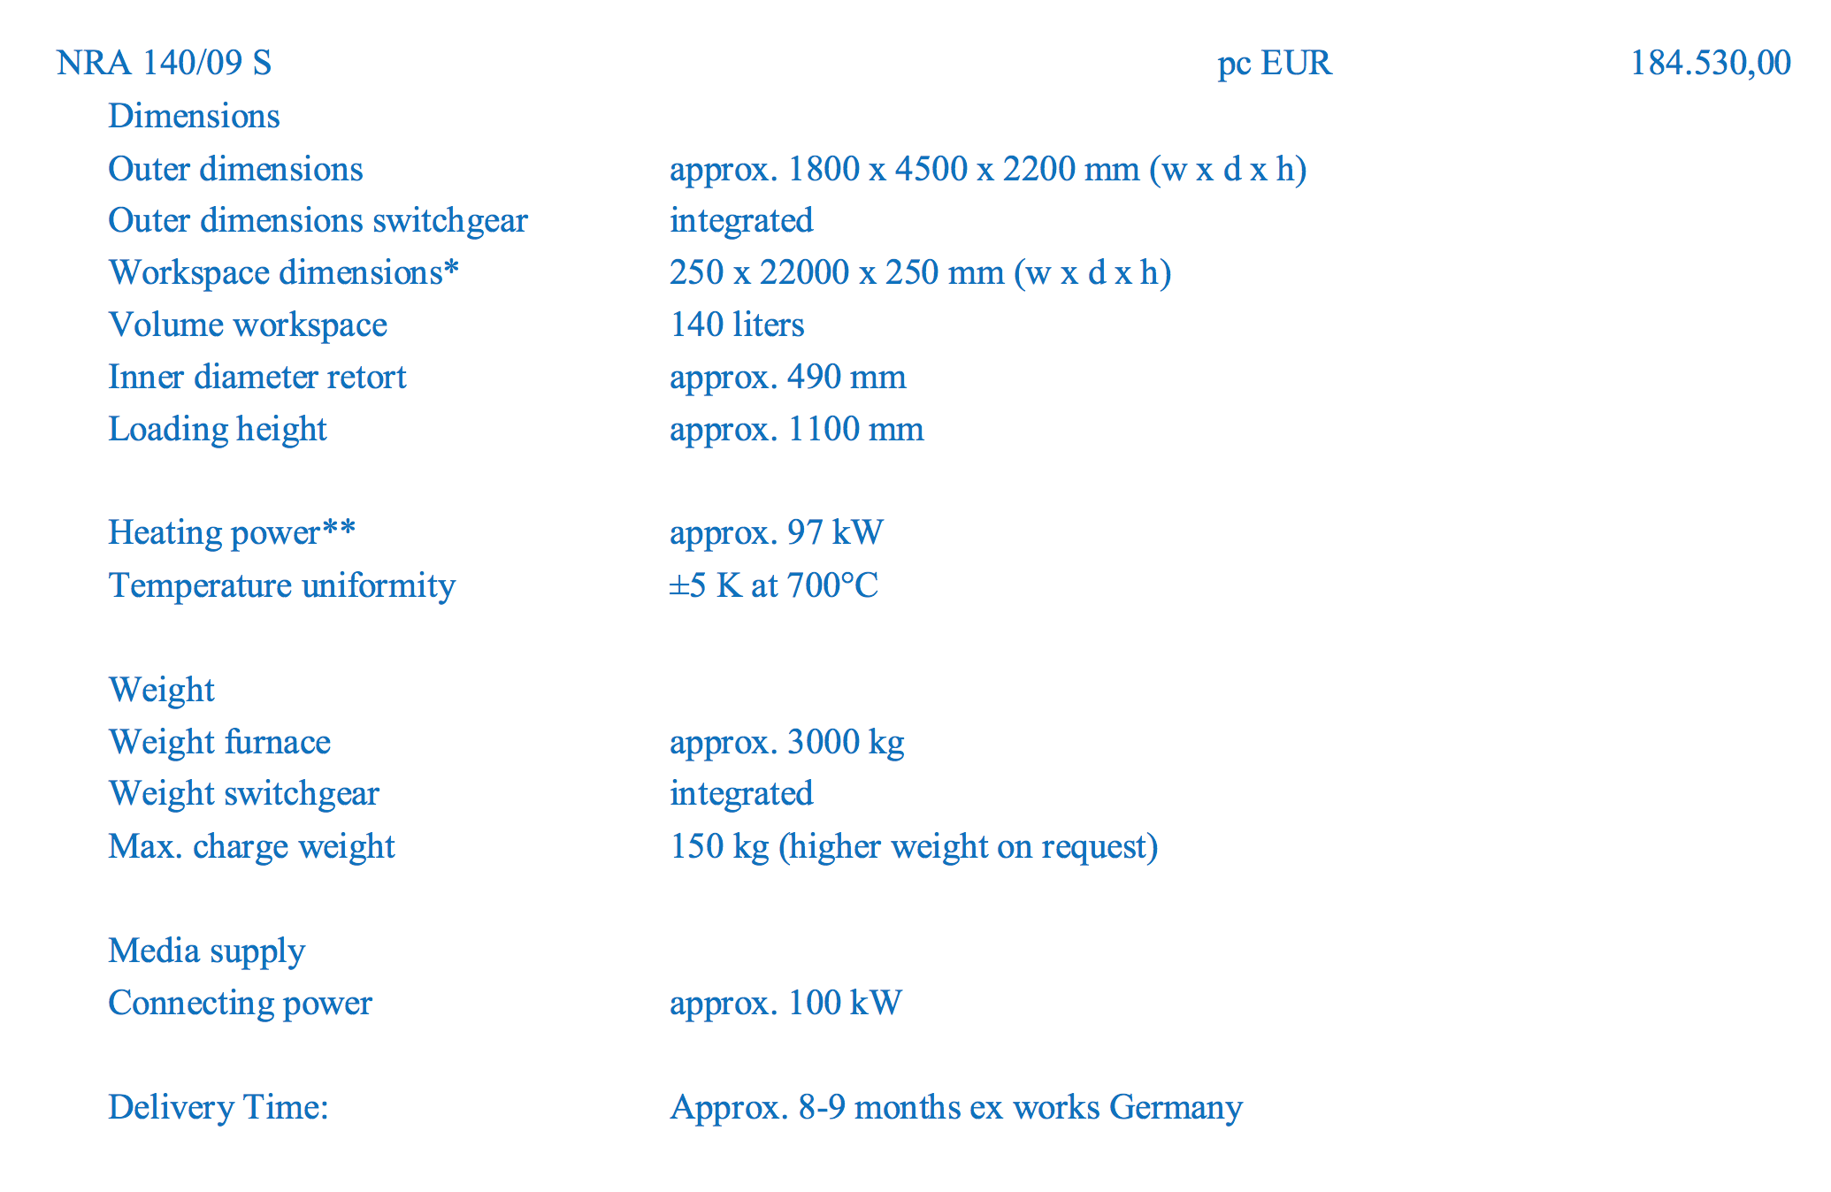
Key data Nabertherm
cold trap?
how many heating zones on 2-m-long oven?
training on-site included?

Slide 7
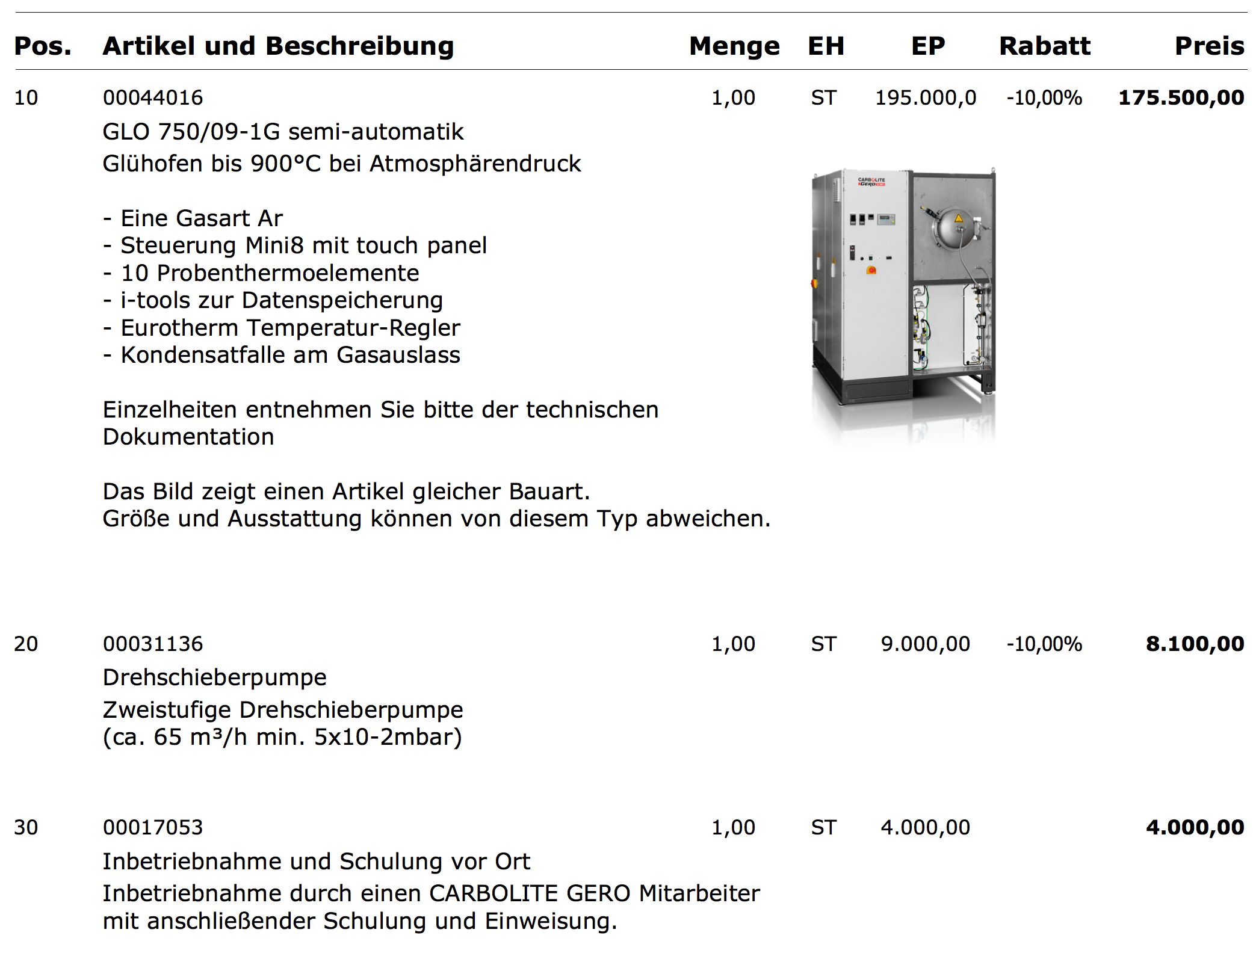
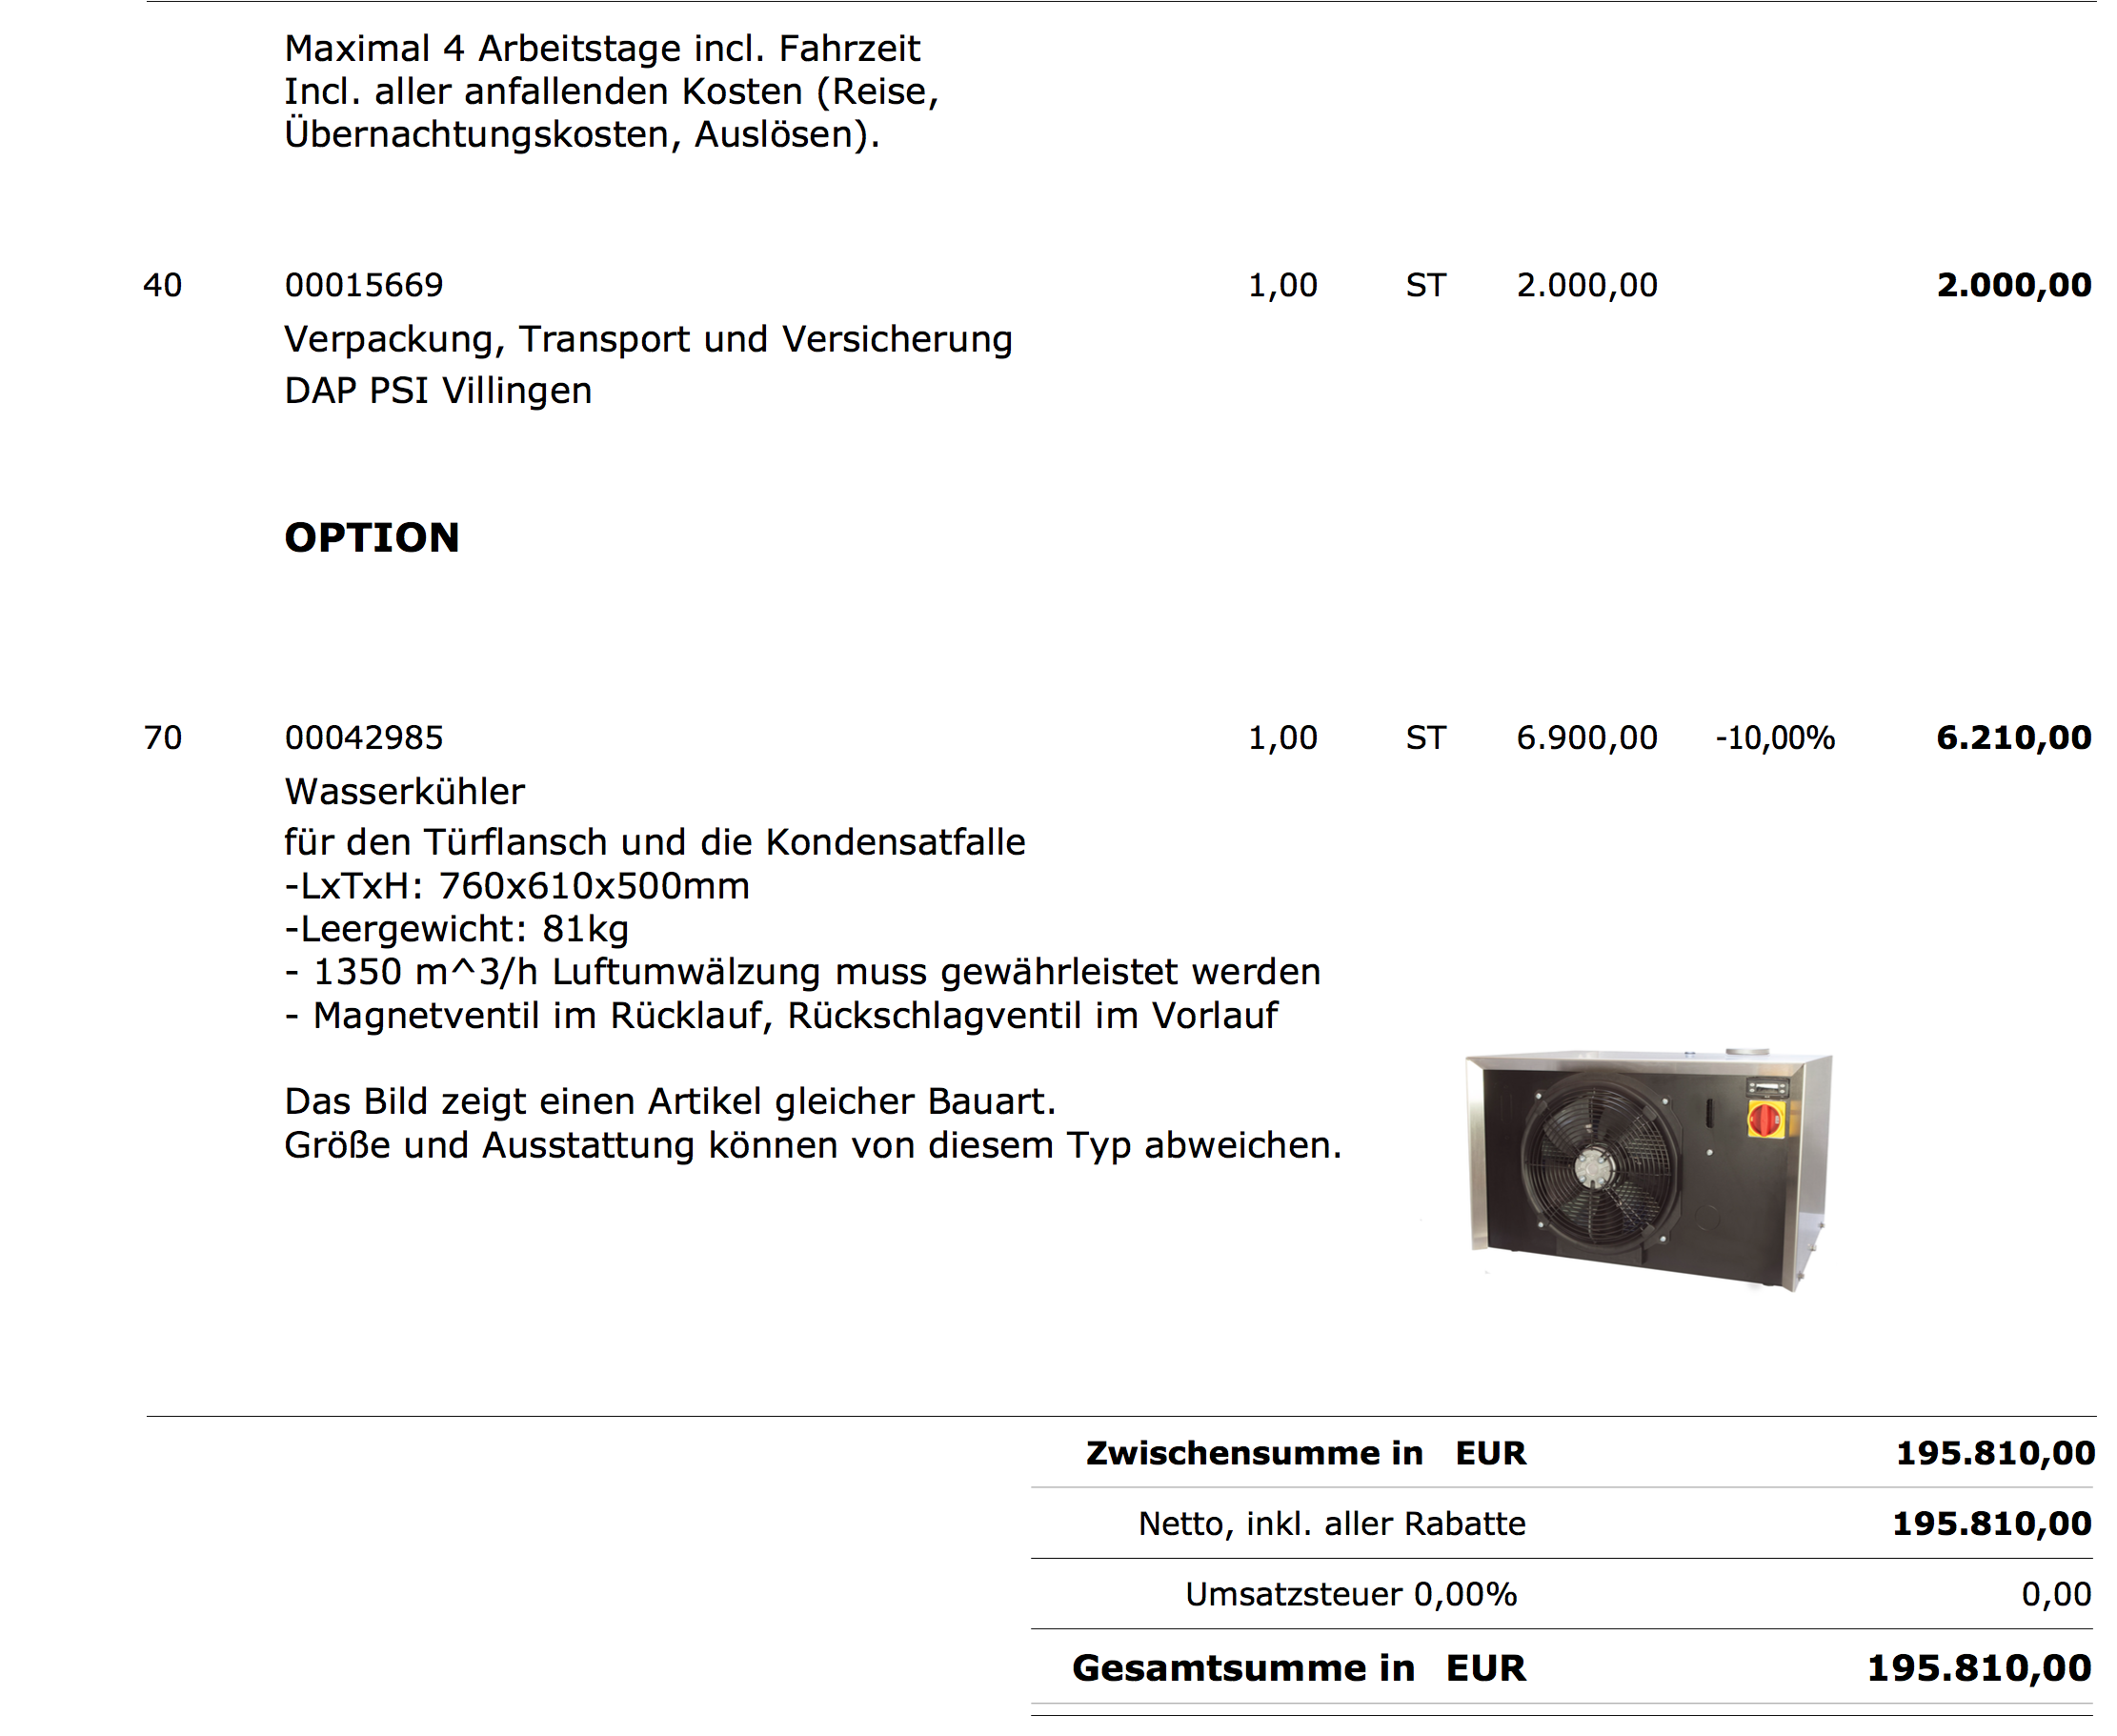
Price Gero

Slide 8
Conclusion Furnace:
Price difference: 10,000 EUR.
  Nabertherm needs to add on-site commissioning and cold-trap for exhaust cleaning.
  Effectively prices are identical.
Gero working volume is cylindrical with 650 mm diameter, Nabertherm is square 250x250 mm.
6 month construction, 7 month delivery with Gero, 8-9 month delivery with Nabertherm.
Gero has experience with tuning of 3 furnaces at CERN.
  Will make our commissioning shorter and quality better.
We opt for Gero.

Slide 9
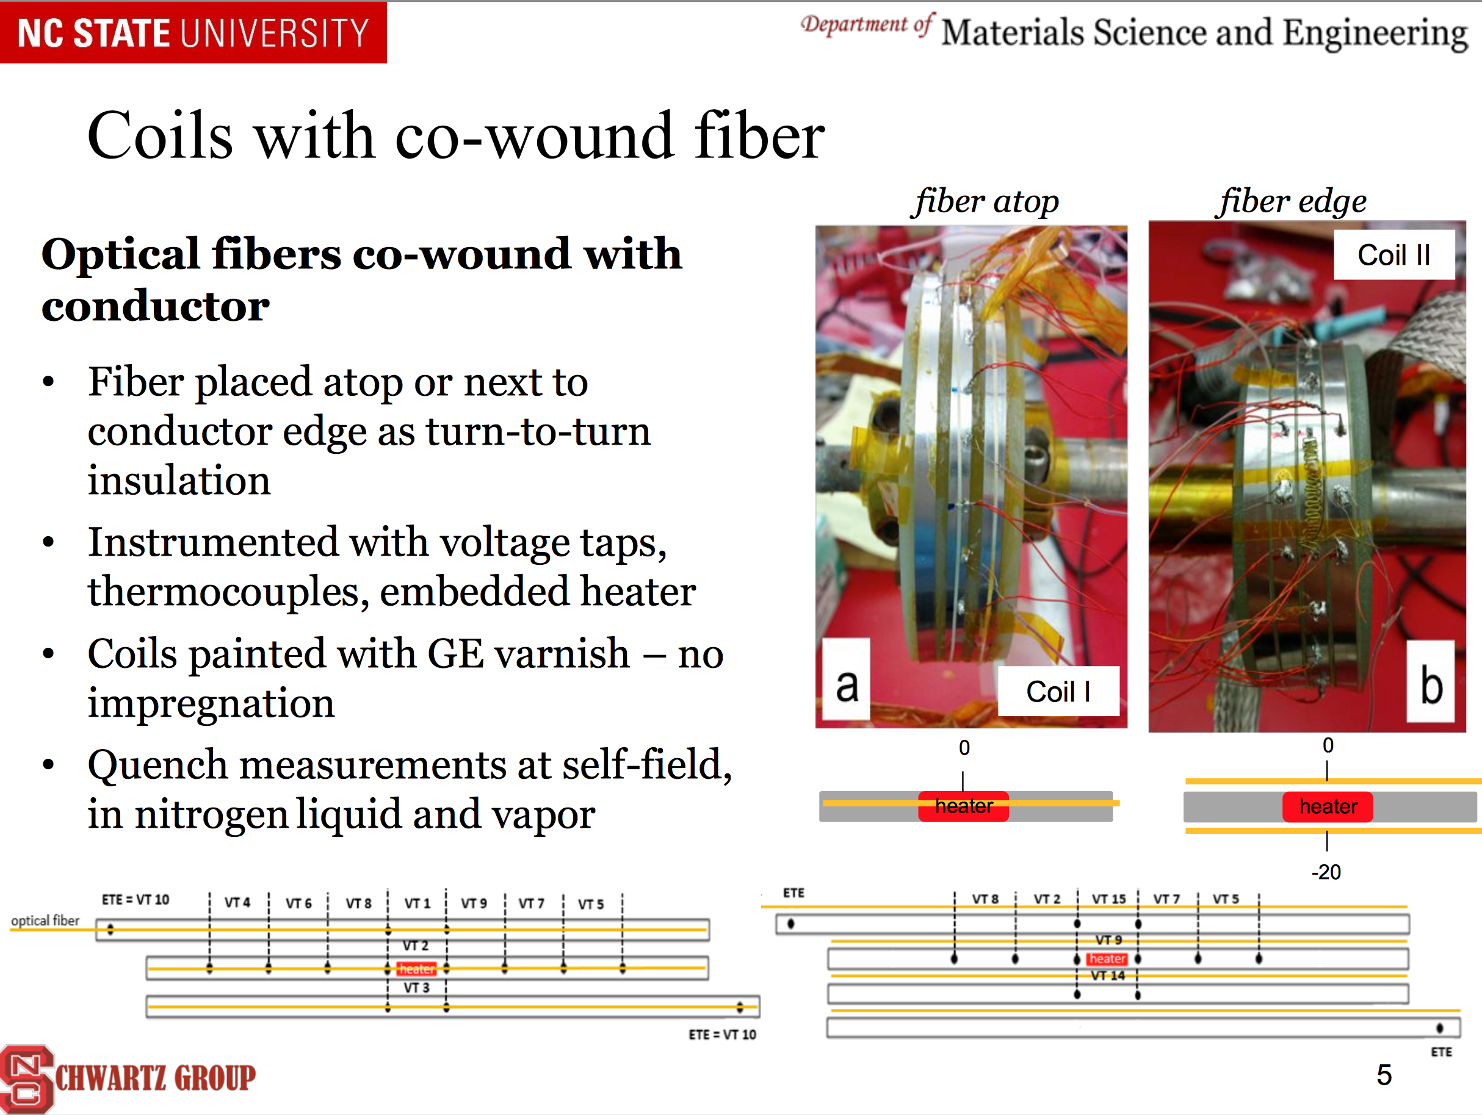
Rayleigh Backscattering

Slide 10
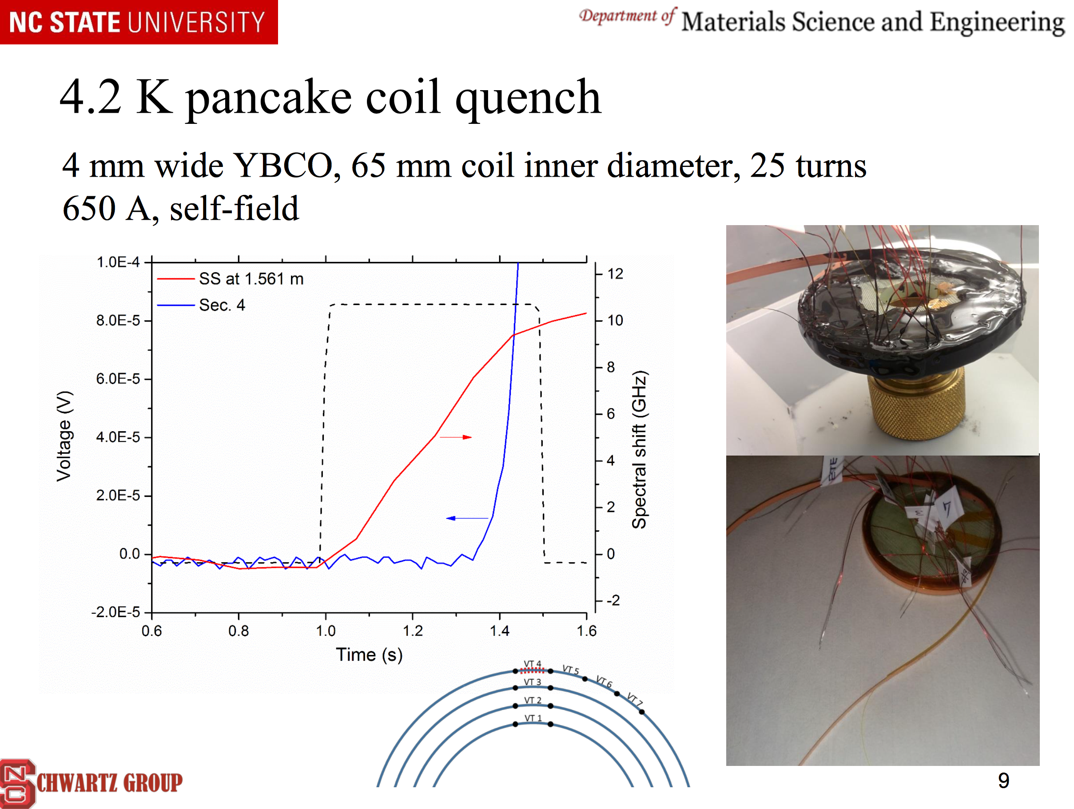
Rayleigh Backscattering

Slide 11
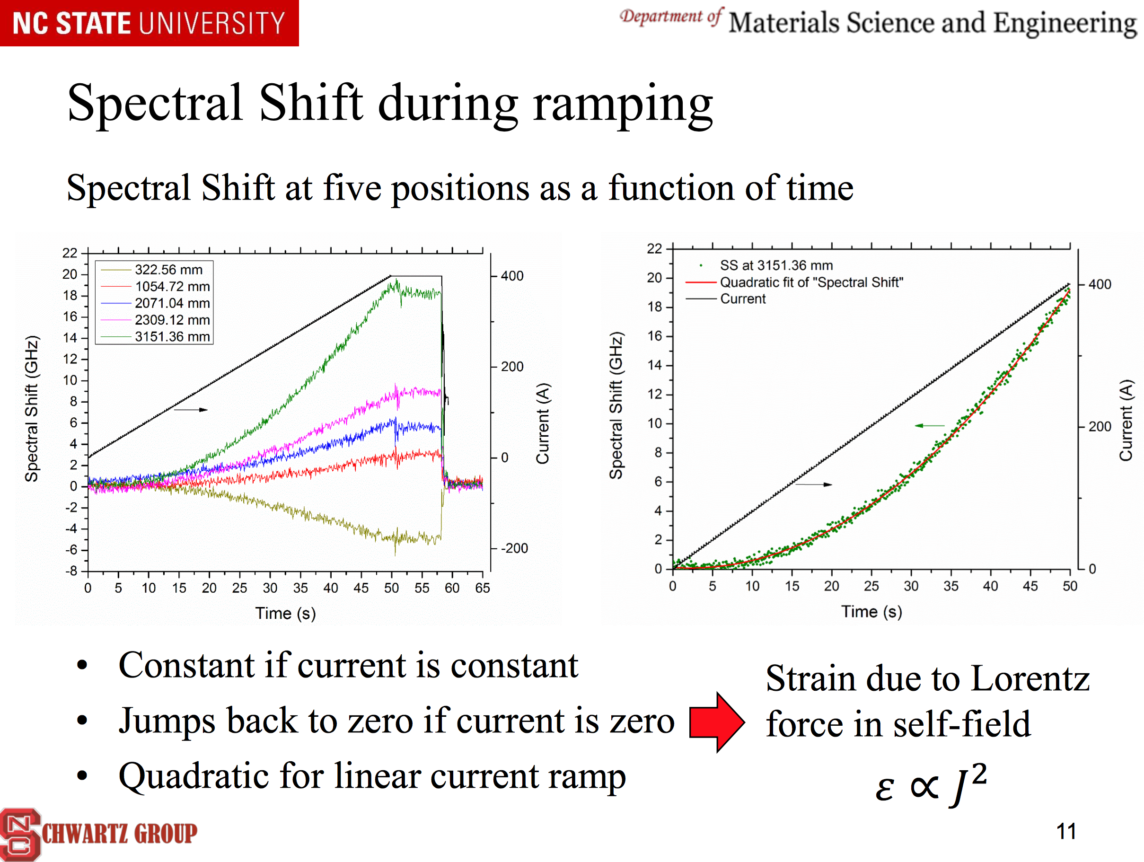
Rayleigh Backscattering

Slide 12
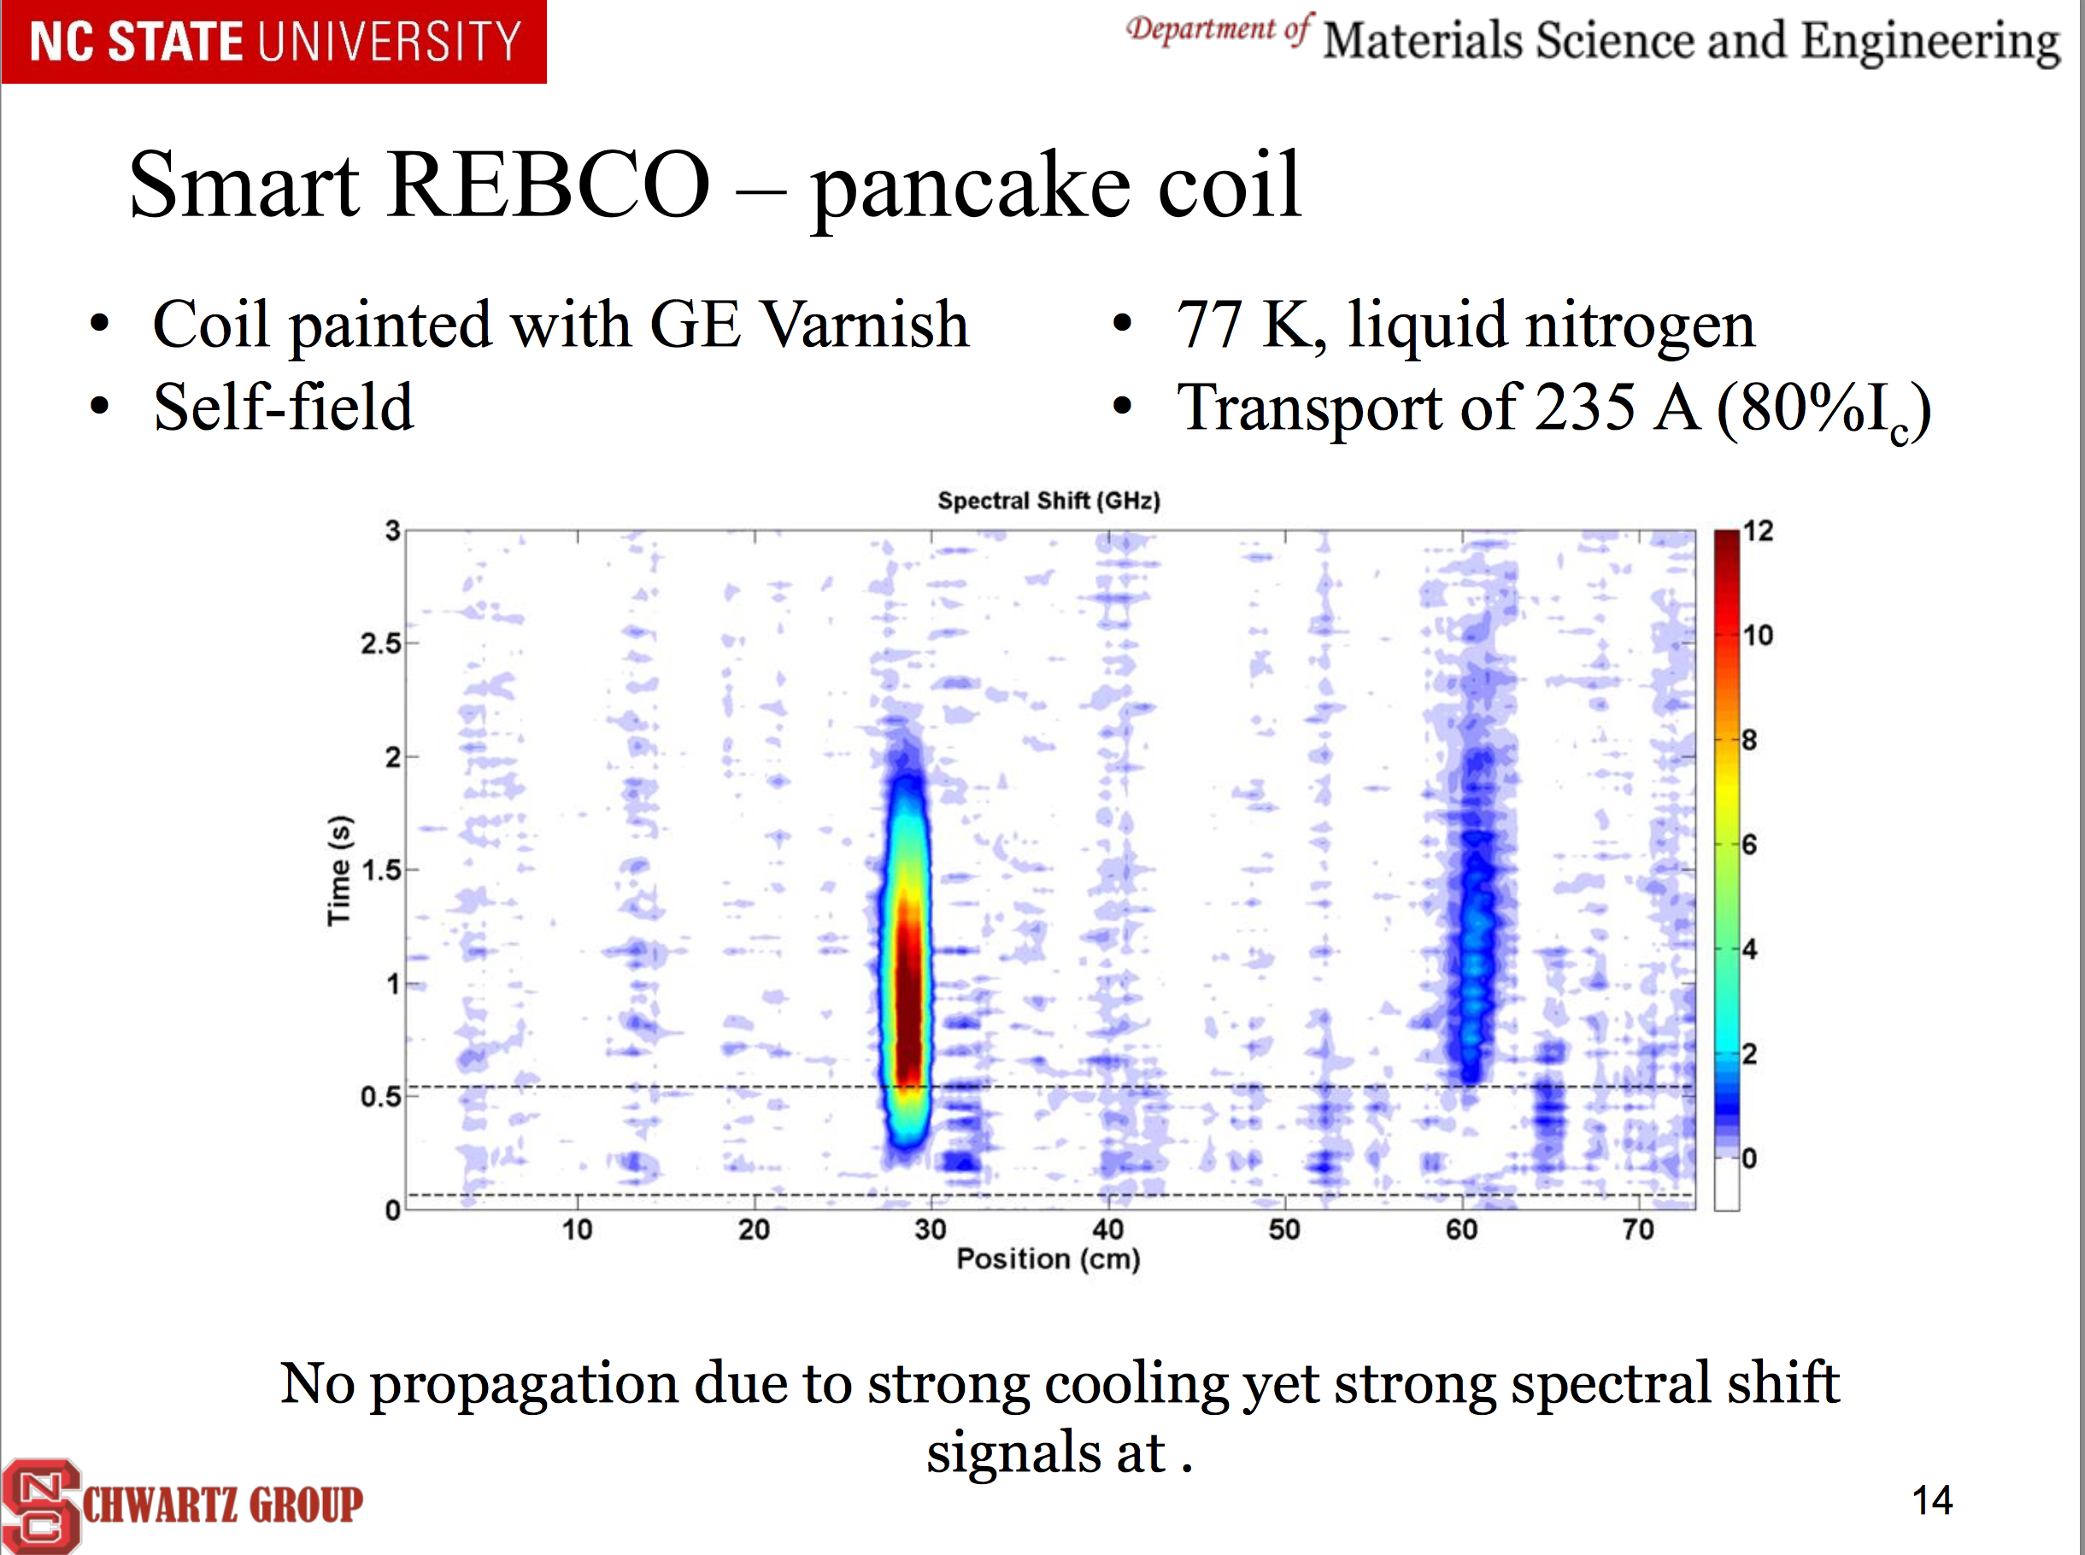
Localization

Slide 13
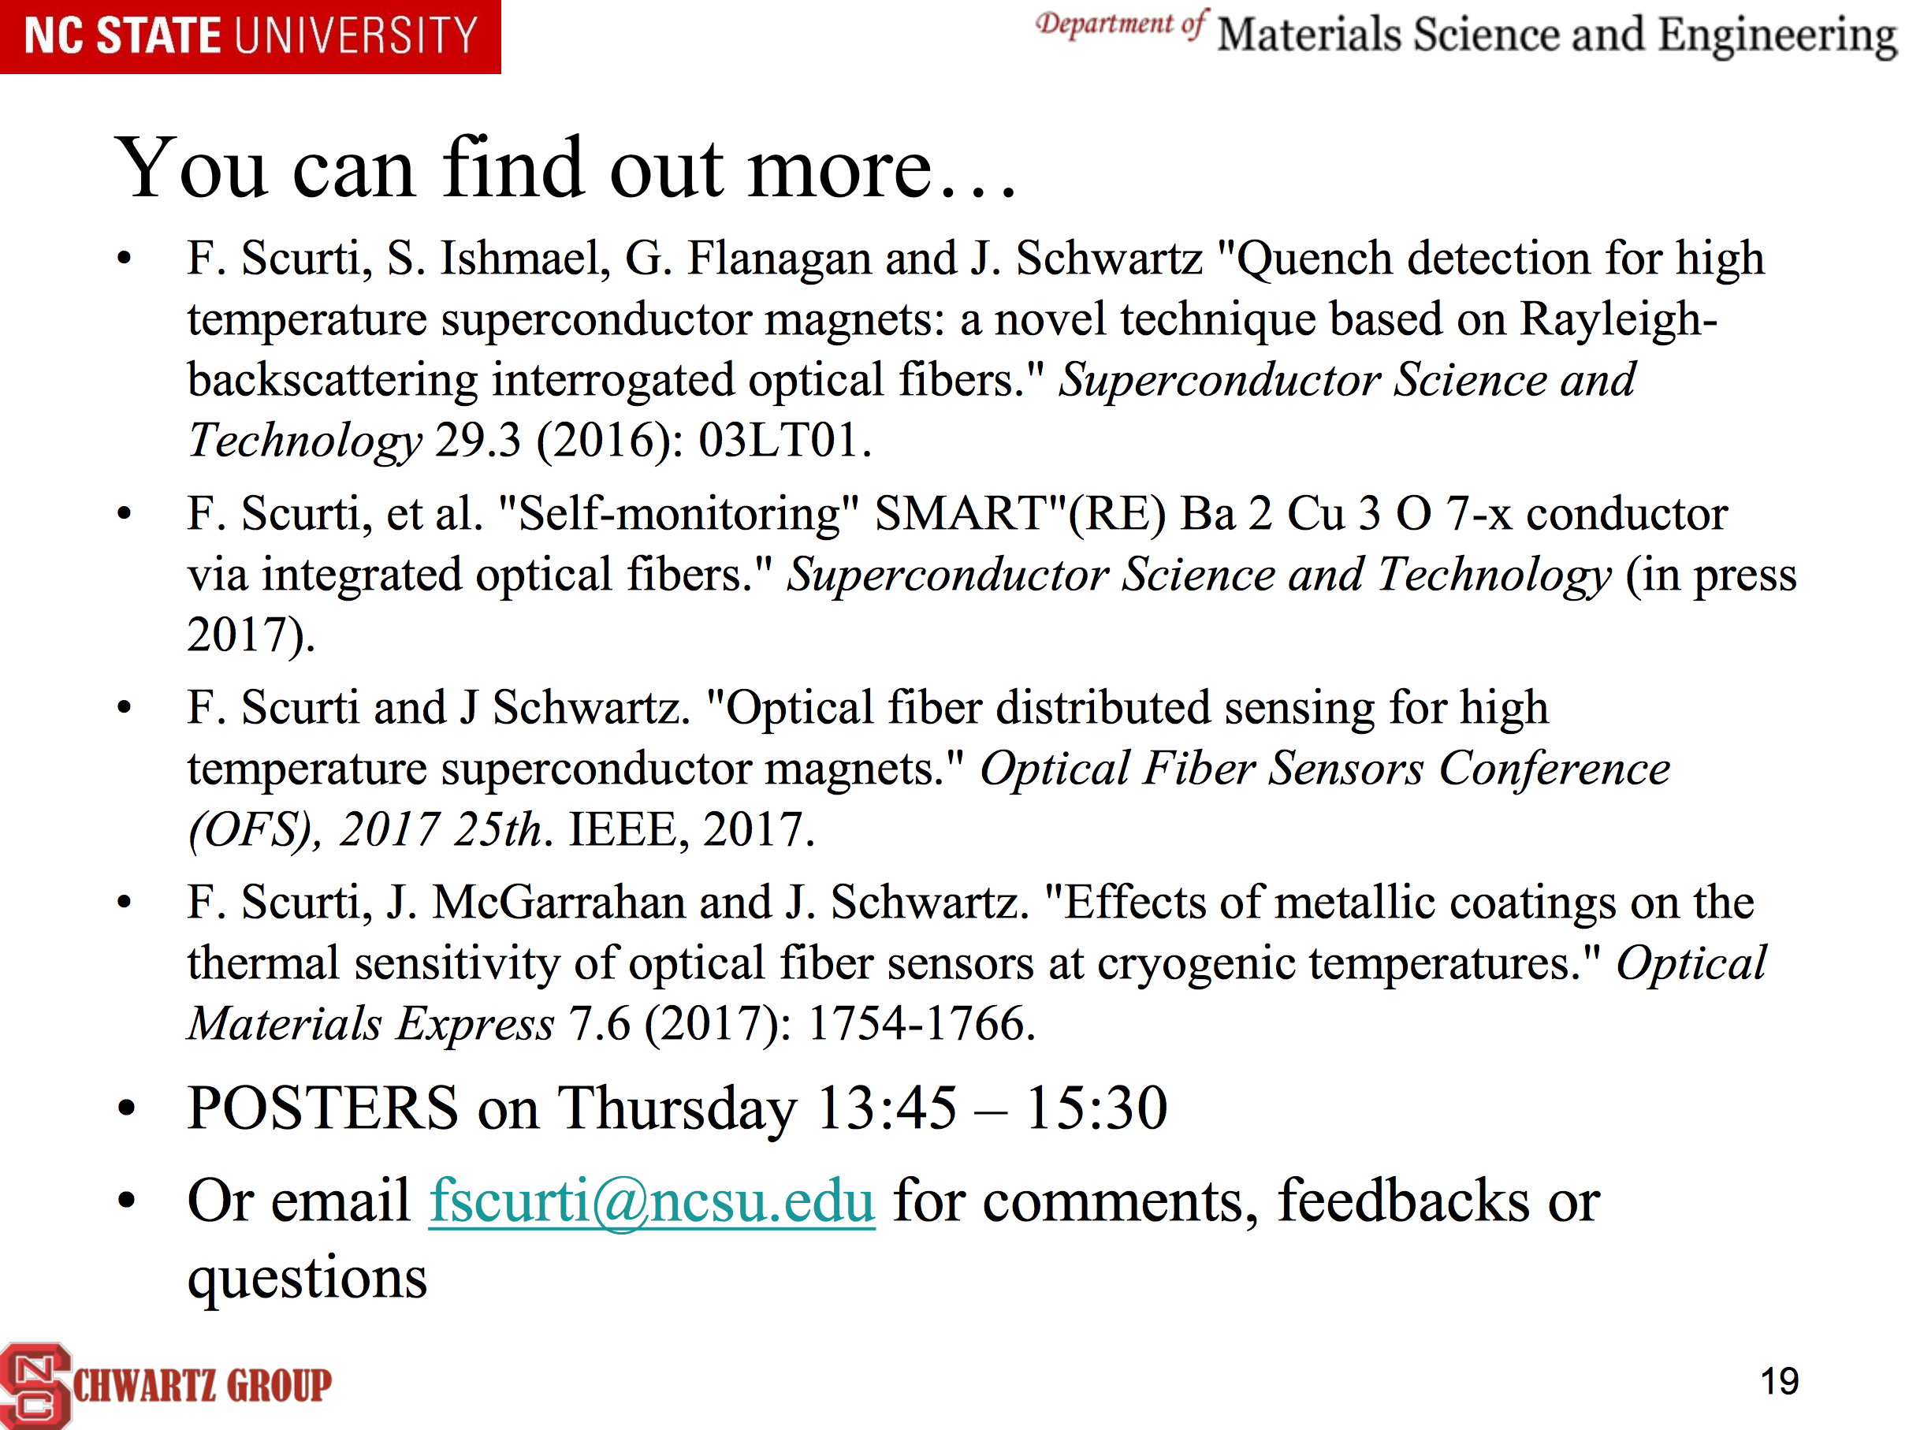
Literature

Slide 14
END

