Slide 1
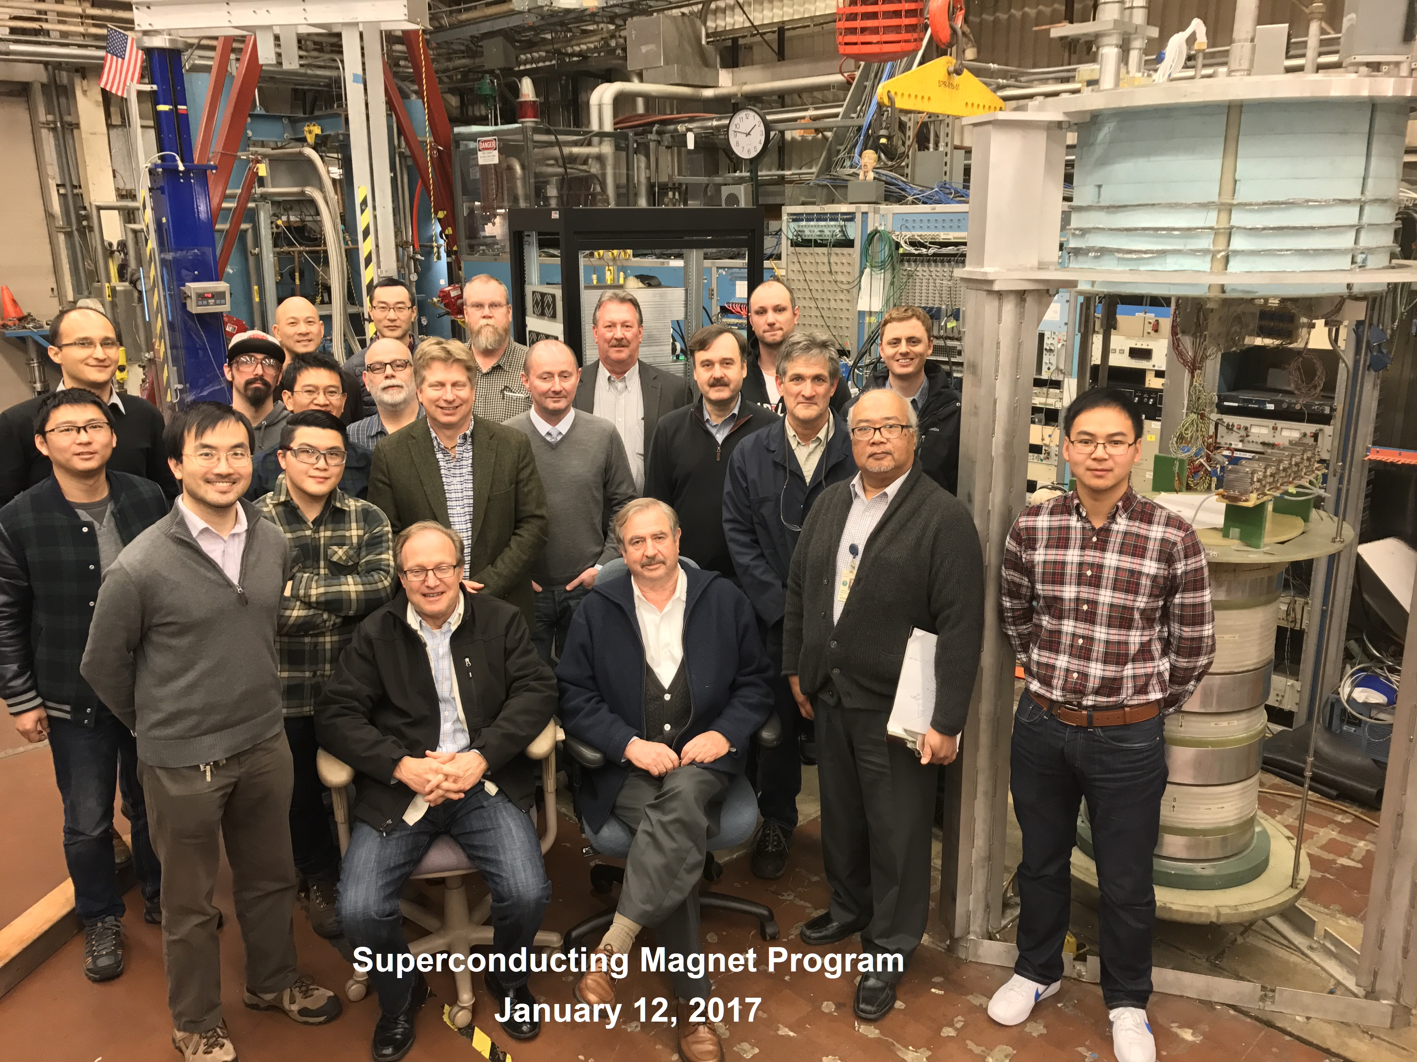
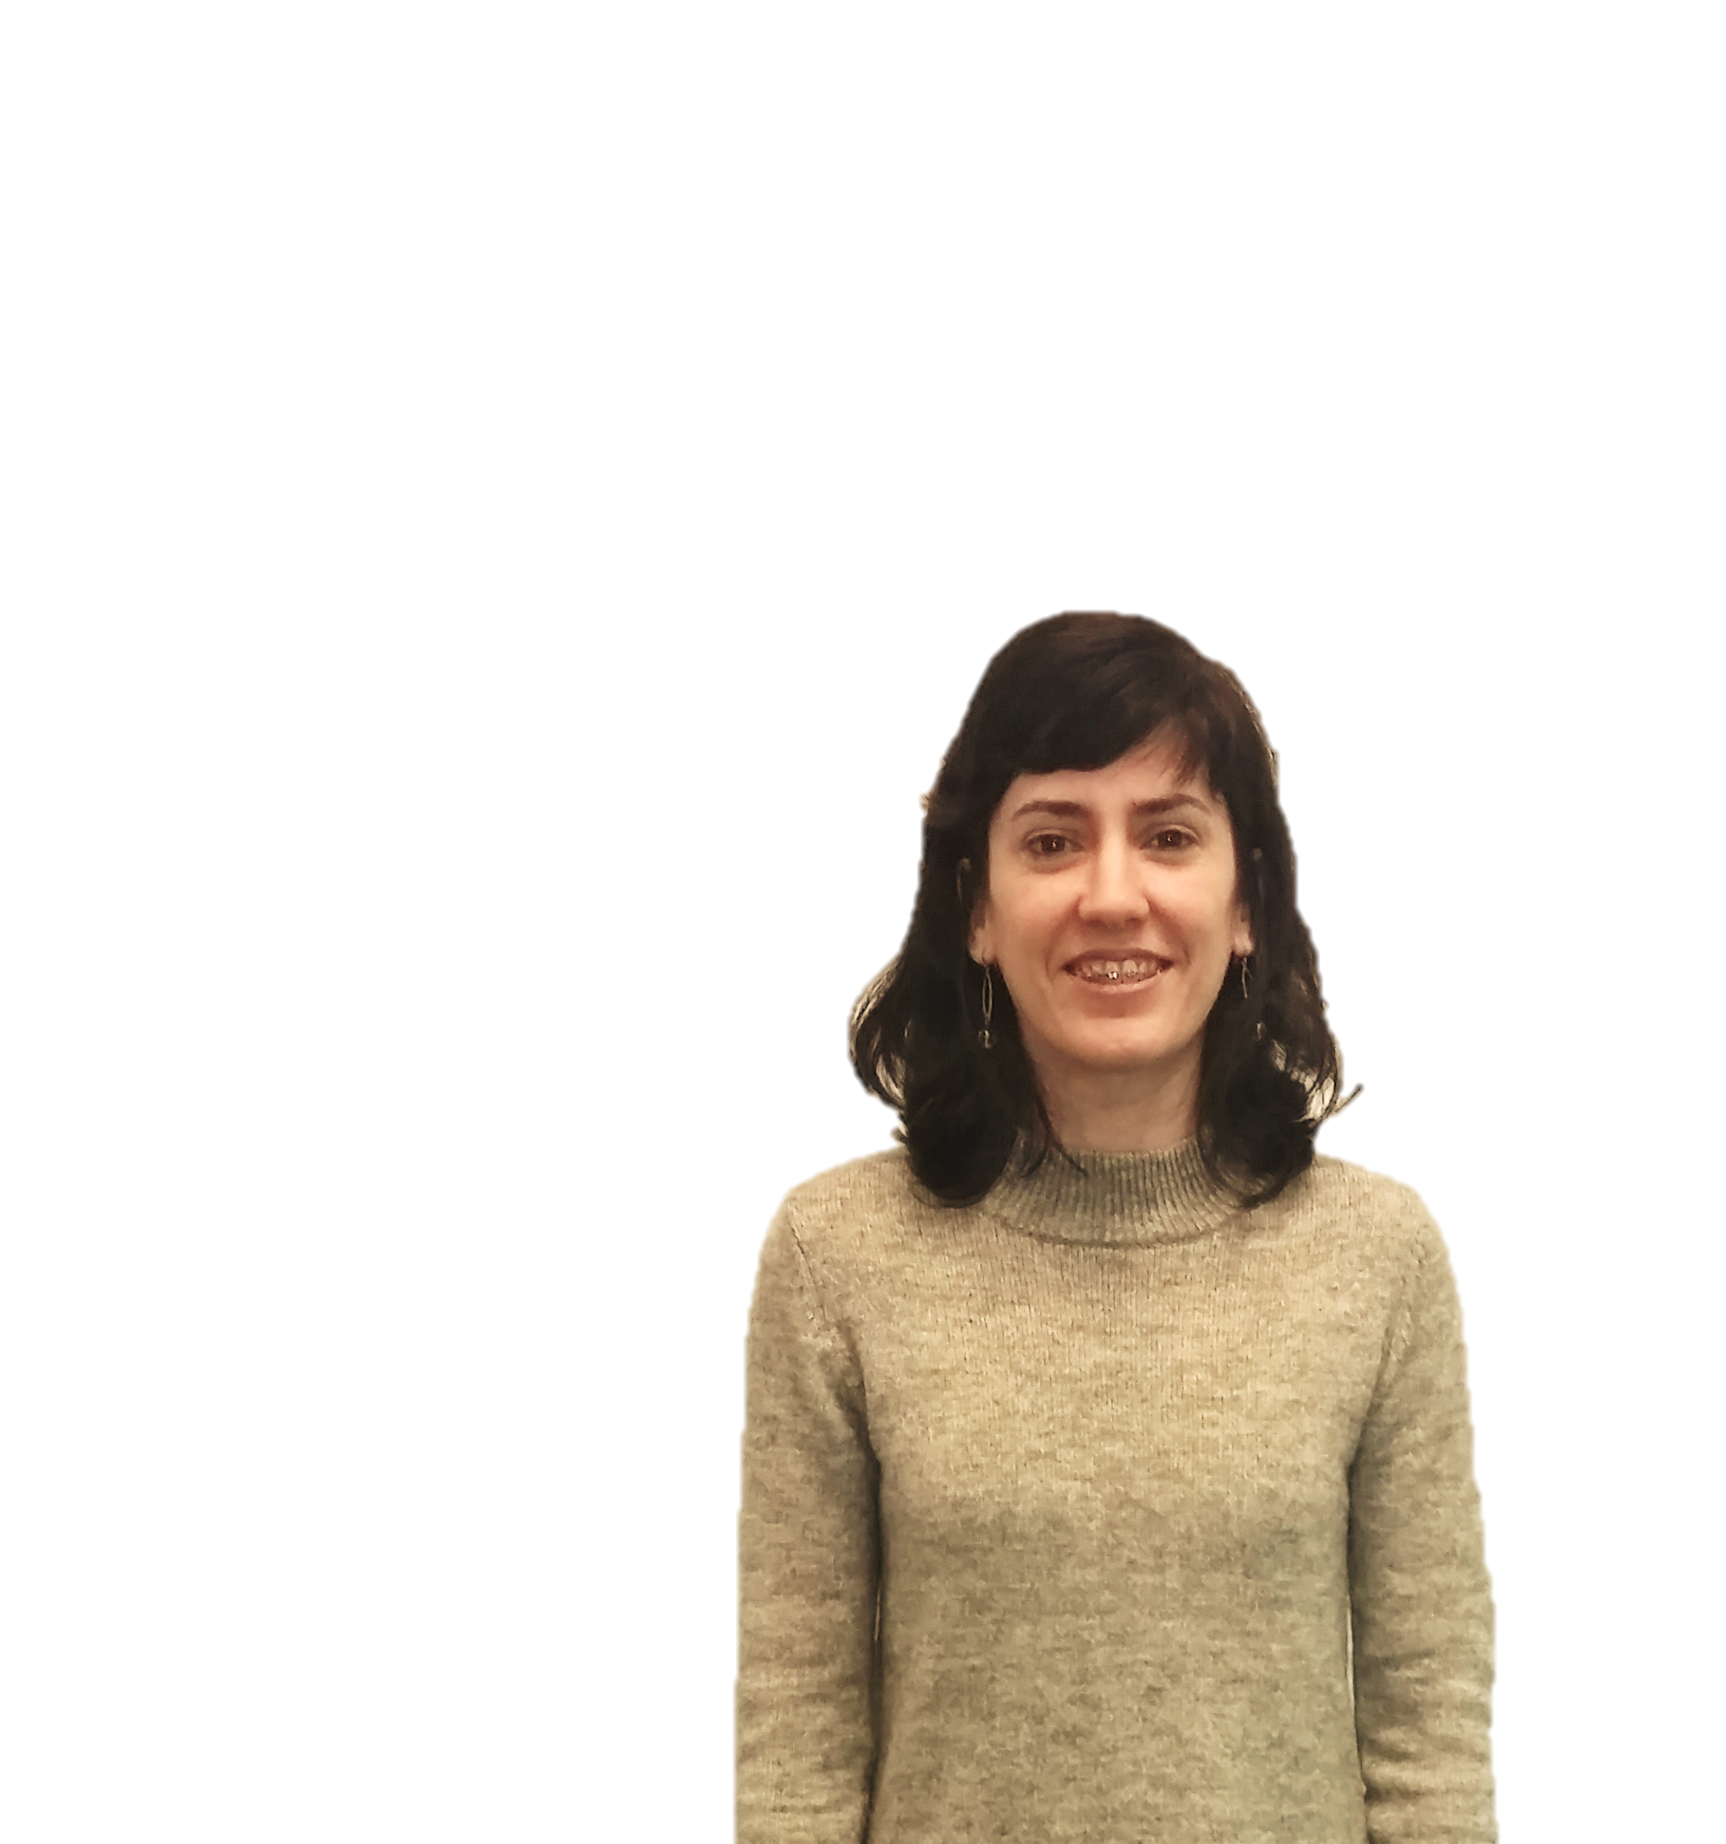
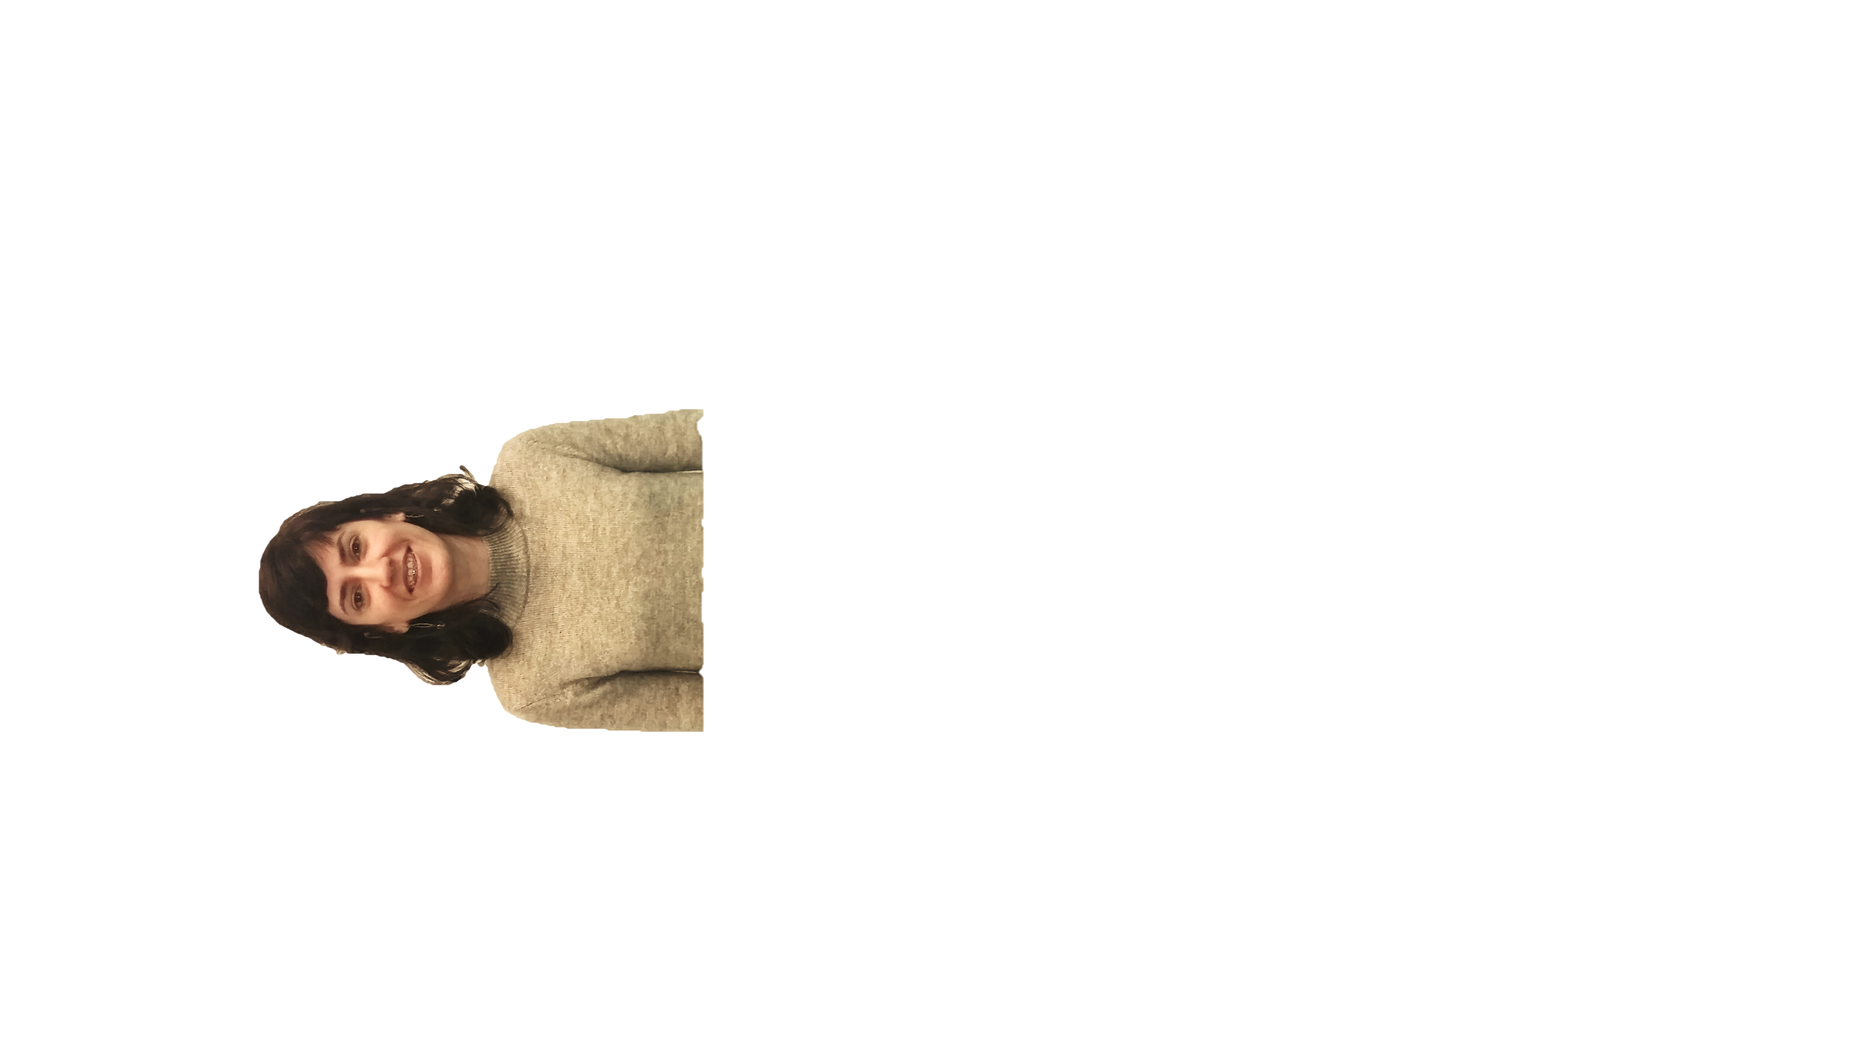


Back row: Dan Cheng, Xiaorong Wang, Jim Swanson, Steve Gourlay, Matt Reynolds
Middle row: Mariusz Juchno, Joshua Herrera, Tengming Shen, Tom Lipton, Eric Anderssen,
Maxim Martchevskii, Hugh Higley, Lucas Brouwer
Front row: Heng Pan, Ian Pong, Andy Lin, Soren Prestemon,
Laura Garcia Fajardo, Ray Hafalia, Kai Zhang
Sitting: Dan Dietderich, Shlomo Caspi

Slide 2
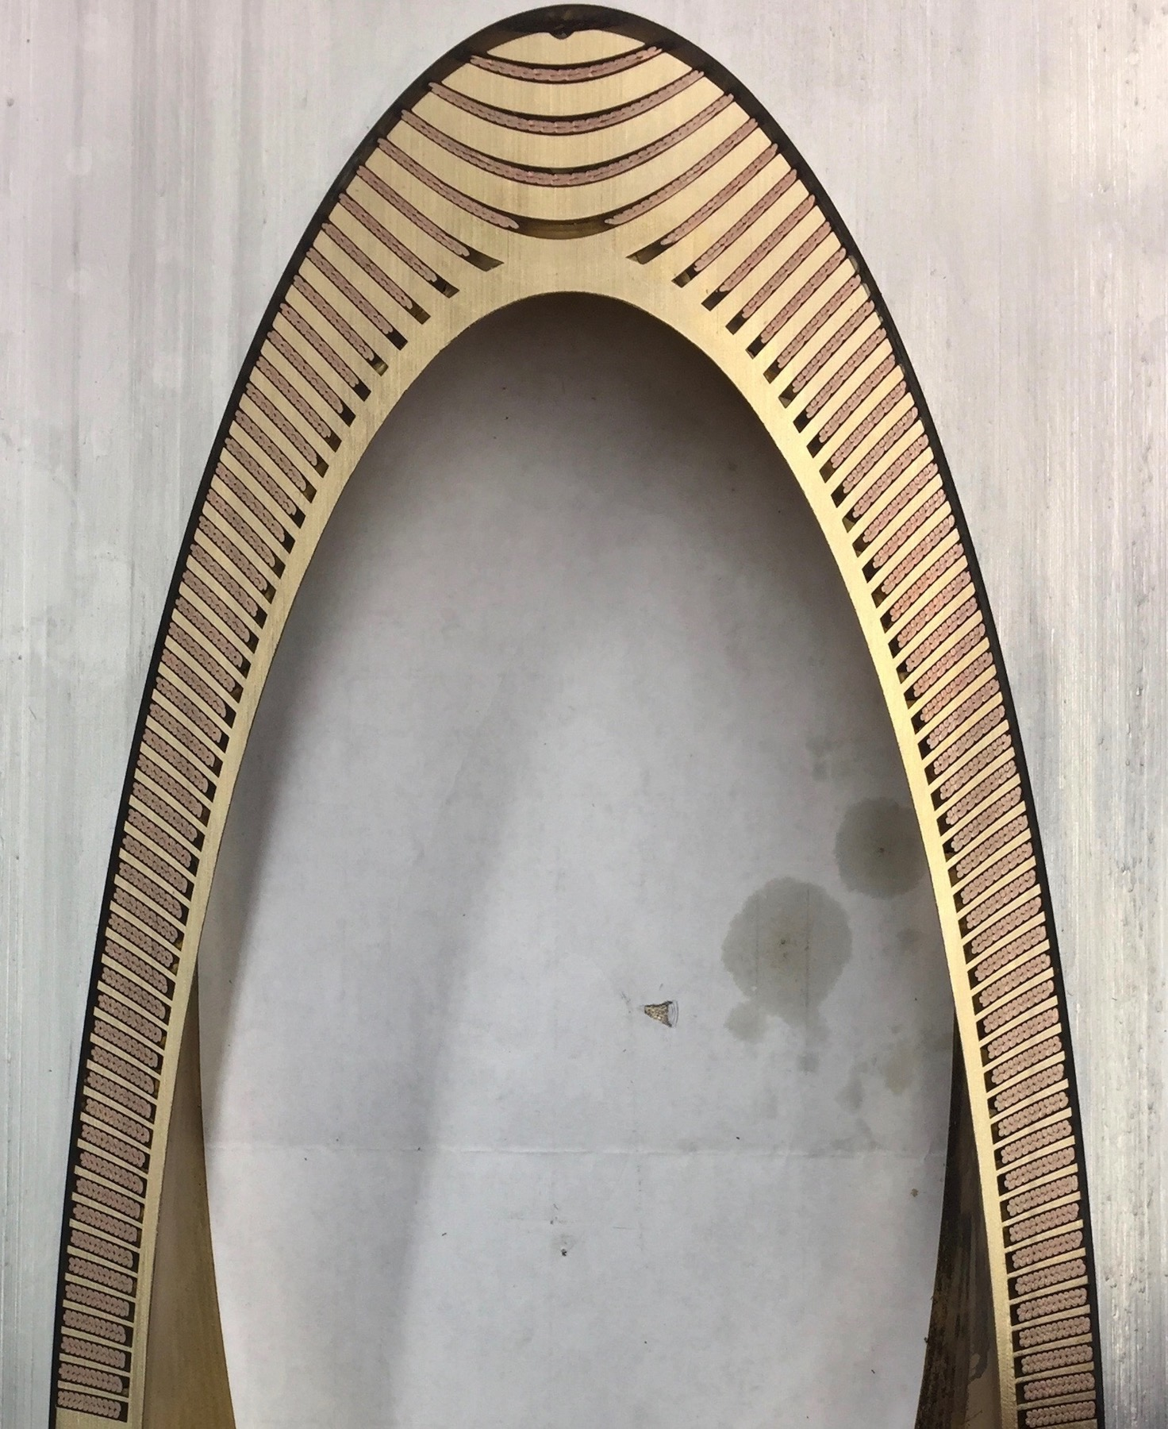

Slide 8
16.7 kA

Slide 17
What’s next ?

Slide 18
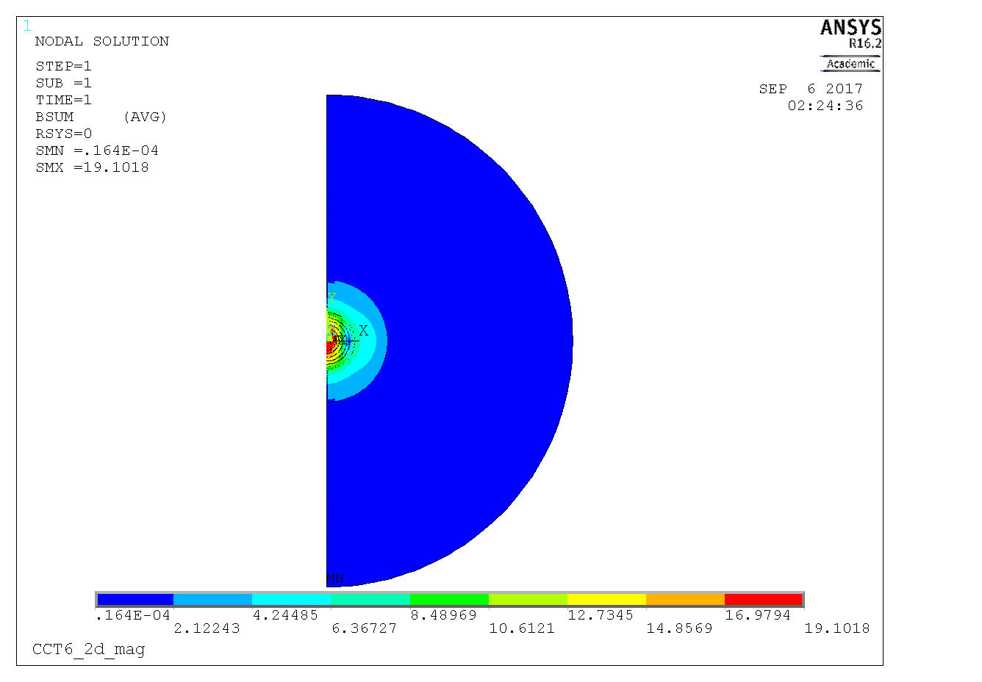
Radial Spread

Slide 19
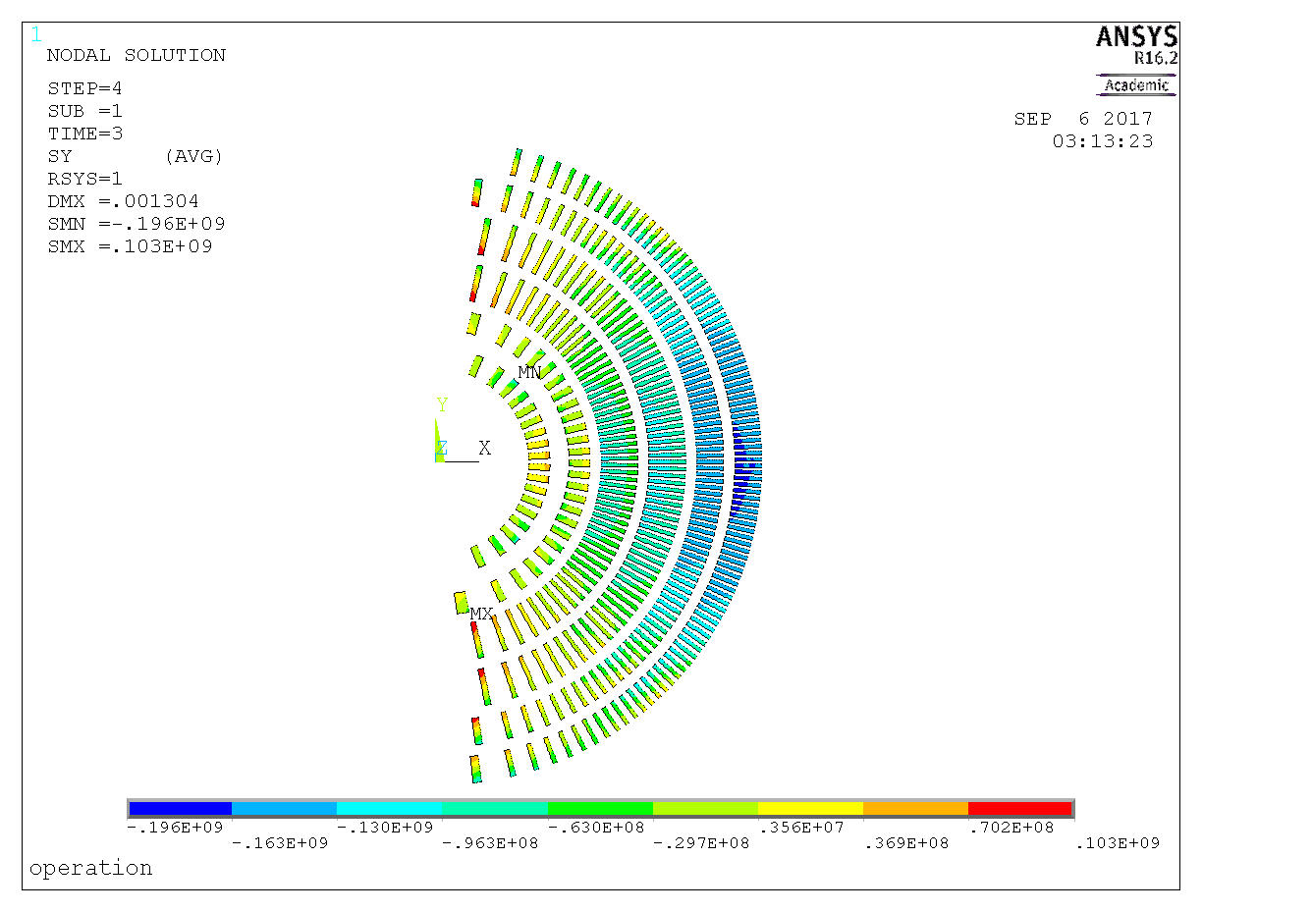
6 layers CCT at 19T
19T operation

Slide 20
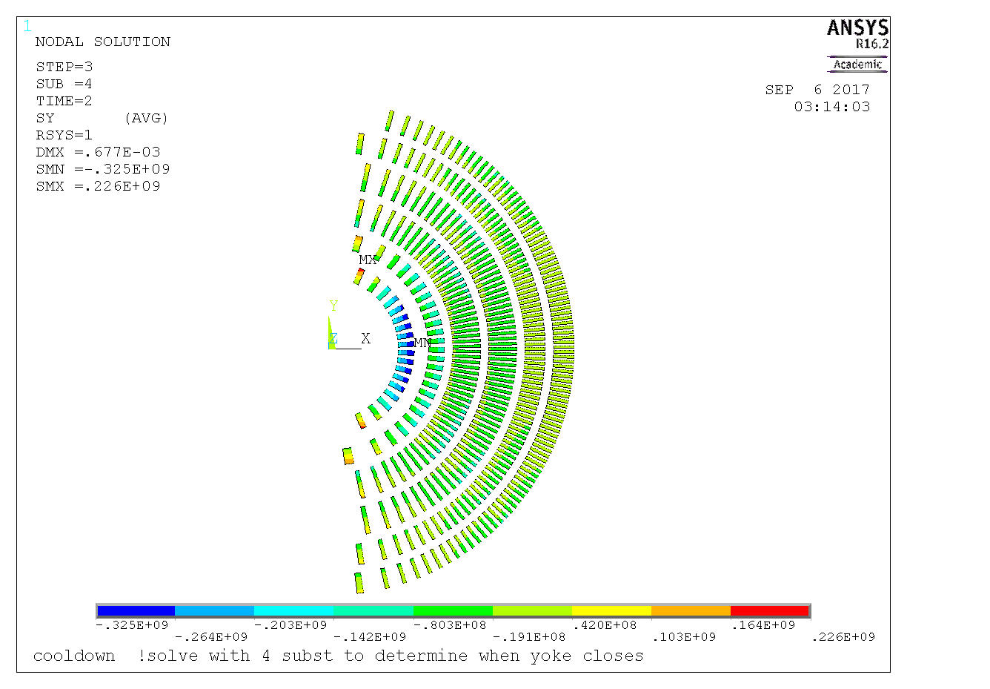
6 layers CCT
cooldown

Slide 21
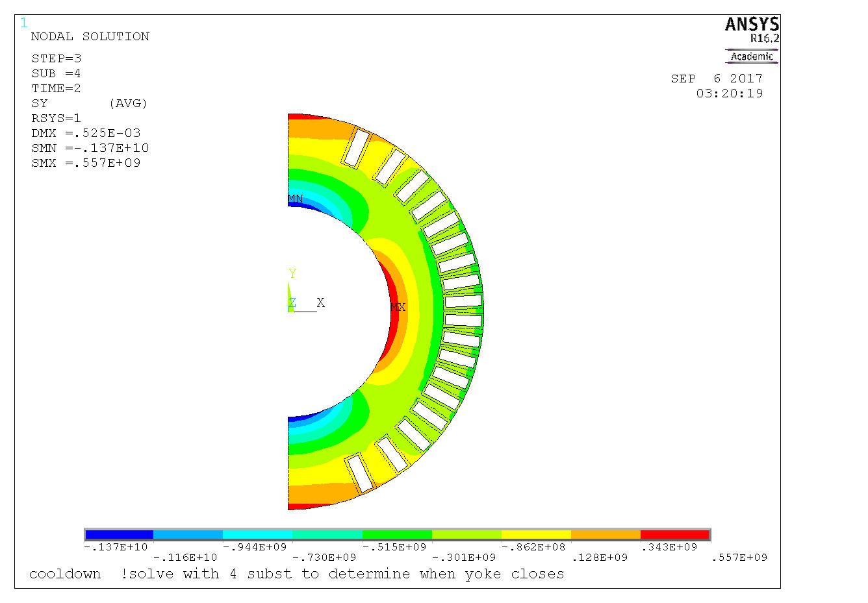
6 layers CCT at 19T
19T operation

Slide 22
6 layers CCT
Cool down

