Slide 1
The pion-nucleon (πN) interaction below 100 MeV
What has been learnt after 30 years of painstaking experimentation and analysis of the meson-factory measurements?

Slide 2
What makes πN Physics interesting?
The πN interaction is used as input in the description of more complex systems, e.g., of the NN system
Determination of the πN coupling constant
  Tests: Current Algebra, PCAC and Goldberger-Treiman relation, GMO sum rule, etc.
  Properties of the deuteron, etc.
Information extracted from the πN system is used in QCD tests (πN σ term)
The πN system is the simplest hadronic system involving one baryon

Slide 3
Low-energy πN reactions and observables
Reactions
  π⁺p → π⁺p (elastic scattering, ES)
  π⁻p → π⁻p (ES)
  π⁻p → π⁰n (charge exchange, CX)
Observables
  Differential cross section (DCS)
  Analysing power (AP)
  Partial-total/total cross section (PTCS/TCS)
  Measurements of the strong shift and width of pionic hydrogen/deuterium → πN scattering lengths
PSI

Slide 4
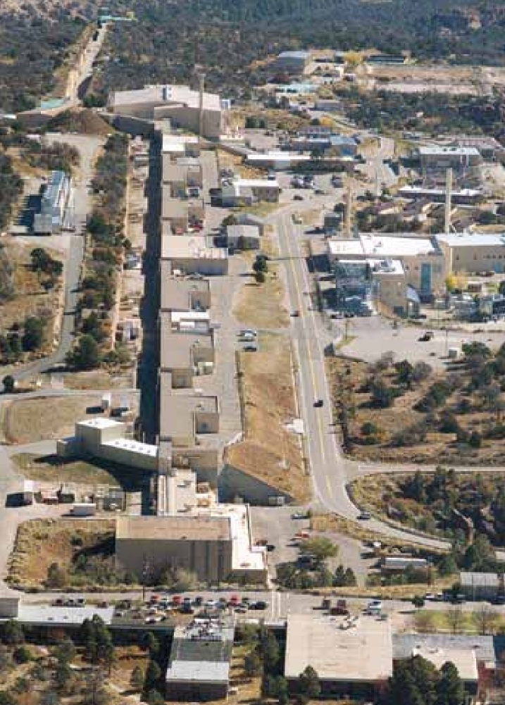

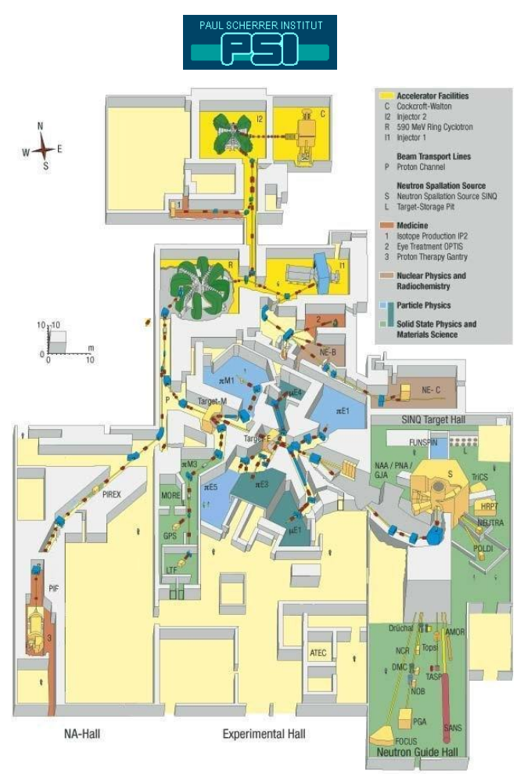
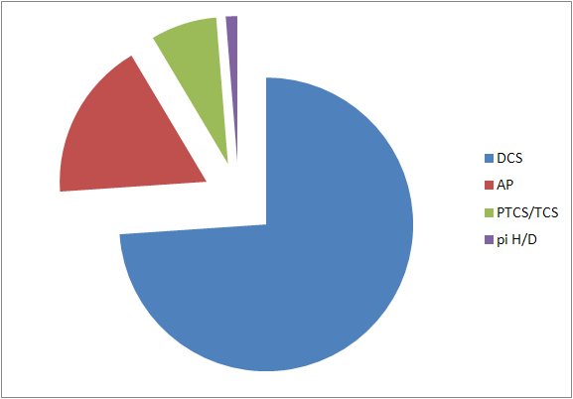
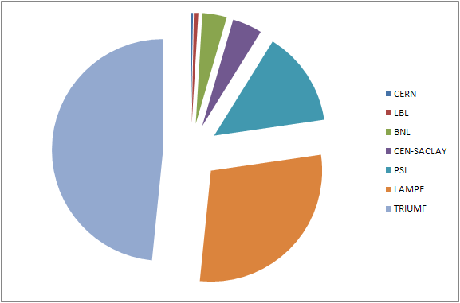
Meson-factory low-energy πN measurements
Los Alamos Meson Physics Facility
Measurements @ PSI

Slide 5
Analyses of the πN measurements
Identifier | Input | Output | Method | Energy range
GWU (SAID) | DCSs, APs | δ_{IJ}, f_{IJ} | DRs | All
Jülich/Bonn | δ_{IJ} (DCSs, APs) | LECs | χPT (DRs) | Up to ≈ 100 MeV
Valencia | δ_{IJ} | LECs | CBχPT | ≤ 100 MeV
Zurich | DCSs, APs, PTCSs, TCSs | Model parameters (LECs, δ_{IJ}, f_{IJ}) | Phenomenological or hadronic model | ≤ 100 MeV
Helsinki, KA/KH, London, Nijmegen, NMSU, etc.
R.A. Arndt, W.J. Briscoe, I.I. Strakovsky, R.L. Workman, Extended partial-wave analysis of πN scattering data, Phys. Rev. C 74 (2006) 045205; R.L. Workman, R.A. Arndt, W.J. Briscoe, M.W. Paris, I.I. Strakovsky, Parameterization dependence of T-matrix poles and eigenphases from a fit to πN elastic scattering data, Phys. Rev. C 86 (2012) 035202; SAID Analysis Program: gwdac.phys.gwu.edu
M. Hoferichter, J. Ruiz de Elvira, B. Kubis, Ulf-G. Meißner, Roy-Steiner-equation analysis of pion-nucleon scattering, Phys. Rep. 625 (2016) 1-88
DRs: Dispersion Relations; LECs: Low-Energy Constants; χPT: Chiral Perturbation Theory; CBχPT : Covariant Baryon χPT

Slide 6
The triangle identity
Isospin invariance in the hadronic part of the πN interaction → only two (complex) amplitudes enter the physical description of the three πN reactions:
  I = 3/2 amplitude (f₃) and
  I = 1/2 amplitude (f₁).
π⁺p: f₃, π⁻p ES: (2f₁ + f₃)/3, π⁻p CX: √2(f₃ − f₁)/3
The triangle identity follows:
W.R. Gibbs, Li Ai, W.B. Kaufmann, Isospin breaking in low-energy pion-nucleon scattering, Phys. Rev. Lett. 74 (1995) 3740-3743
E. Matsinos, Isospin violation in the πN system at low energy, Phys. Rev. C 56 (1997) 3014-3025

Slide 7
The trouble with DR analyses
DR analyses are general, but...
Not possible to analyse the low-energy data without influence from the measurements acquired at high energies: extensive databases (DBs)
Not possible to analyse the measurements of the three reactions separately
Not possible to obtain meaningful uncertainties in the output and predictions
Theoretical constraints are imposed on the analysis in the entire energy range of the measurements

Slide 8
What makes the low-energy πN measurements interesting?
The low-energy πN DB is extensive enough to enable exclusive analyses
Important theoretical constraints, which are valid in the high-energy region (e.g., isospin invariance of the hadronic part of the πN interaction), might not hold at low energy
The extrapolation of the partial-wave amplitudes into the unphysical region (e.g., to extract estimates of the πN Σ term) is expected to be more reliable when exclusively based on ‘close-by’ input
  M.G. Olsson, The nucleon sigma term from threshold parameters, Phys. Lett. B 482 (2000) 50-56
  J.M. Alarcón, J. Martin Camalich, J.A. Oller, Chiral representation of the πN scattering amplitude and the pion-nucleon sigma term, Phys. Rev. D 85 (2012) 051503
The modelling of the hadronic part of the πN scattering amplitude is simple(r) at low energy, as
  hadronic form factors are not needed,
  up to ε² terms suffice in the K-matrix parameterisations, and
  the contributions from the partial waves l>3 are negligible

Slide 9
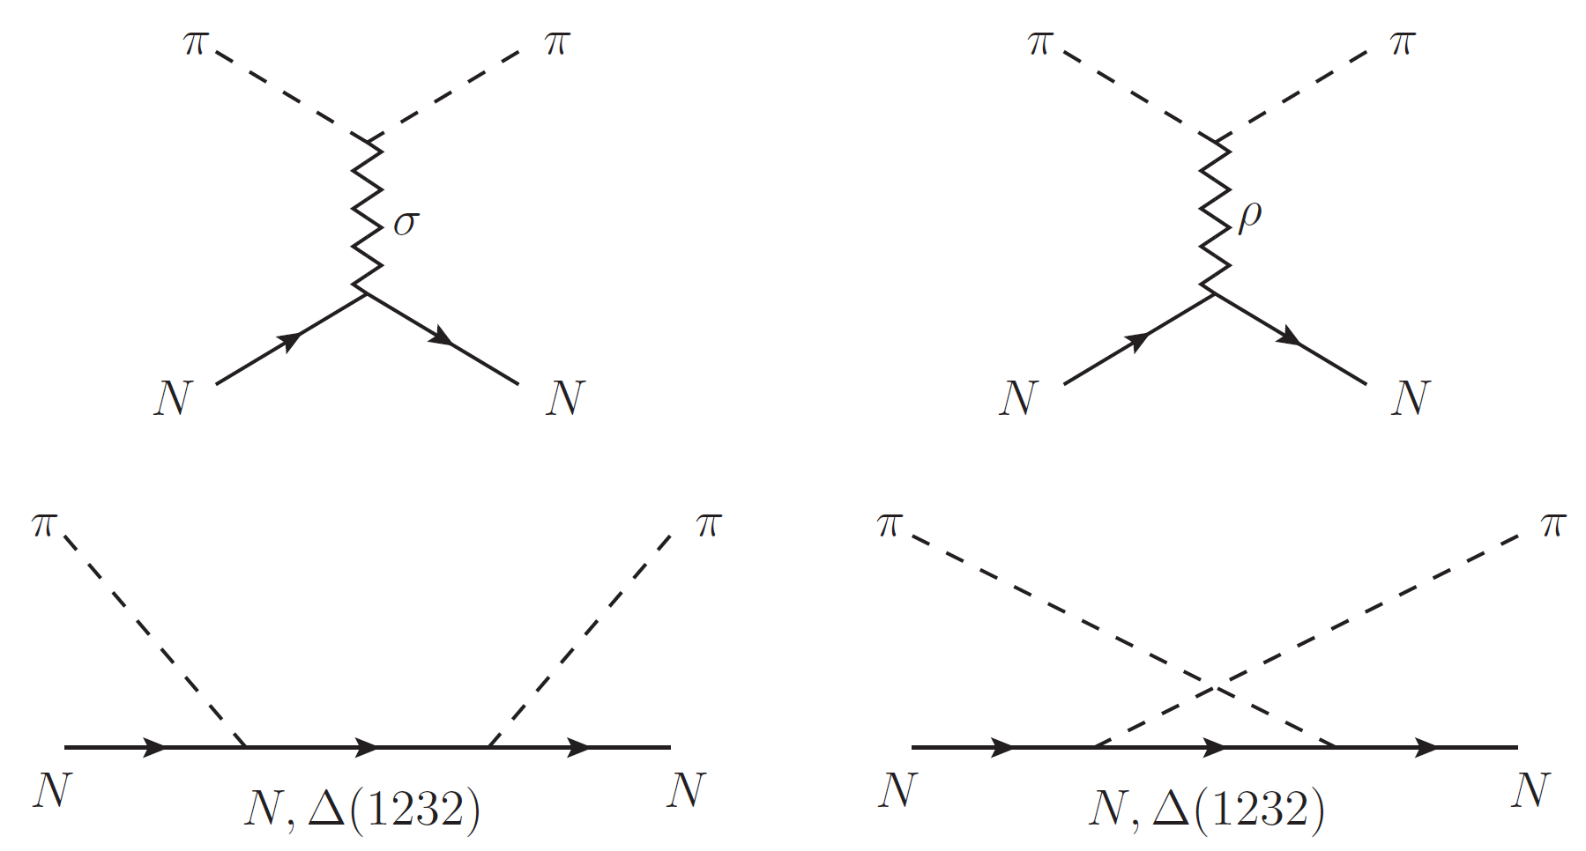
The hadronic model (ETH model)
=
0
+ all well-established (four-star) s and p higher baryon resonances (HBRs) with masses up to 2 GeV

Slide 10
The hadronic model: history
P.F.A. Goudsmit, H.J. Leisi, E. Matsinos
  Pionic atoms, the relativistic mean-field theory and the pion-nucleon scattering lengths, Phys. Lett. B 271 (1991) 290-294
  A pion-nucleon interaction model at the tree level, πN Newsl. 6 (1992) 60
  Pionic atoms, the relativistic mean-field theory and the pion-nucleon scattering lengths, Few-Body Syst., Suppl. 5 (1992) 416-422
  A new pion-nucleon interaction model, Helv. Phys. Acta 65 (1992) 878-879
  A dynamical model for the pion-nucleon interaction, πN Newsl. 8 (1993) 98
  A pion-nucleon interaction model, Phys. Lett. B 299 (1993) 6-10
P.F.A. Goudsmit, H.J. Leisi, E. Matsinos, B.L. Birbrair, A.B. Gridnev, The extended tree-level model of the pion-nucleon interaction, Nucl. Phys. A 575 (1994) 673-706
P.F.A. Goudsmit, H.J. Leisi, E. Matsinos, The low-energy pion-nucleon interaction, Helv. Phys. Acta 67 (1994) 369-391
N. Fettes, E. Matsinos, Analysis of recent π⁺p low-energy differential cross-section measurements, Phys. Rev. C 55 (1997) 464-473
E. Matsinos, πN scattering below 100 MeV, πN Newsl. 13 (1997) 132-137
E. Matsinos, Isospin violation in the πN system at low energy, Phys. Rev. C 56 (1997) 3014-3025
E. Matsinos, G. Rasche, Aspects of the ETH model of the pion-nucleon interaction, Nucl. Phys. A 927 (2014) 147-194

Slide 11
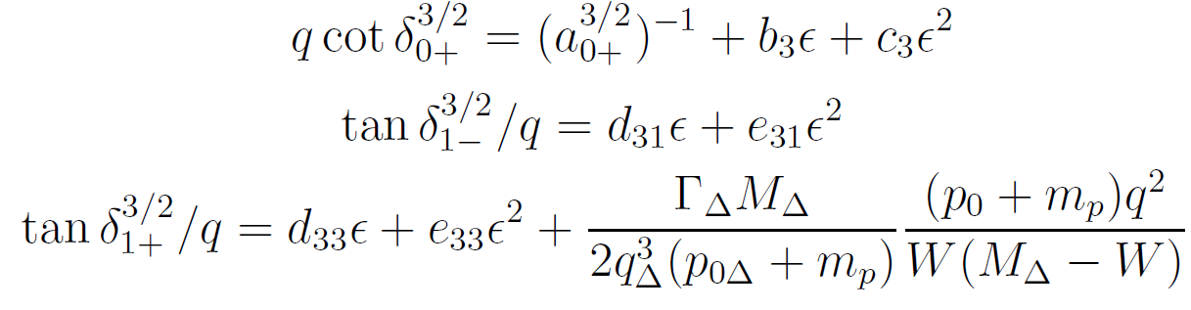
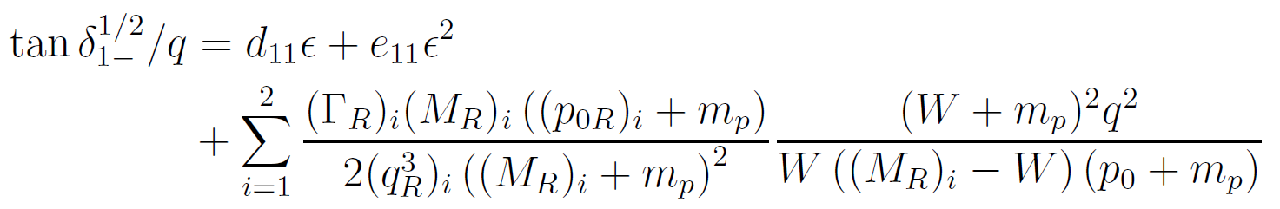
K-matrix parameterisations
π⁺p
Seven parameters for s and p waves
π⁻p ES and CX
Similar expressions for the I=1/2 amplitudes (no HBR in P₁₃, HBRs in P₁₁)
For each of the two reactions, fourteen parameters for s and p waves (seven for the I=3/2, seven for the I=1/2 amplitudes); the seven I=3/2 parameters are fixed from the π⁺p reaction

Slide 12
Electromagnetic corrections
The electromagnetic (EM) interaction induces distortions to the partial-wave amplitudes and phase shifts
  A. Gashi, E. Matsinos, G.C. Oades, G. Rasche, W.S. Woolcock, Electromagnetic corrections to the phase shifts in low energy π⁺p elastic scattering, Nucl. Phys. A 686 (2001) 447-462
  A. Gashi, E. Matsinos, G.C. Oades, G. Rasche, W.S. Woolcock, Electromagnetic corrections for the analysis of low energy π⁻p scattering data, Nucl. Phys. A 686 (2001) 463-477
  G.C. Oades, G. Rasche, W.S. Woolcock, E. Matsinos, A. Gashi, Determination of the s-wave pion-nucleon threshold scattering parameters from the results of experiments on pionic hydrogen, Nucl. Phys. A 794 (2007) 73-86
H.-Ch. Schröder et al., The pion-nucleon scattering lengths from pionic hydrogen and deuterium, Eur. Phys. J. C 21 (2001) 473-488

Slide 13
From amplitudes to observables
No-spin-flip and spin-flip contributions
Expansion of the πN scattering amplitude in a Legendre series
The DCS and the AP are given by the expressions
Sensitivity to small partial waves

Slide 14
Strategy in the analysis
Treat π⁺p, exclude outliers, fix I=3/2 amplitudes (phenomenological model)
Treat π⁻p ES, exclude outliers (phenomenological model)
Treat π⁻p CX, exclude outliers (phenomenological model)
Treat truncated π⁺p and π⁻p ES DBs (hadronic model), extract model parameters
Treat truncated π⁺p and π⁻p CX DBs (hadronic model), extract model parameters
Compare the results (model parameters, phase shifts, scattering lengths/volumes, predictions for the amplitudes and the observables) of the two analyses with the hadronic model
Elimination of the outliers
Main analysis

Slide 15
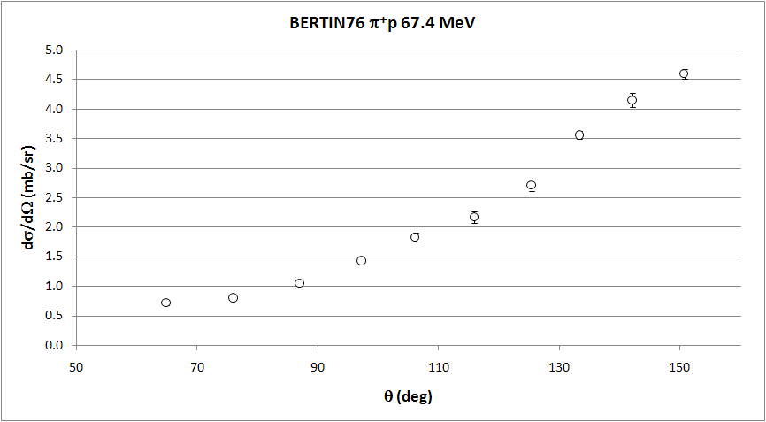
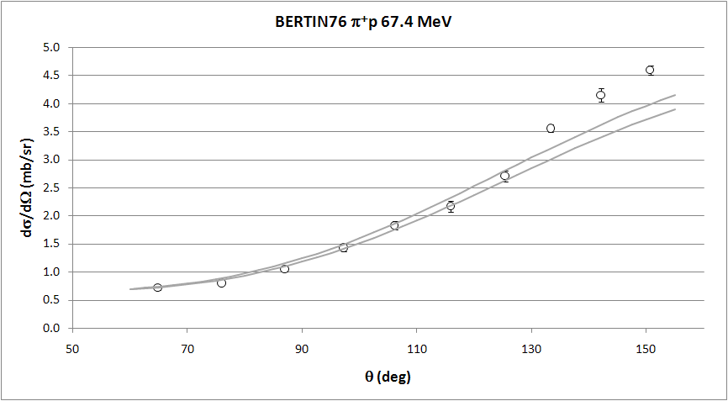
Example of obvious outliers

Slide 16
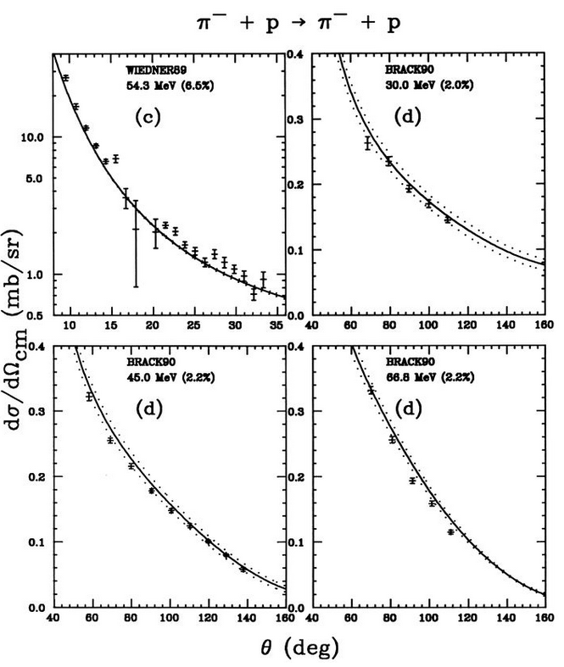
Example of obvious outliers
P.F.A. Goudsmit, H.J. Leisi, E. Matsinos, The low-energy pion-nucleon interaction, Helv. Phys. Acta 67 (1994) 369-391

Slide 17
Low-energy πN measurements not used
H. Denz et al., π±p differential cross sections at low energy, Phys. Lett. B 633 (2006) 209-213; H. Denz, Ph.D. dissertation, Tübingen University, 2004; available from: tobias-lib.uni-tuebingen.de/dbt/volltexte/2004/1323/
E. Matsinos, G. Rasche, Analysis of the low-energy π±p differential cross sections of the CHAOS Collaboration, Nucl. Phys. A 903 (2013) 65-80
E. Matsinos, G. Rasche, New analysis of the low-energy π±p differential cross sections of the CHAOS Collaboration, Int. J. Mod. Phys. E 24 (2015) 1550050
Extensive analyses of the CHAOS π±p DCSs

Slide 18
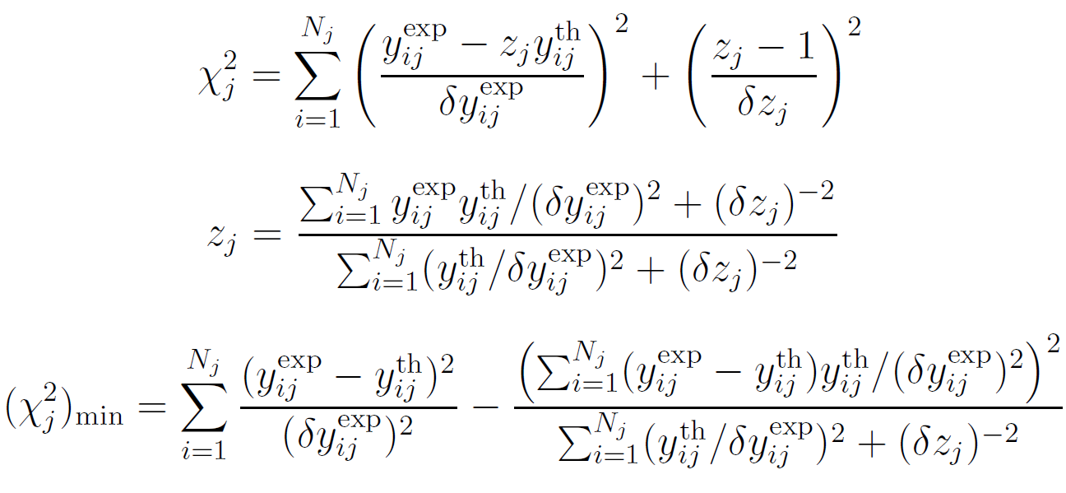
Minimisation function
Scale factor
R.A. Arndt, L.D. Roper, The use of partial-wave representations in the planning of scattering measurements: Application to 330 MeV np scattering, Nucl. Phys. B 50 (1972) 285-300

Slide 19
Analysis
Significance level in statistical tests is set to the equivalent of 2.5σ in the normal distribution (≈1.24∙10⁻²)
Experiment with worst description is treated
Worst measurement of that experiment is removed (the absolute normalisation is also subject to the test)
Outliers are removed one by one and the optimisation with the phenomenological model is repeated
Elimination of the outliers
Reaction | Initial NDF | Initial χ² | Final NDF | Final χ² | Excluded DFs | Reduction in χ² | χ² per excluded DF
π⁺p | 452 | 913.3 | 414 | 537.4 | 38 | 375.9 | 9.9
π⁻p ES | 332 | 519.6 | 324 | 369.1 | 8 | 150.5 | 18.8
π⁻p CX | 326 | 390.2 | 322 | 318.3 | 4 | 71.9 | 18.0
π⁺p and π⁻p ES
π⁺p and π⁻p CX
π⁻p ES and CX
All-eggs-in-one-basket analysis
Possible analyses with the hadronic model

Slide 20
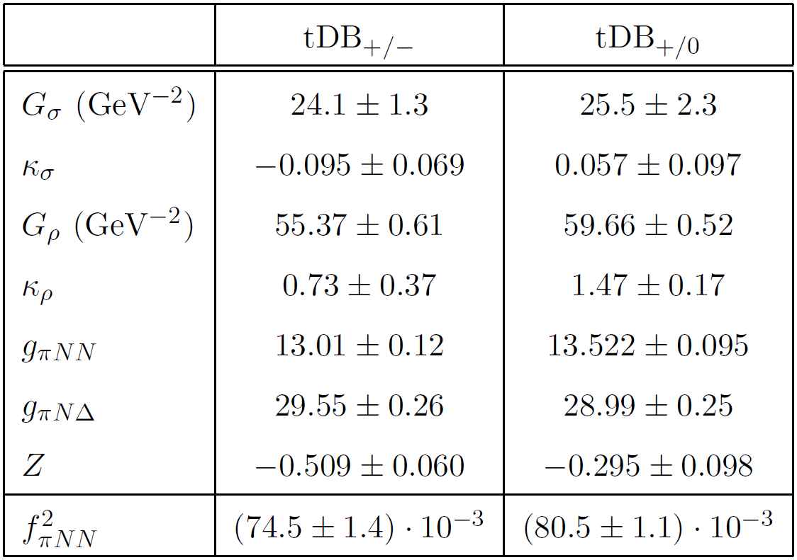
Results for the model parameters

Slide 21
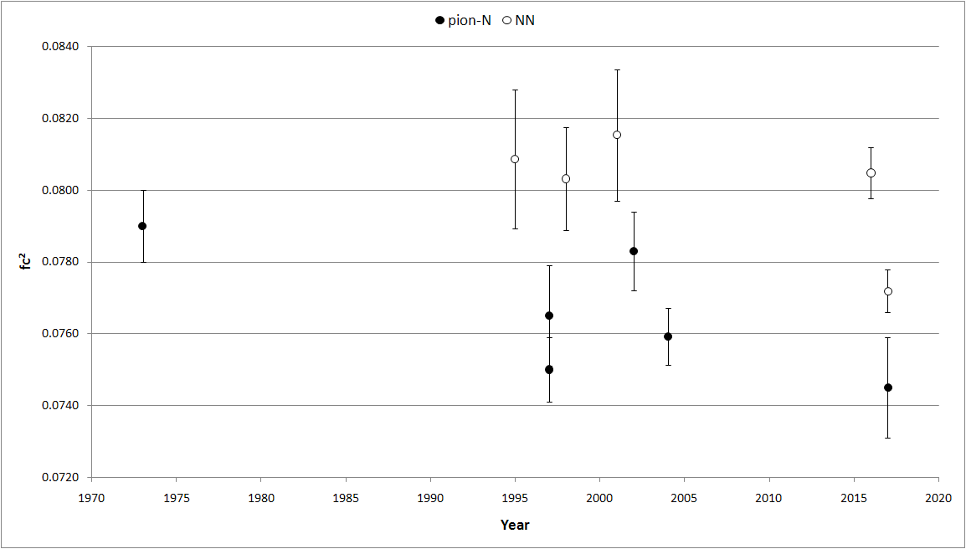
The πN coupling constant
Several determinations, e.g., Nijmegen, SAID, KH, etc.
D.V. Bugg, A.A. Carter, J.R. Carter, New values of pion-nucleon scattering lengths and f₂, Phys. Lett. B 44 (1973) 278-280
T.E.O. Ericson et al., πNN coupling from high precision np charge exchange at 162 MeV, Phys. Rev. Lett. 75 (1995) 1046-1049
J.J. de Swart, M.C.M. Rentmeester, R.G.E. Timmermans, The status of the pion-nucleon coupling constant, πN Newslett. 13 (1997) 96-107; arxiv:nucl-th/9802084
E. Matsinos, Isospin violation in the πN system at low energies, Phys. Rev. C 56 (1997) 3014-3025
J. Rahm et al., np scattering measurements at 162 MeV and the πNN coupling constant, Phys. Rev. C 57 (1998) 1077-1096
J. Rahm et al., np scattering measurements at 96 MeV, Phys. Rev. C 63 (2001) 044001
T.E.O. Ericson, B. Loiseau, A.W. Thomas, Determination of the pion-nucleon coupling constant and scattering lengths, Phys. Rev. C 66 (2002) 014005
D.V. Bugg, The pion nucleon coupling constant, Eur. Phys. J. C 33 (2004) 505-509
V.A. Babenko, N.M. Petrov, Study of the charge dependence of the pion-nucleon coupling constant on the basis of data on low-energy nucleon-nucleon interactions, Phys. Atomic Nuclei 79 (2016) 67-71
R. Navarro Pérez, J.E. Amaro, E. Ruiz Arriola, Precise determination of charge dependent pion-nucleon-nucleon coupling constants, Phys. Rev. C 95 (2017) 064001
E. Matsinos, G. Rasche, Update of the phase-shift analysis of the low-energy πN data, arxiv:1706.05524
“… A recent determination of f² by the Uppsala group from backward np cross sections is shown to be model dependent and inaccurate, and therefore completely uninteresting …”

Slide 22
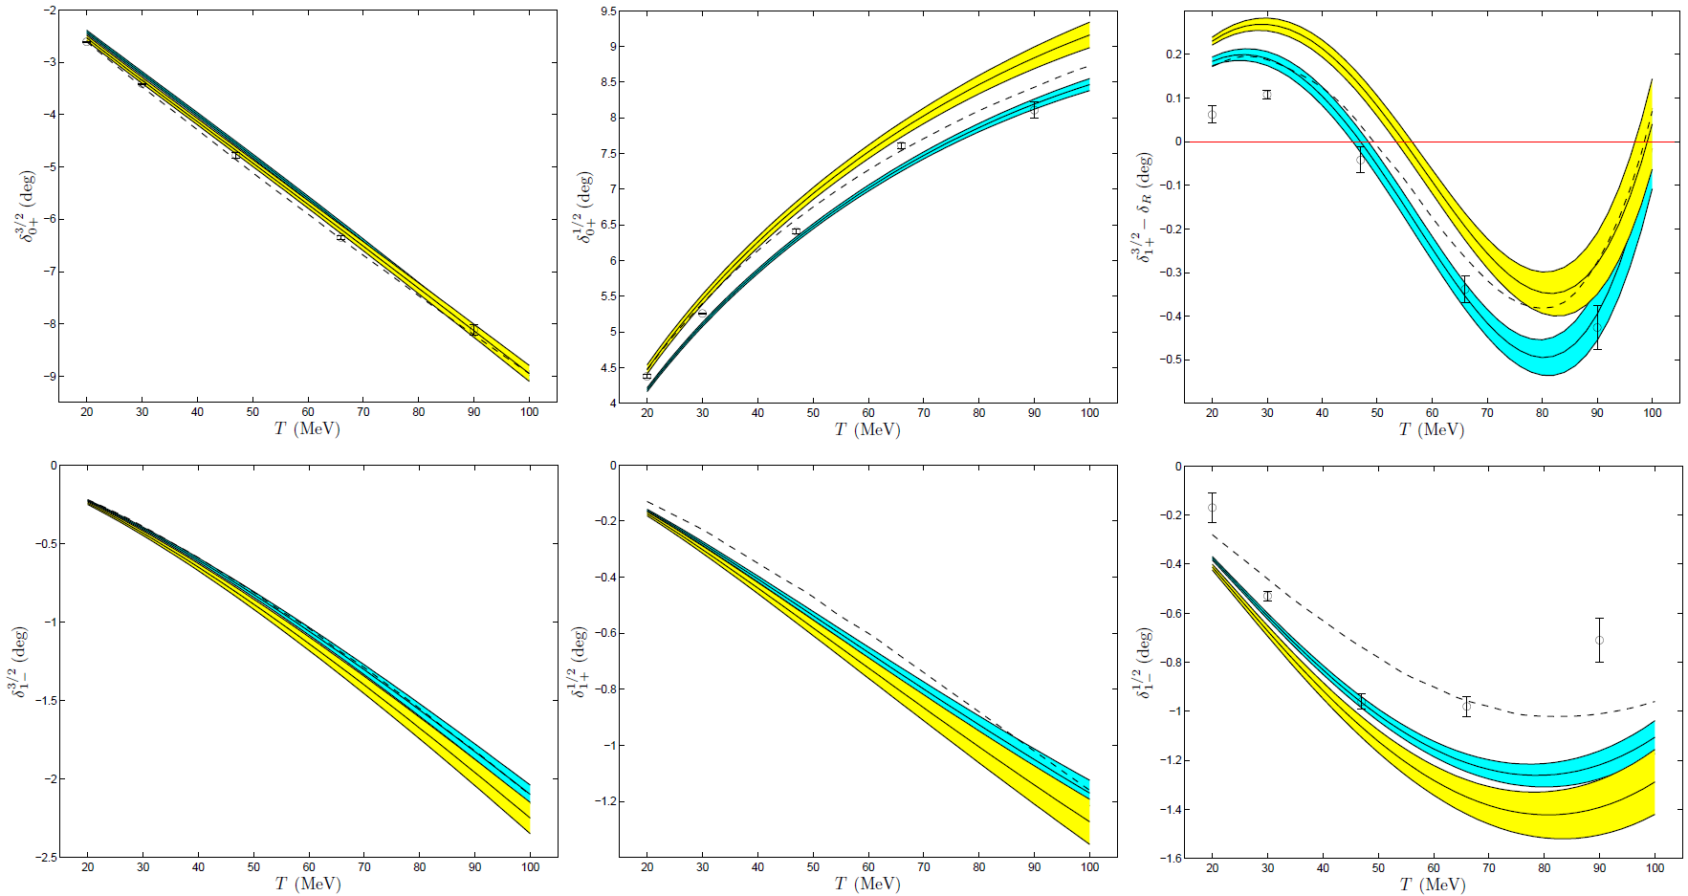
πN s- and p-wave phase shifts
S₃₁
S₁₁
P₃₃
P₃₁
P₁₃
P₁₁
Blue: tDB_{+/−}, Yellow: tDB_{+/0}

Slide 23
Simplification at low energy
s wave
p wave
Isoscalar
Isovector
Analysis shows that the aforementioned effects predominantly originate in differences in the isovector part of the πN scattering amplitude
 | b₀ (m_{c}⁻¹) | b₁ (m_{c}⁻¹) | c₀ (m_{c}⁻³) | c₁ (m_{c}⁻³) | d₀ (m_{c}⁻³) | d₁ (m_{c}⁻³)
σ | 0.0710 | - | 0.0063 | - | -0.0004 | -
ρ | - | -0.07472 | - | -0.0114 | - | -0.01064
N | -0.0097 | -0.00072 | 0.0016 | 0.1513 | -0.1498 | -0.00006
Δ(1232) | -0.0594 | -0.00195 | 0.1904 | 0.0378 | -0.0377 | -0.05014
HBRs | 0.0003 | -0.00032 | 0.0082 | -0.0022 | 0.0023 | -0.00702
Sum | 0.0021(12) | -0.07771(60) | 0.2064(24) | 0.1755(18) | -0.1856(19) | -0.06786(81)

Slide 24
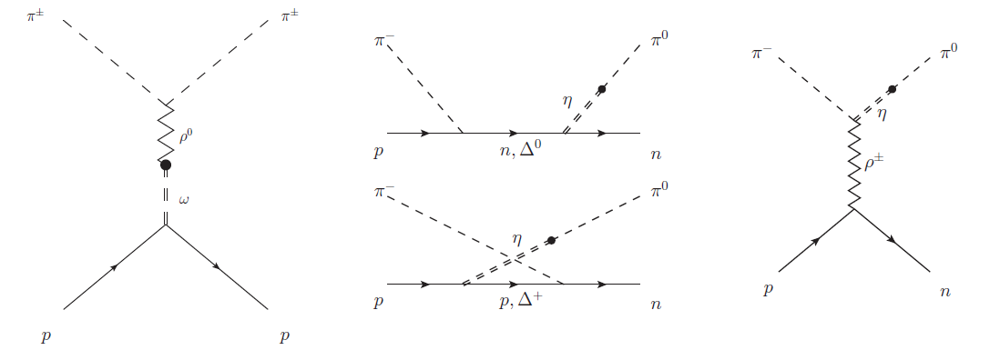
Isospin-violating Feynman graphs
ρ⁰-ω mixing
η-π⁰ mixing
Affects π±p ES reactions
Affects π⁻p CX reaction

Slide 25
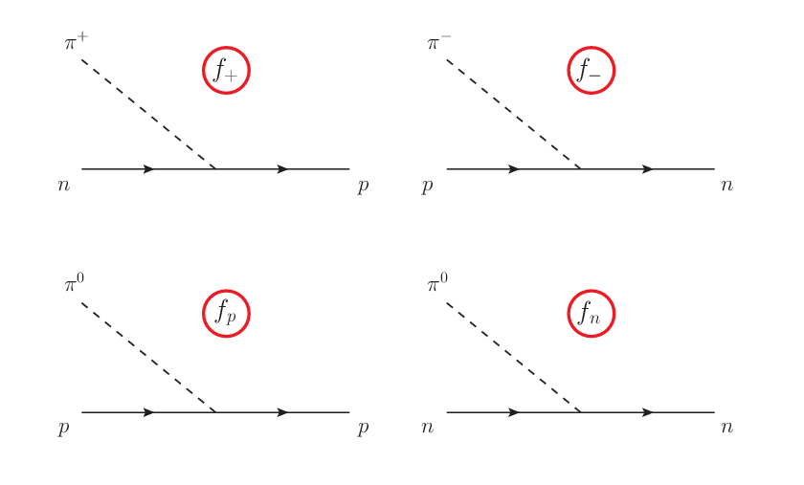
Splitting of the coupling constants
The splitting in g_{πNN} has been predicted/extracted in a variety of studies, which generally agree that
No splitting: J.J. de Swart, M.C.M. Rentmeester, R.G.E. Timmermans, The status of the pion-nucleon coupling constant, πN Newslett. 13 (1997) 96-107; arxiv:nucl-th/9802084

Slide 26
Analysis of the scale factors
When analysed in terms of dependences on quantities relating to the data acquisition, the distribution of the scale factors must not exhibit systematic effects, e.g.,
  No significant energy dependence
  No significant dependence on the time, place, detector, technique, experimental group, etc., involved in the data acquisition

Slide 27
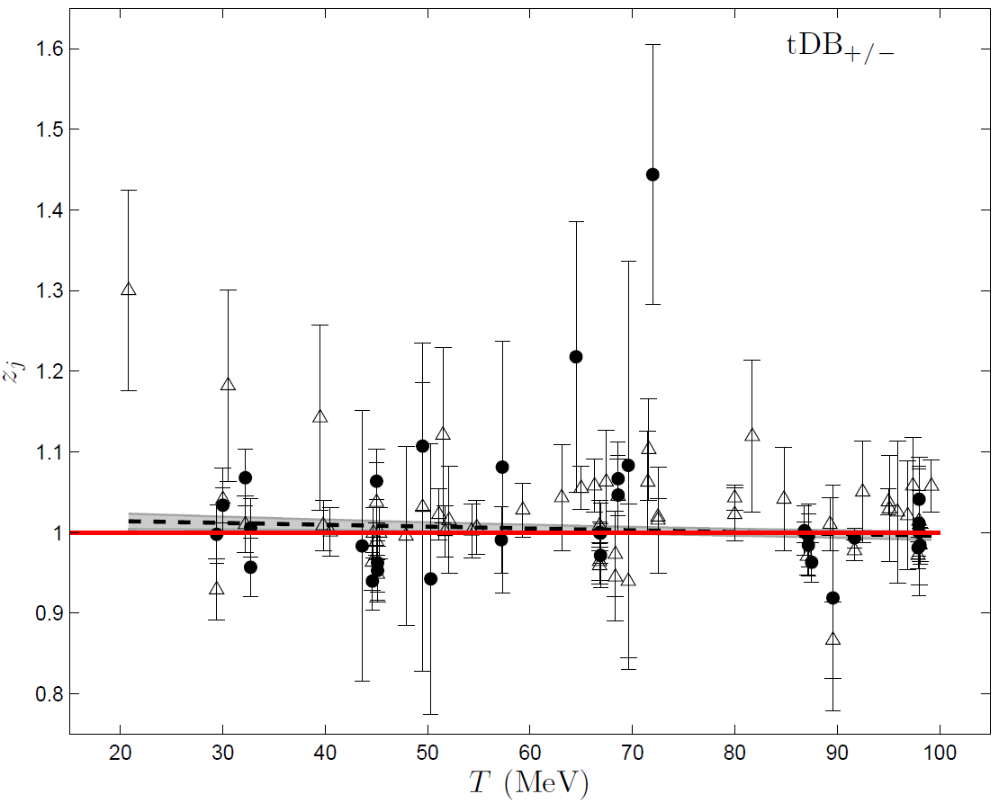
Analysis of the scale factors

Slide 28
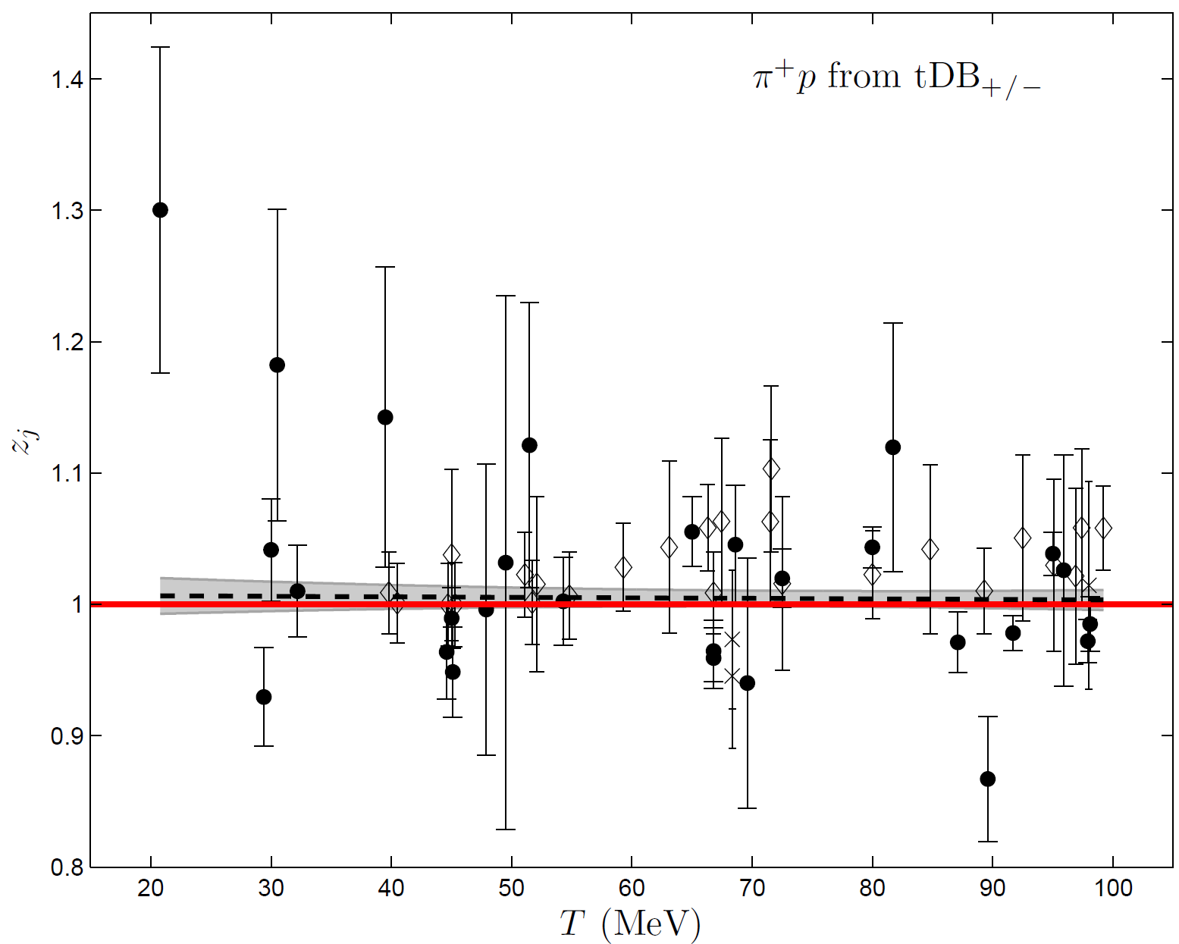
Analysis of the scale factors

Slide 29
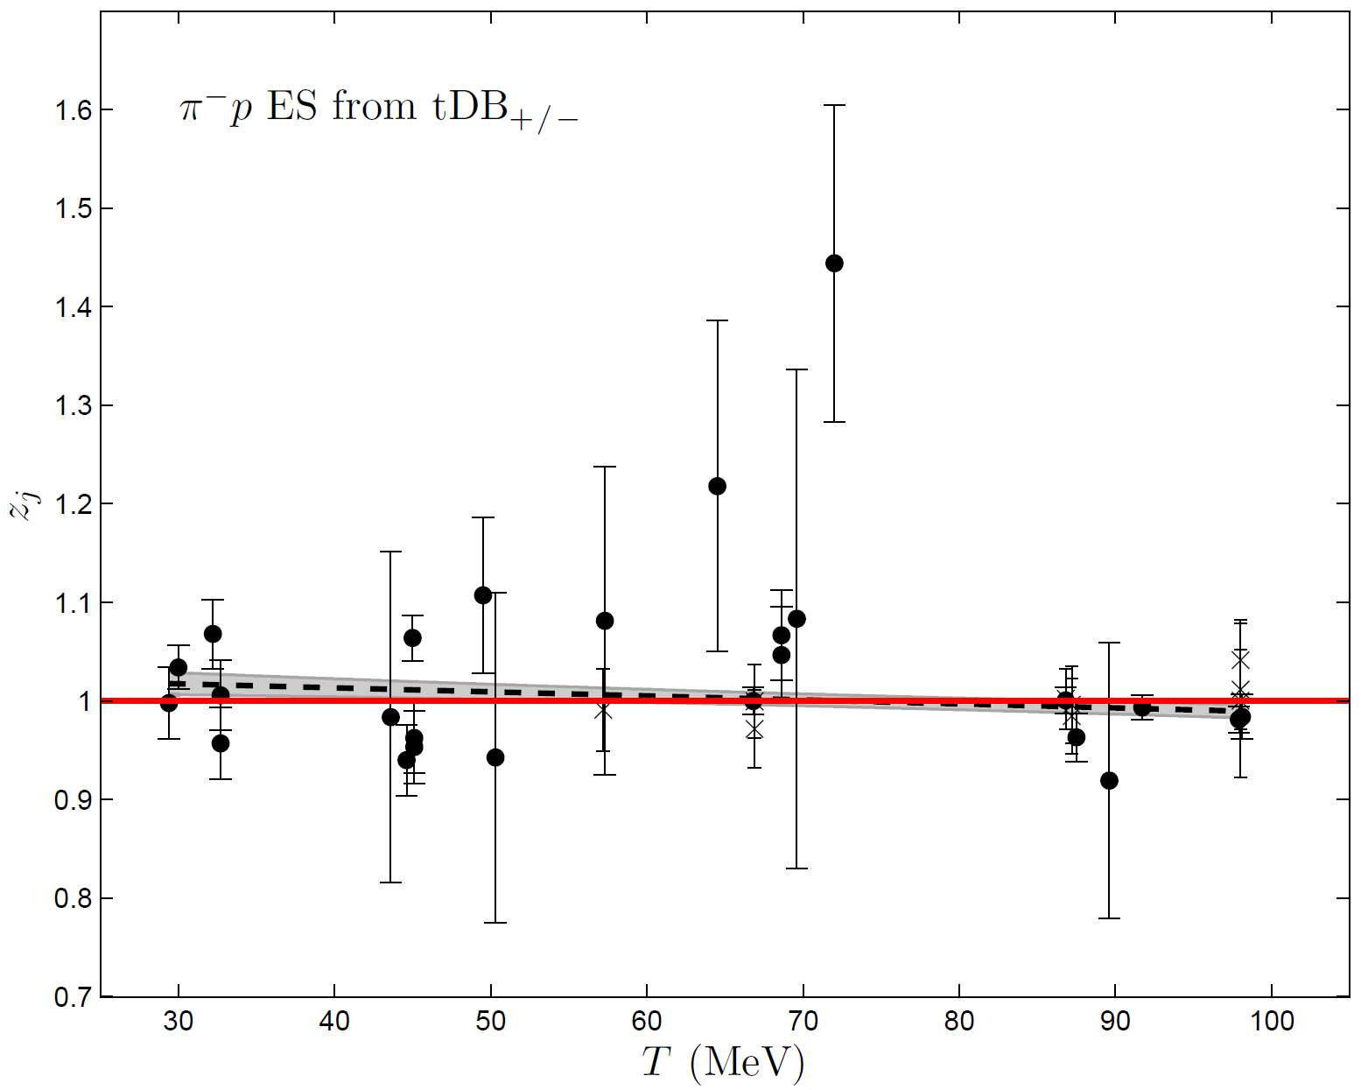
Analysis of the scale factors

Slide 30
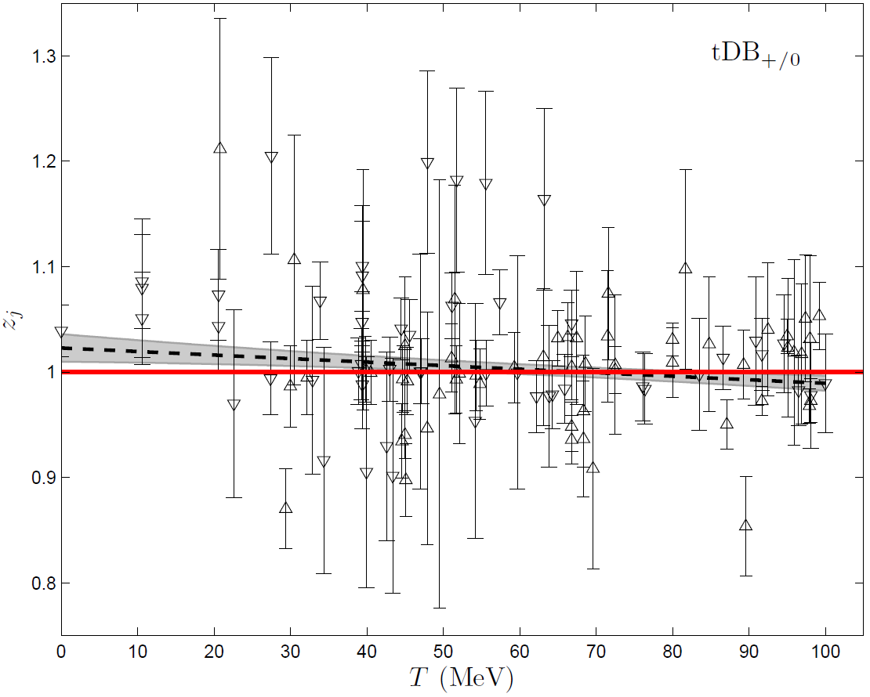
Analysis of the scale factors

Slide 31
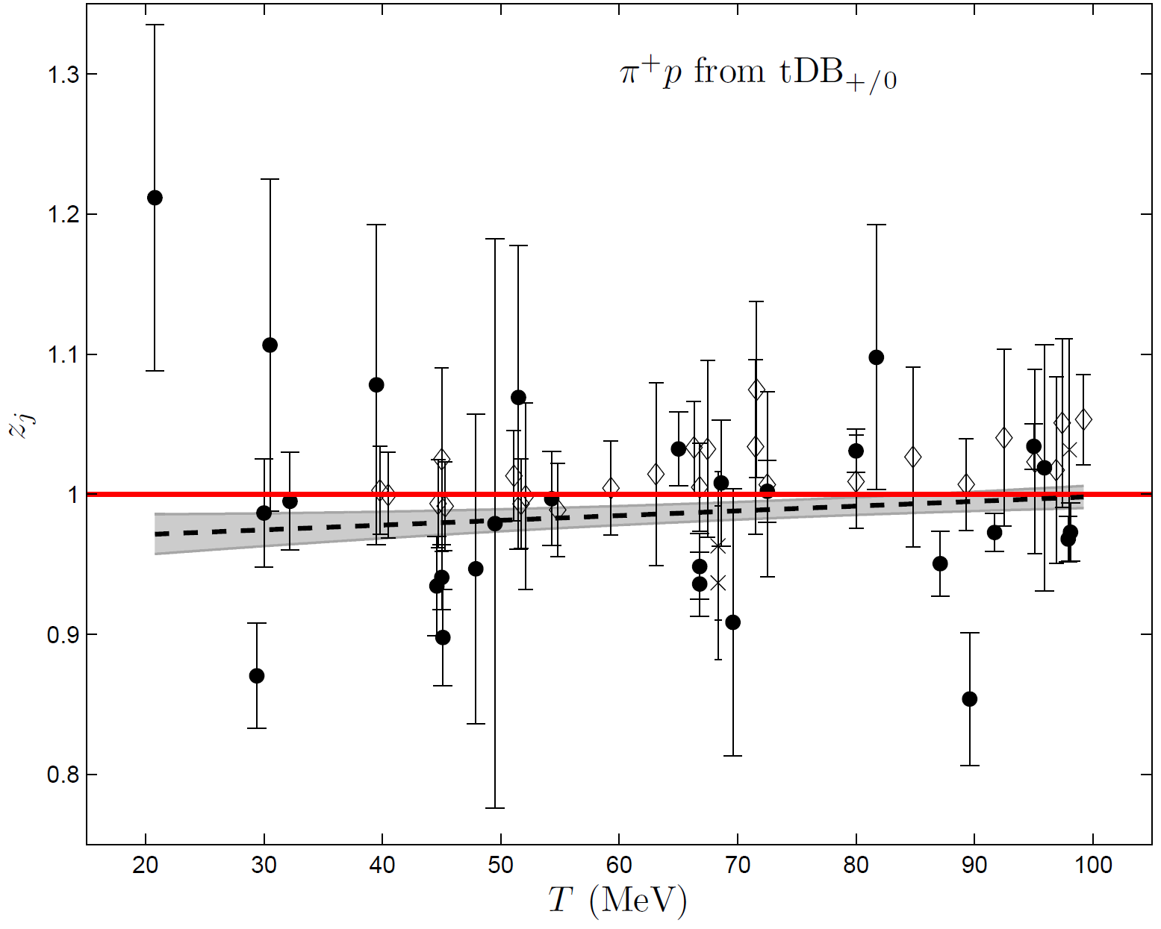
Analysis of the scale factors

Slide 32
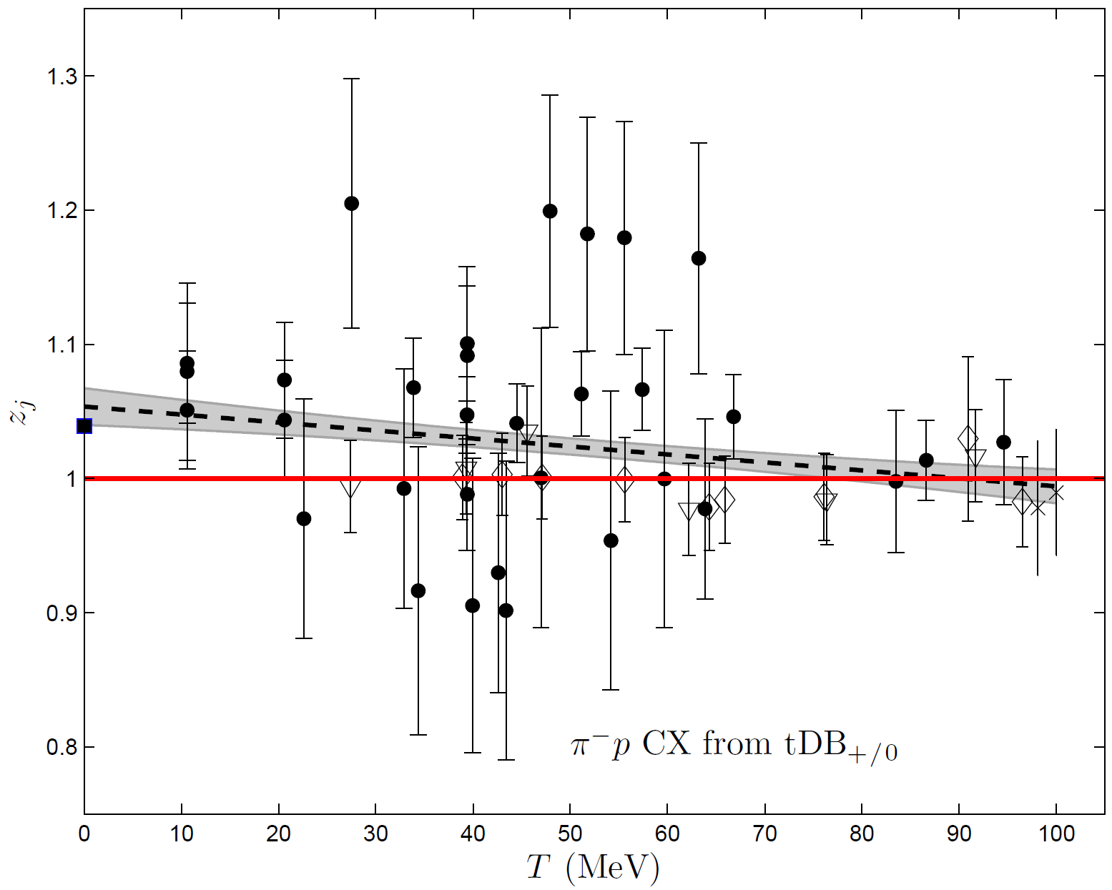
Analysis of the scale factors

Slide 33
Analysis of the scale factors
The analysis of the scale factors of the joint fits of the hadronic model to the π⁺p and π⁻p CX measurements reveals that the overall tendency of the modelling is to generate overestimated fitted DCSs for the π⁺p reaction and underestimated ones for the π⁻p CX reaction at low energy
There is a difficulty to account for the π⁻p CX DB in an isospin-invariant framework

Slide 34
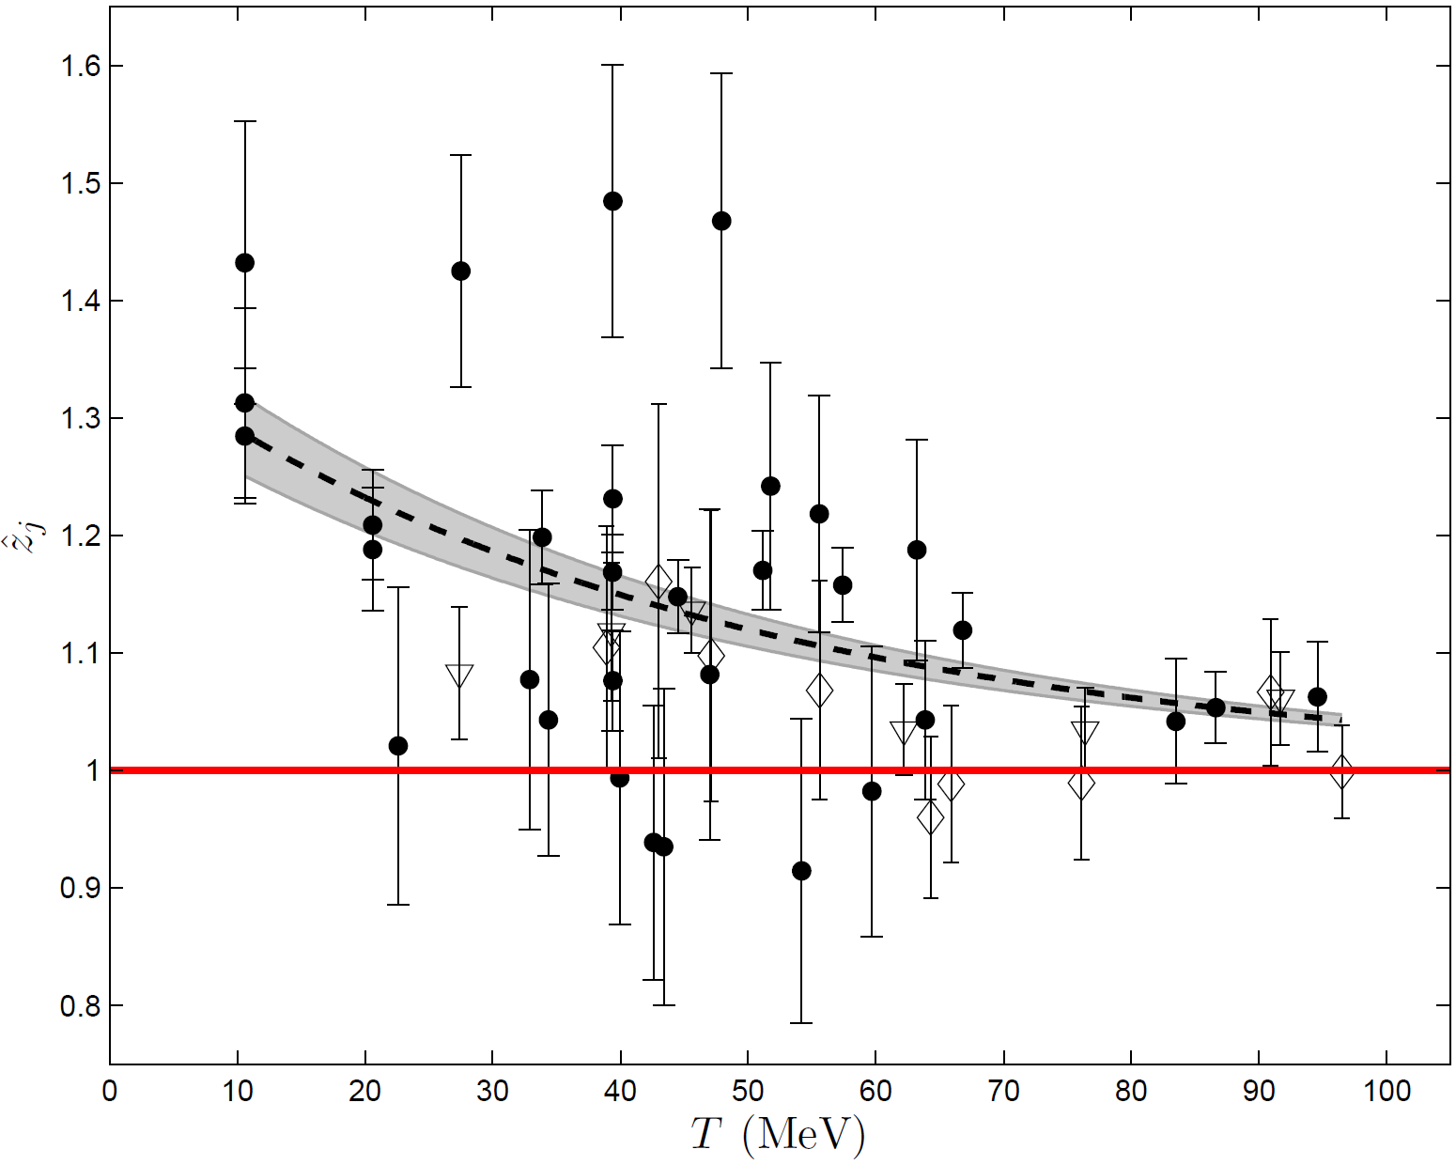
Reproduction of the π⁻p CX measurements

Slide 35
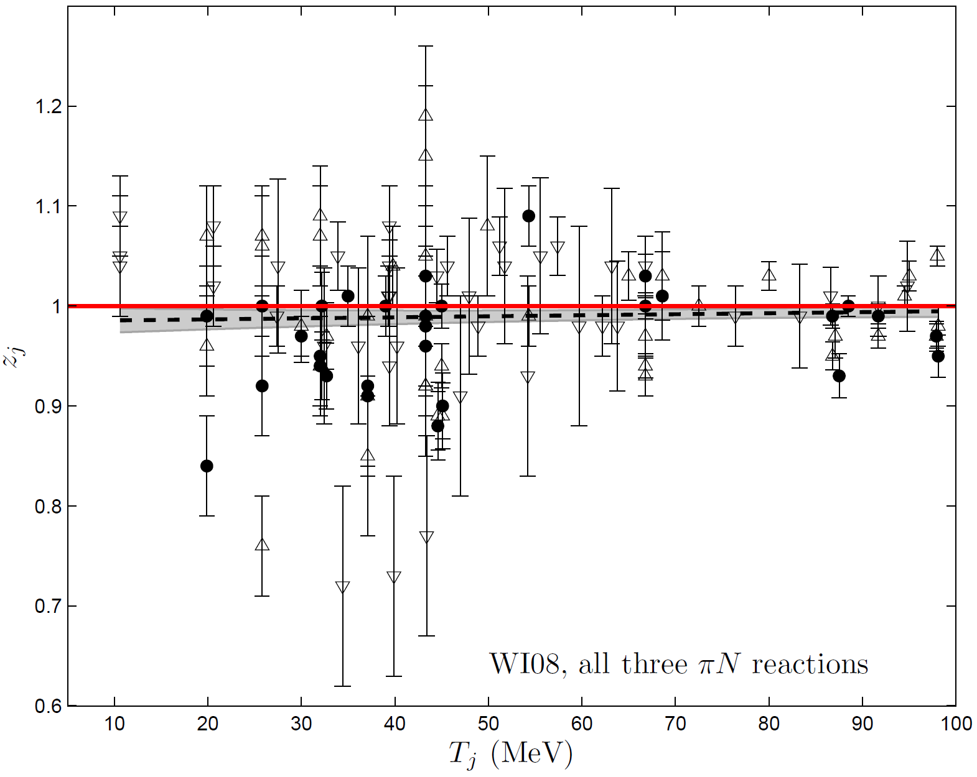
Analysis of the scale factors of WI08
E. Matsinos, G. Rasche, Systematic effects in the low-energy behavior of the current SAID solution for the pion-nucleon system, Int. J. Mod. Phys. E 26 (2017) 1750002

Slide 36
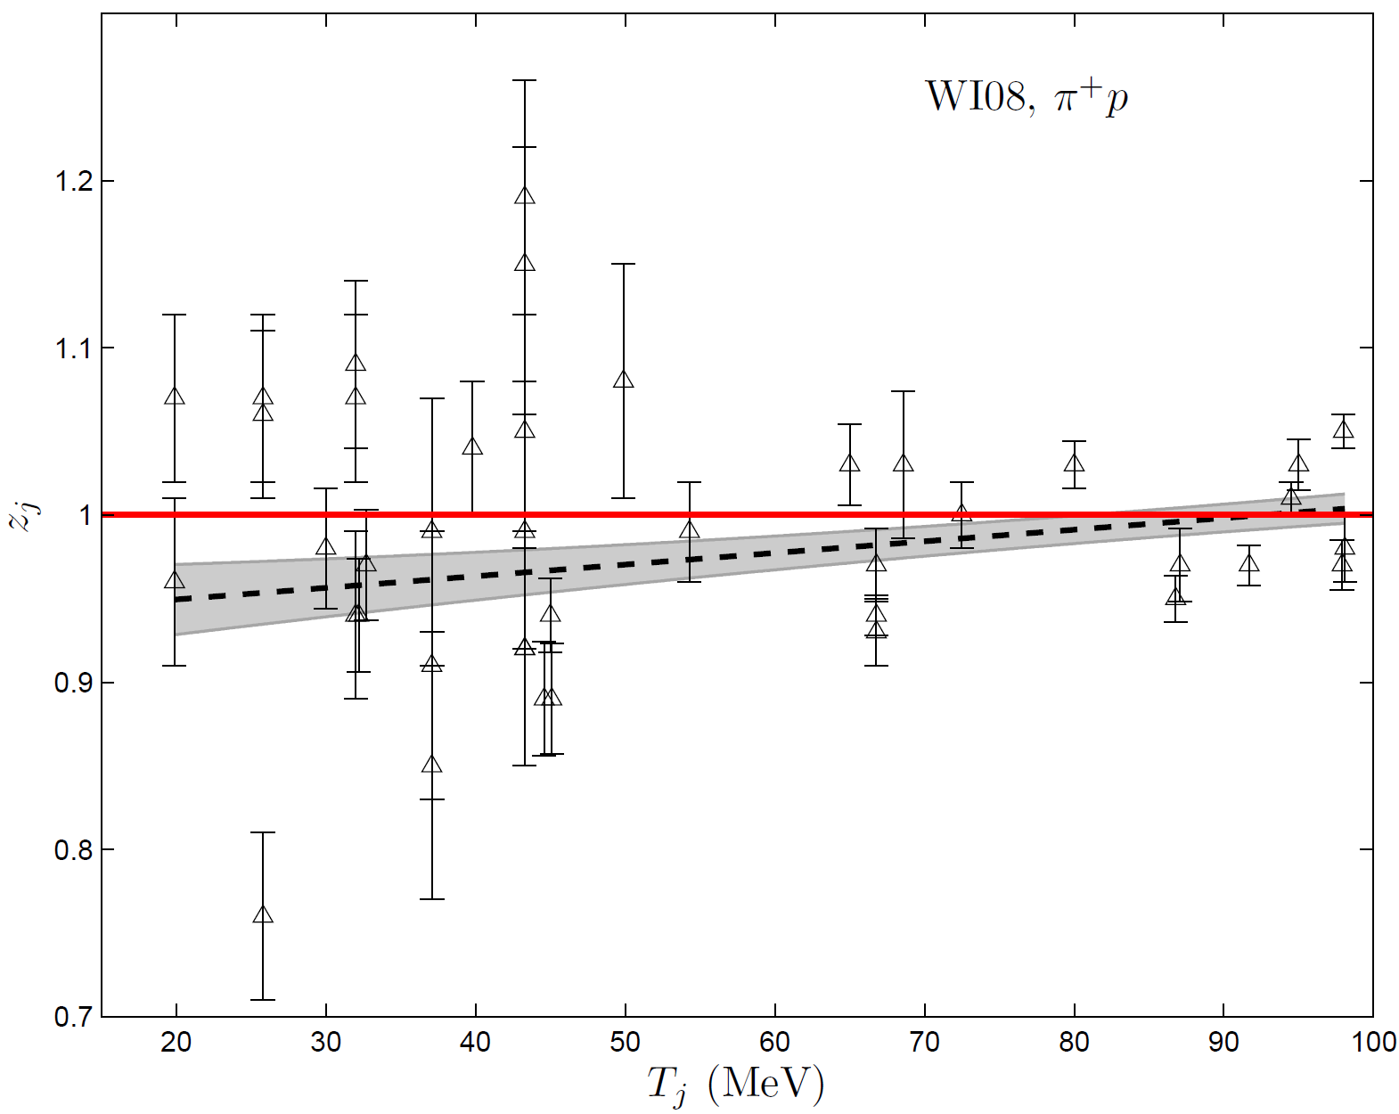
Analysis of the scale factors of WI08
E. Matsinos, G. Rasche, Systematic effects in the low-energy behavior of the current SAID solution for the pion-nucleon system, Int. J. Mod. Phys. E 26 (2017) 1750002

Slide 37
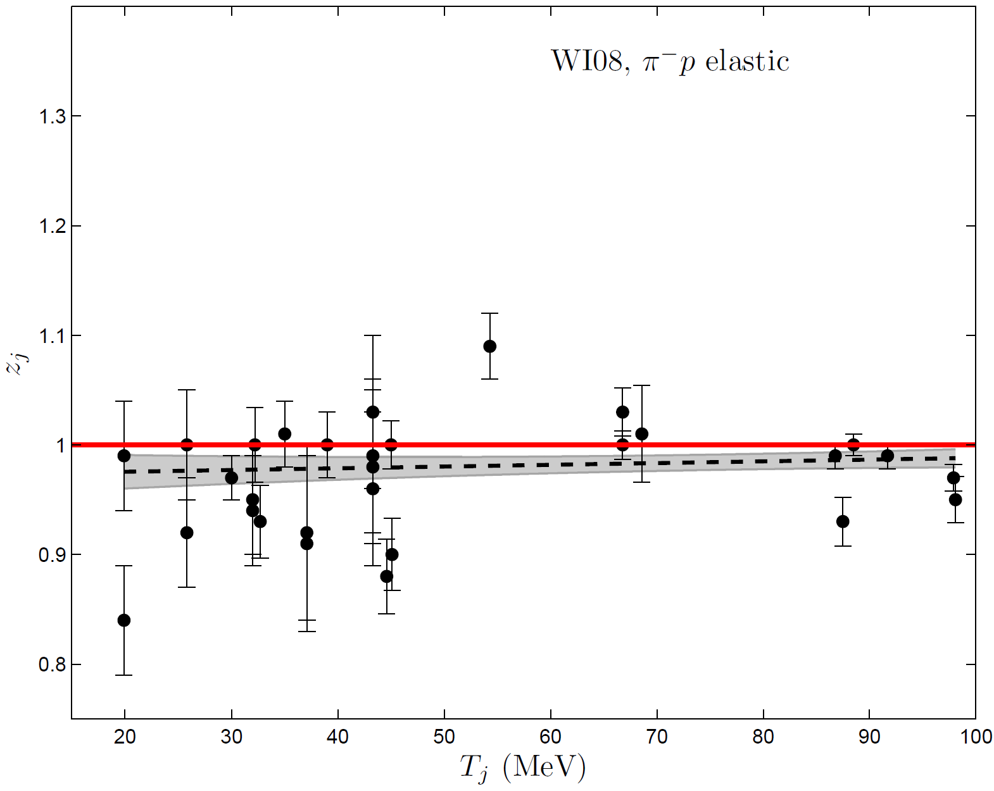
Analysis of the scale factors of WI08
E. Matsinos, G. Rasche, Systematic effects in the low-energy behavior of the current SAID solution for the pion-nucleon system, Int. J. Mod. Phys. E 26 (2017) 1750002

Slide 38
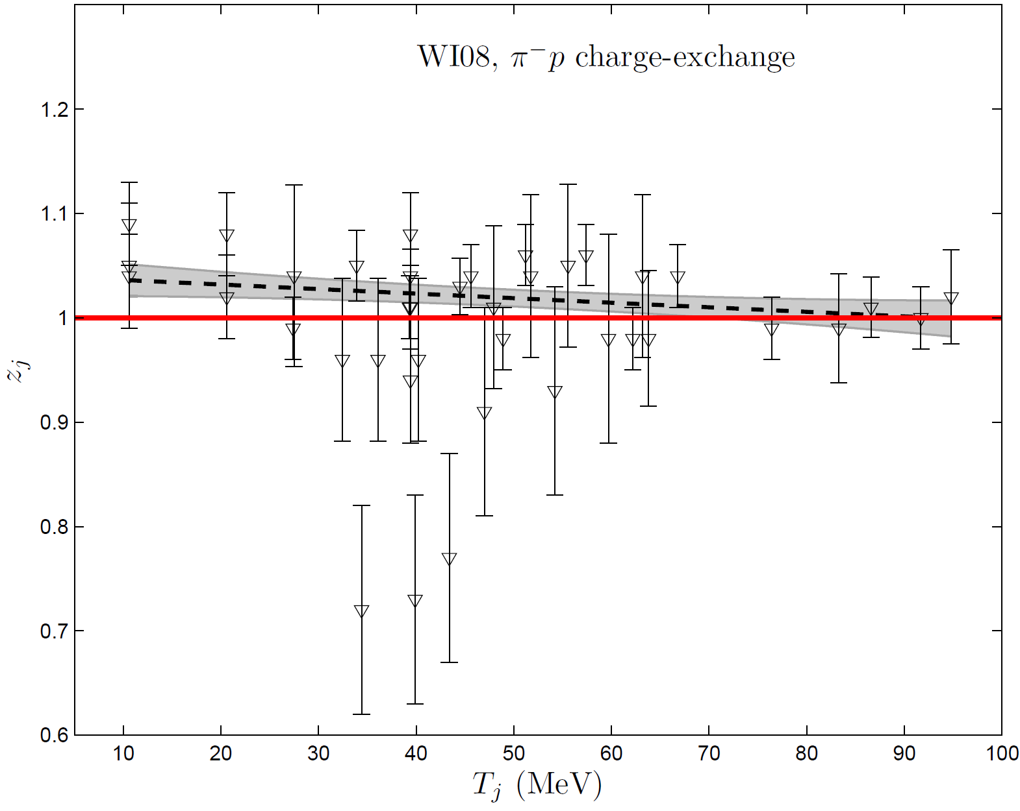
Analysis of the scale factors of WI08
E. Matsinos, G. Rasche, Systematic effects in the low-energy behavior of the current SAID solution for the pion-nucleon system, Int. J. Mod. Phys. E 26 (2017) 1750002

Slide 39
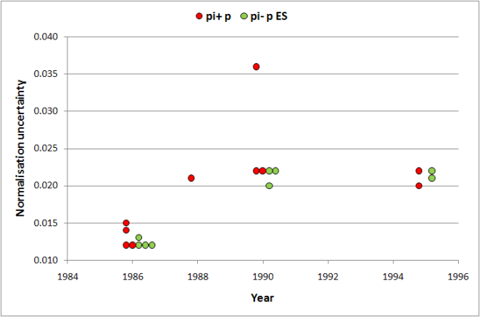
How may the discrepancies be explained?
Do scattered pions evade detection?
Erroneous absolute normalisation?
Underestimated normalisation uncertainties?
The absolute normalisation of the bulk of the low-energy data is reliable
Good
DCS/AP data sets with Δz_{j}<3%
π⁺ p: 15/45 (33.3%)
π⁻ p ES: 10/51 (19.6%)
π⁻ p CX: 5/38 (13.2%)
The residual EM effects are small
Isospin invariance is fulfilled
Cheap
Fast
Physics-wise, the most interesting possibility!
New assessment of EM effects

Slide 40
At the end of the day, what has been learnt?
The analyses
  of the π⁺p and π⁻p ES measurements, and
  of the π⁺p and π⁻p CX measurements
yield different results for the model parameters and for the phase shifts
Differences in the isovector part of the πN scattering amplitude
The reproduction of the absolute normalisation of the π⁻p CX data sets on the basis of the results obtained from the π±p ES measurements (via the use of the triangle identity) is poor
There is a general difficulty to accommodate the π⁻p CX measurements into a joint analysis
When forcing the π⁻p CX measurements into a joint analysis, effects are observed in the overall quality of the fits, as well as in the resulting scale factors of the experiments; similar effects have been observed in the output of the current SAID solution (WI08)
The departure from the triangle identity at low energy may be due to
  experimental discrepancies (e.g., incorrectness of the absolute normalisation of the bulk of the meson-factory low-energy πN measurements),
  sizeable residual EM effects (e.g., use of the hadronic masses), or
  violation of isospin invariance
E. Matsinos, G. Rasche, Update of the phase-shift analysis of the low-energy πN data, arxiv:1706.05524

Slide 41
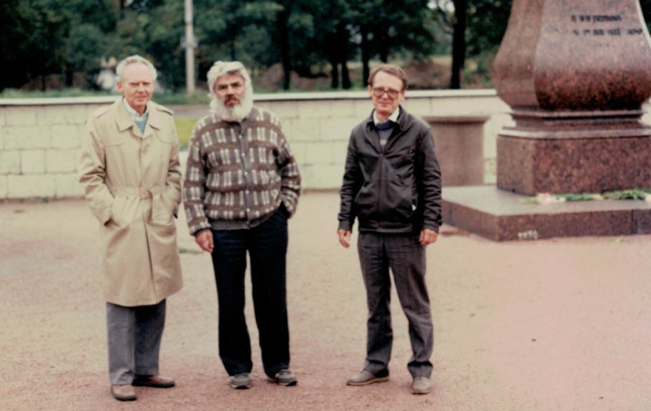

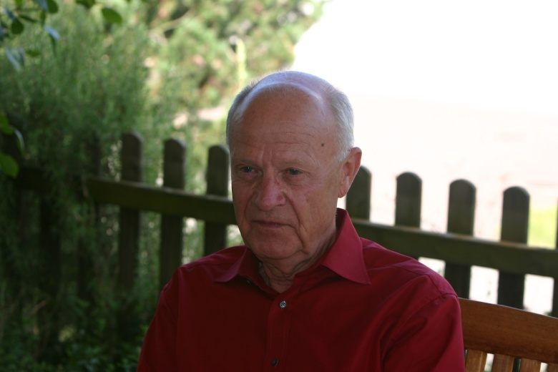
List of collaborators
Boris L. Birbrair
Nadia Fettes
Agim Gashi
Pieter F.A. Goudsmit
Anatoli B. Gridnev
Hans-Jörg Leisi
Geoffrey C. Oades
Günther Rasche
William S. Woolcock
Left to right: H.J. Leisi, B.L. Birbrair, and A.B. Gridnev; Saint Petersburg, 1990
P.F.A. Goudsmit; Schinznach Dorf, 2010
G. Rasche; Schinznach Dorf, 2010

Slide 42


Slide 43

On the πN σ/Σ terms

Slide 44
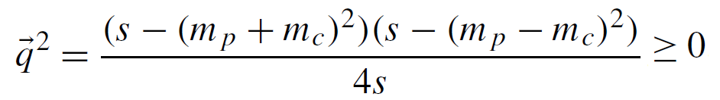
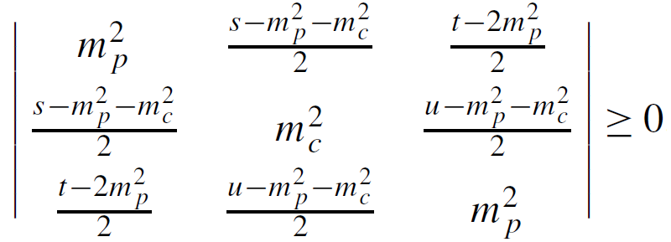

Kinematics
Mandelstam variables
The amplitudes depend on two variables which may be chosen at will; one of the standard choices is to use ν and t
First condition for scattering
Second condition for scattering
or
‘Kibble function’

Slide 45
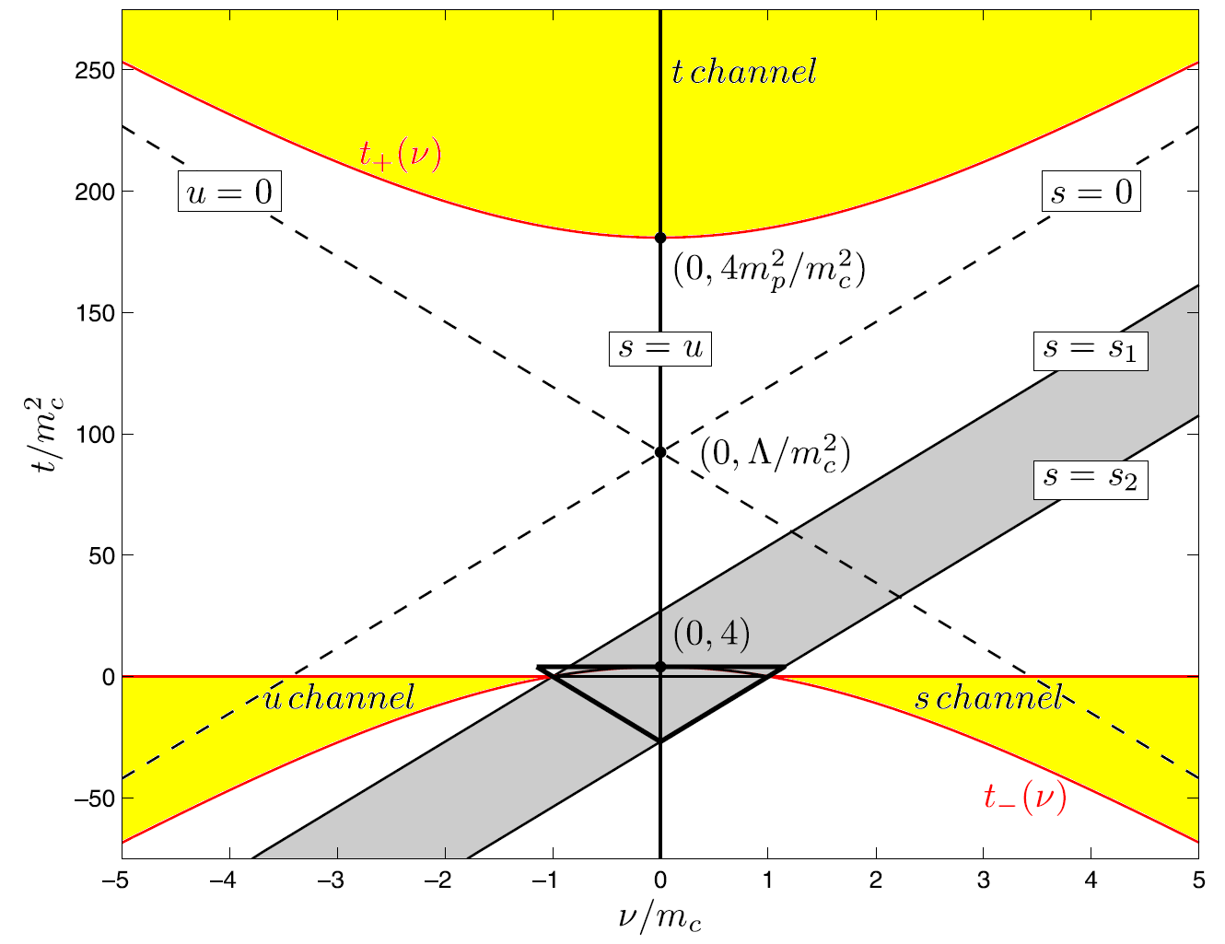
Kinematics
E. Matsinos, G. Rasche, Aspects of the ETH model of the pion-nucleon interaction, Nucl. Phys. A 927 (2014) 147-194

Slide 46
The πN σ/Σ terms
σ (MeV) | Σ (MeV) | Reference
59 ± 7 |  | 1
59.1 ± 1.9(stat.) ± 3.0(syst.) |  | 2
58 ± 5 |  | 3
 | 79 ± 7 | 4
 | 70.3 ± 3.0 | This programme (hadronic model/π±p ES)
 | 68.0 ± 2.4(stat.) ± 1.7(syst.) | This programme (Olsson’s method/π±p ES)
J.M. Alarcón, J. Martin Camalich, J.A. Oller, Chiral representation of the πN scattering amplitude and the pion-nucleon sigma term, Phys. Rev. D 85 (2012) 051503
M. Hoferichter, J. Ruiz de Elvira, B. Kubis, Ulf-G. Meißner, Precision determination of the pion-nucleon σ-term from Roy-Steiner equations, Phys. Rev. Lett. 115 (2015) 092301
J. Ruiz de Elvira, M. Hoferichter, B. Kubis, Ulf-G. Meißner, Extracting the sigma-term from low-energy pion-nucleon scattering, arXiv:1706.01465
M.M. Pavan, R.A. Arndt, I.I. Strakovsky, R.L. Workman, The pion-nucleon Σ term is definitely large: results from a G.W.U. analysis of πN scattering data, πN Newslett. 16 (2002) 110-115

Slide 47
The πN Σ term
The (ν=0,t=m_{c}²) point is known as Cheng-Dashen point and lies in the unphysical region. To obtain the value of the D amplitude at the Cheng-Dashen point, one first needs to extrapolate the D amplitude from the physical region (where it is determined) into the unphysical one (analyticity constraint).
The wave over the amplitudes indicates that the pseudovector pole term (contribution of the N graphs) is removed prior to the extrapolation.

Slide 48
On the πN σ/Σ terms
Scalar form factor σ(t): the matrix element of the u- and d-quark QCD Hamiltonian mass term between two proton states with 4-momenta p and p'
The πN σ term:
The strange-quark content of the proton:
An estimate of y may be obtained from
and
Via the πN data and the Σ term
Mass breaking in the QCD Hamiltonian
J. Gasser, H. Leutwyler, M.E. Sainio, Form factor of the σ-term, Phys. Lett. B253 (1991) 260-264
V. Bernard, N. Kaiser, Ulf-G. Meißner, Critical analysis of baryon masses and sigma-terms in heavy baryon chiral perturbation theory, Z. Phys. C 60 (1993) 111-119
This programme (hadronic model/π±p ES)

Slide 49
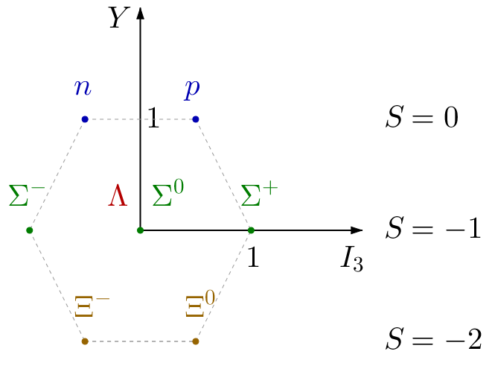
Strange-quark content of the nucleon
M. Gell-Mann, R. Oakes, B. Renner, Behavior of current divergences under SU₃×SU₃, Phys. Rev. 175 (1968) 2195-2199
J. Gasser, Hadron masses and the sigma commutator in light of chiral perturbation theory, Ann. Phys. 136 (1981) 62-112
J. Gasser, H. Leutwyler, Quark masses, Phys. Rep. 87 (1982) 77-169
B. Borasoy, Sigma-terms in heavy baryon chiral perturbation theory revisited, Eur. Phys. J. C8 (1999) 121-130
R. Koch, A new determination of the πN sigma term using hyperbolic dispersion relations in the (ν²,t) plane, Z. Phys. C 15 (1982) 161-168
The meson-factory measurements require an enhanced isoscalar component in the πN scattering amplitude, thus suggesting that a sizeable fraction of the nucleon mass might be due to the strange quark!

Slide 50
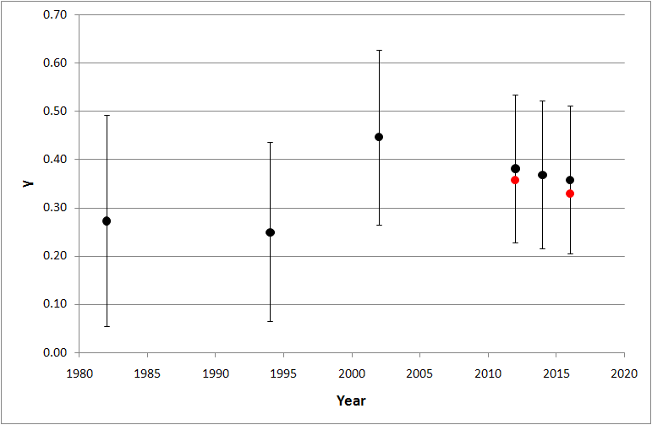
The ‘strange’ strange-quark content of the nucleon
R. Koch, A new determination of the πN sigma term using hyperbolic dispersion relations in the (ν²,t) plane, Z. Phys. C 15 (1982) 161-168
P.F.A. Goudsmit, H.J. Leisi, E. Matsinos, B.L. Birbrair, A.B. Gridnev, The extended tree-level model of the pion-nucleon interaction, Nucl. Phys. A 575 (1994) 673-706
M.M. Pavan, R.A. Arndt, I.I. Strakovsky, R.L. Workman, The pion-nucleon Σ term is definitely large: results from a G.W.U. analysis of πN scattering data, πN Newslett. 16 (2002) 110-115
E. Matsinos, G. Rasche, Aspects of the ETH model of the pion-nucleon interaction, Nucl. Phys. A 927 (2014) 147-194

Slide 51
The voice of one crying in the wilderness
M. Anselmino, M.D. Scadron, Does the proton contain large strange quark components?, Phys. Lett. B 229 (1989) 117-121
G. Clément, M.D. Scadron, J. Stern, Why a large sigma term does not require a large strange quark content in the nucleon, J. Phys. G 17 (1991) 199-204
M.D. Scadron, On the strange quark content of nucleons, Z. Phys. C 54 (1992) 595-597
S.A. Coon, M.D. Scadron, Is there a scalar form-factor suppression of the nucleon σ-term?, J. Phys. G 18 (1992) 1923-1931
Problems with the GL value?

Slide 52
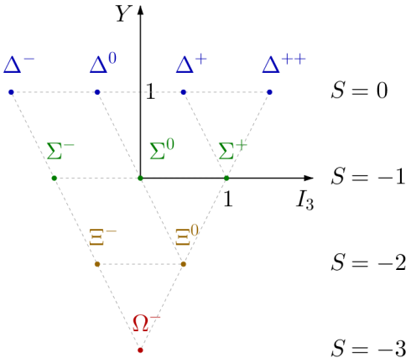
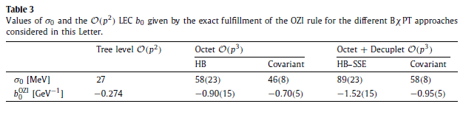
Redetermination of
J.M. Alarcón, L.S. Geng, J. Martin Camalich, J.A. Oller, The strangeness content of the nucleon from effective field theory and phenomenology, Phys. Lett. B 730 (2014) 342-346
+

Slide 53
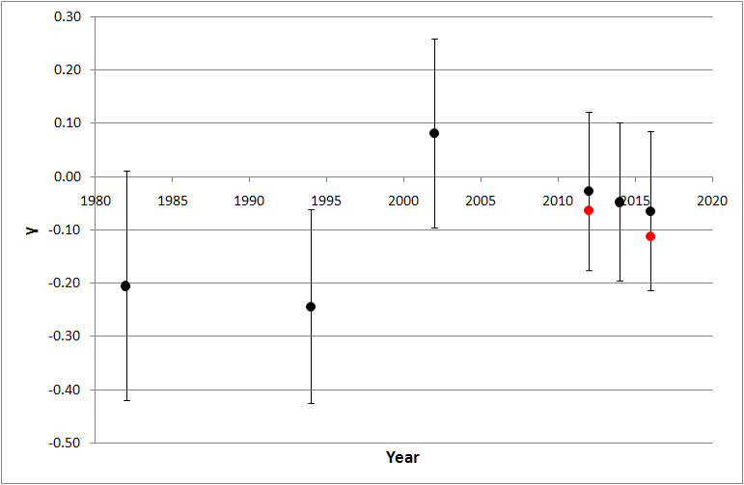
The ‘not-so-strange’ strange-quark content of the nucleon
As a result, the larger values of the Σ term are not in conflict with our picture of the nucleon and our expectations for its small strange-quark content!
Personal opinion: the careful re-evaluation of both and is called for!

