Slide 1
Chip design for dummies
Roberto Dinapoli :: NUM/SLS Detector Group :: Paul Scherrer Institut
LTP Mini review Talk :: 11.12.2017

Slide 2
Outline
Introduction:which electronics?
The ASIC
  building blocks
  design flow
  a simple exercise
  design for radiation tolerance
Chip design at PSI
  origins and present situation
  technologies
  some achievements
Conclusions

Slide 3
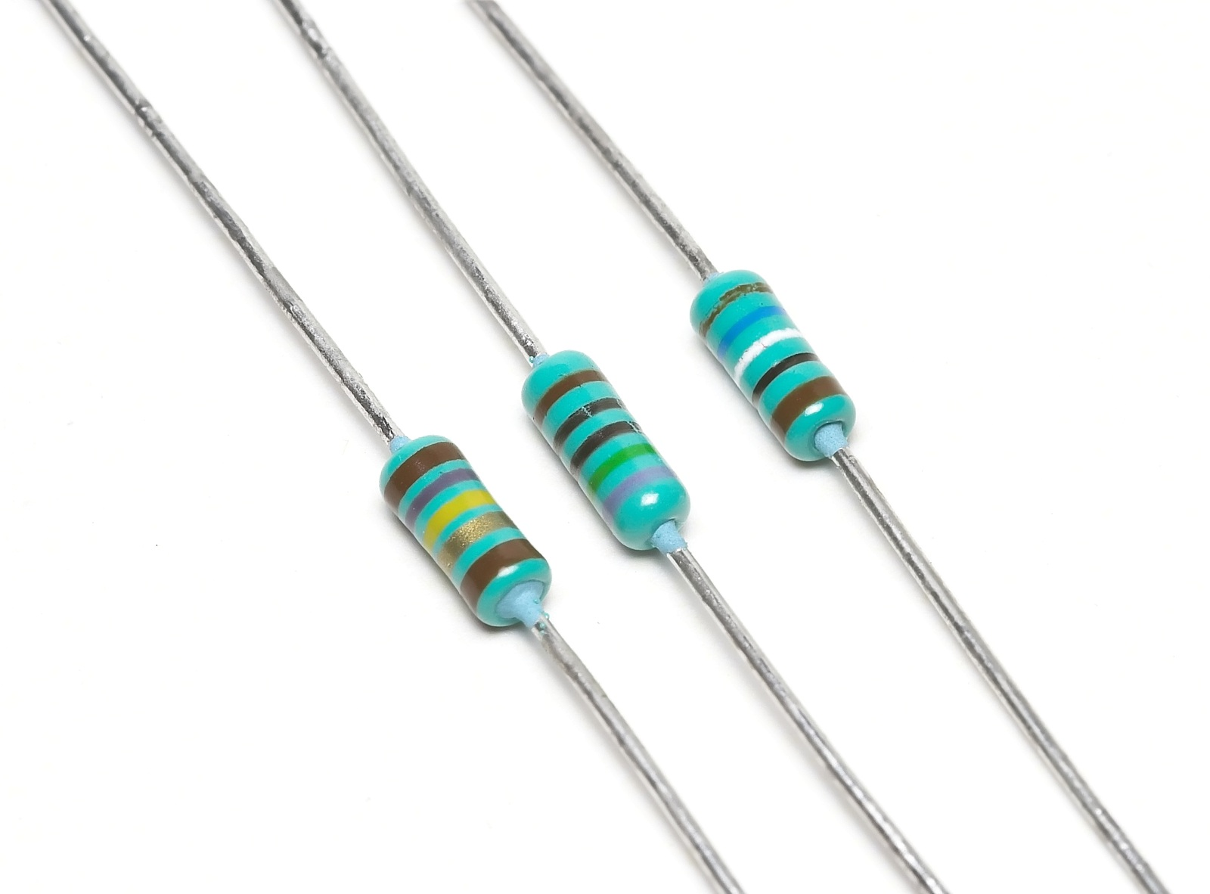
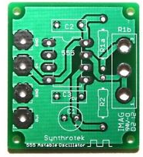
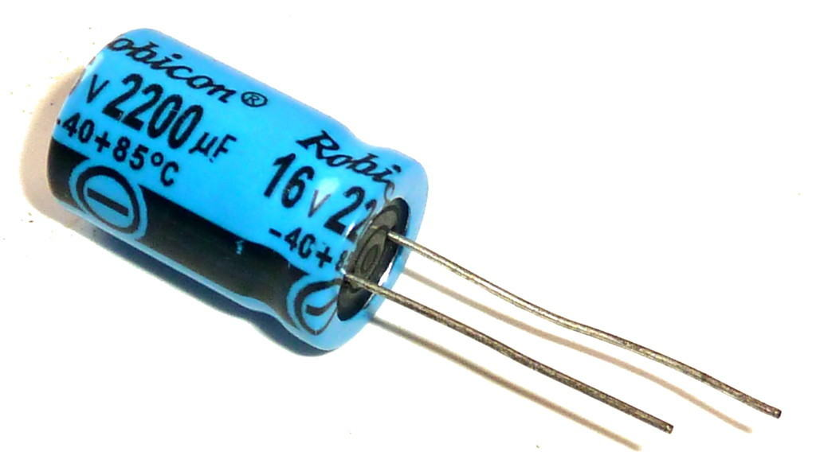
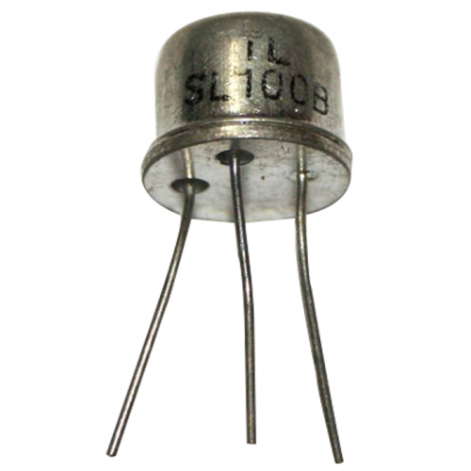
Electronics: but which one ??
Discrete electronics

Slide 4
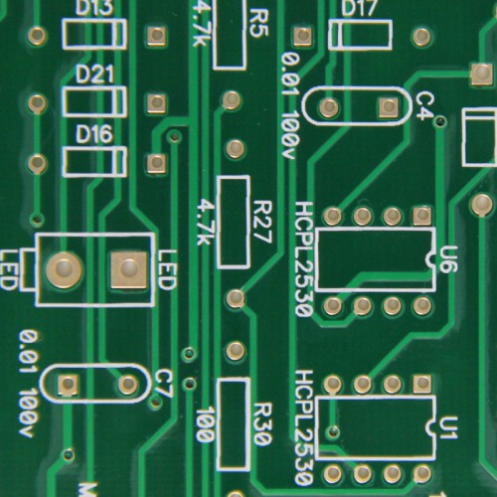
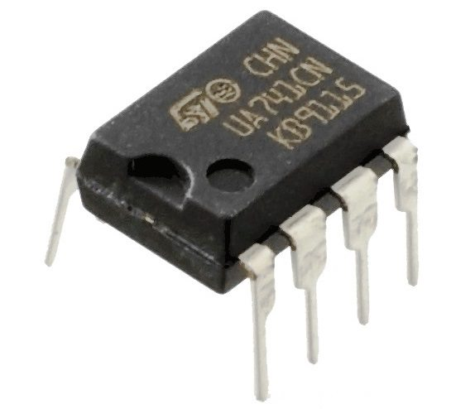
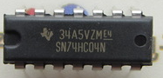
Electronics: but which one ??
“Off the shelf” components

Slide 5
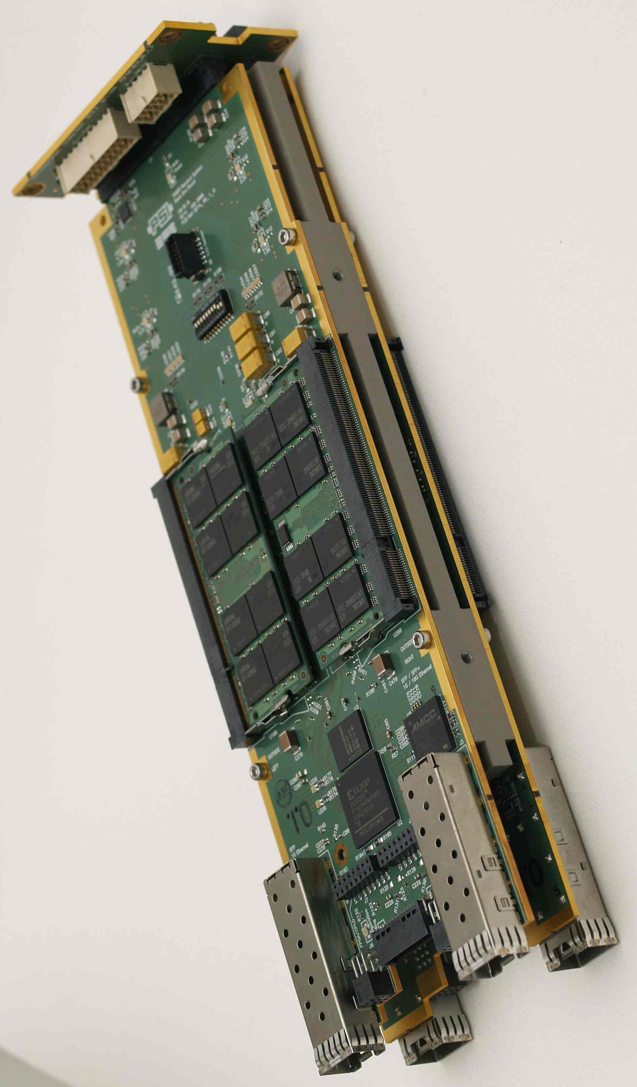
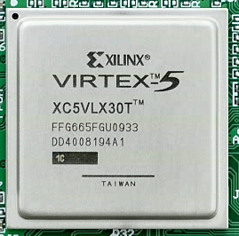
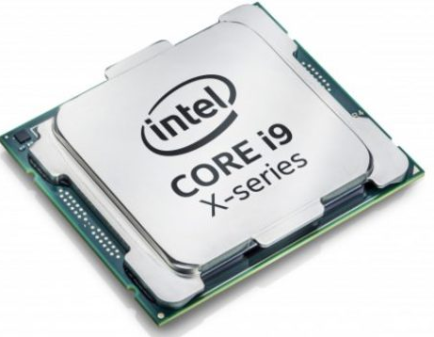
Electronics: but which one ??
Programmable devices

Slide 6
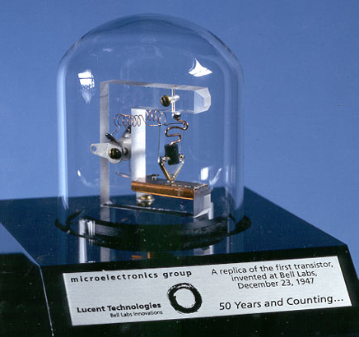
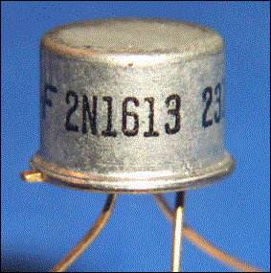
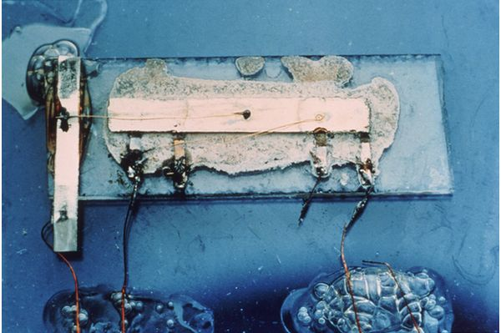
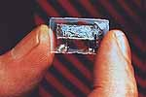
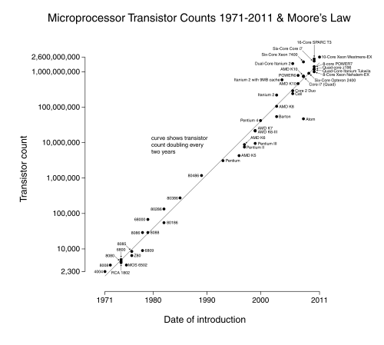
Electronics: but which one ??
Application Specific Integrated Circuit (ASIC)
First integrated circuit developed by Jack Kilby (TI,1958)
First planar transistor by the swiss Jean Hoerni (Fairchild,1959)
Replica of the first point-contact transistor by Bardeen, Brattain and Shockley (Bell Labs,1947)
IEEE spectrum 03.2017 : “Intel Now Packs 100 Million Transistors in Each Square Millimeter”

Slide 7
Electronics: but which one ??
Application Specific Integrated Circuit (ASIC)
Standard cells/IP blocks
Full custom chip
  expensive
  time consuming/long turnaround times
  designers with specific skills needed
  tailored to the user’s needs:
    peculiar application
    analogue and digital on the same chip
    radiation tolerance
    very high transistor density

Slide 8
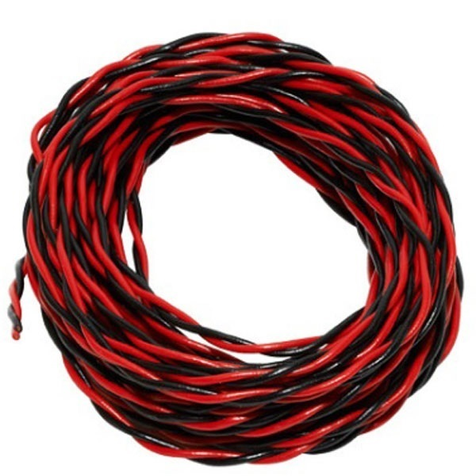

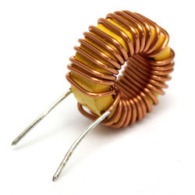
The ASIC building blocks
P-type MOS-FET
N-type MOS-FET
Resistor
Capacitor
Wire
Inductor

Slide 9
The transistor (super)basics
DIGITAL VIEW:
Microscopic switch
Analog VIEW:
Controlled source/amplifier
Id
Id~vg
v=0V
vg
vg
v=2V
Id =K* W/L * vg

Slide 10
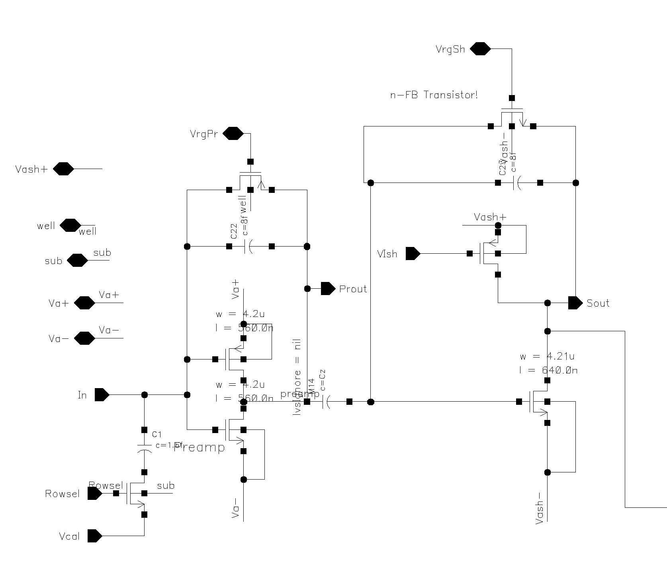
Chip design flow: schematic and simulation
Computer simulations
(Spectre)
output waveforms
Layout
Block diagram analysis
(Mathematica,matlab)
Transistor and device models
Schematic view
Technology information
Design specifications
Simulated circuit parameters:
Gain, noise, speed, variability,
sensitivity…

Slide 11
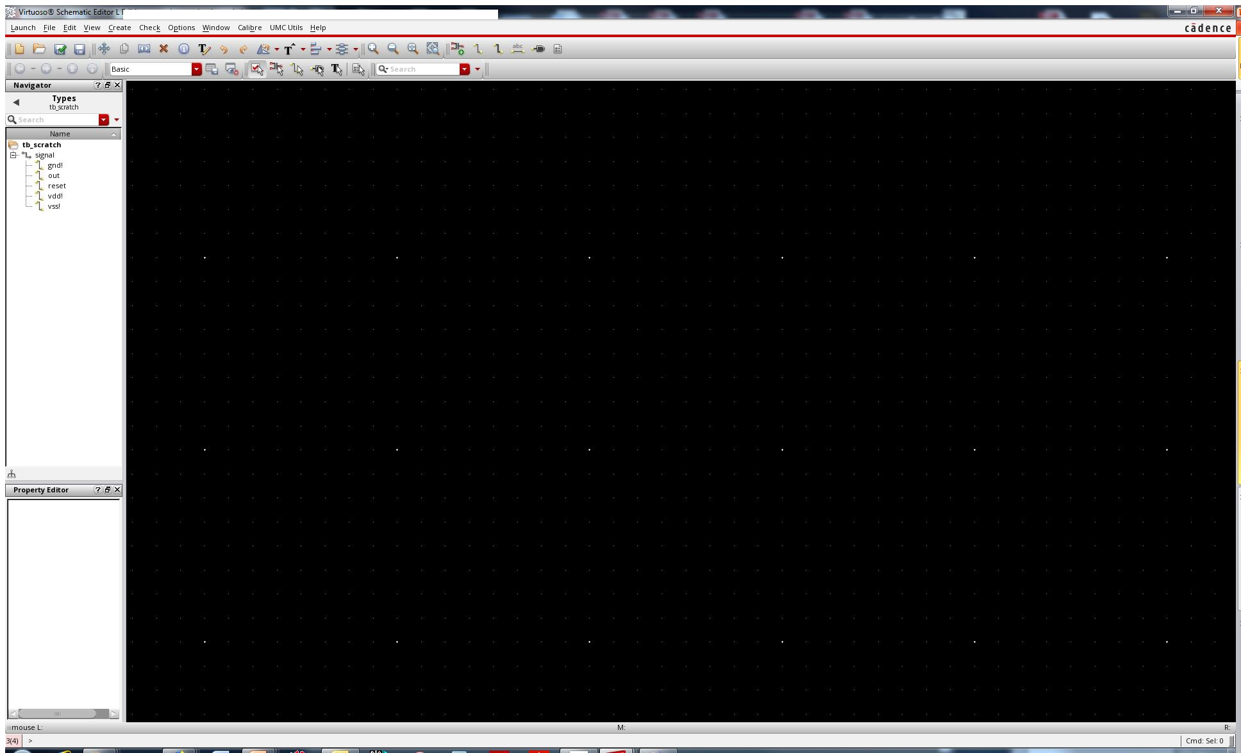
Simple exercise: an inverter

Slide 12
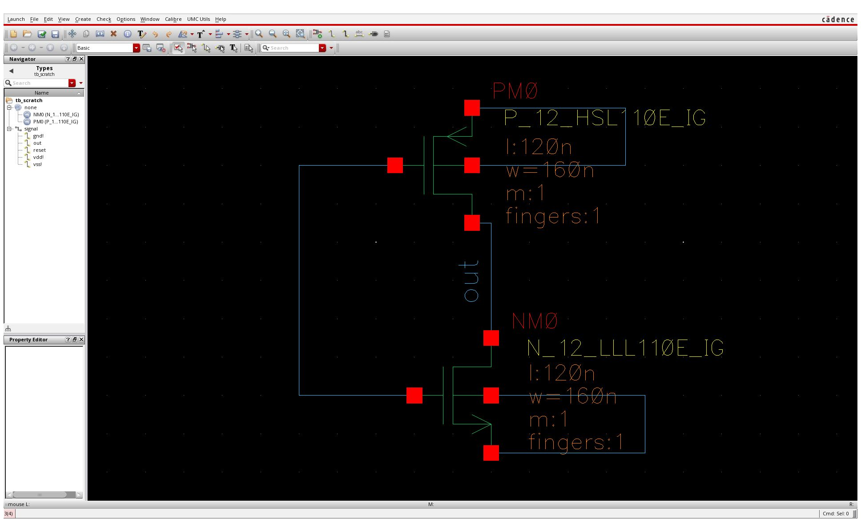
Simple exercise: an inverter

Slide 13
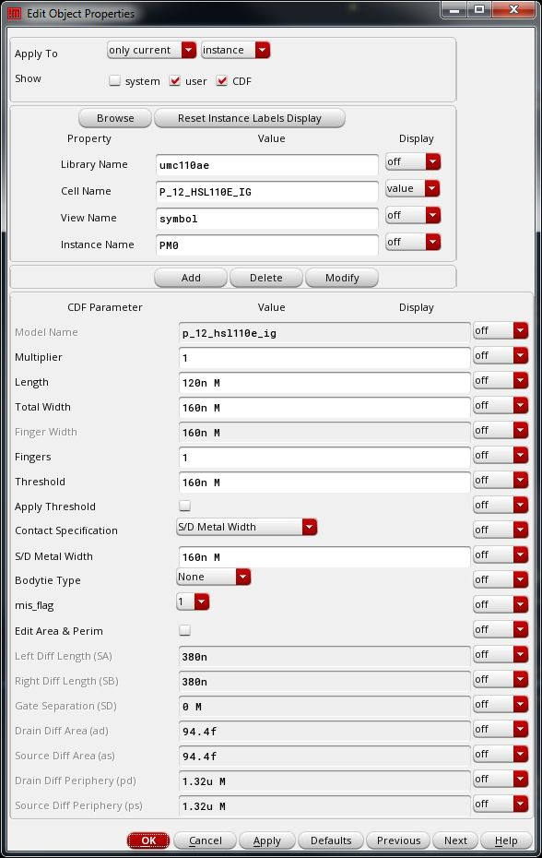

Slide 14
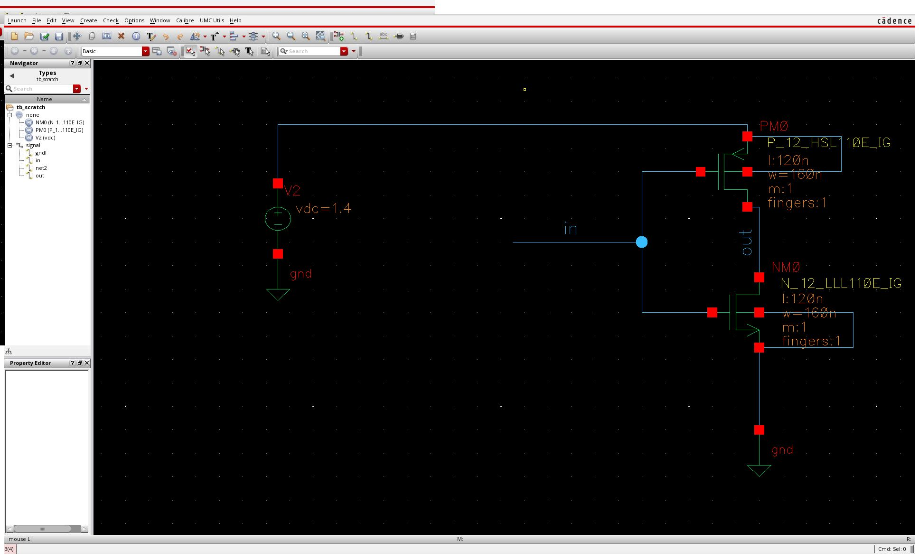

Slide 15
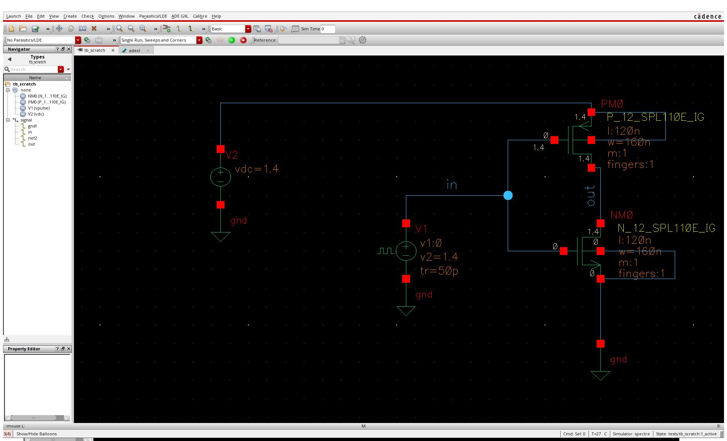

Slide 16
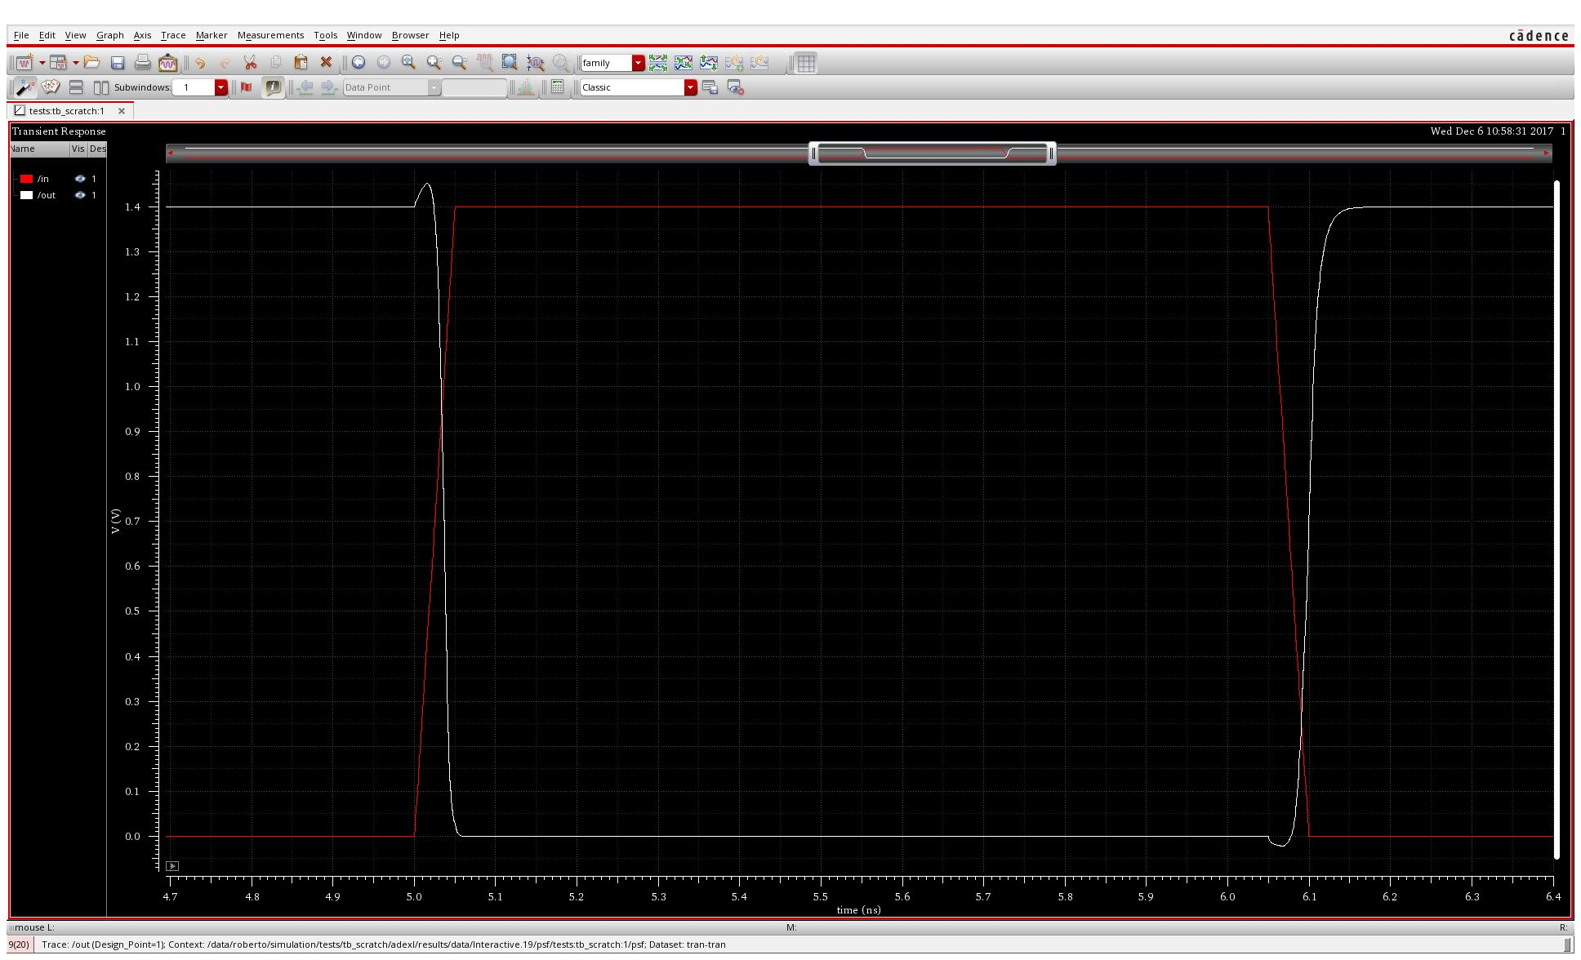
Simple exercise: an inverter

Slide 17
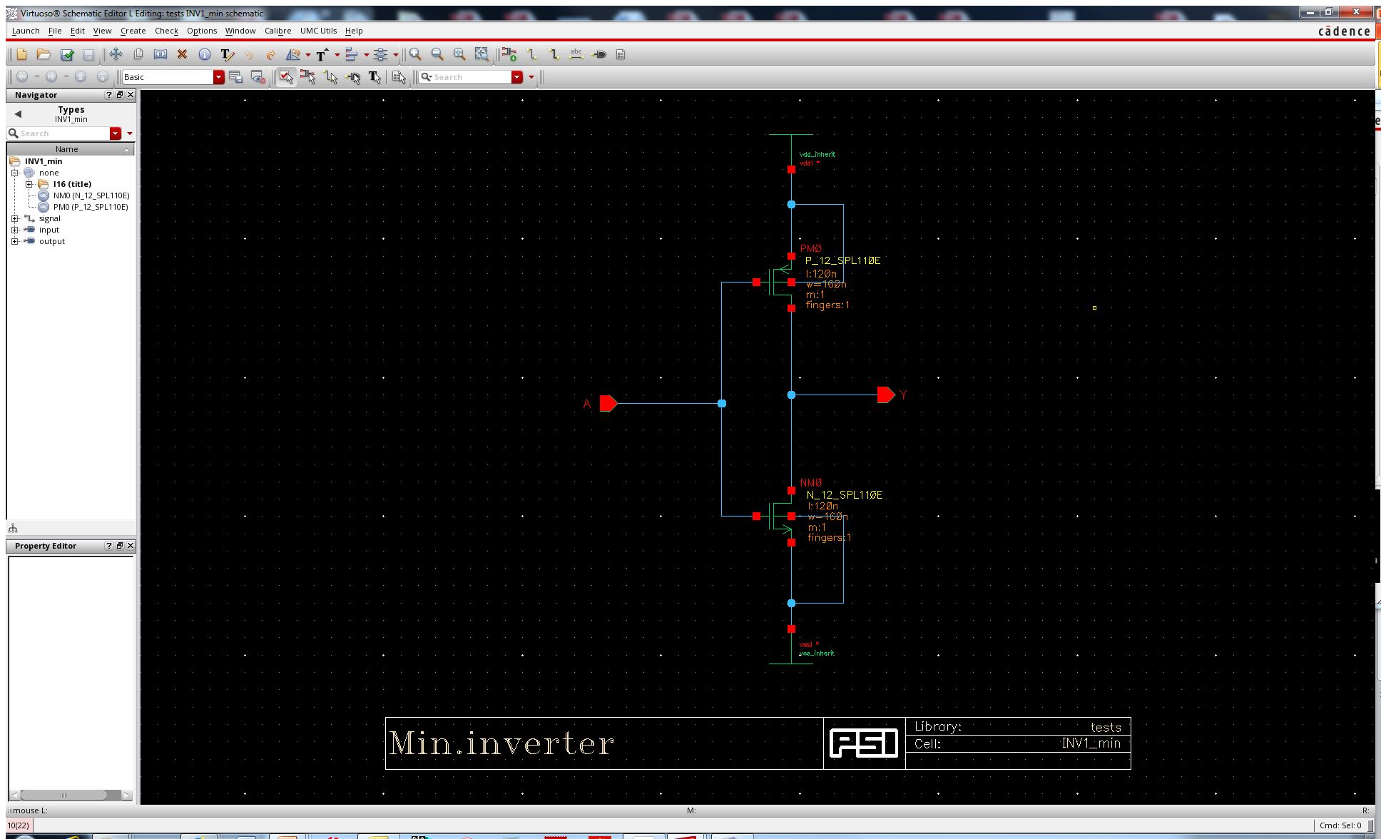
Simple exercise: an inverter

Slide 18
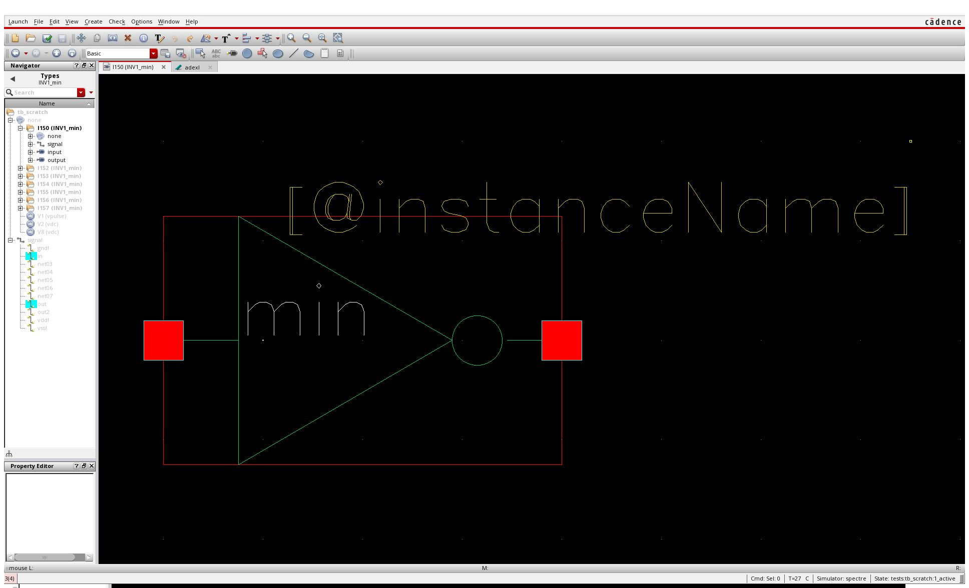
Simple exercise: an inverter

Slide 19
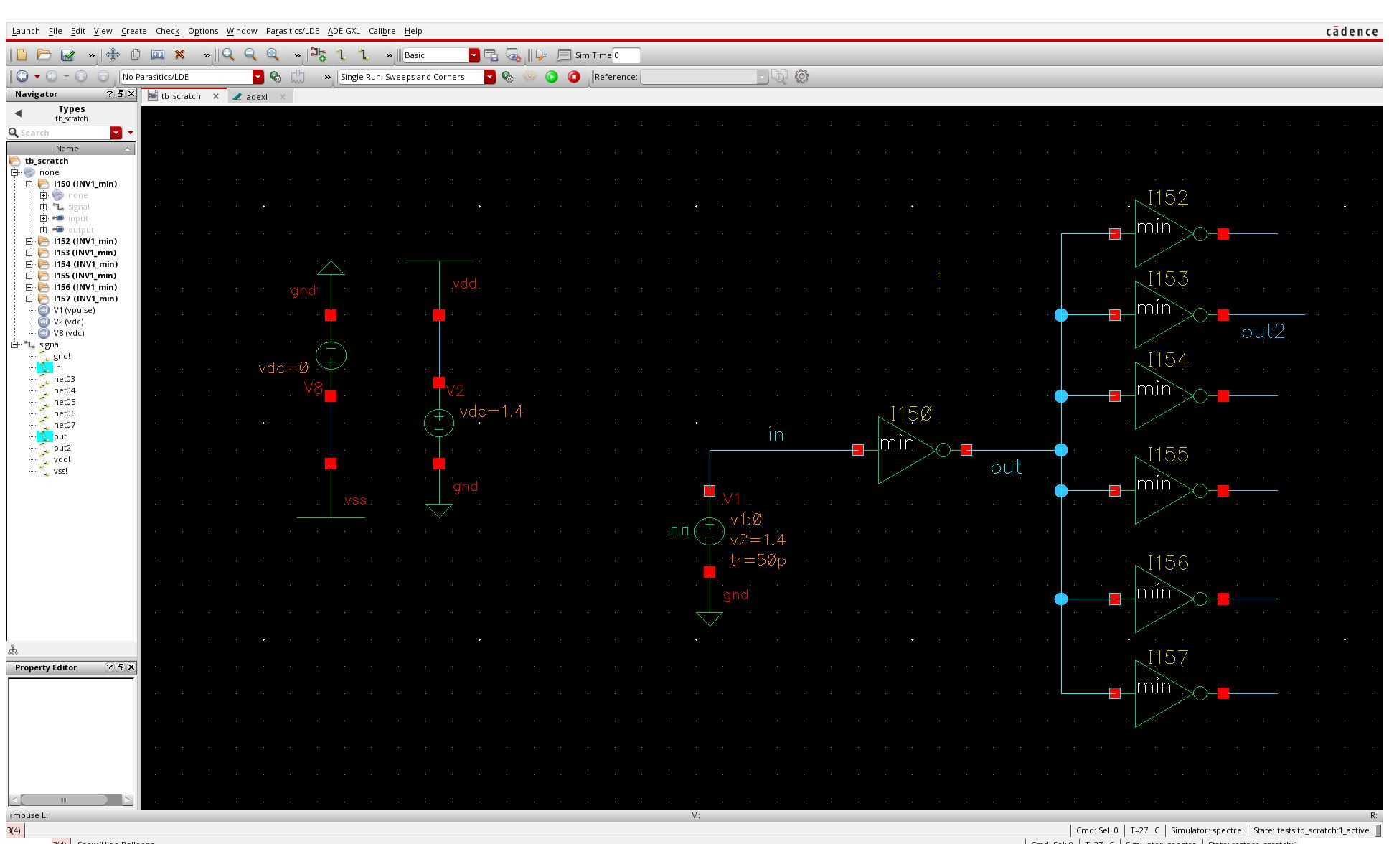
Simple exercise: an inverter

Slide 20
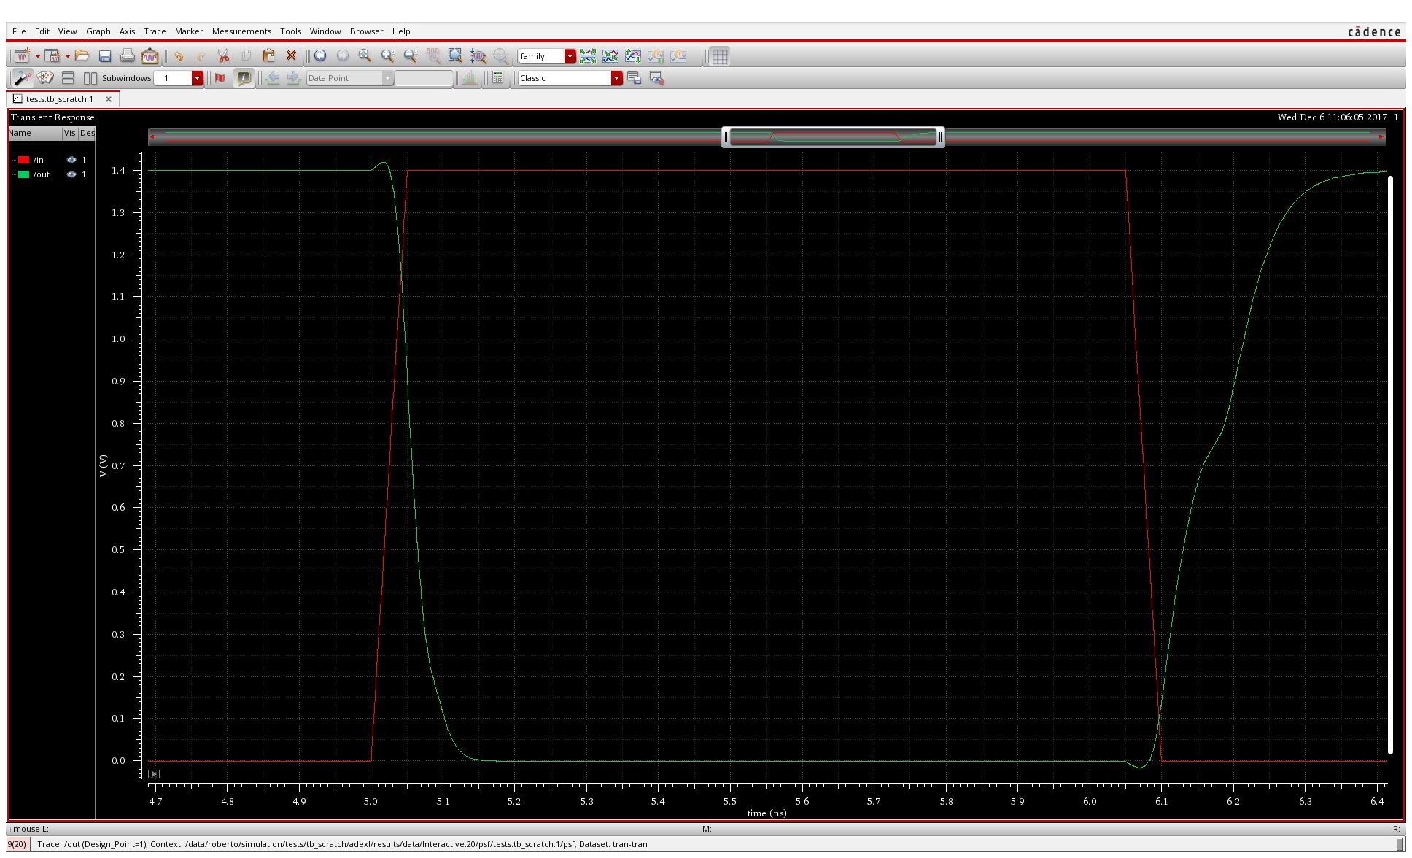
Simple exercise: an inverter

Slide 21
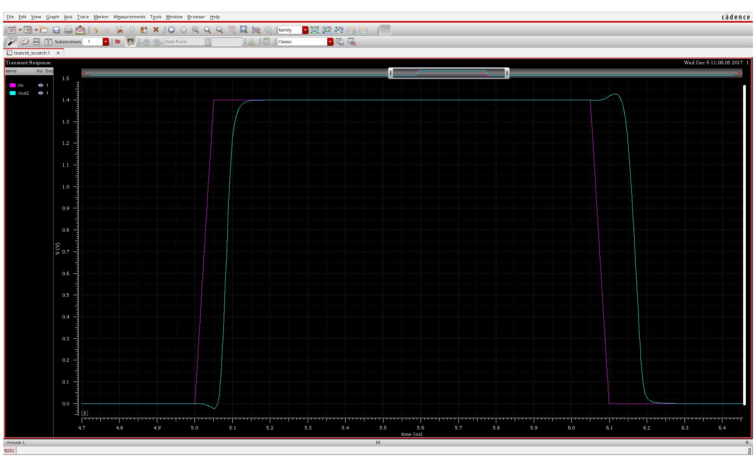
Simple exercise: an inverter

Slide 22
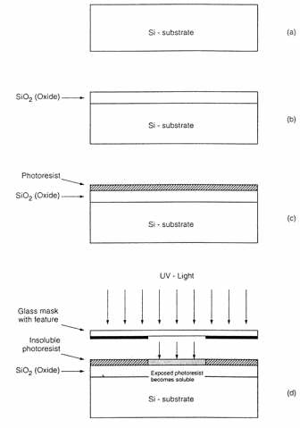
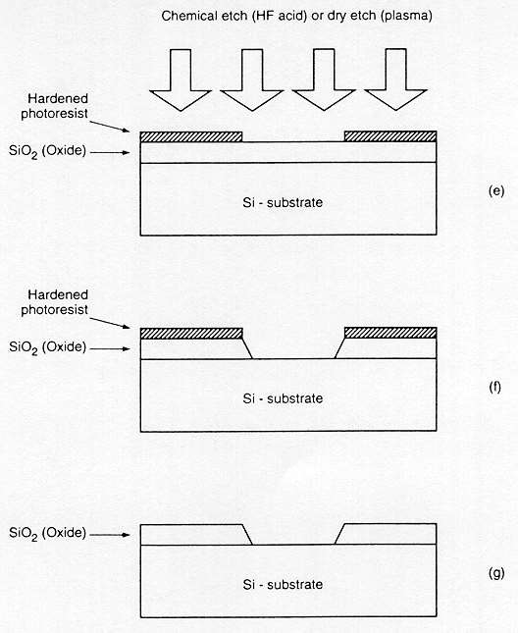
Fabrication process flow, basic steps
Process steps required for patterning of silicon dioxide.

Slide 23
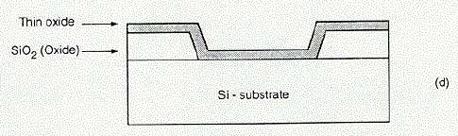
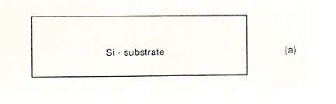
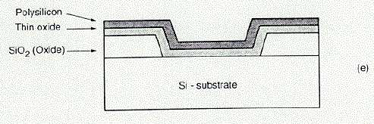
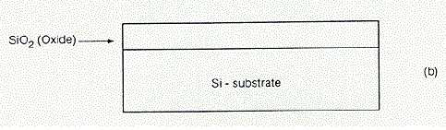
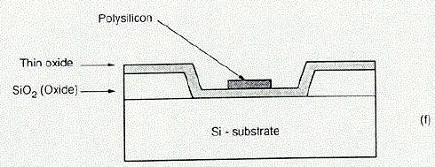
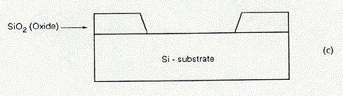
Fabrication process flow, NMOS transistor
Process steps required for generating an NMOS transistor

Slide 24
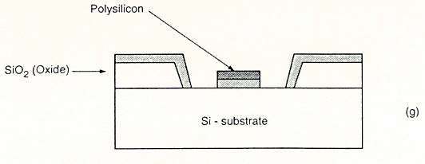
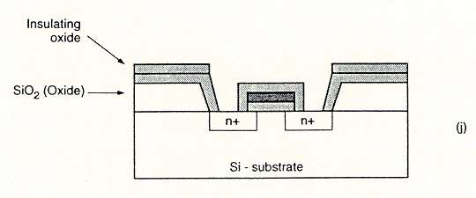
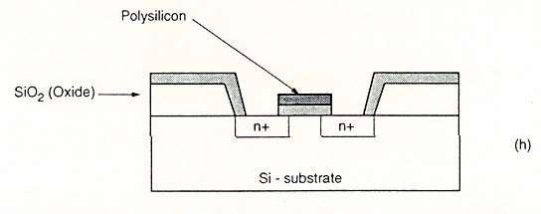
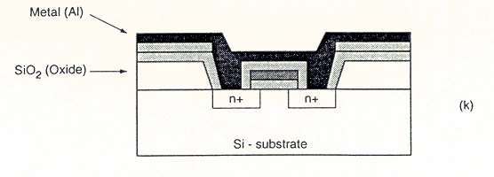
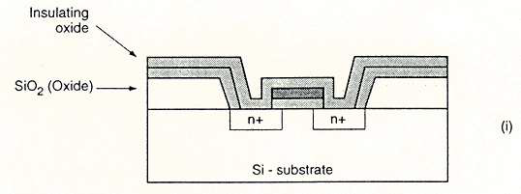
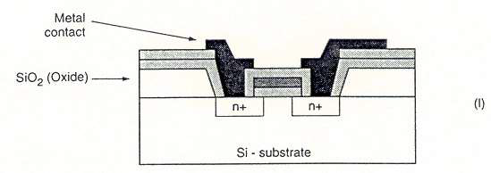
Fabrication process flow, NMOS transistor
Process steps required for generating an NMOS transistor

Slide 25
Fabrication process flow, PMOS transistor
Well
Contact to
well
Source
Transistor implantation
W
Well
L
Gate
Contact to
implantation
Contact to
implantation
Transistor gate
(polysilicon)
Source
Drain
Drain
P-type transistor
N-type silicon
Contact to
polysilicon
P-type silicon

Slide 26
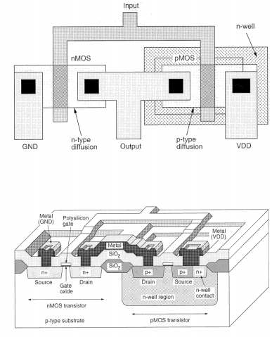
Simple exercise: an inverter

Slide 27
Simple exercise: an inverter

Slide 28
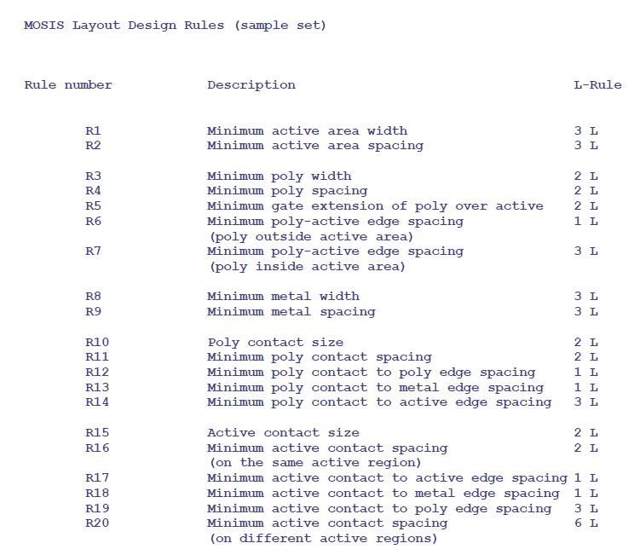
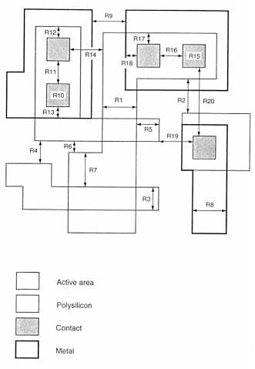
Chip design flow: Design Rules Check (DRC)

Slide 29
Chip design flow: Layout vs Schematic (LVS)
?
=
LVS
Comparison
Netlist Layout
Netlist Schematic
Correct!

Slide 30
Chip design flow: Layout vs Schematic (LVS)
?
=
LVS + PEX
(paras.extr.)
LVS
Comparison
Netlist Layout
Netlist Schematic
Netlist with parasitics
Correct!

Slide 31
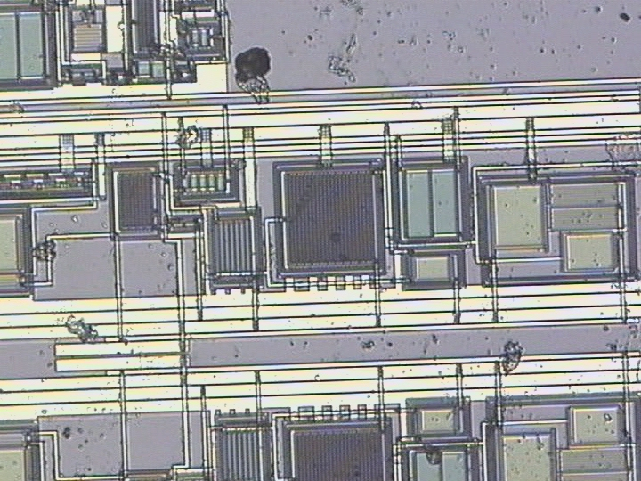
The ASIC building blocks
Metal
connections
Very old technology: AMS 0.8μm BICMOS

Slide 32
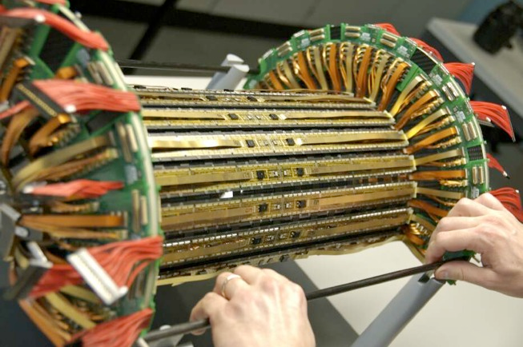
The challenge of LHC inner trackers
Challenges:
High performance
High radiation tolerance
Low power consumption
High density …
Components “off the shelf”
Radiation hard technologies
Design for radiation tolerance

Slide 33

What made LHC inner trackers possible (and affordable): Design for Radiation Tolerance
Thin Oxide-NMOS Transistors in enclosed geometry
Thin Oxide (<6nm) improves radiation tolerance
Enclosed geometry transistors and guard-rings prevent from radiation induced leakage
L
D
W
S
N+
Design implications !
W/L limitation
Transistor modeling
Density
Libraries
Verification routines
L
W

Slide 34
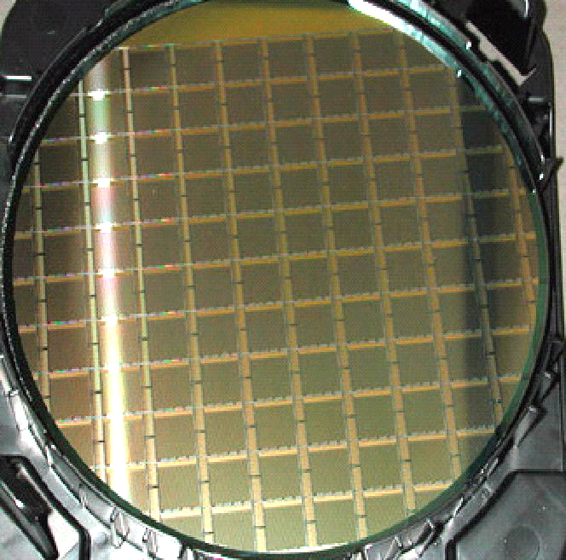
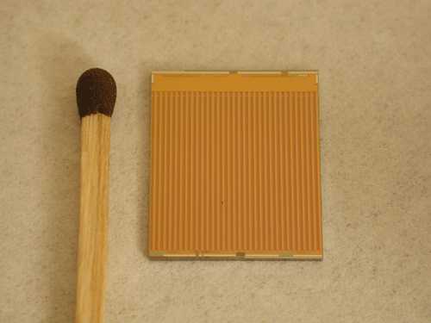
Chip design flow: “final” steps
Full chip layout assembly
Chip global checks
FOUNDRY
(UMC)
Tape out
Wafer dicing
Chip packaging/post-processing
WAFER
Wafer post processing
13.5 mm
15.8 mm
ALICE1LHCb

Slide 35
PART II: Chip design at PSI

Slide 36





Origin of chip design at PSI
SLS
LHC
CMS
ITS
PILATUS II
MYTHEN II
Sept. 2006
PSI46
MEG
Spinoff company: Dectris LTD
DRS 2

Slide 37
Chip design at PSI: Organization
CMS
Department: NUM
Lab:Particle Physics
Group:Electronics
MEG
Chip Design
Core Team
X.Shi (Sw.FEL)
B.Meier (NUM)
R.Dinapoli (NUM)
A.Mozzanica (Sw.FEL)
D.Mezza (NUM/SYN)
SLS Detectors
Others
Most of our design work concerns:
Design of radiation tolerant front end chips for strip and hybrid pixel detectors both for HEP and for photon science

Slide 38
Chip Design Core Team: Tasks
CAD support
Interface with EP/MOSIS
Technical advice
Chip Design
Core Team
(CDCT)
Technology setup
DESIGN
Building blocks
Full chip
Patent filing – Spin offs
Students training
Conferences and publications

Slide 39

EIGER
EIGER: next generation single photon counting detector for X-Ray applications
Technological process | UMC 0.25 µm, full rad tol design
Analog Parameters | 30 ns peaking time, ~150 ns ret. Zero 130e⁻ rms ENC
Chip size | 19.3 x 20.1 mm² , 28M transistor
Pixel size | 75 x 75 µm²
Pixel array | 256 x 256 = 65536
Count rate | 3.4 x 10⁹ x-rays/mm²/s (1-2 Mcounts/pixel/s)
Counter | 12 bits, configurable,double buffered
Frame rate | Up to 23 kHz (in 4 bit mode)
2 cm

Slide 40


EIGER X-ray absorption image
2cm
No stitching, no trimming, with background correction
8cm
4cm
(High Frame Rate Demo)

Slide 41



Towads bigger systems
  MODULE
  500 k pixel
  38 X 77 mm²
  8 GB memory
9M EIGER DETECTOR
Area: 23x23cm²
Number of pixels: 9 million
Frame rate: up to 23 kHz
Developed for SLS cSAXS beamline
Total (raw) data rate: 900Gb/s
Notes:
Cu tube, 25kV, 80mA, pinhole, 1.5m distance

Slide 42


Slide 43






An Eiger self portrait (Ptychography)
Diffraction pattern
from one ½ of a module
Coherent X-rays
FZP
OSA
Object
Phase image
The object is raster scanned
by an out of focus beam
Diffraction patterns at
overlapping positions on the
object are recorded
The information in the overlap
is used to recover the dp phase
Both the attenuation and phase
shift in the object can be
reconstructed
Object:
Eiger readout chip
80 um

Slide 44


Open access link: http://rdcu.be/p7bi

Slide 45




MÖNCH
Micropixel with enhanced pOsition rEsolution usiNg CHarge integration
Pilatus 172 μm
Eiger 75 μm
Mönch 25 μm
x47
x5.3
Small pixels 25 x 25 μm²
  Bump bonding works!
Low noise
  320 eV energy resolution FWHM
Large dynamic range
  Up to now statically selectable
  Will have adaptive gain
Currently 1x1 cm² prototype available
  400x400=160 kpixel
Fast frame rate (> kHz)
  currently 3 kHz
  by design 6 kHz
  Ca. 20 TB/day
Dead-time free operation possible
M. Ramilli, et al. (2017) J. Instr. 12, C01071.http://dx.doi.org/10.1088/1748-0221/12/01/C01071

Slide 46
Charge sharing – Spatial resolution
Division of charge between pixels is strongly position dependent
Can improve the spatial resolution
  Pitch ≈ charge sharing distance
    320 µm thick Si, 120V ≈ 20 µm
    Depends on the drift time:
      Applied bias voltage
      Absorption depth
        Sensor thickness
        X-ray energy
  High SNR
    Low noise
  Isolated photons
    Fast frame rate
    Low flux
Charge sharing
Low resolution analog image
High resolution digital image
“Single shot x-ray phase contrast imaging using a direct conversion microstrip detector with single photon sensitivity” Kagias, M., Cartier, S., Wang, Z., Bergamaschi, A., Dinapoli, R., Mozzanica, A., Schmitt, B. & Stampanoni, M. (2016). Appl. Phys. Lett. 108, 234102.

Slide 47






High resolution imaging
Synchrotron
X-ray tube
Low energy
25 µm pixels
Interpolated
SOLEIL, Nanoscopium
11 keV
Siemens star
2 µm bins
W-tube
55kV
EIGER HDI
5 µm bins
SLS, PHOENIX
2 keV
61µm pitch metal grid
1 µm bins
100µm

Slide 48
Conclusions
Despite the complexity, an ASIC can be the only viable solution for specific requirements
PSI chip design group based on “matrix architecture”, successful model
Several chips already developed for different applications, some spinned-off
Many developments going on for LHC, M3E, synchrotron and most of all for free-electron laser applications

Slide 49
THANKS!

Slide 50
Chip design at PSI: particle detection systems
Pixel chip for the inner tracker (PSI46)
New version for LHC luminosity upgrade
Particle physics
CMS
Domino sampling chips (DRS4)
New version for MEEE (DRS5)
MEG
Pixels (2D)
Strips (1D)
Pilatus (SPC)
Eiger (SPC)
Mönch (INT)
Mythen (SPC)
Gotthard (INT)
Synchrotrons
X-ray detection
(SLS Detectors)
AGIPD (INT)
Mönch (INT)
Gotthard (INT)
Jungfrau (INT)
XFELs
SPC= single photon counting INT=charge integration
HiZ – Neutron – Low energy X-ray –Electron – Space – detectors
Small pitch bump-bonding
Research

Slide 51



The basic principle of hybrid pixel detectors
n-diffusion
Detector substrate
p implant
p implant
Electronics
Electronics
Electronics substrate
Bump-bond
Contact metal pads
Pb-Sn Bump Bond
A silicon detector
bump-bonded with a readout chip
Bump bond metal pad

Slide 52
The basic principle of hybrid pixel detectors
Events counting
Induced
Current
Incoming particle
Amplifier
Shaper
Discriminator
Logic
Analog readout
Induced
Current
Incoming particle
Amplifier
CDS
Buffer

Slide 53
Requirements for an ideal detector
  Single photon resolution
  No spatial distortion and uniform response
  Large dynamic range
  Large area
PILATUS
+
  Small pixel size
  Small dead area
  Fast Frame Rate
  Simultaneous exposure and readout
  Negligible dead time
  High count rate of incoming photons
EIGER

Slide 54
An Eiger self portrait (Ptychography)
Diffraction pattern
from one ½ of a module
Coherent X-rays
FZP
OSA
Object
Phase image
The object is raster scanned
by an out of focus beam
Diffraction patterns at
overlapping positions on the
object are recorded
The information in the overlap
is used to recover the dp phase
Both the attenuation and phase
shift in the object can be
reconstructed
Object:
Eiger readout chip
80 um

Slide 55

Large area, high resolution Ptychography
~50 nm resolution
5 um
0.5 x 0.5 mm²
Zoom in on a pixel

Slide 56

Large area, high resolution Ptychography
~50 nm resolution
5 um
0.5 x 0.5 mm²
Zoom in on a pixel
Notes:
Green- implant
Red- poly silicon
Blue- metal

