Slide 1
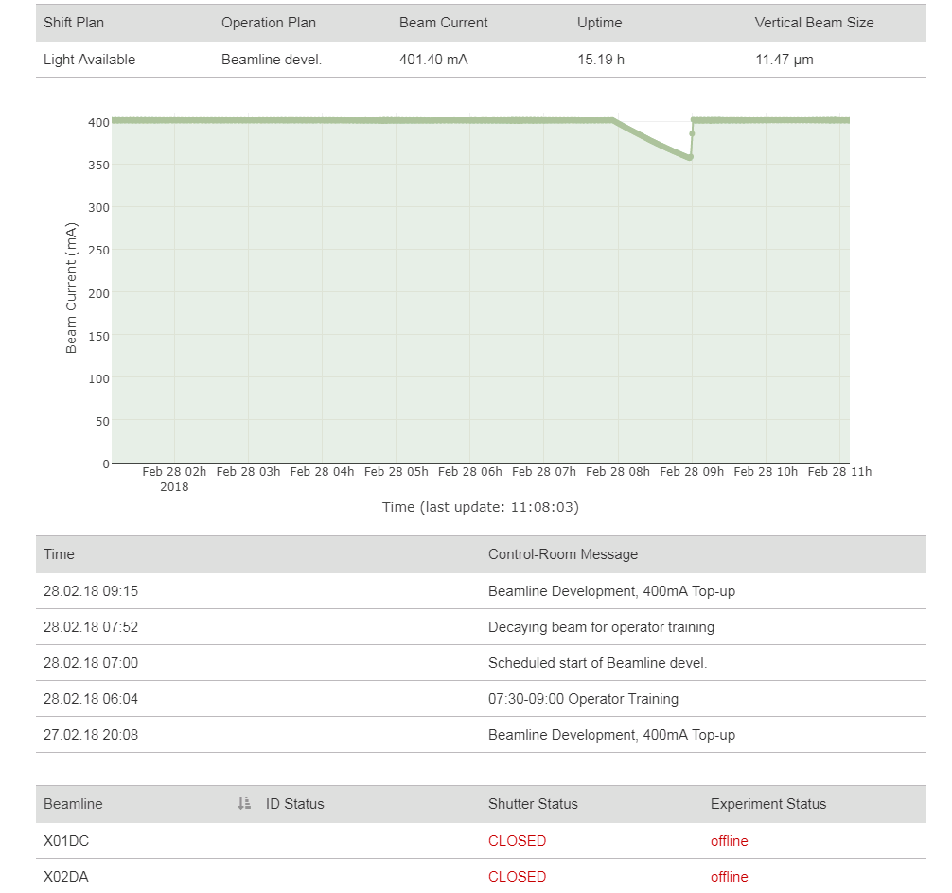
Operation Plan
Beam Current
Beam Energy
Pulse Energy
Photon Energy
User Operation
200.0 pC
2700 MeV
250.0 uJ
2.3 keV
This should be the shift category from the DUO calendar, I need to figure out how to get it
SARUN08-UIND030:FELPHOTENE
Strip-chart of the 4 values above (in case it looks to busy we could remove Photon Energy)
SARFE10-PBPG050:PHOTON-ENERGY-PER-PULSE-US
SINEG01-DBPM340:Q1
SARCL02-DCOL290:ENE
This should be the SF control room message:
SF-OP:CR-MSG:OP-DATE1 SF-OP:CR-MSG:OP-MSG1
SF-OP:CR-MSG:OP-DATE2 SF-OP:CR-MSG:OP-MSG2
SF-OP:CR-MSG:OP-DATE3 SF-OP:CR-MSG:OP-MSG3
(I have to make sure that people are aware of this before having it on the internet ;-)
ARAMIS-ALVRA
ARAMIS-BERNINA
This should be the same as SLS, not there yet but it is coming…
SAROP11-SBST114:PLC_VCS_CLOSE2
SAROP21-SBST114:PLC_VCS_CLOSE2

