Slide 1
Area infrastructure & magnet installation
Mu3e - 2018 - Liverpool
Andreas Knecht & Felix Berg

Slide 2
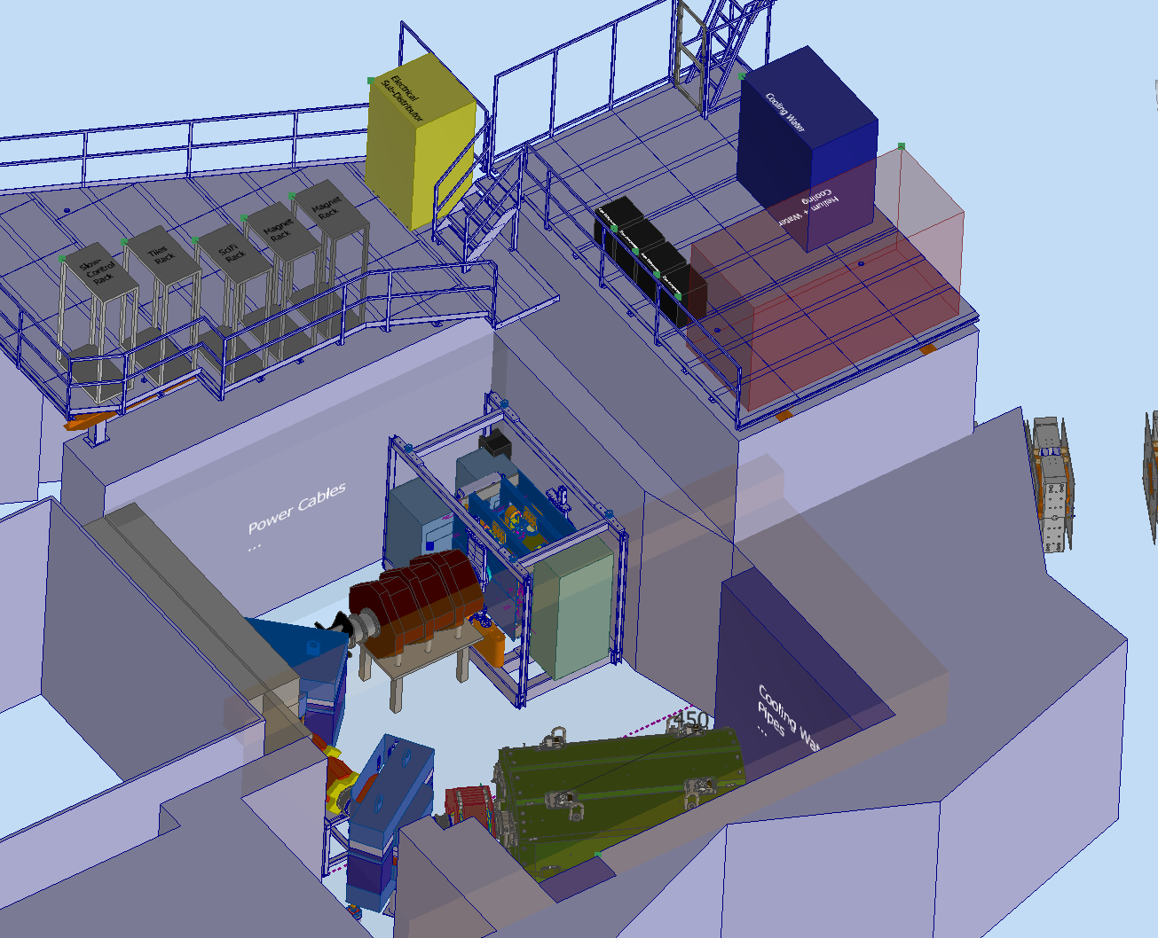

Slide 3
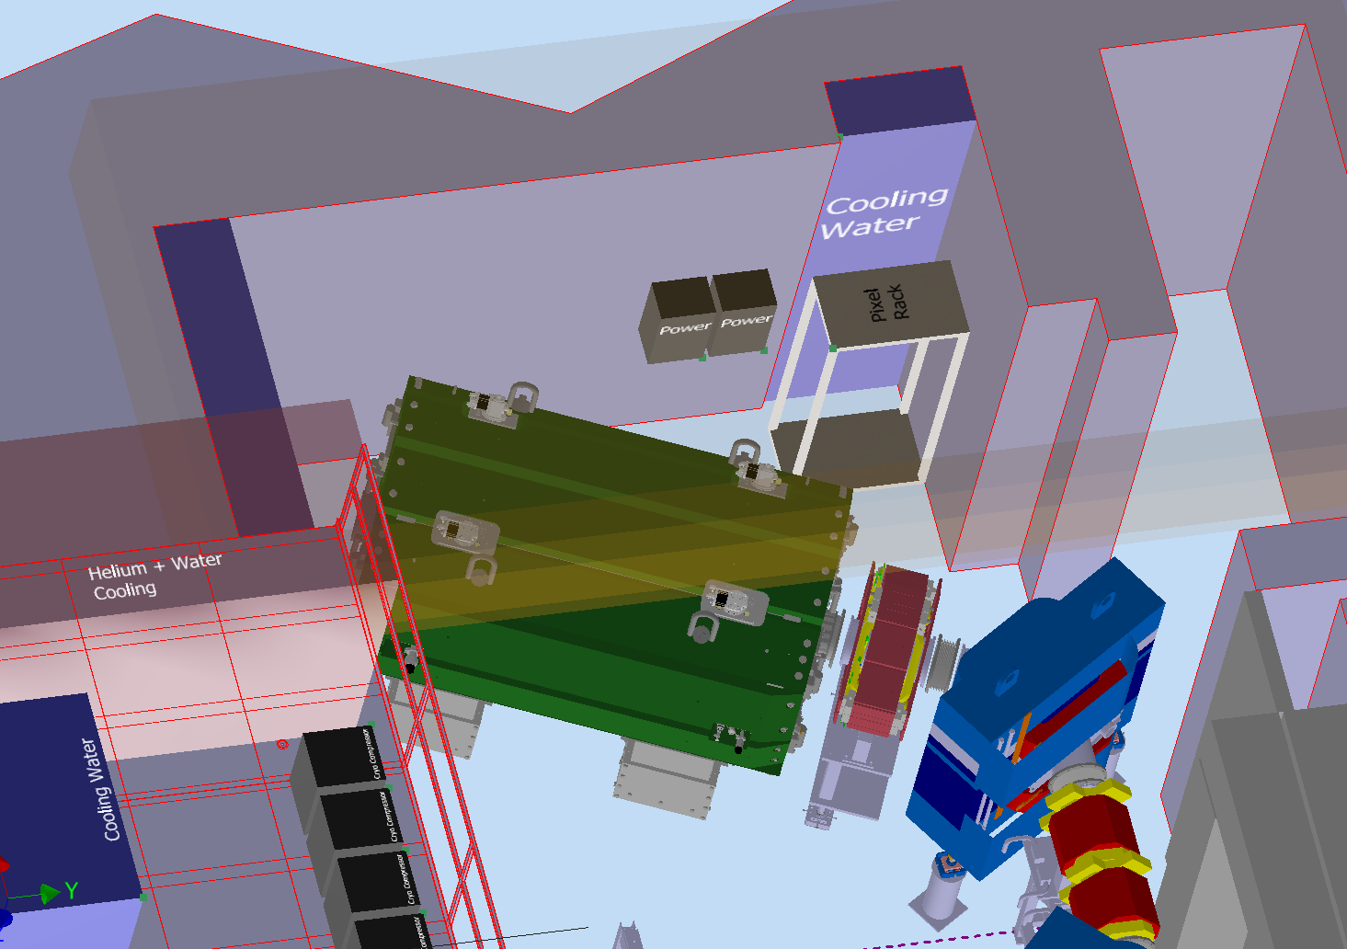

Slide 4
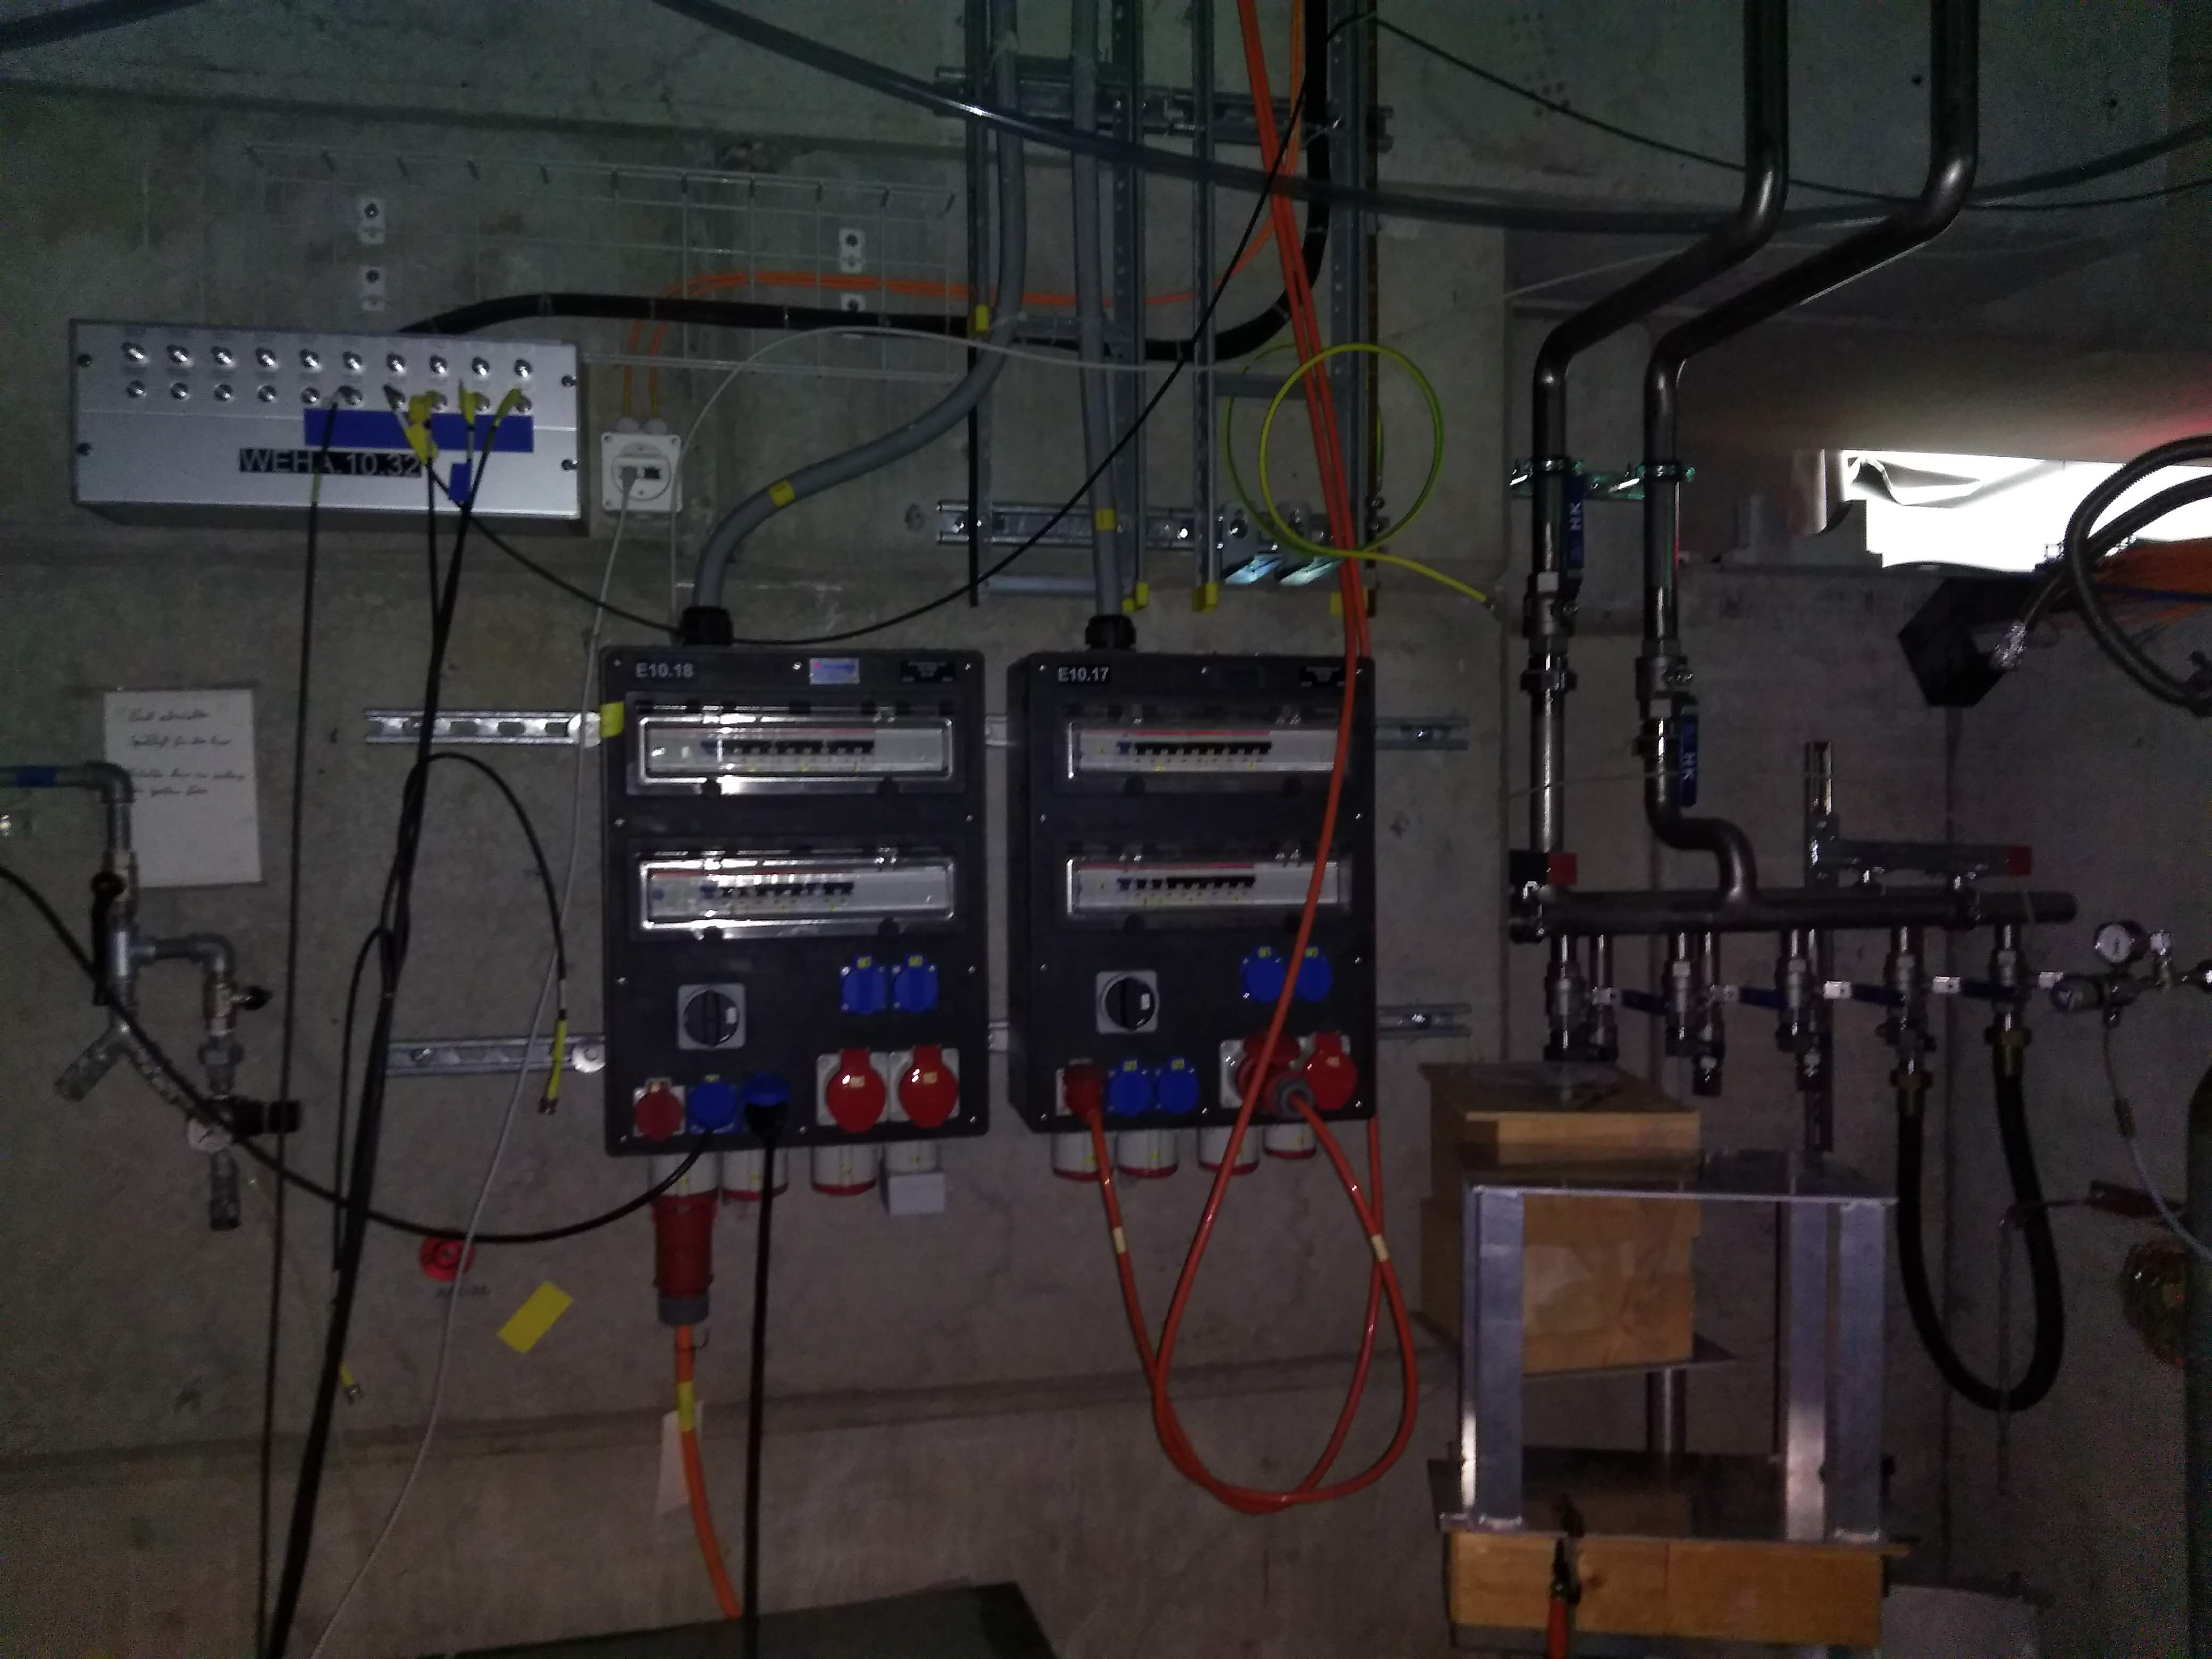

Slide 5
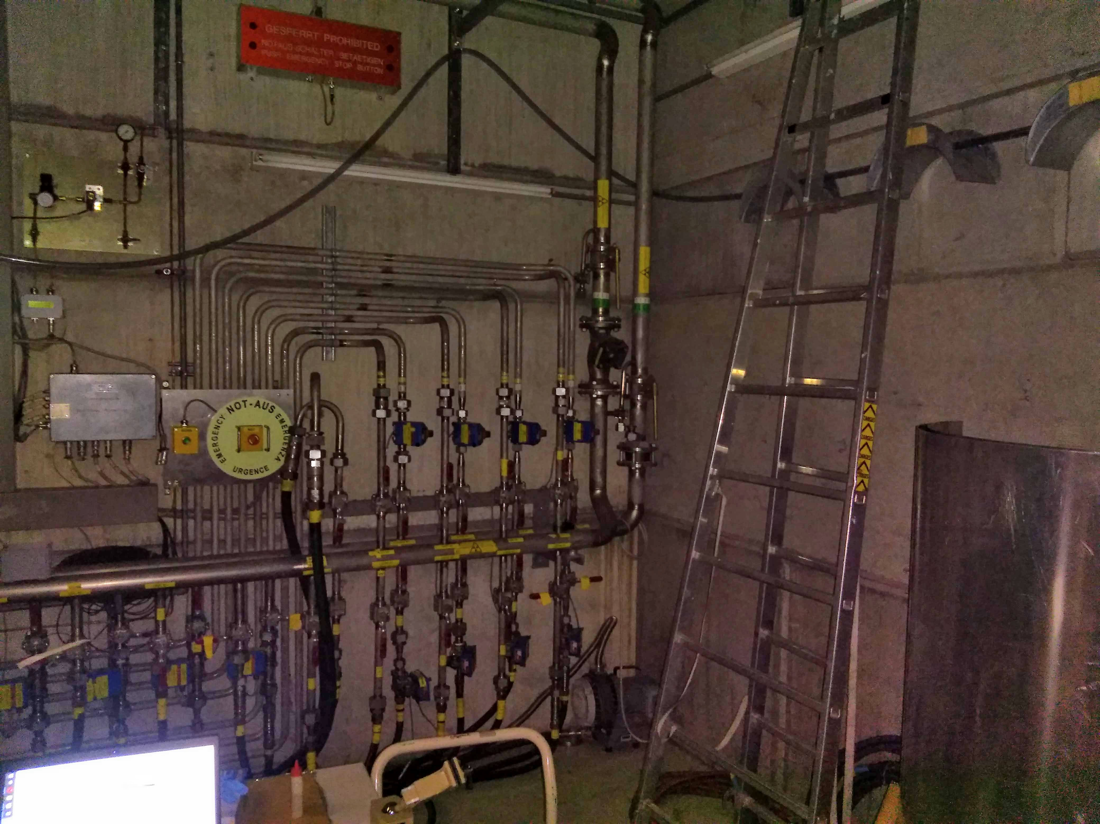

Slide 6
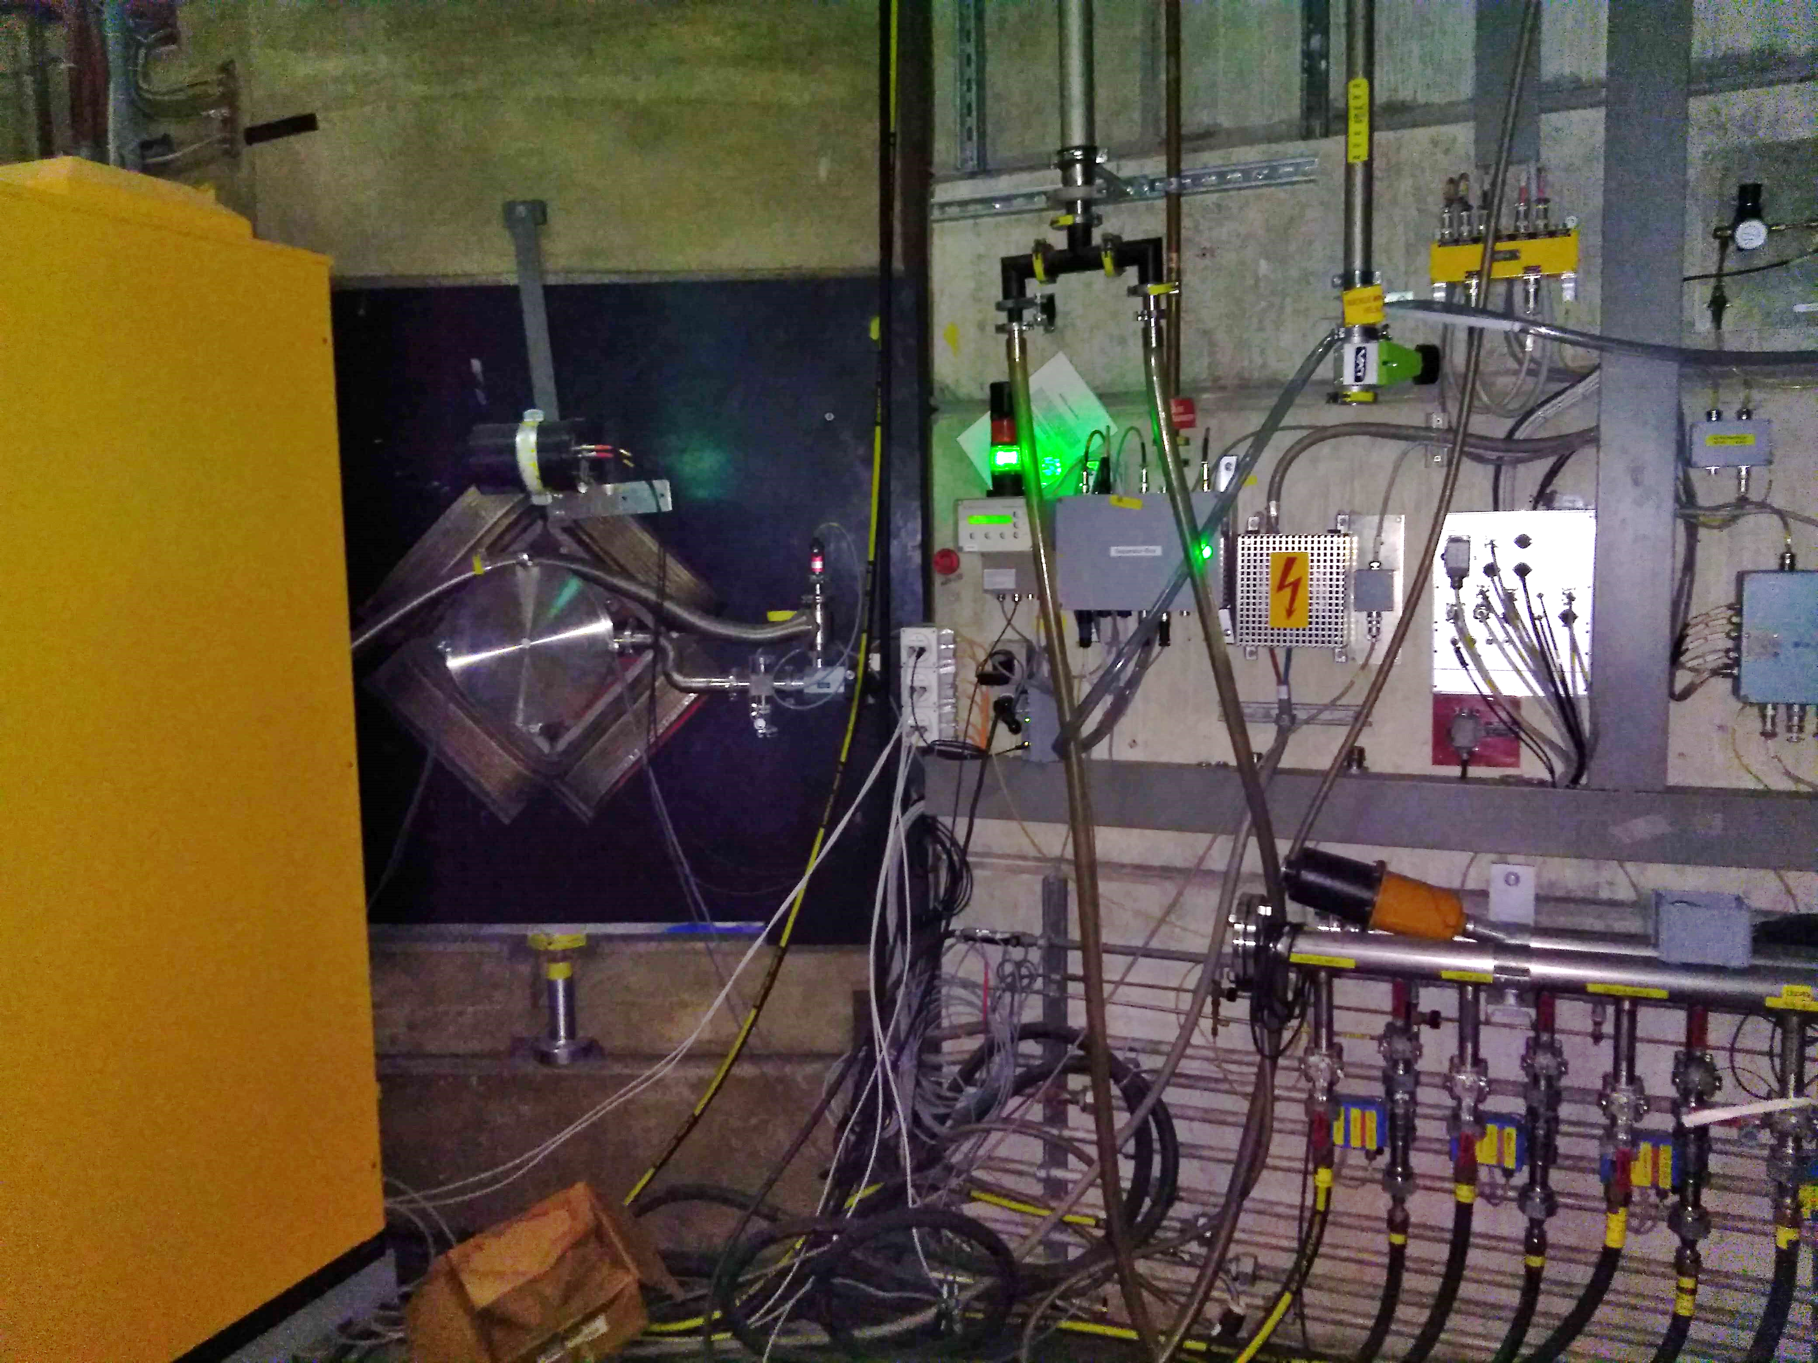

Slide 7
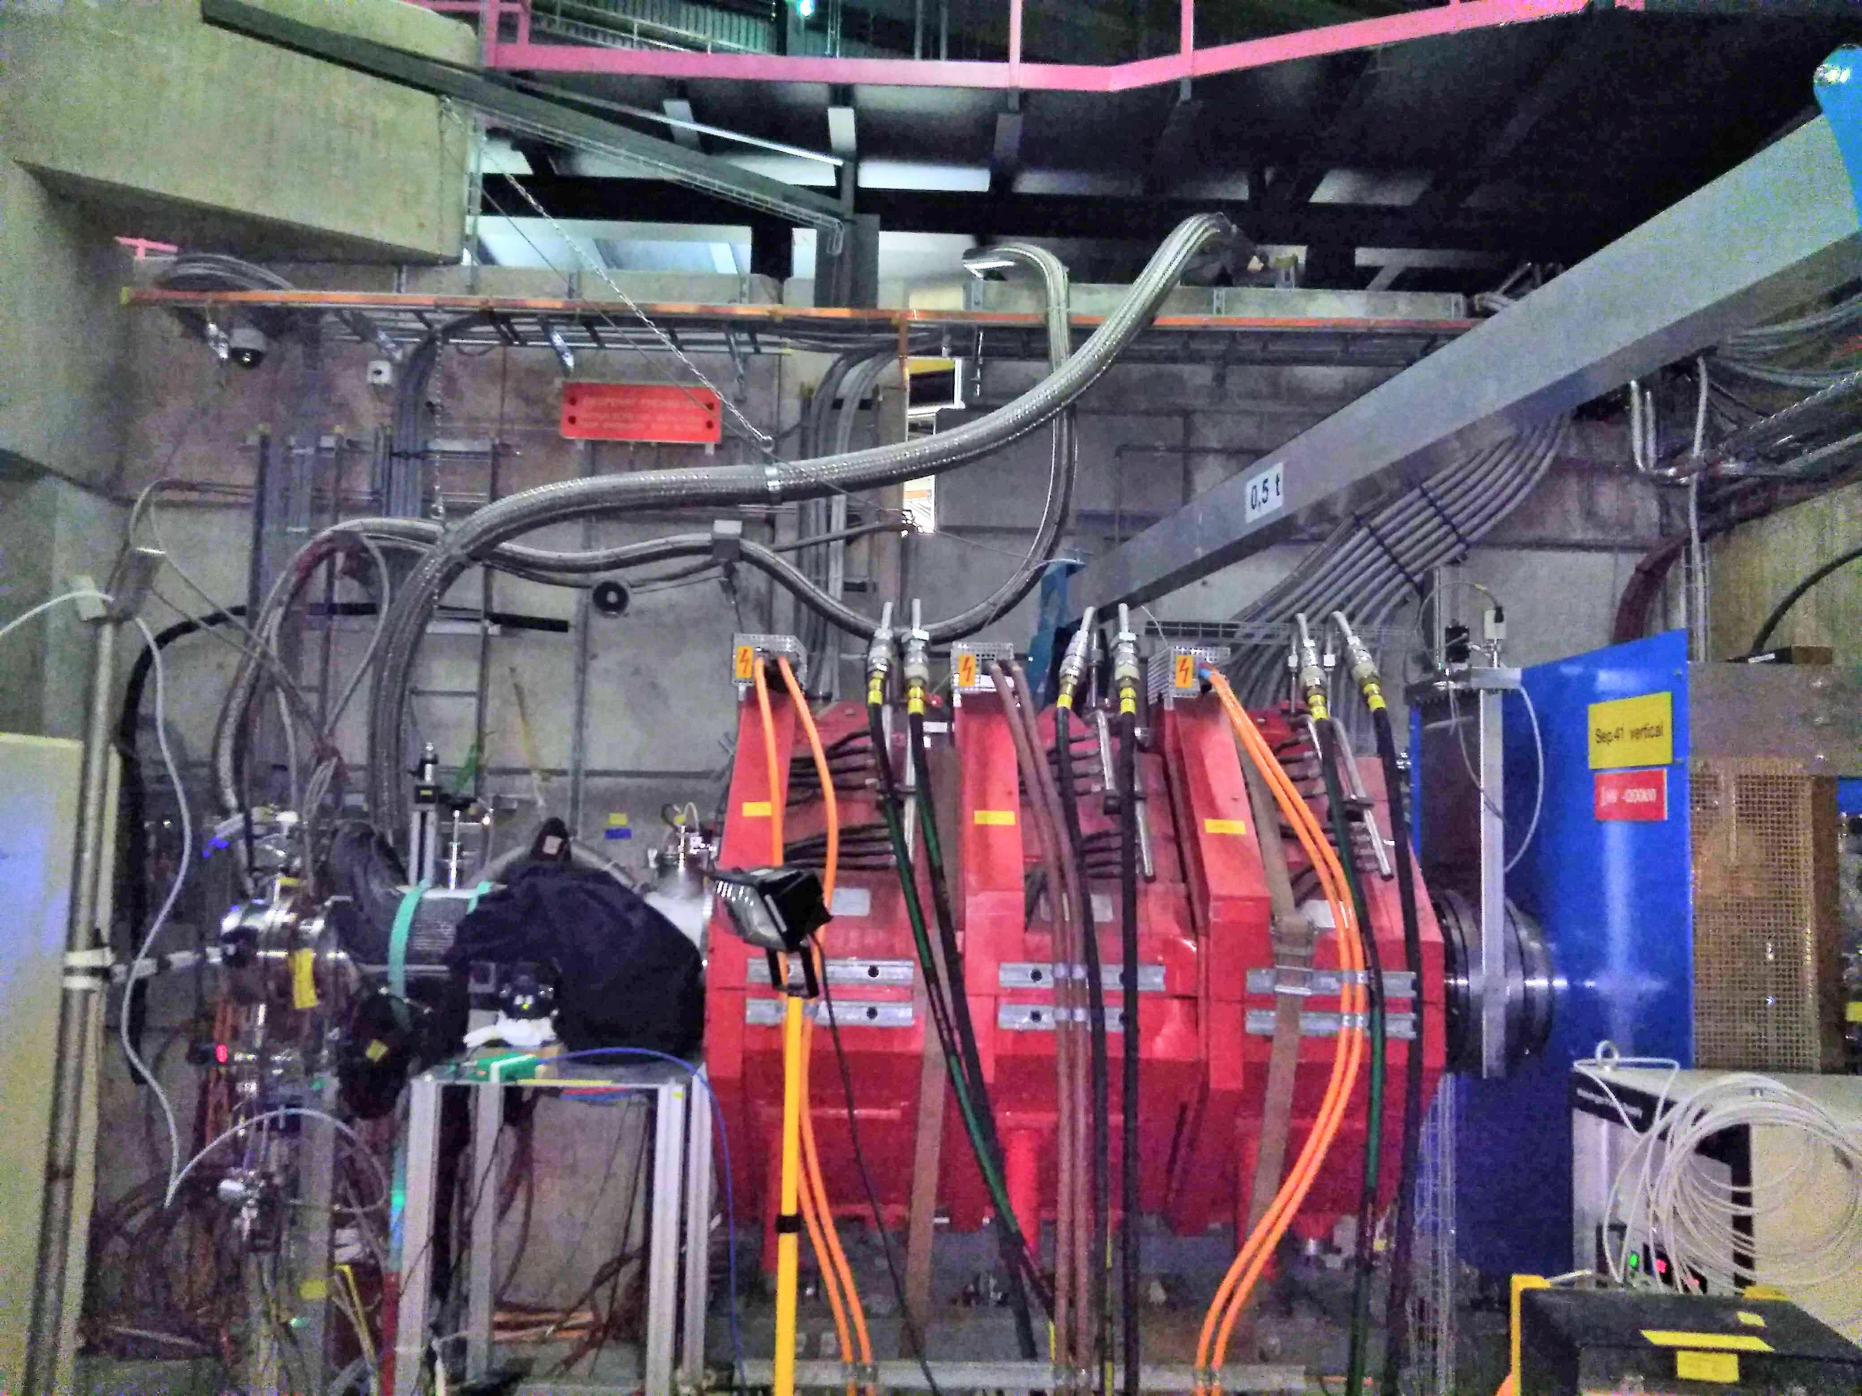

Slide 8
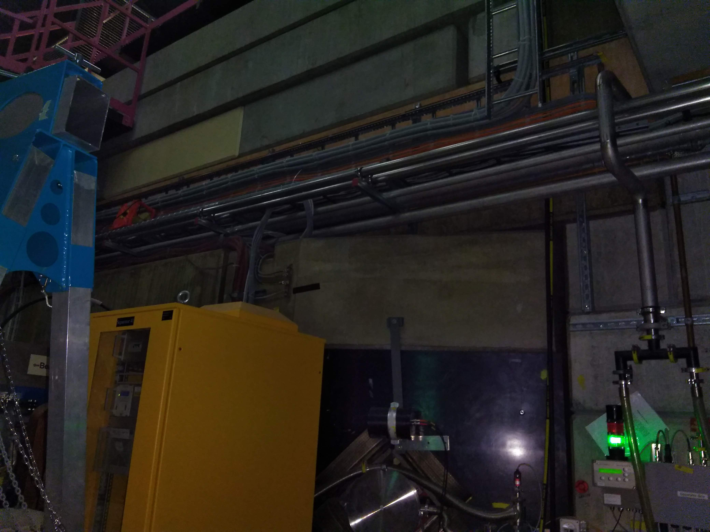

Slide 9
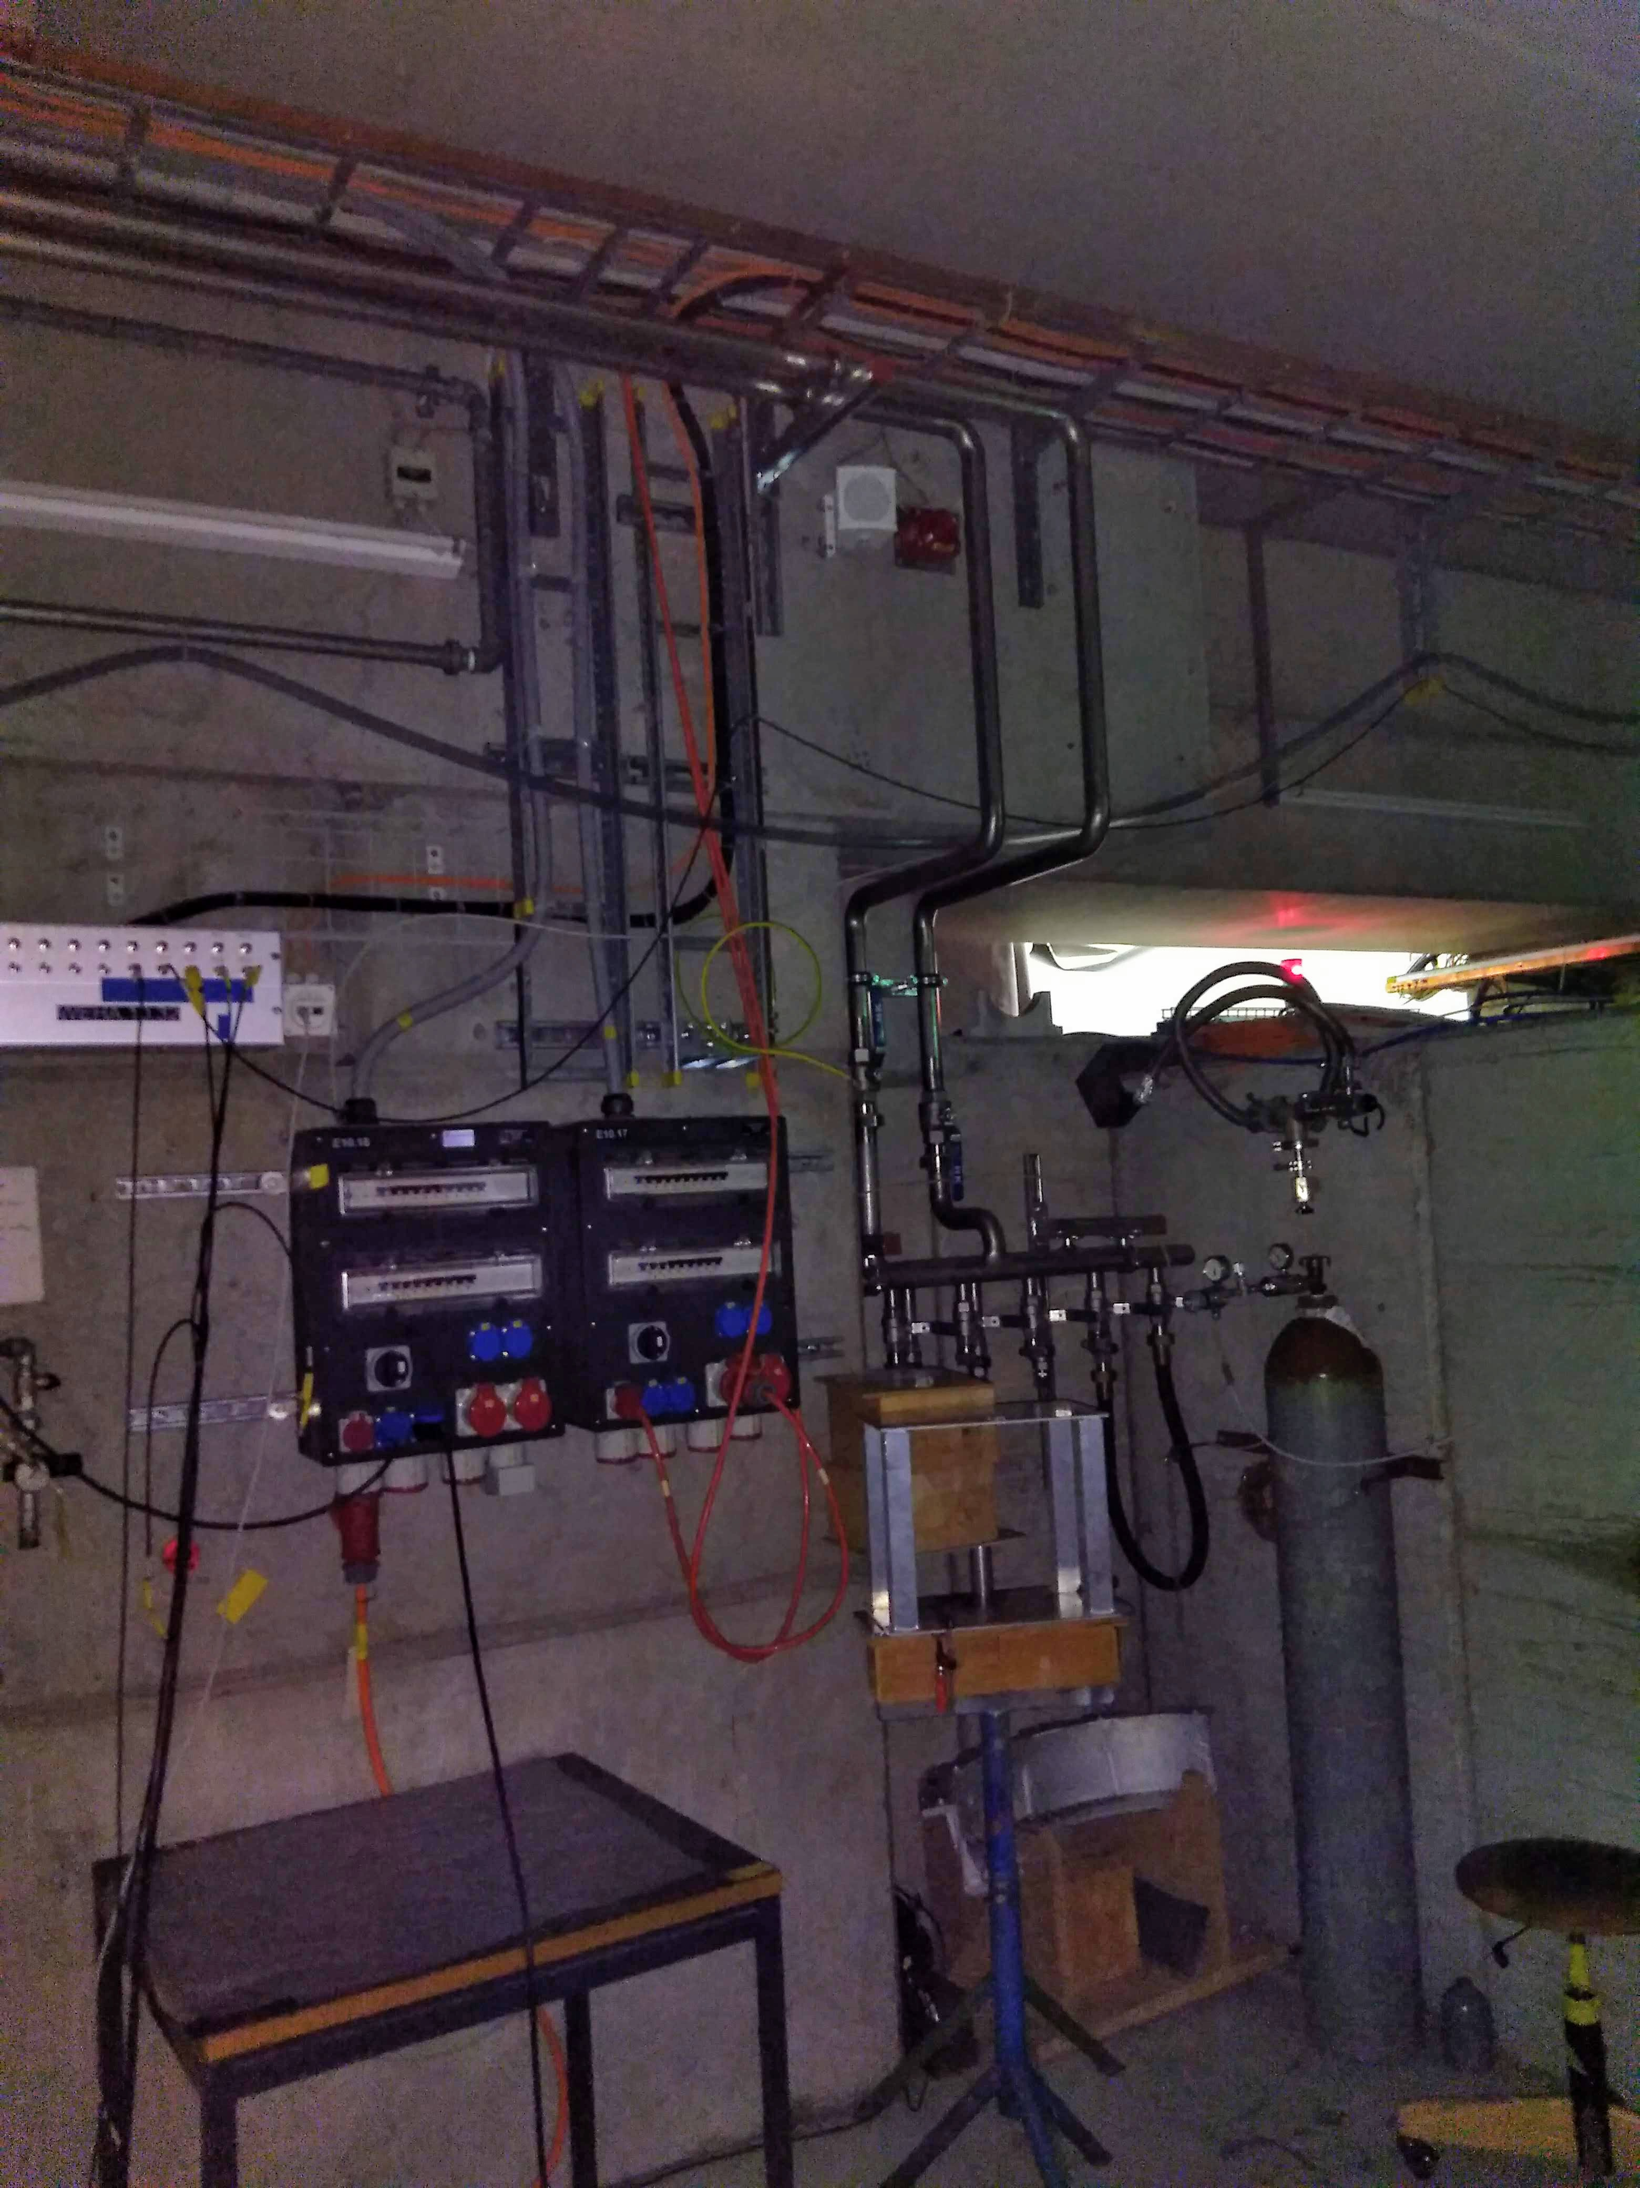

Slide 10
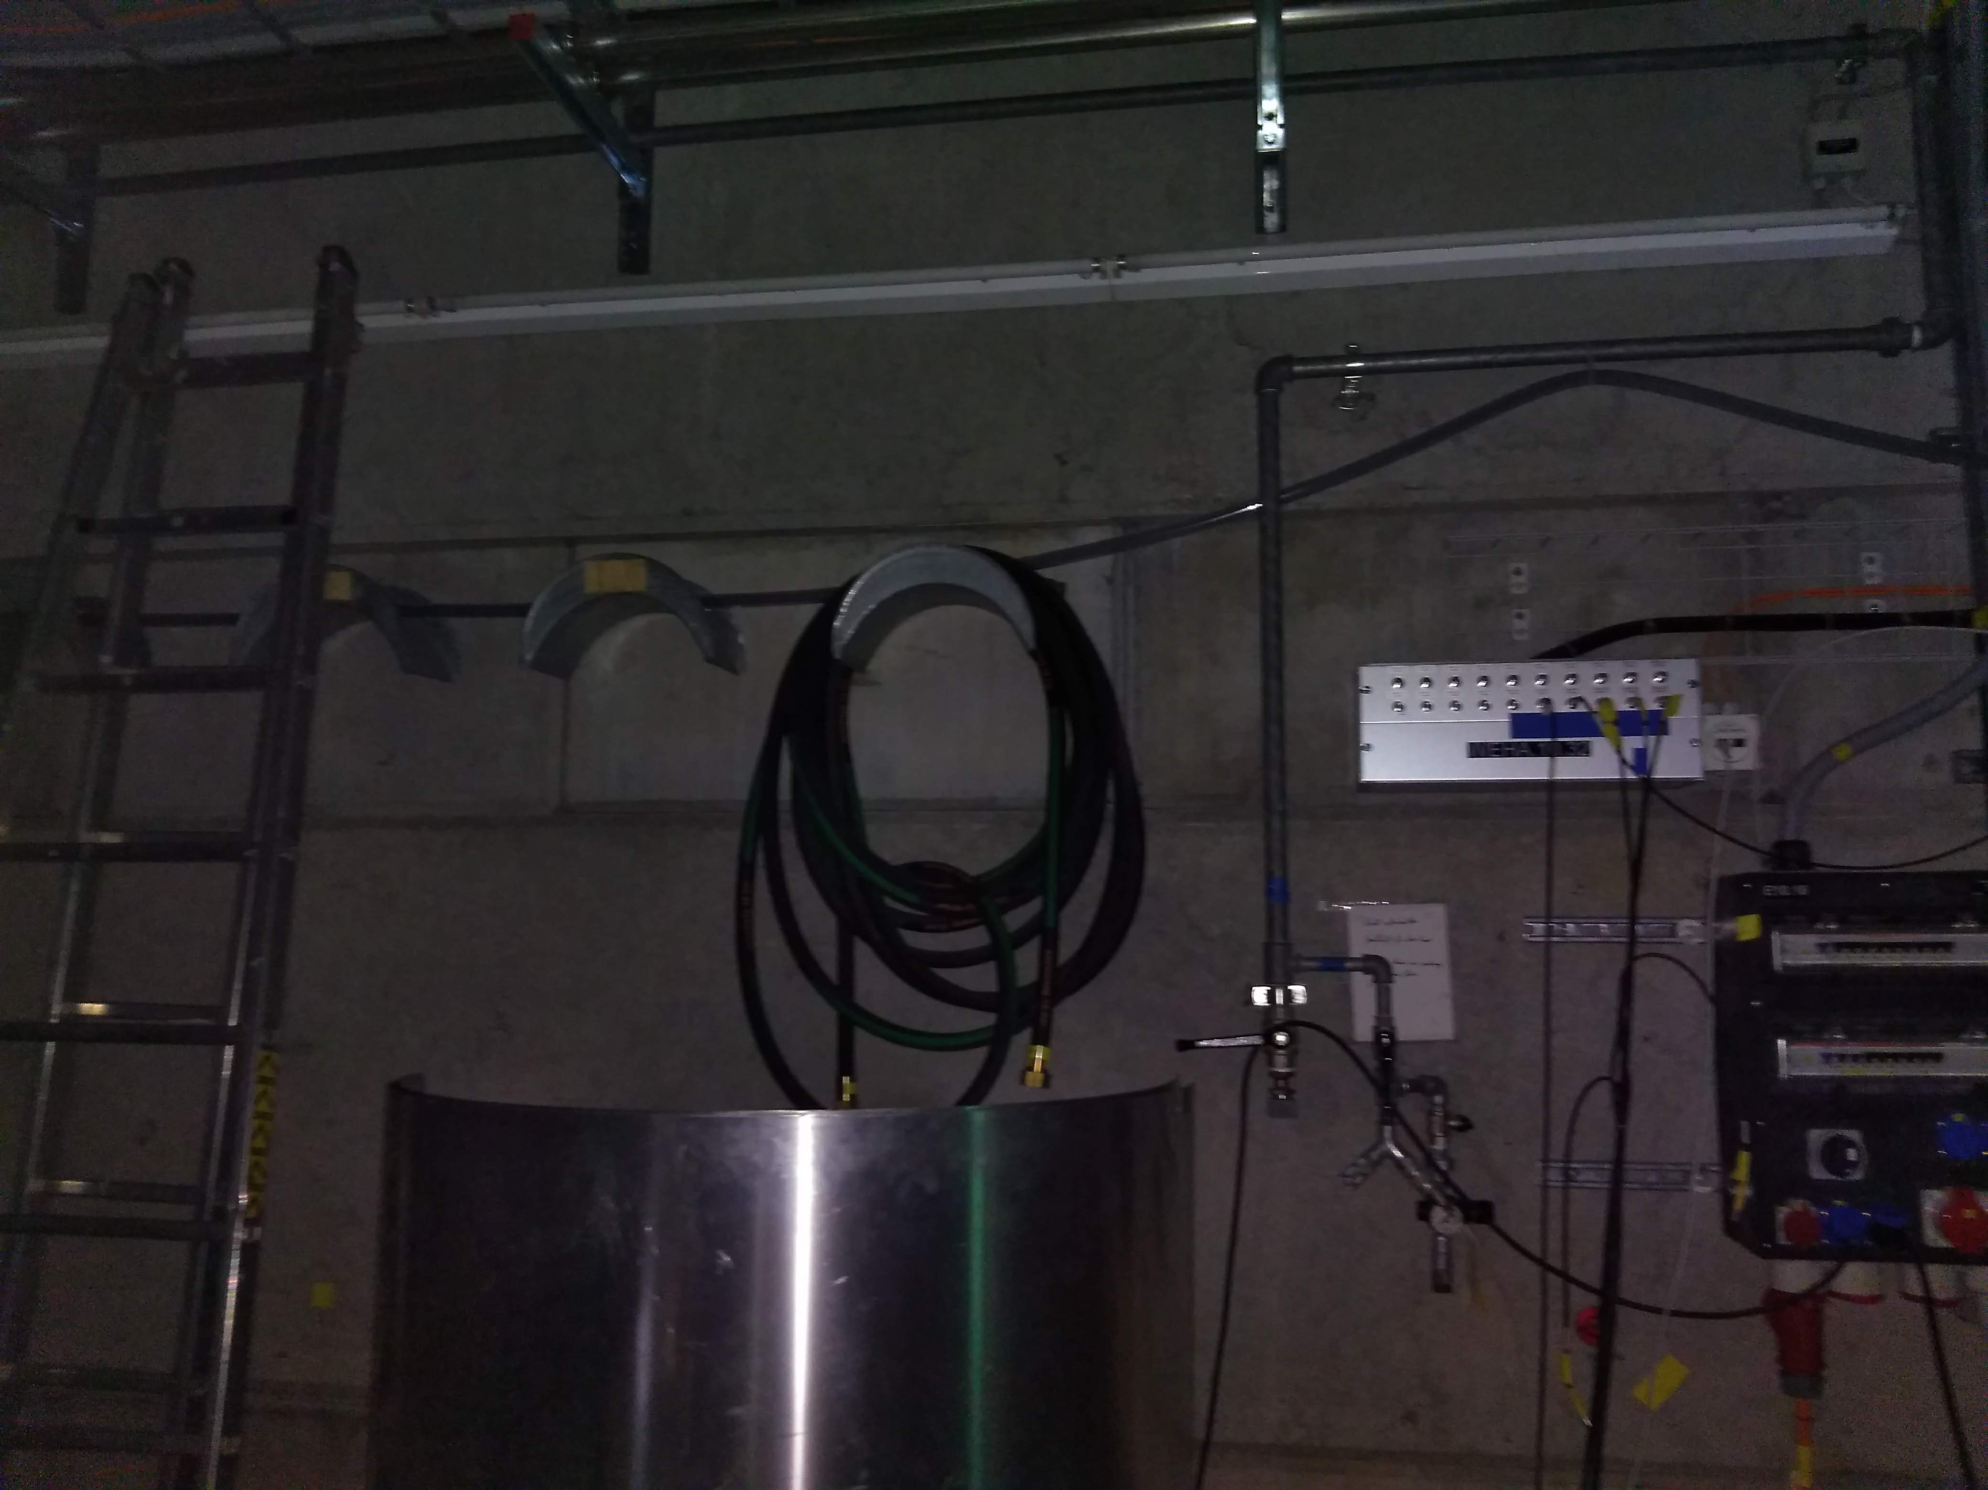

Slide 11
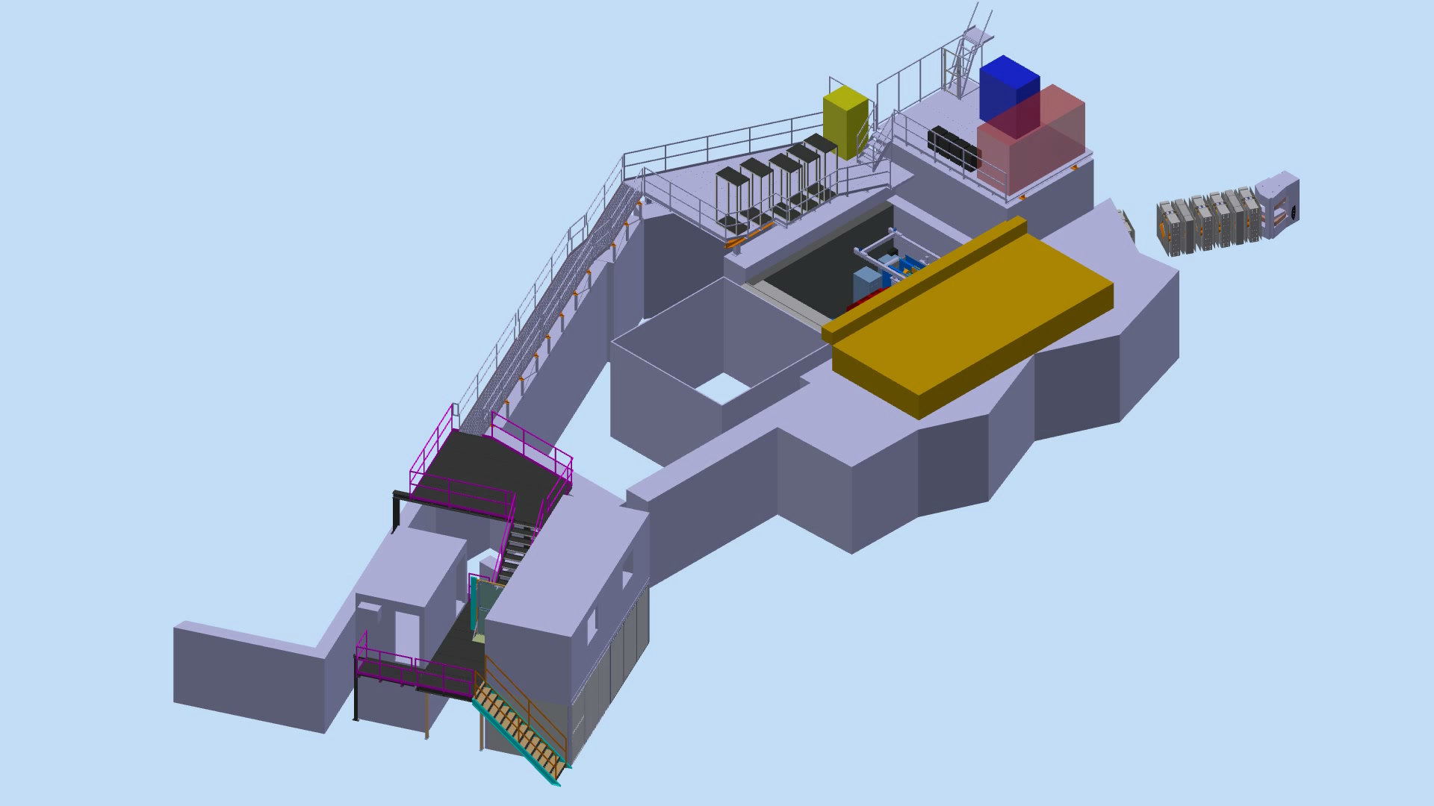
Magnet installation

Slide 12
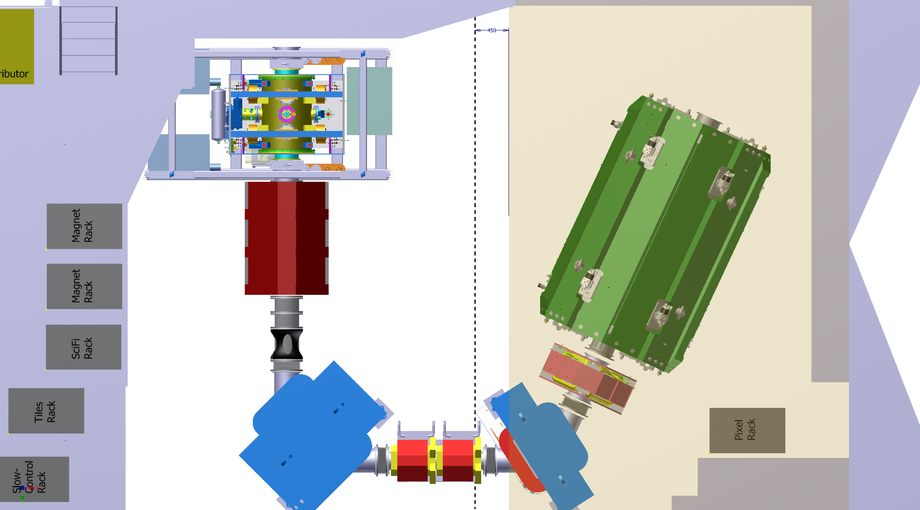

Slide 13
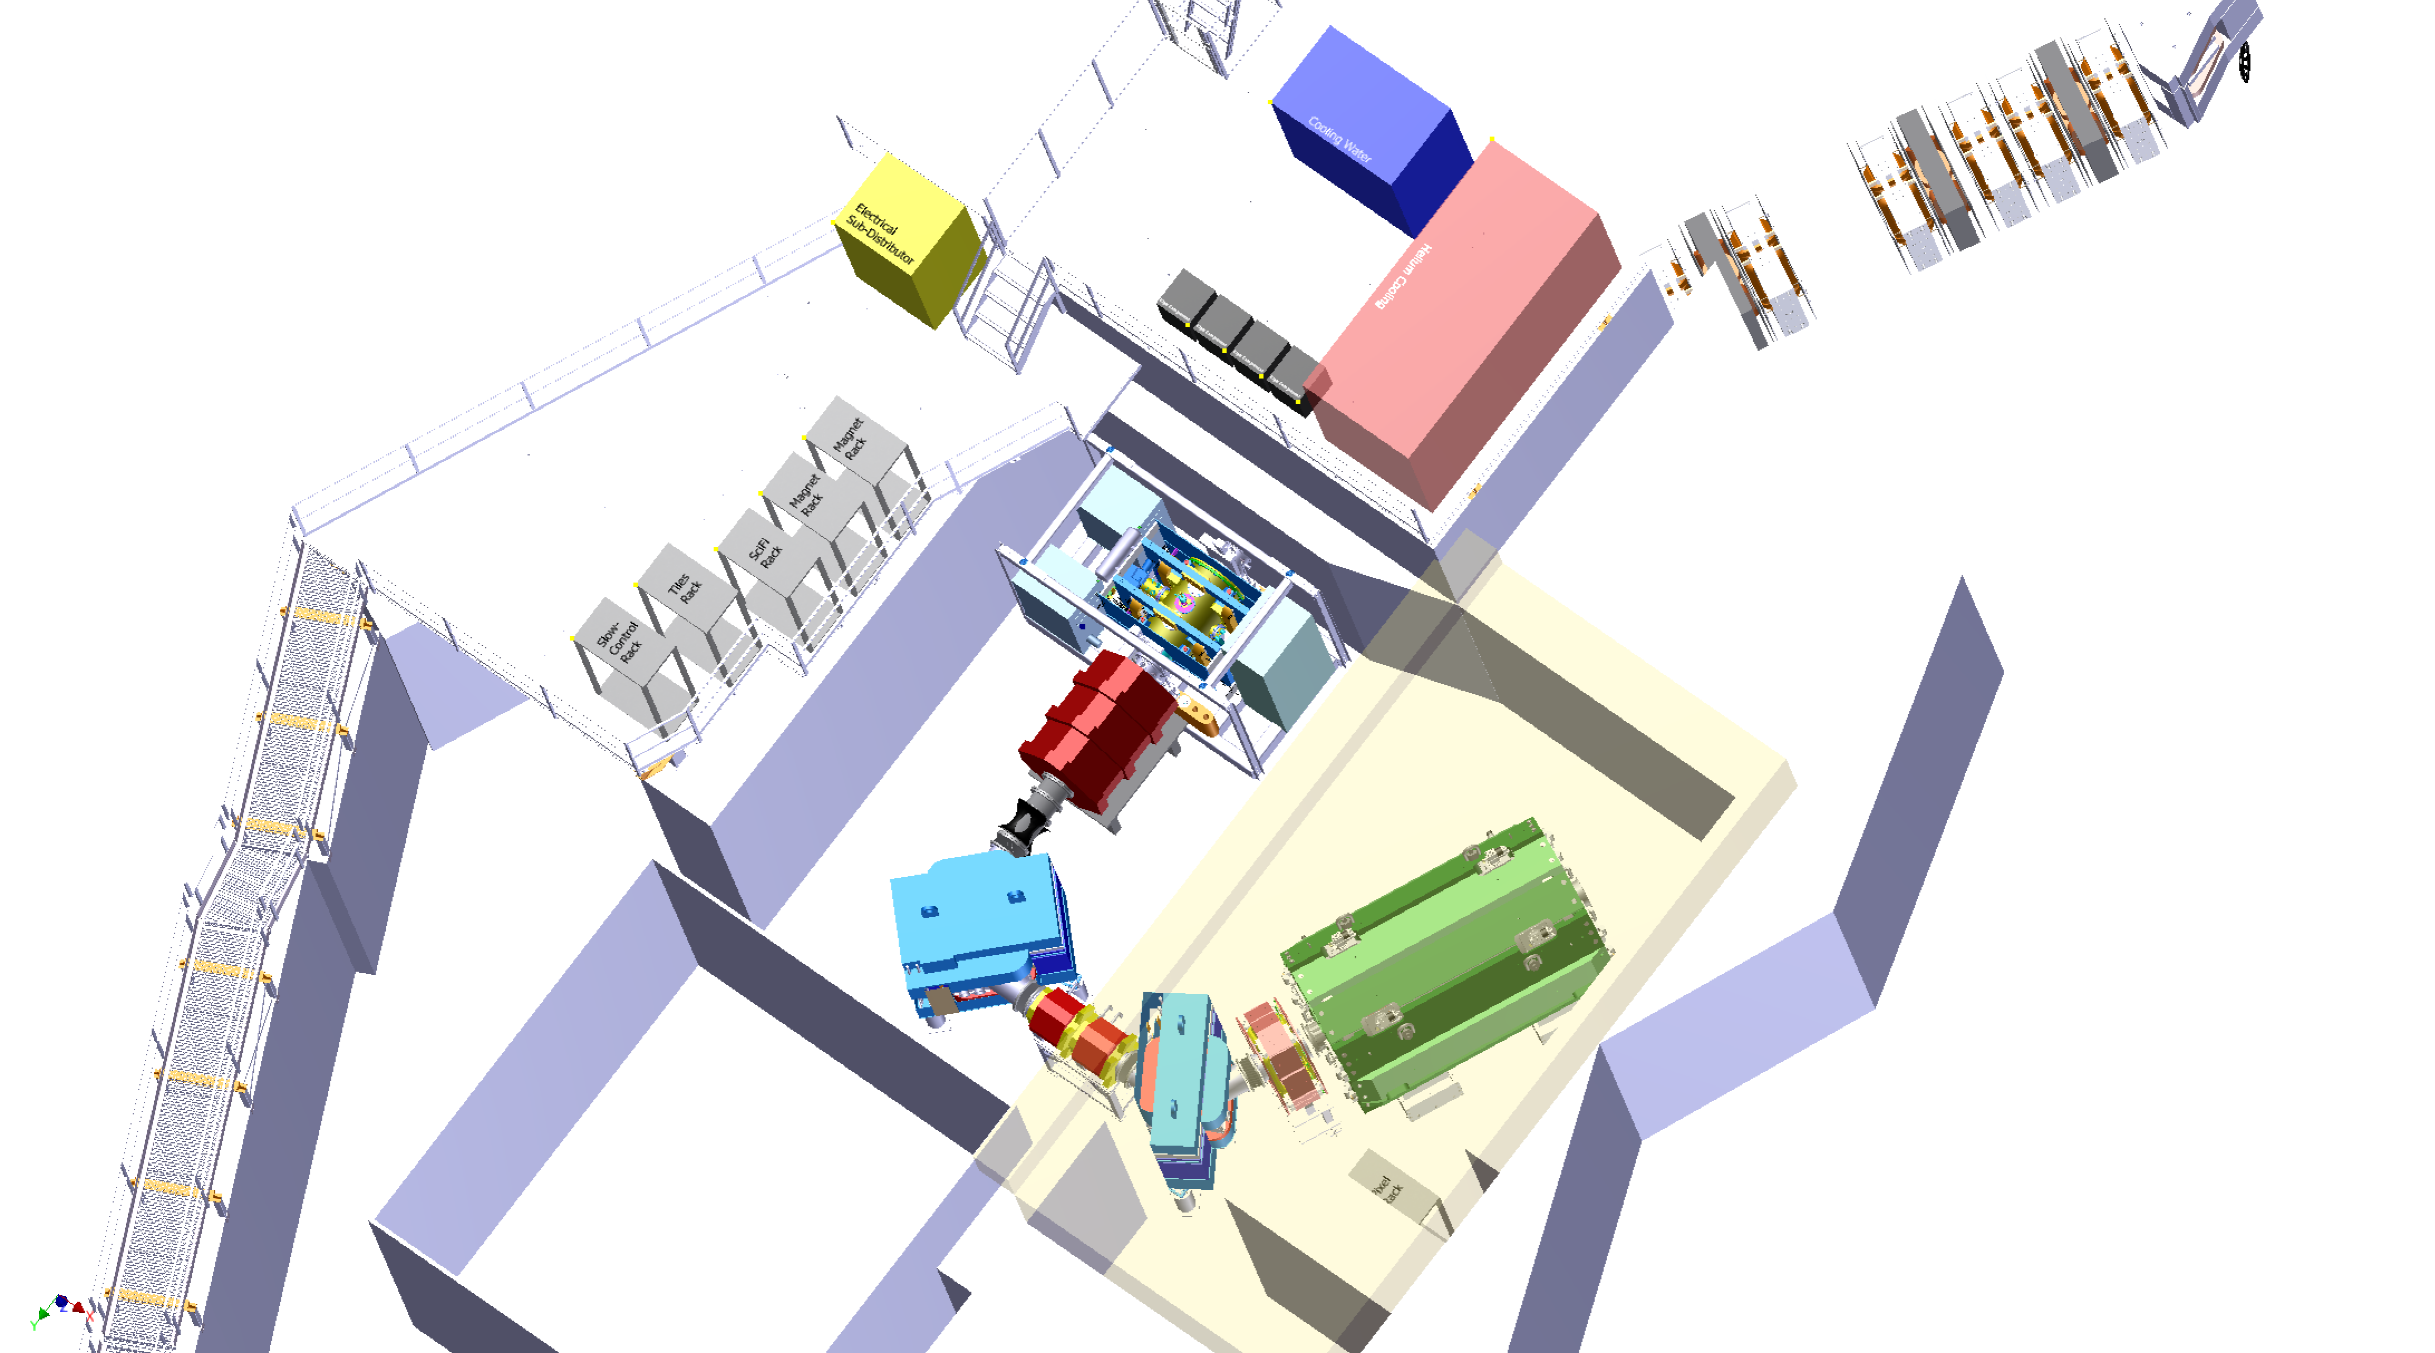
Infrastructure on platforms

Slide 14
Helium compressors (magnet)

Slide 15
Helium cooling (pixels)

Slide 16
Cooling water

Slide 17
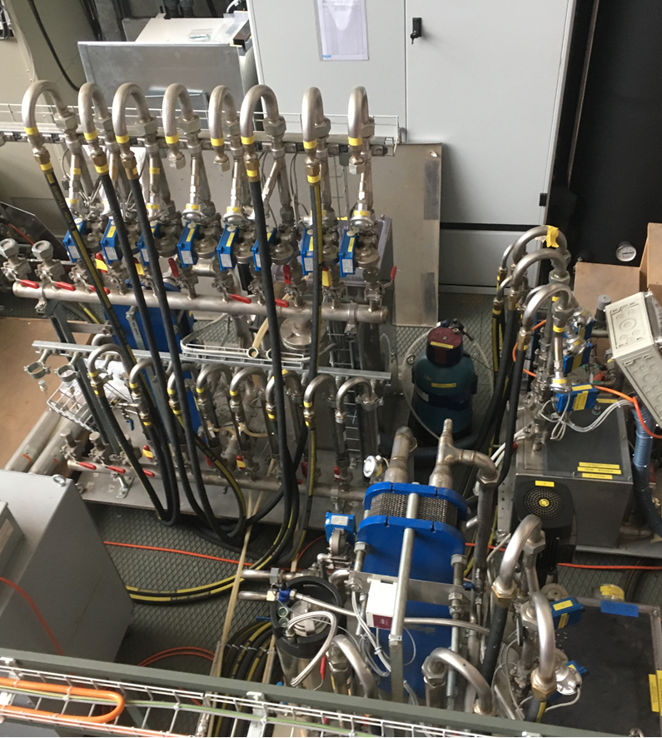
Cooling water

Slide 18
Electrical subdistributor

Slide 19
1 Pixel Rack

Slide 20
2 Magnet Racks

Slide 21
1 Slow Control Rack

Slide 22
1 SciFi Rack

Slide 23
1 Tile Rack

