Slide 1
Bayesian optimization for FEL tuning
Incorporating kernel correlations from simulation to speed tuning
Joseph Duris, Dylan Kennedy, Jane Shtalenkova, Auralee Edelen, Daniel Ratner
2nd ICFA Workshop on Machine Learning at PSI
Feb 27, 2019

Slide 2
Outline
Tuning challenges at LCLS
Why Bayesian optimization?
GP hyper-parameters from archive data
GP hyper-parameters from simple beam physics
Incorporating prior info

Slide 3
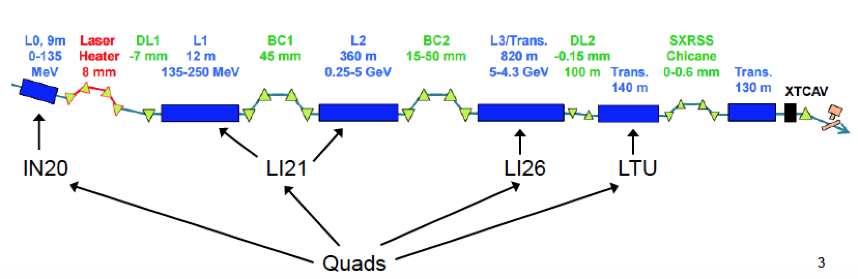
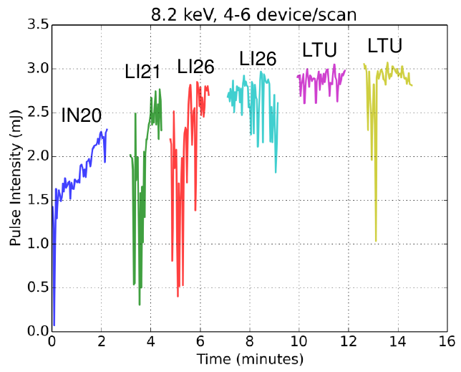
FEL beamline tuning
  LCLS tuning takes ~400 hours of beam time per year
    Change beamline configurations 2-5 times per day
    Online optimization of >30 dimensional space
    Maximize FEL
    pulse energy
    Typical setup
    time ~30 mins
LCLS2 => simultaneous operation of two beamlines (eventually 10 undulator lines)
Action | Time (mins) | Controller | Search space
Config change | 10 | Operators | small
Tune to find FEL | 5-10 | Operators | large
Tune quads | 15 | Simplex | 24
Undulator tuning | 5-10 | Operators | 30
Pointing / focusing | 5 | Operators | small
Most time spent here

Slide 4
Comparison of optimizers
Model based optimization
(machine learning)
Deterministic
Fit model to data
Goal: optimize model prediction (or function of prediction)
Bayesian
Calculate probability over functions given data
Goal: optimize acquisition function given prediction and uncertainty
Numerical optimizers
Local
Gradient descent
Nelder-Mead simplex
Extremum seeking
RCDS
Global
Simulated annealing
Genetic algorithms

Slide 5
Why Bayesian optimization?
  Human optimization
    mental models
    experience
    (relatively) slow decisions
    limited working memory
  Numerical optimization
    fast decisions
    juggle many things
    at once
    blind, local search
      limited search space
Bayesian optimization with machines
combines strengths of both approaches

Slide 6
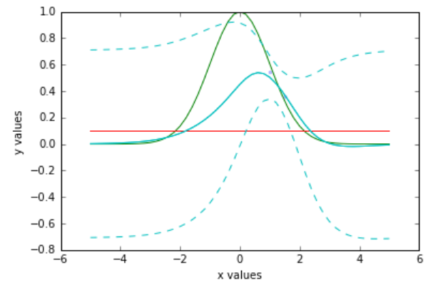
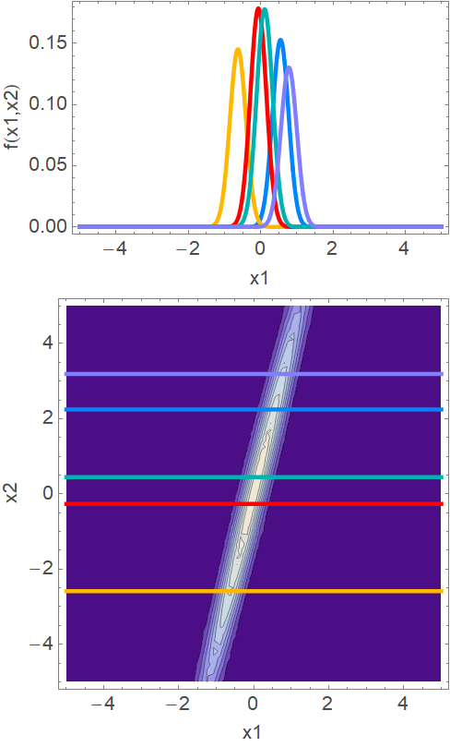
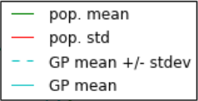
Why GP?
GP regression gives a probability distribution over functions.
Sort of like convolving a kernel function with data.
Latent variables changing day to day => optimum moves
Kernel captures shape
GP regression on 1 sampled point
hidden
Note: these aren’t the correlations we’ll talk about.
observable

Slide 7
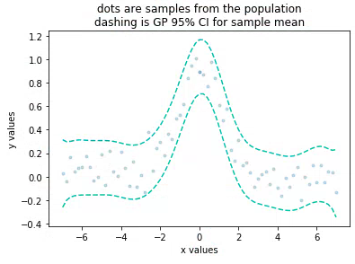
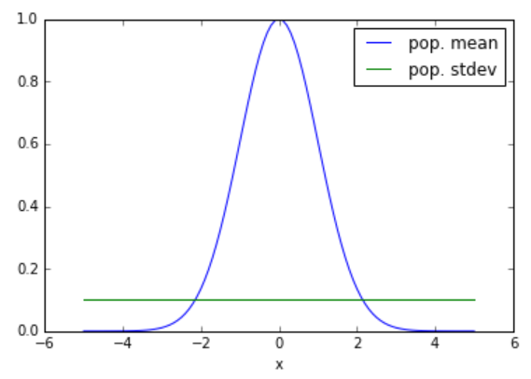
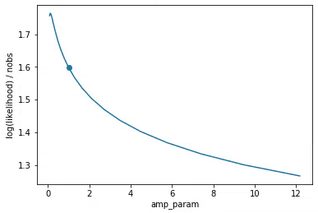
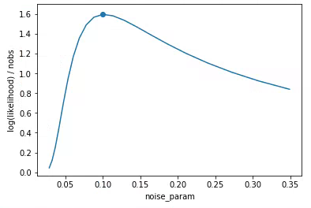
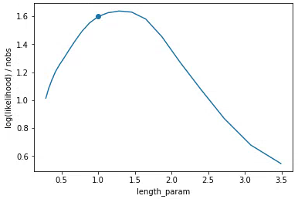

GP fuzzy logic: data is more important than parameters
Ground truth
GP regression
The underlying distribution’s moments, are good approximations to the maximum likelihood estimate hyper-parameters.
Regression is moderately insensitive to kernel parameter errors.
Amp param
Noise param
Length scale

Slide 8
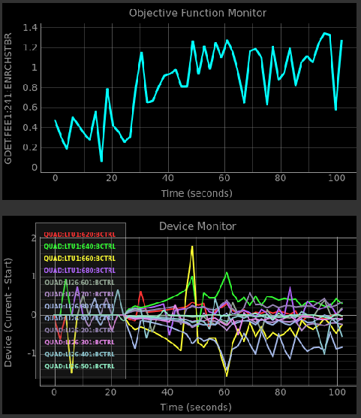
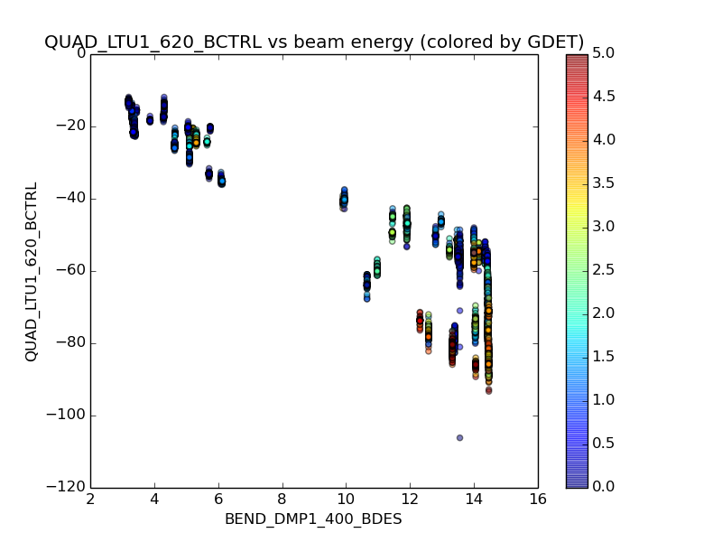
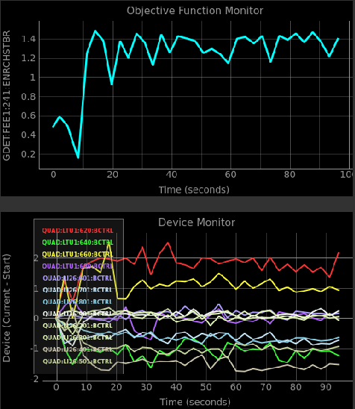
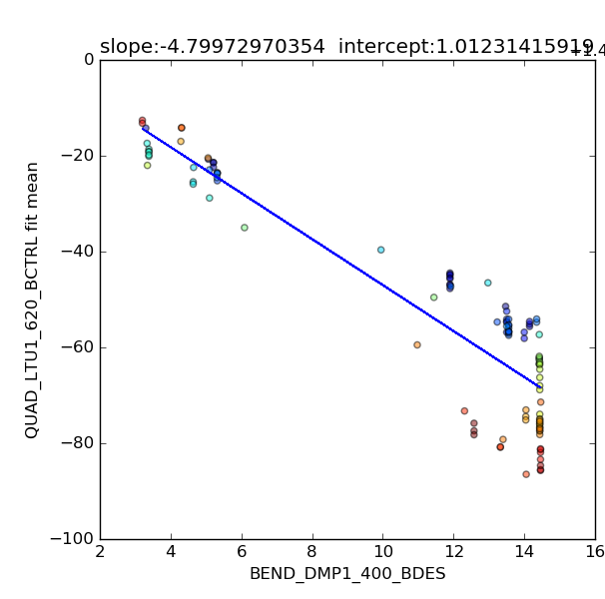
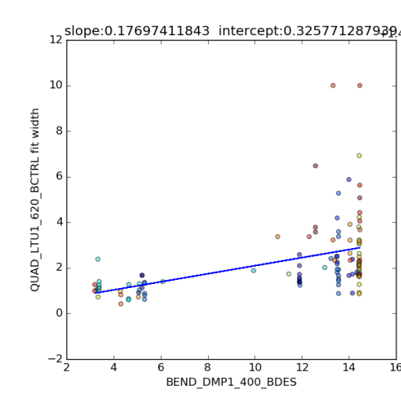
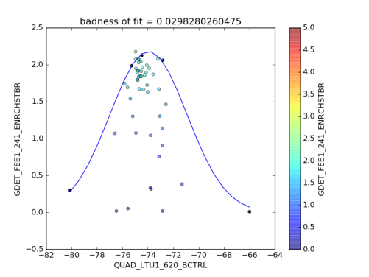
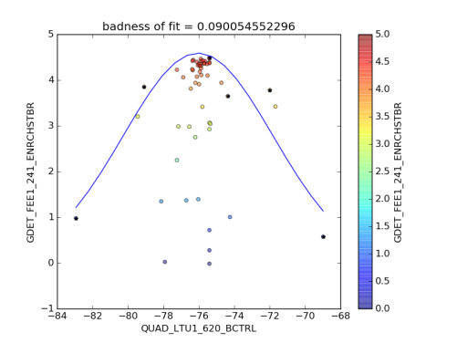
Optimize FEL vs quadrupole magnets
GP length scales from archived
scan data
1
Nelder-
Mead simplex
0.5
0
FEL pulse energy (mJ)
Bayesian optimization with GP
1
Optimizing 12 quads at once
0.5
0
0
20
40
60
80
100
Time seconds
Peaks of scans
Widths of scans
=> length scales
Lengths from fits similar to lengths from maximizing marginal likelihood

Slide 9
ML: maximizing the acquisition function
Machine takes 2-3 seconds for 1 evaluation (serial eval)
Machine learning evolving surrogate model of machine takes milliseconds to evaluate (also parallel evaluation)
In absence of detailed prior, model and acquisition function (AF) is symmetric about first sampled point. This introduces degeneracy
1D: 2 point degeneracy
nD: surface of a hyper-sphere
After several acquisitions, many local maxima
Parallel strategy: For first point, last point, and best point
Evaluate AF at an n-dim Gaussian distributed cluster of points
Choose the points with best AF and perform L-BFGS-B
Stop whenever your computation budget is exceeded

Slide 10
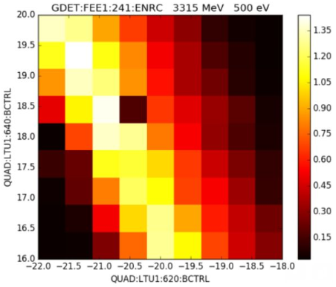
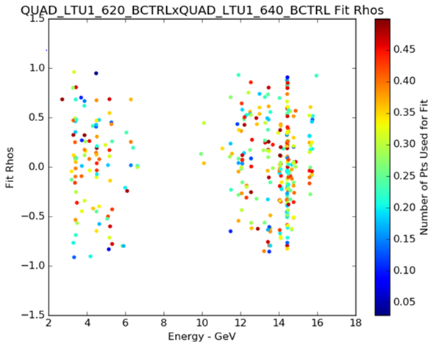
Accommodating correlations between devices
Strong focusing => strong correlations
Correlations are not apparent in the archived data despite obvious relations (adjacent quads are anti-correlated)
High dimensional search space => sparse data
Measured FEL: quads 620 and 640 are adjacent so must be anti-correlated
No trend in correlations between quads 620 and 640 in a bunch of scans

Slide 11
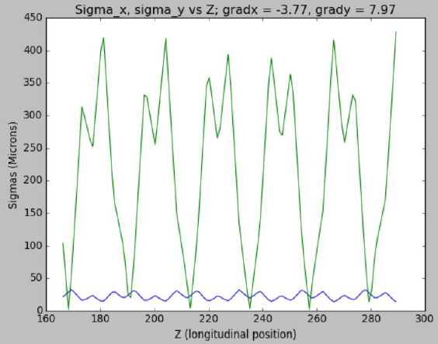
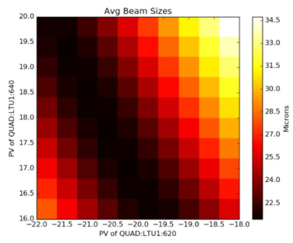
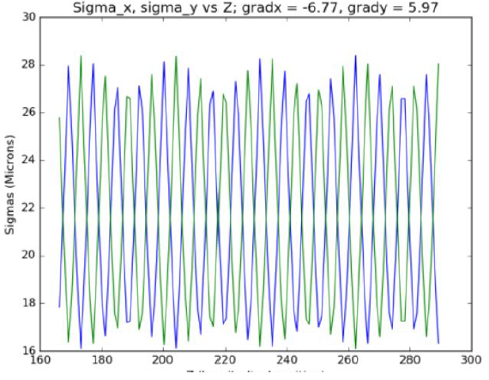
Hyper parameters from simple physical model
Assuming estimate of Twiss functions somewhere along the beamline, we can use a linear transport model to estimate the beam sizes along the undulators as we change quads.
Modeled beam size vs quads
Work by UCSC PhD student
D. Kennedy

Slide 12
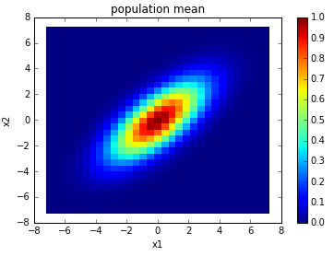
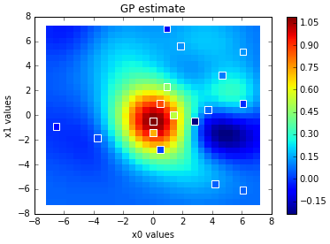
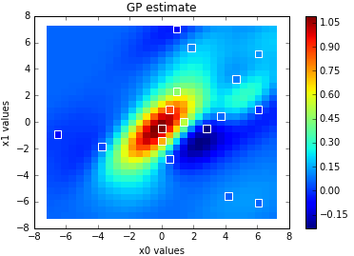
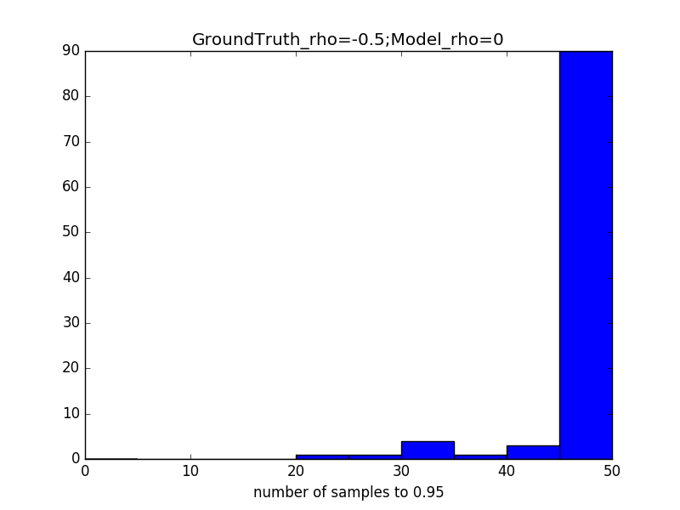
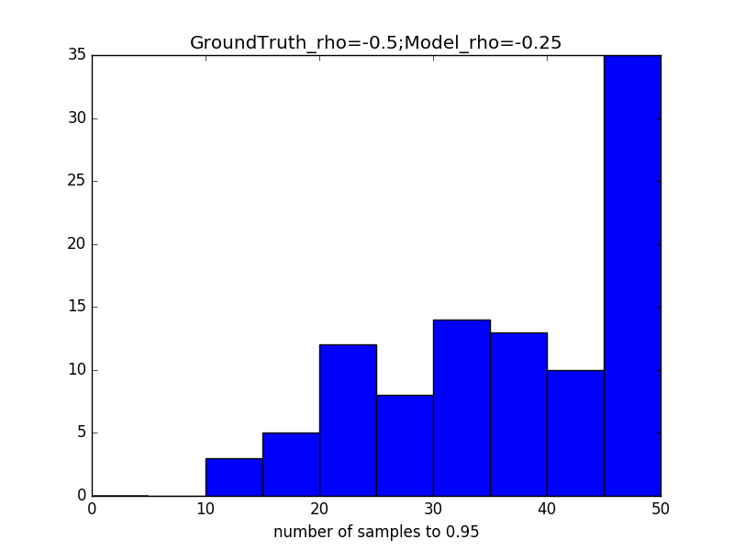
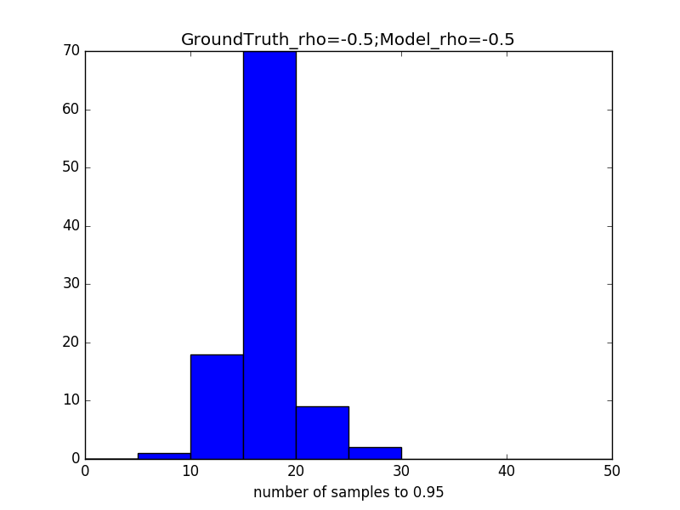
Kernel with correlations
Synthetic ground truth
widths=2; rho=0.7
GP regression on same samples with transformed kernel params
ρ = 0
ρ = 0.7
Monte Carlo tests predict faster convergence when starting in the noise
ρ_{truth} = -0.5
ρ_{model} = 0
ρ_{truth} = -0.5
ρ_{model} = -0.25
ρ_{truth} = -0.5
ρ_{model} = -0.5

Slide 13

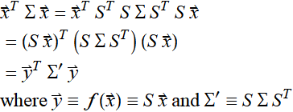
Kernel with correlations
n devices
FEL vs quads with RBF kernel
Diagonal kernel matrix => ignores correlations between quads
One approach: vary kernel matrix elements to maximize marginal likelihood for a set of prior scans (good for data)
Another approach: map x to linearly independent basis y with diagonal kernel matrix (sims/theory)
n x n kernel
precision matrix

Slide 14
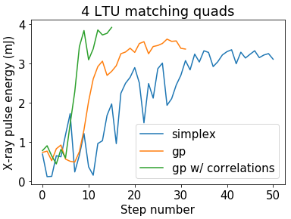
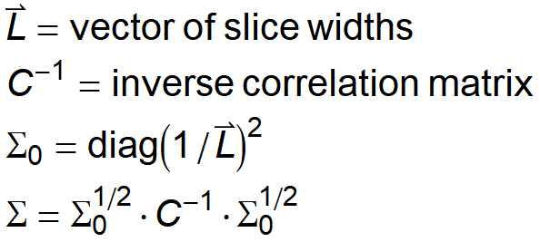
GP with correlations
Tuning with correlations improves speed and effectiveness
Correlations factored into kernel in a way which preserves slice length widths
Inverse correlation matrix estimated from Hessian of beam size model assuming match into undulators.

Slide 15
Online GP model from simulations
William Colocho, Chris Mayes, and others at SLAC working to make a more representative model of the machine with BMAD. Pulls information from machine or archive.
Hessian of simulation also gives length scales (kernel params)
In fact, it also gives a Taylor expansion of the machine behavior near the point we’re interested in starting the optimization (prior).
Plan is to optimize the simulation as a proxy for the machine using Hessians quickly calculated from the sim.

Slide 16
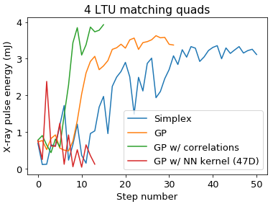
Big picture: the Bayesian dream
Combine all information with Bayes’ rule:
Information
Simulation | Propagate uncertainties with respect to inputs;
Archived data | Parameterized fits (DKLGP or Bayesian NNs) to archived data; residual error incorporated into prior
Online GP | GP helps fill in the gaps in hidden unobservables
Build prior model & expand dimensionality to model more devices.
Online model updates as machine changes.
Notes:
GP built on top of neural network Auralee trained implemented with DKL code Mitch built for us.
Effectively GP with NN kernel and built in prior data
Initially effective but gets lost
Need to better calibrate uncertainty
More data /dat/jduris/for_dylan

Slide 17
Optimization progress / outlook
Hand tuning of quads by expert operators takes 15-30 min
2-3x speedup: simplex on batches of quads via Ocelot
1.5-2x speedup: Gaussian process trained on archive data
2x speedup: add correlations from simulation to GP
Start from noise: prior statistical model from archive
Start from noise without history: GP from physical model
  Replace optimization acquisition function with entropy maximization acquisition fcn => characterize machine
  Vary high fidelity sims to maximize likelihood
  => learn physics

Slide 18
Backup

Slide 19
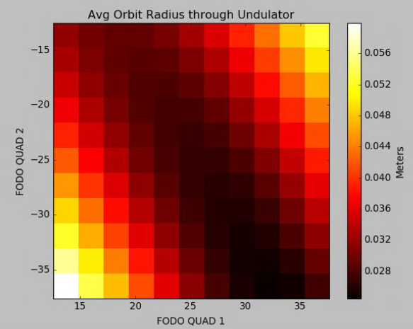
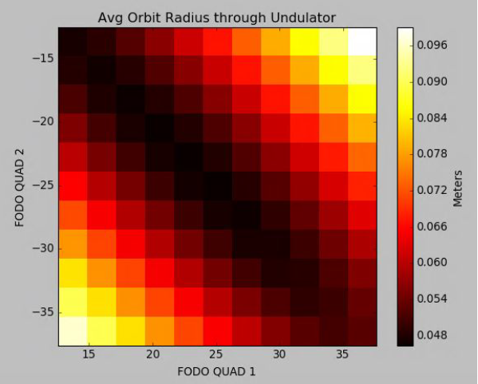
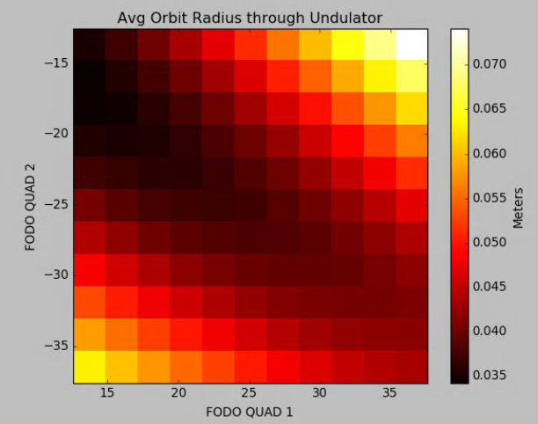
FEL also correlates with orbit deflections
Offset into single matching FODO, then orbit tracked and RMS centroid averaged over 16 undulator FODOs.
Next step: check data for this effect.
May involve dispersion…
X-offset
Y-offset
X-offset
Y-offset
D. Kennedy

Slide 20
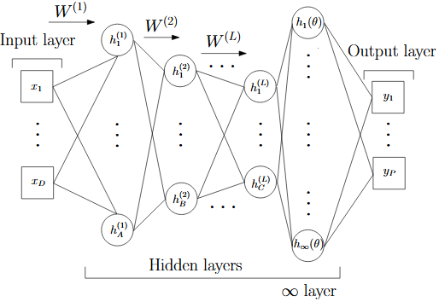
Improving GP flexibility
Arbitrary devices may not be related linearly. Example: FEL ~ f(quads / energy)
A neural network kernel is a non-linear mapping which can help capture these more complicated relations between input parameters.
Rich adaptive basis functions from DNN map on inputs structures data
GP equivalent to a single layer with infinite nodes
Deep Kernel Learning. Wilson, Hu, Salakhutdinov, Xing. arXiv:1511.02222
Stanford CS masters student Mitch McIntire (now at Google) implemented this kernel transform on top of an online GP to improve the generality of GP to arbitrary inputs.

Slide 21
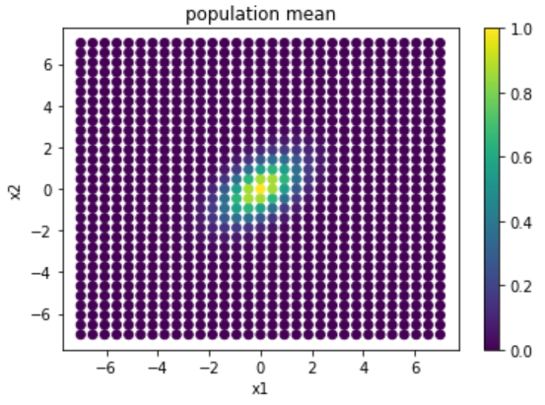
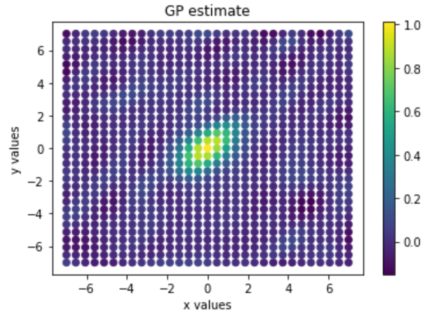
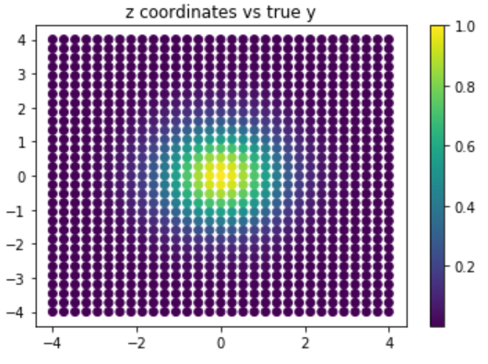
Linear transform
Linear activation functions
x2
x2
Build GP in z space
x1
x1
linear transform
transform
back
If underlying distribution is known, transform is determined;
otherwise, vary parameters to maximize likelihood
z2
z1

Slide 22
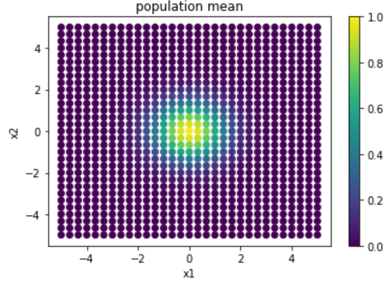
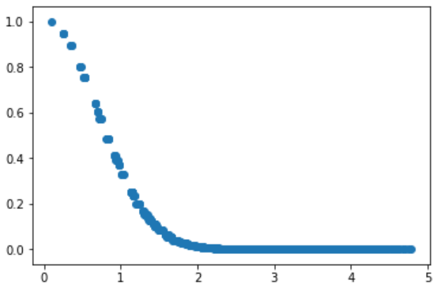
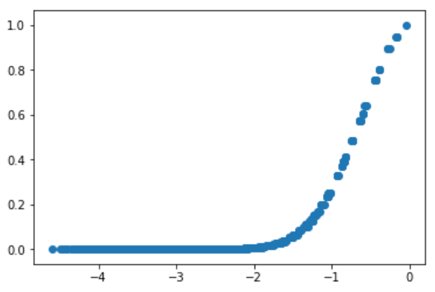
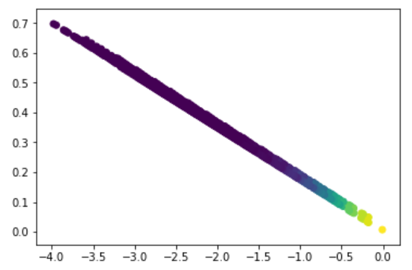
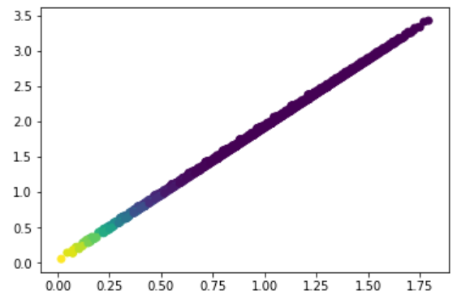
Nonlinear embedding with normal distribution
Nonlinear transform: vary network architecture to maximize GP likelihood
1D output maps (2->8->4->1)
f
f
z1
z1
Maps are not unique due to nonlinearities.
1D projection => distance from peak as it should for any optimization problem
2D output maps (2->4->2)
z2
z2
z1
z1

Slide 23
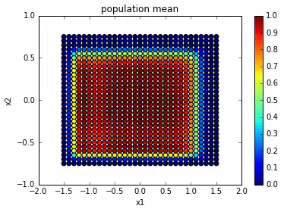
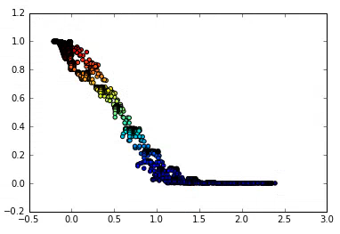
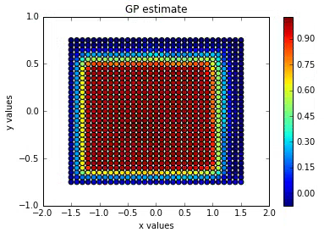
Nonlinear embedding with very nonlinear data
Nonlinear transform: vary network architecture to maximize GP likelihood
1D output map (2->12->2->2->1)
embedding
f
z1
Ground truth
DKL-GP regression

