Slide 1
Session 1: Facility Needs
2nd ICFA Mini-Workshop on Machine Learning for Charged Particle Accelerators

Slide 2
Two upcoming events where we can show progress in the sub-field
Event One – IPAC 2019 May 2019 - Invited Talk
  “Machine Learning, Data Mining and Big Data Handling for Accelerators”
  Invited talk is obviously not just about a singular person’s work or of a small collective group – it is an overview - snapshot in time of a sub-field.
  I will take the opportunity at this invited talk to try to best summarize (in 30 minutes) the excellent progress and validation of our sub-field on use of intelligent techniques.

Slide 3
Event Two - Early May 2019 D.C.
  The U.S. Department of Energy Office of Science (DOE‐SC) is currently planning for an invite only workshop entitled “Basic Research Needs for Compact Accelerators for Security and Medicine.”
  Basic Research Needs (BRN) workshops and their subsequent reports have been used by the DOE‐SC over the last 15 years to inform strategic planning.
  I have been invited to serve as a Working‐Group Co‐Leader at this meeting for the area of “Cross‐Cut Panel on Computer Simulation, Design, & Control of Accelerators”
  The mission of the sub-group is “Looks at the advances in computer hardware and software R&D needed to (1) accurately simulate performance for design purposes, and (2) provide robust highly-automated accelerator control.”

Slide 4
Layer Architecture of the ESS Control System
ESS Main Control Room
Experiment workstations
other human interfaces
System
GUIs
Equipment
GUIs
Physics
Apps
Config.
Tools
Data on
Demand
PSS
GUIs
NICOS
DMSC
High Performance
Data Network
EPICS
EPICS
IOC
EPICS
IOC
EPICS
IOC
EPICS
IOC
EPICS
IOC
Data on
Demand
EPICS
Archiver
Timing System
Event
Generator
Machine Protection
Fast Beam
Interlock System
Personnel
Safety Systems
PLC
PLC
Ether
CAT
MicroTCA
System
MicroTCA
System
PSS
PLC
Fieldbus
Remote
I/O
Controller
Device
Electronics
Device
Electronics
Controller
Remote
I/O
Remote
I/O
Device signals
Pump
Flowmeter
Motor
Sensor
Chopper
Power Supply
Switch
Sensor
Sensor
H₂O Flow
He Flow
Mech. Movement
RF
Proton
Neutron
etc.
Temp
Electricity
Notes:
Togethere we

Slide 5
Goal
Intelligent
Integrated Control System

Slide 6
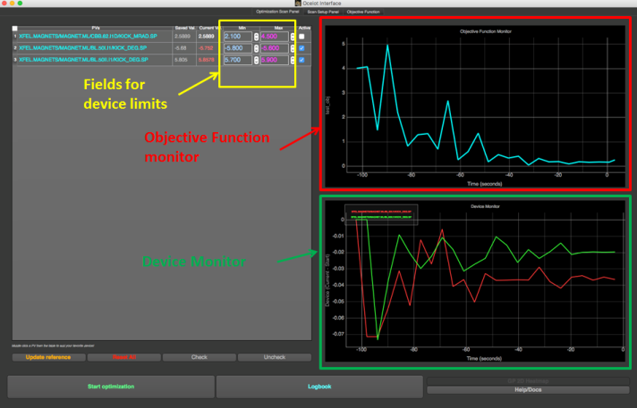
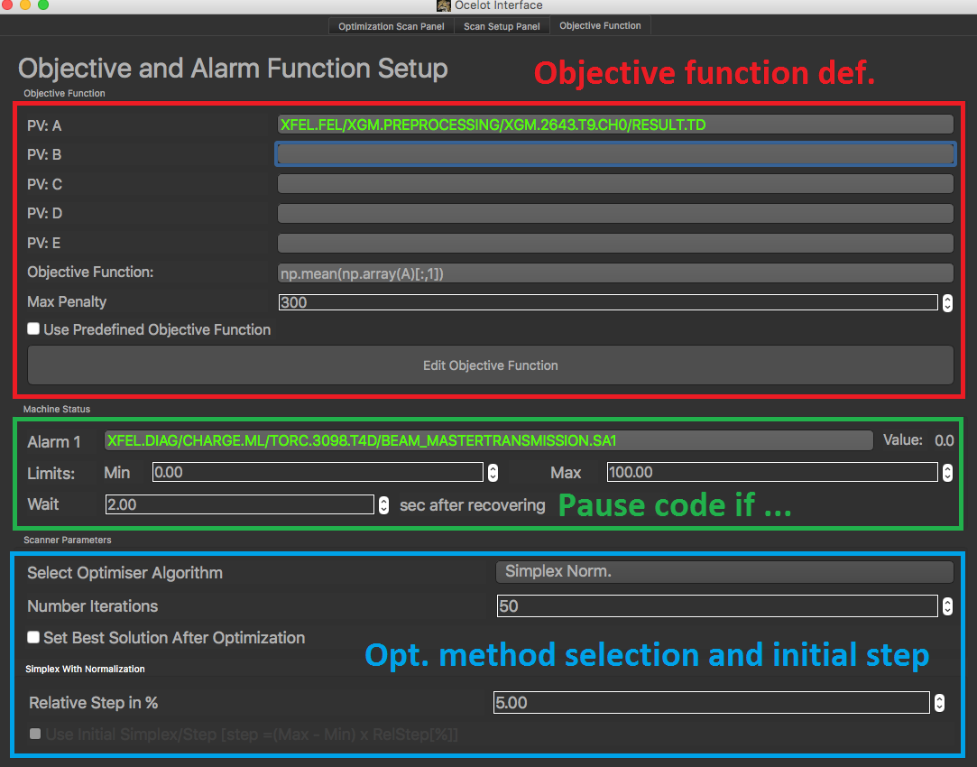
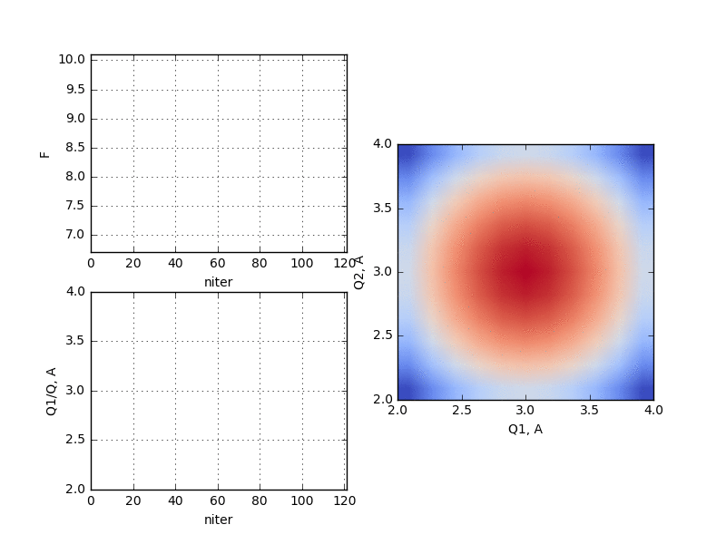
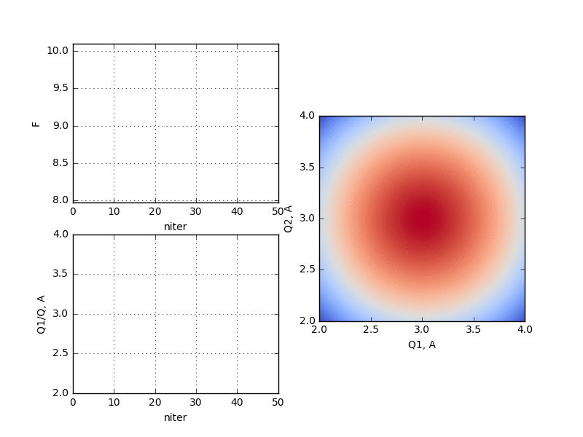
Usage of optimization techniques @ EuXFEL
The generic optimizer
2015: First demonstration at FLASH. I. Agapov et al. TUPWA037 IPAC15
2017: universal tool (generic optimizer) for European XFEL commissioning
Deployed for FLASH, European XFEL, LCLS, …
Scanning
Simplex
Sergey Tomin XFEL GmbH

Slide 7
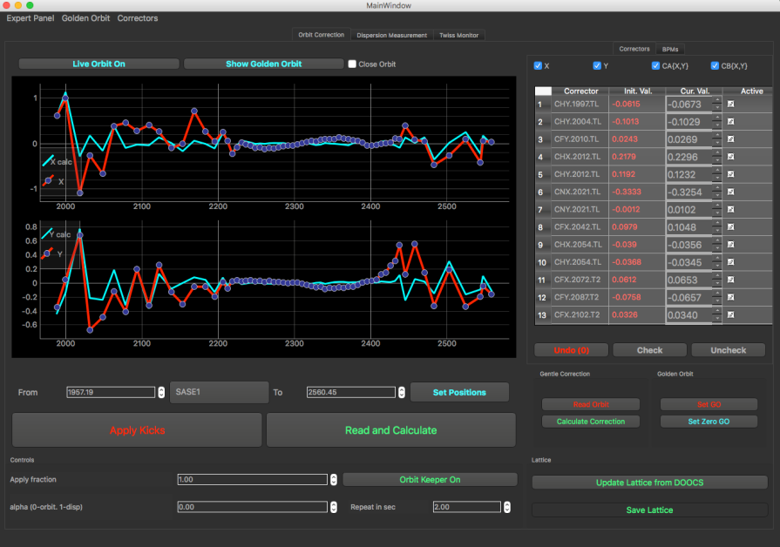
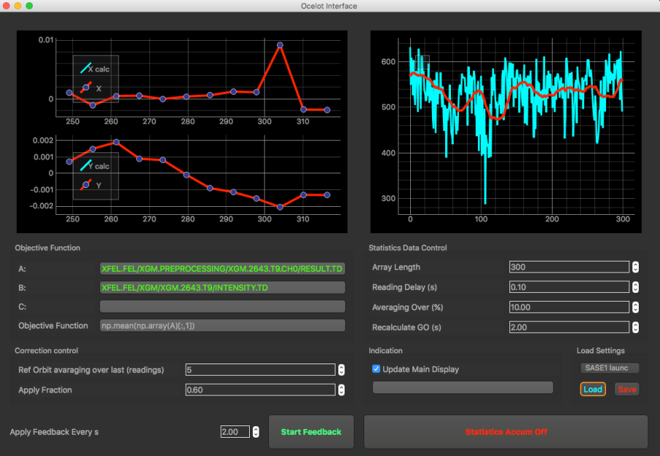
Usage of optimization techniques @ EuXFEL
Orbit correction GUI
The adaptive orbit feedback
OCELOT orbit correction is the standard tool for orbit correction (using SVD algorithm)
The adaptive feedback is a part of the orbit correction tool
Algorithm of Adaptive Feedback*
  Shot-to-shot collection of orbits (~ 300 - 700) and the corresponding SASE pulse energy.
  Sorting orbits according to SASE energy.
  Taking 10-20% of the orbit with highest SASE and calculating new golden orbit for the feedback.
Should one try this on other parameters – RF, energy?
Adaptive feedback GUI
*Idea from: G. Gaio, M. Lonza, Automatic FEL Optimization at FERMI, Proc. of ICALEPCS2015

Slide 8
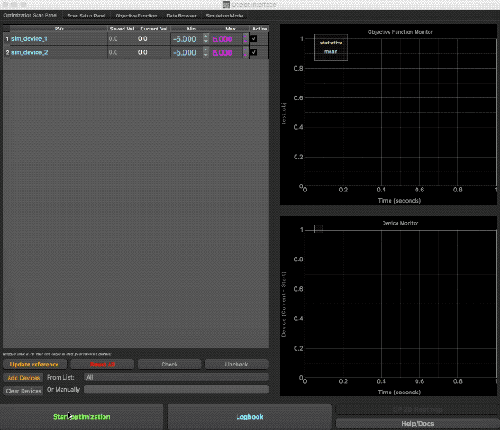
Graphical User Interface
PYTHON
Select different optimizers (Simplex, GP, ES, …)
Select any group of devices
Craft your objective function
  Simple PV
  Do math on up to 5 PVs
  Statistics: mean, stdev, quantiles
  Write python script (loaded/edited via GUI)
  Option to have simulated objective to test optimization methods
Data browser
Save predefined settings & routines

Slide 9
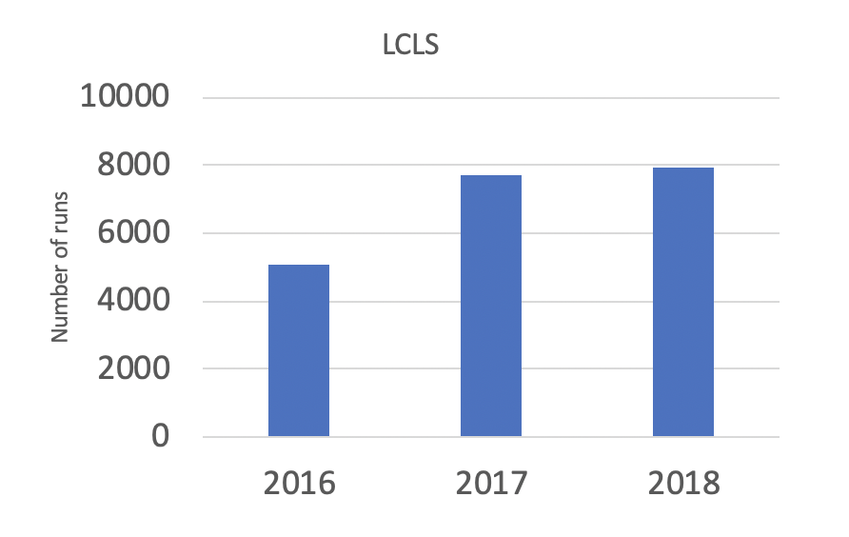
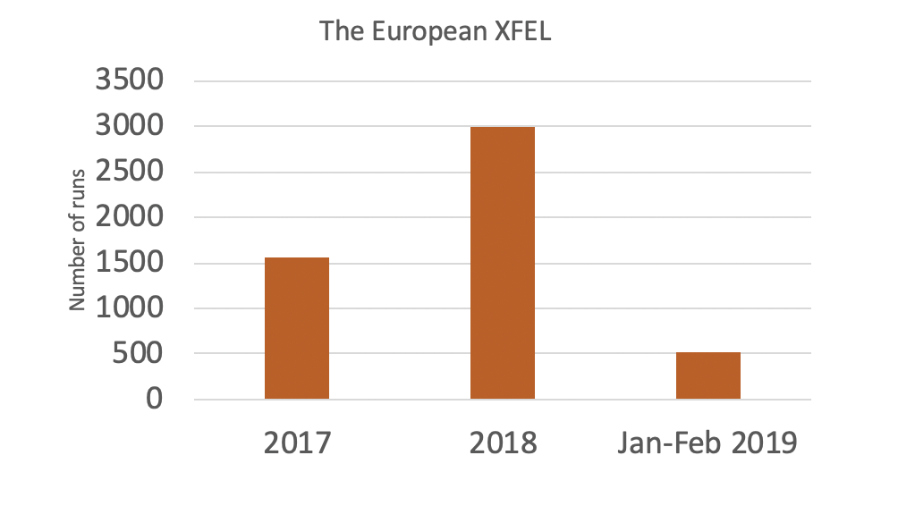
Ocelot optimizer stats
SLAC: Ocelot with Nelder-Mead simplex reduced tuning times on average by 25% to 50% compared to hand tuning

Slide 10
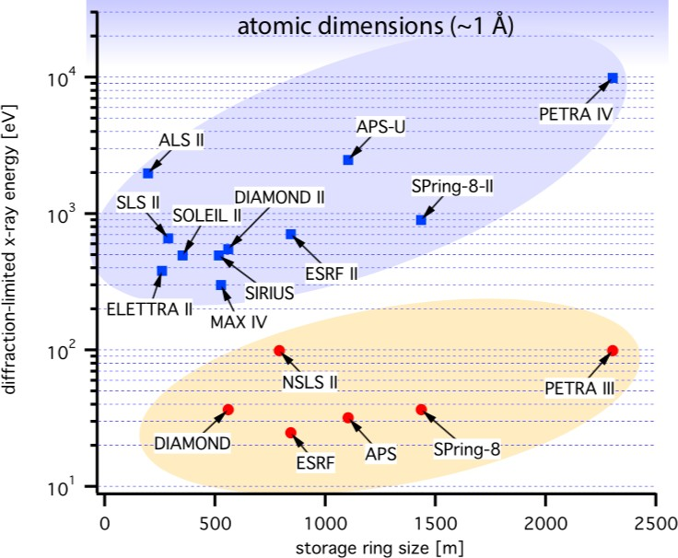
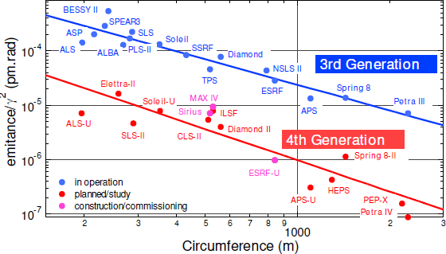
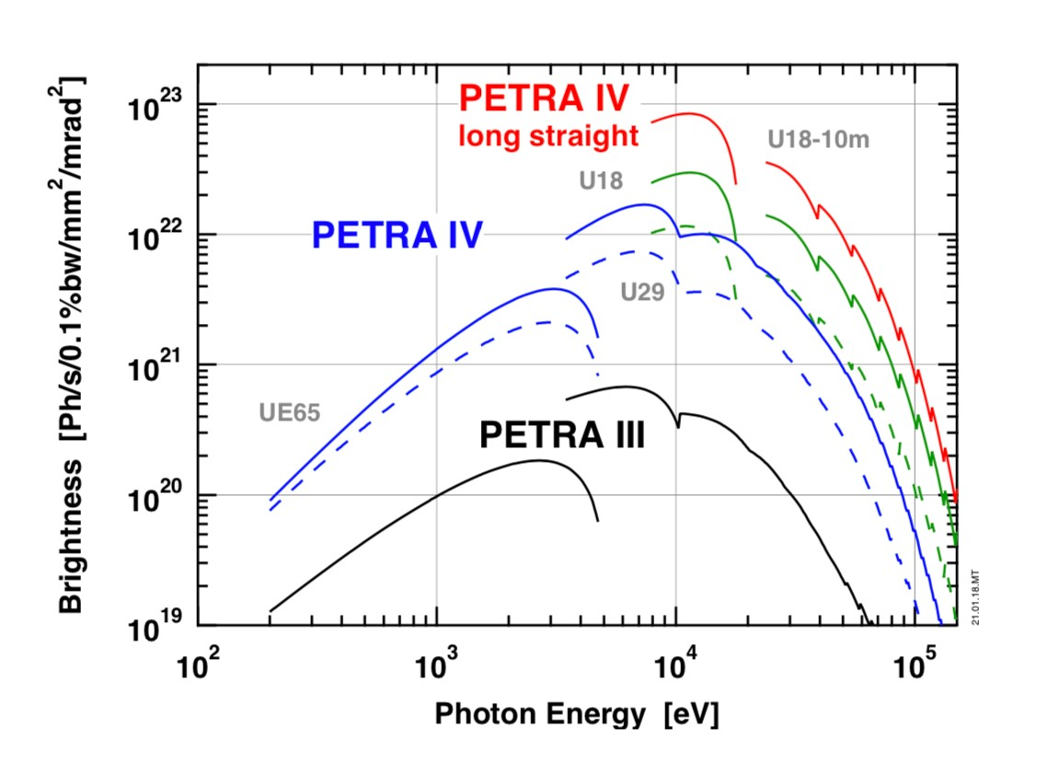
4G light sources
Changing the lattice from DBA to MBA In a storage ring gives up to two orders of magnitude in figures of merit such as Brightness
10

Slide 11
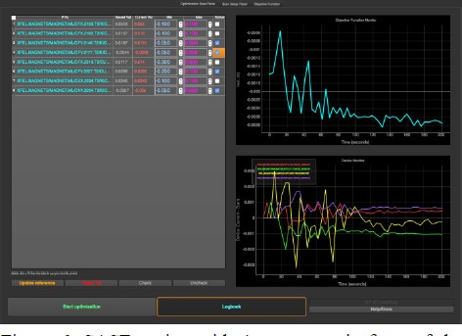
Where does ML come in?
▪
ML first looked at in the FEL optimisation and failure prediction context
FEL tuning has a direct impact on user operation and plays central role
FELs are newer machines, more adequate diagnostics and DAQ
▪
3G storage rings much more stable in operation than FELs. Some optimisation is required but effort incomparable to an FEL. Most optimisation work (lifetime, Dynamic aperture, injection efficiency) has little direct impact on users
Optimizers such as OCELOT, RCDS etc., used at storage rings, but not our biggest. concern
Focus on automation
ML-assisted optimisation
Promise of faster and more efficient hyperparameter tuning
Relevant for storage rings but not of primary importance for operation
11

Slide 12
Data Export & Unification [1]
Raw data characteristics
Large amount of PVs as model features
Different PV has different acquisition period
Handling null or abnormal data
Pandas
DataFrame
Timestamp Alignment
Data Unification
Data Merging

Slide 13
Summary
Better data export, normalization & preparation steps
Simplify development of ML applications
Simple visualization plots and common algorithms for primary tryout
Efficient tool for data exploration and knowledge extraction
Physics experts need to define the subjects or problems
Source code location: https://github.com/NicoleQiao/MLPlatform
Collaborations and data sharing are highly welcome!

