Slide 1
EWPAA 2019 (European Workshop on Photocathodes for Particle Accelerator Applications)
11 – 13th of September PSI
Scientific Programme Committee
Julius Kühn (HZB)
Thorsten Kamps (HZB)
Tim Noakes (UKRI STFC)
Lee Jones (UKRI STFC)
Rong Xiang (HZDR)
Antonella Lorusso (INFN Lecce)
Christoph Hessler (CERN)
Romain Ganter (PSI)
Local Organizing Committee
Romain Ganter (PSI)
Silvia Bacher (PSI)

Slide 2
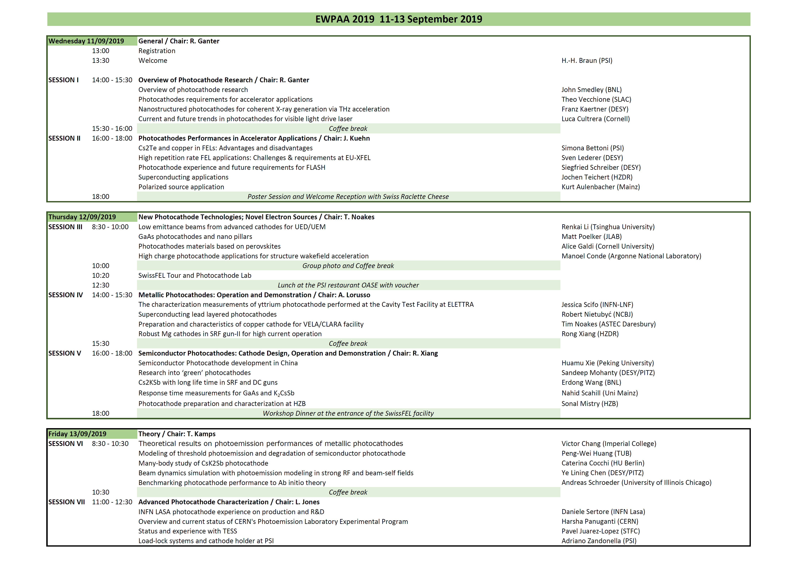
- 20 minutes per talk at maximum
- All talks will be saved on indico !

Slide 3
EWPAA Wednesday
Poster Session in the corridor
Welcome Reception tonight with a Swiss Raclette at the entrance of building
SPC Meeting at 19H00 in this building (upper floor)

Slide 4
Thursday SwissFEL Tour
Departure at 10H20 (OSGA building):
- 2-3 km walk !
- you can leave your bag & laptop in the room
- take your “lunch – voucher” with you
Two groups (with head-sets):
- Thomas Schietinger (PSI)
- Romain Ganter (PSI)
Lunch at 12H30

Slide 5
EWPAA 2019 - Thursday
Group Photo after morning session (Building entrance or Staircase)
SwissFEL Visit: 2 Groups with head sets;
      take your “lunch – voucher”
      bags & computer can stay in the room
Dinner @ SwissFEL Entrance
we should leave before 22H00 (Safety Reason); don’t miss last Bus: 22H16

Slide 6
EWPAA 2019
Friday:
- Sandwich lunch at 12H30

