Slide 1


Modeling of threshold photoemission and degradation of semiconductor photocathode
Pengwei Huang
Tsinghua University, Beijing, China
2019.09.13
EWPAA 2019, 11-13 September 2019, Villigen

Slide 2


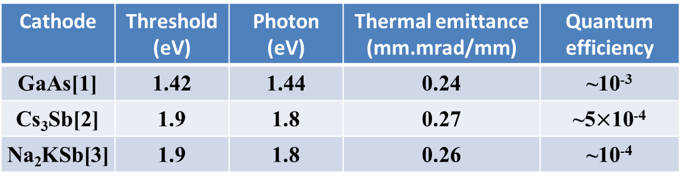
Threshold photoemission
Low mean transverse energy (MTE) cathodes will be favored by XFEL and UED/UEM, which can greatly benefit from low thermal emittance. Threshold photoemission has been experimentally proved to be an effective method to achieve ultralow MTE.
Cathode | Threshold(eV) | Photon (eV) | Thermal emittance (mm.mrad/mm) | Quantum efficiency
GaAs[1] | 1.42 | 1.44 | 0.24 | ~10⁻³
Cs₃Sb[2] | 1.9 | 1.8 | 0.27 | ~5$×$10⁻⁴
Na₂KSb[3] | 1.9 | 1.8 | 0.26 | ~10⁻⁴
Low MTE condition is delicate and easily affected by many factors, setting a lower limit to the achievable MTE.
[1]I. Bazarov , et al. Journal of Applied Physics, 2008, 103(5): 054901.
[2]L. Cultrera , et al. Physical Review Special Topics-Accelerators and Beams, 2015, 18(11): 113401.
[3] J. Maxson, et al. Appl. Phys. Lett. 106, 234102 (2015)

Slide 3
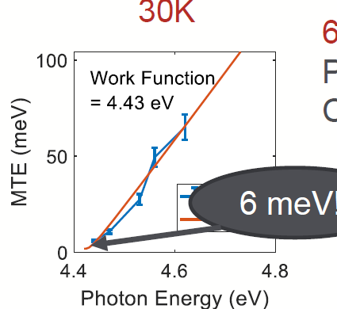
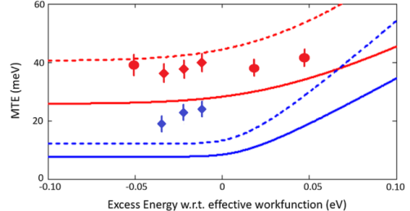
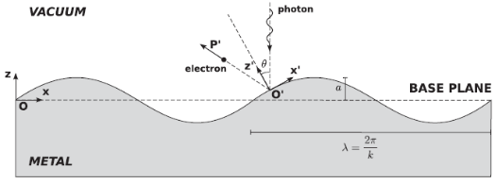
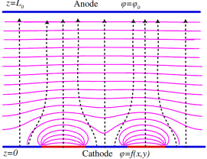
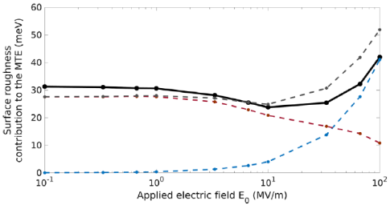
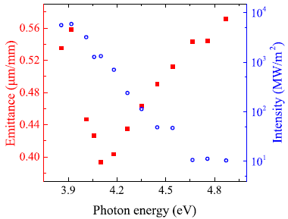
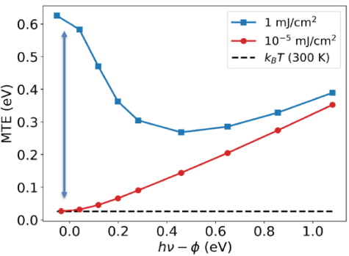
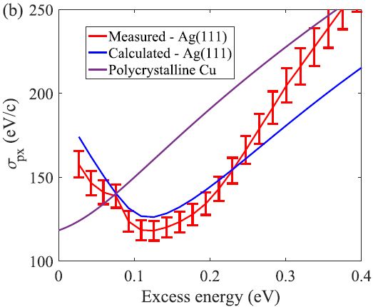
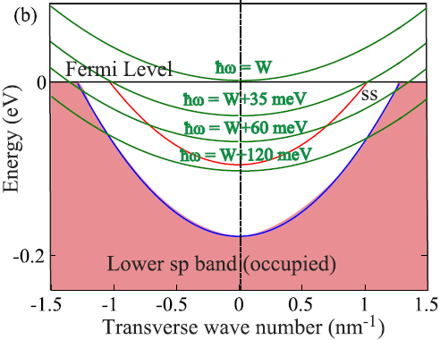
Limitation towards low MTE
Temperature
Roughness
Cs₃Sb
Cu
Z. Zhang and C. Tang, PRSTAB 18, 053401 (2015)
S. Karkare and I. Bazarov, PR Applied 4, 024015 (2015)
L. Cultrera, et al, PRSTAB 18, 113401(2015)
S. Karkare’s talk in P3, 2018
High E field – Physical roughness
Working at low temperature is helpful to achieve low MTE.
Low E field – Chemical roughness
G. Gevorkyan, et al, PRAB 21, 093401 (2018)
Multiphoton emission
Surface state
C An et al, AIP ADVANCES 8, 055225 (2018)
J.K. Bae et al, J. Appl. Phys. 124, 244903 (2018)
S. Karkare et al, PRL 118, 164802 (2017)
The multiphoton emission significantly increase MTE at well below threshold emission with high fluence laser.
The electrons from surface state may result in a higher MTE at smaller excess energy.

Slide 4
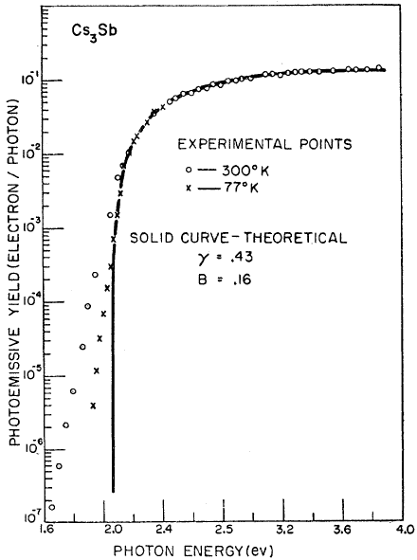
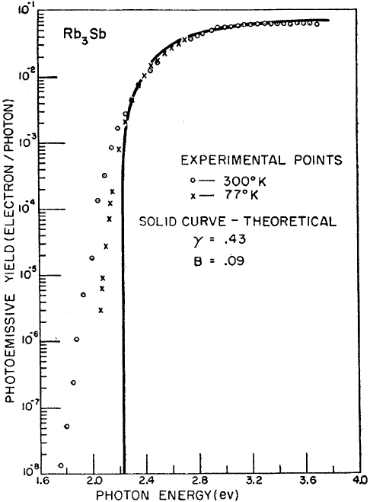
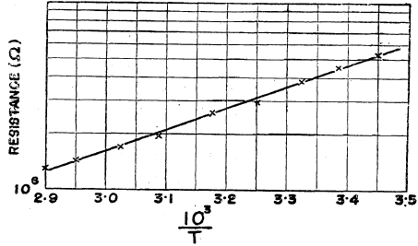

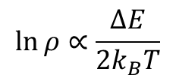
Evidence of the intermediate energy level
300 K
The presence of the intermediate energy level (donors for n-typed and acceptors for p-typed) might be one of the reasons to cause the discrepancy of QE between 300 K and 77 K near the threshold region.
300 K
77 K
77 K
W.E. Spicer, Phys. Rev. 112, 114
W.E. Spicer, Phys. Rev. 112, 114
Cs₃Sb
$$\ln{ρ}∝\frac{∆E}{2k_{B}T}$$
The plot of resistance against temperature confirms the existence of the intermediate energy level. For Cs₃Sb, it locates roughly at 0.5 eV above the filled band.
$$∆E\sim 0.5 eV$$
The model in this talk more focuses on the effect of intermediate energy level.
T. Sakata, J.Phys.Soc.Japan 8 (1953) 793~795

Slide 5


Threshold photoemission model
Excitation: valance band and acceptor level
Transport
Emission
The lattice imperfections, like a foreign atom or vacancy, can result in a donor or acceptor in the band gap.
Since most of the photocathodes used in the electron gun are p-typed semiconductors, only acceptor level is considered.
Part of acceptor level will be occupied with electrons due to the thermal excitation. Higher occupation possibility is expected at higher temperature.
Acceptor level
$$E_{A}$$
The density will be negligible at very low temperature, like 90 K.
Valance band

Slide 6

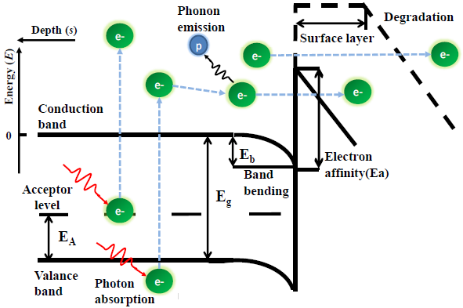
Threshold photoemission model
The distribution of the excited electrons with energy E
The first term is the contribution from acceptor level. The electrons from acceptor level have higher energy than the valance band electrons.
The contribution from the acceptor level should not be negligible when
Photon energy comparable to the threshold
Moderate number of electrons occupied at the acceptor level
Acceptor density
Temperature

Slide 7
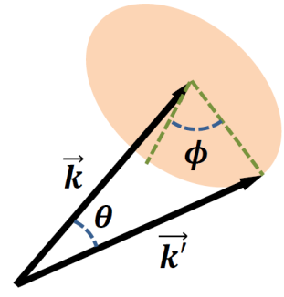
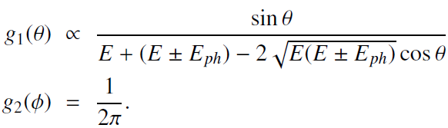

Threshold photoemission model
Excitation
Transport : scattering with phonon
Emission
p
Phonon scattering is the main scattering during the electron’s transport, accompanied with energy change due to phonon absorption and emission.
Energy loss:
$$∆E=t×λ×E_{ph}$$
$t$ – traveling time, $λ$ – scattering rate, $E_{ph}$ - phonon energy
Trajectory
Apart from analytical model, a Monte Carlo simulation script is developed to evaluate not only the energy gain and loss but also the trajectory change due to the scattering.
analytical
MC

Slide 8
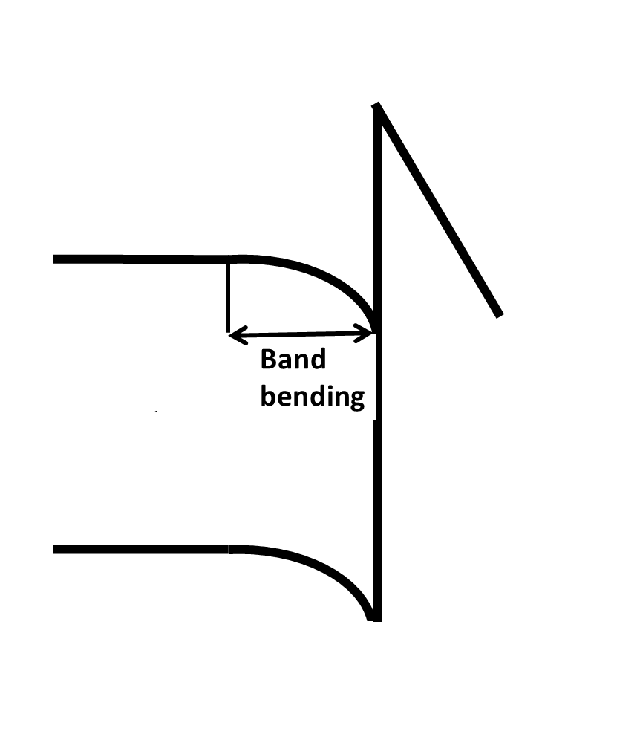
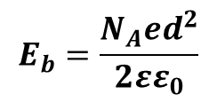
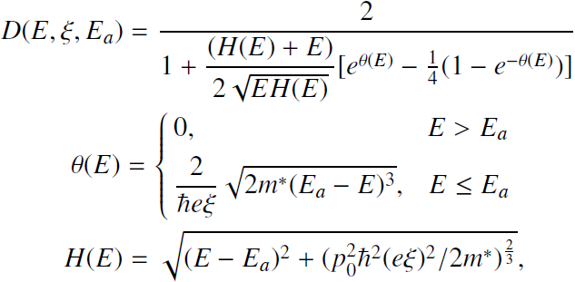


Threshold photoemission model
Excitation
Transport: band bending
Emission: overcome the vacuum barrier
Band bending at the surface
Example:
p-typed bulk; n-typed surface
Triangular model is used.
Semiconductor
Vacuum
$$x$$
$$−eξ⋅x$$
Reflect
Tunnel
Jensen et al. J. Appl. Phys. 104, 044907 (2008)

Slide 9
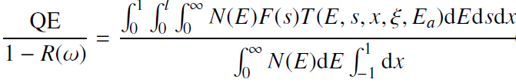
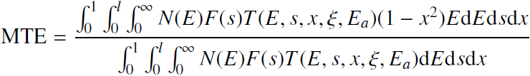



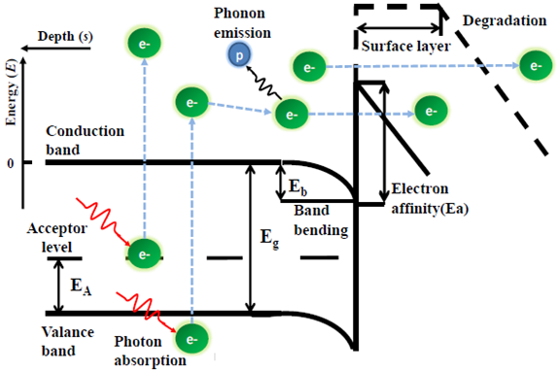

Threshold photoemission model
Equations to analyze the QE and MTE

Slide 10
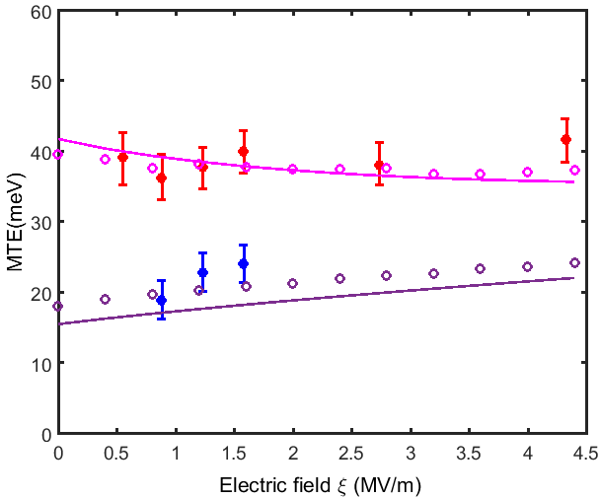
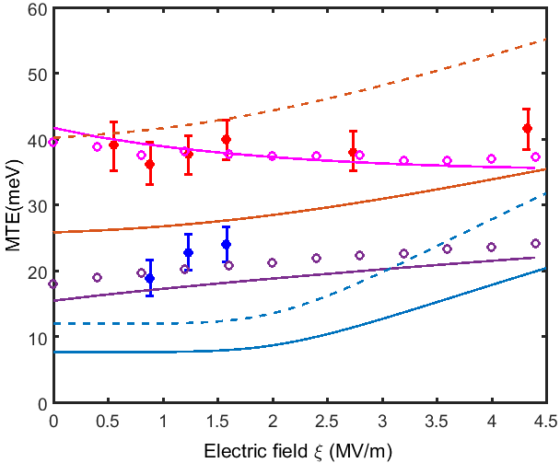
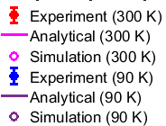
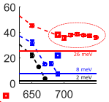
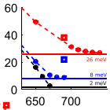

Results
The model is able to explain one example of Cs₃Sb cathode with photon energy 1.8 eV (threshold 1.9 eV) at 300 K and 90 K, corresponding to the conditions of occupied and empty acceptor level.
Cultrera et al, PRSTAB 18, 113401(2015)
300 K
300 K
90 K
90 K
Excess energy = $hν−φ+e\sqrt{eβξ/4πε_{0}}$
The calculated results agree with the experiments.
The presence of the electrons from acceptor level results in a higher MTE
Gupta, Cultrera, and Bazarov, J. Appl. Phys. 121, 215702 (2017)

Slide 11
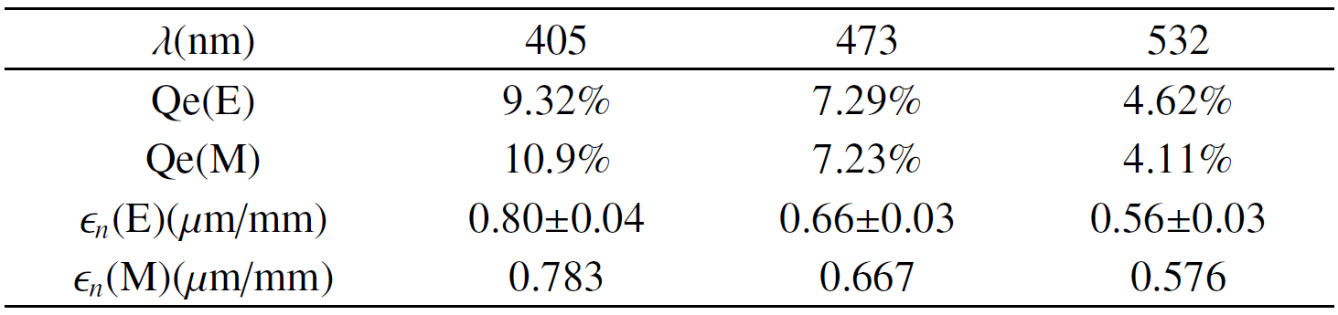
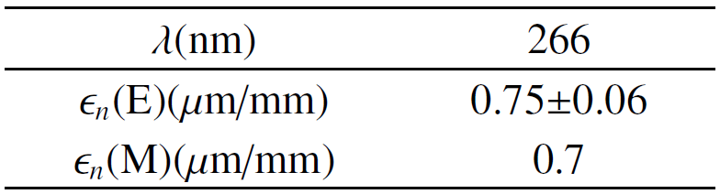
Results
2. The model can give reasonable results for the non-threshold photoemission
Cs₃Sb
E-experiment M-model
L. Cultrera et al, Appl. Phys. Lett. 99, 152110 (2011)
Cs₂Te
The model has been adapted to Cs₂Te with the corresponding parameters.
Filippetto, Qian, and Sannibale, Appl. Phys. Lett. 107, 042104 (2015)

Slide 12
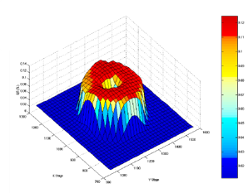
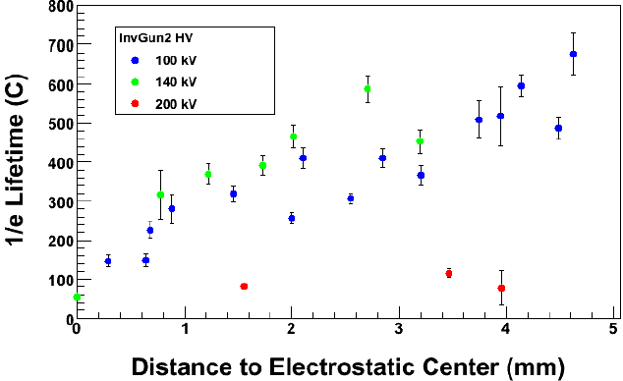
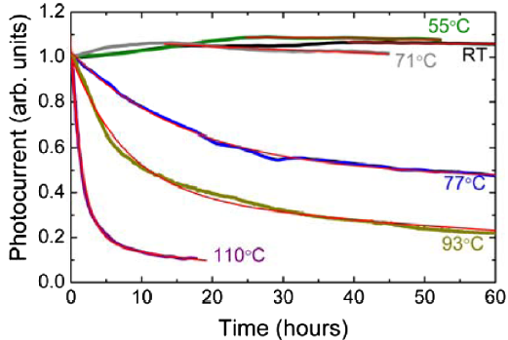
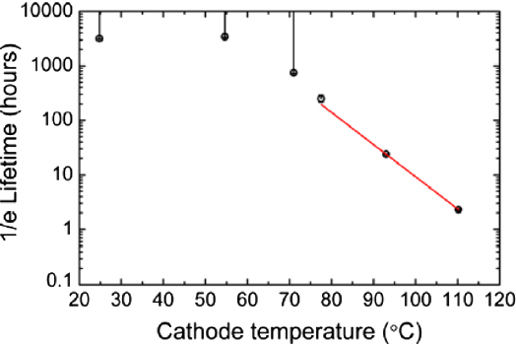
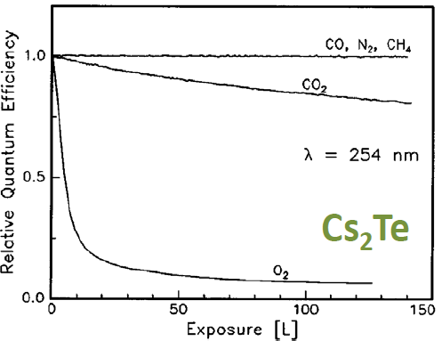
Degradation of semiconductor
Reasons for the QE degradation:
Residual gases, ion back bombardment, thermally activated decomposition ……
Ion back bombardment
Thermally activated decomposition
C. K. Sinclair et al. PRSTAB 10, 023501 (2007)
M. Poelker’s talk in USPAS course, 2011
Z. Ding et al. PRAB 20, 113401 (2017)
High temperature induces material decomposition and cesium loss, leading to a shorter lifetime
The bombardment degrades the QE and shorten the lifetime.
Residual gases
Contamination with residual gases is an important reason for the cathode degradation in the RF electron gun and cathode storage system. It is present under any circumstances.
D. Sertore’ s talk in EWPAA 2017

Slide 13
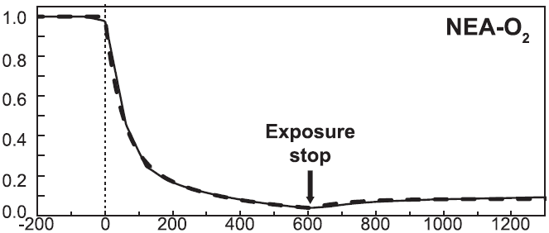
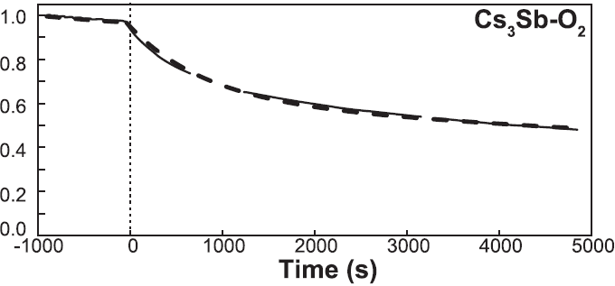
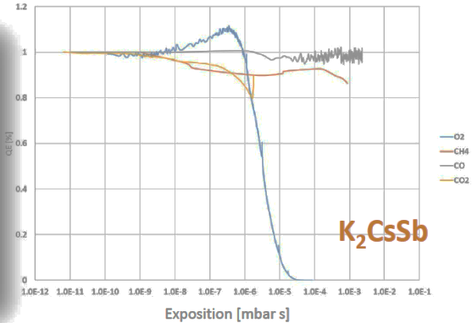
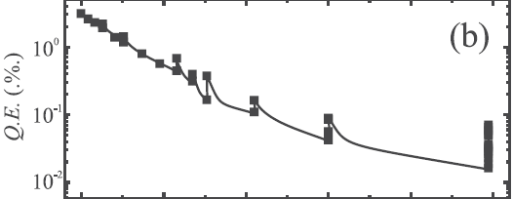
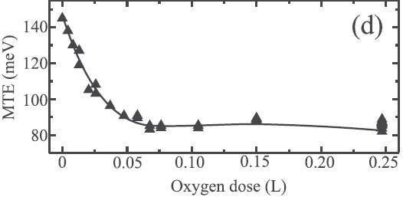
Contamination with residual gases
Oxygen is believed to be the most poisonous one for most of the materials
Experiments have indicated that some changes of MTE (thermal emittance) take place during the QE degradation.
A model to analyze the cathode performance during the degradation is missing.
GaAs
Cs₃Sb
GaAsP
GaAsP
[1] V. Pavlenko et al, AIP Advances 6, 115008 (2016)
[2] D. Sertore’ s talk in EWPAA 2017
[3] Jones et al, J. Appl. Phys. 121, 225703 (2017)

Slide 14
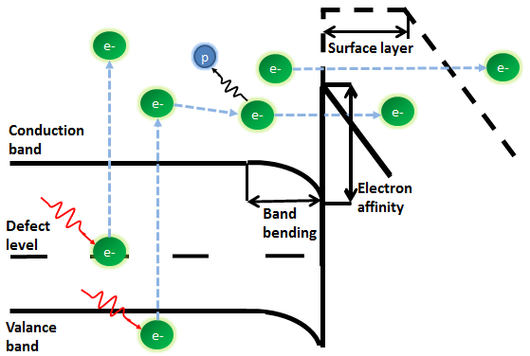
Degradation model of semiconductor
The physical picture of degradation due to residual gases
The surface layer becomes thicker, leading to the reduction of the emission probability.
The electron affinity increases with time.

Slide 15
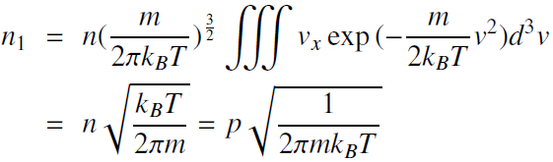
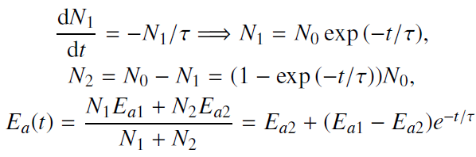

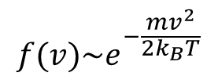

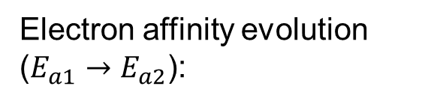
Degradation model of semiconductor
1、The electron affinity increases with time
The time relationship of the change of electron affinity
N
n
$$f(v)\sim e^{−\frac{mv^{2}}{2k_{B}T}}$$
Electron affinity
$$p=nk_{B}T$$
y
x
z
The gas molecules in the vacuum environment stay at thermal equilibrium state, following the ideal gas equation and Maxwell-Boltzmann distribution
Time
Electron affinity evolution ($E_{a1}→E_{a2}$):
Characteristic time estimation

Slide 16
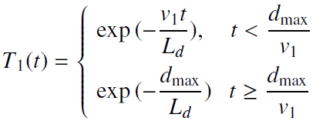
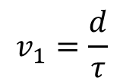
Degradation model of semiconductor
2、The reduction rate of emission possibility due to the formation of the surface layer
Surface layer
Vacuum
Scatter with defects
Recombine with holes
L_{d} is attenuation length. d_{max} is the maximum thickness the surface layer can reach.
$$v_{1}=\frac{d}{τ}$$

Slide 17
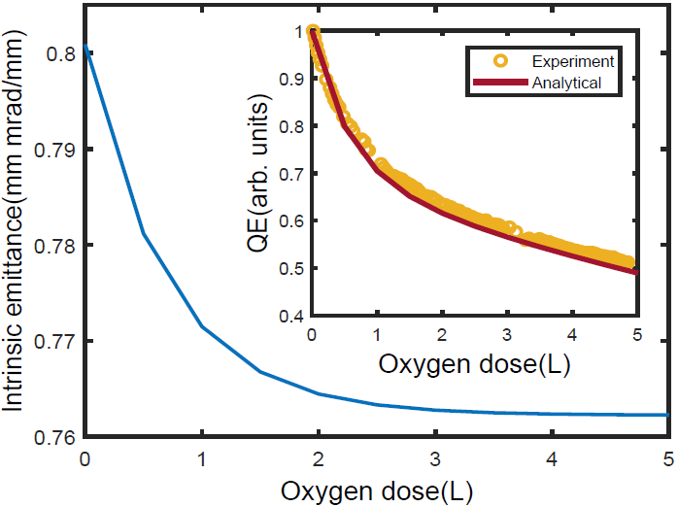
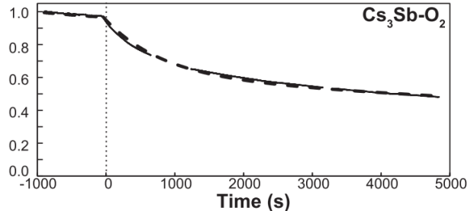

The application of the degradation model
1. Cs₃Sb with controlled contamination of O₂(10⁻⁹Torr), photon energy 3.06eV.
$$f\left(t\right)=a_{1}e^{−λ_{+}t}+a_{2}e^{−λ_{−}t}+a_{3}$$
Pavlenko, AIP Advances 6, 115008 (2016)
The degradation model can fit with the experiments data of QE and predict the evolution of intrinsic emittance.

Slide 18
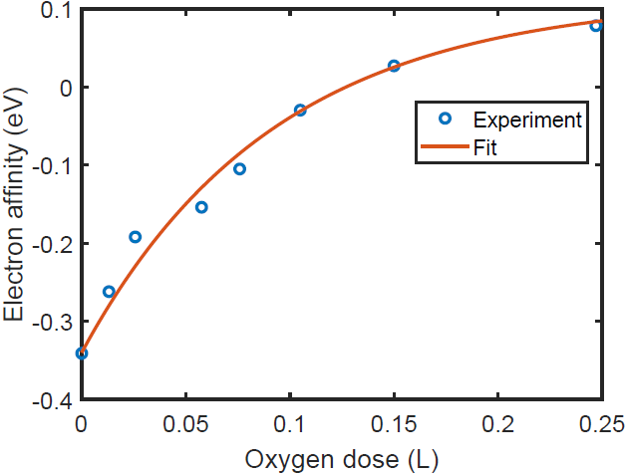



The application of the degradation model
2. The evolution of the electron affinity, QE and MTE with the oxygen dose of GaAsP. The laser wavelength is 532 nm (2.33 eV).
The results from the model have good agreement with the experiment.
L. B. Jones et al, J. Appl. Phys. 121, 225703 (2017)
All the experiment data come from J. Appl. Phys. 121, 225703 (2017)

Slide 19

The application of the degradation model
3. The predictions of the cathode performance at threshold photoemission in the degradation state. Take Cs₃Sb as an example.
(1.9 eV, 4 MV/m) The higher photon energy enables electrons from valance band dominate.
QE up
MTE down
(1.8 eV, 4 MV/m) The emittance grows with degradation. The high energy electrons from acceptor level account for a significant part.
QE up
MTE down
(1.8 eV, 50 MV/m) The high electric field compensates the growth of barrier.
The participation of acceptor level may result in a higher intrinsic emittance at threshold photoemission under fully degradation. Higher field or higher photon energy can suppress its influence

Slide 20
Summary
1. Acceptor level emission is added into the 3-step photoemission model.
Explain the threshold emission experiment data for Cs₃Sb at 300 K and 90 K
  acceptor level emission in room temperature contributes to threshold photoemission, leading to higher MTE
The model also gives consistent results to experiments beyond threshold photoemission. Examples have been given with Cs₃Sb and Cs₂Te
2. A degradation model is built to describe the cathode degradation process due to surface contamination, especially by O₂.
The model fits well to the experiment for Cs₃Sb and GaAsP
The model predicts cathode contamination at low field may increase the MTE for threshold photoemission and it can be suppressed by high field or high photon energy.
Thanks for your attention

